Slide 1
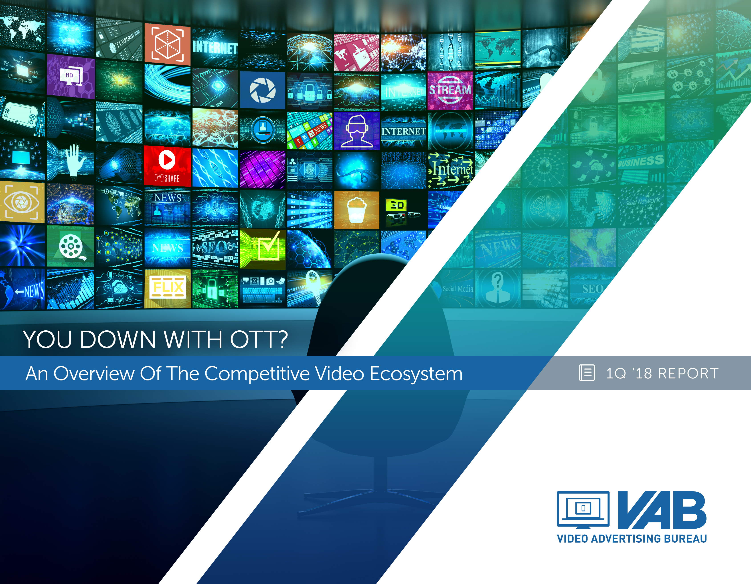
You Down With OTT?
An Overview Of The Competitive Video Ecosystem
Member Center

Slide 2
Contents
The Math of OTT 3
Definition 4
OTT Video Landscape 5-15
Connected Devices 16-25
Streaming Services 26-42
Consumer Behaviors 43-51
Key Takeaways 52
Targeting & Measurement 53-57
Glossary 58
Contact Information 59
VAB: YOU DOWN WITH OTT?

Slide 3
The Math Of OTT: A Formula Of Addition, Not Subtraction
The over-the-top ecosystem, with 820 million connected video devices in the U.S. and hundreds of different streaming services, is about delivering more to the consumer
More…Distribution
  71% of Internet users use an OTT service at least once a month
More…Content
  Consumers have a voracious appetite for content, in fact a large majority of OTT HHs (70%) also have a multichannel subscription
More…Choice
  Nearly one-third of OTT subscribers hold 3 or more means of accessing OTT content, an eight-fold increase over just the last two years
More…Convenience
  45% of streamers say it’s important to them to be able to watch TV programs “on the go” while 81% say its important to them to watch TV programs whenever they want
More…Advertising Opportunities
  Currently, advertising comprises 45% of all online video revenue and is projected to grow to almost 60% over the next 10 years
  65% of people who use a second screen while streaming have looked up info on a product that’s been advertised in a TV show
VAB: YOU DOWN WITH OTT?

Slide 4

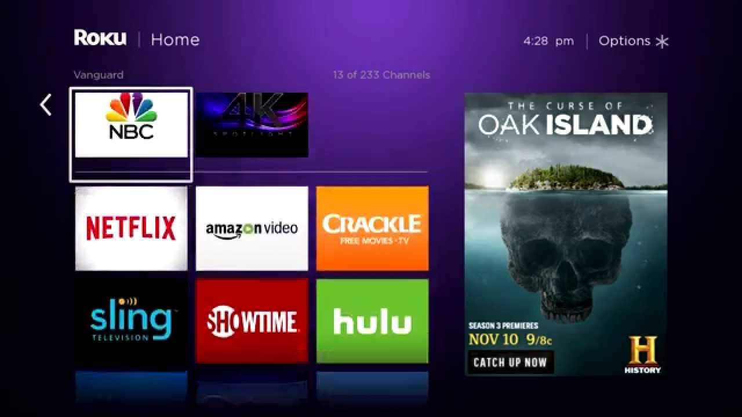
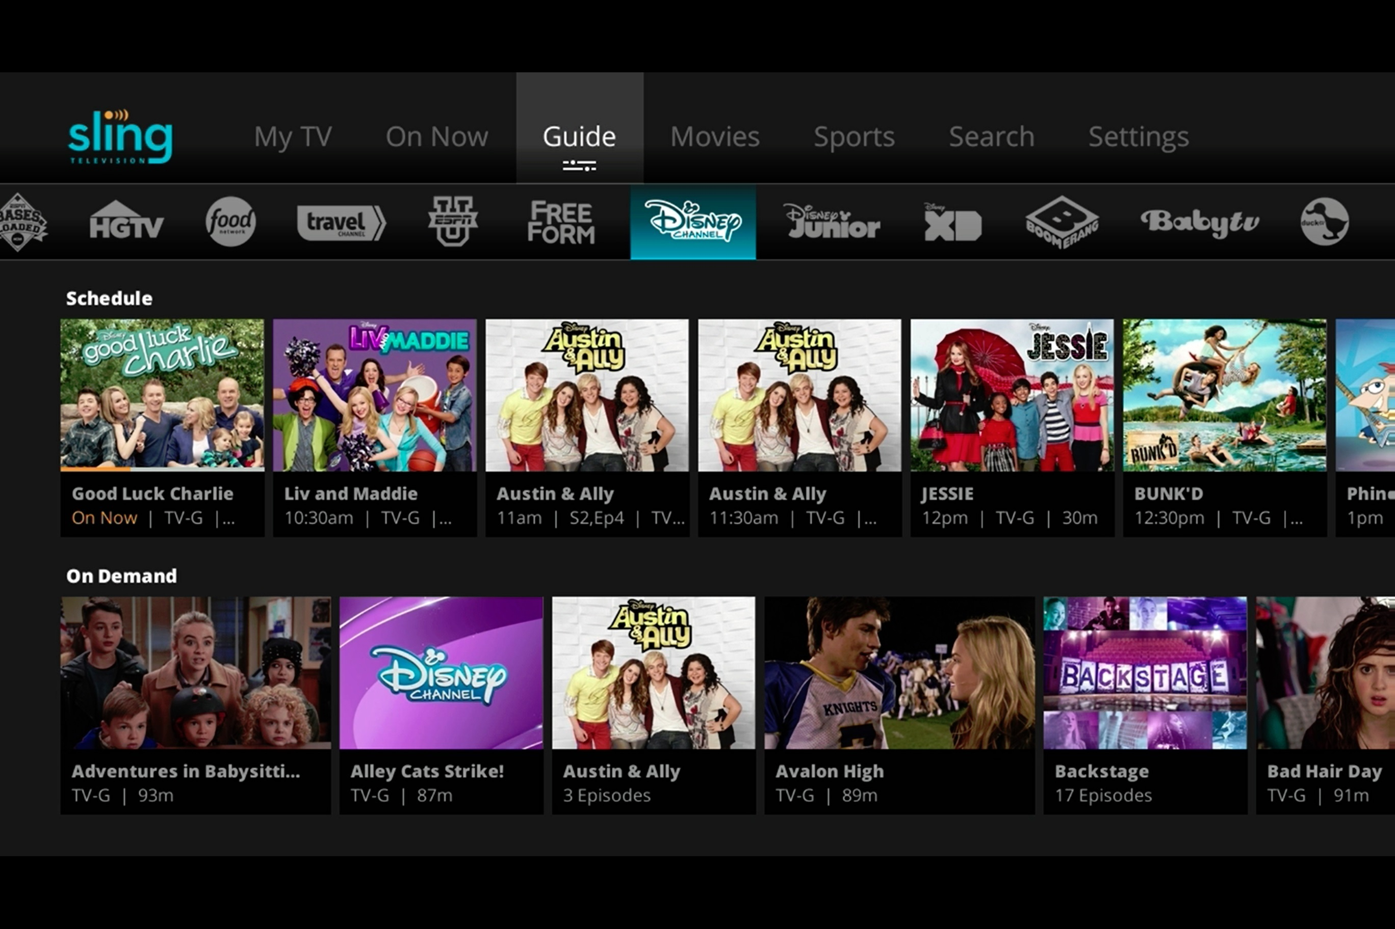

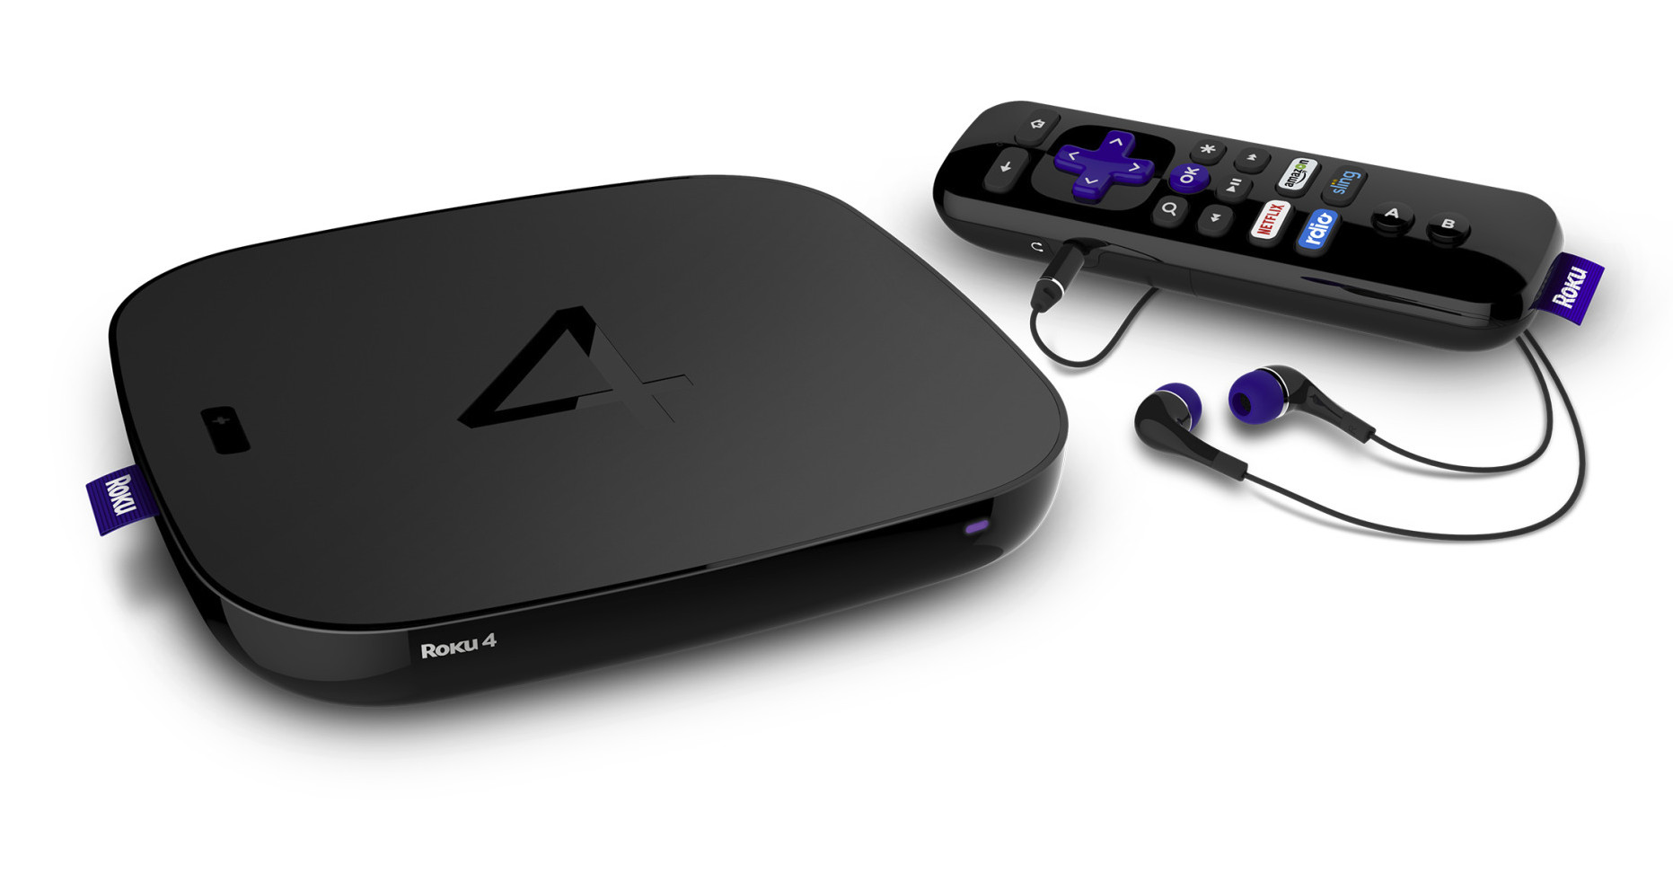
4
What is OTT (Over-The-Top)?
Definition: Premium long form video content that is streamed over the internet through an app or device onto a TV (or PC, Tablet, or Smartphone) without requiring users to subscribe to a wired cable, telco or satellite TV service.
OTT consumer journey: OTT leverages “apps” to stream video content to a television via an internet connection. Viewing methods include: (a) on-demand where viewers select and watch content when they choose to, and (b) linear/live – where viewers watch at the particular time, channel or app (live content is streamed in real time as the event happens)
Viewers stream TV content from the Internet using either a smart TV, OTT device, connected game console or IP set top box that received signals from digital video ad server
All major networks are making their content available either through their own app or via a virtual MVPD like Hulu or Sling TV
Content is streamed and plays instantly in full-screen and can be ad-supported if the network chooses
VAB: YOU DOWN WITH OTT?

Slide 5
The Math of OTT: More Distribution Points
Currently, 71% of Internet users use an OTT service
VAB: YOU DOWN WITH OTT?

Slide 6
6
OTT Content Can Be Accessed In Several Ways And Falls Primarily Into Two Groups
Devices
Connected Devices allows the streaming of specific, selected content.
Devices include Streaming Players/Sticks (e.g. Roku/Amazon Fire TV), Gaming Consoles (e.g. PS4), and Smart TVs
Streaming Services
Means of access are ad-supported, subscription, rental, or purchase.
These access points can take the form of
OTT content aggregators (e.g. Crackle), Standalone apps (e.g. ABC),
or virtual MVPDs (e.g. Sling).
Streaming services and devices often work in tandem. For example, streaming Hulu content from a mobile phone to the television via Google Chromecast.
VAB: YOU DOWN WITH OTT?
Source: SNL Kagan

Slide 7
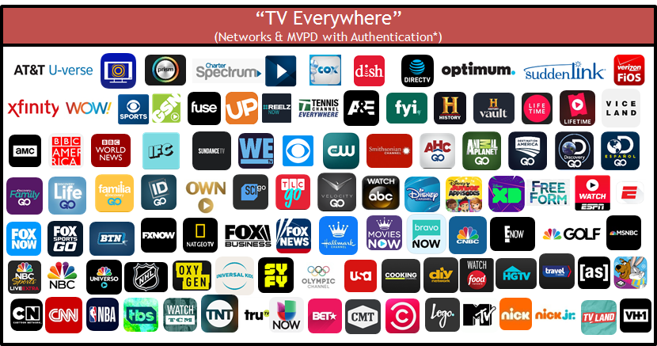
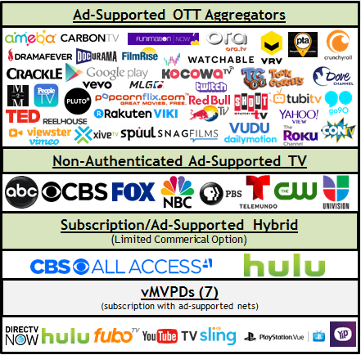
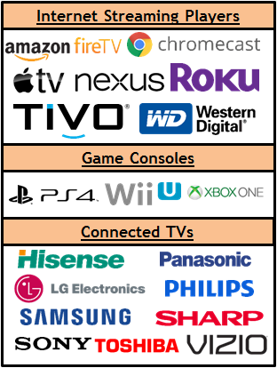
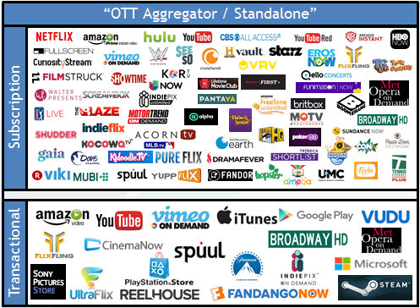

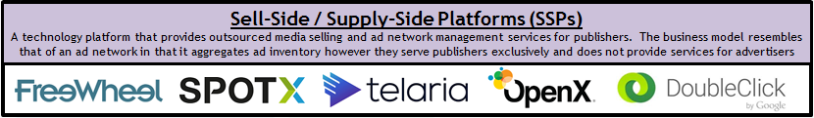
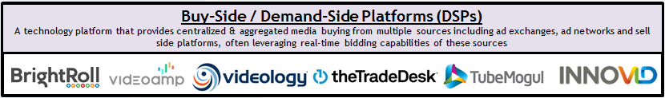
OTT Streaming Services & Devices Ecosystem
VAB: YOU DOWN WITH OTT?
Note: the above reflects a representative sampling of services and devices and each segment does not necessarily reflect every offering available.

Slide 8
OTT Households Are Growing And Currently Represent 14.1MM Homes…
OTT households nearly tripled since 2013
U.S. Households (M)
Source: 2017 S&P Global Market Intelligence, Kagan. 2013 and 2014 data as of June 2014; 2015-2017 data as of June 2017.
OTT HHs (multichannel substitutes) are HHs that rely on unmanaged Internet or OTT delivery to view television shows or movies in lieu of a traditional multichannel subscription. Figure does not include subscribers to virtual service providers such as Sling TV, PlayStation Vue or DIRECTV NOW.
Virtual service providers (vMVPDs) characterized by unmanaged (Internet/OTT) delivery of aggregated live, linear networks and on-demand content similar to a traditional multichannel offering for a monthly subscription

Slide 9
…Which Translates To 11% Of TV Homes; However
Three-Fourths Of All Homes Are Multi-channel TV Households
Video HHs by Method of Delivery
2017
¾ of homes are multi-channel TV HHs
Source: 2017 S&P Global Market Intelligence, Kagan. As of June 2017.
(1) Multichannel HHs - Residential multichannel household count excludes DBS overlap created by households taking multiple multichannel subscriptions. Includes cable, DBS, telco and other multichannel platforms. Excludes commercial subs. (2) OTT HHs (multichannel substitutes) are HHs that rely on unmanaged Internet or OTT delivery to view television shows or movies in lieu of a traditional multichannel subscription. Figure does not include subscribers to virtual service providers such as Sling TV, PlayStation Vue or DIRECTV NOW. (3) Virtual service providers (vMVPDs) characterized by unmanaged (Internet/OTT) delivery of aggregated live, linear networks and on-demand content similar to a traditional multichannel offering for a monthly subscription. (4) OTA HHs - Households that receive broadcast network signals using an antennae. Does not exclude households that also access OTT content

Slide 10
While MVPD Subscriptions Will Maintain A Large Share Of HHs, OTT-Only HHs Are Projected To Grow to 17.9MM Homes By 2021
CAGR %
-2.4%
U.S. Households (M)
+8.2%
+1.9%
+43.4%
Source: 2017 S&P Global Market Intelligence, Kagan. As of June 2017.
(1) Multichannel HHs - Residential multichannel household count excludes DBS overlap created by households taking multiple multichannel subscriptions. Includes cable, DBS, telco and other multichannel platforms. Excludes commercial subs. (2) OTT HHs (multichannel substitutes) are HHs that rely on unmanaged Internet or OTT delivery to view television shows or movies in lieu of a traditional multichannel subscription. Figure does not include subscribers to virtual service providers such as Sling TV, PlayStation Vue or DIRECTV NOW. (3) Virtual service providers (VSPs) characterized by unmanaged (Internet/OTT) delivery of aggregated live, linear networks and on-demand content similar to a traditional multichannel offering for a monthly subscription. (4) Households that receive broadcast network signals using an antennae. Does not exclude households that also access OTT content

Slide 11
11
By 2021, About 200 Million US Consumers Will Use An OTT Video Service Or Connected TV At Least Once Per Month
198.6
202.8
206.4
209.5
193.3
181.5
188.1
191.6
194.4
168.1
# = users in millions
Source: eMarketer, July 2017, “Programmatic Connected TV And OTT Video Advertising: Automation, Audience Attracts Digital And TV Ad Buyers.”. Note: “OTT Video Service Users” reflect individuals of any age who watch video via any app or website at least once per month that provides steaming video content over the internet and bypasses traditional distribution; examples include HBO Now, Hulu, Netflix and YouTube. “Connected TV Users” reflect individuals of any age who use the internet through a connected TV at least once per month.

Slide 12
The Math of OTT: More Access To More Content
70% of OTT households also have an MVPD subscription
VAB: YOU DOWN WITH OTT?

Slide 13
The Overwhelming Majority Of OTT Users Also Have A Cable or Satellite Subscription
Looking at those households that have OTT capabilities, 70% also have a Cable+ subscription
Over-the-Top (OTT) Households by Service Type
VAB: YOU DOWN WITH OTT?
Source: ComScore Total Home Custom Reporting, U.S. December 2016; comScore Single-Source (TV+OTT) Custom Reporting, U.S. December 2016

Slide 14
Because Of This, Streaming - While Growing - Still Only Accounts for a Fraction of Total “TV” Viewing Hours…
VAB: YOU DOWN WITH OTT?
Source: Pivotal Research Analysis of Nielsen Data, A18-49, October 2017; Roku Inc.

Slide 15
15
…Even As The Number Of People That Access TV Content From The Internet Grew By Double-Digits Over The Last Two Years
VAB: YOU DOWN WITH OTT?
Source: PwC Consumer Intelligence Services video survey, 2017 from “Consumer Intelligence Series: I stream, you stream” Report.
© 2017 PricewaterhouseCoopers LLP, a Delaware limited liability partnership.

Slide 16








Let’s Take A Closer Look At Connected Devices…
Devices / Platforms
Internet Streaming Players e.g.
Game Consoles e.g.
Connected TVs e.g.
VAB: YOU DOWN WITH OTT?

Slide 17
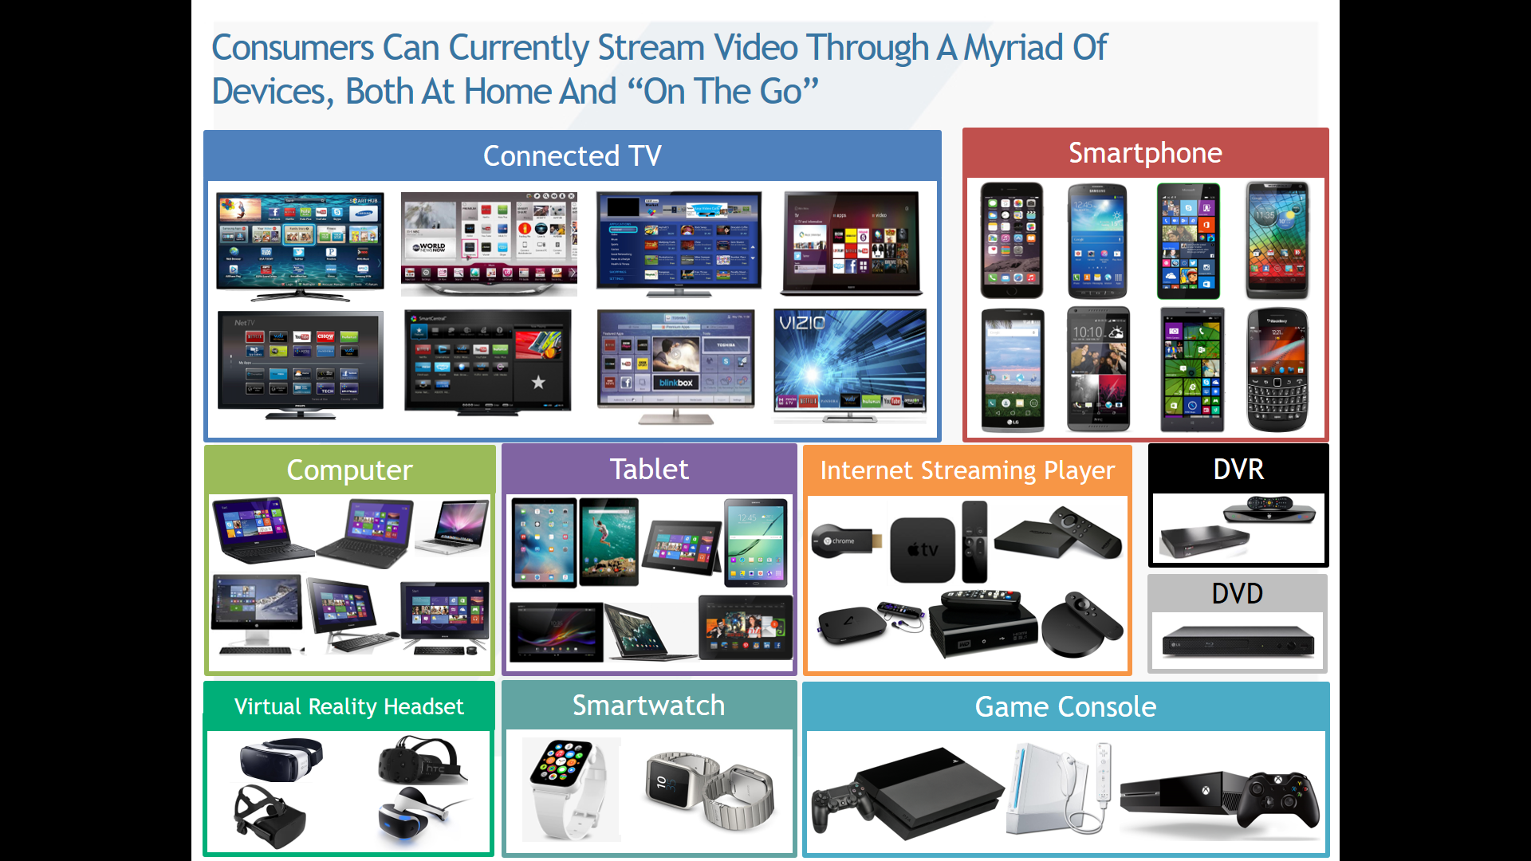
There Are Currently 820 Million Connected Video Devices in the U.S.
The largest segments are smartphones (30% of devices), smart TVs (20%) and PCs/Home Media Servers (15%)
U.S. Connected Devices, 2015 – 2021 (in millions)
Source: 2017 SNL Kagan, a division of S&P Global Market Intelligence. As of October 2017.
(1) Gaming Consoles - Includes the subset of game consoles that are connected to the Internet such as Sony Playstation, Microsoft Xbox and Nintendo Wii.
(2) Streaming Media Players - Includes installed base of Internet-connected standalone set-tops designed for online video viewing such as AppleTV, Roku, GoogleTV, standalone TiVo and other devices. (3) Streaming Sticks - Includes installed base of streaming sticks designed for online content viewing such as Chromecast and the Roku Streaming Stick, often in conjunction with another connected device. (4) Tablets - Excludes enterprise tablets in use.

Slide 18
The Preferred Device For Viewing Streaming Video Is The Television, Either On a Smart TV Or On A TV Using a Streaming Media Player
VAB: YOU DOWN WITH OTT?
Source: 2017 SNL Kagan, a division of S&P Global Market Intelligence

Slide 19
Viewing On-Demand Video Content Is A Top Activity Across All Connected TV Devices
Smart TV Activities | % of Device Owners
Viewed SVOD Content | 70%
Viewed Live Sports | 53%
Viewed TV Everywhere Content | 43%
Viewed Premium Network VOD | 34%
Streamed Online Music | 30%
Download Online Rented Video | 27%
Download Online Purchased Video | 24%
Played a Video Game | 22%
Purchased Physical Goods | 13%
Streaming Media Player Activities | % of Device Owners
Viewed SVOD Content | 71%
Viewed TV Everywhere Content | 41%
Streamed Online Music | 34%
Viewed Premium Network VOD | 29%
Viewed Live Sports | 27%
Download Online Rented Video | 26%
Download Online Purchased Video | 25%
Played a Video Game | 14%
Purchased Physical Goods | 12%
Gaming Console Activities | % of Device Owners
Played a Video Game | 73%
Viewed SVOD Content | 43%
Streamed Online Music | 22%
Viewed TV Everywhere Content | 21%
Viewed Premium Network VOD | 19%
Download Online Purchased Video | 16%
Download Online Rented Video | 16%
Viewed Live Sports | 15%
Purchased Physical Goods | 11%
VAB: YOU DOWN WITH OTT?
Source: 2017 SNL Kagan, a division of S&P Global Market Intelligence, excludes “watching TV” for smart TV activities.

Slide 20
The Majority Of Long-Form Streaming Occurs On A Television
  Viewers prefer watching longer-form streaming video on a TV, and secondly on Mobile devices
VAB: YOU DOWN WITH OTT?
Source: eMarketer, 2016

Slide 21


Streaming Sticks/Boxes & Smart TVs Are The Most Popular “Primary” OTT Streaming Devices
Streaming Sticks/Boxes
Smart TVs
38 MM
U.S. HHs
with this device
28 MM
U.S. HHs
with this device
73%
Of these HHs used their streaming stick/box to stream OTT
63%
Of these HHs used their smart TV to stream OTT
VAB: YOU DOWN WITH OTT?
Source: comScore Connected Home and OTT Intelligence, U.S., April 2017

Slide 22
It’s Projected That Smart TVs Will Widen Their Penetration Gap Against The Next Largest Connected TV Device By 2021
US Connected TV Users, by Device
2016-2021 (Millions)
 | 2016 | 2017 | 2018 | 2019 | 2020 | 2021
Smart TV | 62.0 | 81.2 | 94.2 | 102.6 | 109.3 | 114.3
Connected Game Console | 58.4 | 62.8 | 66.5 | 69.5 | 71.8 | 73.9
Roku | 32.6 | 38.9 | 45.9 | 53.4 | 61.3 | 69.0
Google Chromecast | 29.9 | 36.9 | 44.5 | 51.8 | 58.3 | 64.6
Amazon Fire TV | 26.3 | 35.8 | 44.1 | 50.8 | 56.1 | 62.6
Blu-Ray Player | 29.0 | 29.0 | 29.0 | 29.0 | 29.0 | 29.0
Apple TV | 19.9 | 21.3 | 22.6 | 23.6 | 24.4 | 25.2
Total | 152.7 | 168.1 | 181.5 | 188.1 | 191.6 | 194.4
VAB: YOU DOWN WITH OTT?
Source: eMarketer, August 2017, “Programmatic Connected TV And OTT Video Advertising: Automation, Audience Attracts Digital And TV Ad Buyers.”
Note: reflects individuals of any age who use the internet through a connected TV at least once per month. The total reflects the US connected TV user universe, therefore figures by device are not additive for the total.

Slide 23



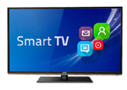

The Smart TV Market Is Currently Led By Samsung & Vizio
MEMBERS ONLY
Other
VAB: YOU DOWN WITH OTT?
Source: comScore Connected Home, U.S., April 2017

Slide 24




There Is Much Competition Between The Major Streaming Stick/Box Device Players
MEMBERS ONLY
VAB: YOU DOWN WITH OTT?
Source: eMarketer, August 2017, “Programmatic Connected TV And OTT Video Advertising: Automation, Audience Attracts Digital And TV Ad Buyers.”

Slide 25
Roku Has The Highest Cumulative Weekly Time Spent Out
Of All The Devices Available For Viewing OTT Content
VAB: YOU DOWN WITH OTT?
Source: Kantar Millward Brown / Roku Streaming Leadership Study, Q3 2017; Roku Inc.

Slide 26
The Math of OTT: More Choice
There’s been an eight-fold increase recently in people who Have access to 3+ OTT subscription services
VAB: YOU DOWN WITH OTT?

Slide 27










Let’s Take A Closer Look At Streaming Services…
Streaming Services
OTT Aggregators e.g.
Standalone TV e.g.
(Authenticated Apps)
Subscription e.g.
(with “limited commercial” option)
Virtual MVPDs e.g.
(subscription with ad-supported nets)
VAB: YOU DOWN WITH OTT?

Slide 28
MEMBERS ONLY
Subscription-Based Is The Most Popular Method Of Accessing OTT Content & Is Projected To Grow 21% By 2021
In 2017, approximately 70% of OTT video viewers accessed content via a Subscription (may or may not be in addition to other methods)
U.S. OTT Video Subscriber Projections
(in millions)
OTT SVOD is defined as the online delivery of subscription on-demand services and direct-to-consumer live linear networks (e.g. Netflix, Amazon Prime Video, Hulu)
VAB: YOU DOWN WITH OTT?
Source: Kagan, a media research group within the TMT offering of S&P Global Market Intelligence, 2017; based on industry data and Kagan estimates.

Slide 29
50% Of Internet Users Access An Online Video Subscription Once A Week, Followed Closely By Network TV Apps
(e.g. HBO, Showtime)
VAB: YOU DOWN WITH OTT?
Source: 2017 SNL Kagan, a division of S&P Global Market Intelligence; U.S. 3Q 2017 Survey Summary Report. Base: 2,526 A18+ internet users.
Q. Over the past three (3) months, how often did you perform these activities?

Slide 30
Nearly One-Third of OTT Subscribers Hold 3 or More Means of Accessing OTT Content, An Eight-Fold Increase vs. Just 2 Years Ago
*’Subscriptions’ includes Netflix, Hulu, Amazon, Network Standalones (HBO Now, CBS All Access, etc.) and vMVPDs (Sling, YouTube TV, etc)
VAB: YOU DOWN WITH OTT?
Source: Hub “What’s TV Worth”, April 2017; Survey fielded to 2,026, ages 16-74

Slide 31
However, Consumers Actually Only Watch Half Of The Subscription Video Services That They Have Access To
Number of Services Available to Me* vs. Number of Services I Watch Regularly
Average Number of Services Regularly Watched
Number of Services Available to Me
2
3.8
Traditional Pay TV Subscribers*
2.8
5.3
Cord Trimmers
1.8
3.2
Cord Cutters + Cord Nevers
VAB: YOU DOWN WITH OTT?
Source: PwC Consumer Intelligence Services video survey, 2017 from “Consumer Intelligence Series: I stream, you stream” Report.
© 2017 PricewaterhouseCoopers LLP, a Delaware limited liability partnership. *Due to heightened levels of password sharing, PwC reports on access to a service rather than subscription to a service. * Reflects Cable/Telco/Satellite subscribers

Slide 32
Millennials And Gen X Are Most Likely To Be Streaming OTT Content And Are Highly Likely To Have 4+ Subscriptions
  SVOD usage is seen across all generations, with heaviest concentration in Millennials & Gen Z
The # of subs is highest for the younger generations
(72
Index)
(129
Index)
(100 Index)
Indices are to population size of each generation
VAB: YOU DOWN WITH OTT?
Source: 2017 SNL Kagan, a division of S&P Global Market Intelligence

Slide 33




Currently, The Four Major OTT Streaming Services (+YouTube) Average 2+ Hours Of Usage Per Viewing Day Per User Household
However, this usage pales in comparison to ad-supported TV which averages
7.9 hours of usage per active TV household everyday
Viewing Metrics for Selected Over-the-Top (OTT) Streaming Services
VAB: YOU DOWN WITH OTT?
Source: comScore OTT Intelligence, U.S., April 2017; streaming usage based on consumption across TV-connected devices only. TV data based on Nielsen Npower R&F Time Period Report, 4/1/17 – 4/30/17, Total Day, Live+SD, Households, ad-supported cable TV + broadcast TV.

Slide 34
While Netflix Leads Major OTT Streaming Services In HH Penetration, It Trails Hulu For The Most Streaming Hours Per HH
Selected Over-the-Top (OTT) Streaming Services by Wi-Fi Household Penetration & Engagement
35.0
30.0
25.0
20.0
Avg. Monthly Viewing Hrs. per HH
15.0
10.0
5.0
0.0
0%
5%
10%
15%
20%
25%
30%
35%
40%
45%
Wi-Fi Household Penetration
How to read the chart: Netflix is watched in 40% of Wi-Fi households for an average of 27 hours per month per user household
Source: comScore OTT Intelligence, U.S., April 2017; streaming usage based on consumption across TV-connected devices only.

Slide 35
The Four Major OTT Streaming Services Account For Nearly 80% Of OTT Viewing Time For OTT Households
Other
VAB: YOU DOWN WITH OTT?
Source: comScore OTT Intelligence, U.S., April 2017

Slide 36
Among The Major SVOD Services, Acquired Network TV Content Is As Popular, Or Even More Popular, Than Original Series
(released within past 2 years)
(released over 2 years ago)
VAB: YOU DOWN WITH OTT?
Source: Kagan, a media research group within the TMT offering of 2018 S&P Global Market Intelligence. Results from an online consumer survey conducted in September 2017, base: Netflix users – 1,480; Hulu users – 549; Amazon Prime Video users – 938. Question: You indicated that you currently have a subscription to (online video service). Which of the following types of video content do you view from the service?

Slide 37
Collectively, Subscribers Also Find Acquired Network TV Series To Be More Enjoyable Than Original Content On These Services
Content Most Enjoyed on Netflix, Hulu and Amazon Prime Video
Source: Kagan, a media research group within the TMT offering of 2018 S&P Global Market Intelligence. Results from an online consumer survey conducted in September 2017, base: Netflix users – 1,480; Hulu users – 549; Amazon Prime Video users – 938. Question: Of the content you view on (online video service) which would you say is the content you most enjoy viewing? “Movies” include recent movies (released within past 2 years) and older movies (released over 2 years ago). “Acquired Network TV Series” includes prior seasons of network TV series and current season of network TV episodes.

Slide 38
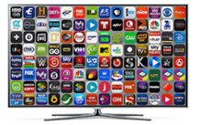
Furthermore, Within Households That Watch Network TV Apps, These Apps + Hulu Account For More Viewing Time Than Netflix
10.1 MM HHs
That View Network TV Apps via OTT
(on connected-TV devices)
VAB: YOU DOWN WITH OTT?
Source: comScore OTT Intelligence, U.S., April 2017. *Network TV App definition excludes premium networks such as HBO and Showtime and Skinny Bundles such as Sling. HHs based on consumption across TV-connected devices only.

Slide 39



In Regards To “Virtual” Skinny Bundles, They Are Only In A Small Fraction Of U.S. HHs
MEMBERS ONLY
Skinny Bundle HHs Watch 5.3 Hours
of Skinny Bundle Content per Viewing Day
3.1 MM
U.S. Skinny Bundle HHs
91%
Of Skinny Bundle Homes Use a Streaming Stick/Box
Is the Most Popular Skinny Bundle in More Than 2 Million Homes
VAB: YOU DOWN WITH OTT?
Source: comScore OTT Intelligence, U.S., April 2017. *Virtual Skinny Bundle HHs defined as viewing Sling, PlayStation Vue or DirecTV Now.

Slide 40



However, “Virtual” Skinny Bundles Account For More Than Half Of OTT Viewing Time in “Virtual” Skinny Bundle Households
MEMBERS ONLY
Other
Skinny Bundles
VAB: YOU DOWN WITH OTT?
Source: comScore OTT Intelligence, U.S., April 2017. *Virtual Skinny Bundle HHs defined as viewing Sling, PlayStation Vue or DirecTV Now.

Slide 41
Sling, Playstation Vue & DirecTV Boast Very High Engagement On A Per HH Basis Vs. Popular OTT Services
MEMBERS ONLY
VAB: YOU DOWN WITH OTT?
Source: comScore OTT Intelligence, U.S., April 2017

Slide 42
vMVPD Subscriptions Are Projected To Top 10 Million Homes By 2021
MEMBERS ONLY
vMVPD Household Projections
(in millions)
VAB: YOU DOWN WITH OTT?
Source: Kagan, a media research group within the TMT offering of S&P Global Market Intelligence, June 2017; virtual service providers characterized by unmanaged (Internet/OTT) delivery of aggregated live, linear networks and on-demand content similar to a traditional multichannel offering for a monthly subscription.

Slide 43
The Math of OTT: More Convenience
81% of streamers say it’s important to them to watch TV programs whenever they want
VAB: YOU DOWN WITH OTT?

Slide 44
Many Consumers Don’t Keep Their Video Subscriptions After Signing Up For A Trial Or Just Share Someone Else’s Passwords
The #1 Reason for Ending a Subscription is “I didn’t use it enough” (29%)
55%
33%
81%
of Cord Trimmers “Regularly” Subscribe to a Trial Version of a Service
Don’t Typically Keep the Subscription After the Trial Period is Over
of Focus Group Participants Report That They Share Passwords With Friends and Family
VAB: YOU DOWN WITH OTT?
Source: PwC Consumer Intelligence Services video survey, 2017 from “Consumer Intelligence Series: I stream, you stream” Report.
© 2017 PricewaterhouseCoopers LLP, a Delaware limited liability partnership.

Slide 45
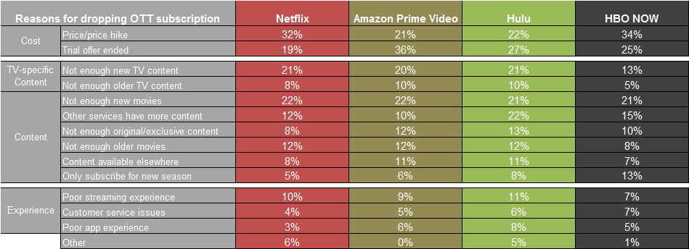
Hulu and HBO Now Experience The Largest Subscriber Churn
MEMBERS ONLY
Most Consumers cite cost and desire for more content as the reasons for dropping the service
OTT subscription video churn (% non-subscribers) | Netflix | Amazon Prime Video | Hulu | HBO Now
Recently dropped (within the last year) | 5% | 13% | 24% | 32%
Dropped a while ago (over a yr ago) | 11% | 13% | 45% | 52%
VAB: YOU DOWN WITH OTT?
Source: 2017 SNL Kagan, a division of S&P Global Market Intelligence; U.S. 3Q 2017 Survey Summary Report

Slide 46
OTT Is About Convenience, Both From A Time & Place Perspective
Flexibility on when and where they watch is important for OTT viewers
Important to me when watching TV programs
% Agree & index vs. Adults
110
150
Index vs. A18+ Pop
103
115
Index vs. A18+ Pop
VAB: YOU DOWN WITH OTT?
Source: Gfk MRI 2016 Doublebase: Definitions – Connected Device Owner (Television Sets Most Recent Purchase-Features Smart TV/Internet Connectable or Internet Video Devices for TV Household Owns Any or All Household Owns Video Game Systems); Streamers Definition (Watch TV through a TV network’s app or through another online streaming TV service.)

Slide 47
Additional Research Continues To Validate That Convenience Is The Primary Reason Why Viewers Use OTT Services
Viewers use OTT to get access to more content
VAB: YOU DOWN WITH OTT?
Source: TiVo Q3 2017 Online Video and Pay TV Trends Report, December 2017

Slide 48
OTT Viewers Also Crave Quality, Engaging TV Programming
They also demand quality programming and access to a variety of library TV content
Important to me when watching TV programs
% Agree & index vs. Adults
101
106
101
106
106
119
107
125
Index vs.A18+ Pop
VAB: YOU DOWN WITH OTT?
Source: Gfk MRI 2016 Doublebase: Definitions – Connected Device Owner (Television Sets Most Recent Purchase-Features Smart TV/Internet Connectable or Internet Video Devices for TV Household Owns Any or All Household Owns Video Game Systems); Streamers Definition (Watch TV through a TV network’s app or through another online streaming TV service.)

Slide 49
The Math of OTT: More Advertising Opportunities
65% of people who use a second screen while streaming have looked up info on a product advertised in a TV show
VAB: YOU DOWN WITH OTT?

Slide 50
Advertising Is The Largest Revenue Model Across The
Entire Online Video Ecosystem & It’s Share Is Projected To Grow
Currently, advertising comprises 45% of all online video revenue and is projected to grow to almost 60% over the next 10 years
41,890
43,597
38,536
40,219
35,215
36,884
31,679
33,585
29,739
27,414
24,657
20,684
VAB: YOU DOWN WITH OTT?
Source: 2017 SNL Kagan, a division of S&P Global Market Intelligence; “The State of the Online Video Delivery,” 2017 Edition

Slide 51
Two-Thirds Of Second Screen Users Look Up Info About A Product They See While Streaming A TV Show
VAB: YOU DOWN WITH OTT?
Source: PwC Consumer Intelligence Services video survey, 2017 from “Consumer Intelligence Series: I stream, you stream” Report.
© 2017 PricewaterhouseCoopers LLP, a Delaware limited liability partnership.

Slide 52
So, Are You Down With OTT?
If you like more then you should be since the math of OTT is a formula of addition, not subtraction.
Consumers have a voracious appetite for video content, especially for premium multiplatform TV, and they can satisfy their cravings anywhere, anytime through a wide selection of devices and streaming services
Distribution
Content
Choice
Convenience
Advertising Opportunities
71% of Internet users use an OTT service at least once a month
65% of people who use a second screen while streaming have looked up info on a product advertised in a TV show
70% of OTT HHs also have a multichannel subscription
More…
81% of streamers say it’s important to them to watch TV programs whenever they want
Eight-fold increase in people who have access to 3+ OTT subscription services
VAB: YOU DOWN WITH OTT?

Slide 53
MEMBERS ONLY
Targeting & Measurement of OTT
VAB: YOU DOWN WITH OTT?

Slide 54






MEMBERS ONLY
OTT Viewers Skew Younger, More Educated, Affluent, And Employed Than The Average Population
Note: these targets do not reflect OTT-only viewers; a large majority of people within these targets also have an MVPD subscription
Device Owners
Streamers
Flat M/F
50%/50%
51%/49%
Skews Millennial
44% 18-34
(125)
47% 18-34
(133)
Skews towards kids at home
50% kids in HH
(128)
47% kids in HH
(133)
Well educated
32% are college+
(105)
33% are college+
(110)
Skews Affluent
51% have HHI $75k+
(112)
48% HHI $75k+
(106)
Majority full-time employed
56% Full Time
(115)
56% Full Time
(114)
Source: Gfk MRI 2016 Doublebase: Note, these groups aren’t exclusively OTT users; they are owners of OTT devices or viewers of streaming content.
Definitions – Connected Device Owner (Television Sets Most Recent Purchase-Features Smart TV/Internet Connectable or Internet Video Devices for TV Household Owns Any or All Household Owns Video Game Systems); Streamers Definition (Watch TV through a TV network’s app or through another online streaming TV service.)

Slide 55


MEMBERS ONLY
They Pursue The New & Different And Seek To Live An Impressive Lifestyle
Device Owners
Streamers
“Risk taking is exciting”
Enjoy novelty and pursuing new things
46% (108)
49% (114)
“I like to live a life that impresses others”
Like attention and seek to impress others
31% (106)
34% (115)
“I enjoy being the center of attention”
27% (105)
31% (120)
VAB: YOU DOWN WITH OTT?
Source: Gfk MRI 2016 Doublebase: Definitions – Connected Device Owner (Television Sets Most Recent Purchase-Features Smart TV/Internet Connectable or Internet Video Devices for TV Household Owns Any or All Household Owns Video Game Systems; Streamers Definition (Watch TV through a TV network’s app or through another online streaming TV service.)

Slide 56
Targeting & Serving Ads In An OTT / Connected TV Environment
MEMBERS ONLY
OTT offers Dynamic Ad Insertion (DAI) delivered instream via VAST ad tag delivery, in a full screen, largely viewable experience. DAI enables OTT advertisers to swap out ad creatives in linear, live and video on demand content
  Since OTT content is delivered over the internet to connected TVs with persistent IP addresses, advertisers can dynamically target and serve ads to specific households
  Addressability can also be enabled via individual app and device-level data (i.e. Roku ID for Advertisers)
  Cookies are of limited use in OTT, though advertisers can leverage 3rd party data (ex: Acxiom, Neustar and Nielsen Catalina) to enrich audience targets. Advertiser CRM data may also be matched with platform registration data for targeting
  Typical targeting parameters include: device, demographics, time of day / day of week, content and category, location etc.
VAB: YOU DOWN WITH OTT?
Source: IAB 2017 “Advanced TV Targeting Overview,” OTT / Connected TV section.

Slide 57
MEMBERS ONLY
Metrics Vary By Service/Device…And Also Client’s Level of Data Sophistication
However, the metrics are largely digital-legacy, which adds complexity in determining “media-bucket” funding source and apples-to-apples video measurement
  Buying Currency/Metrics
  (aka, what an advertiser is putting a buy together based on)
  Impressions
  Completions
  Their derivatives – Completion Rate and Delivered Percent
  Data by device (TV, PC, Mobile)
  Advertiser/Brand KPIs
  (aka “how do I know this ‘worked’)
  Attribution: Lifts in site visits & store visits; conversion rate (exposures:purchases)
  Brand Health: Lifts in brand favorability; likelihood to consider, recommend, or purchase
  3rd Party Measurement
  (aka “who is checking the homework’)
  Audience Validation: Nielsen DAR, Nielsen custom TAR, comScore vCE
  Brand Health: Millward Brown, Research Now
  Sales ROI/Visit Attribution: Experian, IRI, Datalogix, Nielsen, FourSquare Attribution, Millward Brown
VAB: YOU DOWN WITH OTT?

Slide 58
Glossary
Ad Networks: provides an outsourced sales capability for publishers and a means to aggregate inventory and audiences from numerous sources in a single buying opportunity for media buyers
Buy-Side / Demand-Side Platforms (DSPs): a technology platform that provides centralized & aggregated media buying from multiple sources including ad exchanges, ad networks and sell side platforms, often leveraging real-time bidding capabilities of these sources
Multichannel HHs: Households that subscribe to a service offering multiple channels of video programming through either a cable, telco or satellite provider (often referred to as an MVPD – multichannel video programming distributor)
OTA HHs (Over-The-Air): Households that receive broadcast network signals using an antennae; it does not exclude households that also access OTT content
OTT (Over-The-Top): Premium long form video content that is streamed over the internet through an app or device onto a TV (or PC, Tablet, or Smartphone) without requiring users to subscribe to a wired cable, telco or satellite TV service
OTT Aggregator: wide range of content from multiple providers delivered over the internet through one streaming source (i.e. Netflix) without the involvement of a traditional multichannel subscription
OTT-only HHs: Households that rely on unmanaged Internet or OTT delivery to view television shows or movies in lieu of a traditional multichannel subscription
Sell-Side / Supply-Side Platforms (SSPs): a technology platform that provides outsourced media selling and ad network management services for publishers. The business model resembles that of an ad network in that it aggregates ad inventory however they serve publishers exclusively and does not provide services for advertisers
Standalone App: content from one provider delivered directly to the consumer over the internet without the involvement of a traditional multichannel subscription (i.e. CBS All Access)
TV Everywhere (TVE): apps that allow viewers to access content over the internet by logging in with their Multichannel Video Programming Distributor (MVPD) subscription user name / password authentication (i.e. Watch ESPN, Fox Now)
vMPVDs (virtual multichannel video programming distributor): unmanaged (Internet/OTT) delivery of aggregated live, linear networks and on-demand content similar to a traditional multichannel offering for a monthly subscription
VAB: YOU DOWN WITH OTT?

Slide 59


For More Information Visit Us Online
TheVAB.com
Follow us:
@VideoAdBureau
Like us:
facebook.com/VideoAdvertisingBureau

