Slide 1
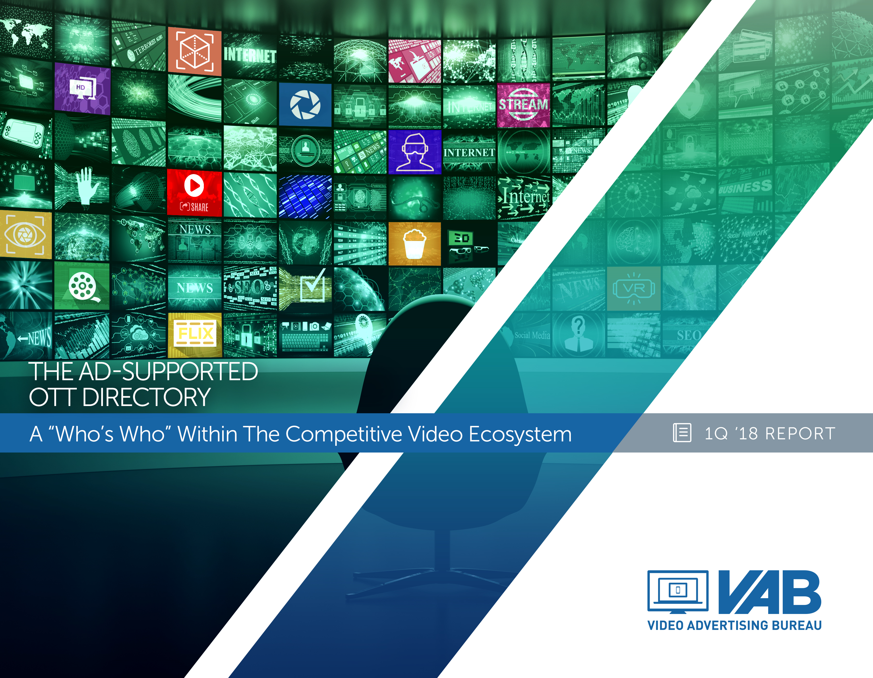
The Ad-Supported OTT Directory
A “Who’s Who” Within The Competitive Video Ecosystem
Member Center

Slide 2
Directory
Summary 3
OTT Video Ecosystem Overview 4-6
Definition 4
Access Points 5
OTT Video Landscape 6
Ad-Supported OTT Video Ecosystem Detail 7-91
Ad-Supported OTT Video Ecosystem 8-10
Ad-Supported OTT Video Services 11-25
Ad-Supported OTT Devices 26-47
Overview 27
Internet Streaming Players 28-37
Smart / Connected TVs 38-42
Game Consoles 43-47
vMVPDs 48-67
Ad-Tech Networks & Platforms (SSPs / DSPs) 68-91
Contact Information 92
VAB: The competitive Ad-Supported OTT Directory

Slide 3
Summary
With 820 million connected video devices in the U.S. and hundreds of different streaming services, the OTT video ecosystem provides consumers with the promise of “more”…more distribution, more content, more choice, more convenience and more advertising opportunities.
Advertising opportunities are growing as more ad-supported services and devices enter the marketplace, led by premium, multi-screen TV content provides.
In this members’ only release, the VAB has compiled a comprehensive ad-supported OTT competitive guide for those who wish to further educate themselves on the video ecosystem.
This competitive analysis includes key usage and audience stats, positioning, partnerships and advertising capabilities of the major competitive streaming services (excluding TV networks & MVPDs), connected TV devices and ad-tech platforms.
As a summary, the following is examined in detail:
  Ad-Supported OTT video streaming services such as Hulu, Crackle, Pluto.TV and Crunchyroll
  Streaming players such as Roku, Amazon Fire TV, Chromecast & Apple TV
  Smart TVs from manufacturers like Samsung, Vizio and Sony
  Game consoles from Playstation, Xbox and Nintendo
  vMVPDs such as Sling TV, Playstation Vue, Hulu with Live TV and YouTube TV
  Ad-tech platforms such as Yume, Brightline, FreeWheel, Telaria, Brightroll, Videology
VAB: The competitive Ad-Supported OTT Directory

Slide 4

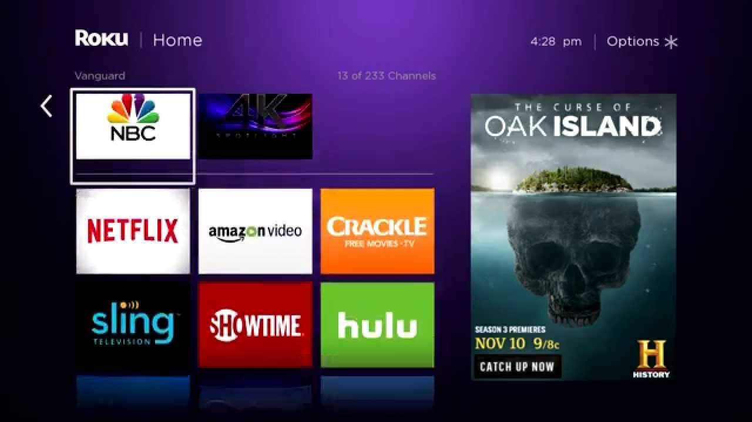
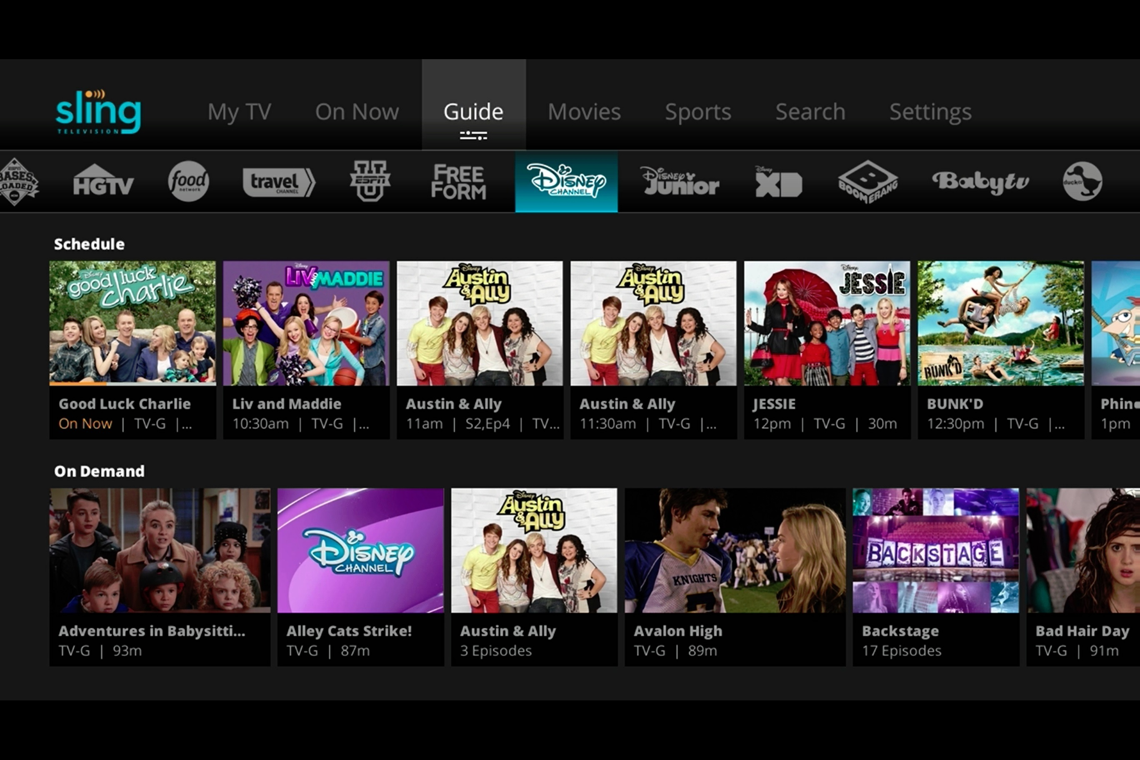

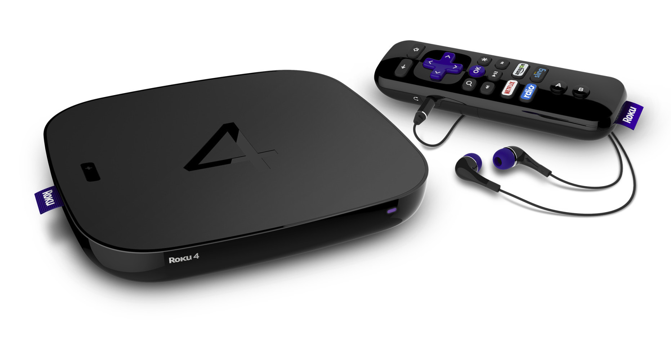
4
What is OTT (Over-The-Top)?
Definition: Premium long form video content that is streamed over the internet through an app or device onto a TV (or PC, Tablet, or Smartphone) without requiring users to subscribe to a wired cable, telco or satellite TV service.
OTT consumer journey: OTT leverages “apps” to stream video content to a television via an internet connection. Viewing methods include: (a) on-demand where viewers select and watch content when they choose to, and (b) linear/live – where viewers watch at the particular time, channel or app (live content is streamed in real time as the event happens)
Viewers stream TV content from the Internet using either a smart TV, OTT device, connected game console or IP set top box that received signals from digital video ad server
All major networks are making their content available either through their own app or via a virtual MVPD like Hulu or Sling TV
Content is streamed and plays instantly in full-screen and can be ad-supported if the network chooses
VAB: The competitive Ad-Supported OTT Directory

Slide 5
5
OTT Content Can Be Accessed In Several Ways And Falls Primarily Into Two Groups
Devices
Connected Devices allows the streaming of specific, selected content.
Devices include Streaming Players/Sticks (e.g. Roku/Amazon Fire TV), Gaming Consoles (e.g. PS4), and Smart TVs
Streaming Services
Means of access are ad-supported, subscription, rental, or purchase.
These access points can take the form of
OTT content aggregators (e.g. Crackle), Standalone apps (e.g. ABC),
or virtual MVPDs (e.g. Sling).
Streaming services and devices often work in tandem. For example, streaming Hulu content from a mobile phone to the television via Google Chromecast.
VAB: The competitive Ad-Supported OTT Directory
Source: SNL Kagan

Slide 6
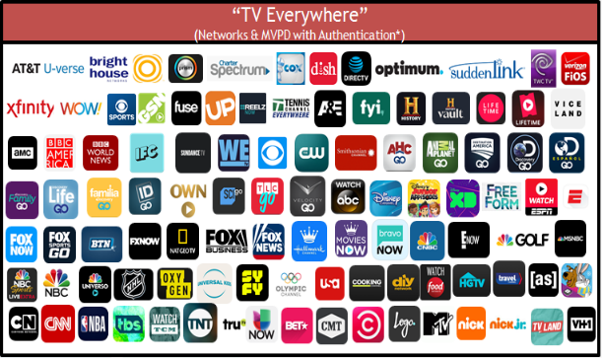
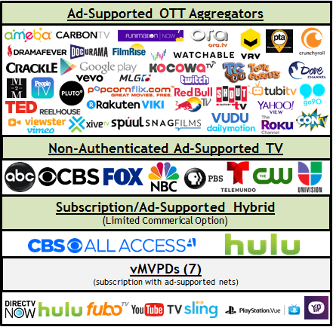
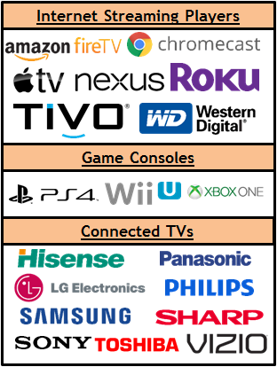
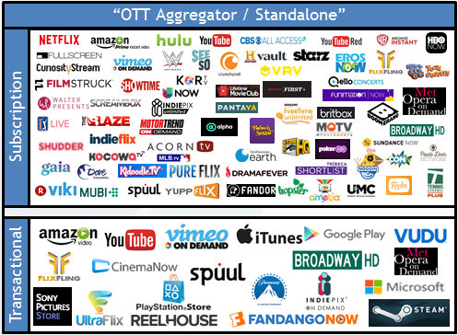



OTT Streaming Services & Devices Ecosystem
VAB: The competitive Ad-Supported OTT Directory
Note: the above reflects a representative sampling of services and devices and each segment does not necessarily reflect every offering available.

Slide 7
Ad-Supported OTT Video Ecosystem - Detail
(Services, Devices & Platforms)
VAB: The competitive Ad-Supported OTT Directory

Slide 8

Ad-Supported OTT Streaming Services & Devices Ecosystem
VAB: The competitive Ad-Supported OTT Directory
Note: the above reflects a representative sampling of services and devices and each segment does not necessarily reflect every offering available.

Slide 9







































































































There Are Dozens Of Authenticated “TV Everywhere” TV Network & MVPD Apps
“TV Everywhere”
(Networks & MVPD with Authentication*)
VAB: The competitive Ad-Supported OTT Directory
Source: 2017 SNL Kagan, a division of S&P Global Market Intelligence

Slide 10






































































Beyond “TV Everywhere,” There Are Dozens Of Services & Devices Within The Ad-Supported OTT Ecosystem
Services
Devices / Platforms
Ad-Supported OTT Aggregators
Internet Streaming Players
Game Consoles
Non-Authenticated Ad-Supported TV
Connected TVs
Subscription (with “limited commercial” option)
vMVPDs
(subscription with ad-supported nets)
VAB: The competitive Ad-Supported OTT Directory
Source: 2017 SNL Kagan, a division of S&P Global Market Intelligence. Note: this chart does not include “authenticated” apps from TV networks or MVPDs.

Slide 11
A More Detailed Look At “Competitive” Ad-Supported OTT
Video Services
*excluding VAB members / TV Network-based services
VAB: The competitive Ad-Supported OTT Directory

Slide 12
Let’s Take A Look At The Ad-Supported Aggregators + Hulu
Services
Devices / Platforms
Ad-Supported OTT Aggregators
Internet Streaming Players
Game Consoles
Non-Authenticated Ad-Supported TV
Connected TVs
Subscription (with “limited commercial” option)
vMVPDs
(subscription with ad-supported nets)
VAB: The competitive Ad-Supported OTT Directory
Source: 2017 SNL Kagan, a division of S&P Global Market Intelligence. Note: this chart does not include “authenticated” apps from TV networks or MVPDs.

Slide 13
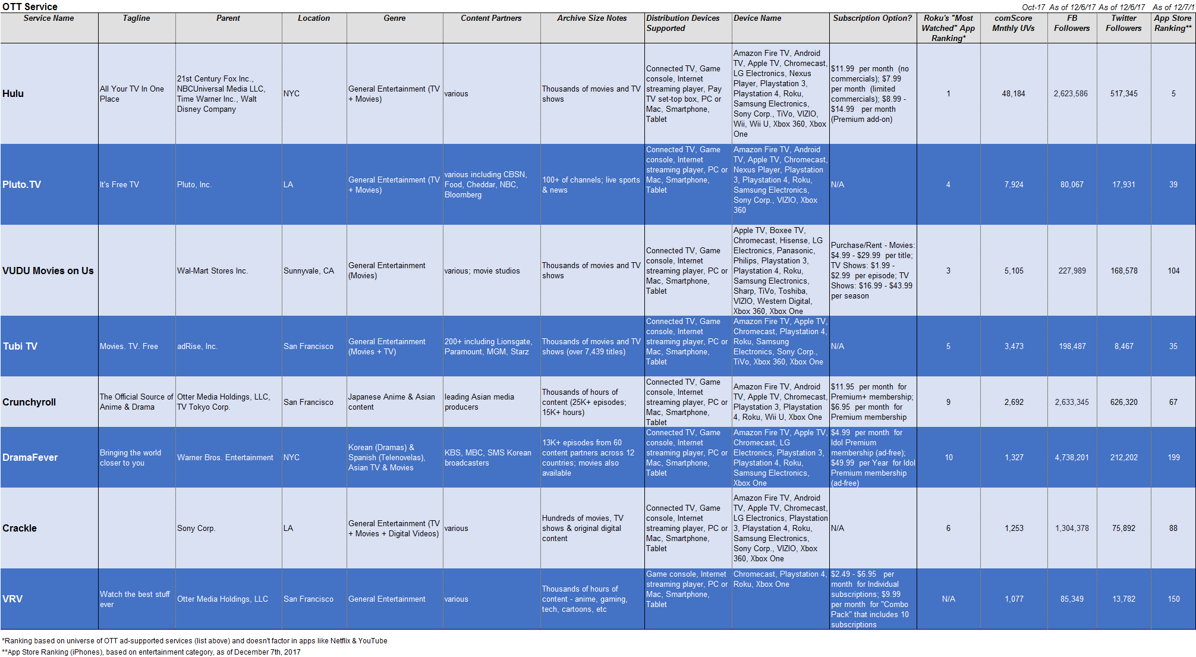
Top Ad-Supported OTT Services
These top services are measured on comScore and have a decent ranking in the App Store
VAB: The competitive Ad-Supported OTT Directory

Slide 14
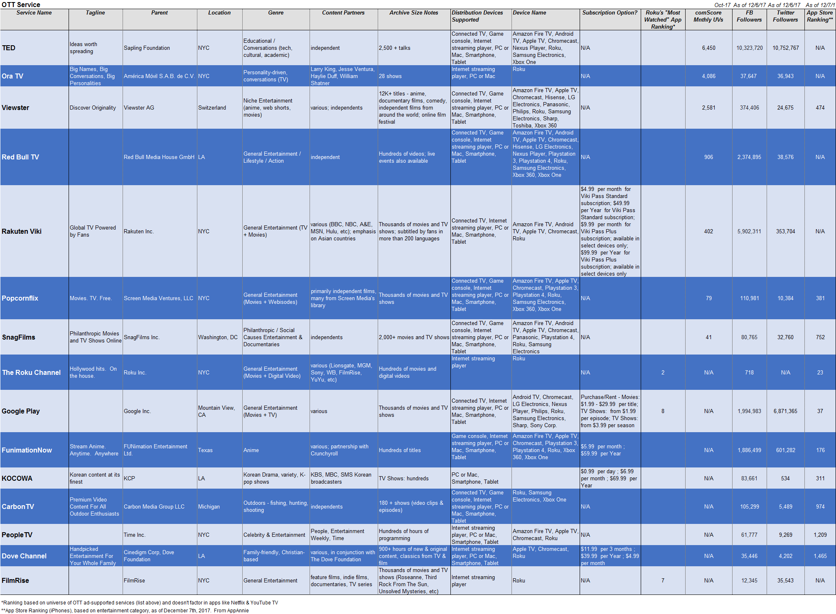
“Mid-Sized” OTT Services
Most of these mid-sized services are either measured in comScore or ranked in the App Store; a few are measured / ranked in both but don’t have big numbers

Slide 15
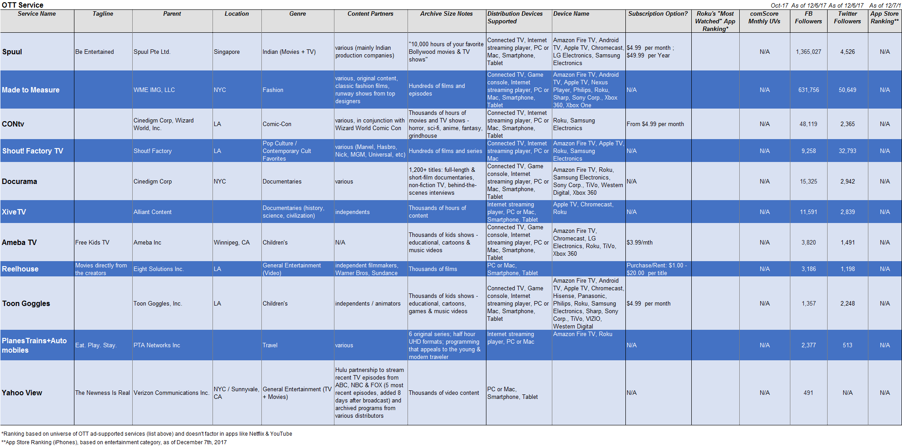
Niche OTT Services
These niche services aren’t measured in comScore or ranked in the App Store
VAB: The competitive Ad-Supported OTT Directory

Slide 16



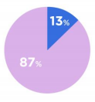

Top Services: Hulu
Hulu’s Positioning: Hulu is a leading premium streaming service that offers instant access to live and on demand channels, original series and films, and a premium library of TV and movies to more than 47 million total unique viewers in the U.S. Since its launch in 2008, Hulu has consistently been at the forefront of entertainment and technology. Hulu is the only streaming service that offers both ad-supported and commercial-free current season shows from the largest U.S. broadcast networks; libraries of hit TV series and films; and acclaimed Hulu Originals including Emmy Award-winning series The Handmaid’s Tale, The Mindy Project, The Path, 11.22.63, and Golden Globe® nominated comedy Casual, as well as upcoming series Future Man, Castle Rock, Marvel’s Runaways and The Looming Tower. In 2017, Hulu added live news, entertainment and sports from 21st Century Fox, The Walt Disney Company, NBCUniversal, CBS Corporation, The CW, Turner Networks, A+E Networks and Scripps Networks Interactive to its offering – making it the only TV service that brings together live, on-demand, originals, and library content all in one place, across living room and mobile devices.
Founded: 2007
Based: Los Angeles, CA
Owned by: Disney (30%), FOX (30%), Comcast (30%), Time Warner (10%)
Advertising Revenue: $900 million annually
Website: www.Hulu.com
Apple App Store Rating: 2.0 Stars, 8.2K Reviews
Audience Composition
Content
Advertising
Audience Size:
Hulu offers a mix of original series (The Handmaid’s Tale, Future Man, 11.22.63, The Path, etc.) and TV content via streaming partnerships with major networks (21st Century Fox, ABC-Disney, NBCUniversal CBS, CW, Turner, A&E, & Scripps).
Overall 2017 Content Budget: $2.5 Billion
They offer a variety of advertising options for brands. Options range from video ads (long-form pre-roll or standard commercial breaks) to brand placement to interactive ads. They like to give viewers options on how they view ads.
Ad Revenue Distribution:
70% Ad Content Provider
10% Distribution Provider
20% Hulu Keeps
Trying to target younger audiences, especially with recent partnership with Nintendo Switch
VAB: The competitive Ad-Supported OTT Directory
Apple App Store Ratings and Reviews as of 12/15/17. Positioning, audience composition, content and advertising detail based on company data.

Slide 17

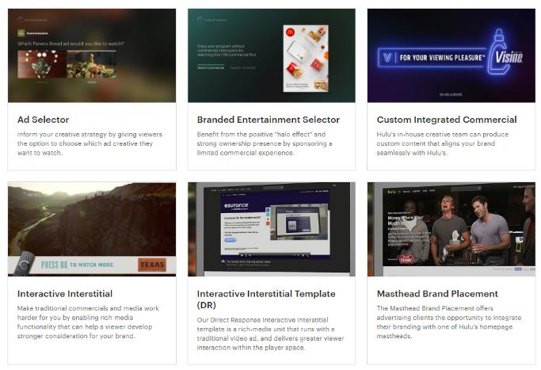
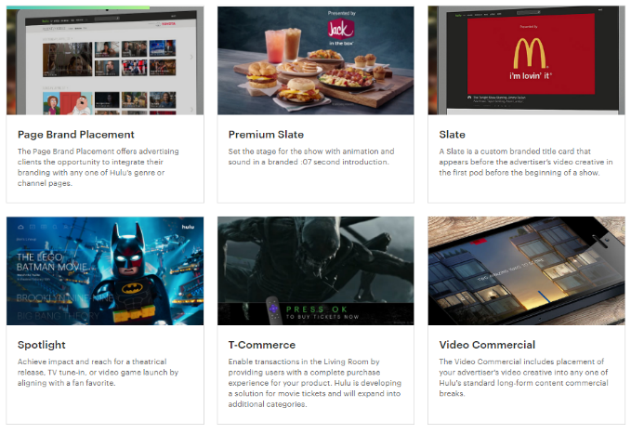
Advertising on Hulu
Samples of Advertising Types
Click-Thru to See Ads
Hulu offers advertisers a variety of options. These include pre-roll and mid-roll video ads, custom integrated commercials, brand placement, and interactive ads. Timing ranges from short :07 second ads to more long-form videos, sometimes depending on the viewer’s selection. They also offer creative partnerships, contextual sponsorships and custom integrated commercials.
VAB: The competitive Ad-Supported OTT Directory
Based on company data.

Slide 18
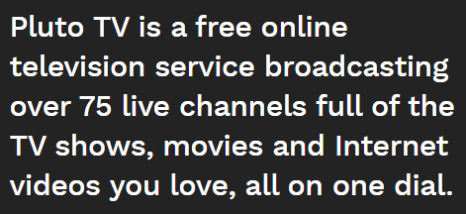
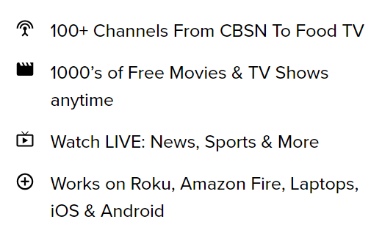








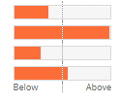
Top Services: Pluto.TV
Pluto.TV Positioning
Partnerships
Founded: 2013
Based: Los Angeles, CA
Funding: has raised $51.8 million to date
Website: www.Pluto.tv
Apple App Store Rating: 4.7 Stars, 3.6K Reviews
Audience Composition
Content
Advertising
Split ad revenue with distributors, but there is no public info available on the split. Ads are sold directly from the service or through ad networks.
Commerical breaks are similar to linear TV with mid-roll ad breaks with multiple ads served from Pluto. The number of ads varies from 1 to 3-4 ads. In the summer of 2017, their CEO was quoted as saying they’re in the early phases of personalizing ads based on user’s viewing preferences.
Pluto TV offers an array of content directly from the distributers, including live sports, news, comedy and movies. No original content. Offers live streaming and VOD. The curate their own channels with a mix of free online content and content from partners.
5 Million Active Monthly Users
VAB: The competitive Ad-Supported OTT Directory
Apple App Store Ratings and Reviews as of 12/15/17. Positioning, audience composition, content and advertising detail based on company data.

Slide 19

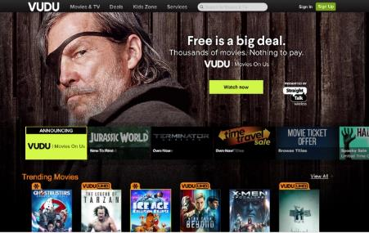
Top Services: VUDU Movies
Vudu was bought by Walmart in 2010. Walmart has since created “Vudu Movies on Us” as a way to break into the on-demand streaming market. They cite that 42% of U.S. consumers prefer to stream free ad-supported movies and TV.
Founded: 2016
Based: Santa Clara, CA
Website: www.Vudu.com
Apple App Store Rating: 2.4 Stars, 661 Reviews
Audience Composition
Content
Advertising
Competing for users of other free ad-supported video platforms like Yahoo View (home of content from what was formerly Hulu’s free service) and Sony Crackle.
Library includes critically-acclaimed films, family-friendly features, date night movies, thrillers, documentaries, etc. Offers more than 3,000 HD movies for free. Original titles included “Mad Max”, “True Grit”, “Abudction” and “School of Rock”
Pre- and mid-roll advertising. They have some partnerships with movie studios to get content. Ads are sold directly by the service or through ad networks.
Recently partnered with company called SpotX to power their programmatic system.
VAB: The competitive Ad-Supported OTT Directory
Apple App Store Ratings and Reviews as of 12/15/17. Positioning, audience composition, content and advertising detail based on company data.

Slide 20

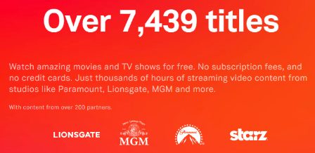
Top Services: Tubi TV
Tubi Positioning
Watch amazing movies and TV shows for free. No subscription fees, and no credit cards. Just thousands of hours of streaming video content from studios like Paramount, Lionsgate, MGM, and more.
Founded: 2014
Based: San Francisco, CA
Advertising Revenue: Since 2014, online video ad sales have increased 20% annually
Website: www.tubitv.com
Apple App Store Rating: 4.5 Stars, 2.9K Reviews
On TV: “Advertisers get to reach an audience they can no longer reach through traditional TV commercials – the cord cutters and cord nevers of the world,” explains [Founder and CEO, Farhad] Massoudi. “That’s a big deal,” he says.
Audience Composition
Content
Advertising
Their goal is to target cord-cutters. Users are said to be mostly tech-savvy Millennials with a household income of $100K. Evenly split between men and women.
Ad-breaks are similar to Hulu or traditional linear TV, ranging from 15 seconds to 2 minutes. Ads are sold directly by the service or through ad networks.
They also work with Brightline to provide interactive ads.
Library offers content from over 200 partners, including Lionsgate, MGM, Paramount and Starz.
VAB: The competitive Ad-Supported OTT Directory
Apple App Store Ratings and Reviews as of 12/15/17. Positioning, audience composition, content and advertising detail based on company data.

Slide 21

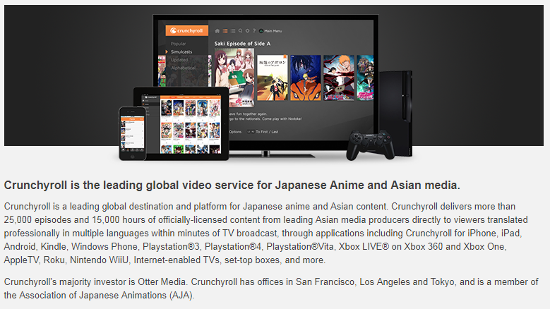
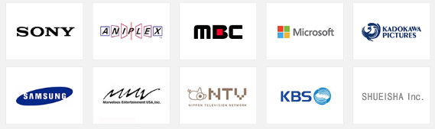
Top Services: Crunchyroll
Some of Their Partners
Crunchyroll Positioning
Founded: 2006
Based: San Francisco, CA
Website: www.Crunchyroll.com
Apple App Store Rating: 3.3 Stars, 1.7K Reviews
Usage Stats
Content
Advertising
They have over 1 million paid subscribers and 20 million registered users.
Users currently stream more than 1.5 billion minutes of video per month, with a per-user average of about 30 minutes per day.
Crunchyroll offers Japanese Anime and other Asian media including manga, drama, music, electronic entertainment and content.
They announced over the summer that they are planning to produce their own anime with NBCUniversal Japan.
Pre- and mid-roll video ad-breaks with several ads in one break. Ads are sold directly from the service or through ad networks.
VAB: The competitive Ad-Supported OTT Directory
Apple App Store Ratings and Reviews as of 12/15/17. Positioning, usage stats, content and advertising detail based on company data.

Slide 22

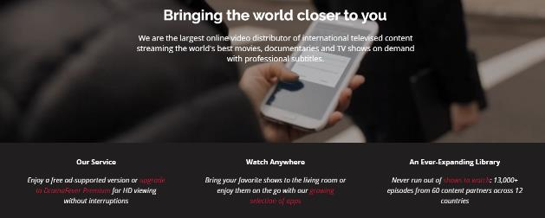
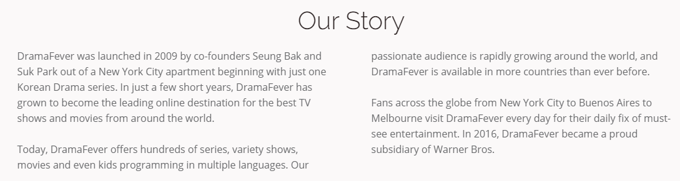
Top Services: DramaFever
DramaFever Positioning
Founded: 2009
Based: New York, NY
Website: www.DramaFever.com
Apple App Store Rating: 4.7 Stars, 3.1K Reviews
Audience Composition
Content
Advertising
Majority of users are young, urban and educated. Females make up 65% of viewers and among these, the 18-34 range is most significant. Over 80% of their estimated 3.5 million monthly viewers are non-Asian.
DramaFever offers on-demand streaming of documentaries, movies and TV shows with subtitles. Their current library includes Korean Dramas, Latin American Telenovelas, and a wide selection of Asian TV shows and movies for free.
Pre-roll and mid-roll video ads. They also offer display ads on their website. Advertising is sold directly from the service or through ad networks.
DramaFever Advertising
VAB: The competitive Ad-Supported OTT Directory
Apple App Store Ratings and Reviews as of 12/15/17. Positioning, audience composition, content and advertising detail based on company data.

Slide 23

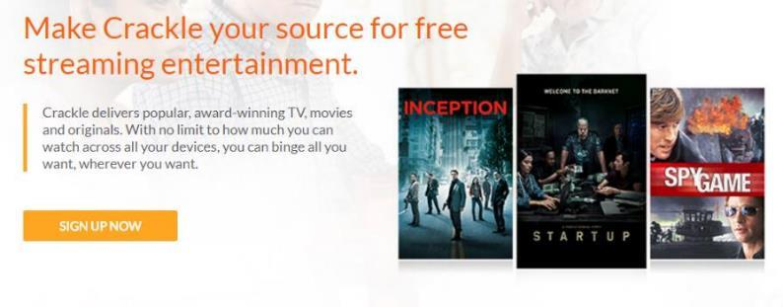
Top Services: Crackle
Crackle Positioning
Founded: 2004
Based: Culver City, CA
Website: www.Crackle.com
Apple App Store Rating: 2.4 Stars, 358 Reviews
Usage Stats
Content
Advertising
Used by 18 million monthly viewers.
“Demographics are good, but psychographics are better,” said Eric Berger, the evp of digital networks for Sony Pictures Television (owner of Crackle) and general manager of Crackle at the event. “Beliefs and values can predict intent better than age or gender.”
Crackle offers an array of original content and series like “Snatch” and “The Art of More”, as well as on-demand TV shows and movies. In 2016 they cut their first distribution deal with Comcast, allowing them to distribute Crackle’s original content.
Pre-roll and mid-roll video ads, video “promercials”, interactive ads. They also offer advertisers sponsorships and branded content that can be integrated into their original content.
Crackle Advertising
VAB: The competitive Ad-Supported OTT Directory
Apple App Store Ratings and Reviews as of 12/15/17. Positioning, usage stats, content and advertising detail based on company data.

Slide 24
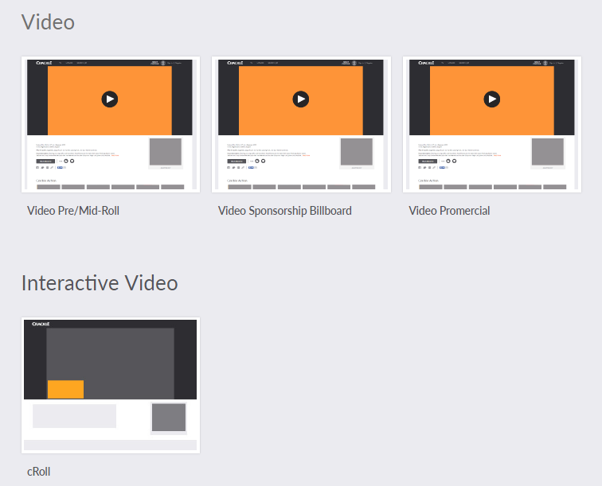
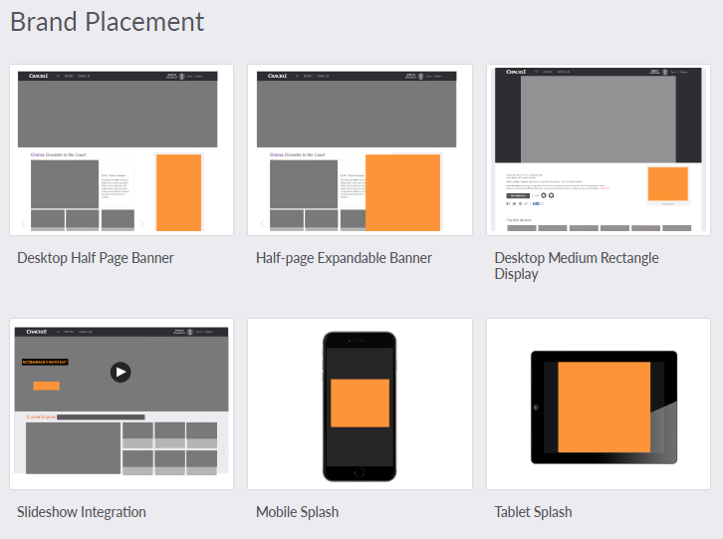
Advertising on Crackle
Samples of Advertising Types
Video Promercial is like an interstitial ad
cRoll is an interactive video ad unit that provides users with more content and information about the film if they chose to interact with it.
Click-Thru to Learn More
VAB: The competitive Ad-Supported OTT Directory
Based on company data.

Slide 25



Top Services: VRV
VRV Positioning
Channels Available
Crunchyroll, Funimation, Rooster Teeth, Cartoon Hangover, Geek & Sundry, Shudder, Nerdist, MONDO, Tested, CuriosityStream, MUBI, CollegeHumor and VRV Select
Founded: 2016
Website: www.VRV.co
Apple App Store Rating: 3.0 Stars, 585 Reviews
Usage Stats
Content
Advertising
Streams anime, cartoons, horror, other niche interests. Is partnered with online channels and allows subscribers to subscribe in bundles or a la carte. San Francisco animation company Mondo Media has created originals for the platform. Has exclusive rights to show Harmonquest.
Users can opt out of ads via a premium subscription. It appears their ads are mostly pop-ups which can be blocked with an ad-blocker. Ads are sold directly by the service or through ad networks.
1.5 million subscribers and 1 million active monthly users who have watched over a billion minutes of video.
VAB: The competitive Ad-Supported OTT Directory
Apple App Store Ratings and Reviews as of 12/15/17. Positioning, usage stats, content and advertising detail based on company data.

Slide 26
A More Detailed Look At The Top Ad-Supported OTT
Video Devices
VAB: The competitive Ad-Supported OTT Directory

Slide 27
Next Let’s Look At The OTT Devices & Platforms
Services
Devices / Platforms
Ad-Supported OTT Aggregators
Internet Streaming Players
Game Consoles
Non-Authenticated Ad-Supported TV
Connected TVs
Subscription (with “limited commercial” option)
vMVPDs
(subscription with ad-supported nets)
VAB: The competitive Ad-Supported OTT Directory
Source: 2017 SNL Kagan, a division of S&P Global Market Intelligence. Note: this chart does not include “authenticated” apps from TV networks or MVPDs.

Slide 28
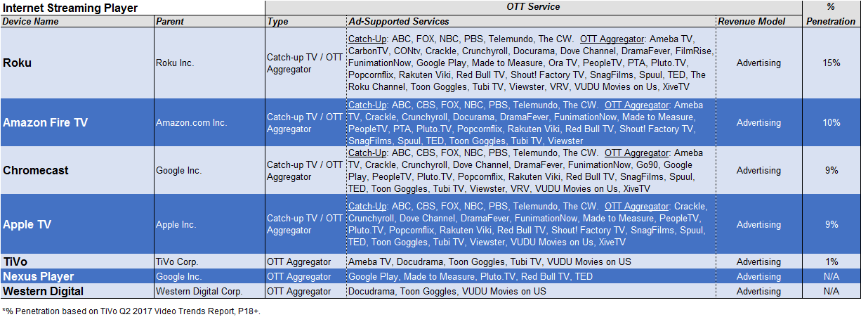
Internet Streaming Players
VAB: The competitive Ad-Supported OTT Directory
Note: % penetration based on A18+ population

Slide 29
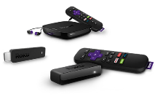

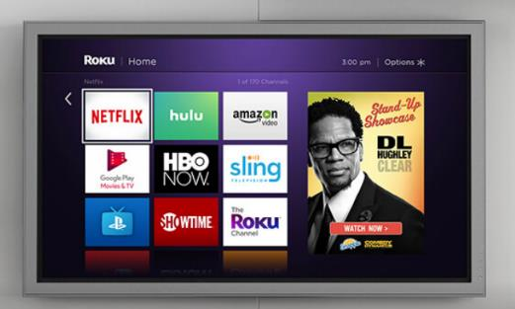
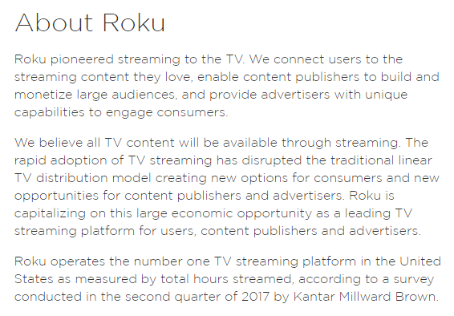
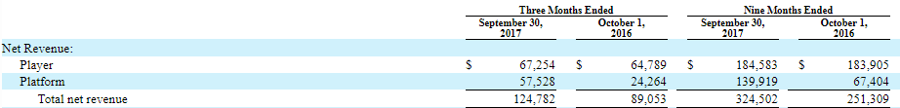
Top Devices: Roku
Roku Positioning
Founded: 2002; First Gen Released in 2008
Website: www.Roku.com
Apple App Store Rating: 4.3 Stars, 4.0K Reviews
Roku CEO says they want to power every TV in the world. In an interview with CNBC this year, he discusses how people leave the traditional Pay TV ecosystem because they want a better, cheaper experience.
15 Million Monthly Active Users, 7 Billion Hours Streamed in First Half of 2017; 38.9 Million Overall U.S. Users
Partnered with Hulu, Amazon, Netflix, “all content providers” to distribute content
VAB: The competitive Ad-Supported OTT Directory
Apple App Store Ratings and Reviews as of 12/15/17. Positioning, revenues and other stats based on company data.

Slide 30
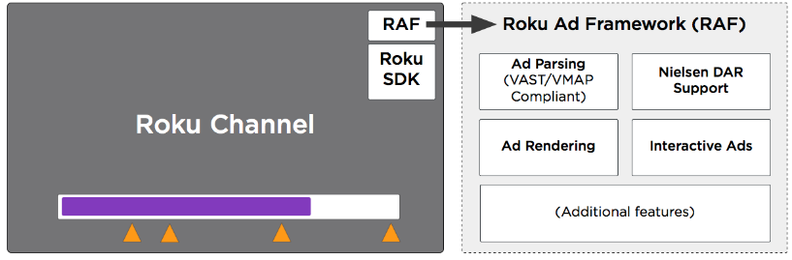
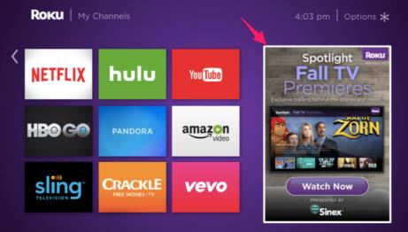
Advertising on Roku
Advertising on Roku
Advertising opportunities are sold directly through Roku
Of the 6.7 billion hours streamed over Roku devices and Roku TVs in the first half of FY 2017, a full 43% were ad supported. 41% of its total revenue for that same period came from advertising.
Sells video inventory to advertisers across a couple of hundred channels available on its platform. Ad-supported programming accounts for half of the viewing on the top 250 most-viewed channels.
Selling advertising like traditional TV, based on audience guarantees from Nielsen’s Digital Ad Ratings
Roku collects money two ways: by selling hardware, which it calls “players”; and by selling advertising and taking a cut of revenues from the video publishers on its platform (% split is agreed upon with each publisher).
They offer display ads on the homepage of the app, as well as pre-roll and mid-roll video ads and interactive ads
VAB: The competitive Ad-Supported OTT Directory
Based on company data.

Slide 31
Roku
Roku Users are Ad-Supportive
54%
“I’m willing to watch ads if that means I get free movies or TV shows” (Top 2 Box)
Roku Users Also Enjoy Testing Out Digital TV Services on Their Device
How Many Digital TV Services Have you Trialed in the Last six Months?
Free
The #1 search term on Roku.com
45%
32%
15%
8%
1 Service
2 Services
3 Services
4+ Services
67%
“Access to ad-supported local TV news on my Roku is important to me” (Top 2 Box)
55%
of Users Trialed 2+ Services
VAB: The competitive Ad-Supported OTT Directory
Source: Roku Survey Data, August, 2017

Slide 32



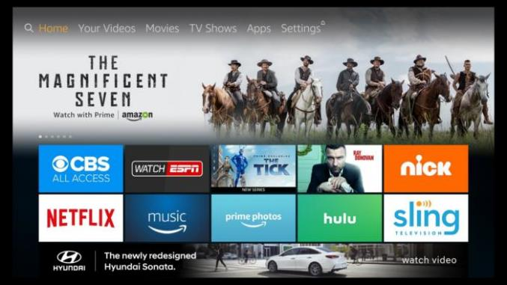
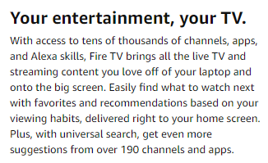
Top Services: Amazon Fire TV
Amazon Fire TV Positioning
Released: 2003
35.8 Million Active U.S. Users
Partners include Hulu, Showtime, Sony’s PlayStation Vue, CBS All Access, NBC, Bravo, CNBC and NBC News
VAB: The competitive Ad-Supported OTT Directory
Apple App Store Ratings and Reviews as of 12/15/17. Positioning, usage and other stats based on company data.

Slide 33
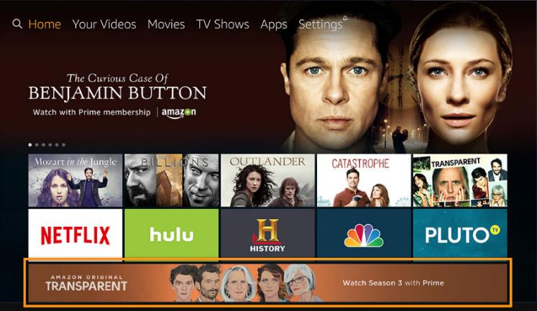
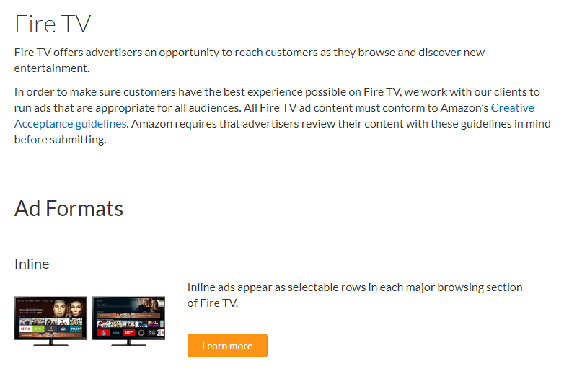
Advertising on Amazon Fire TV
Currently, it’s believed that the only form of advertising they offer are inline ad banners that can be seen by users while they browse for content. In a new update, it appears they’ve made these ads hard to avoid to the dismay of some users.
VAB: The competitive Ad-Supported OTT Directory
Based on company data.

Slide 34


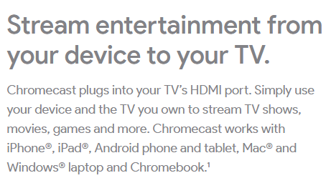
Top Devices: Chromecast
Chromecast Positioning
The Chromecast works differently than the Amazon Fire TV, the Roku, and the Apple TV, the other major streaming devices. Those players all have on-screen interfaces that display the channels/apps that can be played through them and they all come with remotes to navigate through the interface. With the Chromecast, you find the content you want to watch/listen to/play on your Android or iOS mobile device or in your Chrome browser and then “cast” it to your TV through the player. (You’re not actually sending the full signal to the Chromecast from your device; you’re just sending the URL and it picks it up directly from the Internet.)
First Generation Released: 2013
Apple App Store Rating: 4.4 Stars, 11.1K Ratings
Advertising on Chromecast
It does not appear like they sell advertising for Chromecast directly, however ads appear within the apps. For instance, if you are using Hulu with ads, the ads would appear.
VAB: The competitive Ad-Supported OTT Directory
Apple App Store Ratings and Reviews as of 12/15/17. Positioning and other stats based on company data.

Slide 35


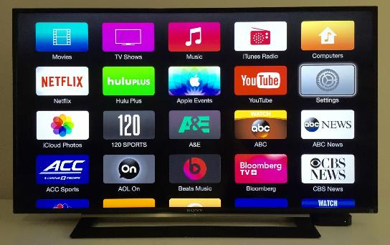
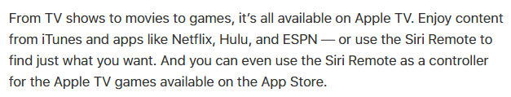
Top Devices: Apple TV
Apple TV Positioning
First Generation Released: 2007
Website: www.apple.com/tv/
21.3 Million Active U.S. Users
Partners include A&E, ABC, Amazon, CBS, NBC, NBA, Netflix, NHL, NFL Now, Bloomberg, PBS, Crunchyroll, Starz, HBO, etc.
Advertising on Apple
The Apple website does not have any information on direct advertising, however ads appear within the apps. For instance, if you are using Hulu with ads, the ads would appear. At the end of 2016, Facebook was discussing selling ads on Apple TV apps.
VAB: The competitive Ad-Supported OTT Directory
Apple App Store Ratings and Reviews as of 12/15/17. Positioning, usage and other stats based on company data.

Slide 36


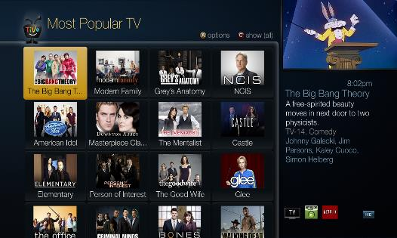
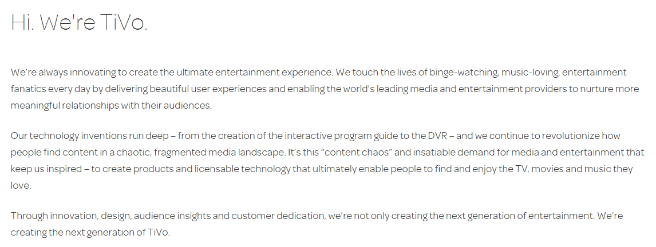
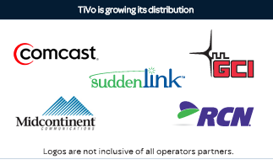
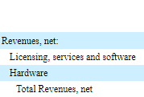
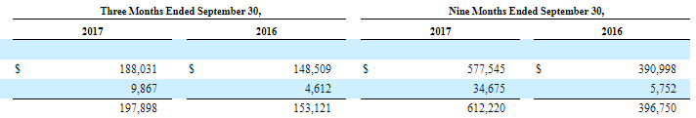
Top Devices: TiVo
TiVo Positioning
First Generation Released: 2009
Website: www.TiVo.com
Subscribers: 7.4 Million
VAB: The competitive Ad-Supported OTT Directory
Apple App Store Ratings and Reviews as of 12/15/17. Positioning, revenues and other stats based on company data.

Slide 37
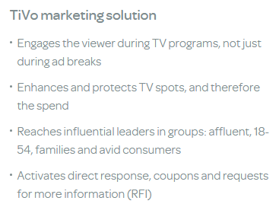
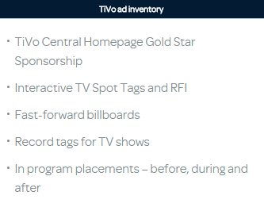
Advertising on TiVo
TiVo Ad Sales
TiVo offers advertisers targeted audience delivery and ads come in a variety of forms.
VAB: The competitive Ad-Supported OTT Directory
Based on company data.

Slide 38
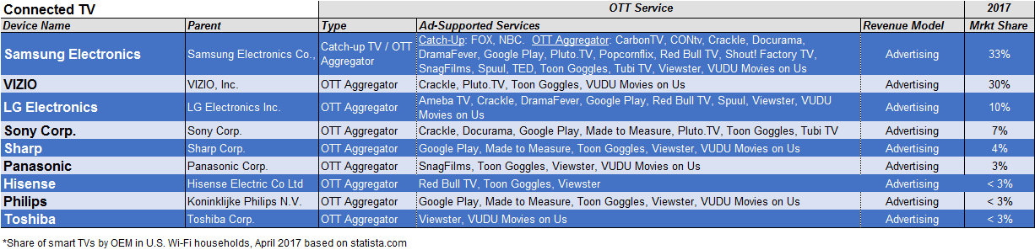
Smart / Connected TVs
VAB: The competitive Ad-Supported OTT Directory

Slide 39
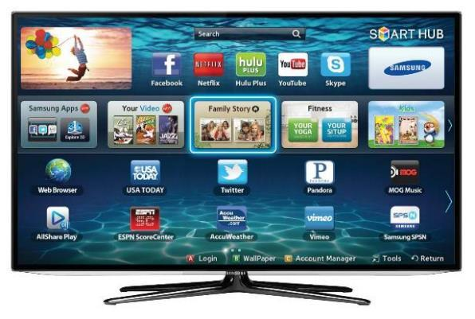


Top Devices: Samsung Smart TV
Samsung Smart TV Positioning
Advertising
Samsung sells advertising directly, offering banner display ads, video ads and tune-in notifications on the homepage. An update in 2016 made it so that users are unable to avoid the ads (consumers weren’t too happy about this update). They have partnerships with third-party research companies to monitor ads.
VAB: The competitive Ad-Supported OTT Directory
Positioning, partnerships and advertising details based on company data.

Slide 40


Top Devices: VIZIO
It doesn’t appear that Vizio Smart TVs offer advertising directly, however it is unclear if there is any revenue share with ad-supported apps.
Vizio had to pay $2.2 million to settle charges related to collected viewing data in the past without consumers’ knowledge
VAB: The competitive Ad-Supported OTT Directory

Slide 41

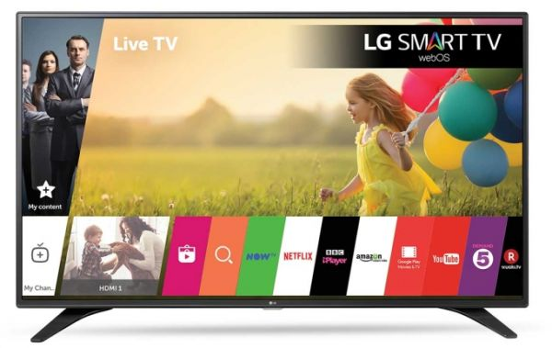
LG Smart TV
Advertising
LG offers advertising opportunities via display ads, as well as banner and pre-roll/mid-roll/post-roll video ads. Their first use of banner and pre-roll ads was in 2011 with embedded YuMe smart-TV SDK. In 2016, LG partnered with OTT services provider Xumo and launched a streaming service, Channel Plus, which is automatically installed on every smart TV and contains video ads. They do collect consumer data but they say that they do not sell this information to third-party vendors.
VAB: The competitive Ad-Supported OTT Directory
Advertising details based on company data.

Slide 42


Sony Smart TV
It doesn’t appear that Sony Smart TVs offer advertising directly, however it is unclear if there is any revenue share with ad-supported apps.
Sony Smart TVs collect usage data, but viewers can opt out. New models are Android TVs so data is collected on behalf of Sony and Google.
VAB: The competitive Ad-Supported OTT Directory

Slide 43

Game Consoles
VAB: The competitive Ad-Supported OTT Directory

Slide 44





Top Devices: PlayStation 4
Playstation 4 Positioning
Playstation 4 Released in 2013
VAB: The competitive Ad-Supported OTT Directory
Positioning and usage stats based on company data.

Slide 45

Advertising on PlayStation 4
Sony offers a variety of advertising opportunities through the PlayStation Network. Ad opportunities range from video and display ads to branded content and sponsorships. Ads can appear on the main screen when users turn on the console and in the store when they are browsing for new games. They are also now offering ads through original series that they are creating with Crackle.
VAB: The competitive Ad-Supported OTT Directory

Slide 46







Top Devices: XBox One
Xbox One: Released 2013
Xbox One S: Released 2016
Xbox One X: Released 2017
Advertising
Ads for Xbox are sold through Oath (a Verizon company), who deal with all Microsoft consumer properties (MSN, Outlook.com, Skype, Windows, Xbox). For Xbox one products, they offer banner ads and video ads.
VAB: The competitive Ad-Supported OTT Directory
Demographics and advertising details based on company data.

Slide 47






Top Devices: Nintendo – Wii U / Switch
Nintendo Wii U: Released 2012
Nintendo Switch: Released 2017
Advertising on the consoles is limited to the game store and is only for games. They recently added Hulu as their first streaming app, which have ads. Otherwise, it does not appear that they sell advertising directly.
VAB: The competitive Ad-Supported OTT Directory
Usage stats and advertising detail based on company data.

Slide 48
A More Detailed Look At vMVPDs
*excludes VAB members
VAB: The competitive Ad-Supported OTT Directory

Slide 49
Separately, We Also Looked At The Major vMPVDs
Services
Devices / Platforms
Ad-Supported OTT Aggregators
Internet Streaming Players
Game Consoles
Non-Authenticated Ad-Supported TV
Connected TVs
Subscription (with “limited commercial” option)
vMVPDs
(subscription with ad-supported nets)
VAB: The competitive Ad-Supported OTT Directory
Source: 2017 SNL Kagan, a division of S&P Global Market Intelligence. Note: this chart does not include “authenticated” apps from TV networks or MVPDs.

Slide 50

vMVPDs (Virtual): A Snapshot
VAB: The competitive Ad-Supported OTT Directory

Slide 51







Top vMVPDs: Sling TV
Sling TV Positioning
Founded: 2015
Headquarters: Meridian, CO
Subscribers: 2.21 million subscribers as of December 2017
Website: www.Sling.com
Advertising
Dish offers targeted advertising via Sling TV with measurement and analytics data reporting. Ads are set up through their live TV offering, as well as through ad-supported apps.
Content Partners
Sling TV offers content from a range of ad-supported networks and offers access to many platforms including Apple TV, Amazon Fire TV, Roku, Chromecast, Xbox One, LG, etc.
Positioning, content and advertising detail based on company data.

Slide 52


Sling TV - Packages
VAB: The competitive Ad-Supported OTT Directory
Based on company data as of December 2017.

Slide 53



Sling TV - Add-Ons
VAB: The competitive Ad-Supported OTT Directory
Based on company data as of December 2017.

Slide 54
Sling TV - Available Markets
Chicago
New York
San Francisco/Oakland/San Jose
Los Angeles
Philadelphia
Houston
Dallas/Fort Worth
Washington D.C.
Fresno/Visalia
Raleigh/Durham
Orlando/Daytona Beach/Melbourne
Tampa/Saint Petersburg
Phoenix
Atlanta
Austin-TX
Gainesville
Minneapolis/Saint Paul
Detroit
Charlotte
Miami/Fort Lauderdale
San Diego
Hartford/New Haven
Boston
Harlingen/Weslaco/Brownsville/Mcallen
San Antonio
Denver
El Paso
Yuma/El Centro
Albuquerque/Santa Fe
Sacramento/Stockton/Modesto
Cleveland
Fort Myers/Naples
Corpus Christi
Odessa/Midland
Oklahoma City
Wichita/Hutchinson
Laredo
Colorado Springs/Pueblo
Salt Lake City
Tucson/Sierra Vista
Bakersfield
Palm Springs
Yakima/Pasco/Richland/Kennewick
Reno
Seattle/Tacoma
Portland-Oregon
Monterey/Salinas
Las Vegas
Santa Barbara/Santa Maria/San Luis Obispo
VAB: The competitive Ad-Supported OTT Directory
Based on company data as of December 2017.

Slide 55



Top vMPVDs: PlayStation Vue
Playstation Vue Positioning
Founded: 2015
Headquarters: San Mateo, CA
Subscribers: Approx 455,000 subscribers as of December 2017
Website: www.vue.playstation.com/watch/
Advertising
Ads on PlayStation Vue are similar to traditional TV with commercial breaks while viewing real-time content and during on-demand content. It’s reasonable to think that ads are sold directly through the PlayStation Network although there is no mention of PlayStation Vue on the site.
Content Partners
PlayStation Vue offers content from networks ranging from CNN to ESPN, along with DVR-like features and on-demand programming.
VAB: The competitive Ad-Supported OTT Directory
Positioning, content and advertising detail based on company data.

Slide 56





PlayStation Vue - Packages
Access Package ($39.99/mo): Popular Live TV
Elite Package ($54.99/mo): Movies, Sports, Popular Live TV
Ultra Package ($74.99/mo): Movies, Sports, Premiums
Core Package ($44.99/mo): Sports, Popular Live TV
VAB: The competitive Ad-Supported OTT Directory
Based on company data as of December 2017.

Slide 57







PlayStation Vue - Available Markets
VAB: The competitive Ad-Supported OTT Directory
Based on company data as of December 2017.

Slide 58

Top vMVPDs: Hulu with Live TV
Hulu with Live TV Positioning
Released: 2017
Headquarters: Los Angeles, CA
Subscribers: Approx 450,000 subscribers as of Dec 2017
Ad Revenue: Analysts believe Hulu Live could pull in $474.3 million a year in ad revenue
Website: www.hulu.com/live-tv
Advertising
Hulu with Live TV has regular commercial breaks that air alongside their live content. There is a “No Commercials” option for viewers, but that only applies to the ads included in the Hulu on-demand library, and will not impact the commercials viewers see during live TV, videos recorded to Cloud DVR, or the additional on-demand shows and movies made available by the networks as part of their live TV service.
According to MoffettNathanson, Hulu with Live TV service could generate annual advertising revenue of $71.1 million and $568.3 million in subscriber fees. At the high end Hulu Live could pull in $474.3 million a year in ad revenue and $2.27 billion in annual subscriber revenue.
MoffettNathanson says advertising avails for Hulu will come from its media partners: NBC, ABC, Fox and Time Warner. Those new deals would also include addressable targeted audience advertising.-MediaPost
VAB: The competitive Ad-Supported OTT Directory
Positioning, content and advertising detail based on company data.

Slide 59

Hulu with Live TV- Available Channels
The channels available to users of Hulu with Live TV depend on the area they live in. By entering your zip code, you can see what local channels are available. Overall, users can watch live and on-demand TV from 50+ top channels (including sports, news, and any available local TV channels), and also get unlimited access to the Hulu streaming library – with full seasons of exclusive series, Hulu Originals, hit movies, and more.
VAB: The competitive Ad-Supported OTT Directory
Based on company data as of December 2017.

Slide 60










Hulu with Live TV - Available Markets
VAB: The competitive Ad-Supported OTT Directory
Based on company data as of December 2017.

Slide 61



Top vMVPDs: YouTube TV
YouTube TV Positioning
Released: 2017
Headquarters: San Bruno, CA
Subscribers: Approx 300,000 subscribers as of Dec 2017
Website: https://tv.youtube.com/welcome/
Advertising
Video ads on YouTube TV appear when viewers are watching Live TV, video on-demand and YouTube videos through the service. As of now, it is believed that advertisements are from the networks themselves, but this is subject to change.
VAB: The competitive Ad-Supported OTT Directory
Positioning and advertising detail based on company data.

Slide 62


YouTube TV - Available Channels
VAB: The competitive Ad-Supported OTT Directory
Based on company data as of December 2017.

Slide 63



YouTube TV - Markets
VAB: The competitive Ad-Supported OTT Directory
Based on company data as of December 2017.

Slide 64


Top vMPVDs: fuboTV
fuboTV Positioning
Founded: 2015
Headquarters: New York, NY
Subscribers: Over 100,000 subscribers as of October 2017
Website: www.fubo.tv
Advertising
fuboTV does have advertising, however available information is limited. Since it is a live streaming service, it’s believed that advertisements are from the networks themselves, but this is subject to change.
Content Partners
NFL, MLB, NBA, NHL, FOX, NBC, HGTV, A&E, Bravo, etc.
VAB: The competitive Ad-Supported OTT Directory
Positioning, content and advertising detail based on company data.

Slide 65





fuboTV - Packages
fubo Premier
fubo Português
fubo Latino
Additional Packages
VAB: The competitive Ad-Supported OTT Directory
Based on company data as of December 2017.

Slide 66





fuboTV - Available Markets
VAB: The competitive Ad-Supported OTT Directory
Based on company data as of December 2017.

Slide 67




Top vMVPDs: YipTV
YipTV Positioning
Founded: 2012
Headquarters: West Palm Beach, FL
Website: www.yiptv.com
Advertising
Information on advertising is limited, however since it is a live streaming service, it’s believed that advertisements are from the networks themselves, but this is subject to change.
Available Channels
VAB: The competitive Ad-Supported OTT Directory
Positioning, content and advertising detail based on company data.

Slide 68
How Do Others Support The AVOD OTT Ecosystem?
VAB: The competitive Ad-Supported OTT Directory

Slide 69
















Major Ad Networks & Tech Platforms That Incorporate
Ad-Supported OTT Services Into Their Offerings
Ad Networks
Provides an outsourced sales capability for publishers and a means to aggregate inventory and audiences from numerous sources in a single buying opportunity for media buyers. Ad networks may provide specific technologies such as targeting capabilities, creative generation & optimization.
Sell-Side / Supply-Side Platforms (SSPs)
A technology platform that provides outsourced media selling and ad network management services for publishers. The business model resembles that of an ad network in that it aggregates ad inventory however they serve publishers exclusively and does not provide services for advertisers
Buy-Side / Demand-Side Platforms (DSPs)
A technology platform that provides centralized & aggregated media buying from multiple sources including ad exchanges, ad networks and sell side platforms, often leveraging real-time bidding capabilities of these sources
VAB: The competitive Ad-Supported OTT Directory
Note: the inventory managed by an SSP is usually purchased by aggregate buyers, either demand-side platforms (DSPs) or ad networks.

Slide 70

Let’s Take A Look At Some Of The Top Ad Networks Within The OTT Space
Ad Networks
Provides an outsourced sales capability for publishers and a means to aggregate inventory and audiences from numerous sources in a single buying opportunity for media buyers. Ad networks may provide specific technologies such as targeting capabilities, creative generation & optimization.
Sell-Side / Supply-Side Platforms (SSPs)
A technology platform that provides outsourced media selling and ad network management services for publishers. The business model resembles that of an ad network in that it aggregates ad inventory however they serve publishers exclusively and does not provide services for advertisers
Buy-Side / Demand-Side Platforms (DSPs)
A technology platform that provides centralized & aggregated media buying from multiple sources including ad exchanges, ad networks and sell side platforms, often leveraging real-time bidding capabilities of these sources
VAB: The competitive Ad-Supported OTT Directory
Note: the inventory managed by an SSP is usually purchased by aggregate buyers, either demand-side platforms (DSPs) or ad networks.

Slide 71




AT&T AdWorks
AT&T AdWorks Positioning
Content Partners
Website: http://adworks.att.com
VAB: The competitive Ad-Supported OTT Directory
Positioning, platform, content and data partnerships detail based on company data.

Slide 72













YuMe
YuMe Positioning
Partnerships
Premium Partners: market collaborators that share joint customers with YuMe
Technology Partners: offer technology and intelligence that enhance YuMe solutions and services by integrating with our SDK or multi-platform solutions
Media Partners: work with YuMe are leading the market and innovating in the digital advertising space.
Founded: 2004
Headquarters: Redwood City, CA
Website: www.yume.com
VAB: The competitive Ad-Supported OTT Directory
Positioning and partnerships detail based on company data.

Slide 73












YuMe- Platforms, Products & Technologies
Platforms
For Advertisers
For Marketplace
Products
Technologies
Click-Thru Pictures for More Info
VAB: The competitive Ad-Supported OTT Directory
Platform and product detail based on company data.

Slide 74






BrightLine
Brightline Positioning
Founded: 2004
Headquarters: New York, NY
Website: www.BrightLine.tv
VAB: The competitive Ad-Supported OTT Directory
Positioning, platform, media partnerships and product detail based on company data.

Slide 75





Teads.tv
Teads.TV Positioning
Founded: 2005
Headquarters: New York, NY
Website: www.teads.tv
Products
Allows clients to create video, mobile & display interactive ads. Delivers ads across any platform and device. Offers detailed campaign analytic reports.
VAB: The competitive Ad-Supported OTT Directory
Positioning, platform, partnerships and product detail based on company data.

Slide 76





Visto
Visto Positioning
Founded: 2005
Headquarters: New York, NY
Website: www.vistohub.com
Partners
VAB: The competitive Ad-Supported OTT Directory
Positioning, partnerships and platform detail based on company data.

Slide 77



Canoe Ventures
Canoe Ventures Positioning
Founded: 2008
Headquarters: New York, NY
Website: www.CanoeVentures.com
VAB: The competitive Ad-Supported OTT Directory
Positioning, partnerships and penetration detail based on company data.

Slide 78









Canoe Ventures - Services
VAB: The competitive Ad-Supported OTT Directory
Platform detail based on company data.

Slide 79
Next, Let’s Look At Some Of The Top Supply-Side Platforms Within The OTT Space
Ad Networks
Provides an outsourced sales capability for publishers and a means to aggregate inventory and audiences from numerous sources in a single buying opportunity for media buyers. Ad networks may provide specific technologies such as targeting capabilities, creative generation & optimization.
Sell-Side / Supply-Side Platforms (SSPs)
A technology platform that provides outsourced media selling and ad network management services for publishers. The business model resembles that of an ad network in that it aggregates ad inventory however they serve publishers exclusively and does not provide services for advertisers
Buy-Side / Demand-Side Platforms (DSPs)
A technology platform that provides centralized & aggregated media buying from multiple sources including ad exchanges, ad networks and sell side platforms, often leveraging real-time bidding capabilities of these sources
VAB: The competitive Ad-Supported OTT Directory
Note: the inventory managed by an SSP is usually purchased by aggregate buyers, either demand-side platforms (DSPs) or ad networks.

Slide 80




FreeWheel
FreeWheel Positioning
Founded: 2007
Headquarters: San Mateo, CA
Website: www.FreeWheel.tv
VAB: The competitive Ad-Supported OTT Directory
Positioning detail based on company data.

Slide 81







SpotX
SpotX Positioning
Founded: 2007
Headquarters: New York, NY
Website: www.SpotX.tv
Ad Units
VAB: The competitive Ad-Supported OTT Directory
Positioning, partnerships, platform and advertising detail based on company data.

Slide 82




Telaria
Telaria Positioning
Founded: 2005
Headquarters: New York, NY
Website: www.Telaria.com
VAB: The competitive Ad-Supported OTT Directory
Positioning, partnerships, platform and revenue detail based on company data.

Slide 83




OpenX
OpenX Positioning
Founded: 2008
Headquarters: Pasadena, CA
Website: www.OpenX.com
Click-Thru Pictures for More Info
VAB: The competitive Ad-Supported OTT Directory
Positioning detail based on company data.

Slide 84


DoubleClick
DoubleClick Positioning
Founded: 1996
Headquarters: New York, NY
Website: www.doubleclickbygoogle.com
VAB: The competitive Ad-Supported OTT Directory
Positioning detail based on company data.

Slide 85
Finally, We’ll Look At Some Of The Top Demand-Side Platforms Within The OTT Space
Ad Networks
Provides an outsourced sales capability for publishers and a means to aggregate inventory and audiences from numerous sources in a single buying opportunity for media buyers. Ad networks may provide specific technologies such as targeting capabilities, creative generation & optimization.
Sell-Side / Supply-Side Platforms (SSPs)
A technology platform that provides outsourced media selling and ad network management services for publishers. The business model resembles that of an ad network in that it aggregates ad inventory however they serve publishers exclusively and does not provide services for advertisers
Buy-Side / Demand-Side Platforms (DSPs)
A technology platform that provides centralized & aggregated media buying from multiple sources including ad exchanges, ad networks and sell side platforms, often leveraging real-time bidding capabilities of these sources
VAB: The competitive Ad-Supported OTT Directory
Note: the inventory managed by an SSP is usually purchased by aggregate buyers, either demand-side platforms (DSPs) or ad networks.

Slide 86





BrightRoll
BrightRoll Positioning
Founded: 2006
Headquarters: San Francisco, CA
Website: www.BrightRoll.com
VAB: The competitive Ad-Supported OTT Directory
Positioning, platform and client detail based on company data.

Slide 87








VideoAmp
VideoAmp Positioning
Partners
Founded: 2014
Headquarters: Santa Monica, CA
Website: www.VideoAmp.com
VAB: The competitive Ad-Supported OTT Directory
Positioning, partnerships and platform detail based on company data.

Slide 88




Videology
Videology Positioning
Founded: 2007
Headquarters: Baltimore, MD
Website: www.videologygroup.com
VAB: The competitive Ad-Supported OTT Directory
Positioning and platform detail based on company data.

Slide 89








The Trade Desk
The Trade Desk Positioning
Founded: 2009
Headquarters: Ventura, CA
Website: www.TheTradeDesk.com
Partners
Products
VAB: The competitive Ad-Supported OTT Directory
Positioning, partnerships, platform, product and revenue detail based on company data.

Slide 90




TubeMogul
TubeMogul Positioning
Founded: 2006
Headquarters: Emeryville, CA
Website: www.TubeMogul.com
VAB: The competitive Ad-Supported OTT Directory
Positioning, platform and revenue detail based on company data.

Slide 91



Innovid
Innovid Positioning
Founded: 2007
Headquarters: New York, NY
Website: www.Innovid.com
Data Partners
VAB: The competitive Ad-Supported OTT Directory
Positioning, partnerships and product detail based on company data.

Slide 92


For More Information Visit Us Online
TheVAB.com
Follow us:
@VideoAdBureau
Like us:
facebook.com/VideoAdvertisingBureau

