Slide 1




What’s the Deal with Viewership Data Collection?
March 2023
Part 1 of a 5-part series on Video Measurement

Slide 2


What’s the Deal with…?
Innovations in video measurement are occurring in abundance with lightning speed. Marketers now have more choices than ever to utilize advanced measurement to plan, buy and measure the success of their video campaigns.
With measurement being such an exciting space brimming with advancements, we’ve compiled some of the most common themes and questions we’ve heard from marketers.
Our new series “What’s the Deal with…” has been built to simplify and provide clarity in five key areas of measurement so that you can make
the most informed measurement decisions.
This 5-part series will answer common questions
asked about these aspects of measurement
Viewership
Data Collection
Identity
Engagement
Outcomes
What’s Next
Coming in April
Coming in May
Coming in June
Coming in July
This information is exclusively provided to VAB members and qualified marketers. Further distribution is prohibited.
PAGE 2

Slide 3





What is Viewership Data Collection?
A core foundation of measurement, viewership data collection is the process of gathering viewing data for business decision-making, strategic planning, research and more
Why is Viewership Data Collection Important?
The cornerstone of measurement is the data source(s) themselves
Viewership and audience data collected/stored properly from a representative source increases the likelihood of accurate measurement
Many measurement providers take a multi-method approach. It is important to consider how the differences in data collection can impact the results you see
Transparency is paramount and measurement partners should be forthcoming in their methods
This information is exclusively provided to VAB members and qualified marketers. Further distribution is prohibited.
PAGE 3

Slide 4

Common Viewership Data Collection Questions
1
What are the most common ways that viewership is measured?
What is census level data and what role does it play in measurement?
Is it possible to get a full picture of the viewership of my cross-platform video campaign?
How do I target and measure campaign impact beyond demographics?
How can I “futureproof” my measurement to best set myself up now to measure better in the future?
2
3
4
5
This information is exclusively provided to VAB members and qualified marketers. Further distribution is prohibited.
PAGE 4

Slide 5
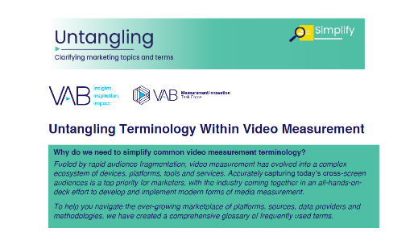




















What are the most common ways that viewership is measured?
1
Click here to download
‘Untangling Terminology Within
Video Measurement’ to learn more
ACR (Smart TV)
Set Top Box (STB)
Panel
Streaming
Big Data
Related Terms – ‘glass level’ & ‘from the glass’
Related Term – ‘RPD (Return Path Data)’
Related Term – ‘’Survey’, ‘Local People Meter’
Related Terms – ‘CTV’, ‘AVOD’ & ‘SVOD’
Identifies ads and programming content across Internet enabled TV-connected devices via audio or video fingerprints
Audience based viewing data that comes from calibrated
set-top boxes installed at
the subscribers' homes
Viewing habits, behaviors and demographic info are collected from a small group of people to represent a larger group
An OTT service that provides content from broadcast and cable networks, plus streaming providers (e.g., Sling TV, YouTube TV, HBO Max, Netflix, Peacock, Hulu, fuboTV)
Census level data that is comprised of multiple sources, which can be used for insights
Can include data from (but not limited to) ACR (Smart TV), STB, Panel and Streaming
Collection Type: Device
Collection Type: Household
Collection Type: Person
Collection Type: Person / Device
Collection Type: Multiple
Solves For: Can capture both linear and OTT viewing
Solves For: Can provide more granular data for the insights on audience behavior across a large footprint
Solves For: When stable, panels can be used to provide a common view of the TV landscape
Solves For: Data can be collected in real time allowing for greater flexibility in campaign reporting and optimization
Solves For: More aggregated data can mean greater opportunities to find valuable insights
Limitations: Audiences are required to ‘opt-in’ for a smart TV to be able to activate its ACR and collect viewing data
Limitations: STB homes can skew to higher HH Income leading to potential biases in viewing data
Limitations: Expensive to maintain and can encounter representation challenges
Limitations: More likely to be restrictive in how they provide access to measurement, attribution, and reporting data
Limitations: Managing large datasets can become unwieldy, requiring large amounts of processing to make it actionable
Example Companies
Example Companies
Example Companies
Example Companies
Example Companies
This information is exclusively provided to VAB members and qualified marketers. Further distribution is prohibited.
PAGE 5

Slide 6
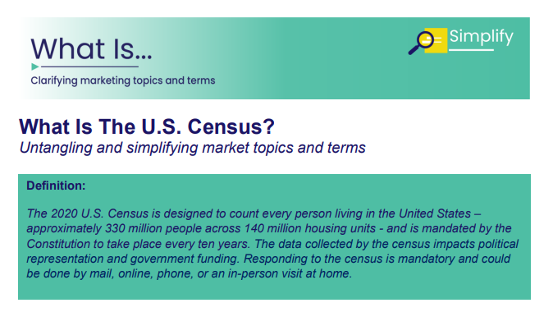



2
What is census level data and what role does it play in measurement?
Click here to download
‘What is The U.S. Census’
to learn more
Census Level Data
Role of Census Level Data
Census level data means every viewer in an ad environment universe is counted.
Reduce ad waste
Enable more representative measurement
Identify audiences in a more granular way
Receive greater coverage across people, platforms, and geographies
Attribute response more granularly
(Not to be confused with the US census)
People
Who is being measured
Platform / Devices
What is being measured
Geography
Where is being measured
Census level data can help marketers…
Census level data can allow for a more demographically representative measurement. All audiences should
be counted fairly and accurately.
Enables more accurate measurement
of diverse audiences. This creates economic growth opportunities for marketers with audiences that are rapidly growing (and historically have not been fairly counted/measured).
Viewership is across multiple screens, and all screens can and should be counted. Consumers have broadened their definition of TV and will find and follow their favorite premium content across platforms and the devices they use.
Coverage across multiple platforms and devices results in reach extension capabilities.
Census level data can allow for greater flexibility in the geographies measured
Creates opportunities for more precise measurement at the local, regional and national level
This information is exclusively provided to VAB members and qualified marketers. Further distribution is prohibited.
PAGE 6

Slide 7






3
Is it possible to get a full picture of the viewership of my cross-platform video campaign?
Click here to download ‘How can a Convergent TV advertising strategy drive business results for brands?’ to learn more
5 Common Cross-Platform Video Campaign Metrics
Advancements in viewership data collection have enabled measurement providers to provide full picture cross-platform video measurement.
Those advancements have resulted in a plethora of ways to measure the success of a cross-platform video campaign.
While there are an increasing number of metrics that can be used to determine the success of a cross-platform video campaign, there are 5 metrics that should be table stakes for how you evaluate your campaign.
Good to know: New advancements such as Open AP XPM and Open ID are making total cross platform measurement easier to achieve.
Total Reach
Total Impressions
Avg. Frequency
Campaign Reach
across all platforms
Total eyeballs reached
by the campaign
Average number of
times a viewer has been exposed to a campaign
Unique Reach
De-deduplicated Reach
Reach of linear only
and reach of digital only
Who saw ads on both,
and who saw ads on just one platform or the other
This information is exclusively provided to VAB members and qualified marketers. Further distribution is prohibited.
PAGE 7

Slide 8






4
How do I target and measure campaign impact beyond demographics?
Click here to download ‘Proven Strategies & Tactics In Audience-Based TV Buying’
to learn more
5 Ways to Target and Reach Consumers Across Platforms
Geographic
Psychographic
Behavioral
Device
1st Party Data
Local, Regional & National
Attitudes, feelings, interests, values, opinions, and lifestyle
Actions taken by consumers like shopping for a product or being light or heavy viewers
Type of device(s) used by consumers
Information collected directly
by the marketer from
their customers
Audience-Based Buying Helps Marketers…
  Advancements in viewership data collection have created greater opportunities in audience targeting and measurement. As marketers shift to an audience-based approach to their video campaigns, these new capabilities allow for more advanced segmentation of audiences that can lead to ‘smarter’ advertising campaigns.
Reach the right audience
Heighten engagement
Drive full funnel outcomes
This information is exclusively provided to VAB members and qualified marketers. Further distribution is prohibited.
PAGE 8

Slide 9





How can I “futureproof” my measurement to meet my current and future marketing goals?
5
Click here to download ‘Today’s Innovations in Measurement–
Q4 2022’ to learn more
5 Actions You Can Take Now to Set Yourself Up for Future Success
Future-proofing your approach
to measurement means taking strategic steps and implementing forward thinking processes
(or investments) that empower you to be agile as the industry evolves.
Anticipating changes in the industry enables you to:
Minimize future challenges
Embrace shifts in the landscape
Address future business requirements
1st Party Data
Modern-Currency
Identity & Privacy
Consider collecting information directly from your customer. 1st party insights can be leveraged for advanced targeting and attribution. Enabling you to connect your campaign to consumer outcomes now and in the future.
With the legacy TV currency retiring in Sept. 2024, consider testing new measurement providers to prepare for the future.
Consider conducting regular identity and privacy internal reviews to ensure you’re compliant with current laws and regulations. Familiarity with your own compliance will prepare to make shifts as laws and regulations evolve.
Cross - Platform
Audience Based Buying
Consider establishing partnerships with measurement providers who have cross-platform capabilities. This can put you in an advantageous position to seamlessly measure future campaigns as viewing behaviors continue to evolve and shift.
As advanced targeting capabilities continue to grow, increasing investments in audience-based buying will drive revenue and expand your customer base.
This information is exclusively provided to VAB members and qualified marketers. Further distribution is prohibited.
PAGE 9

Slide 10





Best Practices for Marketers
TV is data driven. Leverage advancements in viewership data collection to drive customer targeting, acquisition and engagement.
Ask for table-stakes cross-platform viewership metrics to be included in your reporting
Prioritize the future.
Take steps now to
set yourself up for measurement success
Know where your viewership data is coming from
This information is exclusively provided to VAB members and qualified marketers. Further distribution is prohibited.
PAGE 10

Slide 11




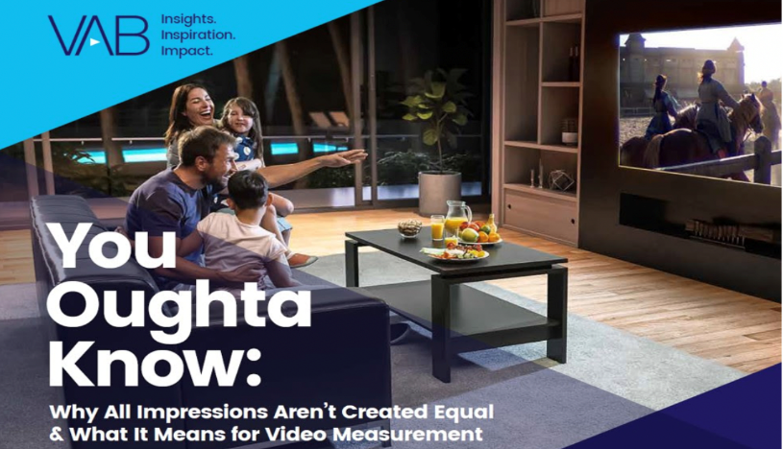
Creators
Benjamin Vandegrift
Reed Kiely
VP, Measurement Solutions
BenjaminV@thevab.com
Associate Insights Director
ReedK@thevab.com
Untangling Terminology
Within Video Measurement
What Is The U.S. Census?
Discover more
Looking for more data, insights and takeaways? Check out this related VAB content
How can a Convergent TV advertising
strategy drive business results for brands?
10 real-world case studies highlighting brand successes
Proven Strategies & Tactics In Audience-Based TV Buying
Success Stories Highlighted Through
Real-World Case Studies
We believe in modern TV measurement.
Let us be your guide.
Visit the VAB’s Measurement Resource Center to get clear answers to questions our industry is asking about TV measurement.
Today’s Innovations in Measurement – Q4 ‘22
Real-world case studies from industry innovators
You Oughta Know
Why all impressions aren’t created equal & what it means for video measurement
VAB Members, brand marketers and agencies get free and immediate access to VAB’s content library. Get access at theVAB.com
This information is exclusively provided to VAB members and qualified marketers. Further distribution is prohibited.
PAGE 11

Slide 12


About VAB
VAB is an insights-driven organization that inspires marketers to reimagine their media strategies resulting in fully informed decisions.
Drawing on our marketing expertise, we simplify the complexities in our industry and discover new insights that transform the way marketers look at their media strategy.
We are committed to your business growth and proud to offer VAB members, brand marketers and agencies complimentary access to our continuously-growing Insights library. Get immediate access at theVAB.com.
Curious to learn more about VAB? Check out this quick video to see what we do and how we can help you develop business-driving marketing strategies.
This information is exclusively provided to VAB members and qualified marketers. Further distribution is prohibited.
PAGE 12

