Slide 1




What’s the Deal with Outcomes?
July 2023

Slide 2


What’s the Deal with…?
Innovations in video measurement are occurring in abundance with lightning speed. Marketers now have more choices than ever to utilize advanced measurement to plan, buy and measure the success of their video campaigns.
With measurement being such an exciting space brimming with advancements, we’ve compiled some of the most common themes
and questions we’ve heard from marketers.
Our new series “What’s the Deal with…” has been built to simplify and provide clarity in five key areas of measurement so that you can make
the most informed measurement decisions.
This 5-part series will answer common questions
asked about these aspects of measurement
Viewership
Data Collection
Identity
Engagement
Outcomes
What’s Next
Click to Download
Click to Download
Click to Download
Coming in August
This information is exclusively provided to VAB members and qualified marketers. Further distribution is prohibited.
PAGE 2

Slide 3


What are Advertising
Outcomes?
Outcomes are performance metrics that a brand uses
to quantify the impact of their advertising efforts. Outcomes can occur and be measured at each stage
of the consumer journey.
From awareness and consideration to intent and ultimately sales, measuring full funnel outcomes such as brand awareness, online search, digital/instore visitation, and sales enables marketers to effectively evaluate their advertising ROI at each stage of the consumer journey.
Outcomes help marketers to go beyond audience measurement to quantifying impact and close the loop on their marketing efforts.
This information is exclusively provided to VAB members and qualified marketers. Further distribution is prohibited.
PAGE 3

Slide 4





Why is Measuring Advertising Outcomes Important?
Provides proof of performance and justification for future and potentially increased budgets
Enables optimization of marketing levers for more efficient spend
Supplies full funnel intelligence on the effectiveness of creative units and messaging
Enables greater understanding of a prospective customer’s behavior which can result in driving greater outcomes
Creates revenue generating opportunities through campaign optimization
This information is exclusively provided to VAB members and qualified marketers. Further distribution is prohibited.
PAGE 4

Slide 5

Common Advertising Outcomes Questions
1
What are common examples of outcomes?
2
What are the three key components for measuring outcomes?
3
What are common ways that outcome data is collected?
4
What attribution models are commonly used to measure outcomes?
5
What are the differences between probabilistic and deterministic approaches for determining outcomes?
This information is exclusively provided to VAB members and qualified marketers. Further distribution is prohibited.
PAGE 5

Slide 6












1
What are common examples of outcomes?
Purchase Funnel Stage
Outcome Examples
Awareness
Intent
Ad Attention
Brand
Awareness
Brand
Recall
Consideration
Search
Queries
Social
Actions
Positive Brand Sentiment
Website
Visitors
In-Store
Visitors
Viewing
Product Online
Sales
Sales
B2B
Conversions
App
Downloads
This information is exclusively provided to VAB members and qualified marketers. Further distribution is prohibited.
PAGE 6

Slide 7














2
What are the three key components for measuring outcomes?
1
2
3
Insights & Optimization Opportunities
Ad Data
Outcomes Data
Identity Resolution
Surveys
Aggregated
Online Behavior
Individual
Level
Household
Level
Privacy
Compliant
Outcomes Over Time
Target Audience Insights
Cross Platform
Outcomes
Impression
Data
Cross Platform Ad Exposure
Web Tags
Sales
Leverage impression-based ad exposure data that reflects when and where your ads ran across the video ecosystem
Collect full funnel outcomes data during your ad campaign to capture a full picture look at the customer journey
Match ad data & outcomes data in a privacy compliant manner via an identity resolution at a HH or individual level
Outcome solutions rooted in identity enable true cross platform measurement of outcomes and supports the ability to layer in valuable audience information
This information is exclusively provided to VAB members and qualified marketers. Further distribution is prohibited.
PAGE 7

Slide 8










3
What are common ways that outcome data is collected?
Aggregated
Online Behavior
Location
Visitation
Surveys
Web Tags
Sales
Outcomes Measured
Outcomes Measured
Outcomes Measured
Outcomes Measured
Outcomes Measured
Brand Awareness / Perception / Recall
Sharing on Social Media
Purchase Consideration
Brand Awareness / Perception / Recall
Purchase Intent
Website Visitation / Engagement
App Downloads / Installs
Online Purchase Intent / Sales
In-Store Visitation
Purchase Intent
In-store and Online sales
B2B Sales
Benefits
Benefits
Benefits
Benefits
Benefits
Aggregated online behavior data connected to video campaigns such as search trends, share of search and social media reactions enable brands to optimize to media channels driving search
By engaging directly with consumers, brands who leverage online/offline surveys can determine to what degree elements of their campaign such as creative message, brand proposition or product resonated with audiences
Tags placed on a brand’s website can enable advertisers to understand a consumer's shopping behavior within their digital showroom and which campaign elements such as creative or platform drove them there in the first place
Location data leveraged from GPS signals, and mobile movement data from opted-in apps combined with mapping technology enables marketers to determine which store location a consumer has visited
1st party sales data and 3rd party consumer purchase datasets enable marketers to close the loop on their marketing efforts and build prospect lists/consumer profiles for future campaigns
Example Companies
Example Companies
Example Companies
Example Companies
Example Companies
This information is exclusively provided to VAB members and qualified marketers. Further distribution is prohibited.
PAGE 8

Slide 9

4
What attribution models are commonly used to measure outcomes?
Model
Description
Visualization
Pros
Cons
First Touch
First interaction with brand receives all credit for the outcome
Simple & easy to implement
Doesn’t consider other following marketing touchpoints
Single-Touch
Attribution Models
Last Touch / Click
Last interaction with brand receives all credit for the outcome
Simple & easy to implement
Doesn’t consider preceding marketing
Linear
All touchpoints leading to the outcome receive the same credit
Considers each marketing touchpoint
Can over or underestimate the impact of a touchpoint. Limited optimization opportunities
Position Based
(U-Shaped)
The first and last interaction each receive 40% of credit, all other touchpoints split up the remaining 20%
Beneficial for marketers that have a long customer journey
May undervalue marketing efforts between first and last interactions
Multi-Touch
Attribution Models
Time Decay
Interaction closest to the outcome receives the most credit, and the interaction furthest away receives the least
Opportunities to optimize leading up to conversions
May not be as effective for marketers that have shorter sales cycles
This information is exclusively provided to VAB members and qualified marketers. Further distribution is prohibited.
PAGE 9

Slide 10



5
What are the differences between probabilistic and deterministic approaches for determining outcomes?
Deterministic Approach
Probabilistic Approach
Hybrid Approach
Outcomes that are known to be true
One-to-one matches are applied using confirmed identifiers such as authenticated logins to measure & report outcomes
Benefit: Authenticated and highly accurate
Challenge: Limited in scalability
Outcomes that are likely to be true
Matches are probable and based on pieces of information. Models are applied to measure & report outcomes
Benefit: Scalable and likely accurate
Challenge: Not guaranteed to 100% be accurate
Comprised of outcomes that are known to be true, as well as likely to be true
When a one to-one match can’t be made, a probabilistic approach is implemented
Benefit: Reduces unmeasured outcomes
Challenge: Often a lack of visibility into which matches are deterministic or probabilistic
This information is exclusively provided to VAB members and qualified marketers. Further distribution is prohibited.
PAGE 10

Slide 11





Best Practices for Marketers
When it comes to campaign measurement, go beyond audience count to measuring impact and outcomes
Identify the outcomes that are most relevant to your brand and business objectives and measure and optimize accordingly.
Carefully consider the way outcomes were determined (e.g. last touch vs. multi-touch) when evaluating results and channel performance.
Utilize an attribution
model that aligns with your measurement goals
This information is exclusively provided to VAB members and qualified marketers. Further distribution is prohibited.
PAGE 11

Slide 12

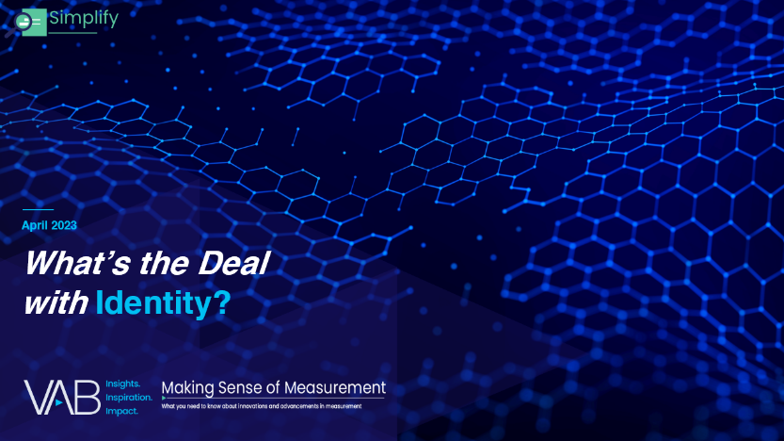
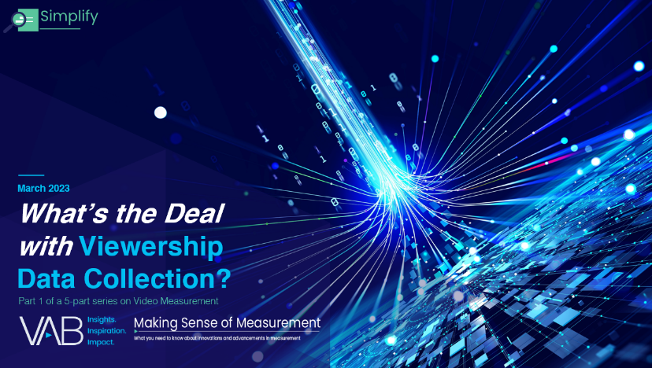
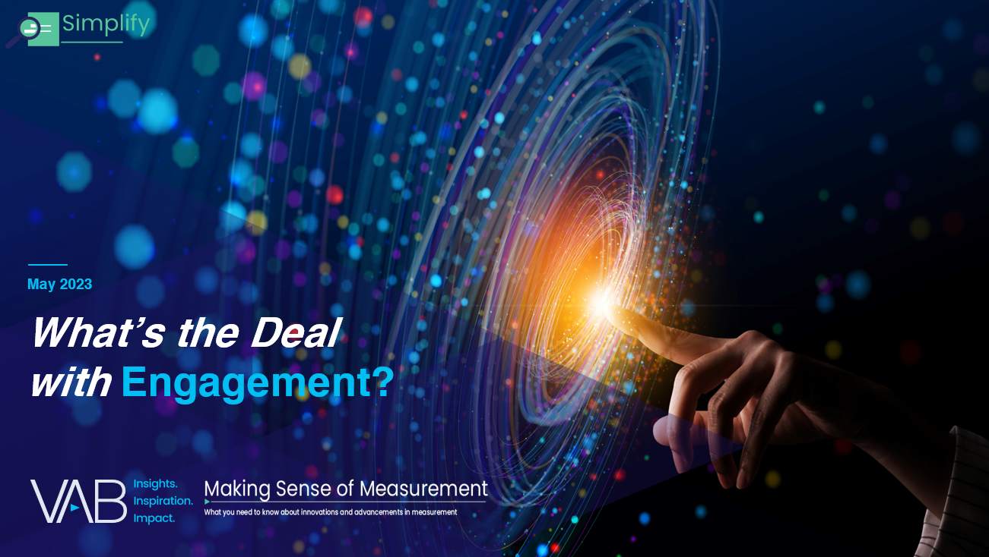
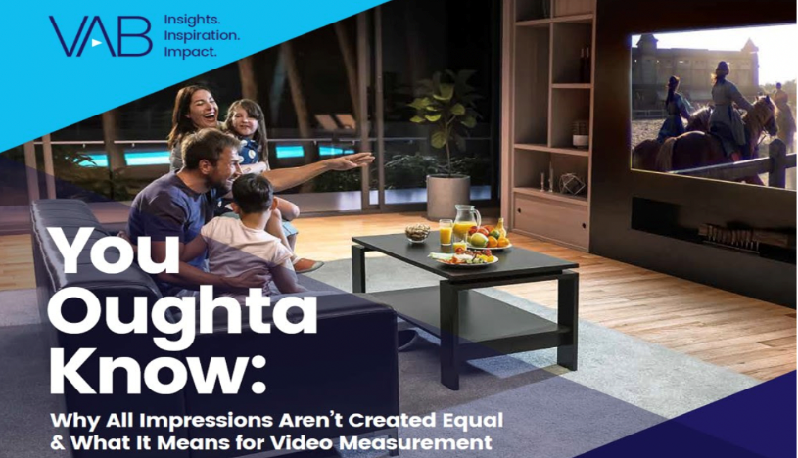
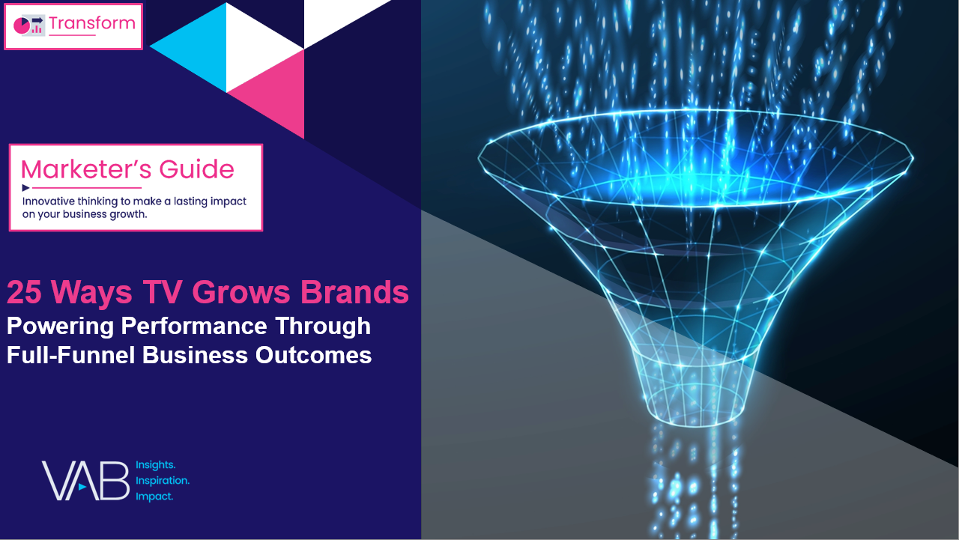
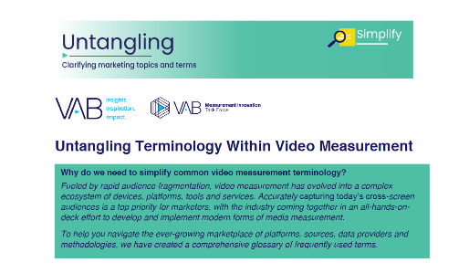
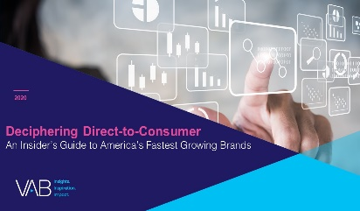
Creators
More from the What’s the Deal With….series
Benjamin Vandegrift
Reed Kiely
VP, Measurement Solutions
BenjaminV@thevab.com
Associate Insights Director
ReedK@thevab.com
What’s the Deal With Identity?
What’s the Deal With Viewership Data Collection?
Discover more
Looking for more data, insights and takeaways? Check out this related VAB content
We believe in modern TV measurement.
Let us be your guide.
Visit the VAB’s Measurement Resource Center to get clear answers to questions our industry is asking about TV measurement.
What’s the Deal With Engagement?
You Oughta Know
Why all impressions aren’t created equal & what it means for video measurement
VAB Members, brand marketers and agencies get free and immediate access to VAB’s content library. Get access at theVAB.com
25 Ways TV Grows Brands
Powering Performance Through Full-Funnel Business Outcomes
Untangling Terminology
Within Video Measurement
This information is exclusively provided to VAB members and qualified marketers. Further distribution is prohibited.
PAGE 12

Slide 13


About VAB
VAB is an insights-driven organization that inspires marketers to reimagine their media strategies resulting in fully informed decisions.
Drawing on our marketing expertise, we simplify the complexities in our industry and discover new insights that transform the way marketers look at their media strategy.
We are committed to your business growth and proud to offer VAB members, brand marketers and agencies complimentary access to our continuously-growing Insights library. Get immediate access at theVAB.com.
Curious to learn more about VAB? Check out this quick video to see what we do and how we can help you develop business-driving marketing strategies.
This information is exclusively provided to VAB members and qualified marketers. Further distribution is prohibited.
PAGE 13

