Slide 1




What’s the Deal with Engagement?
June 2023

Slide 2


What’s the Deal with…?
Innovations in video measurement are occurring in abundance with lightning speed. Marketers now have more choices than ever to utilize advanced measurement to plan, buy and measure the success of their video campaigns.
With measurement being such an exciting space brimming with advancements, we’ve compiled some of the most common themes
and questions we’ve heard from marketers.
Our new series “What’s the Deal with…” has been built to simplify and provide clarity in five key areas of measurement so that you can make
the most informed measurement decisions.
This 5-part series will answer common questions
asked about these aspects of measurement
Viewership
Data Collection
Identity
Engagement
Outcomes
What’s Next
Click to Download
Click to Download
Coming in June
Coming in July
This information is exclusively provided to VAB members and qualified marketers. Further distribution is prohibited.
PAGE 2

Slide 3


What is Advertising
Engagement?
Engagement is the experience of being connected to an advertisement or brand. Fueled by attention and feelings of immersion, engagement can range from what consumers think and feel about a brand to how they interact with a brand.
Measures of engagement help marketers to go beyond audience measurement and understand how effective their advertising with the audiences they’ve reached
has been.
This information is exclusively provided to VAB members and qualified marketers. Further distribution is prohibited.
PAGE 3

Slide 4






Why is Measuring Advertising Engagement Important?
Enables brands to optimize their spend to the media channels that most effectively engage their target audiences
Allows brands to create a more personalized ad experience through a greater understanding of how customers engage with your brand
Enables brands to optimize to audiences who have previously engaged or have higher likelihood to engage with your brand
Provides additional metrics beyond audience count to evaluate the effectiveness of your campaign
Provides brands with a deeper understanding of the consumer response to your advertising which can help drive outcomes
This information is exclusively provided to VAB members and qualified marketers. Further distribution is prohibited.
PAGE 4

Slide 5

Common Advertising Engagement Questions
1
What are the three main ways of measuring ad engagement?
What are the common metrics used to measure ad engagement?
What factors can contribute to ad engagement?
What should I look for in a measurement partner to best quantify engagement ?
What are exciting ways that engagement is being measured today?
2
3
4
5
This information is exclusively provided to VAB members and qualified marketers. Further distribution is prohibited.
PAGE 5

Slide 6



What are the three main ways of measuring advertising engagement?
1
Cognitive
Engagement
Emotional
Engagement
Behavioral
Engagement
Associated with how consumers think about and rationally process an advertisement or brand
Associated with how a consumer feels about an advertisement or brand. Non-conscious physical response.
Associated with how a
consumer physically interacts with an advertisement or brand
This information is exclusively provided to VAB members and qualified marketers. Further distribution is prohibited.
PAGE 6

Slide 7
What are the common metrics used to measure ad engagement?
2
Examples of Ad Engagement Metrics
Within each of the main ways to measure ad engagement, there are several metrics that are often used to quantify how audiences are engaging with an advertisement or brand
Cognitive
Emotional
Behavioral
How consumers think about a brand or advertisement
How consumers feel about a brand or advertisement
How consumers physically interact with a brand or advertisement
Recall
Memorability
Purchase Intent
Consideration
Favorability
Brand Loyalty
Emotional Intensity
Physiological Response
  Heart Rate
  Brain Activity (collected via EEG)
  Galvanic Skin Response (GSR)
Attention
Eye Gaze
Ad completion rate
Dwell time
This information is exclusively provided to VAB members and qualified marketers. Further distribution is prohibited.
PAGE 7

Slide 8






3
What factors can contribute to advertising engagement?
6 Factors that Contribute to Advertising Engagement
Content
Quality
Context
Premium professionally produced content emotionally resonates with audiences and raises brand memorability
Brand safe ad environments that host premium professionally produced content offer a more attentive and engaged audience
An ad that is relevant to the content it is airing alongside can amplify the effects of the ad
Dwell Time
Screen Coverage
Screen Size
The longer someone looks at, or “watches,” an ad, the longer the brand will stay in memory (can vary by platform)
The extent to which an ad fills a screen is correlated to greater attention
and ad recall
Ads shown on larger screens tends to inspire greater engagement than smaller screens
This information is exclusively provided to VAB members and qualified marketers. Further distribution is prohibited.
PAGE 8

Slide 9
4
What should I look for in a measurement partner to best quantify engagement ?
Four Ways to Evaluate an Engagement Partner
1
2
3
4
Transparency
Cross Platform
Identity Based
Multi Metric
A partner forthcoming in their methodology and reporting will give you assurance in the accuracy of how audiences engage with your brand and ads
Engagement can happen across all screens. Partnering with measurement providers with cross platform capabilities ensures you capture cross screen engagement with your brand
A solution supported by identity will allow you to get a more detailed picture of who your audience is, and how they’re engaging with your brand
A single metric can never tell the full story. A solution that provides multiple engagement metrics will enable more intelligent optimization strategies
This information is exclusively provided to VAB members and qualified marketers. Further distribution is prohibited.
PAGE 9

Slide 10










What are exciting ways that engagement is being measured today?
5
Three Measurement Approaches with Exciting and Innovative Ways to Quantify Engagement
In-Home Biometric Measurement
Innovative
Metrics
In-Lab Biometric Measurement
Biometric sensors placed in panels made up of opt-in participant homes
New metrics rooted in data science that are infused with AI and machine learning models
Custom studies conducted in lab environments designed to mimic an at home experience
Technology developed/adapted by measurement providers in this space enables brands to determine who is in the room, how they’re engaging with the content and what content they’re engaging with across platforms and devices
By processing a multitude of ad placement, engagement and creative signals measurement providers in this space are providing business ready metrics that enable brands to quantify and optimize unique measures of engagement quickly and effectively
Enables brands to conduct controlled & repeatable experiments to determine how specific ads, ad formats, and ad platforms are impacting cognitive, emotional and behavioral engagement
Example Companies
Example Companies
Example Companies
This information is exclusively provided to VAB members and qualified marketers. Further distribution is prohibited.
PAGE 10

Slide 11





Best Practices for Marketers
Utilize multiple engagement metrics
to achieve a full picture understanding of how audiences are engaging with your brand
Understand the factors that impact ad engagement to more effectively create and measure campaigns
Determine how you want consumers to engage with your brand and measure accordingly
Leverage cutting edge technologies and methodologies to drive and measure engagement
This information is exclusively provided to VAB members and qualified marketers. Further distribution is prohibited.
PAGE 11

Slide 12

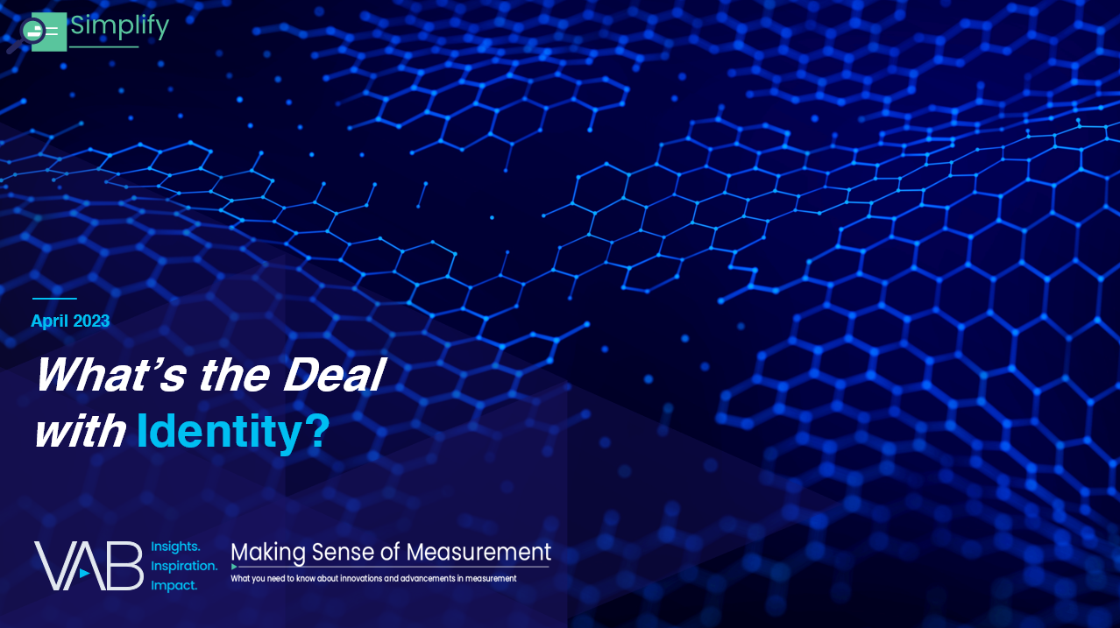


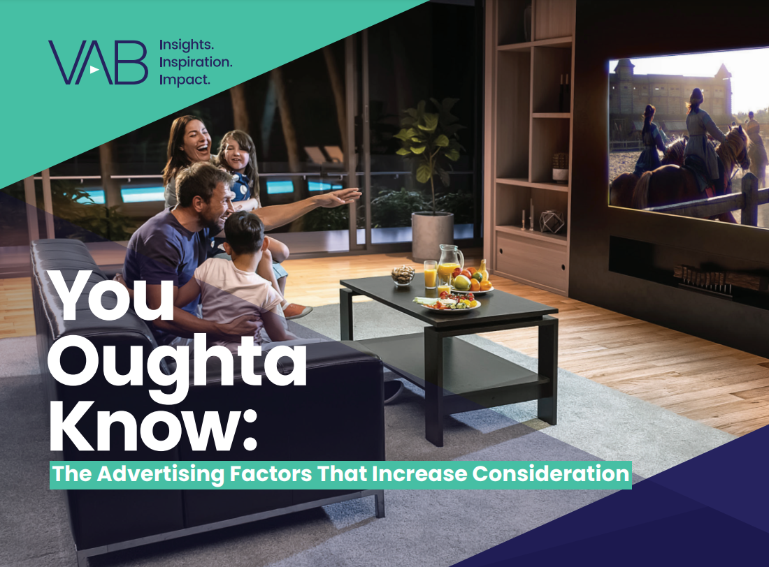
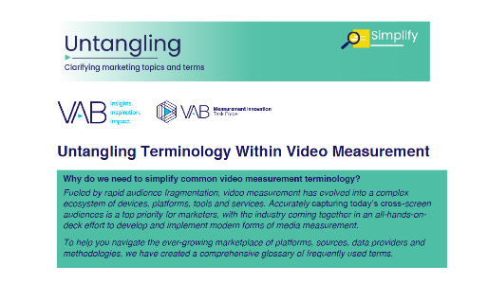
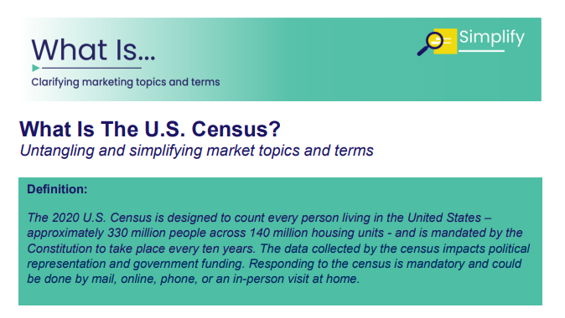
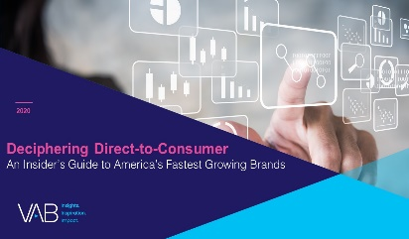
Creators
More from the What’s the Deal With….series
Benjamin Vandegrift
Reed Kiely
VP, Measurement Solutions
BenjaminV@thevab.com
Associate Insights Director
ReedK@thevab.com
Discover more
Looking for more data, insights and takeaways? Check out this related VAB content
What’s the Deal With Identity?
What’s the Deal With Viewership Data Collection?
We believe in modern TV measurement.
Let us be your guide.
Visit the VAB’s Measurement Resource Center to get clear answers to questions our industry is asking about TV measurement.
You Oughta Know
Why all impressions aren’t created equal & what it means for video measurement
You Oughta Know: The Advertising Factors That Increase Consideration
VAB Members, brand marketers and agencies get free and immediate access to VAB’s content library. Get access at theVAB.com
Untangling Terminology
Within Video Measurement
What Is The U.S. Census?
This information is exclusively provided to VAB members and qualified marketers. Further distribution is prohibited.
PAGE 12

Slide 13


About VAB
VAB is an insights-driven organization that inspires marketers to reimagine their media strategies resulting in fully informed decisions.
Drawing on our marketing expertise, we simplify the complexities in our industry and discover new insights that transform the way marketers look at their media strategy.
We are committed to your business growth and proud to offer VAB members, brand marketers and agencies complimentary access to our continuously-growing Insights library. Get immediate access at theVAB.com.
Curious to learn more about VAB? Check out this quick video to see what we do and how we can help you develop business-driving marketing strategies.
This information is exclusively provided to VAB members and qualified marketers. Further distribution is prohibited.
PAGE 13

