Slide 1





Performance Starts With Brand
How marketers are looking to balance short-term sales with long-term growth

Slide 2



Inside how marketers view ‘brand’ vs. ‘performance’ marketing
Between navigating shifting KPIs, budget scrutiny and business mandates, marketers today are under pressure to deliver immediate financial results while building long-term brand value.
Based on a custom survey of 200 U.S. brand marketers, and building on our previously released guides, What does ‘brand’ mean and how does it drive growth for my business? and Keeping Up With the KPIs, our latest report takes a closer look at the balancing act between short-term sales and brand equity across small, medium and large-sized businesses.
By segmenting brand marketers based on annual ad spend, we uncover:
How marketers across different business sizes are prioritizing brand vs. performance strategies
What marketers would do differently if they weren’t faced with intense organizational pressures to achieve short-term financial goals
Why ‘brand’ is so important for sustained growth
Note: see appendix for full details on methodology behind the custom survey
This information is exclusively provided to VAB members and qualified marketers.
PAGE 2

Slide 3
We analyzed three segments based on total ad spend to understand how, or if, balancing short-term and long-term goals vary by business size
For the purposes of this custom study analysis, we created these three ‘brand marketer’ segments:
‘Small-Sized’ Businesses
Brand marketer respondents working for a brand that spent less than $1MM in total on advertising over the
past 12 months
‘Medium-Sized’ Businesses
Brand marketer respondents working for a brand that spent $1MM to less than $25MM in total on advertising over the past 12 months
‘Large-Sized’ Businesses
Brand marketer respondents working for a brand that spent $25MM or more in total on advertising over the
past 12 months
Source: VAB / Advertiser Perceptions ‘Marketer KPI Survey,’ February 2025, fielded January 27 – February 7, 2025 (n=200). Survey base: Brand marketers directly involved in influencing or executing video advertising. ‘Small-Sized’ Businesses: Less than $1MM in annual ad spend (n=65), ‘Medium-Sized’ Businesses: $1MM to less than $25MM in annual ad spend (n=70), ‘Large-Sized’ Businesses: $25MM or more in annual ad spend (n=65).
This information is exclusively provided to VAB members and qualified marketers.
PAGE 3

Slide 4



We answered three key questions to help understand how marketers within businesses of different sizes view ‘brand’ and ‘performance’ marketing
1
2
3
1
How are marketers prioritizing ‘performance’ vs. ‘brand’ investment and short-term sales vs. long-term results?
What would marketers do if they were free from the pressures of achieving short-term goals?
Why is ‘brand’ so important to business success and long-term growth?
How are marketers prioritizing ‘performance’ vs. ‘brand’ investment and short-term sales vs. long-term results?
This information is exclusively provided to VAB members and qualified marketers.
PAGE 4

Slide 5

1
How are marketers prioritizing ‘performance’ vs. ‘brand’ investment and short-term sales vs. long-term results?

Slide 6
Small and mid-sized businesses are more likely to have increased their investment in ‘performance’ than ‘brand’ in the past 12 months
How did your company’s spending on brand or performance marketing change in the past 12 months?
% of brand marketers
‘Small-Sized’ Businesses
‘Medium-Sized’ Businesses
‘Large-Sized’ Businesses
Source: VAB / Advertiser Perceptions ‘Marketer KPI Survey,’ February 2025, fielded January 27 – February 7, 2025 (n=200). Survey base: Brand marketers directly involved in influencing or executing video advertising. Q5. How did your company’s spending on performance marketing change in the past 12 months? Q6. How did your company’s spending on brand marketing change in the past 12 months? ‘Small-Sized’ Businesses: Less than $1MM in annual ad spend, ‘Medium-Sized’ Businesses: $1MM to less than $25MM in annual ad spend, ‘Large-Sized’ Businesses: $25MM or more in annual ad spend.
This information is exclusively provided to VAB members and qualified marketers.
PAGE 6

Slide 7
Over the next 12 months, priorities differ as small businesses lean more into short-term, medium ones strike a balance and large ones hold steady
Over the next 12 months, how do you expect your company’s spending on brand or performance marketing to change?
% of brand marketers
‘Small-Sized’ Businesses
‘Medium-Sized’ Businesses
‘Large-Sized’ Businesses
Source: VAB / Advertiser Perceptions ‘Marketer KPI Survey,’ February 2025, fielded January 27 – February 7, 2025 (n=200). Survey base: Brand marketers directly involved in influencing or executing video advertising. Q7. Over the next 12 months, how do you expect your company’s spending on performance marketing to change? Q8. Over the next 12 months, how do you expect your company’s spending on brand marketing to change? ‘Small-Sized’ Businesses: Less than $1MM in annual ad spend, ‘Medium-Sized’ Businesses: $1MM to less than $25MM in annual ad spend, ‘Large-Sized’ Businesses: $25MM or more in annual ad spend.
This information is exclusively provided to VAB members and qualified marketers.
PAGE 7

Slide 8
Most marketers across all business sizes believe their KPIs today reflect a prioritization of short-term sales over long-term branding results
A focus on short-term sales may come at the expense of long-term value such as building brand equity, loyalty and resilience
Do you feel your KPIs reflect a prioritization to achieve short-term sales over long-term branding results?
‘Small-Sized’ Businesses
‘Medium-Sized’ Businesses
‘Large-Sized’ Businesses
Source: VAB / Advertiser Perceptions ‘Marketer KPI Survey,’ February 2025, fielded January 27 – February 7, 2025 (n=200). Survey base: Brand marketers directly involved in influencing or executing video advertising. Q15. Do you feel your KPIs reflect a prioritization to achieve short-term sales over long-term branding results? ‘Small-Sized’ Businesses: Less than $1MM in annual ad spend, ‘Medium-Sized’ Businesses: $1MM to less than $25MM in annual ad spend, ‘Large-Sized’ Businesses: $25MM or more in annual ad spend. To learn more about marketers’ KPIs, download VAB’s Keeping Up With The KPIs: 10 Key Questions Answered by Marketers to Understand Priorities Across Businesses.
This information is exclusively provided to VAB members and qualified marketers.
PAGE 8

Slide 9





Across all business sizes, there are five key organizational reasons why marketers believe their KPIs reflect a desire to achieve short-term sales
Reasons marketers believe their KPIs reflect a desire to achieve short-term sales
Based on summary of verbatim responses
Pressure to meet financial goals
Easier to measure short-term metrics
Focus on ‘acquisition’ over ‘brand’
Organizational culture and norms
ROI & ROAS mandates
Source: VAB / Advertiser Perceptions ‘Marketer KPI Survey,’ February 2025, fielded January 27 – February 7, 2025 (n=200). Survey base: Brand marketers directly involved in influencing or executing video advertising. Q15a: Why do you feel your KPIs reflect more of a desire to achieve short-term sales?
This information is exclusively provided to VAB members and qualified marketers.
PAGE 9

Slide 10
Marketers across sizes cite revenue pressures, ease of measurement and organizational needs and mandates as reasons for short-term focus
Reasons marketers believe their KPIs reflect a desire to achieve short-term sales
Based on summary of verbatim responses
Category | Sampling of Responses
Pressure to meet financial goals | “Pressure to hit revenue targets” “We are under pressure to deliver quarterly financial results and our internal KPIs reflect this” “Compensation is linked to quarterly and annual goals” “Leadership wants to see an immediate revenue impact”
Easier to measure short-term metrics | “Because they are easier to measure and the industry standard” “Because KPIs can more easily be attributed to short-term sales than to long-term goals” “Easier to measure, shorter time to measure”
Focus on acquisition over brand | “They focus on reaching new customers and getting the first sale, but not so much how to keep a new customer returning” “We are very acquisition focused and need to switch to consider long-term customer engagement” “We do a lot of promotional activity versus growing brand awareness and consideration”
Organizational culture and norms | “Because of the company’s thinking and service offer plan” “Because of tradition, and because our KPIs are based on data. Data becomes obsolete within 4 quarters” “Because it's all focused on sales right now”
ROI & ROAS mandates | “Mandated to spend only within an expected & approved ROAS” “ROI supports short-term sales tactics”
Source: VAB / Advertiser Perceptions ‘Marketer KPI Survey,’ February 2025, fielded January 27 – February 7, 2025 (n=200). Survey base: Brand marketers directly involved in influencing or executing video advertising. Q15a: Why do you feel your KPIs reflect more of a desire to achieve short-term sales?
This information is exclusively provided to VAB members and qualified marketers.
PAGE 10

Slide 11
2
What would marketers do if they were free from the pressures of achieving short-term goals?

Slide 12

Without the pressure of short-term goals, marketers would focus more on ‘branding’ opportunities to achieve long-term, sustainable growth
% of brand marketers who agree that without the pressure of short-term goals they could…
…align marketing efforts with
bigger-picture objectives
(i.e., brand loyalty, customer retention)
…focus on long-term KPIs
(i.e., brand awareness and customer lifetime value (CLTV))
73% / 73% / 79%
83% / 84% / 83%
…invest in more sustainable growth
…explore more innovative and long-term marketing strategies, aligned with overall business goals
49% / 66% / 70%
84% / 85% / 81%
Source: VAB / Advertiser Perceptions ‘Marketer KPI Survey,’ February 2025, fielded January 27 – February 7, 2025 (n=200). Survey base: Brand marketers directly involved in influencing or executing video advertising. Q17. To what extent do you agree with the following statements around alignment of your long-term strategy with short-term goals & objectives? ‘Small-Sized’ Businesses: Less than $1MM in annual ad spend, ‘Medium-Sized’ Businesses: $1MM to less than $25MM in annual ad spend, ‘Large-Sized’ Businesses: $25MM or more in annual ad spend. *Summary of completely or somewhat agree.
This information is exclusively provided to VAB members and qualified marketers.
PAGE 12

Slide 13
3
Why is ‘brand’ so important to business success and long-term growth?

Slide 14
Marketers view outcomes tied to ‘brand’ like customer satisfaction, trust, loyalty and identity as the top drivers of business success
Smaller-sized businesses focus more on establishing their brand identity and creating an effective marketing strategy, while larger businesses emphasize their unique value proposition
Top 5 Factors That Contribute to the Success of a Brand
% of brand marketers
‘Small-Sized’ Businesses
‘Medium-Sized’ Businesses
‘Large-Sized’ Businesses
Source: VAB / Advertiser Perceptions ‘Marketer KPI Survey,’ February 2025, fielded January 27 – February 7, 2025 (n=200). Survey base: Brand marketers directly involved in influencing or executing video advertising. Q10. How does your brand contribute to your company's overall growth strategy? [Rank 1-5]. ‘Small-Sized’ Businesses: Less than $1MM in annual ad spend, ‘Medium-Sized’ Businesses: $1MM to less than $25MM in annual ad spend, ‘Large-Sized’ Businesses: $25MM or more in annual ad spend.
This information is exclusively provided to VAB members and qualified marketers.
PAGE 14

Slide 15






Whether building awareness and visibility or loyalty and retention, ‘brand’ is a key lever for long-term growth across businesses of all sizes
There are subtle differences within the common themes across business sizes; for example, while small businesses are building their reputation among consumers, medium-sized businesses are creating on-going relationships and large businesses are encouraging repeat purchases
How does your brand contribute to your company's overall growth strategy?
Based on summary of verbatim responses (ranked by top themes)
‘Small-Sized’ Businesses
‘Medium-Sized’ Businesses
‘Large-Sized’ Businesses
Customer Trust, Loyalty & Retention
Building initial reputation and customer confidence
‘Brand’ Drives Revenue, Sales & ROI
Increased sales, lead generation, conversion and profitability
Customer Trust, Loyalty & Retention
Retaining customers, encouraging repeat purchases and building long-term value
Brand Awareness & Visibility
Gaining visibility in local or niche markets
Customer Trust, Loyalty & Retention
Driver of ongoing relationships, not just first-time sales
Brand Awareness & Visibility
Increases visibility, recognition and purchasing intent
Differentiation & Identity
Standing out with unique offerings
Brand Awareness & Visibility
Visibility, top-of-mind awareness and recognition
Differentiation & Identity
Vehicle for distinctive proposition development
‘Brand’ Drives Revenue, Sales & ROI
Driving sales via brand presence
Differentiation & Identity
Clear voice that resonates with target audiences
‘Brand’ Drives Revenue, Sales & ROI
Sales performance, market share growth and expansion into new categories
Emotional Connection
Brand tied to personal/founder story
Emotional Connection
Creates emotional resonance that drives purchasing decisions
Premium Perceived Value
Customers recognize the value of the brand
Source: VAB / Advertiser Perceptions ‘Marketer KPI Survey,’ February 2025, fielded January 27 – February 7, 2025 (n=200). Survey base: Brand marketers directly involved in influencing or executing video advertising. Q9a. How does your brand contribute to your company's overall growth strategy? ‘Small-Sized’ Businesses: Less than $1MM in annual ad spend, ‘Medium-Sized’ Businesses: $1MM to less than $25MM in annual ad spend, ‘Large-Sized’ Businesses: $25MM or more in annual ad spend. Responses have been sorted by frequency and relevancy.
This information is exclusively provided to VAB members and qualified marketers.
PAGE 15

Slide 16
Brand-building paves the way for long-lasting performance and business growth
Most marketers today believe their current KPIs reflect a prioritization of short-term sales over long-term brand results;
citing immediate revenue pressures, ease of measurement and organizational mandates as the reasons
However, without the weight of short-term demands, marketers would double down on ‘brand’ strategies and tactics; signaling acknowledgement of its critical role in building lasting business impact
Marketers recognize that ‘brand’ strategies create full-funnel outcomes - awareness, visibility, sales, loyalty, retention –
which are essential to business success and long-term growth
With ‘brand’ strategies being such critical drivers to success,
it’s important for businesses to think in terms of ‘brand and performance’ for their marketing campaigns and not ‘performance only’ because ‘branding’ truly drives long-lasting performance and sustained growth
Key Marketer Takeaways
This information is exclusively provided to VAB members and qualified marketers.
PAGE 16

Slide 17
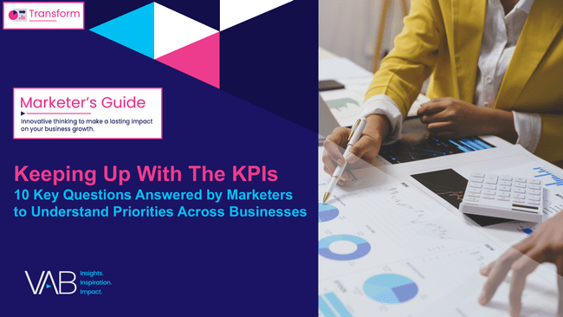
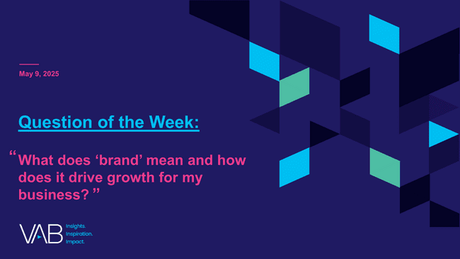
Download our additional reports from our custom study to learn more on how marketers set their KPIs and what ‘brand’ means to them
click the above report covers to download
This information is exclusively provided to VAB members and qualified marketers.
PAGE 17

Slide 18

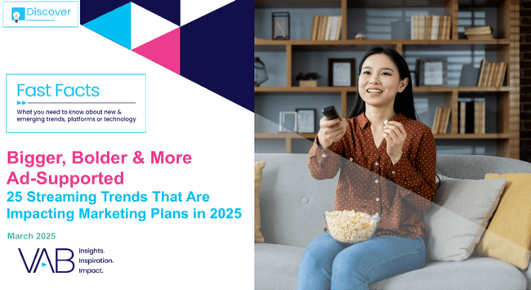
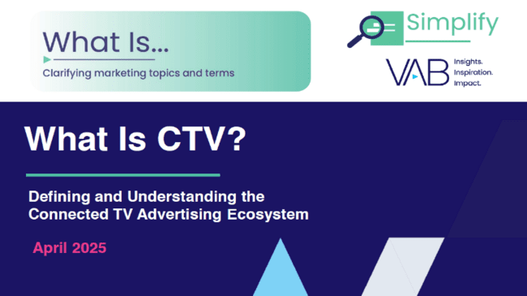

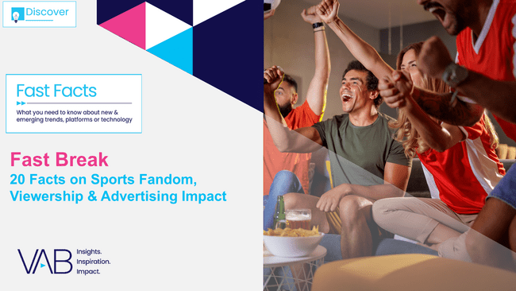

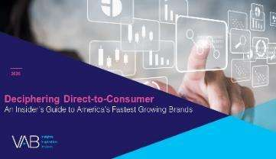
Creators
Jason Wiese
Leah Montner-Dixon
EVP, Strategic Insights & Measurement
jasonw@thevab.com
Director, Audience & Behavioral Insights
leahm@thevab.com
Karolina Guillen
The Power of Premium Video
What It Means for Multiscreen TV
and Why It Matters to Marketers
Bigger, Bolder & More Ad-Supported
25 Streaming Trends That Are Impacting Marketing Plans in 2025
Associate Director, Insights, Strategy & Analytics
karolinag@thevab.com
Discover more
Looking for more data, insights and takeaways? Check out this related VAB content
What Is CTV?
Defining and Understanding the Connected TV Advertising Ecosystem
Best in Show
Five Advantages of Multiscreen TV, From Brand to Performance
Visit our Multiscreen TV Attribution Resources
to learn from the winning marketing strategies of brands who utilize premium video platforms to achieve full-funnel outcomes, ranging from incremental reach to favorability to website visits and sales.
Fast Break
20 Facts on Sports Fandom, Viewership
& Advertising Impact
Welcome to TV – Full Year 2024
The Billion and a Half Dollar Investment from New Advertisers
VAB Members, brand marketers and agencies get free and immediate access to VAB’s content library. Get access at theVAB.com
This information is exclusively provided to VAB members and qualified marketers.
PAGE 18

Slide 19


About VAB
VAB plays a dual role in the video advertising industry. We are leading the change to bring about a more innovative and transparent marketplace. We also provide the insights and thought leadership that enables marketers to develop business-driving marketing strategies.
Drawing on our marketing expertise, we simplify the complexities in our industry and discover new insights that transform the way marketers look at their media strategy.
We are committed to your business growth and proud to offer VAB members, brand marketers and agencies complimentary access to our continuously-growing Insights library. Get immediate access at theVAB.com.
This information is exclusively provided to VAB members and qualified marketers.
PAGE 19

Slide 20


Custom Study Methodology
VAB commissioned Advertiser Perceptions to conduct an online survey between January-February 2025.
The results are based on 200 U.S. brand marketer respondents from Advertiser Perceptions’ survey panel with a wide range of annual total advertising budgets ($10K - $250 MM+) across a variety of market sectors (e.g., CPG, retail, financial, auto, food / B2B, technology, entertainment, etc.)
Respondent Qualifications:
  Brand marketer decision maker involved in influencing or executing video advertising
  National / Regional sales focus
  Mix of job titles (junior, mid, senior level)
This information is exclusively provided to VAB members and qualified marketers.
PAGE 20

