Slide 1


August 1, 2024
Question of the Week:
“
Why is advertising in ‘trusted’ media important for my brand?
”

Slide 2


Answer: Ads appearing in ‘trusted’ media create positive business results
The business case for ‘trust’
Whether it’s transparency, brand safety or ad fraud, there has been much talk recently about the issue of trust (or lack of trust) within the advertising industry and across media partners.
As a part of these discussions, it’s important to understand the value
of aligning with trusted media partners and what this can bring to
a brand’s business.
Integration into quality, trusted content creates a positive impact
on consumer perception of its advertisers and enhances brand attributes like favorability in the eyes of potential customers.
Most importantly, ads in trusted, brand safe environments also drive results lower down the purchase funnel - including higher conversion rates and increased profitability.
This information is exclusively provided to VAB members and qualified marketers.
PAGE 2

Slide 3
Consumers and marketers believe its very important that ads should appear in ‘trustworthy’ environments
nearly
82%
over
90%
80%
of consumers feel that
brands bear responsibility
for ensuring their ads run
beside content that is safe
of consumers say it is important that a brand’s ads appear on content that is safe, accurate and trustworthy
of marketing professionals believe brand safety is a major concern for their organization*
Source: DoubleVerify & Harris Poll, Consumers Reject Brands That Advertise on ‘Fake News’ and Objectionable Content Online, June 2019. *WARC Journal of Advertising Research, Is your brand protected? Assessing brand safety risks in digital campaigns, November 2023. Based on an online survey of advertising and brand management professionals with decision-making authority over the purchasing or spending for brands with at least $10 million in annual advertising spend. Download VAB’s ‘What is Brand Safety’ to learn more.
This information is exclusively provided to VAB members and qualified marketers.
PAGE 3

Slide 4


Multiscreen TV is the most trusted media platform by adult consumers, who are also four times more likely to trust TV over social media
TV is the
#1 trusted media platform
among adults
(adults are over 4x more likely to trust TV than social media)
Source: VAB analysis of MRI-Simmons Spring 2024 USA Study, A18+. Q: What is the media you trust the most? (pick one: TV, radio, podcasts, mobile internet, internet on computer, social media, magazines, newspapers).
This information is exclusively provided to VAB members and qualified marketers.
PAGE 4

Slide 5
Furthermore, multiscreen TV is the most trusted source for financial, science, political and local news
% who trust the following sources by news topic
A18+ (ranked by top five sources for each)
Financial News
Science News
Political News
Local News
Source
%
Source
%
Source
%
Source
%
TV / Streaming
39%
TV / Streaming
34%
TV / Streaming
38%
TV / Streaming
44%
News websites / apps
33%
News websites / apps
32%
News websites / apps
33%
News websites / apps
33%
Family or friends
29%
Federal or organizational websites
(.gov/.org)
30%
Newspapers / Magazines
(print or digital)
28%
Family or friends
29%
Newspapers / Magazines
(print or digital)
27%
Newspapers / Magazines
(print or digital)
26%
Federal or organizational websites
(.gov, .org)
26%
Newspapers / Magazines
(print or digital)
29%
Federal or organizational websites
(.gov/.org)
25%
Family or friends
24%
Family or friends
25%
Social media
26%
Source: VAB analysis of MRI-Simmons Q1 2024 Trending Topics Study, A18+. Reflects respondents who said they trust the following as a source for financial news, science news, political news or local news. Sources: TV/streaming news, news websites/apps, newspapers/magazines (print or digital), social media, radio, documentaries/informational programs, federal or organizational websites (.gov/.org), podcasts, postcards/direct mail, family or friends, other, I don’t look for this information).
This information is exclusively provided to VAB members and qualified marketers.
PAGE 5

Slide 6
The ‘halo effect’ of quality, trusted content creates a much more positive impact on consumer perception of its advertisers vs. digital platforms
Media signaling:
The perceived cost and scale
of an advertising channel that
can enhance brand attributes
in the eyes of the consumer.
Signaling determines a platform’s ability to strengthen brand perception in terms of its financial footing, popularity and degree to which it could be trusted.
‘Signaling strength’ by channel
How to read: 46% of respondents believe TV advertising enhances a brand’s attributes
Source: WARC, Why media quality will take centre stage in 2024, 1/22/24.
This information is exclusively provided to VAB members and qualified marketers.
PAGE 6

Slide 7
Why is trust much lower on digital platforms? A main reason is because they are rife with consumer scams which add up to billions in fraud losses
Reported consumer fraud losses
Jan ‘21 – June ’23, dollars in billions
Source: U.S. Federal Trade Commission, Reported consumer fraud losses by contact method, Jan ‘21 – June ’23. Magenta reflects digital ad platforms.
This information is exclusively provided to VAB members and qualified marketers.
PAGE 7

Slide 8
Lack of transparency and low consumer trust can negatively impact advertiser investment with social media platforms and walled gardens
68%
66%
of media experts say that insufficient transparency
into media quality metrics within proprietary platforms will negatively impact media spend
of media experts say that
eroding consumer trust
in major proprietary platforms
will negatively impact
their media spend
Source: Integral Ad Science (IAS), The 2024 Industry Pulse Report, December 2023. Based on September 2023 IAS / YouGov survey of U.S. digital media experts who use programmatic advertising (n=262). Q. Thinking about in-feed social media in the next 12 months, please indicate whether you agree or disagree with the following statements.
This information is exclusively provided to VAB members and qualified marketers.
PAGE 8

Slide 9
A platform’s trustworthiness extends to its advertising environment which enables brands to create authentic connections with viewers
Types of Advertising U.S. Adults Find Trustworthy
% of respondents
U.S. adults are more likely to find ads on TV trustworthy vs. ads on digital platforms
2.5x
More Likely
to trust ads on TV
vs. ads on social media
1.5x
More Likely
to trust ads on TV
vs. ads on websites
Source: YouGov, Global Study: Which Types of Ads Do People Trust?, commissioned by Campaign, 2/5/2021. Note: Ages 18+ who selected very/somewhat trustworthy.
This information is exclusively provided to VAB members and qualified marketers.
PAGE 9

Slide 10

Ads in trusted, brand safe environments have proven to drive quantifiable results for businesses
+233%
lift in conversions for
brand safe impressions vs.
non brand safe impressions
Source: Integral Ad Science, Does Media Quality Drive Attention and Outcomes?, March 2022. Download VAB’s ‘What is Brand Safety’ to learn more.
This information is exclusively provided to VAB members and qualified marketers.
PAGE 10

Slide 11
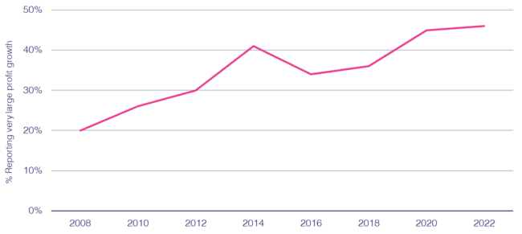
The ability of a ‘brand safe’ ad to build consumer trust in today’s increasingly skeptical society has a direct, positive effect on profitability
% cases with strong ‘trust’ growth reporting strong ‘profit’ growth
67%
of consumers would be likely to
stop using the brand if they viewed the brand’s digital advertising beside false, objectionable
or inflammatory content*
Source: Peter Field, Why TV is Still at the Heart of Effectiveness, presented at ‘The Future of TV Advertising Global’ conference in December 2023. Base: IPA Databank 2004-2022 for profit cases reporting very large trust improvements. NB: insufficient data prior to 2008. Click here to view Peter Field’s full presentation online. *DoubleVerify & Harris Poll, Consumers Reject Brands That Advertise on ‘Fake News’ and Objectionable Content Online, June 2019.
This information is exclusively provided to VAB members and qualified marketers.
PAGE 11

Slide 12
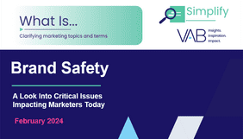
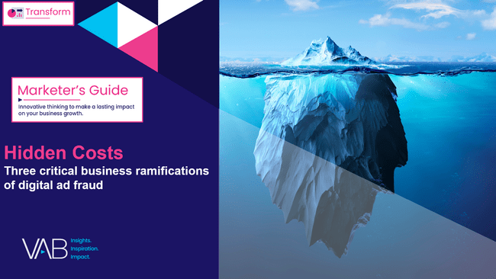
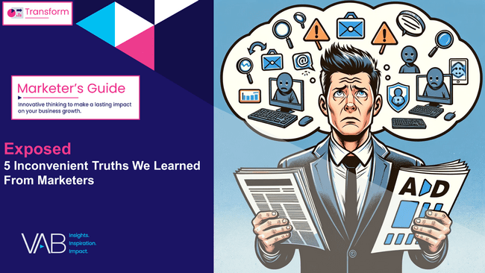
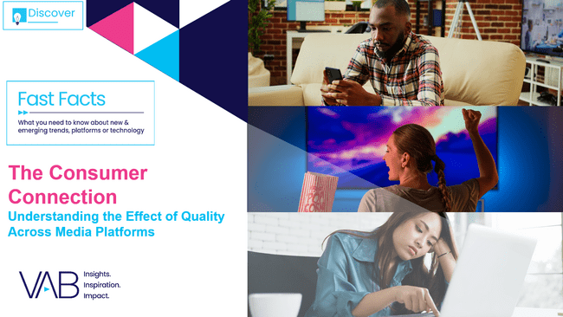

Download these other VAB resources to learn more about the impact of trust
Click to Download
Click to Download
Click to Download
Click to Download
This information is exclusively provided to VAB members and qualified marketers.
PAGE 12

Slide 13


About VAB
VAB plays a dual role in the video advertising industry. We are leading the change to bring about a more innovative and transparent marketplace. We also provide the insights and thought leadership that enables marketers to develop business-driving marketing strategies.
Drawing on our marketing expertise, we simplify the complexities in our industry and discover new insights that transform the way marketers look at their media strategy.
We are committed to your business growth and proud to offer VAB members, brand marketers and agencies complimentary access to our continuously-growing Insights library. Get immediate access at theVAB.com.
This information is exclusively provided to VAB members and qualified marketers.
PAGE 13

