Slide 1




What’s the Deal with
What’s Next in Measurement?
August 2023

Slide 2


What’s the Deal with…?
Innovations in video measurement are occurring in abundance with lightning speed. Marketers now have more choices than ever to utilize advanced measurement to plan, buy and measure the success of their video campaigns.
With measurement being such an exciting space brimming with advancements, we’ve compiled some of the most common themes
and questions we’ve heard from marketers.
Our new series “What’s the Deal with…” has been built to simplify and provide clarity in five key areas of measurement so that you can make
the most informed measurement decisions.
This 5-part series will answer common questions
asked about these aspects of measurement
Viewership
Data Collection
Identity
Engagement
Outcomes
What’s Next
Click to Download
Click to Download
Click to Download
Click to Download
This information is exclusively provided to VAB members and qualified marketers. Further distribution is prohibited.
PAGE 2

Slide 3


What’s Next in
Measurement?
There are many innovations and initiatives being pursued within the video advertising industry that will empower marketers to better engage audiences and measure the impact of their multiscreen TV campaigns.
Through this series, we’ve discussed 4 of the most important topics in measurement today: Viewership data collection, Identity, Engagement and Outcomes. In this final piece of the series, we look at what’s next for these critical components of measurement and how marketers can use that innovation to grow their brands.
This information is exclusively provided to VAB members and qualified marketers. Further distribution is prohibited.
PAGE 3

Slide 4





How Knowing What’s Next Will Help Grow Your Business
Be the first in your business category
to capitalize on new measurement capabilities and increase market share
Enables you to put the customer first by staying ahead of future privacy laws
Leveraging advancements in ad technology enables more opportunities to drive customer targeting and engagement
Adapting measurement strategies to follow viewing behavior enables you to maximize reach and engagement
Sharpen your campaign’s resonance with innovative ways to measure and enhance creative messaging
This information is exclusively provided to VAB members and qualified marketers. Further distribution is prohibited.
PAGE 4

Slide 5


Common Questions about What’s Next in Measurement
1
What advancements should I expect in viewership data collection?
2
What aspect of identity will see greater adoption?
3
What new possibilities will there be in quantifying engagement?
4
What will improve my ability to understand and optimize outcomes?
5
How will AI continue to impact measurement?
This information is exclusively provided to VAB members and qualified marketers. Further distribution is prohibited.
PAGE 5

Slide 6




What advancements should I expect in viewership data collection?
1
The future of TV measurement will likely be dependent on both big data and panels, with panels acting as a complement to modern measurement. In many instances big data would serve as the source of viewing data in order to get the most comprehensive picture of viewership. It will be vital that big data being leveraged is calibrated and validated to ensure accuracy
Measurement Panel
Calibration Panel
Validation Panel
Overview
Overview
Overview
Viewing habits, behaviors and demographic info are collected from a small group of people to represent a larger group
Used along with another data asset (such as big data) and is used to understand where the gaps or biases are within that dataset
Used to show mathematically that you’re solving for the gaps in the measurement (such as representation or bias)
Benefits
Benefits
Benefits
When stable, panels can be used to provide a common view of the TV landscape
Can provide a path to demographic, geographic and television household type representation in TV measurement
Can be used to prove that relevant changes/adjustments have been made to solve bias issues
Challenges
Challenges
Challenges
Can lack in representation of certain television household types such as OTA
If there are issues with the panel, those biases can be passed into the dataset they are meant to benefit
Requires a well-trained Machine Learning Model
This information is exclusively provided to VAB members and qualified marketers. Further distribution is prohibited.
PAGE 6

Slide 7








What aspect of identity will see greater adoption?
2
While Universal IDs have been around for several years, the increased adoption and interoperability of Universal IDs will play an important role in enhancing audience targeting and measurement capabilities
Multiple Universal IDs
Universal IDs can help marketers to…
Universal ID (UID) - Unique identifier that allows publishers and advertisers to recognize and authenticate users across publishers, platforms & devices, providing a holistic view of audiences.
There are several Universal IDs in the marketplace that can serve as a futureproof way to target and measure audiences for CTV and programmatic campaigns.
Eliminate dependency on 3rd party cookies
More seamlessly partner with publishers and data providers to match first-party data on PII in a privacy compliant and secure manner
Achieve greater precision in audience targeting
Increases accuracy of cross-channel measurement
Universal ID Examples
UID 2.0
Open ID
Ramp ID
This information is exclusively provided to VAB members and qualified marketers. Further distribution is prohibited.
PAGE 7

Slide 8



What new possibilities will there be in quantifying engagement?
3
Greater availability and adoption of innovative ad formats will create greater opportunities for marketers to engage with and measure audiences
Innovative ad formats are advertisements that audiences can engage directly with by using their remote control, connected device or scanning a QR code with a mobile device.
The proliferation of streaming has made them more commonplace and therefore more valuable to marketers as they look for more opportunities to engage with and measure audiences.
Three Ad Formats with Exciting and Innovative Ways to Quantify Engagement
Dynamic Placement
Interactive
Shoppable
Enables audiences to take immediate action with a
brand by actively participating with an ad
Enables audiences to make a purchase directly through an advertisement or piece of content
Enables audiences to connect with a brand in a contextual environment through the placement of ads directly within content in a targetable and unobtrusive way
Example
Audiences can ”choose their own adventure” with an ad, share their brand sentiment via an in-ad survey, or download an app via a QR code
Example
Shop the product(s) of a brand used directly in content such as cookware on a cooking show or clothing worn by your favorite sitcom character via a remote control, or by scanning a QR code
Example
Brand logo being placed on a score board during a sports telecast or a beverage being consumed by their favorite sitcom character
This information is exclusively provided to VAB members and qualified marketers. Further distribution is prohibited.
PAGE 8

Slide 9







What will improve my ability to understand and optimize outcomes?
4
Enhancement and industry wide standardization in the metadata of both content & ads will enable deeper and more consistent opportunities to measure, understand and optimize the outcomes of cross platform campaigns
Metadata
Metadata is data about other data. In video advertising metadata can be information that describes the context, quality, and other characteristics of content and ads. Common examples of metadata are network, daypart, program name, and program genre.
Benefits of Innovative Metadata
Better understand the alignment of context between ads and content and how that impacts outcomes
Use learnings to guide future creative development
Develop synergy between brand placement in content and ad space
Innovative Metadata Examples
Content Type – Professional vs. UGC
Mood – Happy, Energetic, Sad, Serious, Funny etc.
Characteristics – Major and minor themes (ex. Futuristic, period piece, computers)
Character Types – Animated, Actors
Dominant Facial Expression – Smiling, Crying, Serious etc.
Program Popularity Score
Program and Ad Engagement Score
Brands shown in content
Example Metadata Providers
This information is exclusively provided to VAB members and qualified marketers. Further distribution is prohibited.
PAGE 9

Slide 10



5
How will AI continue to impact measurement?
Adoption of artificial intelligence (AI) and machine learning (ML) will continue exponentially as their ability to unlock and power new measurement capabilities expands
AI and Machine Learning Technologies Improving Measurement
Computer Vision
Synthetic Data
A field of AI focused on training computers to interpret, understand, and derive meaningful information from digital images and videos
Example
Screen OCR (Optical Character Recognition)
A tool used to recognize, capture and translate images and text from a screen
  Can be used to inform and enhance viewership data by determining what brand names and/or logos are shown on screen
Utilizes known information about a population to train a model to make accurate predictions about others in the population that you don’t have a full set of data for
Example
VID (Virtual People Identifiers) Models
VIDs are synthetic individuals that mimic the general population through the assignment of probabilistic demographics
A way to label impression data consistently across all data providers enabling de-duplicated cross platform reach and frequency
  Can be used to complement and enhance calibration panels
This information is exclusively provided to VAB members and qualified marketers. Further distribution is prohibited.
PAGE 10

Slide 11





Best Practices to Prepare for What’s Next in Measurement
Utilize universal identifiers to connect and measure cross platform campaigns
Integrate innovative ad formats into your campaign to drive engagement
Leverage advancements
in metadata to refine your optimization strategies
Partner with measurement providers that are leveraging cutting edge technologies
This information is exclusively provided to VAB members and qualified marketers. Further distribution is prohibited.
PAGE 11

Slide 12


Creators
Benjamin Vandegrift
Reed Kiely
VP, Measurement Solutions
BenjaminV@thevab.com
Associate Insights Director
ReedK@thevab.com
Discover more
Looking for more insights and takeaways? Register for VAB’s State of TV Measurement 2023 Series
CLICK HERE TO REGISTER
This information is exclusively provided to VAB members and qualified marketers. Further distribution is prohibited.
PAGE 12

Slide 13
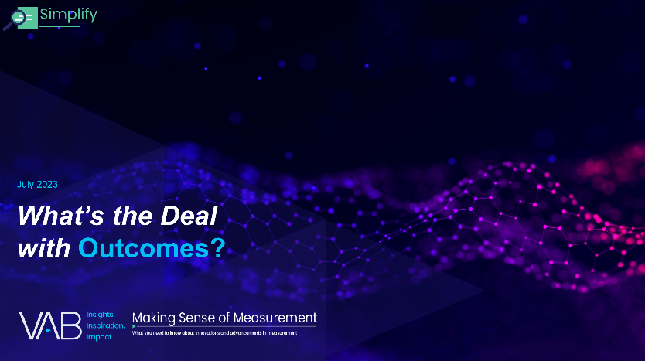
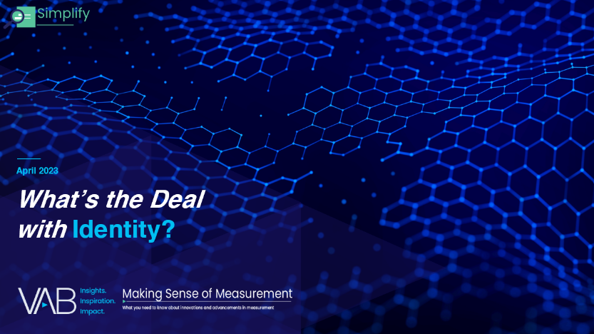
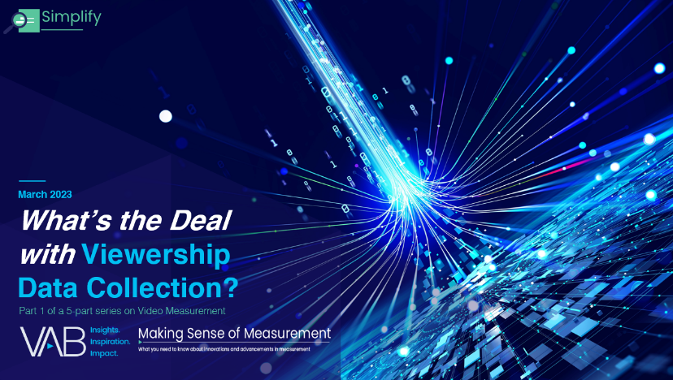
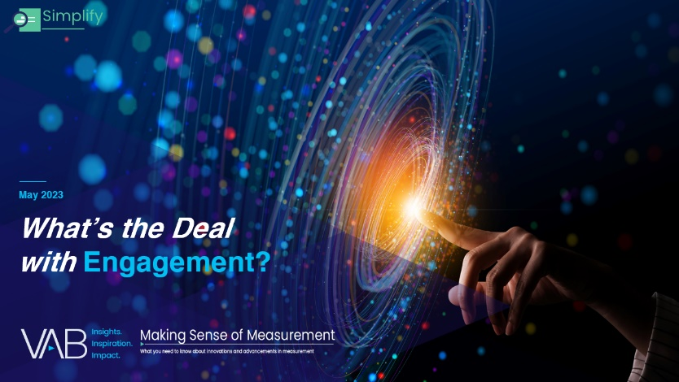
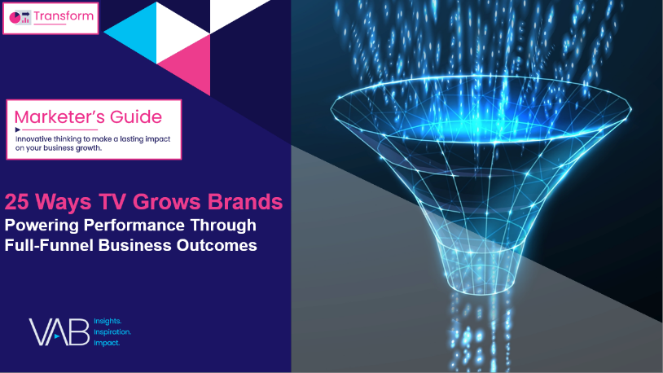
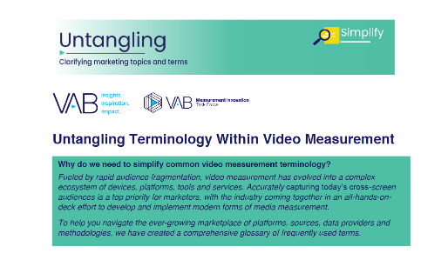
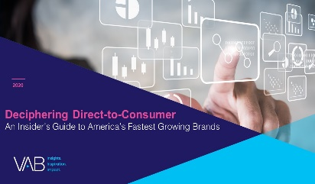
More from the What’s the Deal With….series
What’s the Deal With Outcomes?
What’s the Deal With Identity?
Discover more
Check out this related VAB content
What’s the Deal With Viewership Data Collection?
What’s the Deal With Engagement?
VAB Members, brand marketers and agencies get free and immediate access to VAB’s content library. Get access at theVAB.com
25 Ways TV Grows Brands
Powering Performance Through Full-Funnel Business Outcomes
Untangling Terminology
Within Video Measurement
This information is exclusively provided to VAB members and qualified marketers. Further distribution is prohibited.
PAGE 13

Slide 14


About VAB
VAB is an insights-driven organization that inspires marketers to reimagine their media strategies resulting in fully informed decisions.
Drawing on our marketing expertise, we simplify the complexities in our industry and discover new insights that transform the way marketers look at their media strategy.
We are committed to your business growth and proud to offer VAB members, brand marketers and agencies complimentary access to our continuously-growing Insights library. Get immediate access at theVAB.com.
Curious to learn more about VAB? Check out this quick video to see what we do and how we can help you develop business-driving marketing strategies.
This information is exclusively provided to VAB members and qualified marketers. Further distribution is prohibited.
PAGE 14

