Slide 1
What’s APP’ning!!
The TV-Traffic Correlation For Mobile Apps

Slide 2
The Download
With the ubiquity of smartphones, mobile apps are flooding the marketplace with over 1,000 being added to the Apple app store each day.
It’s now become crucial for app developers to build large audiences quickly in hopes of monetizing their product and maximizing their investment. Because of this, the category has been increasingly turning towards the power of TV advertising to increase downloads, visits and in-app purchases and now collectively spends almost $1 billion annually in the medium.
This is the third report in the VAB’s commitment to illustrate critical effects of TV advertising that are hidden by the silo nature of syndicated data.
Two years ago, we looked at the correlation between TV advertising and website traffic for 75 pure-play Internet companies and found 85% showed a direct correlation between TV spending and website traffic
Last year, we looked at 125 brands in six “Call-To-Action” categories – restaurants, retail, travel, telco, financial and insurance – and found that 82% showed a correlation between TV advertising and website traffic
This time, we looked at 60 mobile apps across 10 categories – games, ecommerce / retail, media, sports, tech / telco, financial, restaurants, travel, music and education.
We looked at a cross-section of apps – brands that live as an app only, brands that have a mix of browser and app access and brands that have an app supporting their bricks & mortar presence – and specifically isolated mobile app only TV spending and traffic of each brand.
For comparative purposes, results are based on average TV spend & traffic metrics between “When TV On” vs. “When TV Off” months from the October 2014 – December 2015 period.
2
VAB analysis was based on the last 15 months of available data through the end of 2015 (October 2014-December 2015)

Slide 3
Although Smartphones Are Prevalent Across All Ages, Millennials Represent Almost Half Of Those Who Actively Use Mobile Apps
Used A Mobile App On A Smartphone In Last 30 Days
A18-34
48%
(157 index)
When looking at specific categories, “gaming” app usage skews even more towards Millennials as they’re 71% more likely to actively use them than the average population
3
Source: 2015 GfK MRI Doublebase; A18+

Slide 4
Within The Mobile App Category, Games Are Big Business With The Top Titles Generating Over $1 Million Of Revenue Per Day
While many games are free to download and play, most thrive on a “freemium” model where the initial download is free but certain virtual goods within a game’s digital universe cost real cash in order to provide players advantages like the ability to advance to higher levels with more ease.
Top U.S. Grossing iOS Mobile Gaming Apps by Daily Revenue
4
Sources: Think Gaming, iPhone only, top 10 ranked, March 2016. Statista.com. #K = thousands; #M = millions.

Slide 5
Mobile Apps Exist In An Extremely Saturated Marketplace With Over 1.5 Million Apps Currently Available In The Apple Store
Competition is fierce because, even with all these apps available, the average smartphone user will use only 25 apps per month and almost 80% of their app time will be spent with just 3.
# of Available Apps In Apple App Store (June)
5
Source: Apple (worldwide); comScore “The 2015 U.S. Mobile App Report” (app usage)

Slide 6
With All These Apps Competing For Attention, The Category Now Collectively Spends Nearly $1 Billion On TV Advertising
As smartphone penetration matured, the app category grew from one TV advertiser to almost 400 in six short years as more brands look to Television to drive downloads, usage and, in many cases, in-app purchases
# of Apps
1
4
38
128
178
265
395
6
Source: Nielsen AdIntel. Total TV includes cable TV, broadcast TV, Spanish language cable TV, Spanish language broadcast TV, syndication TV, cable TV

Slide 7
The App Category Buys Deep In TV To Build Scale And Maximize Reach Across A Variety of Networks And Genres
In 2015, mobile app advertising appeared on over 120+ national TV networks across over 13 sub-genres
Including live sports, talk/variety, dramas, comedies, films, kids, music, news, documentaries, adult animation
Reflects 100% of Nielsen-measured networks
7
Source: Nielsen AdIntel (national TV only = broadcast TV, cable TV, Spanish language broadcast TV, Spanish language cable TV)

Slide 8
How Effective Is TV For The Mobile App Category?
A TV-Traffic Correlation Analysis

Slide 9




























































Our Analysis Universe: 60 Mobile Apps Across 10 Categories
Games
eCommerce / Retail
Media
Sports
Restaurants
Financial / Insurance / Real Estate
Music
Travel
Education
Tech / Telco
The list reflects apps that are measured in both comScore and Nielsen AdIntel (under the “web-based app-game” product category). To be included, apps had to have at least two months of active comScore measurement between October 2014 – December 2015 and at least $500K in Nielsen AdIntel reported total 2015 TV spend. Furthermore for comparison purposes, these apps must also have had at least one month each of “When TV On” and “When TV Off” activity during comScore measured months.
9

Slide 10
Our “Universe” Findings:
A Definitive Correlation Between TV Spend & App Traffic
46 of the 60 Mobile Apps (77%) Analyzed Exhibited a Direct Correlation Between TV Spend & App Traffic
46 Brands
“TV Off” Months Led To In Monthly Unique Visitors
“TV On” Months Led To In Monthly Unique Visitors
14 Brands
Lack of correlation between “TV Off” & “TV On” Months Vs. Monthly Unique Visitors
Sources: Nielsen AdIntel, (web-based app game product category), TV spend (cable TV, broadcast TV, Spanish language cable TV, Spanish language broadcast TV, syndication TV, spot TV); October 2014 – December 2015. comScore mobile metrix media trend (application access only), unique visitors (P2+), October 2014 – December 2015. Analysis is based on comparison of average monthly unique visitors for “When TV Off” vs. “When TV On” months of activity.
10

Slide 11
Our “Universe” Findings:
TV Spend Impact On The 46 Apps With A Definitive Correlation
46 Mobile App Advertisers: Unique Visitors vs. TV Spend
“When Off” & “When On” TV During 15 Month Time Period (Oct. ‘14 – Dec. ’15)
“When Off” TV Months
“When On” TV Months
46 “Correlation” Advertisers
-20% less Unique Visitors
(on average)
46 “Correlation” Advertisers
+25% more Unique Visitors +$2.0MM TV Spend
(on average)
Sources: Nielsen AdIntel, (web-based app game product category), TV spend (cable TV, broadcast TV, Spanish language cable TV, Spanish language broadcast TV, syndication TV, spot TV); October 2014 – December 2015. comScore mobile metrix media trend (application access only), unique visitors (P2+), October 2014 – December 2015. Analysis is based on comparison of average monthly unique visitors for “When TV Off” vs. “When TV On” months of activity.
11

Slide 12



















Our “Games” Segment Findings: 86% Correlation Among 21 Apps
18 of the 21 Mobile “Games” Apps (86%) Analyzed Exhibited a Direct Correlation Between TV Spend & App Traffic
18 Brands
“TV Off” Months Led To In Monthly Unique Visitors
“TV On” Months Led To In Monthly Unique Visitors
3 Brands
No correlation between “TV Off” & “TV On” Months Vs. Monthly Unique Visitors
Games
Line: Disney Tsum Tsum
Sources: Nielsen AdIntel, (web-based app game product category), TV spend (cable TV, broadcast TV, Spanish language cable TV, Spanish language broadcast TV, syndication TV, spot TV); October 2014 – December 2015. comScore mobile metrix media trend (application access only), unique visitors (P2+), October 2014 – December 2015. Analysis is based on average comparison of monthly unique visitors for “When TV Off” vs. “When TV On” months of activity.
Pet Rescue Saga
12

Slide 13
Our “Games” Segment Findings:
TV Spend Impact On The 18 Apps With A Definitive Correlation
18 Mobile Games App Advertisers: Unique Visitors vs. TV Spend
“When Off” & “When On” TV During 15 Month Time Period (Oct. ‘14 – Dec. ’15)
“When Off” TV Months
“When On” TV Months
18 “Correlation” Advertisers
-23% less Unique Visitors
(on average)
18 “Correlation” Advertisers
+30% more Unique Visitors +$1.9MM TV Spend
(on average)
Sources: Nielsen AdIntel, (web-based app game product category), TV spend (cable TV, broadcast TV, Spanish language cable TV, Spanish language broadcast TV, syndication TV, spot TV); October 2014 – December 2015. comScore mobile metrix media trend (application access only), unique visitors (P2+), October 2014 – December 2015. Analysis is based on comparison of average monthly unique visitors for “When TV Off” vs. “When TV On” months of activity.
13

Slide 14
Deep Dives: Select Examples of “Games” Apps’ Demonstrated TV Spend / Traffic Correlation
“When On” / “When Off” Comparison
Avg Mnthly Unique Visitors (000):
“When TV On”:
1,938
11,892
7,653
2,525
3,463
“When TV Off”:
1,440
10,200
6,923
1,983
2,385
% Difference:
+35%
+17%
+11%
+27%
+45%
Avg Mnthly TV Spend “When On” (000):
+$740
+$4,523
+$2,123
+$3,300
+$1,321
Avg Mnthly Unique Visitors (000):
“When TV On”:
1,982
1,897
Pet Rescue Saga
2,470
3,192
2,526
“When TV Off”:
1,209
1,318
1,769
2,646
2,025
% Difference:
+64%
+44%
+40%
+21%
+25%
+$157
+$2,493
+$1,062
+$839
Avg Mnthly TV Spend “When On” (000):
+$9,112
Source: comScore, mobile metrix media trend (application access only); Total audience (P2+), Oct ‘14 – Dec ‘15. Nielsen AdIntel (web-based app game product category), TV spend (cable TV, broadcast TV, Spanish language cable TV, Spanish language broadcast TV, syndication, spot TV) Oct ‘14-Dec ’15.
14

Slide 15
Deep Dives: Select Examples of “Games” Apps’ Demonstrated TV Spend / Traffic Correlation
“When On” / “When Off” Comparison
Avg Mnthly Unique Visitors (000):
“When TV On”:
1,446
1,105
461
1,627
347
624
“When TV Off”:
693
100
286
1,001
182
278
% Difference:
+109%
+1,006%
+61%
+63%
+90%
+124%
Avg Mnthly TV Spend “When On” (000):
+$1,070
+$2,345
+$4,098
+$383
+$344
+$258
Driven primarily by their 2015 Super Bowl TV ad
Source: comScore, mobile metrix media trend (application access only); Total audience (P2+), Oct ‘14 – Dec ‘15. Nielsen AdIntel (web-based app game product category), TV spend (cable TV, broadcast TV, Spanish language cable TV, Spanish language broadcast TV, syndication TV, spot TV) Oct ‘14-Dec ’15.
15

Slide 16
Their TV Investments Have Been Quite Successful As Current Monthly Revenues Typically Far Outpace Their “When On” Spend
Apps’ cumulative TV spend has also led to explosive, and sustained, revenue growth
Gaming Apps: Avg Month “When On” TV Spend Vs. Estimated Monthly U.S. Revenues
Sources: TV spend based on Nielsen AdIntel (web-based app game product category), TV spend (cable TV, broadcast TV, Spanish language cable TV, Spanish language broadcast TV, syndication TV, spot TV). Estimated monthly revenues based on VAB analysis of daily U.S. revenue estimates from Think Gaming, iPhone only, April 18th, 2016 (monthly estimates based on a 30-day month). Gaming apps reflect those that had active TV spending towards the end of the October 2014 – December 2015 analysis time period.
16

Slide 17
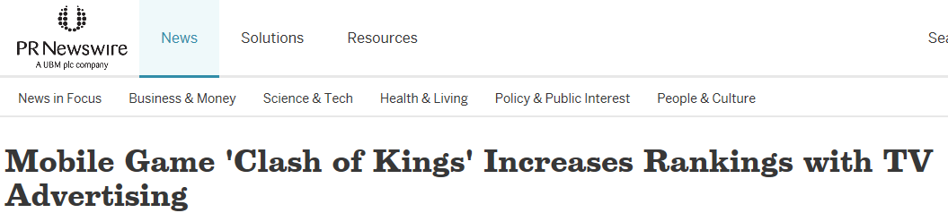
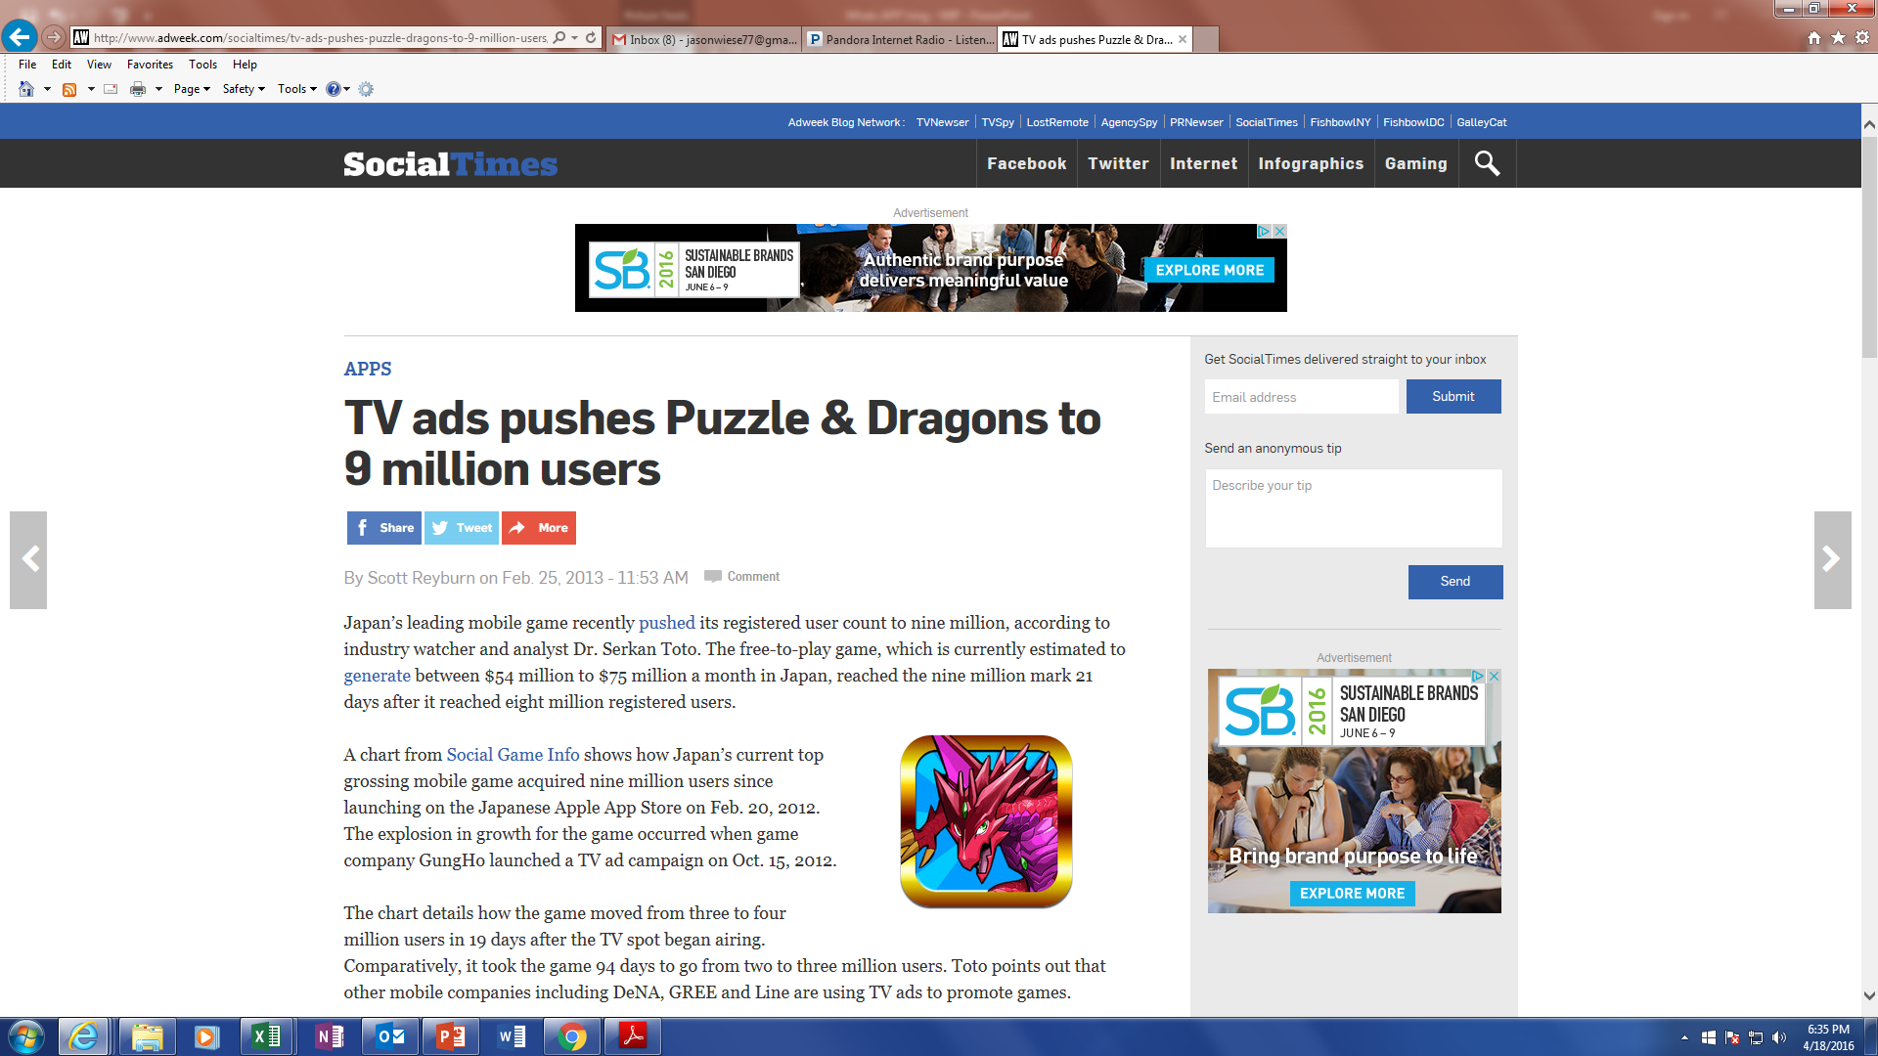

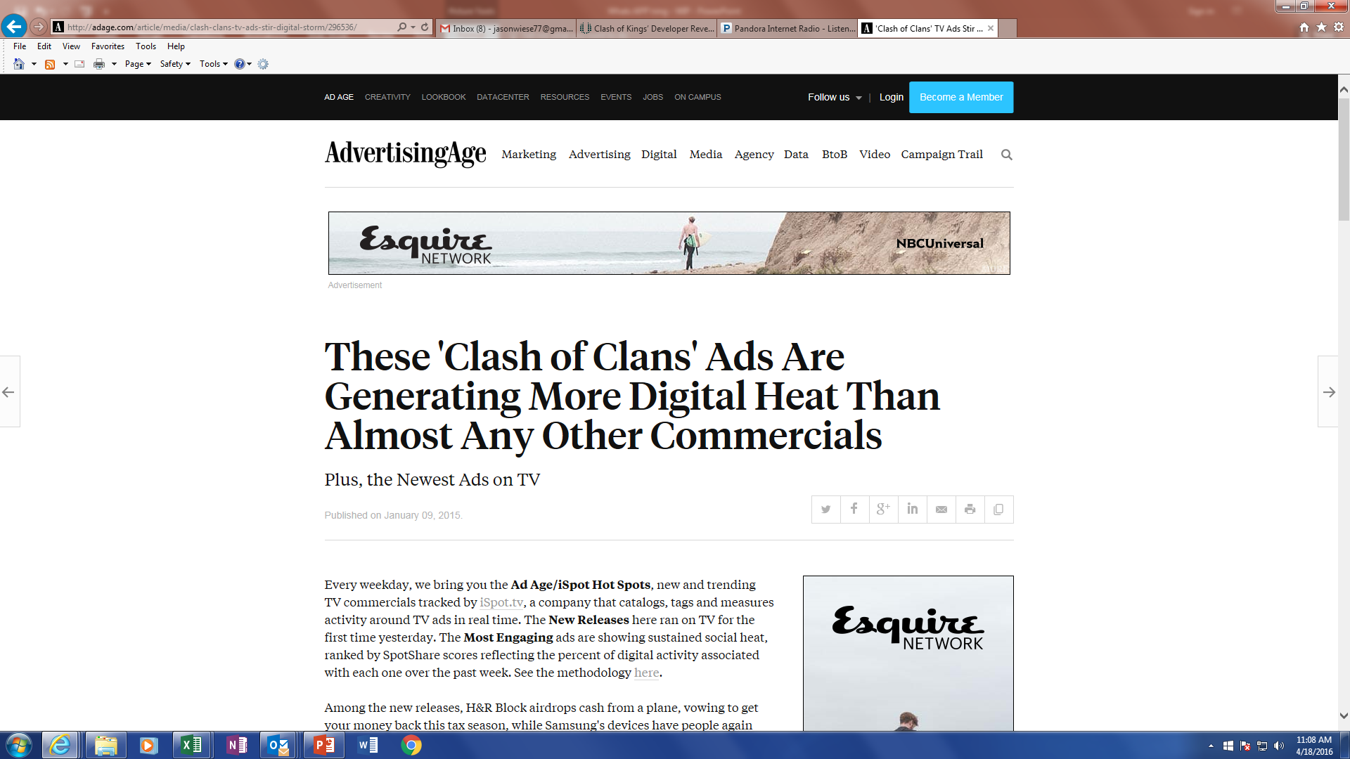



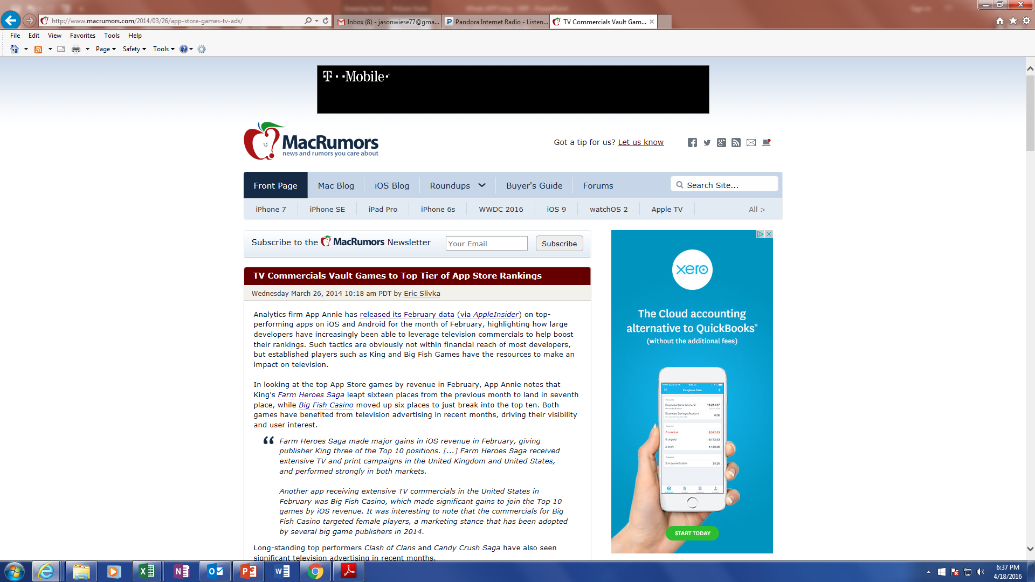
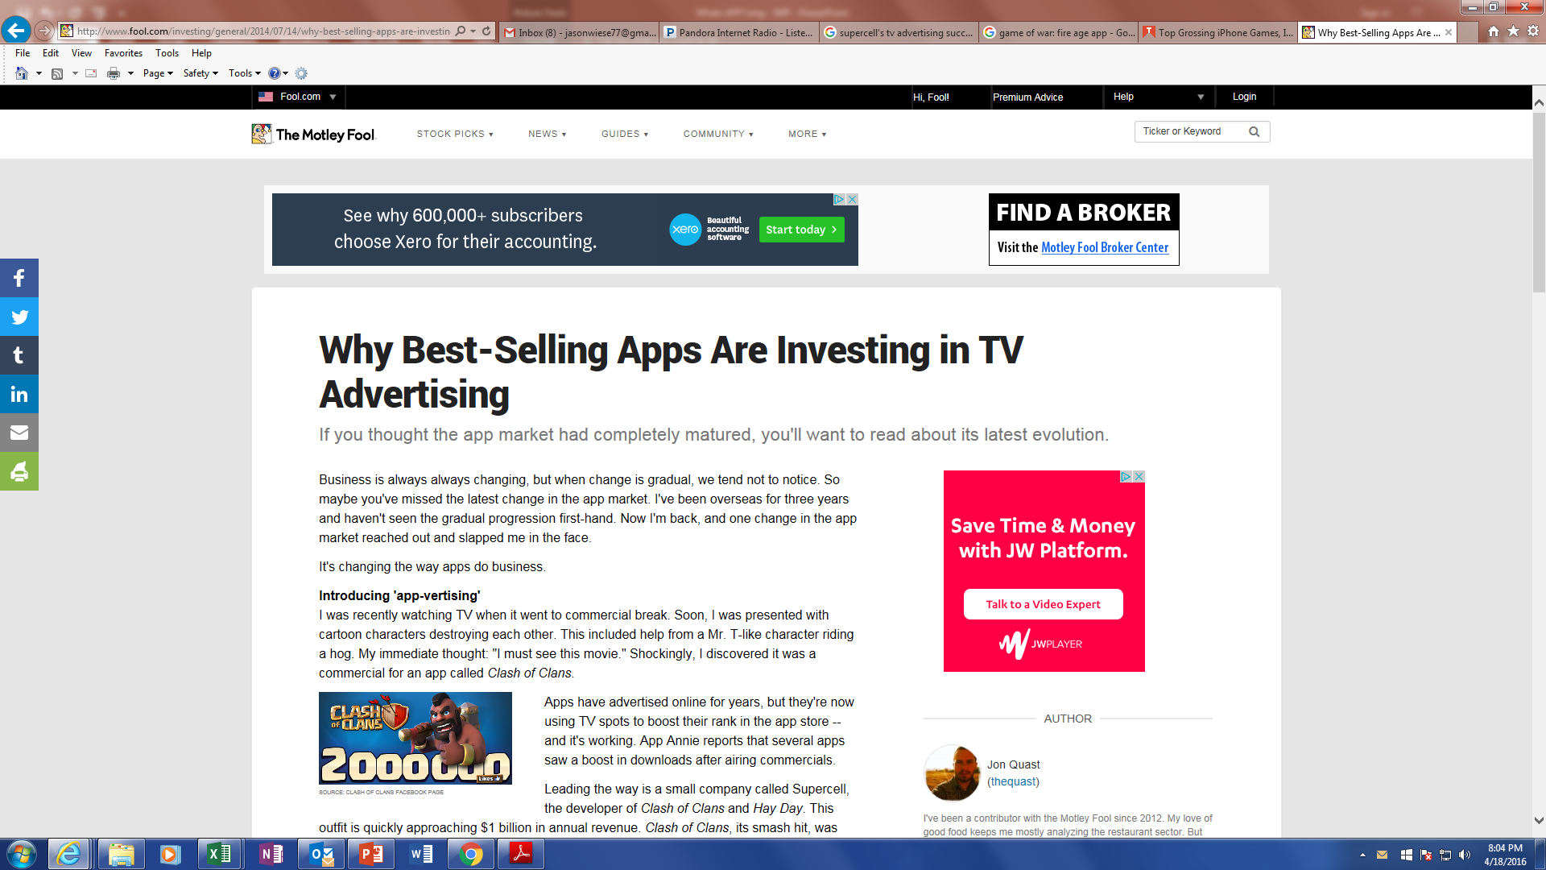
This Success Is Confirmed By The Developers Who Directly Credit Their TV Spend For Growing Users And Increasing Revenue
17

Slide 18



















Our “Services” Segment Findings: 78% Correlation Among 23 Apps
18 of the 23 Mobile “Services” Apps (78%) Analyzed Exhibited a Direct Correlation Between TV Spend & App Traffic
18 Brands
“TV Off” Months Led To In Monthly Unique Visitors
“TV On” Months Led To In Monthly Unique Visitors
5 Brands
No correlation between “TV Off” & “TV On” Months Vs. Monthly Unique Visitors
Geico
Orbitz
Hotels.com
5Miles
Wal-Mart
“Services” include:
Music
Apple Music
Travel
Tech / Telco
Financial / Insurance / Real Estate
Progressive
Realtor.com
eCommerce / Retail
FreePrints
Sources: Nielsen AdIntel, (web-based app game product category), TV spend (cable TV, broadcast TV, Spanish language cable TV, Spanish language broadcast TV, syndication TV, spot TV); October 2014 – December 2015. comScore mobile metrix media trend (application access only), unique visitors (P2+), October 2014 – December 2015. Analysis is based on comparison of average monthly unique visitors for “When TV Off” vs. “When TV On” months of activity.
18

Slide 19
Our “Services” Segment Findings:
TV Spend Impact On The 18 Apps With A Definitive Correlation
18 Mobile Services App Advertisers: Unique Visitors vs. TV Spend
“When Off” & “When On” TV During 15 Month Time Period (Oct. ‘14 – Dec. ’15)
“When Off” TV Months
“When On” TV Months
18 “Correlation” Advertisers
-18% less Unique Visitors
(on average)
18 “Correlation” Advertisers
+22% more Unique Visitors +$2.7MM TV Spend
(on average)
Sources: Nielsen AdIntel, (web-based app game product category), TV spend (cable TV, broadcast TV, Spanish language cable TV, Spanish language broadcast TV, syndication TV, spot TV); October 2014 – December 2015. comScore mobile metrix media trend (application access only), unique visitors (P2+), October 2014 – December 2015. Analysis is based on comparison of average monthly unique visitors for “When TV Off” vs. “When TV On” months of activity.
19

Slide 20
Deep Dives: Select Examples of “Services” Apps’ Demonstrated TV Spend / Traffic Correlation
“When On” / “When Off” Comparison
Avg Mnthly Unique Visitors (000):
“When TV On”:
Wal-Mart
Orbitz
Progressive
2,620
29,550
778
1,117
5,076
“When TV Off”:
1,427
24,348
667
774
2,756
% Difference:
+84%
+21%
+17%
+44%
+84%
Avg Mnthly TV Spend “When On” (000):
+$942
+$3,151
+$304
+$5,164
+$3,915
Avg Mnthly Unique Visitors (000):
“When TV On”:
3,978
5Miles
FreePrints
Apple Music
1,757
725
57,325
372
“When TV Off”:
1,741
1,474
340
44,348
188
% Difference:
+129%
+19%
+113%
+30%
+98%
+$5,774
+$941
+$188
+$1,605
+$3,157
Avg Mnthly TV Spend “When On” (000):
Source: comScore, mobile metrix media trend (application access only); Total audience (P2+), Oct ‘14 – Dec ‘15. Nielsen AdIntel (web-based app game product category), TV spend (cable TV, broadcast TV, Spanish language cable TV, Spanish language broadcast TV, syndication TV, spot TV) Oct ‘14-Dec ’15.
20

Slide 21















Our “Sports & Media” Segment Findings: 63% Correlation Among 16 Apps
10 of the 16 Mobile “Sports & Media” Apps (63%) Analyzed Exhibited a Direct Correlation Between TV Spend & App Traffic
10 Brands
“TV Off” Months Led To In Monthly Unique Visitors
“TV On” Months Led To In Monthly Unique Visitors
6 Brands
No correlation between “TV Off” & “TV On” Months Vs. Monthly Unique Visitors
Team Stream
Sports
Viggle
Media
Sources: Nielsen AdIntel, (web-based app game product category), TV spend (cable TV, broadcast TV, Spanish language cable TV, Spanish language broadcast TV, syndication TV, spot TV); October 2014 – December 2015. comScore mobile metrix media trend (application access only), unique visitors (P2+), October 2014 – December 2015. Analysis is based on comparison of average monthly unique visitors for “When TV Off” vs. “When TV On” months of activity.
21

Slide 22
Our “Sports & Media” Segment Findings:
TV Spend Impact On The 10 Apps With A Definitive Correlation
10 Mobile Sports & Media App Advertisers: Unique Visitors vs. TV Spend
“When Off” & “When On” TV During 15 Month Time Period (Oct. ‘14 – Dec. ’15)
“When Off” TV Months
“When On” TV Months
10 “Correlation” Advertisers
-32% less Unique Visitors
(on average)
10 “Correlation” Advertisers
+48% more Unique Visitors +$971K TV Spend
(on average)
Sources: Nielsen AdIntel, (web-based app game product category), TV spend (cable TV, broadcast TV, Spanish language cable TV, Spanish language broadcast TV, syndication TV, spot TV); October 2014 – December 2015. comScore mobile metrix media trend (application access only), unique visitors (P2+), October 2014 – December 2015. Analysis is based on comparison of average monthly unique visitors for “When TV Off” vs. “When TV On” months of TV activity.
22

Slide 23
Deep Dives: Select Examples of “Sports & Media” Apps’ Demonstrated TV Spend / Traffic Correlation
“When On” / “When Off” Comparison
Avg Mnthly Unique Visitors (000):
“When TV On”:
3,676
649
445
2,791
2,423
“When TV Off”:
1,812
599
249
2,041
1,999
% Difference:
+103%
+8%
+79%
+37%
+21%
Avg Mnthly TV Spend “When On” (000):
+$626
+$89
+$5,209
+$186
+$1,932
Avg Mnthly Unique Visitors (000):
“When TV On”:
973
432
333
103
Viggle
1,697
“When TV Off”:
787
310
225
60
1,059
% Difference:
+24%
+40%
+48%
+30%
+60%
+$369
+$215
+$256
+$616
+$216
Avg TV Spend “When On” (000):
Source: comScore, mobile metrix media trend (application access only); Total audience (P2+), Oct ‘14 – Dec ‘15. Nielsen AdIntel (web-based app game product category), TV spend (cable TV, broadcast TV, Spanish language cable TV, Spanish language broadcast TV, syndication TV, spot TV) Oct ‘14-Dec ’15.
23

Slide 24
Our “Universe” (60 Mobile Apps) Findings Based On Male / Female Audience Skews

Slide 25
“When On,” Television Drove A Higher Percentage of Increased Visitors For Mobile Apps That Have A More Targeted Audience
Female-Skewing
(21 apps)
Dual
(16 apps)
Male-Skewing
(23 apps)
16 “Correlation” Advertisers
12 “Correlation” Advertisers
18 “Correlation” Advertisers
“When Off” TV Months
-18% less Unique Visitors (on average)
-22% less Unique Visitors (on average)
“When Off” TV Months
“When Off” TV Months
-23% less Unique Visitors (on average)
“When On” TV Months
“When On” TV Months
“When On” TV Months
+30% more Unique Visitors +$1.3MM TV Spend
(on average)
+22% more Unique Visitors +$3.1MM TV Spend
(on average)
+28% more Unique Visitors +$1.9MM TV Spend
(on average)
Sources: Nielsen AdIntel, (web-based app game product category), TV spend (cable TV, broadcast TV, Spanish language cable TV, Spanish language broadcast TV, syndication TV, spot TV); October 2014 – December 2015. comScore mobile metrix media trend (application access only), unique visitors (P2+), October 2014 – December 2015. Analysis is based on comparison of average monthly unique visitors for “When TV Off” vs. “When TV On” months of activity. Female & male-skewing apps determined based on P2+ audience data from comScore December 2015. 60%+ female audience comp = female-skewing; 41% - 59% male/female audience comp = dual; 60%+ male audience comp = male-skewing.
9

Slide 26
Bonus Analysis
How Recent TV Campaigns For Other Mobile Apps Have Driven Measurable Audience Growth

Slide 27








Up Close: 8 Recent TV Launches For Mobile Apps Have Attracted Big Audiences
In addition to the 60 mobile apps we included in our correlation analysis, we also looked at 8 mobile apps that were unmeasured until they launched a recent TV campaign during the 15-month time period we analyzed.
The results are clear, audiences flocked to these apps almost immediately after their TV launch.
App Measurement by comScore
App
App Launch
TV Launch
Measurement Begins
Dec ‘15 Monthly Uniques (000)
September ‘15
No measurement
November ‘15
TV campaign
December ‘15
TV campaign
2,304
Close5
April ‘16 est monthly revenue: $1M+
July ‘15
No measurement
November ‘15
TV campaign
December ‘15
TV campaign
1,885
April ‘16 est monthly revenue: $12M+
August ‘14
No measurement
September ‘15
TV campaign
September ‘15
TV campaign
1,067
August ‘15
No measurement
October ‘15
TV campaign
October ‘15
TV campaign
666
August ‘14
No measurement
April ‘15
TV campaign
May ‘15
TV campaign
655
July ‘14
No measurement
April ‘15
TV campaign
August ‘15
TV campaign
1,791
March ‘15
No measurement
March ‘15
TV campaign
October ‘15
TV campaign
621
Close5
August ‘14
No measurement
December ‘14
TV campaign
July ‘15
TV campaign
3,572
Source: comScore, mobile metrix media trend (application access only); Total audience (P2+), Oct ‘14 – Dec ‘15. Nielsen AdIntel (web-based app game product category), TV spend (cable TV, broadcast TV, Spanish language cable TV, Spanish language broadcast TV, syndication TV, spot TV) Oct ‘14-Dec ’15. All eight apps’ comScore measurement based on “panel only,” meaning that at least 6 panelists per mobile platform (250K panel) visited an app in order for it to be reported. This audience level needs to be maintained for continued measurement. Estimated monthly revenues based on VAB analysis of daily revenue estimates from Think Gaming, iPhone only, April 18th, 2016 (monthly estimates based on a 30-day month).
25

Slide 28
So, In Conclusion, What’s App’ning In The Mobile App Category?
In this oversaturated, highly competitive, millennial-driven category, successful app brands – whether they be games, ecommerce, services, sports or media - are effectively leveraging Television to drive downloads, visits and in-app purchases.
The results are clear for apps that show a correlation between TV spend and traffic – unique visitors increase by double digits (+25%) when TV runs and decrease by double digits (-20%) when it doesn’t. Furthermore, TV campaign launches have shown the ability to build quick, and measurable, audiences for apps which ignites revenue.
And for the games segment in particular, where direct correlations can be made more easily, the correlation is even tighter (86%), the TV impact is stronger (+30% unique visitors “When On”) and it’s clear that an app’s cumulative TV spend is the driving force behind increasing revenues.
This report continues to add to a mounting body of sophisticated evidence pointing to one conclusion: TV advertising is the primary driver of traffic and revenue generation.
26

Slide 29


For More Information Visit Us Online TheVAB.com
Follow us: @VideoAdBureau
Like us: facebook.com/VideoAdvertisingBureau

