Slide 1



What Is Programmatic TV?
Automation and Technology in TV Advertising
September 2025

Slide 2











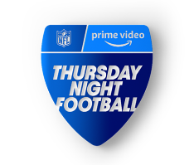

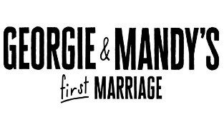



Programmatic TV
Understanding the evolution of buying and selling TV advertising
In a world where every impression and ad dollar is expected to perform, programmatic technology is increasingly relied on by marketers to reach audiences in an automated, data driven and cost-effective way.
While over 90% of digital display ad dollars are transacted programmatically, the biggest increases in programmatic spending are being driven by video.¹ In the next two years, by 2027, programmatic ad spend in video is expected to grow by nearly $43 billion in the United States alone, reaching a total of nearly $160 billion.²
As programmatic spending continues to grow and proliferate, it’s critical that marketers align their strategies with transparent and trusted media partners. This importance is highlighted by the $26.8 billion in global media value that is still lost each year to programmatic inefficiencies.³ By understanding key programmatic concepts and aligning with Premium Programmatic TV partners, advertisers have a clearer path to fraud free inventory ensuring ads reach real engaged viewers in a brand-safe environment.
Programmatic TV Advertising Defined
Programmatic TV advertising provides marketers with an opportunity to automate the ad buying process of premium video content, enabling advertisers to reach audiences consuming premium content across multiple devices and platforms in an automated and efficient way.
Programmatic TV Devices & Platforms
Traditional TV
Connected TV
Streaming TV*
Addressable TV
Sampling of premium content where programmatic TV ads could be delivered
72%
of marketers plan to increase programmatic investment in 2025⁴
*Streaming TV includes devices (sticks, dongles, pucks, etc.) and apps
PAGE 2
This information is exclusively provided to VAB members and qualified marketers.

Slide 3






Programmatic TV Budgeting and Success Metrics
CTV leads in programmatic TV adoption, with an estimated 88% of CTV ad spend being transacted programmatically. ⁵
Advertisers will be reallocating funds from a variety of budgets as they increase their investment in Programmatic CTV in 2025⁴
1in 5
of those increasing programmatic CTV budgets are able to garner a new budget
to support this growing media channel
The top 5 metrics marketers use to measure the effectiveness of programmatic campaigns⁴
Reach / Frequency
Conversion Rate
Click-Through Rate (CTR)
70%
69%
63%
Return on Ad Spend (ROAS)
Engagement Metrics
(.e.g, likes, shares)
58%
46%
PAGE 3
This information is exclusively provided to VAB members and qualified marketers.

Slide 4




Buying Programmatic TV: The Decision Tree
Programmatic Buying Type Decision Tree
Is inventory being auctioned?
Yes
No
Real-Time Bidding
Programmatic Direct
Is the auction open to everyone?
Is inventory guaranteed?
Yes
No
Yes
No
Open Marketplaces
Private Exchange
Programmatic Guaranteed
Preferred Deal
Ad impressions are bought and sold in real time through an open auction
Auction that offers real-time-bidding
in a closed, invitation only auction
Advertisers and publishers agree in advance on a fixed price and set number of impressions
Priority access to inventory at a fixed price before it becomes available in the open or private marketplace
78%
of advertisers agree that programmatic makes buying easier⁶
67%
of programmatic deals are done via private marketplace⁷
PAGE 4
This information is exclusively provided to VAB members and qualified marketers.

Slide 5

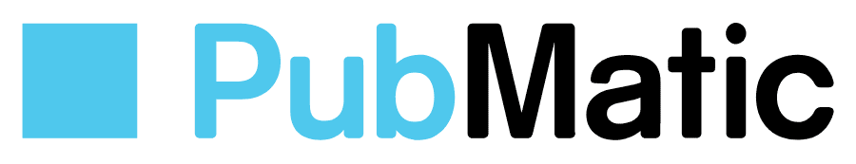












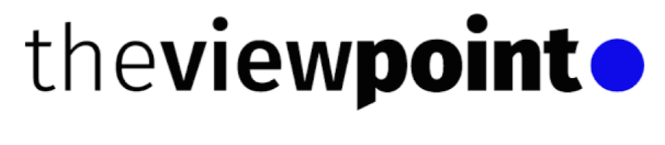













Programmatic TV Advertising Ecosystem Overview
The Programmatic TV ecosystem is comprised of many tools, platforms and solutions that enable marketers to access Premium TV inventory in an automated way.
Ad Exchange: A marketplace where the buy side and sell side meet enabling DSPs (Demand Side Platforms) to bid on impressions supplied by SSPs (Supply Side Platforms).
Demand Side Platform
Supply Side Platform
Enables advertisers to bid automatically for available inventory across streaming apps, CTV platforms, linear and addressable TV.
Who Uses It: Advertisers who want to plan, target and purchase TV ads in real time.
Why DSPs are Essential:
Automates the buying process
Centralizes media buying
Enables advanced targeting and frequency capping capabilities
Increased campaign flexibility and adjustability for optimized results
Enables publishers and media owners to
sell inventory efficiently, at scale, and with precision.
Who Uses It: Publishers, streaming apps,
TV networks and device platforms
Why SSPs are Essential:
Automates the selling process
Maximizes yield of inventory
Provides marketers access to premium, brand safe and curated inventory
Allows buyers to align ads with relevant genres, shows, or moments in a privacy compliant way
Ad Server: Ensures ads are delivered to the right viewer on the right screen while also tracking results
Ad Tech Platforms: Technology backbone that enables and optimizes the buying, selling, delivery and measurement of digital ads across the programmatic TV ecosystem
Companies shown above represent a sampling
PAGE 5
This information is exclusively provided to VAB members and qualified marketers.

Slide 6
















Programmatic TV Advertising Benefits
As programmatic advertising evolves, so do the challenges of fragmentation and fraud, making it critical for marketers to be strategic in their approach. Partnering with premium publishers ensures brands can unlock Programmatic TV’s full potential by reaching and engaging with real audiences in high-quality, brand-safe, fully measurable environments.
Premium
Professionally produced, long-form content captures audience attention fostering deep emotional connections with brands in secure environments
Automated
Programmatic TV reduces time and effort required to execute campaigns, enabling advertisers to scale campaign across multiple platforms
Professionally Produced
High Emotional Engagement
Scalable
Adjustable
Brand Safe Environment
Transparent
Ad Placements
Cross Platform
Efficient
Precise
Leverage granular targeting and advanced audience segmentations to deliver tailored and relevant messaging to the consumer
Measurable
Programmatic measurement delivers near real-time results enabling marketers to make informed decisions and optimize campaign strategies
First and Third-Party
Data Matching
Behavioral
Real Time
Reporting
Reach Management
Innovative
Ad Formats
Contextual Advertising
Frequency Management
Outcomes
PAGE 6
This information is exclusively provided to VAB members and qualified marketers.

Slide 7



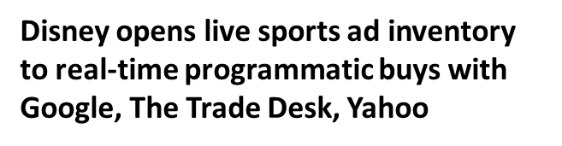
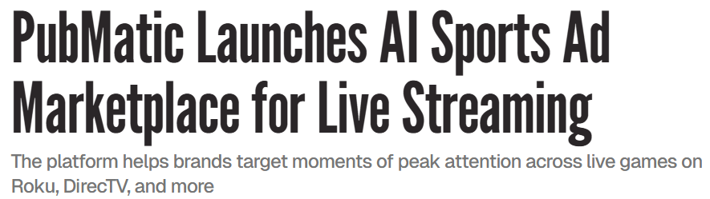



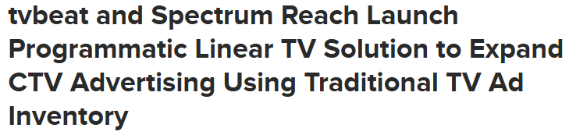
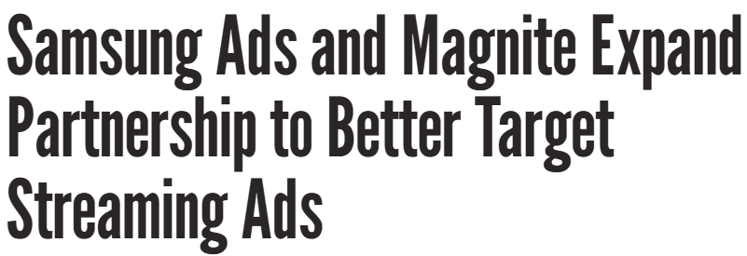
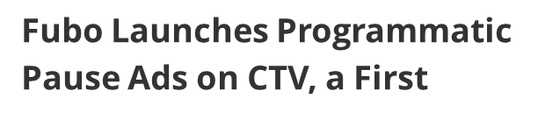

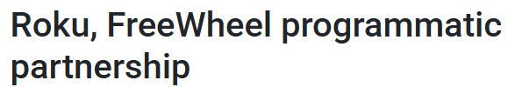
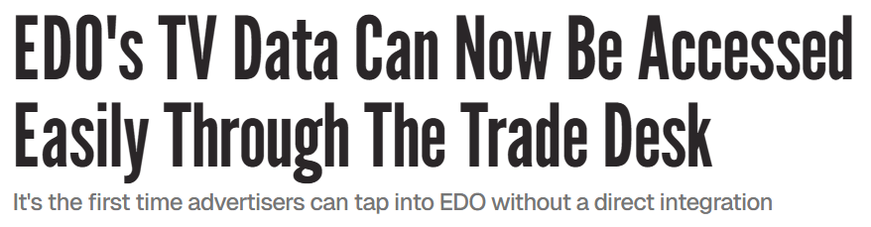
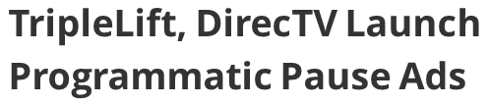
Programmatic TV Partnerships
The programmatic TV ecosystem is brimming with new partnerships, giving marketers more ways to activate campaigns across streaming, addressable and other data-enabled TV platforms
1/6/2025
7/17/2025
6/16/2025
5/30/2025
8/12/2025
4/9/2025
12/13/2024
6/10/2025
6/10/2025
Industry Perspectives
“Programmatic is becoming the dominant means that we transact as an industry. Because
of that it allows us to become so much more successful with our clients, because of the promise of what automation brings to the table – make optimizations in real time, drive towards many different results…with success up and down the funnel.”
- Matt Barnes, VP, Automated Sales, Disney Advertising
“Streaming has changed the way we all watch our favorite live programming, and programmatic has changed the way those ads are bought, sold, and delivered.”
- Mark McKee, General Manager, FreeWheel
“The idea that programmatic is only a lower funnel tactic at this point hasn’t been true for the last couple of years….It’s always been a full funnel solution… something that we tap into for awareness, something that we tap into for convergence and kind of across the board.”
  - Francis D’Hondt, SVP of Addressable Health, Kinesso
“We’re launching programmatic live sports access for SMB and local advertisers. That’s been a tough nut to crack, but we’re working with publishing and tech partners to make it happen in time for football season. It’s a huge opportunity, and one that’s largely been out of reach for local buyers - until now.”
- Daniel Spinosa, President, Premion
PAGE 7
This information is exclusively provided to VAB members and qualified marketers.

Slide 8





Five Opportunities in the Programmatic TV Ecosystem
Partner with Premium Publishers
As the supply of Programmatic TV advertising grows, partnering with premium publishers ensures that marketers engage with real audiences in high-quality, brand-safe content. With the precision of digital targeting and measurable results, Programmatic TV combines the strength of premium video with rapid adaptability so marketers can achieve their desired business outcomes in an automated and cost-effective way.
Programmatic is Going Live
Increasingly more publishers are linking the power of traditional live TV with programmatic technology. The share of live event advertising will continue to grow as the industry works to ensure the right capabilities are established.
This will allow both advertisers and publishers to easily activate programmatic campaigns for live content.
Establish Durable Data Practices
Programmatic TV enables advertisers to utilize first-party, third-party, contextual, behavioral, and location-based data to precisely target audiences. By working with transparent partners and adopting data strategies rooted in privacy and fidelity, marketers set themselves for a future of accurate and effective campaigns.
Build Protections Against Ad Fraud
Multiscreen TV’s use of programmatic technologies could create the opportunity for potential bad actors to engage in fraud. Mitigating risk through direct relationships, standardization, transparency, and accountability helps
protect campaigns and reduce the potential for ad fraud.
Ongoing Education
As the Programmatic TV ecosystem continuously develops, ongoing education and the establishment of standards will help align the demand and supply sides’ ability to unlock the full potential of Programmatic TV advertising.
PAGE 8
This information is exclusively provided to VAB members and qualified marketers.

Slide 9
Related Terms:
Ad Exchange: A marketplace that allows advertisers and publishers to buy and sell advertising space in real-time. It connects multiple ad networks and Demand-Side Platforms (DSPs) with Supply Side Platforms (SSPs), automating the process of buying and selling ads.
Ad Server: A platform that delivers ads to end devices (e.g., smart TV, computer, smartphone) and tracks their performance.
Ads.txt: Stands for “Authorized Digital Sellers.” A text file on a publisher’s site that lists who is allowed to sell its inventory, giving buyers transparency and helping prevent ad fraud.
Ad Tech Platform: Technology backbone that enable and optimize the buying, selling, delivery, and measurement of digital ads across the programmatic TV ecosystem.
Agency Trading Desk: A centralized programmatic buying platform run by major ad agencies, it connects to multiple DSPs and DMPs, giving clients broader inventory access and enhanced data-driven targeting.
Application Programming Interface (API): A tool that allows different software programs to interact. It defines a set of methods and standards for requesting and exchanging information between applications, enabling them to share data and features seamlessly.
Audience Networks: A way to expand the reach of a digital campaign with a single publisher by using cookies to identify and track user’s activity on other websites/apps and then serving ads to the same audiences on those 3rd party websites/apps. Examples include Google Video Partners Network, Meta Audience Network, Pangle (TikTok), LinkedIn Audience Network and Microsoft Audience Network.
Deal ID: A unique identifier for programmatic ad deals that enables specific terms and conditions between buyers and sellers.
Demand Side Platform (DSP): A technology platform that provides centralized & aggregated media buying from multiple sources - including ad exchanges, ad networks and sell-side platforms - which often leverages the real-time bidding capabilities of these sources.
Data Management Platform (DMP): A platform that unifies and centralizes collecting, organizing and activating large sets of data from disparate sources. Any audience built within the DMP can be defined and analyzed using audience profile reporting.
Floor Price: The minimum amount a publisher sets for selling its ad inventory in programmatic auctions.
Header Bidding: A programmatic advertising technique where publishers offer ad inventory to multiple exchanges simultaneously, maximizing ad value through real-time auctions which leads to higher CPMs.
Open Auction: A type of real-time bidding (RTB) mechanism that allows multiple advertisers to bid on ad inventory in an open marketplace. In an open auction, this ad inventory is made available to all advertisers who want to participate which they use demand-side platforms (DSPs) to bid on this inventory.
Open Exchanges: A digital marketplace where publishers list their ad inventory for real-time bidding by any advertiser, allowing broad access and automated transactions between buyers and sellers.
Open ID: a unique identifier that enables resolution of both linear and digital viewership to a single identity framework.
PAGE 9
This information is exclusively provided to VAB members and qualified marketers.

Slide 10
Related Terms:
Private Auction: A type of deal within the private marketplace where select advertisers / publishers / providers can participate to bid on publisher inventory. Unlike open auctions where any advertiser can bid on inventory, private auctions are invitation-only.
Preferred Deal: Priority access to inventory at a fixed price before it becomes available in the open or private marketplace
Private Marketplace (PMP): A programmatic auction that offers real-time-bidding in a closed, invitation only auction. When handled appropriately by responsible sell-side partners, it can offer assurance to buyers that they are not buying fraudulent inventory and it can also offer a "first look" opportunity into quality – and sometimes exclusive or rare - inventory that cannot be found in the open auction.
Programmatic Advertising: The automated process of buying and selling advertising that uses advanced audience data and automation to efficiently target consumers at a granular level by serving ads to the right audience at the right time.
Programmatic Direct: An arrangement between a publisher and an advertiser conducted via a programmatic ad buying system where ad space is directly sold and assured.
Programmatic Guaranteed: A type of programmatic advertising where advertisers and publishers agree in advance on
a set number of ad impressions at a fixed price, ensuring inventory is reserved and eliminating bidding.
Programmatic TV Taxonomy: A standardized system for classifying TV and CTV content, audiences, and ad products.
It enables consistent labeling across platforms to improve targeting, segmentation, and brand safety while supporting advanced, data-driven advertising.
Real-Time Bidding (RTB): Dynamic form of programmatic advertising where digital ad space is bought and sold instantly. As a user accesses a website or app, an automated auction occurs immediately. Advertisers compete for the available ad slot, with the highest bidder winning the opportunity to display their ad to the user. This process happens in milliseconds, allowing for highly targeted and efficient ad placement based on user data and advertiser preferences.
Supply Side Platform (SSP): A technology platform that provides outsourced media selling and ad network management services for publishers. The business model resembles that of an ad network in that it aggregates ad inventory, however they serve publishers exclusively and do not provide services for advertisers (e.g., FreeWheel, SpotX).
Video Ad-Serving Template (VAST): A standardized framework that organizes tags and metadata passed from an ad server to a video player. VAST ensures compatibility, allowing video ads to be delivered seamlessly from multiple ad servers into any player that supports the template.
Sources
EMARKETER Forecast, April 2025 – U.S. Programmatic Digital Display Ad Spend.
EMARKETER Forecast, April 2025 - U.S. Programmatic Digital Video Ad Spend.
ANA, Q2 2025 Programmatic Transparency Benchmark Report.
Proximic by Comscore, State of Programmatic, 2025.
EMARKETER Forecast, April 2025 – Connected TV Programmatic Video Ad Spend.
Comcast Advertising and AdExchanger, Premium Video Performance: Assessing the Role of Multiscreen TV as a Full-funnel Performance Driver, 2025.
ANA, Q1 2025 Programmatic Transparency Benchmark Report.
Looking for more industry terminology? VAB’s advertising glossaries cover topics like industry terminology and acronyms, AI & machine learning, brand safety, audience-based buying, video measurement, streaming, data privacy and identity and more!
PAGE 10
This information is exclusively provided to VAB members and qualified marketers.

Slide 11
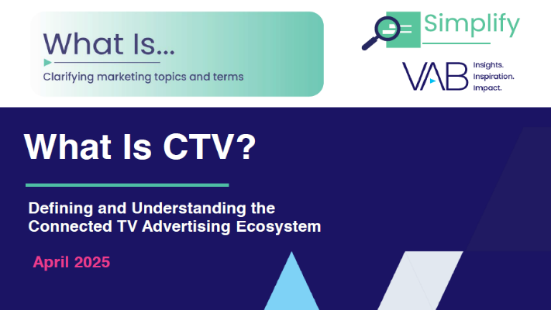
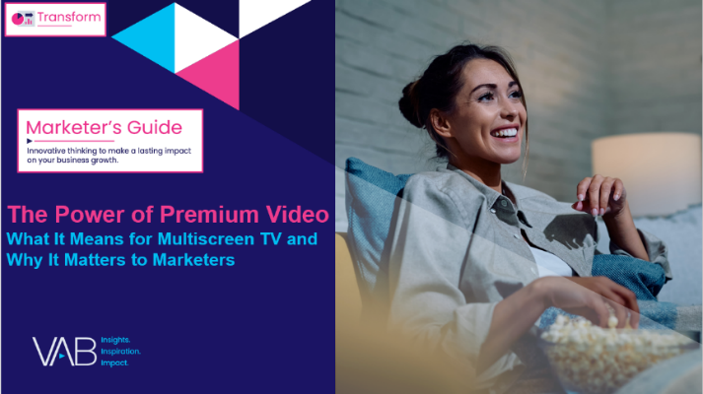
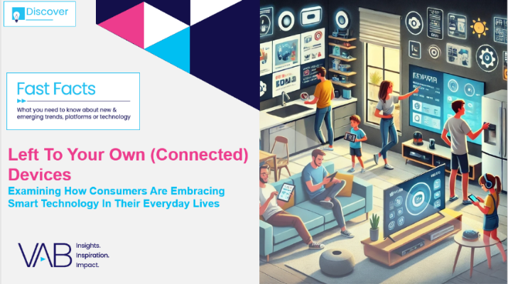
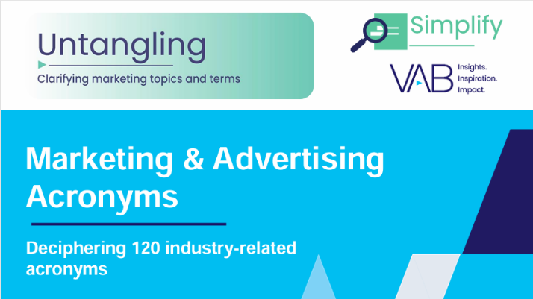
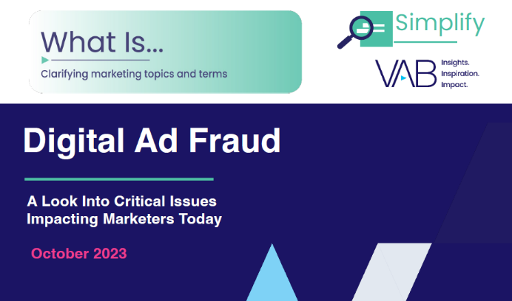
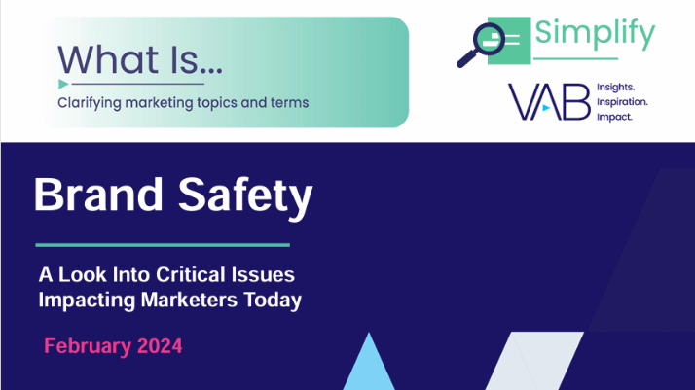
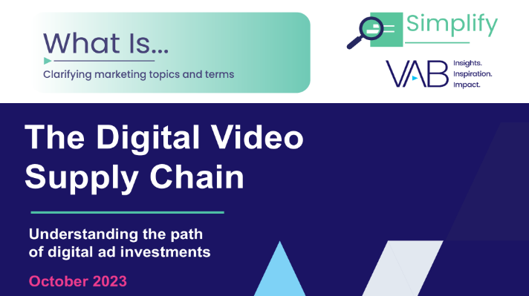
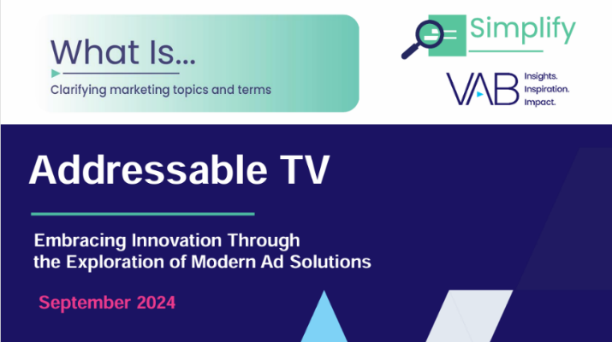
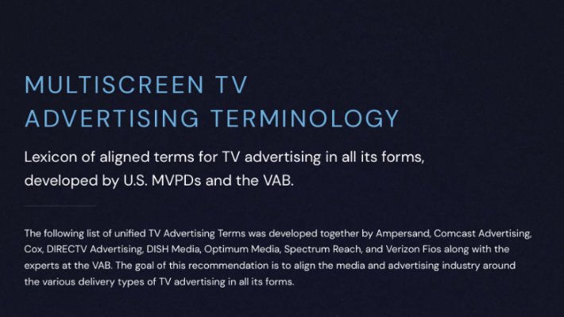
Want to learn more?
Click on the images below for the content
What is CTV?
Defining and Understanding the Connected TV Advertising Ecosystem
The Power of Premium Video
What it Means for Multiscreen TV
and Why It Matters to Marketers
Left To Your Own
(Connected) Devices
Examining How Consumers Are Embracing Smart Technology in Their Everyday Lives
Untangling Marketing & Advertising Acronyms
Deciphering 120
Industry-Related Acronyms
What is Digital Ad Fraud?
A Look Into Critical Issues
Impacting Marketers Today
What is Brand Safety?
A Look Into Critical Issues
Impacting Marketers Today
What is the Digital Video Supply Chain?
Understanding the Path of Digital Ad Investments
What is Addressable TV?
Embracing Innovation Through the Exploration of Modern Ad Solutions
Multiscreen TV
Advertising Terminology
Lexicon of aligned terms for TV advertising in all its forms
About VAB
VAB plays a dual role in the video advertising industry. We are leading the change to bring about a more innovative and transparent marketplace. We also provide the insights and thought leadership that enables marketers to develop business-driving marketing strategies.
Drawing on our marketing expertise, we simplify the complexities in our industry and discover new insights that transform the way marketers look at their media strategy.
We are committed to your business growth and proud to offer VAB members, brand marketers and agencies complimentary access to our continuously-growing Insights library. Get immediate access at theVAB.com.
PAGE 11
This information is exclusively provided to VAB members and qualified marketers.

