Slide 1


July 21, 2025
Question of the Week:
“
What KPIs do marketers use to evaluate the impact of their video campaigns?
”

Slide 2


Our custom study of 200 brand marketers provides answers
Amid continuing conversations across the ad industry around investment in branding and performance marketing, we sought to understand what KPIs matter most to businesses of all sizes – and how are they determined?
To explore what drives brand marketers’ thinking and planning, we partnered with Advertiser Perceptions on a custom survey of 200 marketers.
In this piece, we spotlight a couple of key findings:
KPI priorities evolve by company size, moving from performance-driven to more brand-focused measures as businesses grow
Reach & frequency metrics continue to be key components for measuring effectiveness across businesses of all sizes
Learn what this shift reveals about how marketers approach strategy at different stages of growth.
This information is exclusively provided to VAB members and qualified marketers.
PAGE 2

Slide 3
Smaller businesses prioritize lower-funnel KPIs to drive immediate returns, while larger brands focus on upper-funnel metrics to build brand equity
Top 5 KPIs Used to Measure Effectiveness of Video Ad Campaigns
% of brand marketer respondents
‘Small-Sized’ Businesses
‘Medium-Sized’ Businesses
‘Large-Sized’ Businesses
Source: VAB / Advertiser Perceptions ‘Marketer KPI Survey,’ February 2025, fielded January 27 – February 7, 2025 (n=200). Survey base: Brand marketers directly involved in influencing or executing video advertising. Q12. What are the main KPIs you currently use to measure the effectiveness of your company’s video advertising? Based on respondents selecting up to 3 choices. ‘Small-Sized’ Businesses: Less than $1MM in annual ad spend, ‘Medium-Sized’ Businesses: $1MM to less than $25MM in annual ad spend, ‘Large-Sized’ Businesses: $25MM or more in annual ad spend. *Perception, memorability, favorability, consideration, etc. Dotted line across chart denotes the top 3.
This information is exclusively provided to VAB members and qualified marketers.
PAGE 3

Slide 4
In our full guide, we answer 10 key questions to help understand how businesses set strategy, define success and plan for growth
1
2
3
4
5
How well do business and marketing objectives align?
Who are the key decision-makers guiding marketing strategy?
How do marketers balance short-term sales with long-term brand growth?
What factors influence an organization’s selection of marketing KPIs?
Are there organizational disconnects between KPIs and overarching business goals?
6
7
8
9
10
What KPIs do marketers use to evaluate the impact
of their video campaigns?
Which media channels do marketers believe are the most effective in achieving KPIs throughout the funnel?
What do marketers expect from their
media partners to help achieve campaign success?
Would marketers shift their strategy if they could develop longer-term plans?
What KPIs would marketers be focused on for future growth?
This information is exclusively provided to VAB members and qualified marketers.
PAGE 4

Slide 5

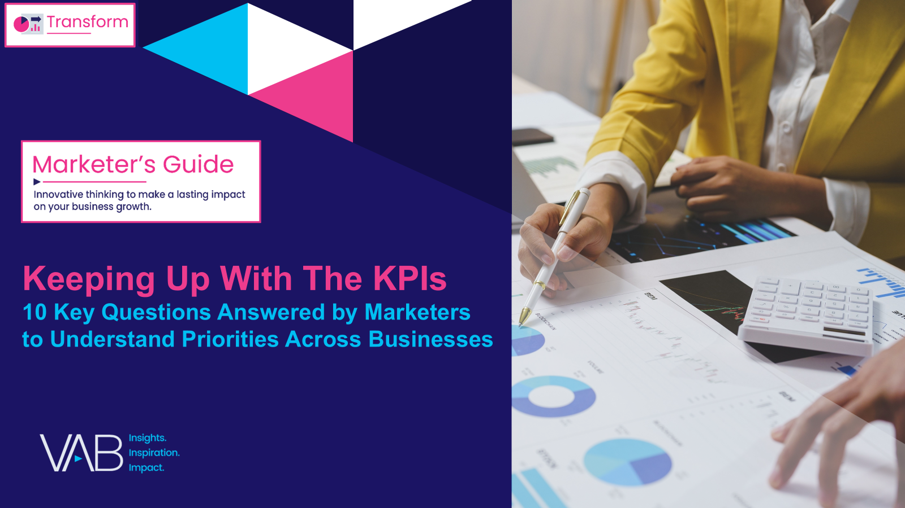
Download our full guide, Keeping Up With The KPIs, to learn the marketing strategies behind small, medium and large businesses
custom study
of 200 brand marketers
Click report cover above to download
44 pages
This information is exclusively provided to VAB members and qualified marketers.
PAGE 5

Slide 6

About VAB
VAB plays a dual role in the video advertising industry. We are leading the change to bring about a more innovative and transparent marketplace. We also provide the insights and thought leadership that enables marketers to develop business-driving marketing strategies.
Drawing on our marketing expertise, we simplify the complexities in our industry and discover new insights that transform the way marketers look at their media strategy.
We are committed to your business growth and proud to offer VAB members, brand marketers and agencies complimentary access to our continuously-growing Insights library. Get immediate access at theVAB.com.
This information is exclusively provided to VAB members and qualified marketers.
PAGE 6

