Slide 1




What Is…NextGen TV?
Answers to three common questions on the latest technology in Broadcast TV

Slide 2

Understanding NextGen TV and its challenges towards greater consumer adoption
Launched initially in 2017, NextGen TV, also known as ATSC 3.0, is a free service available to TV antenna users. Audiences can access NextGen TV depending on their proximity to updated broadcast towers and the type of TV they own.
When accessible, NextGen TV promises an improved viewing experience for Over-the-Air (OTA) audiences, including enhanced picture and sound quality in comparison to ATSC 1.0, which was established over 15 years ago.
However, adoption of this technology is dependent on several factors including consumer interest and user investment.
In this piece, we explore three common questions that are asked about NextGen TV in hopes to further educate the industry on the latest in broadcast TV technology.
Note: Over-the-Air (OTA) refers to households that receive a TV signal via an antenna rather than cable or satellite.
This information is exclusively provided to VAB members and qualified marketers.
PAGE 2

Slide 3
What You’ll Learn…
3 Common Questions on NextGen TV
1
2
3
What is
NextGen TV?
What is the real scale potential
of NextGen TV?
What are the challenges to adoption of NextGen TV?
This information is exclusively provided to VAB members and qualified marketers.
PAGE 3

Slide 4
1
What is NextGen TV?
1
2
What is the real scale
potential of NextGen TV?
What is NextGen TV?
3
What are the challenges to adoption of NextGen TV?
This information is exclusively provided to VAB members and qualified marketers.
PAGE 4

Slide 5


NextGen TV is the newest broadcast technology that enables broadcasters to merge the capabilities of over-the-air TV and the Internet
Defining NextGen TV
Also known as ATSC 3.0, NextGen TV is the latest version of over-the-air (OTA) antenna TV
Built on an IP (Internet Protocol) backbone
(much like today’s streaming media platforms)
Enables local broadcast stations to improve personalization their broadcasts with information
and interactive features
Provides opportunities for enhanced targeting and measurement capabilities
Note: Over-the-Air (OTA) refers to households that receive a TV signal via an antenna rather than cable or satellite. Learn more about ATSC in the appendix.
This information is exclusively provided to VAB members and qualified marketers.
PAGE 5

Slide 6






The broadcast industry expects NextGen TV will offer improvements over ATSC 1.0 in terms of video, audio, connectivity and interactivity
Promoted Viewer Improvements of NextGen TV compared to ATSC 1.0
Enhanced Video Quality
(4K/HDR picture clarity)
Improved Audio
Quality
More Reliable
Signal Transmission
Advanced Emergency
Alerts
Interactivity & Commerce
Opportunities
Increased
Personalization
This information is exclusively provided to VAB members and qualified marketers.
PAGE 6

Slide 7




Consumers ability to access NextGen TV is dependent on multiple factors including where they are viewing and the equipment they own
The most common way viewers can access NextGen TV
Devices must be connected to the internet to access upgraded personalization capabilities
Consumer is viewing on a Smart TV that is NextGen-enabled
+
+
Consumer must live
in a market where the broadcast networks have enabled an
ATSC 3.0 Signal
TV is connected to an antenna that can receive the NextGen TV signal
or
Consumer’s TV is connected to NextGenTV tuner
Note: Please note that there are variations in how consumers can access NextGen TV depending on their TV model (e.g., NextGen-enabled) and/or if the device is connected directly to the Internet.
This information is exclusively provided to VAB members and qualified marketers.
PAGE 7

Slide 8
1
What is NextGen TV?
2
2
What is the real scale
potential of NextGen TV?
What is the real scale potential
of NextGen TV?
3
What are the challenges to adoption of NextGen TV?
This information is exclusively provided to VAB members and qualified marketers.
PAGE 8

Slide 9

Three-quarters of U.S. households can now access NextGen TV signals, however access doesn’t equate to usage
According to Pearl TV,
76% of U.S. households now have access to NextGen TV signals,
but access shouldn’t
imply usage
Source: TVTech, Pearl TV: NextGen TV Now Available in 76% of U.S. Homes, 10/8/24.
This information is exclusively provided to VAB members and qualified marketers.
PAGE 9

Slide 10
NextGen TV is expected to soon cover 89 out of the 210 DMAs, or 82% of U.S. TV households
Markets where ATSC 3.0 is available
82 currently, 7 coming soon
Albany-Schenectady-Troy, NY
Albuquerque-Santa Fe, NM
Atlanta, GA
Austin, TX
Baltimore, MD
Baton Rouge, LA
Birmingham (Anniston & Tuscaloosa), AL
Boston, MA
Buffalo, NY
Champaign-Springfield-Decatur, IL
Charleston-Huntington, WV
Charleston, SC
Charlotte, NC
Chicago, IL
Cincinnati, OH
Columbus, OH
Dallas-Fort Worth, TX
Dayton, OH
Davenport,IA
Denver, CO
Des Moines, IA
Detroit, MI
El Paso, TX
Flint-Saginaw-Bay City, MI
Fresno-Visalia, CA
Grand Rapids-Kalamazoo, MI
Green Bay-Appleton, WI
Greensboro-Winston-Salem-High Point, NC
Greenville-New Bern-Washington, NC
Greenville-Spartanburg-Anderson, SC & Asheville, NC
Harrisburg, PA
Hartford-New Haven, CT
Honolulu, HI
Houston, TX
Indianapolis, IN
Jacksonville, Florida
Kansas City, KS-MO
Lansing, MI
Las Vegas, NV
Little Rock-Pine Bluff, AR
Los Angeles, CA
Louisville, KY
Miami-Ft. Lauderdale, FL
Minneapolis-St. Paul, MN
Myrtle Beach, SC
Mobile, AL-Pensacola, FL
Nashville, TN
New Orleans, LA
New York, NY
Norfolk-Portsmouth-Newport News, VA
Oklahoma City, OK
Omaha, NE
Orlando-Daytona Beach-Melbourne, FL
Philadelphia, PA
Phoenix, AZ
Pittsburgh, PA
Portland, OR
Portland-Auburn, ME
Raleigh-Durham, NC
Reno, NV
Richmond, VA
Roanoke, VA
Rochester, NY
Sacramento-Stockton-Modesto, CA
Salt Lake City, UT
San Antonio, TX
San Diego, CA
San Francisco-Oakland-San Jose, CA
Santa Barbara-Santa Marie-San Luis Obispo, CA
Seattle-Tacoma, WA
Shreveport, LA
South Bend, IN
Springfield-Holyoke, MA
Springfield, MO
St. Louis, MO
Syracuse, NY
Tallahassee, FL
Tampa-St. Petersburg-Sarasota, FL
Tucson, AZ
Washington, D.C.
West Palm Beach-Ft. Pierce, FL
Wichita-Hutchinson Plus, KS
Coming Soon
Chattanooga, Tennessee
Cleveland-Akron, OH
Memphis, Tennessee
Milwaukee, Wisconsin
Providence, RI-New Bedford, MA
Tulsa, Oklahoma
Wilkes Barre-Scranton-Hazelton, PA
Source: The Advanced Television Systems Committee (ATSC).
This information is exclusively provided to VAB members and qualified marketers.
PAGE 10

Slide 11
However, only 20% of U.S. households have access to TV content through an OTA antenna which limits the true reach of NextGen TV
24.8 MM HHs
with access to TV content through an OTA antenna
(20% of U.S. TV HHs)
Cable & Satellite
HHs with OTA-Capable TV Sets
6.7 MM
(5.4% of U.S. TV HHs)
OTA-Only Households
18.1 MM
(14.4% of U.S. TV HHs)
=
+
Source: VAB analysis of Nielsen Universe Estimates data, Total U.S., Base: Households, January 2025. Note: Over-the-Air (OTA) refers to households that receive a TV signal via an antenna rather than cable or satellite.
This information is exclusively provided to VAB members and qualified marketers.
PAGE 11

Slide 12
Furthermore, only 3% of TVs in the U.S. are NextGen-capable as of 2025, with penetration projected to still be below 10% three years from now
Estimated Number of NextGen-Capable TVs in the U.S.
According to Richard Kowalski, Senior Director of Business intelligence, Consumer Technology Association
2023
2024
2025
2026
2027
2028
11MM
27MM
31MM
34MM
3.8MM
5.5MM
% of total U.S. TV Installed Base*
1%
1.5%
3%
7%
8%
9%
Source: TV New Check, ATSC Touts 3.0 Progress Despite Spectrum Challenges, 6/20/24. *S&P Global Market Intelligence Kagan estimates; industry data.
This information is exclusively provided to VAB members and qualified marketers.
PAGE 12

Slide 13
1
What is NextGen TV?
3
2
What is the real scale
potential of NextGen TV?
What are the challenges to adoption of NextGen TV?
3
What are the challenges to adoption of NextGen TV?
This information is exclusively provided to VAB members and qualified marketers.
PAGE 13

Slide 14

The precursor to NextGen TV (ATSC 1.0) launched over 15 years ago and broadcasters have been working toward upgrades ever since
Over-the-air (OTA) signals, the delivery method for NextGen TV, are sent from broadcast towers to households with antenna-connected TVs
ATSC 1.0
ATSC 3.0
Since June 13, 2009,
full-power television stations nationwide have been required to broadcast exclusively in a digital format
In November 2017 the FCC approved rules enabling local broadcast TV to upgrade to an
IP-based standard to transmit over-the-air signals
Note: Over-the-Air (OTA) refers to households that receive a TV signal via an antenna rather than cable or satellite.
This information is exclusively provided to VAB members and qualified marketers.
PAGE 14

Slide 15
ATSC 3.0 is not seen as a top priority even by broadcast professionals themselves
Which technologies will have the biggest effect on broadcast production in the next five years?
According to broadcast industry professionals
Source: HAIVISION via Variety VIP+. Note: Results from HAIVISION polling of broadcast industry professionals. Q: Which three technologies will have the biggest effect on broadcast production in the next five years? ‘SMPTE (Society of Motion Picture and Television Engineers ) ST 2110’ refers to a set of standards that define how to transport professional media over an IP network. The standards describe how video, audio, and ancillary data should be packaged and transported over an IP link and maintain synchronization and quality.
This information is exclusively provided to VAB members and qualified marketers.
PAGE 15

Slide 16
Most consumers are not currently in-market for a new TV, which may limit the penetration growth of NextGen-capable sets over the next few years
75%
of TVs* are less than 7 years old
On average, people choose to upgrade their TV every 7 years**
Source: Circana’s TV Ownership Trends Report via Variety VIP+, The State of Smart TV, January 2024. *TVs = installed TVs, i.e., TVs that are currently in use within homes. **Tom’s Guide, When should you upgrade your TV? Here’s how long it should last, 8/4/23.
This information is exclusively provided to VAB members and qualified marketers.
PAGE 16

Slide 17
Only 17% of adults own a digital antenna and use it often, with over half the population not knowing what it is or not interested in buying one
Source: CivicScience, Over-the-Air Audience Tracker Preview: Why Advertisers Should Watch TV Antenna Users, 04/16/2024. Based on 2,132 responses from 02/27/2024 to 04/15/2024. Weighted by U.S. Census 18+.
This information is exclusively provided to VAB members and qualified marketers.
PAGE 17

Slide 18

NextGen TV, which launched in 2017 (ATSC 3.0), enables broadcast TV to merge the capabilities of over-the-air TV and the internet
Access to, and usage of, NextGen TV is dependent on several factors including where people are viewing,
the need to purchase additional equipment that they
may not already have and consumer education
Although the technology promises to deliver advancements to broadcast TV like improved video & audio quality and enhanced personalization; consumer adoption of this technology has been very limited to-date with continued slow growth expected over the next several years
These factors and beyond have limited the real scale of NextGen TV - especially as broadcasters themselves are
not prioritizing ATSC 3.0 in comparison to other technology - leaving its role within a media mix still to be determined
Key Marketer Takeaways
This information is exclusively provided to VAB members and qualified marketers.
PAGE 18

Slide 19

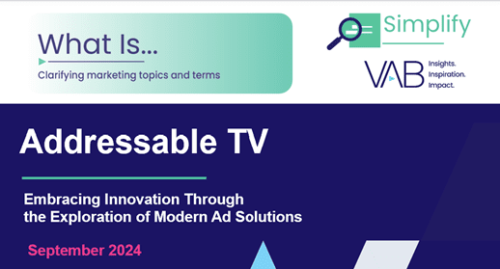
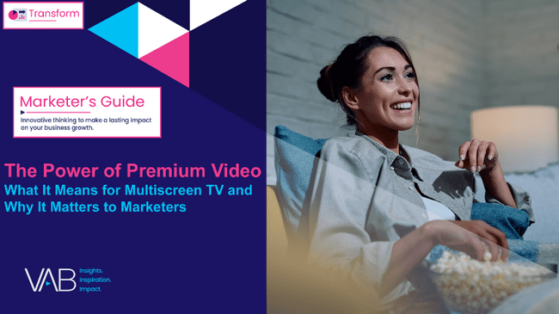
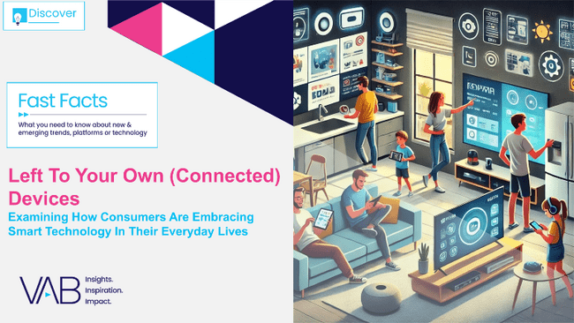



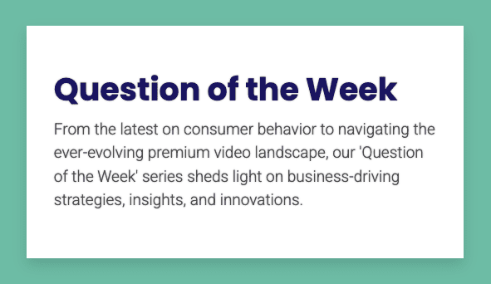


Discover more: Looking for more data, insights and takeaways?
Check out this related content
What is Addressable TV?
Embracing Innovation Through the Exploration of Modern Ad Solutions
The Power of Premium Video
What It Means for Multiscreen TV
and Why It Matters to Marketers
Left To Your Own (Connected) Devices
Examining How Consumers Are Embracing Smart Technology In Their Everyday Lives
Best in Show
Five Advantages of Multiscreen TV,
From Brand to Performance
Unlocking Brand Growth with Audience-Based Buying
A fresh look at how marketers are adopting innovative TV strategies
Reaching the Right Audiences
Why brands and agencies are increasing their adoption of audience-based TV buying
Question of the Week
Answers to your most pressing marketing questions
Grab and Go
Access charts, stats and figures on some of the most important topics in the industry
This information is exclusively provided to VAB members and qualified marketers.
PAGE 19

Slide 20


About VAB
VAB is an insights-driven organization that inspires marketers to reimagine their media strategies resulting in fully informed decisions.
Drawing on our marketing expertise, we simplify the complexities in our industry and discover new insights that transform the way marketers look at their media strategy.
We are committed to your business growth and proud to offer VAB members, brand marketers and agencies complimentary access to our continuously-growing Insights library. Get immediate access at theVAB.com.
This information is exclusively provided to VAB members and qualified marketers.
PAGE 20

Slide 21
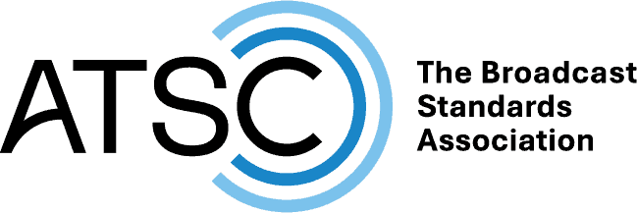



What is ATSC? The Advanced Television Systems Committee plays a critical role in the development and implementation of NextGen TV
An international, non-profit organization developing voluntary standards and recommended practices for digital broadcasting
Defines how exactly television signals are broadcasted and interpreted
ATSC member organizations represent the broadcast, broadcast equipment, motion picture, consumer electronics, computer, cable, satellite, and semiconductor industries
Develops digital broadcasting implementation strategies and supports educational activities on ATSC standards
This information is exclusively provided to VAB members and qualified marketers.
PAGE 21

