Slide 1



What Is…AI Fluency?
A foundational guide to
key terms and concepts

Slide 2

Understanding AI is essential for marketers to navigate today’s data-driven world
Artificial Intelligence (AI) is rapidly transforming how the advertising ecosystem operates, making its mark as one of the most powerful tools in modern marketing. From planning and execution to measurement, AI is helping marketers work faster, smarter and with greater precision.
As AI adoption accelerates, marketers have a growing responsibility to understand how AI works, where value is created, and how to deploy AI in responsible and ethical ways.
With most advertisers already experimenting and implementing AI driven solutions, building foundational AI literacy is no longer an option, but a critical and competitive necessity for the modern marketer.
Continue reading to build your fluency in the key AI terms and concepts that are transforming the modern marketing landscape.
This information is exclusively provided to VAB members and qualified marketers.
PAGE 2

Slide 3
Global AI spending is growing at an unprecedented rate as companies continue to invest in their future technological capabilities
Worldwide AI Forecasted Spending Across All Industries
(in trillions)
+32%
YoY
+44%
YoY
Source: Gartner Forecast: January 2026
This information is exclusively provided to VAB members and qualified marketers. Further distribution is prohibited.
PAGE 3

Slide 4



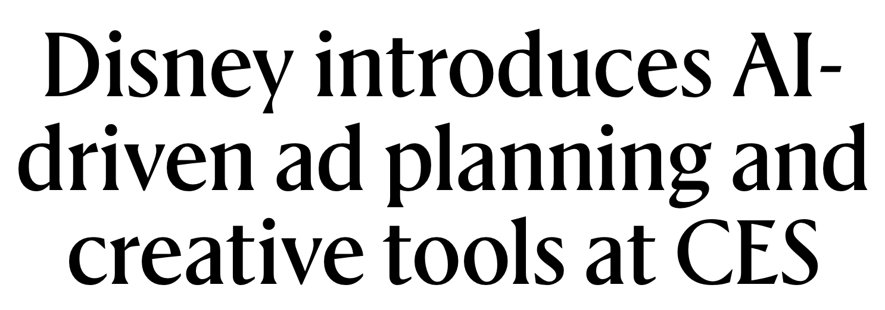
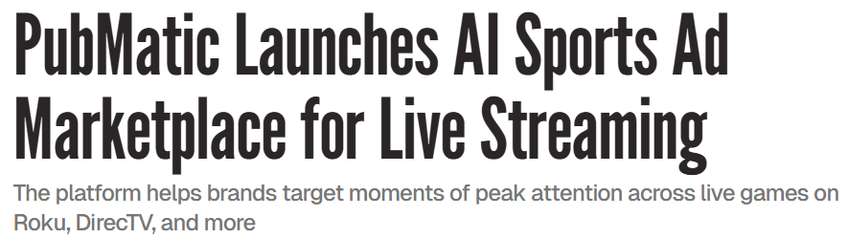
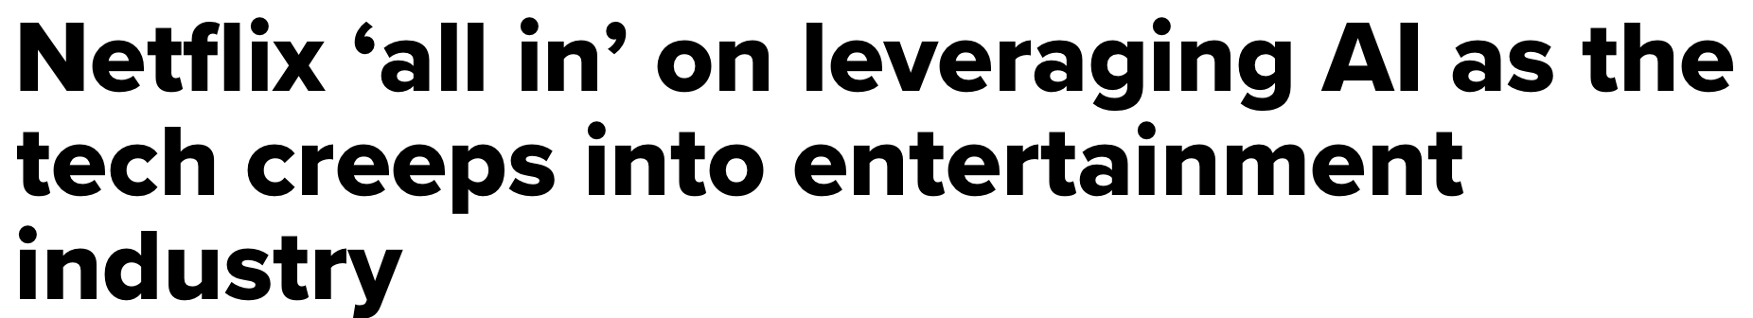


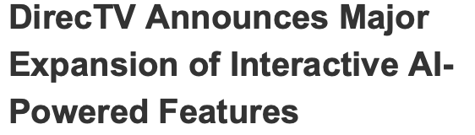
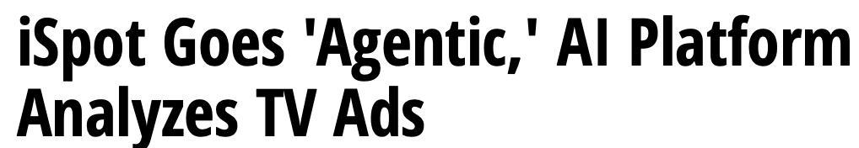
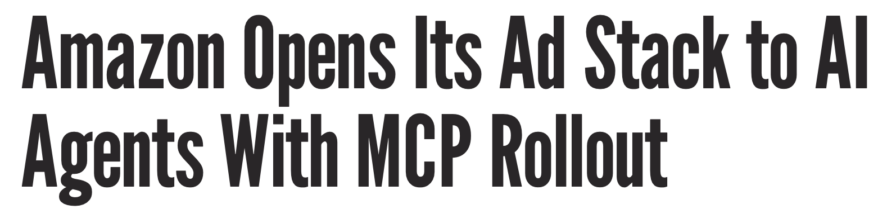


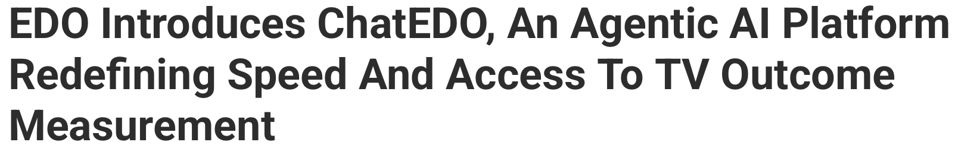
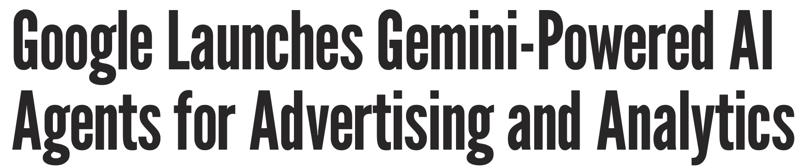

The advertising ecosystem is entering a new AI-driven era of innovation, unlocking new tools and pathways for marketers
1/8/2026
7/17/2025
10/21/2025
10/14/2025
2/10/2026
2/2/2026
2/5/2026
11/12/2025
12/18/2025
PAGE 4

Slide 5
What You’ll Learn…
AI is fundamentally changing the ways businesses operate. Explore these 5 questions to build your knowledge of AI and the way it is impacting advertising today.
1
2
3
4
5
What is Artificial Intelligence (AI)?
What are common data sources fueling AI?
Are there best practices for managing data responsibly?
What are some common AI powered capabilities?
How are marketers utilizing AI?
This information is exclusively provided to VAB members and qualified marketers.
PAGE 5

Slide 6
As AI becomes more deeply integrated into daily life, it is imperative to understand what it is
1
2
3
4
5
What is Artificial Intelligence (AI)?
What are common data sources fueling AI?
Are there best practices for managing data responsibly?
What are some common AI powered capabilities?
How are marketers utilizing AI?
This information is exclusively provided to VAB members and qualified marketers.
PAGE 6

Slide 7


Definition: What is Artificial Intelligence (AI)?
z
  Artificial intelligence (AI) is technology that enables computers and machines to simulate human capabilities such as
  Learning
  Comprehension
  Problem solving
  Decision making
  Creativity
  Autonomy
Source: IBM Think : What is AI: Accessed March, 2026
This information is exclusively provided to VAB members and qualified marketers.
PAGE 7

Slide 8


Machine Learning and Deep Learning are the building blocks for the development of AI, enabling machines to learn and improve over time
Artificial Intelligence
Machine Learning
Deep Learning
Machine Learning
The backbone of AI
Uses historical data to train computers
Learns patterns from data to improve performance
Deep Learning
The brainpower of AI
Uses vast amounts of unstructured
data (images, text, audio) to make predictions
Develops inferences based on observed patterns
This information is exclusively provided to VAB members and qualified marketers.
PAGE 8

Slide 9
The exponential growth of AI-driven advertising is a sign of how important AI fluency should be for marketers
Estimated U.S. AI-Powered Advertising Revenue
(in billions)
AI-Powered Advertising Revenue is expected to increase
154%
From 2026 to 2030
Source: Madison & Wall; How AI-Powered Advertising Totals $142 Billion by 2030: February 2026. To quantify AI-driven spending, Madison & Wall defined AI-powered advertising narrowly based on campaign spending that flows through platforms where AI controls targeting, bidding, budget allocation, placement, and ongoing optimization with minimal human intervention.
This information is exclusively provided to VAB members and qualified marketers. Further distribution is prohibited.
PAGE 9

Slide 10
Effective AI training and improvement relies on high fidelity data from a variety of compliant sources
1
2
3
4
5
What is Artificial Intelligence (AI)?
What are common data sources fueling AI?
Are there best practices for managing data responsibly?
What are some common AI powered capabilities?
How are marketers utilizing AI?
This information is exclusively provided to VAB members and qualified marketers.
PAGE 10

Slide 11



First-Party Data offers consistent accuracy and relevance with many considering it the gold standard in a privacy-focused world
How can AI utilize First-Party Data?
Uncover patterns in customer behavior enabling smarter predictions and more precise targeting.
Different Types of Data
What is First-Party Data?
  Information that a company collects from its audience or customers directly through its owned channels.
First-Party
Data collected from your audience, customers or consumers
(Ex: Customer emails, phone numbers, purchase history)
Second-Party
First-party data from another company or entity that has been shared with you
(Ex: Website activity, customer feedback, social media profiles)
Third-Party
Data collected by a business or company that you have no direct relationship with.
(Ex: Income, age, interests, psychographics, location)
This information is exclusively provided to VAB members and qualified marketers.
PAGE 11

Slide 12




Synthetic Data allows companies to share data and test its applications without compromising personal information
How can AI utilize Synthetic Data?
Safely model audiences, test strategies and train AI systems when real world data is limited or restricted.
What is an example of Synthetic Data?
VID (Virtual People Identifiers) Models
VIDs are synthetic individuals that can be grouped together to mimic the general population through the assignment of probabilistic demographics
A way to label impression data consistently across all data providers enabling de-duplicated cross platform reach and frequency
  Can be used to complement and enhance calibration panels
What is Synthetic Data?
  Artificially generated and modeled data that mimics real world behaviors without using actual personal data.
Examples of companies that offer Synthetic Data solutions
This information is exclusively provided to VAB members and qualified marketers.
PAGE 12

Slide 13







Web Crawlers are used by search engines to scour the internet which provides information for AI to train models and recognize patterns
How can AI utilize Web Crawlers?
Search, ingest, and help structure vast amounts of data to train AI models to improve accuracy and knowledge.
Types of Web Crawlers
General Purpose
Designed to crawl the entire web and *index broad content
Focused/Vertical
Focuses on specific niches and verticals.
Incremental
Revisits known pages to update only new/changed content
What are Web Crawlers?
  Software programs that scan web pages across the internet including text, images and metadata.
(Ex: Googlebot crawls the internet to index pages for Google Search)
(Ex: Indeed’s job crawler targets job listings across niche job boards)
(Ex: Bingbot “re-crawls” sites to keep its search index up to date)
Examples of companies that utilize Web Crawlers
*Note: Indexing refers to web crawlers storing and organizing content so it can be searched for and retrieved efficiently
Googlebot
Indeed Scrapper
Bingbot
This information is exclusively provided to VAB members and qualified marketers.
PAGE 13

Slide 14
Responsible data management practices rely on a foundation of trust supported by strong data governance frameworks
1
2
3
4
5
What is Artificial Intelligence (AI)?
What are common data sources fueling AI?
Are there best practices for managing data responsibly?
What are some common AI powered capabilities?
How are marketers utilizing AI?
This information is exclusively provided to VAB members and qualified marketers.
PAGE 14

Slide 15




Your AI is only as good as your data, and your data is only as good as your data management strategy
Data governance establishes policies for security and privacy throughout the entire data lifecycle
Data Inputs
Data Outputs
First-Party Data
Data Analysis
Data Governance
Structured data management frameworks that set standards for transparency, security and accessibility for an organization’s data
AI Models
Synthetic Data
Images, Video, Text
Web Crawlers
This information is exclusively provided to VAB members and qualified marketers.
PAGE 15

Slide 16



Data Governance frameworks ensure marketers are implementing responsible AI practices by keeping their data accurate and secure
Three Key Components of Data Governance
Quality
Compliance
Adaptability
AI models trained on high fidelity datasets are more likely to produce reliable and stable outputs.
Accurate and complete training data ensures marketers avoid the scenario of “garbage in - garbage out”.
Privacy constraints should be followed for the construction
of AI models.
By enforcing ethical and secure data practices, marketers can maintain consumer trust and avoid compliance issues.
The continuous journey of improvement and refinement ensures AI models are constantly advancing.
It is critical marketers keep up with industry advancements to ensure their AI models adapt to future changes.
This information is exclusively provided to VAB members and qualified marketers.
PAGE 16

Slide 17
Data Governance is a core business strategy that can minimize risk and maximize the value of data assets
Current Stage of Data Governance Strategy by Marketers
52%
of marketers have currently implemented data governance strategies
Source: EMARKETER Content Marketing Institute (CMI), "B2B Content & Marketing Trends: Insights for 2026", October 2025.
This information is exclusively provided to VAB members and qualified marketers.
PAGE 17

Slide 18
AI powered tools are becoming increasingly more present to enhance and empower human labor while streamlining marketing workflows
1
2
3
4
5
What is Artificial Intelligence (AI)?
What are common data sources fueling AI?
Are there best practices for managing data responsibly?
What are some common AI powered capabilities?
How are marketers utilizing AI?
This information is exclusively provided to VAB members and qualified marketers.
PAGE 18

Slide 19






Chatbots aren’t inherently AI as many are built on static, pre-defined outputs, while those that are AI enhanced can adapt in real-time
How Can Marketers Leverage Chatbots?
Deliver instant support, qualify leads and guide consumers on platform websites through personalized, always available conversations.
Types of Chatbots
Rule-Based
Best for simple questions
Uses static decision tree answers
Limited and preset responses
AI-Enhanced
Handles complex questions
Learns and improves over time
Deeper and more personalized responses
What are Chatbots?
  Programs that can simulate conversations with people through text or voice to answer questions and complete tasks.
Examples of companies that offer Chatbot solutions
This information is exclusively provided to VAB members and qualified marketers.
PAGE 19

Slide 20





Generative AI can turn month long creative processes into minutes, enabling highly efficient workflows for marketers
How can marketers leverage Generative AI?
Create and scale personalized creative assets and new content ideas with speed and efficiency.
How Generative AI Works
Output
Prompt
Gen AI Model
Text
What is Generative AI?
Images
  AI that can create new content such as text, images or videos based on what a user asks or prompts it to do.
Inputs that a user provides to an AI model to complete a task
Uses large amounts of historical data to generate prompted content
Videos
Examples of companies that offer Generative AI solutions
ChatGPT
Gemini
Claude
This information is exclusively provided to VAB members and qualified marketers.
PAGE 20

Slide 21



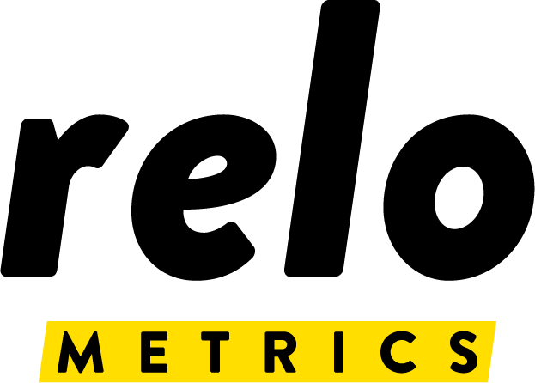
Computer Vision transforms visual signals into actionable insights to help marketers understand what audiences engage with
How can marketers leverage Computer Vision?
Detect features in videos, measure on-screen engagement and optimize creative strategies based on what’s on screen.
What is an example of Computer Vision?
Screen OCR (Optical Character Recognition)
A tool used to recognize, capture and translate images and text from a screen
Can be used to inform and enhance viewership data by determining what brand names and/or logos are shown on screen
What is Computer Vision?
  AI that trains computers to recognize features, logos, and letters the way humans do to interpret and derive information from images and videos.
Examples of companies that offer Computer Vision solutions
This information is exclusively provided to VAB members and qualified marketers.
PAGE 21

Slide 22




Agentic AI is turning assistive workflows into autonomous ones to achieve user defined goals and improve over time
How can marketers leverage Agentic AI?
Automatically plan, execute, and continuously optimize campaigns in real time to drive performance with minimal effort.
Assistive Workflow
Autonomous Workflow
Specify
Task
AI Assists Execution
Human Reviews & Acts
Define Objectives
What is Agentic AI?
  Continuously learning AI software that can set goals, make decisions, and take actions on its own to complete a task with minimal human intervention.
AI Learns & Evolves
AI Executes & Optimizes
Examples of companies that offer Agentic AI solutions
Copilot
Watson
Agentforce
This information is exclusively provided to VAB members and qualified marketers.
PAGE 22

Slide 23
Marketers are using AI to successfully enhance their businesses in more efficient and intelligent ways
1
2
3
4
5
What is Artificial Intelligence (AI)?
What are common data sources fueling AI?
Are there best practices for managing data responsibly?
What are some common AI powered capabilities?
How are marketers utilizing AI?
This information is exclusively provided to VAB members and qualified marketers.
PAGE 23

Slide 24

Generative AI in marketing is focused on data analysis and research, with rising use for creative and campaign optimization
How Are Marketers Currently Using Generative AI?
Source: Mediaocean, 2026 H1 Advertising Outlook Report.
This information is exclusively provided to VAB members and qualified marketers.
PAGE 24

Slide 25
Marketers are leveraging AI for a variety of use cases, ranging from audience analysis to data integration and reporting visualization
Top ways organizations are using or planning to use AI to support advertising campaigns
“AI will further accelerate to become a core efficiency engine for the TV industry…streamlining production, accelerating creative ideation, and improving how we plan, optimize, and measure campaigns.
Marketers are pushing for clearer ROI, and AI is helping the industry connect exposure to real business outcomes with greater precision.”
Tim Natividad
President of U.S. Advertising Sales and Marketing, TelevisaUnivision
Source: Comcast, 2026 Comcast Advertising Report
This information is exclusively provided to VAB members and qualified marketers.
PAGE 25

Slide 26
AI in measurement is here now, with most marketers actively implementing AI tools into their advanced analytics operations
Current AI Adoption in Analytics Advanced Measurement
nearly
70%
of marketers are already integrating AI into their analytics workflows
Source: IAB, State of Data 2026, February 2026.
This information is exclusively provided to VAB members and qualified marketers. Further distribution is prohibited.
PAGE 26

Slide 27












Measurement providers are integrating AI tools and strategies to increase efficiencies and performance on Premium Video Platforms
Common Ways Measurement Companies are Leveraging AI with Marketers
Audience Segmentation
Forecasting
Attribution
How it Works?
How it Works?
How it Works?
AI pulls in data from a variety of trusted sources to group consumers into audiences based on behavioral similarities
AI utilizes Machine Learning and Deep Learning to analyze vast datasets to make informed “what-if” scenario predictions
AI analyzes the customer journey to determine which touchpoints influence conversions and customer action
Why it Matters?
Why it Matters?
Why it Matters?
By utilizing precise and scalable data, marketers can create high performing, privacy-first actionable audiences
By analyzing massive, diverse datasets with AI, marketers can make real-time adaptive changes to media plans
By diagnosing performance with AI, marketers can effectively analyze resonance and intent to provide strong strategic recommendations
Example Companies
Example Companies
Example Companies
This information is exclusively provided to VAB members and qualified marketers. Further distribution is prohibited.
PAGE 27

Slide 28












AI is enhancing how Premium Video Platforms are transforming both advertiser and audience experiences
Common Ways Multiscreen TV Publishers are Leveraging AI with Marketers
Workflow Optimization
Creative Generation
Content Recommendation
How it Works?
How it Works?
How it Works?
AI uses data-driven insights to help recommend and streamline targeting, bidding and optimization strategies based on specific goals
AI generative models turn prompts into personalized ad creatives delivering high-quality content at scale and speed
AI matches user profiles and attributes based on historical viewing to determine optimal content mix recommendations
Why it Matters?
Why it Matters?
Why it Matters?
By analyzing patterns of past performance data with AI, marketers can reduce operational costs and minimize human error through automating repetitive tasks
By minimizing cost and maximizing efficiency, marketers enable the same high-quality visual storytelling abilities for their brands
By making personalized content recommendations through AI analysis, marketers can boost user engagement and improve consumer perception
Example Companies
Example Companies
Example Companies
This information is exclusively provided to VAB members and qualified marketers. Further distribution is prohibited.
PAGE 28

Slide 29
Key Marketer Takeaways: Three Pillars of AI Fluency to Help Marketers Navigate an Autonomous World
1
2
3
Cognitive Fluency
Ethical Fluency
Dynamic Fluency
Nourish AI with proper brainfood in the form of clean, high-quality data
Responsibly implement AI through transparent and privacy-first channels
Continually learn AI capabilities to futureproof your marketing strategies
This information is exclusively provided to VAB members and qualified marketers.
PAGE 29

Slide 30


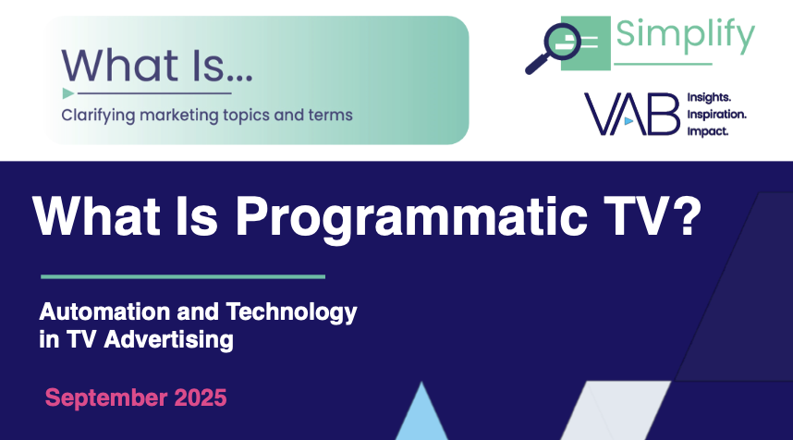
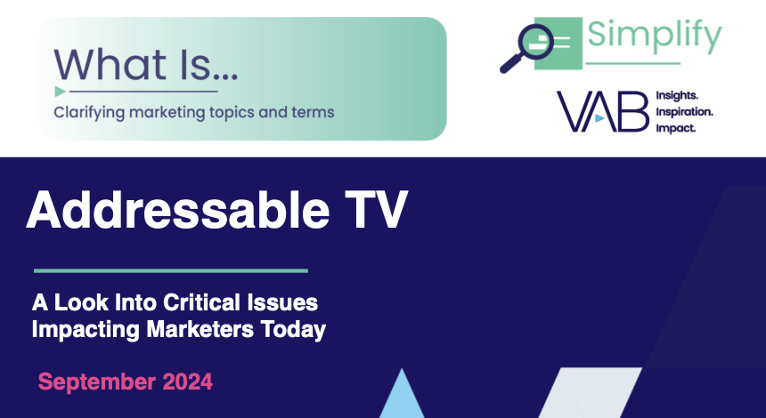
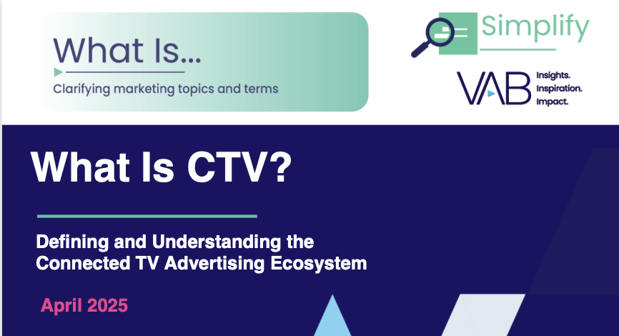
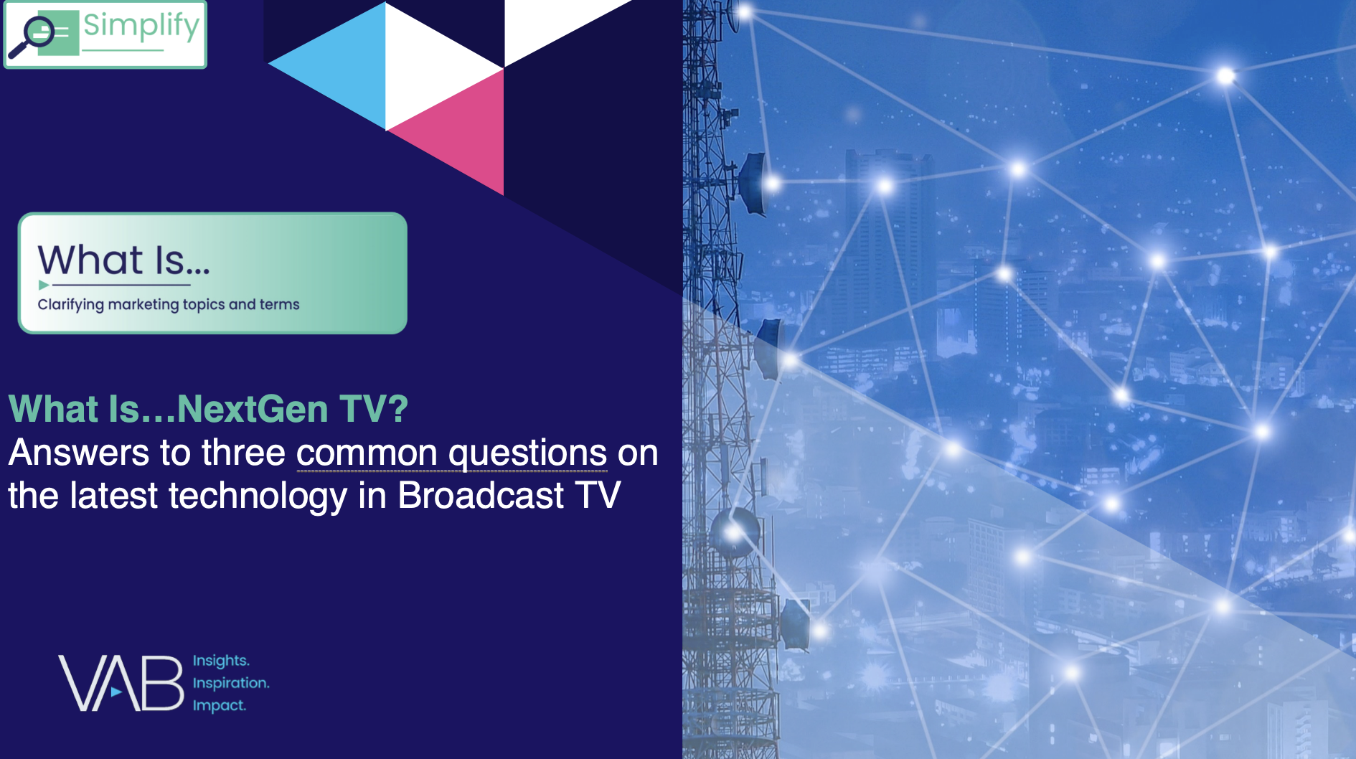
Creators
Jason Wiese
Benjamin Vandegrift
EVP, Strategic Insights & Measurement
jasonw@thevab.com
SVP, Measurement Strategy & Innovation benjaminv@thevab.com
Rohan Gosalia
Data Privacy and Security 101: The Complete Guide for Marketers
The Impression Gap
What works harder for marketers on CTV - Premium Video or YouTube?
Associate Director, Measurement Intelligence
rohang@thevab.com
Discover more
Looking for more data, insights and takeaways? Check out this related VAB content
What is Programmatic TV?
What is Addressable TV?
Visit the VAB’s Advertising Essentials Hub for more overviews, glossaries and infographics on key topics within marketing and advertising.
What is CTV?
What is NextGen TV?
This information is exclusively provided to VAB members and qualified marketers.
PAGE 30

Slide 31


About VAB
VAB plays a dual role in the video advertising industry. We are leading the change to bring about a more innovative and transparent marketplace. We also provide the insights and thought leadership that enables marketers to develop business-driving marketing strategies.
Drawing on our marketing expertise, we simplify the complexities in our industry and discover new insights that transform the way marketers look at their media strategy.
We are committed to your business growth and proud to offer VAB members, brand marketers and agencies complimentary access to our continuously-growing Insights library. Get immediate access at theVAB.com.
This information is exclusively provided to VAB members and qualified marketers.
PAGE 31

