Slide 1


May 9, 2025
Question of the Week:
“
What does ‘brand’ mean and how does it drive growth for my business?
”

Slide 2


‘Brand’ includes image, perception, reputation and trust which all combine to fuel performance
In an industry that’s seemingly always discussing what the right balance is between brand vs. performance, we thought we’d take a step back and define what ‘brand’ truly means to marketers.
Therefore, in partnership with Advertiser Perceptions, we asked 200 marketers:
What does ‘brand’ mean to you in the context of your company’s products or services?
How does ‘brand’ contribute to your company’s overall growth strategy?
What are the factors that contribute to the success of a brand?
The key takeaway was clear based on marketers’ own words to these questions:
Brand is Performance
Note: see appendix for full details on methodology behind the custom survey
This information is exclusively provided to VAB members and qualified marketers.
PAGE 2

Slide 3

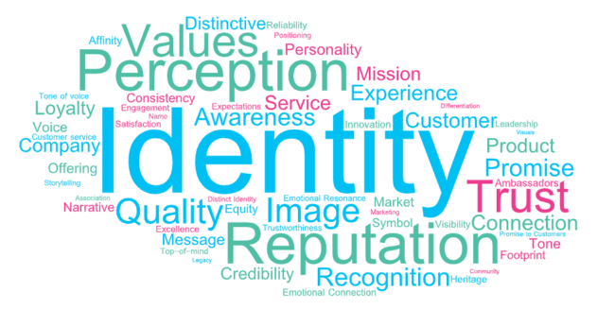
‘Brand’ is typically defined by how a product or service is seen, identified, perceived and experienced
In your own words, what does ‘brand’ mean to you in the context of your company's products or services?
Based on summary of verbatim responses
Source: VAB / Advertiser Perceptions ‘Marketer KPI Survey,’ February 2025, fielded January 27 – February 7, 2025 (n=200). Survey base: Brand marketers directly involved in influencing or executing video advertising. Q9. In your own words, what does "brand" mean to you in the context of your company's products or services?
This information is exclusively provided to VAB members and qualified marketers.
PAGE 3

Slide 4








Marketers’ definition of ‘brand’ generally fall within eight themes, with the most common being across identity, image, reputation & perception
In your own words, what does ‘brand’ mean to you in the context of your company's products or services?
Based on summary of verbatim responses
Top Themes | Common Responses Among Marketers
Identity & Image | The identity of the company or product How the brand comes across visually
Reputation & Perception | How customers and non-customers perceive the brand including trust, recognition, sentiment The quality and reliability associated with the brand
Values, Purpose & Mission | The brand reflects the company’s values and what it stands for Core values as a reflection of company beliefs and aspirations Mission-driven, representing a higher purpose or community goal
Promise & Value Proposition | A promise of quality or consistency to the customer Articulates what the company delivers and why it matters
Awareness & Recognition | Branding is key to awareness and growth What makes the company stand out / be remembered
Customer Experience | How someone experiences the brand What customers think or feel about the brand Customer familiarity and mental association with the company
Emotional Connection & Loyalty | The emotional bond between consumers and the brand What makes customers loyal or choose the product repeatedly
Differentiation & Positioning | Standing out against competitors or positioning the brand as a leader or unique market-player Clear market position or POV Unique and exciting providers in the marketplace
Source: VAB / Advertiser Perceptions ‘Marketer KPI Survey,’ February 2025, fielded January 27 – February 7, 2025 (n=200). Survey base: Brand marketers directly involved in influencing or executing video advertising. Q9. In your own words, what does "brand" mean to you in the context of your company's products or services? Responses have been sorted by frequency and relevancy.
This information is exclusively provided to VAB members and qualified marketers.
PAGE 4

Slide 5
Building customer trust and loyalty is the most vital factor in brand success, making it essential for marketers to prioritize authentic connections
Top Factors That Contribute to the Success of a Brand
% of brand marketers
Source: VAB / Advertiser Perceptions ‘Marketer KPI Survey,’ February 2025, fielded January 27 – February 7, 2025 (n=200). Survey base: Brand marketers directly involved in influencing or executing video advertising. Q10. Which of the following factors contribute to the success of a brand? [Rank up to 3].
This information is exclusively provided to VAB members and qualified marketers.
PAGE 5

Slide 6





‘Brand’ is seen as a critical enabler across the purchase funnel that builds awareness, trust and distinction which directly impacts revenue
How does your ‘brand’ contribute to your company's overall growth strategy?
Top themes based on summary of verbatim responses
Drives Awareness & Visibility
Builds Trust & Reputation
Differentiates in the Marketplace
Reinforces Identity & Company Values
Fuels Customer Acquisition & Revenue
Source: VAB / Advertiser Perceptions ‘Marketer KPI Survey,’ February 2025, fielded January 27 – February 7, 2025 (n=200). Survey base: Brand marketers directly involved in influencing or executing video advertising. Q9a. How does your brand contribute to your company's overall growth strategy?
This information is exclusively provided to VAB members and qualified marketers.
PAGE 6

Slide 7
‘Brand’ delivers performance – it attracts leads, converts consumers to customers, creates repeat buyers, enhances pricing and improves ROI
How does your ‘brand’ contribute to your company's overall growth strategy?
Sampling of responses from marketers
Drives Awareness & Visibility
Builds Trust & Reputation
Differentiates in the Marketplace
Reinforces Identity & Company Values
Fuels Customer Acquisition & Revenue
Brand recognition and awareness are critical for reaching new audiences, increasing visibility and attracting leads
Trust in the brand leads to customer loyalty, long-term relationships and repeat business which is all crucial for sustainable growth
A strong brand sets companies apart from competitors, allowing them to charge a premium, position effectively and target specific niches
Communicate values, mission and culture, making it foundational to both alignment and external perception
Branding is seen as a tool that not only attracts but converts, playing a direct role in growing sales, expanding customer base and improving ROI
Ex., “It contributes a lot to our company growth strategy by making more folks aware of our brands”
Ex., “Our reputation helps us attract new customers”
Ex., “It allows us to be relatable to our specific demographic”
Ex., “It was built on a set of core values that are community and customer focused.”
Ex., “If we raise brand awareness and have a good reputation then we will generate more sales”
Source: VAB / Advertiser Perceptions ‘Marketer KPI Survey,’ February 2025, fielded January 27 – February 7, 2025 (n=200). Survey base: Brand marketers directly involved in influencing or executing video advertising. Q9a. How does your brand contribute to your company's overall growth strategy?
This information is exclusively provided to VAB members and qualified marketers.
PAGE 7

Slide 8
Separate research has illustrated just how important TV and cinema is in enhancing the key brand attributes of its advertisers
Media signaling:
The perceived cost and scale
of an advertising channel that
can enhance brand attributes
in the eyes of the consumer.
Signaling determines a platform’s ability to strengthen brand perception in terms of its financial footing, reputation, popularity and degree to which it could be trusted.
‘Signaling strength’ by channel
How to read: 46% of respondents believe TV advertising enhances a brand’s attributes
Source: WARC, Why media quality will take centre stage in 2024, 1/22/24.
This information is exclusively provided to VAB members and qualified marketers.
PAGE 8

Slide 9
Additional research has shown Multiscreen TV to be the most trusted media platform which enables brands to boost their credibility
“Trust is very important for brand marketing. It’s the driver for purchasing behavior for most consumers. A lot of the time, trust is going to play a different role in the relationships consumers have with brands.”
TV is the #1 trusted media platform among adults, and they are…
4x
over 4x more likely to trust TV
vs. social media
- Matt Prince, Head of PR, Taco Bell
Taco Bell’s Matt Prince on how trust ties brands to new consumers, WARC, 9/24/24
Source: VAB analysis of MRI-Simmons Spring 2024 USA Study, A18+. Q: What is the media you trust the most? (pick one: TV, radio, podcasts, mobile internet, internet on computer, social media, magazines, newspapers).
This information is exclusively provided to VAB members and qualified marketers.
PAGE 9

Slide 10

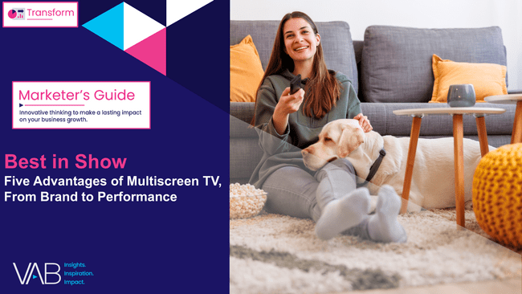


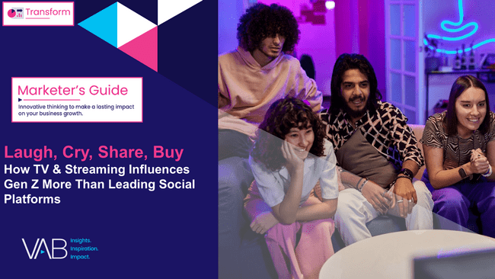
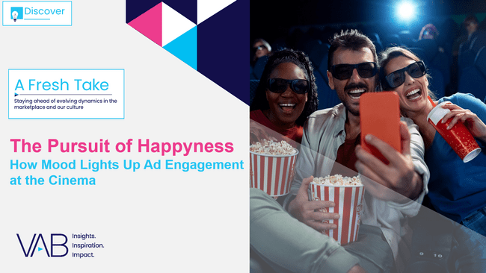
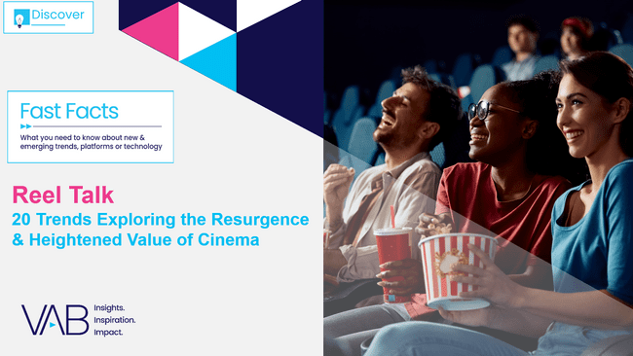
To learn more about premium video’s ability to strengthen both ‘brand’ and ‘performance,’ download these VAB reports
This information is exclusively provided to VAB members and qualified marketers.
PAGE 10

Slide 11
‘Brand’ is a strategic asset that drives performance
Marketers see brand not just as identity, but as a strategic asset that drives awareness, shapes perception and fuels sales and customer retention, which makes it foundational to business growth
Marketers rank customer trust and loyalty as the most vital elements of brand success, making genuine, audience-aligned messaging a top priority
As the most trusted platform among consumers, premium video plays a unique role in enhancing brand reputation and delivering stronger awareness and credibility to customer prospects
Key Marketer Takeaways
PAGE 11
This information is exclusively provided to VAB members and qualified marketers.

Slide 12

About VAB
VAB plays a dual role in the video advertising industry. We are leading the change to bring about a more innovative and transparent marketplace. We also provide the insights and thought leadership that enables marketers to develop business-driving marketing strategies.
Drawing on our marketing expertise, we simplify the complexities in our industry and discover new insights that transform the way marketers look at their media strategy.
We are committed to your business growth and proud to offer VAB members, brand marketers and agencies complimentary access to our continuously-growing Insights library. Get immediate access at theVAB.com.
This information is exclusively provided to VAB members and qualified marketers.
PAGE 12

Slide 13


Custom Study Methodology
VAB commissioned Advertiser Perceptions to conduct an online survey between January-February 2025.
The results are based on 200 U.S. brand marketer respondents from Advertiser Perceptions’ survey panel with a wide range of annual total advertising budgets ($10K - $250 MM+) across a variety of market sectors (e.g., CPG, retail, financial, auto, food / B2B, technology, entertainment, etc.)
Respondent Qualifications:
  Brand marketer decision maker involved in influencing or executing video advertising
  National / Regional sales focus
  Mix of job titles (junior, mid, senior level)
This information is exclusively provided to VAB members and qualified marketers.
PAGE 13

