Slide 1
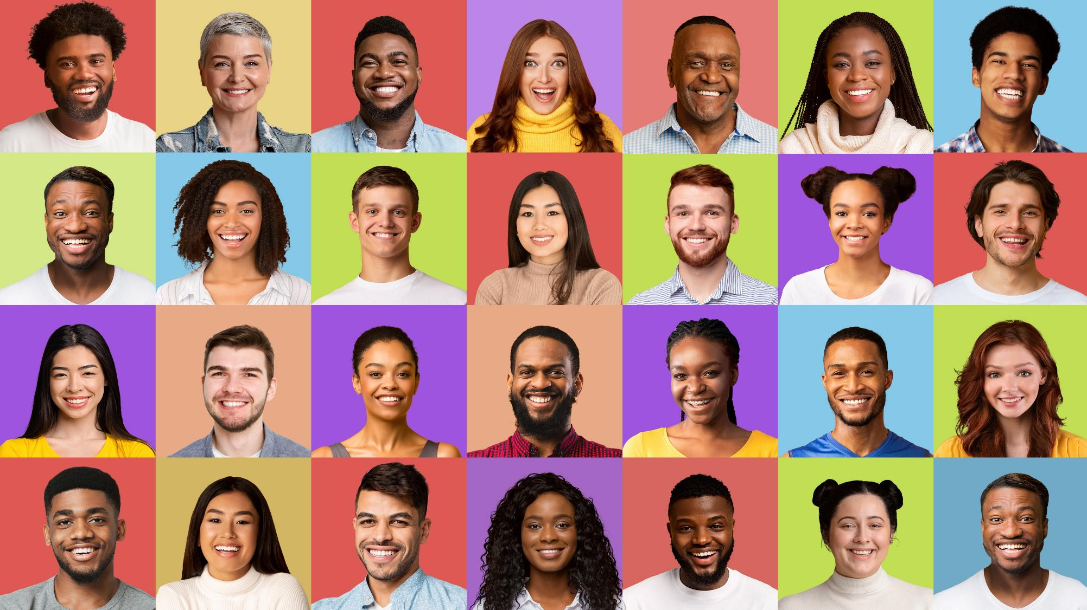




Marketer FAQs
What does authentic representation mean to diverse audiences?

Slide 2
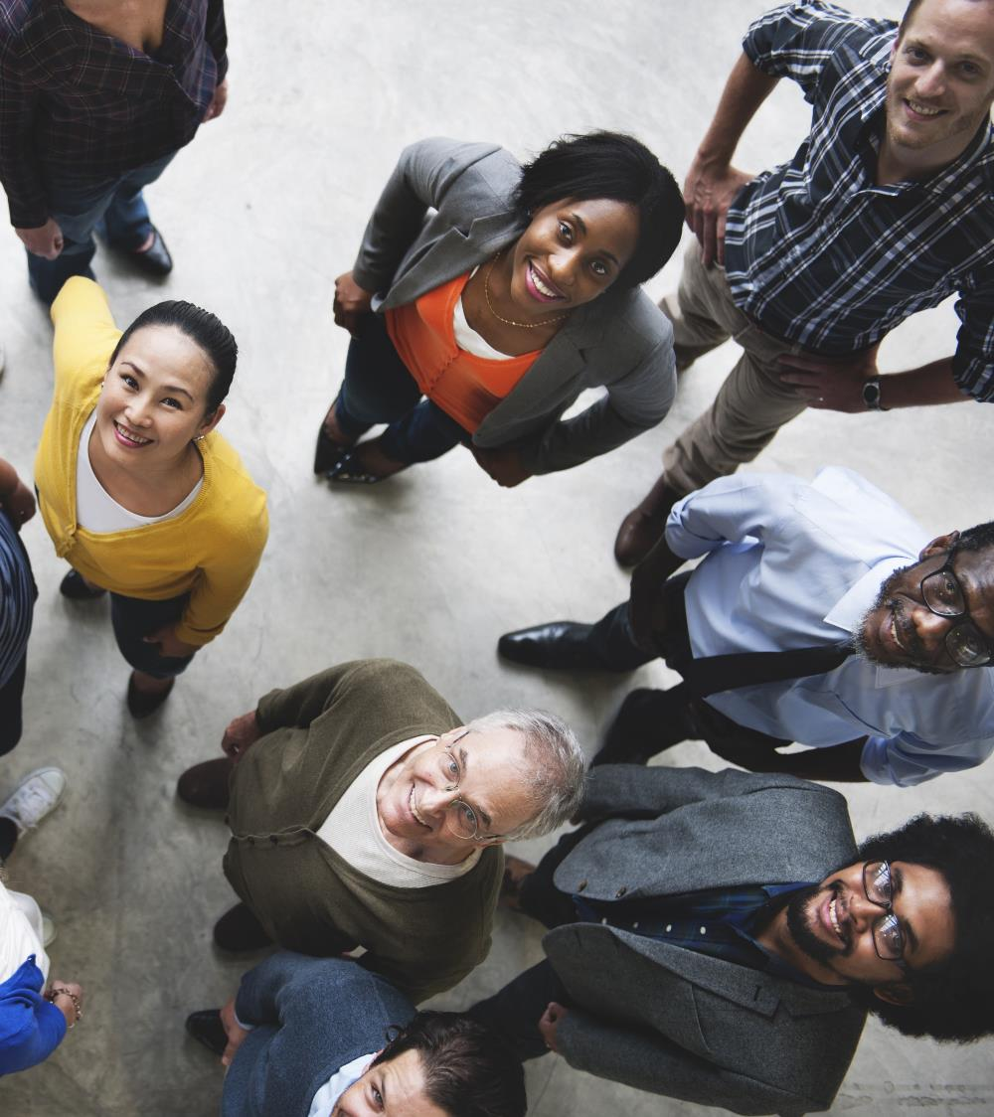
Adults over 50 account for 36% of the total population and nearly half of all adults
Marketer FAQs
Representation of diverse audiences is a top priority for marketers, and the key to positive engagement with these consumers is always authenticity.
In order to achieve truly authentic messaging, it is important to hear from multicultural people themselves to learn exactly what ‘representation’ means to them.
Each month in 2022, VAB has released a new Marketer FAQ to help marketers create inclusive plans reflective of our rich diversity, unique cultural nuances and behaviors.
Now, we would like to take a step back and hear directly from Black, Hispanic, Asian, Indigenous American and LGBTQ+ audiences on how they define ‘representation’
and why accurate portrayals of all identities is so important in TV shows, movies and advertising.
This information is exclusively provided to VAB members and qualified marketers. Further distribution is prohibited.
PAGE 2

Slide 3
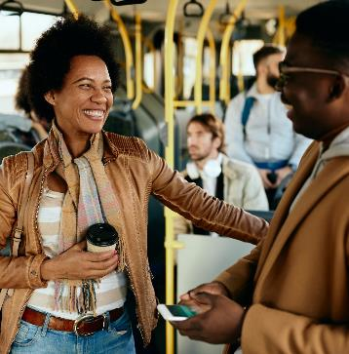
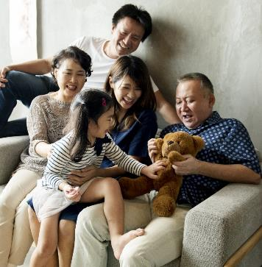
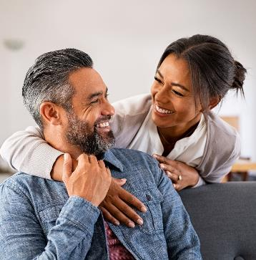
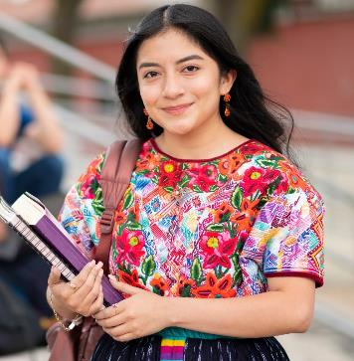
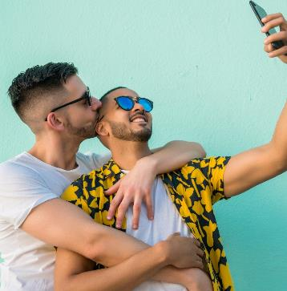
What does ‘representation’ mean to….
Black Audiences
Asian Audiences
Hispanic Audiences
Indigenous American Audiences
LGBTQ+ Audiences
Click through each box to be brought to the appropriate section
This information is exclusively provided to VAB members and qualified marketers. Further distribution is prohibited.
PAGE 3

Slide 4
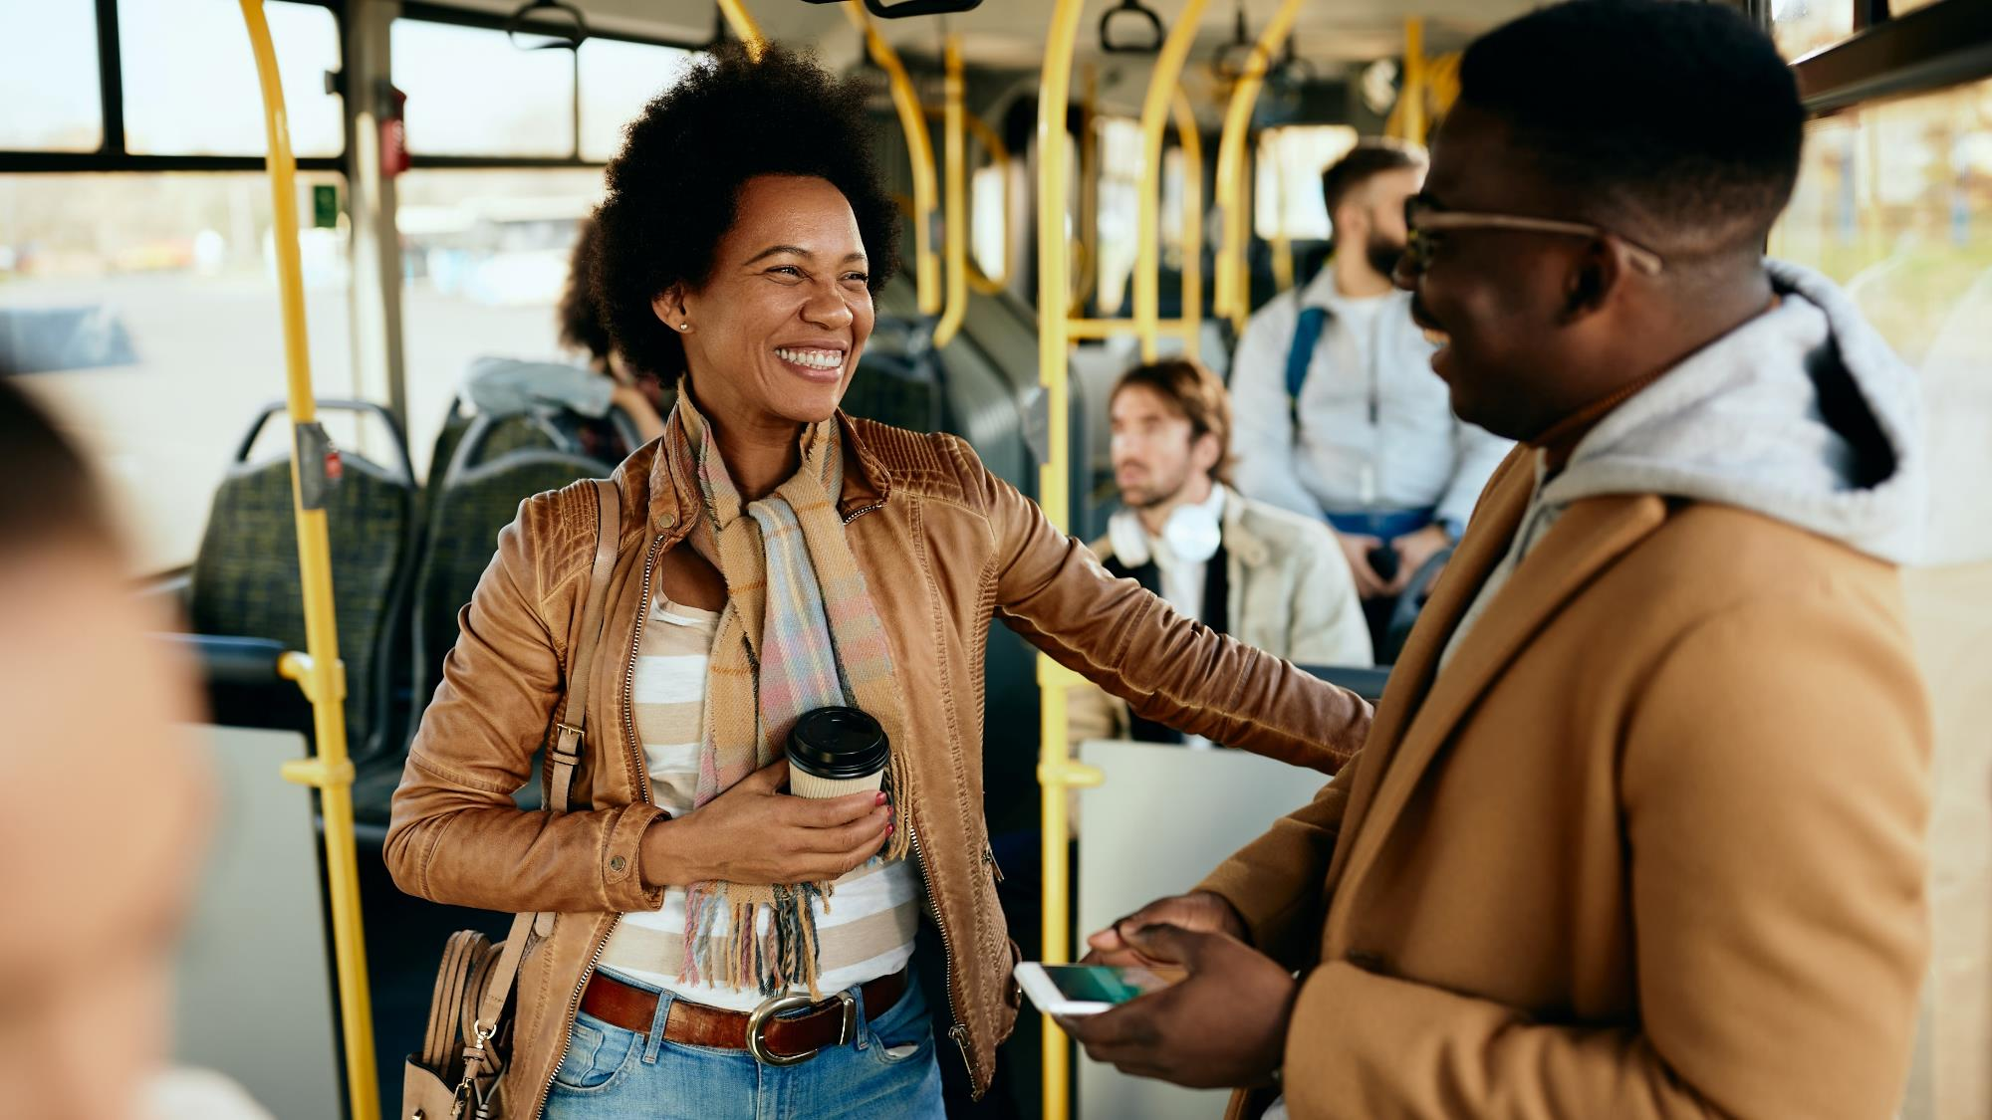
What does ‘representation’
mean to Black audiences?

Slide 5
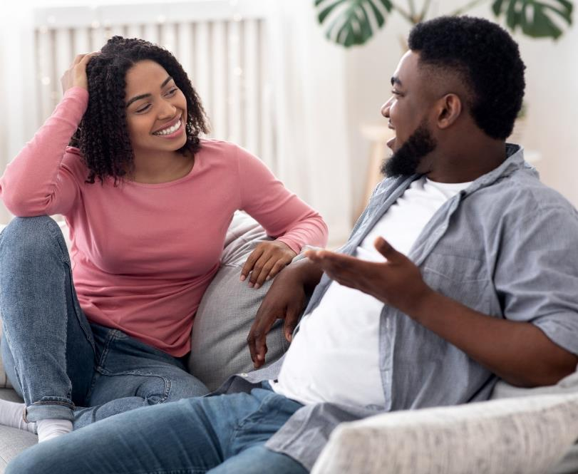
Black audiences desire more accurate representation on-screen
in order to feel a deeper connection with the stories they are watching
Reasons why ‘it is important to you that television shows and movies
accurately represent your (racial, ethnic, religious, etc.) identities’*
Responses related to ‘feeling connected’, among Black respondents
“If I don’t see people like me on shows and movies, then I won’t watch the programs.
I want to feel like people like me are included in TV shows and movies.”
“I want to feel included.
I want to feel like the message
is for people like me.”
“So I feel connected to it and [it] piques my interest.”
“I like watching movies and shows where I can at least relate to the characters.”
Source: VAB analysis of Morning Consult, Media Representation, September 2021. *Survey respondents that selected ‘it is important to you that television shows and movies accurately represent your (racial, ethnic, religious, etc.) identities. Why? (‘very / somewhat important’). For more information, download: How does on-screen representation deepen engagement with Black consumers and drive business impact for brands?
This information is exclusively provided to VAB members and qualified marketers. Further distribution is prohibited.
PAGE 5

Slide 6
83%
“Across streaming, cable and broadcast platforms, viewership among adults age[s] 18 to 49 peaked in many cases when a show had a majority-minority cast.
People basically want to see the TV shows that look like America, that have characters they can relate to and have experiences that resonate with them.”
of Black adults believe that their cultural & ethnic heritage is an important part of who they are
Represents the highest percentage among ethnicity groups*
Darnell Hunt
Dean of the Social Sciences at UCLA
Source: VAB analysis of MRI-Simmons USA Study, Fall 2021; Black P18+. ‘My cultural / ethnic heritage is an important part of who I am (any agree)’. *% of P18+ respondents that agree with this statement: Asian - 82%, Hispanic – 78%, American Indian or Alaska Native - 75%, NH White – 52%.
For more information, download: How does on-screen representation deepen engagement with Black consumers and drive business impact for brands?
This information is exclusively provided to VAB members and qualified marketers. Further distribution is prohibited.
PAGE 6

Slide 7
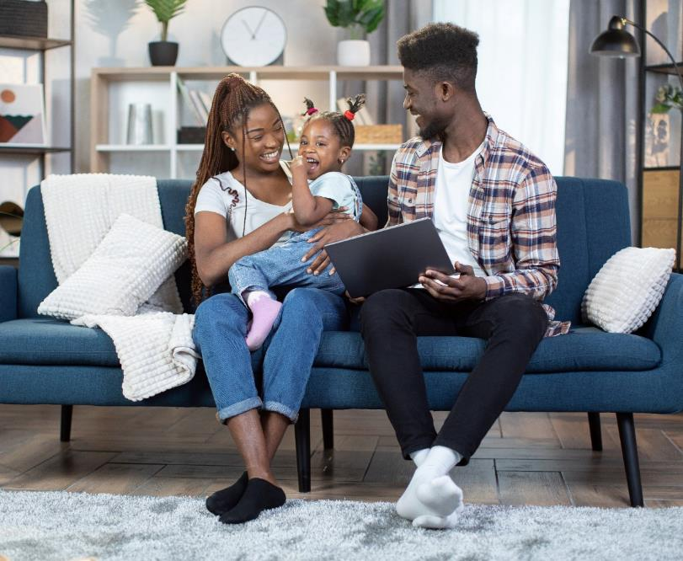
With the importance of cultural identity, it’s imperative to consider the context of on-screen representation, ensuring it does not reinforce stereotypes or promote racial discrimination within the Black community
Reasons why ‘it is important to you that television shows and movies accurately represent your (racial, ethnic, religious, etc.) identities’*
Responses related to ‘overcoming stereotypes,’ among Black respondents
“Representation within media we consume impacts our mindset and views of the world overtime, it also impacts the minds of children.”
“Because false representations
of black people lead to racial stereotypes and discrimination.”
“More diversity needs to be displayed for the youth of today so they can know they are seen and are valued as well.”
“It is important that our Black culture is reflected in the right way. I do not think that stereotypes in the media reflect who we truly are as a race and as people.”
Source: VAB analysis of Morning Consult, Media Representation, September 2021. *Survey respondents that selected ‘it is important to you that television shows and movies accurately represent your (racial, ethnic, religious, etc.) identities. Why? (‘very / somewhat important’). For more information, download: How does on-screen representation deepen engagement with Black consumers and drive business impact for brands?
This information is exclusively provided to VAB members and qualified marketers. Further distribution is prohibited.
PAGE 7

Slide 8
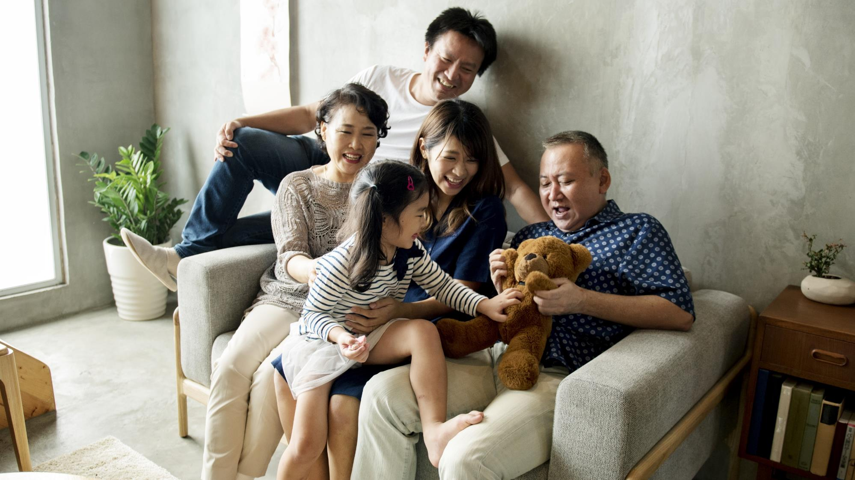
What does ‘representation’
mean to Asian audiences?

Slide 9
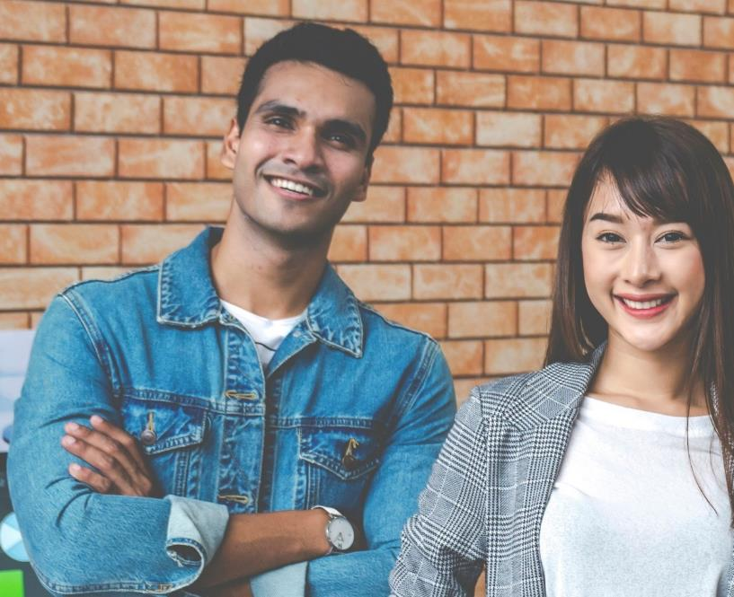
To best resonate with Asian American consumers, it is important to include programming within media buys that highlights the nuances of different cultural identities and stories via relatable characters
Reasons why ‘it is important to you that television shows
and movies accurately represent your (racial, ethnic, religious, etc.) identities’*
Responses related to ‘increases relatability’, ‘fights stereotypes’, ‘fosters understanding’ & ‘multifaceted portrayals’, among Asian American respondents
“I can relate more.”
“It is important that television show[s] accurately represent identities so that people can learn how to respect them as maybe the TV shows will explore the depth of their character in a positive light.”
“It should accurately represent identities to reduce the stigmas and stereotypes that sometimes come out of media.”
“I believe that every identity should be portrayed and represented decently. Honoring their uniqueness and commonalities based on their truth.”
Source: VAB analysis of Morning Consult, Media Representation, September 2021. *Survey respondents that selected ‘it is important to you that television shows and movies accurately represent your (racial, ethnic, religious, etc.) identities. Why? (‘very / somewhat important’). For more information, download: How can I best use video to connect with influential Asian American consumers?
This information is exclusively provided to VAB members and qualified marketers. Further distribution is prohibited.
PAGE 9

Slide 10
59%
“Being Asian American, there is this truth serum that we all have, I take a lot of pride in being able to say that I’m Asian and talking about it. Talking about it will normalize casting more Asians and giving them those opportunities, then that means a lot.”
of Asian respondents agree that ‘having shows that highlight issues / stories that are important to racially diverse communities available on a streaming service makes it more valuable to me’
Olivia Munn, Actress & Advocate for Stop Asian Hate
(USC Annenberg Media, 9/8/20)
Source: VAB analysis of MRI-Simmons Cord Evolution Study, March 2022; Asian P18+. % of P18+ respondents that agree with this statement: Black - 66%, Hispanic – 59%, American Indian or Alaska Native - 51%, NH White – 43%; USC Annenberg Media, “Olivia Munn discusses Asian heritage and representation with USC Price”, 9/8/20.
For more information, download: How can I best use video to connect with influential Asian American consumers?
This information is exclusively provided to VAB members and qualified marketers. Further distribution is prohibited.
PAGE 10

Slide 11
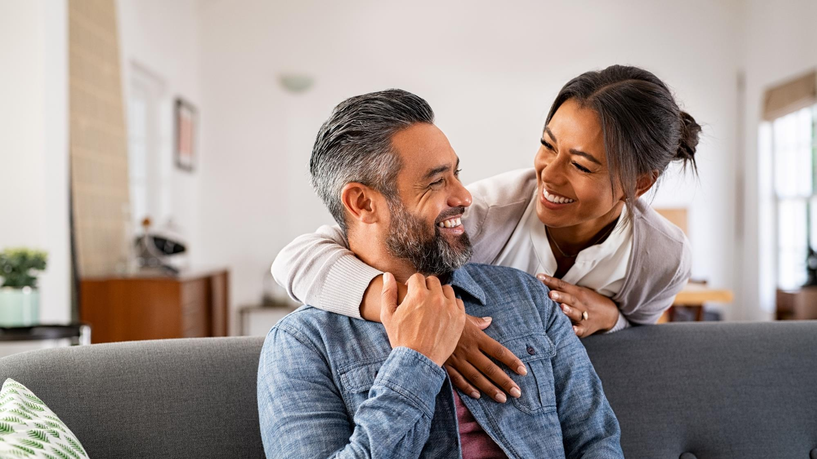
What does ‘representation’
mean to Hispanic audiences?

Slide 12
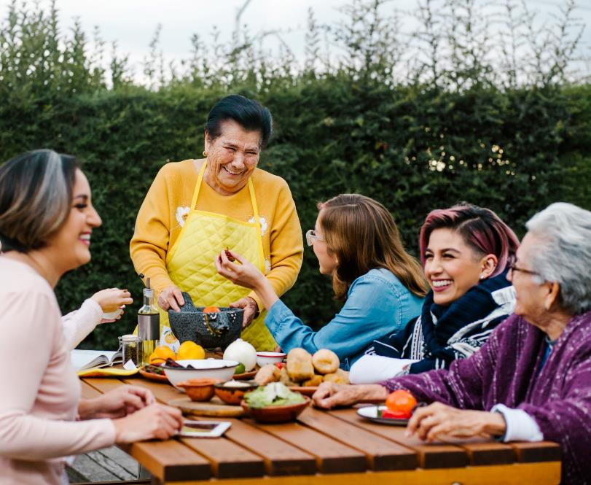
Among Hispanic audiences, seeing themselves in authentic, layered roles can both inspire and add more dimension and depth to the content they are watching, ultimately making it more enjoyable
Reasons why ‘it is important to you that television shows
and movies accurately represent your (racial, ethnic, religious, etc.) identities’*
Responses related to ‘relatability’ & ‘aspirational’, among Hispanic respondents
“I enjoy watching POC families in sitcoms and shows based on people who look like me.”
“It’s important so that generations that are growing up now know that they have representation so they know they can achieve the same goals.”
“It not only makes the shows / movies more interesting, but also makes characters 3D [and] more relatable while adding dimension & depth.”
“To give the community hope that no matter what your color, where you’re from you can still be whatever you set your goal on.”
Source: VAB analysis of Morning Consult, Media Representation, September 2021. *Survey respondents that selected ‘it is important to you that television shows and movies accurately represent your (racial, ethnic, religious, etc.) identities. Why? (‘very / somewhat important’). For more information, download: How can my brand leverage the strength of the rising Latina consumer through video?
This information is exclusively provided to VAB members and qualified marketers. Further distribution is prohibited.
PAGE 12

Slide 13
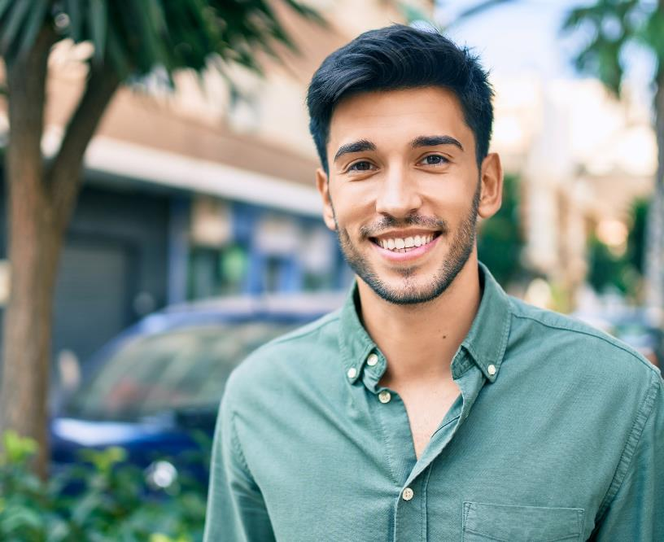
And when looking to create an authentic feel, it is important to research and thoroughly understand the group you are looking to reach to avoid damaging stereotypes and inaccuracies
Reasons why ‘it is important to you that television shows
and movies accurately represent your (racial, ethnic, religious, etc.) identities’*
Responses related to ‘authenticity’ & ‘accuracy is essential’, among Hispanic respondents
“I prefer an authentic feel to TV shows and movies. When identities are inaccurately portrayed, [the] viewing experience is weakened. It feels fake.”
“Stereotypes in TV shows feel like mockery. I think it’s even worse when they choose people who are slightly knowledgeable of a culture or race and to speak in native languages but don’t sound authentic at all. It’s better to just not try.”
“It makes it so that people understand different cultures better.”
“…nobody likes to see themselves represented poorly or mocked. I want representation but it needs to be accurate.”
Source: VAB analysis of Morning Consult, Media Representation, September 2021. *Survey respondents that selected ‘it is important to you that television shows and movies accurately represent your (racial, ethnic, religious, etc.) identities. Why? (‘very / somewhat important’). For more information, download: How can my brand leverage the strength of the rising Latina consumer through video?
This information is exclusively provided to VAB members and qualified marketers. Further distribution is prohibited.
PAGE 13

Slide 14
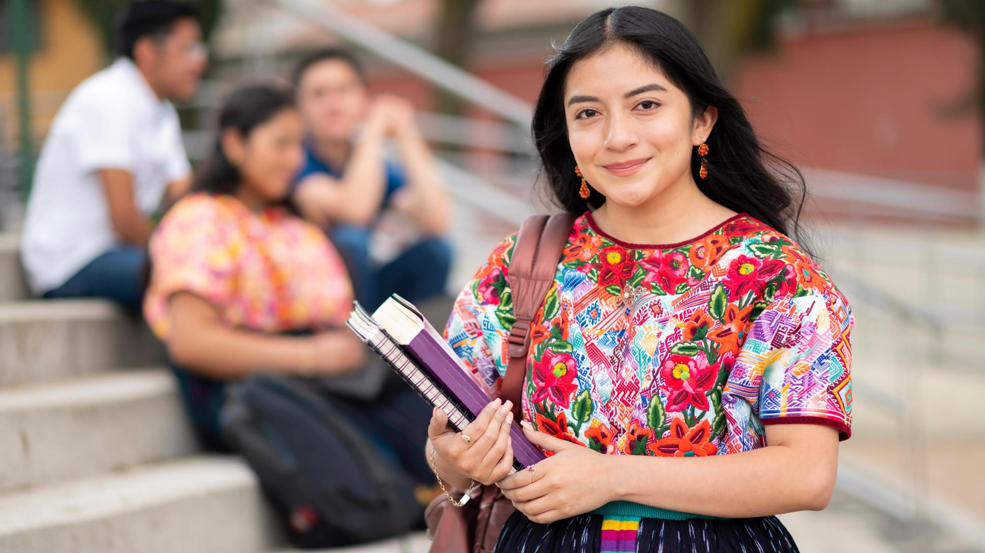
What does ‘representation’
mean to Indigenous American audiences?

Slide 15
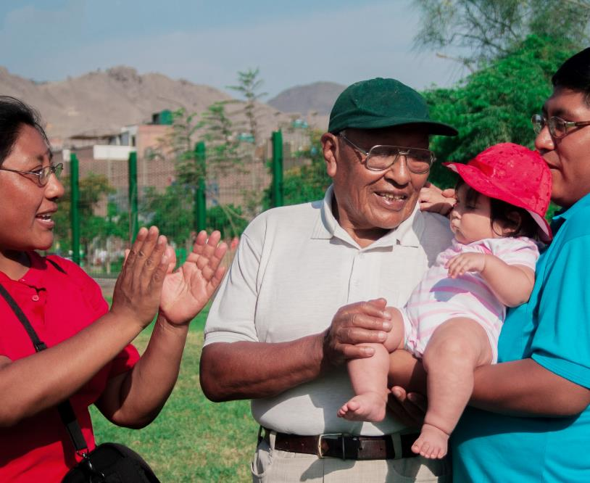
Marketers looking to engage with Indigenous Americans should prioritize content and messaging that contributes to dispelling stereotypes and myths, and reinforces realistic representations
Reasons why it is important that television shows
and movies accurately represent your (racial, ethnic, religious, etc.) identities
among Native Americans
“When people only see Native mascots, people tend to see Native people as more aggressive, as a result of viewing these stereotypes.”¹
“I feel like there are stereotypes that we are exhausted by, that non-Native people aren’t even aware of…So there’s a weird dance where you want to dispel these myths, but then you also have to explain that the myth exists.”²
“I think that the educational experience of most Americans in the country, compounded with the invisibility across American popular culture, creates a big problem.”³
“To create the best Indigenous content…you have to be willing to re-contemplate a different production method and to vary the production method.”³
Source: Nielsen, Nielsen at SXSW 2022: The Native representation TV needs, 5/26/22. ¹Leah Salgado, Chief Impact Officer of IllumiNative & citizen of the Pascua Yaqui Tribe. ²Sierra Teller Ornelas, Showrunner, Executive Producer and co-creator of Rutherford Falls and a citizen of the Navajo Nation. ³Bird Runningwater, a veteran of The Sundance Institute, producer with Amazon Studios, and citizen of Cheyenne and Mescalero Apache Tribes.
This information is exclusively provided to VAB members and qualified marketers. Further distribution is prohibited.
PAGE 15

Slide 16
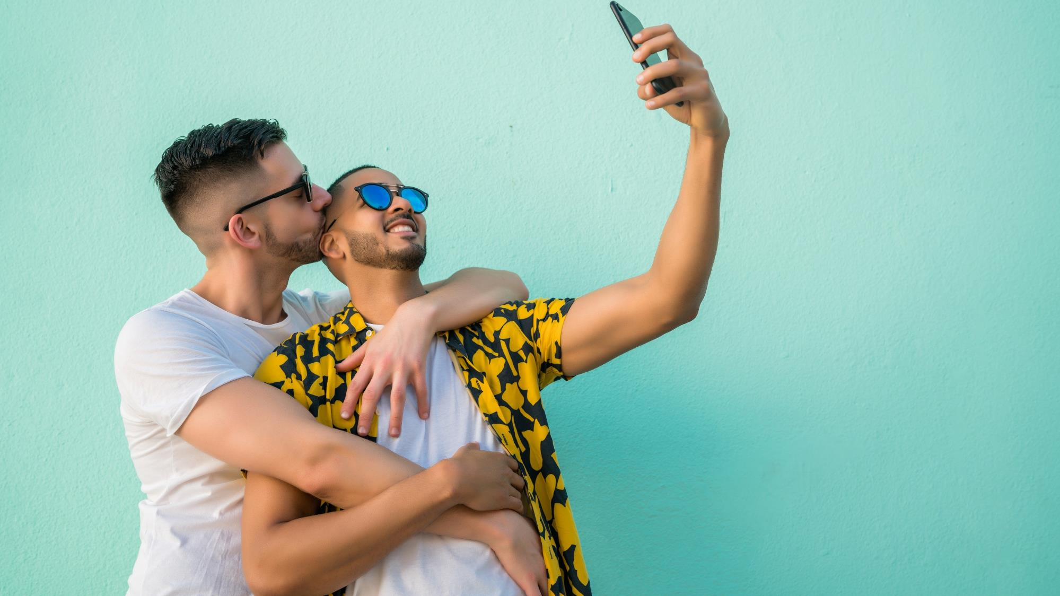
What does ‘representation’
mean to LGBTQ+ audiences?

Slide 17
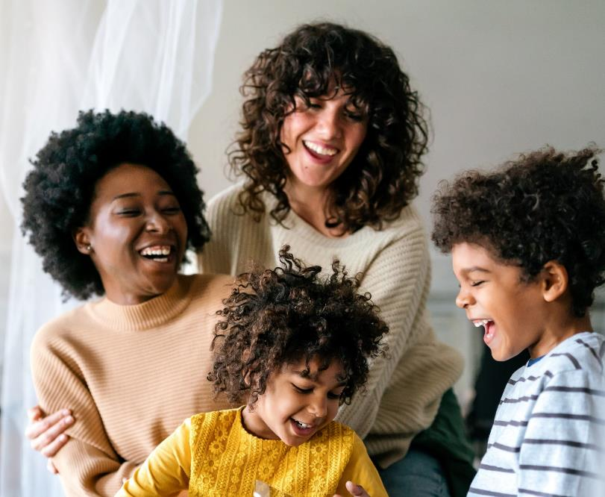
Like other multicultural segments that are often comprised of several different groups themselves, LGBTQ+ audiences want to see each identity within their community depicted both accurately and respectfully
Reasons why ‘it is important to you that television shows
and movies accurately represent your (racial, ethnic, religious, etc.) identities’*
Responses related to ‘more respectful and accurate depictions’ & ‘depictions missing’, among LGBTQ+ respondents
“There needs to be more accurate representation.”
“A lot of times we are overlooked. It is nice to have TV shows that display the struggles I went through and those like me.”
“I think we should be depicted respectfully in all forms of media.”
“As a lesbian woman in America, it is very important to me that we are represented. Many shows show gay men, however lesbian women hardly get recognition and representation in shows…”
Source: VAB analysis of Morning Consult, Media Representation, September 2021. *Survey respondents that selected ‘it is important to you that television shows and movies accurately represent your (racial, ethnic, religious, etc. ) identities. Why? (‘very / somewhat important’). For more information, download: What is the market opportunity for the LGBTQ+ community?
This information is exclusively provided to VAB members and qualified marketers. Further distribution is prohibited.
PAGE 17

Slide 18
Adults over 50 account for 36% of the total population and nearly half of all adults
Authentic representation is a must-have for marketers looking to connect and form relationships with multicultural consumers. While the media world has been working to address issues around diversity and inclusion, it is important to take the time to hear directly from consumers of all different backgrounds in order to comprehensively tackle the systemic changes that need to happen.
The belief that all identities deserve to be represented accurately and respectfully is found among all groups. Brands who prioritize diverse content and inclusive messaging will demonstrate to all audiences that they are seen and sought after for who they really are.
Key Implications for Marketers
This information is exclusively provided to VAB members and qualified marketers. Further distribution is prohibited.
PAGE 18

Slide 19

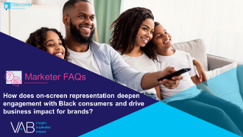
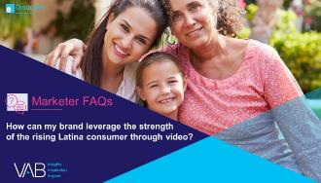
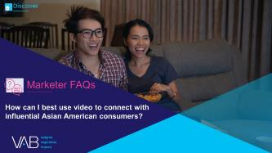
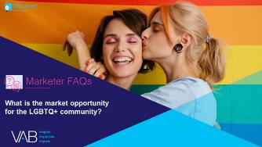
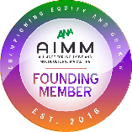
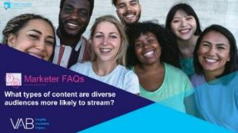
Adults over 50 account for 36% of the total population and nearly half of all adults
Creators
Jason Wiese
Leah Montner-Dixon
SVP, Director of Strategic Insights jasonw@thevab.com
Associate Insights Director
leahm@thevab.com
Reed Kiely
Karolina Guillen
Associate Insights Director
reedk@thevab.com
Insights Manager
karolinag@thevab.com
How does on-screen representation deepen engagement with Black consumers and drive business impact for brands?
How can my brand leverage the strength of the rising Latina consumer through video?
Discover more
Looking for more data, insights and takeaways? Check out this related VAB content
We are committed to providing marketers with the data and insights they need to develop thoughtful, inclusive campaigns & strategies. To find out more on the unique media consumption behaviors and cultural trends of multicultural consumers, visit the VAB’s Multicultural Marketing Resource Center.
How can I best use video to connect with influential Asian American consumers?
What is the market opportunity
for the LGBTQ+ community?
What types of content are diverse audiences more likely to stream?
VAB Members, brand marketers and agencies get free and immediate access to VAB’s content library. Get access at theVAB.com
This information is exclusively provided to VAB members and qualified marketers. Further distribution is prohibited.
PAGE 19

Slide 20


About VAB
VAB is an insights-driven organization that inspires marketers to reimagine their media strategies resulting in fully informed decisions.
Drawing on our marketing expertise, we simplify the complexities in our industry and discover new insights that transform the way marketers look at their media strategy.
We are committed to your business growth and proud to offer VAB members, brand marketers and agencies complimentary access to our continuously-growing Insights library. Get immediate access at theVAB.com.
Curious to learn more about VAB? Check out this quick video to see what we do and how we can help you develop business-driving marketing strategies.
This information is exclusively provided to VAB members and qualified marketers. Further distribution is prohibited.
PAGE 20

