Slide 1


July 22, 2025
Question of the Week:
“
What do marketers expect from their media partners to help achieve campaign success?
”

Slide 2


Our custom study of 200 brand marketers provides answers
Amid continuing conversations across the ad industry around investment in branding and performance marketing, we sought to understand what KPIs matter most to businesses of all sizes – and how are they determined?
To explore what drives brand marketers’ thinking and planning, we partnered with Advertiser Perceptions on a custom survey of 200 marketers.
In this piece, we spotlight a key finding: While partnership priorities vary slightly by company size, marketers consistently rely on media partners to deliver effective targeting, innovative solutions and a brand safe environment in high quality content.
Learn what really matters to marketers as they select media partners for their advertising campaigns.
This information is exclusively provided to VAB members and qualified marketers.
PAGE 2

Slide 3





Businesses of all sizes expect their media partners to deliver precision, attribution and innovation in trusted, transparent, high-quality content
Top 5 Criteria Brand Marketers Expect Their Media Partners to Deliver on
% of brand marketer respondents
‘Small-Sized’ Businesses
‘Medium-Sized’ Businesses
‘Large-Sized’ Businesses
Effective targeting
64%
Effective targeting
58%
Effective targeting
43%
High quality content / brand safe ad environment
45%
Campaign measurement / attribution
37%
Campaign measurement / attribution
38%
Innovative solutions*
34%
Innovative solutions*
36%
Innovative solutions*
34%
Campaign measurement / attribution
32%
High quality content / brand safe ad environment
35%
High quality content / brand safe ad environment
32%
Transparency**
27%
Transparency**
29%
Transparency**
31%
Source: VAB / Advertiser Perceptions ‘Marketer KPI Survey,’ February 2025, fielded January 27 – February 7, 2025 (n=200). Survey base: Brand marketers directly involved in influencing or executing video advertising. Q11. As a brand marketer, which of the following criteria do you expect your media partners to deliver on the most? Based on respondents selecting up to 3 choices. ‘Small-Sized’ Businesses: Less than $1MM in annual ad spend, ‘Medium-Sized’ Businesses: $1MM to less than $25MM in annual ad spend, ‘Large-Sized’ Businesses: $25MM or more in annual ad spend. *Media, creative, measurement, etc. **Buying, placements, reporting, etc. Dotted line across chart denotes the top 3.
This information is exclusively provided to VAB members and qualified marketers.
PAGE 3

Slide 4
In our full guide, we answer 10 key questions to help understand how businesses set strategy, define success and plan for growth
1
2
3
4
5
How well do business and marketing objectives align?
Who are the key decision-makers guiding marketing strategy?
How do marketers balance short-term sales with long-term brand growth?
What factors influence an organization’s selection of marketing KPIs?
Are there organizational disconnects between KPIs and overarching business goals?
6
7
8
9
10
What KPIs do marketers use to evaluate the impact
of their video campaigns?
Which media channels do marketers believe are the most effective in achieving KPIs throughout the funnel?
What do marketers expect from their
media partners to help achieve campaign success?
Would marketers shift their strategy if they could develop longer-term plans?
What KPIs would marketers be focused on for future growth?
This information is exclusively provided to VAB members and qualified marketers.
PAGE 4

Slide 5

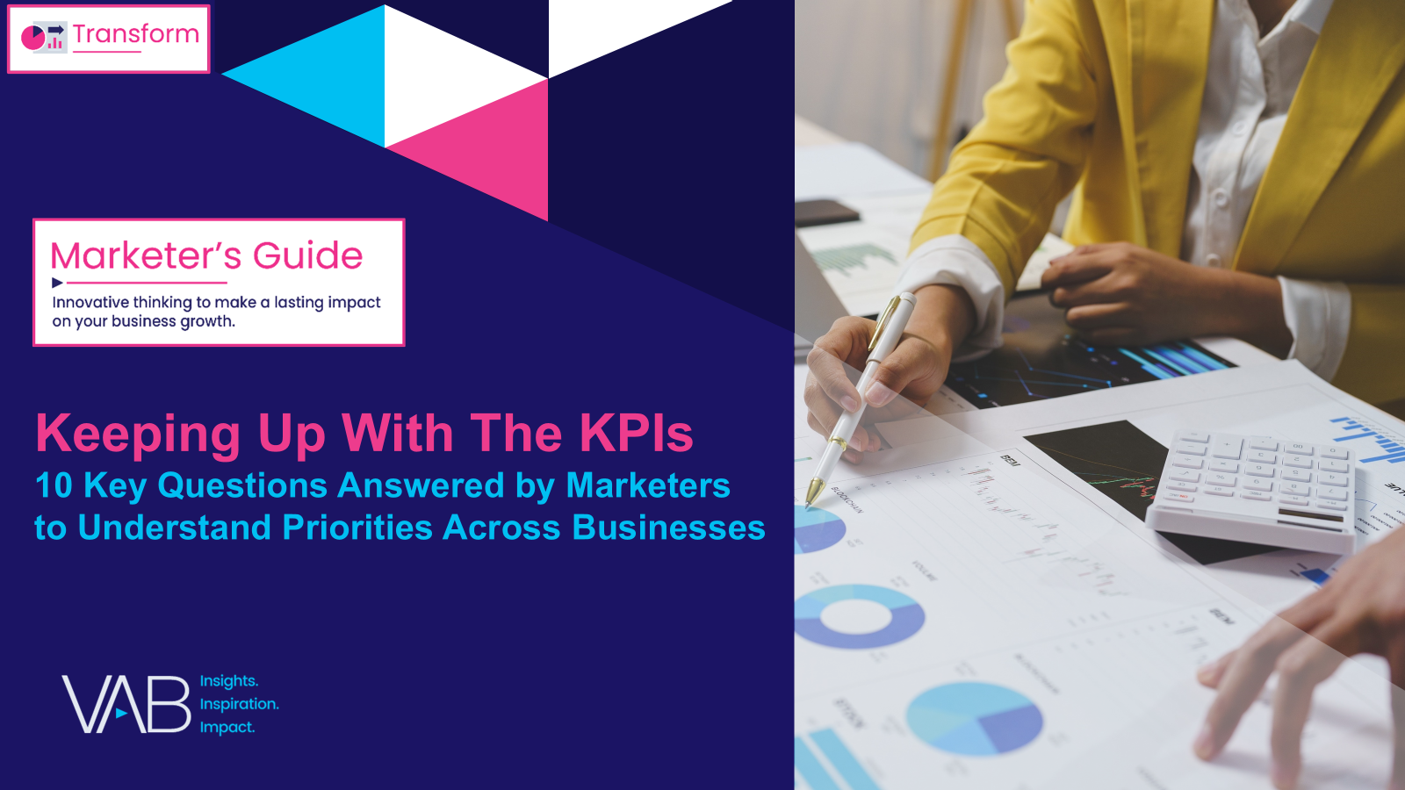
Download our full guide, Keeping Up With The KPIs, to learn the marketing strategies behind small, medium and large businesses
custom study
of 200 brand marketers
Click report cover above to download
44 pages
This information is exclusively provided to VAB members and qualified marketers.
PAGE 5

Slide 6

About VAB
VAB plays a dual role in the video advertising industry. We are leading the change to bring about a more innovative and transparent marketplace. We also provide the insights and thought leadership that enables marketers to develop business-driving marketing strategies.
Drawing on our marketing expertise, we simplify the complexities in our industry and discover new insights that transform the way marketers look at their media strategy.
We are committed to your business growth and proud to offer VAB members, brand marketers and agencies complimentary access to our continuously-growing Insights library. Get immediate access at theVAB.com.
This information is exclusively provided to VAB members and qualified marketers.
PAGE 6

