Slide 1


February 10, 2026
Question of the Week:
“
What are the most popular sports to reach audiences through streaming?
”
February 2026 Update

Slide 2



Most streamers enjoy streaming live sports and over four out of ten are habitual viewers who watch this type of content at least once a month
% of streamers that…
57%
41%
27%
Like to stream
live sports
Have streamed sports in the last month
Are driven to subscribe to a streaming service for live sports
Source: VAB analysis of MRI-Simmons Cord Evolution November 2025 study (fielded Sep 30, 2025 - Oct 20, 2025), Base: has streamed in the last 12 months.
This information is exclusively provided to VAB members and qualified marketers
PAGE 2

Slide 3
NFL, WNBA and Boxing have seen the largest audience growth among the most streamed sports since 2023
Which of the following sports have you streamed live in the last 12 months?
% of sports streamers
Summer or Winter
Source: VAB analysis of MRI-Simmons Cord Evolution November 2023 (fielded Oct 2, 2023 - Oct 18, 2023) & November 2025 (fielded Sep 30, 2025 - Oct 20, 2025) studies, Base: has streamed live sports in the last 30 days. Note: Olympics can include people streaming relevant content such as replays, highlights and other related programming after the Olympics have aired.
This information is exclusively provided to VAB members and qualified marketers
PAGE 3

Slide 4

What are the most popular sports to reach diverse audiences through streaming?

Slide 5
Hispanic Streamers: Boxing, NFL and WNBA have seen the largest audience growth among the most streamed sports since 2023
Which of the following sports have you streamed live in the last 12 months?
% of Hispanic sports streamers
Summer or Winter
Source: VAB analysis of MRI-Simmons Cord Evolution November 2023 (fielded Oct 2, 2023 - Oct 18, 2023) & November 2025 (fielded Sep 30, 2025 - Oct 20, 2025) studies, Base: Hispanic & has streamed live sports in the last 30 days. Note: Olympics can include people streaming relevant content such as replays, highlights and other related programming after the Olympics have aired.
This information is exclusively provided to VAB members and qualified marketers
PAGE 5

Slide 6
Black Streamers: WNBA, NBA and Boxing have seen the largest audience growth among the most streamed sports since 2023
Which of the following sports have you streamed live in the last 12 months?
% of Black sports streamers
Summer or Winter
Source: VAB analysis of MRI-Simmons Cord Evolution November 2023 (fielded Oct 2, 2023 - Oct 18, 2023) & November 2025 (fielded Sep 30, 2025 - Oct 20, 2025) studies, Base: Non-Hispanic Black & has streamed live sports in the last 30 days.
Note: Olympics can include people streaming relevant content such as replays, highlights and other related programming after the Olympics have aired.
This information is exclusively provided to VAB members and qualified marketers
PAGE 6

Slide 7
Asian Streamers: MLB, WNBA and Boxing have seen the largest audience growth among the most streamed sports since 2023
Which of the following sports have you streamed live in the last 12 months?
% of Asian sports streamers
Summer or Winter
Source: VAB analysis of MRI-Simmons Cord Evolution November 2023 (fielded Oct 2, 2023 - Oct 18, 2023) & November 2025 (fielded Sep 30, 2025 - Oct 20, 2025) studies, Base: Non-Hispanic Asian & has streamed live sports in the last 30 days.
Note: Olympics can include people streaming relevant content such as replays, highlights and other related programming after the Olympics have aired.
This information is exclusively provided to VAB members and qualified marketers
PAGE 7

Slide 8
Hispanic audiences over-index on boxing and WWE, Black audiences stream basketball and NFL & Asian streamers watch more MLB and golf
Which of the following sports have you streamed live in the last 12 months?
% of sports streamers
Summer or Winter
Source: VAB analysis of MRI-Simmons Cord Evolution November 2025 (fielded Sep 30, 2025 - Oct 20, 2025) studies, Base: has streamed live sports in the last 30 days. NH = Non-Hispanic. Note: Data sorted on NH White. Note: Olympics can include people streaming relevant content such as replays, highlights and other related programming after the Olympics have aired.
This information is exclusively provided to VAB members and qualified marketers
PAGE 8

Slide 9



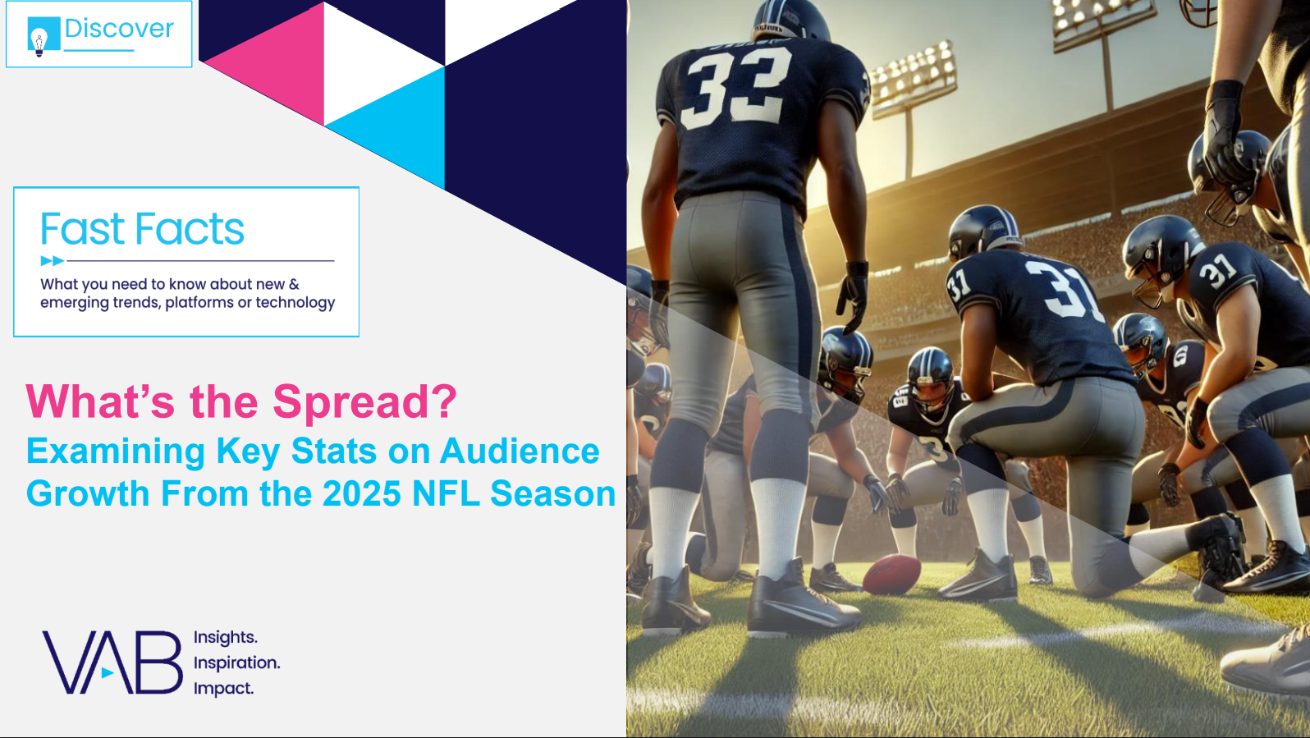


Discover more: Looking for more insights and takeaways on sports and streaming? Download these reports below!
Click here
to download
Click here
to download
Click here
to download
Click here
to download
This information is exclusively provided to VAB members and qualified marketers
PAGE 9

Slide 10


About VAB
VAB plays a dual role in the video advertising industry. We are leading the change to bring about a more innovative and transparent marketplace. We also provide the insights and thought leadership that enables marketers to develop business-driving marketing strategies.
Drawing on our marketing expertise, we simplify the complexities in our industry and discover new insights that transform the way marketers look at their media strategy.
We are committed to your business growth and proud to offer VAB members, brand marketers and agencies complimentary access to our continuously-growing Insights library. Get immediate access at theVAB.com.
This information is exclusively provided to VAB members and qualified marketers
PAGE 10

