Slide 1
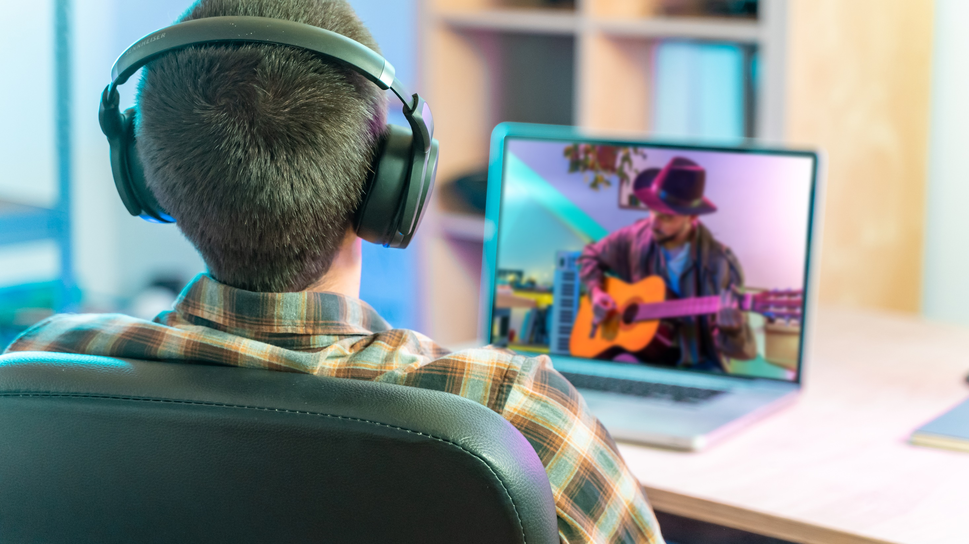


September – 2020
We’re Going Live
How consumers are living vicariously through live-streamed events in the time of COVID-19

Slide 2

About VAB
VAB is an insights-driven organization that inspires marketers to reimagine their media strategies resulting in fully informed decisions.
Drawing on our marketing expertise, we simplify the complexities in our industry and discover new insights that transform the way marketers look at their media strategy.
Simplify
We save you time by bringing you the latest data & actionable takeaways you can use to inform your marketing plans.
Discover
We keep you one step ahead with the latest thinking so you can create innovative, forward-looking strategies.
Transform
We help you build your brand by focusing on core marketing principles that will help drive tangible business outcomes.
This information is exclusively provided to VAB members and qualified marketers. Further distribution is prohibited.
PAGE 2

Slide 3
What You’ll Learn…
Despite the cancellation of almost all live events, livestream has quickly been adopted by countless fans looking for an alternative form of live entertainment during this time of isolation due to the pandemic and the social unrest the country is facing
As with all streaming entertainment, content is a key factor for viewers; if the right content is available, they will tune-in and engage through social media with entertainers and brands, creating their own virtual communities
Livestream events provide unique and creative opportunities for marketers to reach consumers virtually through these “live events”
Methodology
VAB commissioned Lucid to conduct an online survey between 6/23/2020 – 6/30/2020. The results are based on 1,000 adult 18+ U.S. respondents in households with access and have viewed content on streaming services within the past seven days. The respondents cover all age groups, races and ethnic backgrounds.
This information is exclusively provided to VAB members and qualified marketers. Further distribution is prohibited.
PAGE 3
Notes:
https://livestream.com/blog/62-must-know-stats-live-video-streaming?category=research

Slide 4
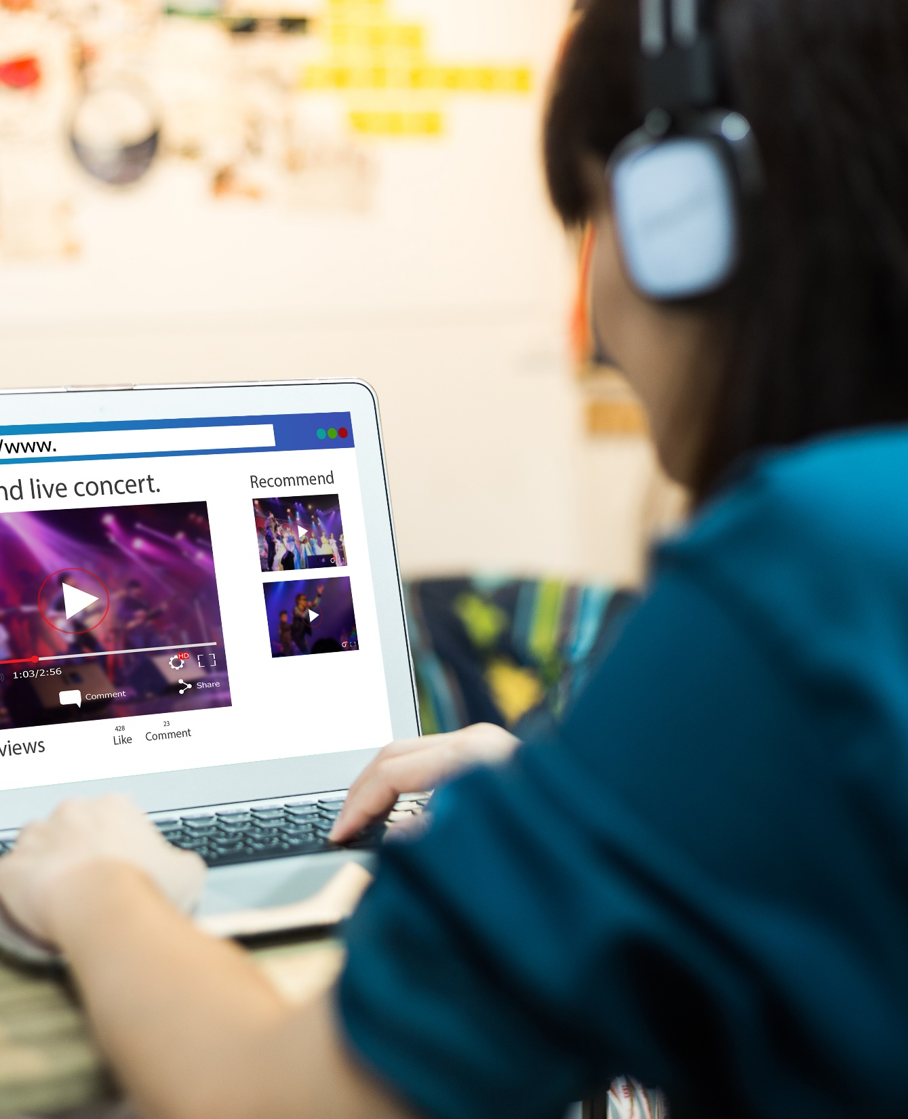
What is Livestreaming?
By ‘livestreaming’, we are referring to streaming a program online live as it happens (e.g., Concert - One World: Together at Home, Sporting Event - Virtual NFL Draft)
This information is exclusively provided to VAB members and qualified marketers. Further distribution is prohibited.
PAGE 4

Slide 5



Of the many lessons learned during the COVID-19 pandemic, from a media perspective three stand out: Zoom, Smart TV & Livestream
% of respondents who agree with the statement
P18+
66%
54%
31%
“I am more open to trying new types of media”
(e.g. new streaming services, podcasts, social media platforms, etc.)
“I have learned how to use more features on my smart TV or a TV related device/platform”
“I have livestreamed concerts/events during quarantine”
Source: VAB / Lucid ‘Media Usage In The Time of COVID-19 Survey,’ April 2020. Survey base: P18+ & household subscribes to cable, telco, internet TV or satellite TV (n=1,004). Q9: Thinking of your behavior during the COVID-19 Pandemic, please indicate below how much you agree or disagree with the following statements.; Source: VAB / Lucid ‘COVID-19 Streaming Behavior Survey,’ June 2020. Survey base: P18+ in households with access to streaming services and have viewed content on streaming services within the past seven days (n=1,000). Q14.When thinking about livestreaming, by which we mean: streaming a program online live as it happens (e.g., Concert - One World: Together at Home, Sporting Event - Virtual NFL Draft) - which of the following statements do you feel apply to you?
This information is exclusively provided to VAB members and qualified marketers. Further distribution is prohibited.
PAGE 5

Slide 6


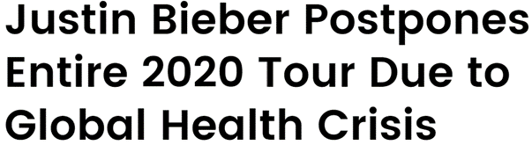

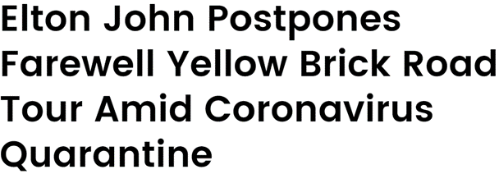

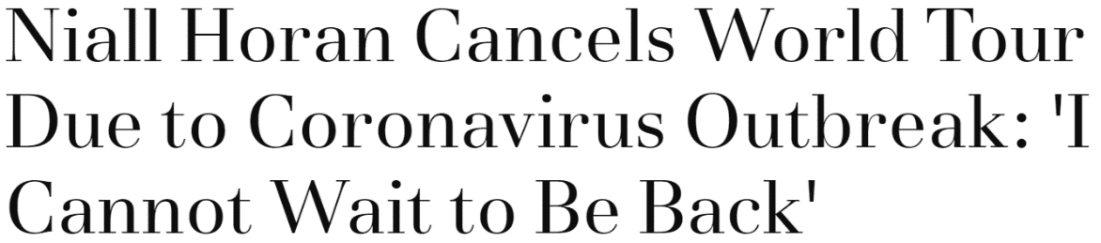

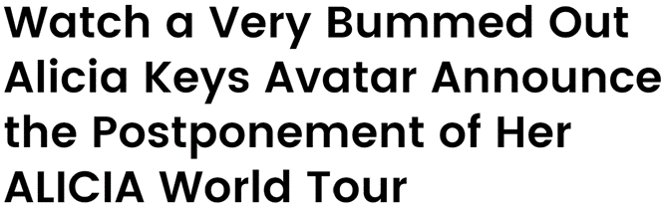


Since the pandemic began, the elimination of large gatherings has forced big-name artists to cancel major tours and in-person performances
This information is exclusively provided to VAB members and qualified marketers. Further distribution is prohibited.
PAGE 6

Slide 7



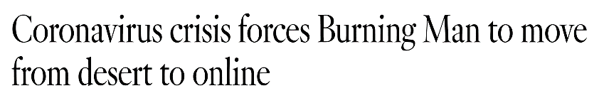



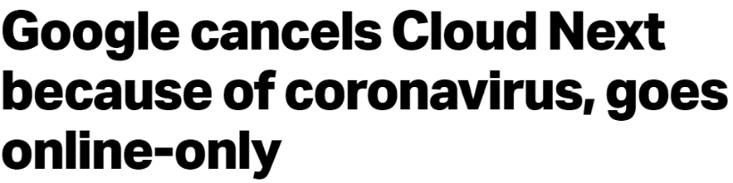





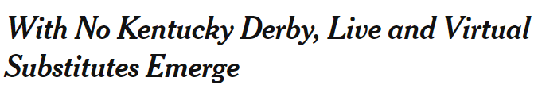



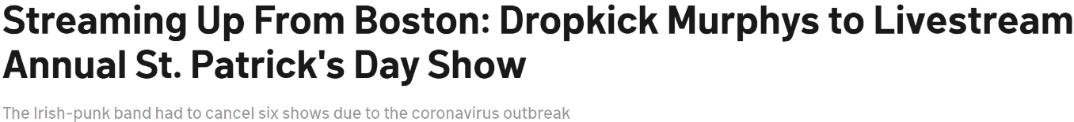
However many organizers have moved to modify and stream their events online instead of canceling them completely or rescheduling them to a later date
This information is exclusively provided to VAB members and qualified marketers. Further distribution is prohibited.
PAGE 7

Slide 8
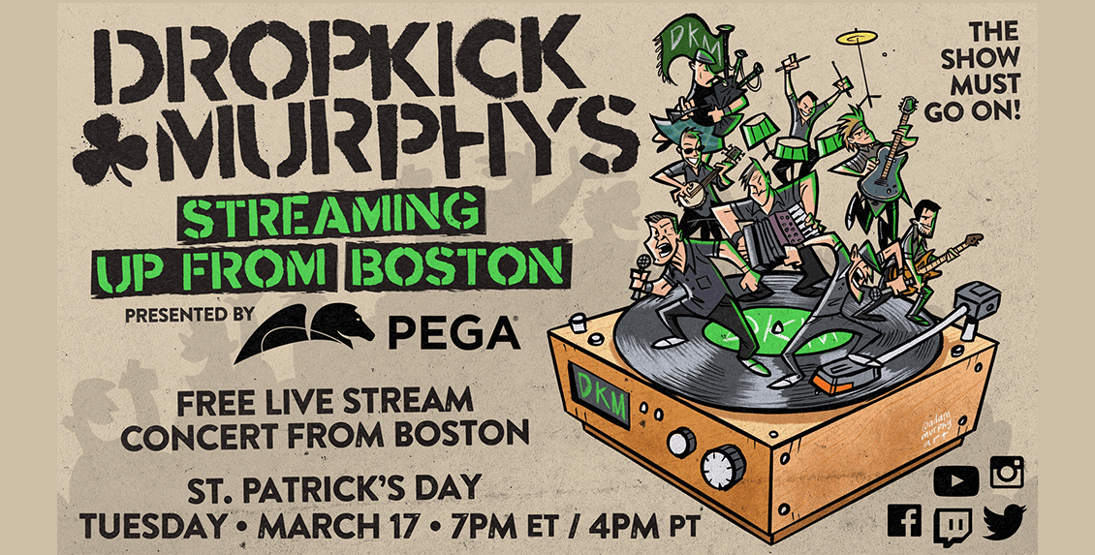
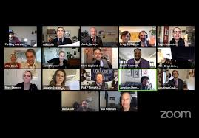
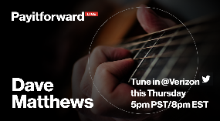
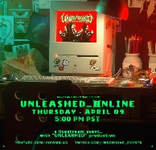
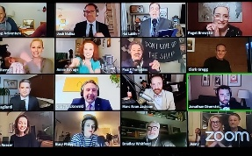

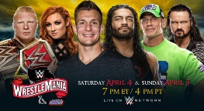
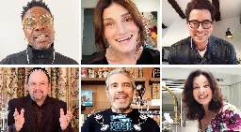


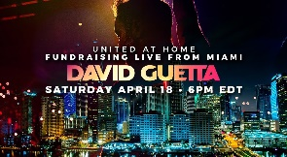

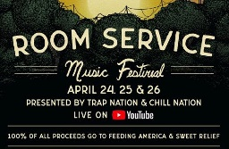
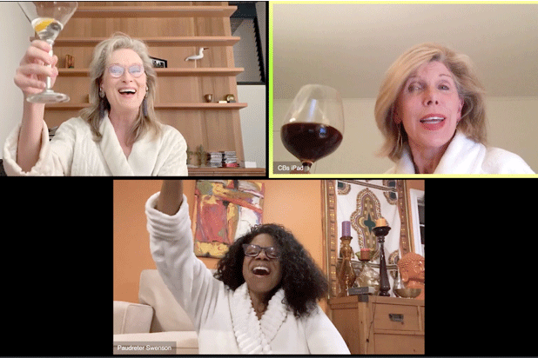
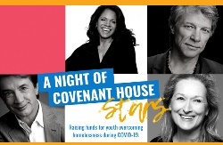
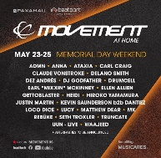
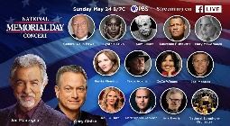

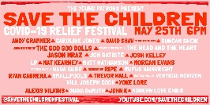

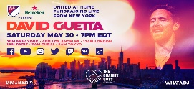
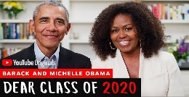
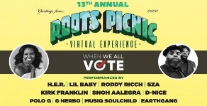
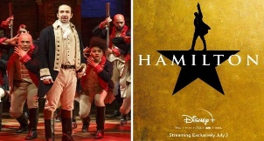
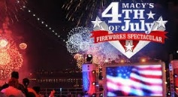

Providing consumers with a breadth of livestream events to attend from the comfort of their homes including concerts, performances, pandemic-related fundraisers, graduation ceremonies, holiday events and more as time goes by
Dropkick Murphys Annual St. Patrick’s Day Concert
The Rosie O’Donnell Show
Thrilling Adventure Hour
PayItForwardLive
WrestleMania 36
Unleashed (Kayzo)
Thrilling Adventure Hour
Saturday Night Seder
BangBangCon
Mar-17
Mar-22
Mar-22
Mar-26
Apr-4 - Apr-5
Apr-9
Apr-11
Apr-17 – Apr-18
Apr-11
One World: Together At Home
United at Home: Live from Miami
Fortnite & Travis Scott Present: Astronomical
Take Me To The Moon: A Steven Sondheim 90th Birthday Celebration
A Night of Covenant House Stars
National Memorial Day Concert
Room Service Music Festival
Dis Dance Festival
Movement At Home
Apr-18
Apr-18
Apr-23
Apr-25
Apr-26
May-18
May-23
May-23 – May-25
May-24
Upcoming Events
Elton John’s Classic Concert Series (Jul-18)
Lollapalooza (Jul-30 – Aug-2)
…and more!
Save the Children Music Festival
Dropkick Murphys: Streaming Outta Fenway
United at Home: Live from New York
Dear Class of 2020
Macy’s 4th of July Fireworks
The Roots Picnic 2020
Broadway’s Hamilton
CMA’s Best of Fest
May-25
May-29
May-30
Jun-6
Jun-27
Jul-3
Jul-4
Jul-13
This information is exclusively provided to VAB members and qualified marketers. Further distribution is prohibited.
PAGE 8

Slide 9

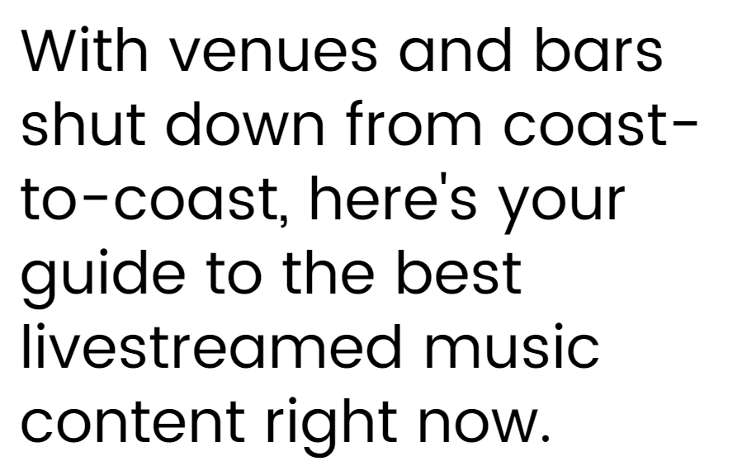
These livestream events are a good substitute to in-person events as fans crave performances from their favorite artists
“I believe livestreamed events are a good substitute if I can't attend in person”
% who agree
Source: VAB / Lucid ‘COVID-19 Streaming Behavior Survey,’ June 2020. Survey base: P18+ in households with access to streaming services and have viewed content on streaming services within the past seven days (n=1,000). Q14.When thinking about livestreaming, by which we mean: streaming a program online live as it happens (e.g., Concert - One World: Together at Home, Sporting Event – Virtual NFL Draft) - which of the following statements do you feel apply to you?
This information is exclusively provided to VAB members and qualified marketers. Further distribution is prohibited.
PAGE 9

Slide 10
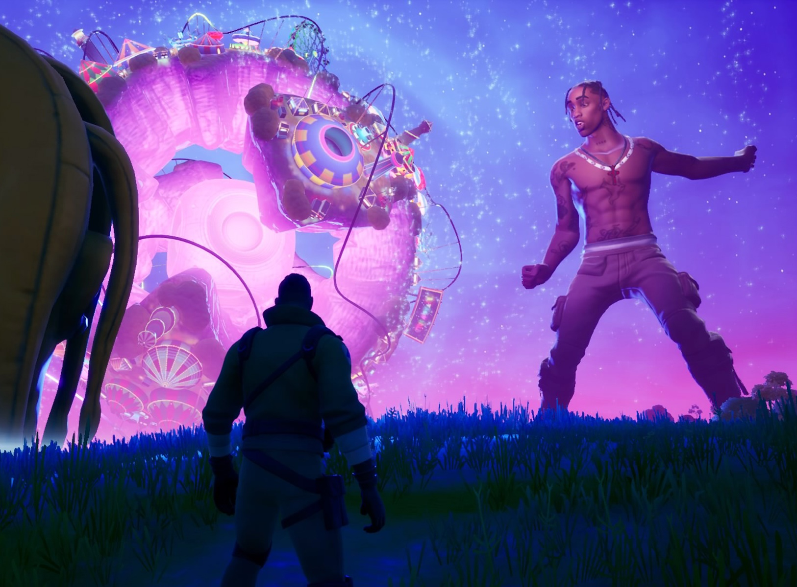

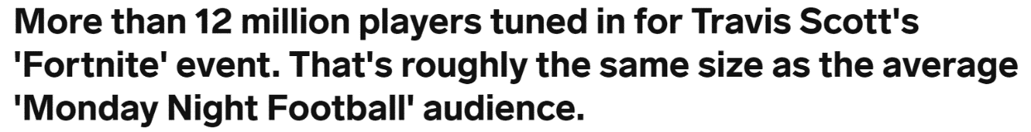

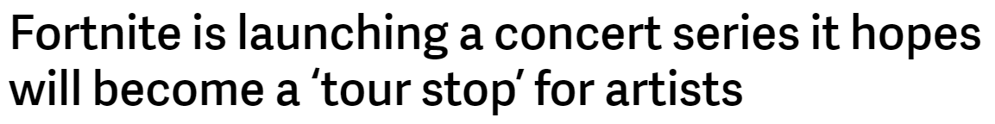
In fact, nearly one-third of all adults are tuning in and enjoying the streaming versions of these events
Livestreamed concerts like Travis Scott’s ‘Fortnite’ event have attracted big audiences, and more events like it are already on the way
“I have livestreamed concerts and / or events
while in quarantine”
% who agree
April 24th, 2020
September 8th, 2020
Source: VAB / Lucid ‘COVID-19 Streaming Behavior Survey,’ June 2020. Survey base: P18+ in households with access to streaming services and have viewed content on streaming services within the past seven days (n=1,000). Q14.When thinking about livestreaming, by which we mean: streaming a program online live as it happens (e.g., Concert - One World: Together at Home, Sporting Event – Virtual NFL Draft) - which of the following statements do you feel apply to you?
This information is exclusively provided to VAB members and qualified marketers. Further distribution is prohibited.
PAGE 10

Slide 11
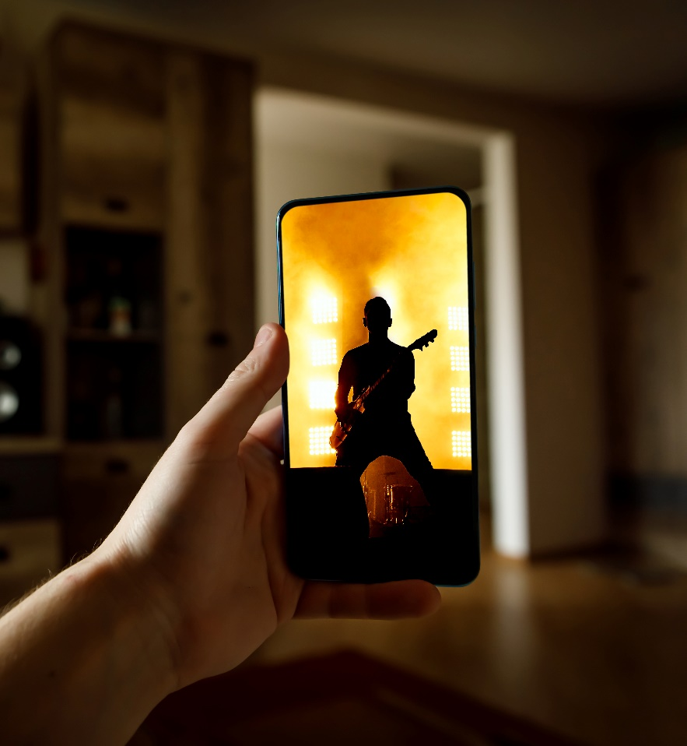
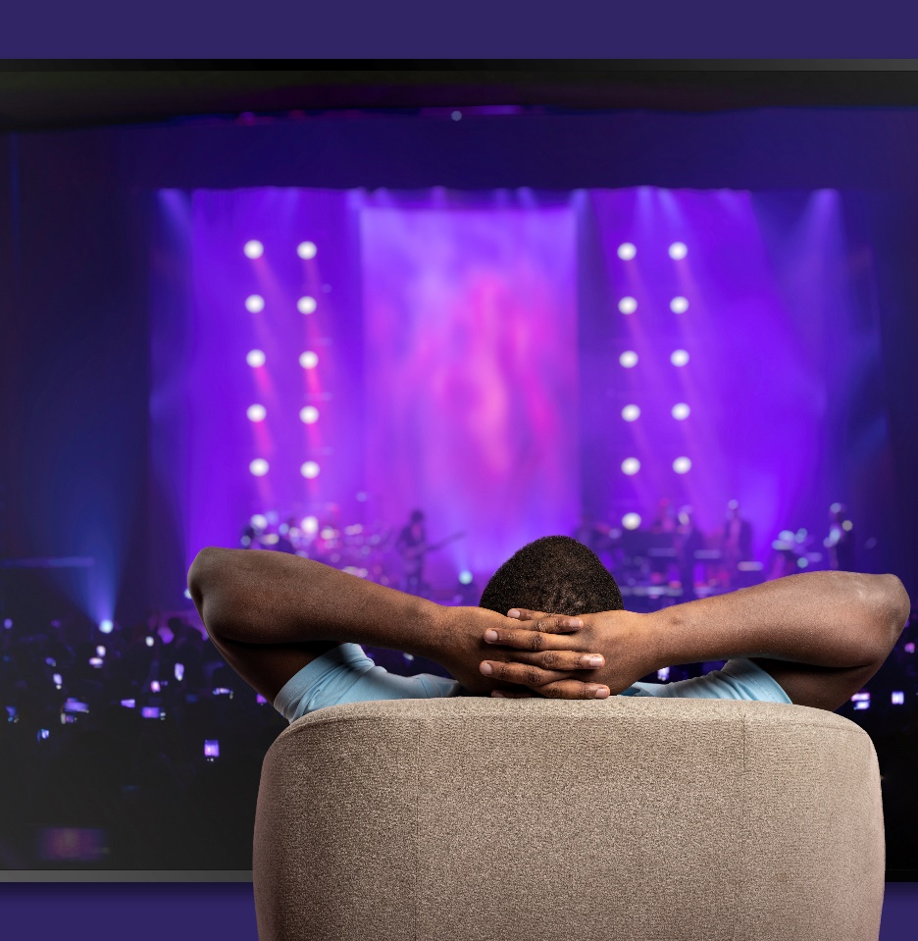

And there seems to be something for everyone to enjoy and tune into
“I have livestreamed concerts and / or events while in quarantine”
% who agree
38% Hispanic
27% Non-Hispanic Black
42% HHs with Kids
52% HHI $100K+
31% P18+
Source: VAB / Lucid ‘COVID-19 Streaming Behavior Survey,’ June 2020. Survey base: P18+ in households with access to streaming services and have viewed content on streaming services within the past seven days (n=1,000). Q14.When thinking about livestreaming, by which we mean: streaming a program online live as it happens (e.g., Concert - One World: Together at Home, Sporting Event – Virtual NFL Draft) - which of the following statements do you feel apply to you?
This information is exclusively provided to VAB members and qualified marketers. Further distribution is prohibited.
PAGE 11

Slide 12

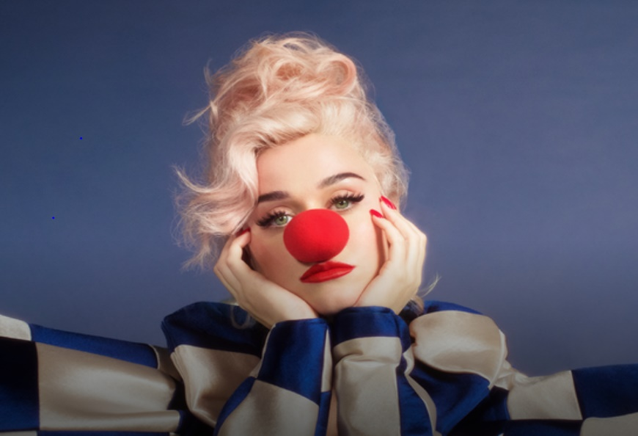

Content continues to play a key role in all areas of entertainment, including virtual events, with four in ten adults 18-24 saying “they would consider livestreaming if there was something that interested them”
“I haven’t livestreamed an event or concert, but would consider if there was something that interested me”
% who agree
37%
42%
29%
P18+
P18-24
Single
Source: VAB / Lucid ‘COVID-19 Streaming Behavior Survey,’ June 2020. Survey base: P18+ in households with access to streaming services and have viewed content on streaming services within the past seven days (n=1,000). Q14.When thinking about livestreaming, by which we mean: streaming a program online live as it happens (e.g., Concert - One World: Together at Home, Sporting Event – Virtual NFL Draft) - which of the following statements do you feel apply to you?
This information is exclusively provided to VAB members and qualified marketers. Further distribution is prohibited.
PAGE 12

Slide 13
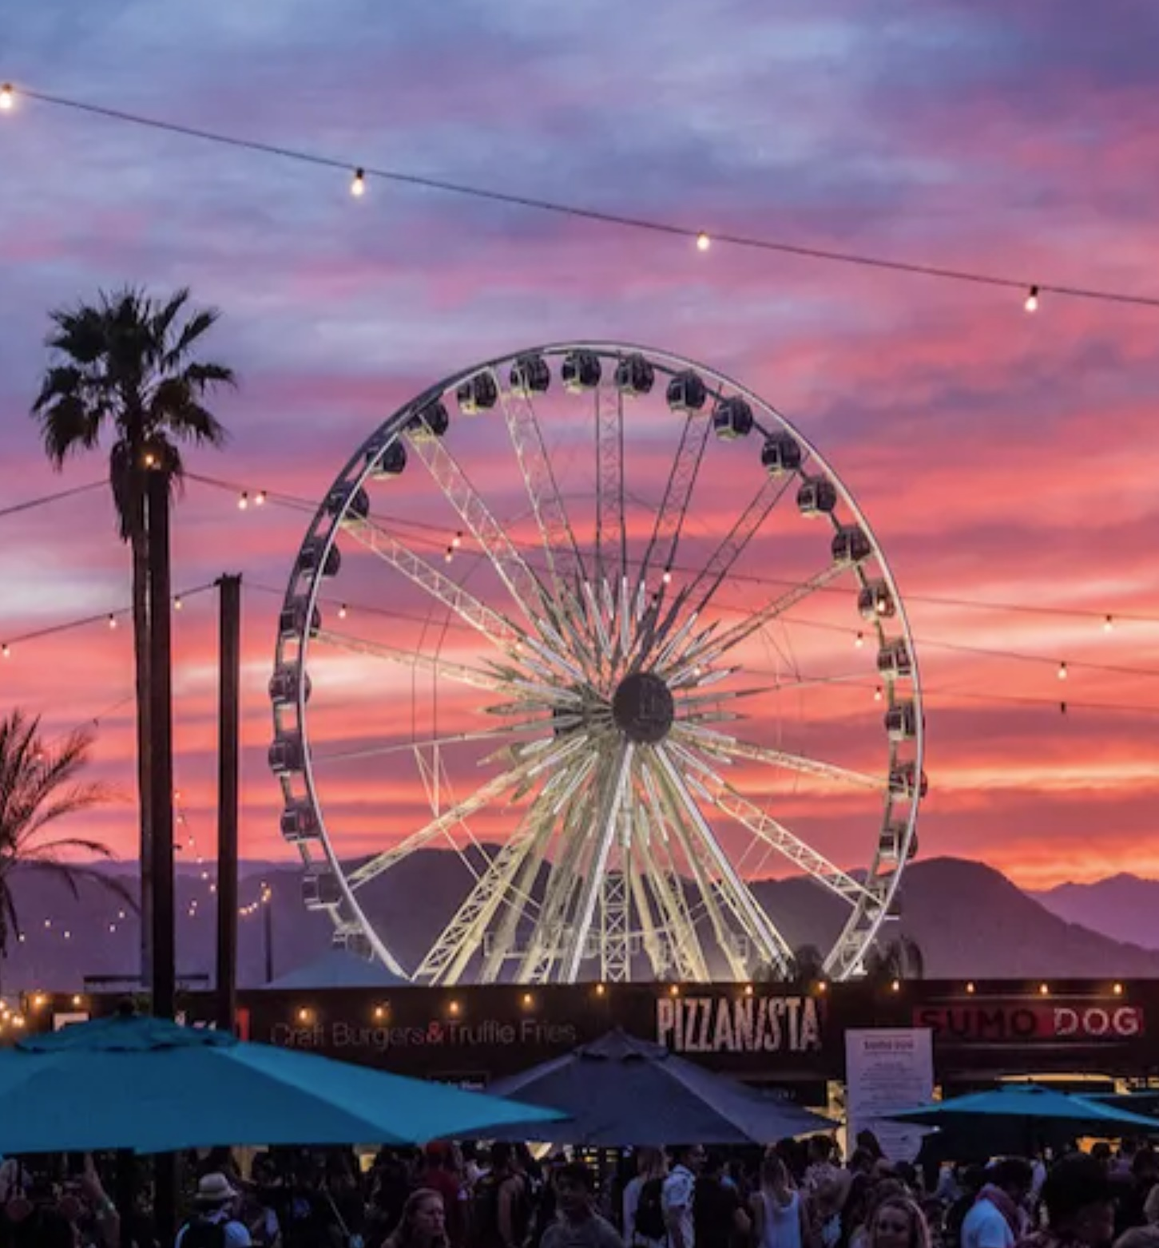
While we’re hopeful that 2021 will bring back in-person festivals like Coachella, households with higher incomes or with children show interest in paid livestream events
“If live concerts / events are cancelled until the end of the year due to COVID-19, I would be willing to pay to attend a livestreamed concerts / events”
% who agree
Source: VAB / Lucid ‘COVID-19 Streaming Behavior Survey,’ June 2020. Survey base: P18+ in households with access to streaming services and have viewed content on streaming services within the past seven days (n=1,000). Q14.When thinking about livestreaming, by which we mean: streaming a program online live as it happens (e.g., Concert - One World: Together at Home, Sporting Event – Virtual NFL Draft) - which of the following statements do you feel apply to you?
This information is exclusively provided to VAB members and qualified marketers. Further distribution is prohibited.
PAGE 13

Slide 14


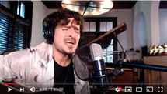
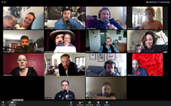
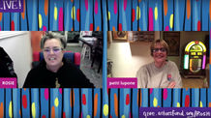



Along with tune-in, livestream content sparked engagement via online conversations between artists performing from their homes, and viewers confined to their own homes
Video Streaming ‘Special’ Content That Trended in the Twitter Top 10
(March 16th – April 8th)
3/17
3/18
3/21
3/22
3/22
3/26
4/4-4/5
4/7
(#3)
(#1)
(#10)
(#6)
(#7)
(#1)
(#1) / (#1)
(#4)
Dropkick Murphy’s live streamed their annual St. Patrick’s Day concert across various platforms.
Beyoncé fans were encouraged to join a Twitter watch party for her 2019 Netflix documentary, Homecoming, conversation was further fueled when Beyoncé retweeted in support.
Latin musician, Tommy Torres, streamed a live ‘concert’ on YouTube for fans
Members of the former radio podcast, Thrilling Adventure Hour, brought the show back by live streaming an episode on YouTube.
The Rosie O'Donnell Show came back for a one-night special return through Broadway.com and their YouTube channel with celebrities live streaming from their homes to benefit the Actors Fund to provide aid during the coronavirus outbreak.
Dave Matthews live streamed a concert on Twitter for Verizon's 'Pay It Forward Live’ weekly livestream event which features musicians performing from their living rooms to support small businesses.
WrestleMania 36 aired on WWE Network as a two-night event on April 4th and 5th, 2020.
Instagram and Twitter held a Quarantine Watch Party for Guardians of the Galaxy with director James Gunn who asked fans to start watching the movie at 9p on Disney+ or iTunes.
(#) = the highest ranking the trending topic achieved during the night
Source: VAB custom analysis of Top 10 trending Twitter Topics each night (9:30p & 11p) aggregated during the analysis time period (3/16/2020 – 4/8/2020). Results include both ‘direct’ and ‘related’ topics.
This information is exclusively provided to VAB members and qualified marketers. Further distribution is prohibited.
PAGE 14

Slide 15




Key Takeaways for Marketers
Right place, right time, right message is more important than ever
Livestreaming is not just for sports fans
Content that entertains
Multiscreen is so important
Develop and deepen trust between consumers & your brand
Consumers see livestream concerts and events as a welcome addition to their entertainment needs, giving marketers an opportunity to think beyond the :30 second ad
Creativity and agility are so important for marketers today – give your customers or potential customers the opportunity to engage with you "IRL" via a virtual event centered around content they are passionate about
Reaching consumers where they are is more important than ever and virtual live events provide ideal platforms for marketers to entertain and reach audiences across all screens and platforms
Sponsoring a live virtual event or partnering with an organization that your consumer cares about will deepen the trust and respect consumers have for your brand
This information is exclusively provided to VAB members and qualified marketers. Further distribution is prohibited.
PAGE 15
Notes:
Tour sponsorship and advertising accounted for $590 million of concert giant Live Nation’s budget last year, and all that money is shut down for the foreseeable future -- but brands have spent the last month providing crucial capital for artists. In addition to Jameson, Jack Daniel’s, Chipotle, Bud Light, the Baton Rouge chicken-fingers chain Raising Cane’s, Levi’s and Verizon, among others, have sponsored livestreams, donated to music-related charities and made direct deals for product placement and social-media marketing

Slide 16

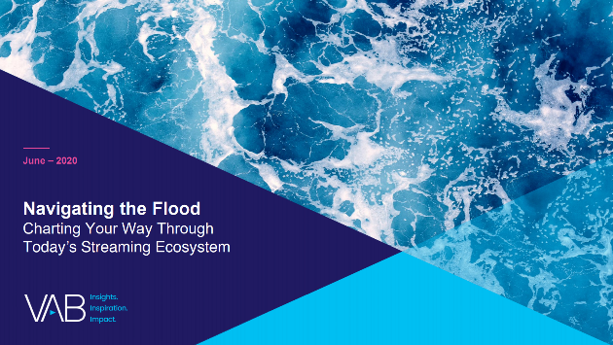
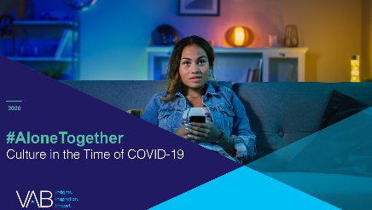
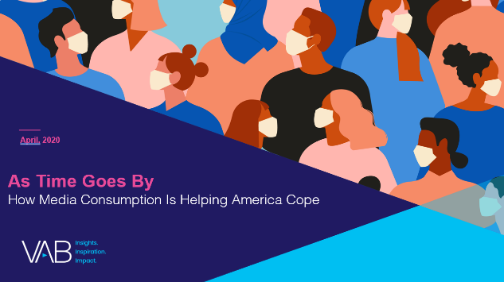
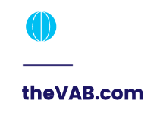


Thank You
Creators
Kathy Grey
Leah Montner-Dixon
Karolina Guillen
SVP, Research Innovation
kathyg@thevab.com
Insights Manager
leahm@thevab.com
Senior Insights Analyst
karolinag@thevab.com
Interested in learning more? Check out this related content:
Navigating the Flood:
Charting Your Way Through Today’s Streaming Ecosystem
#AloneTogether:
Culture in the Time of COVID-19
As Time Goes By:
How Media Consumption Is Helping America Cope
This information is exclusively provided to VAB members and qualified marketers. Further distribution is prohibited.
PAGE 16

Slide 17

Get immediate access to the VAB Insights library
We’ve answered hundreds of marketers’ questions.
Our guides, reports, webinars and videos provide actionable insights to help marketers navigate today’s video landscape and think differently about their strategy.
We are committed to your business growth and proud to offer brand marketers and agencies complimentary access to our continuously-growing Insights library.
Get Access at theVAB.com or visit us here
This information is exclusively provided to VAB members and qualified marketers. Further distribution is prohibited.
PAGE 17

