Slide 1





Welcome to TV
Meet the New Advertisers Investing in Outcomes Amidst Economic Uncertainty
Full Year 2022 Update

Slide 2



Despite a new wave of economic uncertainty in 2022, Television was resilient.
Under the threat of recession, first-time TV advertisers collectively invested more in the platform last year than any other time since we began this analysis four-years ago.
Why are they turning to TV? New advertisers are employing TV campaigns to deliver on an array of brand KPIs - from igniting awareness and establishing brand legitimacy to taking market share from category competitors.
Who are the new spenders? Due to inflationary pressures, most new advertisers are from categories that serve functional needs – pharma, financial, apparel, wellness, insurance – however, the variety of brands, including innovative leaders and digital-natives, shows the versality of TV as an advertising platform.
This information is exclusively provided to VAB members and qualified marketers. Further distribution is prohibited.
PAGE 2

Slide 3

Inflation continued to be the top concern for consumers through 2022 - ranking above gun violence, the pandemic and abortion laws
1
Source: McKinsey US Consumer Pulse survey. July 6-10, 2022; n=4,009, sampled and weighed to match the US general population 18+ years. *Question: ‘What are the greatest source(s) of concern for you right now? (choose as many as 3 from provided list of options).
This information is exclusively provided to VAB members and qualified marketers. Further distribution is prohibited.
PAGE 3

Slide 4
2
Despite inflation being a top concern, retail spend continues to increase as more consumers return to their pre-COVID lives and activities
+7.0%
+14.4%
+7.6%
+4.3%
+3.5%
+3.3%
+2.9%
+3.5%
+2.9%
+4.1%
Source: National Retail Federation, NRF Forecasts 2023 Retail Sales to Grow Between 4% and 6%, March 29, 2023. 2013 – 2022 reflects NRF’s analysis of U.S. Census data.
This information is exclusively provided to VAB members and qualified marketers. Further distribution is prohibited.
PAGE 4

Slide 5

Creating and maintaining a presence is imperative for advertisers to build brand equity among consumers,
especially in times of economic uncertainty when people are still spending
“In times of uncertainty, all of us are looking for stability…If consumers are feeling uncertainty, the wrong thing to do is stop talking to them.”
Kirk McDonald, CEO, GroupM North America
‘Advertising in Uncertain Times: Adapt Your Messaging to Today’s Environment’ panel session,
Advertising Week New York, October 2022
This information is exclusively provided to VAB members and qualified marketers. Further distribution is prohibited.
PAGE 5

Slide 6
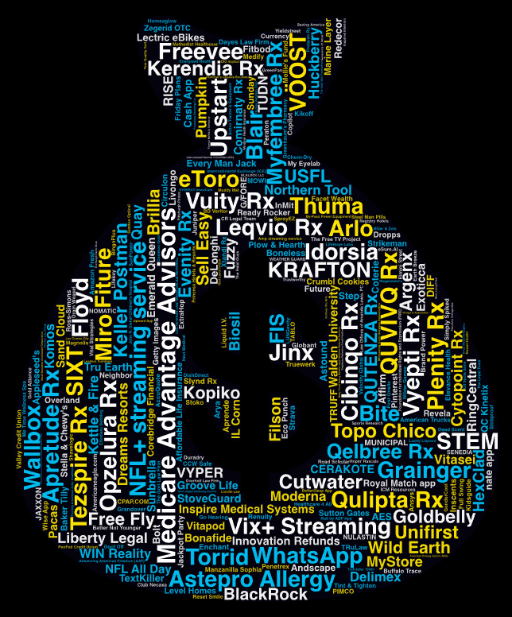
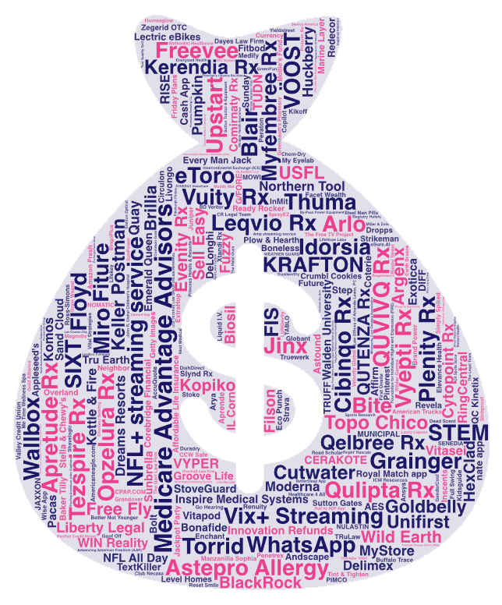



3
TV has been quite resilient amidst economic uncertainty with more dollars being invested by new advertisers in 2022 than prior years
New
TV Advertisers
New National TV Advertisers
2019 - 2022
Year | # of New Advertisers | # of Categories | New TV $$$ (MM)
2019 | 114 | 61 | $843.4
2020 | 283 | 95 | $1,279.1
2021 | 315 | 74 | $1,320.2
2022 | 303 | 71 | $1,331.6
For a full list of the 303 brands with spend click here
Source: VAB analysis of Nielsen Ad Intel data as of 2/16/23, 1/1/22-12/31/22. Prior years based on VAB analysis of Nielsen Ad Intel Data from the following periods: 1/1/2019-12/31/2019, 1/1/2020-12/31/2020, 1/1/2021-12/31/2021. TV spend includes national cable TV, broadcast TV, Spanish language cable TV, Spanish language broadcast TV. Brands reflect those with national TV spend over $100K.
This information is exclusively provided to VAB members and qualified marketers. Further distribution is prohibited.
PAGE 6

Slide 7






4
Looking to stand out in a challenging economy, brands launched TV campaigns to grow awareness, build brand equity and excite consumers
“Now that the brand is more established, our goal is to reach a broader audience to showcase the benefits of Arlo’s smarter security solutions.”
“It’s important for us to find different channels to build brand awareness in a mass way… TV allows for us to get on the radar of those who may have not been familiar with our digital presence, especially as it gives us access to several different audiences and demographics.”
“We’ve always focused on helping our customers design cozy, comfortable spaces that inspire enduring memories and connections. TV allows us to share Plow & Hearth’s story while highlighting the variety and quality of our offering.”
Lily Knowles, Senior Vice President of Sales and Marketing, Arlo
(MediaPost, 8/1/22)
Leslie Newton, CEO, Plow & Hearth
(Plow & Hearth Press Release, 4/25/22)
Nick Guillen, Co-Founder and Co-CEO, Truff
(Ad Age, 9/30/22)
“Our spot [during the Super Bowl] will continue to accelerate awareness as we focus on expanding Cutwater’s footprint across the nation.”
“This is our opportunity to share this amazing American brand with millions which has been rooted in our New England heritage and real-life versatility… and we’re excited for new customers to discover us.”
“We wanted the campaign to position Sunbrella as a lifestyle brand that people proactively seek out to ensure they enjoy their living spaces, worry-free.”
Fabricio Zonzini, President, Beyond Beer (AB InBev)
(Forbes, 2/11/22)
Bobby Ferrario, General Manager and CMO, Orchard Brands
(Business Wire, 9/13/22)
Eric Kallman, Chief Creative Officer / Partner, Erich and Kallman
(campaign ad agency)
(Little Black Book, 4/28/22)
This information is exclusively provided to VAB members and qualified marketers. Further distribution is prohibited.
PAGE 7

Slide 8








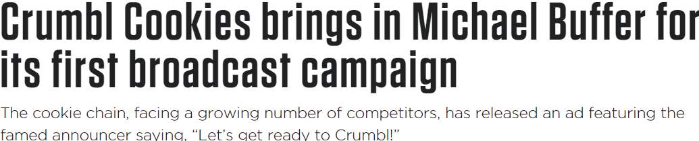
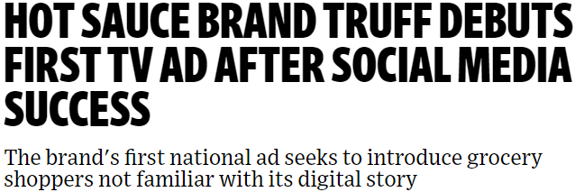










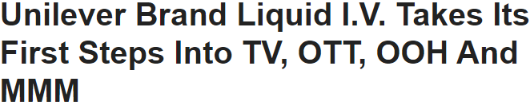
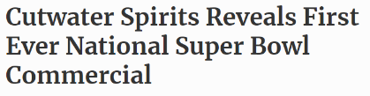








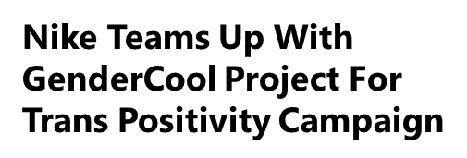

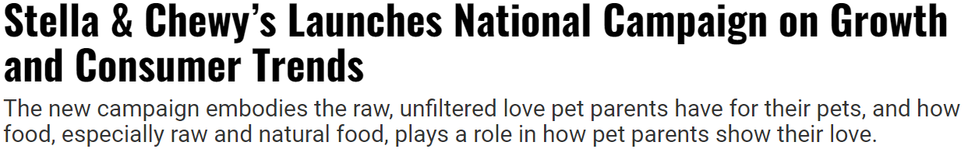





5
Several first-time advertisers also launched in high-profile TV events and created partnerships to generate brand recognition and legitimacy
August 3, 2022
October 17, 2022
September 30, 2022
January 13, 2022
May 27, 2022
August 3, 2022
February 11, 2022
August 23, 2022
September 13, 2022
January 4,2022
March 16, 2022
August 25, 2022
January 28, 2022
December 7, 2022
August 18, 2022
This information is exclusively provided to VAB members and qualified marketers. Further distribution is prohibited.
PAGE 8

Slide 9













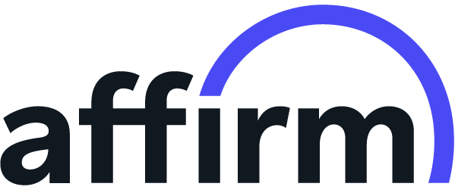

















6
Leading-edge brands and digital-native companies are using TV to engage consumers and ignite trial of their products or services
*Click on any logo to visit their website
‘Younger-skewing’ brands
Brands targeting younger audiences
Innovative products
Brands using cutting-edge technology to offer inventive products / services
Digital endemics
Brands specializing in digital services across
a range of categories
Source: VAB analysis of Nielsen Ad Intel data as of 2/16/23, 1/1/22-12/31/22. TV spend includes national cable TV, broadcast TV, Spanish language cable TV, Spanish language broadcast TV. Brands reflect those with national TV spend over $100K.
This information is exclusively provided to VAB members and qualified marketers. Further distribution is prohibited.
PAGE 9

Slide 10























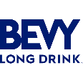





7
New advertisers in functional categories that serve ‘everyday’ needs also seized opportunities to engage with inflation-wary consumers
Functional categories that are seizing opportunities through a new wave of economic uncertainty
Staying on top of their health in order to avoid pricier treatments, consumers are turning to both healthcare & pharma brands
to aid in their ‘everyday concerns’
There has been an influx in spending on insurance across medical, life, pet and auto as consumers look for services to protect themselves during a time of economic uncertainty
With high inflation, consumers’ financial future is top of mind for many, and they are looking for guidance from financial services related to investments, estate & financial planning and personal loans
In addition to providing people solutions to help navigate hybrid work situations, professional services are also aiding the workforce through freelancing opportunities
As economic challenges continue for consumers, more organizations focused on the advancements of energy resources, farming and employment are advertising on TV
for the first time
Consumers are seeking versatile apparel as they look for affordable options that allow them to diversify their wardrobe with a mix of active wear to casual wear and more diverse workplace attire
As consumers put more focus on their holistic health while on a budget, they are turning to affordable and flexible fitness options, as well as vitamin regiments, with the help of fitness & wellness brands
Lifestyle brands that provide ‘affordable luxuries’ like alcohol beverages, food, home and travel are supporting consumers who want to indulge in their pre-Covid activities
in a relatively inexpensive way
*Click on any logo to visit their website
Source: VAB analysis of Nielsen Ad Intel data as of 2/16/23, 1/1/22-12/31/22. TV spend includes national cable TV, broadcast TV, Spanish language cable TV, Spanish language broadcast TV. Brands reflect those with national TV spend over $100K.
This information is exclusively provided to VAB members and qualified marketers. Further distribution is prohibited.
PAGE 10

Slide 11
8
These functional categories were a driving force behind new entrants, accounting for almost $1 billion of first-time TV advertiser investments
2022 New National TV Advertisers
# of Brands
Total Spend ($$$)
Source: VAB analysis of Nielsen Ad Intel data as of 2/16/23, 1/1/22-12/31/22. TV spend includes national cable TV, broadcast TV, Spanish language cable TV, Spanish language broadcast TV. Brands reflect those with national TV spend over $100K. *Brands that align within at least one of the ‘functional’ categories (healthcare / pharma, insurance, financial services, professional services, organizations, apparel & accessories, fitness & wellness and ‘lifestyle’ brands that incorporate home furnishing, home improvement, education, alcohol beverages, food and travel).
This information is exclusively provided to VAB members and qualified marketers. Further distribution is prohibited.
PAGE 11

Slide 12
9
Overall, categories that serve ‘everyday’ needs for consumers took on a renewed importance in an uncertain economy with high inflation
2022 New National TV Advertisers: Top 20 Categories Ranked by Total Spend (including brands)
Rank | Category | # of Brands | % of total brands | Category $$$ (000) | % of total spend
1 | Pharmaceutical | 24 | 14% | $479,694.7 | 40%
2 | Streaming Services | 4 | 2% | $140,767.3 | 12%
3 | Insurance | 9 | 5% | $115,270.8 | 10%
4 | Communications | 2 | 1% | $65,411.9 | 5%
5 | Professional Services | 9 | 5% | $60,047.3 | 5%
6 | Financial Services | 19 | 11% | $57,379.2 | 5%
7 | Apparel & Accessories | 17 | 10% | $45,228.2 | 4%
8 | Health & Wellness | 10 | 6% | $34,664.1 | 3%
9 | Legal Services | 17 | 10% | $28,356.4 | 2%
10 | Home Furnishing | 8 | 5% | $24,632.9 | 2%
Rank | Category | # of Brands | % of total brands | Category $$$ (000) | % of total spend
11 | Insecticides | 1 | 1% | $21,890.2 | 2%
12 | Pet Care | 5 | 3% | $21,480.3 | 2%
13 | Alcoholic Beverages | 9 | 5% | $16,646.3 | 1%
14 | Beverages | 1 | 1% | $15,560.8 | 1%
15 | Gaming | 2 | 1% | $15,440.9 | 1%
16 | Medical Devices | 6 | 4% | $14,946.0 | 1%
17 | Home | 10 | 6% | $13,965.5 | 1%
18 | Fitness | 5 | 3% | $13,846.1 | 1%
19 | Car Rental | 1 | 1% | $12,923.4 | 1%
20 | Vitamins & Supplements | 8 | 5% | $12,715.1 | 1%
 | Category Total | 167 | 55% | $1,210,867.1 | 91%
=categories highlighted align, and are serving, at least one of the functional behaviors (healthcare / pharma, insurance, financial services, professional services, organizations, apparel & accessories, fitness & wellness and ‘lifestyle’ brands that incorporate home furnishing, home improvement, education, alcohol beverages, food and travel).
Source: VAB analysis of Nielsen Ad Intel data as of 2/16/23, 1/1/22-12/31/22. TV spend includes national cable TV, broadcast TV, Spanish language cable TV, Spanish language broadcast TV. Brands reflect those with national TV spend over $100K.
This information is exclusively provided to VAB members and qualified marketers. Further distribution is prohibited.
PAGE 12

Slide 13

Consumer optimism about heading ‘back to school,’ ‘back to work’ and early holiday planning drove a large increase in Q3 TV investment
10
In 2022, over half (56%) of U.S. consumers were intending to start their holiday shopping in October (vs. 45% in 2021)*
New National TV Advertisers
Quarterly spend (MM)
2021
Total $$$: $1,320.2 MM
2022
Total $$$: $1,331.6 MM
Quarter | % difference in spend YOY
Q1 | +5%
Q2 | flat
Q3 | +31%
Q4 | -14%
Source: VAB analysis of Nielsen Ad Intel data as of 2/16/23, 1/1/22-12/31/22. 2021 data based on VAB analysis of Nielsen Ad Intel Data, 1/1/21-12/31/21. TV spend includes national cable TV, broadcast TV, Spanish language cable TV, Spanish language broadcast TV. Brands reflect those with national TV spend over $100K. *Statista, Intended Holiday Shopping Timeline of U.S. Consumers, 1/12/23. Survey was fielded October 9-15, 2022, n=1,073 U.S. respondents.
This information is exclusively provided to VAB members and qualified marketers. Further distribution is prohibited.
PAGE 13

Slide 14
11
While some brands immediately ‘go big’ to support their products, more brands also began ‘testing’ TV to achieve their business KPIs
New National TV Advertisers by Spend Segment
2021 New Entrants
% of Brands within Spend Buckets
2022 New Entrants
% of Brands within Spend Buckets
Source: VAB analysis of Nielsen Ad Intel data as of 2/16/23, 1/1/22-12/31/22. 2021 data based on VAB analysis of Nielsen Ad Intel Data, 1/1/21-12/31/21. TV spend includes national cable TV, broadcast TV, Spanish language cable TV, Spanish language broadcast TV. Brands reflect those with national TV spend over $100K.
This information is exclusively provided to VAB members and qualified marketers. Further distribution is prohibited.
PAGE 14

Slide 15

12
The success of their initial TV campaign activity leads new advertisers to increase their investment as brands battle for market share
2022 New Advertisers Average National TV Spend
Launch Month vs. Post-Launch
($$$)
+54%
(Average Advertiser)
(Monthly Average)
Source: VAB analysis of Nielsen Ad Intel data as of 2/16/23, 1/1/22-12/31/22. TV spend includes national cable TV, broadcast TV, Spanish language cable TV, Spanish language broadcast TV. Brands reflect those with national TV spend over $100K.
This information is exclusively provided to VAB members and qualified marketers. Further distribution is prohibited.
PAGE 15

Slide 16

The need for brands to maintain a relationship with its consumers is heightened in periods of economic uncertainty.
Brands of all types – from digital innovators to those serving more functional consumer needs – create a competitive advantage for themselves by launching TV, using it to ignite awareness and build brand equity, recognition, legitimacy, excitement and trial.
Brands are also aligning with high-profile TV events and creating partnerships to further stand out, drive greater relevancy and emotional engagement.
The versality of TV is a benefit to brands who find they can employ different go-to-market strategies depending upon their objectives and KPIs - some ‘test and learn’ while others immediately ‘go big.’
Evidenced by their significant post-launch investment increase, many brands are seeing the early success of their campaigns.
Key Marketer Takeaways
This information is exclusively provided to VAB members and qualified marketers. Further distribution is prohibited.
PAGE 16

Slide 17


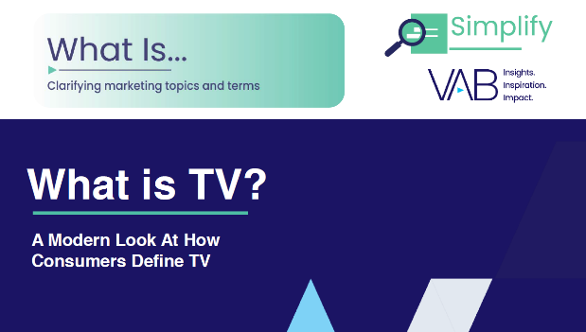




Creators
Jason Wiese
Leah Montner Dixon
SVP, Director of Strategic Insights
jasonw@thevab.com
Associate Insights Director
leahm@thevab.com
Karolina Guillen
25 Ways TV Grows Brands
Powering Performance Through Full-Funnel Business Outcomes
You Oughta Know
Why All Impressions Aren’t Created Equal & What it Means for Video Measurement
Insights Manager
karolinag@thevab.com
Discover more
Looking for more data, insights and takeaways? Check out this related VAB content
What is TV?
A Modern Look At How Consumers Define TV
Let’s Get Down to Business
How Brand-Building Drives Outcomes
for Innovative B2B Advertisers
Through Upfront season, marketers are making important decisions about their video investment strategy.
We’re here to help.
Visit our Upfront Planning Resource Center
for a curated a list of resources filled with the data, analysis and insights needed to make informed investment decisions.
Under Pressure
6 marketing strategies to successfully navigate your brand through inflation
Welcome to TV: 1H ‘22
Meet the Advertisers Seizing Opportunities During a New Wave of Uncertainty
VAB Members, brand marketers and agencies get free and immediate access to VAB’s content library. Get access at theVAB.com
This information is exclusively provided to VAB members and qualified marketers. Further distribution is prohibited.
PAGE 17

Slide 18


About VAB
VAB is an insights-driven organization that inspires marketers to reimagine their media strategies resulting in fully informed decisions.
Drawing on our marketing expertise, we simplify the complexities in our industry and discover new insights that transform the way marketers look at their media strategy.
We are committed to your business growth and proud to offer VAB members, brand marketers and agencies complimentary access to our continuously-growing Insights library. Get immediate access at theVAB.com.
Curious to learn more about VAB? Check out this quick video to see what we do and how we can help you develop business-driving marketing strategies.
This information is exclusively provided to VAB members and qualified marketers. Further distribution is prohibited.
PAGE 18

Slide 19

2022 New National TV Advertiser Lists

Slide 20
New Advertiser List: The national TV marketplace enabled these 303 bold new advertisers across categories and budget levels to increase reach and relevancy
2022 New National TV Advertisers
Brands | $$$ (000) | Brands | $$$ (000) | Brands | $$$ (000) | Brands | $$$ (000) | Brands | $$$ (000) | Brands | $$$ (000) | Brands | $$$ (000) | Brands | $$$ (000)
Medicare Advantage Advisors | $102,610.0 | QUTENZA Rx | $6,443.9 | USFL | $2,193.5 | Baker Tilly | $953.6 | Coterie | $509.2 | Future | $282.2 | Employee Retention Credit Hotline | $196.1 | Gold Alliance | $142.8
Cibinqo Rx | $69,328.2 | Wild Earth | $5,864.2 | Plow & Hearth | $2,184.9 | Redecor | $950.8 | Velocity Global | $497.7 | Road Scholar | $280.6 | Full Swing | $195.8 | SENEDIA | $142.4
Vix+ Streaming | $65,716.4 | Torrid | $5,730.5 | Sunbrella | $1,997.6 | Biosil | $942.2 | Juniper | $487.9 | Copilot | $276.5 | Inspired Interiors | $195.5 | Oil Spots Gone | $140.7
WhatsApp | $64,428.2 | WIN Reality | $5,689.9 | Valley Credit Union | $1,898.2 | Vitasei | $887.2 | Energized Health | $486.2 | Chem-Dry | $273.3 | Founders Brewing Co. | $189.9 | Goof Off | $139.8
Qulipta Rx | $62,150.4 | Walden University | $5,426.8 | Bite | $1,876.8 | American Trucks | $869.1 | Methodist Healthcare | $456.6 | Grandover | $272.0 | Miller & Zois | $187.4 | Linville Law | $139.4
Leqvio Rx | $58,475.9 | Arlo | $5,300.6 | Exoticca | $1,790.0 | Boneless | $862.6 | SYNERGY HomeCare | $442.2 | Registry Hotels | $272.0 | Small Business Assistance Corporation | $187.3 | GreenPan | $134.6
NFL+ streaming service | $57,148.7 | Floyd | $5,243.1 | VYPER | $1,717.5 | Ross-Simons | $853.4 | Circulon | $434.2 | CCW Safe | $271.9 | Trustworthy | $186.4 | AES | $134.6
Opzelura Rx | $50,656.4 | Unifirst | $5,064.0 | Delimex | $1,700.3 | Elevance Health | $786.7 | TRUFF | $433.0 | Windsor Health Insurance | $270.9 | SprayEZ | $184.0 | Heroes Vacation Club | $133.4
QUVIVQ Rx | $28,650.5 | Sell Easy | $4,858.4 | DeLonghi | $1,678.9 | Strikeman | $775.7 | Princess Hotels & Resorts | $431.6 | Magnolia | $256.7 | Pittsburgh Pirates | $180.9 | Northern Sky Brite | $129.4
Tezspire Rx | $27,344.7 | BlackRock | $4,827.1 | Crumbl Cookies | $1,674.5 | Amp streaming service | $763.2 | Yieldstreet | $430.1 | Medify | $255.2 | Wise App | $178.4 | Novant Health | $124.9
Astepro Allergy | $27,055.0 | Free Fly | $4,798.6 | Sutton Gates | $1,572.8 | TUDN | $758.6 | Minnesota Corn Growers Association | $424.2 | Drain Weasel | $254.3 | Stanton Optical | $178.2 | Effortless Bedding | $121.0
Vyepti Rx | $25,312.7 | Huckberry | $4,703.9 | Ready Rocker | $1,551.9 | nate app | $742.8 | Pinterest | $421.8 | Renuity | $253.4 | Stoko | $177.0 | Ropin' Rascals | $116.7
Upstart | $25,008.2 | Dreams Resorts | $4,561.0 | Tru Earth | $1,539.2 | Livongo | $735.9 | ExtraHop | $412.4 | DishDirect | $250.3 | ICM Resources | $175.9 | TABLO | $114.4
Grainger | $24,980.3 | Northern Tool | $4,498.5 | Fuzzy | $1,536.7 | Eco Punch | $699.0 | Sutton Tractor & Equipment | $410.2 | Saving America | $247.3 | SunPower | $175.3 | Monge & Associates | $113.3
Vuity Rx | $22,277.7 | Every Man Jack | $4,281.7 | Appleseed's | $1,533.5 | MUNICIPAL | $686.2 | Homeaglow | $404.5 | Wilder Games | $246.6 | Muddy Mat | $172.7 | eSure.AI | $111.7
STEM | $21,890.2 | CERAKOTE | $4,171.3 | Zegerid OTC | $1,503.9 | Slynd Rx | $674.4 | Aprende | $388.0 | PenFed Credit Union | $242.9 | Kikoff | $170.7 | Think Digital Wellbeing Summit | $110.4
Apretude Rx | $21,586.4 | Kettle & Fire | $4,075.4 | Manzanilla Sophia | $1,499.7 | My Eyelab | $657.4 | Xtandi Rx | $376.7 | The Daily Mile Foundation | $240.4 | Duradry | $168.1 | Guaranteed Acceptance Life Insurance | $110.3
Myfembree Rx | $20,716.9 | Fiture | $3,795.3 | Jackpot Party | $1,499.0 | Simply Spiked | $650.4 | Inscents | $375.4 | Driver Discount Helpline | $233.6 | Tour Quality Golf | $164.4 | MOWI | $105.6
Miro | $18,127.5 | RingCentral | $3,744.4 | Greenbaum's Pharmacy | $1,385.3 | Vital Strategies | $641.6 | Kidsguide | $368.6 | Roll by ADP App | $229.9 | InMit | $163.8 | Pioneer Life Group | $104.7
Freevee | $17,139.0 | Royal Match app | $3,739.5 | Dayes Law Firm | $1,343.3 | Sunday | $637.4 | Liquid I.V. | $365.9 | The Gori Law Firm | $229.8 | Strava | $163.7 | DIO Implact | $104.2
Idorsia | $16,789.3 | Lectric eBikes | $3,554.6 | Filson | $1,323.6 | Neighbor | $636.8 | Dropps | $364.3 | TRuLaw | $229.3 | Truthteller 19839 | $162.2 | Generators Of Maine | $103.4
Kerendia Rx | $16,735.9 | Corebridge Financial | $3,467.9 | QC Kinetix | $1,316.9 | FIS | $631.0 | International Rescue Committee (IRC) | $347.7 | Puncher's Chance Bourbon | $228.7 | Arya | $161.9 | Bevy Long Drink | $103.1
Plenity Rx | $16,729.7 | Argenx | $3,453.9 | Overland | $1,308.1 | Me Time Wellness Spa | $611.7 | Advancing American Freedom (AAF) | $339.3 | BD Veritor | $228.2 | Protaren Rx | $161.3 | Bolt | $101.6
Qelbree Rx | $15,936.8 | Comirnaty Rx | $3,433.6 | Andscape | $1,298.9 | Truewerk | $605.1 | WEATHER GUARD | $325.0 | Sports Research | $228.0 | Exchange Pawn Shop | $159.9
Topo Chico | $15,560.8 | Emerald Queen | $3,339.7 | Komos | $1,296.7 | Amazon Fresh | $590.1 | Buffalo Trace | $315.7 | JAXXON | $227.2 | Las Cruces City | $159.5
KRAFTON | $14,490.1 | Affordable Life Insurance | $3,253.0 | John R. Oishei Children's Hospital | $1,295.4 | Better Not Younger | $589.8 | NULASTIN | $315.1 | Healthcare 4 All | $227.1 | Shavelogic | $158.8
eToro | $14,422.3 | Groove Life | $3,159.5 | Law Offices of Amanda Lewis, PC | $1,186.5 | CR Legal Team | $575.2 | Step | $309.5 | Club Necaxa | $225.3 | First Onsite | $158.6
Thuma | $14,388.3 | Jinx | $3,154.0 | Getty Images | $1,167.4 | Steel Man Pills | $570.2 | Leaders Furniture | $309.4 | PIMCO | $222.8 | Common Goal | $157.7
Inspire Medical Systems | $13,883.0 | MyStore | $3,097.7 | Americaneagle.com | $1,161.3 | RISE | $565.6 | Revela | $305.6 | BetterSleep App | $222.7 | Peachtree Orthopedics | $156.9
Cutwater | $13,550.9 | Pumpkin | $3,043.1 | FIRE | $1,157.5 | By-Pass Power Equipment | $562.1 | DIFF | $297.1 | Forrest McKie & Company | $220.4 | Lifekey | $156.9
Liberty Legal | $13,035.8 | HexClad | $2,913.9 | Bonafide | $1,149.8 | IL Corn | $559.9 | Enchant | $295.2 | American Energy Action (AEA) | $217.9 | Slobproof | $154.3
SIXT | $12,923.4 | NFL All Day | $2,855.8 | Astound | $1,121.9 | Currency | $557.0 | NOMATIC | $293.2 | Riegelmann's | $215.8 | Reset Smile | $152.3
Blair | $11,903.2 | Kopiko | $2,852.1 | Friday Plans | $1,088.7 | Brand Power | $556.3 | Peraton | $291.1 | Penetrex | $213.9 | GenderCool | $150.9
Innovation Refunds | $9,771.7 | Stella & Chewy's | $2,735.4 | The Free TV Project | $1,084.6 | USA Veteran Law Group | $545.4 | Pacas | $290.2 | Fueling American Jobs Coalition | $213.4 | Dead Scent | $150.7
VÖOST | $9,233.3 | StoveGuard | $2,484.1 | Intercontinental Exchange (ICE) | $1,067.2 | Tint & Tighten | $538.7 | Rimini Street | $288.2 | The Halal Guys | $213.0 | Upward App | $148.8
Wallbox | $8,329.2 | Marine Layer | $2,480.9 | Facet Wealth | $1,036.0 | Baby Food Heavy Metals Legal Helpline Referral Services | $526.1 | LifeHope Labs | $287.5 | BLALOCK LLC | $211.0 | Lucky Liquors | $148.5
Cytopoint Rx | $8,190.0 | Moderna | $2,429.9 | Quay | $1,007.8 | Mollie's Fund | $524.5 | Go Hearing | $285.7 | Overholt Law Firm | $207.9 | Next Medical | $146.8
Keller Postman | $7,836.3 | Sand Cloud | $2,406.6 | Vitapod | $997.8 | Fitbod | $524.1 | AccuQuote | $285.3 | Affirm | $206.6 | The Legal Team | $144.9
Evenity Rx | $7,555.4 | Cash App | $2,276.5 | TextKiller | $983.7 | Globant | $522.7 | BingoPlus | $285.0 | Earth Breeze | $204.9 | Ansys | $143.8
To click through to a brand’s website, view in ‘slide show’ and click on the appropriate link.
Source: VAB analysis of Nielsen Ad Intel data as of 2/16/23, 1/1/22-12/31/22. TV spend includes national cable TV, broadcast TV, Spanish language cable TV, Spanish language broadcast TV. Brands reflect those with national TV spend over $100K.
This information is exclusively provided to VAB members and qualified marketers. Further distribution is prohibited.
PAGE 20

Slide 21



























The DTC segment continues to drive new entrants with 99 brands across 37 categories, spending over $377 million
2022 New National TV DTC Advertisers
Brands | Categories | $$$ (000) |  | Brands | Categories | $$$ (000) |  | Brands | Categories | $$$ (000)
Vix+ Streaming | Streaming Services | $65,716.4 |  | Sunbrella | Home Furnishing | $1,997.6 |  | Homeaglow | Cleaning & Sanitation | $404.5
NFL+ streaming service | Streaming Services | $57,148.7 |  | Valley Credit Union | Financial Services | $1,898.2 |  | Aprende | Online Education | $388.0
Upstart | Financial Services | $25,008.2 |  | Bite | Personal Care | $1,876.8 |  | Dropps | Home | $364.3
Miro | Professional Services | $18,127.5 |  | Exoticca | Travel | $1,790.0 |  | NULASTIN | Personal Care | $315.1
Freevee | Streaming Services | $17,139.0 |  | VYPER | Chairs | $1,717.5 |  | Step | Financial Services | $309.5
eToro | Financial Services | $14,422.3 |  | Fuzzy | Pet Care | $1,536.7 |  | DIFF | Eyewear | $297.1
Thuma | Home Furnishing | $14,388.3 |  | Andscape | Media | $1,298.9 |  | Pacas | Apparel & Accessories | $290.2
Inspire Medical Systems | Medical Devices | $13,883.0 |  | Bonafide | Personal Care | $1,149.8 |  | AccuQuote | Financial Services | $285.3
Blair | Apparel & Accessories | $11,903.2 |  | The Free TV Project | Entertainment | $1,084.6 |  | CPAP.COM | Medical Devices | $283.0
Wallbox | Automotive | $8,329.2 |  | Facet Wealth | Financial Services | $1,036.0 |  | Future | Fitness | $282.2
Goldbelly | Online Food Delivery Service | $7,200.3 |  | Quay | Eyewear | $1,007.8 |  | Road Scholar | Educational Travel | $280.6
Wild Earth | Pet Care | $5,864.2 |  | Vitapod | Vitamins & Supplements | $997.8 |  | Copilot | Mobile Apps | $276.5
Torrid | Apparel & Accessories | $5,730.5 |  | TextKiller | Communications | $983.7 |  | Medify | Home | $255.2
WIN Reality | Fitness | $5,689.9 |  | American Trucks | Automotive | $869.1 |  | Renuity | Home Improvement | $253.4
Arlo | Home | $5,300.6 |  | Strikeman | Shooting Training | $775.7 |  | Wilder Games | Entertainment | $246.6
Floyd | Home Furnishing | $5,243.1 |  | Amp streaming service | Streaming Services | $763.2 |  | PenFed Credit Union | Financial Services | $242.9
BlackRock | Financial Services | $4,827.1 |  | TUDN | Media | $758.6 |  | Roll by ADP App | Financial Services | $229.9
Free Fly | Apparel & Accessories | $4,798.6 |  | Livongo | Health & Wellness | $735.9 |  | JAXXON | Jewelry | $227.2
Huckberry | Apparel & Accessories | $4,703.9 |  | MUNICIPAL | Apparel & Accessories | $686.2 |  | Earth Breeze | Cleaning & Sanitation | $204.9
Every Man Jack | Personal Care | $4,281.7 |  | Sunday | Home Improvement | $637.4 |  | Full Swing | Sports Equipment | $195.8
Kettle & Fire | Food | $4,075.4 |  | Neighbor | Storage | $636.8 |  | Small Business Assistance Corporation | Financial Services | $187.3
Fiture | Fitness | $3,795.3 |  | FIS | Financial Services | $631.0 |  | Trustworthy | Security System | $186.4
RingCentral | Professional Services | $3,744.4 |  | Truewerk | Apparel & Accessories | $605.1 |  | Wise App | Financial Services | $178.4
Lectric eBikes | Fitness | $3,554.6 |  | Amazon Fresh | Grocery Stores | $590.1 |  | Stoko | Apparel & Accessories | $177.0
Groove Life | Apparel & Accessories | $3,159.5 |  | Better Not Younger | Personal Care | $589.8 |  | Duradry | Personal Care | $168.1
Jinx | Pet Care | $3,154.0 |  | RISE | Health & Wellness | $565.6 |  | Shavelogic | Personal Care | $158.8
Pumpkin | Insurance | $3,043.1 |  | Currency | Financial Services | $557.0 |  | Lifekey | Wearable Devices | $156.9
HexClad | Home | $2,913.9 |  | Fitbod | Fitness | $524.1 |  | Reset Smile | Personal Care | $152.3
NFL All Day | Fandom / Collectibles | $2,855.8 |  | Coterie | Personal Care | $509.2 |  | Dead Scent | Cleaning & Sanitation | $150.7
Marine Layer | Apparel & Accessories | $2,480.9 |  | Velocity Global | Professional Services | $497.7 |  | Oil Spots Gone | Home Improvement | $140.7
Sand Cloud | Towels | $2,406.6 |  | TRUFF | Food | $433.0 |  | GreenPan | Home | $134.6
Cash App | Financial Services | $2,276.5 |  | Yieldstreet | Financial Services | $430.1 |  | MOWI | Online Food Delivery Service | $105.6
Plow & Hearth | Home Furnishing | $2,184.9 |  | ExtraHop | Cybersecurity | $412.4 |  | Bolt | Financial Services | $101.6
DTC brands accounted for 33% of total new TV advertisers and 28%
of total TV spend
(vs. 2021: 42% of advertisers; 43% of spend)
Logos represent a sampling of new national TV DTC advertisers
Source: VAB analysis of Nielsen Ad Intel data as of 2/16/23, 1/1/22-12/31/22. TV spend includes national cable TV, broadcast TV, Spanish language cable TV, Spanish language broadcast TV. Brands reflect those with national TV spend over $100K.
This information is exclusively provided to VAB members and qualified marketers. Further distribution is prohibited.
PAGE 21

