Slide 1





Welcome to TV
Understanding the 16 Consumer Behaviors That Are Driving New Advertisers
2022
Full Year 2021 Update

Slide 2
Since We Last Spoke…
Over the last two editions of VAB’s bi-annual series, Welcome to TV, we saw a burst of new advertisers enter the national TV marketplace across a variety of emerging categories that were either driven by, or accelerated due to, pandemic influences.
Since then, a lot has changed and consumer optimism on economic recovery grew in the second half of 2021. Even though
the number of new entrants was propped up by an influx of COVID-related advertisers during the height of the pandemic, the national TV marketplace welcomed even more brands and spend in 2021 despite its shift away from COVID-related categories
as competition increased across traditional categories that may have pulled back investment at the start of the pandemic.
With the marketplace shifting towards a post-pandemic world, TV is a valuable platform for brands from all walks of life
to tap into new audiences on a larger scale and drive awareness.
New TV Advertisers
 | Full-Year 2020 |  | 1st Half of 2021 |  | 2nd Half of 2021
 | # | % | # | % | # | %
COVID-related brands | 140 | 49% | 76 | 47% | 4 | 3%
Non-COVID related brands | 143 | 51% | 86 | 53% | 149 | 97%
Total # of brands | 283 |  | 162 |  | 153
Source: VAB analysis of Nielsen Ad Intel data, 1/1/20-12/31/21. TV spend includes national cable TV, broadcast TV, Spanish language cable TV, Spanish language broadcast TV. Brands reflect those with national TV spend over $100K. ‘COVID-related’ includes brands in categories that serve consumer needs directly associated with the pandemic like hand sanitizers and telemedicine (endemic) or driven by the pandemic like online delivery, home improvement and health (COVID-related).
‘non-COVID’ related include brands in categories not related to the pandemic that most likely would’ve expanded and advertised regardless of the pandemic like streaming services, crypto and pharmaceuticals.
This information is exclusively provided to VAB members and qualified marketers. Further distribution is prohibited.
PAGE 2

Slide 3
As consumer optimism in U.S. economic recovery grew, marketers were
given the encouragement needed to invest in their brands after a period of unprecedented uncertainty
Confidence in U.S. Economic Recovery After COVID-19
% of U.S. respondents who feel optimistic*
+29%
*Optimistic: The economy will rebound within 2-3 months and become just as strong as it was before COVID-19 or stronger
Source: McKinsey & Company, US Consumer sentiment and behaviors during the coronavirus crisis, December 14, 2021.
This information is exclusively provided to VAB members and qualified marketers. Further distribution is prohibited.
PAGE 3

Slide 4
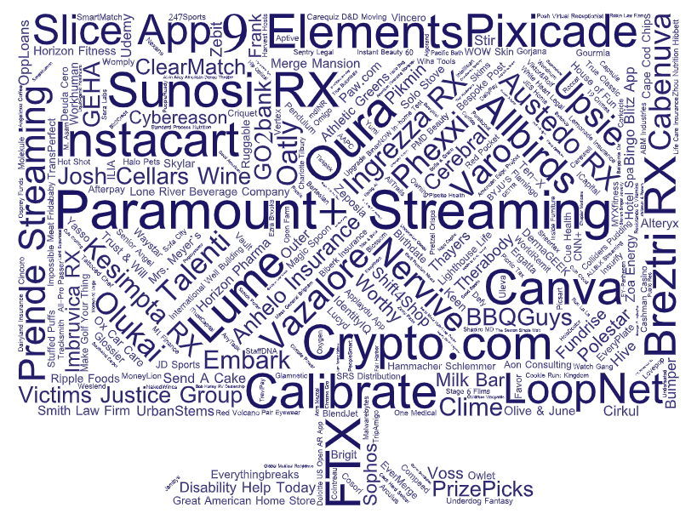
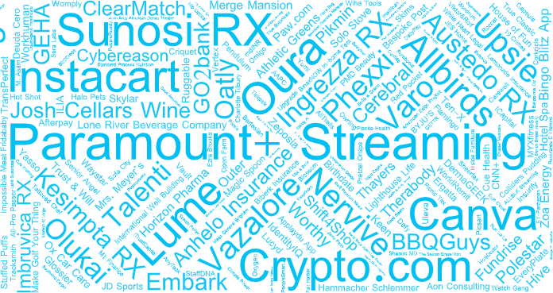
Emboldened by this shift
in both consumer and marketer mindsets,
315 advertisers across
74 categories invested
over $1.3 billion in national TV advertising for the first time, resulting in a higher total spend and more new advertisers vs. the year prior
Source: VAB analysis of Nielsen Ad Intel data, 1/1/21-12/31/21. TV spend includes national cable TV, broadcast TV, Spanish language cable TV, Spanish language broadcast TV. Brands reflect those with national TV spend over $100K.
This information is exclusively provided to VAB members and qualified marketers. Further distribution is prohibited.
PAGE 4

Slide 5



Categories born out
of COVID-related needs declined in relevance and, as a result, disappeared from the landscape. However, there was a surge in brands from
both new and traditional categories.
New National TV Advertisers
2020 vs. 2021 Comparison
Year | # of Brands | # of Categories | New TV $$$ (MM)
2020 | 283 | 95 | $1,279.1
2021 | 315 | 74 | $1,320.2
# YoY Diff | +32 | -21 | +$41.2
% YoY Diff | +11% | -22% | +3%
The increase in brands is attributable to entrants in newer categories like cryptocurrency and greater competition within traditional categories
like home, apparel & accessories and personal care.
For a full list of the 315 brands with spend click here
Source: VAB analysis of Nielsen Ad Intel data, 1/1/20-12/31/20 vs. 1/1/21-12/31/21. TV spend includes national cable TV, broadcast TV, Spanish language cable TV, Spanish language broadcast TV. Brands reflect those with national TV spend over $100K. MM = millions.
This information is exclusively provided to VAB members and qualified marketers. Further distribution is prohibited.
PAGE 5

Slide 6




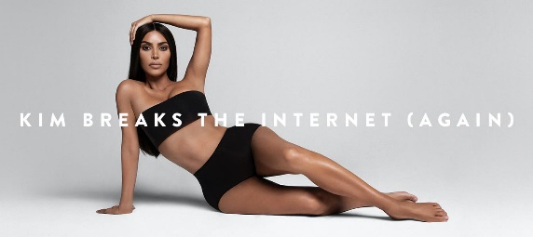

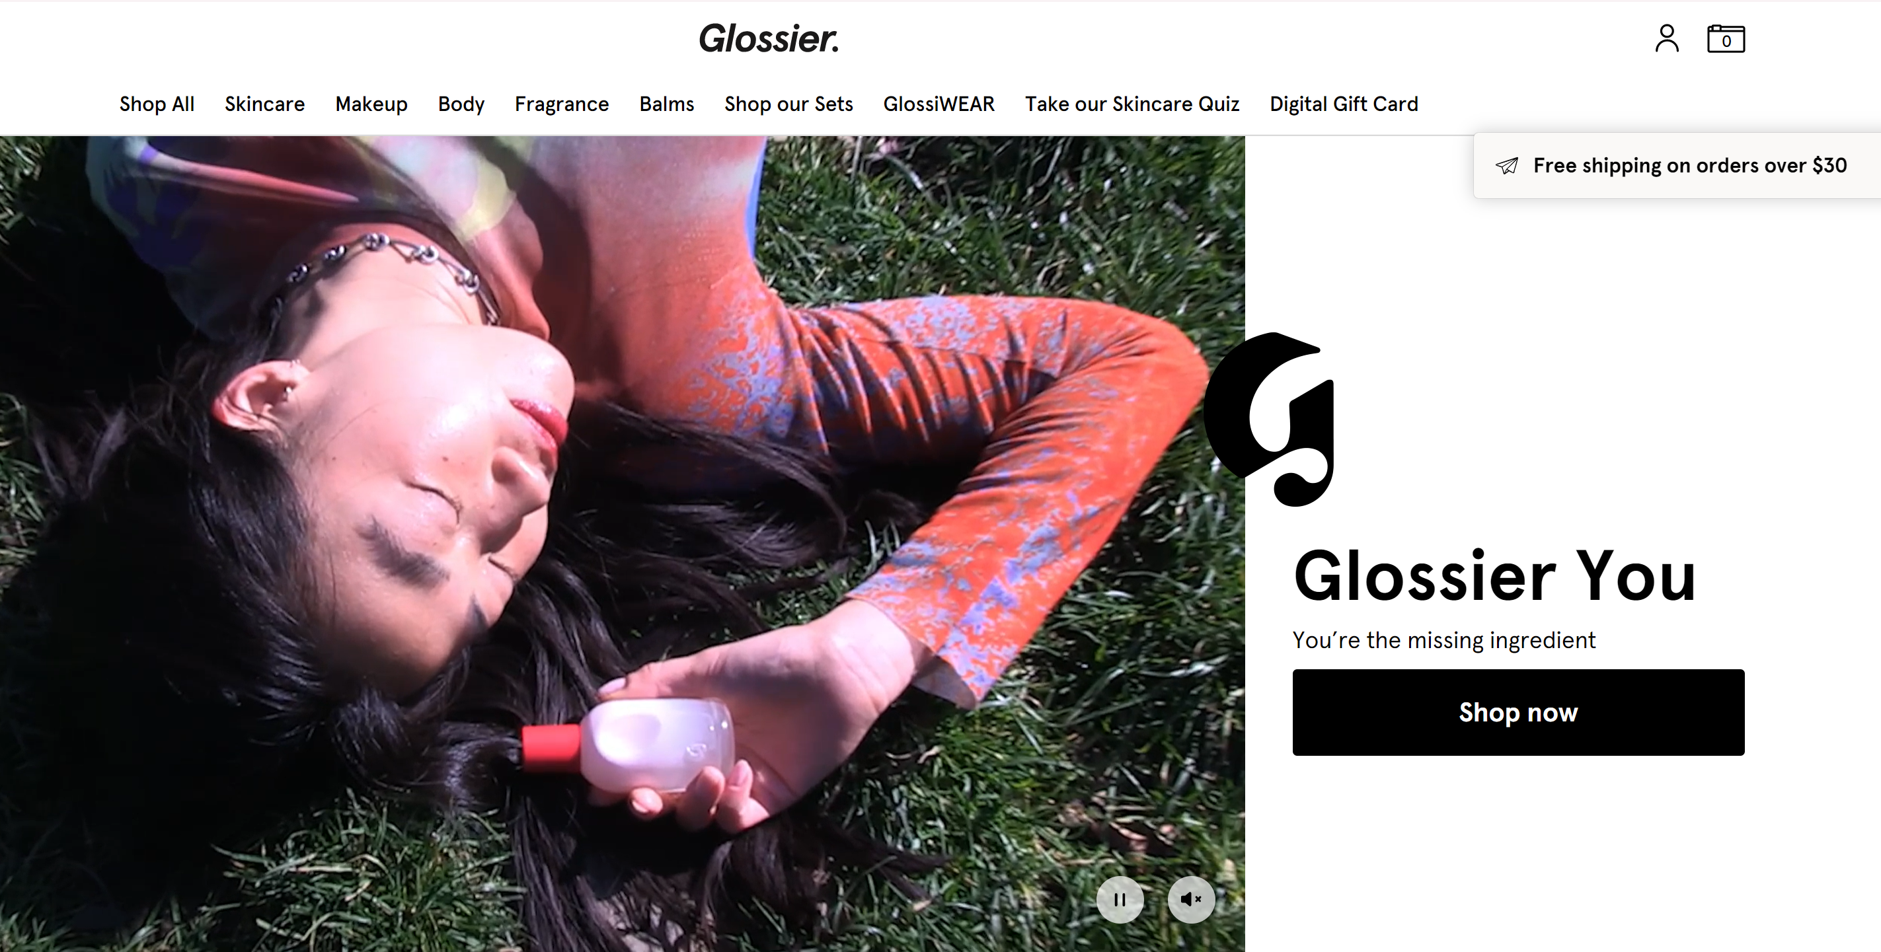
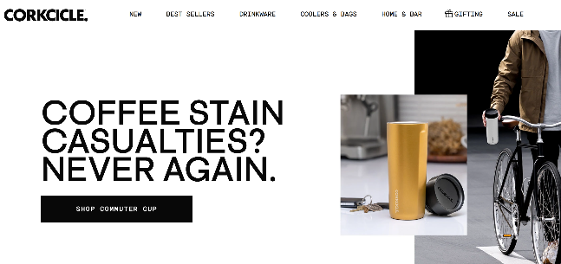





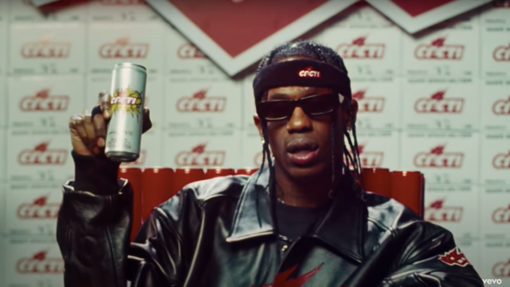
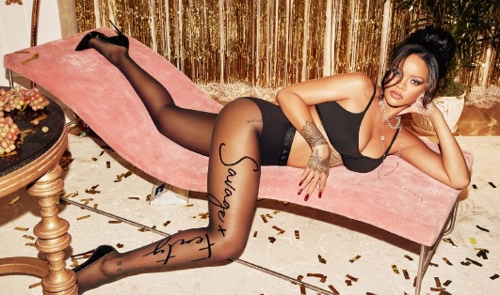
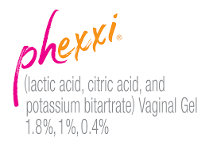



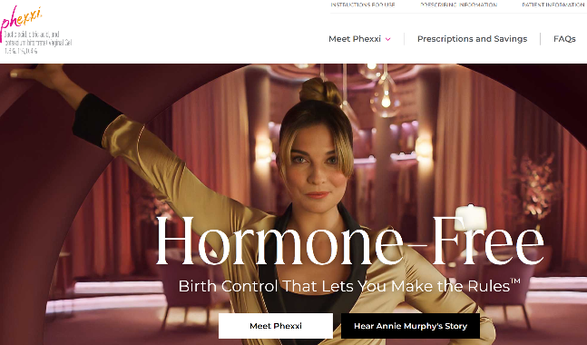
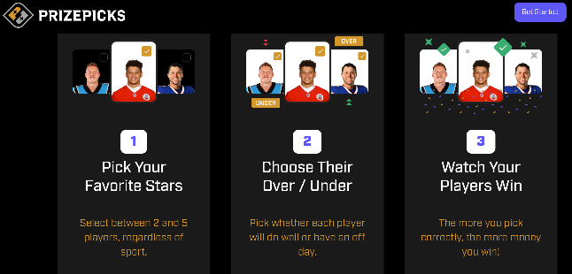



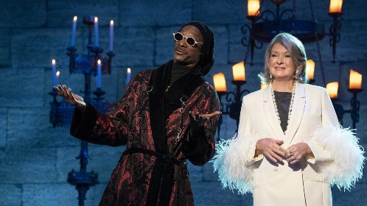
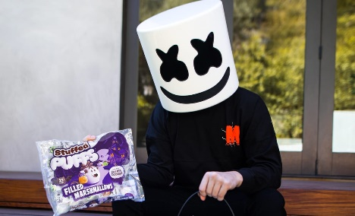

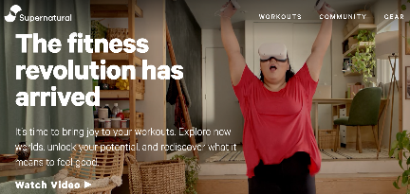

Fueled by post-Covid optimism and energy, brands used TV to shift their tone, taking risks and pushing boundaries to disrupt the norms
Sampling of New ‘Disruptor’ National TV Advertisers
*Click on any logo to visit their website
‘Celebrity’ brands
Brands owned by or partnering with celebrities
‘Younger-skewing’ brands
Brands that are targeting younger audiences
‘Newer’ brands
Brands across newer categories and unique / disruptor brands across traditional categories
Cryptocurrency is an emerging and fast-growing category with several new advertisers accounting for a significant amount of new national TV spend.
Several brands are disrupting traditional categories like insurance, fitness and auto. For example, Lemonade claims to “reverse the traditional insurance model,” offering transparency and donating to charitable causes.
Source: VAB analysis of Nielsen Ad Intel data, 1/1/21-12/31/21. TV spend includes national cable TV, broadcast TV, Spanish language cable TV, Spanish language broadcast TV. Brands reflect those with national TV spend over $100K. DTC brands are active across these categories. Click on any brand logo above to visit their URL.
This information is exclusively provided to VAB members and qualified marketers. Further distribution is prohibited.
PAGE 6

Slide 7








Looking for revenue growth, these younger-skewing, disruptor brands use TV to attract new customers and create excitement
“This is the introduction of our brand to the world. We just want to raise awareness and show folks what we stand for.”
“We decided to use TV the night before launch to make a big statement and build excitement around Cacti's launch.”
“This work is all about investing in the growth of our customer base.”
Steven Kalifowitz, CMO, Crypto.com
(Ad Age, 10/28/21)
Geoff Seeley, Global CMO, Afterpay
(Ad Age, 5/21/21)
Lana Buchanan, VP of Marketing, AB InBev’s Beyond Beer Division
(Ad Age, 3/15/21)
“It’s about scale and the halo effect television offers…. As we try to expose our brand to a larger audience and get that reach, you can really see the sound and sight of TV being able to do that.”
“We're excited to bring Stuffed Puffs to a bigger audience this season in collaboration with our partner Marshmello.”
“Broadcast gives us the ability to introduce this brand in really a powerful way…We’re reaching a bigger audience [than we would have before].”
Alvaro De La Rocha, CMO, Bespoke Post
(Digiday, 9/30/21)
Russ Barrans, Chief Commercial Officer, Evofem Biosciences
(manufacturer of Phexxi)
(Fierce Pharma, 2/22/21)
Michael Tierney, CEO and Founder, Stuffed Puffs
(Stuffed Puffs Press Release, 5/17/21)
“Launching a commercial is the natural next step to drive more awareness and excitement around the brand and products.”
“We as a brand were very excited to share with more consumers via our TV campaigns what supplements can do for their pets and pet ownership.”
“Our mission is to say, hey, our product is for every person, so we want to reach really broad audiences.
Sarah Galletti, Founder & Chief Creative Officer, Tattooed Chef
(Tattooed Chef Press Release, 4/5/21)
Manbir Sodhia, VP of Growth, Oura
(AdExchanger, 3/30/22)
Yvethe Tyszka, VP of Marketing, Zesty Paws
(Brand Innovators, 1/12/21)
This information is exclusively provided to VAB members and qualified marketers. Further distribution is prohibited.
PAGE 7

Slide 8






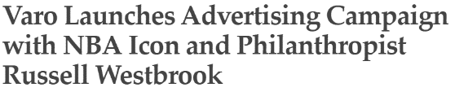

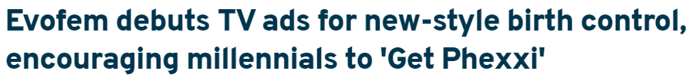
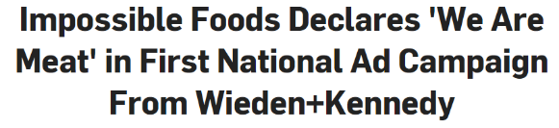

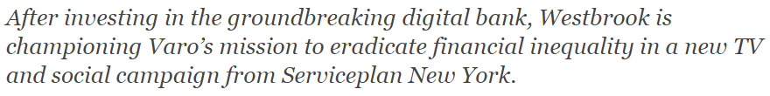





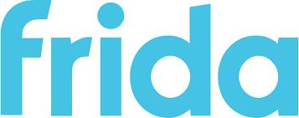
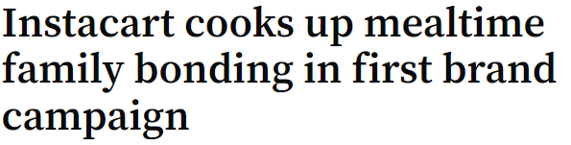
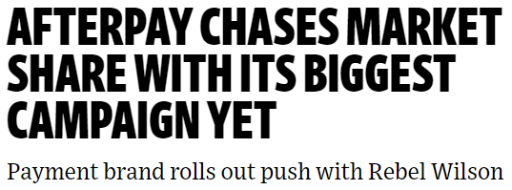
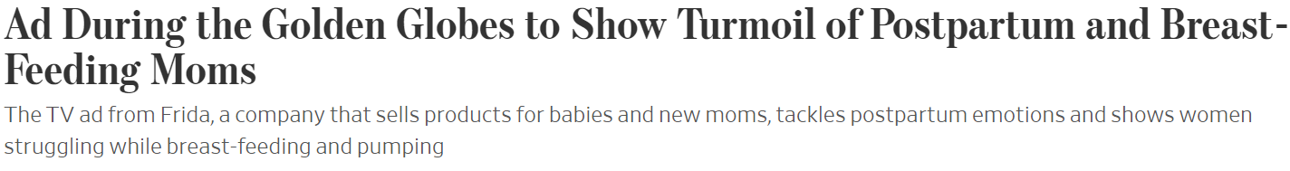



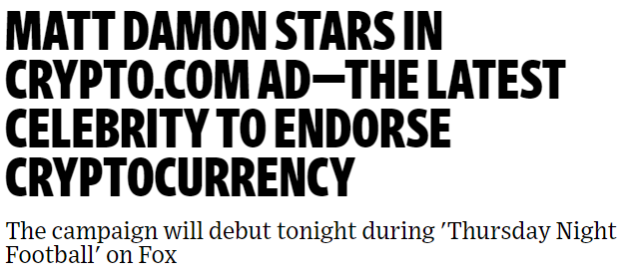




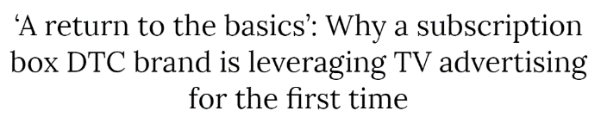





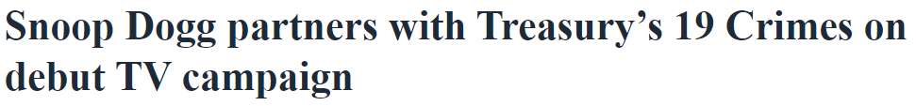

To generate wide-scale instant legitimacy, many new advertisers launched their first national TV campaign during high profile events and/or through partnerships with iconic personalities, creating a positive halo effect on their brand
February 22, 2021
May 12, 2021
April 6, 2021
February 7, 2021
September 9, 2021
November 15, 2021
February 26, 2021
May 21, 2021
February 18, 2021
October 28, 2021
January 25, 2021
July 12, 2021
July 12, 2021
November 28, 2021
March 15, 2021
This information is exclusively provided to VAB members and qualified marketers. Further distribution is prohibited.
PAGE 8

Slide 9

As COVID concerns waned and consumer optimism grew, new national TV investment
was driven by a series of evolving consumer behaviors and category pivots

Slide 10
Consumer optimism over the vaccine rollout and economic recovery drove increases in new advertiser TV investment in 1Q and 4Q, respectively
New National TV Advertisers
Quarterly spend (MM)
2020
Total $$$: $1,279.1 MM
2021
Total $$$: $1,320.2 MM
Quarter | % difference in spend YOY
Q1 | +27%
Q2 | -10%
Q3 | -14%
Q4 | +16%
Source: VAB analysis of Nielsen Ad Intel data, 1/1/20-12/31/21. TV spend includes national cable TV, broadcast TV, Spanish language cable TV, Spanish language broadcast TV. Brands reflect those with national TV spend over $100K. Percentages may not add up to 100% due to rounding. MM=millions.
This information is exclusively provided to VAB members and qualified marketers. Further distribution is prohibited.
PAGE 10

Slide 11
As optimism grew in the second half of 2021, more advertisers invested over $500k into their first campaign as competition to connect with consumers intensified
1H vs. 2H ’21 New National TV Advertisers by Spend Segment
1H ’21 New Entrants*
% of Brands within Spend Buckets
2H ’21 New Entrants
% of Brands within Spend Buckets
Source: VAB analysis of Nielsen Ad Intel data, 1/1/21-12/31/21. TV spend includes national cable TV, broadcast TV, Spanish language cable TV, Spanish language broadcast TV. Brands reflect those with national TV spend over $100K. MM = millions. Percentages may not add up to 100% due to rounding. ‘New entrants’ refers to advertisers that launched a national TV campaign for the first time during a specific time period (i.e., 1H vs. 2H). *1H ‘21 new advertiser spend buckets aren’t inclusive of their spend invested in 2H. MM=millions.
This information is exclusively provided to VAB members and qualified marketers. Further distribution is prohibited.
PAGE 11

Slide 12
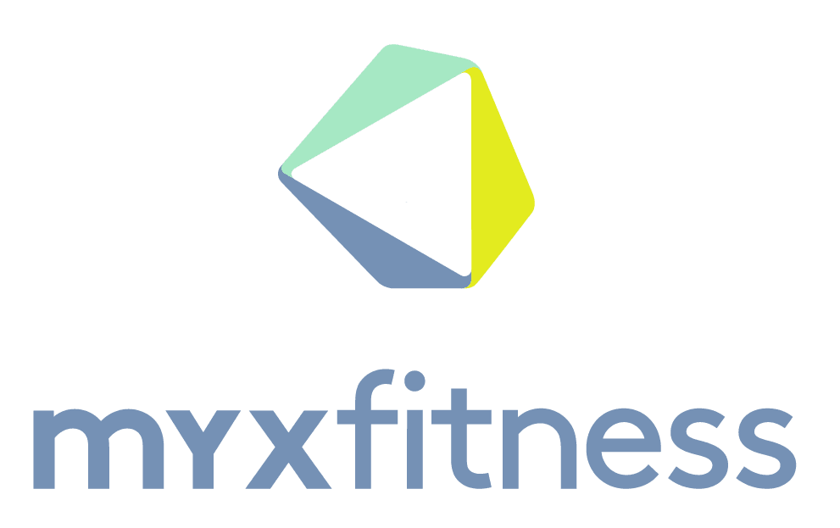

















To best gauge the impact of the pandemic on new advertisers, we continued to segment the brands into COVID-related and non-COVID
‘COVID-Related’ Brands*:
brands in categories that serve consumer needs
that were either driven by or directly associated with COVID
(i.e., lifestyle / behavioral changes – home improvement, exercise equipment; hand sanitizers; contactless solutions – online delivery,
online banking)
‘non-COVID’ Brands:
brands in categories not related to the pandemic that most likely would have advertised regardless
(i.e., streaming services, pharmaceuticals unrelated
to COVID, skincare & beauty)
Sampling of ‘COVID-related’ brands
Sampling of ‘non-COVID’ related brands
Source: VAB analysis of Nielsen Ad Intel data, 1/1/21-12/31/21. TV spend includes national cable TV, broadcast TV, Spanish language cable TV, Spanish language broadcast TV. Brands reflect those with national TV spend over $100K. *’COVID-related’ brands includes ‘COVID-endemic’ brands, which are in categories that serve consumer needs directly associated with COVID (i.e., hand sanitizers, telemedicine, at-home medical testing).
This information is exclusively provided to VAB members and qualified marketers. Further distribution is prohibited.
PAGE 12

Slide 13
While new entrants in 1H ’21 were almost evenly split between COVID and non-COVID related brands, nearly all the brands to emerge in 2H ’21 sought to capitalize on a renewed sense of consumer optimism
New National TV Advertisers
COVID vs. non-COVID comparison
1st Half ’21 New Entrants
% (# of brands - total spend)
2nd Half ’21 New Entrants
% (# of brands - total spend)
1H ‘21
2H ‘21
162 Brands
153 Brands
Source: VAB analysis of Nielsen Ad Intel data, 1/1/21-12/31/21. TV spend includes national cable TV, broadcast TV, Spanish language cable TV, Spanish language broadcast TV. Brands reflect those with national TV spend over $100K. Percentages may not add up to 100% due to rounding.
This information is exclusively provided to VAB members and qualified marketers. Further distribution is prohibited.
PAGE 13

Slide 14

As the marketplace shifts away from a divide of COVID vs. non-COVID brands, which pandemic-influenced consumer behaviors spurred new category entrants?

Slide 15




























New advertisers launched TV campaigns to meet the needs of several lasting consumer behaviors that accelerated, or emerged, during the pandemic and which are now evolving towards a post-pandemic society
8 Key Evolving COVID-related Consumer Behaviors
*Click on any logo to visit their website
Even as people spent more time at home earlier in the pandemic, home improvement has continued to be relevant and important as homeowners are inspired to renovate
Cleaning and sanitation are now
a staple among households and workplaces even as the second half saw fewer entrants
Consumers who may have paid more attention to their healthcare during the height of the pandemic turned to brands that provide at-home testing, telemedicine, and guidance around health insurance benefits
Those spending more time indoors turned to wellness and fitness brands that offer exercise equipment and vitamins & supplements
Online delivery services made ordering products more accessible for consumers who preferred less direct in-person contact, and the convenience factor has stuck even
as society opened back up
Brands that offer professional services, in-house or remotely, are capitalizing on the need for workplace solutions as professionals go back to the office and companies look for ways to improve performance
As vaccinations rose and restrictions eased, outdoor recreation /
in-country travel became a popular leisure time activity, a behavior likely to continue as a cost-friendly vacation alternative during this inflationary time
‘Buy now & pay later’ brands are capitalizing on the trend of providing consumers with online financing and flexible payment options, which represents another offering that’s useful during an inflationary period
Source: VAB analysis of Nielsen Ad Intel data, 1/1/21-12/31/21. TV spend includes national cable TV, broadcast TV, Spanish language cable TV, Spanish language broadcast TV. Brands reflect those with national TV spend over $100K. DTC brands are active across these categories. Click on any brand logo above to visit their URL. Brands are a sampling across categories affected by evolving consumer behaviors.
This information is exclusively provided to VAB members and qualified marketers. Further distribution is prohibited.
PAGE 15

Slide 16
Beyond the direct effects of COVID, what other behaviors emerged that inspired new advertisers?

Slide 17
























Eight additional evolving consumer behaviors across categories like entertainment, finance, fashion and health and wellness inspired new entrants to enter the marketplace
8 Key Evolving non-COVID-related Consumer Behaviors
*Click on any logo to visit their website
Several crypto brands have launched campaigns as digital currency has entered the mainstream and become a popular way to make transactions
Major media companies continue to launch their direct-to-consumer video streaming platforms as audiences’ appetite for streamed content grows
More financial services / online banking are launching in the marketplace to satisfy consumers’ need for easier access to their finances and planning
Brands across fashion & beauty such as apparel, personal care and skincare & beauty are re-emerging now that social distancing practices have been relaxed
The desire to connect with ‘celebrity’ brands has become popular as famous entrepreneurs have launched or partnered with brands across a variety of categories like alcoholic beverages, snacks and apparel
Organizations (mindful brands) are investing at a time when consumers are passionate about brands that promote social change
Organic & plant-based foods have emerged as people become more conscious about what they eat and the source of ingredients in their food
Gaming, including esports, continues to grow in popularity as an interactive entertainment alternative to other video platforms
Source: VAB analysis of Nielsen Ad Intel data, 1/1/21-12/31/21. TV spend includes national cable TV, broadcast TV, Spanish language cable TV, Spanish language broadcast TV. Brands reflect those with national TV spend over $100K. DTC brands are active across these categories. Click on any brand logo above to visit their URL. Brands are a sampling across categories affected by evolving consumer behaviors.
This information is exclusively provided to VAB members and qualified marketers. Further distribution is prohibited.
PAGE 17

Slide 18






Even brands that had pivoted to focus on products influenced by the pandemic re-shifted to promote more of their broad-based products
Examples include:
The apparel & accessories category, which saw many brands pivot to comfortable attire or facemasks during the pandemic, has seen advertisers return to promoting their full line of products suited to a more social lifestyle
Cleaning and sanitation brands advertising hand sanitizers and air filters that could eliminate COVID germs have shifted to be more focused on the general cleaning properties of their products
Health & wellness brands that highlighted how their products could alleviate stress caused by the pandemic or even diagnose symptoms of COVID have since
re-adopted their pre-pandemic messaging
Source: VAB analysis of Nielsen Ad Intel data, 1/1/21-12/31/21. TV spend includes national cable TV, broadcast TV, Spanish language cable TV, Spanish language broadcast TV. Brands reflect those with national TV spend over $100K. DTC brands are active across these categories. Click on any brand logo above to visit their URL.
This information is exclusively provided to VAB members and qualified marketers. Further distribution is prohibited.
PAGE 18

Slide 19
In total, the 16 consumer behaviors identified were a driving force behind new TV entrants, accounting for 61% of new advertisers in 2021
2021 New National TV Advertisers
# of Brands
Total Spend ($$$)
*’Behavior-Driven’ brands = brands that align, and are serving, at least one of the 16 consumer behaviors outlined previously
Source: VAB analysis of Nielsen Ad Intel data, 1/1/21-12/31/21. TV spend includes national cable TV, broadcast TV, Spanish language cable TV, Spanish language broadcast TV. Brands reflect those with national TV spend over $100K.
This information is exclusively provided to VAB members and qualified marketers. Further distribution is prohibited.
PAGE 19

Slide 20
Signifying their importance, the key consumer behaviors fueled brand campaign launches across 21 of the top 30 categories
2021 New National TV Advertisers: Top 30 Categories Ranked by # of Brands (including spend)
Rank | Category | # of Brands | % of total brands | Category $$$ (000) | % of total spend
1 | Financial Services | 21 | 7% | $30,029.2 | 2%
2 | Apparel & Accessories | 19 | 6% | $41,635.6 | 3%
3 | Professional Services | 15 | 5% | $19,186.3 | 1%
4 | Insurance | 15 | 5% | $87,377.4 | 7%
5 | Skincare & Beauty | 14 | 4% | $17,055.0 | 1%
6 | Pharmaceutical | 11 | 3% | $331,010.8 | 25%
7 | Legal Services | 11 | 3% | $20,329.2 | 2%
8 | Home | 11 | 3% | $12,667.6 | 1%
9 | Personal Care | 10 | 3% | $18,922.5 | 1%
10 | Alcoholic Beverages | 10 | 3% | $11,541.8 | 1%
11 | Health & Wellness | 9 | 3% | $50,566.6 | 4%
12 | Mobile Apps | 8 | 3% | $18,761.6 | 1%
13 | Crypto | 7 | 2% | $79,446.8 | 6%
14 | Food (misc) | 7 | 2% | $16,996.6 | 1%
15 | Vitamins & Supplements | 7 | 2% | $21,688.5 | 2%
Rank | Category | # of Brands | % of total brands | Category $$$ (000) | % of total spend
16 | Gaming | 6 | 2% | $9,694.9 | 1%
17 | Fitness | 6 | 2% | $4,718.1 | 0%
18 | Home Furnishing | 6 | 2% | $5,638.5 | 0%
19 | Pet Care | 5 | 2% | $7,670.9 | 1%
20 | Cybersecurity | 5 | 2% | $11,531.9 | 1%
21 | Cleaning & Sanitizing | 5 | 2% | $25,825.8 | 2%
22 | Beverages | 5 | 2% | $12,038.9 | 1%
23 | Organizations | 5 | 2% | $9,060.3 | 1%
24 | Jewelry | 5 | 2% | $952.2 | 0%
25 | Online Banking | 4 | 1% | $19,466.1 | 1%
26 | Snacks | 4 | 1% | $13,721.1 | 1%
27 | Online Education | 4 | 1% | $2,507.5 | 0%
28 | Food Delivery | 4 | 1% | $26,760.5 | 2%
29 | Streaming Services | 4 | 1% | $265,929.0 | 20%
30 | Home Improvement | 4 | 1% | $2,034.4 | 0%
30 Category Total |  | 247 | 78% | $1,194.8 MM | 90%
=categories highlighted align, and are serving, at least one of the 16 consumer behaviors outlined previously
Source: VAB analysis of Nielsen Ad Intel data, 1/1/21-12/31/21. TV spend includes national cable TV, broadcast TV, Spanish language cable TV, Spanish language broadcast TV. Brands reflect those with national TV spend over $100K.
21 out of the 30 top categories align with the 16 evolving consumer behaviors, accounting for 71% of brands and 58% of spend within those categories.
This information is exclusively provided to VAB members and qualified marketers. Further distribution is prohibited.
PAGE 20

Slide 21
The ‘behavior’-driven brands increased their investment dramatically following their TV launch after seeing positive outcomes and the opportunity to further grow their customer base and market share
2021 New Advertisers Average National TV Spend: Launch Month vs. Post-Launch Month
Monthly Average (000)
Brands Aligning with the 16 Behaviors
All Other Brands
+27%
+122%
TV Campaign Launch Month
(Monthly Average)
TV Campaign
Post-Launch
(Monthly Average)
TV Campaign Launch Month
(Monthly Average)
TV Campaign
Post-Launch
(Monthly Average)
Source: VAB analysis of Nielsen Ad Intel data, 1/1/21-12/31/21. TV spend includes national cable TV, broadcast TV, Spanish language cable TV, Spanish language broadcast TV. Brands reflect those with national TV spend over $100K.
This information is exclusively provided to VAB members and qualified marketers. Further distribution is prohibited.
PAGE 21

Slide 22





Key Takeaways For Marketing Plans
The lingering effects of COVID influence consumer behavior
Advertisers Are Using TV to Drive Awareness & Recognition
TV is a Valuable Platform
for Brands of All Kinds
No ‘One Size Fits All’ Approach for New Advertisers
These changed behaviors have resulted in new products and categories entering the marketplace, along with a
swell of new advertising spend.
Many brands are launching their first national TV campaigns by aligning with high-profile TV events and celebrity partnerships to reach big audiences that will drive immediate recognition and create consumer excitement.
Looking to introduce their brand to the world, a wide swath of unique categories with different brand personalities, business models and life stages across a variety of consumer audiences have turned to TV to grow.
Depending on the business objectives and desired outcomes, different brands employ different go-to-market strategies to deliver successful results – some ‘test and learn’ while others immediately ‘go big.’
This information is exclusively provided to VAB members and qualified marketers. Further distribution is prohibited.
PAGE 22

Slide 23





Jason Wiese
Leah Montner-Dixon
Karolina Guillen
SVP, Director of Strategic Insights
jasonw@thevab.com
Associate Insights Director
leahm@thevab.com
Insights Manager
karolinag@thevab.com
Discover more
Looking for more data, insights and takeaways? Check out this related VAB content
Today’s Innovations in Measurement
Real-world case studies from industry innovators
The Secret of My Success
Examining The Winning Marketing Strategy That’s Fueling High-Growth DTC Brands
Click here for the full list of 2021 new national TV advertisers by brand spend
Welcome to TV: 1H ‘21
Meet the New Advertisers and See How Categories Are Evolving Due To Consumer Demand
Welcome to TV: FY 2020
Who’s Behind The $1.3 Billion Investment During a Year of Uncertainty
VAB Members, brand marketers and agencies get free and immediate access to VAB’s content library. Get access at theVAB.com
This information is exclusively provided to VAB members and qualified marketers. Further distribution is prohibited.
PAGE 23

Slide 24


About VAB
VAB is an insights-driven organization that inspires marketers to reimagine their media strategies resulting in fully informed decisions.
Drawing on our marketing expertise, we simplify the complexities in our industry and discover new insights that transform the way marketers look at their media strategy.
We are committed to your business growth and proud to offer VAB members, brand marketers and agencies complimentary access to our continuously-growing Insights library. Get immediate access at theVAB.com.
Curious to learn more about VAB? Check out this quick video to see what we do and how we can help you develop business-driving marketing strategies.
This information is exclusively provided to VAB members and qualified marketers. Further distribution is prohibited.
PAGE 24

Slide 25
2021 New National TV Advertiser Lists

Slide 26
New Advertiser List: The national TV marketplace enabled these 315 bold new advertisers across categories and budget levels to increase reach and relevancy
2021 New National TV Advertisers
Brands | $$$ (000) | Brands | $$$ (000) | Brands | $$$ (000) | Brands | $$$ (000) | Brands | $$$ (000) | Brands | $$$ (000) | Brands | $$$ (000) | Brands | $$$ (000)
Paramount+ Streaming | $178,920.3 | Colliders Pudding | $5,389.1 | OppLoans | $2,310.4 | Clime | $1,312.9 | Owning | $738.8 | Women at Large | $447.6 | ITA Restructuring | $255.8 | SurelyWell | $166.3
Prende Streaming | $84,665.4 | Make Golf Your Thing | $4,968.6 | WorldRemit | $2,249.9 | Mass General Brigham | $1,244.9 | Uncommon Goods | $733.7 | Brigit | $443.1 | Favor | $247.3 | Scotch Porter | $164.8
Anhelo Insurance | $57,554.0 | Sophos | $4,891.1 | Tattooed Chef | $2,167.7 | 19 Crimes | $1,239.0 | Underdog Fantasy | $726.3 | MoneyLion | $431.4 | Harvest Hosts | $246.0 | NakedWines | $162.4
Ingrezza RX | $57,119.5 | Fundrise | $4,736.2 | IdentityIQ | $2,144.0 | Red Pocket | $1,218.6 | Picnic Tax | $718.1 | Cointreau | $428.0 | Oxygen | $245.0 | Standard Process Nutrition | $156.3
Breztri RX | $50,818.1 | Cape Cod Chips | $4,615.4 | Ruggable | $2,120.5 | Capsule | $1,203.2 | Zebit | $709.0 | Omigo | $427.7 | SmartMatch | $244.1 | The Sexton Single Malt | $155.4
Kesimpta RX | $49,560.9 | Josh Cellars Wine | $4,608.6 | Cashman Casino | $2,114.5 | M1 Finance | $1,182.9 | Afterpay | $695.5 | Motorsport Games | $419.6 | Owlet | $241.9 | Carequiz | $152.9
Crypto.com | $46,856.0 | Worthy | $4,605.3 | Paw.com | $2,054.8 | Ergatta | $1,163.6 | JD Sports | $694.9 | Skylar | $408.4 | Watch Gang | $241.2 | Weitzman & Powers | $146.8
Sunosi RX | $45,024.5 | Zoa Energy | $4,576.7 | Merge Mansion | $2,052.7 | Pretzel Crisps | $1,143.9 | Carewell | $683.6 | Blossom | $406.2 | Posh Virtual Receptionist | $240.7 | Robin Law Firm | $146.1
Austedo RX | $39,764.9 | Impossible Meat | $4,281.5 | EveryPlate | $1,993.9 | Climate Power | $1,143.7 | HolaDoctor | $682.8 | Sera Labs | $397.0 | Picsart | $239.9 | PeopleReady | $145.0
Canva | $34,871.5 | Workhuman | $4,217.1 | Send A Cake | $1,929.8 | MYXfitness | $1,088.2 | Ezra Brooks | $672.7 | AllTrails | $392.5 | Cozy Earth Bedding | $236.0 | Childress Vineyards | $143.2
Cabenuva | $33,346.8 | Lighthouse Life | $4,124.6 | PMD Beauty | $1,885.8 | WOW Skin | $1,054.2 | SRS Distribution | $666.0 | Arculus | $386.6 | Biz2Credit | $234.3 | EasyKnock | $142.2
FTX | $31,026.6 | Pixicade | $4,121.1 | Everythingbreaks | $1,882.7 | ICapital | $1,047.0 | TripAmigo | $650.7 | Simplehuman | $376.3 | Acre Mezcal | $232.4 | TreviPay | $141.5
Oura | $30,462.0 | Ox Car Care | $3,965.1 | True Classic | $1,860.2 | Open Farm | $1,036.1 | iTrustCapital | $633.4 | PeopleSmart | $375.1 | Chroma Gro | $232.3 | Confide | $141.1
Allbirds | $24,857.5 | Bespoke Post | $3,926.8 | American Edge Project | $1,847.9 | JES Home | $1,036.1 | Good Sports | $622.7 | Womply | $370.0 | Intelliloan | $224.1 | Hello Bag | $137.4
9 Elements | $18,954.6 | Solo Stove | $3,859.9 | Zeposia | $1,806.7 | Instant Beauty 60 | $1,026.8 | Bartesian | $620.4 | AnyTask | $364.6 | Gorjana | $223.7 | Defy | $136.9
Imbruvica RX | $18,426.9 | House of Fun | $3,845.6 | Aon Consulting | $1,795.9 | Hammacher Schlemmer | $1,018.7 | Pureboost | $612.5 | Pair Eyewear | $362.5 | Algorand | $219.4 | Shapiro MD | $135.6
Instacart | $16,959.4 | BBQGuys | $3,812.2 | Ripple Foods | $1,783.6 | Swift Premium Meats | $993.1 | Good American | $609.4 | Global Medical Response | $359.1 | Yumi | $215.8 | Roccat | $132.8
Vazalore | $14,844.0 | GEHA | $3,792.0 | Smith Law Firm | $1,727.9 | Voss | $976.2 | Zesty Paws | $601.5 | Tickpick | $358.2 | ILIA | $211.1 | Pacific Bath | $132.8
Lume | $13,245.6 | Disability Help Today | $3,579.9 | Frank | $1,722.2 | Zhou Nutrition | $962.2 | Hot Shot | $598.3 | ABM Industries | $353.7 | Wiha Tools | $207.5 | Aptive | $130.8
GO2bank | $12,547.9 | BinaxNOW In-home Test | $3,553.6 | Horizon Fitness | $1,718.5 | Viktor&Rolf | $958.2 | Gourmia | $587.7 | Gallagher Law Group | $345.3 | Top Eleven App | $206.9 | Bitwise Investments | $129.6
Nervive | $11,819.8 | Thayers | $3,468.7 | Waystar | $1,714.4 | CNN+ | $940.2 | Wondrium | $585.0 | Savage X Fenty | $338.8 | Criquet | $201.3 | Glamnetic | $127.8
LoopNet | $11,555.3 | Embark | $3,456.7 | Glossier | $1,694.7 | Cacti Hard Seltzer | $919.2 | Vault | $580.2 | Pegasystems | $336.7 | EY-Parthenon | $200.8 | Vertex | $123.5
Phexxi | $10,893.8 | DermaGEEK | $3,358.9 | Charlotte Tilbury | $1,658.9 | Udemy | $918.2 | BOOM! by Cindy Joseph | $561.3 | Augustinus Bader | $328.5 | Steven Singer Jewelry | $200.3 | SwitchUp | $121.0
International Well Building | $10,192.6 | Trust & Will | $3,313.5 | Pendulum | $1,505.7 | American Financing Mortgage | $885.1 | Life Care Insurance | $531.7 | Public Rec | $321.5 | Fancy Sprinkles | $199.7 | Fair Harbor | $119.6
Cerebral | $10,028.5 | EverMerge | $3,096.4 | Cue Health | $1,501.7 | BYJU’S | $883.3 | Upgrade | $523.5 | Alteryx | $319.3 | Coin Cloud | $195.2 | Wolf & Badger | $117.9
Horizon Pharma | $9,404.7 | ClearMatch | $3,075.0 | Bumper | $1,487.5 | Lucyd | $877.0 | Stage 6 Films | $522.8 | CrossCountry Mortgage | $318.2 | Pipette Health | $192.4 | Pixels | $116.7
Talenti | $8,973.2 | TransPerfect | $3,011.4 | Birthdate | $1,485.7 | Yasso | $864.5 | Halo Pets | $521.8 | Resistance C Vitamins | $318.1 | Angelinos Coffee | $191.9 | Jet Academy | $116.7
Calibrate | $8,573.4 | Applaydu App | $2,971.5 | Compeed | $1,484.1 | Tracksmith | $841.6 | Vincero | $515.2 | Quiver Distribution | $307.9 | One Medical | $189.4 | Cuts Clothing | $113.9
Upsie | $8,083.9 | Cybereason | $2,969.8 | Flamingo | $1,459.0 | Keen | $822.7 | Sentry Legal | $514.0 | Belpointe Oz | $307.0 | AAPC | $188.8 | True Hardwoods | $112.4
Olukai | $7,429.0 | Magic Spoon | $2,913.9 | Social Media Victims Law Center | $1,443.0 | Skims | $819.4 | BlendJet | $513.8 | mdINR | $296.2 | Laird Superfood | $185.8 | Weslend | $109.5
Therabody | $6,886.3 | Lone River Beverage Company | $2,866.1 | UrbanStems | $1,432.3 | Insurify | $816.2 | Molekule | $512.0 | Cookie Run: Kingdom | $293.2 | Supernatural | $183.6 | Undefeated | $107.9
Bingo Blitz App | $6,774.9 | Deloitte US Open AR App | $2,865.0 | Hotel Spa | $1,431.7 | Fridababy | $809.0 | D&D Moving | $503.8 | 247Sports | $293.1 | LiquidAgents Healthcare | $179.6 | Epilog AI | $106.3
Shift4Shop | $6,369.0 | Milk Bar | $2,850.2 | Outer | $1,411.5 | Cirkul | $794.1 | Sofia & Grace | $501.2 | Osprey Funds | $291.8 | StaffDNA | $179.6 | Uleva | $105.8
Athletic Greens | $6,314.0 | Lemonade Insurance | $2,833.3 | ALLBLK Streaming | $1,403.1 | Cosori | $788.0 | Rue La La | $497.0 | Red Volcano | $287.2 | Origin In-home Test | $176.0 | Los Andes Homes | $104.3
Varo | $6,241.8 | PrizePicks | $2,790.4 | Malwarebytes | $1,385.8 | Sheertex | $782.1 | Working For Women | $477.3 | Hibbett | $287.2 | GETTR | $171.5 | Stir | $101.9
Victims Justice Group | $6,087.0 | White Heart Legal | $2,770.0 | Deuda Cero | $1,381.8 | Great American Home Store | $762.9 | Inside Furniture | $466.2 | Jambys | $281.0 | Corkcicle | $169.9
Slice App | $5,877.4 | Pikmin | $2,730.5 | All-Pro Passer | $1,377.0 | Southwind Carpet | $761.3 | Nitya Capital | $459.0 | Alvin Ailey American Dance Theater | $279.5 | Nice & Bella | $169.1
Polestar | $5,876.1 | Stuffed Puffs | $2,572.8 | Hive | $1,367.9 | Sofa City | $760.7 | Lovepop | $455.3 | Cincoro | $277.4 | Chapter Medicare | $169.0
Mrs. Meyer’s | $5,839.2 | Senior Angel | $2,553.7 | Dairyland Insurance | $1,366.0 | True Botanicals | $759.0 | Legacy Quote Insurance | $455.1 | Nexans | $263.3 | M. Asam | $168.2
Oatly | $5,500.0 | Biberk Insurance | $2,456.3 | Ten-X | $1,350.7 | Olive & June | $751.1 | Hip Optical | $448.8 | DailyPay | $258.3 | Bob Hurley RV Dealership | $168.1
To click through to a brand’s website, view in ‘slide show’ and click on the respective link.
Source: VAB analysis of Nielsen Ad Intel data, 1/1/21-12/31/21. TV spend includes national cable TV, broadcast TV, Spanish language cable TV, Spanish language broadcast TV. Brands reflect those with national TV spend over $100K.
The above chart represents the full list of new advertisers, including direct-to-consumer brands.
This information is exclusively provided to VAB members and qualified marketers. Further distribution is prohibited.
PAGE 26

Slide 27























The DTC segment continues to drive new entrants with 132 brands across 52 categories, spending over $570 million
2021 New National TV DTC Advertisers
Brands | Categories | $$$ (000) |  | Brands | Categories | $$$ (000) |  | Brands | Categories | $$$ (000) |  | Brands | Categories | $$$ (000)
Paramount+ Streaming | Streaming Services | $178,920.3 |  | Lemonade Insurance | Insurance | $2,833.3 |  | Insurify | Insurance | $816.2 |  | Tickpick | Mobile Tickets | $358.2
Crypto.com | Crypto | $46,856.0 |  | PrizePicks | Online Betting | $2,790.4 |  | Fridababy | Personal Care | $809.0 |  | Savage X Fenty | Apparel & Accessories | $338.8
Canva | Graphic Design | $34,871.5 |  | Pikmin | Gaming | $2,730.5 |  | Sheertex | Apparel & Accessories | $782.1 |  | Pegasystems | Professional Services | $336.7
FTX | Crypto | $31,026.6 |  | WorldRemit | Financial Services | $2,249.9 |  | Owning | Financial Services | $738.8 |  | Alteryx | Computer Software | $319.3
Allbirds | Apparel & Accessories | $24,857.5 |  | IdentityIQ | Cybersecurity | $2,144.0 |  | Uncommon Goods | Gifts | $733.7 |  | Quiver Distribution | Film Production | $307.9
Instacart | Food Delivery | $16,959.4 |  | Ruggable | Home Furnishing | $2,120.5 |  | Underdog Fantasy | Gaming | $726.3 |  | Cookie Run: Kingdom | Mobile Apps | $293.2
Lume | Personal Care | $13,245.6 |  | Cashman Casino | Mobile Apps | $2,114.5 |  | Zebit | Marketplace | $709.0 |  | Osprey Funds | Financial Services | $291.8
GO2bank | Online Banking | $12,547.9 |  | Merge Mansion | Gaming | $2,052.7 |  | Afterpay | Financial Services | $695.5 |  | Favor | Personal Care | $247.3
Nervive | Vitamins & Supplements | $11,819.8 |  | EveryPlate | Food Delivery | $1,993.9 |  | Carewell | Personal Care | $683.6 |  | SmartMatch | Insurance | $244.1
Cerebral | Telemedicine | $10,028.5 |  | Send A Cake | Food Delivery | $1,929.8 |  | TripAmigo | Travel | $650.7 |  | Owlet | Health & Wellness | $241.9
Talenti | Food (misc) | $8,973.2 |  | True Classic | Apparel & Accessories | $1,860.2 |  | iTrustCapital | Crypto | $633.4 |  | Picsart | Mobile Apps | $239.9
Upsie | Insurance | $8,083.9 |  | Frank | Social Network | $1,722.2 |  | Bartesian | Home | $620.4 |  | Biz2Credit | Financial Services | $234.3
Therabody | Health & Wellness | $6,886.3 |  | Waystar | Financial Services | $1,714.4 |  | Good American | Apparel & Accessories | $609.4 |  | Chroma Gro | Plant Care | $232.3
Bingo Blitz App | Mobile Apps | $6,774.9 |  | Glossier | Skincare & Beauty | $1,694.7 |  | Zesty Paws | Pet Care | $601.5 |  | Gorjana | Jewelry | $223.7
Athletic Greens | Vitamins & Supplements | $6,314.0 |  | Pendulum | Vitamins & Supplements | $1,505.7 |  | Wondrium | Online Education | $585.0 |  | Algorand | Crypto | $219.4
Varo | Online Banking | $6,241.8 |  | Cue Health | At-Home Testing | $1,501.7 |  | Vault | Health & Wellness | $580.2 |  | Top Eleven App | Gaming | $206.9
Slice App | Food Delivery | $5,877.4 |  | Bumper | Automotive | $1,487.5 |  | Upgrade | Financial Services | $523.5 |  | Coin Cloud | Crypto | $195.2
Mrs. Meyer’s | Cleaning & Sanitizing | $5,839.2 |  | Birthdate | Gifts | $1,485.7 |  | Vincero | Apparel & Accessories | $515.2 |  | Pipette Health | Personal Care | $192.4
Make Golf Your Thing | Organizations | $4,968.6 |  | Flamingo | Personal Care | $1,459.0 |  | Sofia & Grace | Personal Care | $501.2 |  | Angelinos Coffee | Beverages | $191.9
Fundrise | Financial Services | $4,736.2 |  | UrbanStems | Flower Delivery | $1,432.3 |  | Rue La La | Apparel & Accessories | $497.0 |  | One Medical | Health & Wellness | $189.4
Josh Cellars Wine | Alcoholic Beverages | $4,608.6 |  | Outer | Home Furnishing | $1,411.5 |  | Lovepop | Gifts | $455.3 |  | Supernatural | Fitness | $183.6
Worthy | Marketplace | $4,605.3 |  | ALLBLK Streaming | Streaming Services | $1,403.1 |  | Legacy Quote Insurance | Insurance | $455.1 |  | StaffDNA | Professional Services | $179.6
Pixicade | Direct Response | $4,121.1 |  | Hive | Online Delivery | $1,367.9 |  | Hip Optical | Eyewear | $448.8 |  | GETTR | Social Network | $171.5
Bespoke Post | Online Subscription Service | $3,926.8 |  | Clime | Weather | $1,312.9 |  | Brigit | Financial Services | $443.1 |  | Corkcicle | Drinkware | $169.9
House of Fun | Gaming | $3,845.6 |  | Capsule | Online Delivery | $1,203.2 |  | MoneyLion | Online Banking | $431.4 |  | NakedWines | Alcohol Delivery | $162.4
BinaxNOW In-home Test | At-Home Testing | $3,553.6 |  | MYXfitness | Fitness | $1,088.2 |  | Omigo | Home | $427.7 |  | Confide | Cybersecurity | $141.1
Embark | Pet Care | $3,456.7 |  | Instant Beauty 60 | Skincare & Beauty | $1,026.8 |  | Motorsport Games | Esports | $419.6 |  | Hello Bag | Home | $137.4
EverMerge | Mobile Apps | $3,096.4 |  | Swift Premium Meats | Food (misc) | $993.1 |  | Skylar | Fragrances | $408.4 |  | Bitwise Investments | Crypto | $129.6
Applaydu App | Mobile Apps | $2,971.5 |  | CNN+ | Streaming Services | $940.2 |  | Blossom | Mobile Apps | $406.2 |  | Fair Harbor | Apparel & Accessories | $119.6
Cybereason | Cybersecurity | $2,969.8 |  | Udemy | Online Education | $918.2 |  | AllTrails | Outdoor Recreation | $392.5 |  | Wolf & Badger | Jewelry | $117.9
Magic Spoon | Food (misc) | $2,913.9 |  | BYJU’S | Online Education | $883.3 |  | Arculus | Crypto | $386.6 |  | Pixels | Home Furnishing | $116.7
Deloitte US Open AR App | Mobile Apps | $2,865.0 |  | Tracksmith | Apparel & Accessories | $841.6 |  | AnyTask | Professional Services | $364.6 |  | Cuts Clothing | Apparel & Accessories | $113.9
Milk Bar | Food (misc) | $2,850.2 |  | Keen | Psychic Readings | $822.7 |  | Pair Eyewear | Eyewear | $362.5 |  | Stir | Online Dating | $101.9
DTC brands accounted for 42% of total new TV advertisers and 43%
of total TV spend
(vs. 2020: 42% of advertisers; 36% of spend)
Logos represent a sampling of new national TV DTC advertisers
Source: VAB analysis of Nielsen Ad Intel data, 1/1/21-12/31/21. TV spend includes national cable TV, broadcast TV, Spanish language cable TV, Spanish language broadcast TV. Brands reflect those with national TV spend over $100K.
This information is exclusively provided to VAB members and qualified marketers. Further distribution is prohibited.
PAGE 27

Slide 28
COVID-related brands
2021 New National TV COVID-Related Advertisers
Brands | Category | Total Spend $$$ (000) |  | Brands | Category | Total S$$ (000) |  | Brands | Category | Total Spend $$$ (000)
Anhelo Insurance | Insurance | $57,554.0 |  | Outer | Home Furnishing | $1,411.5 |  | Resistance C Vitamins | Vitamins & Supplements | $318.1
Oura | Health & Wellness | $30,462.0 |  | Hive | Online Delivery | $1,367.9 |  | mdINR | At-Home Testing | $296.2
Allbirds | Apparel & Accessories | $24,857.5 |  | Ten-X | Real Estate | $1,350.7 |  | Harvest Hosts | Travel | $246.0
9 Elements | Cleaning & Sanitizing | $18,954.6 |  | Mass General Brigham | Hospitals | $1,244.9 |  | Oxygen | Online Banking | $245.0
GO2bank | Online Banking | $12,547.9 |  | MYXfitness | Fitness | $1,088.2 |  | SmartMatch | Insurance | $244.1
LoopNet | Real Estate | $11,555.3 |  | American Financing Mortgage | Financial Services | $885.1 |  | Chroma Gro | Plant Care | $232.3
International Well Building | Professional Services | $10,192.6 |  | BYJU’S | Online Education | $883.3 |  | Intelliloan | Financial Services | $224.1
Cerebral | Telemedicine | $10,028.5 |  | Tracksmith | Apparel & Accessories | $841.6 |  | Wiha Tools | Tools | $207.5
Calibrate | Health & Wellness | $8,573.4 |  | Skims | Apparel & Accessories | $819.4 |  | Top Eleven App | Gaming | $206.9
Therabody | Health & Wellness | $6,886.3 |  | Sofa City | Home Furnishing | $760.7 |  | Angelinos Coffee | Beverages | $191.9
Shift4Shop | Financial Services | $6,369.0 |  | Zebit | Marketplace | $709.0 |  | One Medical | Health & Wellness | $189.4
Varo | Online Banking | $6,241.8 |  | Afterpay | Financial Services | $695.5 |  | AAPC | Professional Services | $188.8
Slice App | Food Delivery | $5,877.4 |  | Vault | Health & Wellness | $580.2 |  | StaffDNA | Professional Services | $179.6
Mrs. Meyer’s | Cleaning & Sanitizing | $5,839.2 |  | Life Care Insurance | Insurance | $531.7 |  | Origin In-home Test | At-Home Testing | $176.0
Workhuman | Professional Services | $4,217.1 |  | Sentry Legal | Legal Services | $514.0 |  | Bob Hurley RV Dealership | Travel | $168.1
BBQGuys | Home | $3,812.2 |  | Molekule | Cleaning & Sanitizing | $512.0 |  | SurelyWell | Cleaning & Sanitizing | $166.3
BinaxNOW In-home Test | At-Home Testing | $3,553.6 |  | D&D Moving | Moving & Storage | $503.8 |  | NakedWines | Alcohol Delivery | $162.4
Trust & Will | Legal Services | $3,313.5 |  | Inside Furniture | Home Furnishing | $466.2 |  | Standard Process Nutrition | Vitamins & Supplements | $156.3
ClearMatch | Insurance | $3,075.0 |  | Legacy Quote Insurance | Insurance | $455.1 |  | Carequiz | Insurance | $152.9
White Heart Legal | Legal Services | $2,770.0 |  | Hip Optical | Eyewear | $448.8 |  | PeopleReady | Professional Services | $145.0
WorldRemit | Financial Services | $2,249.9 |  | MoneyLion | Online Banking | $431.4 |  | Roccat | Gaming | $132.8
EveryPlate | Food Delivery | $1,993.9 |  | Sera Labs | Health & Wellness | $397.0 |  | SwitchUp | Online Education | $121.0
Horizon Fitness | Fitness | $1,718.5 |  | AllTrails | Outdoor Recreation | $392.5 |  | Pixels | Home Furnishing | $116.7
Waystar | Financial Services | $1,714.4 |  | Simplehuman | Home | $376.3 |  | Jet Academy | Fitness | $116.7
Cue Health | At-Home Testing | $1,501.7 |  | AnyTask | Professional Services | $364.6 |  | True Hardwoods | Home | $112.4
UrbanStems | Flower Delivery | $1,432.3 |  | Pair Eyewear | Eyewear | $362.5 |  | Weslend | Financial Services | $109.5
Hotel Spa | Home | $1,431.7 |  | ABM Industries | Cleaning & Sanitizing | $353.7
Source: VAB analysis of Nielsen Ad Intel data, 1/1/21-12/31/21. TV spend includes national cable TV, broadcast TV, Spanish language cable TV, Spanish language broadcast TV. Brands reflect those with national TV spend over $100K.
This information is exclusively provided to VAB members and qualified marketers. Further distribution is prohibited.
PAGE 28

Slide 29
Non-COVID related brands
2021 New National TV Non-COVID Related Advertisers
Brands | Category | Total Spend $$$ (000) |  | Brands | Category | Total Spend $$$ (000) |  | Brands | Category | Total Spend $$$ (000) |  | Brands | Category | Total Spend $$$ (000)
Paramount+ Streaming | Streaming Services | $178,920.3 |  | Worthy | Marketplace | $4,605.3 |  | Cashman Casino | Mobile Apps | $2,114.5 |  | Pretzel Crisps | Snacks | $1,143.9
Prende Streaming | Streaming Services | $84,665.4 |  | Zoa Energy | Beverages | $4,576.7 |  | Paw.com | Pet Care | $2,054.8 |  | Climate Power | Organizations | $1,143.7
Ingrezza RX | Pharmaceutical | $57,119.5 |  | Impossible Meat | Plant-Based Food | $4,281.5 |  | Merge Mansion | Gaming | $2,052.7 |  | WOW Skin | Skincare & Beauty | $1,054.2
Breztri RX | Pharmaceutical | $50,818.1 |  | Lighthouse Life | Financial Services | $4,124.6 |  | Send A Cake | Food Delivery | $1,929.8 |  | ICapital | Financial Services | $1,047.0
Kesimpta RX | Pharmaceutical | $49,560.9 |  | Pixicade | Direct Response | $4,121.1 |  | PMD Beauty | Skincare & Beauty | $1,885.8 |  | Open Farm | Pet Care | $1,036.1
Crypto.com | Crypto | $46,856.0 |  | Ox Car Care | Insurance | $3,965.1 |  | Everythingbreaks | Insurance | $1,882.7 |  | JES Home | Home Improvement | $1,036.1
Sunosi RX | Pharmaceutical | $45,024.5 |  | Bespoke Post | Online Subscription Service | $3,926.8 |  | True Classic | Apparel & Accessories | $1,860.2 |  | Instant Beauty 60 | Skincare & Beauty | $1,026.8
Austedo RX | Pharmaceutical | $39,764.9 |  | Solo Stove | Home | $3,859.9 |  | American Edge Project | Organizations | $1,847.9 |  | Hammacher Schlemmer | Marketplace | $1,018.7
Canva | Graphic Design | $34,871.5 |  | House of Fun | Gaming | $3,845.6 |  | Zeposia | Pharmaceutical | $1,806.7 |  | Swift Premium Meats | Food (misc) | $993.1
Cabenuva | Pharmaceutical | $33,346.8 |  | GEHA | Insurance | $3,792.0 |  | Aon Consulting | Professional Services | $1,795.9 |  | Voss | Beverages | $976.2
FTX | Crypto | $31,026.6 |  | Disability Help Today | Legal Services | $3,579.9 |  | Ripple Foods | Plant-Based Food | $1,783.6 |  | Zhou Nutrition | Vitamins & Supplements | $962.2
Imbruvica RX | Pharmaceutical | $18,426.9 |  | Thayers | Skincare & Beauty | $3,468.7 |  | Smith Law Firm | Legal Services | $1,727.9 |  | Viktor&Rolf | Apparel & Accessories | $958.2
Instacart | Food Delivery | $16,959.4 |  | Embark | Pet Care | $3,456.7 |  | Frank | Social Network | $1,722.2 |  | CNN+ | Streaming Services | $940.2
Vazalore | Pharmaceutical | $14,844.0 |  | DermaGEEK | Skincare & Beauty | $3,358.9 |  | Glossier | Skincare & Beauty | $1,694.7 |  | Cacti Hard Seltzer | Alcoholic Beverages | $919.2
Lume | Personal Care | $13,245.6 |  | EverMerge | Mobile Apps | $3,096.4 |  | Charlotte Tilbury | Skincare & Beauty | $1,658.9 |  | Udemy | Online Education | $918.2
Nervive | Vitamins & Supplements | $11,819.8 |  | TransPerfect | Translation Services | $3,011.4 |  | Pendulum | Vitamins & Supplements | $1,505.7 |  | Lucyd | Eyewear | $877.0
Phexxi | Pharmaceutical | $10,893.8 |  | Applaydu App | Mobile Apps | $2,971.5 |  | Bumper | Automotive | $1,487.5 |  | Yasso | Food (misc) | $864.5
Horizon Pharma | Pharmaceutical | $9,404.7 |  | Cybereason | Cybersecurity | $2,969.8 |  | Birthdate | Gifts | $1,485.7 |  | Keen | Psychic Readings | $822.7
Talenti | Food (misc) | $8,973.2 |  | Magic Spoon | Food (misc) | $2,913.9 |  | Compeed | Personal Care | $1,484.1 |  | Insurify | Insurance | $816.2
Upsie | Insurance | $8,083.9 |  | Lone River Beverage Company | Alcoholic Beverages | $2,866.1 |  | Flamingo | Personal Care | $1,459.0 |  | Fridababy | Personal Care | $809.0
Olukai | Apparel & Accessories | $7,429.0 |  | Deloitte US Open AR App | Mobile Apps | $2,865.0 |  | Social Media Victims Law Center | Legal Services | $1,443.0 |  | Cirkul | Beverages | $794.1
Bingo Blitz App | Mobile Apps | $6,774.9 |  | Milk Bar | Food (misc) | $2,850.2 |  | ALLBLK Streaming | Streaming Services | $1,403.1 |  | Cosori | Home | $788.0
Athletic Greens | Vitamins & Supplements | $6,314.0 |  | Lemonade Insurance | Insurance | $2,833.3 |  | Malwarebytes | Cybersecurity | $1,385.8 |  | Sheertex | Apparel & Accessories | $782.1
Victims Justice Group | Legal Services | $6,087.0 |  | PrizePicks | Online Betting | $2,790.4 |  | Deuda Cero | Financial Services | $1,381.8 |  | Great American Home Store | Home Furnishing | $762.9
Polestar | Automotive | $5,876.1 |  | Pikmin | Gaming | $2,730.5 |  | All-Pro Passer | Direct Response | $1,377.0 |  | Southwind Carpet | Home Improvement | $761.3
Oatly | Beverages | $5,500.0 |  | Stuffed Puffs | Snacks | $2,572.8 |  | Dairyland Insurance | Insurance | $1,366.0 |  | True Botanicals | Skincare & Beauty | $759.0
Colliders Pudding | Snacks | $5,389.1 |  | Senior Angel | Health & Wellness | $2,553.7 |  | Clime | Weather | $1,312.9 |  | Olive & June | Skincare & Beauty | $751.1
Make Golf Your Thing | Organizations | $4,968.6 |  | Biberk Insurance | Insurance | $2,456.3 |  | 19 Crimes | Alcoholic Beverages | $1,239.0 |  | Owning | Financial Services | $738.8
Sophos | Cybersecurity | $4,891.1 |  | OppLoans | Financial Services | $2,310.4 |  | Red Pocket | Telecommunications | $1,218.6 |  | Uncommon Goods | Gifts | $733.7
Fundrise | Financial Services | $4,736.2 |  | Tattooed Chef | Plant-Based Food | $2,167.7 |  | Capsule | Online Delivery | $1,203.2 |  | Underdog Fantasy | Gaming | $726.3
Cape Cod Chips | Snacks | $4,615.4 |  | IdentityIQ | Cybersecurity | $2,144.0 |  | M1 Finance | Financial Services | $1,182.9 |  | Picnic Tax | Tax Services | $718.1
Josh Cellars Wine | Alcoholic Beverages | $4,608.6 |  | Ruggable | Home Furnishing | $2,120.5 |  | Ergatta | Fitness | $1,163.6 |  | JD Sports | Apparel & Accessories | $694.9
Source: VAB analysis of Nielsen Ad Intel data, 1/1/21-12/31/21. TV spend includes national cable TV, broadcast TV, Spanish language cable TV, Spanish language broadcast TV. Brands reflect those with national TV spend over $100K.
This information is exclusively provided to VAB members and qualified marketers. Further distribution is prohibited.
PAGE 29

Slide 30
Non-COVID related brands continued
2021 New National TV Non-COVID Related Advertisers
Brands | Category | Total Spend $$$ (000) |  | Brands | Category | Total Spend $$$ (000) |  | Brands | Category | Total Spend $$$ (000) |  | Brands | Category | Total Spend $$$ (000)
Carewell | Personal Care | $683.6 |  | Arculus | Crypto | $386.6 |  | Acre Mezcal | Alcoholic Beverages | $232.4 |  | Bitwise Investments | Crypto | $129.6
HolaDoctor | Health & Wellness | $682.8 |  | PeopleSmart | Professional Services | $375.1 |  | Gorjana | Jewelry | $223.7 |  | Glamnetic | Skincare & Beauty | $127.8
Ezra Brooks | Alcoholic Beverages | $672.7 |  | Womply | Professional Services | $370.0 |  | Algorand | Crypto | $219.4 |  | Vertex | Tax Services | $123.5
SRS Distribution | Contractor (B2B) | $666.0 |  | Global Medical Response | Medical Transportation | $359.1 |  | Yumi | Food (misc) | $215.8 |  | Fair Harbor | Apparel & Accessories | $119.6
TripAmigo | Travel | $650.7 |  | Tickpick | Mobile Tickets | $358.2 |  | ILIA | Skincare & Beauty | $211.1 |  | Wolf & Badger | Jewelry | $117.9
iTrustCapital | Crypto | $633.4 |  | Gallagher Law Group | Legal Services | $345.3 |  | Criquet | Apparel & Accessories | $201.3 |  | Cuts Clothing | Apparel & Accessories | $113.9
Good Sports | Organizations | $622.7 |  | Savage X Fenty | Apparel & Accessories | $338.8 |  | EY-Parthenon | Professional Services | $200.8 |  | Undefeated | Apparel & Accessories | $107.9
Bartesian | Home | $620.4 |  | Pegasystems | Professional Services | $336.7 |  | Steven Singer Jewelry | Jewelry | $200.3 |  | Epilog AI | Artificial Intelligence | $106.3
Pureboost | Vitamins & Supplements | $612.5 |  | Augustinus Bader | Skincare & Beauty | $328.5 |  | Fancy Sprinkles | Sprinkles | $199.7 |  | Uleva | CBD Products | $105.8
Good American | Apparel & Accessories | $609.4 |  | Public Rec | Apparel & Accessories | $321.5 |  | Coin Cloud | Crypto | $195.2 |  | Los Andes Homes | Home Improvement | $104.3
Zesty Paws | Pet Care | $601.5 |  | Alteryx | Computer Software | $319.3 |  | Pipette Health | Personal Care | $192.4 |  | Stir | Online Dating | $101.9
Hot Shot | Pest Control | $598.3 |  | CrossCountry Mortgage | Financial Services | $318.2 |  | Laird Superfood | Food (misc) | $185.8
Gourmia | Home | $587.7 |  | Quiver Distribution | Film Production | $307.9 |  | Supernatural | Fitness | $183.6
Wondrium | Online Education | $585.0 |  | Belpointe Oz | Financial Services | $307.0 |  | LiquidAgents Healthcare | Professional Services | $179.6
BOOM! by Cindy Joseph | Skincare & Beauty | $561.3 |  | Cookie Run: Kingdom | Mobile Apps | $293.2 |  | GETTR | Social Network | $171.5
Upgrade | Financial Services | $523.5 |  | 247Sports | Sports Media | $293.1 |  | Corkcicle | Drinkware | $169.9
Stage 6 Films | Film Production | $522.8 |  | Osprey Funds | Financial Services | $291.8 |  | Nice & Bella | Jewelry | $169.1
Halo Pets | Pet Care | $521.8 |  | Red Volcano | Direct Response | $287.2 |  | Chapter Medicare | Insurance | $169.0
Vincero | Apparel & Accessories | $515.2 |  | Hibbett | Apparel & Accessories | $287.2 |  | M. Asam | Skincare & Beauty | $168.2
BlendJet | Home | $513.8 |  | Jambys | Apparel & Accessories | $281.0 |  | Scotch Porter | Personal Care | $164.8
Sofia & Grace | Personal Care | $501.2 |  | Alvin Ailey American Dance Theater | Entertainment | $279.5 |  | The Sexton Single Malt | Alcoholic Beverages | $155.4
Rue La La | Apparel & Accessories | $497.0 |  | Cincoro | Alcoholic Beverages | $277.4 |  | Weitzman & Powers | Legal Services | $146.8
Working For Women | Organizations | $477.3 |  | Nexans | Energy | $263.3 |  | Robin Law Firm | Legal Services | $146.1
Nitya Capital | Real Estate | $459.0 |  | DailyPay | Professional Services | $258.3 |  | Childress Vineyards | Alcoholic Beverages | $143.2
Lovepop | Gifts | $455.3 |  | ITA Restructuring | Legal Services | $255.8 |  | EasyKnock | Financial Services | $142.2
Women at Large | Fitness | $447.6 |  | Favor | Personal Care | $247.3 |  | TreviPay | Professional Services | $141.5
Brigit | Financial Services | $443.1 |  | Owlet | Health & Wellness | $241.9 |  | Confide | Cybersecurity | $141.1
Cointreau | Alcoholic Beverages | $428.0 |  | Watch Gang | Jewelry | $241.2 |  | Hello Bag | Home | $137.4
Omigo | Home | $427.7 |  | Posh Virtual Receptionist | Professional Services | $240.7 |  | Defy | Entertainment | $136.9
Motorsport Games | Esports | $419.6 |  | Picsart | Mobile Apps | $239.9 |  | Shapiro MD | Personal Care | $135.6
Skylar | Fragrances | $408.4 |  | Cozy Earth Bedding | Bedding | $236.0 |  | Pacific Bath | Home Improvement | $132.8
Blossom | Mobile Apps | $406.2 |  | Biz2Credit | Financial Services | $234.3 |  | Aptive | Pest Control | $130.8
Source: VAB analysis of Nielsen Ad Intel data, 1/1/21-12/31/21. TV spend includes national cable TV, broadcast TV, Spanish language cable TV, Spanish language broadcast TV. Brands reflect those with national TV spend over $100K.
This information is exclusively provided to VAB members and qualified marketers. Further distribution is prohibited.
PAGE 30

Slide 31
Full Year 2020 vs. 2021 New National TV Advertiser Categories: # of Brands & Ranked by Total $$$
2020
2021
Rank | Categories | # of Brands | Total Spend $$$ (000) |  | Rank | Categories | # of Brands | Total Spend $$$ (000)
1 | Pharmaceutical | 12 | $542,526.4 |  | 30 | Kitchen | 4 | $3,953.4
2 | Streaming Service | 9 | $249,776.9 |  | 31 | Education | 3 | $3,911.0
3 | Vitamins & Supplements | 12 | $39,610.5 |  | 32 | Wallets | 1 | $3,759.5
4 | Beverages | 6 | $38,172.0 |  | 33 | At-Home Medical Testing | 2 | $3,706.7
5 | Skincare & Beauty | 12 | $33,240.7 |  | 34 | Legal Services | 5 | $3,692.9
6 | Financial Services | 18 | $30,870.8 |  | 35 | Real Estate | 3 | $3,533.0
7 | Pain Relief | 3 | $30,678.9 |  | 36 | Hearing Aids | 1 | $3,244.4
8 | Alcoholic Beverages | 7 | $20,160.9 |  | 37 | Technology | 4 | $2,983.6
9 | Apparel | 9 | $20,118.7 |  | 38 | Computer Software | 7 | $2,763.2
10 | Home Furnishing | 8 | $19,727.5 |  | 39 | Social Networking | 1 | $2,608.3
11 | Food | 8 | $15,455.5 |  | 40 | Pet Care | 3 | $2,501.9
12 | Moving & Storage | 3 | $15,324.3 |  | 41 | CBD Products | 2 | $2,329.6
13 | Insurance | 9 | $14,414.7 |  | 42 | Book Subscription | 1 | $2,281.4
14 | Medical Equipment | 7 | $14,069.6 |  | 43 | Cleaning Products | 2 | $2,264.9
15 | Telco | 1 | $13,150.9 |  | 44 | Transportation | 3 | $2,233.4
16 | Automotive | 2 | $12,756.2 |  | 45 | Golf | 4 | $2,116.2
17 | COVID-19 Related | 11 | $12,353.2 |  | 46 | Nutrition | 4 | $1,966.4
18 | Personal Care | 13 | $12,171.4 |  | 47 | Delivery | 2 | $1,724.2
19 | Business Services | 13 | $11,966.9 |  | 48 | Online Education | 5 | $1,642.1
20 | Fitness | 8 | $11,405.5 |  | 49 | Gifts | 1 | $1,124.0
21 | Healthcare | 8 | $11,330.7 |  | 50 | Online Dating | 2 | $1,080.8
22 | Jewelry | 4 | $8,566.5 |  | 51 | Fragrances | 2 | $869.0
23 | Security | 3 | $7,596.0 |  | 52 | Video Games | 1 | $757.1
24 | E-Commerce | 2 | $6,387.4 |  | 53 | Restaurant | 3 | $577.0
25 | Mobile App | 9 | $6,091.4 |  | 54 | Economic Development | 1 | $484.2
26 | Phone Accessories | 2 | $6,028.5 |  | 55 | Waste Management | 1 | $447.5
27 | Online Printing | 1 | $5,493.9 |  | 56 | Resorts | 2 | $406.4
28 | Sports Media | 1 | $5,224.5 |  | 57 | Online Gambling | 1 | $337.6
29 | Direct Response | 8 | $4,581.9 |  | 58 | Gold / Silver | 2 | $312.8
Total |  |  | 283 |  |  | $1,279,108.8
Rank | Category | # of Brands | Total Spend $$$ (000) |  | Rank | Category | # of Brands | Total Spend $$$ (000)
1 | Pharmaceutical | 11 | $331,010.8 |  | 38 | Online Betting | 1 | $2,790.4
2 | Streaming Services | 4 | $265,929.0 |  | 39 | Gifts | 3 | $2,674.7
3 | Insurance | 15 | $87,377.4 |  | 40 | Online Delivery | 2 | $2,571.1
4 | Crypto | 7 | $79,446.8 |  | 41 | Online Education | 4 | $2,507.5
5 | Health & Wellness | 9 | $50,566.6 |  | 42 | Home Improvement | 4 | $2,034.4
6 | Apparel & Accessories | 19 | $41,635.6 |  | 43 | Social Network | 2 | $1,893.7
7 | Graphic Design | 1 | $34,871.5 |  | 44 | Eyewear | 3 | $1,688.2
8 | Financial Services | 21 | $30,029.2 |  | 45 | Flower Delivery | 1 | $1,432.3
9 | Food Delivery | 4 | $26,760.5 |  | 46 | Weather | 1 | $1,312.9
10 | Cleaning & Sanitizing | 5 | $25,825.8 |  | 47 | Hospitals | 1 | $1,244.9
11 | Vitamins & Supplements | 7 | $21,688.5 |  | 48 | Telecommunications | 1 | $1,218.6
12 | Legal Services | 11 | $20,329.2 |  | 49 | Travel | 3 | $1,064.7
13 | Online Banking | 4 | $19,466.1 |  | 50 | Jewelry | 5 | $952.2
14 | Professional Services | 15 | $19,186.3 |  | 51 | Tax Services | 2 | $841.6
15 | Personal Care | 10 | $18,922.5 |  | 52 | Film Production | 2 | $830.7
16 | Mobile Apps | 8 | $18,761.6 |  | 53 | Psychic Readings | 1 | $822.7
17 | Skincare & Beauty | 14 | $17,055.0 |  | 54 | Pest Control | 2 | $729.1
18 | Food (misc) | 7 | $16,996.6 |  | 55 | Contractor (B2B) | 1 | $666.0
19 | Snacks | 4 | $13,721.1 |  | 56 | Moving & Storage | 1 | $503.8
20 | Real Estate | 3 | $13,365.0 |  | 57 | Esports | 1 | $419.6
21 | Home | 11 | $12,667.6 |  | 58 | Entertainment | 2 | $416.4
22 | Beverages | 5 | $12,038.9 |  | 59 | Fragrances | 1 | $408.4
23 | Alcoholic Beverages | 10 | $11,541.8 |  | 60 | Outdoor Recreation | 1 | $392.5
24 | Cybersecurity | 5 | $11,531.9 |  | 61 | Medical Transportation | 1 | $359.1
25 | Telemedicine | 1 | $10,028.5 |  | 62 | Mobile Tickets | 1 | $358.2
26 | Gaming | 6 | $9,694.9 |  | 63 | Computer Software | 1 | $319.3
27 | Organizations | 5 | $9,060.3 |  | 64 | Sports Media | 1 | $293.1
28 | Plant-Based Food | 3 | $8,232.8 |  | 65 | Energy | 1 | $263.3
29 | Pet Care | 5 | $7,670.9 |  | 66 | Bedding | 1 | $236.0
30 | Automotive | 2 | $7,363.6 |  | 67 | Plant Care | 1 | $232.3
31 | Marketplace | 3 | $6,333.1 |  | 68 | Tools | 1 | $207.5
32 | Direct Response | 3 | $5,785.2 |  | 69 | Sprinkles | 1 | $199.7
33 | Home Furnishing | 6 | $5,638.5 |  | 70 | Drinkware | 1 | $169.9
34 | At-Home Testing | 4 | $5,527.5 |  | 71 | Alcohol Delivery | 1 | $162.4
35 | Fitness | 6 | $4,718.1 |  | 72 | Artificial Intelligence | 1 | $106.3
36 | Online Subscription Service | 1 | $3,926.8 |  | 73 | CBD Products | 1 | $105.8
37 | Translation Services | 1 | $3,011.4 |  | 74 | Online Dating | 1 | $101.9
Total |  |  | 315 |  |  | $1,320,247.9
Source: VAB analysis of Nielsen Ad Intel data, 1/1/21-12/31/21. TV spend includes national cable TV, broadcast TV, Spanish language cable TV, Spanish language broadcast TV. Brands reflect those with national TV spend over $100K.
The above chart represents the full list of new advertisers, including direct-to-consumer brands.
This information is exclusively provided to VAB members and qualified marketers. Further distribution is prohibited.
PAGE 31

Slide 32
Appendix

Slide 33


















National TV spend was particularly heavy during November as advertisers connected with consumers who were looking forward to celebrating the holidays again with friends and family
2020 vs. 2021 New National TV Advertisers Monthly Spend
Millions
$181.0 MM
$284.4 MM
$268.5 MM
$586.4 MM
Q1 ‘21 New National TV Advertiser Spend
Q2 ‘21 New National TV Advertiser Spend
Q3 ‘21 New National TV Advertiser Spend
Q4 ‘21 New National TV Advertiser Spend
Sampling of Q1 ‘21 new brands
Sampling of Q2 ‘21 new brands
Sampling of Q3 ‘21 new brands
Sampling of Q4 ‘21 new brands
Source: VAB analysis of Nielsen Ad Intel data, 1/1/20-12/31/20 vs. 1/1/21-12/31/21. TV spend includes national cable TV, broadcast TV, Spanish language cable TV, Spanish language broadcast TV. Brands reflect those with national TV spend over $100K. MM=millions.
This information is exclusively provided to VAB members and qualified marketers. Further distribution is prohibited.
PAGE 33

