Slide 1





Welcome to TV
Meet the New Advertisers Who Are Creating Consumer Curiosity and Brand Consideration
1st Half 2025 Update

Slide 2

Multiscreen TV enables brands of all sizes to boost consumer curiosity and consideration
In early 2025, a wave of new advertisers entered the marketplace seeking stronger awareness, a greater share of voice and the ability to challenge category leaders. Industries ranging from automotive and AI to health and wellness turned to multiscreen TV, recognizing its unmatched reach and reputation to elevate perception and enhance brand consideration.
Why are they turning to multiscreen TV?
These advertisers see multiscreen TV as a deliberate investment in brand equity. By placing themselves alongside trusted, high-quality content, they aim to build credibility, connect with audiences at scale and differentiate themselves from competitors.
As we’ll show, multiscreen TV also fosters consumer curiosity and increased consideration by driving substantial, immediate lifts in online branded search for both younger and more established brands.
Who are the new advertisers?
A wide range of bold, first-time multiscreen TV advertisers, across various life stages, budget sizes and categories which include digital native brands and those that provide for essential consumer needs such as pharma, financial services and apparel.
This information is exclusively provided to VAB members and qualified marketers.
PAGE 2

Slide 3

Understanding consumer sentiment and behaviors through the first half of 2025

Slide 4
Consumer sentiment improved only slightly through the first half of 2025, as over 60% of adults continued to have a negative view of the economy
How consumers are feeling about the state of the U.S. economy
66%
67%
65%
63%
Source: Dentsu, Consumer Navigator: American Mindset, June 2025.
This information is exclusively provided to VAB members and qualified marketers.
PAGE 4

Slide 5
Consumers’ negative view of tariffs softened slightly by June as prices held relatively steady after initial policies were announced in April
Expected impact of tariffs on the U.S. economy
46% more negative than positive,
-6% percentage points since May
Source: Dentsu, Consumer Navigator: American Mindset, June 2025.
This information is exclusively provided to VAB members and qualified marketers.
PAGE 5

Slide 6
Even with economic uncertainty, a subset of Americans increased their spending on experiences as well as goods and services
% of Consumers who have increased their spending or made an impulse purchase in the past 30 days, by category
Source: Dentsu, Consumer Navigator: American Mindset, June 2025.
This information is exclusively provided to VAB members and qualified marketers.
PAGE 6

Slide 7

While there were positive economy signs in the first half of 2025, tariff policies weighed on the minds of cautious consumers
“Overall, the economy has shown continued momentum so far in 2025 — bolstered by low unemployment and real wage gains — however, significant policy uncertainty is weighing on consumer and business confidence.”
Matthew Shay, President and CEO, National Retail Federation
NRF Press Release, 4/2/2025
This information is exclusively provided to VAB members and qualified marketers
PAGE 7

Slide 8
In the first half of 2025, many emerging advertisers turned to multiscreen TV to
build awareness, spark brand interest
and drive customer growth

Slide 9
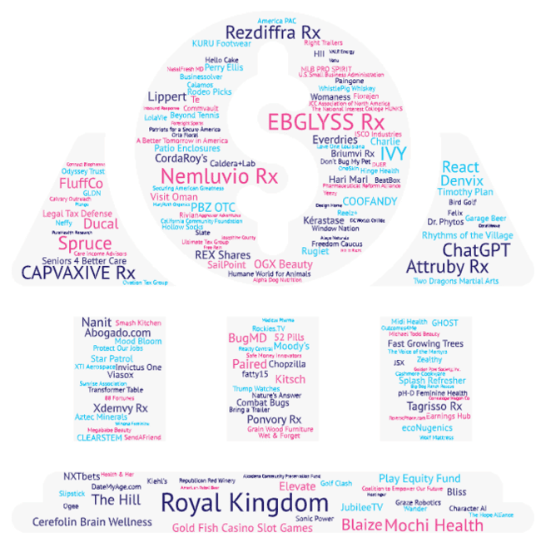
Despite continued economic uncertainty,
187 advertisers across
41 categories invested
over $313MM in multiscreen TV nationally for the first time in 1H 2025
New National TV Advertisers
1H 2025
For a full list of the 187 brands with TV spend, see page 27 in the appendix or click here
Source: VAB analysis of Nielsen Ad Intel data as of 9/4/25, 1/1/25-6/30/25. TV spend includes national cable TV, broadcast TV, Spanish language cable TV, Spanish language broadcast TV, streaming TV. Brands reflect those with national TV spend over $50K.
This information is exclusively provided to VAB members and qualified marketers.
PAGE 9

Slide 10


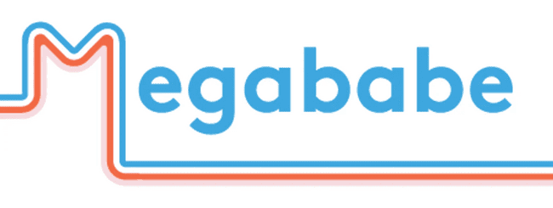



Brands who launched their first TV campaign preached the platform’s ability to drive reach, awareness and relevancy
“Excited to celebrate a milestone moment for Kiehl’s—our first-ever national TV commercial, debuting during the Oscars and spotlighting one of Hollywood’s unsung heroes –
stunt doubles!”
“Launching in Walmart means you need to support the products. There needed to be more awareness brought to us, so we finally felt it was time to lean into a more official campaign - and we are profitable, so we could make that decision responsibly.”
“We want the message to feel relevant to the audience that is watching the Super Bowl, which includes tens of millions of people who have no familiarity with AI.”
Kate Rouch, Chief Marketing Officer, OpenAI
(The Verge, 2/9/25)
Devin Merullo, Assistant Vice President, YSL Beauty
(LinkedIn, March 2025)
Katie Sturino, Co-Founder, Megababe
(Inc, 5/15/25)
“We just launched our first commercial for Smash Kitchen!! In a category that often plays it safe, we wanted to do something different and delicious.”
“We’re constantly infusing creative and audience insights, so the media engine
gets better every second, just like the Slate vehicle itself.”
“We made our first TV commercial - attacking the concept of being told that we are fine…
Fine is not good enough. You deserve better than fine - and we want you to feel great.”
Sameer Mehta, Co-Founder & CEO, Smash Kitchen
(LinkedIn, June 2025)
Kasha Cacy, Chief Media Officer, Slate
(AdAge, 4/24/25)
Joanna Strober, CEO & Founder, Midi Health
(Instagram, 6/25/25)
This information is exclusively provided to VAB members and qualified marketers.
PAGE 10

Slide 11



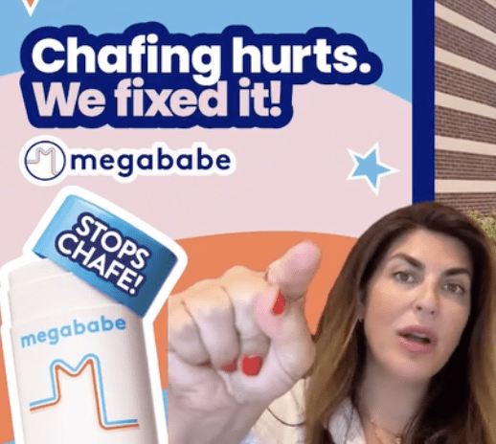
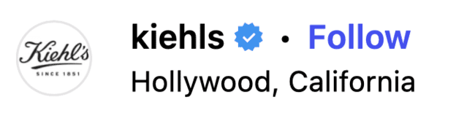
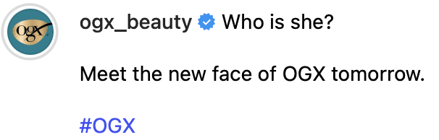


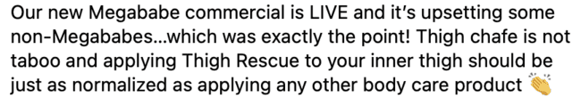




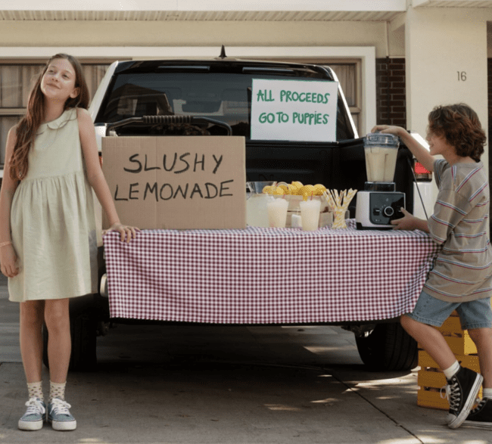


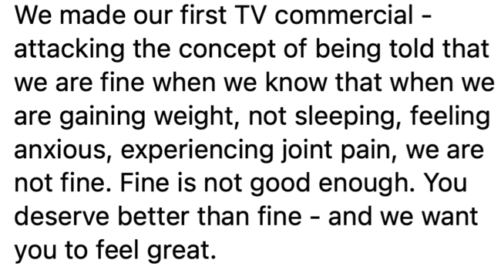
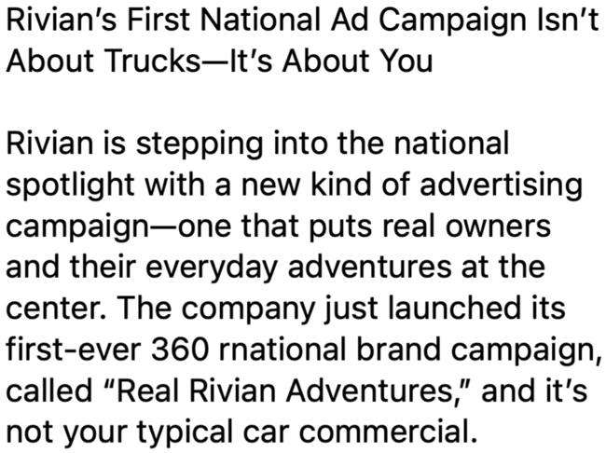


First-time advertisers turned to social media to celebrate their launches, helping amplify awareness and conversation beyond the TV screen
Source: Social media posts found across Instagram, Facebook and LinkedIn as of 10/8/25.
This information is exclusively provided to VAB members and qualified marketers.
PAGE 11

Slide 12
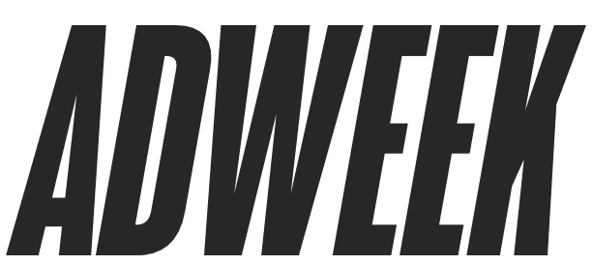






By connecting their launches to recognizable partners and marquee televised events, brands established authenticity and enhanced perception
February 5, 2025
March 2, 2025
May 13, 2025
Kiehl’s Makes National Commercial Debut During Oscars 2025 With Western Campaign Honoring Hollywood Stunt Performers
Why Jennifer Aniston Says ‘No Gimmicks Needed’ in Her Hair Care Brand LolaVie’s First TV Campaign
OpenAI to Air Its First Super Bowl Ad
April 7, 2025
April 24, 2025
OGX names Shay Mitchell as first global ambassador in bold campaign
Inside the unorthodox marketing plans for Slate, a Jeff Bezos - backed EV
July 22, 2024
March 28, 2025
How DTC wellness brand fatty15 turned TV screens into shopping carts with Roku Ads Manager
American Rebel Launches Nationwide Ad Campaign on March 31 with 30 Second TV Spot, Complemented by Digital Media Across Leading Websites, to Increase Exposure of the Company and its Products to Millions of Viewers
May 1, 2025
April 22, 2025
As Tesla's Favorability Dips Below Zero, EV Maker Rivian Drops Its First Major Ad Campaign
Galderma, seeking to build $2B product, starts DTC campaign for eczema drug across TV, digital
Note: Magenta border represents celebrity partnerships, blue border represents high-profile announcements like the Superbowl or Grammys.
This information is exclusively provided to VAB members and qualified marketers.
PAGE 12

Slide 13



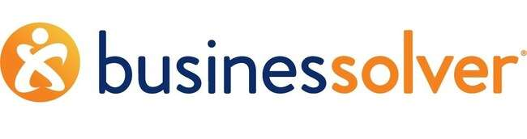
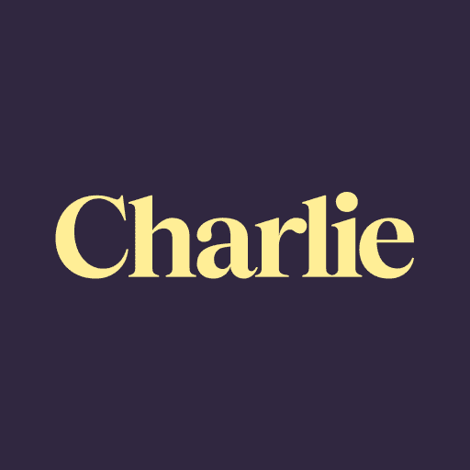










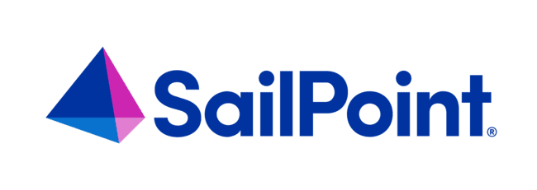







Multiscreen TV helps modern, digitally born brands expand beyond niche audiences and accelerate performance
*Click on any logo to visit their website
‘Younger-skewing’ brands
Brands targeting younger audiences
Innovative products
Brands using cutting-edge technology to offer inventive products / services
Digital endemics
Brands specializing in digital services across a range of categories
Source: VAB analysis of Nielsen Ad Intel data as of 9/4/25, 1/1/25-6/30/25. TV spend includes national cable TV, broadcast TV, Spanish language cable TV, Spanish language broadcast TV, streaming TV. Brands reflect those with national TV spend over $50K.
This information is exclusively provided to VAB members and qualified marketers.
PAGE 13

Slide 14




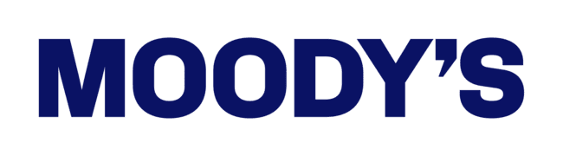


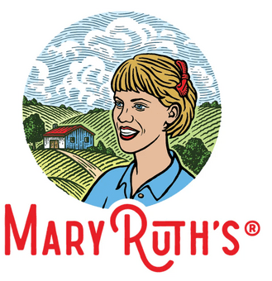



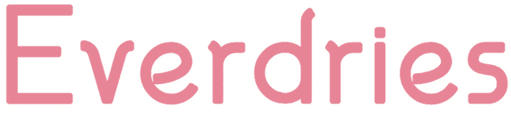
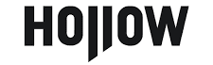






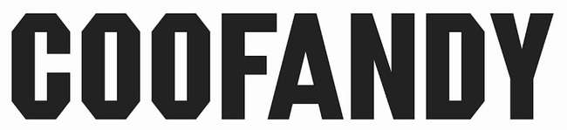


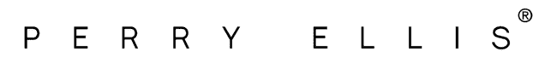

First time multiscreen TV entrants come from a wide range of categories that meet essential consumer needs such as healthcare and apparel
Functional categories that are seizing opportunities across multiscreen TV
Consumers are increasingly seeking out health and pharmaceutical brands that offer practical ways to support their everyday mental and physical
well-being.
With lingering economic uncertainty due mainly to tariff policies, consumers are focusing on essential financial services like insurance, planning and loans to protect their finances and peace of mind.
Across industries such as cybersecurity, AI and printing, professional services are equipping consumers to manage hybrid work more efficiently through practical digital solutions.
Apparel & accessory brands are emphasizing adaptable styles, from activewear to casual and workwear, helping consumers seamlessly manage different parts of their daily lives.
Amid ongoing economic concerns in the first half of the year, consumers turned to fitness and health and wellness brands that provide budget-friendly ways to support their physical and mental health.
Consumers turned to lifestyle brands
and attainable luxuries despite economic pressures, such as travel, alcoholic beverages and jewelry, allowing consumers to enjoy meaningful
experiences and passions.
*Click on any logo to visit their website
Source: VAB analysis of Nielsen Ad Intel data as of 9/4/25, 1/1/25-6/30/25. TV spend includes national cable TV, broadcast TV, Spanish language cable TV, Spanish language broadcast TV, streaming TV. Brands reflect those with national TV spend over $50K.
This information is exclusively provided to VAB members and qualified marketers.
PAGE 14

Slide 15
In addition to brands in ‘essentials’ categories, there was a surge in new TV advertisers from digital-native categories like mobile apps and AI
1H ‘25 New National TV Advertisers: Top 15 Categories Ranked by Total Spend
Rank | Category | # of Brands | % of total brands | Category $$$ (000) | % of total spend
1 | Pharmaceutical | 18 | 10% | $113,531.2 | 36%
2 | Mobile Apps | 14 | 7% | $62,637.5 | 20%
3 | Personal Care | 16 | 9% | $26,725.2 | 9%
4 | Home Improvement | 8 | 4% | $26,093.3 | 8%
5 | AI | 3 | 2% | $15,681.2 | 5%
6 | Organization | 20 | 11% | $9,985.5 | 3%
7 | Health & Wellness | 15 | 8% | $9,200.8 | 3%
8 | Apparel & Accessories | 11 | 6% | $9,083.7 | 3%
9 | Home Furnishing | 4 | 2% | $7,431.1 | 2%
10 | Legal Services | 2 | 1% | $7,240.8 | 2%
11 | Vitamins & Supplements | 3 | 2% | $3,574.7 | 1%
12 | Food & Beverage | 8 | 4% | $3,326.6 | 1%
13 | Financial Services | 12 | 6% | $2,469.8 | 1%
14 | Media | 3 | 2% | $2,048.3 | 1%
15 | Real Estate | 2 | 1% | $1,883.8 | 1%
16 | Other Categories (26) | 48 | 26% | $300,913.3 | 96%
 | Grand Total | 187 |  | $313,668.5
=represents a consumer ‘essentials’ category including pharma, financial services, apparel & accessories, health & wellness.
Source: VAB analysis of Nielsen Ad Intel data as of 9/4/25, 1/1/25-6/30/25. TV spend includes national cable TV, broadcast TV, Spanish language cable TV, Spanish language broadcast TV, streaming TV. Brands reflect those with national TV spend over $50K.
This information is exclusively provided to VAB members and qualified marketers.
PAGE 15

Slide 16

TV investment ranges from ‘test and learn’ campaigns and launches from small & medium-sized businesses to immediate ‘big bets’ by larger brands
1H ’25 New National TV Advertisers by Spend Segment
% of brands within spend buckets
64% of brands invested $500K or less
Source: VAB analysis of Nielsen Ad Intel data as of 9/4/25, 1/1/25-6/30/25. TV spend includes national cable TV, broadcast TV, Spanish language cable TV, Spanish language broadcast TV, streaming TV. Brands reflect those with national TV spend over $50K.
This information is exclusively provided to VAB members and qualified marketers.
PAGE 16

Slide 17
First-time multiscreen TV campaigns spark measurable increases in consumer engagement, turning heightened awareness into real customer growth through substantial lifts in online branded search
How to read the charts in this section:
Google Search Trend Index = represents search interest relative to the highest point during a specific time period for a given region, a value of 100 is the peak popularity for the term, a value of 50 means that the term is half as popular.

Slide 18

Category: Mobile Gaming App
Royal Kingdom, a gaming app with heavy digital spend, saw an
immediate lift in branded online search once they launched a TV campaign
Royal Kingdom: Weekly Google Search Trends Index
Six Months Pre-TV Campaign vs. TV Campaign Launch
(Weeks of 11/10/24 – 4/27/25)
3x
vs. pre- TV launch
w/o 4/27
(100 index)
w/o 4/20
(94 index)
TV Launch Week
(59 index)
Week Before TV Launch
(33 index)
TV Campaign
TV Launch: 4/15/25
Source: VAB analysis of Google Trends, United States only, All Categories, Web Search, weeks of 11/10/24 – 4/27/25. Google Search Index represents search interest relative to the highest point on the chart for the given region and time period, a value of 100 is the peak popularity for the term, a value of 50 means that the term is half as popular. VAB analysis of Nielsen Ad Intel, TV launch month is based on the first activity reported across national cable TV, broadcast TV, Spanish language cable TV, Spanish language broadcast TV, January 2025 – June 2025 (calendar months). Royal Kingdom was launched in the U.S. on November 21, 2024. Note: Light blue line marks the first day of TV spending for each brand.
This information is exclusively provided to VAB members and qualified marketers.
PAGE 18

Slide 19
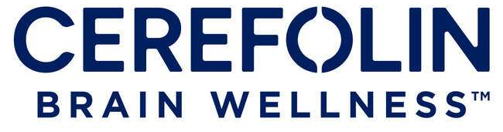
Category: Vitamins & Supplements
Cerefolin, a cognitive support / brain wellness brand, saw their first meaningful branded online search only when they launched a TV campaign
Cerefolin: Weekly Google Search Trends Index
Six Months Pre-TV Campaign vs. TV Campaign Launch
(Weeks of 12/1/24 – 6/1/25)
w/o 5/25
(100 index)
w/o 5/18
(63 index)
TV Launch Week
(43 index)
TV Campaign
Week Before TV Launch
(0 index)
TV Launch: 5/11/25
Source: VAB analysis of Google Trends, United States only, All Categories, Web Search, weeks of 12/1/24 – 6/1/25. Google Search Index represents search interest relative to the highest point on the chart for the given region and time period, a value of 100 is the peak popularity for the term, a value of 50 means that the term is half as popular. VAB analysis of Nielsen Ad Intel, TV launch month is based on the first activity reported across national cable TV, broadcast TV, Spanish language cable TV, Spanish language broadcast TV, January 2025 – June 2025 (calendar months). Cerefolin was launched on November 11, 2003. Note: Light blue line marks the first day of TV spending for each brand.
This information is exclusively provided to VAB members and qualified marketers.
PAGE 19

Slide 20

Category: Organization
Humane World for Animals, a 70-year-old organization, also saw their first meaningful search activity once they launched their first TV campaign
Humane World for Animals: Weekly Google Search Trends Index
Six Months Pre-TV Campaign vs. TV Campaign Launch
(Weeks of 9/7/24 – 2/16/25)
w/o 2/16
(100 index)
Week Before TV Launch
(0 index)
TV Launch: 2/14/25
Source: VAB analysis of Google Trends, United States only, All Categories, Web Search, weeks of 9/7/24 – 2/16/25. Google Search Index represents search interest relative to the highest point on the chart for the given region and time period, a value of 100 is the peak popularity for the term, a value of 50 means that the term is half as popular. VAB analysis of Nielsen Ad Intel, TV launch month is based on the first activity reported across national cable TV, broadcast TV, Spanish language cable TV, Spanish language broadcast TV, January 2025 – June 2025 (calendar months). Humane World for Animals was founded on November 22, 1954. Note: Light blue line marks the first day of TV spending for each brand.
This information is exclusively provided to VAB members and qualified marketers.
PAGE 20

Slide 21
Category: Personal Care
Kiehl’s, a 174-year-old cosmetics brand, saw their branded search nearly double when they launched their first nat’l TV campaign during the Oscars
Kiehl’s: Weekly Google Search Trends Index
TV Campaign Launch vs. 1H ‘25 Activity
(Weeks of 1/5/25 – 3/2/25)
TV Launch Week
(100 index)
Week Before TV Launch
(56 index)
TV Launch: 3/2/25
Source: VAB analysis of Google Trends, United States only, All Categories, Web Search, weeks of 1/5/25 – 6/29/25. Google Search Index represents search interest relative to the highest point on the chart for the given region and time period, a value of 100 is the peak popularity for the term, a value of 50 means that the term is half as popular. VAB analysis of Nielsen Ad Intel, TV launch month is based on the first activity reported across national cable TV, broadcast TV, Spanish language cable TV, Spanish language broadcast TV, January 2025 – June 2025 (calendar months). Kiehl’s was founded in 1851. Note: Light blue line marks the first day of TV spending for each brand.
This information is exclusively provided to VAB members and qualified marketers.
PAGE 21

Slide 22

Category: Auto
Slate Trucks launched their TV campaign only two days after their public debut to drive immediate online interest among potential customers
Slate Trucks: Weekly Google Search Trends Index
Six Months Pre-TV Campaign vs. TV Campaign Launch
(Weeks of 11/3/24 – 4/27/25)
TV Launch Week
(100 index)
TV Launch: 4/26/25
Source: VAB analysis of Google Trends, United States only, All Categories, Web Search, weeks of 11/3/24 – 4/27/25. Google Search Index represents search interest relative to the highest point on the chart for the given region and time period, a value of 100 is the peak popularity for the term, a value of 50 means that the term is half as popular. VAB analysis of Nielsen Ad Intel, TV launch month is based on the first activity reported across national cable TV, broadcast TV, Spanish language cable TV, Spanish language broadcast TV, January 2025 – June 2025 (calendar months). Slate Trucks debuted on April 24, 2025. Note: Light blue line marks the first day of TV spending for each brand.
This information is exclusively provided to VAB members and qualified marketers.
PAGE 22

Slide 23
Adults over 50 account for 36% of the total population and nearly half of all adults
Multiscreen TV helps brands of all sizes build awareness and ignite consumer engagement
Multiscreen TV is an accessible and effective platform for brands of all sizes and lifestages which helps new advertisers break through and connect meaningfully with their target audiences.
Emerging companies, including Direct-to-Consumer brands, and small & medium-sized businesses are turning to multiscreen TV to build brand credibility, enhance perception and drive mid-funnel metrics such as interest and consideration.
Multiscreen TV campaigns ignite significant increases in online search activity, pushing engaged consumers to brands’ digital platforms and accelerating performance across the purchase funnel for both younger and more established brands.
Key Marketer Takeaways
This information is exclusively provided to VAB members and qualified marketers.
PAGE 23

Slide 24


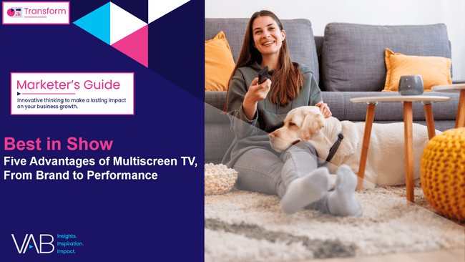


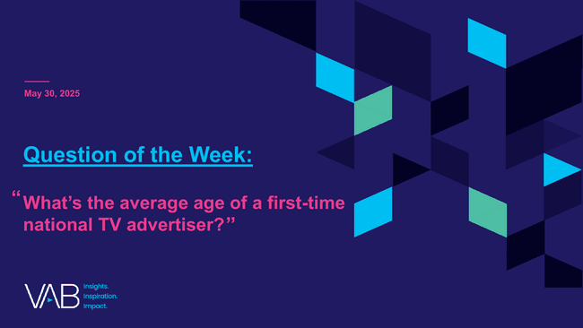



Creators
Jason Wiese
Leah Montner Dixon
SVP, Director of Strategic Insights
jasonw@thevab.com
Director, Audience & Behavioral Insights
leahm@thevab.com
Karolina Guillen
Breaking Through
How New Advertisers Are Using TV
To Ignite Interest & Turn Consumers Into Customers
Best in Show
Five Advantages of Multiscreen TV,
From Brand to Performance
Associate Director, Insights, Strategy & Analytics
karolinag@thevab.com
Discover more
Looking for more data, insights and takeaways? Check out this related VAB content
Dedicated to Your Good Health
How TV Drives Discovery & Encourages Education
in the Pharma DTC Category
The Power of Premium Video
What it Means for Multiscreen TV and Why it Matters to Marketers
Visit our Multiscreen TV Attribution Resources
to learn from the winning marketing strategies of brands who utilize premium video platforms to achieve
full-funnel outcomes, ranging from incremental reach
to favorability to website visits and sales.
What’s the average age of a
first-time national TV advertiser?
Welcome to TV: Full Year ‘24
The Billion and a Half Dollar Investment from New Advertisers
VAB Members, brand marketers and agencies get free and immediate access to VAB’s content library. Get access at theVAB.com
This information is exclusively provided to VAB members and qualified marketers.
PAGE 24

Slide 25


About VAB
VAB is an insights-driven organization that inspires marketers to reimagine their media strategies resulting in fully informed decisions.
Drawing on our marketing expertise, we simplify the complexities in our industry and discover new insights that transform the way marketers look at their media strategy.
We are committed to your business growth and proud to offer VAB members, brand marketers and agencies complimentary access to our continuously-growing Insights library. Get immediate access at theVAB.com.
This information is exclusively provided to VAB members and qualified marketers.
PAGE 25

Slide 26

1H ‘25 New National TV Advertiser Lists

Slide 27

New Advertiser List: The national TV marketplace enabled these 187 bold new advertisers across categories and budget levels to increase reach and relevancy
1st Half 2025 New National TV Advertisers
Brand | $$$ (000)
Royal Kingdom | $42,592.6
Nemluvio Rx | $21,939.7
EBGLYSS Rx | $21,802.6
CAPVAXIVE Rx | $18,015.2
Attruby Rx | $16,642.7
Spruce | $16,591.9
ChatGPT | $15,000.0
Rezdiffra Rx | $10,534.8
Mochi Health | $9,529.2
Gold Fish Casino Slot Games | $8,645.2
DateMyAge.com | $7,642.9
OGX Beauty | $7,451.3
Abogado.com | $7,037.7
Ponvory Rx | $6,449.8
Tagrisso Rx | $6,390.9
CordaRoy's | $6,355.1
Xdemvy Rx | $4,777.8
Everdries | $3,551.2
Kitsch | $3,529.9
Cerefolin Brain Wellness | $3,040.2
Play Equity Fund | $2,768.8
Fast Growing Trees | $2,652.8
Star Patrol | $2,547.4
52 Pills | $2,443.9
Seniors 4 Better Care | $2,351.3
Splash Refresher | $1,956.7
Viasox | $1,943.9
Te | $1,744.0
Patio Enclosures | $1,665.9
Briumvi Rx | $1,596.4
Chopzilla | $1,588.7
Combat Bugs | $1,510.1
ecoNugenics | $1,460.6
Rhythms of the Village | $1,253.7
Two Dragons Martial Arts | $1,253.7
Brand | $$$ (000)
Zealthy | $1,232.9
Coalition to Empower Our Future | $1,181.1
Megababe Beauty | $1,170.8
The National Interest | $1,166.2
88 Fortunes | $1,123.1
Orla Floral | $1,097.0
Michael Todd Beauty | $1,036.5
Realty Central | $1,023.3
Securing American Greatness | $972.1
OneSkin | $952.4
NasalFresh MD | $949.8
Yeezy | $940.3
Humane World for Animals | $919.5
LolaVie | $908.9
MLB PRO SPIRIT | $897.7
Florajen | $882.0
Wander | $860.5
Kiehl's | $818.2
Window Nation | $736.4
Rockies.TV | $727.8
BeatBox | $710.7
Transformer Table | $699.3
Rivian | $699.2
Wet & Forget | $640.2
Paingone | $630.8
Neffy | $626.4
Midi Health | $608.9
Protect Our Jobs | $605.0
Trump Watches | $577.8
pH-D Feminine Health | $571.9
Smash Kitchen | $529.4
Calamos | $509.4
Reelz+ | $480.6
Felix | $465.6
Hello Cake | $455.9
Brand | $$$ (000)
Altadena Community Preservation | $439.7
PureHealth Research | $434.1
Golden Paw Society, Inc. | $426.9
CoreWeave | $422.6
Winona Feminine | $413.6
Foresight Sports | $407.6
ReversePhone.com | $406.2
MaryRuth Organics | $404.8
Josephine County | $400.3
Venu | $395.6
Alaya Naturals | $391.8
VALR Energy | $361.6
Free Rein | $347.5
Medicus Pharma | $345.3
Hit It Rich! | $343.0
DC Worlds Collide | $341.9
Plunge | $331.1
Design Home | $306.0
Hostinger | $294.4
A Better Tomorrow in America | $288.2
Slipstick | $265.9
Commvault | $259.3
Character AI | $258.6
Businessolver | $256.9
GLDN | $256.4
America PAC | $255.6
Golf Clash | $247.4
Bird Golf | $238.7
REX Shares | $224.3
Timothy Plan | $222.5
Hari Mari | $213.9
Rugiet | $211.9
Charlie | $209.6
Bliss | $206.1
Legal Tax Defense | $203.2
Brand | $$$ (000)
California Community Foundation | $199.3
Beyond Tennis | $197.8
U.S. Small Business Administration | $193.7
DUER | $178.1
Wolf Mattress | $172.8
JCC Association of North America | $172.0
The Voice of the Martyrs | $171.9
Visit Oman | $171.0
COOFANDY | $170.9
FluffCo | $159.7
The Hill | $154.2
Invictus One | $152.0
Dr. Phytos | $148.3
fatty15 | $142.7
HII | $141.4
Safe Money Innovators | $140.4
Sunrise Association | $140.0
Denvix | $136.7
WhistlePig Whiskey | $135.2
Slate | $128.0
Ogee | $115.6
SendAFriend | $114.3
JSX | $113.1
Grain Wood Furniture | $110.7
BugMD | $109.6
PBZ OTC | $107.9
Blaize | $106.4
Ducal | $105.4
Republican Red Winery | $100.5
Kérastase | $100.3
Rodeo Picks | $99.9
Don't Bug My Pet | $99.2
IVY | $98.2
Moody's | $98.2
Freedom Caucus | $96.9
Brand | $$$ (000)
Perry Ellis | $96.8
Nature's Answer | $94.6
Paired | $93.3
Patriots for a Secure America | $92.1
Mood Bloom | $92.0
Calvary Outreach | $91.2
Alpha Dog Nutrition | $88.6
Bring a Trailer | $88.2
KURU Footwear | $87.9
GHOST | $86.4
SailPoint | $83.2
Ultimate Tax Group | $81.1
Aztec Minerals | $77.1
Pharmaceutical Reform Alliance | $75.0
Right Trailers | $73.8
Hinge Health | $71.4
Caldera+Lab | $70.7
ISCO Industries | $69.4
Hollow Socks | $69.1
NXTbets | $67.7
Lippert | $67.1
Cashmere Cookware | $66.1
Love One Louisiana | $65.7
Conestoga Wagon Co | $64.4
Care Income Advisors | $63.7
JubileeTV | $59.9
CLEARSTEM | $59.2
React | $58.8
Graze Robotics | $57.7
Womaness | $57.7
Ovation Tax Group | $57.3
Outcomes4Me | $57.2
Odyssey Trust | $57.1
Nanit | $56.4
Earnings Hub | $56.2
Brand | $$$ (000)
Health & Her | $56.0
Elevate | $55.8
American Rebel Beer | $53.5
Aggressor Adventures | $53.4
Big Dog Ranch Rescue | $53.2
Inbound Response | $52.4
College HUNKS | $52.3
XTI Aerospace | $52.1
Sonic Power | $51.8
Garage Beer | $51.3
Connect Biopharma | $51.0
The Hope Alliance | $50.1
To click through
to a brand’s website, view
in ‘slide show’
and click on the respective link.
Source: VAB analysis of Nielsen Ad Intel data as of 9/4/25, 1/1/25-6/30/25. TV spend includes national cable TV, broadcast TV, Spanish language cable TV, Spanish language broadcast TV, streaming TV. Brands reflect those with national TV spend over $50K. The above chart represents the full list of new advertisers, including direct-to-consumer brands.
This information is exclusively provided to VAB members and qualified marketers.
PAGE 27

Slide 28

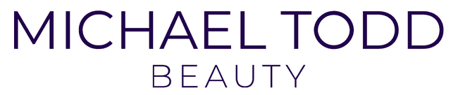
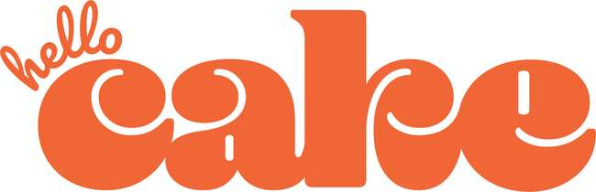
The Direct-to-Consumer segment continues to drive new entrants with 54 brands across 19 categories, spending almost $50 million during the first half of 2025
1st Half 2025 New National TV DTC Advertisers
Brand | Category | $$$ (000)
Mochi Health | Personal Care | $9,529.2
Abogado.com | Legal Services | $7,037.7
CordaRoy's | Home Furnishing | $6,355.1
Everdries | Apparel & Accessories | $3,551.2
Fast Growing Trees | Home Improvement | $2,652.8
Viasox | Apparel & Accessories | $1,943.9
Te | Health & Wellness | $1,744.0
ecoNugenics | Health & Wellness | $1,460.6
Zealthy | Pharmaceutical | $1,232.9
Megababe Beauty | Personal Care | $1,170.8
Michael Todd Beauty | Personal Care | $1,036.5
OneSkin | Personal Care | $952.4
Yeezy | Apparel & Accessories | $940.3
LolaVie | Personal Care | $908.9
Wander | Real Estate | $860.5
Transformer Table | Home Furnishing | $699.3
Midi Health | Personal Care | $608.9
Reelz+ | Streaming Services | $480.6
Felix | Financial Services | $465.6
Hello Cake | Pharmaceutical | $455.9
Brand | Category | $$$ (000)
Winona Feminine | Health & Wellness | $413.6
ReversePhone.com | Security | $406.2
MaryRuth Organics | Health & Wellness | $404.8
Alaya Naturals | Vitamins & Supplements | $391.8
Plunge | Home Improvement | $331.1
Hostinger | Computer Software | $294.4
Businessolver | Professional Services | $256.9
GLDN | Jewelry | $256.4
Hari Mari | Apparel & Accessories | $213.9
Rugiet | Pharmaceutical | $211.9
Charlie | Financial Services | $209.6
Bliss | Personal Care | $206.1
DUER | Apparel & Accessories | $178.1
COOFANDY | Apparel & Accessories | $170.9
FluffCo | Bedding | $159.7
Dr. Phytos | Pet Care | $148.3
fatty15 | Vitamins & Supplements | $142.7
Denvix | Auto | $136.7
Ogee | Personal Care | $115.6
SendAFriend | Gift Box | $114.3
Brand | Category | $$$ (000)
Grain Wood Furniture | Home Furnishing | $110.7
BugMD | Personal Care | $109.6
Don't Bug My Pet | Pet Care | $99.2
Perry Ellis | Apparel & Accessories | $96.8
Alpha Dog Nutrition | Pet Care | $88.6
KURU Footwear | Apparel & Accessories | $87.9
Caldera+Lab | Personal Care | $70.7
Hollow Socks | Apparel & Accessories | $69.1
CLEARSTEM | Personal Care | $59.2
Womaness | Personal Care | $57.7
Outcomes4Me | Health & Wellness | $57.2
Nanit | Health & Wellness | $56.4
Earnings Hub | Financial Services | $56.2
Inbound Response | Professional Services | $52.4
To click through to a brand’s website, view in ‘slide show’ and click on the respective link.
DTC brands accounted for 29% of total new TV advertisers and 16%
of total TV spend
Logos represent a sampling of new national TV DTC advertisers
Source: VAB analysis of Nielsen Ad Intel data as of 9/4/25, 1/1/25-6/30/25. TV spend includes national cable TV, broadcast TV, Spanish language cable TV, Spanish language broadcast TV, streaming TV. Brands reflect those with national TV spend over $50K.
This information is exclusively provided to VAB members and qualified marketers.
PAGE 28

