Slide 1


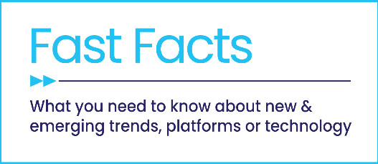


Welcome to TV
14 Facts on the $1.4 Billion Investment from New Advertisers
Full Year 2023 Update

Slide 2


2023 marked the highest TV investment by new advertisers since we began this analysis five years ago
Although economic uncertainty among consumers continued through 2023, optimism began to improve towards the end of the year as inflation rates declined and spending grew.
Throughout this period, the national TV marketplace was resilient with a continual influx of new entrants. Surpassing investment from each of the last five years, this analysis underscores the renewed focus by many advertisers and categories on brand-building strategies to grow their business, especially through premium video – both TV and streaming.
Why are new advertisers turning to premium video, like TV?
TV - and it’s advanced, data-driven targeting capabilities – builds brands while powering performance that delivers business results. From marketers’ own words, they are launching new TV campaigns to improve brand awareness, build relevancy and ignite consumer excitement while driving growth and profitability.
This information is exclusively provided to VAB members and qualified marketers.
PAGE 2

Slide 3







1
The economy has been under the shadow of a potential recession for a while, which has caused some marketers to be cautious about spending
April 10, 2022
March 8, 2023
October 17, 2023
The U.S. economy in 2023: Most people have jobs, but many are unhappy about their money
Recession Or Soft Landing: What’s Next for the U.S. Economy?
September 13, 2022
May 12, 2023
INFLATION DRIVES COMPANIES TO SPEND LESS ON MARKETING, OFFER MORE VALUE
CMO Survey shows supply-chain issues, job market fears and threats of recession sink marketer optimism
Why current US recession warnings are unlike all the others
Mar ‘22
Apr ‘22
May ‘22
Sep ‘22
Feb ‘23
Mar ‘23
Apr ‘23
May ‘23
Aug ‘23
Oct ‘23
March 29, 2022
February 27, 2023
The Fed Has Made a U.S. Recession Inevitable
U.S. recession expected to start later than previously predicted
August 29, 2023
US Consumer Confidence Pulled Back in August
May 20, 2022
April 28, 2023
‘Cost conscious consumers, restrictive economy’: Advertising’s tough ride in 2022
US consumers send mixed signals in an uncertain economy
This information is exclusively provided to VAB members and qualified marketers.
PAGE 3

Slide 4
2
Despite recession concerns, the decline in the U.S. inflation rate is getting closer to the Federal Reserve’s target needed to stabilize pricing
Inflation rates dropped
47%
Between January and December 2023
Note: According to the Federal Reserve, a 2% average inflation rate is a standard target during ‘healthy’ economic periods.
Source: Statista monthly inflation rate data, 2/15/2024. *CoinNews, U.S. Annual Inflation Rates 2021-2023.
This information is exclusively provided to VAB members and qualified marketers.
PAGE 4

Slide 5


3
Consumer optimism began improving by the end of the year as inflation rates declined and recessionary anxieties started to subside
51%
of consumers either believe the economy
is fine or is experiencing just a downturn,
but not a recession
(vs. 44% in April)
41%
Believe the economy will get better
in the next 6-12 months
(vs. 29% vs. April)
Source: Dentsu, Consumer Navigator: Pandemic & Economic Sentiment, November 2023.
This information is exclusively provided to VAB members and qualified marketers.
PAGE 5

Slide 6

Wages and disposable income also increased by year end which, coupled with higher consumer optimism, drove higher spending
4
YOY Change in Financial Standing
% increase, December ’23 vs. December ‘22
Source: NRF, NRF State of Retail & the Consumer, February 1, 2024.
This information is exclusively provided to VAB members and qualified marketers.
PAGE 6

Slide 7


Marketers are increasingly implementing brand-building efforts to foster relationships with consumers as optimism increases
“This campaign is a significant milestone for Paysend for us to build the brand in the U.S. and disrupt the market with a competitive alternative.”
Rupert Bedell, CMO, Paysend
(Paysend, 8/21/23)
This information is exclusively provided to VAB members and qualified marketers.
PAGE 7

Slide 8
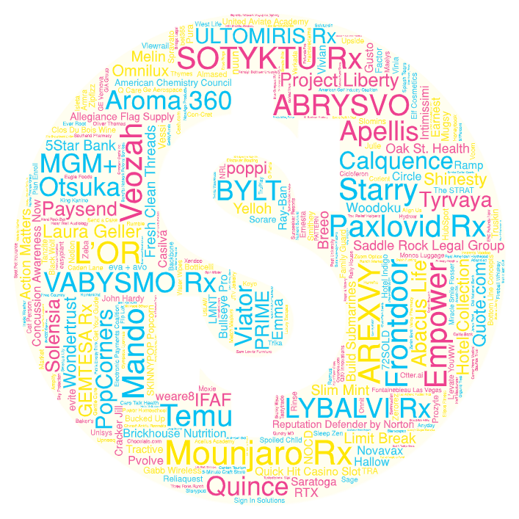





Even though economic uncertainty persists, 2023 saw the highest TV investment by new advertisers since we began this analysis 5 years ago
5
During the full year of 2023, 313 advertisers across 56 categories invested over $1.36 billion in national TV for the first time
New National TV Advertisers
2019 – 2023
New
TV Advertisers
Year | # of New Advertisers | # of Categories | New TV $$$
2019 | 114 | 61 | $840MM
2020 | 283 | 95 | $1.28B
2021 | 315 | 74 | $1.32B
2022 | 303 | 71 | $1.33B
2023 | 313 | 56 | $1.36B
For a full list of the 313 brands with spend click here
Source: VAB analysis of Nielsen Ad Intel data as of 2/7/24, 1/1/23-12/31/23. Prior years based on VAB analysis of Nielsen Ad Intel Data from the following periods: 1/1/2019-12/31/2019, 1/1/2020-12/31/2020, 1/1/2021-12/31/2021, 1/1/2022-12/31/2022. TV spend includes national cable TV, broadcast TV, Spanish language cable TV, Spanish language broadcast TV. Brands reflect those with national TV spend over $100K.
This information is exclusively provided to VAB members and qualified marketers.
PAGE 8

Slide 9
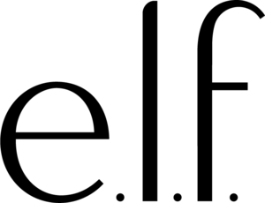





6
Advertisers launched national TV campaigns to improve brand awareness, ignite excitement and build business growth
“We are always building everything we do on insight… We had very high performance in CTV, so this [Super Bowl Campaign] is another way of us leaning into our signals.”
"Bringing PopCorners to the Super Bowl stage for the first time is a tremendous moment for a brand on the rise… We're showcasing why fans love this air-popped, never fried snack in an exciting and unexpected way.”
“Our goal has always been making quality essentials accessible to more people, and
TV advertising can help us bring that purpose
to larger audiences while supporting business growth.”
Kory Marchisotto, Chief Marketing Officer, Elf
(AdAge, 2/9/23)
Tori Moreland, Head of Branding, Quince
(Business Wire, 4/10/23)
Brett O'Brien, Chief Marketing Officer, Frito-Lay North America.
(Cision, 2/6/23)
“It’s our first time, and we are thrilled to be part of the 2023 Big Game lineup…Through the largest stage possible, we want to share with our consumers that they can shop with a sense of freedom.”
“Prime will be getting its own Super Bowl commercial. Holy sh*t. The first ever YouTuber Super Bowl commercial for a product that KSI and I created…Actually f**king insane.”
“We are taking our marketing efforts to new heights by expanding our presence through major streaming TV partnerships. But it's not just about the channels we're utilizing; it's about how we are highlighting our consumers.”
Spokesperson, Temu
(AdAge, 2/12/2023)
Logan Paul, Co-Founder, PRIME
(Dextero, 1/26/23)
Allison Ellsworth, Chief Brand Officer, Poppi.
(PR Newswire, 6/16/23)
This information is exclusively provided to VAB members and qualified marketers.
PAGE 9

Slide 10


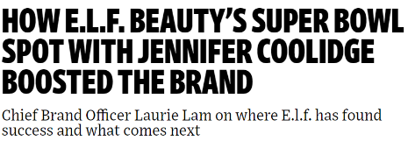
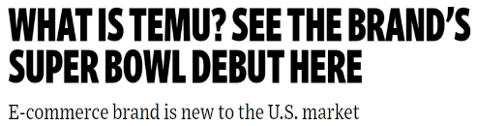







7
National TV newcomers strategically timed their brand debuts with high-profile events and partnerships to cultivate legitimacy and ‘talk value’
June 16, 2023
April 12, 2023
February 12, 2023
October 2, 2023
Soda's Back! Poppi Unveils Largest Consumer-Driven Ad Campaign, Bridging Streaming, Social and Out-of-Home Across Major Markets This Summer
HubSpot Launches First National Ad Campaign On NFL Sunday Ticket
March 30, 2023
September 8, 2023
February 13, 2023
February 17, 2023
Memphis-based Frontdoor gears up for national ad campaign with MLB star Ronald Acuña Jr.
bet365 & Aaron Paul kickstart NFL season with ‘Never Ordinary’ TV campaign
YouTube Stars Run Ad for Sports Drink Prime
Prime, the sports drink founded by social-media stars Logan Paul and KSI, ran a pre-game Super Bowl ad in part to get kids’ parents familiar with the product.
76ers star Tyrese Maxey to make Starry debut in new commercial with Keke Palmer
February 5, 2023
February 6, 2023
BMS’ DTC plaque psoriasis ad debuts during Grammys
Limit Break’s Upcoming Super Bowl Commercial Breaks the Paradigm for Online Gaming; Interactive Advertising
May 12, 2023
August 22, 2023
February 6, 2023
Bradley Beal's LMNT Commercials Share A Message Of Hunger & Humility
Pvolve Unveils its First-Ever Global Ad Campaign Featuring Brand Partner Jennifer Aniston
PopCorners® First Super Bowl Campaign Reimagines "Breaking Bad" TV Series to Break Into Something Good™ - the Wholesome Snacking Business
Note: Magenta border represents celebrity partnerships, blue border represents high-profile announcements like the Superbowl or Grammys, Purple represents hybrid.
This information is exclusively provided to VAB members and qualified marketers.
PAGE 10

Slide 11


























8
Cutting-edge brands and ‘digital-natives’ are leveraging TV to captivate audiences across demographics, including young adults and affluent
*Click on any logo to visit their website
‘Younger-skewing’ brands
Brands targeting younger audiences
Innovative products
Brands using cutting-edge technology to offer inventive products / services
Digital endemics
Brands specializing in digital services across
a range of categories
Source: VAB analysis of Nielsen Ad Intel data as of 2/7/24, 1/1/23-12/31/23. TV spend includes national cable TV, broadcast TV, Spanish language cable TV, Spanish language broadcast TV. Brands reflect those with national TV spend over $100K.
This information is exclusively provided to VAB members and qualified marketers.
PAGE 11

Slide 12































9
National TV has seen a sustained surge in categories that cater to essential consumer ‘needs’ and their lifestyle ‘wants’
Categories that are seizing opportunities as consumer optimism increases
Consumers turn to healthcare and pharmaceutical brands for proactive health solutions, aiming to avoid costly medical treatments or visits to professionals.
Increasing consumer optimism is raising demand for financial, legal and insurance services, which encompasses financial counseling, loan assistance and medical and life insurance.
To address the evolving demands of hybrid work environments, professional services brands provide tailored digital solutions to streamline workflows, boost productivity and aid HR operations.
Versatile apparel meets consumer needs with a wide range of activewear, casualwear and professional attire, allowing individuals to navigate daily routines seamlessly while prioritizing comfort and style.
Consumers increasingly seek holistic health solutions from affordable and adaptable fitness and wellness brands. These brands address physical, mental and emotional health needs.
Lifestyle brands emphasize 'affordable luxuries’ – spanning home improvement, alcoholic beverages and travel – which supports consumers' passions while staying budget-conscious.
*Click on any logo to visit their website
Source: VAB analysis of Nielsen Ad Intel data as 2/7/24, 1/1/23-12/31/23. TV spend includes national cable TV, broadcast TV, Spanish language cable TV, Spanish language broadcast TV. Brands reflect those with national TV spend over $100K.
This information is exclusively provided to VAB members and qualified marketers.
PAGE 12

Slide 13
10
The categories catering to essential consumer ‘needs’ and lifestyle ‘wants’ account for over three-fourths of new TV advertiser investment
FY ‘23 New National TV Advertisers: Top 15 Categories Ranked by Total Spend
Rank | Category | # of Brands | % of total brands | Category $$$ (000) | % of total spend
1 | Pharmaceutical | 23 | 7% | $691,391.9 | 51%
2 | Beverages (Non-Alcohol) | 11 | 4% | $59,427.6 | 4%
3 | Organizations | 10 | 3% | $59,226.3 | 4%
4 | Apparel & Accessories | 21 | 7% | $58,628.2 | 4%
5 | Professional Services | 19 | 6% | $52,072.9 | 4%
6 | Legal Services | 1 | 0% | $34,501.3 | 3%
7 | Personal Care | 6 | 2% | $30,202.4 | 2%
8 | Home | 6 | 2% | $28,752.0 | 2%
9 | Food | 7 | 2% | $27,781.0 | 2%
10 | Wellness & Beauty | 12 | 4% | $24,618.2 | 2%
11 | Travel | 10 | 3% | $21,853.4 | 2%
12 | Marketplace | 2 | 1% | $21,313.0 | 2%
13 | Vitamins & Supplements | 14 | 4% | $19,624.3 | 1%
14 | Financial Services | 7 | 2% | $18,918.0 | 1%
15 | Insurance | 4 | 1% | $17,493.7 | 1%
16 | Other Categories (47) | 160 | 51% | $197,321.3 | 14%
 | Grand Total | 313 |  | $1,363,125.6
=categories highlighted align within at least one of the ‘functional’ categories (healthcare & pharma, financial services & personal protection, professional services, versatile apparel, fitness & wellness and ‘lifestyle’ brands that incorporate alcohol beverages, home and travel)
Source: VAB analysis of Nielsen Ad Intel data as of 2/7/24, 1/1/23-12/31/23. TV spend includes national cable TV, broadcast TV, Spanish language cable TV, Spanish language broadcast TV. Brands reflect those with national TV spend over $100K.
This information is exclusively provided to VAB members and qualified marketers.
PAGE 13

Slide 14

11
New advertisers employ different strategies as some begin by ‘testing’ TV while other immediately ‘go big’ to support their campaign launch
FY ’23 New National TV Advertisers by Spend Segment
% of brands within spend buckets
Source: VAB analysis of Nielsen Ad Intel data as of 2/7/24, 1/1/23-12/31/23. TV spend includes national cable TV, broadcast TV, Spanish language cable TV, Spanish language broadcast TV. Brands reflect those with national TV spend over $100K.
This information is exclusively provided to VAB members and qualified marketers.
PAGE 14

Slide 15












12
Brands invested more dollars in 4Q ’23 TV launches as consumer confidence began to rebound within a long period of uncertainty
2023 New National TV Advertisers Monthly Spend
Millions
$218.9 MM
$285.7 MM
$318.7 MM
$542.9 MM
Q1 ‘23 New National TV Advertiser Spend
Q2 ‘23 New National TV Advertiser Spend
Q3 ‘23 New National TV Advertiser Spend
Q4 ‘23 New National TV Advertiser Spend
Sampling of Q1 ‘23 new brands
Sampling of Q2 ‘23 new brands
Sampling of Q3 ‘23 new brands
Sampling of Q4 ‘23 new brands
Source: VAB analysis of Nielsen Ad Intel data as of 2/7/24, 1/1/23-12/31/23. 2022 data based on VAB analysis of Nielsen Ad Intel Data, 1/1/22-12/31/22. TV spend includes national cable TV, broadcast TV, Spanish language cable TV, Spanish language broadcast TV. Brands reflect those with national TV spend over $100K. Click on any brand logo above to visit their website.
This information is exclusively provided to VAB members and qualified marketers.
PAGE 15

Slide 16

13
The initial success of a TV campaign prompts new advertisers to boost their investments and battle for additional category market share
FY ‘23 New Advertisers Average National TV Spend
Launch Month vs. Post-Launch
($$$)
+37%
(Average Advertiser)
(Monthly Average)
To gauge how advertisers perceived the impact of their TV campaigns, we compared the average investment across brands during the first month of their campaigns with the average investment for the months that followed.
Source: VAB analysis of Nielsen Ad Intel data as of 2/7/24, 1/1/23-12/31/23. TV spend includes national cable TV, broadcast TV, Spanish language cable TV, Spanish language broadcast TV. Brands reflect those with national TV spend over $100K.
This information is exclusively provided to VAB members and qualified marketers.
PAGE 16

Slide 17
14
A huge opportunity exists for new advertisers to engage high-growth audiences by including Spanish-Language TV nets within their buys
2023 New National TV Advertisers
# of Brands
Total Spend ($$$)
Source: VAB analysis of Nielsen Ad Intel data as of 2/7/24, 1/1/23-12/31/23. TV spend includes national cable TV, broadcast TV, Spanish language cable TV, Spanish language broadcast TV. Brands reflect those with national TV spend over $100K.
This information is exclusively provided to VAB members and qualified marketers.
PAGE 17

Slide 18
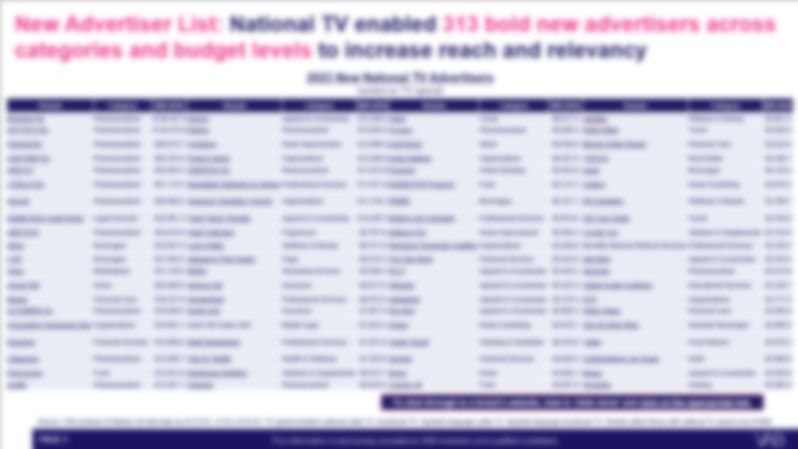
Interested in getting the full new TV advertisers’ list, complete with total TV spending and hyperlinks to each of their websites?
Click this button to download the list!
This information is exclusively provided to VAB members and qualified marketers.
PAGE 18

Slide 19
While the economy has been marked by an extended period of uncertainty, consumer optimism began to increase towards the end of the year as inflation rates decreased and disposable income grew
Throughout periods of economic uncertainty and growing consumer optimism, new advertisers have constantly entered the TV marketplace to increase brand visibility, establish credibility and enhance profitability
Data-driven TV and advanced targeting solutions affords advertisers the flexibility to employ different strategies based on their KPIs - from experimental ‘test and learn’ campaigns to large buys aimed at achieving mass reach
Diverse-targeted media, like Spanish Language TV, represents an opportunity for new advertisers to engage highly desirable and growing audience segments
Key Marketer Takeaways
This information is exclusively provided to VAB members and qualified marketers.
PAGE 19

Slide 20









Creators
Jason Wiese
Leah Montner Dixon
SVP, Director of Strategic Insights
jasonw@thevab.com
Director, Audience & Behavioral Insights
leahm@thevab.com
Karolina Guillen
Kaileen Cain
25 Ways TV Grows Brands
Powering Performance Through Full-Funnel Business Outcomes
How TV Drives Outcomes
Real data and examples on the effectiveness of TV to inform your go-to-market strategy
Associate Director, Insights, Strategy & Analytics
karolinag@thevab.com
Senior Insights Analyst
kaileenc@thevab.com
Discover more
Looking for more data, insights and takeaways? Check out this related VAB content
Advertising, Accelerated
An Update on 15 Streaming Trends That Are Impacting Marketing Plans
You Oughta Know
Why All Impressions Aren’t Created Equal & What it Means for Video Measurement
TV Upfront Historical Primetime CPMs
Welcome to TV: Full Year ‘22
Learn more about the 303 new advertisers that invested over $1.3 Billion in national TV in 2022
VAB Members, brand marketers and agencies get free and immediate access to VAB’s content library. Get access at theVAB.com
This information is exclusively provided to VAB members and qualified marketers.
PAGE 20

Slide 21


About VAB
VAB is an insights-driven organization that inspires marketers to reimagine their media strategies resulting in fully informed decisions.
Drawing on our marketing expertise, we simplify the complexities in our industry and discover new insights that transform the way marketers look at their media strategy.
We are committed to your business growth and proud to offer VAB members, brand marketers and agencies complimentary access to our continuously-growing Insights library. Get immediate access at theVAB.com.
This information is exclusively provided to VAB members and qualified marketers.
PAGE 21

