Slide 1




Welcome to TV
Meet the New Advertisers Who Are Turning Attention into Action
Full Year 2025 Update

Slide 2

Multiscreen TV converts attentive viewers into customer prospects for first-time advertisers
In 2025, a wave of first-time multiscreen TV advertisers, especially emerging direct-to-consumer brands and small-to-medium-sized businesses, invested in Premium Video across TV and streaming to build consumer trust, reach audiences in high-attention environments and turn the attention into action by potential customers.
Why are they turning to multiscreen TV?
Multiscreen TV helps marketers unify branding and performance – delivering meaningful reach while also influencing behaviors through the funnel like branded search, site visitation, in-store traffic and purchase intent.
Who are the new advertisers?
A wide range of advertisers across various life stages, budget sizes and categories which include digital-endemics, innovative tech companies and younger-skewing brands along with brands from more traditional categories like pharma, health & wellness and professional services.
This information is exclusively provided to VAB members and qualified marketers.
PAGE 2

Slide 3
Consumer sentiment on the economy improved marginally through 2025, though it still skewed more negative by the end of the year
How consumers feel about the shape of the U.S. economy
Rolling 3-month average
66%
63%
62%
61%
Source: Dentsu, American Mindset Consumer Navigator, November 2025. Based on survey of 1,000 U.S. respondents 18 years of age or older, administered August 4, 2025.
This information is exclusively provided to VAB members and qualified marketers.
PAGE 3

Slide 4

Despite uncertainty, consumers were spending more, signaling demand and reinforcing the value of building brand presence
“December Retail Monitor data saw a sharp surge in growth as consumers continued prioritizing holiday spending on family and friends. Continued economic momentum helped land 2025 holiday sales near the top of NRF’s forecast, reaffirming that consumers remain on solid footing.”
Matthew Shay, President and CEO, National Retail Federation
NRF Press Release, 1/12/2026
This information is exclusively provided to VAB members and qualified marketers.
PAGE 4

Slide 5
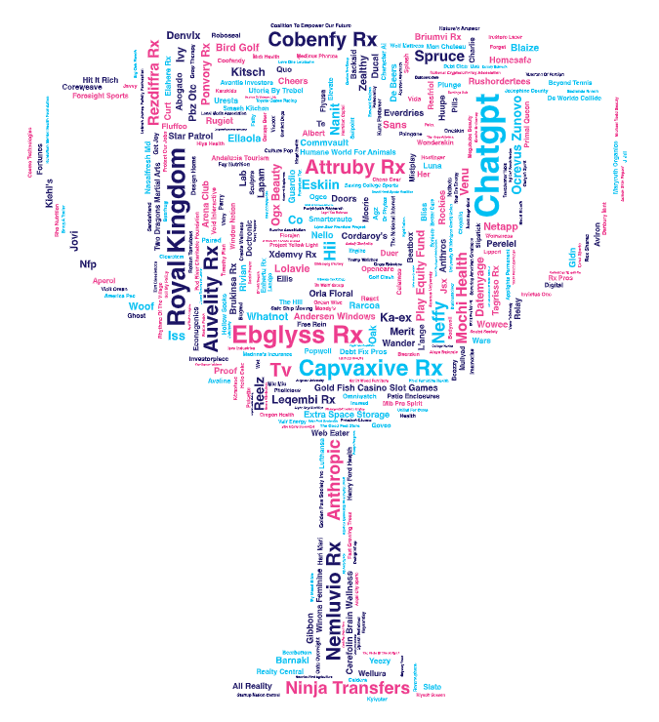
Across multiscreen TV,
354 advertisers across
52 categories invested
over $1.07B for the first time in 2025
New National TV Advertisers
FY 2025
For a full list of the 354 brands with TV spend, see page 30-32 in the appendix or click here
Source: VAB analysis of Nielsen Ad Intel data as of 3/2/26, 1/1/25-12/31/25. TV spend includes national cable TV, broadcast TV, Spanish language cable TV, Spanish language broadcast TV, streaming TV. Brands reflect those with total measured 2025 national TV spend of $100K+ (however, for the sake of continuity, brands featured in the 1H ’25 report with spend over $50K are also included in this analysis even if their total 2025 TV spend was below $100K).
This information is exclusively provided to VAB members and qualified marketers.
PAGE 5

Slide 6






New brand entrants pointed to their first national TV campaign as a catalyst for expanding their visibility and building consumer trust
“With this campaign, we’re introducing J.Jill to more people, in more places, and inviting them to see that style isn't static... It’s a reminder that when you have the right story and the right strategy, you can turn what’s already yours into something unstoppable.”
“We want the message to feel relevant to the audience that is watching the Super Bowl, which includes tens of millions of people who have no familiarity with AI.”
“We thought TV was out of reach. Starting with $500/week in streaming retargeting felt doable, and the results gave us confidence to jump into linear. TV builds trust you don’t always get on social. People see you on TV and connect the dots - then they buy on Walmart.com or in store.”
Kate Rouch, Chief Marketing Officer, OpenAI
(The Verge, 2/9/25)
Joseph Trudeau, Co-founder, Pholicious
(Tatari , 2/5/25)
Whitney Stratten, Chief Client Officer, Marketing Architects
(Business Wire, 5/19/25)
“With empowering campaign visuals and a new brand platform, “Bold Spirits, Rise” marks a new era for DELEÓN and celebrates rising talent and fearless creativity.”
“Excited to celebrate a milestone moment for Kiehl’s - our first-ever national TV commercial, debuting during the Oscars and spotlighting one of Hollywood’s unsung
heroes - stunt doubles!”
“We made our first TV commercial - attacking the concept of being told that we are fine…
Fine is not good enough. You deserve better than fine - and we want you to feel great.”
Ari Anderman, Head of Marketing, Diago
(LinkedIn, April 2025)
Devin Merullo, Assistant Vice President, YSL Beauty
(LinkedIn, March 2025)
Joanna Strober, CEO & Founder, Midi Health
(Instagram, 6/25/25)
This information is exclusively provided to VAB members and qualified marketers.
PAGE 6

Slide 7

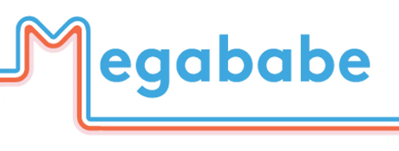

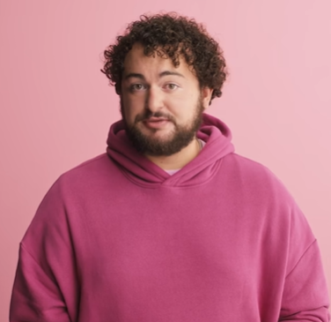
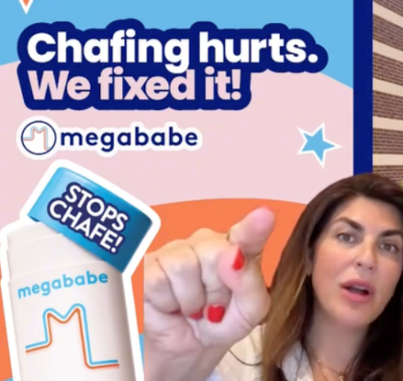





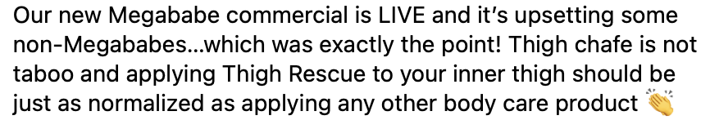




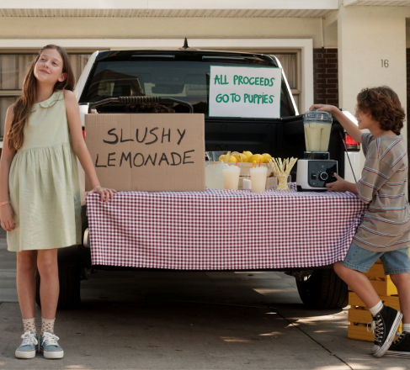

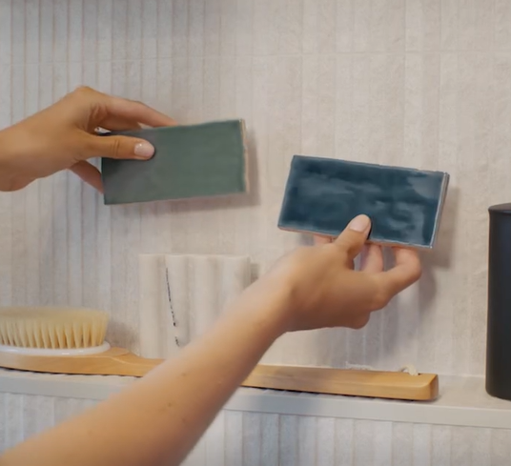

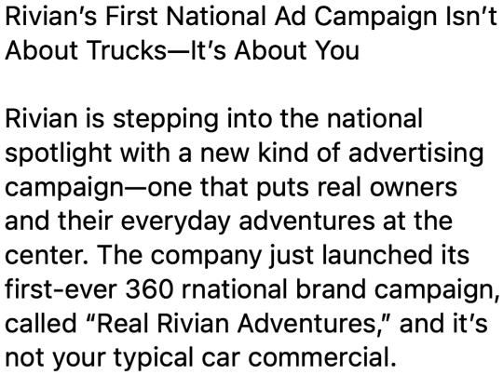
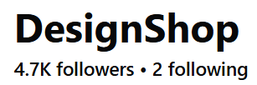
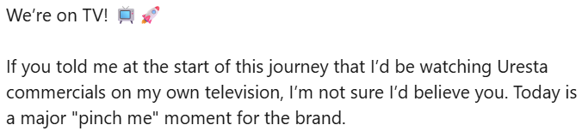

First-time advertisers proudly celebrate campaign launches on their social media channels, helping amplify awareness and conversation
Source: Social media posts found across Instagram, Facebook and LinkedIn as of 4/1/26.
This information is exclusively provided to VAB members and qualified marketers.
PAGE 7

Slide 8









Celebrity partnerships and associations with marquee televised events helped brands build credibility and enhance perception among consumers
February 5, 2025
March 2, 2025
May 13, 2025
Kiehl’s Makes National Commercial Debut During Oscars 2025 With Western Campaign Honoring Hollywood Stunt Performers
Why Jennifer Aniston Says ‘No Gimmicks Needed’ in Her Hair Care Brand LolaVie’s First TV Campaign
OpenAI to Air Its First Super Bowl Ad
April 7, 2025
September 1, 2025
OGX names Shay Mitchell as first global ambassador in bold campaign
Cody Campbell’s group launches TV blitz to “save college sports”
May 19, 2025
June 6, 2025
November 10, 2025
National Retailer J.Jill and Marketing Architects Debut New TV Campaign to Tell a Deeper Brand Story
Vktry’s Marketing Grows Up with First National TV Ad Campaign
Derek Jeter Fronts Arena Club’s Debut TV Spot from Orchard
April 24, 2025
March 20, 2025
Inside the unorthodox marketing plans for Slate, a Jeff Bezos - backed EV
Andersen Windows Announces New ‘Nice Windows’ Ad Campaign Featuring Drew and Jonathan Scott
Note: Magenta border represents celebrity partnerships, blue border represents high-profile announcements like the Super Bowl or Oscars.
This information is exclusively provided to VAB members and qualified marketers.
PAGE 8

Slide 9




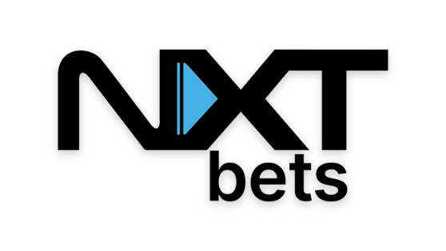












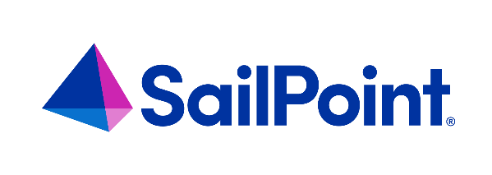





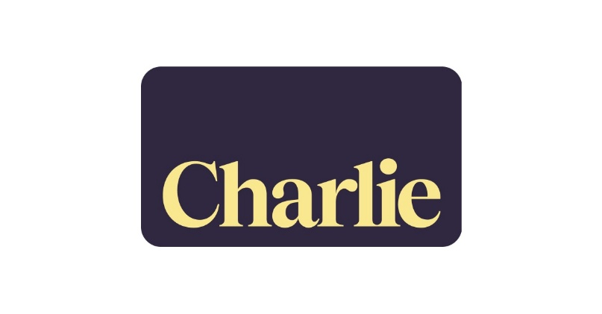




Multiscreen TV enables younger-skewing, innovative and digital-endemic brands to expand their audience and accelerate performance
*Click on any logo to visit their website
‘Younger-skewing’ brands
Brands targeting younger audiences
Innovative products
Brands using cutting-edge technology to offer inventive products / services
Digital-endemics
Brands specializing in digital services across
a range of categories
Source: VAB analysis of Nielsen Ad Intel data as of 3/2/26, 1/1/25-12/31/25. TV spend includes national cable TV, broadcast TV, Spanish language cable TV, Spanish language broadcast TV, streaming TV.
This information is exclusively provided to VAB members and qualified marketers.
PAGE 9

Slide 10





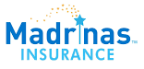




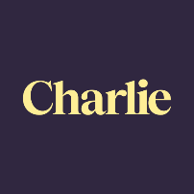

























New multiscreen TV entrants come from a range of categories related to organizations, health & wellness, professional services, lifestyle and more
Categories that are driving new ad investment in multiscreen TV
*Click on any logo to visit their website
Organizations, which accounted for 12% of first-time multiscreen TV entrants, signals a shift toward purpose-driven advertising where brands and advocacy groups alike are using TV to meet consumer needs, influence decisions and drive action at scale.
Brands that serve the overall health & wellness of consumers are investing in national multiscreen TV to service their needs within pharmaceuticals, vitamins and supplements, fitness and more.
The focus on financial security grows amidst economic uncertainty, creating interest for new entrants across banking, insurance and legal services to connect with consumers seeking stability and greater control of their finances.
As self-expression and personal identity grow in importance, apparel, beauty, jewelry and fragrance brands are investing in TV and offering consumers products with messaging that reflect individuality, confidence and evolving everyday rituals.
Lifestyle brands across home, food, beverage, travel, pet care, alcohol and more are investing in multiscreen TV to build brand reputation and favorability among consumers who are looking to engage in experiences and affordable luxuries.
Innovative digital-native brands across AI, software, electronics, cybersecurity, aerospace and more are investing in multiscreen TV to build trust as consumers and businesses turn to technology to enhance their lives, work and personal security.
Source: VAB analysis of Nielsen Ad Intel data as of 3/2/26, 1/1/25-12/31/25. TV spend includes national cable TV, broadcast TV, Spanish language cable TV, Spanish language broadcast TV, streaming TV.
This information is exclusively provided to VAB members and qualified marketers.
PAGE 10

Slide 11
As with past years, Pharma continues to be the top ‘new TV ad investment’ category although there was a surge in digital-endemic categories
FY ‘25 New National Multiscreen TV Advertisers: Top 15 Categories Ranked by Total Spend
Rank | Category | # of Brands | % of total brands | Category $$$ (000) | % of total spend
1 | Pharmaceutical | 26 | 7% | $423,747.5 | 39%
2 | Artificial Intelligence | 6 | 2% | $116,968.5 | 11%
3 | Mobile Apps | 16 | 5% | $107,865.4 | 10%
4 | Health & Wellness | 30 | 8% | $51,784.6 | 5%
5 | Organizations | 41 | 12% | $46,991.1 | 4%
6 | Home Improvement | 16 | 5% | $44,564.2 | 4%
7 | Beauty | 17 | 5% | $35,414.9 | 3%
8 | Apparel & Accessories | 18 | 5% | $35,377.1 | 3%
9 | Personal Care | 11 | 3% | $28,759.0 | 3%
10 | Arts & Crafts | 1 | 0% | $25,407.4 | 2%
11 | Vitamins & Supplements | 14 | 4% | $24,840.7 | 2%
12 | Home Furnishing | 8 | 2% | $16,138.1 | 2%
13 | Financial Services | 22 | 6% | $14,643.5 | 1%
14 | Food & Beverage | 11 | 3% | $10,842.7 | 1%
15 | Jewelry | 4 | 1% | $9,879.0 | 1%
16 | Other Categories (37) | 113 | 32% | $81,166.2 | 8%
 | Grand Total | 354 |  | $1,074,389.7
Source: VAB analysis of Nielsen Ad Intel data as of 3/2/26, 1/1/25-12/31/25. TV spend includes national cable TV, broadcast TV, Spanish language cable TV, Spanish language broadcast TV, streaming TV.
This information is exclusively provided to VAB members and qualified marketers.
PAGE 11

Slide 12



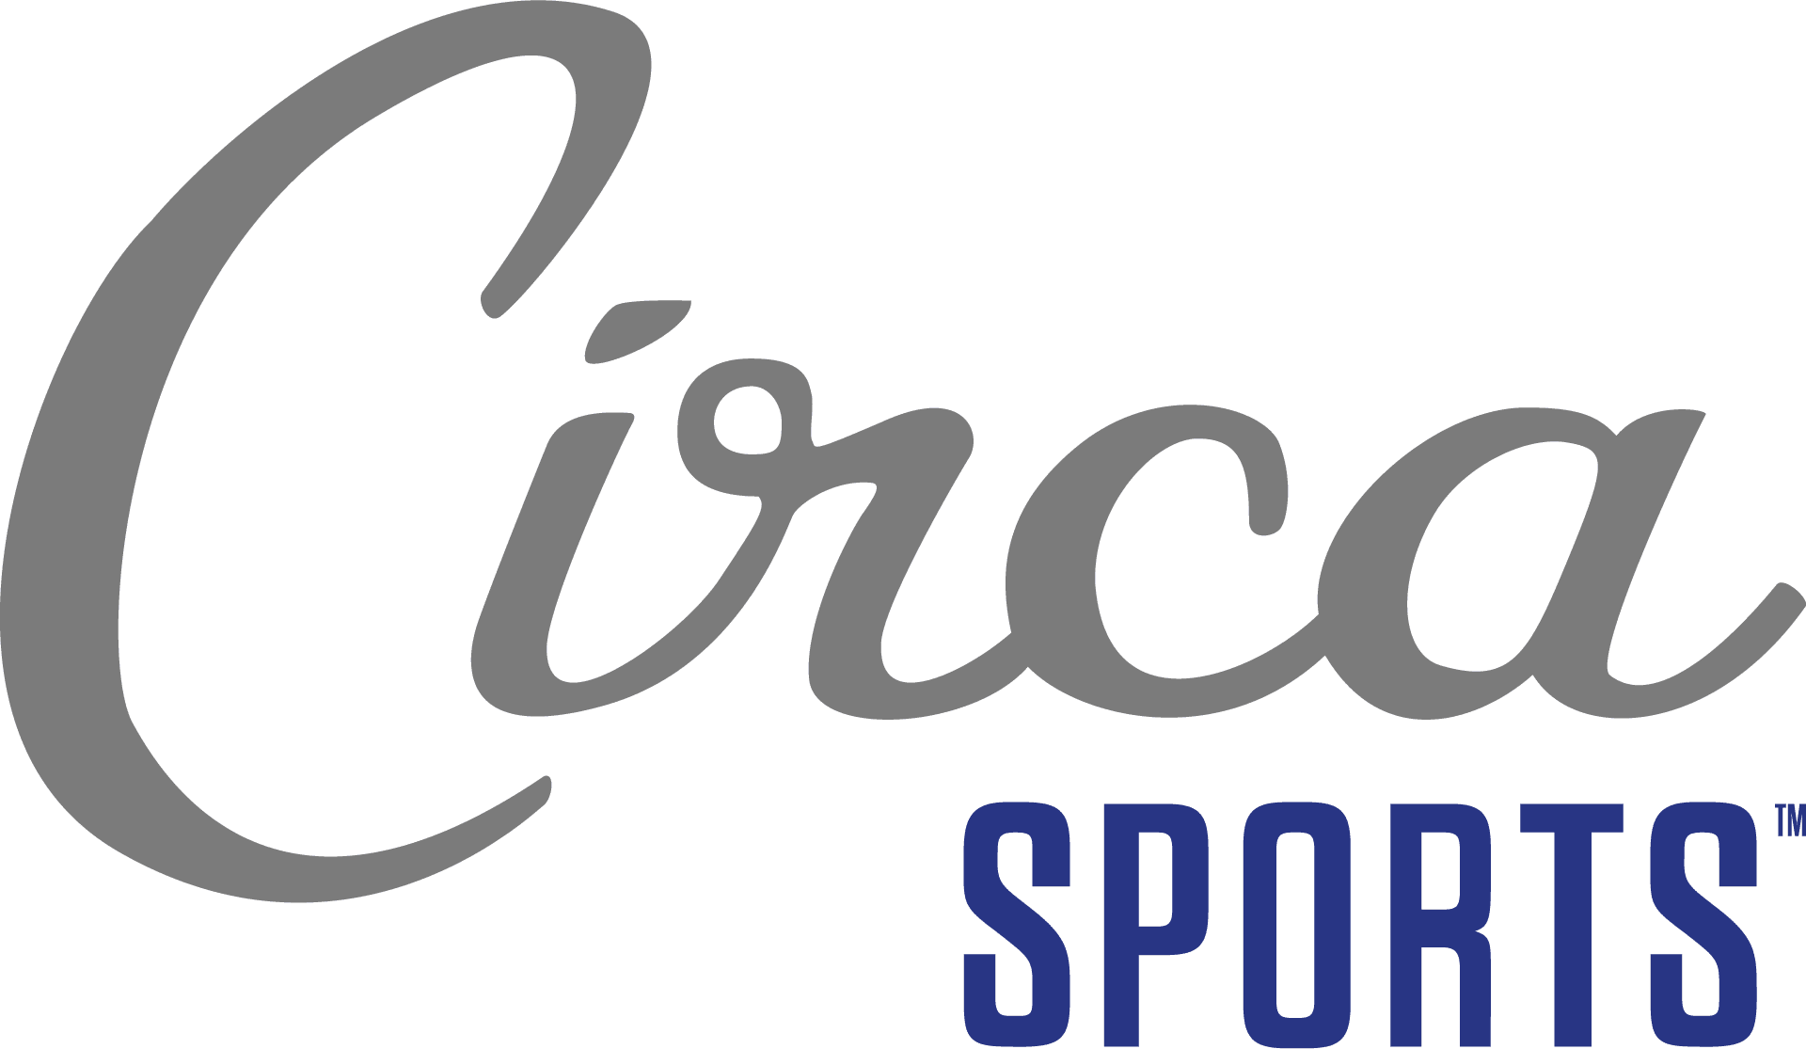





First-time TV advertiser investment skewed towards the last four months of the year to capitalize on consumer spending leading into the holidays
2025 New National Multiscreen TV Advertisers: Total Monthly Spend
Millions
$87.1 MM
$236.4 MM
$263.4 MM
$487.4 MM
Q1 ‘25 New National TV Advertiser Spend
Q2 ‘25 New National TV Advertiser Spend
Q3 ‘25 New National TV Advertiser Spend
Q4 ‘25 New National TV Advertiser Spend
Sampling of Q1 ‘25 new brands
Sampling of Q2 ‘25 new brands
Sampling of Q3 ‘25 new brands
Sampling of Q4 ‘25 new brands
Source: VAB analysis of Nielsen Ad Intel data as of 3/2/26, 1/1/25-12/31/25. TV spend includes national cable TV, broadcast TV, Spanish language cable TV, Spanish language broadcast TV, streaming TV. Brands reflect those with total measured 2025 national TV spend of $100K+ (however, for the sake of continuity, brands featured in the 1H ’25 report with spend over $50K are also included in this analysis even if their total 2025 TV spend was below $100K). $$$ % by quarter: 1Q = 8%; 2Q = 22%; 3Q = 25%; 4Q = 45%.
This information is exclusively provided to VAB members and qualified marketers.
PAGE 12

Slide 13

TV investment ranges from ‘test and learn’ campaigns and launches from small & medium-sized businesses to ‘bigger bets’ by larger brands
FY ’25 New National Multiscreen TV Advertisers by Spend Segment
% of brands within spend buckets
Source: VAB analysis of Nielsen Ad Intel data as of 3/2/26, 1/1/25-12/31/25. TV spend includes national cable TV, broadcast TV, Spanish language cable TV, Spanish language broadcast TV, streaming TV. Brands reflect those with national TV spend over $100K. Brands featured in 1H’25 report with spend over $50k are included for the full year analysis, incorporating any 2H’25 spend. Brands reflect those with total measured 2025 national TV spend of $100K+ (however, for the sake of continuity, brands featured in the 1H ’25 report with spend over $50K are also included in this analysis even if their total 2025 TV spend was below $100K).
This information is exclusively provided to VAB members and qualified marketers.
PAGE 13

Slide 14

First-time multiscreen TV campaigns sparked substantial lifts in online branded search, converting attentive viewers into real customer prospects
How to read the charts in this section:
Google Search Index = represents search interest relative to the highest point during a specific time period for a given region, a value of 100 is the peak popularity for the term, a value of 50 means that the term is half as popular.

Slide 15
Category: Personal Care
Kiehl’s, a 174-year-old cosmetics brand, saw their branded search nearly double once they launched their first nat’l TV campaign during the Oscars
Kiehl’s: Weekly Google Search Trends Index
TV Campaign Launch vs. 1H ‘25 Activity
(Weeks of 1/5/25 – 3/2/25)
+79%
vs. week before TV launch
TV Launch Week
(100 index)
Week Before TV Launch
(56 index)
TV Launch: 3/2/25
Source: VAB analysis of Google Trends, United States only, All Categories, Web Search, weeks of 1/5/25 – 6/29/25. Google Search Index represents search interest relative to the highest point on the chart for the given region and time period, a value of 100 is the peak popularity for the term, a value of 50 means that the term is half as popular. VAB analysis of Nielsen Ad Intel, TV launch month is based on the first activity reported across national cable TV, broadcast TV, Spanish language cable TV, Spanish language broadcast TV, streaming TV January 2025 – June 2025 (calendar months). Kiehl’s was founded in 1851. Note: Light blue line marks the first day of TV spending for each brand. Kiehl’s = $818K TV spend in 2025.
This information is exclusively provided to VAB members and qualified marketers.
PAGE 15

Slide 16

Category: Vitamins & Supplements
AGZ, a nighttime drink sleeping aid, saw a six-fold increase in online branded search by the week after their first TV campaign launch
AGZ: Weekly Google Search Trends Index
Six Months Pre-TV Campaign vs. TV Campaign Launch
(Weeks of 3/2/25 – 9/14/25)
6.3x
vs. week before TV launch
w/o 9/14
(100 index)
TV Launch Week
(52 index)
TV Campaign
Week Before TV Launch
(16 index)
TV Launch: 9/9/25
Source: VAB analysis of Google Trends, United States only, All Categories, Web Search, weeks of 3/2/2025 – 9/14/2025. Google Search Index represents search interest relative to the highest point on the chart for the given region and time period, a value of 100 is the peak popularity for the term, a value of 50 means that the term is half as popular. VAB analysis of Nielsen Ad Intel, TV launch month is based on the first activity reported across national cable TV, broadcast TV, Spanish language cable TV, Spanish language broadcast TV, streaming TV between January 2025 – December 2025 (calendar months). Note: Light blue line marks the first day of TV spending for each brand. AGZ launched August 21, 2025. Click here to view AGZ’s commercial (via iSpot.tv). AGZ = $901K TV spend in 2025.
This information is exclusively provided to VAB members and qualified marketers.
PAGE 16

Slide 17

Category: Mobile Gaming App
Royal Kingdom, a gaming app with heavy digital spend, saw an
immediate lift in branded online search once they launched a TV campaign
Royal Kingdom: Weekly Google Search Trends Index
Six Months Pre-TV Campaign vs. TV Campaign Launch
(Weeks of 11/10/24 – 4/27/25)
3x
vs. week before
TV launch
w/o 4/27
(100 index)
w/o 4/20
(94 index)
TV Launch Week
(59 index)
Week Before TV Launch
(33 index)
TV Campaign
TV Launch: 4/15/25
Source: VAB analysis of Google Trends, United States only, All Categories, Web Search, weeks of 11/10/24 – 4/27/25. Google Search Index represents search interest relative to the highest point on the chart for the given region and time period, a value of 100 is the peak popularity for the term, a value of 50 means that the term is half as popular. VAB analysis of Nielsen Ad Intel, TV launch month is based on the first activity reported across national cable TV, broadcast TV, Spanish language cable TV, Spanish language broadcast TV, streaming TV January 2025 – June 2025 (calendar months). Royal Kingdom was launched in the U.S. on November 21, 2024. Note: Light blue line marks the first day of TV spending for each brand. Royal Kingdom = $79.8MM TV spend in 2025.
This information is exclusively provided to VAB members and qualified marketers.
PAGE 17

Slide 18

Category: Travel
Andalucia (Spain) Tourism doubled their online branded search a week into their first TV campaign compared to the week prior to launch
Andalucia: Weekly Google Search Trends Index
Six Months Pre-TV Campaign vs. TV Campaign Launch
(Weeks of 1/5/25 – 7/27/25)
2x
vs. week before TV launch
TV Launch Week
(85 index)
w/o 7/27
(100 index)
TV Campaign
Week Before TV Launch
(49 index)
TV Launch: 7/25/25
Source: VAB analysis of Google Trends, United States only, All Categories, Web Search, weeks of 1/5/25 – 7/27/25. Google Search Index represents search interest relative to the highest point on the chart for the given region and time period, a value of 100 is the peak popularity for the term, a value of 50 means that the term is half as popular. VAB analysis of Nielsen Ad Intel, TV launch month is based on the first activity reported across national cable TV, broadcast TV, Spanish language cable TV, Spanish language broadcast TV, streaming TV between January 2025 – December 2025 (calendar months). Note: Light blue line marks the first day of TV spending for each brand. Andalucia Tourism launched in November 2023. Click here to view Andalucia’s commercial (via iSpot.tv). Andalucia = $1.5MM TV spend in 2025.
This information is exclusively provided to VAB members and qualified marketers.
PAGE 18

Slide 19

Category: Electronics
Bodywell, a radiation protection product, saw a significant lift in online branded search after launching their first national TV campaign
Bodywell: Weekly Google Search Trends Index
Six Months Pre-TV Campaign vs. TV Campaign Launch
(Weeks of 6/1/2025 – 12/21/25)
+52%
vs. week before TV launch
TV Launch Week
(91 index)
w/o 12/21
(100 index)
Week Before TV Launch
(66 index)
TV Launch: 12/17/25
Source: VAB analysis of Google Trends, United States only, All Categories, Web Search, weeks of 6/1/2025 – 12/21/25. Google Search Index represents search interest relative to the highest point on the chart for the given region and time period, a value of 100 is the peak popularity for the term, a value of 50 means that the term is half as popular. VAB analysis of Nielsen Ad Intel, TV launch month is based on the first activity reported across national cable TV, broadcast TV, Spanish language cable TV, Spanish language broadcast TV, streaming TV between January 2025 – December 2025 (calendar months). Note: Light blue line marks the first day of TV spending for each brand. Bodywell was formally established in 2009. Click here to view Bodywell’s commercial (via iSpot.tv). Bodywell = $150K TV spend in 2025.
This information is exclusively provided to VAB members and qualified marketers.
PAGE 19

Slide 20

Category: Cybersecurity
Guardio, a cybersecurity service, saw their online branded search incrementally grow through the first few weeks of their TV campaign
Guardio: Weekly Google Search Trends Index
Six Months Pre-TV Campaign vs. TV Campaign Launch
(Weeks of 4/6/2025 – 10/19/25)
+47%
vs. week before TV launch
w/o 10/19
(100 index)
TV Launch Week
(70 index)
TV Campaign
Week Before TV Launch
(68 index)
TV Launch: 10/2/25
Source: VAB analysis of Google Trends, United States only, All Categories, Web Search, weeks of 4/6/2025 – 10/19/25. Google Search Index represents search interest relative to the highest point on the chart for the given region and time period, a value of 100 is the peak popularity for the term, a value of 50 means that the term is half as popular. VAB analysis of Nielsen Ad Intel, TV launch month is based on the first activity reported across national cable TV, broadcast TV, Spanish language cable TV, Spanish language broadcast TV, streaming TV between January 2025 – December 2025 (calendar months). Note: Light blue line marks the first day of TV spending for each brand. Enhertu Rx was founded in 2018. Click here to view Guardio’s commercial (via iSpot.tv). Guadrio’s = $5.8MM TV spend in 2025.
This information is exclusively provided to VAB members and qualified marketers.
PAGE 20

Slide 21

Category: Hobbies
Arena Club, an online trading card marketplace, saw their online branded search rebound and increase through the first month of their TV campaign
Arena Club: Weekly Google Trends Index
Six Months Pre-TV Campaign vs. TV Campaign Launch (Weeks of 1/5/25 –7/27/25)
+32%
vs. week before TV launch
TV Launch Week
(62 index)
w/o 7/27
(100 index)
“Collecting has always been about ‘the chase,’ that heart-pounding moment of discovery. This ad brings it to life. Our mission at Arena Club remains constant: to deliver trust, excitement, and accessibility to every collector.”
TV Campaign
Week Before TV Launch
(76 index)
TV Launch: 7/3/25
Brian Lee
CEO & co-founder, Arena Club
(Little Black Book Online, 6/6/2025)
Source: VAB analysis of Google Trends, United States only, All Categories, Web Search, Weeks of 1/5/25 –7/27/25. Google Search Index represents search interest relative to the highest point on the chart for the given region and time period, a value of 100 is the peak popularity for the term, a value of 50 means that the term is half as popular. VAB analysis of Nielsen Ad Intel, TV launch month is based on the first activity reported across national cable TV, broadcast TV, Spanish language cable TV, Spanish language broadcast TV, streaming TV between January 2025 – December 2025 (calendar months); Note: Light blue line marks the first day of TV spending for each brand. Arena Club launched in September 2022. Click here to view Arena Club’s commercial (via iSpot.tv). Arena Club = $1.7MM TV spend in 2025.
This information is exclusively provided to VAB members and qualified marketers.
PAGE 21

Slide 22

Category: Home Improvement
AppLights PERMANENT saw their first meaningful branded online search when they launched a TV campaign at the beginning of the holiday season
AppLights PERMANENT: Weekly Google Search Trends Index
Six Months Pre-TV Campaign vs. TV Campaign Launch
(Weeks of 5/4/2025 – 11/9/25)
2x
vs. prior week
w/o 11/9
(100 index)
TV Campaign
TV Launch Week
(48 index)
Week Before TV Launch
(0 index)
TV Launch: 11/4/25
Source: VAB analysis of Google Trends, United States only, All Categories, Web Search, weeks of 5/4/2025 – 11/9/25. Google Search Index represents search interest relative to the highest point on the chart for the given region and time period, a value of 100 is the peak popularity for the term, a value of 50 means that the term is half as popular. VAB analysis of Nielsen Ad Intel, TV launch month is based on the first activity reported across national cable TV, broadcast TV, Spanish language cable TV, Spanish language broadcast TV, streaming TV between January 2025 – December 2025 (calendar months). Note: Light blue line marks the first day of TV spending for each brand. AppLights PERMANENT launched on November 3, 2025. Click here to view AppLights PERMANENT’s commercial (via iSpot.tv). $3.4MM TV spend in 2025.
This information is exclusively provided to VAB members and qualified marketers.
PAGE 22

Slide 23

Category: Vitamins & Supplements
Cerefolin, a cognitive support / brain wellness brand, saw their first meaningful branded online search only when they launched a TV campaign
Cerefolin: Weekly Google Search Trends Index
Six Months Pre-TV Campaign vs. TV Campaign Launch
(Weeks of 12/1/24 – 6/1/25)
+59%
vs. prior week
w/o 5/25
(100 index)
w/o 5/18
(63 index)
TV Launch Week
(43 index)
TV Campaign
Week Before TV Launch
(0 index)
TV Launch: 5/11/25
Source: VAB analysis of Google Trends, United States only, All Categories, Web Search, weeks of 12/1/24 – 6/1/25. Google Search Index represents search interest relative to the highest point on the chart for the given region and time period, a value of 100 is the peak popularity for the term, a value of 50 means that the term is half as popular. VAB analysis of Nielsen Ad Intel, TV launch month is based on the first activity reported across national cable TV, broadcast TV, Spanish language cable TV, Spanish language broadcast TV, streaming TV January 2025 – June 2025 (calendar months). Cerefolin was launched on November 11, 2003. Note: Light blue line marks the first day of TV spending for each brand. Cerefolin = $10.3MM TV spend in 2025.
This information is exclusively provided to VAB members and qualified marketers.
PAGE 23

Slide 24

First-Time TV Advertiser: Case Study from Tatari
Examining how a data-driven TV strategy evolved from streaming retargeting into a broader linear TV campaign to drive sales

Slide 25



Category:
Food
Tatari and Pholicious leveraged a CTV and linear TV campaign to grow awareness, build credibility and drive sales growth
Challenge
Pholicious, an instant pho brand, wanted to educate consumers to help build authenticity and credibility, drive sales growth and support retail partners
Solution
Pholicious enabled Tatari’s Pixel (one-click via Shopify) to build remarketing pools and track conversions ahead of their appearance on Shark Tank
The brand launched 30-second streaming retargeting ads at ~$500 / week, focusing on site visitors who hadn’t purchased the product and delivering TV ads where they streamed content
Then, they launched a national linear TV campaign working closely with Tatari to manage spend within their budget alignment and furthering creative messaging around a 3,000-store feature with Walmart
Tatari and Pholicious aligned TV flights with retail windows to drive in-store traffic and website demand
They measured performance by channel and creative (testing dayparts, networks and spend levels to stay on CPA and ROAS targets)
Results
Streaming retargeting delivered substantial ROAS with their Walmart-specific creative ROAS jumping from 4.5 to 7.9
During the linear TV campaign, online impressions for Walmart.com grew from 150K to 600K
Pholicious doubled down on linear TV spend to sustain the momentum
Company / Platform
Tatari / CTV, Linear TV
500+
Conversions
8x
ROAS
Source: Tatari, Case Study: How Pholicious Went from Shark Tank to Walmart with a Scalable TV Ad Strategy, September 2025.
This information is exclusively provided to VAB members and qualified marketers.
PAGE 25

Slide 26
Adults over 50 account for 36% of the total population and nearly half of all adults
Multiscreen TV attracts high-intent audiences & creates quantifiable action
Multiscreen TV is an accessible and effective platform for brands of all life stages, sizes and budgets which helps new advertisers break through and connect meaningfully with their target audiences.
Emerging direct-to-consumer brands, innovative tech companies and small-to-medium-sized businesses are turning to multiscreen TV to build meaningful reach, expand awareness, establish consumer trust and generate momentum among prospective customers
Multiscreen TV is driving measurable mid-funnel impact – leading to immediate spikes and incremental increases in online branded search as first-time campaigns are launched and a sustaining presence is created
Key Marketer Takeaways
This information is exclusively provided to VAB members and qualified marketers.
PAGE 26

Slide 27


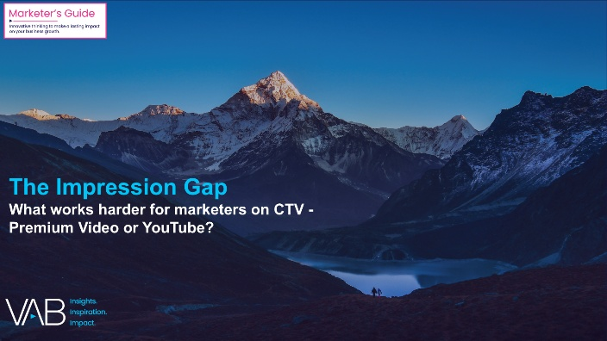





Creators
Jason Wiese
Leah Pujalte
EVP, Strategic Insights & Measurement
jasonw@thevab.com
VP, Audience & Behavioral Insights
leahm@thevab.com
Karolina Guillen
Amanda Cashman
Rising Tides
26 Streaming Insights That Are Impacting Marketing Plans in 2026
The Impression Gap
What works harder for marketers on CTV - Premium Video or YouTube?
Associate Director, Insights, Strategy & Analytics
karolinag@thevab.com
Insights Analyst
amandac@thevab.com
Discover more
Looking for more data, insights and takeaways? Check out this related VAB content
The Power of Premium Video
What It Means for Multiscreen TV and Why It Matters to Marketers
The Illusions of the Internet
Uncovering the Fallacies & Realities of Audience, Advertising & Content
Through Upfront season, marketers are making important decisions about their video investment strategy.
We’re here to help.
Visit our Upfront Planning Resource Center
for a curated a list of resources filled with the data, analysis and insights needed to make informed investment decisions.
Performance Starts With Brand
How marketers are looking to balance short-term sales with long-term growth
A Commanding Presence
How Ad Continuity in Multiscreen TV Drives Incremental Growth for Brands
VAB Members, brand marketers and agencies get free and immediate access to VAB’s content library. Get access at theVAB.com
This information is exclusively provided to VAB members and qualified marketers.
PAGE 27

Slide 28


About VAB
VAB is an insights-driven organization that inspires marketers to reimagine their media strategies resulting in fully informed decisions.
Drawing on our marketing expertise, we simplify the complexities in our industry and discover new insights that transform the way marketers look at their media strategy.
We are committed to your business growth and proud to offer VAB members, brand marketers and agencies complimentary access to our continuously-growing Insights library. Get immediate access at theVAB.com.
This information is exclusively provided to VAB members and qualified marketers.
PAGE 28

Slide 29

FY ‘25 New National Multiscreen TV Advertiser Lists

Slide 30
New Advertiser List: The national TV marketplace welcomed
354 bold new advertisers across categories and life stages to build scale
FY 2025 New National Multiscreen TV Advertisers
Brand | $$$ (000) | Brand | $$$ (000) | Brand | $$$ (000) | Brand | $$$ (000)
ChatGPT | $91,065.5 | 88 Fortunes | $4,046.5 | Megababe Beauty | $1,573.8 | Vida | $864.2
Royal Kingdom | $79,783.1 | Coalition to Empower Our Future | $3,823.3 | VKTRY | $1,569.5 | Wander | $860.5
EBGLYSS Rx | $68,961.7 | Red River Charitable Foundation | $3,689.4 | Avantis Investors | $1,552.5 | Hollow Socks | $859.2
CAPVAXIVE Rx | $62,631.0 | Viasox | $3,668.5 | Andalucia Tourism | $1,544.9 | Wowee | $856.6
Nemluvio Rx | $62,481.8 | Midi Health | $3,654.2 | Henry Ford Health | $1,514.1 | Perelel | $829.3
Cobenfy Rx | $56,201.5 | OneSkin | $3,594.6 | University of Michigan Credit Union | $1,514.1 | Kiehl's | $818.2
Attruby Rx | $32,903.8 | Kars4Kids | $3,467.2 | Badlands Ranch | $1,510.1 | Madrina's Insurance | $807.7
Auvelity Rx | $27,111.2 | AppLights Permanent | $3,405.1 | Nanit | $1,400.8 | Window Nation | $736.4
Ninja Transfers | $25,407.4 | J Jill | $3,329.3 | Zealthy | $1,389.0 | Rockies.TV | $727.8
Neffy | $24,792.1 | Oats Overnight | $3,236.9 | Merit | $1,371.0 | Rivian | $723.1
Anthropic | $22,692.2 | Chopzilla | $3,048.6 | NetApp | $1,364.5 | RARCOA | $719.9
Mochi Health | $21,680.2 | Javvy | $2,912.6 | MaryRuth Organics | $1,262.6 | BeatBox | $719.7
Rezdiffra Rx | $20,414.0 | fatty15 | $2,792.8 | Rhythms of the Village | $1,253.7 | EllaOla | $684.7
Spruce | $18,474.8 | Saving College Sports | $2,782.6 | Two Dragons Martial Arts | $1,253.7 | Web Eater | $669.6
Ocrevus Zunovo | $17,985.2 | Fast Growing Trees | $2,652.8 | The National Interest | $1,166.2 | Lone Star Freedom Project | $659.3
Play Equity Fund | $14,258.9 | Create Wellness | $2,642.7 | Pulsetto | $1,142.4 | Rotten Tomatoes | $633.1
OGX Beauty | $12,257.4 | Engine | $2,577.9 | Paingone | $1,134.9 | Protect Our Jobs | $631.8
LEQEMBI Rx | $11,543.4 | Ocean Wise | $2,393.1 | DC Worlds Collide | $1,129.7 | Angel City Sports | $621.8
Kitsch | $10,766.1 | Insmed | $2,376.8 | Orla Floral | $1,097.0 | Venu | $620.0
DateMyAge.com | $10,465.4 | Seniors 4 Better Care | $2,351.3 | Project Yellow Light | $1,089.4 | ENHERTU Rx | $613.5
Ponvory Rx | $10,386.1 | Wet & Forget | $2,315.1 | Grow Therapy | $1,080.2 | RoboSeal | $608.7
Cerefolin Brain Wellness | $10,339.7 | Miu Miu | $2,234.2 | Doctronic | $1,079.4 | Oregon Health & Science University | $608.5
RushOrderTees | $10,287.7 | Florajen | $2,181.1 | Elahere Rx | $1,028.0 | Uforia by TREBEL | $607.0
Xdemvy Rx | $9,647.7 | National Cryptocurrency Association | $2,116.3 | Realty Central | $1,023.3 | Lebron James Family Foundation | $587.1
De Beers | $9,376.5 | Michael Todd Beauty | $2,107.4 | Plunge | $1,014.7 | pH-D Feminine Health | $581.4
Rugiet | $8,965.2 | Transformer Table | $2,092.1 | Gibbon | $1,014.5 | Mistplay | $571.1
Gold Fish Casino Slot Games | $8,645.2 | Splash Refresher | $2,050.1 | InvestorPlace | $986.0 | iMemories | $570.1
Abogado.com | $8,373.3 | Alaya Naturals | $2,025.1 | Securing American Greatness | $972.1 | Wonderskin | $561.8
Briumvi Rx | $8,011.2 | Paleovalley | $1,967.6 | Reelz+ | $960.9 | Timothy Plan | $552.5
Andersen Windows & Doors | $7,985.7 | Felix | $1,890.8 | MLB PRO SPIRIT | $957.9 | iRestore Laser | $545.6
CordaRoy's | $6,907.6 | Combat Bugs | $1,889.8 | NasalFresh MD | $949.8 | Design Home | $545.2
Brukinsa Rx | $6,888.6 | The Good Feet Store | $1,849.7 | Quo | $946.6 | Smash Kitchen | $529.4
Extra Space Storage | $6,560.0 | PureHealth Research | $1,823.8 | Yeezy | $940.3 | Eskiin | $528.4
Tagrisso Rx | $6,390.9 | Trump Watches | $1,796.8 | Wellura | $933.4 | HII | $525.6
Everdries | $6,117.4 | Toyota Gazoo Racing | $1,771.8 | All Reality | $918.2 | PBZ OTC | $521.8
Anthros | $5,953.5 | Commvault | $1,749.3 | LolaVie | $908.9 | Calamos | $509.4
Guardio | $5,813.2 | Winona Feminine | $1,745.4 | Whatnot | $907.0 | Danbury Mint | $500.4
Star Patrol | $5,160.6 | Te | $1,744.0 | Opencare | $905.7 | Medicus Pharma | $494.8
PROOF | $5,081.3 | ecoNugenics | $1,740.9 | AGZ | $901.1 | Jovi | $486.0
Debt Fix Pros | $4,818.8 | Arena Club | $1,733.7 | LAPAM | $900.1 | Startup Nation Central | $483.4
52 Pills | $4,352.4 | HomeSafe | $1,696.6 | Primal Queen | $893.3 | L'ange | $482.6
SmarterAuto | $4,166.6 | Patio Enclosures | $1,665.9 | Safe Ship Moving | $883.1 | Woof | $480.4
Humane World for Animals | $4,146.2 | Golden Paw Society, Inc. | $1,663.4 | Void Interactive | $875.5 | Foresight Sports | $470.9
Source: VAB analysis of Nielsen Ad Intel data as of 3/2/26, 1/1/25-12/31/25. TV spend includes national cable TV, broadcast TV, Spanish language cable TV, Spanish language broadcast TV, streaming TV. Brands reflect those with total measured 2025 national TV spend of $100K+ (however, for the sake of continuity, brands featured in the 1H ’25 report with spend over $50K are also included in this analysis even if their total 2025 TV spend was below $100K).
To click through to a brand’s website, view in ‘slide show’ and click on the respective link.
This information is exclusively provided to VAB members and qualified marketers.
PAGE 30

Slide 31
New Advertiser List Cont.: The national TV marketplace welcomed
354 bold new advertisers across categories and life stages to build scale
FY 2025 New National Multiscreen TV Advertisers
Brand | $$$ (000) | Brand | $$$ (000) | Brand | $$$ (000) | Brand | $$$ (000)
Hostinger | $294.4 | Wolf Mattress | $172.8 | Republican Red Winery | $110.6 | Odyssey Trust | $57.1
Businessolver | $294.1 | JCC Association of North America | $172.0 | BugMD | $109.6 | Earnings Hub | $56.2
RAD Technologies | $292.9 | The Voice of the Martyrs | $171.9 | Augusta University | $107.7 | Health & Her | $56.0
A Better Tomorrow in America | $288.2 | Visit Oman | $171.0 | Blaize | $106.4 | Elevate | $55.8
Hiya Health | $285.1 | Dr. Phytos | $170.3 | Rodeo Picks | $106.0 | Big Dog Ranch Rescue | $53.2
Slipstick | $265.9 | Emerald Cruises | $168.8 | DeLeon Tequila | $105.7 | Inbound Response | $52.4
Hamilton CapTel | $264.3 | Kyivstar | $167.7 | Ducal | $105.4 | College HUNKS | $52.3
Cheers | $263.4 | SendAFriend | $166.2 | Vapor Technology | $105.3 | Sonic Power | $51.8
Moerie | $258.1 | Elm Biosciences | $163.2 | Freedom Caucus | $105.0 | Garage Beer | $51.5
GLDN | $256.4 | DesignShop | $160.3 | NeuOra Microceuticals | $102.8 | The Hope Alliance | $50.1
America PAC | $255.6 | Active Skin Repair | $160.2 | Kérastase | $100.3
Liz Buys Houses | $250.7 | Texas Bullion Exchange | $159.5 | Don't Bug My Pet | $99.2
Golf Clash | $247.4 | COOFANDY | $157.1 | IVY | $98.2
United for Cures | $246.2 | Avaline | $151.5 | Moody's | $98.2
Aperol | $246.1 | Bodywell | $149.9 | Perry Ellis | $96.8
FlyUSA | $244.6 | Govee | $147.6 | Nature's Answer | $94.6
Orion Metal Exchange | $243.0 | HeySunday | $142.8 | Paired | $93.3
Rx Pros | $238.9 | Miss Universe Skincare | $142.1 | Patriots for a Secure America | $92.1
Bring a Trailer | $234.3 | Safe Money Innovators | $140.4 | Mood Bloom | $92.0
Riyadh Season | $225.6 | Sunrise Association | $140.0 | Calvary Outreach | $91.2
Circa Sports | $222.9 | Happy Yappers | $138.5 | GHOST | $86.4
New Era Energy & Digital | $216.0 | Veterans of Foreign Wars | $138.1 | SailPoint | $83.2
Hari Mari | $213.9 | WhistlePig Whiskey | $135.2 | Right Trailers | $82.1
Charlie | $209.6 | Denvix | $133.8 | Ultimate Tax Group | $81.1
Bearbottom | $208.6 | Albert | $133.4 | Aztec Minerals | $77.1
The Hill | $206.8 | Canyon Spirit | $130.2 | Hinge Health | $74.2
Bliss | $206.1 | Aggressor Adventures | $128.1 | Caldera+Lab | $70.7
Legal Tax Defense | $203.2 | Slate | $128.0 | Connect Biopharma | $70.0
Pharmaceutical Reform Alliance | $203.0 | Oak & Luna | $127.7 | CURT | $69.5
California Community Foundation | $199.3 | Lufthansa | $127.2 | NXTbets | $67.7
Beyond Tennis | $197.8 | Get Joy & Co. | $126.0 | Cashmere Cookware | $66.1
Local Media Association | $197.3 | ISCO Industries | $123.4 | Love One Louisiana | $65.7
America First Agriculture (AFA) | $195.4 | Big Oak Ranch | $120.8 | Conestoga Wagon Co | $64.4
U.S. Small Business Administration | $194.1 | Pompa Program | $120.6 | American Rebel Beer | $64.2
Bowlers to Veterans Link | $191.5 | XTI Aerospace | $120.5 | Care Income Advisors | $63.7
Noble Gold Investments | $187.0 | Grown Brilliance | $118.3 | Lippert | $63.5
NFP | $185.7 | Alpha Dog Nutrition | $117.6 | Womaness | $62.2
BAERSkin | $185.5 | Motor Home Specialist | $116.5 | JubileeTV | $59.9
Advantage Gold | $179.1 | Mon Chateau | $115.8 | CLEARSTEM | $59.2
Lendgo | $178.9 | Ogee | $115.6 | React | $58.8
DUER | $178.1 | Debt Clear USA | $114.3 | Graze Robotics | $57.7
Chene Gear | $177.7 | JSX | $113.1 | Ovation Tax Group | $57.3
Huntsman Mental Health Foundation | $176.7 | Bearhug | $110.7 | Outcomes4Me | $57.2
To click through to a brand’s website, view in ‘slide show’ and click on the respective link.
Source: VAB analysis of Nielsen Ad Intel data as of 3/2/26, 1/1/25-12/31/25. TV spend includes national cable TV, broadcast TV, Spanish language cable TV, Spanish language broadcast TV, streaming TV. Brands reflect those with total measured 2025 national TV spend of $100K+ (however, for the sake of continuity, brands featured in the 1H ’25 report with spend over $50K are also included in this analysis even if their total 2025 TV spend was below $100K).
This information is exclusively provided to VAB members and qualified marketers.
PAGE 31

Slide 32




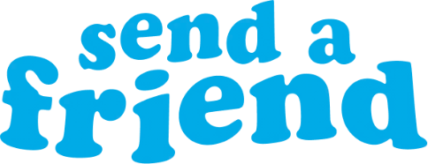



The Direct-to-Consumer segment continues to drive new entrants with 81 brands across 24 categories, spending over $146 million in 2025
FY 2025 New National Multiscreen TV DTC Advertisers
Brand | Category | $$$ (000) | Brand | Category | $$$ (000) | Brand | Category | $$$ (000)
Ninja Transfers | Arts & Crafts | $25,407.4 | Quo | Professional Services | $946.6 | Bliss | Beauty | $206.1
Mochi Health | Personal Care | $21,680.2 | Yeezy | Apparel & Accessories | $940.3 | Advantage Gold | Financial Services | $179.1
Rugiet | Pharmaceutical | $8,965.2 | All Reality | Streaming Services | $918.2 | Lendgo | Financial Services | $178.9
Abogado.com | Legal Services | $8,373.3 | LolaVie | Beauty | $908.9 | DUER | Apparel & Accessories | $178.1
CordaRoy's | Home Furnishing | $6,907.6 | Opencare | Health & Wellness | $905.7 | Dr. Phytos | Pet Care | $170.3
Everdries | Apparel & Accessories | $6,117.4 | Wander | Real Estate | $860.5 | SendAFriend | Gift Box | $166.2
Anthros | Home Furnishing | $5,953.5 | Hollow Socks | Apparel & Accessories | $859.2 | Elm Biosciences | Beauty | $163.2
SmarterAuto | Insurance | $4,166.6 | Perelel | Health & Wellness | $829.3 | DesignShop | Home Improvement | $160.3
Viasox | Apparel & Accessories | $3,668.5 | iMemories | Photography | $570.1 | COOFANDY | Apparel & Accessories | $157.1
Midi Health | Personal Care | $3,654.2 | iRestore Laser | Personal Care | $545.6 | Bodywell | Electronics | $149.9
OneSkin | Beauty | $3,594.6 | Jovi | Health & Wellness | $486.0 | HeySunday | Home Improvement | $142.8
fatty15 | Vitamins & Supplements | $2,792.8 | Hello Cake | Pharmaceutical | $455.9 | Denvix | Auto | $133.8
Fast Growing Trees | Home Improvement | $2,652.8 | Relay | Financial Services | $450.7 | Pompa Program | Health & Wellness | $120.6
Michael Todd Beauty | Beauty | $2,107.4 | Barnakl | Home Improvement | $432.2 | Alpha Dog Nutrition | Pet Care | $117.6
Transformer Table | Home Furnishing | $2,092.1 | Sell My Policy | Insurance | $390.1 | Ogee | Beauty | $115.6
Alaya Naturals | Vitamins & Supplements | $2,025.1 | OmniWatch | Cybersecurity | $380.9 | BugMD | Home Improvement | $109.6
Felix | Financial Services | $1,890.8 | Grain Wood Furniture | Home Furnishing | $324.9 | Don't Bug My Pet | Pet Care | $99.2
Winona Feminine | Health & Wellness | $1,745.4 | KURU Footwear | Apparel & Accessories | $324.7 | Caldera+Lab | Beauty | $70.7
Te | Health & Wellness | $1,744.0 | Uresta | Health & Wellness | $324.6 | Womaness | Personal Care | $62.2
ecoNugenics | Health & Wellness | $1,740.9 | FluffCo | Home Furnishing | $305.4 | CLEARSTEM | Beauty | $59.2
Arena Club | Sports | $1,733.7 | Protection Tax | Financial Services | $303.5 | Outcomes4Me | Health & Wellness | $57.2
Megababe Beauty | Beauty | $1,573.8 | Hostinger | Computer Software | $294.4 | Earnings Hub | Financial Services | $56.2
Avantis Investors | Financial Services | $1,552.5 | Businessolver | Professional Services | $294.1 | Inbound Response | Professional Services | $52.4
Nanit | Health & Wellness | $1,400.8 | GLDN | Jewelry | $256.4
Zealthy | Pharmaceutical | $1,389.0 | Liz Buys Houses | Real Estate | $250.7
MaryRuth Organics | Health & Wellness | $1,262.6 | Rx Pros | Health & Wellness | $238.9
Plunge | Home Improvement | $1,014.7 | Hari Mari | Apparel & Accessories | $213.9
InvestorPlace | Financial Services | $986.0 | Charlie | Financial Services | $209.6
Reelz+ | Streaming Services | $960.9 | Bearbottom | Apparel & Accessories | $208.6
To click through to a brand’s website, view in ‘slide show’
and click on the respective link.
DTC brands accounted for 23% of total new TV advertisers and 14%
of total TV spend
Logos represent a sampling of new national TV DTC advertisers
Source: VAB analysis of Nielsen Ad Intel data as of 3/2/26, 1/1/25-12/31/25. TV spend includes national cable TV, broadcast TV, Spanish language cable TV, Spanish language broadcast TV, streaming TV. Brands reflect those with national TV spend over $100K. Brands featured in 1H’25 report with spend over $50k are included for the full year analysis, incorporating any 2H’25 spend.
This information is exclusively provided to VAB members and qualified marketers.
PAGE 32

