Slide 1



January 2021
Weathering The Storm
TV’s Resilience Amid A Pandemic & Economic Uncertainty

Slide 2


About VAB
VAB is an insights-driven organization that inspires marketers to reimagine their media strategies resulting in fully informed decisions.
Drawing on our marketing expertise, we simplify the complexities in our industry and discover new insights that transform the way marketers look at their media strategy.
Simplify
We save you time by bringing you the latest data & actionable takeaways you can use to inform your marketing plans.
Discover
We keep you one step ahead with the latest thinking so you can create innovative, forward-looking strategies.
Transform
We help you build your brand by focusing on core marketing principles that will help drive tangible business outcomes.
This information is exclusively provided to VAB members and qualified marketers. Further distribution is prohibited.
PAGE 2

Slide 3
What You’ll Learn…
How the national TV advertising marketplace fared in 2020 amid a global pandemic and economic downturn
Why many brands turned to TV to defend, and even grow, their brands during this time of crisis
How you can apply these brands’ success strategies to your own brand marketing plans
This information is exclusively provided to VAB members and qualified marketers. Further distribution is prohibited.
PAGE 3

Slide 4
The national TV advertising marketplace fared much better than expected in 2020 amid a global pandemic and economic downturn. Here are key reasons why:
Savvy marketers focused on long-term branding efforts increased their TV ad investment in order to achieve positive business outcomes.
Data-driven, performance-obsessed Direct-to-Consumer brands have been particularly well-positioned for the pandemic and their TV spending as a category has been relatively consistent versus the prior year.
Advertisers are launching their first TV campaigns earlier in their brand stage than before and are seeing a greater impact to their digital performance as a result. Earlier campaign launches also create a larger universe of TV advertisers.
A set of new TV advertisers launched their first TV campaigns in the first half of 2020, many of whom launched at the beginning of the pandemic in 2Q.
This information is exclusively provided to VAB members and qualified marketers. Further distribution is prohibited.
PAGE 4

Slide 5

Due to COVID-19, many marketers immediately changed their media plans and industry forecasters were initially predicting severe doom and gloom for TV advertising
This information is exclusively provided to VAB members and qualified marketers. Further distribution is prohibited.
PAGE 5

Slide 6
At the beginning of the pandemic, 89% of advertisers took action with their ad budgets due to COVID-19, with 44% canceling new campaigns completely
How has Coronavirus impacted your advertising efforts?
Source: Advertiser Perceptions, “Coronavirus Effect on Advertising’ Report. Q12: In which of the following ways has the Coronavirus (COVID-19) outbreak impact your recent or ongoing advertising efforts? Base: Total Respondents. Wave 1 = survey fielded March 17-20, 2020, 203 interviews conducted. Wave 2 = survey fielded April 1-4, 2020, 152 interviews conducted.
This information is exclusively provided to VAB members and qualified marketers. Further distribution is prohibited.
PAGE 6

Slide 7
In March, 80% of brands said they planned to reduce their media budget for the rest of the year; more than half expect to cut spend by >20%... naturally there was concern of a looming advertising depression
How do you expect your media budgets will change for the rest of the year?
Decrease
Increase
<10%
10-20%
30-40%
No Change
>50%
40-50%
30-40%
20-30%
10-20%
<10%
85%
75%
65%
55%
45%
35%
25%
15%
5%
5%
15%
Source: Ebiquity, ‘COVID-19 & Media: Ebiquity Client Survey Results.’ Survey conducted between March 19-31, 2020. n=43.
This information is exclusively provided to VAB members and qualified marketers. Further distribution is prohibited.
PAGE 7

Slide 8
However, in December, GroupM estimated there would be only an 8% dip in 2020 national TV spending with a nearly full recovery in 2021
‘The big takeaway is, it could’ve been worse’ – Brian Wieser, GroupM’s global president of business intelligence, in reference to the overall U.S. advertising forecast (Ad Age 12/1/20)
+0.6%
+5.1%
-3.6%
+2.8%
-0.3%
-7.9%
+6.6%
+0.5%
-0.6%
-0.8%
Source: GroupM, ‘This Year, Next Year: U.S. End-Of-Year Forecast,’ December 2020.
This information is exclusively provided to VAB members and qualified marketers. Further distribution is prohibited.
PAGE 8

Slide 9
With the economy in a recession, the storyline for TV could have been much worse. So why wasn’t it?
This information is exclusively provided to VAB members and qualified marketers. Further distribution is prohibited.
PAGE 9

Slide 10

100 years of analyses conducted during recessions proves that marketers need to maintain their share of voice to grow market share and avoid a prolonged and expensive recovery afterwards
This information is exclusively provided to VAB members and qualified marketers. Further distribution is prohibited.
PAGE 10

Slide 11
Academic scholars who have analyzed the historical relationship between Share of Voice (SOV) and Share of Market (SOM) have found there’s a rather clear equilibrium that exists between the two
SOV vs. SOM
Market share is a function of many things. But one of the biggest drivers of sales is a brand’s share of voice.
The more a brand spends on advertising vs. its competitors, the more it will grow. This proven relationship is called ‘Excess Share of Voice (ESOV).’
If a brand has a 20% share of market but a 30% share of voice, it has an ESOV of +10.
In almost every recorded instance, a brand with a positive ESOV will gradually grow its share of the market to a level that will eventually match its share of voice.
-Mark Ritson (4/6/20)
Source: VAB’s ‘Keep Calm and Advertise On: How to Successfully Navigate Your Brand Through an Economic Downturn.’
This information is exclusively provided to VAB members and qualified marketers. Further distribution is prohibited.
PAGE 11

Slide 12








And history has shown that during times of economic uncertainty, savvy marketers that focus on long-term branding efforts by increasing (or at least maintaining) TV ad investment achieve positive business outcomes
Business outcome examples of brands who increased their TV spend during the last recession (2008-2009)
Ecommerce
Retail
Telecommunications
Restaurants
Amazon launched its first TV campaign in the middle of the recession in 2008 and saw a compound annual growth rate of 34% between 2008-2012
Walmart significantly increased their TV investment in both 2008 & 2009 and saw high single digit sales increases
in each year with continued growth after the recession
T-Mobile had a moderate increase in their TV investment in both 2008 & 2009 and saw a compound annual growth rate of 21% between 2008-2011
Darden increased their TV investment in both 2008 & 2009 and increased their sales by an average of 14%
over those two years
Source: VAB’s ‘Keep Calm and Advertise On: How to Successfully Navigate Your Brand Through an Economic Downturn.’ U.S. TV spend based on VAB analysis of Nielsen Ad Intel data, national TV spend (national cable TV, national broadcast TV, Spanish language broadcast TV, Spanish language cable TV), CY 2007-2012. U.S. revenues are based on company filings (10-K) for U.S. revenue via SEC.gov (EDGAR). Darden’s was for Olive Garden.
This information is exclusively provided to VAB members and qualified marketers. Further distribution is prohibited.
PAGE 12
Notes:
Advertising during a recession will deliver results

Slide 13




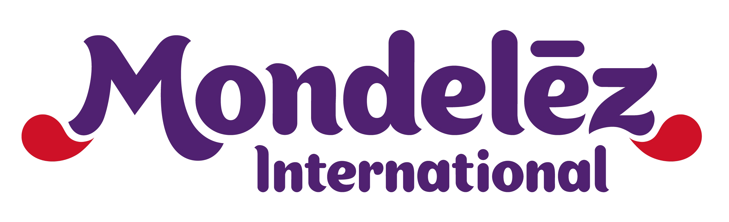




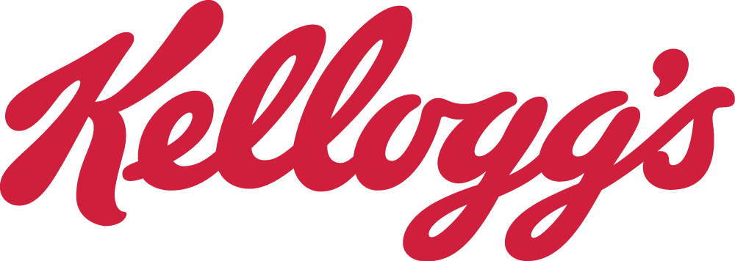

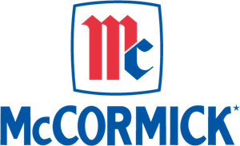






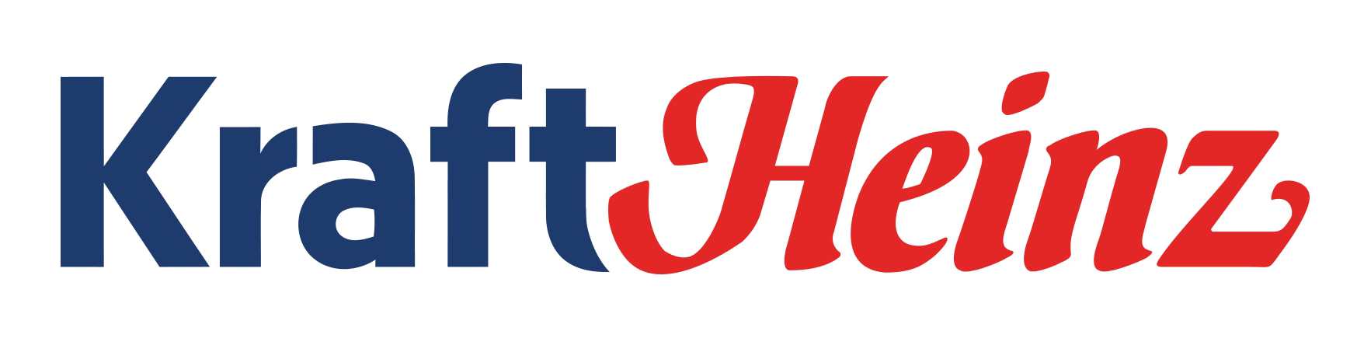


















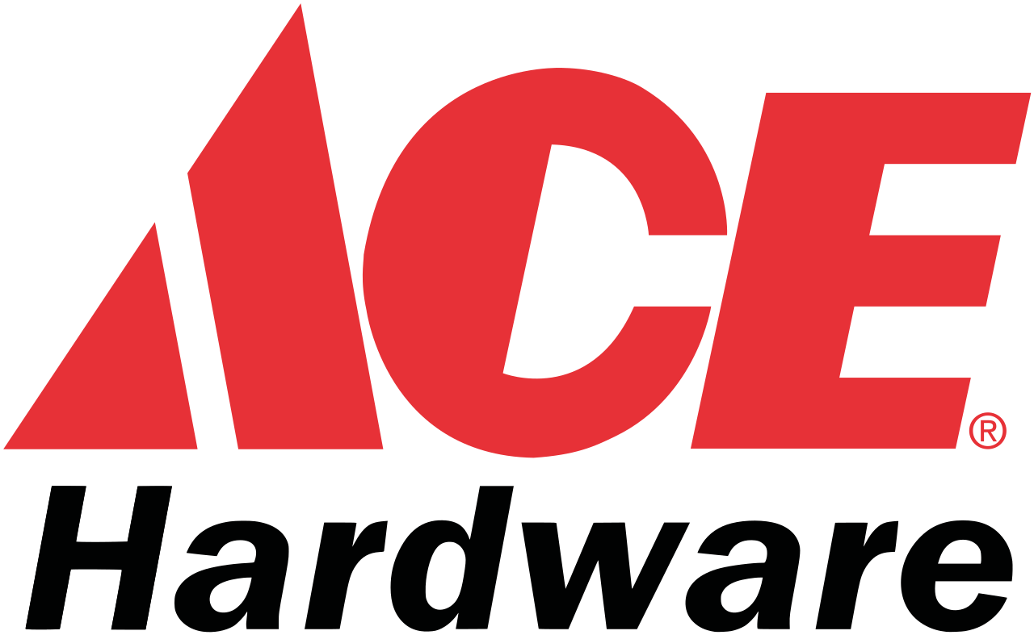
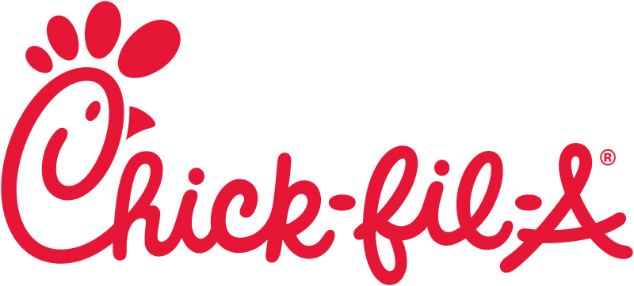

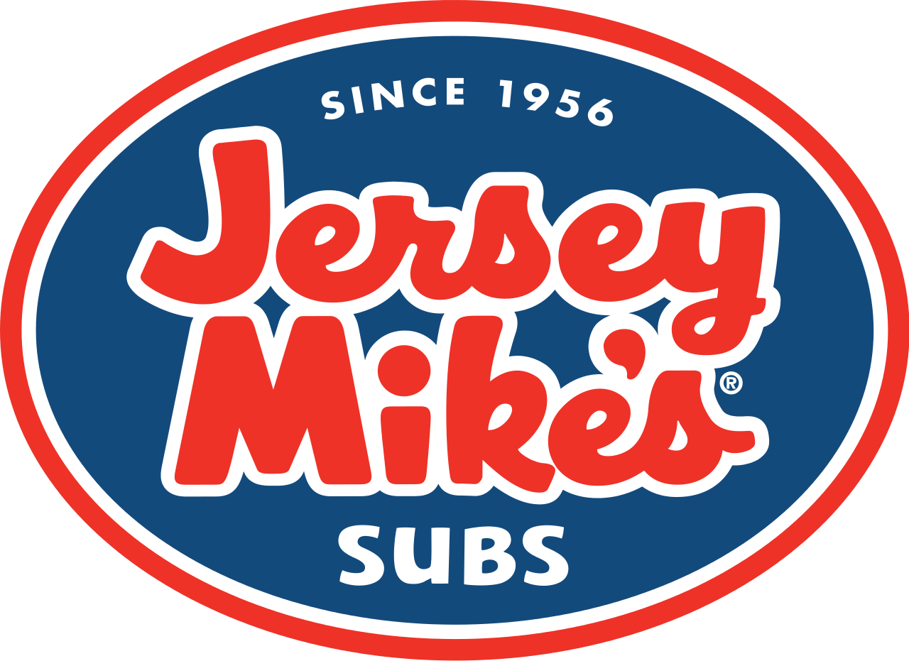









This year was no different, amid a global pandemic many major brands increased their TV investment in an effort to gain market share within their category
Sampling of 50 brands that increased their TV investment in 2020
Source: VAB analysis of Nielsen Ad Intel data, Jan-Oct ‘19 vs. Jan-Oct ‘20. TV spend includes national cable TV, broadcast TV, Spanish language cable TV, Spanish language broadcast TV. Brands reflected had measured total TV spend of at least $25MM between Jan-Oct ‘20 with a YoY TV spend increase of at least +10%.
This information is exclusively provided to VAB members and qualified marketers. Further distribution is prohibited.
PAGE 13

Slide 14
After four challenging months at the start of the pandemic, TV advertising stabilized in 3Q ‘20 as advertisers adapted to the current environment and many started re-investing
-1.7%
+0.9%
-19.1%
+0.3%
Source: iSpot.tv, national TV includes broadcast and cable TV networks
This information is exclusively provided to VAB members and qualified marketers. Further distribution is prohibited.
PAGE 14

Slide 15
Direct-to-Consumer brands have been particularly well-positioned for the pandemic and their TV spending, as a category, has been relatively flat YTD, with increases over the last four months
-1.5%
+4.1%
-3.9%
+3.7%
Source: iSpot.tv, national TV includes broadcast and cable TV networks, direct-to-consumer custom category.
This information is exclusively provided to VAB members and qualified marketers. Further distribution is prohibited.
PAGE 15

Slide 16
There have been many relevant DTC products/services - especially among financial, pharma, online food ordering/meal kit subscriptions, adult education – that have substantially increased their TV investment YTD
Performance-based DTC brands also tend to buy more TV networks than non-DTC advertisers
+
+
+
+
+
+
+
+
+
+
+
+
+
+
+
+
+
+
+
+
Source: iSpot.tv, national TV includes broadcast and cable TV networks, direct-to-consumer custom category.
This information is exclusively provided to VAB members and qualified marketers. Further distribution is prohibited.
PAGE 16

Slide 17
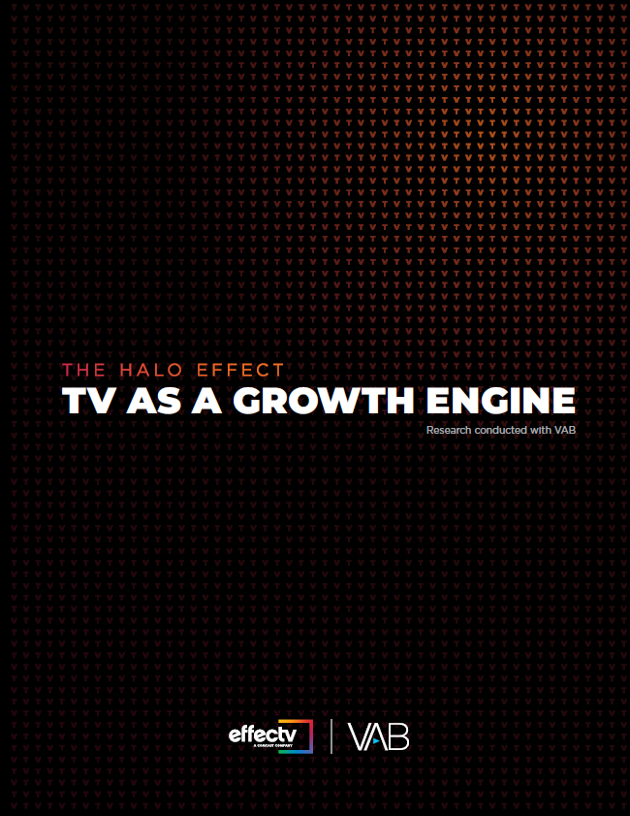
Advertisers are also launching their first TV campaigns earlier in their brand life stage than before and are seeing a greater impact to
their digital performance as a result
190 brand analysis:
  140 DTC brands
  50 non-DTC brands
This information is exclusively provided to VAB members and qualified marketers. Further distribution is prohibited.
PAGE 17

Slide 18















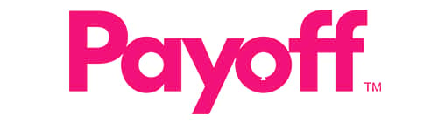


In the past, the journey from a DTC brand’s first social media buy to their initial TV investment would take about eight years on average
However, even before the onset of the pandemic, DTC brands have been accelerating their advertising journey to TV over the last few years and launching TV earlier in their company life stage
Typical Direct-to-Consumer Brand Advertising Evolution
Social Media
Sampling of brands that are primarily advertising in this channel
Podcasts, Out-of-Home, Satellite Radio
Sampling of brands that have added these channels to their media mix
Multiscreen TV
Sampling of brands that have added TV to their media mix
DTC Brand Maturity
Source: VAB’s ‘The Halo Effect: TV As A Growth Engine.’
This information is exclusively provided to VAB members and qualified marketers. Further distribution is prohibited.
PAGE 18

Slide 19
DTC brands that launch TV earlier in their life stage see strong, immediate outcomes in their digital performance
TV Launch Month vs. Three-Month Average Prior To TV
Average Website Unique Visitors
Three Years Old or Younger
Between Four – Seven Years Old
Eight Years or Older
+23%
+19%
+10%
Unique Visitors % increase:
Unique Visitors increase:
+137K
+370K
+329K
# of Brands:
40
60
40
Source: VAB’s ‘The Halo Effect: TV As A Growth Engine,’ VAB analysis of Nielsen Ad Intel data, TV spend (national cable TV, national broadcast TV, Spanish language broadcast TV, Spanish language cable TV, spot TV, syndicated TV), Jun ‘16 – Jun ’20 (calendar months). VAB analysis of Comscore mediametrix multiplatform (desktop + mobile) media trend data; P18+, Jun ’16 – Jun ‘20 (calendar months).
This information is exclusively provided to VAB members and qualified marketers. Further distribution is prohibited.
PAGE 19

Slide 20
A sustained presence on TV (longer campaigns / more months ‘on’) drives even greater, triple-digit lifts in digital performance for younger brands
“When On TV” Monthly Average vs. Three-Month Average Prior To TV
Average Website Unique Visitors
Three Years Old or Younger
Between Four – Seven Years Old
Eight Years or Older
+138%
+72%
+23%
Unique Visitors % increase:
Unique Visitors increase:
+811K
+1,383K
+803K
# of Brands:
40
60
40
Source: VAB’s ‘The Halo Effect: TV As A Growth Engine.’ VAB analysis of Nielsen Ad Intel data, TV spend (national cable TV, national broadcast TV, Spanish language broadcast TV, Spanish language cable TV, spot TV, syndicated TV), Jun ‘16 – Jun ’20 (calendar months). VAB analysis of Comscore mediametrix multiplatform (desktop + mobile) media trend data; P18+, Jun ’16 – Jun ‘20 (calendar months).
This information is exclusively provided to VAB members and qualified marketers. Further distribution is prohibited.
PAGE 20

Slide 21
Similar results were seen for Non-DTC advertisers as well - brands across each life stage experienced double-digit increases at launch…
Non-DTC Brands: TV Launch Month vs. Three-Month Average Prior To TV
Average Website Unique Visitors
Under Twenty Years Old
Over Twenty Years Old
+15%
+12%
Unique Visitors % increase:
Unique Visitors increase:
+700K
+187K
# of Brands:
25
25
Source: VAB’s ‘The Halo Effect: TV As A Growth Engine.’ VAB analysis of Nielsen Ad Intel data, TV spend (national cable TV, national broadcast TV, Spanish language broadcast TV, Spanish language cable TV, spot TV, syndicated TV), Jun ‘16 – Jun ’20 (calendar months). VAB analysis of Comscore mediametrix multiplatform (desktop + mobile) media trend data; P18+, Jun ’16 – Jun ‘20 (calendar months).
This information is exclusively provided to VAB members and qualified marketers. Further distribution is prohibited.
PAGE 21

Slide 22
…and a sustained presence on TV drives greater digital lifts for young non-DTC brands, just like with DTC brands
Non-DTC Brands: “When On TV” Monthly Average vs. Three-Month Average Prior To TV
Average Website Unique Visitors
Under Twenty Years Old
Over Twenty Years Old
+50%
+21%
Unique Visitors % increase:
Unique Visitors increase:
+2,302K
+315K
# of Brands:
25
25
Source: VAB’s ‘The Halo Effect: TV As A Growth Engine.’ VAB analysis of Nielsen Ad Intel data, TV spend (national cable TV, national broadcast TV, Spanish language broadcast TV, Spanish language cable TV, spot TV, syndicated TV), Jun ‘16 – Jun ’20 (calendar months). VAB analysis of Comscore mediametrix multiplatform (desktop + mobile) media trend data; P18+, Jun ’16 – Jun ‘20 (calendar months).
This information is exclusively provided to VAB members and qualified marketers. Further distribution is prohibited.
PAGE 22

Slide 23

There were also the brave, new TV advertisers of 2020, many of whom launched their first campaign at the beginning of the pandemic in 2Q
This information is exclusively provided to VAB members and qualified marketers. Further distribution is prohibited.
PAGE 23

Slide 24








































































































Nearly $460 million entered
the national TV marketplace in 1H 2020 from 110 first-time national advertisers across 59 categories
Diversity of budget levels:
  15%: $5MM+
  23%: $1-$5MM
  21%: $500K - $5MM
  41%: under $500K
Source: VAB’s ‘Welcome to TV: Introducing The ‘New Kids On The Block.’’ VAB analysis of Nielsen Ad Intel data, Q1’20-Q2’20. TV spend includes national cable TV, broadcast TV, Spanish language cable TV, Spanish language broadcast TV. Brands reflect those with national TV spend over $100K.
This information is exclusively provided to VAB members and qualified marketers. Further distribution is prohibited.
PAGE 24

Slide 25









Nearly 70% of new 1st half national TV dollars were invested during 2Q, the heart of the pandemic, with over $316 million from 60 advertisers
50 new national TV advertisers launched in 1Q (45% of total 1st half advertisers) and invested a total of $143 million in the quarter (31% of 1st half spend by new advertisers)
2020 New Nat’l TV Advertisers Monthly Spend
Millions
Sampling of Q1’20 brand entrants
Sampling of Q2’20 brand entrants
Source: VAB’s ‘Welcome to TV: Introducing The ‘New Kids On The Block.’’ VAB analysis of Nielsen Ad Intel data, Q1’20-Q2’20. TV spend includes national cable TV, broadcast TV, Spanish language cable TV, Spanish language broadcast TV. Brands reflect those with national TV spend over $100K.
This information is exclusively provided to VAB members and qualified marketers. Further distribution is prohibited.
PAGE 25

Slide 26














Of the new advertisers, there were 60 Direct-to-Consumer brands across 34 categories who collectively spent over $144 million in national TV
DTC brands accounted for 56% of total new advertisers and 31% of total spend (non-DTC pharma spending was particularly big this year)
Streaming
Underwear & Lingerie
Skincare
Financial Services
Personal Care
Moving & Storage
Hearing Aids
Online Printing
Wine Club
Women’s Healthcare
Social Networking
Cleaning Products
Phone Accessories
Pet Care
Online Dating
Computer Software
Eyewear
E-Commerce
Medical Apparel
Vitamins & Supplements
Mobile App
Telemedicine
Children’s Book Subscription
Wellness & Fitness
At-Home Medical Testing
Shoes
Apparel
Wallets
Laser Therapy
Wigs
Online Banking
Medical Service
Online Education
Source: VAB’s ‘Welcome to TV: Introducing The ‘New Kids On The Block.’’ VAB analysis of Nielsen Ad Intel data, Q1’20-Q2’20. TV spend includes national cable TV, broadcast TV, Spanish language cable TV, Spanish language broadcast TV. Brands reflect those with national TV spend over $100K.
This information is exclusively provided to VAB members and qualified marketers. Further distribution is prohibited.
PAGE 26

Slide 27





Key Takeaways For Marketers
TV’s resilience is entrenched in its ability to drive business outcomes for brands
Marketing Principles as Your Guide
Fill a Consumer Need
No Brand is Too Young, No Budget Too Small
Learn From
High-Growth Brands
After four challenging months, TV advertising stabilized in 3Q ’20 as savvy marketers knew that increasing (or at least maintaining) TV ad investment was critical to driving positive business outcomes.
At any time, but especially in times of consumer distress, examine what role your brand plays and increase investment to widen your consumer base and fill that need.
A sustained presence on TV drives significant business outcomes for new, not-yet-established brands and for brands at relatively lower budget levels. Don’t let your brand’s life stage, size or budget hold you back.
Knowing the immediacy, legitimacy and scale that TV delivers, data-driven, performance-obsessed DTC brands continued their TV investment in line with the prior year.
This information is exclusively provided to VAB members and qualified marketers. Further distribution is prohibited.
PAGE 27

Slide 28





Creators
Jason Wiese
SVP, Director of Strategic Insights
jasonw@thevab.com
Leah Montner-Dixon
Reed Kiely
Karolina Guillen
Insights Manager
leahm@thevab.com
Insights Manager
reedk@thevab.com
Senior Insights Analyst
karolinag@thevab.com
Interested in learning more? Check out this related content:
Keep Calm and Advertise On
How to Successfully Navigate Your Brand Through an Economic Downturn
The Halo Effect
TV As A Growth Engine
Welcome to TV
Introducing The ‘New Kids On The Block’ – 1H 2020
Deciphering Direct-to-Consumer
An Insider’s Guide to America’s Fastest Growing Brands
This information is exclusively provided to VAB members and qualified marketers. Further distribution is prohibited.
PAGE 28

Slide 29

Get immediate access to the VAB Insights library
We’ve answered hundreds of marketers’ questions.
Our guides, reports, webinars and videos provide actionable insights to help marketers navigate today’s video landscape and think differently about their strategy.
We are committed to your business growth and proud to offer brand marketers and agencies complimentary access to our continuously-growing Insights library.
Get Access at theVAB.com or visit us here
This information is exclusively provided to VAB members and qualified marketers. Further distribution is prohibited.
PAGE 29

