Slide 1



2020
#VideoIsSocial
#Ep5 #HolidaySeason
How Premium Video Leads Online Conversations

Slide 2
Topics
1
2
3
4
5
Premium Video Is Social
Premium Video Trending Topics: Topline Stats
How ‘Live’
Ad-Supported TV Drives Online Engagement
Appendix
Ad-Supported TV Trending Topics: Detailed Analysis
Members Exclusive Section
A Deeper Look At
The Ad-Supported TV Mix

Slide 3
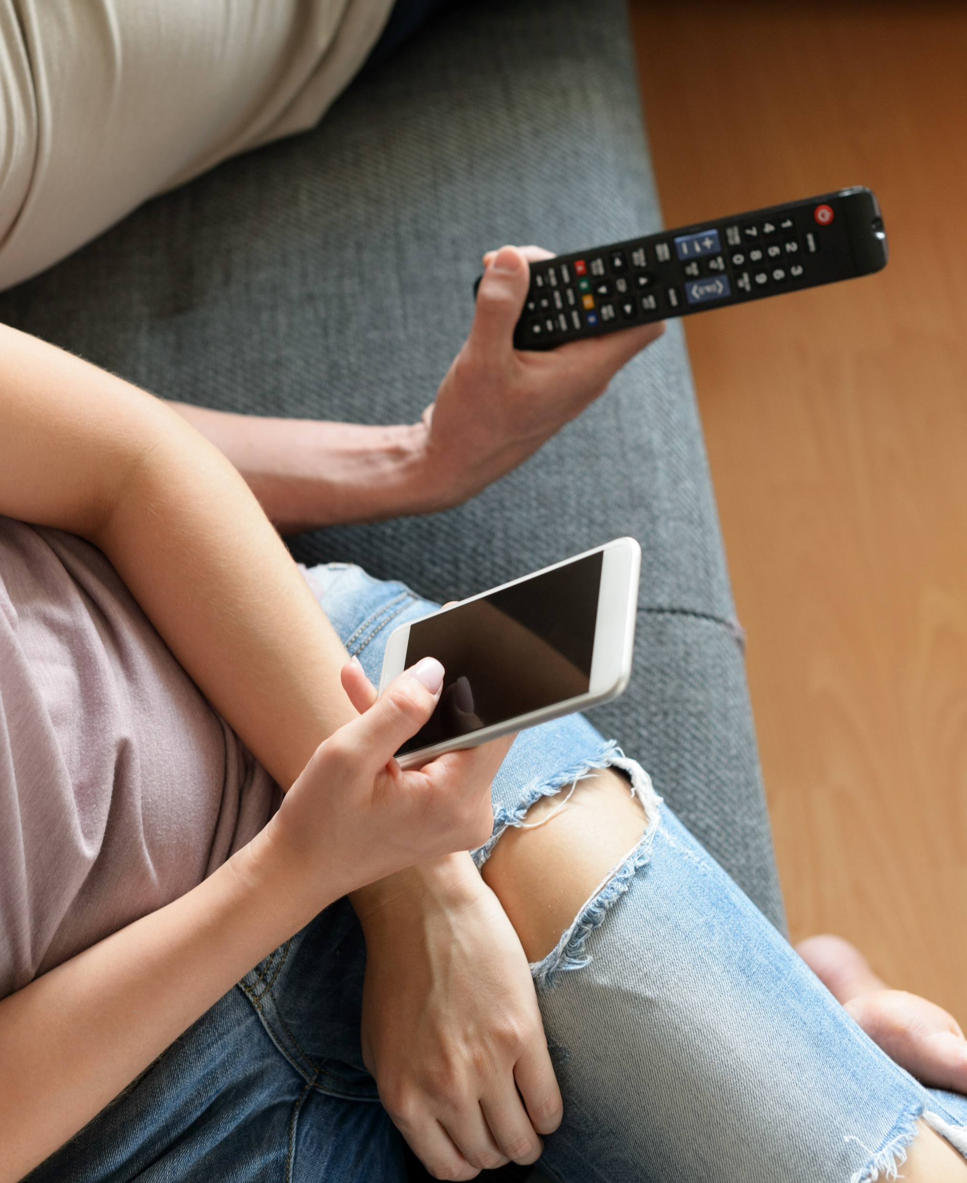
Premium Video Is Social
The fourth quarter time period between Thanksgiving and Christmas is no doubt a busy time of year as holiday planning, travel and celebrations seemingly take over many peoples’ lives – there’s road trips, countless shopping excursions and numerous gatherings between friends, family and colleagues. This past holiday season was even more hectic with continuous news coverage of the presidential impeachment process.
Even with all these diversions, one thing remained constant: no topic gets people talking online like premium video content, especially ad-supported TV. Between the holiday cheer and political drama, the calendar was filled with a constant flow of popular programming that has high social sharing and ‘talk value’ including live sports and specials, signature series, new streaming releases and holiday movies and marathons.
Re-branded from #TVisSocial due to the greater breadth of cross-platform content now trending across social media, #VideoIsSocial is the fifth installment of our report series which follows our previous analyses from 4Q ‘16, summer ‘17, 4Q ‘17 and fall ‘18.
In this report, we analyzed the top 10 Twitter trending topics during the four-week time period between Thanksgiving Day and Christmas Day in 2019 to understand what people are talking about online, at scale, during the holidays.
Our results show there’s no doubt, premium video is social.
This information is exclusively provided to VAB members and qualified marketers. Further distribution is prohibited.
PAGE 3

Slide 4


























How We Define ‘Premium Video’
For This Analysis
Premium video reflects professionally produced content accessed by consumers via various platforms and devices (e.g. multiscreen TV, streaming services, cinema) in a curated user experience that reaches highly engaged viewers in a brand-safe context.
Examples Of Premium Video Platforms & Properties*
Ad-Supported TV
Streaming Services
Cinema
Pay-TV
Video Gaming
*Note: Premium Video examples shown above are for illustrative purposes only and do not necessarily reflect the same platforms included within this analysis.
This information is exclusively provided to VAB members and qualified marketers. Further distribution is prohibited.
PAGE 4

Slide 5
By the numbers: premium video content, led by ad-supported TV, drives the most popular social conversations on Twitter
Four-Week Time Period (Primetime)
Nov. 28th – Dec. 25th, 2019
% of Total
Trending Topics in Top 10
# of Trending Programs / Content in Top 10
Unique Trending
Topics in Top 10
Number of #1
Trending Topics
Premium video content accounted for 80%
of the total top 10 trending Twitter topics
127+ premium video programs/content trended in the top 10 trending Twitter topics
382 unique premium video topics trended in the top 10 trending Twitter topics
56 unique premium video topics trended #1 on Twitter (26 of 28 days featured a #1 topic)
Premium Video
Ad-supported TV, by itself, accounted for 71% of the total top 10 trending Twitter topics
of that, 102+ ad-supported TV programs trended in the top 10 trending Twitter topics
of that, 333 unique ad-supported TV topics trended in the top 10 trending Twitter topics
of that, 52 unique ad-supported TV topics trended #1 on Twitter
(25 of 28 days featured
a #1 topic)
Ad-Supported TV
Source: VAB custom analysis of Top 10 trending Twitter Topics each night (8:30p, 9:30p, 10:30p, 11:30p) during 4-week time period (11/28/2019 – 12/25/2019). Results include both ‘direct’ and ‘related’ topics. Premium video includes ad-supported TV, video streaming platforms (subscription and ad-based), cinema, pay-TV channels and video games.
This information is exclusively provided to VAB members and qualified marketers. Further distribution is prohibited.
PAGE 5
PAGE 1

Slide 6




Premium video content fosters emotional connections which is amplified through social engagement
Premium video consistently creates and captures moments that are exciting, entertaining, humorous, enlightening, uplifting, aspirational, inspirational
and educational.
In addition to providing escapism, premium video delivers engaging content centered on real-life people, situations and themes that viewers desire to learn more about.
Engaging content has the ability to bring people together and compels millions to share their thoughts and feelings on
the content that they are currently consuming.
Their desire for community and shared experiences often leads viewers to take action by participating in online conversations with fellow fans and connecting with others that share similar interests.
This information is exclusively provided to VAB members and qualified marketers. Further distribution is prohibited.
PAGE 6
PAGE 1

Slide 7
A central hub for ‘real time’ social engagement is Twitter, a social platform built around what’s current and what people are talking about right now
Adults 18-34 account for over half of the total time spent among the 68 million active users on Twitter
18-34
52%
of total time spent
18-34
34%
(145 index vs. U.S. Pop)
Source: VAB analysis of Comscore, MediaMetrix Key Measures multiplatform (desktop + mobile) data, December 2019; P13-17, P18-24, P25-34, P35-44, P45-54, P55-64, P65+; P18-34 population comparison based on VAB analysis
of Nielsen 2019-20 Universe Estimate. *Total number of active users comes from Twitter’s Selected Company Metrics and Financials and accounts for Q1’19 active users in the United States only. Note: percentages represent base of P13+.
This information is exclusively provided to VAB members and qualified marketers. Further distribution is prohibited.
PAGE 7

Slide 8

Premium Video Trending Topics: Topline Stats

Slide 9

Quantifying How Much Premium Video Drives Social Conversations
To quantify the important role that video plays in people’s lives, even during major holiday periods, we analyzed the impact of premium video programming on the top 10 trending Twitter topics for the four weeks between Thanksgiving (Thurs, 11/28/19) and Christmas (Wed, 12/25/19).
Since trending topics are ever-changing, we monitored four “points in time” each night to capture what people are talking about online throughout the evening: 8:30p, 9:30p, 10:30p, 11:30p.
For the purposes of this analysis, premium video includes ad-supported TV, video streaming platforms (subscription and ad-based), cinema, pay-TV channels and video games.
Trending topics based on premium video content were further grouped into one of two types:
  Direct: specific ‘official’ hashtags of premium entertainment shows, sports events or news programming
  Related: topics associated with specific premium video programming including athletes, general team hashtags, collegiate school mentions (including nicknames), show characters, celebrity personalities, and specific video platform-related news references
*Geography reflects United States-based Twitter Top 10 trending data
This information is exclusively provided to VAB members and qualified marketers. Further distribution is prohibited.
PAGE 9

Slide 10
Premium video content accounted for 80% of the top 10 Twitter trending topics through the four-week 4Q holiday time period
Premium video dominates the top social conversations deeper into the night as more people settle in at home to watch their favorite programming
% of Premium Video Topics in the Top 10 During Primetime
Source: VAB custom analysis of Top 10 trending Twitter Topics each night (8:30p, 9:30p, 10:30p, 11:30p) aggregated during 4-week time period (11/28/2019 – 12/25/2019). Results include both ‘direct’ and ‘related’ topics. Premium video includes ad-supported TV, video streaming platforms (subscription and ad-based), cinema, pay-TV channels and video games.
This information is exclusively provided to VAB members and qualified marketers. Further distribution is prohibited.
PAGE 10

Slide 11
Over half of the top 10 trending topics on any night were based on premium video content
Four Week Average: % of Top 10 Trending Topics that are Based on Premium Video Content
Monday
Tuesday
Wednesday
Thursday
Friday
Saturday
Sunday
Overall
86%
58%
86%
83%
58%
93%
99%
8:30p
63%
33%
83%
58%
43%
90%
100%
9:30p
93%
50%
88%
85%
60%
95%
100%
10:30p
90%
70%
85%
95%
63%
93%
98%
11:30p
98%
80%
90%
93%
65%
93%
98%
Source: VAB custom analysis of Top 10 trending Twitter Topics each night (8:30p, 9:30p, 10:30p, 11:30p) aggregated during 4-week time period (11/28/2019 – 12/25/2019). Results include both ‘direct’ and ‘related’ topics. Premium video includes ad-supported TV, video streaming platforms (subscription and ad-based), cinema, pay-TV channels and video games.
This information is exclusively provided to VAB members and qualified marketers. Further distribution is prohibited.
PAGE 11

Slide 12


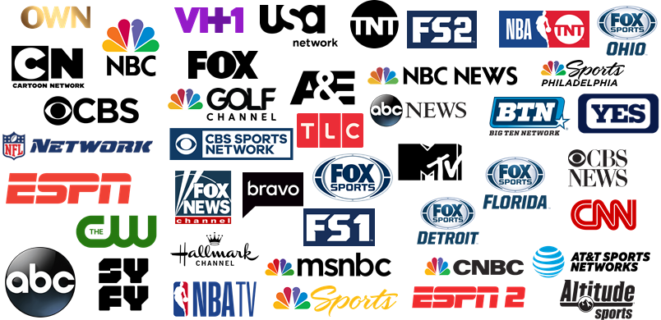











Programming content from over 63 different premium video platforms and networks trended in the top 10 during the four-week primetime analysis
Trending topics included programming from ad-supported TV, video streaming, cinema, Pay-TV and video games
Ad-Supported TV (48+)
Video Streaming (9+)
Cinema (4)
Pay-TV (1)
Video Games (1)
*
Source: VAB custom analysis of Top 10 trending Twitter Topics each night (8:30p, 9:30p, 10:30p, 11:30p) during 4-week time period (11/28/2019 – 12/25/2019). Results include both ‘direct’ and ‘related’ topics. Premium video includes ad-supported TV, video streaming platforms (subscription and ad-based), cinema, pay-TV channels and video games. Ad-supported TV network count (+) because regionally aired sporting events are allocated to one primary network even though they can air on multiple RSNs. Video Streaming platform count (+) because The Game Awards aired across various streaming platforms.
This information is exclusively provided to VAB members and qualified marketers. Further distribution is prohibited.
PAGE 12

Slide 13
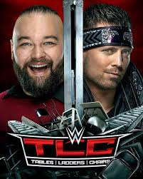
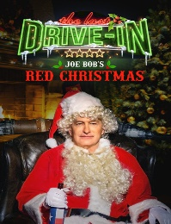
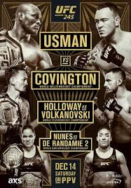

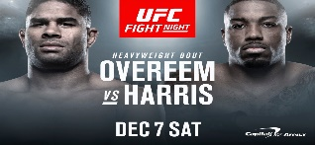
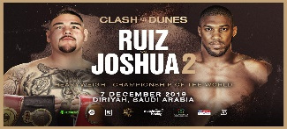
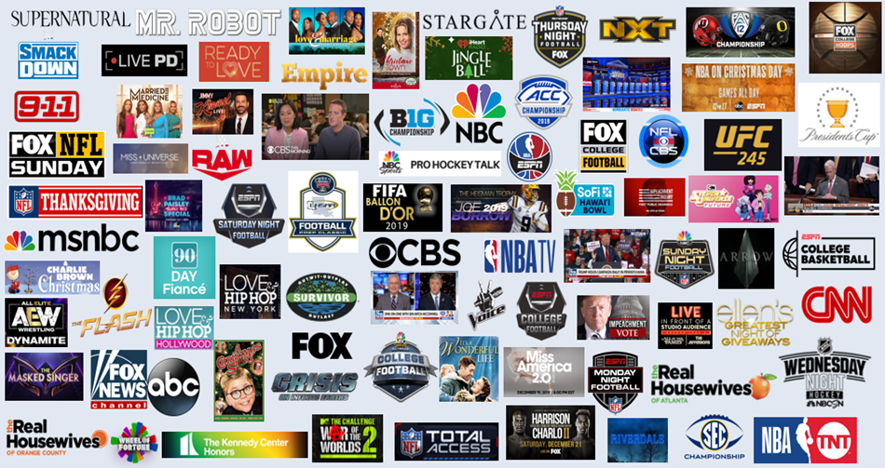



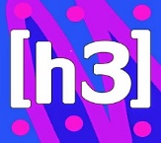


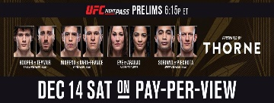


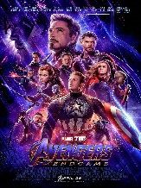





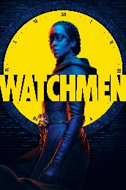

Within premium video platforms and networks, over 127 individual pieces of content trended in the top 10 during the four-week primetime analysis
Programming included live sports, award shows, reality TV, scripted dramas, movies, current events and news
Ad-Supported TV (102+)
Video Streaming (17)
Cinema (6)
Pay-TV (1)
Video Games (1)
*
Source: VAB custom analysis of Top 10 trending Twitter Topics each night (8:30p, 9:30p, 10:30p, 11:30p) during 4-week time period (11/28/2019 – 12/25/2019). Results include both ‘direct’ and ‘related’ topics. Premium video includes ad-supported TV, video streaming platforms (subscription and ad-based), cinema, pay-TV channels and video games. *Xbox Game Pass is a video game subscription service. Ad-supported TV program count (+) because TV-related news topics can be trending due to coverage across multiple news programs.
This information is exclusively provided to VAB members and qualified marketers. Further distribution is prohibited.
PAGE 13

Slide 14
When it comes to premium video content, nothing else spurs online conversations at scale like ad-supported TV programs
-Star Wars: The Rise of the Skywalker
-Star Wars: The Last Jedi
-John Wick 4
-Avengers: Endgame
-Percy Jackson & the Olympians
-Home Alone 3
-AEW Dark
-Variety
-H3H3
-DAZN YT
-Avalanche
-UFCDC: Overeem
vs Harris Main Card
- UFC 245: Las Vegas
Main Card
- WWE Starrcade
- WWE: Tables, Ladders & Chairs
The
Mandalorian
Joe Bob’s
Red Xmas
The Witcher
Watchmen
Clash On The Dunes
-UFC 245: Las Vegas
Early Prelims
-UFC DC: Early Prelims
Sample of Content From Non-TV Premium Video Platforms
Source: VAB custom analysis of Top 10 trending Twitter Topics each night (8:30p, 9:30p, 10:30p, 11:30p) during 4-week time period (11/28/2019 – 12/25/2019). Results include both ‘direct’ and ‘related’ topics. Note: UFC 245: Las Vegas aired the early prelims on UFC Fightpass and the main card was on ESPN+ event & UFC DC aired the early prelims on UFC Fightpass and the main card was on ESPN+. *Xbox Game Pass is a video game subscription service. **The Game Awards streamed across multiple platforms: Twitch, YouTube, Twitter, Facebook Live, Steam, Mixer, MLG, Caffeine, Playstation, IGN, Gamespot and Pluto TV.
This information is exclusively provided to VAB members and qualified marketers. Further distribution is prohibited.
PAGE 14

Slide 15
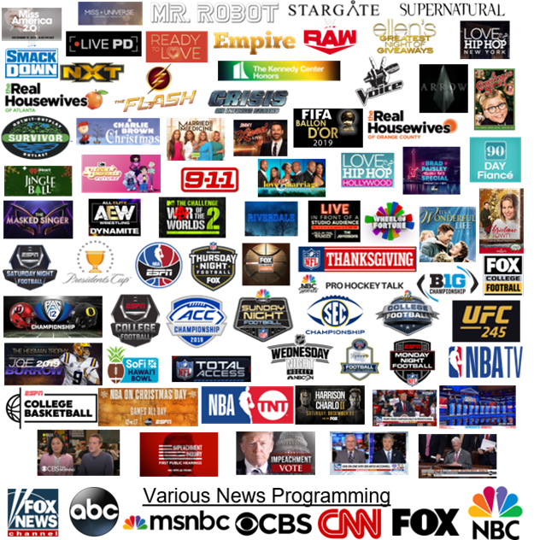
In fact, ad-supported TV accounted for 80% of the premium video content that trended in the top 10
% of Top 10 Trending Programs / Content by Platform
Source: VAB custom analysis of Top 10 trending Twitter Topics each night (8:30p, 9:30p, 10:30p, 11:30p) during 4-week time period (11/28/2019 – 12/25/2019). Results include both ‘direct’ and ‘related’ topics. *Xbox Game Pass is a video game subscription service. **The Game Awards streamed across multiple platforms: Twitch, YouTube, Twitter, Facebook Live, Steam, Mixer, MLG, Caffeine, Playstation, IGN, Gamespot and Pluto TV.
This information is exclusively provided to VAB members and qualified marketers. Further distribution is prohibited.
PAGE 15

Slide 16
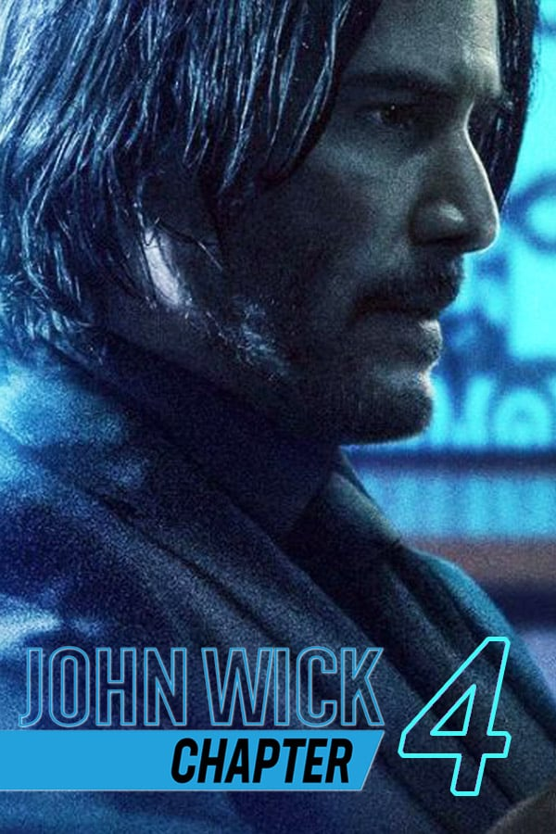




Beyond ad-supported TV, people’s love of movie franchises, characters
and film actors drive cinema-related topics to trend on Twitter
Whether it’s a new release or even a classic film, movies create excitement that encourages fans to engage online
Cinema Topics That Trended in the Top 10 During Four-Week Analysis
John Wick
Fans of Keanu Reeves were quick to notice that John Wick 4 and The Matrix 4 are scheduled to premiere on the same day.
#TheRiseOfSkyWalker
Star Wars fans share on social media on release night with the official hashtag for the premiere of Star Wars: The Rise of SkyWalker.
#TheLastJedi
Fans of the Star Wars franchise argue over which film in the latest trilogy is the best.
#HomeAlone3
Viewers express their different opinions on the classic holiday movie.
Thanos
Avenger fans create memes involving the character, Thanos.
#DisneyAdaptPercyJackson
Fans of the novel series speculate over Rick Riordan negotiating with Disney in an attempt to reboot the movie series.
Source: VAB custom analysis of Top 10 trending Twitter Topics each night (8:30p, 9:30p, 10:30p, 11:30p) during 4-week time period (11/28/2019 – 12/25/2019). Results include both ‘direct’ and ‘related’ topics.
This information is exclusively provided to VAB members and qualified marketers. Further distribution is prohibited.
PAGE 16

Slide 17
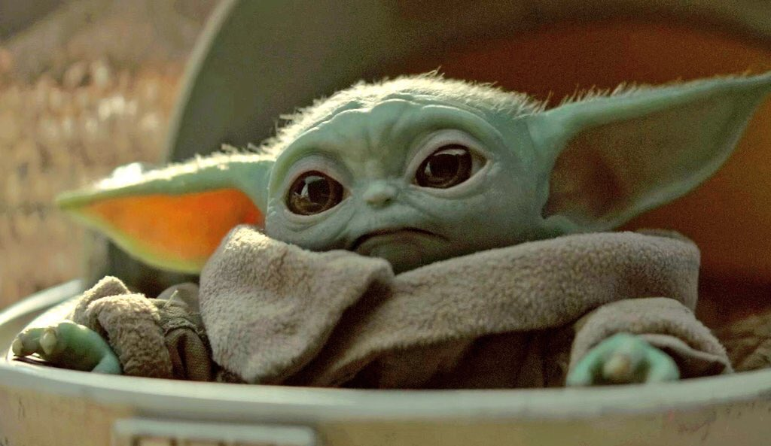
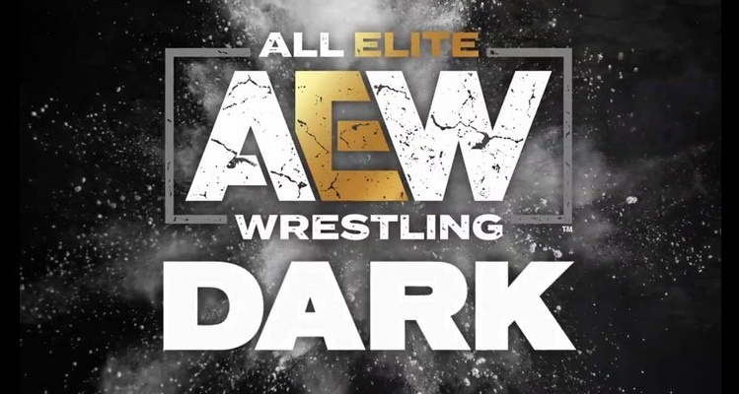
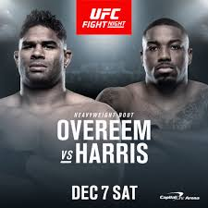


Another social strength is video streaming which collectively accounts for 13% of top 10 trending premium video programs
Live sports, millennial-targeted award shows, and entertainment programs ingrained into today’s pop culture
are the drivers within these platforms
Sample of Video Streaming Topics That Trended in the Top 10
#BabyYodasFirstWords
Disney+ released episodes of The Mandalorian featuring a baby-like Yoda and fans were quick to fantasize about him speaking.
#AEWDark
Official hashtag for AEW Dark, a program produced by All American Wrestling (AEW) and is aired on their YouTube channel.
#UFCDC
Official hashtag for the MMA matchup event between
Alistair Overeem and Walt Harris.
#TheWitcher
Official hashtag for a new series produced by Netflix.
#TheGameAwards*
Official hashtag for the annual awards ceremony honoring achievements in the video game industry.
Source: VAB custom analysis of Top 10 trending Twitter Topics each night (8:30p, 9:30p, 10:30p, 11:30p) during 4-week time period (11/28/2019 – 12/25/2019). Results include both ‘direct’ and ‘related’ topics. Video Streaming Platforms include DAZN, Disney+, Netflix, Shudder, UFC Fight Pass, Vudu, WWE, YouTube. *The Game Awards was streaming across multiple platforms: Twitch, YouTube, Twitter, Facebook Live, Steam, Mixer, MLG, Caffeine, Playstation, IGN, Gamespot and Pluto TV.
This information is exclusively provided to VAB members and qualified marketers. Further distribution is prohibited.
PAGE 17

Slide 18
Within individual programs/content across premium video,
382 unique topics trended in the top 10 during the four-week period;
87% of those topics were from ad-supported TV
Source: VAB custom analysis of Top 10 trending Twitter Topics each night (8:30p, 9:30p, 10:30p, 11:30p) aggregated during 4-week time period (11/28/2019 – 12/25/2019). Results include both ‘direct’ and ‘related’ topics. Premium video includes ad-supported TV, video streaming platforms (subscription and ad-based), cinema, pay-TV channels and video games.
This information is exclusively provided to VAB members and qualified marketers. Further distribution is prohibited.
PAGE 18

Slide 19
How ‘Live’ Ad-Supported TV Drives Online Engagement

Slide 20
Overall, the vast majority of people’s TV viewing is done ‘live’ which allows online conversations to be driven at scale on a platform like Twitter
Source: Nielsen Npower R&F Time Period Report, Primetime, Live vs. Live+7, ad-supported cable TV + broadcast TV, 11/28/2019-12/25/2019. P13+, P18-24, P18-34, P18-49.
This information is exclusively provided to VAB members and qualified marketers. Further distribution is prohibited.
PAGE 20

Slide 21
Ad-supported TV accounted for 7 of the top 10 Twitter trending topics throughout the four-week 4Q holiday time period
Ad-supported TV dominates the social conversations deeper into the night as more primetime shows and sporting events air
% of Ad-Supported TV Topics in the Top 10 During Primetime
Source: VAB custom analysis of Top 10 trending Twitter Topics each night (8:30p, 9:30p, 10:30p, 11:30p) aggregated during 4-week time period (11/28/2019 – 12/25/2019). Results include both ‘direct’ and ‘related’ topics.
This information is exclusively provided to VAB members and qualified marketers. Further distribution is prohibited.
PAGE 21

Slide 22
Over half of the top 10 trending topics on all nights except Friday
were based on ad-supported TV content
Four Week Average: % of Top 10 Trending Topics that are Based on Ad-Supported TV Content
Monday
Tuesday
Wednesday
Thursday
Friday
Saturday
Sunday
Overall
84%
51%
83%
65%
46%
83%
89%
8:30p
60%
20%
75%
48%
28%
75%
95%
9:30p
90%
43%
83%
73%
48%
88%
88%
10:30p
88%
65%
83%
73%
53%
88%
88%
11:30p
98%
75%
90%
68%
55%
75%
88%
Source: VAB custom analysis of Top 10 trending Twitter Topics each night (8:30p, 9:30p, 10:30p, 11:30p) aggregated during 4-week time period (11/28/2019 – 12/25/2019). Results include both ‘direct’ and ‘related’ topics.
This information is exclusively provided to VAB members and qualified marketers. Further distribution is prohibited.
PAGE 22

Slide 23



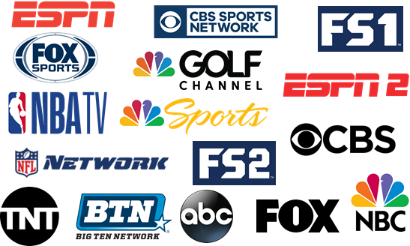



















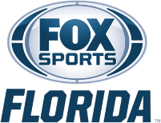











Programming from over 48 ad-supported TV networks trended
in the top 10 during the four-week primetime analysis
Entertainment (18)
Sports (23+)
News (7)
Regional Networks
Source: VAB custom analysis of Top 10 trending Twitter Topics each night (8:30p, 9:30p, 10:30p, 11:30p) during 4-week time period (11/28/2019 – 12/25/2019). Results include both ‘direct’ and ‘related’ topics. Note: sports network logos are a sampling of total sports networks. Ad-supported TV network count (+) because regionally aired sporting events are allocated to one primary network even though they can air on multiple RSNs.
This information is exclusively provided to VAB members and qualified marketers. Further distribution is prohibited.
PAGE 23

Slide 24
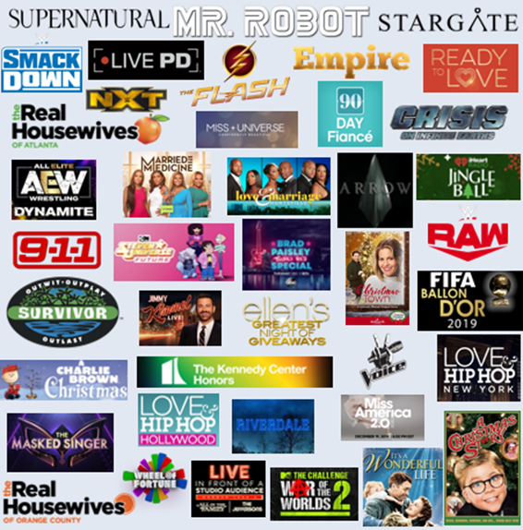
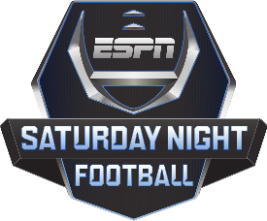




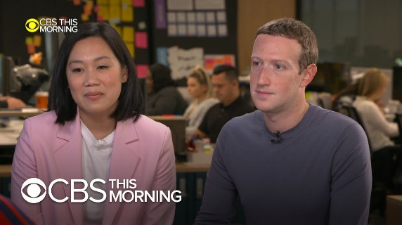
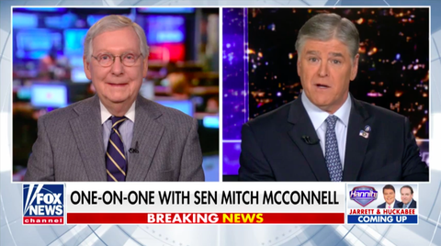
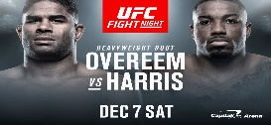


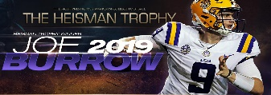



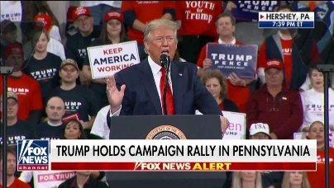
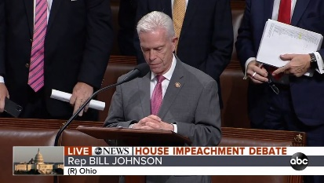
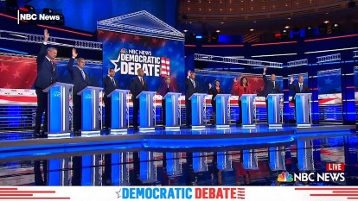

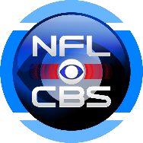


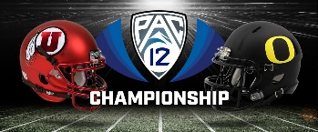

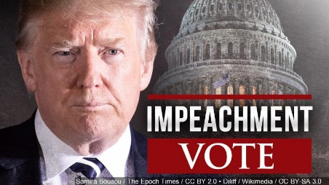

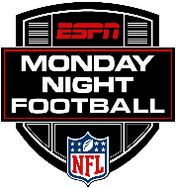






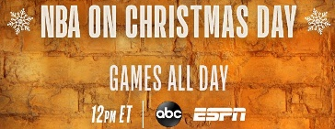
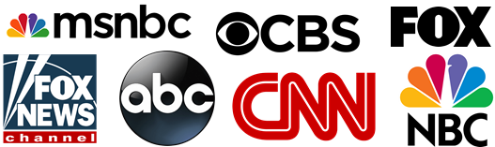




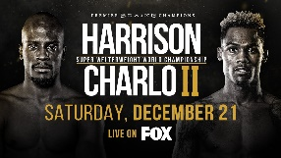
Over 102 ad-supported TV programs trended in the top 10 during
the four-week primetime analysis
Entertainment (41)
Sports (54)
News (7+)
Various News Programming
Source: VAB custom analysis of Top 10 trending Twitter Topics each night (8:30p, 9:30p, 10:30p, 11:30p) during 4-week time period (11/28/2019 – 12/25/2019). Results include both ‘direct’ and ‘related’ topics. Ad-supported TV program count (+) because TV-related news topics can be trending due to coverage across multiple news programs. Note: sports programming logos are a sampling of total sports programming.
This information is exclusively provided to VAB members and qualified marketers. Further distribution is prohibited.
PAGE 24

Slide 25
Sports accounted for 53% of programs that trended in the top 10
while entertainment wasn’t far behind at 40% of programs
Note: news-related trending topics had to be based primarily on a televised event to be attributed to ad-supported TV
(ex. Democratic Debate, Impeachment Hearings, interviews on news programs, etc)
Source: VAB custom analysis of Top 10 trending Twitter Topics each night (8:30p, 9:30p, 10:30p, 11:30p) aggregated during 4-week time period (11/28/2019 – 12/25/2019). Results include both ‘direct’ and ‘related’ topics.
This information is exclusively provided to VAB members and qualified marketers. Further distribution is prohibited.
PAGE 25

Slide 26
Aided by NFL, NCAA Football and NBA, sports accounted for a majority of the total ad-supported TV topics that trended in the top 10
Between hashtags, featured athletes and game action, sports tends to have several more individual topics trending during an airing than entertainment programs
Source: VAB custom analysis of Top 10 trending Twitter Topics each night (8:30p, 9:30p, 10:30p, 11:30p) aggregated during 4-week time period (11/28/2019 – 12/25/2019). Results include both ‘direct’ and ‘related’ topics.
This information is exclusively provided to VAB members and qualified marketers. Further distribution is prohibited.
PAGE 26

Slide 27

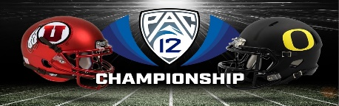

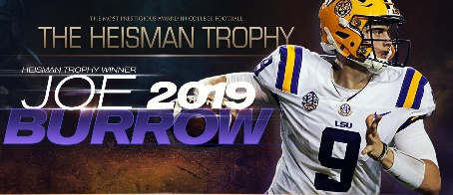




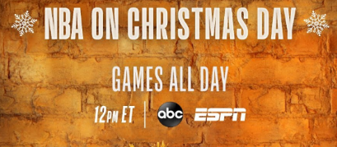




Major sporting events, live TV specials and holiday movie marathons provided a constant flow of popular ad-supported TV programming with high social engagement throughout the holiday time period
‘Seasonal’ Ad-Supported TV Program Schedule And What Trended in the Top 10
11/28
12/6-12/7
12/8
12/14
12/18
12/19
12/20-1/13
12/25
NFL On Thanksgiving
NCAA Football
Conference Championships
Miss Universe
Heisman Trophy
Live TV Specials
Miss America
NCAA Bowl Season
NBA On Christmas Day
- #BUFvsDAL
- #NOvsATL
- #PAC12Championship
- #PAC12FCG
- #MissUniverse2019
- #HeismanTrophy
- #LiveInFrontofaStudioAudience
- #MissAmerica2020
- #HawaiiBowl
- #NBAXmas
- Clemson
11/28
12/25
Holiday Specials, Movies and Marathons
12/1
12/5
12/24
12/24
Christmas Town
A Charlie Brown Christmas
A Christmas Story
It’s A Wonderful Life
- #ChristmasTown
- #CharlieBrownChristmas
- #AChristmasStory
- #ItsAWonderfulLife
Source: VAB custom analysis of Top 10 trending Twitter Topics each night (8:30p, 9:30p, 10:30p, 11:30p) during 4-week time period (11/28/2019 – 12/25/2019). Results include both ‘direct’ and ‘related’ topics. Green represents sports ad-supported TV programming, blue represents awards shows, magenta represents live specials and yellow represents holiday specials and movies.
This information is exclusively provided to VAB members and qualified marketers. Further distribution is prohibited.
PAGE 27

Slide 28














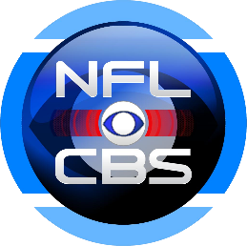
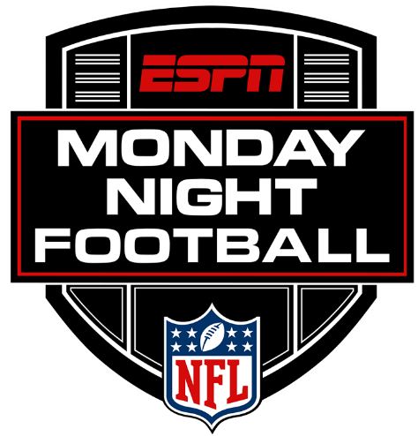






In terms of consistent engagement, several ad-supported shows and signature sports series ‘own’ the social conversation on specific nights of the week
No other type of tweet subject is as much of a recurring topic as ad-supported TV programming
Trending in the Top 10 During at Least 2 of the 4 Weeks Analyzed
Monday
Tuesday
Wednesday
Thursday
Friday
Saturday
Sunday
Source: VAB custom analysis of Top 10 trending Twitter Topics each night (8:30p, 9:30p, 10:30p, 11:30p) aggregated during 4-week time period (11/28/2019 – 12/25/2019). Results include both ‘direct’ and ‘related’ topics. Programs shown represent programs that trended on the same day of the week in at least 2 of the 4 weeks monitored.
This information is exclusively provided to VAB members and qualified marketers. Further distribution is prohibited.
PAGE 28

Slide 29


Key takeaways about premium video’s ability to drive popular social conversations on Twitter
Premium video creates strong emotional connections
Viewers have a voracious appetite for premium video
Ad-supported TV is the most popular content that young adults engage with online
The reach of ‘live’ ad-supported TV drives social conversations at scale
Viewers develop a deep commitment to compelling content and character-driven programming which fosters further engagement both offline and online.
With an increased number
of video platforms and more available access points, the consumer has more content choices than ever before and, with over 127 programs trending during this analysis, they are actively ‘talking’ about more content than ever before.
Twitter’s user base is 45% more likely to be adults 18-34 than the average population and this age group accounts for 52% of total time spent on the platform. With 71% of the top trending topics based on ad-supported TV, young adults clearly enjoy engaging with this content.
Twitter is a central hub for
‘real time’ social engagement and with 85% of adults 18-34 viewing being done ‘live,’
ad-supported TV has the
ability to create mass online ‘communities’ and shared experiences among fans.
This information is exclusively provided to VAB members and qualified marketers. Further distribution is prohibited.
PAGE 29

Slide 30




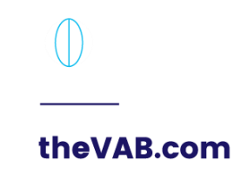
Creators
Jason Wiese
SVP, Director of Strategic Insights
jasonw@thevab.com
Reed Kiely
Insights Manager
reedk@thevab.com
Karolina Guillen
Senior Insights Analyst
karolinag@thevab.com

Slide 31

Appendix
Ad-Supported TV Trending Topics: Detailed Analysis

Slide 32
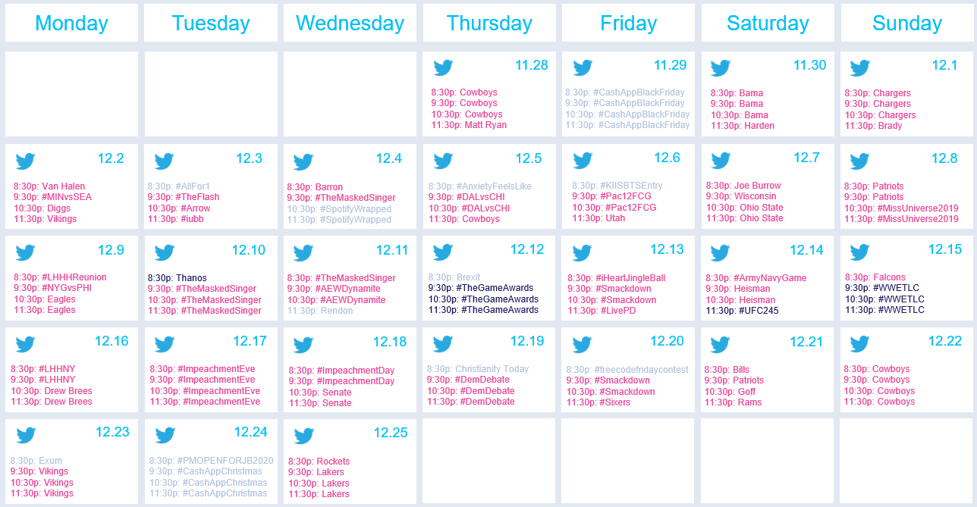
52 different ad-supported TV topics trended #1 during primetime over the four-week time period
For 25 out of 28 nights, an ad-supported TV topic trended #1 during at least one of the four monitored ‘points in time’
#1 Twitter Trending TV Topics by Night
Source: VAB custom analysis of Top 10 trending Twitter Topics each night (8:30p, 9:30p, 10:30p, 11:30p) during 4-week time period (11/28/2019 – 12/25/2019). Results include both ‘direct’ and ‘related’ topics. Magenta represents ad-supported TV topics, blue represents premium video, non ad-supported TV topics and gray represents non-premium video topics. Note: similar topics trending on different nights are counted separately in the total.
This information is exclusively provided to VAB members and qualified marketers. Further distribution is prohibited.
PAGE 32

Slide 33
At least one sporting event had a topic trend in the Top 10 on 96%
of nights, while an entertainment show trended on 89% of nights
# of Nights When Ad-Supported TV Programming Trended in the Top 10 Topics by Genre
Four-Week Time Period
Reminder: news-related trending topics had to be based primarily on a televised event to be attributed to ad-supported TV
(ex. Democratic Debate, Impeachment Hearings, interviews on news programs, etc)
Source: VAB custom analysis of Top 10 trending Twitter Topics each night (8:30p, 9:30p, 10:30p, 11:30p) aggregated during 4-week time period (11/28/2019 – 12/25/2019). Results include both ‘direct’ and ‘related’ topics.
This information is exclusively provided to VAB members and qualified marketers. Further distribution is prohibited.
PAGE 33

Slide 34
On average, over five different ad-supported TV programs trended
in the top 10 at some point during each night
13
10
9
7
7
7
7
7
7
6
6
6
6
6
5
5
5
5
4
4
4
3
3
3
3
2
2
1
Source: VAB custom analysis of Top 10 trending Twitter Topics each night (8:30p, 9:30p, 10:30p, 11:30p) during 4-week time period (11/28/2019 – 12/25/2019). Results include both ‘direct’ and ‘related’ topics.
This information is exclusively provided to VAB members and qualified marketers. Further distribution is prohibited.
PAGE 34

Slide 35
Popular social conversations around TV entertainment and news skew towards weeknights while televised sports split rather evenly across weeknights and weekends
Genre-Specific Top 10 Ad-Supported TV Trending Topics by Day
Four-Week Time Period
Source: VAB custom analysis of Top 10 trending Twitter Topics each night (8:30p, 9:30p, 10:30p, 11:30p) aggregated during 4-week time period (11/28/2019 – 12/25/2019). Results include both ‘direct’ and ‘related’ topics.
This information is exclusively provided to VAB members and qualified marketers. Further distribution is prohibited.
PAGE 35

Slide 36
Three-fourths of ad-supported TV topics that trended in the top 10
on Twitter were related to programming characters, events, issues
or other subjects
‘Related’ Topic Examples
Entertainment:
Billie Eilish
Chris Daughtry
Sheamus
Sports:
Joe Burrow
Lakers
Pro Bowl
News
Andrew Yang
Donald Trump
Senate
‘Direct’ Topic Examples
Entertainment:
#90DayFiance
#911onFOX
#AChristmasStory
Sports:
#BigTenChampionship
#PresidentsCup
#MINvsSEA
#UFC245
News
#DemocraticDebate
#ImpeachmentDebate
#Impeachment Vote
‘Direct’: specific hashtags related to televised entertainment shows, sporting events or news programming. ‘Related’: topics associated with TV programming airing during the trending timeframe including athletes, general team hashtags, collegiate school mentions, show characters, celebrity personalities and specific TV-related news references.
Source: VAB custom analysis of Top 10 trending Twitter Topics each night (8:30p, 9:30p, 10:30p, 11:30p) aggregated during 4-week time period (11/28/2019 – 12/25/2019). Based on the aggregated number of top 10 Twitter trending topics over the 4-week time period.
This information is exclusively provided to VAB members and qualified marketers. Further distribution is prohibited.
PAGE 36

Slide 37

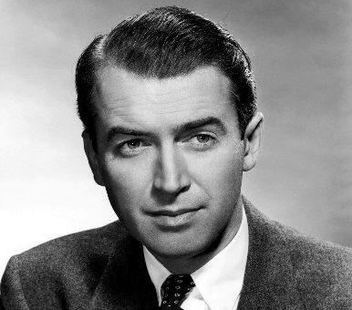
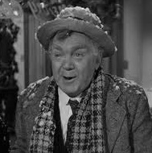

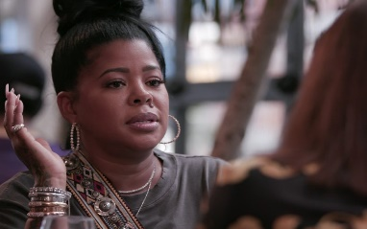
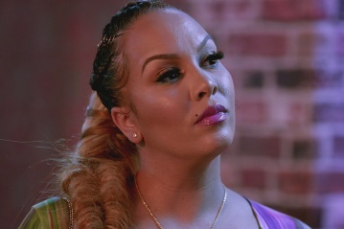
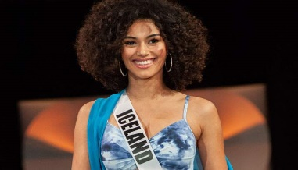
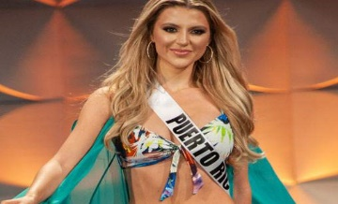

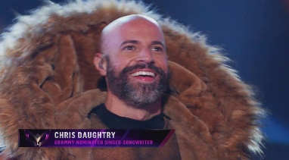
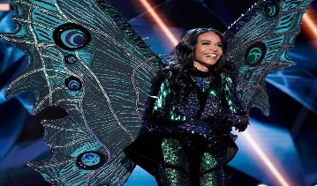



These are some examples of how entertainment programs had both ‘direct’ and ‘related’ topics trending while on air
‘Direct’ Trending Program Hashtags
‘Related’ Trending Program Topics
#ItsAWonderfulLife
George Bailey
Uncle Billy
#LHHNY
Chrissy
Kimbella
#MissUniverse2019
Miss Iceland
Madison
#TheMaskedSinger
Chris Daughtry
Michelle Williams
#Smackdown
Lacey Evans
Sheamus
Source: VAB custom analysis of Top 10 trending Twitter Topics each night (8:30p, 9:30p, 10:30p, 11:30p) during 4-week time period (11/28/2019 – 12/25/2019). Results include both ‘direct’ and ‘related’ topics.
This information is exclusively provided to VAB members and qualified marketers. Further distribution is prohibited.
PAGE 37

Slide 38
Almost two-thirds of entertainment topics that trend feature the specific program hashtag
The majority of sports topics that trend are related to the televised event – teams, athletics, game action
% of Top 10 Trending Topics by Type
‘Direct’: specific hashtags related to televised entertainment shows, sporting events or news programming. ‘Related’: topics associated with TV programming airing during the trending timeframe including athletes, general team hashtags, collegiate school mentions, show characters, celebrity personalities and specific TV-related news references.
Source: VAB custom analysis of Top 10 trending Twitter Topics each night (8:30p, 9:30p, 10:30p, 11:30p) aggregated during 4-week time period (11/28/2019 – 12/25/2019). Results include both ‘direct’ and ‘related’ topics.
This information is exclusively provided to VAB members and qualified marketers. Further distribution is prohibited.
PAGE 38

Slide 39
On average, 12 unique ad-supported TV topics (direct + related) trended in the top 10 throughout each night
Slightly more ‘direct’ hashtags trended for entertainment programming than for sporting events
Entertainment: 67
Direct: 42
Related: 25
Genre % Breakout of ‘Direct’ Programs
333
Top 10 Trending TV Topics
Sports: 234
Direct: 38
Related: 196
News: 32
Direct: 5
Related: 27
Source: VAB custom analysis of Top 10 trending Twitter Topics each night (8:30p, 9:30p, 10:30p, 11:30p) aggregated during 4-week time period (11/28/2019 – 12/25/2019). Results include both ‘direct’ and ‘related’ topics. Note: news-related trending topics had to be based primarily on a televised event to be attributed to ad-supported TV (ex. Democratic Debate, Impeachment Hearings, interviews on news programs, etc).
This information is exclusively provided to VAB members and qualified marketers. Further distribution is prohibited.
PAGE 39

Slide 40
Three official ad-supported TV shows or sports/news events hashtags trended in the top 10 on an average night during the four-week analysis
Entertainment (42)
#90DayFiance | #Married2Med
#911onFOX | #MissAmerica2020
#AChristmasStory | #MissUniverse2019
#AEWDynamite | #MrRobot
#Arrow | #readytolove
#BlackLightning | #RHOA
#BradPaisleySpecial | #RHOC
#CharlieBrownChristmas | #Riverdale
#ChristmasTown | #Smackdown
#CrisisInfiniteEarths | #SmackDownOnFox
#CrisisOnInfiniteEarths | #StevenUniverseFuture
#EllensGreatestNight | #Supernatural
#Empire | #Survivor
#iHeartJingleBall | #SurvivorFinale
#ItsAWonderfulLife | #TheChallenge34
#KCHonors | #TheFlash
#LAMH | #TheMaskedSinger
#LHHHReunion | #TheVoice
#LHHNY | #VoiceFinale
#LiveInFrontofaStudioAudience | #wheeloffortune
#LivePD | #WWENXT
Sports (39)
#ALAvsAUB | #LALvsMIA
#ArmyNavyGame | #LALvsMIL
#ATLvsSF | #LARvsDAL
#B1GFCG | #LARvsSF
#BigTenChampionship | #LSUvsUGA
#BUFvsDAL | #MINvsSEA
#BUFvsNE | #NBAXmas
#BUFvsPIT | #NEvsHOU
#DALvsCHI | #NOvsATL
#DALvsPHI | #NYGvsPHI
#EggBowl | #NYJvsBAL
#GBvsMIN | #OAKvsKC
#HawaiiBowl | #OSUvsWISC
#HeismanTrophy | #PAC12Championship
#INDvsNO | #Pac12FCG
#IronBowl | #PresidentsCup
#KCvsNE | #SEAvsLAR
#LACvsDEN | #SECChampionship
#LACvsLAL | #UFC245
#UFCDC
News (5)
#DemDebate
#DemocraticDebate
#ImpeachmentDay
#impeachmentDebate
#ImpeachmentVote
Source: VAB custom analysis of Top 10 trending Twitter Topics each night (8:30p, 9:30p, 10:30p, 11:30p) during 4-week time period (11/28/2019 – 12/25/2019). Results include both ‘direct’ and ‘related’ topics.
This information is exclusively provided to VAB members and qualified marketers. Further distribution is prohibited.
PAGE 40

Slide 41




Football gamedays, both NFL and college, generated heavy social chatter during the four-week analysis
274 separate sports TV topics trended in the top 10; an average of 10 topics each night
# of Top 10 Trending Topics by Sport
MMA
Boxing
NHL
Golf
High School Football
Source: VAB custom analysis of Top 10 trending Twitter Topics each night (8:30p, 9:30p, 10:30p, 11:30p) during 4-week time period (11/28/2019 – 12/25/2019). Results include both ‘direct’ and ‘related’ topics. Topics include direct program hashtags as well as sports TV-related topics tied to athletes, teams and game references. The 274 sports TV topics includes duplication for similar topics trending in different games on different nights (ex. ‘Cowboys’).
This information is exclusively provided to VAB members and qualified marketers. Further distribution is prohibited.
PAGE 41

Slide 42










TV sports-related trending topics typically involved athletes, teams
and game references
Most Viral Athlete by Major Sport
Josh Allen
Buffalo Bills
Patrick Kane
Chicago Blackhawks
Joe Burrow
LSU Tigers
James Harden
Houston Rockets
Tre Jones
Duke Blue Devils
Source: VAB custom analysis of Top 10 trending Twitter Topics each night (8:30p, 9:30p, 10:30p, 11:30p) during 4-week time period (11/28/2019 – 12/25/2019). Results reflect just “related” sports TV topics and doesn’t include official televised event hashtags. “Most Viral Athlete” = the athlete who was a top 10 trending topic the most in their respective sport during the time period.
This information is exclusively provided to VAB members and qualified marketers. Further distribution is prohibited.
PAGE 42

Slide 43

















Beyond ad-supported TV and premium video, the balance of trending topics were mainly music related or organic Twitter hashtags related to either current events, the holidays or random fun like you see below
Organic Twitter Trending Topics
Source: VAB custom analysis of Top 10 trending Twitter Topics each night (8:30p, 9:30p, 10:30p, 11:30p) during 4-week time period (11/28/2019 – 12/25/2019).
This information is exclusively provided to VAB members and qualified marketers. Further distribution is prohibited.
PAGE 43

Slide 44
Members Exclusive Section
A Deeper Look At The Ad-Supported TV Mix

Slide 45
In total, 55% of the top 10 trending Twitter TV topics involved programming that aired on ad-supported cable TV
*Ad-supported Cable & Broadcast TV topics involve programs that were mentioned or aired on various networks such as popular news events and NFL Thursday Night Football
Source: VAB custom analysis of Top 10 trending Twitter Topics each night (8:30p, 9:30p, 10:30p, 11:30p) aggregated during 4-week time period (11/28/2019 – 12/25/2019). Results include both ‘direct’ and ‘related’ topics.
This information is exclusively provided to VAB members and qualified marketers. Further distribution is prohibited.
PAGE 45

Slide 46
Ad-supported TV accounted for 4 of the top 10 Twitter trending topics throughout the four-week primetime 4Q holiday time period
% of Ad-Supported Cable TV Topics in the Top 10 During Primetime
Source: VAB custom analysis of Top 10 trending Twitter Topics each night (8:30p, 9:30p, 10:30p, 11:30p) aggregated during 4-week time period (11/28/2019 – 12/25/2019). Results include both ‘direct’ and ‘related’ topics. Percentages include programming that aired on both cable and broadcast TV such as NFL Thursday Night Football and televised news events that were covered by multiple TV networks.
This information is exclusively provided to VAB members and qualified marketers. Further distribution is prohibited.
PAGE 46

Slide 47
At least one cable TV sporting event had a topic trend in the Top 10
on 75% of nights; entertainment shows on 64% of nights
# of Nights When Ad-Supported Cable TV Programming Trended in Top 10 Topics by Genre
Four-Week Time Period
Source: VAB custom analysis of Top 10 trending Twitter Topics each night (8:30p, 9:30p, 10:30p, 11:30p) aggregated during 4-week time period (11/28/2019 – 12/25/2019). Results include both ‘direct’ and ‘related’ topics. Chart includes programming that aired on both cable and broadcast TV such as NFL Thursday Night Football and televised news events that were covered by multiple TV networks.
This information is exclusively provided to VAB members and qualified marketers. Further distribution is prohibited.
PAGE 47

Slide 48
Ad-supported cable TV programming trended in the top 10
on 27 out of 28 nights during the analysis
On average, three different ad-supported cable TV programs trended in the top 10 during each night
9
8
6
5
5
5
4
4
4
4
4
4
3
3
3
3
2
2
2
2
2
2
2
1
1
1
1
Source: VAB custom analysis of Top 10 trending Twitter Topics each night (8:30p, 9:30p, 10:30p, 11:30p) during 4-week time period (11/28/2019 – 12/25/2019). Results include both ‘direct’ and ‘related’ topics. Chart includes programming that aired on both cable and broadcast TV such as NFL Thursday Night Football and televised news events that were covered by multiple TV networks.
This information is exclusively provided to VAB members and qualified marketers. Further distribution is prohibited.
PAGE 48

