Slide 1



2021 – 1st Quarter

Slide 2

About VAB
VAB is an insights-driven organization that inspires marketers to reimagine their media strategies resulting in fully informed decisions.
Drawing on our marketing expertise, we simplify the complexities in our industry and discover new insights that transform the way marketers look at their media strategy.
Simplify
We save you time by bringing you the latest data & actionable takeaways you can use to inform your marketing plans.
Discover
We keep you one step ahead with the latest thinking so you can create innovative, forward-looking strategies.
Transform
We help you build your brand by focusing on core marketing principles that will help drive tangible business outcomes.
We are committed to your business growth and proud to offer VAB members, brand marketers and agencies complimentary access to our continuously-growing Insights library. Get immediate access at theVAB.com.
This information is exclusively provided to VAB members and qualified marketers. Further distribution is prohibited.
PAGE 2

Slide 3



The Effects of ‘Ageism’ In Media: By ignoring adults 55+, brands are overlooking a group that controls 4 out of 10 dollars spent in the U.S. each year
Click here for the full report
This translates to $3.4 trillion in total yearly spend
Source: VAB analysis of Consumer Expenditure Survey 2019 data, U.S. Bureau of Labor Statistics, reported as of September 2020, Data represents adults 55+ due to data age group breakouts.
This information is exclusively provided to VAB members and qualified marketers. Further distribution is prohibited.
PAGE 3

Slide 4
Multicultural Population Growth: Over the next decade, multicultural audience segments will account for 78% of the total adult 50+ growth
Click here for the full report
167.0
156.7
145.2
132.4
119.3
41%
45%
37%
32%
27%
Source: VAB analysis of U.S. Census Bureau data, Population Division: Washington, DC., Projected Age Groups and Sex Composition of the Population: Main Projections Series for the United States, 2017-2060. NH = Non-Hispanic. Other – includes Non-Hispanic American Indian, Alaska Native, Native Hawaiian and Other Pacific Islander.
This information is exclusively provided to VAB members and qualified marketers. Further distribution is prohibited.
PAGE 4

Slide 5




















Adult 55+ Purchasing Clout: Older consumers collectively spend more on goods & services than any other demographic segment
Click here for the full report
A55+ Total Annual Expenditures By Category
(% Share of Total Category Spend)
$633.5B
(39%)
$381.8B
(56%)
$259.3B
(42%)
$208.0B
(36%)
$170.0B
(37%)
$119.2B
(43%)
$102.7B
(37%)
Housing
Healthcare
Food at Home
Vehicle Purchases
Food Away
From Home
Household Furnishings
& Equipment
Gasoline / Fuel
$75.1B
(40%)
$61.1B
(46%)
$55.7B
(29%)
$49.3B
(49%)
$49.0B
(42%)
$44.4B
(43%)
$40.3B
(45%)
Phone Services
Audio & Visual
Equipment & Services
Education
Housekeeping Supplies
Entertainment Fees / Admissions
Pets
Transportation
$39.7B
(40%)
$35.5B
(38%)
$34.3B
(45%)
$19.1B
(32%)
$18.2B
(33%)
$7.0B
(57%)
Personal Care
Products & Services
Women & Girls
Apparel
Alcohol
Men & Boys Apparel
Footwear
Reading
Source: VAB analysis of Consumer Expenditure Survey 2019 data, U.S. Bureau of Labor Statistics, reported as of September 2020. Data represents adults 55+ due to data age group breakouts.
This information is exclusively provided to VAB members and qualified marketers. Further distribution is prohibited.
PAGE 5

Slide 6










Evolving Online Behaviors By Older Consumers: Adults 50+ have been flocking to direct-to-consumer brands’ digital platforms during the pandemic; brands that are also significant spenders on TV
Click here for the full report
Average monthly unique adult 50+ visitors increase by digital platform
6-month average YoY comparison: Apr-Sep ‘19 vs. Apr-Sep ‘20
+35%
(+307K avg monthly UVs)
+26%
(+253K avg monthly UVs)
+89%
(+919K avg monthly UVs)
+18%
(+1.2MM avg monthly UVs)
+30%
(+1.7MM avg monthly UVs)
+28%
(+198K avg monthly UVs)
+9%
(+118K avg monthly UVs)
+35%
(+235K avg monthly UVs)
+30%
(+5.7MM avg monthly UVs)
+20%
(+6.7MM avg monthly UVs)
Source: VAB analysis of Comscore MediaMetrix Media Trend multiplatform (desktop + mobile) data, April 2019 – September 2019 vs. April 2020 – September 2020, P50+, total digital population, total monthly unique visitors/viewers. Percentages = average monthly unique visitors increase between the two 6-month time periods.
This information is exclusively provided to VAB members and qualified marketers. Further distribution is prohibited.
PAGE 6

Slide 7


The Halo Effect of TV: The greatest impact seen from DTC brand’s TV investment, especially for younger brands, is the digital conversion lifts that occur when they build a sustained TV presence
Click here for the full report
DTC Brands: ‘When On TV’ Monthly Average vs. Three-Month Average Prior To TV
Average Website Unique Visitors
Three Years Old or Younger
Between Four – Seven Years Old
Eight Years or Older
+138%
+72%
+23%
Average Monthly
Unique Visitors % increase:
Average Monthly
Unique Visitors increase:
+811K
+1,383K
+803K
Source: VAB analysis of Nielsen Ad Intel data, TV spend (national cable TV, national broadcast TV, Spanish language broadcast TV, Spanish language cable TV, spot TV, syndicated TV), Jun ‘16 – Jun ’20 (calendar months). VAB analysis of Comscore mediametrix multiplatform (desktop + mobile) media trend data; P18+, Jun ’16 – Jun ‘20 (calendar months). Measurement Time Period: June 2016 – June 2020.
This information is exclusively provided to VAB members and qualified marketers. Further distribution is prohibited.
PAGE 7

Slide 8


Valuable Video Advertising Tactics For Marketers: Today, more than half of advertisers identify linear TV, collectively in all forms, as their most valuable video tactics
Click here for the full report
All Video Advertising Tactics Used
Summary of Top Rank
Any Linear TV:
51%
Source: Advertiser Perceptions, Video Advertising Convergence Report, Wave 9, 2H 2020, released February 2021.
This information is exclusively provided to VAB members and qualified marketers. Further distribution is prohibited.
PAGE 8

Slide 9

Black Consumer Spending Power: Black consumers have collectively increased their spending power by 60% over the last decade which far outpaces their population growth during the same time period
Click here for the full report
U.S. Aggregate Expenditures of Black / African-Americans
in Billions
+60%
vs. 2009
U.S. Population of Black / African-Americans
(000)
+17%
vs. 2009
40,216
41,577
45,326
46,919
Source: VAB Analysis of Bureau of Labor Statistics data, Race of reference person: Shares of annual aggregate expenditures and sources of income, Consumer Expenditure Survey, 2009, 2011, 2016 & 2019. VAB Analysis of U.S. Census Bureau data The Black Alone or in Combination Population in the United States: Table 1. Population by Sex and Age, for Black Alone or in Combination : 2009; Table 1. Population by Sex and Age, for Black Alone or in Combination: 2011; Table 15. Population by Sex and Age, for Black Alone or in Combination: 2016; Table 15. Population by Sex and Age, for Black Alone or in Combination: 2019.
This information is exclusively provided to VAB members and qualified marketers. Further distribution is prohibited.
PAGE 9

Slide 10









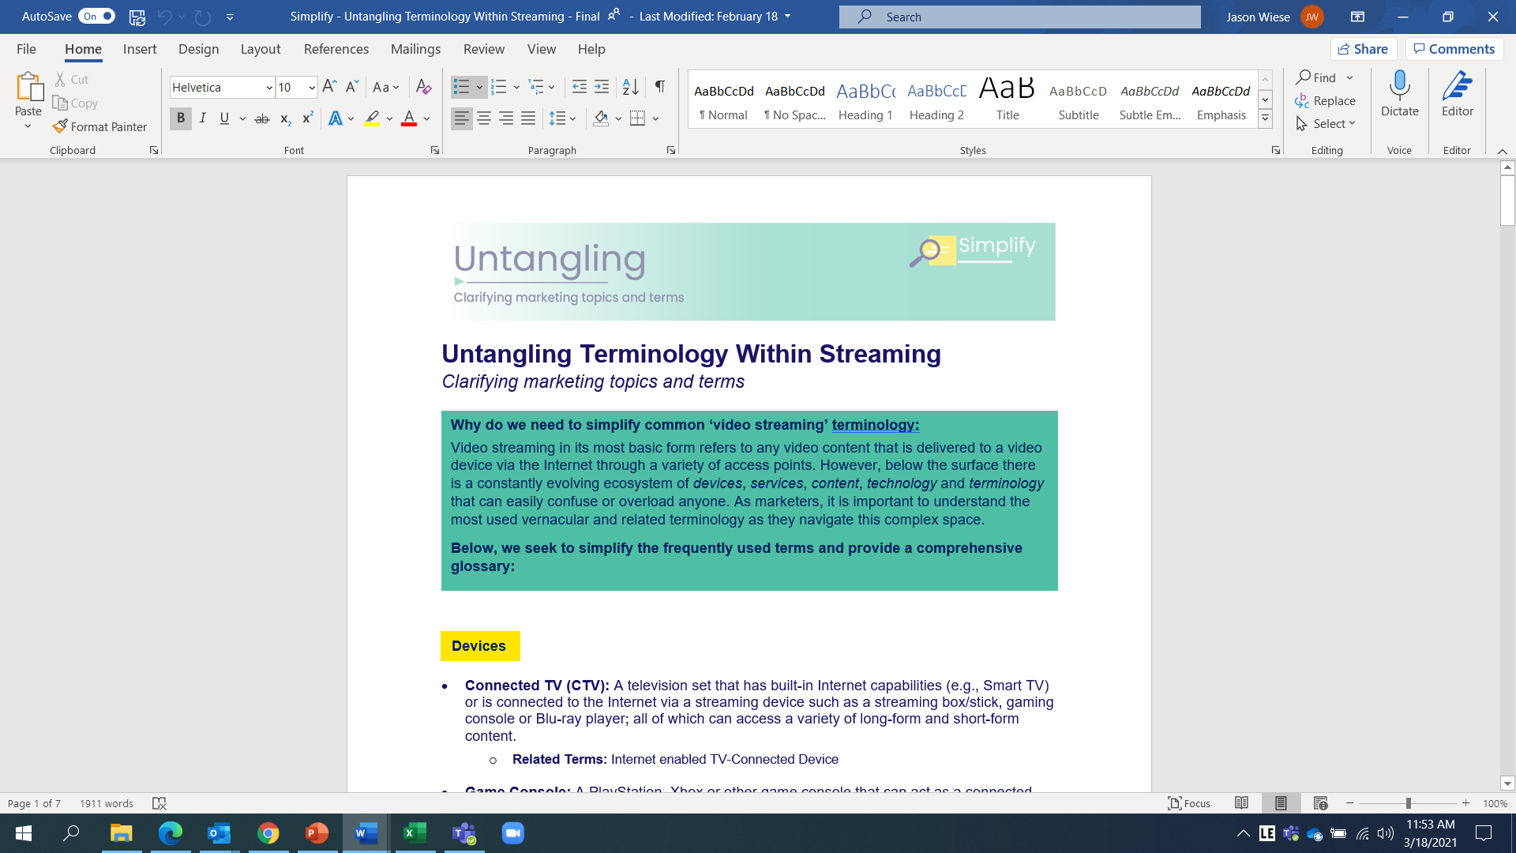


Streaming Wars Heating Up: Beyond linear, several major TV network groups have recently established their own streaming services that already offer, or will soon offer, an ad-supported option
Click here for the full report
Service | Streaming Model | Ad-Free Monthly Pricing | Ad-Supported Monthly Pricing
 | Hybrid AVOD/SVOD* | $14.99 | N/A*
 | Hybrid AVOD/SVOD | $11.99 | $5.99
 | Hybrid AVOD/SVOD | $9.99 | $4.99**
 | Hybrid AVOD/SVOD | $9.99 | Free*** or $4.99
 | Hybrid AVOD/SVOD | $6.99 | $4.99
 | SVOD | $8.99-17.99 | N/A
 | SVOD | $8.99 | N/A
 | SVOD | $7.99 | N/A
 | SVOD | $8.99-17.99 | N/A
Click below to untangle the
terminology within video streaming
Notes: *Ad-supported tier of HBOMax is coming Q2 2021; **‘Base Tier’ Ad-Supported Paramount+ launches in June 2021; ***Peacock offers a free tier that is ad-supported with limited content library. Chart reflects costs as of 3/1/21. AVOD = Ad-Supported Video-on-Demand; SVOD = Subscription Video-on-Demand
This information is exclusively provided to VAB members and qualified marketers. Further distribution is prohibited.
PAGE 10

Slide 11

The Election Showcased Successful Strategies For Marketers:
The winning formula for President Biden was a sustained presence with an extended heavy-up leading right into voter decision time
Click here for the full report
2020 Presidential General Election: Weekly TV Spend
(Candidate, Party & Issue-Based)
$ in Millions, 6/16/20 – 11/2/20
Source: VAB analysis of Kantar CMAG Political Competitive Data Gathering, 2020 Presidential Election data measured from 6/16/20 to 11/2/20 across general election ‘heavy-up period’ spend. Political weeks begin Tuesdays and end Mondays. TV Platforms: Cable TV, Broadcast TV (including Spanish Language Broadcast TV), Spanish Language Broadcast TV and Satellite TV. Candidate represents spend from only the candidates. Party represents spend from the political party and candidate/party co-op. Issue-Based represents spend from election-affiliated third-party sources (e.g. PACs, The Lincoln Project, NRA Victory Fund, Republican Voters Against Trump). Note: Biden invested over $15MM in TV during 12 separate weeks vs. 7 for Trump.
This information is exclusively provided to VAB members and qualified marketers. Further distribution is prohibited.
PAGE 11

Slide 12











Analyzing ‘Tech Giants’ TV Investment: Rather than relying solely on their own platforms or digital media, GAFAM invested heavily in TV becoming the #1 U.S. advertiser during the pandemic
Click here for the full report
Rank | Company | CY 2020 U.S. Total TV Spend
1 |  | $2.7 B
2 |  | $2.4 B
3 |  | $1.4 B
4* |  | $1.2 B
5 |  | $923 MM
6 |  | $911 MM
7 |  | $888 MM
8 |  | $882 MM
9 |  | $864 MM
10 |  | $840 MM
Source: VAB analysis of Nielsen AdIntel, calendar year 2020. TV spend includes cable TV, broadcast TV, Spanish language cable TV, Spanish language broadcast TV, spot TV, and syndicated TV. U.S. TV spend only. Rankings are based on total TV spend for parent companies based on their subsidiaries and brands as of March 2021. GAFAM includes Google (Alphabet), Apple, Facebook, Amazon and Microsoft. *Amazon, which would’ve ranked #3, shifted into #1 for the purposes of this chart.
This information is exclusively provided to VAB members and qualified marketers. Further distribution is prohibited.
PAGE 12

Slide 13

With state restrictions loosening throughout the country and movie theaters now allowed to re-open in all major markets, cinema will once again become an important platform for marketers to reach desirable consumers as high-profile movie releases ramp up
Bonus Slide!
Click here to download infographic
This information is exclusively provided to VAB members and qualified marketers. Further distribution is prohibited.
PAGE 13

Slide 14






Leah Montner-Dixon
Reed Kiely
Karolina Guillen
Insights Manager
leahm@thevab.com
Insights Manager
reedk@thevab.com
Senior Insights Analyst
karolinag@thevab.com
Discover more
Looking for more data, insights and takeaways? Check out this related VAB content
VAB Members, brand marketers and agencies get free and immediate access to VAB’s content library. Get access at theVAB.com
This information is exclusively provided to VAB members and qualified marketers. Further distribution is prohibited.
PAGE 14

