Slide 1



2022 – 2nd Quarter

Slide 2



About VAB
VAB is an insights-driven organization that inspires marketers to reimagine their media strategies resulting in fully informed decisions.
Drawing on our marketing expertise, we simplify the complexities in our industry and discover new insights that transform the way marketers look at their media strategy.
We are committed to your business growth and proud to offer VAB members, brand marketers and agencies complimentary access to our continuously-growing Insights library. Get immediate access at theVAB.com.
Curious to learn more about VAB? Check out this quick video to see what we do and how we can help you develop business-driving marketing strategies.
This information is exclusively provided to VAB members and qualified marketers. Further distribution is prohibited.
PAGE 2

Slide 3



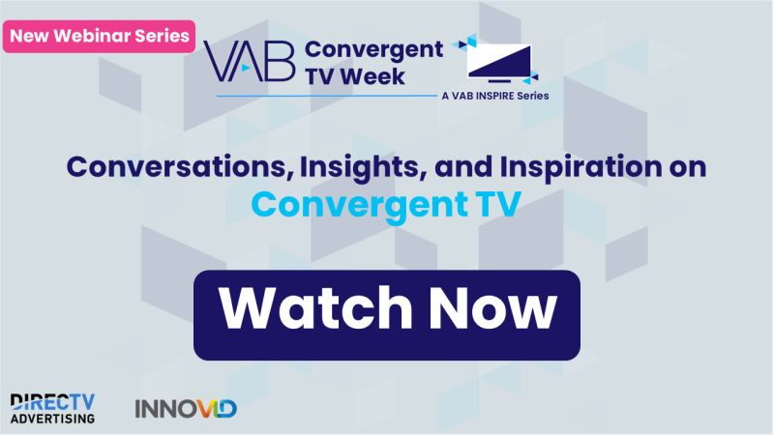
Increased consumer choice within convergent TV: Greater availability of, and accessibility to, linear and streaming platforms has enabled viewers to more than double their number of services
Click here for the full report
Average Number of Video Services
Adults 18+
73%
of viewers feel that their number of subscriptions are ‘just right’
And check out our webinar series,
VAB Convergent TV Week, to learn more about the trends shaping the growth of convergent TV
Free Services:
2.4
Paid Services*:
6.5
Source: TiVo, Q4 2021 Video Trends Report. Video services include cable / satellite / telco (MVPD) subscription in addition to TV Everyhwere apps, broadcast TV and OTT services. *Paid services include authenticated TVE apps associated with Pay TV. Note: Convergent TV represents linear TV and streaming.
This information is exclusively provided to VAB members and qualified marketers. Further distribution is prohibited.
PAGE 3

Slide 4
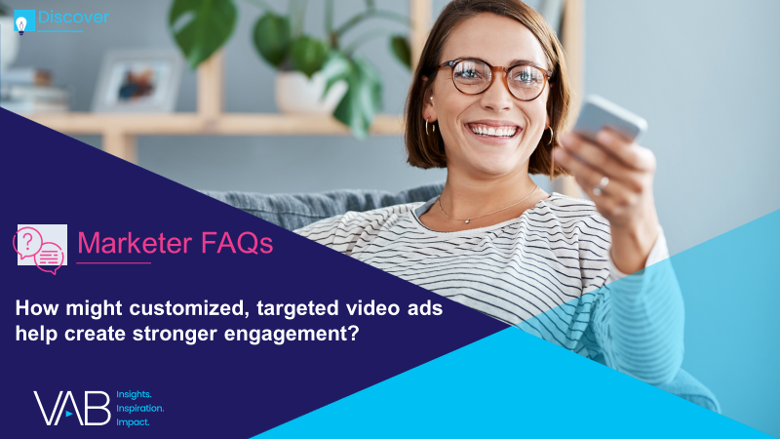
Marketers’ growing commitment to convergent TV: Brands are increasingly leveraging targeted advertising solutions across
data-enabled multiscreen TV platforms
Click here for the full report
And check out our webinar series,
VAB Convergent TV Week, to learn more about the trends shaping the growth of convergent TV
Source: Advertiser Perceptions, 2H 2021 Video Advertising Convergence Report. Based on survey of 250 marketer and agency respondents who are involved in video advertising decision-making.
This information is exclusively provided to VAB members and qualified marketers. Further distribution is prohibited.
PAGE 4

Slide 5
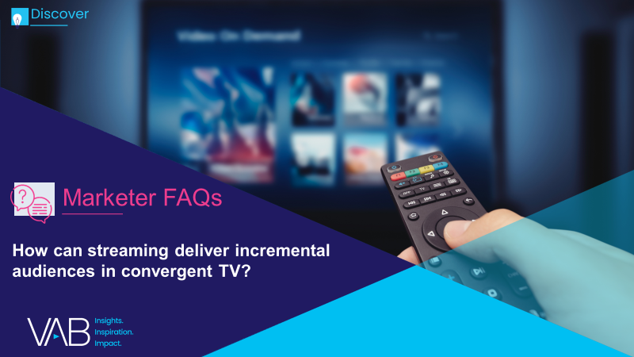
The ad-supported streaming content advantage: AVOD services have larger TV libraries than the top SVOD platforms, providing marketers a variety of environments to engage viewers
Click here for the full report
73%
of people place a higher value on streaming services that offer content they can’t get anywhere else
TV Library Size By Service Comparison
# of TV Series
# of Total TV Episodes
And check out our webinar series,
VAB Convergent TV Week, to learn more about the trends shaping the growth of convergent TV
Netflix would rank #4 in terms of TV episode library size among the largest AVOD/FAST services
(4-Service Avg*)
(4-Service Avg*)
Source: VAB analysis of S&P Global Market Intelligence, Kagan estimates. TV Show Summaries by service, 2021-2022. *Ad-Supported Streaming Average includes Tubi, Roku Channel, Hulu, PlutoTV. Fandom – State of Streaming 2022.
This information is exclusively provided to VAB members and qualified marketers. Further distribution is prohibited.
PAGE 5

Slide 6




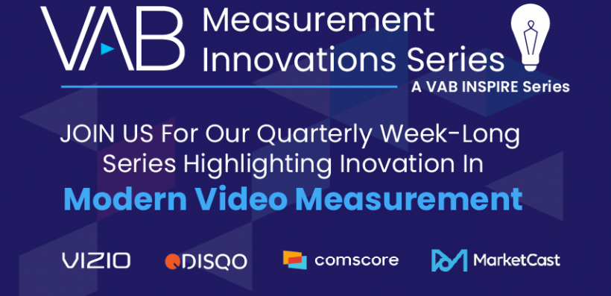




One of 15 new case studies on measurement innovation: A DTC health tech brand partnered with Tatari to manage their campaign’s frequency resulting in increased reach and sign-up cost reduction
Click here for the full report
Category:
Health
Frequency Management
Challenge
A health tech brand running a local streaming campaign was concerned with over-frequency to the same viewers. It sought to manage its frequency in order to expand its reach of new HHs
Measurement Innovation
Tatari analyzed response and conversion rates to understand how frequency impacted each
Tatari developed Net Funnel Efficiency (NFE), a calculation that multiplies response rate and conversion rate. NFE enabled Tatari to identify the maximum weekly and daily frequency caps that should be put in place.
Target Segment
Streaming audiences that are incremental to linear TV DMA targets
Learnings
As a result of the frequency management, they were able to increase the reach of their campaign by 95%, as they were able to more effectively distribute impressions with the same budget
From a cost perspective, the brand saw a 65% reduction in Cost Per Website Sign-Up after implementing the above-mentioned caps
Company / Viewing Source / Media Type
Tatari / Streaming Platform / CTV
Overview Of Results for the Campaign
And check out our webinar series
on Modern Video Measurement Innovations to hear from our partners: Comscore, DISQO, Vizio & MarketCast!
+65%
Reduction in Cost Per Website Sign-Up after implementing frequency caps
+95%
Increase in reach with impressions spread further with frequency caps
Source: Tatari, Case study: DTC Health Tech Case Study. Campaign dates: Q2 2020 - Q2 2021.
This information is exclusively provided to VAB members and qualified marketers. Further distribution is prohibited.
PAGE 6

Slide 7




2021 new TV advertisers: There was a surge in brands attributable to entrants in newer categories like crypto and greater competition within traditional categories like home, apparel and personal care
Click here for the full report
New National TV Advertisers
2020 vs. 2021 Comparison
Year | # of Brands | # of Categories | New TV $$$ (MM)
2020 | 283 | 95 | $1,279.1
2021 | 315 | 74 | $1,320.2
# YoY Diff | +32 | -21 | +$41.2
% YoY Diff | +11% | -22% | +3%
For a full list of the 315 brands download the full report here
Source: VAB analysis of Nielsen Ad Intel data, 1/1/20-12/31/20 vs. 1/1/21-12/31/21. TV spend includes national cable TV, broadcast TV, Spanish language cable TV, Spanish language broadcast TV. Brands reflect those with national TV spend over $100K. MM = millions.
This information is exclusively provided to VAB members and qualified marketers. Further distribution is prohibited.
PAGE 7

Slide 8


Linear TV reach: Ad-supported TV offers immediate scale, delivering 8 out of 10 homes in an average month
Click here for the full report
Source: VAB analysis of Nielsen NPower R&F Time Period, ad-supported TV (broadcast TV & cable TV), total day, Live+SD, April broadcast month (3/28/22 – 4/24/22). Average daily reach is based on the average of daily reach for each day across the broadcast month, average weekly reach is based on the average of weekly reach for each week across the broadcast month.
This information is exclusively provided to VAB members and qualified marketers. Further distribution is prohibited.
PAGE 8

Slide 9
Tech Giants spend billions on TV: In 2021, ‘MAAMA’ collectively spent over $3 billion on TV, their highest level ever, as they defended their SOV from competitors and supported new product launches
Click here for the full report
MAAMA U.S. TV Spend
($$$ in Millions)
$2,989.0
$3,128.1
+18%
$2,660.9
+18%
$2,530.2
+33%
-11%
$2,049.8
$1,904.5
$1,551.3
+32%
-7%
Source: VAB analysis of Nielsen AdIntel, calendar year 2015-2021, as of February 2022. TV spend includes cable TV, broadcast TV, Spanish language cable TV, Spanish language broadcast TV, spot TV, and syndicated TV. U.S. TV spend only.
This information is exclusively provided to VAB members and qualified marketers. Further distribution is prohibited.
PAGE 9

Slide 10

Demographics of the LGBTQ+ community: Brands can foster greater engagement with this young and diverse segment through inclusivity messaging
Click here for the full report
LGBTQ Community by Generation
LGBTQ Community by Ethnicity
Index vs. A18+
79%
of people who identify as LGBTQ are between the ages of 18-49
Source: VAB analysis of MRI-Simmons Winter 2022 Study, March 2022; LGBTQ represents P18+ that identify as LGBTQ. Birth ranges for generations: Gen Z = 1997-2010, Millennials = 1977-1996, Gen X = 1965-1976, Boomers = 1946-1964. Native American refers to American Indian or Alaska Native. To derive at 100%, ethnicities were broken out by the following: White = Non-Hispanic White Only; Hispanic = Spanish or Hispanic Origin; Black = Non-Hispanic Black / African American Only; Asian = Non-Hispanic Asian; Native American = Non-Hispanic American Indian or Alaska Native.
This information is exclusively provided to VAB members and qualified marketers. Further distribution is prohibited.
PAGE 10

Slide 11

Asian Americans’ adoption of ad-supported streaming: Marketers have a growing opportunity to reach and engage these tastemakers through premium video via streaming campaigns
Click here for the full report
% of Asian adults 18+ that have ‘streamed in the past 12 months’
% change in Asian adults 18+ streamers who have access to a…
July ‘18 vs. March ‘22
+10%
vs. 2018
+38%
+6%
Free / Ad-Based
streaming service
Subscription streaming service
Source: VAB analysis of MRI-Simmons Cord Evolution Study, July 2018 vs. March 2022. Access to free/ad-based vs. subscription streaming service: Base = ‘Streamed in the past 12 months.’ Free Streaming services (e.g., Pluto TV, YouTube, Tubi, etc.). Subscription services may include ads or limited ad load tiers.
This information is exclusively provided to VAB members and qualified marketers. Further distribution is prohibited.
PAGE 11

Slide 12



The cinema opportunity for younger adults: Over 3 days, more adults 18-34 went to see The Batman than went to a sporting event across the six major leagues over 12 months
Click here for the full report
Sports League Attendance Over Last 12 Months vs. Opening Weekend Cinema Admissions
Adults 18-34
Adults 18-34
6 Major Sports Leagues
6.06 MM
The Batman
6.14 MM
Estimated Unique Adults 18-34 Combined
Regular Season & Playoff Attendance
(last 12 Months)
Estimated Adults 18-34
Opening Weekend Admissions
(3 Days)
Source: VAB analysis of MRI-Simmons 2021 Fall Doublebase, P18-34, 6 Major Sports League attendance reflects unique P18-34 reach for both regular season and playoff games in the last 12 months across: NFL, NBA, MLB, NHL, NCAA Football & NCAA Basketball. VAB analysis of Box Office Mojo and Comscore post-track data based on an estimate of 62% P18-34 audience admissions composition for the opening weekend. Analysis also based on Screendollars, 3/6/22 and supported by data from EntTelligence.
This information is exclusively provided to VAB members and qualified marketers. Further distribution is prohibited.
PAGE 12

Slide 13

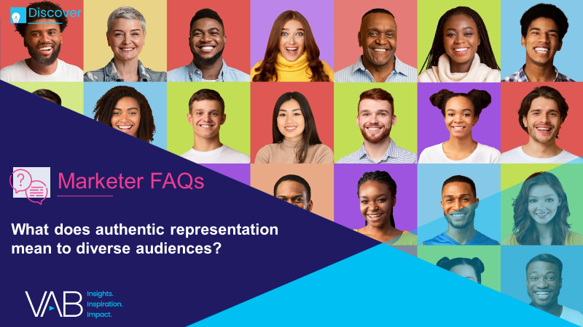
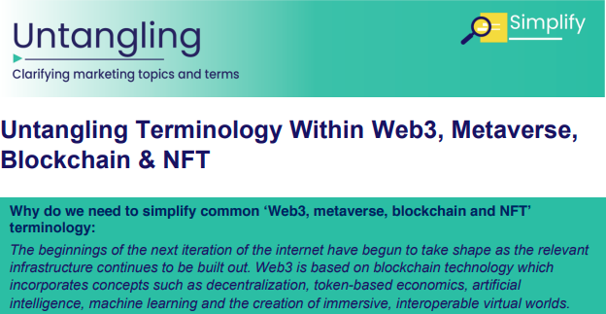


Jason Wiese
Reed Kiely
SVP, Director of Strategic Insights
jasonw@thevab.com
Associate Insights Director
reedk@thevab.com
Leah Montner-Dixon
Karolina Guillen
Associate Insights Director
leahm@thevab.com
Insights Manager
karolinag@thevab.com
Discover more
Looking for more data, insights and takeaways? Check out this related VAB content
We are committed to providing marketers with the data and insights they need to develop thoughtful, inclusive campaigns & strategies. To find out more on the unique media consumption behaviors and cultural trends of multicultural consumers, visit the VAB’s Multicultural Marketing Resource Center.
VAB Members, brand marketers and agencies get free and immediate access to VAB’s content library. Get access at theVAB.com
This information is exclusively provided to VAB members and qualified marketers. Further distribution is prohibited.
PAGE 13

