Slide 1



2022 – 1st Quarter

Slide 2


About VAB
VAB is an insights-driven organization that inspires marketers to reimagine their media strategies resulting in fully informed decisions.
Drawing on our marketing expertise, we simplify the complexities in our industry and discover new insights that transform the way marketers look at their media strategy.
We are committed to your business growth and proud to offer VAB members, brand marketers and agencies complimentary access to our continuously-growing Insights library. Get immediate access at theVAB.com.
Curious to learn more about VAB? Check out this quick video to see what we do and how we can help you develop business-driving marketing strategies.
This information is exclusively provided to VAB members and qualified marketers. Further distribution is prohibited.
PAGE 2

Slide 3



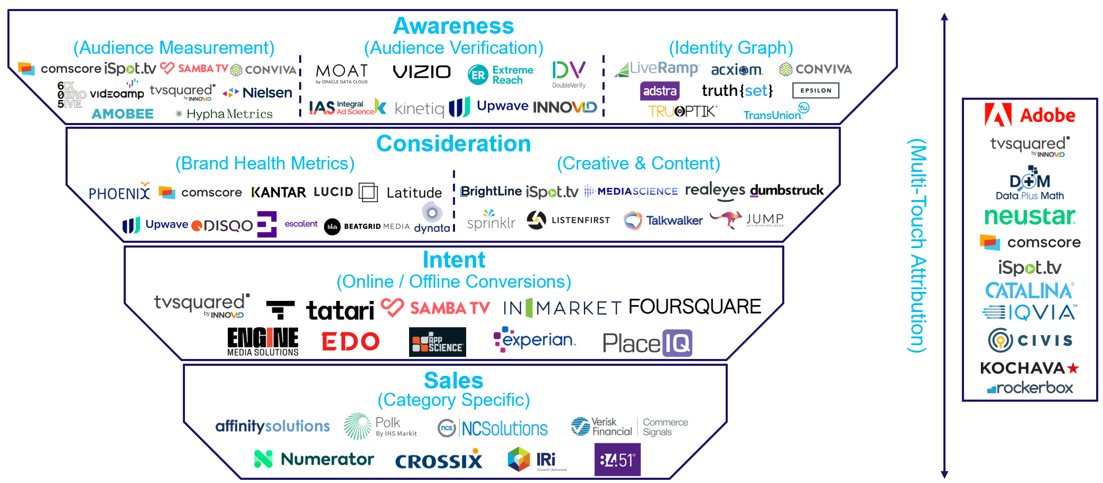

Measurement solutions across the path to purchase: Today, customized solutions are available for marketers to measure
the impact of their TV campaign across every stage of the funnel
Click here for the full report
Note: logos reflect a sampling of companies that provide measurement solutions within each funnel stage and is not meant to be an exhaustive list of all companies with related solutions; companies’ solutions can also cross funnel stages as well.
This information is exclusively provided to VAB members and qualified marketers. Further distribution is prohibited.
PAGE 3

Slide 4








One of 13 case studies on measurement innovation: A QSR brand partnered with LiveRamp to optimize their converged TV campaign in order to drive incremental reach
Click here for the full report
Category:
QSR
View the 5 companion webinars – hear directly from these measurement platforms as they explain their solutions and review how they were implemented on TV campaigns.
Challenge
A major QSR brand needed to concretely identify how their key OTT/CTV partners overlapped with their linear TV buy
Audience Measurement Innovation
LiveRamp helped the brand create a learning agenda based on their OTT/CTV partnerships (see footnote for more details*)
Focused on the brand’s most desired partners,
the plan centered on YOY comparisons on how well each OTT/CTV partner drove incremental reach relative to complement their linear TV buy
Target Segment
All households
Learnings
The brand gained the ability to better optimize toward incremental reach across OTT/CTV (see charts on the right side)
Company / Viewing Source / Media Type
LiveRamp, Data Plus Math (D+M) / ACR, Pixel Integration / National Linear TV, CTV, OTT
The brand gained the ability to evolve its linear media strategy
to maximize its incremental reach across OTT/CTV
Incremental OTT/CTV campaign reach averaged a 5x increase over the course of media flights, allowing the campaign to reach a wider audience
Eliminated wasted impressions going to HHs who had already
seen their benchmark of < 8 linear impressions per month
Source: LiveRamp, Case study: How a Major QSR Brand Revised their Linear Media Strategy Toward Driving Incremental Reach With CTV/OTT. Campaign time period: 9/28/2020-11/8/2020 & 11/9/2020-12/26/2020. Advanced TV Measurement: Data Plus Math. *Innovation Detail: Combining ad exposures from ACR data via Inscape partnership and D+M pixel integration with CTV/OTT publishers resolved to RampID & HHID, x-screen projection scaling methodology, custom report views to support insights agenda.
This information is exclusively provided to VAB members and qualified marketers. Further distribution is prohibited.
PAGE 4

Slide 5


One of 13 case studies on measurement innovation: A cross-platform strategy with TVSquared allowed an online delivery service
advertiser to extend reach and increase share of voice
Click here for the full report
Category:
Online Delivery
Service
View the 5 companion webinars – hear directly from these measurement platforms as they explain their solutions and review how they were implemented on TV campaigns.
Challenge
With a partnership base that will soon exceed 5,000 retailers, an online delivery service needed a strategy that would get their message above the noise of their competitors and make it as far-reaching and effective as possible
Audience Measurement Innovation
Always-on, cross-platform insights from TVSquared by Innovid enabled the advertiser to track and act on its audience reach across platforms to maintain efficiencies and improve ROI
Target Segment
Men 25-54
Learnings
While CTV only represented 4% of total impressions, and 5% of reach, the audience reached across streaming was 87% unique to linear, opening the doors to nearly 30,000 first time customer purchases
Insights found that the level of app engagement was over 60% higher than web, and the media mix strategy resulted in a remarkably efficient cost per response (CPR). OTT’s CPR came in 25% lower and contributed a 22% increase in responses
Company / Viewing Source / Media Type
TVSquared by Innovid / Smart TV, ACR / Data-Driven Linear TV, CTV, OTT
Cross-platform strategy provided e-commerce advertiser
with the reach to stay on top of this competitive category
Total Reach:
Share of Reach
500MM+ Impressions
20MM+ HHs
(average per month)
CTV
5%
LINEAR
94%
Web & App Visits:
1% overlap
1.7MM+
CTV Unique Reach: 87%
Source: TVSquared by Innovid, Case study: Converged TV Campaign Extends Reach for Online Delivery Service. Campaign time period: April – September 2021. SOV = Share of Voice.
This information is exclusively provided to VAB members and qualified marketers. Further distribution is prohibited.
PAGE 5

Slide 6

Full 16-Month Update: 5 fast stats you should know about the Nielsen TV Out-of-Home ratings undercounting
Click here for the full report
Quantifying the ‘Error’: Total 16-Month ‘Undercounting’ Time Period
1
2
3
4
5
Almost 54 billion ad impressions went uncounted during the 16-month time period
(P2+ Total Day, Sep’20-Dec ‘21)
Over $690 million
in TV ads could not be bought or sold between Sep ’20 – Dec ’21
(NPower monthly audience lifts applied to Ad Intel $$$ across sports, entertainment, news, general genres)
Nearly 350K people were not counted in the Primetime ratings every night from Sep ‘20 – Dec ‘21
(on average across broadcast & cable, Sep’20-Dec’21)
Almost 19.5 billion
18-34 ad impressions disappeared
(P18-34, Total Day, Sep’20-Dec ‘21)
12.0 billion Black ad impressions and over 10.5 billion Hispanic ad impressions disappeared
(Black & Hispanic P2+, Total Day, Sep’20-Dec’21)
PAGE 6

Slide 7
Audience undercounting was seen across demos and genres:
The greatest ‘loss’ of impressions occurred among the highly coveted adult 18-34 segment, especially within sports and news
Click here for the full report
Major Genres: Estimated ‘Undercounted’ Impressions Based on Reprocessing Lift
aggregated across ad-supported broadcast & cable TV
Live + Same Day
16-Month Time Period: Sep ’20 – Dec ‘21
(8/31/20 – 12/21/21)
Sports
News
Entertainment
Demo | Monthly Avg % Lift | Total IMPEs (MM) Lift | Monthly Avg % Lift | Total IMPEs (MM) Lift | Monthly Avg % Lift | Total IMPEs (MM) Lift
P2+ | 1.6% | 12,294.9 | 0.6% | 9,170.9 | 0.5% | 20,739.8
P18-34 | 5.2% | 5,165.3 | 3.5% | 1,992.3 | 2.2% | 8,407.4
P18-49 | 3.4% | 8,600.6 | 2.0% | 4,389.1 | 1.3% | 14,683.2
P25-54 | 2.6% | 7,474.3 | 1.4% | 4,577.1 | 0.9% | 12,993.1
Source: % Lift - Nielsen NPower, Ratings Analysis Program Report, Live+SD, P2+, P18-34, P18-49, P25-54. Genres: sports = sports events; news = news & news documentary; entertainment = audience participation, award ceremonies, comedy variety, concert music, conversations, colloquies, daytime drama, evening animation, feature film, general drama, general variety, instruction/advice, musical drama, participation variety, popular music, quiz give away, quiz panel, situation comedy, suspense/mystery. Time periods reflect: Sep ’20 – Dec ’21 broadcast months (8/31/20 – 12/21/21). *Reprocessing Lift reflects increase in aggregated average audience across ad-supported broadcast & cable TV based on the reported difference between the ‘National OOH – Pre-Reprocessing (9/20-12/21)’ and revised ‘National’ Sample (AA Proj (000)); OOH reprocessing data goes through 12/21/21. IMPEs (MM) Lift - Nielsen Ad Intel, Live+SD, P2+, P18-34, P18-49, P25-54, equivalized impressions, % lift was applied to the reported national TV impressions during the time period by genre to establish an estimate of total monthly impressions undercounted. The subgenres in Ad Intel were aligned with the subgenres in NPower to develop estimates for each genre.
PAGE 7

Slide 8
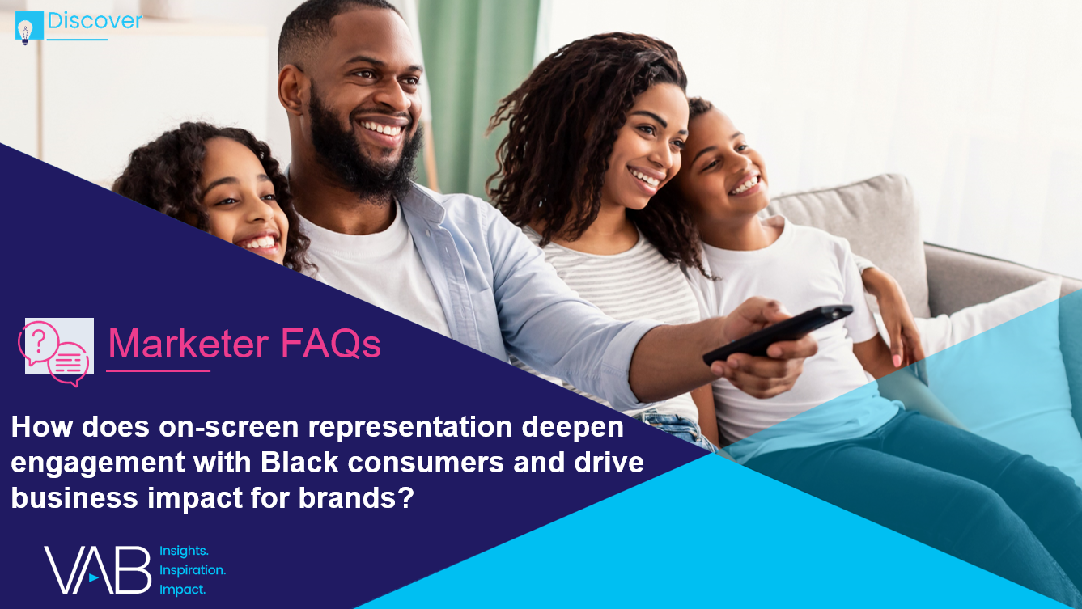

On-screen representation deepens engagement: By building campaigns around inclusive TV content, marketers can further engage diverse audiences, particularly Black viewers
Click here for the full report
% that are more likely to start watching a television show or movie because characters with similar (racial, ethnic, religious, etc.) identities
as you are represented?
% of respondents who answered very/somewhat likely
Almost 80% of Black audiences believe it is important that television shows and movies accurately represent their identities
81%
71%
68%
Black
LGBTQ
Hispanic
67%
61%
Asian
non-Hispanic White
Source: VAB analysis of Morning Consult, Media Representation, September 2021.
This information is exclusively provided to VAB members and qualified marketers. Further distribution is prohibited.
PAGE 8
This information is exclusively provided to VAB members and qualified marketers. Further distribution is prohibited.

Slide 9
Inclusive advertising drives relevance: Marketers can authentically connect with Black consumers by creating culturally diverse advertising campaigns
Click here for the full report
‘It is important for companies to create advertising that is culturally diverse in order to stay relevant’
% of respondents who agree
81%
74%
74%
Black
Hispanic
LGBTQ
73%
65%
61%
Asian
Native American
non-Hispanic White
Source: VAB analysis of MRI-Simmons USA Study, Fall 2021; P18+.
This information is exclusively provided to VAB members and qualified marketers. Further distribution is prohibited.
PAGE 9
This information is exclusively provided to VAB members and qualified marketers. Further distribution is prohibited.

Slide 10






Streaming programming that attracts Native American viewers: Family-friendly, sports and other premium content are popular within their communal viewing experience
Click here for the full report
Download the report to learn more about the types of TV content also streamed by Black, Hispanic, Asian and LGBTQ audiences.
Type of TV content streamed
American Indian or Alaska Native A18+ Index vs. non-Hispanic White A18+ respondents
+53%
more likely to watch
Foreign language programming
+51%
more likely to watch
Kids programming
+16%
more likely to watch
Sports talk / debate shows
(e.g., First Take, Undisputed, The Herd)
+15%
more likely to watch
Sports
(e.g., Football, soccer, baseball games)
+12%
more likely to watch
Series that are currently airing on traditional
TV networks
(e.g., The Walking Dead, The Good Place, This Is Us, etc.)
15% of Native Americans
vs. 10% of NH White adults
25% of Native Americans
vs. 17% of NH White adults
9% of Native Americans
vs. 8% of NH White adults
27% of Native Americans
vs. 23% of NH White adults
43% of Native Americans
vs. 38% of NH White adults
Source: VAB analysis of MRI-Simmons Cord Evolution Study, November 2021; P18+. Base = ‘Used any streaming services in the past 12 months’.
This information is exclusively provided to VAB members and qualified marketers. Further distribution is prohibited.
PAGE 10
This information is exclusively provided to VAB members and qualified marketers. Further distribution is prohibited.

Slide 11
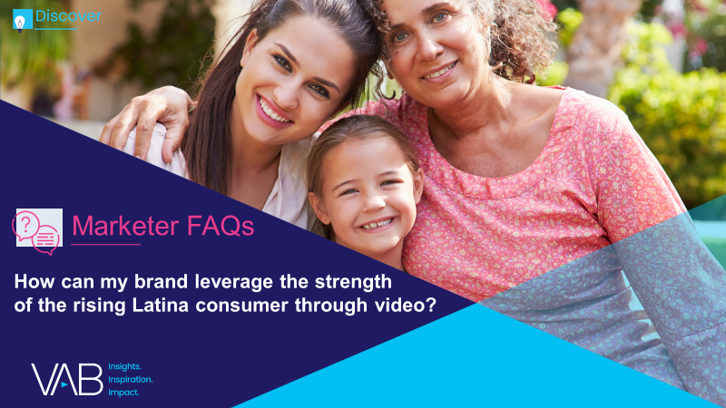








Latina influence on household consumption: Latinas are more likely to act as decision-makers and live in larger households than non-Hispanic women, presenting an outsized opportunity for marketers
Click here for the full report
Latina buyer growth by category
2018 vs. 2014
3.8
Investments
+247%
vs. +78% of NH women
Alcoholic Beverages
+26%
vs. +6% of NH women
Bottled Water
+21%
vs. +9% of NH women
Mobile
+18%
vs. +13% of NH women
Average household size among Hispanic women
(vs. 2.8 among
non-Hispanic women)
Automotive
+15%
vs. +1% of NH women
Casual Dining
+13%
vs. +3% of NH women
Makeup
+12%
vs. +4% of NH women
Department Store
+9%
vs. +1% of NH women
Source: VAB analysis of MRI-Simmons Fall 2021 Doublebase (average household size). Telemundo, Latinas Powering Forward, 2019 (buyer growth by category).
This information is exclusively provided to VAB members and qualified marketers. Further distribution is prohibited.
PAGE 11

Slide 12
Latinas are voracious video viewers in search of authenticity:
They seek content that appeals to their values and traits of family, hard work, language, faith and ‘cultural bothness’
Click here for the full report
% of Hispanic women who agree with the following statements
65%
‘Having shows that highlight issues / stories that are important to racial diverse communities available on a streaming service makes it more valuable to me’
Hispanic women spend 30+ hours watching TV and 22 hours viewing videos, using apps or surfing the internet on smartphones
&
88% of Hispanic women have streamed in the past 12 months
52%
‘I wish there was more Spanish-language content to stream’
Source: Telemundo, Latinas Powering Forward, 2019. VAB analysis of MRI-Simmons November 2021 Cord Evolution Study. Base = Any agree. ‘Cultural bothness’ refers to the equal integration of two cultures and languages into one.
This information is exclusively provided to VAB members and qualified marketers. Further distribution is prohibited.
PAGE 12

Slide 13



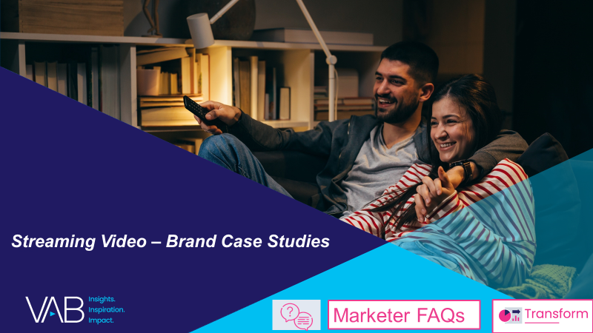
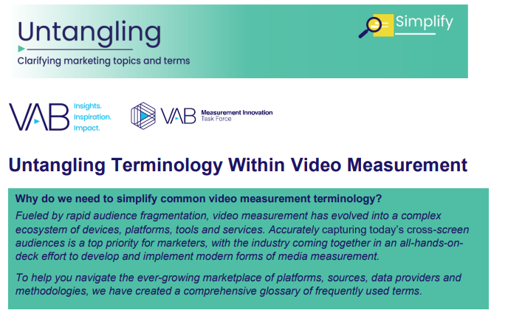
Leah Montner-Dixon
Reed Kiely
Associate Insights Director
leahm@thevab.com
Associate Insights Director
reedk@thevab.com
Karolina Guillen
Insights Manager
karolinag@thevab.com
Discover more
Looking for more data, insights and takeaways? Check out this related VAB content
We are committed to providing marketers with the data and insights they need to develop thoughtful, inclusive campaigns & strategies. To find out more on the unique media consumption behaviors and cultural trends of multicultural consumers, visit the VAB’s Multicultural Marketing Resource Center.
VAB Members, brand marketers and agencies get free and immediate access to VAB’s content library. Get access at theVAB.com
This information is exclusively provided to VAB members and qualified marketers. Further distribution is prohibited.
PAGE 13

