Slide 1


July, 2021
Just the Facts:
Why VAB Requested MRC Suspend Nielsen’s National Accreditation

Slide 2


Overview
On July 21st, VAB requested MRC (Media Ratings Council) suspend the accreditation of Nielsen’s national ratings service.
On behalf of member publishers and distributors, we provided the MRC, a highly detailed 10-page document outlining why Nielsen’s national accreditation should be revoked due to multiple, major and persistent violations. (Out of respect to the MRC’s confidential process, we are not sharing that document)
To help the marketplace understand why we took this historic action in pursuit of real improvements in measurement and currency, the following document provides a look at the in-depth analysis we performed, including:
The current state of Nielsen’s panel vs. pre-Covid
Root cause of why issues remain with Nielsen’s sample
Result of viewership undercounting to the industry
Recommendation for path forward
This information is exclusively provided to VAB members and qualified marketers. Further distribution is prohibited.
PAGE 2

Slide 3

TV’s 2021 Post-COVID Must-Haves:
Highest-Priority Restoration: Nielsen’s (COVID-damaged) National Panel
1.
July 2021 status of Nielsen’s national panel (seven charts)
2.
Root causes of COVID-period TV undercounting
3.
The cost of continued undercounting to the 2021 buy/sell marketplace
4.
2021 Panel fixes needed for restoration of buyer/seller market confidence
1

Slide 4
July 2021 Status of Nielsen’s National Panel:
The Details of Why National TV Undercounting Will Continue
Cadence of Seven Charts that Follow:
NPM panel not recovered from COVID damage…thru June 2021 - Page 3
Thru June ’21 - Blacks & Hispanics still under-represented in Nielsen national panel - Page 4
Thru June ‘21 - Younger demos still under-represented in Nielsen national panel - Page 5
Into June ‘21 – Panel declines continue disproportionately among larger homes - Page 6
Into June ‘21 – Panel declines continue disproportionately among 3+ & 4+ TV set homes - Page 7
Abnormally high spikes in non-viewers begin to correct after Nielsen’s 9,478 maintenance - Page 8
Recovery of artificial TUT declines - begin to correct after Nielsen’s 9,478 maintenance - Page 9
PAGE 2

Slide 5
Thru June ‘21: The Nielsen Panel Still Had 18% Fewer Respondents vs. Feb ‘20
2019
2020
2021
Avg Scaled Intab
Diff YoY Avg Scaled Intab
Source: Nielsen NPower, Universe Estimates, UE and Sample Information Report, P2+. Reflects broadcast months from January 2019 – June 2021 (thru w/o 6/21/21). 2019 YoY monthly comparisons vs. 2018 broadcast month data.
PAGE 3

Slide 6
Thru June ‘21: Both Black and Hispanic Homes Had Still
Lost Over 20% of Their Representation Within the Nielsen Panel
Avg Daily Scaled Intab Counts: Share By Ethnicity
February 2020 vs. June 2021
36,951
30,125
YoY % Diff
-23%
-17%
-23%
-7%
-21%
Source: Nielsen NPower, Universe Estimate, UE and Sample Information Report, P2+. Market breaks: Origin / Race. Reflects broadcast months.
PAGE 4

Slide 7
Thru June ’21: Younger Adult Demos Had Still
Lost Almost a Quarter of Their Representation Within the Nielsen Panel
Avg Daily Scaled Intab Counts: Share By Demographic
February 2020 vs. June 2021
28,968
YoY % Diff
23,876
-13%
-20%
-19%
-17%
-17%
-23%
Source: Nielsen NPower, Universe Estimate, UE and Sample Information Report, P18+. Reflects broadcast months.
PAGE 5

Slide 8
Panel Declines vs. Feb ‘20 - Continue to be Disproportionately
Among Larger Homes…Which are Heavier TV Viewing Homes
Avg Daily Scaled Intab Counts: Household Size
CY 2019 – June 2021 (YTD)
2019
2020
2021
Avg Scaled Intab
Jun ‘21
vs.
Feb ‘20
-23%
-18%
Diff YoY Avg Scale Intab
-13%
-11%
Source: Nielsen NPower, Universe Estimates, UE and Sample Information Report, P2+. Market breaks: Household Size – 1, 2, 3, 4+. Reflects broadcast months from January 2019 – June 2021 (thru w/o 6/21/21). 2019 YoY monthly comparisons vs. 2018 broadcast month data.
PAGE 6

Slide 9
Panel Declines vs. Feb ‘20 - Continue to be Disproportionately
Among Homes with 3+ & 4+ TVs…Which are Heavier TV Viewing Homes
Avg Daily Scaled Intab Counts: # of TV Sets Per HH
CY 2019 – June 2021 (YTD)
2019
2020
2021
Avg Scaled Intab
Jun ‘21
vs.
Feb ‘20
-25%
-17%
Diff YoY Avg Scale Intab
-15%
-9%
Source: Nielsen NPower, Universe Estimates, UE and Sample Information Report, P2+. Market breaks: # of TV Sets per HH – 1, 2, 3, 4+. Reflects broadcast months from January 2019 – June 2021 (thru 6/21/21). 2019 YoY monthly comparisons vs. 2018 broadcast month data.
PAGE 7

Slide 10
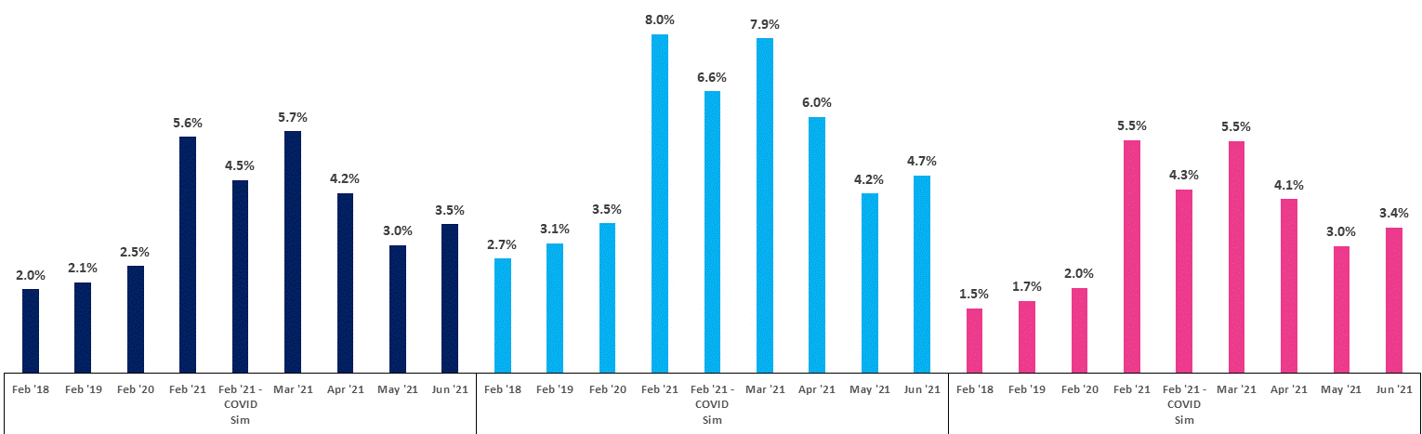
The Feb ‘21 COVID Simulation Data Still Showed
Very High Non-Viewer Spikes - While Now “Better” are Still Too High
Total Use of Television (TUT) Segmentation: Non-Viewers % of Unified Sample
Feb ‘18, Feb ‘19, Feb ‘20, Feb ‘21, Feb ‘21 COVID Simulation, Mar ‘21 – June ‘21
P2+
P18-49
P25-54
Source: Nielsen NPower, Number of Minutes Time Period Segmentation Report. Reflects broadcast months. % = non-viewers as a % of total unified sample.
PAGE 8

Slide 11
TUT Weekly Reach Began to Quickly Recover in April, As Nielsen Returned to
At- Home Maintenance for TV Panel - Early June TUT was Highest in a Year
Weekly Reach (000), Total Use of Television (TUT), P2+
CY 2019 – YTD 2021
2019
2020
2021
COVID impact begins
Return to in-field maintenance
(w/o 3/22)
Weekly Reach (000) (1 min)
Source: Nielsen R&F Time Period Report, Live+7, Total Day, P2+. Viewing Source: Total Use of Television. Time period: w/o 12/31/18 – w/o 6/21/21. The numbers on the horizontal axis represent the week # of the appropriate calendar year.
PAGE 9

Slide 12
Highest-Priority Restoration: Nielsen’s (COVID-damaged) National Panel
1.
July 2021 status of Nielsen’s national panel (seven charts)
2.
Root causes of COVID-period TV undercounting
3.
The cost of continued undercounting to the 2021 buy/sell marketplace
4.
2021 Panel fixes needed for restoration of buyer/seller market confidence
10

Slide 13
The Root Causes of COVID-Period TV Undercounting…
Started with a reduced/degraded panel:
A Quick Example:
Avg. Daily Scaled
Intab Counts, P2+
2020
2021
January-
36,357
29,533
February-
36,957
29,451
March-
36,727
29,847
20% panel loss leads to sharply increased variability/volatility due to increased weighting on fewer homes…with:
A much less diverse profile
A weaker TV usage profile
An older profile
11
Source: Nielsen NPower, Universe Estimates, UE and Sample Information Report, P2+. Reflects broadcast months from January – March 2020 & 2021.

Slide 14
The Root Causes of COVID-Period TV Undercounting…
The damage was then compounded by – 9K of the degraded homes being impaired:
A Quick Example:
Avg. Daily Scaled
Intab Counts, P2+
96% of Those 9,478 Homes
Did Require Repairs or Removal:
2020
2021
January-
5,795 - Maintenance Performed (61%)
2,407 - Temporarily Removed (25%)
876 - Permanently Removed (9%)
400 - No Action Needed (4%)
36,357
29,533
February-
36,957
29,451
March-
36,727
29,847
The pre-COVID profile of the 9,478:
20% panel loss leads to sharply increased variability/volatility due to increased weighting on fewer homes…with:
Younger, w/ robust TV usage
The COVID damage from the 9,478:
A much less diverse profile
A weaker TV usage profile
An older profile
The full range of malfunctions
Lost ability to count critical viewers
Drove false spikes in Zero-viewing
Source: Nielsen NPower, Universe Estimates, UE and Sample Information Report, P2+. Reflects broadcast months from January – March 2020 & 2021. Panel home maintenance figures based on Nielsen external communications release dated 6/3/21.
12

Slide 15
The Root Causes of COVID-Period TV Undercounting…
Further, deeper damage has not been addressed: the other 20,000+ panel homes
Avg. Daily Scaled
Intab Counts, P2+
96% of Those 9,478 Homes
Did Require Repairs or Removal:
2021
5,795 - Maintenance Performed (61%)
2,407 - Temporarily Removed (25%)
876 - Permanently Removed (9%)
400 - No Action Needed (4%)
January-
29,533
February-
29,451
March-
29,847
The pre-COVID profile of the 9,478:
Questions about the very high likelihood that COVID-year damage degraded the entire 29,000+ homes panel are being asked…
Younger, w/ robust TV usage
The COVID damage from the 9,478:
…But NOT answered.
The full range of malfunctions
Lost ability to count critical viewers
Drove false spikes in Zero-viewing
Source: Nielsen NPower, Universe Estimates, UE and Sample Information Report, P2+. Reflects broadcast months from January – March 2020 & 2021. Panel home maintenance figures based on Nielsen external communications release dated 6/3/21.
13

Slide 16
The Root Causes of COVID-Period TV Undercounting…
The May 2021 maintenance performed by Nielsen on these homes:
96% of Those 9,478 Homes
Did Require Repairs or Removal:
5,795 - Maintenance Performed (61%)
2,407 - Temporarily Removed (25%)
876 - Permanently Removed (9%)
400 - No Action Needed (4%)
The pre-COVID profile of the 9,478:
Younger, w/ robust TV usage
The COVID damage from the 9,478:
The full range of malfunctions
Lost ability to count critical viewers
Drove false spikes in Zero-viewing
14
Source: Panel home maintenance figures based on Nielsen external communications release dated 6/3/21.

Slide 17
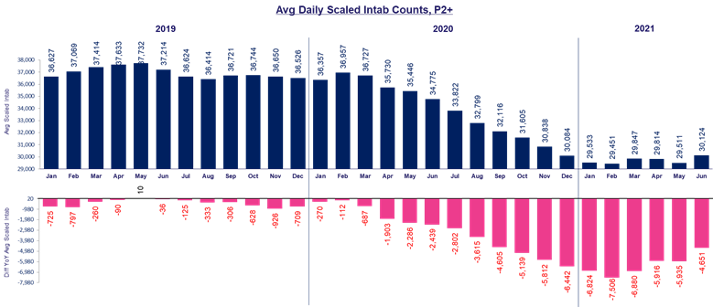
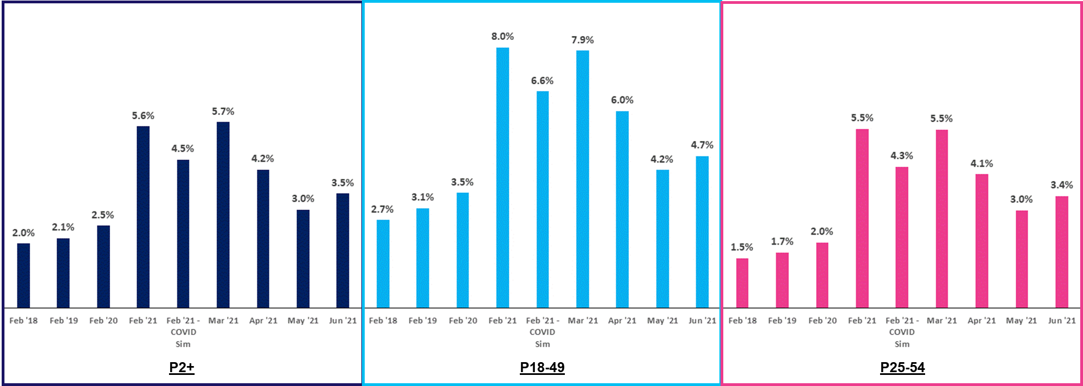
The Root Causes of COVID-Period TV Undercounting…
Did NOT “Fix” the COVID-damaged Nielsen national panel:
A Quick Example:
Avg. Daily Scaled
Intab Counts, P2+
2020
2021
January-
36,357
29,533
February-
36,957
29,451
March-
36,727
29,847
20% panel loss leads to sharply increased variability/volatility due to increased weighting on fewer homes…with:
A much less diverse profile
A weaker TV usage profile
An older profile
Source: Nielsen NPower, Universe Estimates, UE and Sample Information Report, P2+. Reflects broadcast months from January – March 2020 & 2021. Nielsen NPower, Universe Estimates, UE and Sample Information Report, P2+. Reflects broadcast months from January 2019 – June 2021 (thru w/o 6/21/21). 2019 YoY monthly comparisons vs. 2018 broadcast month data. Nielsen NPower, Number of Minutes Time Period Segmentation Report. Reflects broadcast months. % = non-viewers as a % of total unified sample.
15

Slide 18
Highest-Priority Restoration: Nielsen’s (COVID-damaged) National Panel
1.
July 2021 status of Nielsen’s national panel (seven charts)
2.
Root causes of COVID-period TV undercounting
3.
The cost of continued undercounting to the 2021 buy/sell marketplace
4.
2021 Panel fixes needed for restoration of buyer/seller market confidence
16

Slide 19
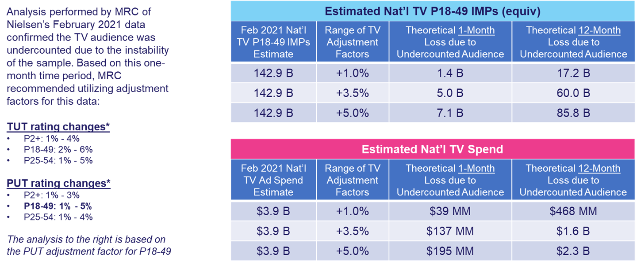
The Cost of Continued Undercounting
to the 2021 Buy/Sell Marketplace
Over 85 Billion impressions couldn’t be activated due to a year’s worth of undercounting…
That translates to over $2 billion in ad inventory wasn’t available to advertisers in a COVID year:
Note on 12-Month Calculation:
The 1 month $ loss x 12 is meant to provide rough sense of potential year-long loss of ad revenue.
Arguments can certainly be made for lower (or higher) estimates.
It is irrefutable that even the most conservative estimates of ad revenue losses are still in the hundreds of millions – at least
Source: Nielsen Ad Intel, February 2021, broadcast months. Cable TV, Network TV (broadcast), Spanish language cable TV, Spanish language network TV (broadcast), includes all dayparts, excludes promos and PSAs. Impressions are P18-49 equivalized, Live +7 and includes Spanish language networks, excludes promos and PSAs. 12-month estimation based on 1-month theoretical estimate x 12. *The adjustment factors are based on only one month of data (February 2021), however the MRC believes the undercounting could be higher during the affected measurement period: March ‘20 – March ‘21.
PAGE 17
6

Slide 20
Highest-Priority Restoration: Nielsen’s (COVID-damaged) National Panel
1.
July 2021 status of Nielsen’s national panel (seven charts)
2.
Root causes of COVID-period TV undercounting
3.
The cost of continued undercounting to the 2021 buy/sell marketplace
4.
2021 Panel fixes needed for restoration of buyer/seller market confidence
18

Slide 21
2021 Panel Fixes Needed
For the Restoration of Buyer/Seller Market Confidence
First & Obvious: National panel restoration to Pre-COVID level (minimally) of:
Current Shortfall Thru June 2021
Overall panel size – needs to be restored to 36,900+
- 6,800
(Avg. Daily Scaled Intabs, P2+)
Black panel size – needs to be restored to 5,000+
- 1,150
Hispanic panel size – needs to be restored to 6,800+
- 1,450
P18-24 panel size – needs to be restored to 3,000+
- 680
P25-34 panel size – needs to be restored to 4,500+
- 770
Restoration of larger homes & multi-set homes to Pre-COVID levels also needed
19

Slide 22
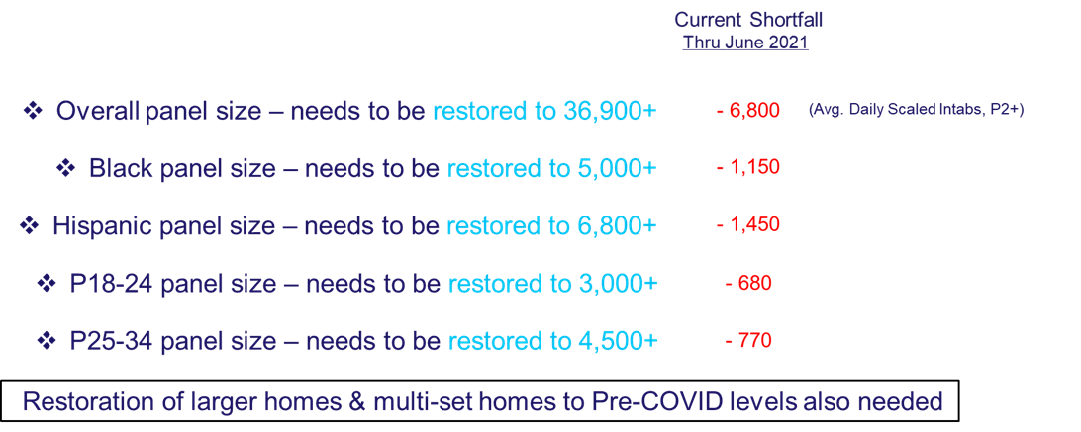
2021 Panel Fixes Needed
For the Restoration of Buyer/Seller Market Confidence
Second high priority – auditing the full impact of the 9,478 on the national panel
May’s independent MRC analysis of Nielsen’s February 2021 data gave insight into a partial look at the 9,478 ; it was that look at a partial data set that produced the below MRC-recommended adjustment factors for the buy/sell marketplace:
TUT rating changes*
P2+: 1% - 4%
P18-49: 2% - 6%
P25-54: 1% - 5%
PUT rating changes*
P2+: 1% - 3%
P18-49: 1% - 5%
P25-54: 1% - 4%
The buy/sell market should learn what variances in the adjustment factors
would be called for by the completed analysis of the full 9,478 impaired homes
20

Slide 23
2021 Panel Fixes Needed
For the Restoration of Buyer/Seller Market Confidence
Obvious co-priority: disclosure on the full national panel – Including the 20,000+ Other Homes
The buy/sell market should learn what variances in the adjustment factors
would be called for by the completed analysis of the full 29,000+ panel homes
21

Slide 24
TV’s 2021 Post-COVID Must-Haves:
Highest-Priority Restoration: Nielsen’s (Covid-damaged) National Panel
Highest-Priority Disclosures: Transparency of Panel Restoration to the
Full Buy/Sell TV Marketplace
Seizing a transparency imperative should be the buy/sell marketplace’s
mission-critical achievement during the remainder of 2021
22

Slide 25

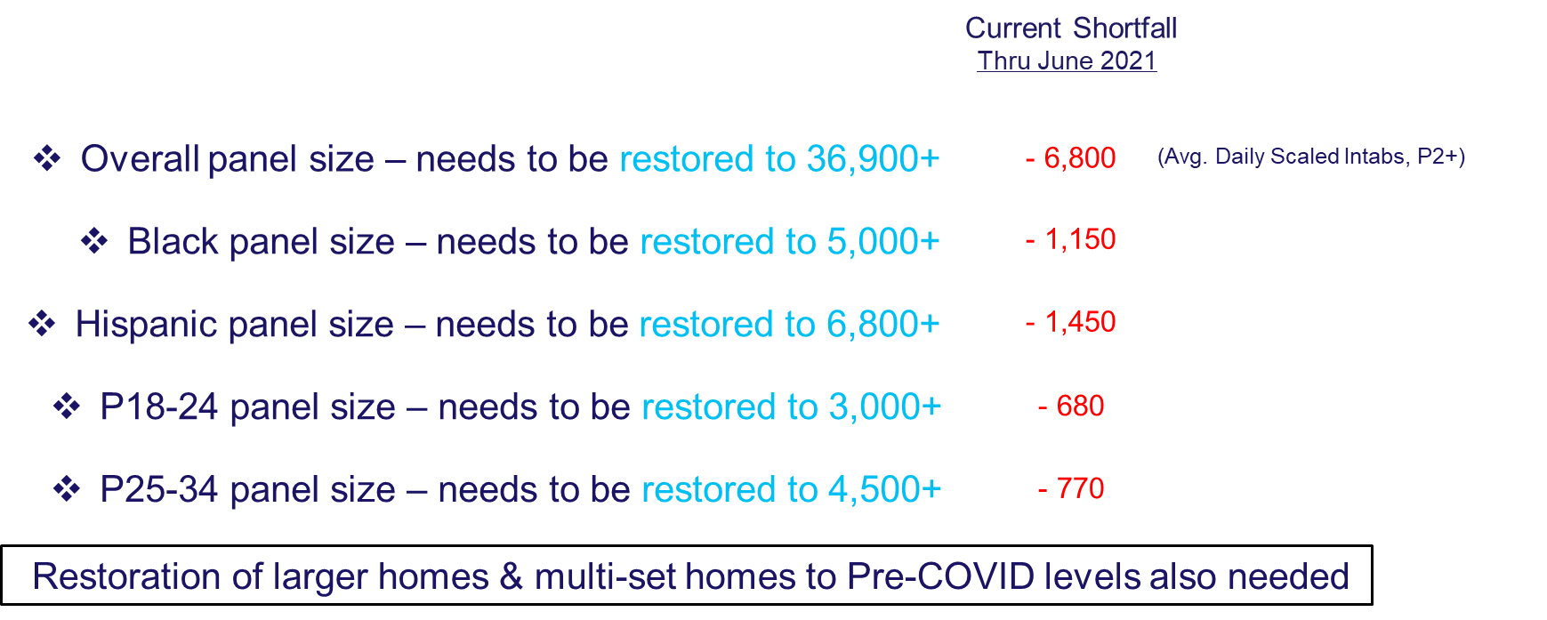
Seizing a Transparency Imperative Should be the Buy/Sell Marketplace’s
Mission-Critical Achievement During the Remainder of 2021
Independent
Audit & Oversight of
Panel Restoration
Creation & Enforcement of 2021 Verification Timetable
Empowered to Call Out Completions or Shortfalls
PAGE 23
6

Slide 26
Seizing a Transparency Imperative Should be the Buy/Sell Marketplace’s
Mission-Critical Achievement During the Remainder of 2021
Independent
Audit & Oversight of
Panel Restoration
Creation & Enforcement of 2021 Verification Timetable
Empowered to Call Out Completions or Shortfalls
The full marketplace of measurement/currency customers should expect to be able to
easily access & monitor a transparent dashboard of panel restoration progress
PAGE 24
6

Slide 27

About VAB
VAB is an insights-driven organization that inspires marketers to reimagine their media strategies resulting in fully informed decisions.
Drawing on our marketing expertise, we simplify the complexities in our industry and discover new insights that transform the way marketers look at their media strategy.
Transform
We help you build your brand by focusing on core marketing principles that will help drive tangible business outcomes.
Simplify
We save you time by bringing you the latest data & actionable takeaways you can use to inform your marketing plans.
Discover
We keep you one step ahead with the latest thinking so you can create innovative, forward-looking strategies.
We are committed to your business growth and proud to offer VAB members, brand marketers and agencies complimentary access to our continuously-growing Insights library. Get immediate access at theVAB.com.
This information is exclusively provided to VAB members and qualified marketers. Further distribution is prohibited.
PAGE 27

