Slide 1





VAB Investigation:
Did YouTube allow for targeted campaigns to be served on
“Made for Kids” channels?

Slide 2


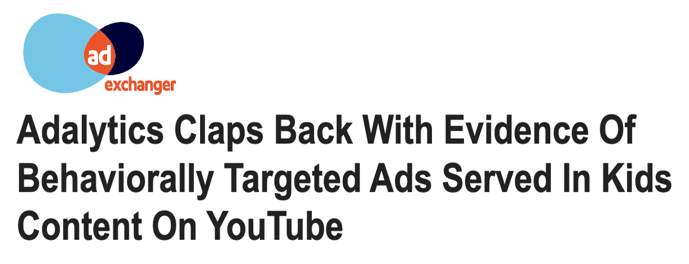
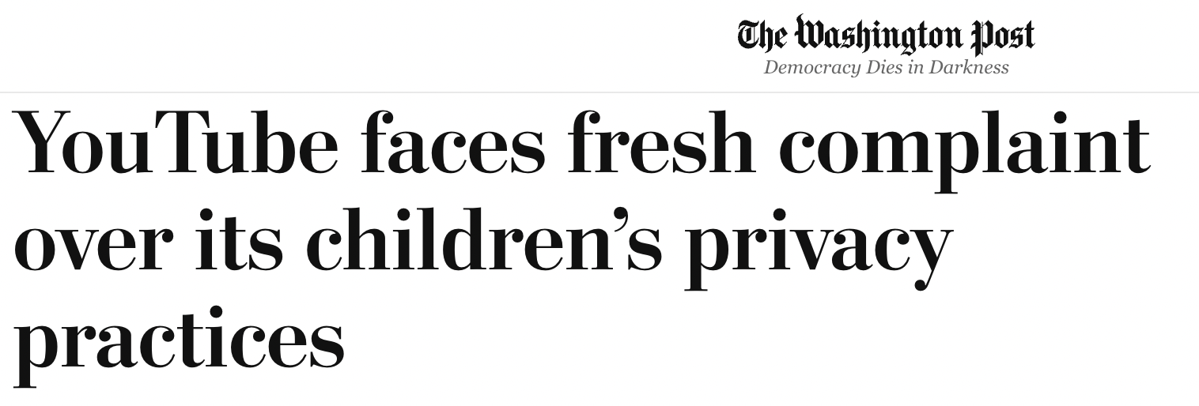
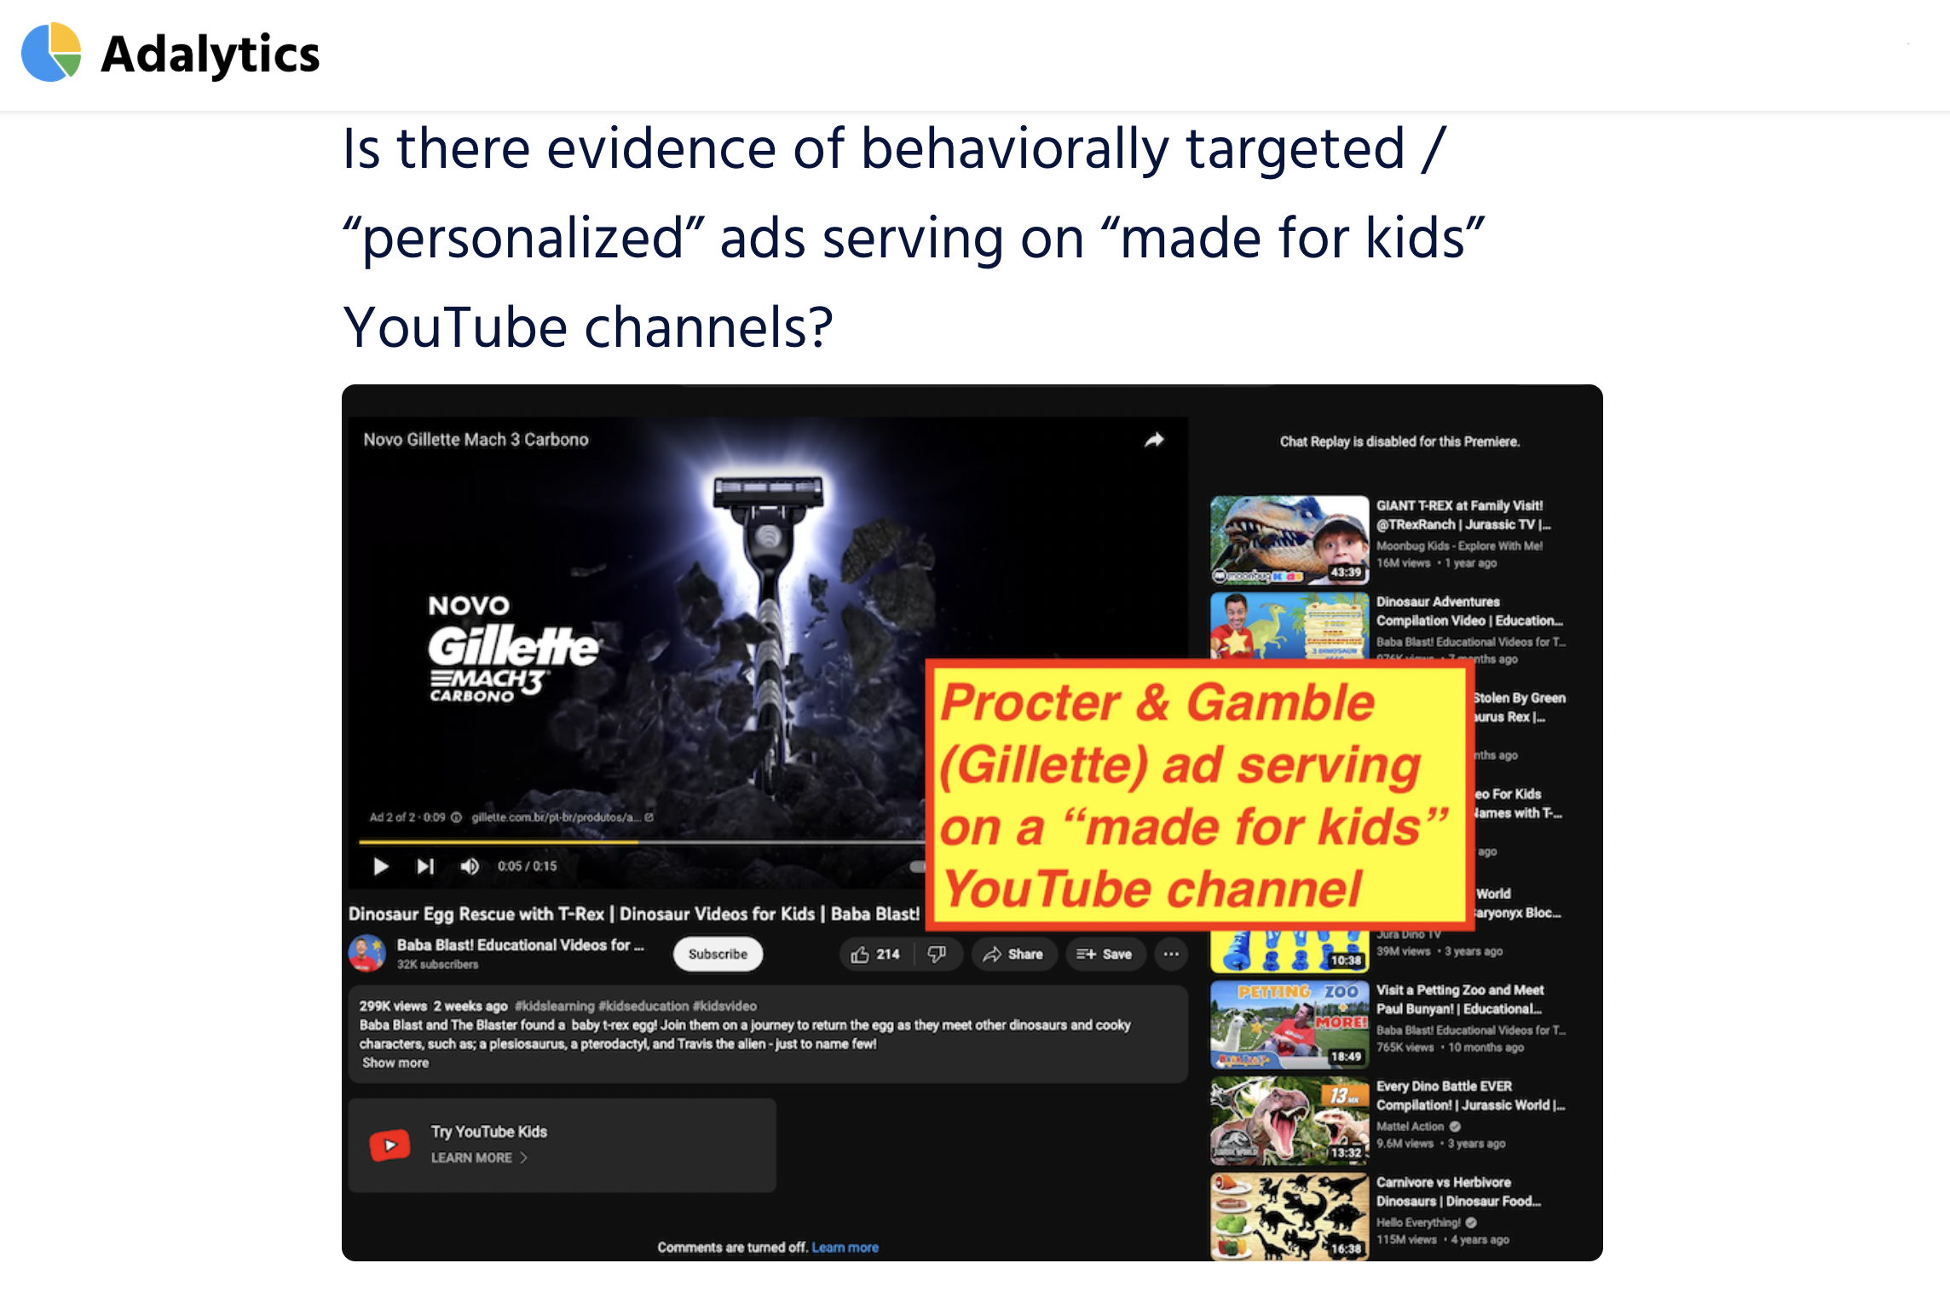
In the wake of the Adalytics report highlighting YouTube’s serving of targeted ads to children, the VAB conducted an independent test campaign to investigate.
This report illustrates the step-by-step details of a real YouTube ad campaign utilizing audience targeting
and the results that followed.
This information is exclusively provided to VAB members and qualified marketers. Further distribution is prohibited.
PAGE 2

Slide 3
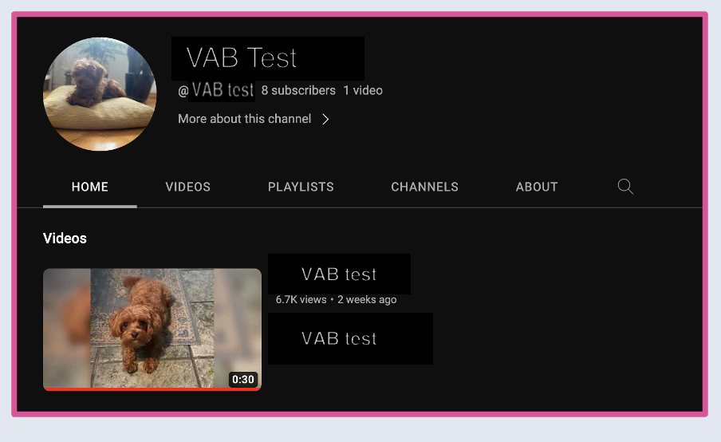
The VAB created a YouTube channel with neutral, brand safe content
to conduct our experiment
Test Campaign Details
Sample of YouTube channel utilized
Campaign Spend: $10
Campaign Flight: 2 days
Networks: YouTube Only (Video Partners on Google Display Network deselected)
Demographics: Demographics: Parental Status Not a Parent or Unknown, (Parent deselected)
Audience: 24 audience targets selected (see step 6 for details)
Video Ad Format: Skippable In-stream Ad
This information is exclusively provided to VAB members and qualified marketers. Further distribution is prohibited.
PAGE 3

Slide 4

The following is a 7-step guide for how we conducted our buy (and how you can too)

Slide 5
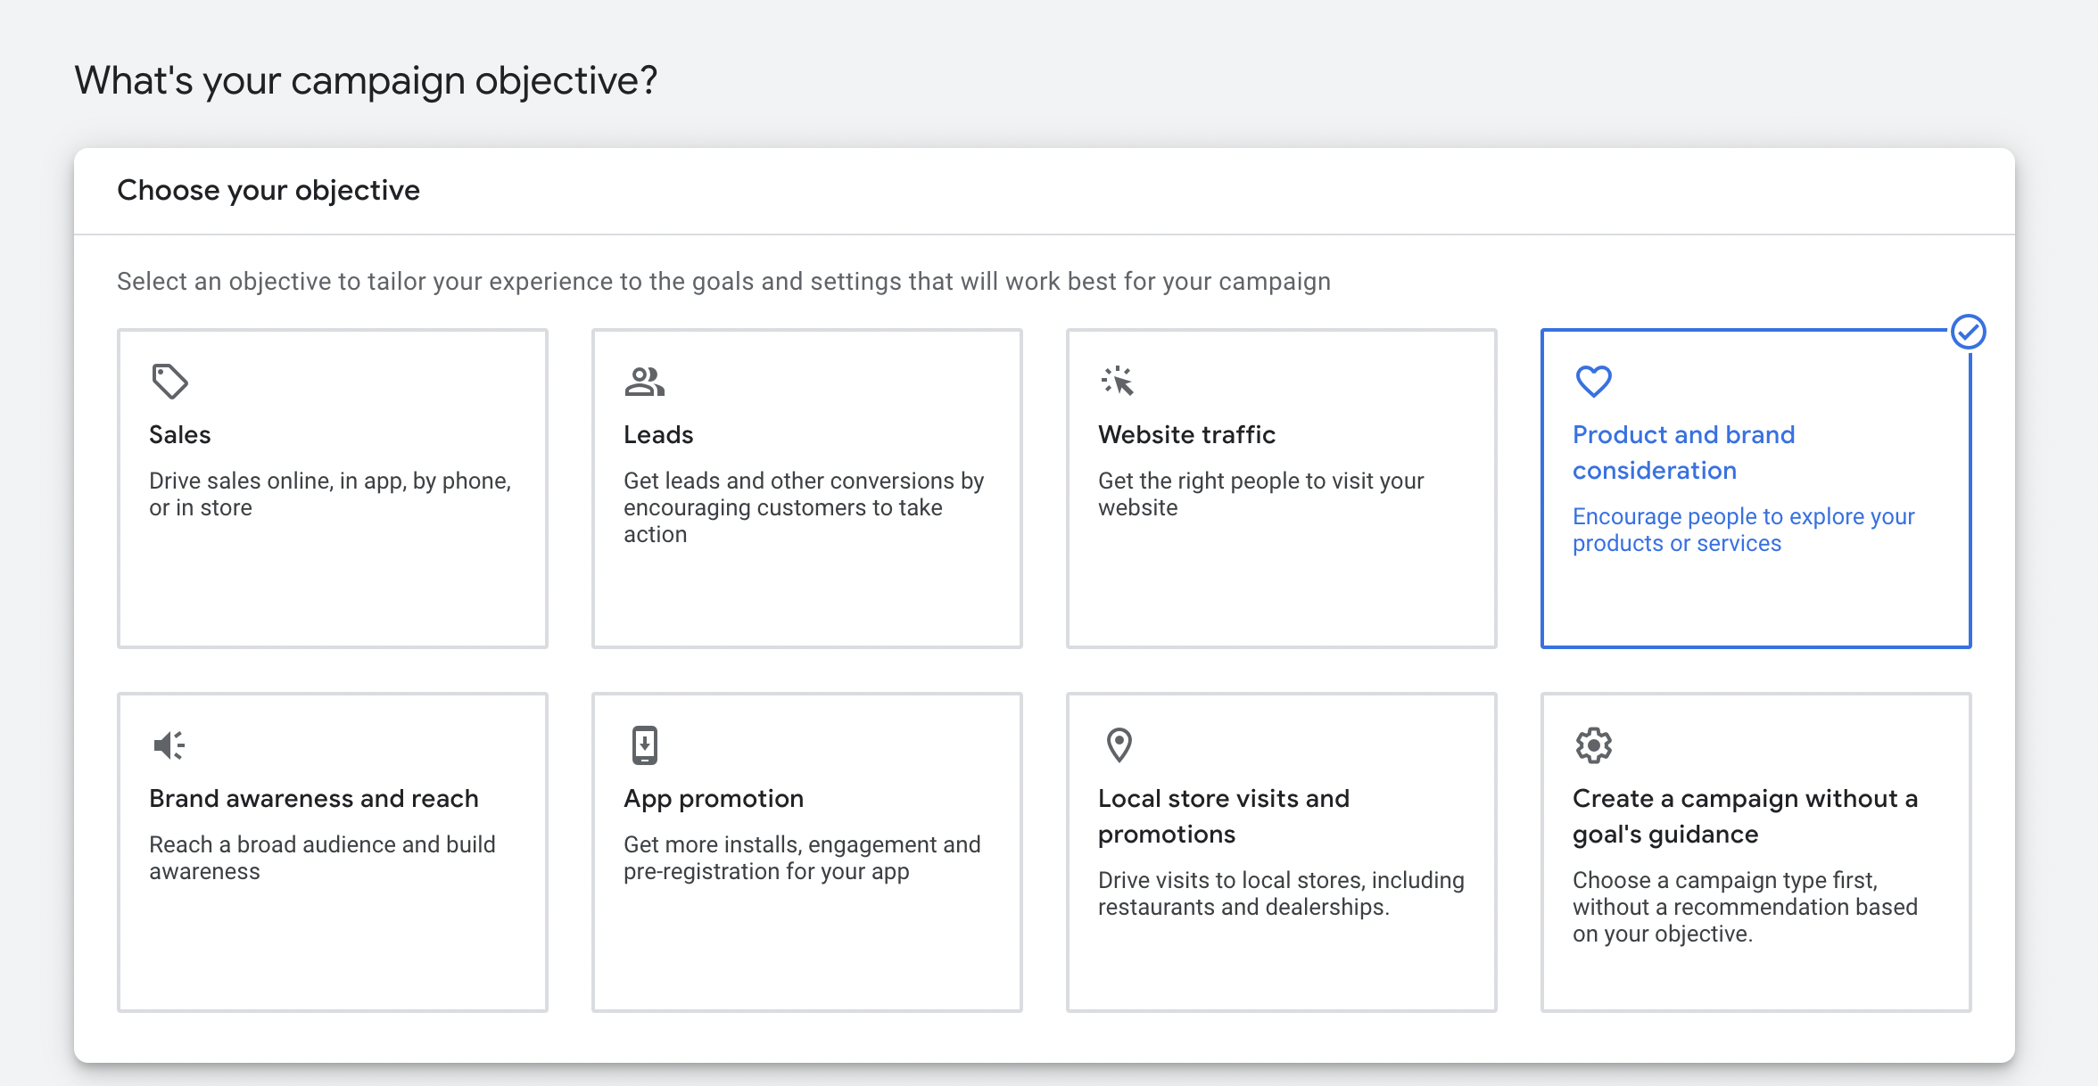
1
Campaign Set-up
Select the Campaign Objective of your Choosing
This information is exclusively provided to VAB members and qualified marketers. Further distribution is prohibited.
PAGE 5

Slide 6
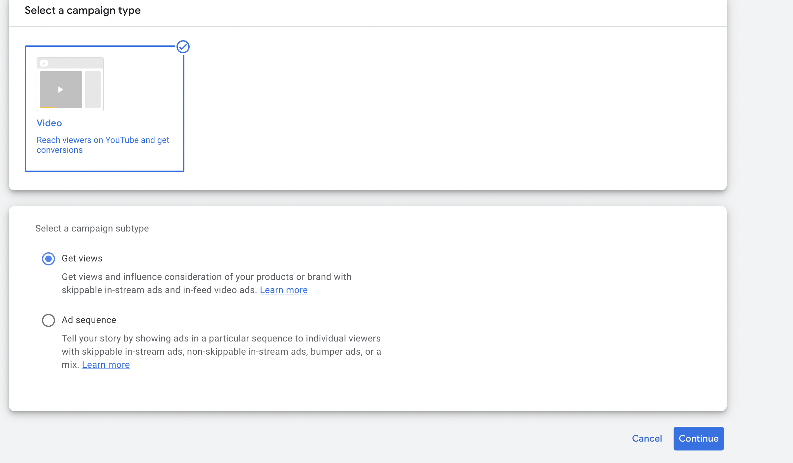
2
Campaign Set-up
Select Video Campaign Type
This information is exclusively provided to VAB members and qualified marketers. Further distribution is prohibited.
PAGE 6

Slide 7
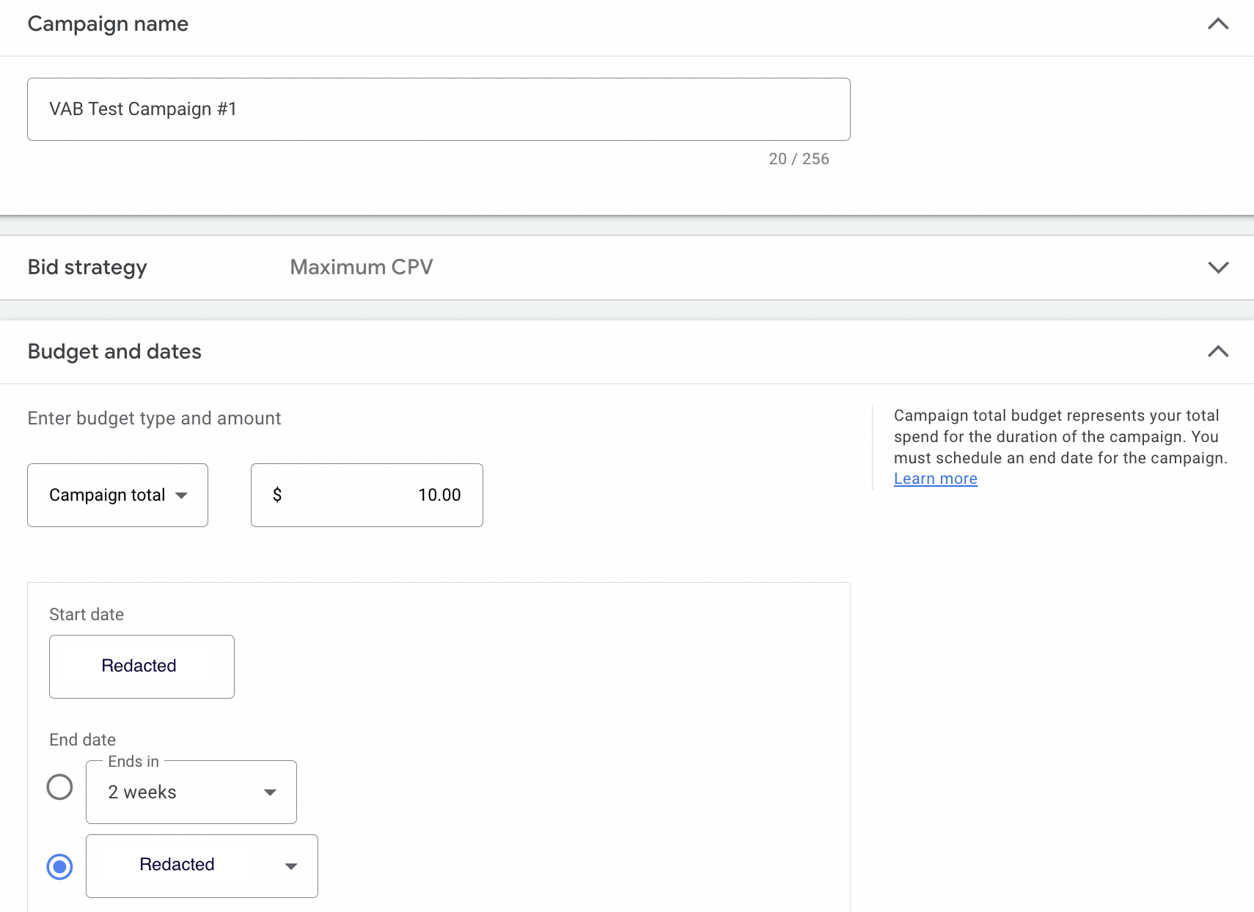
3
Campaign Set-up
Input Campaign Name, Budget & Campaign Dates
This information is exclusively provided to VAB members and qualified marketers. Further distribution is prohibited.
PAGE 7

Slide 8
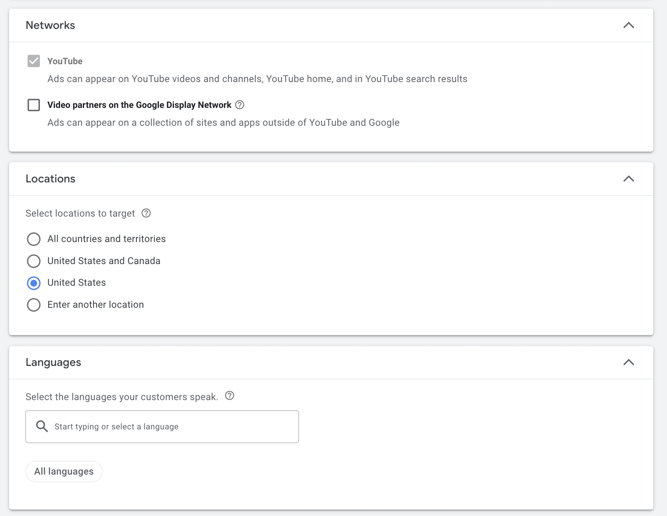
4
Campaign Set-up
Deselect Video Partners on Google Display Network
to ensure campaign runs on YouTube only
This information is exclusively provided to VAB members and qualified marketers. Further distribution is prohibited.
PAGE 8

Slide 9
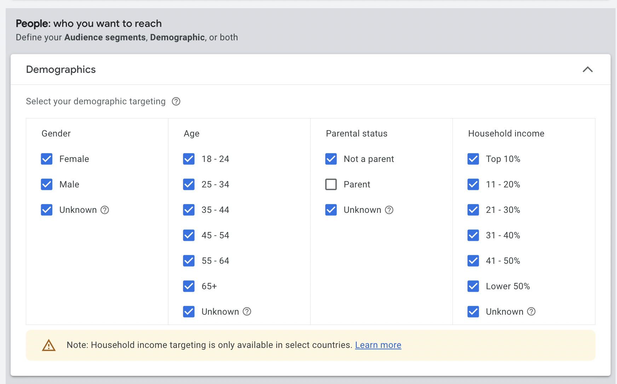
5
Campaign Set-up
Parental Status: Not a parent, Unknown
To remove the possibility of parental co-viewing from the test, the VAB deselected ‘Parent’ as a campaign demographic target.
This information is exclusively provided to VAB members and qualified marketers. Further distribution is prohibited.
PAGE 9

Slide 10
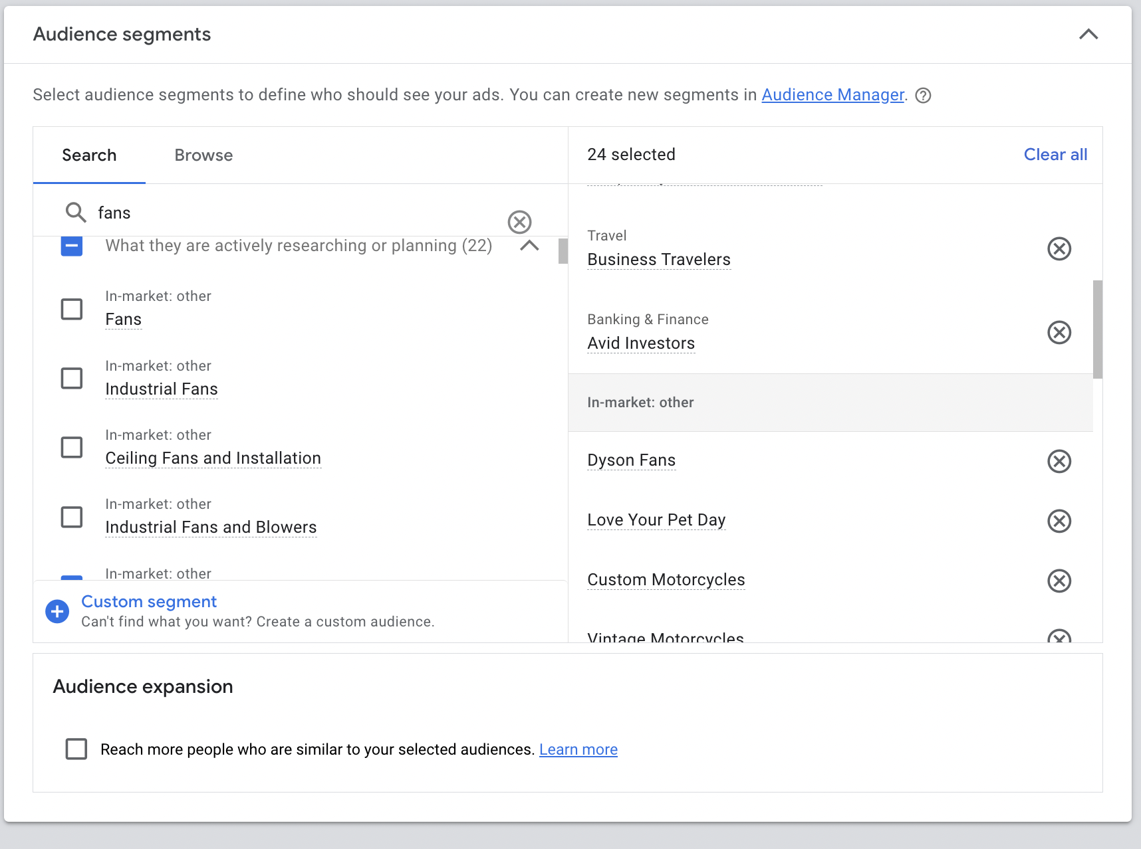
6
Campaign Details
Select Audience Segment Targets
Sampling of behavioral targeting segments
highly unlikely to be related to children selected
Type | Audience segment
In-market segment | Home Appliances
In-market segment | Climate Control & Air Quality
Life event | Recently Purchased a Home
Life event | Recently Added Dog to Household
Affinity segment | Business Travelers
In-market segment | Bedroom
Affinity segment | High-End Computer Aficionados
Affinity segment | Avid Investors
Life event | Recently Renovated Home
Affinity segment | Outdoor Enthusiasts
Life event | Renovating Home Soon
In-market segment | Household Cleaning Supplies
Life event | Adding Cat to Household Soon
Affinity segment | Frequently Attends Live Events
Life event | Purchasing a Home Soon
Affinity segment | Cloud Services Power Users
In-market segment | Fireplaces
In-market segment | Lights & Fixtures
Affinity segment | Motorcycle Enthusiasts
This information is exclusively provided to VAB members and qualified marketers. Further distribution is prohibited.
PAGE 10

Slide 11
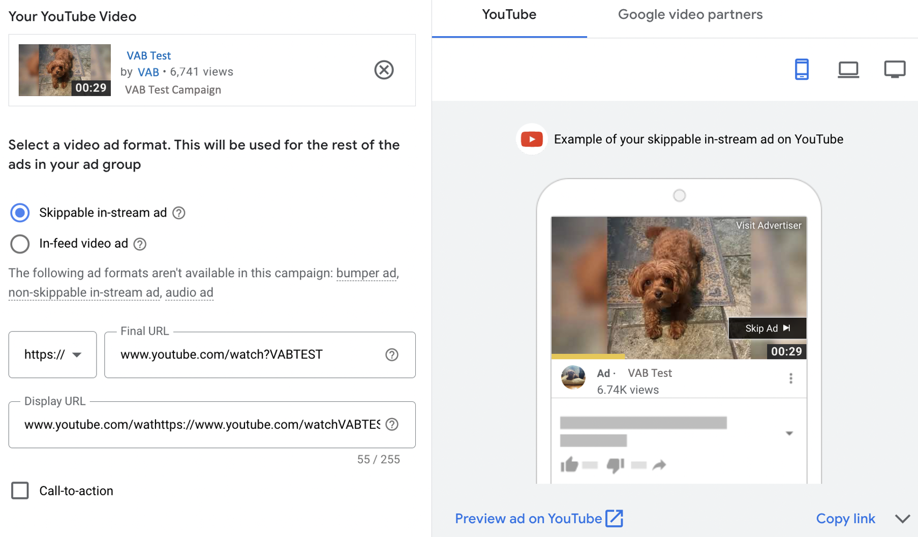
7
Campaign Details
Skippable in-stream ads
This information is exclusively provided to VAB members and qualified marketers. Further distribution is prohibited.
PAGE 11

Slide 12
Campaign Findings

Slide 13
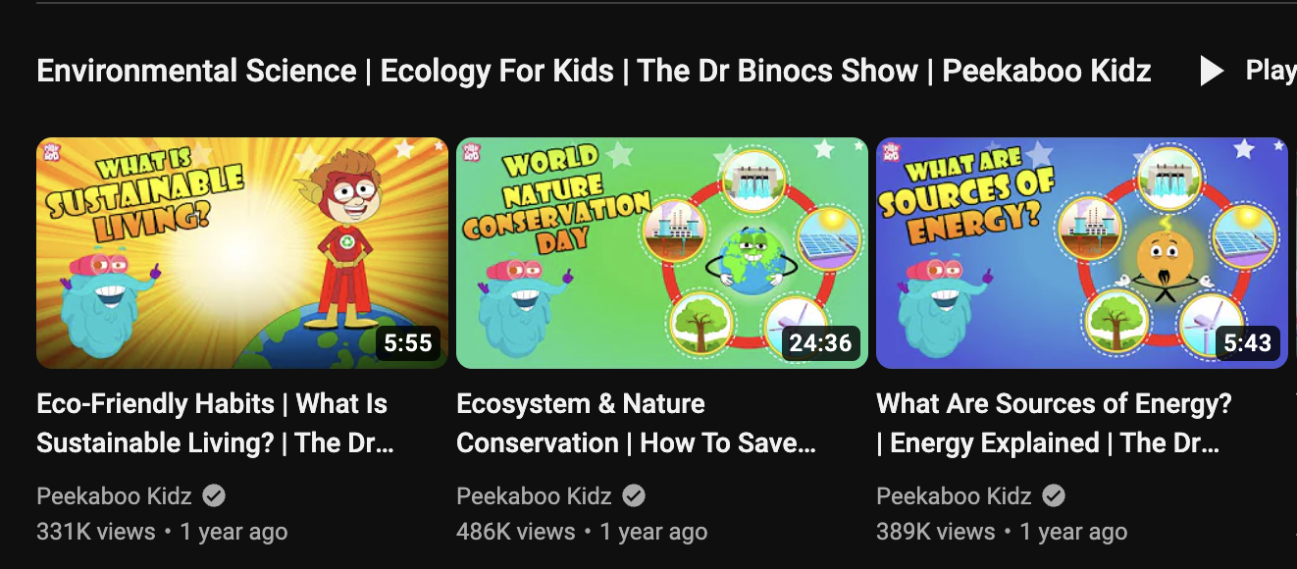
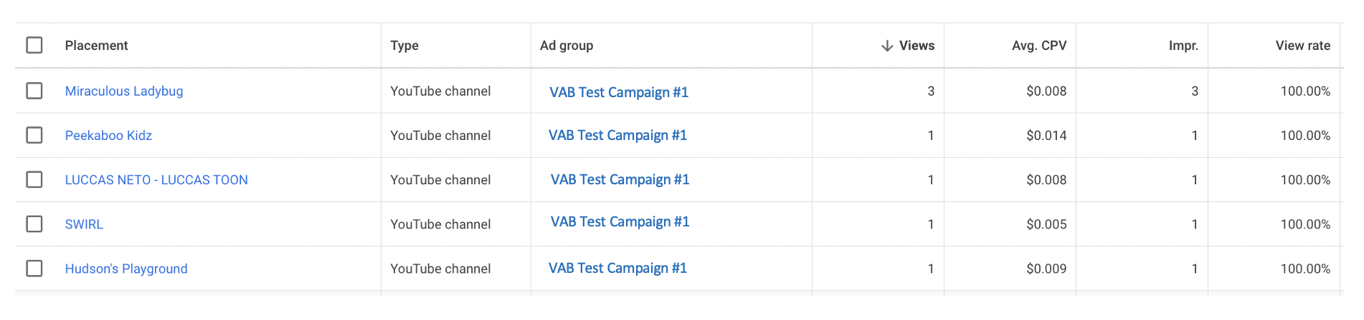
In our analysis of the ‘Campaign Placement Report’ more than 25 placements to “Made for Kid’s” channels were observed in campaign designed not to reach kids
5 examples of placements on “Made for Kid’s” channels being served behaviorally targeted ads
Link
Link
One of the channels included is “Peekaboo Kidz”, which describes itself as “Specially designed for kids as they explore the World of Kids Educational Videos”
Link
Link
Link
*763 total campaign placements
This information is exclusively provided to VAB members and qualified marketers. Further distribution is prohibited.
PAGE 13

Slide 14
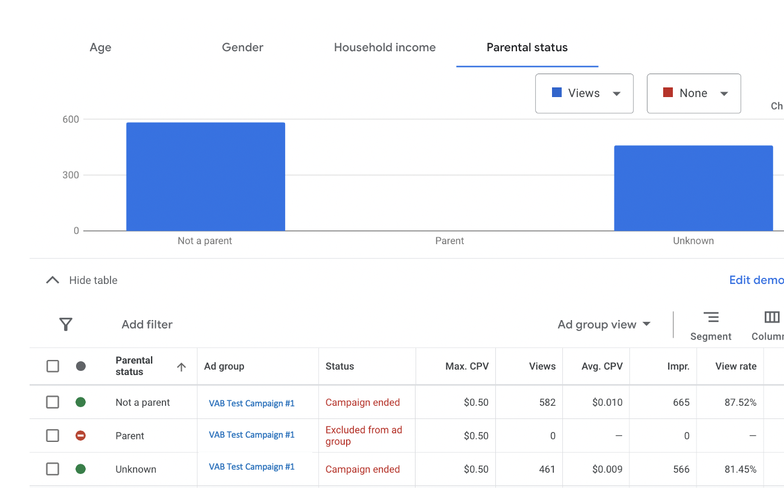
In our analysis of the ‘Campaign Demographics Report’
all 1,200+ impressions were delivered to ‘Not Parents’ or ‘Unknown’
The absence of impressions served to ‘Parents’ confirms that co-viewing with children is not a viable reason for ads being served on “Made for Kids” channels
PAGE 14
This information is exclusively provided to VAB members and qualified marketers. Further distribution is prohibited.

Slide 15
Why this Matters

Slide 16



What is the potential impact of personalized campaigns targeted at adults – not kids – running on “Made for Kids” YouTube channels?
Federal Investigations
Massive
Fines
Ad Waste &
Brand Risk
“United States senators sent a letter to the F.T.C., urging it to investigate whether Google and YouTube had violated COPPA.”
“Children’s privacy advocates are urging federal regulators to consider issuing a massive fine ‘upwards of tens of billions of dollars’… "
“It doesn’t just lead to wasted ad investments, but also inadvertent exposure to serious compliance and brand reputation risks…”
Ruben Schreurs, Chief Strategy Officer at Ebiquity
New York Times​, "YouTube Ads May Have Led to Online Tracking of Children, Research Says" , 8/17/23
Washington Post,​ "YouTube faces fresh complaint over its children’s privacy practices", 8/23/23
AdExchanger,​ "Adalytics Claps Back With Evidence Of Behaviorally Targeted Ads Served In Kids Content On YouTube", 8/23/23
This information is exclusively provided to VAB members and qualified marketers. Further distribution is prohibited.
PAGE 16

Slide 17



What is the potential impact on children?
Privacy
Abused
Exposure to
inappropriate content
Exploitation
“There is no reasonable excuse for ads running on content intended primarily for kids other than to extort advertisers through a toddler-enabled click farm”
Sr. Advertising Executive
who chose to remain anonymous
““They have created a conveyor belt that is scooping up the data of children”
Jeff Chester, Executive Director at the Center for Digital Democracy
“Some of these ads reportedly involved content inappropriate for children, such as car wrecks, medical injuries, and clips from TV-MA shows.”
New York Times​, "YouTube Ads May Have Led to Online Tracking of Children, Research Says" , 8/17/23
Adalytics,​ "Are YouTube Advertisers Inadvertently Harvesting Data From Millions of Children?", 8/21/23
The Verge,​ "Senators want YouTube investigated over showing targeted ads to kids, again", 8/18/23
This information is exclusively provided to VAB members and qualified marketers. Further distribution is prohibited.
PAGE 17

Slide 18




Marketers should be aware or prepared for the business ramifications
1
2
3
Financial
Risk
Brand Reputational
& Corporate Risk
Legal
Risk
This information is exclusively provided to VAB members and qualified marketers. Further distribution is prohibited.
PAGE 18

Slide 19
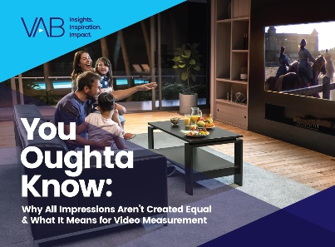

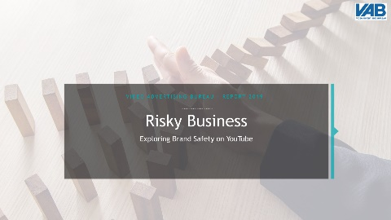
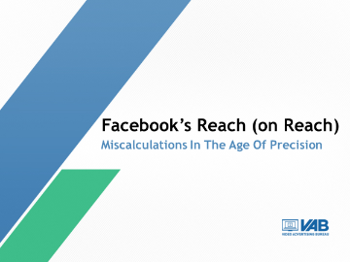





Marketing Thought Leadership
Digital Ad-Tech Transparency Issues
Discover more
Looking for more data, insights and takeaways? Check out this related VAB content
The Value of Premium Video Platforms
VAB Members, brand marketers and agencies get free and immediate access to VAB’s content library. Get access at theVAB.com
This information is exclusively provided to VAB members and qualified marketers. Further distribution is prohibited.
PAGE 19

Slide 20


About VAB
VAB is an insights-driven organization that inspires marketers to reimagine their media strategies resulting in fully informed decisions.
Drawing on our marketing expertise, we simplify the complexities in our industry and discover new insights that transform the way marketers look at their media strategy.
We are committed to your business growth and proud to offer VAB members, brand marketers and agencies complimentary access to our continuously-growing Insights library. Get immediate access at theVAB.com.
Curious to learn more about VAB? Check out this quick video to see what we do and how we can help you develop business-driving marketing strategies.
This information is exclusively provided to VAB members and qualified marketers. Further distribution is prohibited.
PAGE 20

