Slide 1

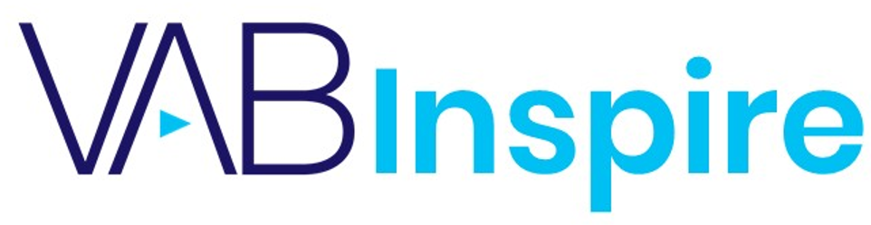

Do The Right Thing:
The Business Impact
of Multicultural Marketing

Slide 2
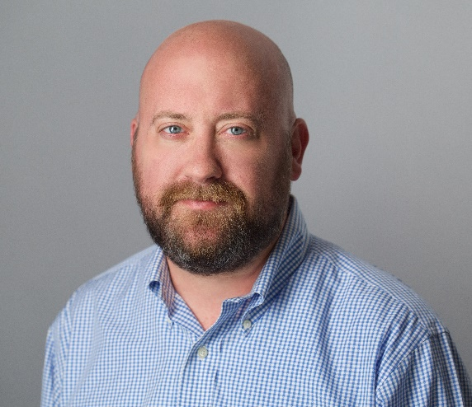

Today’s Speaker
Jason Wiese
VAB
SVP, Director of Strategic Insights
jasonw@thevab.com
This information is exclusively provided to VAB members and qualified marketers. Further distribution is prohibited.
PAGE 2

Slide 3
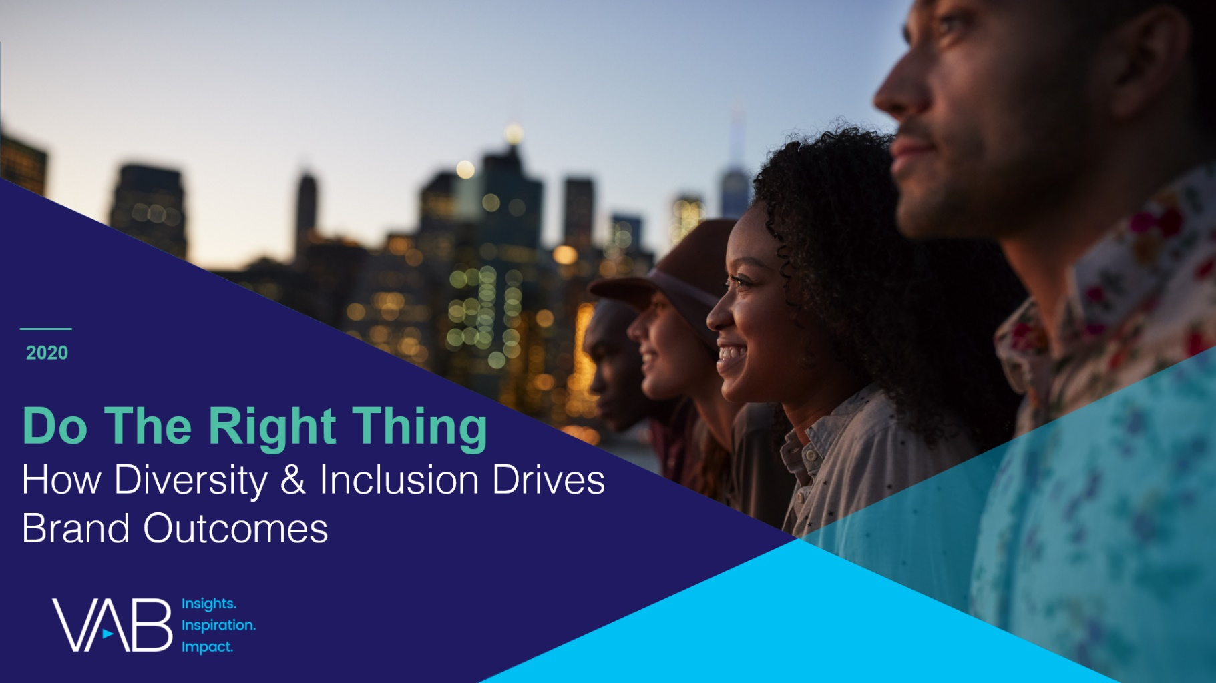
Today, we’ll distill the key insights and essential takeaways from our recent analysis on diversity & inclusion ad campaigns
Brand marketers and agencies get free and immediate access to VAB’s content library. Get access at theVAB.com
This information is exclusively provided to VAB members and qualified marketers. Further distribution is prohibited.
PAGE 3

Slide 4
What you’ll learn today…
1
How ad campaigns with a core message of diversity and inclusion deliver stronger business results for brands
2
How these results drive positive outcomes throughout the purchase funnel, from awareness and consideration to website visitations and sales
3
How brands can better engage multicultural audiences by understanding the campaign themes and strategies that have proven successful
This information is exclusively provided to VAB members and qualified marketers. Further distribution is prohibited.

Slide 5
Background on Analysis Purpose and Methodology
In the current business environment and economic climate where
every dollar counts and brand results are more scrutinized than ever,
we wanted to understand what effect campaigns with a core message
of diversity and inclusion have on business outcomes.
To do this, we analyzed hundreds of campaigns and more than 3,300 TV spots from over 50 brands across a mix of categories spanning the last five years.
Key Finding: not only is a multicultural approach essential in a modern society, but the resulting 20+ cases studies that we developed clearly illustrate the bottom-line business benefits of inclusivity.
This information is exclusively provided to VAB members and qualified marketers. Further distribution is prohibited.
PAGE 5
PAGE 1

Slide 6
Through our analysis and case studies, we uncovered eight strategies for diversity and inclusion campaign messaging that resonate the most with consumers and drive greater business outcomes for brands
Showcasing Real, Authentic, Inspirational Voices
Embracing People’s Strengths & Vulnerabilities
Promoting Empowerment
Celebrating
Modern Society
Supporting
Their Community
Speaking Their Language… Authentically
Creating Products For Underrepresented People & Underserved Markets
Taking A Stand For Social Justice
This information is exclusively provided to VAB members and qualified marketers. Further distribution is prohibited.
PAGE 6

Slide 7


To conduct our analysis and quantify the relative success of a marketing campaign, we analyzed TV creative through iSpot.tv as a surrogate for overall business results in our case studies
Analyzing TV creative enables us to:
Develop comparable metrics across categories, brands, ad executions, etc.
Compare diversity / inclusivity campaigns to non-diversity / inclusivity campaigns with the same success metrics
Understand investment levels and campaign dates to align marketing activity with brand metrics such as website traffic and sales
Note: TV creative review was based on VAB analysis of iSpot.tv TV occurrence data.
This information is exclusively provided to VAB members and qualified marketers. Further distribution is prohibited.
PAGE 7
PAGE 1

Slide 8
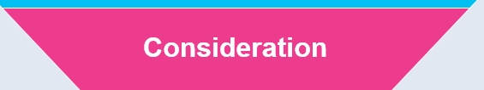
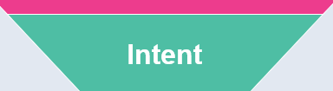
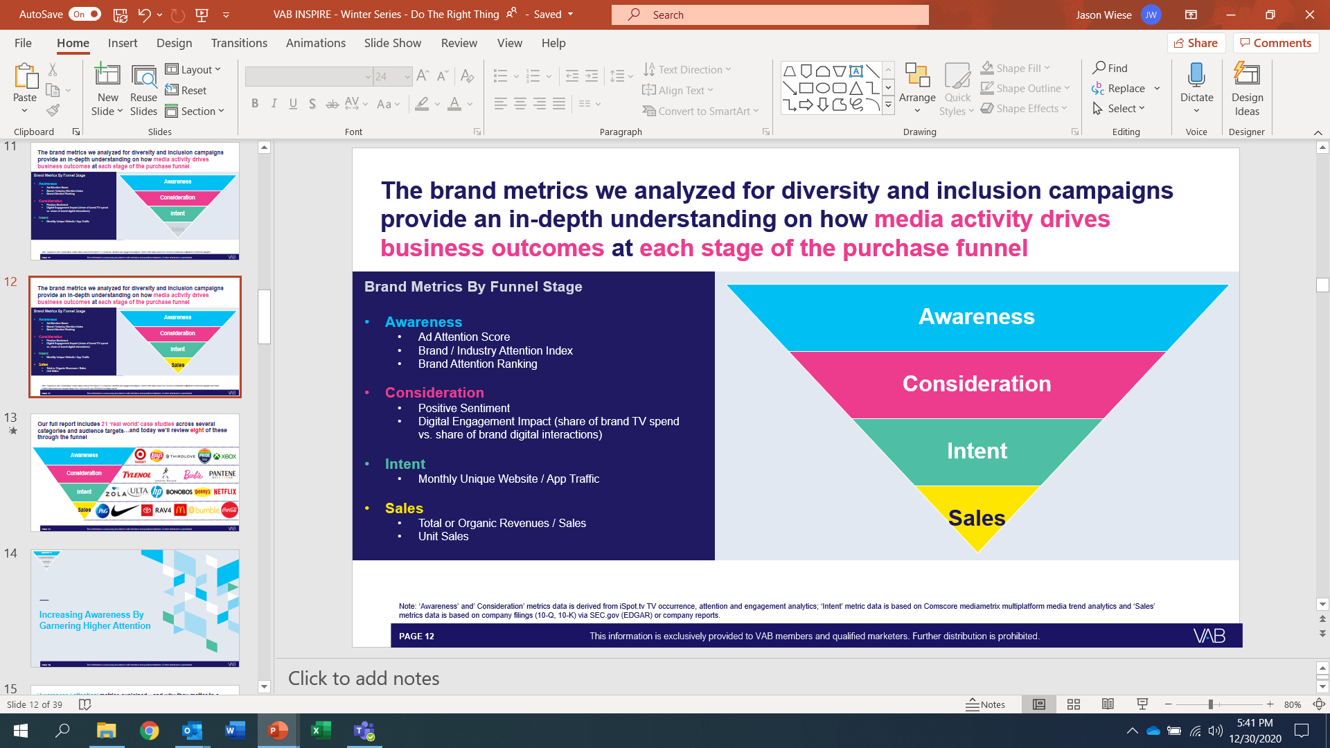
The brand metrics we analyzed for diversity and inclusion campaigns provide an in-depth understanding on how media activity and creative drives business outcomes at each stage of the purchase funnel
Brand Metrics By Funnel Stage
Awareness
  Ad Attention Score
  Brand / Industry Attention Index
  Brand Attention Ranking
Awareness
Consideration
Sales
Intent
Consideration
  Positive Sentiment
  Digital Engagement Impact (share of brand TV spend vs. share of brand digital interactions)
Intent
  Monthly Unique Website / App Traffic
Sales
  Total or Organic Revenues / Sales
  Unit Sales
Note: ‘Awareness’ and’ Consideration’ metrics data is derived from iSpot.tv TV occurrence, attention and engagement analytics; ‘Intent’ metric data is based on Comscore mediametrix multiplatform media trend analytics and ‘Sales’ metrics data is based on company filings (10-Q, 10-K) via SEC.gov (EDGAR) or company reports.
This information is exclusively provided to VAB members and qualified marketers. Further distribution is prohibited.
PAGE 8
PAGE 1

Slide 9





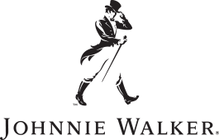








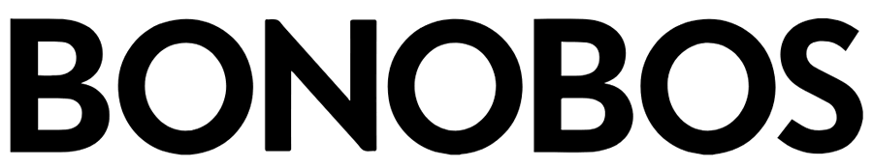




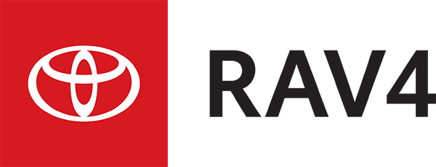

Our full report includes 21 ‘real world’ case studies across several categories and audience targets
…and today we’ll review six of these across the funnel
Awareness
Consideration
Sales
Intent
This information is exclusively provided to VAB members and qualified marketers. Further distribution is prohibited.
PAGE 9
PAGE 1

Slide 10

Awareness
Consideration
Sales
Intent
Increasing Awareness By Garnering Higher Attention
This information is exclusively provided to VAB members and qualified marketers. Further distribution is prohibited.
PAGE 10
PAGE 1

Slide 11
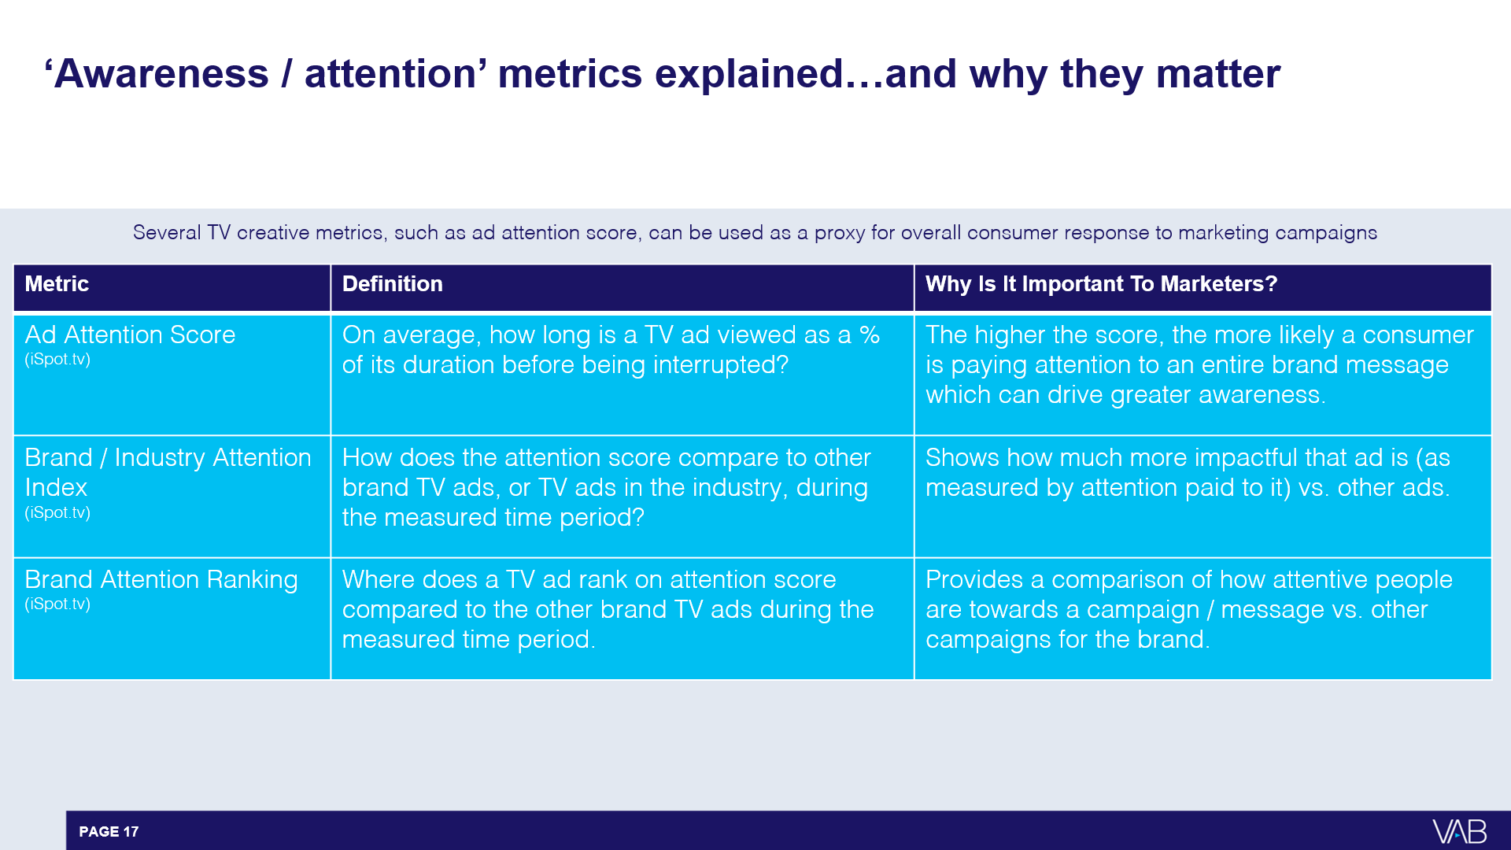
‘Awareness / attention’ metrics explained…and why they matter to a marketing campaign
Interruptions = changing the channel, skipping the ad (via DVR), turning off the TV device or pulling up the programming guide.
This information is exclusively provided to VAB members and qualified marketers. Further distribution is prohibited.
PAGE 11

Slide 12
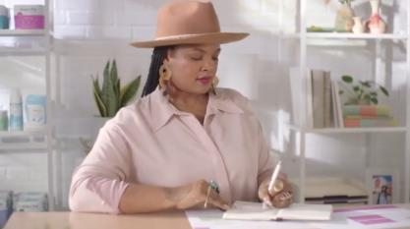
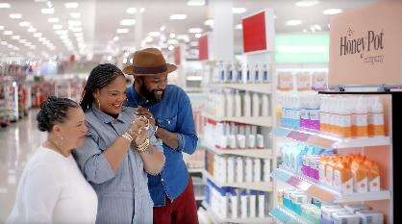
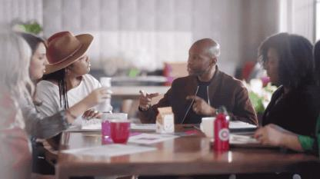
Target: Their ‘Entrepreneur’ campaign, featuring positive messaging and support of minority female-owned businesses, ranked #8 in attentiveness out of 296 ads
Awareness
Consideration
Sales
Intent
During Black History Month, as part of their ‘Founders We Believe In’ series, Target created a spot that featured Beatrice Dixon, owner of The Honey Pot, who talked about the difficulties of starting her own company while expressing gratitude to Target for helping her overcome obstacles and paving the way for her to get shelf space in other retailers.
Results: One of the highest attention scores of all Target ads, the heightened awareness enabled Honey Pot sales to increase 20-30% across its retailers a month after the campaign launched.
Business Outcomes
Ad Attention Score: 96.8
On average, the ad was viewed for 97% of its duration before interruption.
Brand Attention Index: 170
This ad garnered 70% fewer interruptions than the average Target ad during the measured time period.
Brand Attention Ranking: #8
Ad ranked #8 in viewer attention among 296 Target ads that aired between January 1st, 2016 – June 30th, 2020.
‘Entrepreneur: The Honey Pot’ TV spot - $15.3 MM
6-Week Flight: 2/1/20 – 3/16/20
4,473 Airings / 1,244.8 MM HH IMPs
Source: VAB analysis of iSpot.tv TV occurrence data and attention analytics, time period: 1/1/16 – 6/30/20, estimated media spend. Impressions represent US TV HHs and include activity within measured national broadcast and cable TV linear, national time-shifted, local, VOD and OTT. Attention scoring is based on national aired impressions viewed live/same day and played from the beginning. Interruptions = changing the channel, skipping the ad (via DVR), turning off the TV device or pulling up the programming guide.
This information is exclusively provided to VAB members and qualified marketers. Further distribution is prohibited.
PAGE 12

Slide 13

What to know from our ‘Awareness’ case studies
Inclusive campaigns break through the advertising clutter, which in turn drives stronger awareness and exposure for brands
Diversity & inclusion campaigns drive outsized attention relative to their investment and can generate awareness regardless of spend level or duration
Beyond multi-year campaigns, quantifiable impacts can be made with campaigns below $1MM and flights that are tied into specific events and societal moments
    See additional case studies in the full report including Sam Adams, Lay’s potato chips and ThirdLove
This information is exclusively provided to VAB members and qualified marketers. Further distribution is prohibited.
PAGE 13

Slide 14
Awareness
Consideration
Sales
Intent
Fostering Greater Brand Consideration Through Increased Digital Interactions
This information is exclusively provided to VAB members and qualified marketers. Further distribution is prohibited.
PAGE 14
PAGE 1

Slide 15
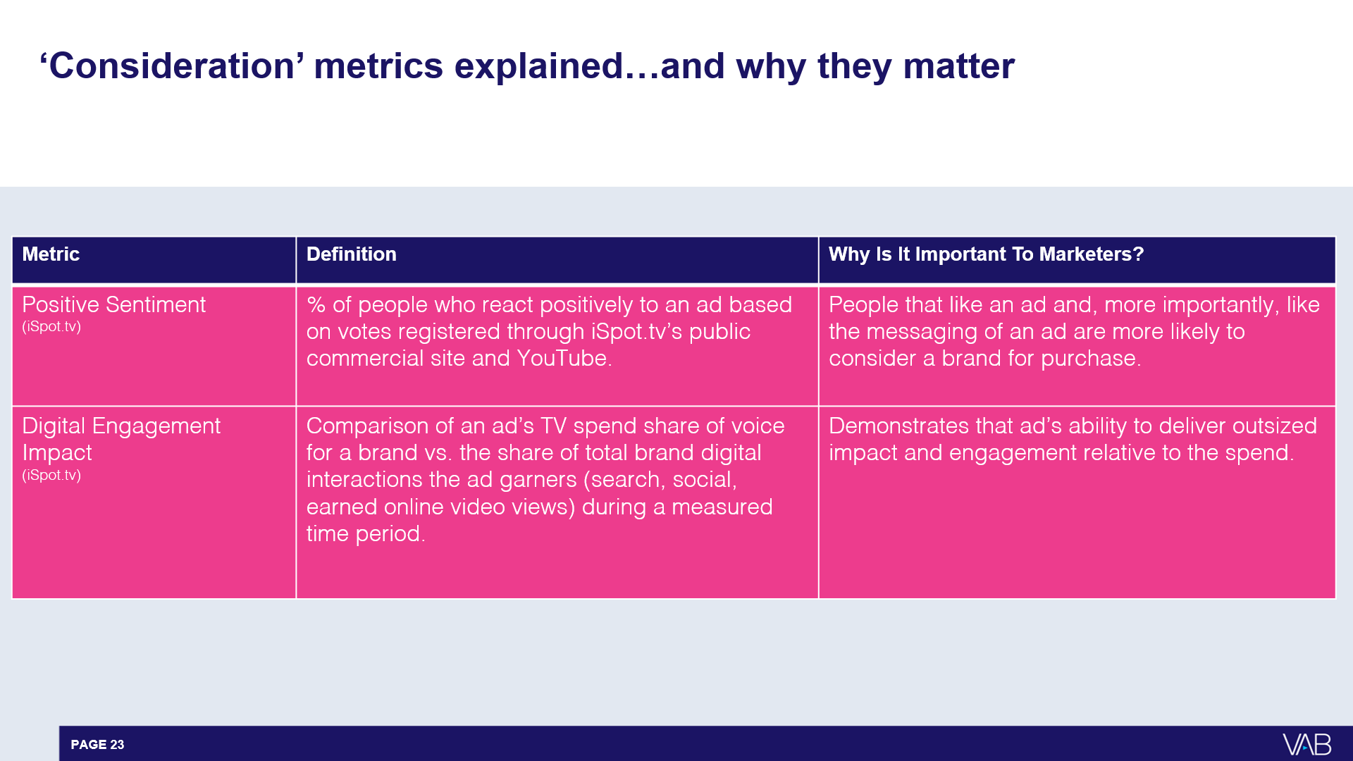
‘Consideration’ metrics explained…and why they matter to a marketing campaign
This information is exclusively provided to VAB members and qualified marketers. Further distribution is prohibited.
PAGE 15

Slide 16

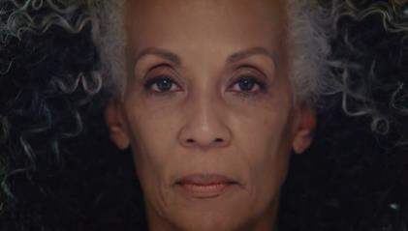
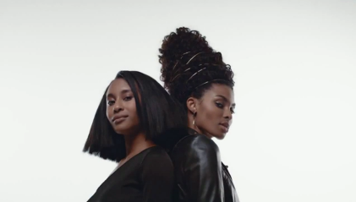
Pantene: Although smaller in spend to other campaigns,
their ad celebrating strong, black women was very positively received and drove over one-quarter of their digital interactions
Awareness
Consideration
Sales
Intent
In March 2017, Pantene released the ‘Celebrating Strong, Beautiful African American Hair’ ad as part of their ‘Strong is Beautiful’ campaign in order to celebrate the beauty and diversity of different hair textures and styles from Black women. The spot introduced their Gold Series, a collection of hair products formulated to address the specific needs of Black women.
Results: The campaign drove more digital interactions than any of the other 29 ads aired during the measurement period, including ones that had between 3x - 10x more TV investment support.
Business Outcomes
Positive Sentiment: 97%
Average positive sentiment for all other Pantene ads: 87%
Digital Engagement Impact:
Although only 3% of TV spend, it resulted in 26% of total earned online activity
‘Celebrating Strong, Beautiful African American Hair’ TV spot - $3.8 MM
Airings Throughout 21 Months: 3/22/17 – 12/30/18
1,240 Airings / 165.1 MM HH IMPs
Source: VAB analysis of iSpot.tv TV occurrence data and engagement analytics, time period: 1/1/17 – 6/30/20, estimated media spend. Impressions represent US TV HHs and include activity within measured national broadcast and cable TV linear, national time-shifted, local, VOD and OTT. ‘Digital Engagement Impact’ figures are based on all measured TV activity between 1/1/17 – 6/30/20. ‘Total Earned Online Activity’ = TV-driven searches, TV-driven social actions, TV-driven earned online video views.
This information is exclusively provided to VAB members and qualified marketers. Further distribution is prohibited.
PAGE 16

Slide 17
What to know from our ‘Consideration’ case studies
When marketers embrace topics that sharply resonate with consumers it yields significant dividends in terms of engagement like:
  Stirring social conversation
  Driving search queries
  Increasing online video views
Over time we’ve seen positive sentiment rates increase, indicating that beyond just being accepted, campaigns that celebrate inclusivity have come to be expected by consumers
  In 2015, Tylenol’s #HowWeFamily campaign featuring same sex and interracial couples had a 74% positive sentiment
This information is exclusively provided to VAB members and qualified marketers. Further distribution is prohibited.
PAGE 17

Slide 18
Awareness
Consideration
Sales
Intent
Driving More Consumer Intent Through Increased Website Engagement
This information is exclusively provided to VAB members and qualified marketers. Further distribution is prohibited.
PAGE 18
PAGE 1

Slide 19
‘Intent’ metric explained…and why it matters to a marketing campaign
Metric | Definition | Why Is It Important To Marketers?
Monthly Unique Website / App Visitors (Comscore) | The number of individuals visiting a brands’ website and / or app in a specific month or averaged over multiple months. This can also be expressed as a % increase when comparing two time periods. | Indicates how many consumers are ‘coming to the brand’s digital front door’ to learn more about a product or service and to make a purchase.
This information is exclusively provided to VAB members and qualified marketers. Further distribution is prohibited.
PAGE 19

Slide 20

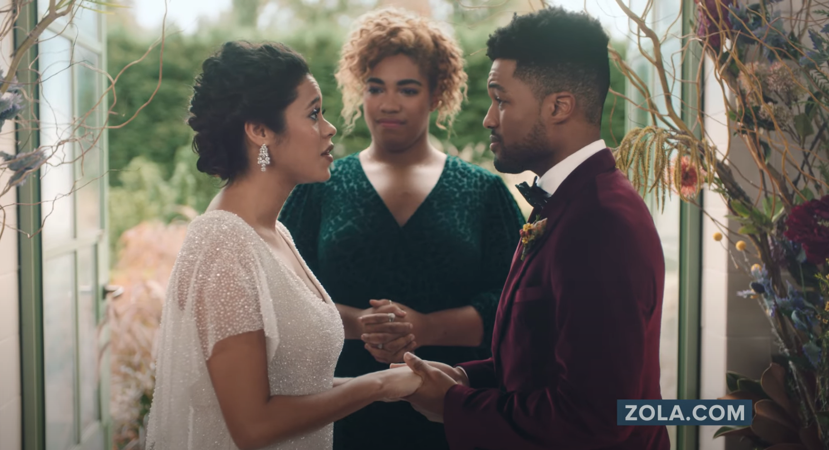
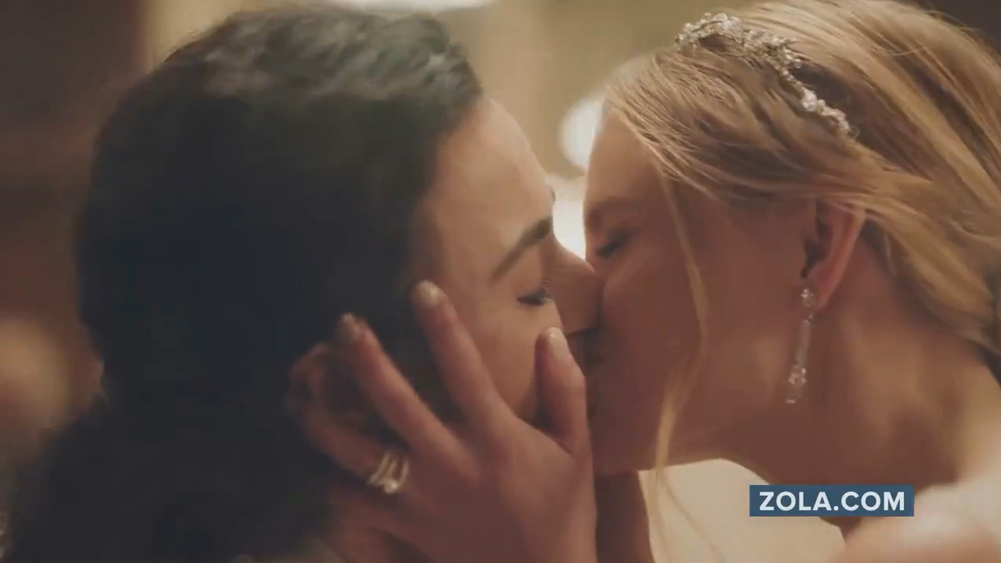
Zola: The launch of their diversity and LGBTQ+ inclusivity campaign led to the brand’s most trafficked month ever
on their website
Awareness
Consideration
Sales
Intent
In December 2019, Zola debuted their ‘No Regrets’ campaign which included six different spots focused specifically on diversity and LGBTQ+ inclusivity across three couples exchanging their vows.
Results: Zola saw their highest monthly unique website traffic ever in January 2020, two months into the campaign launch, with 345K more digital visitors than their second highest trafficked month (January 2019). Additionally, Zola was continuing their upward momentum through first quarter 2020 until COVID-19 hit…
Business Outcomes
Persons 18+ Website Traffic: +15% increase
in Zola’s two-month average P18+ unique visitors towards
the end of the campaign between Feb-Mar ‘20 (YoY comparison).
Black 18+ Website Traffic: +70% increase
during the same time period comparison
‘No Regrets’ TV spot (six creatives) - $2.7 MM
16-Week Campaign: 12/2/19 – 3/24/20
3,852 Airings / 698.1 MM HH IMPs
Source: VAB analysis of iSpot.tv TV occurrence data, time period: 1/1/19 – 6/30/20, estimated media spend. Impressions represent US TV HHs and include activity within measured national broadcast and cable TV linear, national time-shifted, local, VOD and OTT. VAB analysis of Comscore mediametrix multiplatform media trend data (desktop and mobile), P18+, Black 18+, January ‘19 – March ‘20. Comparisons reflect January ‘20 vs. January ‘19 and February-March ‘20 vs. February-March ‘19.
This information is exclusively provided to VAB members and qualified marketers. Further distribution is prohibited.
PAGE 20

Slide 21
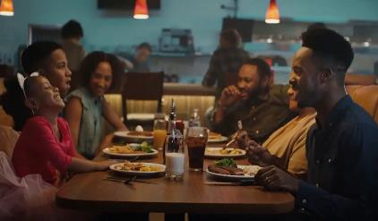
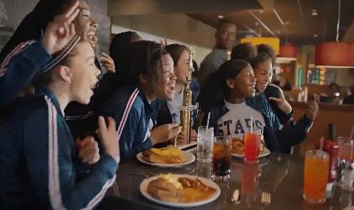
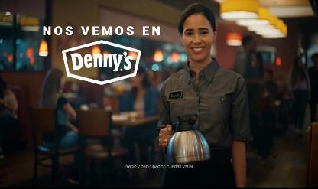
Denny’s: The ‘See You At Denny’s’ diversity and inclusivity campaign drove a triple-digit increase in website traffic among Black / African-American audiences
Awareness
Consideration
Sales
Intent
In late April 2019, Denny’s launched their ‘See You At Denny’s’ campaign with a message of inclusiveness in both English and Spanish language spots. The ads were inspired by the diversity of Denny’s guests and captures the inclusive gatherings of modern, multicultural families and friends.
Results: There was an immediate surge in Denny’s website visitation upon launch, especially by Black / African-Americans, and monthly visitors continued to increase through the duration of the campaign.
‘See You At Denny’s’ TV spot (three creatives) - $6.4 MM
4-Month Campaign: 4/29/19 – 8/25/19 (Spanish-Language ad was extended through 2/17/20)
3,381 Airings / 574.7 MM HH IMPs
Business Outcomes
Persons 18+ Website Traffic: +86% increase
in Denny’s unique website visitors during August ‘19
(final month of campaign) vs. March ‘19 (month prior
to the campaign launch).
Black 18+ Website Traffic: +135% increase
during the same time period comparison
Source: VAB analysis of iSpot.tv TV occurrence data, time period: 1/1/19 – 6/30/20, estimated media spend. Impressions represent US TV HHs and include activity within measured national broadcast and cable TV linear, national time-shifted, local, VOD and OTT. VAB analysis of Comscore mediametrix multiplatform media trend data (desktop and mobile), P18+, Black 18+, March ‘19 – May ‘20.
This information is exclusively provided to VAB members and qualified marketers. Further distribution is prohibited.
PAGE 21

Slide 22
What to know from our ‘Intent’ case studies
Regardless of your brand’s target consumer, category or business model, embracing diversity can inspire greater engagement, interaction and purchase intent by bringing more potential customers onto your digital platforms
Embracing an inclusivity mindset creates an important point of differentiation for a brand. And a meaningful, authentic brand message gives consumers a reason to prefer one brand over another
This information is exclusively provided to VAB members and qualified marketers. Further distribution is prohibited.
PAGE 22

Slide 23
Awareness
Consideration
Sales
Intent
Converting Consumer Action Into Sales
This information is exclusively provided to VAB members and qualified marketers. Further distribution is prohibited.
PAGE 23
PAGE 1

Slide 24
‘Sales’ metric explained…and why it matters to a marketing campaign
Metric | Definition | Why Is It Important To Marketers?
Revenues / Unit Sales (SEC filings / 10-Ks / company reports) | Our analysis to quantify sales is dependent on publicly available company data including units sold and total or organic sales. | The bottom of the funnel and the ultimate customer action taken.
This information is exclusively provided to VAB members and qualified marketers. Further distribution is prohibited.
PAGE 24

Slide 25
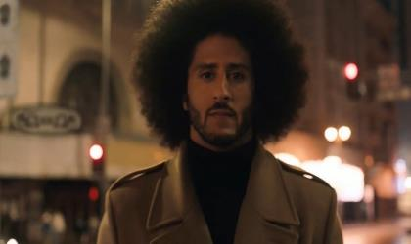
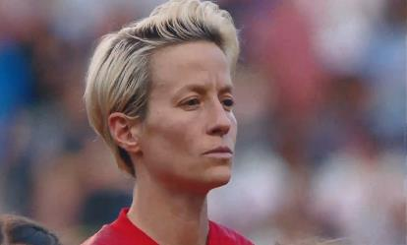
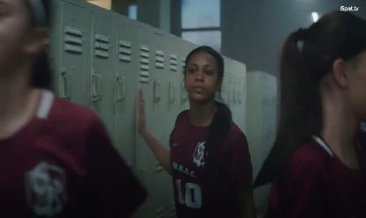
Nike: Record-breaking sales have been achieved in each quarter since the launch of their ‘Dream Crazy’ campaign featuring Colin Kaepernick
Awareness
Consideration
Sales
Intent
In September 2018, Nike released their first in a series of ‘Dream’ spots for their on-going ‘Just Do It’ campaign which featured NFL star turned social activist, Colin Kaepernick. The series celebrated the rich diversity found in sports through the collection of stories that represented athletes who are household names and younger, unknown athletes (including 29-year-old basketball wheelchair athlete Megan Blunk and Isaish Bird, a 10-year-old wrestler born without legs).
Results: Nike launched the Kaepernick ‘Dream Crazy’ ad at the beginning of their 3rd quarter and saw their highest 3Q revenues ever at that point. Record-breaking quarterly sales continued in each successive quarter through our evaluation period (ending Feb ‘20), with increases ranging between +4% - +9% vs. prior year.
Business Outcomes
North America Quarterly Revenue Comparison:
Sep-Nov ‘18 (‘Dream Crazy’ launch) vs. PY: +9%
Dec ‘18-Feb ‘19 vs. PY:+7%
Mar-May ‘19 (‘Dream Crazier’ active) vs. PY: +7%
Jun-Aug ‘19 (‘Dream Us’ active) vs. PY: +4%
Sep-Nov ‘19 vs. PY: +5%
‘Dream Crazy / Dream Crazier / Dream With Us’ TV spots (five creatives) - $21.7 MM
14-Month Campaign: 9/6/18 – 10/23/19
683 Airings / 371.1 MM HH IMPs
PY = Previous Year (same quarter)
Source: VAB analysis of iSpot.tv TV occurrence data, time period: 1/1/18 – 6/30/20, estimated media spend. Impressions represent US TV HHs and include activity within measured national broadcast and cable TV linear, national time-shifted, local, VOD and OTT. Revenues are based on quarterly company filings (10-Q) for North American revenue (Nike does not report at the United States geographical level) via SEC.gov (EDGAR), revenues reflect Nike brands and excludes Converse.
This information is exclusively provided to VAB members and qualified marketers. Further distribution is prohibited.
PAGE 25

Slide 26
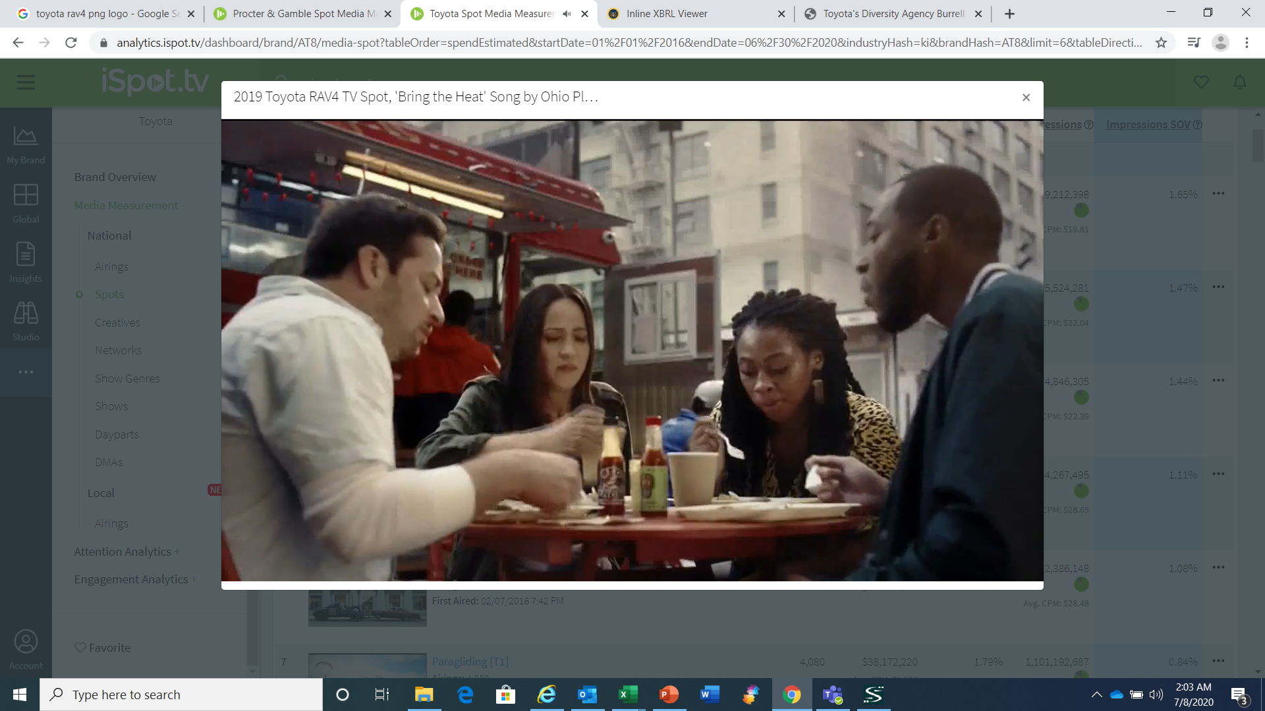
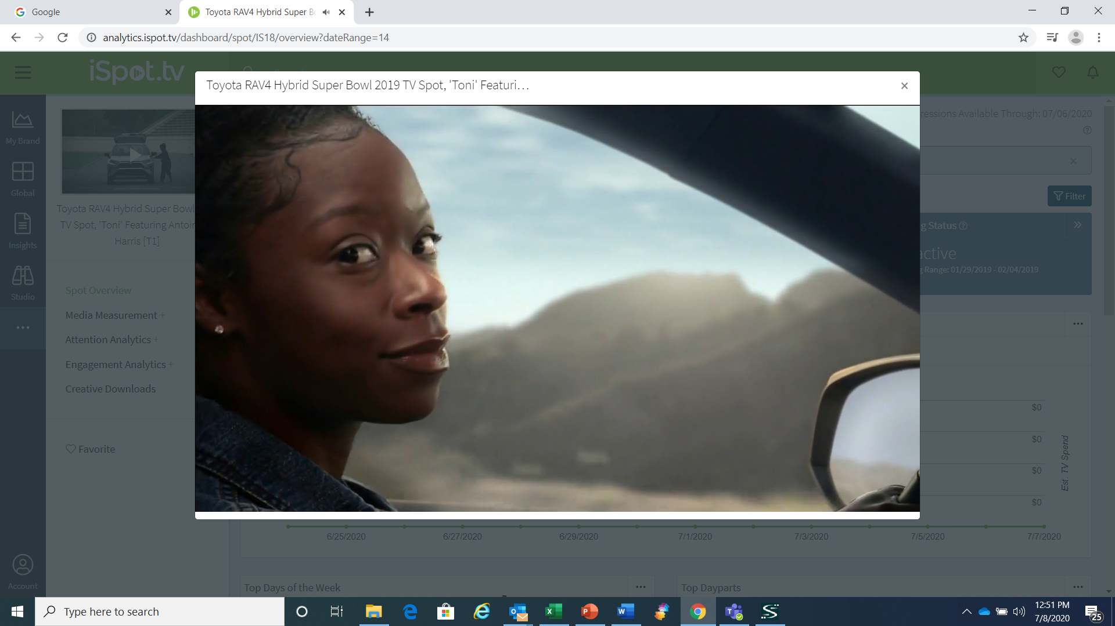
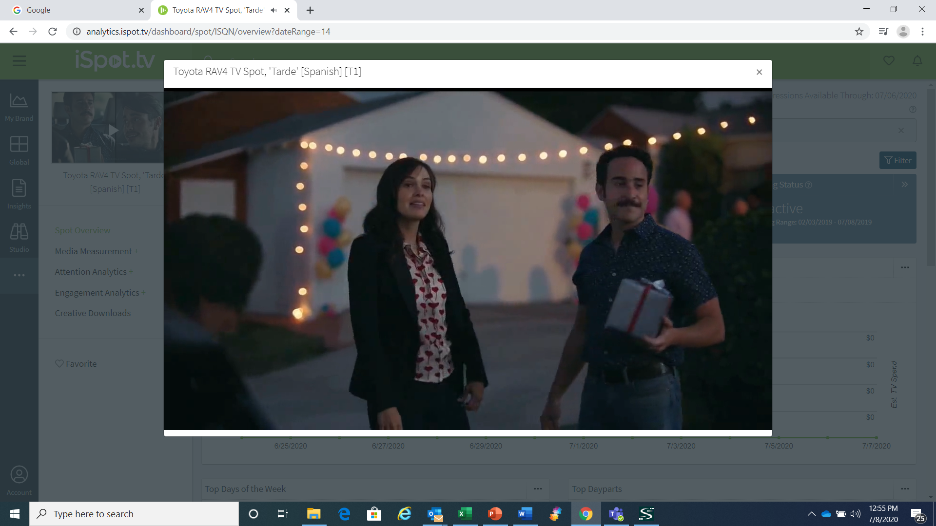
Awareness
Consideration
Sales
Intent
Toyota RAV4: The nameplate has become the best-selling SUV in America behind strong diversity and female empowerment campaigns
Not only is RAV4 the best-selling SUV but it’s also Toyota’s highest selling nameplate in America. During their rise, diversity and inclusion messaging has featured prominently in their advertising which includes a host of Spanish-language campaigns. The brand also produced a Super Bowl ad with an empowering message about shattering perceptions featuring Toni Harris, the first female athlete to receive a full college football scholarship in a skill position.
Results: 2019 was Toyota RAV4’s highest annual unit sales ever and it marked their eighth straight year of successive unit growth – the nameplate sold 130K+ units more than they did five years ago in 2015 (which reflects a +42% increase).
‘Bring The Heat’ TV spot - $42.0 MM
12-Month Campaign:
2/4/19 – 2/2/20
4,865 Airings / 1,874.8 MM HH IMPs
‘Toni’ TV spot - $21.6 MM
10-Month Campaign:
1/29/19 – 11/24/19
284 Airings / 330.5 MM HH IMPs
13 Spanish-Language TV spots - $22.6 MM
Various Flights: 1/12/16 – 3/29/20
7,018 Airings / 933.8 MM HH IMPs
Business Outcomes
Annual U.S. Unit Sales: +42% increase
in RAV4 vehicles sold annually in the U.S. over the last five years between 2015 and 2019 (315,142 vs. 448,071).
Source: VAB analysis of iSpot.tv TV occurrence data, time period: 1/1/16 – 6/30/20, estimated media spend. Impressions represent US TV HHs and include activity within measured national broadcast and cable TV linear, national time-shifted, local, VOD and OTT. Revenues are based on Toyota Motor North America’s U.S. Sales Annual Summaries available through their online news pressroom portal.
This information is exclusively provided to VAB members and qualified marketers. Further distribution is prohibited.
PAGE 26

Slide 27
What to know from our ‘Sales’ case studies
Doing the right thing by developing and investing in diverse, inclusive campaigns grows the bottom line
Marketers should create distinct in-language executions to more strongly relate to all consumers
In addition to their ad campaigns, marketers should consider what other ways they can go to market with a message of inclusivity (e.g. partnerships, packaging, product lines)
  Packaging examples from Coca Cola and Lay’s are included in the full report
This information is exclusively provided to VAB members and qualified marketers. Further distribution is prohibited.
PAGE 27

Slide 28



Key Takeaways For Marketers
A clear correlation between ‘doing the right thing’ through diversity & inclusion campaigns and business success
Embrace diversity & inclusion as a core part
of your brand’s DNA
Campaigns need to be ‘Real’ to be effective
Video is a strong platform for inclusivity messaging
Brands that are embracing inclusion and making it a core part of their messaging are seeing greater business outcomes as a result, including double and triple-digit increases in website traffic along with sustained sales growth during and after a campaign launch.
The campaigns that resonate the most are those that showcase authentic voices, embrace real people, promote empowerment, celebrate modern society, support the community, speak their language, create relevant products and take a stand
for social justice.
The sight, sound and emotion of video is a powerful platform to drive attention at scale and positive sentiment as well as second-screen engagement.
This information is exclusively provided to VAB members and qualified marketers. Further distribution is prohibited.
PAGE 28

Slide 29
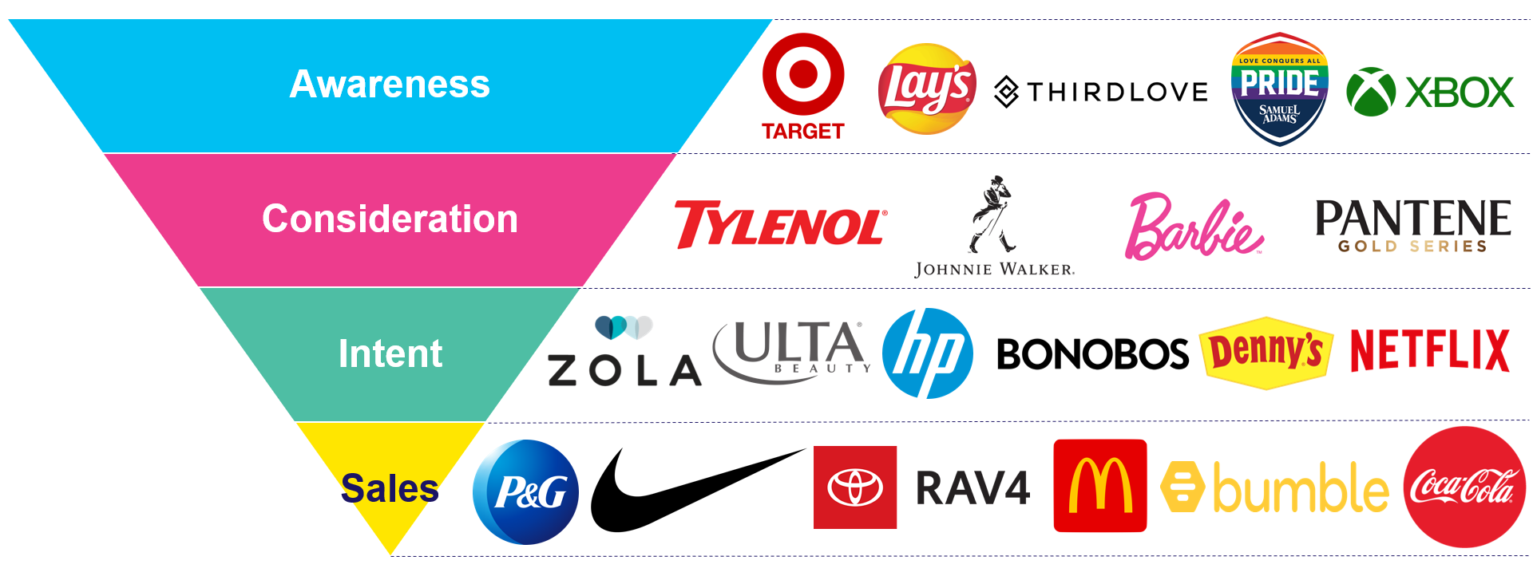

Download ‘Do The Right Thing’ at www.thevab.com to read all 21 ‘real world’ case studies across the purchase funnel
Do The Right Thing
How Diversity & Inclusion Drives Brand Outcomes
Brand marketers and agencies get free and immediate access to VAB’s content library. Get access at theVAB.com
This information is exclusively provided to VAB members and qualified marketers. Further distribution is prohibited.
PAGE 29

Slide 30
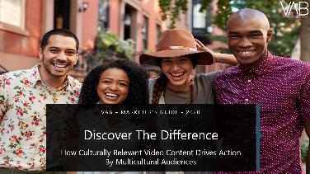
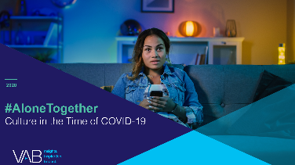
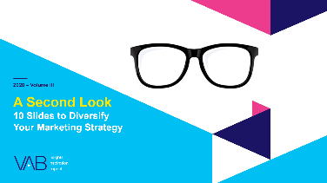
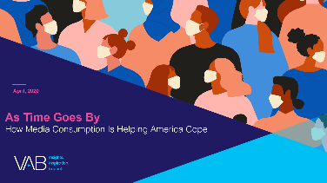

VAB’s Multicultural Marketing Resource Center
We are committed to providing marketers with the data and insights you need to develop thoughtful, inclusive campaigns & strategies.
The marketer guides, reports, videos and infographics featured within our center offer education on the unique media consumption behaviors and cultural trends of Black, Hispanic and Asian consumers and provide marketers with tangible, actionable insights.
www.thevab.com/insight/multicultural-marketing
This information is exclusively provided to VAB members and qualified marketers. Further distribution is prohibited.
PAGE 30

Slide 31

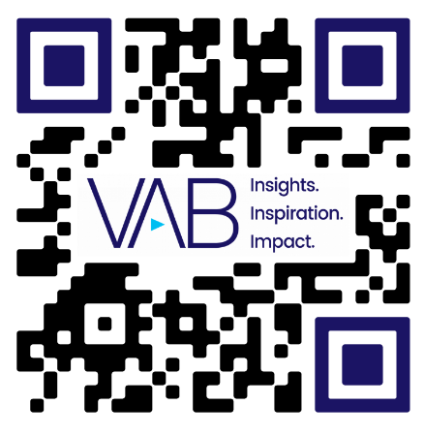
Thank You!
Get immediate access to the VAB Insights library
We’ve answered hundreds of marketers’ questions.
Our guides, reports, webinars and videos provide actionable insights to help marketers navigate today’s video landscape and think differently about their strategy.
We are committed to your business growth and proud to offer brand marketers and agencies complimentary access to our continuously-growing Insights library.
Get Access at theVAB.com or visit us here
This information is exclusively provided to VAB members and qualified marketers. Further distribution is prohibited.
PAGE 31

