Slide 1




Realize the Power of
Cross-Platform TV Advertising:
Exploring the Roles of Measurement, Outcomes
& Audience in the New Wave of TV
in partnership with

Slide 2



Today’s speakers
Danielle DeLauro
VAB
Executive Vice President
danielled@thevab.com
Jo Kinsella
TVSquared
President
jo.kinsella@tvsquared.com
This information is exclusively provided to VAB members and qualified marketers. Further distribution is prohibited.

Slide 3
What you’ll learn today…
x
1
How to define TV today and the market factors responsible for reinventing it
2
Cross-platform measurement and what to look for to make your data-driven TV strategy successful
3
Examples of how TV-first and digital-first advertisers leaned into the new world of advanced TV
This information is exclusively provided to VAB members and qualified marketers. Further distribution is prohibited.
PAGE 3

Slide 4






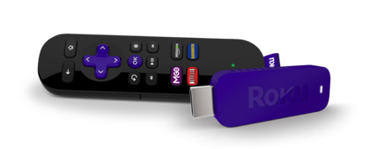
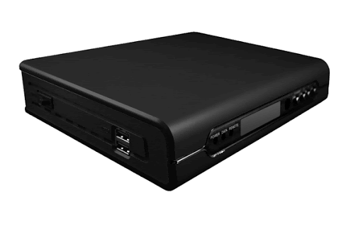



TV has been redefined
cross-channel
cross-platform
cross-screen
Watches Live Cable
Views Live Content Via Apps
If you don’t think about TV differently,
you will miss a large portion
of your audience
Streams on Roku
Watches Video on Demand
Accesses Hulu on Smart TV
Watches “The Bachelor” in-app

Slide 5




Market Factors
TV viewing has changed
Need to track customer journey and audiences through the purchase funnel to conversion

Slide 6



Consumers have experimented with new platforms and discovered the
full functionality of their devices
% of respondents who agree with the statement
P18+
66%
54%
36%
“I am more open to trying new types of media”
(e.g. new streaming services, podcasts, social media platforms, etc)
“I have learned how to use more features on my smart TV or a TV related device/platform”
“I have added a new streaming service”
(i.e., Apple TV+, Disney+, Netflix, etc.)
Source: VAB’s 'As Time Goes By: How Media Consumption Is Helping America Cope’. VAB / Lucid ‘Media Usage In The Time of COVID-19 Survey,’ April 2020. Survey base: P18+ & household subscribes to cable, telco, internet TV or satellite TV (n=1,004). Q9: Thinking of your behavior during the COVID-19 Pandemic, please indicate below how much you agree or disagree with the following statements. Q10: Since the COVID-19 Pandemic, have you done any of the following? Note: Percentages don’t add to 100% because it excludes “none of the above” response.
This information is exclusively provided to VAB members and qualified marketers. Further distribution is prohibited.
PAGE 6

Slide 7


Market Factors
Industry demands modern currencies
Proof of performance is a priority across all platforms, channels and devices

Slide 8
With a surge of ad spend during the pandemic, CTV shows no sign of slowing down as marketers race to catch up to consumer viewing
U.S. Connected TV Ad Spending Projections
(in billions)
+12%
+16%
+24%
+40%
+27%
Source: eMarketer, October 2020. Note: digital advertising that appears on connected TV devices; includes display ads that appear on home screens and in-stream video ads that appear on CTVs from platforms like Hulu, Roku and YouTube; excludes network-sold inventory from traditional linear TV and addressable TV advertising.
This information is exclusively provided to VAB members and qualified marketers. Further distribution is prohibited.
PAGE 8

Slide 9

Market Factors
Buy-side and sell-side have same needs
Precise digital metrics available in near-real time and tied directly to outcomes and audiences

Slide 10


To capture nimble, multiplatform viewers, both buyers and sellers recognize the need to prioritize precision targeting and measurement
“My expectations are that we will accelerate the migration toward audience-based, holistic video commitments. The media partners that lean into data needed for planning, optimizations and measurement will reap the benefits.”
% of Buyers Who Plan To Increase…
Matt Sweeney, CIO, GroupM
(Adweek, 12/28/20)
“The most important thing we need to do is embrace a currency that accounts for the total audience. Purchasing behavior is so different than when these legacy demos were created, it is no longer tenable to maintain A18-49 and A25-54,”
Peter Olsen, EVP, Ad Sales, A+E Networks
(Adweek, 12/28/20)
Source: IAB, Coronavirus Ad Spend Impact: Buy Side, 3/27/20. Q: Please indicate whether you plan to increase, decrease or make no change regarding usage of any of the following tactics. Base: Yes to advertising tactical changes, n=164.
This information is exclusively provided to VAB members and qualified marketers. Further distribution is prohibited.
PAGE 10

Slide 11


Market Factors
Impressions are the new reality
The TV industry needs precise analytics to support 1:1 deterministic measurement and attribution

Slide 12










Brands who measure success through data-driven business outcomes, rather than demos, have experienced tremendous growth
Average monthly unique adult 50+ visitors increase by digital platform
6-month average YoY comparison: Apr-Sep ‘19 vs. Apr-Sep ‘20
+35%
(+307K avg monthly UVs)
+26%
(+253K avg monthly UVs)
+89%
(+919K avg monthly UVs)
+18%
(+1.2MM avg monthly UVs)
+30%
(+1.7MM avg monthly UVs)
+28%
(+198K avg monthly UVs)
+9%
(+118K avg monthly UVs)
+35%
(+235K avg monthly UVs)
+30%
(+5.7MM avg monthly UVs)
+20%
(+6.7MM avg monthly UVs)
Source: VAB analysis of Comscore MediaMetrix Media Trend multiplatform (desktop + mobile) data, April 2019 – September 2019 vs. April 2020 – September 2020, P50+, total digital population, total monthly unique visitors/viewers. Percentages = average monthly unique visitors increase between the two 6-month time periods.
This information is exclusively provided to VAB members and qualified marketers. Further distribution is prohibited.
PAGE 12

Slide 13
What you’ll learn today…
x
1
How to define TV today and the market factors responsible for reinventing it
2
Cross-platform measurement and what to look for to make your data-driven TV strategy successful
3
Examples of how TV-first and digital-first advertisers leaned into the new world of advanced TV
This information is exclusively provided to VAB members and qualified marketers. Further distribution is prohibited.
PAGE 13

Slide 14





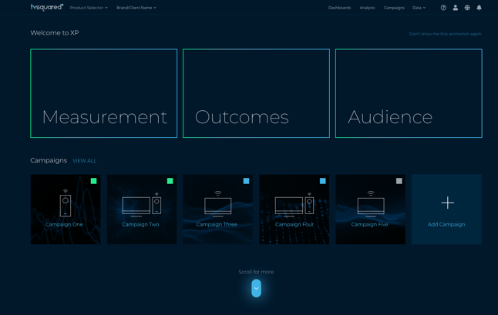



Introducing
Infinite
Scale
census-level data and large scale publisher footprint with 50+ OTT partners
Measurement uniformity
across channels, platform, device and identity partners
Unified
platform
for impression-based TV advertising including linear, addressable and OTT/CTV campaigns
From DTC to
CPG, QSR
full-funnel brand and performance metrics including reach and frequency, reach extension to audience and online and offline outcomes
Always-on
measurement and outcomes
analytics that inform activation for inventory and audience

Slide 15
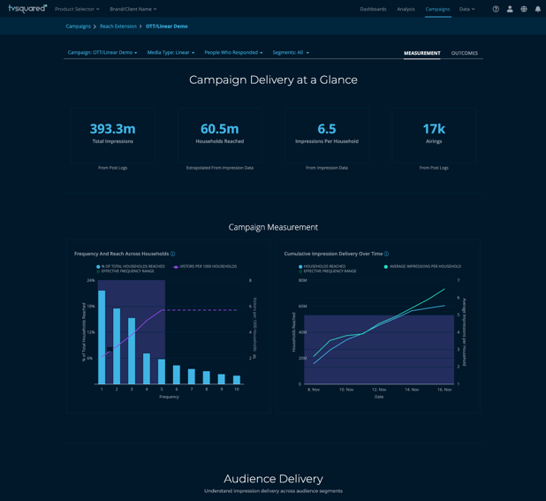
Cross-Platform TV Measurement
From ratings and spots to impressions
Point of diminishing return
Understanding the overexposed
Optimal frequency to achieve KPIs
Capping frequency by publisher

Slide 16
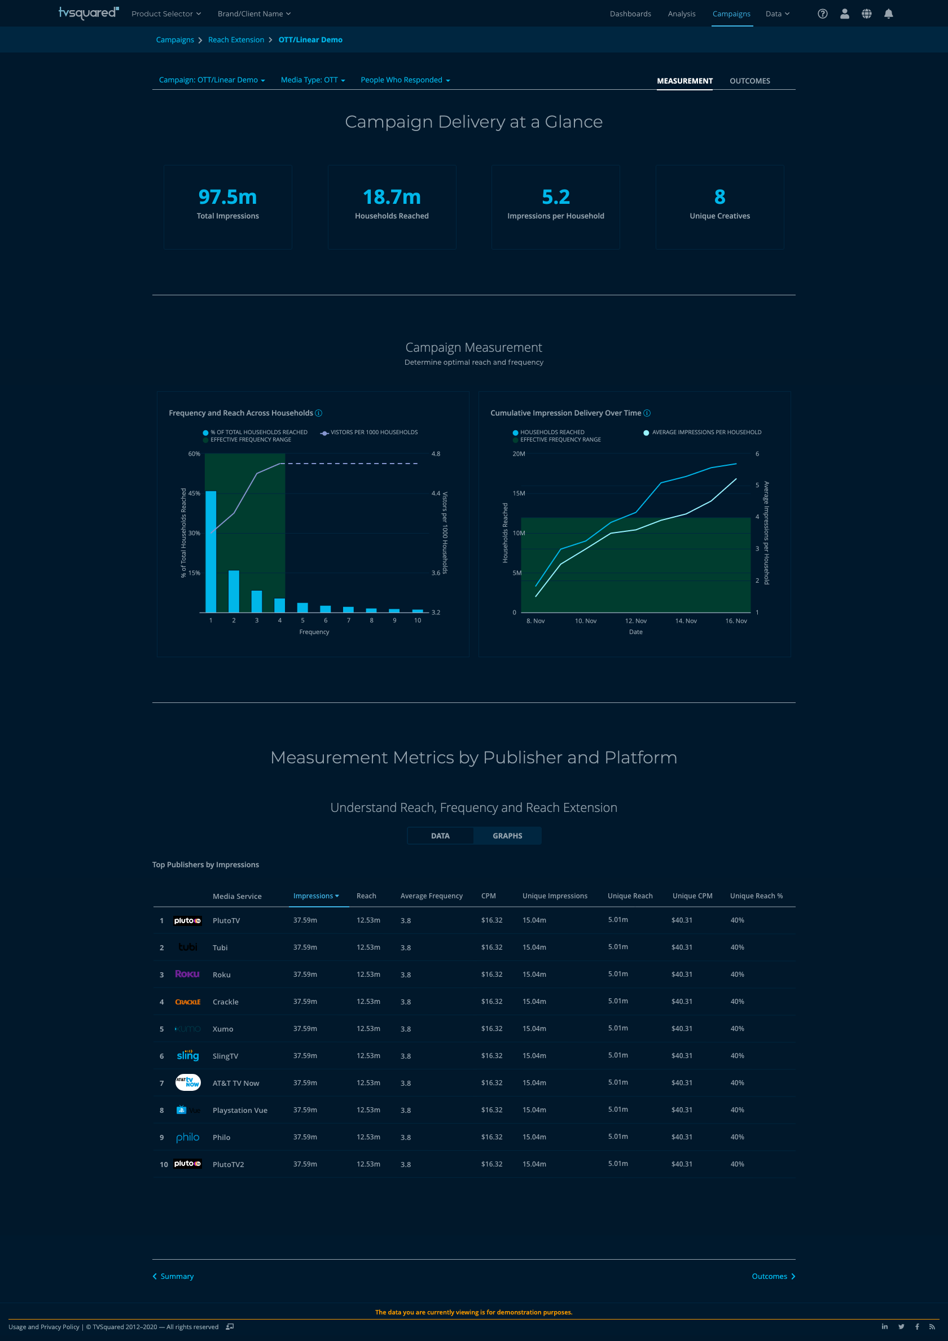
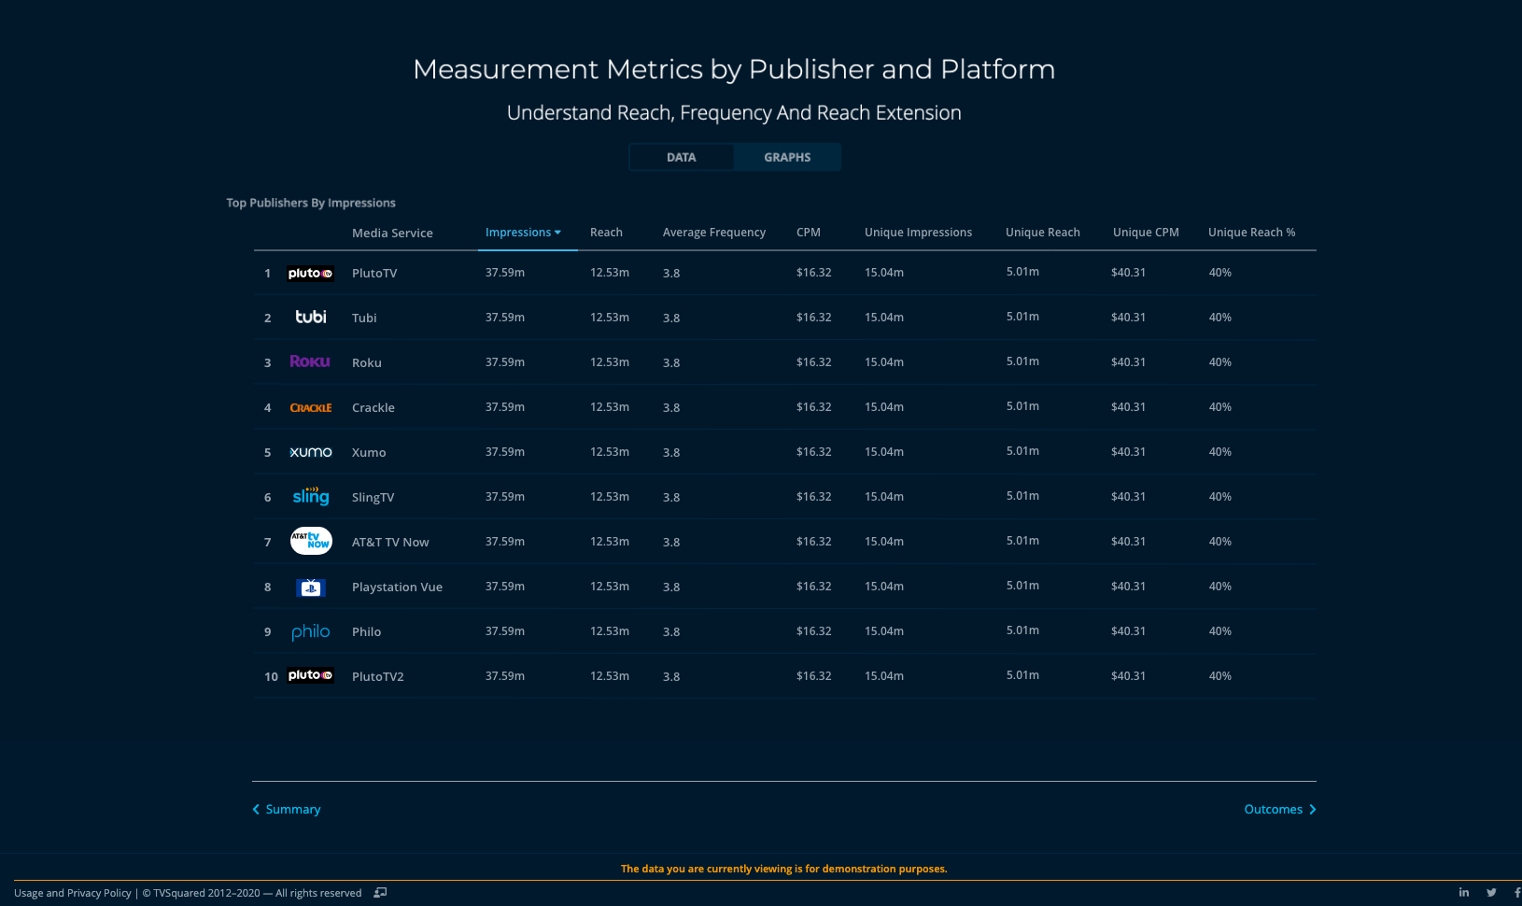
Cross-Platform TV Measurement
From audience fragmentation to
quantified reach extension
Identify audience overlap
Reduce duplication and wasted impressions
Reallocate media to reach new audiences
Double-down on finding high value audiences

Slide 17
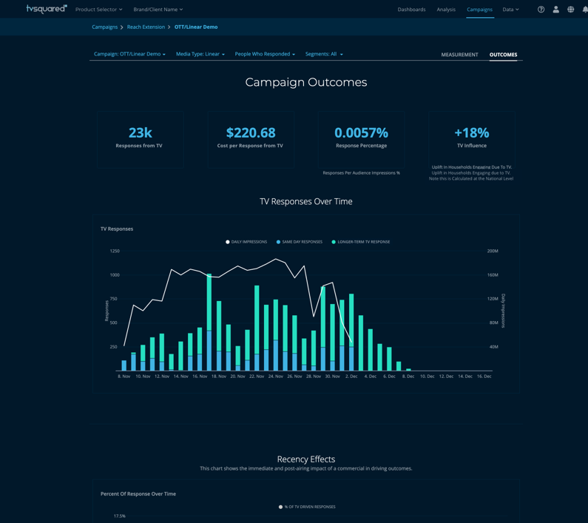
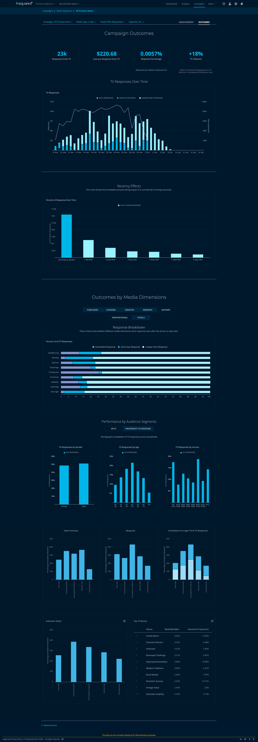
Cross-Platform TV Measurement
From basic insights to precise outcomes
and audience analytics
Tracking TV’s impact in the immediate
and longer-term
Go beyond traditional buying to identify audiences most likely to convert
Activate new audience segments

Slide 18
What you’ll learn today…
x
1
How to define TV today and the market factors responsible for reinventing it
2
Cross-platform measurement and what to look for to make your data-driven TV strategy successful
3
Examples of how TV-first and digital-first advertisers leaned into the new world of advanced TV
This information is exclusively provided to VAB members and qualified marketers. Further distribution is prohibited.
PAGE 18

Slide 19

Case Study
The Power of Programmatic TV
Entertainment advertiser launched new subscription service
Leveraged CTV to run targeted TV campaign testing look-alikes
Tapped real-time measurement for transparency and optimization
Increased audience targets
Improved response rate
Reduced share of impressions across initial targets
Optimized
across
look-alike
segments
50% increase
30% shift
Increased look-alike segments
Re-allocated media by target
10 to 20

Slide 20

Case Study
Extending Reach with OTT
DTC electronics advertiser tests OTT for reach extension
Traditional TV advertiser tested OTT in 2020, relaunched in 2H
Started small and increased over 6-month period
Optimized by impression delivery across publishers, increasing household reach
Determined optimal frequency to reduce wasted impressions
Leveraged measurement insights for reach, frequency and audience
Added new publishers over
6-month period
Significant increases in OTT spend
Increased household reach
1 to 9
150%
35%

Slide 21


Case Study
Where Impressions Meet Outcomes for Linear TV
DTC insurance advertiser transitions to data-driven linear
Traditional TV advertiser adopts impression-based linear advertising
Leverages precise analytics for optimization and future TV buys including households reached, avg. frequency, outcomes by media dimensions
More isn’t always better – measure, optimize, reallocate
Precise analytics led to optimization opportunities across dayparts and networks:
Reallocated share of response with share of impressions delivered on specific day parts
Scaled back the number of networks and reallocated impressions to top performing networks by outcomes
Linear campaign reached large # of households
70M+
HH
Reduced cost per response
Optimal frequency to drive KPIS
42%
4

Slide 22
Be prepared to embrace
TV’s watershed moment
More content
Increased viewership
New currencies
Precise measurement
Advanced attribution
Enhanced advertising

Slide 23


Thank You!
Get immediate access to the VAB Insights library
We’ve answered hundreds of marketers’ questions.
Our guides, reports, webinars and videos provide actionable insights to help marketers navigate today’s video landscape and think differently about their strategy.
We are committed to your business growth and proud to offer brand marketers and agencies complimentary access to our continuously-growing Insights library.
Get Access at theVAB.com or visit us here
This information is exclusively provided to VAB members and qualified marketers. Further distribution is prohibited.
PAGE 23

