Slide 1

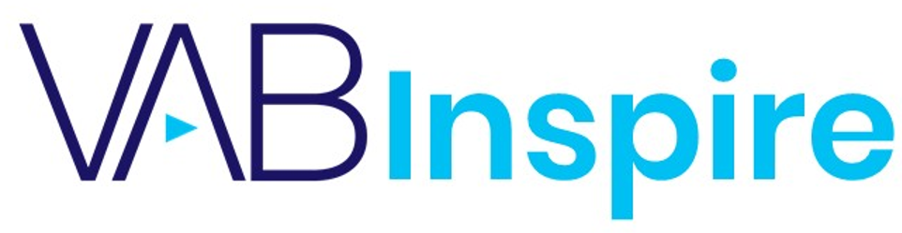

Sea Change:
Custom Research on the Latest Video Streaming Behaviors
and Trends

Slide 2



Today’s speakers
Leah Montner-Dixon
VAB
Insights Manager
leahm@thevab.com
Jason Wiese
VAB
SVP, Director of Strategic Insights
jasonw@thevab.com
This information is exclusively provided to VAB members and qualified marketers. Further distribution is prohibited.

Slide 3
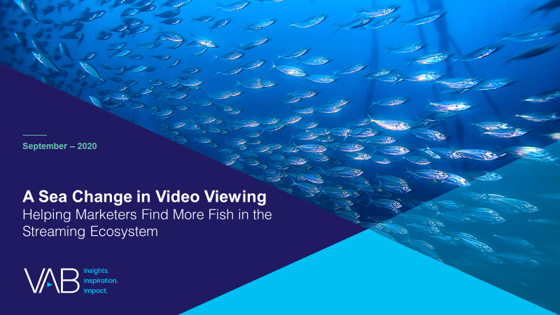
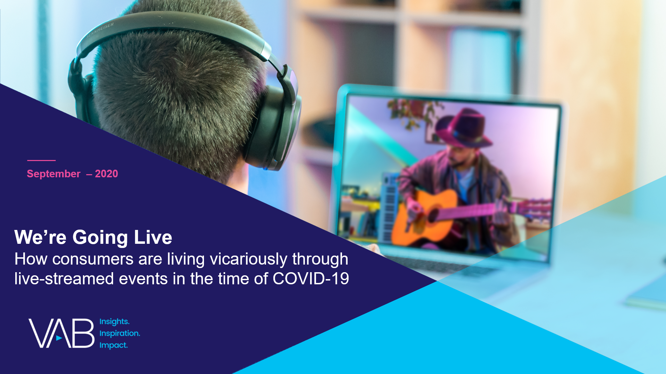
Today, we’ll distill the key insights and essential takeaways from our recent reports on video streaming
In summer 2020, we conducted a custom online survey through Lucid to capture and understand the evolving media consumption habits and behaviors of adults following the first few months of the COVID-19 pandemic.
The results are based on 1,000 U.S. adults 18+ in households with access to streaming services and have viewed content on streaming services.
A Sea Change in Video Viewing
Helping Marketers Find More Fish in the Streaming Ecosystem
We’re Going Live
How Consumers are Living Vicariously Through Live-Streamed Events in the Time of COVID-19
Brand marketers and agencies get free and immediate access to VAB’s content library. Get access at theVAB.com
This information is exclusively provided to VAB members and qualified marketers. Further distribution is prohibited.
PAGE 3

Slide 4
What you’ll learn today…
1
How video streaming is experiencing a sea change, with audiences of all ages and backgrounds increasingly streaming every day, if not multiple times a day.
2
Why ad-supported streaming services are attracting content-hungry audiences with their vast supply of library content.
3
What the future of video streaming may hold as consumers begin to reach their limit on paid streaming services.
This information is exclusively provided to VAB members and qualified marketers. Further distribution is prohibited.
PAGE 4

Slide 5



With more time in their day during the pandemic, people of all ages utilized new platforms and discovered the full functionality of their existing and new video devices
% of respondents who agree with the statement
P18+
84%
66%
54%
“I have more time to watch/listen/read media”
“I am more open to trying new types of media”
(e.g. new streaming services, podcasts, social media platforms, etc)
“I have learned how to use more features on my smart TV or a TV related device/platform”
Source: VAB / Lucid ‘Media Usage In The Time of COVID-19 Survey,’ April 2020. Survey base: P18+ & household subscribes to cable, telco, internet TV or satellite TV (n=1,004). Q9: Thinking of your behavior during the COVID-19 Pandemic, please indicate below how much you agree or disagree with the following statements
This information is exclusively provided to VAB members and qualified marketers. Further distribution is prohibited.
PAGE 5

Slide 6



Streaming across both paid and free services quickly saw a boost among viewers of all ages, and livestreamed events became a popular substitute for in-person ones
Since the COVID-19 Pandemic, have you done any of the following?
P18+
37%
36%
31%
Watched a free streaming service
Added a new streaming subscription
Livestreamed concerts / events
(e.g. Roku, Pluto or Tubi)
(i.e., Apple TV+, Disney+, Netflix, etc.)
Source: VAB / Lucid ‘Media Usage In The Time of COVID-19 Survey,’ April 2020. Survey base: P18+ & household subscribes to cable, telco, internet TV or satellite TV (n=1,004). Q10: Since the COVID-19 Pandemic, have you done any of the following? Note: Percentages don’t add to 100% because it excludes “none of the above” response. VAB / Lucid ‘COVID-19 Streaming Behavior Survey,’ June 2020. Survey base: P18+ in households with access to streaming services and have viewed content on streaming services within the past seven days (n=1,000). Q14.When thinking about livestreaming, by which we mean: streaming a program online live as it happens (e.g., Concert - One World: Together at Home, Sporting Event - Virtual NFL Draft) - which of the following statements do you feel apply to you?
This information is exclusively provided to VAB members and qualified marketers. Further distribution is prohibited.
PAGE 6

Slide 7

Searching for additional TV content while sheltered in place, viewers became more comfortable streaming video
“I have become more comfortable streaming video”
% of respondents who agree completely
A18-34
71%
A35-54
77%
HHI$100K+
80%
Employed Full-time
76%
Hispanic A18+
72%
Households w/ Children
78%
Source: VAB / Lucid ‘COVID-19 Streaming Behavior Survey,’ June 2020. Survey base: A18+ in households with access to streaming services and have viewed content on streaming services (n=1,000). Q9.Thinking of your behavior over the past 30 days, which of the following statements do you feel apply to you?
This information is exclusively provided to VAB members and qualified marketers. Further distribution is prohibited.
PAGE 7

Slide 8

And as comfort levels rose, time spent streaming increased
With many individuals and households experiencing significant lifestyle changes such as more time at home or adult children moving back in with parents, older audiences have started streaming more
“I am spending more time streaming video”
% of respondents who agree
A18+
A55+
59%
42%
Source: VAB / Lucid ‘COVID-19 Streaming Behavior Survey,’ June 2020. Survey base: A18+ in households with access to streaming services and have viewed content on streaming services (n=1,000). Q4. Overall, please choose the statement below that best describes your video streaming viewing (e.g., Netflix, Disney+, Pluto TV, TV network or cable provider app, etc.) during the past 30 days.
This information is exclusively provided to VAB members and qualified marketers. Further distribution is prohibited.
PAGE 8
PAGE 1

Slide 9

With more time on hand, viewers tend to watch more services –
more than one-third of AVOD users have access to 4 or more services
Young adults, affluent households, and families are most likely to subscribe to more services
How many streaming services does your household currently have access to?
Source: VAB / Lucid ‘COVID-19 Streaming Behavior Survey,’ June 2020. Survey base: A18+ in households with access to streaming services and have viewed content on streaming services (n=1,000). Q2. How many streaming services does your household currently have access to? AVOD Users = respondents who regularly watch free subscription streaming services with commercials (e.g., Crackle, Pluto TV, Tubi TV) (n= 298).
This information is exclusively provided to VAB members and qualified marketers. Further distribution is prohibited.
PAGE 9
PAGE 1

Slide 10

Time, comfort, technology adoption and more choices have all combined to establish video streaming as a habitual, daily activity for many viewers
20% of respondents stream multiple times a day and these ‘super streamers’ are driven by young adults and families... separately, even 40% of adults 45-54 are streaming daily now.
On average, how many times per week do you watch a video streaming service?
Source: VAB / Lucid ‘COVID-19 Streaming Behavior Survey,’ June 2020. Survey base: A18+ in households with access to streaming services and have viewed content on streaming services (n=1,000). S3. On average, how many times per week do you watch a video streaming service? (e.g., Netflix, Disney +, Tubi, Hulu, CBS All Access, etc.)
This information is exclusively provided to VAB members and qualified marketers. Further distribution is prohibited.
PAGE 10
PAGE 1

Slide 11
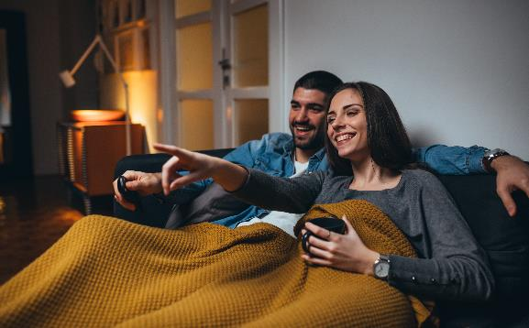

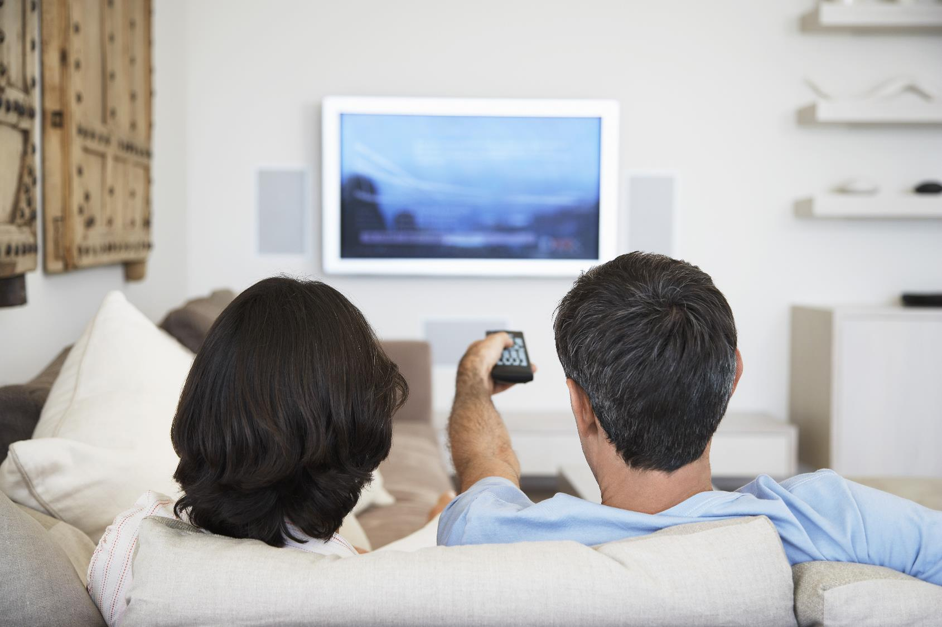
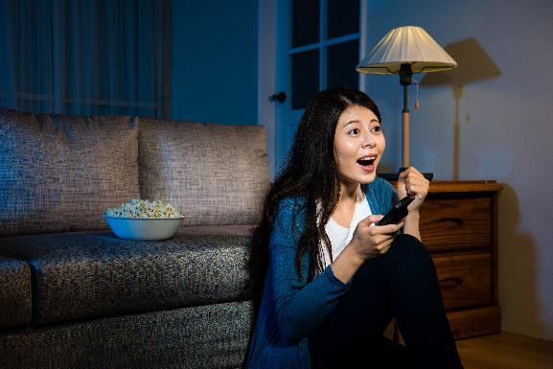
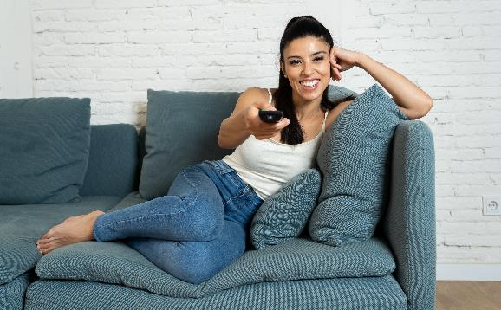

Currently, streamers are comfortable with the value they receive from their streaming services
Audiences across the board find that the array of services available to them are worth it because they love the content, whether they’re paying for a subscription or watching ads, especially among women (62%)
“Streaming services are a good value for your money”
% of respondents who agree completely
AVOD Users:
59%
A45-54:
59%
SVOD Users:
58%
A18-24:
57%
Hispanic:
53%
Households with Children:
62%
Source: VAB / Lucid ‘COVID-19 Streaming Behavior Survey,’ June 2020. Survey base: A18+ in households with access to streaming services and have viewed content on streaming services (n=1,000). Q3. When thinking about streaming video services, how much do you agree or disagree with the following statements? AVOD Users = respondents who regularly watch free subscription streaming services with commercials (e.g., Crackle, Pluto TV, Tubi TV) (n= 298). SVOD Users = respondents who regularly watch paid subscription streaming services with no commercials (e.g., Netflix, Disney+) (n= 817).
This information is exclusively provided to VAB members and qualified marketers. Further distribution is prohibited.
PAGE 11

Slide 12


However, there are limits to how much consumers are willing to pay even though there are no limits to the amount of content they want access to
59% of American streamers will not pay more than $20 a month for streaming subscriptions, and while that might limit paid options, free streaming services are the answer to those looking for more content without the added expense
% of respondents who agree with the statement
“My attitude is, the more content, the better!”*
“I would rather watch ads than pay more for an ad-free experience”
A18+
AVOD Users
A18+
AVOD Users
38%
43%
42%
59%
Source: Needham & Company, Streaming Wars: Winners & Losers, 8/14/20. The Trade Desk, January 2020. VAB / Lucid ‘COVID-19 Streaming Behavior Survey,’ June 2020. Survey base: A18+ in households with access to streaming services and have viewed content on streaming services (n=1,000). Q8. How much do you agree or disagree with the following statements? *Reflects respondents who answered ‘agree completely’. Q10. Which of the following statements describe your views on free streaming services? (e.g., Tubi, Pluto, Crackle , etc.) AVOD Users = respondents who regularly watch free subscription streaming services with commercials (e.g., Crackle, Pluto TV, Tubi TV) (n= 298).
This information is exclusively provided to VAB members and qualified marketers. Further distribution is prohibited.
PAGE 12
PAGE 1

Slide 13

What to remember
Streaming of all kinds – paid subscription, free ad-supported and live - saw a boost at the onset of the pandemic as people utilized new platforms and discovered the full functionality of their video devices
Audiences across the board are now streaming every day or even multiple times a day, especially among early adopters (young adults & families), expanding the opportunity for marketers to reach these coveted groups
Content-hungry viewers subscribe to multiple services, showcasing room for growth for ad supported services, especially as we hit the limit consumers are willing to spend in this category
This information is exclusively provided to VAB members and qualified marketers. Further distribution is prohibited.
PAGE 13

Slide 14
What you’ll learn today…
1
How video streaming is experiencing a sea change, with audiences of all ages and backgrounds increasingly streaming every day, if not multiple times a day.
2
Why ad-supported streaming services are attracting content-hungry audiences with their vast supply of library content.
3
What the future of video streaming may hold as consumers begin to reach their limit on paid streaming services.
This information is exclusively provided to VAB members and qualified marketers. Further distribution is prohibited.
PAGE 14

Slide 15





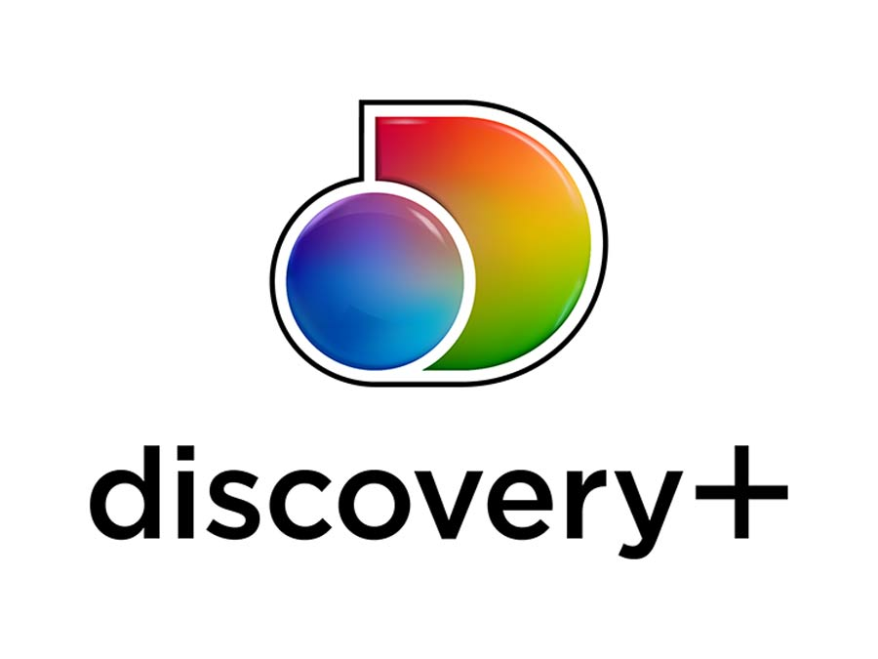















With an established content library and name recognition on their side, paid streaming services currently have the largest subscriber base
Ad-supported video-on-demand services (AVOD) have been gaining traction over the last few years as they increase their content libraries and intensify their tactics to attract subscribers
Streaming platforms used regularly by type
% of respondents that use the following services regularly
Ad-Supported Subscription Services
Paid Subscription Services
vMVPD Services
Source: VAB / Lucid ‘COVID-19 Streaming Behavior Survey,’ June 2020. Survey base: A18+ in households with access to streaming services and have viewed content on streaming services (n=1,000). Q7. Please select which of the following services you currently watch regularly.
This information is exclusively provided to VAB members and qualified marketers. Further distribution is prohibited.
PAGE 15
PAGE 1

Slide 16

Due to heightened interest and attention during COVID-19, trial and adoption of AVOD services accelerated, with 1 in 4 viewers stacking AVOD subscriptions on top of paid
As more AVOD services launch, audiences are taking advantage of the strong combination of high-quality programming that's available at a very affordable price – free
27%
of SVOD users also subscribe to AVOD services
75%
of AVOD users also access SVOD services
Source: VAB / Lucid ‘COVID-19 Streaming Behavior Survey,’ June 2020. Survey base: A18+ in households with access to streaming services and have viewed content on streaming services (n=1,000). Q5. Which of the following streaming service types do you watch regularly? Does not equal 100% due to the ability to choose multiple responses. AVOD Users = respondents who regularly watch free subscription streaming services with commercials (e.g., Crackle, Pluto TV, Tubi TV) (n= 298). SVOD Users = respondents who regularly watch paid subscription streaming services with no commercials (e.g., Netflix, Disney+) (n= 817).
This information is exclusively provided to VAB members and qualified marketers. Further distribution is prohibited.
PAGE 16

Slide 17



People enjoy AVOD platforms because they satisfy viewers' desire for more premium content of both current and library TV shows
Which of the following statements about streaming video content do you agree with?
% of respondents who agree completely
AVOD Users
72%
“I like the large selection of TV shows and movies they offer”
67%
“I like having access to every show, past or present”
58%
“I enjoy the original content the service offers”
Source: VAB / Lucid ‘COVID-19 Streaming Behavior Survey,’ June 2020. Survey base: A18+ in households with access to streaming services and have viewed content on streaming services (n=1,000). Q3. When thinking about streaming video services, how much do you agree with the following statements? Does not equal 100% due to the ability to choose multiple responses. AVOD Users = respondents who regularly watch free subscription streaming services with commercials (e.g., Crackle, Pluto TV, Tubi TV) (n= 298).
This information is exclusively provided to VAB members and qualified marketers. Further distribution is prohibited.
PAGE 17

Slide 18
Library content, a core attribute for many AVOD services, is an important driver for signups, especially for young adults who appreciate ‘retro’ classics
A combination of both newer originals and older classics appeal rather equally to both AVOD users (67%) and SVOD users (66%)
“I like having access to every show, past or present”
% of respondents who agree completely
Source: VAB / Lucid ‘COVID-19 Streaming Behavior Survey,’ June 2020. Survey base: A18+ in households with access to streaming services and have viewed content on streaming services (n=1,000). Q3. When thinking about streaming video services, how much do you agree or disagree with the following statements? AVOD Users = respondents who regularly watch free subscription streaming services with commercials (e.g., Crackle, Pluto TV, Tubi TV) (n= 298). SVOD Users = respondents who regularly watch paid subscription streaming services with no commercials (e.g., Netflix, Disney+) (n= 817).
This information is exclusively provided to VAB members and qualified marketers. Further distribution is prohibited.
PAGE 18

Slide 19
AVOD users are satisfied with the experience as nearly half say they are watching more content on ad-supported platforms than paid services
“I have found myself streaming more free, ad-supported video content than paid content”
% of respondents who agree completely
Source: VAB / Lucid ‘COVID-19 Streaming Behavior Survey,’ June 2020. Survey base: A18+ in households with access to streaming services and have viewed content on streaming services (n=1,000). Q9. Thinking of your behavior over the past 30 days, which of the following statements do you feel apply to you? Does not equal 100% due to the ability to choose multiple responses. AVOD Users = respondents who regularly watch free subscription streaming services with commercials (e.g., Crackle, Pluto TV, Tubi TV) (n= 298).
This information is exclusively provided to VAB members and qualified marketers. Further distribution is prohibited.
PAGE 19

Slide 20

…And almost 40% hope more ad-supported services launch
Nearly 4 in 10 AVOD users wish
there were more free streaming video services
Source: VAB / Lucid ‘COVID-19 Streaming Behavior Survey,’ June 2020. Survey base: A18+ in households with access to streaming services and have viewed content on streaming services (n=1,000). Q10.Which of the following statements describe your views on free streaming services? (e.g., Tubi, Pluto, Crackle , etc.)
This information is exclusively provided to VAB members and qualified marketers. Further distribution is prohibited.
PAGE 20

Slide 21
Why do people desire more AVOD services? Because viewers are not deterred by advertising, in fact they acknowledge that ads make their viewing experience more affordable
Which of the following statements about streaming video content do you agree with?
% of respondents who agree completely
“I appreciate the fact that ads are making this service cheaper for me”
“I don’t mind seeing ads in free streaming programming”
AVOD Users
AVOD Users
53%
35%
A18-34
A35-54
A18-34
A35-44
41%
35%
25%
30%
Source: VAB / Lucid ‘COVID-19 Streaming Behavior Survey,’ June 2020. Survey base: A18+ in households with access to streaming services and have viewed content on streaming services (n=1,000). Q10. Which of the following statements describe your views on free streaming services? Q12. Which of the following statements about advertisements that appear in streaming services that have ads do you agree with? Does not equal 100% due to the ability to choose multiple responses. AVOD Users = respondents who regularly watch free subscription streaming services with commercials (e.g., Crackle, Pluto TV, Tubi TV) (n= 298).
This information is exclusively provided to VAB members and qualified marketers. Further distribution is prohibited.
PAGE 21

Slide 22
What to remember
While paid services are the most popular streaming platforms, their content libraries are under siege as new services are being rolled out by nearly all of the major media players
Consumers value content and are looking to get it wherever they can, providing more opportunity for free ad-supported streaming services
AVOD viewers are not deterred by ads or even cost – their ultimate driver is a passion for content
Ad-supported services’ growth is a positive sign for marketers looking to reach an engaged and expanding audience
This information is exclusively provided to VAB members and qualified marketers. Further distribution is prohibited.
PAGE 22

Slide 23
What you’ll learn today…
1
How video streaming is experiencing a sea change, with audiences of all ages and backgrounds increasingly streaming every day, if not multiple times a day.
2
Why ad-supported streaming services are attracting content-hungry audiences with their vast supply of library content.
3
What the future of video streaming may hold as consumers begin to reach their limit on paid streaming services.
This information is exclusively provided to VAB members and qualified marketers. Further distribution is prohibited.
PAGE 23

Slide 24

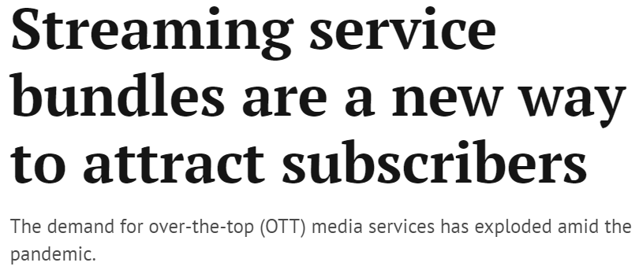

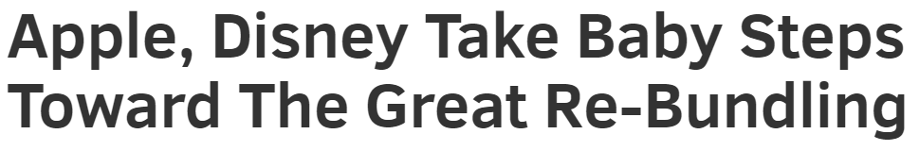

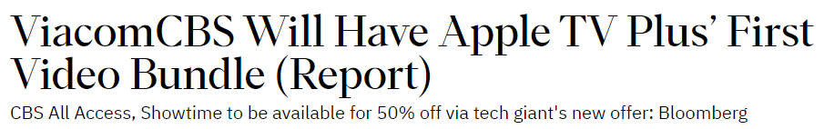
Many of the major media companies are setting up bundle partnerships to entice new subscribers by making their services more accessible to viewers, as well as more affordable, while aiming to minimize churn
Which of the following statements about streaming video content do you agree with?
% of respondents who agree completely
A18+
“I wish there were discounts for bundling certain streaming services”
August 18th, 2020
57%
August 18th, 2020
“I wish there was one bundle I could buy that included everything”
53%
August 13th, 2020
Bundling, i.e., aggregating more content at an attractive price point, is also an appealing way to lure in more consumers especially now that many services are moving away from free trials
Source: VAB / Lucid ‘COVID-19 Streaming Behavior Survey,’ June 2020. Survey base: A18+ in households with access to streaming services and have viewed content on streaming services (n=1,000). Q3. When thinking about streaming video services, how much do you agree or disagree with the following statements?
This information is exclusively provided to VAB members and qualified marketers. Further distribution is prohibited.
PAGE 24

Slide 25
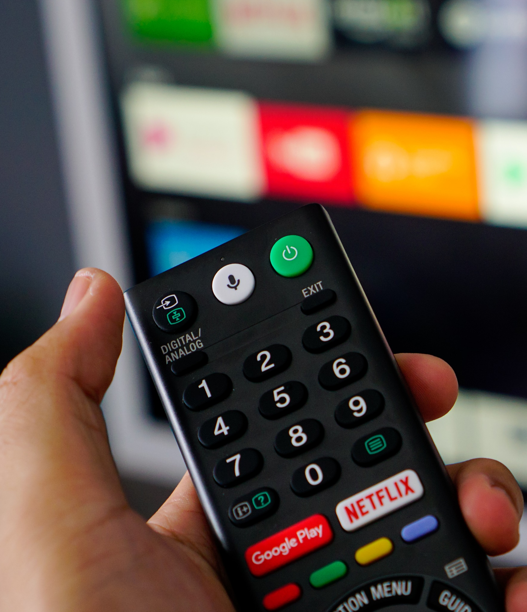
In addition to bundling, consumers are looking for ease of use in the form of built-in functionality and availability across all devices
The established paid services have had the advantage, as many smart TVs and streaming players offer one-click access for viewers, whereas the ad-supported services are still building their relationships with OEM’s…
When considering video streaming attributes:
81%
of consumers place a high importance on ease of use
58%
value availability across devices
However, smart TVs, which are the fastest growing streaming devices, have been evolving and many now feature a much more seamless interface with many more pre-installed streaming apps than before – which creates more opportunities for AVOD
Source: Nielsen Total Audience Report, February 2020..
This information is exclusively provided to VAB members and qualified marketers. Further distribution is prohibited.
PAGE 25

Slide 26
Due to their satisfaction with the ad-supported streaming experience, more viewers have been watching each of the major AVOD platforms during the pandemic, increases weren’t just seen on one or two services…
Use of Major AVOD Services
% of U.S. A18+ using service
Source: VIP+: Variety Intelligence Platform, COVID Impact on Media, 8/14/20. Hub Research.
This information is exclusively provided to VAB members and qualified marketers. Further distribution is prohibited.
PAGE 26

Slide 27


…and this increase in viewership has led to significant revenue increases across major AVOD services
Ad revenues across some of the top AVOD services rose 31% in Q2 2020, for a total of $849 million among these five services
Ad revenues across 5 AVOD streaming services
2Q ’20 ($ in millions)
Source: MediaPost, 8/14/20. Comscore, State of OTT, 2020.
This information is exclusively provided to VAB members and qualified marketers. Further distribution is prohibited.
PAGE 27

Slide 28

AVOD services are committed to improving the viewing experience by limiting commercial loads (and offering hybrid free/paid models), developing advanced targeting solutions to increase relevancy and creating engaging interactive ads
Many ad-supported services have improved the ad experience by:
Committing to limited commercial time
Using interactive / shoppable ads (including QR codes) to increase engagement
Source: VAB / Lucid ‘COVID-19 Streaming Behavior Survey,’ June 2020. Survey base: A18+ in households with access to streaming services and have viewed content on streaming services (n=1,000). Q12. Which of the following statements about advertisements that appear in streaming services that have ads do you agree with? AVOD Users = respondents who regularly watch free subscription streaming services with commercials (e.g., Crackle, Pluto TV, Tubi TV) (n= 298).
This information is exclusively provided to VAB members and qualified marketers. Further distribution is prohibited.
PAGE 28

Slide 29

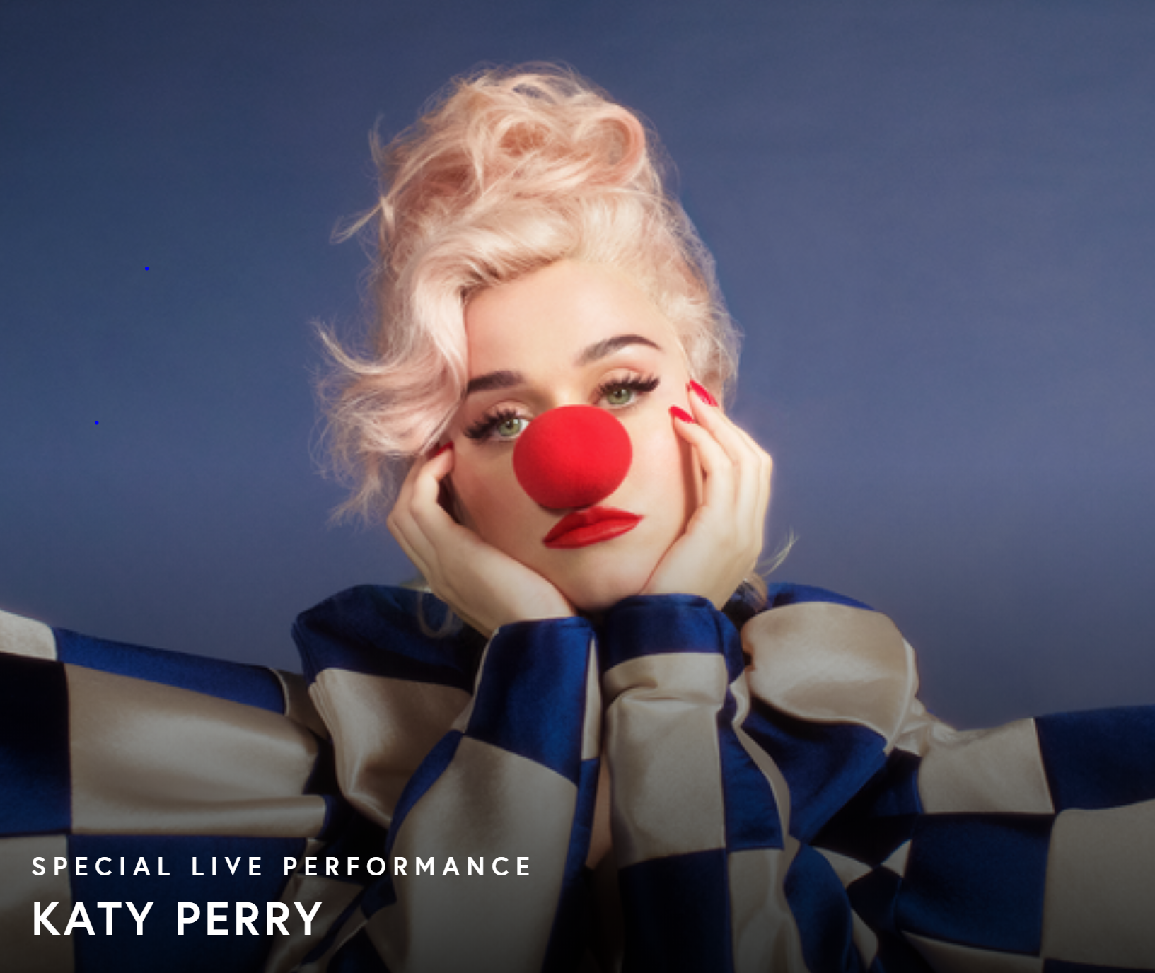

Beyond scripted content, livestreaming as a format is poised for even greater growth as more events become virtual and, in a post-pandemic world, more virtual experiences are created as a complement to live, in-person events
“I haven’t livestreamed an event or concert, but would consider if there was something that interested me”
% who agree
37%
42%
29%
P18+
P18-24
Single
Source: VAB / Lucid ‘COVID-19 Streaming Behavior Survey,’ June 2020. Survey base: P18+ in households with access to streaming services and have viewed content on streaming services within the past seven days (n=1,000). Q14.When thinking about livestreaming, by which we mean: streaming a program online live as it happens (e.g., Concert - One World: Together at Home, Sporting Event – Virtual NFL Draft) - which of the following statements do you feel apply to you?
This information is exclusively provided to VAB members and qualified marketers. Further distribution is prohibited.
PAGE 29

Slide 30

According to Nielsen, streaming now accounts for almost one-quarter of total TV usage in OTT-capable homes (approx. 20% for total homes)
Streaming TV as % of Total TV Usage
among OTT-capable homes
+33%
Streaming now accounts for 24% of total usage among OTT capable homes
Increased usage is due to streaming enablement and expanded offerings
Source: Nielsen: Streaming Meter Homes. Share of Average Weekly Steaming Minutes (Weighted) as a percent of Total TV Usage among Streaming Capable Homes, P2+ Total Day
This information is exclusively provided to VAB members and qualified marketers. Further distribution is prohibited.
PAGE 30

Slide 31





Streaming should continue to increase steadily as the recently launched services from major media companies mature and more original content is released to attract, and retain, subscribers and sign-ups
Below represents the largest disruption in on-demand video since the introduction of Netflix streaming & Hulu 10+ years ago
Streaming Services Launch Dates
2019
2020
2021
Nov. 1, 2019
Nov. 12, 2019
May 27, 2020
Jul. 15, 2020
Jan. 4, 2021
Q1 2021
Recently announced:
10 new Star Wars series
10 new Marvel series
30 other series / films
17 feature films being released day-and-date on streaming in 2021
26 million sign-ups as of Dec ‘20
Source: TV Time and United Talent Agency, Beyond The Big Three: The Streaming Wars Are Upon Us, October 2019. Discovery Inc, 12/2/2020.
This information is exclusively provided to VAB members and qualified marketers. Further distribution is prohibited.
PAGE 31

Slide 32
As of now, SVOD services continue to account for a majority of total streaming minutes but ad-supported options have been increasing share recently (now representing a 30%+ share)
Paid Subscription Services
Ad-Supported Subscription Services
vMVPD Services
Source: Nielsen, Streaming Meter Homes, Sum of Daily Streaming Minutes (Weighted) as a percent of Total Streaming, P2+, Total Day, 7/27/2020 – 8/30/2020
This information is exclusively provided to VAB members and qualified marketers. Further distribution is prohibited.
PAGE 32

Slide 33

Beyond the ‘Top 5’ (Netflix, Hulu, Amazon Prime, YouTube & Disney+), three of which are SVOD platforms, ‘Linear TV’ is the most popular streaming service category followed by AVOD platforms
Source: Nielsen, Streaming Meter Homes, Sum of Daily Streaming Minutes (Weighted) as a percent of Total Streaming, P2+, Total Day, 7/27/2020 – 8/30/2020.
This information is exclusively provided to VAB members and qualified marketers. Further distribution is prohibited.
PAGE 33

Slide 34
What to remember
Although the video streaming ecosystem has not yet hit saturation, the limit of paid services may soon be peaking, giving rise to the demand for free ad-supported services featuring both scripted and live-streamed content
In order to stay competitive, ‘pure’ paid services may need to introduce tiered pricing options, including ad-supported options, or offer some of their exclusive content (such as a series episode or season) for free to attract new subscribers
With so much content spread across multiple services, bundling of services and programming has become a popular strategy for attracting new viewers
AVOD services are continually committed to improving the viewing experience by limiting commercial loads, increasing advertising relevancy and innovating through shoppable ads
This information is exclusively provided to VAB members and qualified marketers. Further distribution is prohibited.
PAGE 34

Slide 35





Key Takeaways for Marketers
AVOD is an Incremental Reach Opportunity
AVOD is in Growth Mode
Content is King
Opportunity in the
Ad Experience
Audiences across the board are now streaming every day or even multiple times a day and viewing multiple services.
As viewers continue to stack AVOD platforms on top of paid, marketers have an opportunity to expand reach and ‘fuel their funnel’ with more consumers.
The increased access, tech adoption, comfort level and time that viewers had early
on in the pandemic drove increases in video streaming.
These behaviors are holding, signaling AVOD’s place as an important piece of a holistic video campaign into the future.
Viewers choose which services to watch based upon the content, not the price or even the presence of ads.
Because of their extensive libraries of programming, AVOD platforms attract viewers and deliver marketers an engaged, attentive and committed audience.
Viewers accept and appreciate that ads are a ‘part of the deal’ in getting free content.
With this comes a marketing opportunity to be creative, innovative, interactive and targeted with your brand message and build relationships with these engaged viewers.
This information is exclusively provided to VAB members and qualified marketers. Further distribution is prohibited.
PAGE 35

Slide 36
In these reports you’ll find additional data including:
1.) Advertising investment levels of both paid subscription and ad-supported services
2.) Demographic reach of individual paid subscription services
3.) Many more consumer insights on the growing popularity of live-streaming
A Sea Change in Video Viewing
Helping Marketers Find More Fish in the Streaming Ecosystem
We’re Going Live
How Consumers are Living Vicariously Through Live-Streamed Events in the Time of COVID-19
Brand marketers and agencies get free and immediate access to VAB’s content library. Get access at theVAB.com
This information is exclusively provided to VAB members and qualified marketers. Further distribution is prohibited.
PAGE 36

Slide 37


Thank You!
Get immediate access to the VAB Insights library
We’ve answered hundreds of marketers’ questions.
Our guides, reports, webinars and videos provide actionable insights to help marketers navigate today’s video landscape and think differently about their strategy.
We are committed to your business growth and proud to offer brand marketers and agencies complimentary access to our continuously-growing Insights library.
Get Access at theVAB.com or visit us here
This information is exclusively provided to VAB members and qualified marketers. Further distribution is prohibited.
PAGE 37

