Slide 1
Unrivaled:
How Multi-Screen TV Continues to Dominate in Reach, Relevance, and Results

Slide 2




















































































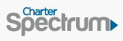










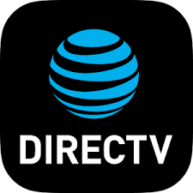





























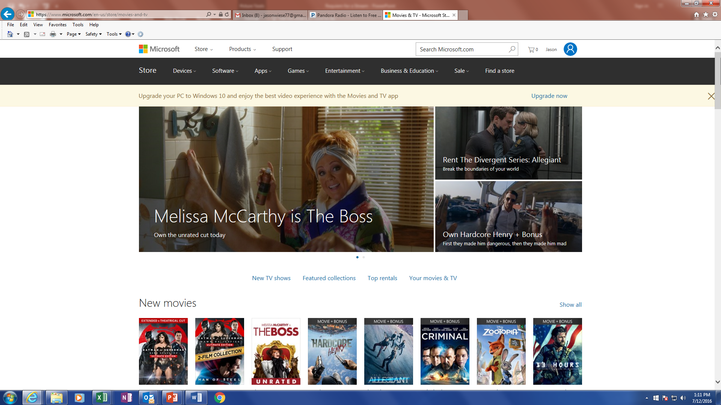






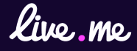

















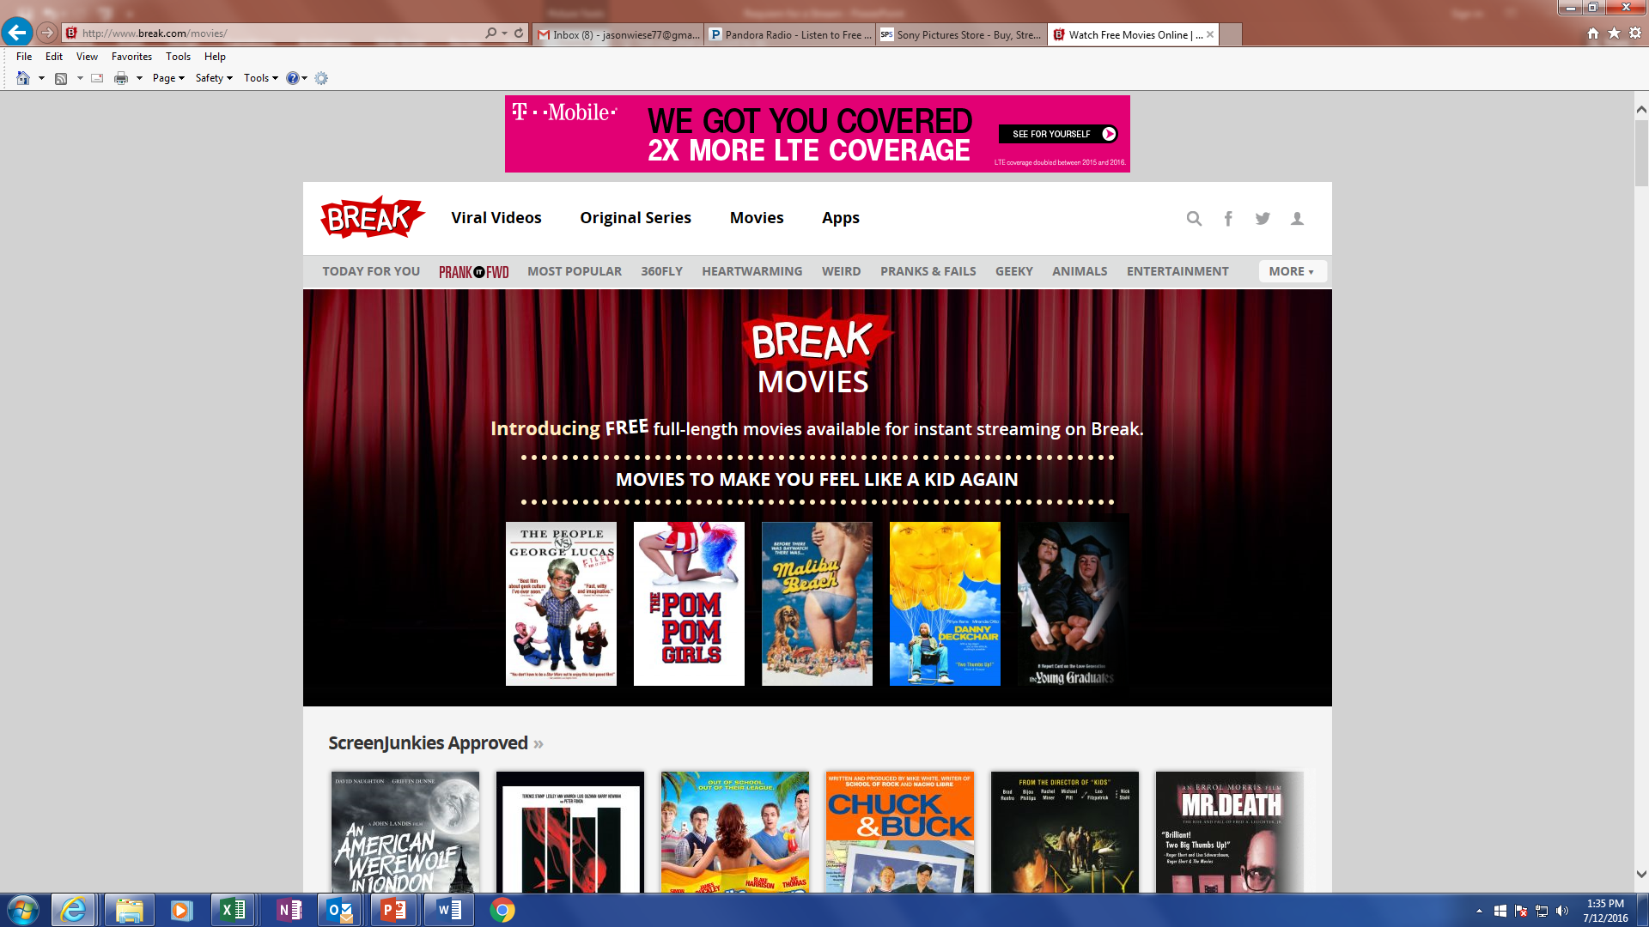















The Video Landscape Offers Marketers (And Consumers) More Choices Than Ever
Streaming Video
Networks, MVPDs & “TV Everywhere”
“Live Social Stream”
“vMVPD”
2
Based on offerings available as of August 8, 2016

Slide 3
The Truth
No platform drives business like TV’s premium video-at-scale
Reach
Offers unparalleled awareness-driving ability
Relevance
Engages consumers & provokes real-time conversation
Results
Ignites the response that builds brand health & drives business

Slide 4

Reach
Offers Unparalleled Awareness-Driving Ability

Slide 5
“TV is the giant megaphone. When you want to get a message out, that's still really the most powerful means to do it.”
- Isaac Weber, VP of strategy at MarketShare
Notes:
5
5

Slide 6

TV reaches 301,670,000 Americans every month.
That’s 96% of the total US population.
Nearly 100 Million Households subscribe to Television, a figure that has remained consistent over the last 5+ years.
Source: Nielsen Universe Estimate, August 2017

Slide 7

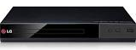
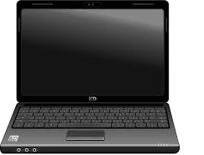

In Any Given Minute, 50 Million Adults Are Tuned Into TV
Source: Nielsen Comparable Metrics Report Q4 2016; Data based on average week between September 26, 2016 – December 25, 2016. A18+ UE = 245,740,000.
29

Slide 8
16x more Millennials Are Tuning Into Television Over Smartphone Video
Source: Nielsen Comparable Metrics Report Q4 2016; Data based on average week between September 26, 2016 – December 25, 2016. A18-34 UE = 73,460,000.
30

Slide 9


















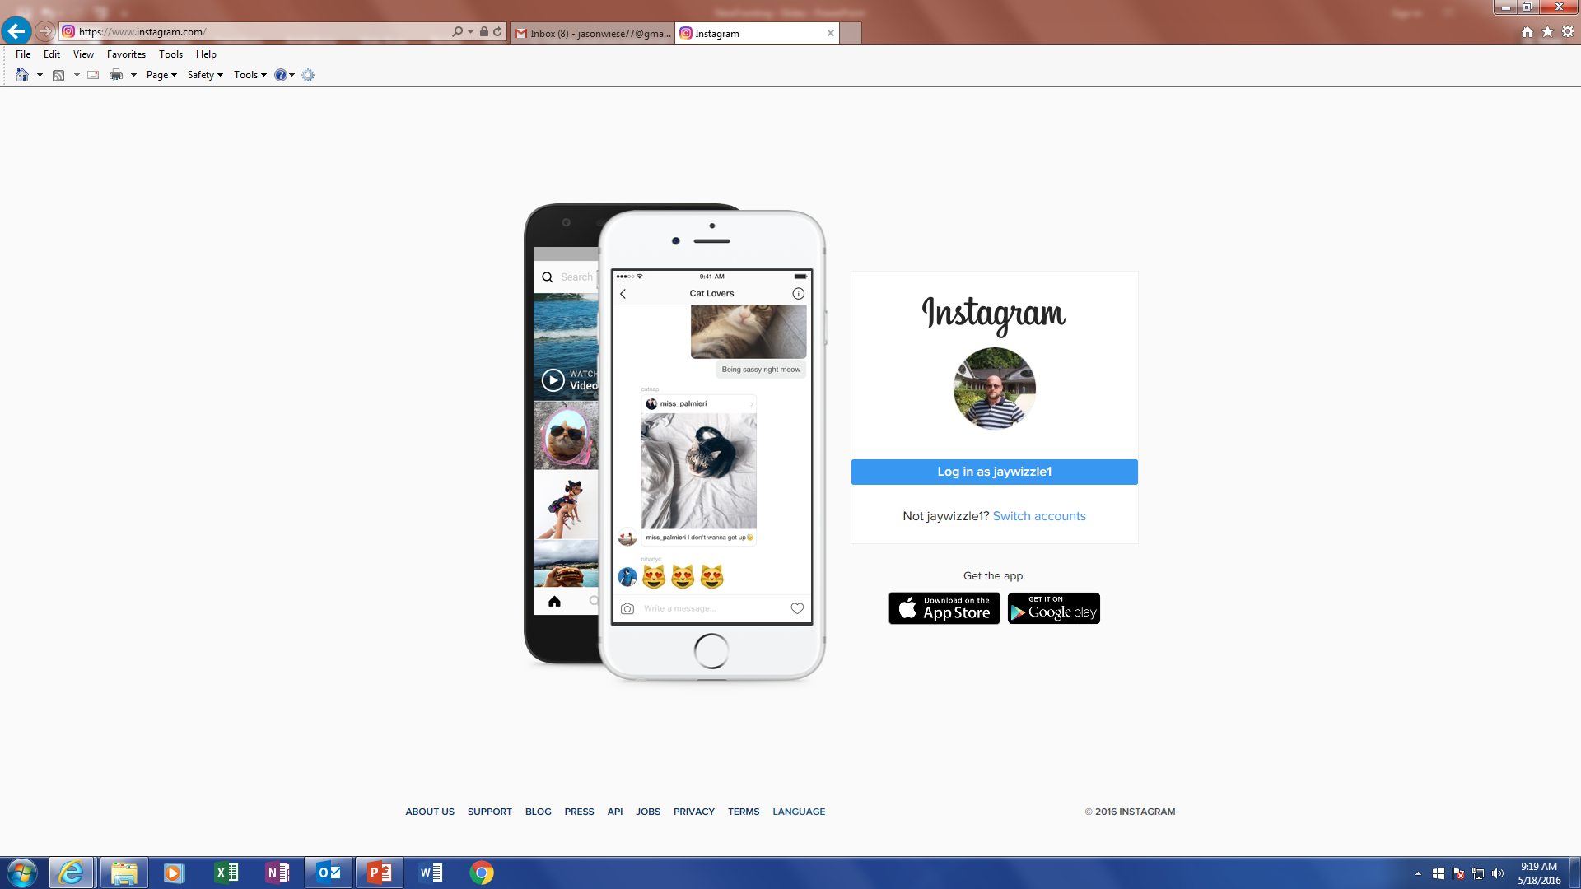
Adult 18+ Average Audience (000)
10x More People are Watching Ad-Supported TV Content Than Are On Facebook; 13x More Than YouTube
Multiscreen (TV + online)
Multiscreen (TV + online)
Source: comScore MediaMetrix Key Measures (multiplatform), May 2017; A18+ Nielsen R&F Time Period Report, Live + SD, Total Day. May 1-31, 2017; A18+. “Average Audience” is based on the average minute, which is factored across the full month for websites and TV. TV Brands include linear TV and TV-related websites. Digital website measurement includes all visitor activity, not just video consumption.

Slide 10
Adult 18-34 Average Audience (000)
Multi-Screen TV Reaches More Millennials Than YouTube, Facebook, Snapchat and Instagram Combined
4x more people are watching ad-supported TV content than are on Facebook
3x more Millennials are watching ad-supported TV content than are on YouTube
Multiscreen (TV + online)
Multiscreen (TV + online)
Source: comScore MediaMetrix Key Measures (multiplatform), May 2017; A18-34 Nielsen R&F Time Period Report, Live + SD, Total Day. May 1-31, 2017; A18-34. “Average Audience” is based on the average minute, which is factored across the full month for websites and TV. TV Brands include linear TV and TV-related websites. Digital website measurement includes all visitor activity, not just video consumption.

Slide 11

















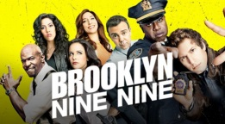






Where Would Top Websites Rank Among Ad-Supported TV Programs?
Based on Adults 18+
Avg. Audience
Based on Adults 18-34
Avg. Audience
Before
Website Rank
After
Before
Website Rank
After
Facebook
# 176
# 42
(ABC)
(NBC)
(NBC)
(NFL Network)
YouTube
# 279
# 40
(FOX)
(FOX)
(CBS)
(ABC)
Instagram
# 948
# 131
(ID)
(ID)
(CBS)
(ABC)
Snapchat
# 1,295
# 169
(TNT)
(Lifetime)
(FOX)
(Adult Swim)
Twitter
# 3,718
# 1,631
(DIY)
(Weather Channel)
(Nick Jr.)
(NBC)
Source: comScore MediaMetrix Key Measures (multiplatform), December 2016; Nielsen Npower, Live + SD, Total Day. December 1-31, 2016; “Average Audience” is based on the average minute, which is factored across the full month for websites and across program run time for TV. Digital website measurement includes all visitor activity, not just video consumption.

Slide 12
While Multi-Screen TV Offers Exceptional Reach, It Can Also Deliver Niche Audiences

Slide 13
Across A Variety Of Enthusiast Targets, Multi-Screen TV Brands Offer 2x+ Greater Reach Than The Top Ad Tech Site In The Genre
Reach of Multi-Screen TV and Ad Tech Sites
Home
HGTV + HGTV.com
Countryliving.com (#1)
Sports
ESPN + ESPN.com
SBNation.com (#6)
Science & Tech
Discovery + Discovery.com
Purch.com (#1)
News
CNN + CNN.com
USAToday.com (#6)
Entertainment
E! + Eonline.com
People.com (#1)
Sources: Nielsen Npower Live+7, Total Day, P2+, 4/1/17-4/30/17, TV - Linear with VOD; comScore April 2017 Total Unique Visitors; Ad Tech sites are the highest reaching in their category, after any TV brand sites
13

Slide 14
Through Addressable TV, Advertisers Can Precisely Target Their Most Lucrative Consumers
Precision
Customized Creative / Tracking
Minimized Waste
Goes beyond the traditional buying demographics to buy based on granular demographics, geography, transactional / consumption & behavioral activities
Ability to tailor creative message for different target segments & optimize based on HHs response
ROI Measurement & Testing
In-depth post-campaign reporting with attribution tracking through media providers and third-party data partners
Reduction of non-targeted ad impressions by eliminating ads seen by viewers who are unlikely to take action, but also allowing advertisers to frequency cap to avoid message wear-out
14
14

Slide 15

Relevance
Engages Consumers & Provokes Real-Time Conversation

Slide 16
“Viewers actively look forward to watching TV platforms and say they are more personally invested, immersing themselves in content that engages and excites them.”
- IPSOS/Discovery Video Perceptions study
16

Slide 17
Consumers Prefer Watching Content on Television
“Enjoyment” is a measure of program engagement
Source: CRE and Hub Research custom study “New study finds that TV outperforms Digital platforms in viewer ad attention & recall” 6/26/16
Notes:
17
17

Slide 18
Adults Spend 7x More Time Watching TV Than Video on a PC
Put in perspective, Adults spend one-third of their waking hours watching TV
Source: Nielsen Total Audience Report, Q1 ’17; TV = Live TV + DVR + Time Shifted

Slide 19
Younger Millennials Spend 2x and 10x More Time With TV Than With Video On A PC Or Smartphone, Respectively
Adults 18-24
Adults 25-34
Source: Nielsen Total Audience Report, Q1 ’17; TV = Live TV + DVR + Time Shifted

Slide 20
Even The Most “Unlikely” TV Viewers View More TV than Streaming Video
The Heaviest Streamers are watching 8x more TV a day than streaming video on a PC
PC: Streaming:
29 minutes
TV:
236 minutes
PC: Streaming:
5 minutes
TV:
77 minutes
The Lightest TV Viewers are watching 15x more TV a day than streaming video on a PC
Source: Q1 ‘17 Nielsen Total Audience Report. Streaming based on home PC only. Chart based on “average daily minutes”. Heaviest Streamers (Quintile 1 – they represent 90% of all minutes streamed). Lightest TV (Quintiles 4/5 – they represent 8% of all TV minutes viewed)

Slide 21
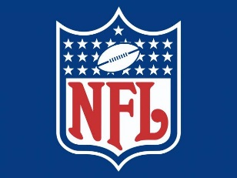




















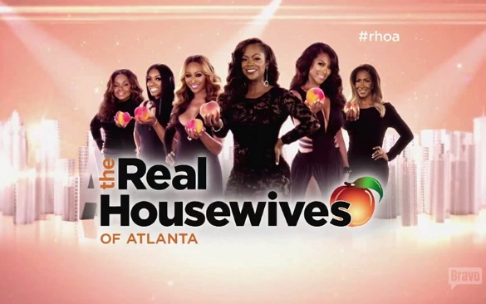










Why? Because TV is in the Business of Creating Iconic Hits
Sports
Awards & Specials
Drama
Reality
Comedy
News
26

Slide 22
And TV Brands Invest Heavily in This Premium, Long Form Video Content
Programming Expenses
($Billions)
Source: SNL Kagan 2016
22

Slide 23
TV Brands Behave as Cultural Touchstones, With The Unrivaled Power To Create Community And Drive Real-Time Conversation

Slide 24
Over 75% Of All Primetime Viewing Is Live – Even Among Millennials
% Live v. Playback Minutes: Primetime (the most time-shifted daypart)
Half of all HHs do not have a DVR
Source: Nielsen, Base=DVR HHs; 9/21/15-7/24/16
24

Slide 25
In A Recent Study, Ad-Supported TV Accounted For Nearly 8 Of The Top 10 Trending Twitter Topics Throughout Primetime Hours
79%
of the Top-Trending Primetime Twitter topics were about TV
Demonstrates TV’s appeal to millennial viewers – 58% of all time spent on Twitter is by 18-34 year olds
Underscores that the majority of TV is viewed live – 77% of primetime is watched in real-time
Source: VAB custom analysis of Top 10 trending Twitter Topics each night (8:15p, 9:15p, 10:15p, 11:15p) aggregated during 4-week time period (10/10-2016 – 11/6/2016). Results include both “direct” and “related” TV topics; Twitter data - comScore, mediametrix multiplatform, October 2016. DVR data - Nielsen 2016-2017 Universe Estimate for A18-34 population comparison; Nielsen, Base=DVR HHs; 9/21/15-7/24/16.
25
25

Slide 26



















































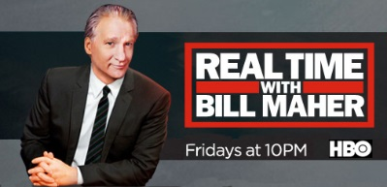


90% Of The Trending Entertainment Content Was About
Ad-Supported TV
% of Top 10 Trending Entertainment Programs By Platform
(Four-Week Time Period - Primetime)
No presence of YouTube channels/personalities or sVOD (Hulu, Netflix, Amazon) original programming
Source: VAB custom analysis of Top 10 trending Twitter Topics each night (8:15p, 9:15p, 10:15p, 11:15p) during 4-week time period (10/10-2016 – 11/6/2016). Based on unique program counts.
26

Slide 27












Similarly, Nationally Televised Sports Almost Automatically Spurred Some Of The Top Social Conversations
88% of nationally televised NFL, MLB, NBA and evening college football games across the major TV networks trended in the top 10 during primetime on their respective nights
NFL: 100% (12 out of 12 games)
MLB: 91% (21 out of 23 games)
88%
(53 out of 61 games)
Top 10 Trending Topics
NBA: 71% (10 out of 14 games)
NCAA Football: 83% (10 out of 12 games)
Source: VAB custom analysis of Top 10 trending Twitter Topics each night (8:15p, 9:15p, 10:15p, 11:15p) during 4-week time period (10/10-2016 – 11/6/2016). Results include both “direct” and “related” TV topics. NFL: Sunday Night Football on NBC – 10/16, 10/23, 10/30, 11/6; ESPN Monday Night Football – 10/10, 10/17, 10/24, 10/31; Thursday Night Football – 10/13, 10/20, 10/27, 11/3. NCAA Football: ESPN Friday Night Football – 10/14, 10/21, 10/28, 11/4; ABC Saturday Night Football – 10/15, 10/22, 10/29, 11/5; ESPN 10/15, 10/22, 10/29, 11/5. NBA: ESPN – 10/26, 10/28, 11/2, 11/4; TNT – 10/25, 10/27, 11/3. MLB: MLBN – 10/10; TBS – 10/10, 10/14, 10/15, 10/17, 10/18, 10/19; FS1 – 10/10, 10/11, 10/13, 10/15, 10/16, 10/18, 10/19, 10/20, 10/22; FOX – 10/25, 10/26, 10/28, 10/29, 10/30, 11/1, 11/2
27
27

Slide 28


It’s No Surprise That The Passion Consumers Have For TV Brands Extends To Their Presence Online
Top 5 Rank by Internet Genre
P2+ Total Minutes Viewed
Sports
Sports
Comedy
TV Entertainment - Black
General News
Finance News
ESPN
Resignation Media
CBS
ABC News
Yahoo Finance
NBC Sports
9GAG
NBCU
CNN News
MSN Money
MLB
Comedy Central
ABC
FOX News
Dow Jones
Bleacher Report
Tickld
VH1
NBC News
CNBC
CBS Sports
Funny Or Die
A&E
CBS News
CNN Money
Home
Weather
TV Entertainment
Food
Kids
HGTV
WeatherBug
ABC
Food Network
Roblox
Hearst
The Weather Channel
NBCU
AllRecipes
Disney Entertainment
HomeTalk
AccuWeather
CBS
MSN Food & Drink
PBS Kids
Houzz
Yahoo Weather
GSN
CafeMedia Food
Totally Kidz
CafeMedia Home
MSN Weather
MSN TV
Time Inc Food
Playwire Media
Source: VAB analysis of Media Metrix multi-platform comScore data, April 2017 (Ranking based on “Total Minutes Viewed”)
28

Slide 29
Millennials Love TV Brands Online
Top 5 Rank by Internet Genre
A18-34 Total Minutes Viewed
Sports
Sports
Comedy
TV Entertainment - Black
General News
LGBTQ
ESPN
Resignation Media
NBCU
CNN
Adam4Adam
NBC Sports
9GAG
ABC
Buzzfeed
Logo
MLB
Comedy Central
VH1
ABC News
Here Media
Bleacher Report
Elecutus
CBS
CBS NEws
Queerty
Fox Sports
Cracked
CW
NBC News
Pink News
Home
Weather
TV Entertainment
Food
Kids
Hearst
WeatherBug
ABC
Food Network
Roblox
HGTV
The Weather Channel
NBCU
AllRecipes
Disney Entertainment
CafeMedia Home
AccuWeather
CBS
CafeMedia Food
Totally Kidz
Houzz
Yahoo Weather
CW
Time Inc. Food
PBS Kids
IB Home & Garden
Weather.Gov
Turner
Bon Appetit
Playwire
Source: VAB analysis of Media Metrix multi-platform comScore data, April 2017 (Ranking based on “Total Minutes Viewed”)
29

Slide 30

Results
Ignites the response that builds brand health & drives business

Slide 31
"Someone who is highly attached is three times more likely to engage with the brand. They are less price sensitive, go deeper into the product line and have a higher lifetime value to an advertiser.”
- Gary Reisman, CEO and Founder, LEAP Media Investments
“TV offers the best ROI across all media”
-Marcos de Quinto, Global CMO, The Coca Cola Company
Notes:
31
31

Slide 32
TV Advertising Is More Emotionally Compelling
(Social Media, Radio, & Newspapers)
(YouTube)
(Social Media)
(Social Media & YouTube)
SourceTV/Ad Nation, 2016, Ipsos Connect/Thnkbox, adults 15+
Notes:
32
32

Slide 33
Higher Emotional Connection Delivers Stronger TV Ad Recall and Attention
% of viewers able to identify half or more advertisers after viewing content
% of viewers who reported full or nearly-full attention
Source: CRE and Hub Research custom study. “New study finds that TV outperforms Digital platforms in viewer ad attention & recall” 6/26/16
Notes:
33
33

Slide 34
TV Advertising Heightens Brand Awareness
(Social Media)
(Social Media)
SourceTV/Ad Nation, 2016, Ipsos Connect/Thnkbox, adults 15+
Notes:
34
34

Slide 35
As A Result, TV Advertising Is More Impactful
Source: IAB/Research Now Cross Media Effectiveness Study, January 2017; Digital Only = Desktop + Mobile Web
Notes:
35
35

Slide 36











The “Best Perceived” Brands Are Big TV Advertisers
The brands span categories, sizes/lifestages, target consumers, and business models
The 2016 “best perceived” brands increased their total TV spend by +25% vs. ‘15
Source: Yougov 2016 ranking, http://www.brandindex.com/ranking/us/2016-annual ; Spend data, AdIntel, full and mid year 2016
36

Slide 37
A Presence In TV Stirs Consumers To Action
Increase in TV Spend & Increase in Social Actions
’15 vs ‘16
Source: TV spending based on Nielsen Ad Intel, TV spend (national cable TV, national broadcast TV, Spanish language broadcast TV, Spanish language cable TV, spot TV, syndication TV), CY 2015-2016. Digital actions based on iSpot.tv and reflects social actions (posts, likes, shares and comments related to TV ads on Facebook, Twitter, YouTube, iSpot.tv). Digital actions are correlated to TV ad airing data.
37
Notes:
Search +7%, Views of Ad Online +14%

Slide 38







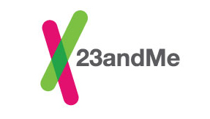




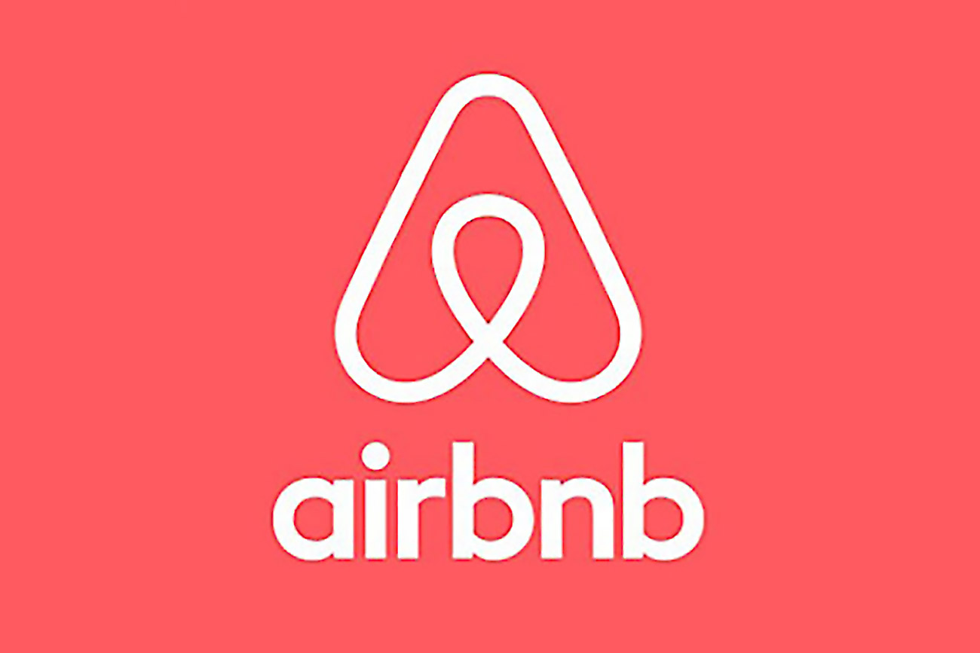

Similarly, Among Category Game-Changer “Disruptor” Brands, TV Piques Curiosity And Inspires Engagement
As TV spend increases, we see significant increases in brand searches, views of ads online, and consumers engaging with the brand via social media
Increase in TV Spend & Increase in Digital Actions
Source: TV spending based on Nielsen Ad Intel, TV spend (national cable TV, national broadcast TV, Spanish language broadcast TV, Spanish language cable TV, spot TV, syndication TV), CY 2015-2016. Digital actions based on iSpot.tv and reflects TV commercial-related searches (Google, Bing, Yahoo!), social actions (posts, likes, shares and comments related to TV ads on Facebook, Twitter, YouTube, iSpot.tv) and earned, not promoted, online video views of TV ads (YouTube, iSpot.tv). Digital actions are correlated to TV ad airing data.
38

Slide 39
There Is Also A Clear Correlation Between TV Spend and Business Growth
Taco Bell plans to “spend a greater amount on TV ads in 2017. TV is important to us. TV still works for us.”
- Marisa Thalberg, CMO Taco Bell,
Notes:
39
39

Slide 40
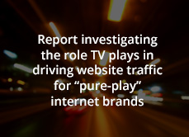
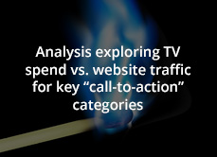
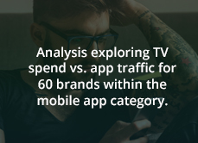

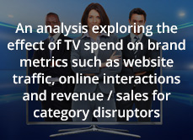
VAB Has Done Exhaustive Attribution Analyses, Covering 400+ Brands And 20 Categories
Year 1:
What’s Driving Digital?
Year 2:
6 Call-to-Action Ad Categories
Year 3:
What’s App’ning!! The TV-Traffic Correlation for Mobile Apps
Year 4:
Shifting Gears: How TV Drives Online Traffic for Automotive
The Market-Changer’s Playbook: Why TV is Where Disruptors Go To Grow Big
40
Notes:
40
40

Slide 41
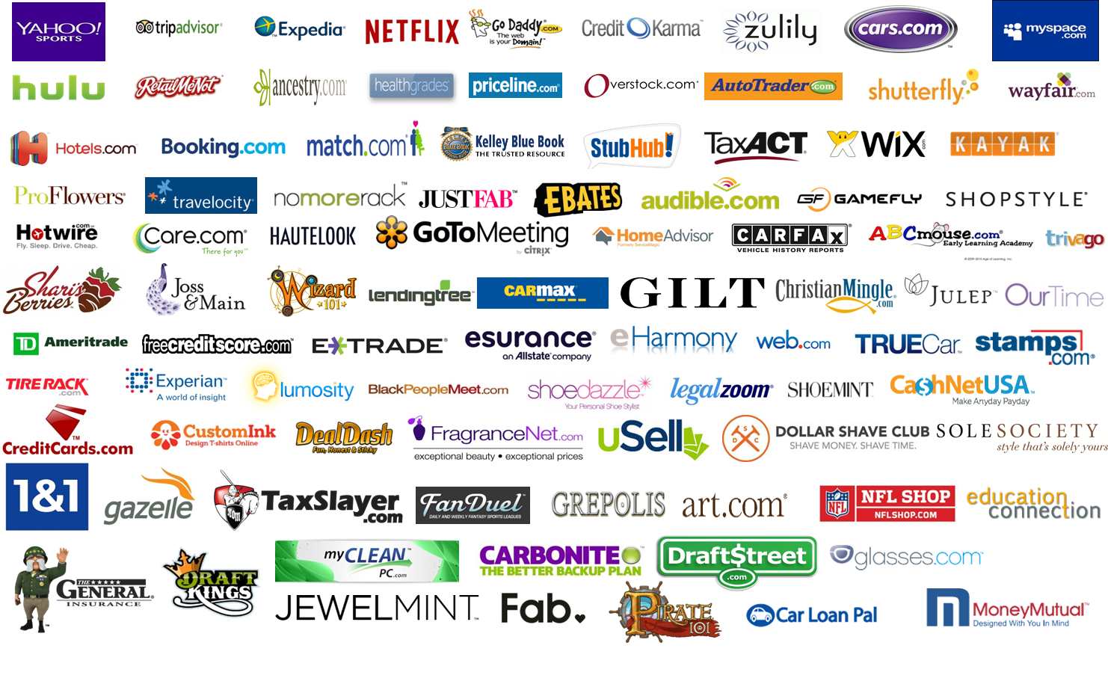
85% Of “Pure-Play” Internet Brands Exhibited A Direct Correlation Between TV Spend & Website Traffic
Year 1:
What’s Driving Digital?
63 Website Brand Advertisers: Unique Visitors vs. TV Spend
When Spend DOWN
-22% less
unique visitors
(on average)
When Spend UP
+33% more
unique visitors
(on average)
41

Slide 42























































































































82% of the “Call-To-Action” Brands Exhibited a Direct Correlation Between TV Spend & Website Traffic
Year 2:
6 Call-to-Action Ad Categories
102 Call-To-Action Advertisers: Unique Visitors vs. TV Spend
When Spend UP
+33% more
unique visitors
(on average)
-10% less TV Spend
-9% less Unique Visitors
(on average)
+22% more TV Spend
+24% more Unique Visitors
(on average)
Source: Nielsen AdViews, TV spend (cable TV, broadcast TV, SLC TV, SLN TV, syndication, spot TV) Feb 2014-Mar 2015; comScore, mediametrix multiplatform, unique visitors Total Audience (P2+). Spend & unique visitors based on Feb-Aug ‘14 vs. Sep’14-Mar ‘15 monthly avg
42

Slide 43

































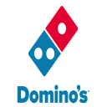












Year 3:
What’s App’ning!! The TV-Traffic Correlation for Mobile Apps
77% of Mobile Apps Exhibited A Definitive Correlation Between TV Spend And Website Traffic
46 Website Brand Advertisers: Unique Visitors vs. TV Spend “off” and “on” months
“When Off” TV Months
“When On” TV Months
When Spend DOWN
-20% less
unique visitors
(on average)
When Spend UP
+25% more
unique vistors
(on average)
Sources: Nielsen AdIntel, (web-based app game product category), TV spend (cable TV, broadcast TV, Spanish language cable TV, Spanish language broadcast TV, syndication TV, spot TV); October 2014 – December 2015. comScore mobile metrix media trend (application access only), unique visitors (P2+), October 2014 – December 2015. Analysis is based on comparison of average monthly unique visitors for “When TV Off” vs. “When TV On” months of activity.
43

Slide 44















75% Of Automotive Manufacturers Exhibited a Direct Correlation Between TV Spend & Website Traffic
Year 4:
Shifting Gears: How TV Drives Online Traffic for Automotive
15 Automotive Advertisers: Unique Visitors vs. TV Spend
-10% less TV Spend
-12% less Unique Visitors
(on average)
+16% more TV Spend
+37% more Unique
Visitors
(on average)
44

Slide 45

All 14 “Brand Building” Disruptor Brands Saw Their Website Traffic Skyrocket After They Launched A TV Campaign
Year 4:
The Market-Changer’s Playbook: Why TV is Where Disruptors Go To Grow Big
Each company below saw an immediate double-digit lift in their monthly average website visits once their TV campaign launched
Exponential Increase
+98%
+65%
Exponential Increase
+307%
+139%
+210%
+1,075%
Exponential Increase
+284%
+292%
+130%
+79%
+11%
Source: comScore mediametrix multiplatform media trend; Total audience (P2+), March ‘14 – February ‘17. Nielsen Ad Intel, TV spend (national cable TV, national broadcast TV, Spanish language broadcast TV, Spanish language cable TV, spot TV, syndication TV), March ‘14 – February ‘17. N/A = not enough traffic for comScore to measure.
45

Slide 46
Digital Spend on Television Continues to Increase
The five major, established “digital” disruptors collectively spent almost $1.4 Billion on TV in 2016, nearly triple what they spent just 5 years ago
Source: Nielsen Ad Intel. TV spend includes national cable TV, broadcast TV, Spanish language cable TV, Spanish language broadcast TV, spot TV, syndication TV. Reflects all monitored TV spend by parent company; Google includes YouTube.
46

Slide 47
Common (Mis)perceptions And Realities
Perception: Viewers are moving to online video; YouTube’s audience has grown greater than that of TV
Perception: TV is only relevant to certain demos, and definitely not Millennials
Perception: Nobody’s watching live TV anymore - people are cord-cutting, time-shifting, or watching SVOD
The TV audience is 15x larger than that watching video on a PC. For every hour a viewer spends with YouTube, she spends over 13 with TV service
Younger Millennials spend 10x more time watching TV than video on a Smartphone ross generations, including Millennials
Only 4% of Households are broadband only; more than 77% of Primetime viewing is live
Perception: TV content isn’t relevant and so TV advertisers will be viewed as out of touch
Nearly 80% of primetime Twitter trending topics were about ad-supported TV

Slide 48
Common (Mis)perceptions And Realities
Perception: TV advertisers don’t need to be on both the network and its website
Perception: TV is too upper funnel and has limited ability to make a sales impact or drive consumers online
Across a variety of genres, TV brand websites rank in the top 5 for time spent
88% of pure-play Internet brands saw a direct correlation between TV spend and site visits
Perception: Bigger brands don’t need TV and smaller brands can’t benefit from it
TV drives double-digit increases in web traffic for niche brands like Birchbox, to larger, more established brands like GM

Slide 49
