Slide 1

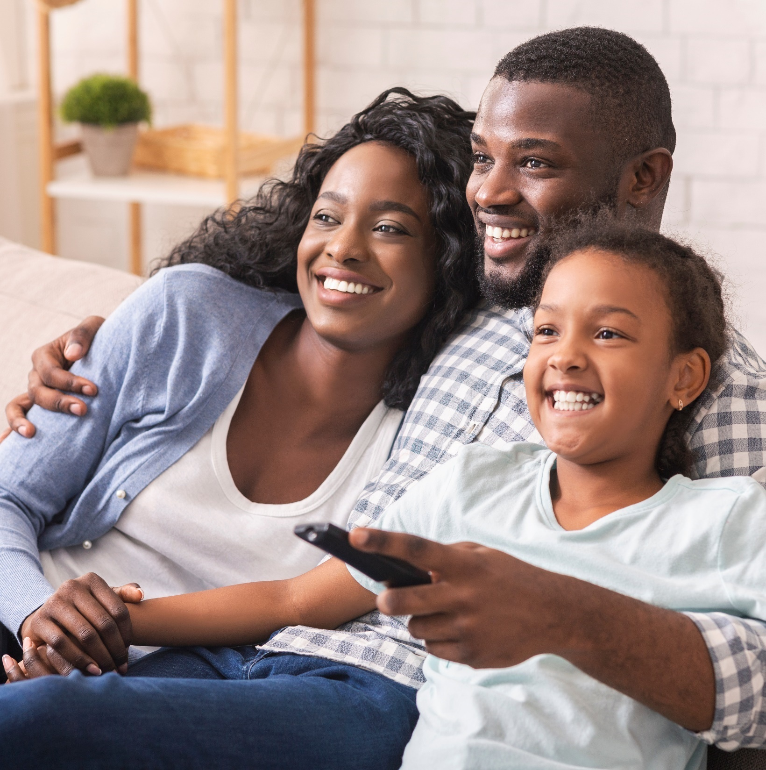



Unite, Empower, Reflect, Shop
How TV & Streaming Cultivate Richer Interactions with Black Audiences Than Social Media

Slide 2
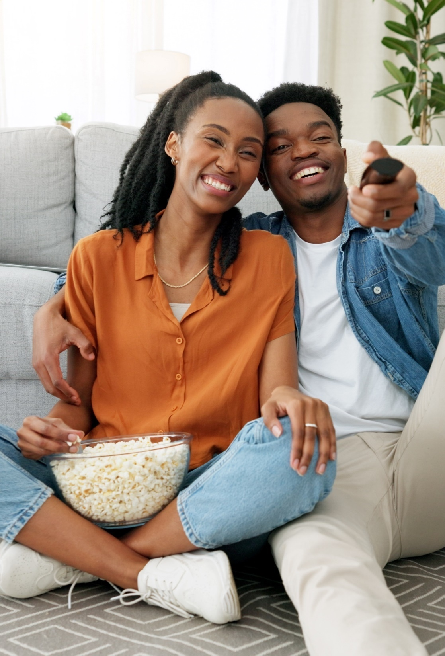

TV & Streaming deepens connections with Black audiences more than social
Black consumers seek culturally relevant content with authentic representation and storytelling that reflects their experiences. This type of content creates deep emotional connection, enriches engagement and inspires action.
Recent custom research from VAB shows that Black audiences are more engaged with the high-quality content on TV and streaming than with content
from top social media platforms.
Why does this matter?
To build and establish a deep emotional connection with Black audiences, brands should align with content that truly resonates and spurs action.
What you’ll learn:
How Black audiences’ emotions and reactions to their favorite TV & streaming content differs compared to content on leading social platforms
Why TV and streaming creates stronger connections with Black viewers than social media content
How marketers can leverage the influence of TV & streaming content to inspire action across key categories among Black audiences
*See appendix for full details on methodology behind custom survey.
This information is exclusively provided to VAB members and qualified marketers.
PAGE 2

Slide 3

The rising impact of the Black community makes them an increasingly valuable and desirable audience for marketers

Slide 4


The size and economic buying power of Black Americans is expanding, making them an increasingly valuable and culturally influential segment
~48 million
Black Americans are currently
in the U.S.
(+32% in 2022 vs. 2000)
$2 trillion
U.S. Black population estimated buying power by 2026
(vs. an estimated $1.8 trillion by 2025)*
Source: Pew Research Center, 1/18/2024. * Nielsen, Nielsen report shows growing demand for investment in more diverse media content to engage Black America, February 2024.
This information is exclusively provided to VAB members and qualified marketers.
PAGE 4

Slide 5

Marketers can reach this key segment by investing in content that features diverse representation and stories that resonate personally
90%
of Black audiences agree that having diverse representation is important to them when choosing what content to watch*
“Black viewers are among the most valuable
for media brands because historically they are much more likely to spend more time with media and entertainment.”
- Adriana Waterston, Executive VP of Insights & Strategy, Horowitz Research
Source: Horowitz, FOCUS Black: State of Media, Entertainment & Tech: Viewing Behaviors, 2024. *SambaTV, State of Diversity, June 2024.
This information is exclusively provided to VAB members and qualified marketers.
PAGE 5

Slide 6
Black audiences dedicate more time to media than the general U.S. population, with over half of that time devoted to TV
Weekly time spent with media
(hrs:mins)
Black
18+
Gen Pop
18+
Black
18-34
Gen Pop
18-34
% Diff
% Diff
Total Media
81:13
69:22
+17%
vs. gen pop
60:02
52:16
+15%
vs. gen pop
Total Use of TV*
(live, time-shifted, CTV)
44:32
32:18
+38%
vs. gen pop
25:13
18:14
+38%
vs. gen pop
TV % Share
of Total Media
55%
47%
42%
35%
Source: Nielsen, Creating connections with Black Americans across media, February 2024. *Total use of TV includes live programming, time-shifted viewing and CTV.
This information is exclusively provided to VAB members and qualified marketers.
PAGE 6

Slide 7
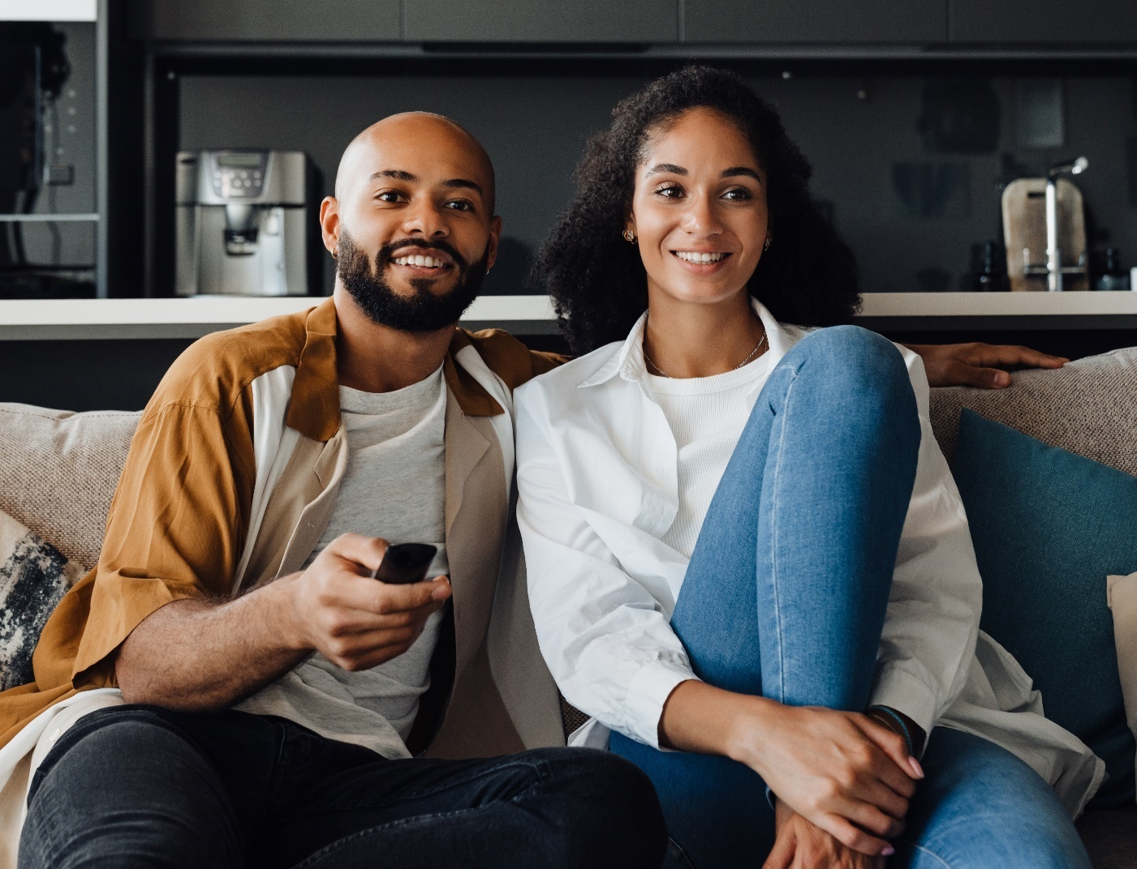
Black audiences spend more time with TV & streaming than other video platforms due to their focus on authentic stories and cultural depictions
Hours per week spent watching TV & Movies vs. Non-Premium Videos
Among weekly non-premium video content viewers (Black 13+)
Source: Hub Entertainment Research, Video Redefined, January 2024. Based on survey of 1,900 consumers, ages 13-74. Black respondents = 228 (unweighted). Data collected December 2023. ‘Non-premium video’ includes short-form or user-generated video on YouTube, influencer video content, etc.
This information is exclusively provided to VAB members and qualified marketers.
PAGE 7

Slide 8






TV & streaming resonates with Black audiences because of its high-quality environment and ability to create richer interactions
Aligning ads with emotional content can quadruple their effectiveness in creating impact and building brand equity*
What differentiates premium video content found on TV in all its forms from user-generated content (UGC) on digital platforms?
‘Emotion’ is the new ‘Premium’
‘Premium content’ – industry shorthand for advertising impact – has primarily been related to the cost of production, with more expensive programming being deemed more premium.
However, research suggests that ‘premium’ has more to do with the emotional connection viewers have with their favorite content, which can be significantly impactful at driving ad receptivity.
High Production Quality
Complex Character Development
Emotional Storytelling
Brand Safe Environment
Content Duration
Download VAB’s ‘What Is TV’ to learn more. *Source: Kantar, Harness the power of emotion in digital advertising, 3/13/2023.
This information is exclusively provided to VAB members and qualified marketers.
PAGE 8

Slide 9
VAB conducted custom research to understand how ‘emotion’ cultivates richer interactions with Black audiences

Slide 10











































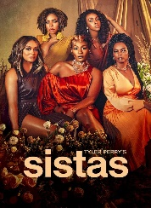




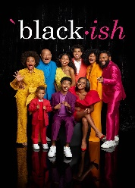
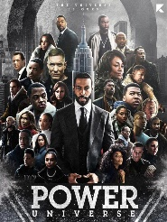
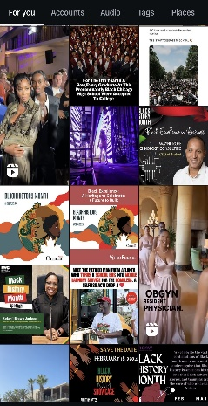
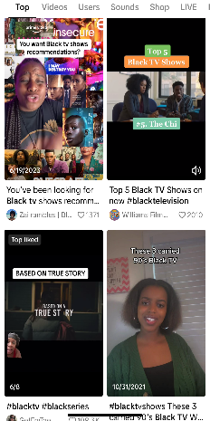
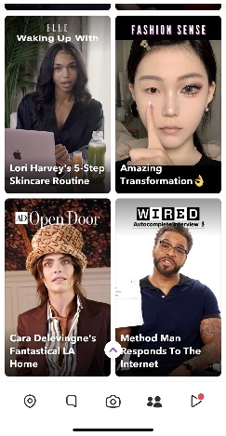
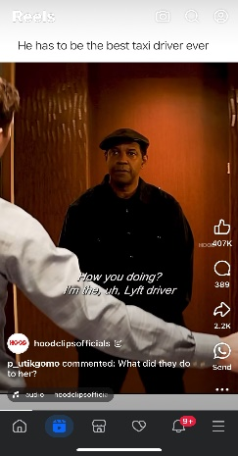
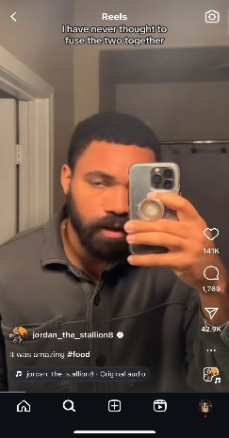


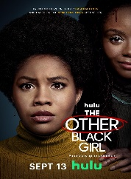
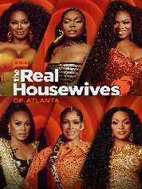
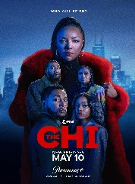


In our custom research, we sought to understand the impact that TV and streaming has on Black audiences vs. the leading social media platforms
Examples of TV & Streaming Content
High-quality, professionally-produced content on trusted and
brand-safe linear TV networks or streaming services
Leading Social Media Platforms
Typically, short-form videos on social networks which are produced by digital-native creators, online and offline media brands or ‘everyday’ social media users
This information is exclusively provided to VAB members and qualified marketers.
PAGE 10

Slide 11




Among Black audiences, TV & streaming fosters deeper emotional connections, engagement and actions compared to social platforms
Emotional Reactions
Enriched Engagement
Inspired Actions
Black audiences have strong emotional responses to TV and streaming content that resonates with their experiences, highlights their resilience and represents their rich communities and identity
Black audiences engage deeply with TV and streaming content that authentically portrays their journeys, promotes cultural pride and emphasizes relevant stories
Black consumers are heavily influenced by TV & streaming content that features authentic representation and cultural interests
Stronger Emotional Reactions
Appointment Viewing
Influences Personal Style
Deeper Personal Connections
Shared Quality Experiences
Stimulates Consumers’ Appetites
Influencers
Online Communities
Inspires Culinary Enthusiasts
Motivates DIY Projects
Encourages Cultural Impact
This information is exclusively provided to VAB members and qualified marketers.
PAGE 11

Slide 12

Black audiences experience deeper emotions and greater communal enjoyment from TV and streaming content that reflects their identity
Emotional Reactions
Enriched Engagement
Inspired Actions
Black audiences have strong emotional responses to TV and streaming content that resonates with their experiences, highlights their resilience and represents their rich communities and identity
Black audiences engage deeply with TV and streaming content that authentically portrays their journeys, promotes cultural pride and emphasizes relevant stories
Black consumers are heavily influenced by TV & streaming content that features authentic representation and cultural interests
Stronger Emotional Reactions
Appointment Viewing
Influences Personal Style
Deeper Personal Connections
Shared Quality Experiences
Stimulates Consumers’ Appetites
Influencers
Online Communities
Inspires Culinary Enthusiasts
Motivates DIY Projects
Encourages Cultural Impact
This information is exclusively provided to VAB members and qualified marketers.
PAGE 12

Slide 13
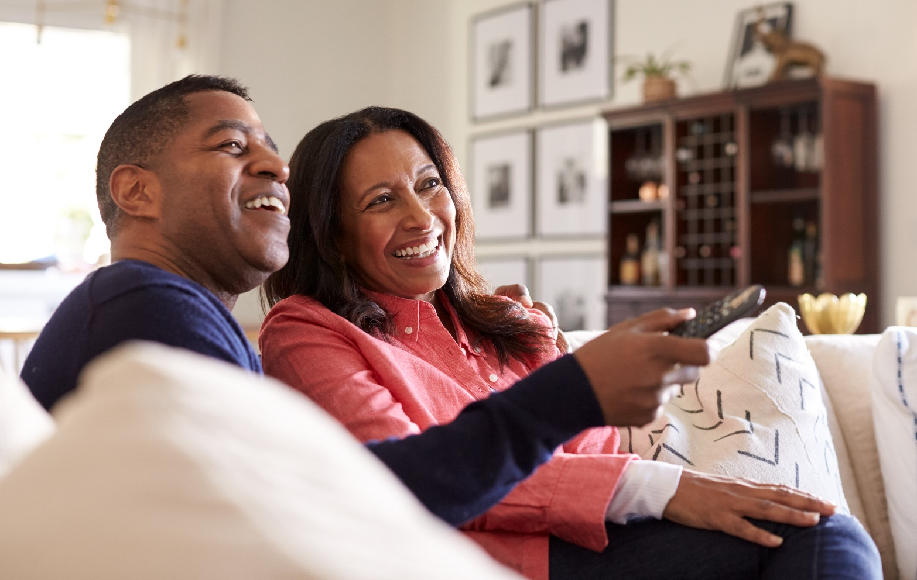





Stronger Emotional Reactions
TV and streaming shows that reflect Black experiences with humor resonate culturally and evoke more laughter than short social content
52%
% of Black viewers who have laughed out loud because of something they watched on the following platforms
TV / Streaming vs. Social Media*
% more likely
37%
+42%
of Black viewers say something they
watched on TV or streaming has
‘made me laugh out loud’
19%
+175%
VS.
35%
+50%
35%
+51%
51%
+3%
*How to read: Black viewers are 42% more likely to have laughed out loud because of something they watched in TV or streaming content vs. TikTok content
Source: VAB custom research fielded by Hub Entertainment Research as part of the 2023 Video Redefined report. Data sourced from Hub’s survey of 1,900 consumers, ages 13-74. Black respondents = 228 (unweighted). Data collected December 2023. Q1: Which of the following statements apply to you when you watch videos, shows or movies on the following platforms?
This information is exclusively provided to VAB members and qualified marketers.
PAGE 13

Slide 14
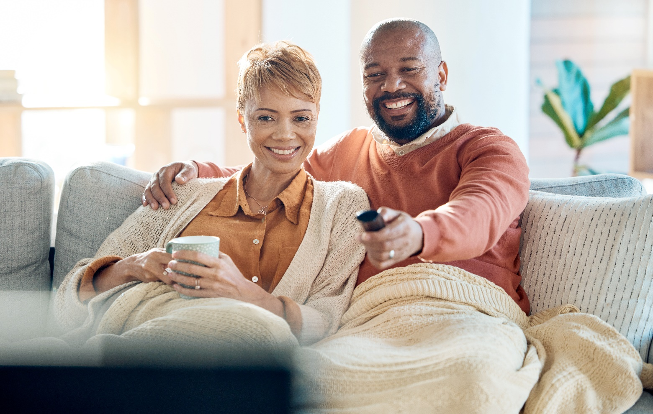

Stronger Emotional Reactions
Black audiences feel a greater sense of joy when they see characters and stories in TV & streaming that reflect their personal identities
30%
% of Black viewers who have felt overjoyed because of something they watched on the following platforms
TV / Streaming vs. Social Media*
% more likely
21%
+42%
of Black viewers say something they
watched on TV or streaming has
‘made me feel overjoyed’
12%
+159%
VS.
18%
+65%
29%
+3%
31%
-4%
*How to read: Black viewers are 159% more likely to feel overjoyed because of something they watched in TV or streaming content vs. Snapchat content
Source: VAB custom research fielded by Hub Entertainment Research as part of the 2023 Video Redefined report. Data sourced from Hub’s survey of 1,900 consumers, ages 13-74. Black respondents = 228 (unweighted). Data collected December 2023. Q1: Which of the following statements apply to you when you watch videos, shows or movies on the following platforms?
This information is exclusively provided to VAB members and qualified marketers.
PAGE 14

Slide 15


Stronger Emotional Reactions
Black viewers are more likely to be moved to tears by TV & streaming shows that reflect triumphs and struggles that they can relate to personally
28%
% of Black viewers who have cried because of something they watched
on the following platforms
TV / Streaming vs. Social Media*
% more likely
13%
+123%
of Black viewers say something they watched on TV or streaming has
‘brought me to tears’
5%
+425%
VS.
7%
+313%
16%
+77%
17%
+66%
*How to read: Black viewers are 123% more likely to cry because of something they watched in TV or streaming content vs. TikTok content
Source: VAB custom research fielded by Hub Entertainment Research as part of the 2023 Video Redefined report. Data sourced from Hub’s survey of 1,900 consumers, ages 13-74. Black respondents = 228 (unweighted). Data collected December 2023. Q1: Which of the following statements apply to you when you watch videos, shows or movies on the following platforms?
This information is exclusively provided to VAB members and qualified marketers.
PAGE 15

Slide 16


Stronger Emotional Reactions
Black audiences are more likely to have gotten angry or upset with the powerful and intense stories of TV and streaming than short social content
26%
% of Black viewers who have felt angry or upset by something they watched on the following platforms
TV / Streaming vs. Social Media*
% more likely
14%
+95%
of Black viewers say something they
watched on TV or streaming has
‘made them angry or upset’
9%
+199%
VS.
14%
+91%
23%
+13%
21%
+24%
*How to read: Black viewers are 95% more likely to feel angry or upset because of something they watched in TV or streaming content vs. TikTok content
Source: VAB custom research fielded by Hub Entertainment Research as part of the 2023 Video Redefined report. Data sourced from Hub’s survey of 1,900 consumers, ages 13-74. Black respondents = 228 (unweighted). Data collected December 2023. Q1: Which of the following statements apply to you when you watch videos, shows or movies on the following platforms?
This information is exclusively provided to VAB members and qualified marketers.
PAGE 16

Slide 17
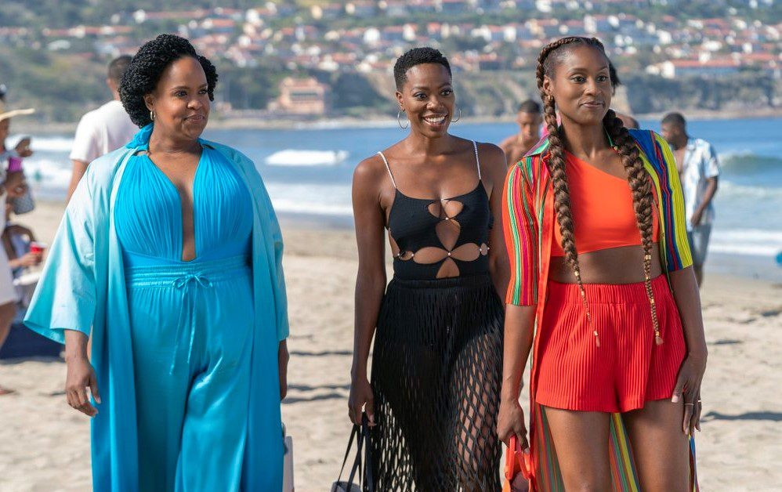

Deeper Personal Connections
Black viewers, influenced by their cultural identities and collective history, are more likely to form connections with TV and streaming personalities
% of Black viewers who feel personally connected to a character / personality from content on the following platforms
TV / Streaming vs. Social Media*
% more likely
31%
15%
+117%
9%
+266%
of Black viewers say they
‘feel personally connected to a character / personality’
from TV or streaming content
VS.
18%
+80%
19%
+63%
27%
+15%
*How to read: Black viewers are 266% more likely to feel personally connected to a character / personality from TV or streaming content vs. Snapchat content
Source: VAB custom research fielded by Hub Entertainment Research as part of the 2023 Video Redefined report. Data sourced from Hub’s survey of 1,900 consumers, ages 13-74. Black respondents = 228 (unweighted). Data collected December 2023. Q1: Which of the following statements apply to you when you watch videos, shows or movies on the following platforms?
This information is exclusively provided to VAB members and qualified marketers.
PAGE 17

Slide 18
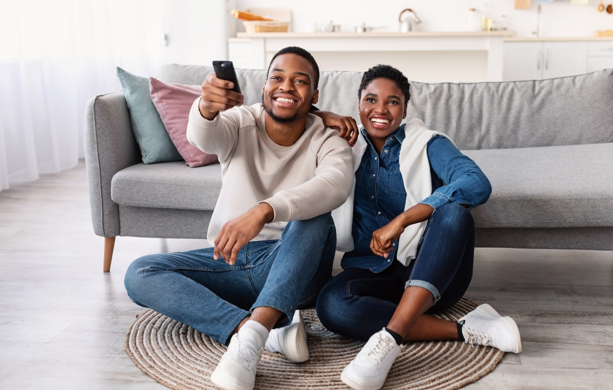

Influencers
Driven by a desire to unite on meaningful cultural narratives, Black adults enjoy sharing their TV and streaming experiences with friends
% of Black viewers who tried to convince a friend to watch a TV show, movie or video the following platforms
TV / Streaming vs. Social Media*
% more likely
25%
18%
+41%
7%
+284%
of Black viewers say they have
‘tried to convince a friend to watch a TV show, movie or video’
on TV or streaming
VS.
18%
+42%
19%
+36%
25%
+1%
*How to read: Black viewers are 284% more likely to have tried to convince a friend to watch a TV or streaming show, movie or video vs. Snapchat content
Source: VAB custom research fielded by Hub Entertainment Research as part of the 2023 Video Redefined report. Data sourced from Hub’s survey of 1,900 consumers, ages 13-74. Black respondents = 228 (unweighted). Data collected December 2023. Q1: Which of the following statements apply to you when you watch videos, shows or movies on the following platforms?
This information is exclusively provided to VAB members and qualified marketers.
PAGE 18

Slide 19
TV & streaming content with diverse representation that emphasizes relevant stories fosters greater engagement with Black audiences
Emotional Reactions
Enriched Engagement
Inspired Actions
Black audiences have strong emotional responses to TV and streaming content that resonates with their experiences, highlights their resilience and represents their rich communities and identity
Black audiences engage deeply with TV and streaming content that authentically portrays their journeys, promotes cultural pride and emphasizes relevant stories
Black consumers are heavily influenced by TV & streaming content that features authentic representation and cultural interests
Stronger Emotional Reactions
Appointment Viewing
Influences Personal Style
Deeper Personal Connections
Shared Quality Experiences
Stimulates Consumers’ Appetites
Influencers
Online Communities
Inspires Culinary Enthusiasts
Motivates DIY Projects
Encourages Cultural Impact
This information is exclusively provided to VAB members and qualified marketers.
PAGE 19

Slide 20
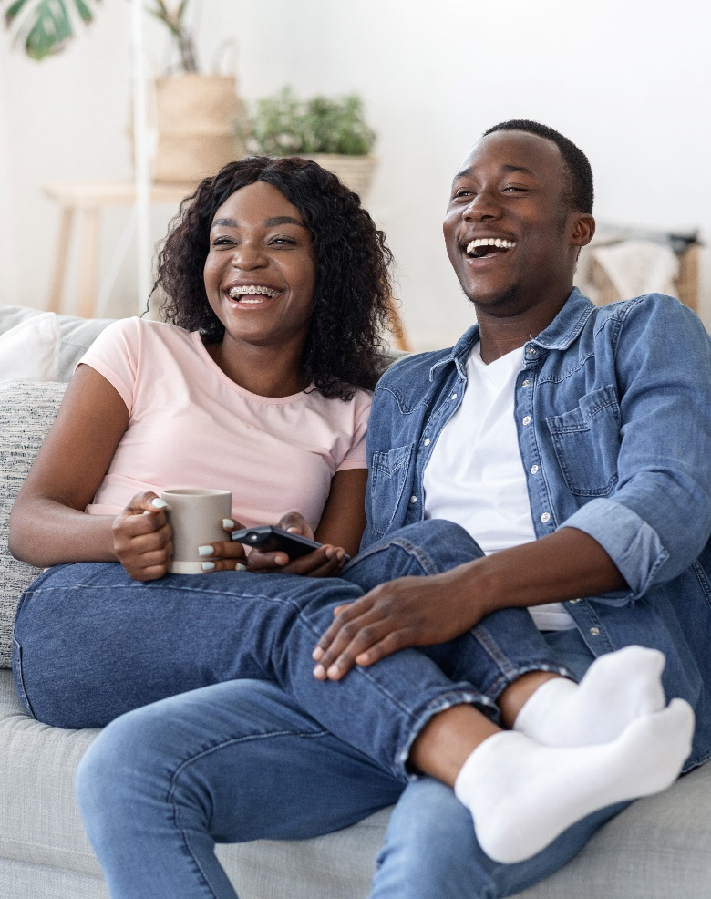
Appointment Viewing
Black audiences are voracious video viewers who are more likely to regularly set aside time to watch their favorite TV & streaming content
 | % who regularly set aside time to watch content on the following platforms | TV / Streaming vs. Social Media* % more likely
45%
22%
+110%
18%
+153%
of Black viewers say
‘I regularly set aside
time in my schedule
to watch my favorite
TV or streaming content’
+110%
22%
19%
+135%
28%
+59%
*How to read: Black viewers are 59% more likely to set aside time to enjoy their favorite TV or streaming content vs. YouTube content
Source: VAB custom research fielded by Hub Entertainment Research as part of the 2023 Video Redefined report. Data sourced from Hub’s survey of 1,900 consumers, ages 13-74. Black respondents = 228 (unweighted). Data collected December 2023. Q2: Which of the following statements apply to you when you watch something on the following platforms?
This information is exclusively provided to VAB members and qualified marketers.
PAGE 20

Slide 21

Shared Quality Experiences
Close-knit Black communities are more likely to unite with friends and family by watching TV and streaming content together
 | % of Black viewers who enjoy quality time with friends and family from content on the following platforms | TV / Streaming vs. Social Media* % more likely
38%
14%
+181%
10%
+266%
of Black viewers say they
‘enjoy the quality time they share with friends and family’ while watching TV or streaming content
15%
+148%
21%
+79%
22%
+76%
*How to read: Black viewers are 266% more likely to quality time with friends and family while watching TV or streaming content vs. Snapchat content
Source: VAB custom research fielded by Hub Entertainment Research as part of the 2023 Video Redefined report. Data sourced from Hub’s survey of 1,900 consumers, ages 13-74. Black respondents = 228 (unweighted). Data collected December 2023. Q1: Which of the following statements apply to you when you watch videos, shows or movies on the following platforms?
This information is exclusively provided to VAB members and qualified marketers.
PAGE 21

Slide 22

Online Communities
Seeking further engagement with stories and characters, Black viewers crave learning more about their favorite TV & streaming content
 | % of Black viewers who visit sites, forums and blogs on the following platforms | TV / Streaming vs. Social Media* % more likely
22%
16%
+38%
15%
+43%
of Black viewers say they
‘visit websites, forums and blogs’ when watching
TV or streaming content
17%
+30%
17%
+30%
15%
+48%
*How to read: Black viewers are 38% more likely to visit sites, forums and blogs while watching TV or streaming content vs. TikTok content
Source: VAB custom research fielded by Hub Entertainment Research as part of the 2023 Video Redefined report. Data sourced from Hub’s survey of 1,900 consumers, ages 13-74. Black respondents = 228 (unweighted). Data collected December 2023. Q2: Which of the following statements apply to you when you watch something on the following platforms?
This information is exclusively provided to VAB members and qualified marketers.
PAGE 22

Slide 23

Online Communities
Black audiences who exhibit a strong sense of cultural pride are more likely to share, post or tweet opinions or clips of TV and streaming content
 | % who share, post or tweet opinions or clips while watching content on the following platforms | TV / Streaming vs. Social Media* % more likely
20%
16%
+25%
11%
+84%
of Black viewers say when watching TV or streaming
‘they share, post or tweet opinions or clips’
+8%
18%
24%
-16%
14%
+40%
*How to read: Black viewers are 25% more likely to share, post or tweet opinions or clips while watching TV or streaming content vs. TikTok content
Source: VAB custom research fielded by Hub Entertainment Research as part of the 2023 Video Redefined report. Data sourced from Hub’s survey of 1,900 consumers, ages 13-74. Black respondents = 228 (unweighted). Data collected December 2023. Q2: Which of the following statements apply to you when you watch something on the following platforms?
This information is exclusively provided to VAB members and qualified marketers.
PAGE 23

Slide 24
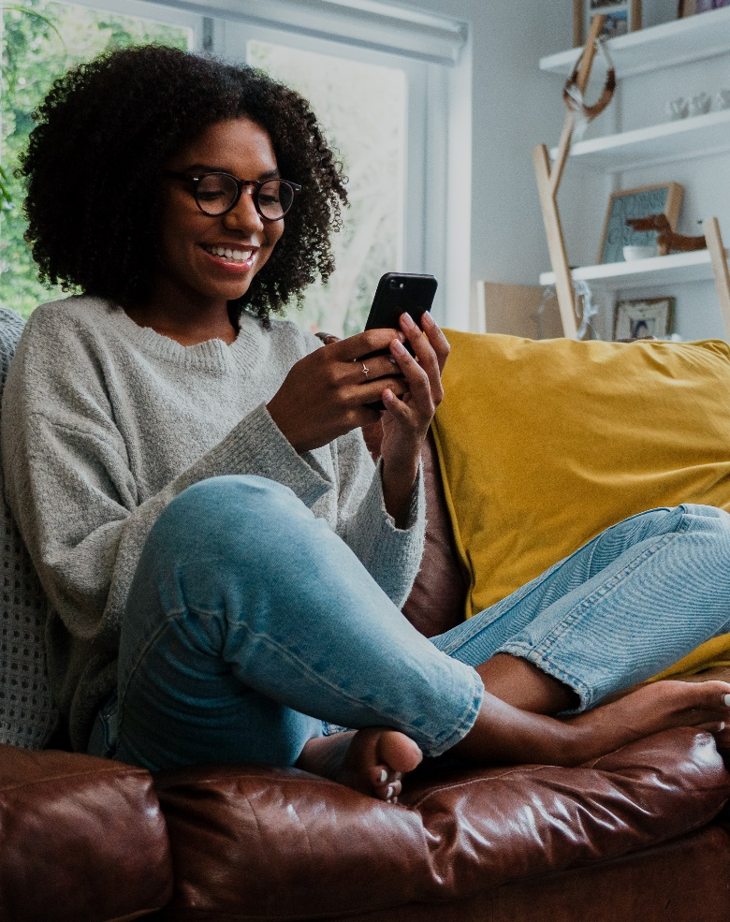
Online Communities
As avid fans, Black audiences follow personalities online from TV and streaming content that they feel resonate with their experiences
 | % who follow actors, characters or personalities from the following platforms | TV / Streaming vs. Social Media* % more likely
25%
22%
+13%
17%
+50%
of Black viewers say they
‘follow actors, characters or personalities’ from
TV or streaming content
+2%
25%
22%
+14%
24%
+8%
*How to read: Black viewers are 50% more likely to follow actors, characters or personalities from TV or streaming content vs. Snapchat content
Source: VAB custom research fielded by Hub Entertainment Research as part of the 2023 Video Redefined report. Data sourced from Hub’s survey of 1,900 consumers, ages 13-74. Black respondents = 228 (unweighted). Data collected December 2023. Q2: Which of the following statements apply to you when you watch something on the following platforms?
This information is exclusively provided to VAB members and qualified marketers.
PAGE 24

Slide 25
The resonance of TV & streaming content fosters greater inspiration and action across relevant categories for Black audiences
Emotional Reactions
Enriched Engagement
Inspired Actions
Black audiences have strong emotional responses to TV and streaming content that resonates with their experiences, highlights their resilience and represents their rich communities and identity
Black audiences engage deeply with TV and streaming content that authentically portrays their journeys, promotes cultural pride and emphasizes relevant stories
Black consumers are heavily influenced by TV & streaming content that features authentic representation and cultural interests
Stronger Emotional Reactions
Appointment Viewing
Influences Personal Style
Deeper Personal Connections
Shared Quality Experiences
Stimulates Consumers’ Appetites
Influencers
Online Communities
Inspires Culinary Enthusiasts
Motivates DIY Projects
Encourages Cultural Impact
This information is exclusively provided to VAB members and qualified marketers.
PAGE 25

Slide 26

Influences Personal Style
Retail: Black consumers have a desire to emulate cultural trends through fashion and will model their style after TV and streaming personalities
14%
% of Black consumers who have modeled their personal style after an actor or personality on the following platforms
TV / Streaming vs. Social Media*
% more likely
12%
+22%
of Black consumers say they have
‘modeled their personal style after an actor or personality’
in TV or streaming content
14%
Flat
VS.
12%
+19%
11%
+31%
9%
+53%
*How to read: Black consumers are 22% more likely to have modeled their personal style from TV or streaming content vs. TikTok content
Source: VAB custom research fielded by Hub Entertainment Research as part of the 2023 Video Redefined report. Data sourced from Hub’s survey of 1,900 consumers, ages 13-74. Black respondents = 228 (unweighted). Data collected December 2023. Q3: Which of the following actions have you taken as a result of watching something on the following platforms?
This information is exclusively provided to VAB members and qualified marketers.
PAGE 26

Slide 27

Stimulates Consumers’ Appetite
Restaurants: TV and streaming content that celebrates diverse culinary experiences inspires Black audiences to dine out
% of Black consumers who have eaten at a restaurant or purchased a cookbook seen in the following platforms
TV / Streaming vs. Social Media*
% more likely
20%
16%
+25%
16%
+24%
VS.
of Black consumers say they have
‘eaten at a restaurant because a
chef / owner / author was featured’
in TV or streaming content
15%
+32%
17%
+17%
16%
+25%
*How to read: Black consumers are 25% more likely to have eaten in a restaurant featured in TV or streaming content vs. TikTok content
Source: VAB custom research fielded by Hub Entertainment Research as part of the 2023 Video Redefined report. Data sourced from Hub’s survey of 1,900 consumers, ages 13-74. Black respondents = 228 (unweighted). Data collected December 2023. Q3: Which of the following actions have you taken as a result of watching something on the following platforms?
This information is exclusively provided to VAB members and qualified marketers.
PAGE 27

Slide 28
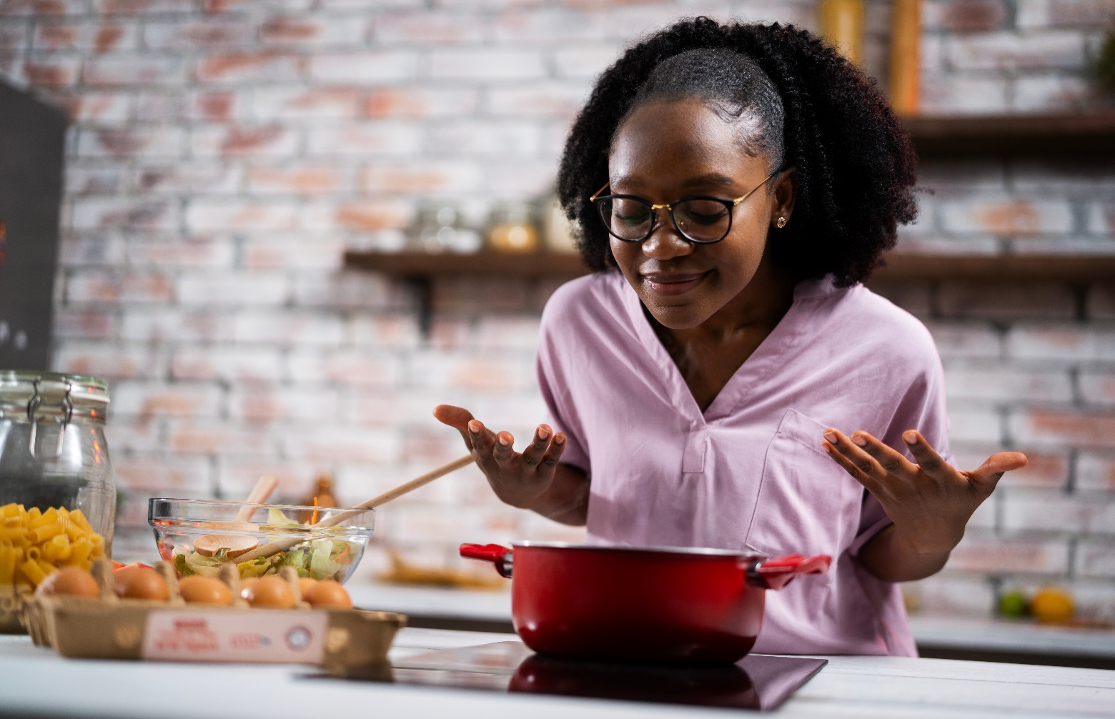
Inspires Culinary Enthusiasts
Food & CPG: Passionate about their culinary traditions, Black consumers are more likely to make a food recipe inspired from TV & streaming shows
29%
% of Black consumers who have made a food recipe inspired from content on the following platforms
TV / Streaming vs. Social Media*
% more likely
27%
+7%
18%
+63%
of Black consumers say they’ve been
‘inspired to make a food recipe’
because of TV or streaming content
VS.
23%
+31%
25%
+19%
31%
-4%
*How to read: Black consumers are 7% more likely to make a food recipe inspired from TV or streaming content vs. TikTok content
Source: VAB custom research fielded by Hub Entertainment Research as part of the 2023 Video Redefined report. Data sourced from Hub’s survey of 1,900 consumers, ages 13-74. Black respondents = 228 (unweighted). Data collected December 2023. Q3: Which of the following actions have you taken as a result of watching something on the following platforms?
This information is exclusively provided to VAB members and qualified marketers.
PAGE 28

Slide 29

Motivates DIY projects
Home: TV & streaming content is more likely to inspire Black audiences to express themselves by taking on DIY projects in their home
% of Black consumers who have completed a home improvement project inspired by content
from the following platforms
TV / Streaming vs. Social Media*
% more likely
18%
11%
+67%
9%
+92%
VS.
of Black consumers say they have
‘have completed a home improvement project inspired’
from TV or streaming content
15%
+20%
16%
+9%
20%
-14%
*How to read: Black consumers are 92% more likely to have completed a home improvement project inspired from TV or streaming content vs. Snapchat content
Source: VAB custom research fielded by Hub Entertainment Research as part of the 2023 Video Redefined report. Data sourced from Hub’s survey of 1,900 consumers, ages 13-74. Black respondents = 228 (unweighted). Data collected December 2023. Q3: Which of the following actions have you taken as a result of watching something on the following platforms?
This information is exclusively provided to VAB members and qualified marketers.
PAGE 29

Slide 30
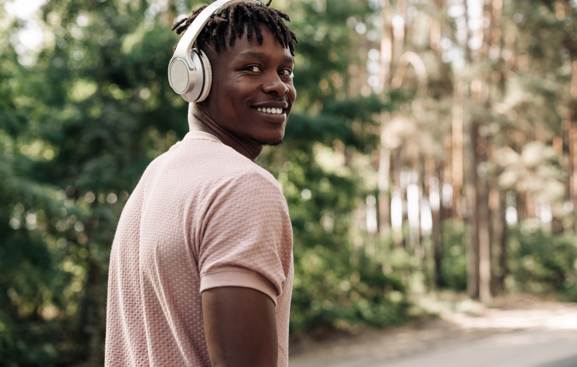
Encourages Cultural Impact
Brands Searching for Relevancy: TV and streaming content strengthens cultural ties among Black audiences who are deeply influenced by music
% of Black consumers who have listened to or purchased songs that was featured in content on the following platforms
TV / Streaming vs. Social Media*
% more likely
23%
19%
+24%
13%
+77%
of Black consumers have
‘listened to or purchased songs because it was featured’
in TV or streaming content
VS.
25%
-5%
20%
+19%
22%
+7%
*How to read: Black consumers are 77% more likely to listen to or purchase songs featured in TV or streaming content vs. Snapchat content
Source: VAB custom research fielded by Hub Entertainment Research as part of the 2023 Video Redefined report. Data sourced from Hub’s survey of 1,900 consumers, ages 13-74. Black respondents = 228 (unweighted). Data collected December 2023. Q3: Which of the following actions have you taken as a result of watching something on the following platforms?
This information is exclusively provided to VAB members and qualified marketers.
PAGE 30

Slide 31
Adults over 50 account for 36% of the total population and nearly half of all adults
Black audiences resonate more with TV & streaming content than with social media
TV and streaming content is more emotionally resonant to Black audiences than social platforms, as they form personal connections and strong bonds to storylines and characters while actively uniting others to watch content that reflects their collective cultural identity, community and experiences
TV & streaming content has a significant impact on the shopping behaviors of Black consumers across key categories like retail apparel & fashion, restaurants, consumer packaged goods, home and popular culture
Understanding what influences them from a content perspective can help marketers tailor strategies that resonate authentically with Black audiences, such as leveraging cultural representation and community values
to create meaningful connections that drive engagement
Key Marketer Takeaways
This information is exclusively provided to VAB members and qualified marketers.
PAGE 31

Slide 32
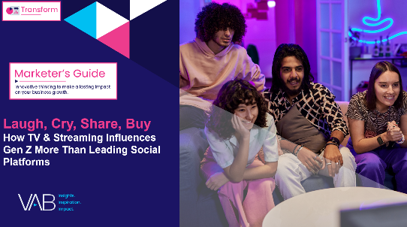
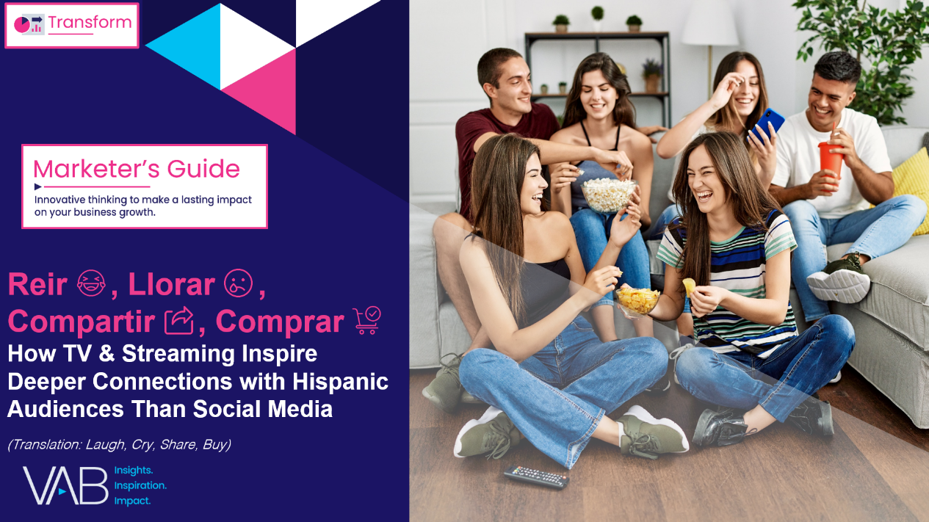

Want to learn more about content engagement between TV & Streaming and social media? Check out other custom research on Gen Z and Hispanics
Laugh, Cry, Share, Buy
How TV & Streaming Influences Gen Z More Than
Leading Social Platforms
Reir, Llorar, Compartir, Comprar
How TV & Streaming Inspire Deeper Connections
with Hispanic Audiences Than Social Media
This information is exclusively provided to VAB members and qualified marketers.
PAGE 32

Slide 33
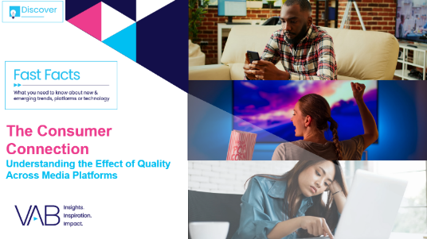
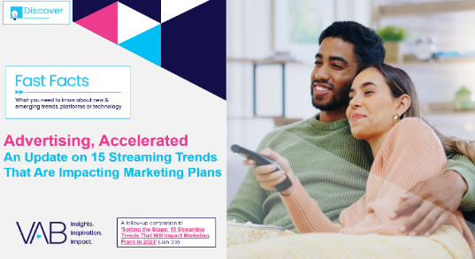
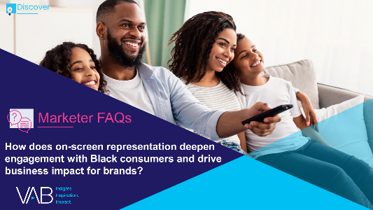
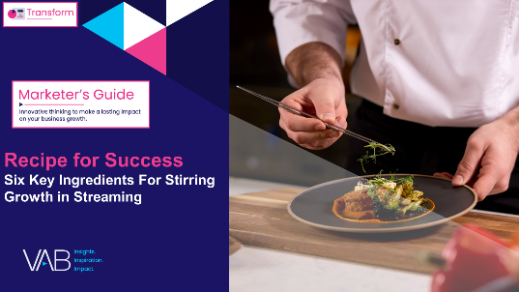

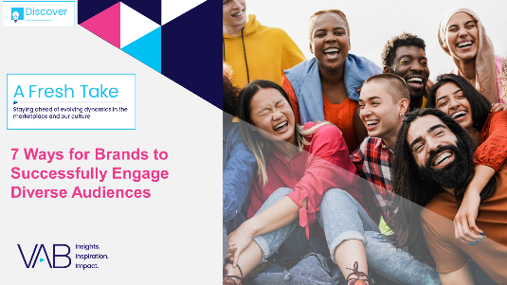
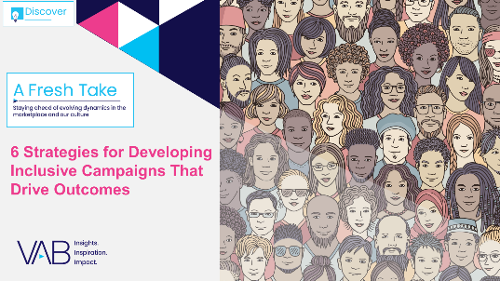
Creators
Jason Wiese
Leah Montner-Dixon
SVP, Director of Strategic Insights
jasonw@thevab.com
Director, Audience & Behavioral Insights
leahm@thevab.com
Karolina Guillen
Kaileen Cain
The Consumer Connection
Understanding the Effect of Quality Across Media Platforms
Advertising, Accelerated
An Update on 15 Streaming Trends
That Are Impacting Marketing Plans
Associate Director, Insights, Strategy & Analytics
karolinag@thevab.com
Senior Insights Analyst
kaileenc@thevab.com
Discover more
Looking for more data, insights and takeaways? Check out this related VAB content
How does on-screen representation deepen engagement with Black consumers and drive business impact for brands?
Recipe for Success
Six Key Ingredients for Stirring Growth
in Streaming
We are committed to providing marketers with the data and insights they need to develop thoughtful, inclusive campaigns & strategies. To find out more on the unique media consumption behaviors and cultural trends of diverse audiences, visit the VAB’s DEIB Marketing Resources.
7 Ways for Brands to Successfully Engage Diverse Audiences
6 Strategies for Developing Inclusive Campaigns That Drive Outcomes
This information is exclusively provided to VAB members and qualified marketers.
PAGE 33

Slide 34


About VAB
VAB plays a dual role in the video advertising industry. We are leading the change to bring about a more innovative and transparent marketplace. We also provide the insights and thought leadership that enables marketers to develop business-driving marketing strategies.
Drawing on our marketing expertise, we simplify the complexities in our industry and discover new insights that transform the way marketers look at their media strategy.
We are committed to your business growth and proud to offer VAB members, brand marketers and agencies complimentary access to our continuously-growing Insights library. Get immediate access at theVAB.com.
This information is exclusively provided to VAB members and qualified marketers.
PAGE 34

Slide 35

VAB conducted independent research to gauge how TV & streaming content resonates with Black adults relative to leading social media platforms
VAB is often asked how engagement with TV & streaming compares to leading social platforms, especially among diverse audiences.
Following our recent ‘Laugh, Cry, Share, Buy’ and ‘Reir, Llorar, Compartir y Comprar’ reports, we leveraged our custom research partnership with Hub Entertainment Research to reassess and understand how Black audiences are engaging with TV & streaming content compared to social media.
The custom study results are based on responses from online surveys
of 1,900 consumers, ages 13-74 in December 2023.
This information is exclusively provided to VAB members and qualified marketers.
PAGE 35

