Slide 1
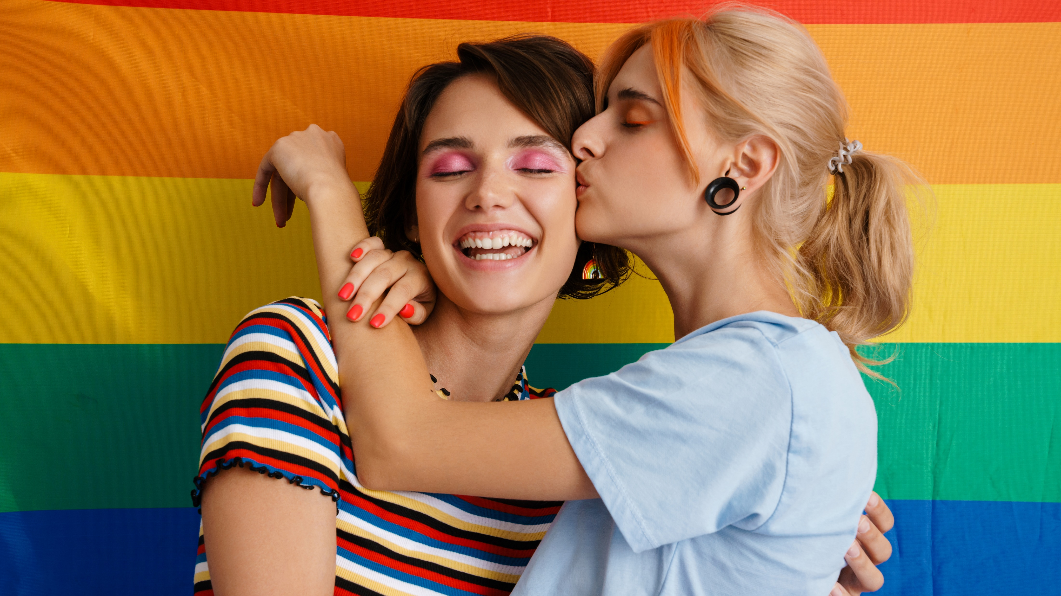




Marketer FAQs
What is the market opportunity
for the LGBTQ+ community?

Slide 2
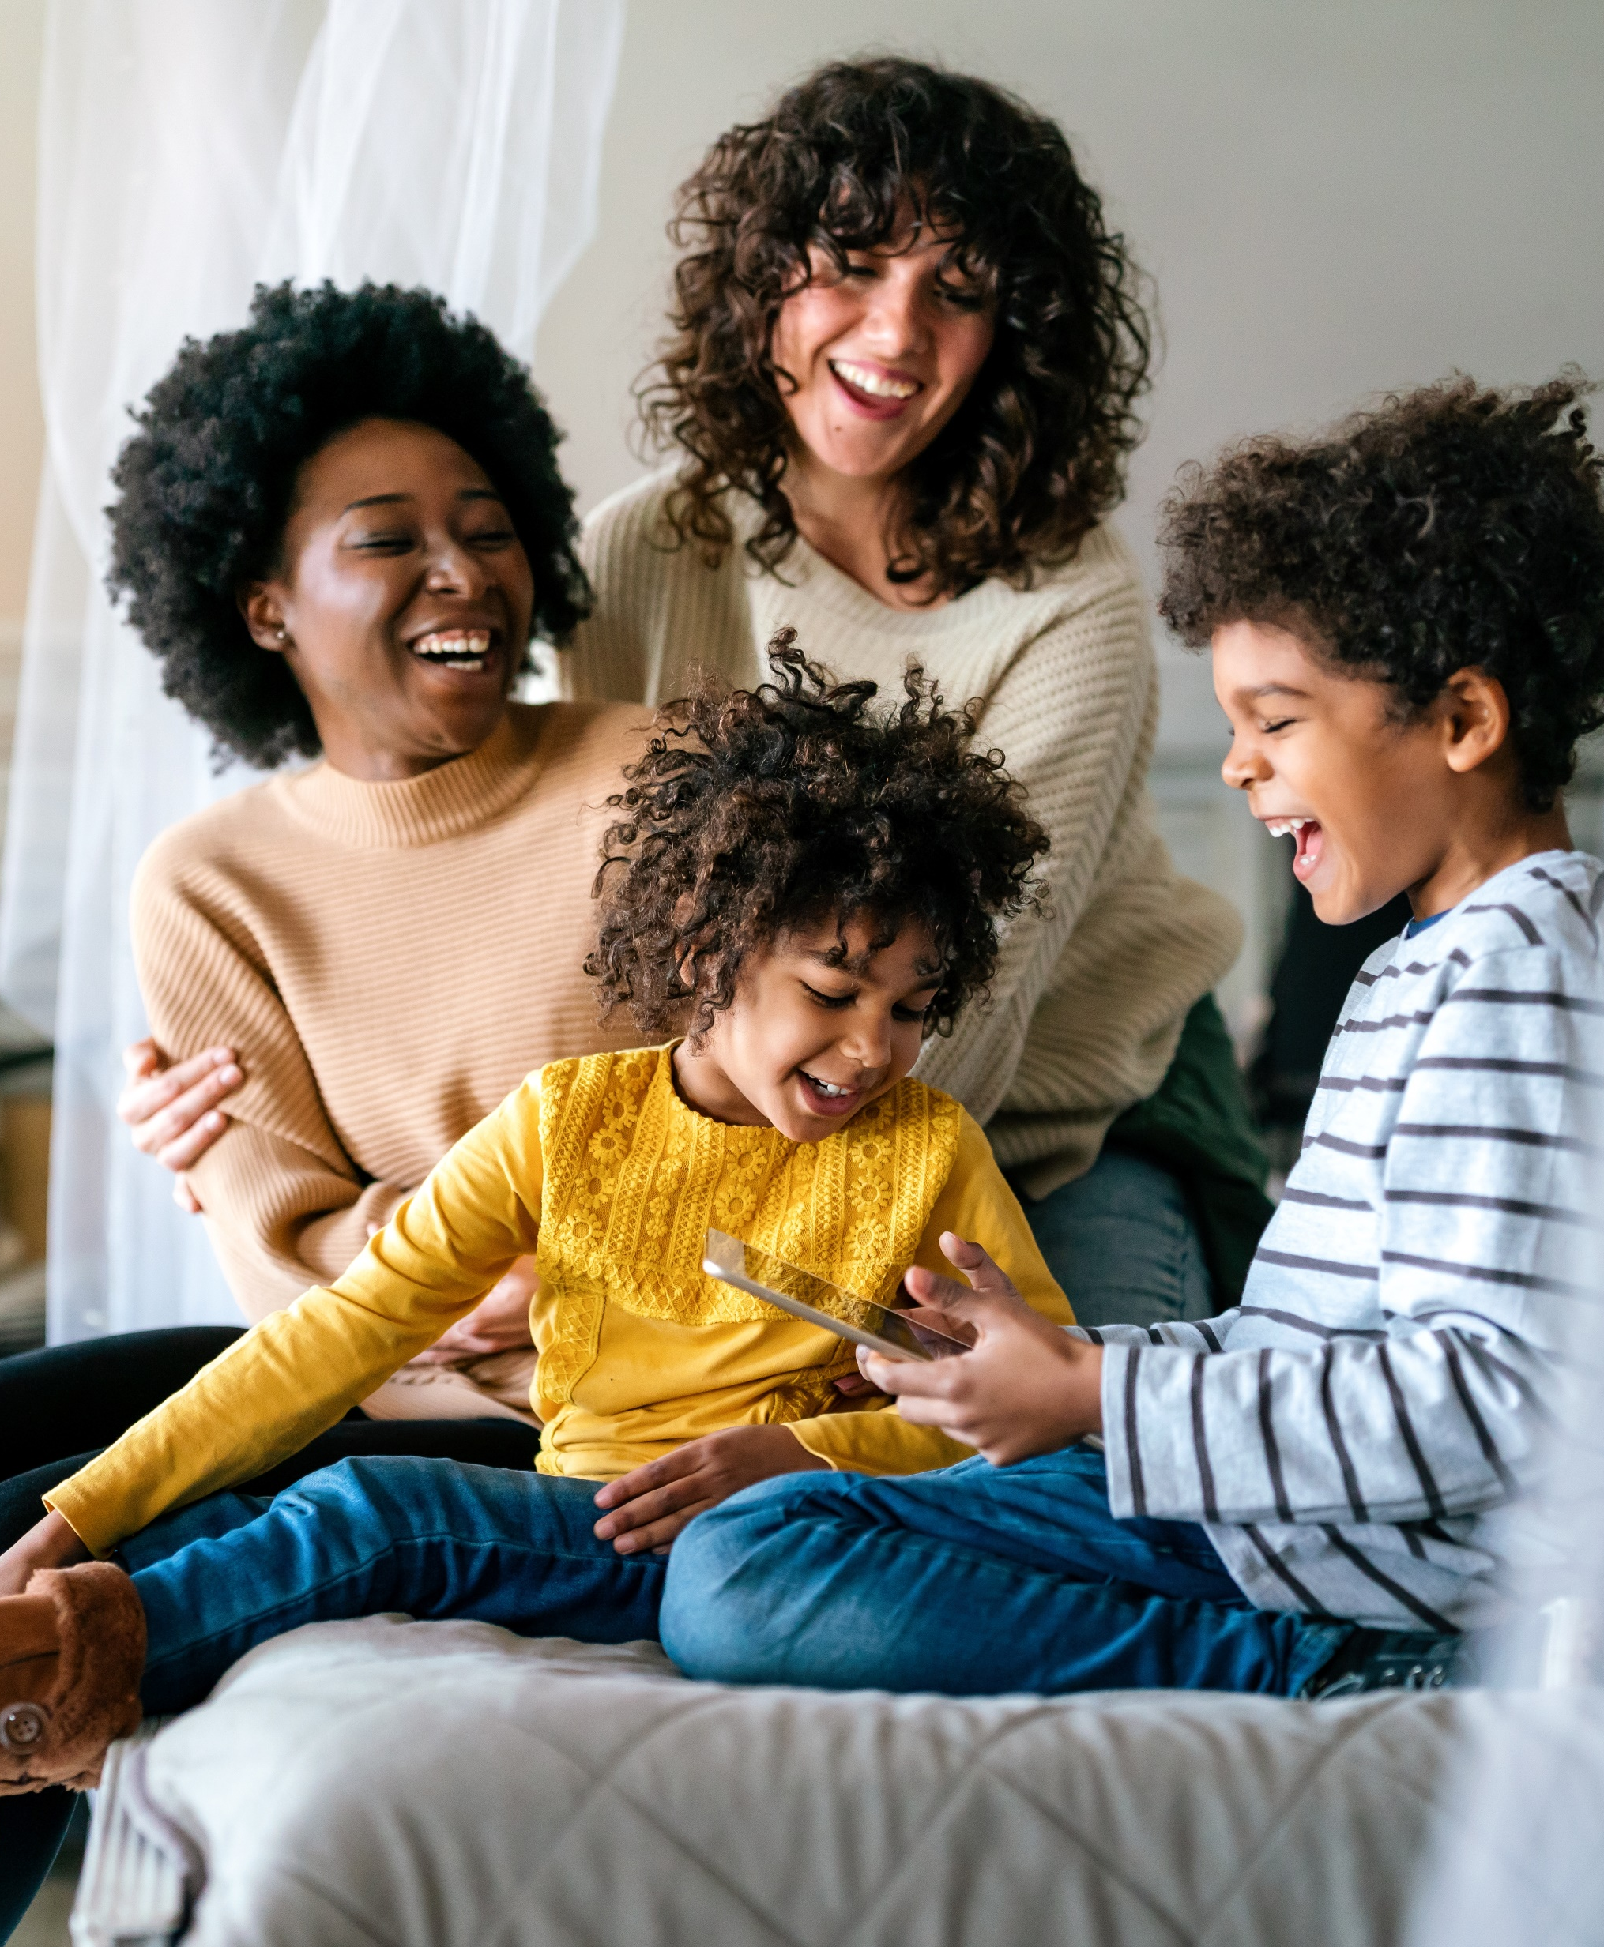
Adults over 50 account for 36% of the total population and nearly half of all adults
Marketer FAQs
Marketers may find the LGBTQ+ community challenging to understand as research for this self-identifying group can be limited and sometimes age-biased (older generations tend to under-identify).
However, as people from all walks of life and different backgrounds and ethnicities can fall anywhere within the LGBTQ+ spectrum, understanding this segment has become expected for marketers.
By staying on top of the latest trends and figures of the growing LGBTQ+ community, marketers can gain a better understanding on how to effectively engage this audience and the greater sphere of advocates to drive positive brand outcomes.
This information is exclusively provided to VAB members and qualified marketers. Further distribution is prohibited.
PAGE 2

Slide 3



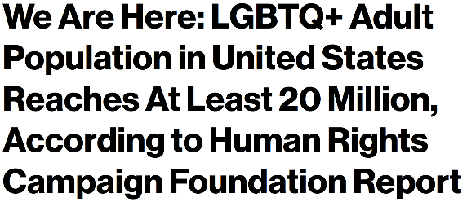
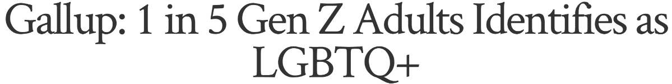
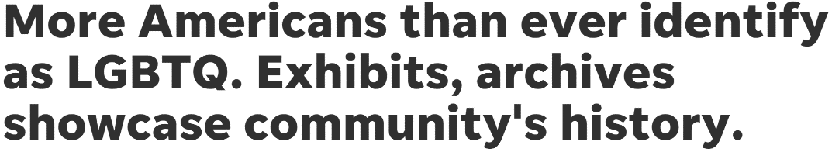
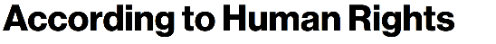
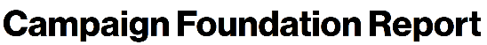
Although the LGBTQ+ community is sizeable, as a self-identifying group this segment can create a challenge for marketers looking for a definitive population universe
Population sizes of people who identify as LGBTQ+ from different sources
The Hill
Gallup
MRI-Simmons
20 MM
people identify as LGBTQ+
(~8% of the general population)
17.8 MM*
people identify as LGBTQ+
(7.1% of the general population)
13.3 MM
people identify as LGBTQ+
(5.3% of the general population)
Source: VAB analysis of MRI-Simmons Winter 2022 Study. Gallup: LGBT Identification in U.S. Ticks Up to 7.1%, 2/17/2022. The Hill: US LGBTQ+ population hits 20 million, 12/14/2021. * The Hill population size projected from % composition.
This information is exclusively provided to VAB members and qualified marketers. Further distribution is prohibited.
PAGE 3

Slide 4
Young and diverse audiences are more likely to identify as part of
the LGBTQ+ community, therefore brands can foster greater engagement with this segment through inclusivity messaging
LGBTQ Community by Generation
LGBTQ Community by Ethnicity
Index vs. A18+
79%
of people who identify as LGBTQ are between the ages of 18-49
Source: VAB analysis of MRI-Simmons Winter 2022 Study, March 2022; LGBTQ represents P18+ that identify as LGBTQ. Birth ranges for generations: Gen Z = 1997-2010, Millennials = 1977-1996, Gen X = 1965-1976, Boomers = 1946-1964. Native American refers to American Indian or Alaska Native. To derive at 100%, ethnicities were broken out by the following: White = Non-Hispanic White Only; Hispanic = Spanish or Hispanic Origin; Black = Non-Hispanic Black / African American Only; Asian = Non-Hispanic Asian; Native American = Non-Hispanic American Indian or Alaska Native.
This information is exclusively provided to VAB members and qualified marketers. Further distribution is prohibited.
PAGE 4

Slide 5
LGBTQ+ identifying consumers are similar to non-LGBTQ+ consumers when it comes to their education and income levels
Highest Education Level Completed
% of Respondents With $100k+ HHI
LGBTQ
39%
Non-LGBTQ
41%
Source: VAB analysis of MRI-Simmons Winter 2022 Study; LGBTQ represents P18+ that identify as LGBTQ & Non-LGBTQ represents P18+ that do not identify as LGBTQ.
This information is exclusively provided to VAB members and qualified marketers. Further distribution is prohibited.
PAGE 5

Slide 6

While marriage rates are flat in the U.S., LGBTQ+ marriage rates are growing and they are more likely to have children than non-LGBTQ+ couples
LGBTQ+ marriages have doubled since 2015 when same-sex marriage was legalized nationwide; this enabled more couples to form their own family units, complete with children, which has strengthened the consumer segment opportunity for marketers among these larger households
% Married
% Married with Children
+1.5%
+112%
Source: VAB analysis of MRI-Simmons Fall 2015 Study & Winter 2022 Study. ‘% Married with Children’ chart based on MRI-Simmons Winter 2022 Study. LGBTQ represents P18+ that identify as LGBTQ & Non-LGBTQ represents P18+ that do not identify as LGBTQ.
This information is exclusively provided to VAB members and qualified marketers. Further distribution is prohibited.
PAGE 6

Slide 7



The LGBTQ+ community cares passionately for the world around them, supporting and acting for the betterment of society
Their penchant for advocacy makes them good ambassadors for brands they feel connected to
Social Advocacy Attitudes
% who agree among LGBTQ P18+
86%
56%
45%
‘Working for the welfare
of society is important* to me’
‘I am more likely to purchase brands that support a cause I care about’
‘If I feel strongly about an issue,
I will participate in a civil protest’
+13% more likely than
non-LGBTQ respondents
+28% more likely than
non-LGBTQ respondents
Source: VAB analysis of MRI-Simmons Winter 2022 Study; LGBTQ represents P18+ that identify as LGBTQ. Base = any agree. *Respondents categorized this statement as ‘average importance’ or ‘very important.’
This information is exclusively provided to VAB members and qualified marketers. Further distribution is prohibited.
PAGE 7

Slide 8



LGBTQ+ consumers are more likely to be non-conforming trendsetters that try new products and have major influence over their peers
‘Influencer’ Attitudes
% who agree among LGBTQ P18+
52%
32%
27%
‘Following traditional roles
for men and women are
not important* to me’
‘People come to me for advice before buying new things’
‘I’m always one of the first
of my friends to try new products or services’
+44% more likely than
non-LGBTQ respondents
+24% more likely than
non-LGBTQ respondents
+23% more likely than
non-LGBTQ respondents
Source: VAB analysis of MRI-Simmons Winter 2022 Study; LGBTQ represents P18+ that identify as LGBTQ & Non-LGBTQ represents P18+ that do not identify as LGBTQ. Base = any agree. *Respondents categorized this statement as ‘not important.’
This information is exclusively provided to VAB members and qualified marketers. Further distribution is prohibited.
PAGE 8

Slide 9



With an affinity for the internet and technology, LGBTQ+ consumers are plugged-in; seeking out entertainment, purchases and information online
Digital Attitudes
% who agree among LGBTQ P18+
71%
69%
56%
‘The internet has become a primary source of entertainment for me’
‘I am more likely to purchase a product online than in a store’
‘When I see something interesting on TV, I often go online to find out more about it’
+18% more likely than
non-LGBTQ respondents
+11% more likely than
non-LGBTQ respondents
+18% more likely than
non-LGBTQ respondents
Source: VAB analysis of MRI-Simmons Winter 2022 Study; LGBTQ represents P18+ that identify as LGBTQ & Non-LGBTQ represents P18+ that do not identify as LGBTQ. Base = any agree.
This information is exclusively provided to VAB members and qualified marketers. Further distribution is prohibited.
PAGE 9

Slide 10
Adults over 50 account for 36% of the total population and nearly half of all adults
The LGBTQ+ community is sizeable, young and diverse and represents a growing opportunity for marketers especially as marriage rates continue to increase and their households expand.
Although it can be a challenge to understand the nuances of a segment based on identity rather than ethnicity, what differentiates them are their qualities
as social advocates, non-conformist trendsetters and digital natives.
Marketers have an opportunity to better engage with the LGBTQ+ community through their video campaigns, using tactics like audience-based buying and contextual targeting to drive engagement and connect with this audience.
Key Implications for Marketers
This information is exclusively provided to VAB members and qualified marketers. Further distribution is prohibited.
PAGE 10

Slide 11

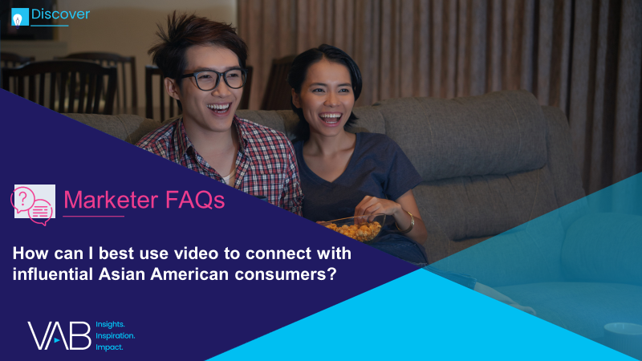
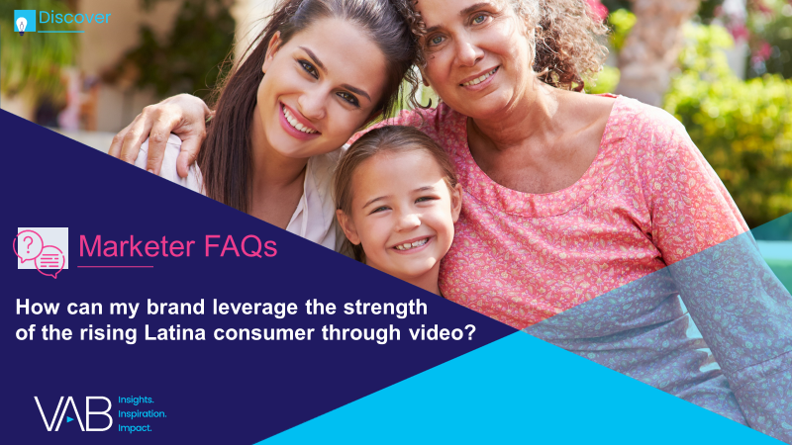
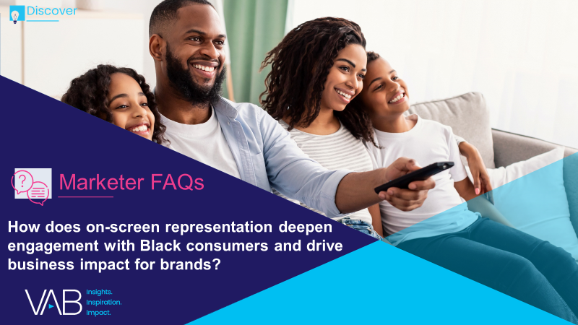
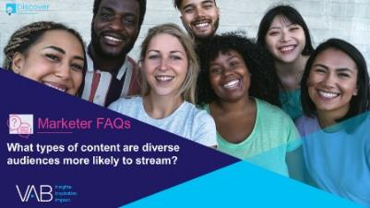
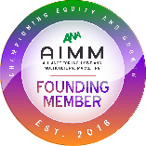
Adults over 50 account for 36% of the total population and nearly half of all adults
Creators
Jason Wiese
Reed Kiely
SVP, Director of Strategic Insights jasonw@thevab.com
Associate Insights Director
reedk@thevab.com
Karolina Guillen
Insights Manager
karolinag@thevab.com
Discover more
Looking for more data, insights and takeaways? Check out this related VAB content
How can I best use video to connect with influential Asian American consumers?
How can my brand leverage the strength of the rising Latina consumer through video?
We are committed to providing marketers with the data and insights they need to develop thoughtful, inclusive campaigns & strategies. To find out more on the unique media consumption behaviors and cultural trends of multicultural consumers, visit the VAB’s Multicultural Marketing Resource Center.
How does on-screen representation deepen engagement with Black consumers and drive business impact for brands?
What types of content are diverse audiences more likely to stream?
VAB Members, brand marketers and agencies get free and immediate access to VAB’s content library. Get access at theVAB.com
This information is exclusively provided to VAB members and qualified marketers. Further distribution is prohibited.
PAGE 11

Slide 12


About VAB
VAB is an insights-driven organization that inspires marketers to reimagine their media strategies resulting in fully informed decisions.
Drawing on our marketing expertise, we simplify the complexities in our industry and discover new insights that transform the way marketers look at their media strategy.
We are committed to your business growth and proud to offer VAB members, brand marketers and agencies complimentary access to our continuously-growing Insights library. Get immediate access at theVAB.com.
Curious to learn more about VAB? Check out this quick video to see what we do and how we can help you develop business-driving marketing strategies.
This information is exclusively provided to VAB members and qualified marketers. Further distribution is prohibited.
PAGE 12

