Slide 1





2022
Under Pressure
6 marketing strategies to successfully navigate your brand through inflation

Slide 2
What You’ll Learn…
During periods of inflation, consumers are increasingly price sensitive and may be looking more critically at what they purchase. As a result, many marketers are grappling with how they should pivot their strategy to maintain market share and consumer relevance…
How do I ensure that consumers continue to believe my product is worth paying for?
How should I rethink my messaging, media touchpoints and investment approach to better resonate with distressed consumers…and protect my bottom line?
This piece provides guidance to successfully navigate this challenging consumer environment:
See what consumers are saying about inflation – to what degree do they feel impacted? Which categories are most vulnerable (and which aren’t)?
Learn how the industry has begun to react – what level of stagnation is predicted and what is the ad revenue forecast?
Equip yourself with the 6 marketing success strategies – based on real brand examples and proven marketing principles, learn the winning formula that protects - and grows - brands during periods of economic stress
This information is exclusively provided to VAB members and qualified marketers. Further distribution is prohibited.
PAGE 2

Slide 3

Rising Prices, Rising Concerns
Inflation is impacting consumers minds and wallets

Slide 4
As Americans navigate a turbulent time, inflation is overwhelmingly their top concern, even above gun violence, racism and unemployment
% who say each of the following is ‘a very big problem’ in the country today
Source: Pew Research Center, By a wide margin, Americans view inflation as the top problem facing the country today, 5/12/22. Based on survey of U.S. adults conducted April 25 – May 1, 2022.
This information is exclusively provided to VAB members and qualified marketers. Further distribution is prohibited.
PAGE 4

Slide 5
The current rate of inflation is at the highest it has been in more than
40 years, driven by a range of factors including the pandemic and its impact on supply and demand, as well as the war in Ukraine
How much of an impact, if any at all, do you think the following
have had on price increases in the past year?
% of respondents who answered ‘major’ or ‘significant’ impact
In June 2022, on average, the price
of goods and services increased
9.2%
Increase in Consumer Price Index* for all items
in June 2022, reflecting the largest 12-month increase
since November 1981
Source: Bureau of Labor Statistics Consumer Price Index News Release, 7/13/22. *The Consumer Price Index (CPI) is a measure of the average change over time in the prices paid by urban consumers for a market basket of consumer goods and services. Ipsos & FiveThirtyEight, 2022 Election Tracking Survey. Data based on poll conducted April 27 – May 5, 2022 on behalf of FiveThirtyEight using the probability-based KnowledgePanel®. This poll is based on a nationally representative probability sample of 2,006 adults age 18 or older interviewed online in English and Spanish.
This information is exclusively provided to VAB members and qualified marketers. Further distribution is prohibited.
PAGE 5

Slide 6

As a result of rising costs and a decline in purchasing power, Americans are actively searching for cheaper alternatives
% of people who agree that the following statement applies to them
Source: Ipsos, Here’s how inflation is affecting our shopping, June 2022. Ipsos Coronavirus Consumer Tracker, fielded May 24 – 25, 2022 among 1,120 U.S. adults. Q: For each statement below, please indicate whether or not this applies to you. – ‘Yes’ summary.
This information is exclusively provided to VAB members and qualified marketers. Further distribution is prohibited.
PAGE 6

Slide 7
Many Americans have been forced to cut their spending in order to either stay within their means or to save money
In the last six months, have you cut back spend on…
52%
42%
42%
39%
41%
38%
31%
30%
32%
30%
23%
22%
25%
22%
18%
15%
16%
11%
Source: YouGov via Adweek. Based on survey of nearly 2,300 Americans completed in early June 2022. “Necessary” spend cuts refer to those made by consumers to stay within their means. “Discretionary” spend cuts refer to those consumers willing make to save money.
This information is exclusively provided to VAB members and qualified marketers. Further distribution is prohibited.
PAGE 7

Slide 8



The type and severity of cutbacks vary by financial status, with lower income homes increasingly worried about affording the necessities
Americans’ Financial Worries, by Annual Household Income
% of respondents who feel very/moderately worried
<$40K Household Income
$100K+ Household Income
Not Having Enough Money to Pay Monthly Bills
Paying Rent, Mortgage, Other Housing Costs
Paying Medical Costs in the Event of Serious Illness or Accident
66% / 18%
59% / 15%
72% / 37%
+15% pp / +11% pp vs. 2021
+12% pp / +8% pp vs. 2021
+10% pp / -2% pp vs. 2021
Source: Gallup Poll Social Series, Americans' Financial Worries Tick Up in Past Year, May 2022. PP = percentage point.
This information is exclusively provided to VAB members and qualified marketers. Further distribution is prohibited.
PAGE 8

Slide 9


While affluent homes have felt a less direct effect, they are more concerned about having savings for major milestones
Americans’ Financial Worries, by Annual Household Income
% of respondents who feel very/moderately worried
<$40K Household Income
$100K+ Household Income
Not Having Enough Money for Retirement
Not Having Enough Money to Pay for Child’s College Education
75% / 54%
37% / 31%
+12% pp / +8% pp vs. 2021
-2% pp / N/A vs. 2021
Source: Gallup Poll Social Series, Americans' Financial Worries Tick Up in Past Year, May 2022. PP = percentage point.
This information is exclusively provided to VAB members and qualified marketers. Further distribution is prohibited.
PAGE 9

Slide 10
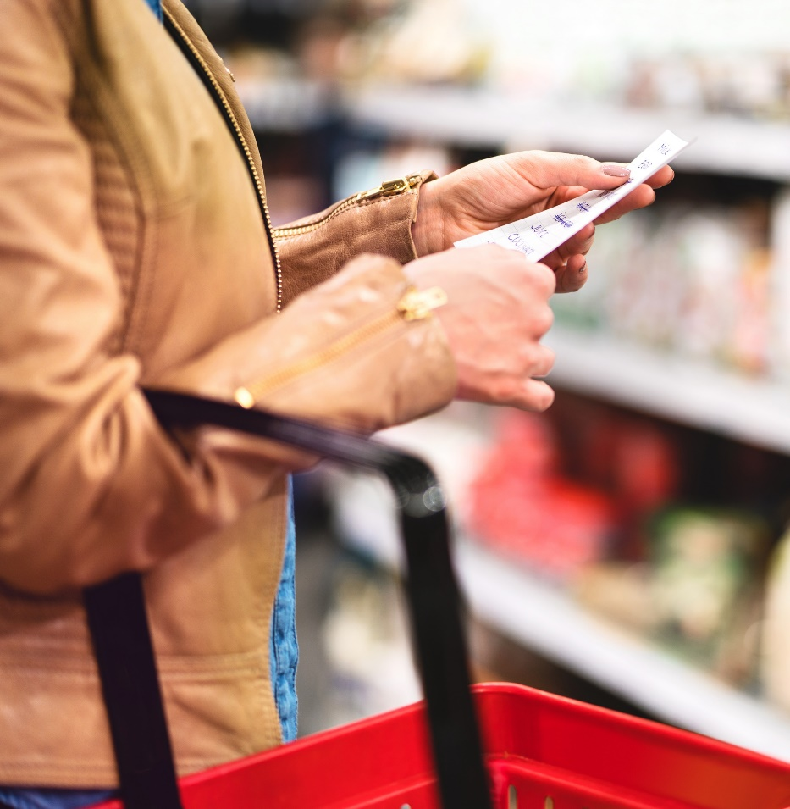
Regardless of the current economic uncertainties, the average American is still spending more than they were a year ago as they eagerly resume their pre-pandemic lifestyles
Increases in monthly spend are primarily driven by the more financially secure Americans
% change in reported monthly spending by income
From May 2021 to May 2022
Less than $50K
U.S. Household Population by Income (000)
All Households
129,231
Under $50K
49,106
(38% of total pop)
$50K+
80,825
(63% of total pop)
Source: Morning Consult, U.S. Household Finances & Consumer Spending Report, June 2022, U.S. adults. Morning Consult Economic Intelligence, Bureau of Labor Statistics. U.S. Census Bureau, Current Population Survey, 2021 Annual Social and Economic Supplement (CPS ASEC); Selected Characteristics of Households by Total Money Income in 2020.
This information is exclusively provided to VAB members and qualified marketers. Further distribution is prohibited.
PAGE 10

Slide 11

With many consumers still resisting changes to their post-lockdown lifestyle, most brands have not yet experienced a major impact to their bottom line
Impact of rising inflation rates on business as of April 2022
Among Brand Marketers
68%
‘No Impact’
or ‘Slight Negative Impact’
Source: Advertiser Perceptions, Monthly Omnibus, April 2022.
This information is exclusively provided to VAB members and qualified marketers. Further distribution is prohibited.
PAGE 11

Slide 12
However, economists are predicting that economic challenges may persist into 2023, so marketers should prepare for stagnating consumer spending
Real Consumer Spending Outlook, 2020 - 2023
percentage change quarter-over-quarter, seasonally adjusted annual rates
Source: The Conference Board Economic Forecast for the U.S. Economy, July 12, 2022.
This information is exclusively provided to VAB members and qualified marketers. Further distribution is prohibited.
PAGE 12

Slide 13
Because of this predicted stagnation, marketer spend is also forecasted to slow down in the second half of 2022 into 2023
+
+
+
+
+
N/A*
Source: *Consensus = simple average across the media divisions of all four major agency holding companies (Dentsu, GroupM, Magna, Zenith). ‘Revised Forecast’ based on GroupM, Magna and Zenith U.S. media spend forecast from June 2022, Dentsu from July 2022. ‘Previous Forecast’ based on prior U.S. media spend forecasts: Zenith – July 2021, GroupM – December 2021, Dentsu – January 2022, Magna – 2022. *NA = data not available as 2023 projections from GroupM and Magna were not available until their most recent forecasts (‘revised’) released in June 2022.
This information is exclusively provided to VAB members and qualified marketers. Further distribution is prohibited.
PAGE 13

Slide 14
Higher the Stakes, Higher the Reward
Marketers who invest in advertising during an inflationary period reap long-term rewards

Slide 15






Six Marketing Strategies to Successfully Navigate Your Brand Through An Inflationary Period
1
2
3
Continue building brand equity
Rethink creative with a focus on empathy
Leverage personalized messaging
4
5
6
Demonstrate your brand’s unique value and point of differentiation
Prioritize customer service
& experience to attract
repeat business
Reward loyalty among
new & existing customers
This information is exclusively provided to VAB members and qualified marketers. Further distribution is prohibited.
PAGE 15
This information is exclusively provided to VAB members and qualified marketers. Further distribution is prohibited.

Slide 16

1
Continue Building Brand Equity

Slide 17
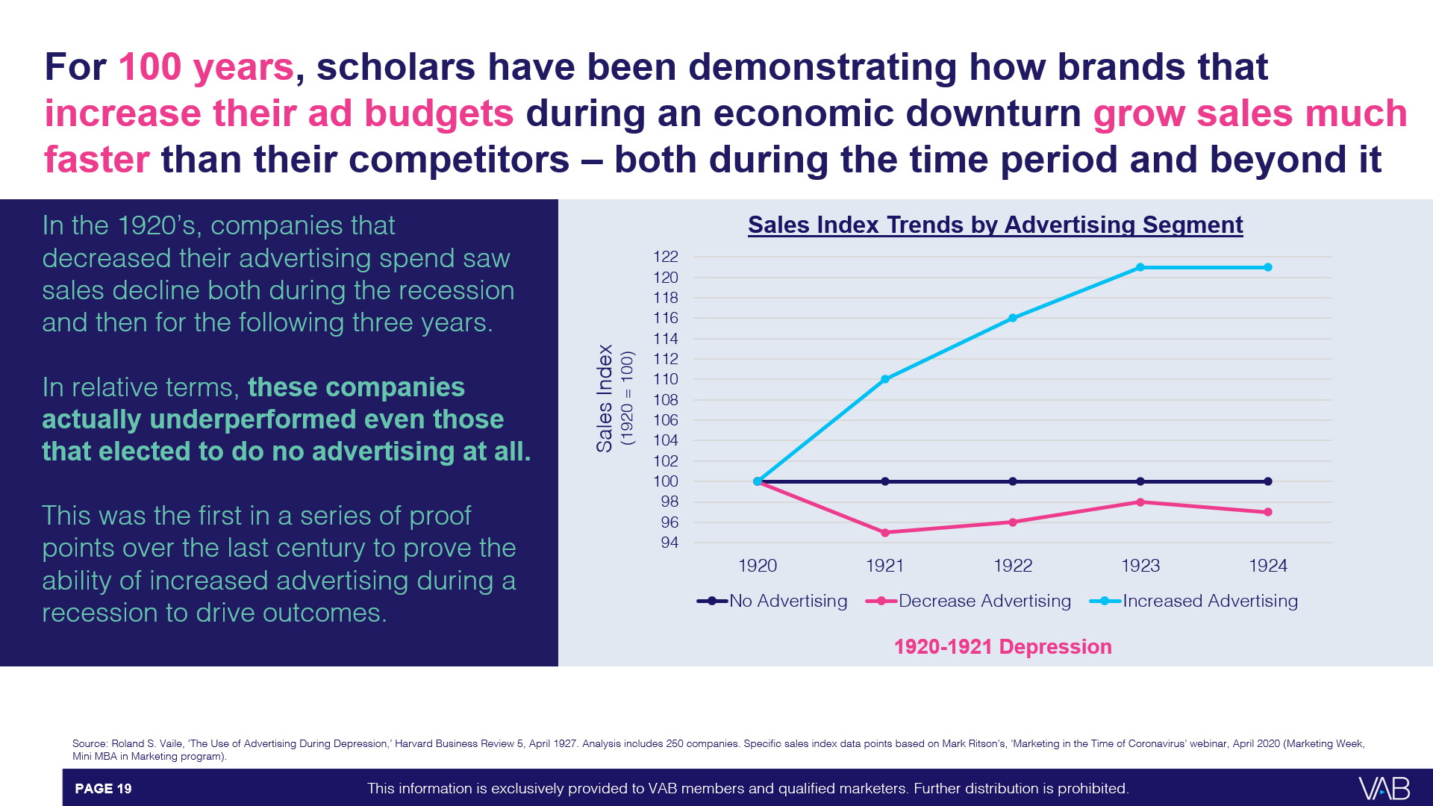
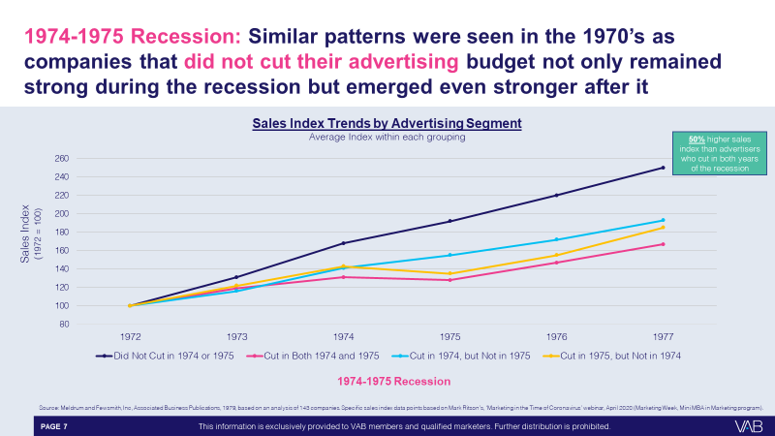
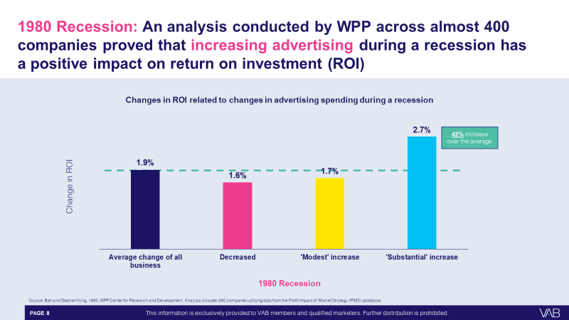
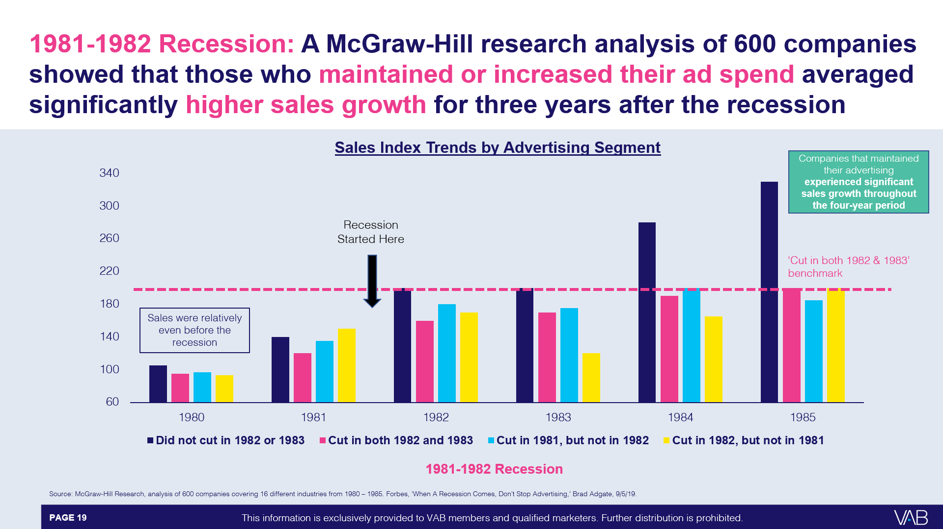
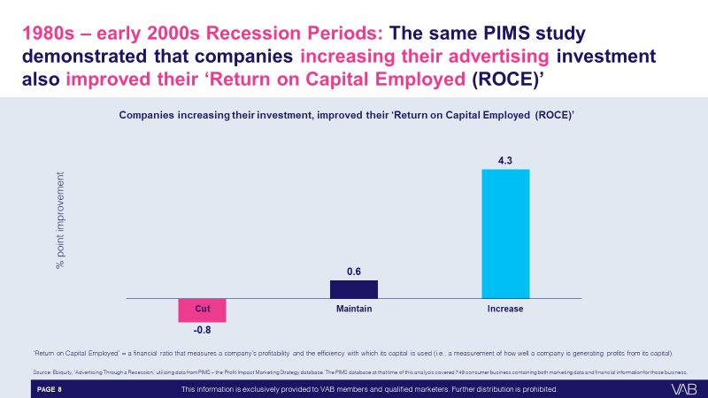
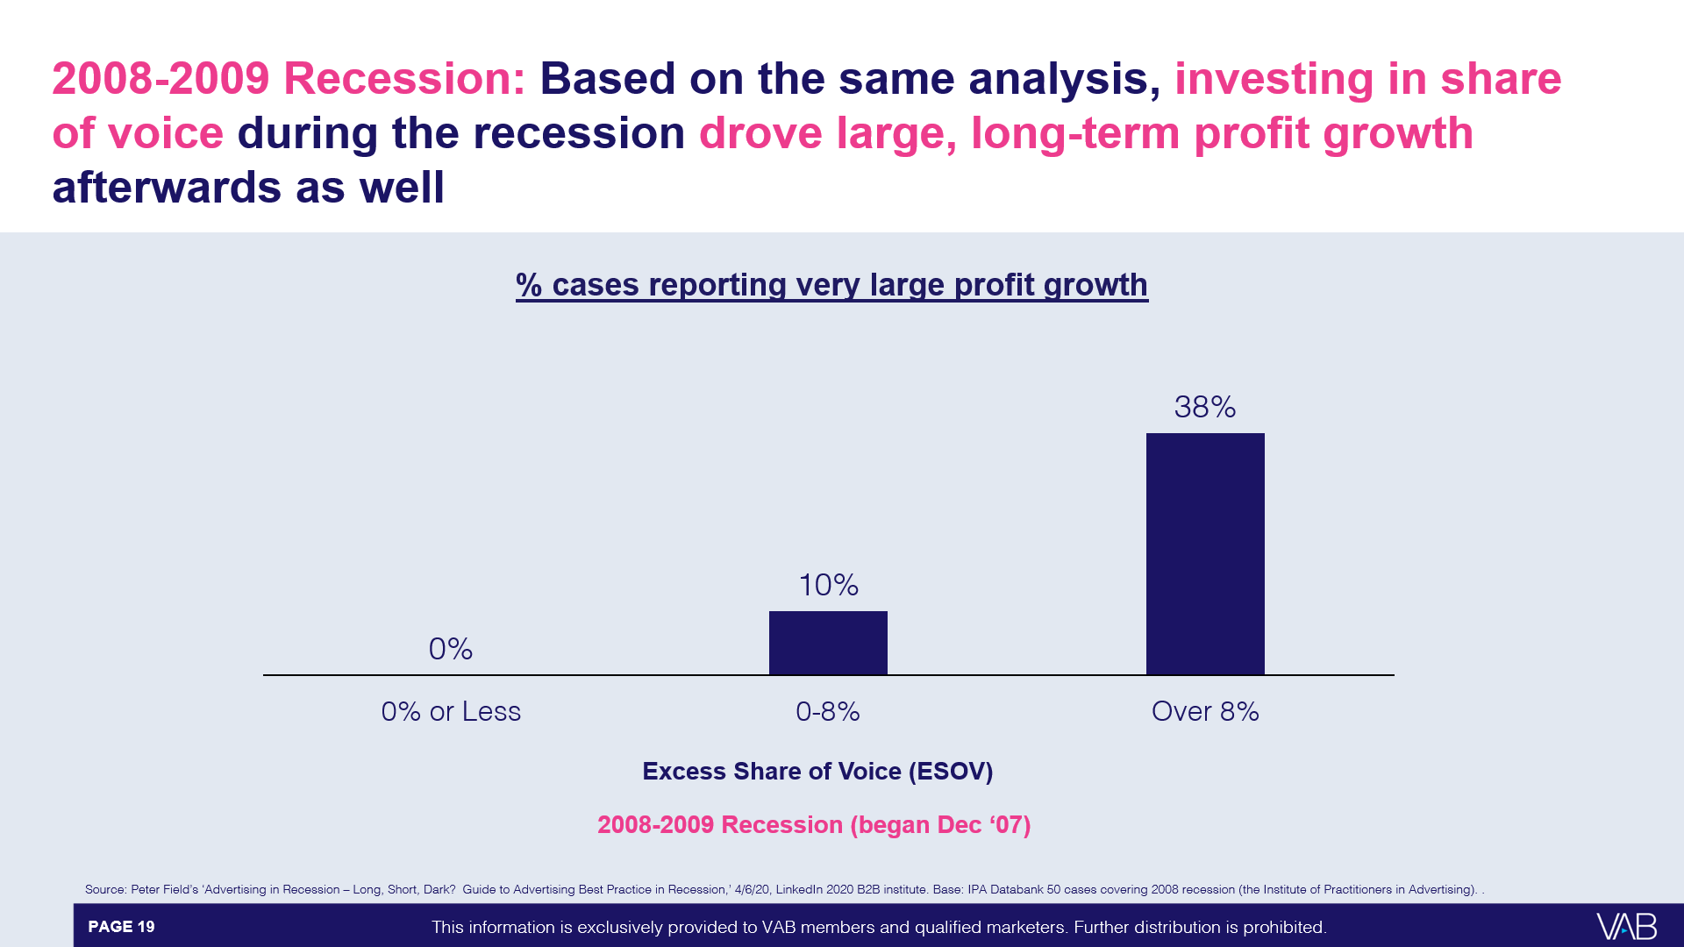
100 years of analyses demonstrate how brands that invest in their brand equity during times of economic uncertainty grow sales faster than their competitors – both during the time period and beyond it
To learn more, download: Keep Calm and Advertise On: How to Successfully Navigate Your Brand Through an Economic Downturn
To learn more, download: Keep Calm and Advertise On: How to Successfully Navigate Your Brand Through an Economic Downturn
This information is exclusively provided to VAB members and qualified marketers. Further distribution is prohibited.
PAGE 17

Slide 18
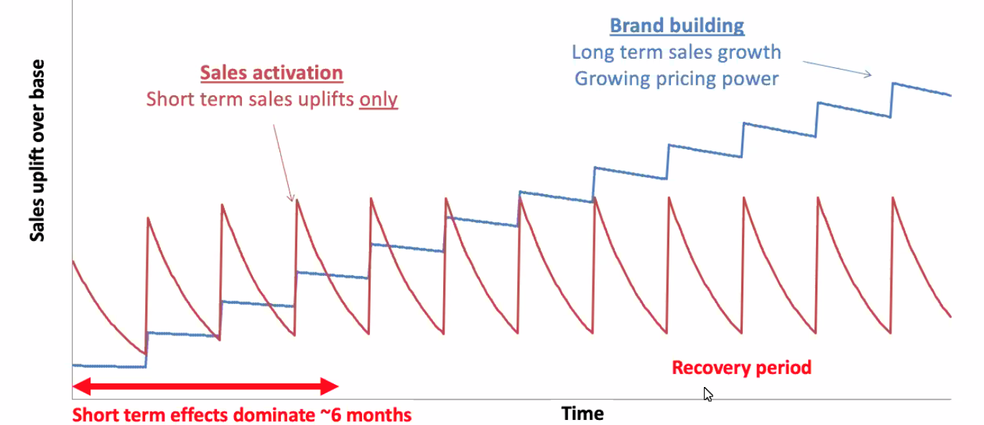
Brand building strategies particularly matter during economic downturns
as they provide long-term sales growth and increased pricing power
Source: Binet & Field, 2013. ‘The Long and the Short of It: Balancing Short and Long-Term Marketing Strategies. To learn more, download: Keep Calm and Advertise On: How to Successfully Navigate Your Brand Through an Economic Downturn
This information is exclusively provided to VAB members and qualified marketers. Further distribution is prohibited.
PAGE 18

Slide 19

“Companies that have spent time, resources and focus on
building brand equity prior to and through COVID may see the benefit of that investment, as they seek to convince consumers they are a worthy contender for their diminishing discretionary income.”
Nancy Lan
National Managing Director, Starcom
AdNews, 6/8/22
This information is exclusively provided to VAB members and qualified marketers. Further distribution is prohibited.
PAGE 19

Slide 20

During COVID, consumers built stronger emotional bonds with their favorite brands and companies, illustrating the outsized equity and love formed during uncertain times
‘I feel an emotional connection to the brand I buy from the most’
% of consumers who agree with the following
+17%
vs. 2020
Pre-Covid
Today
Source: Salesforce, State of the Connected Consumer, 2022. Base = 13,020 consumers among 29 countries.
This information is exclusively provided to VAB members and qualified marketers. Further distribution is prohibited.
PAGE 20

Slide 21



Customers with strong brand love are more likely to overlook reasonable price increases, even citing “empathy” for the business
% of people that agree with the following statements
81%
73%
71%
“I have empathy for small businesses that need to increase prices due
to inflation or shortages.”
“I am willing to continue to buy from companies that increase their prices if I feel valued as a customer.”
"I have empathy for companies where I've been a long-time customer when they need to increase their prices due
to inflation or shortages."
Source: Ipsos, Here’s how inflation is affecting our shopping, June 2022. Ipsos Coronavirus Consumer Tracker, fielded May 24 – 25, 2022 among 1,120 U.S. adults. Q: How much do you agree or disagree with the following statements – agree summary.
This information is exclusively provided to VAB members and qualified marketers. Further distribution is prohibited.
PAGE 21

Slide 22
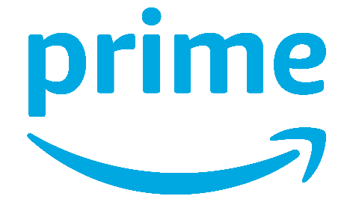
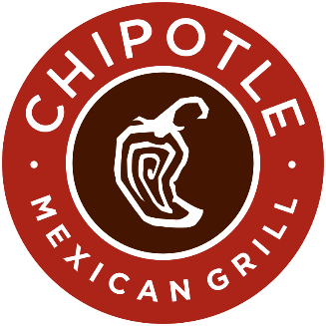
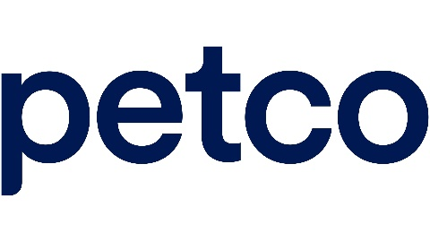
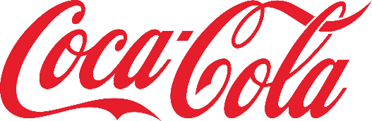

Recent examples of successful brands who have increased prices, relying on their strong customer relationships to retain business
More than half (56%) of retailers have raised prices beyond inflation to boost profits, while 55% have increased their prices by 20% or more*
Ecommerce
QSR
Pet Care
Beverages
Subscription prices for Amazon Prime in the US have recently risen by 17%, a move the company felt confident about because of its brand loyalty.
Chipotle saw “very little resistance” despite raising prices by around 10% over the course of last year. In fact, the fast-food company reported 15% YoY growth in Q4 ’21 for
its restaurant sales.
Petco CEO Ron Coughlin sees the industry as “resilient to inflation,” because even as costs rise, pet parents will still need to provide food and care to their charges.
CEO of Coca-Cola, James Quincey says “we’re going to err towards taking the price increase rather than not taking the price increase”, with analysts predicting consumers aren’t as likely to cut back on small indulgences like a soda at lunch despite price increases.
Source: Raconteur, For CMOs, inflation is both challenge and opportunity, 6/17/2022. eMarketer Insider Intelligence, Price increases wallop retailers as consumer behavior shifts, 2/14/2022. eMarketer Insider Intelligence, Petco’s CEO thinks the pet industry is inflation-proof, 3/24/2022. Forbes, Companies Rush To Raise Prices While They Still Can, 5/2/2022. *Based on a November 2021 survey from Digital.com.
This information is exclusively provided to VAB members and qualified marketers. Further distribution is prohibited.
PAGE 22

Slide 23

1. Continue Building Brand Equity
Why it matters
Creating strong emotional connections with your brand can lessen price sensitivities among consumers, even during times of inflation and economic uncertainty
How to apply to your media campaign
Align your brand with equity-building content; content that is premium, high-quality and engaging
How do I apply to media?
This information is exclusively provided to VAB members and qualified marketers. Further distribution is prohibited.
PAGE 23

Slide 24

2
Rethink Creative With A Focus On Empathy

Slide 25
2. Rethink Creative Messaging Based on Target
To compete for a shrinking share of wallet, savvy marketers understand they need to rethink their messaging
My (company / main client’s) company will have to rethink our messaging in order
to compete for a share of consumers’ smaller discretionary spending
% of respondents who agree
50% Agree
17% Disagree
Source: Advertiser Perceptions, Monthly Omnibus, April 2022.
This information is exclusively provided to VAB members and qualified marketers. Further distribution is prohibited.
PAGE 25

Slide 26


Americans are experiencing mixed emotions as they celebrate their newfound Covid freedom while also encountering economic struggles
% of adults 18+ who are generally feeling…
Content
36%
Hopeful
Anxious
33%
20%
Overwhelmed
Excited
19%
19%
Source: MRI-Simmons 2022 Q2 Trending Topics Study, A18+.
This information is exclusively provided to VAB members and qualified marketers. Further distribution is prohibited.
PAGE 26

Slide 27


During times when people are struggling and craving empathy and understanding, a shift to like messaging can drive greater effectiveness for advertisers
Ads about humanity and community are more effective and garner greater attention than those about self, self-image and performance
Features of ads described as ‘left-’ or ‘right-brained’
Left Brain
Right Brain
Flatness
Abstracted product, feature, ingredient
Abstracted body part (e.g., hands, mouth)
Words obtrude during the ad
Voiceover
Monologue (e.g., testimonial)
Adjectives used as nouns
Freeze-frame effect
Audio repetition (metered prose, sound effects)
Highly rhythmic soundtrack
A clear sense of place
One scene unfolding with progression
Characters with agency (voice, movement, expression)
Implicit, unspoken communication (knowing glances)
Dialogue
Distinctive accents
Play on words or subversion of language
Set in the past (costumes & sets)
Reference to other cultural works (pastiche / parody)
Music with melody
Source: System1, ‘COVID-19: A right-brain reset for advertisers’, 3/23/2020 System1’s Orlando Wood via LinkedIn, ‘What Should Ads Look Like in the Time of Recession?’, 4/21/2020; Peter Field, ‘Advertising in a Downturn Revisited’, April 2020.
To learn more, download: Keep Calm and Advertise On: How to Successfully Navigate Your Brand Through an Economic Downturn.
This information is exclusively provided to VAB members and qualified marketers. Further distribution is prohibited.
PAGE 27

Slide 28
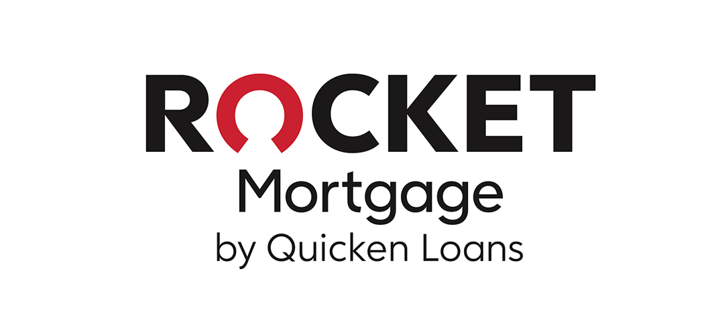



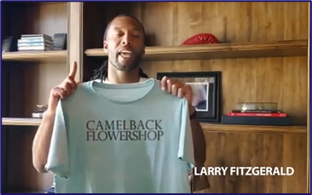
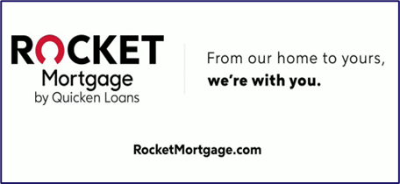

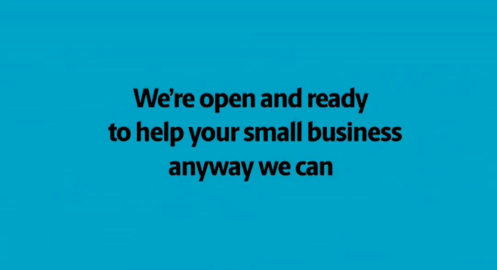
For example, at the height of COVID lockdowns, marketers who evolved their messaging to foster greater connection with consumers and their community experienced new customer growth
Digital Platform: Unique Visitors (000)
3-Month Average YoY:
Apr – Jun ’19 vs. Apr – Jun ’20
+99%
(+1.2 MM)
+79%
(+1.2 MM)
+57%
(+3.4 MM)
+23%
(+6.2 MM)
Source: VAB analysis of Comscore mediametrix multiplatform (website + mobile) media trend data, P18+. Three-month average: April – June 2019 vs. April – June 2020 (calendar months).
This information is exclusively provided to VAB members and qualified marketers. Further distribution is prohibited.
PAGE 28

Slide 29
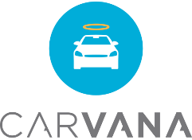
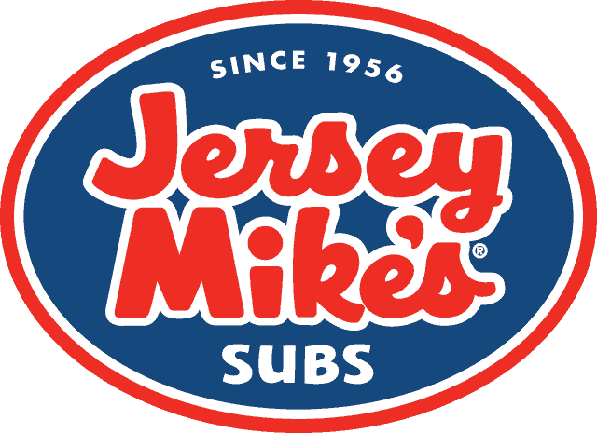
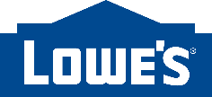



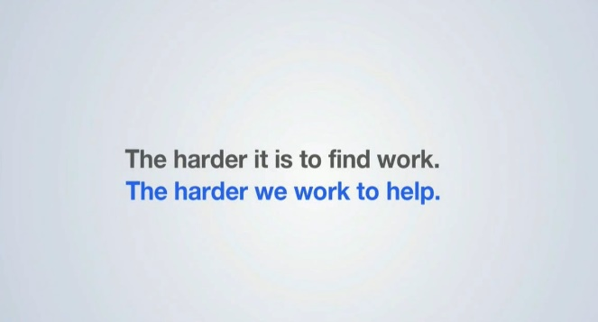
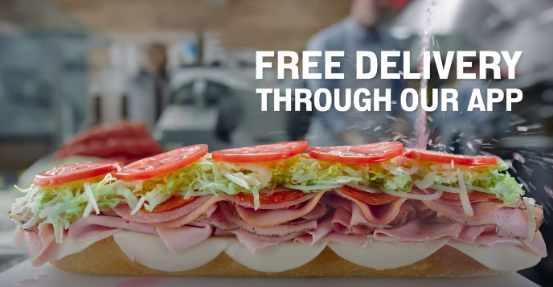
Many marketers who offered reassurance, hope and practical help during COVID experienced increased interest and trial
Digital Platform: Unique Visitors (000)
3-Month Average YoY:
Apr – Jun ’19 vs. Apr – Jun ’20
+35%
(+1.0 MM)
+26%
(+10.2 MM)
+15%
(+5.0 MM)
+57%
(+1.0 MM)
Source: VAB analysis of Comscore mediametrix multiplatform (website + mobile) media trend data, P18+. Three-month average: April – June 2019 vs. April – June 2020 (calendar months).
This information is exclusively provided to VAB members and qualified marketers. Further distribution is prohibited.
PAGE 29

Slide 30
2. Rethink Creative With A Focus On Empathy
Why it matters
A campaign that prioritizes emotion can build relationships with consumers, often leading to action and favorable business outcomes
How to apply to your media campaign
Consider the environment in which you place your message. Look for moments and places where viewers may be more receptive to messages of empathy or support
This information is exclusively provided to VAB members and qualified marketers. Further distribution is prohibited.
PAGE 30

Slide 31

3
Leverage Personalized Messaging

Slide 32



Personalized messaging can help brands authentically connect with their most relevant target
% of consumers who are more likely to…
Purchase
Repurchase
Recommend
76%
78%
78%
Consider purchasing from brands that engage with them in a personalized and tailored way
Repurchase from brands that offer personalized communications and products / services
Recommend brands to their friends and family that offer personalized communications and products / services
Source: McKinsey & Company, Next in Personalization 2021 Report. Based on consumer survey fielded 9/7/2021-9/8/2021 (n=1,013), sampled and weighted to match the US general population 18+. Question: “Please indicate how much you agree or disagree with the statements below when it comes to personalized communications and products/services from brands/businesses.”; Purchase: “I am more likely to consider buying from brands/businesses that engage with me in a personalized and tailored way.”; Repurchase: “I am more likely to repurchase from brands/businesses that offer personalized communications and products/services.”; Recommend: “I am more likely to recommend brands/businesses to my friends and family that offer personalized communications and products/services.” Numbers shown indicate respondents that selected “somewhat agree”, “agree” and “strongly agree”.
For more information, download: How Might Customized, Targeted Video Ads Help Create Stronger Engagement?
This information is exclusively provided to VAB members and qualified marketers. Further distribution is prohibited.
PAGE 32

Slide 33








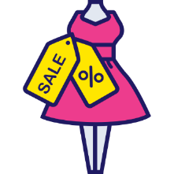







As marketers look to reach their best customer prospects, they can utilize an audience-based buying approach to target by income, life stage and buying habits across their premium multiscreen TV campaigns
Sample Target ‘A’
Sample Target ‘B’
Personal Characteristics
Under $50K HHI
Expectant Mothers
College Students
Avid
Gamers
$150K+ HHI
Business Executives
Binge Streamers
Health-Conscious Adults
Buying Habits
Affordable Fashionistas
Trending Recipe Chefs
Ready-Made Meal Buyers
American-Made Auto Enthusiasts
Seasoned Travelers
Tech Junkies
Luxury Vehicle Buyers
Organic Eaters
Source: MRI-Simmons Winter 2022 USA Study, A18+. Sample Target ‘A’ (21% of A18+ population) = (Household Income Under $50K) + (Agree with 2 out of 5 statements: “The economy has a direct effect on my spending habits [any agree]”, “I prefer road trips over trips that require a flight [any agree]”, “I only save for a specific purpose [any agree]”, “I like to experiment with new clothing styles [any agree]” , “Meeting new friends on social media is important [somewhat important / very important]”). Sample Target ‘B’ (16% of A18+ population) = (Household Income $150K+) + (Agree with 2 out of 5 statements: “I consider my work to be a career, not just a job [any agree]”, “My friends and acquaintances look to me to organize our activities [any agree]”, “My budget allows for me to buy expensive designer clothes [any agree]” , “I am willing to pay more for a flight in order to travel on my favorite airline [any agree]”, “I would be comfortable buying a "big ticket" item, like a car or appliance, completely online [any agree]”. “Any agree” = somewhat / strongly agree.
This information is exclusively provided to VAB members and qualified marketers. Further distribution is prohibited.
PAGE 33

Slide 34
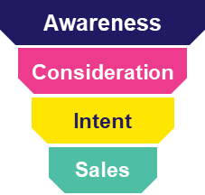
This audience-based TV buying approach drives business outcomes for brands through each stage of the purchase process, from awareness down to sales
Most Impactful KPIs of Audience-Based Buying of TV Advertising
% who answered ‘very impactful’ or ‘extremely impactful’
Full-Funnel
Full-Funnel
Full-Funnel
Source: VAB / Advertiser Perceptions ‘Audience-Based Buying Survey,’ fielded March 23 – 31, 2021. Survey base: Advertising decision-makers who are involved in buying or planning digital video, cable / broadcast TV, or advanced TV (n=211). Q150. To what extent do you believe audience-based buying of TV advertising can impact each of the following KPIs? (extremely impactful / very impactful). Base: Total Respondents. *such as site visits, sign ups, login ins, downloads. For more information, download: The VAB Top 10.
This information is exclusively provided to VAB members and qualified marketers. Further distribution is prohibited.
PAGE 34

Slide 35
As a portion of Americans struggle to pay for essentials, like groceries and gas, marketers can ensure message relevancy through audience-based buying
% who agree with the following statements
by household income
Less than $50k
$50k - $99k
More than $100k
I worry about having enough money to afford groceries each week
I feel like I have enough saved in case something unplanned happens
(i.e., home repairs, car repairs, etc.)
Source: Ipsos Consumer COVID tracker, survey fielded April 12-13, 2022, among 1,165 adults.
This information is exclusively provided to VAB members and qualified marketers. Further distribution is prohibited.
PAGE 35

Slide 36
“We do believe that there is a sort of bifurcation that has happened as a result of the inflation…Urban [Outfitters] customer tends to be the younger…and they're making a little bit less money than their Anthropologie and Free People counterparts. And as a result of that, inflation is really hitting them much harder. That sort of higher-income bracket of those two brands, we don't see any signs of inflation impacting their buying decisions.”
Richard Hayne
CEO, Urban Outfitters
Earnings Call Transcript via Seeking Alpha, 5/24/22
This information is exclusively provided to VAB members and qualified marketers. Further distribution is prohibited.
PAGE 36

Slide 37

As marketers develop strategies for engaging inflation-wary consumers,
it is important to go deeper than financial status to understand who they are and what motivates them
VAB explored the core characteristics of homes financially struggling and developed a custom archetype
to provide insight into this
sometimes-overlooked segment
This information is exclusively provided to VAB members and qualified marketers. Further distribution is prohibited.
PAGE 37

Slide 38


While more vulnerable to economic shifts, ‘Living Life on a Budget’ consumers prefer to live in the moment and are passionate about showcasing their personal style and connecting with others on social media, including influencers and brands
It is important for marketers to be mindful of the nuances of different consumer segments when targeting their ad campaigns, especially at a time when Americans are facing such varying degrees of financial security
Key Characteristics of ‘Living Life on a Budget’ Consumers
Live in the Moment
Socially Connected
Inspired by Influencers
Deal Seekers
58% feel they are better off having what they want now as you never know what tomorrow brings (125)
34% tend to spend money without thinking (125)
48% agree the Internet is a good way to meet new people (122)
26% like to create videos and other content to share on social media (144)
42% agree celebrity chefs inspire them to cook/bake (122)
21% say a celebrity endorsement may motivate them to buy a product (144)
40% like to receive coupons on their cell phone that are based on their location (126)
34% like to receive exclusive offers, coupons or other discounts via social media (124)
Aided by Advertising
Flair for Style
Convenience Oriented
Brand / Product Advocates
40% agree advertising helps them choose products to buy for their children (121)
27% think brands that are advertised are better in quality than brands that are not advertised (136)
37% often try different ways to style their hair (141)
35% like to make a unique fashion statement (131)
37% appreciate receiving text alerts about deals while I am near a store (129)
30% often eat store-made,
pre-cooked meals (134)
34% feel social media is a good way for them to tell people about companies and products they like (138)
% = percent of ‘Living Life on a Budget’ consumers. (xxx) = index vs. A18+
Source: MRI-Simmons Winter 2022 USA Study, A18+. *‘Living Life on a Budget’ Consumer Target (21% of A18+ population) = (Household Income Under $50K) + (Agree with 2 out of 5 statements: “The economy has a direct effect on my spending habits [any agree]”, “I prefer road trips over trips that require a flight [any agree]”, “I only save for a specific purpose [any agree]”, “I like to experiment with new clothing styles [any agree]” , “Meeting new friends on social media is important [somewhat important / very important]”).
This information is exclusively provided to VAB members and qualified marketers. Further distribution is prohibited.
PAGE 38

Slide 39
3. Leverage Personalized Messaging
Why it matters
With consumers facing varying degrees of financial security, it is better to target audiences by life stage, buying behaviors and characteristics than strictly age and gender demographics
How to apply to your media campaign
Marketers can drive business results by aligning different messaging with different demographic and behavioral segments through audience-based TV
This information is exclusively provided to VAB members and qualified marketers. Further distribution is prohibited.
PAGE 39

Slide 40
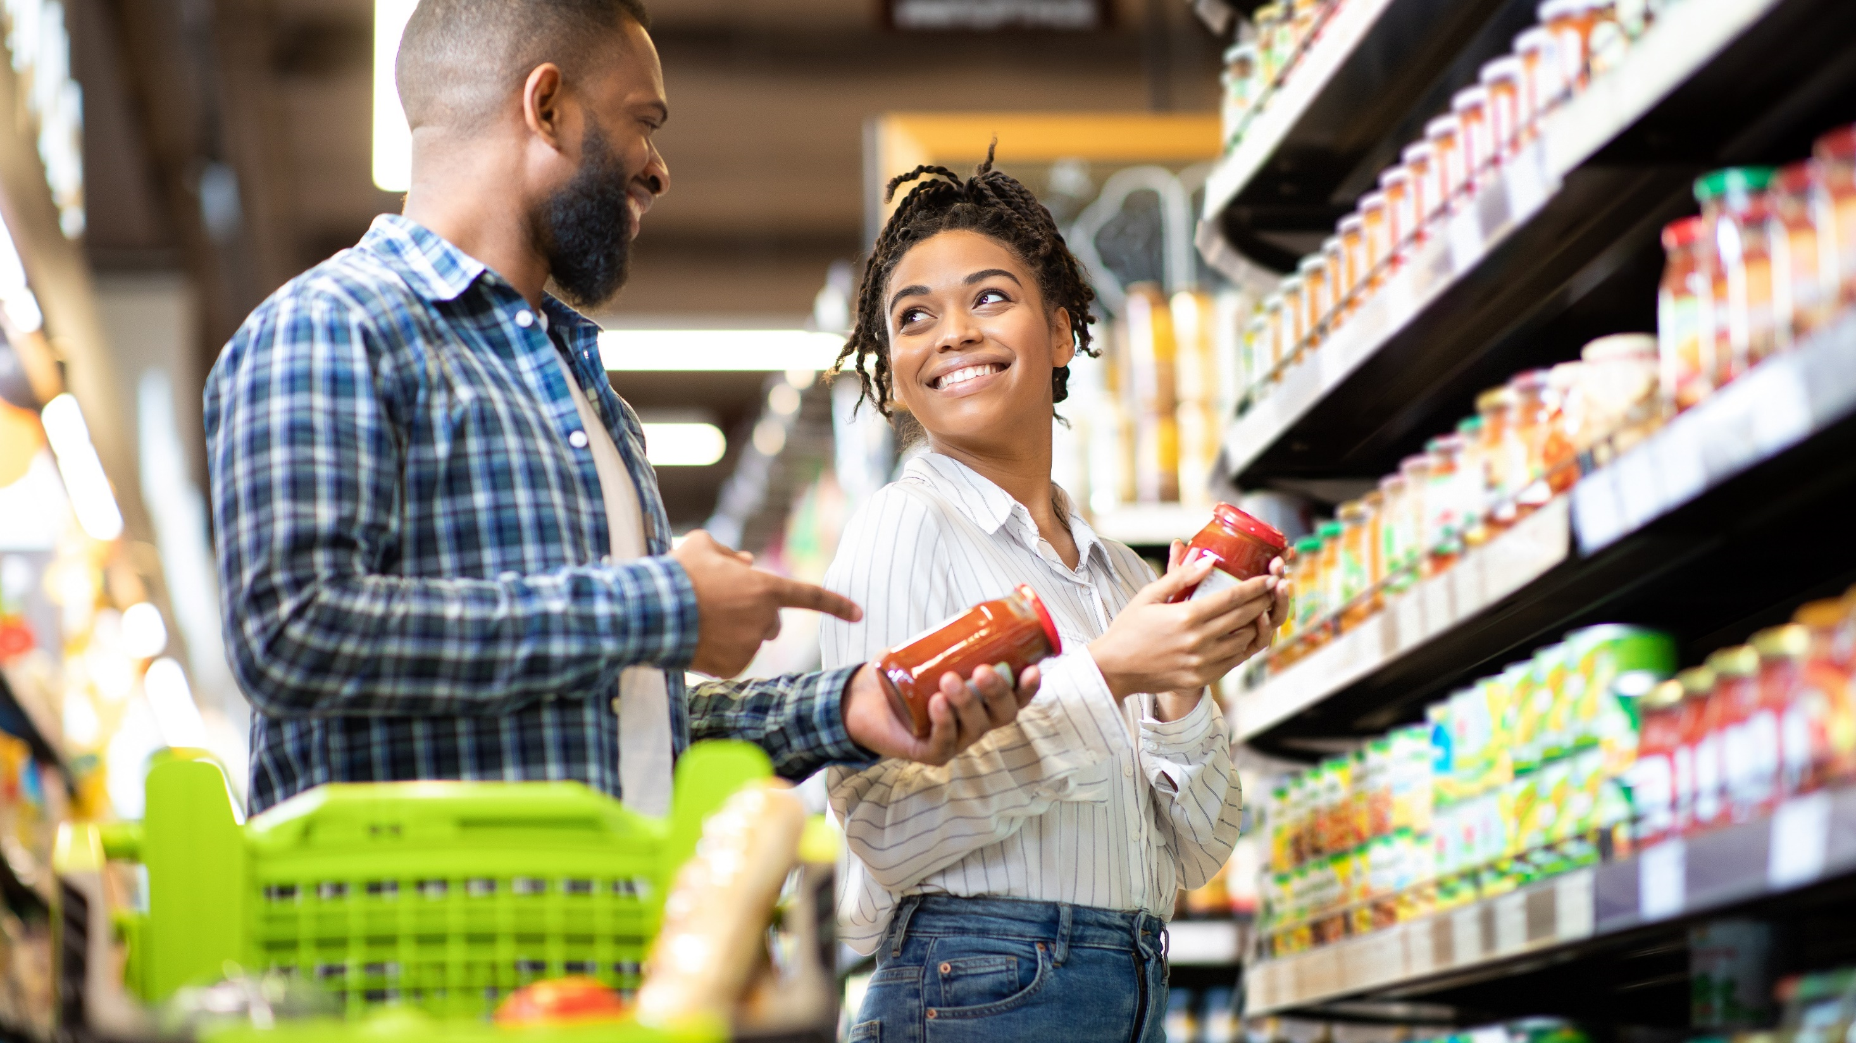
4
Demonstrate your brand’s unique value and point of differentiation

Slide 41


Amidst the highest prices in 40 years, many would still rather just spend more in order to get what they want from their favorite brands, illustrating the importance of reinforcing your brand’s unique value
% of adults 18+ who agree with the following statements
‘Even though prices are rising due to inflation, I am not going to stop buying what I want’
‘I don't mind spending more money to get the products I want’
54%
65%
Source: Ipsos, Here’s how inflation is affecting our shopping, June 2022. Ipsos Coronavirus Consumer Tracker, fielded May 24 – 25, 2022 among 1,120 U.S. adults. MRI-Simmons 2022 Q2 Trending Topics Study, A18+. “Any agree” = somewhat / strongly agree.
This information is exclusively provided to VAB members and qualified marketers. Further distribution is prohibited.
PAGE 41

Slide 42
Increasingly popular ‘Buy Now, Pay Later’ options mean price is less
of a consideration when consumers are looking to buy the non-essential products they can only get from their favorite brands
The value of the ‘Buy Now, Pay Later’ market is estimated to reach $76 billion in 2022 and projected to almost double to $143 billion by 2026
% of respondents who have purchased the following using ‘Buy Now, Pay Later’ (BNPL) services in the past year
18%
of U.S. adults have used a
‘Buy Now, Pay Later’ service
As of June 2022
37%
30%
Gen Z Adults
Millennials
21%
20%
Income $50K-$99K
Income $100K+
Source: eMarketer Insider Intelligence, U.S. Buy Now, Pay Later Payment Value, June 2022. Buy now, pay later (BNPL) services are defined as installment loan solutions provided by third-party payment platforms that allow consumers to purchase and finance a product or service, and pay in scheduled installments. Morning Consult, Inflation and a Possible Recession May Cement BNPL in Consumers’ Wallets Forever, 7/12/22. Morning Consult Brand Intelligence; survey conducted monthly among a representative sample of roughly 2,200 or 4,400 U.S. adults, with an unweighted margin of error of up to +/-2 percentage points. Data based on survey conducted June 30 – July 1, 2022 among 541 U.S. adults who said they had used a BNPL (Buy now, pay later) service in the past year, with an unweighted margin of error of +/-4 percentage points.
This information is exclusively provided to VAB members and qualified marketers. Further distribution is prohibited.
PAGE 42

Slide 43



However discretionary spend is becoming more limited and brands need to establish their unique value beyond price in order to retain customers who might otherwise be tempted by competitors
Inflationary times mean
doubling-down on what your
brand uniquely solves
Brands can’t always control pricing – particularly during an inflationary cycle – but instead they can focus on the other elements that got consumers buying them in the first place.
Reflect your target audience’s
‘fantasy self’ in your brand
Brands need to amplify the beliefs, bonds and emotional common ground that consumers consider to be value vindicators.
This is usually irrespective of price and more about what each brand can make happen – from fantasy and storytelling to imagination
and emotion.
Highlight what consumers can
only get from you
Many of the elements that consumers value about their favorite brands have nothing to do with price but more to do with what makes your brand proprietary.
These “value vindicators” create a pathway toward being able to create some protection when prices are rising.
Example:
Warby Parker eliminates the hassle of getting a new pair of glasses by delivering frames right to the customer’s front door rather than having to go to an optometrist. People will pay for the convenience
of products and services that make their lives easier.
Example:
People choose Noom’s weight loss program because it helps them work towards being their best self without depriving themselves. The brand reflects the kind of person they want to be – healthy and mindful of not just what they eat, but why.
Example:
While there are plenty of pet care brands out there, consumers like Chewy because of their steadfast commitment to customer service. By making the customer and their experience a top priority, they remind people of what makes them stand out and builds long-term relationships with loyal clients.
Source: WARC, How role model brands add to brand value during inflationary times, July 2022.
This information is exclusively provided to VAB members and qualified marketers. Further distribution is prohibited.
PAGE 43

Slide 44
“A differentiated brand can desensitize its customers to higher prices. And just like that, you are no longer fighting against competitors on price and consumers feel that paying more for your product or service is justified.”
Mary Kyriakidi
Global Thought Leader, Brand Guidance, Kantar
Graham Staplehurst
Director, Thought Leadership, Kantar BrandZ
Source: Kantar, Modern Marketing Dilemmas: Is brand differentiation an effective way to reduce customer price sensitivity?, 5/12/22.
This information is exclusively provided to VAB members and qualified marketers. Further distribution is prohibited.
PAGE 44

Slide 45
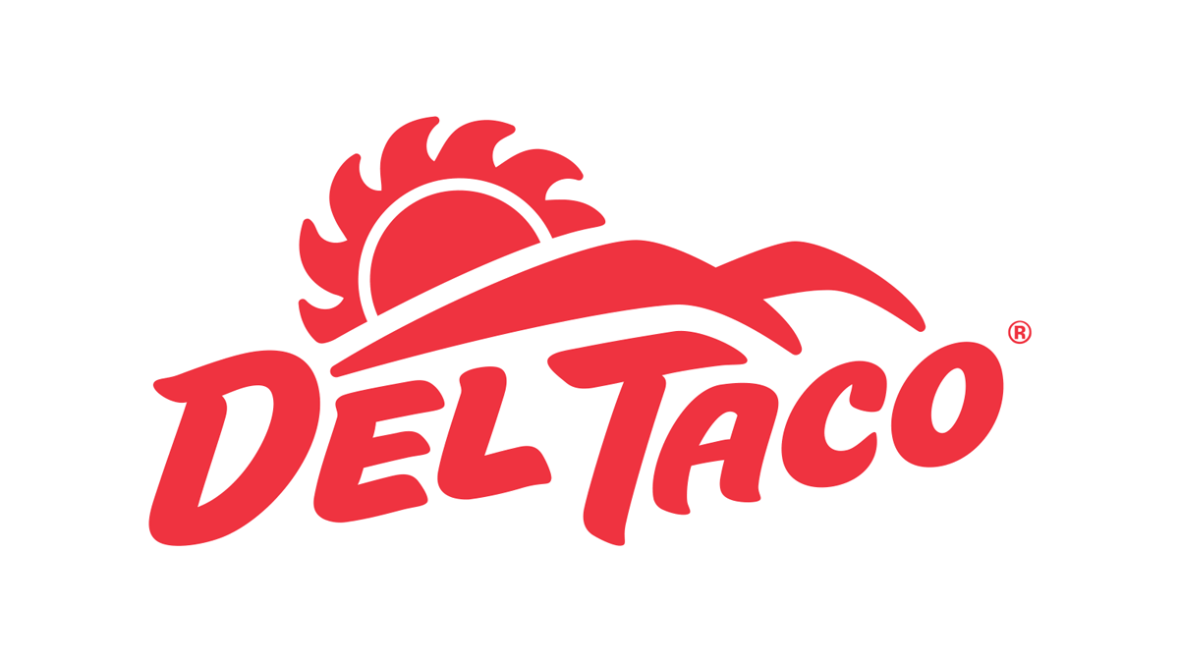

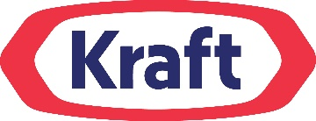
Several large brands have already taken steps to combat price sensitivity by focusing on their unique product offering or benefit
Examples of Brands Who Have Tailored Their Messaging in Response to Inflation
m
Del Taco's "We Get It" campaign promoted its “20 Under $2” menu at a time when its competitors were abandoning their own value menus.
Kraft has simplified the branding for its macaroni and cheese to support the idea of “positive comfort,” officially changing the name to Kraft Mac & Cheese based on how consumers refer to the product.
T-Mobile is launching a campaign dubbed Coverage Beyond targeted at enhancing the summer travel experience.
Through Labor Day, the carrier will provide savings at Shell gas stations, a complimentary one-year membership to AAA, free Wi-Fi on some flights and better international internet rates in a select number of European countries.
“We immediately noticed that the majority of our competitors were beginning to abandon that value area. And we thought 'Wow, that's a really great opportunity for us because we know how to do that very well for consumers and with inflation.’”
Kraft Mac and Cheese is reinforcing its unique ability to create "positive comfort" among American families at a time when they are looking for it.
Source: eMarketer Insider Intelligence, How brands are responding to consumers' inflation concerns, 6/27/2022.
This information is exclusively provided to VAB members and qualified marketers. Further distribution is prohibited.
PAGE 45

Slide 46
4. Demonstrate your brand’s unique value and point of differentiation
Why it matters
Consumers need to be given a reason to pay more for a product or service. Brands should highlight their point of difference and unique value, whether that is rational / needs based (e.g., a feature or benefit) or emotional (e.g., nostalgic, comfort-based).
How to apply to your media campaign
Create activations and programs that allow your brand to showcase and reinforce its unique role, benefit and value
in the lives of its consumers
This information is exclusively provided to VAB members and qualified marketers. Further distribution is prohibited.
PAGE 46

Slide 47

5
Prioritize customer service & experience to attract repeat business

Slide 48
“From a customer experience viewpoint, over 80% of consumers are willing to pay up to 15% more for products and services when the organization gets the customer experience right…Customer experience has become more important than price in most cases now.”
Patty Soltis
eMarketer principal analyst at Insider Intelligence
eMarketer Insider Intelligence, 2/14/22
This information is exclusively provided to VAB members and qualified marketers. Further distribution is prohibited.
PAGE 48

Slide 49
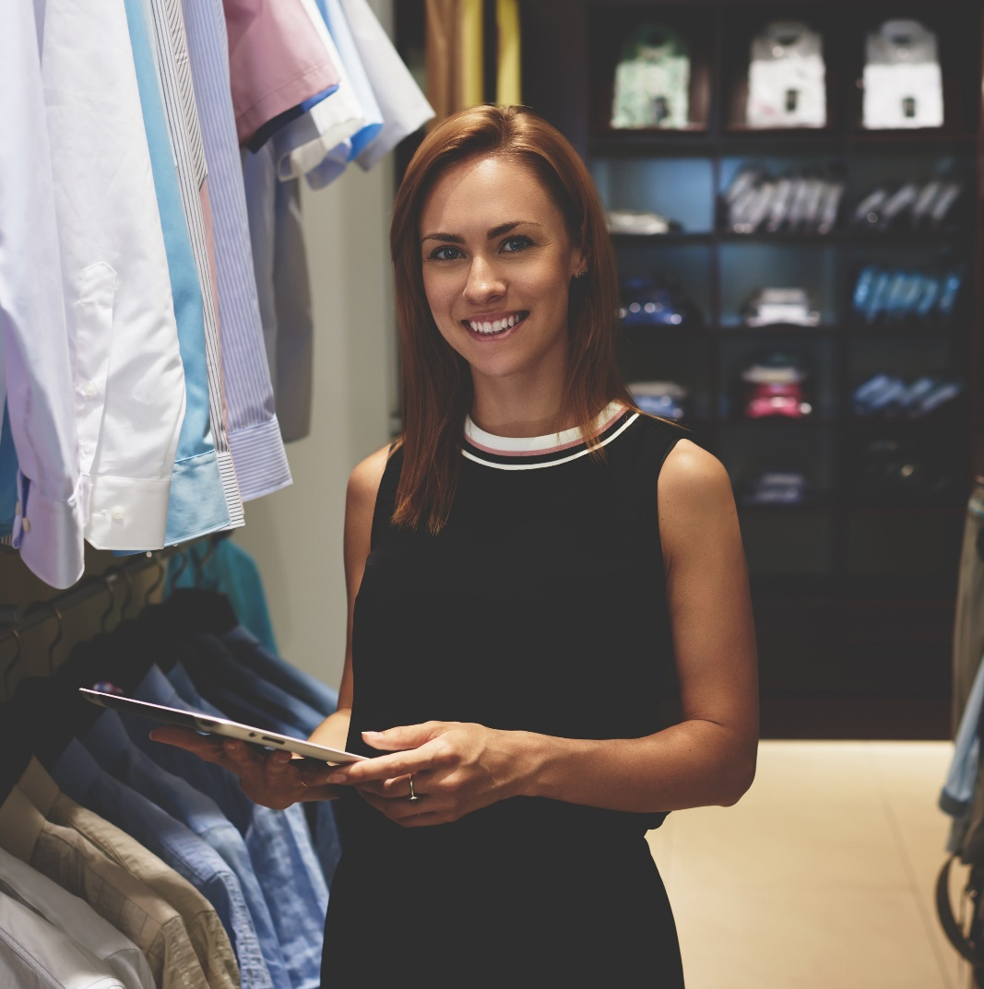
As consumers navigate an uncertain post-pandemic world, they are searching for brands who understand their needs and simplify their lives
% of consumers who agree with the following
Source: Salesforce, State of the Connected Consumer, 2022. Base = 13,020 consumers among 29 countries, surveyed 12/8/21-2/1/22.
This information is exclusively provided to VAB members and qualified marketers. Further distribution is prohibited.
PAGE 49

Slide 50
And companies who prioritize improving in areas like customer support experience tend to achieve greater customer satisfaction and retention
Customer-Related Objectives that are Very High Priority for Investment at Their Company
% of marketing and customer experience professionals
Source: eMarketer Insider Intelligence. Data is from the June 2022 Medallia report "Uncovering the Secrets Behind a Successful Customer Experience Program." 583 marketing and customer experience professionals worldwide were surveyed online during September 2021. Respondents were from companies located in North America (42%), Europe (35%), Australia/New Zealand (13%), or Latin America (10%) with annual revenues of $99 million or less (34%), $100 to $999 million (25%), or over $1 billion (30%) with number of employees of less than 1,000 (47%), 1,000 to 9,999 (34%), or over 10,000 (19%). *Defined as a company that scored in the 90th percentile of an average measure reflecting the extent to which it was able to achieve customer satisfaction and retention. **Defined as a company that scored in the 10th percentile or below of an average measure reflecting the extent to which it was able to achieve customer satisfaction and retention.
This information is exclusively provided to VAB members and qualified marketers. Further distribution is prohibited.
PAGE 50

Slide 51


By demonstrating how your brand can deliver on their expectations, quality customer service and a consistent brand experience can turn first-time buyers into reliable, repeat customers
% of respondents who agree the following would impact the likelihood of them continuing to do business with a brand
Customer Service
Consistent Customer Experience
77%
75%
Source: Merkle, 2022 Loyalty Barometer. Based on April 2022 survey of 1,500 consumers sourced outside of the loyalty marketing programs that Merkle manages for clients. Responses came from U.S. residents aged 18 to 65.
This information is exclusively provided to VAB members and qualified marketers. Further distribution is prohibited.
PAGE 51

Slide 52
5. Prioritize customer service
& experience to attract repeat business
Why it matters
A quality product combined with an exceptional experience can attract new customers and keep existing ones coming back with the knowledge that they will be consistently met with the same level of service, even when times are hard
How to apply to your media campaign
Consider the end-to-end experience of your consumer; from when they first engage with your brand through nurturing that relationship post-purchase
This information is exclusively provided to VAB members and qualified marketers. Further distribution is prohibited.
PAGE 52

Slide 53
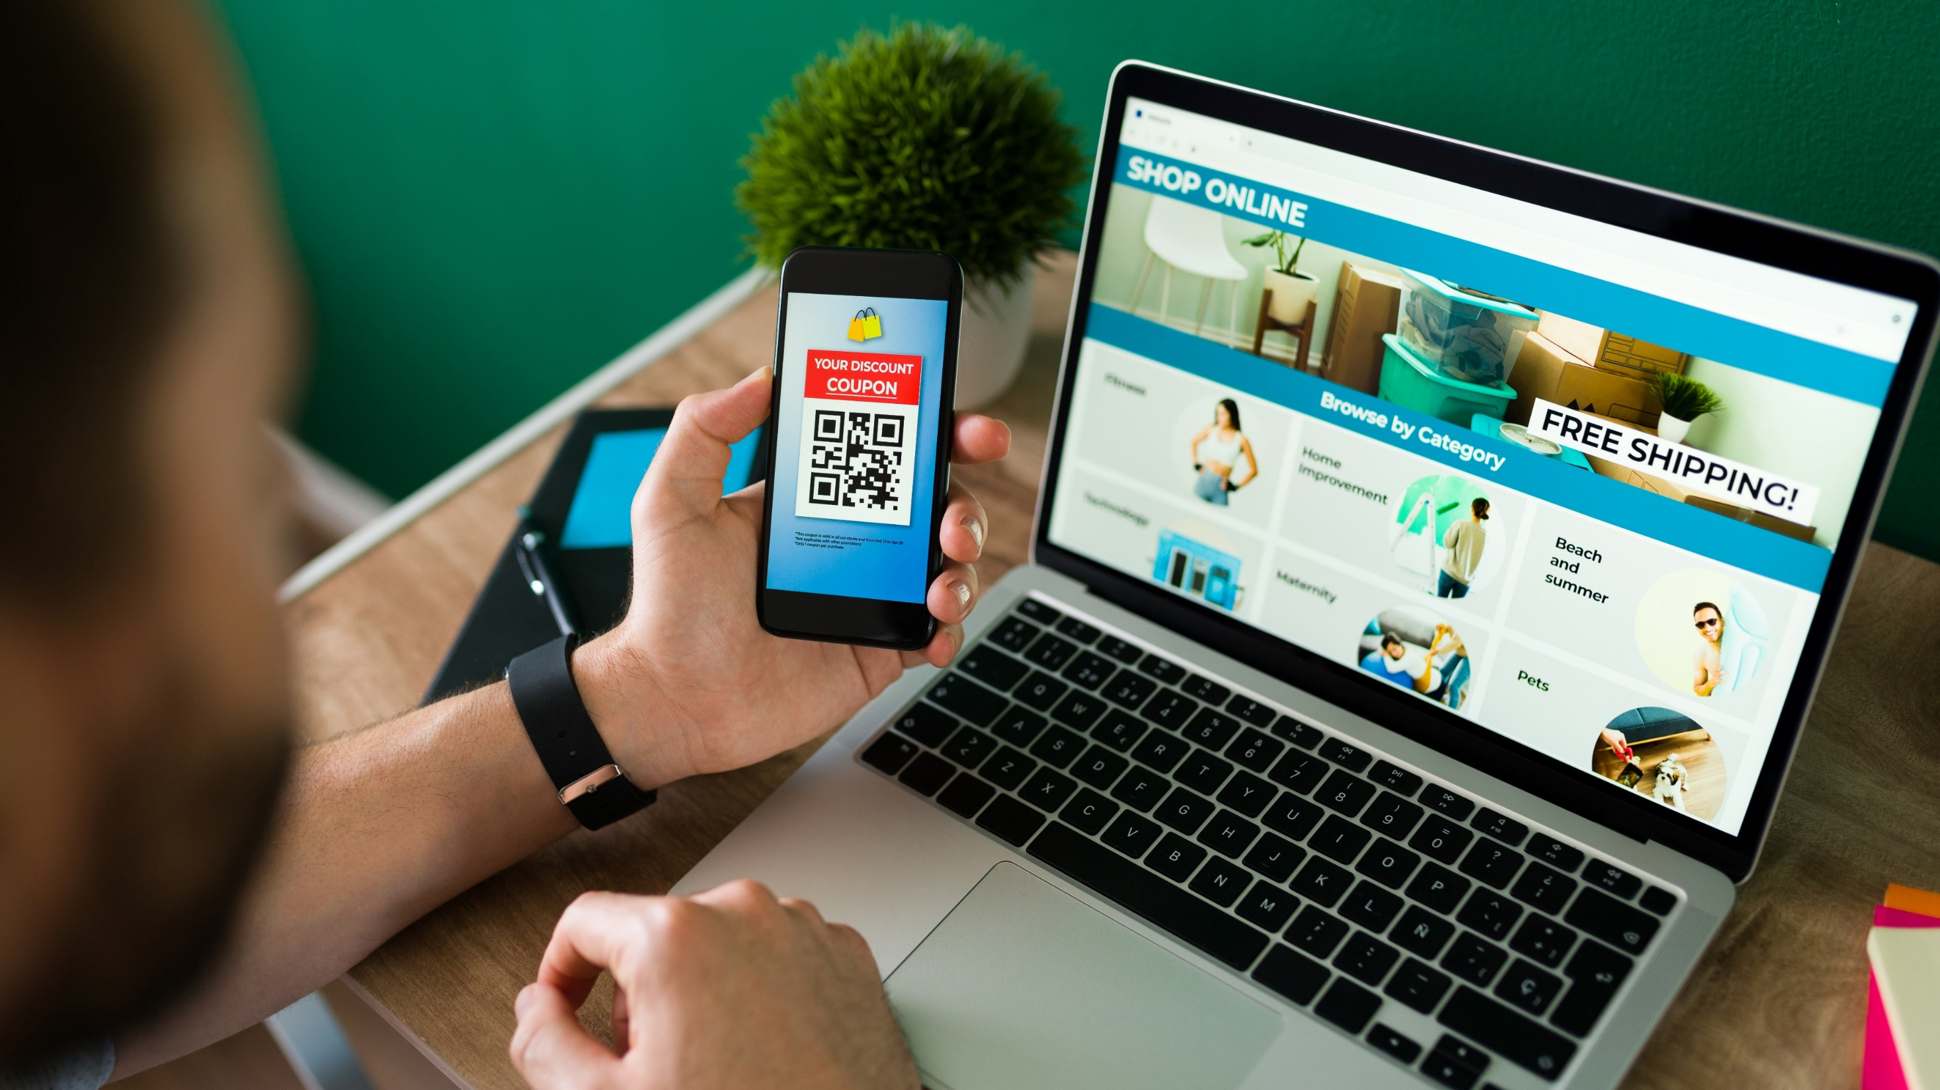
6
Reward Loyalty Among New & Existing Customers

Slide 54
Most consumers prefer to stick to their favorite brands, however, as they navigate rising costs many are forced to re-evaluate what they are buying
% of A18+ who agree
any agree
% of A18+ who have shopped a different brand recently
+13
percentage points
86%
“When I find a brand I like,
I stick to it”
Source: MRI-Simmons Winter 2022 USA Study, A18+. “Any agree” = somewhat / strongly agree. McKinsey & Company, How U.S. consumers are feeling, shopping and spending – and what it means for companies, 5/4/2022. McKinsey COVID-19 U.S. Consumer Pulse Surveys: February 25 – March 1, 2022, n = 2,160, October 9-15, 2021, n = 2,095, September 18-24, 2020, n = 1,026; sampled and weighted to match the U.S. general population aged 18 years and older.
This information is exclusively provided to VAB members and qualified marketers. Further distribution is prohibited.
PAGE 54

Slide 55

Sampling competitors or lower priced options often leads to adoption, reinforcing the importance of both customer retention and acquisition programs
~90%
of consumers who have switched brands or retailers plan to incorporate these new behaviors into
their routine
Source: McKinsey & Company, How U.S. consumers are feeling, shopping and spending – and what it means for companies, 5/4/2022. McKinsey COVID-19 U.S. Consumer Pulse Surveys: February 25 – March 1, 2022, n = 2,160, October 9-15, 2021, n = 2,095, September 18-24, 2020, n = 1,026; sampled and weighted to match the U.S. general population aged 18 years and older.
This information is exclusively provided to VAB members and qualified marketers. Further distribution is prohibited.
PAGE 55

Slide 56

Loyalty programs boost sentiment around brands and the likelihood of turning someone into a repeat customer by providing more ‘rational’ value
79%
of consumers are more likely to do business with a brand because of its loyalty program
Source: Merkle, 2022 Loyalty Barometer. Based on April 2022 survey of 1,500 consumers sourced outside of the loyalty marketing programs that Merkle manages for clients. Responses came from U.S. residents aged 18 to 65.
This information is exclusively provided to VAB members and qualified marketers. Further distribution is prohibited.
PAGE 56

Slide 57

Consumers tend to think broadly about brand loyalty, with a quality product being a key component for many
What are the top things that make you feel loyal to your favorite brand?*
% of respondents
60%
26%
24%
Great Product
Convenience
Enhances Life
22%
22%
Great Service
Loyalty Program
Source: Merkle, 2022 Loyalty Barometer. Based on April 2022 survey of 1,500 consumers sourced outside of the loyalty marketing programs that Merkle manages for clients. Responses came from U.S. residents aged 18 to 65. *Based on respondents’ ranking of the top two factors that make them feel loyal to their favorite brand.
This information is exclusively provided to VAB members and qualified marketers. Further distribution is prohibited.
PAGE 57

Slide 58
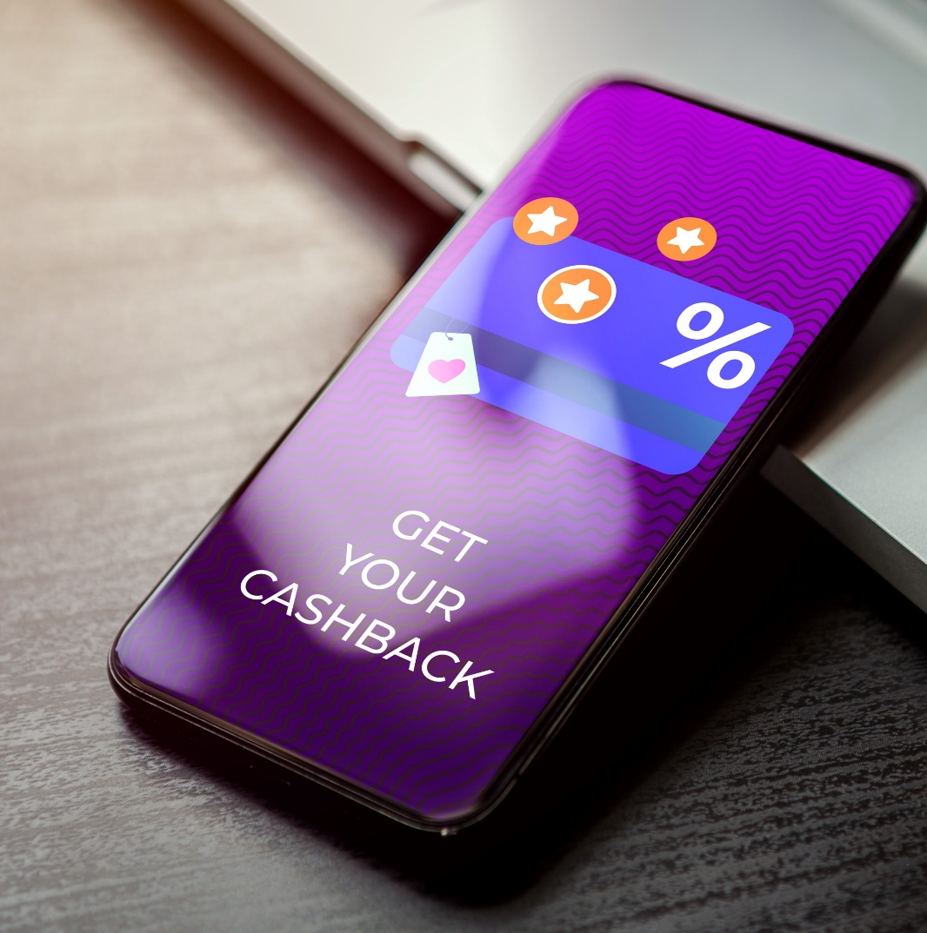
Discounts and ‘free’ rewards are the preferred benefits for loyalty programs, especially as households have been pushing to maintain their lifestyle amidst rising costs
Preferred types of loyalty rewards/benefits
Source: Merkle, 2022 Loyalty Barometer. Based on April 2022 survey of 1,500 consumers sourced outside of the loyalty marketing programs that Merkle manages for clients. Responses came from U.S. residents aged 18 to 65.
This information is exclusively provided to VAB members and qualified marketers. Further distribution is prohibited.
PAGE 58

Slide 59

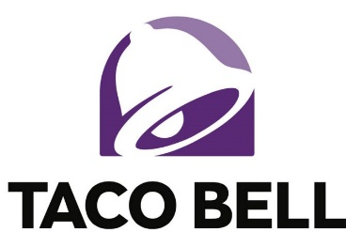
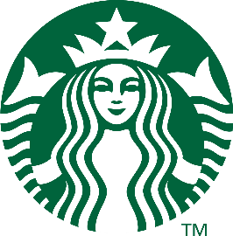
Loyalty programs have proven successful for several big-name brands, boosting sales by attracting repeat customers with advantageous deals
Examples of Brands With Successful Loyalty Programs
m
In its first six months, McDonald’s US loyalty program enrolled 30 million members, more than two-thirds of whom were actively earning rewards, president Chris Kempczinski said on the company’s Q4 2021 earnings call. The fast-food brand has seen a 10% increase in digital customer frequency since launching the program.
Subscribers to Taco Bell’s Taco Lover’s Pass were three times more likely to visit the fast-food chain monthly. Taco Bell’s loyalty membership has grown by 20% since the program’s launch nationwide.
Starbucks Rewards added more than
1 million members to reach 24.2 million active US members in Q2 2021 —up 48% annually and 8% over pre-pandemic levels. True to their loyalty status, they make up 51% of the chain’s US spending, per the company’s earnings call.
Source: eMarketer Insider Intelligence, Restaurants double down on loyalty programs to retain customers, maximize revenues, 3/25/2022. eMarketer Insider Intelligence, Starbucks’ digital investments pay dividends—other eateries should take note, 7/29/2021.
This information is exclusively provided to VAB members and qualified marketers. Further distribution is prohibited.
PAGE 59

Slide 60
6. Reward Loyalty Among New & Existing Customers
Why it matters
Brand loyalty is a relationship often built upon trust, quality and convenience, but some customers are being tempted to switch to lower cost options in the face of rising prices
How to apply to your media campaign
Marketers can leverage their 1st-party shopping data as a resource to retarget and communicate directly with loyal customers to reward them with special offers
This information is exclusively provided to VAB members and qualified marketers. Further distribution is prohibited.
PAGE 60

Slide 61

The 6 strategies marketers can use to overcome price sensitivity among consumers
Continue building brand equity
Rethink creative with a focus on empathy
Leverage personalized messaging
Brands that continue advertising during times of economic uncertainties build up brand equity and establish emotional connections among consumers which allows them to maintain, or increase prices, even during inflationary periods
Historically, during times of crisis, many brands that integrate empathy into their messaging have seen quantifiable business results through double-digit increases in their digital platform traffic
With Americans facing varying degrees of financial stability, marketers can reach their best prospects by utilizing personalized messaging and audience-based buying to target the most relevant consumers
Demonstrate your brand’s unique value and point of differentiation
Prioritize customer service & experience to attract repeat business
Reward loyalty among new & existing customers
Over half of adults still want to spend their money on products they want - give them a reason to buy yours by highlighting your brand's unique value and point of differentiation
Brands that offer a quality customer service and consistent brand experience can turn first-time buyers into habitual customers while even driving price increases
Effective loyalty programs that drive ‘real value’ can ward off competitors while bringing new customers in, lapsed customers back and increased purchase frequency from existing customer
This information is exclusively provided to VAB members and qualified marketers. Further distribution is prohibited.
PAGE 61

Slide 62

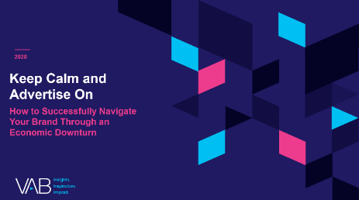
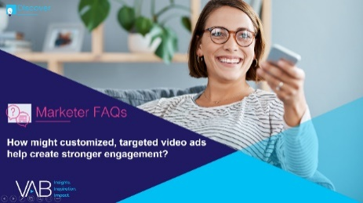
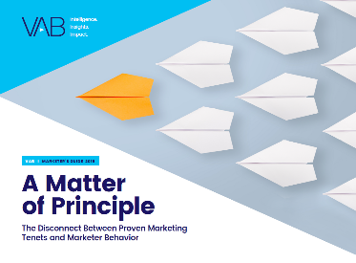
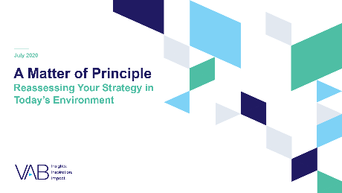
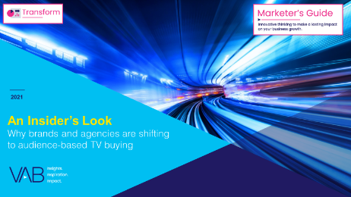
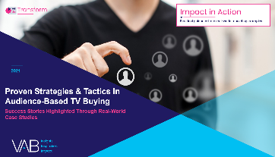

Jason Wiese
Leah Montner-Dixon
SVP, Director of Strategic Insights
jasonw@thevab.com
Associate Insights Director
leahm@thevab.com
Karolina Guillen
Insights Manager
karolinag@thevab.com
Discover more
Looking for more data, insights and takeaways? Check out this related VAB content
Keep Calm and Advertise On
How to Successfully Navigate Your Brand Through an Economic Downturn
How Might Customized, Targeted Video Ads Help Create Stronger Engagement?
A Matter of Principle
The Disconnect Between Proven
Marketing Tenets and Marketing Behavior
A Matter of Principle
Reassessing Your Strategy in
Today’s Environment
An Insider’s Look
Why Brands and Agencies are Shifting
to Audience-Based TV Buying
Proven Strategies & Tactics In Audience-Based TV Buying
Success Stories Highlighted Through Real-World Case Studies
VAB Members, brand marketers and agencies get free and immediate access to VAB’s content library. Get access at theVAB.com
This information is exclusively provided to VAB members and qualified marketers. Further distribution is prohibited.
PAGE 62

Slide 63


About VAB
VAB is an insights-driven organization that inspires marketers to reimagine their media strategies resulting in fully informed decisions.
Drawing on our marketing expertise, we simplify the complexities in our industry and discover new insights that transform the way marketers look at their media strategy.
We are committed to your business growth and proud to offer VAB members, brand marketers and agencies complimentary access to our continuously-growing Insights library. Get immediate access at theVAB.com.
Curious to learn more about VAB? Check out this quick video to see what we do and how we can help you develop business-driving marketing strategies.
This information is exclusively provided to VAB members and qualified marketers. Further distribution is prohibited.
PAGE 63

