Slide 1





The Illusions of the Internet
Uncovering the Fallacies & Realities of Audience, Advertising & Content

Slide 2


The internet is facing a crisis of reality
Much of what is online today - whether its audiences, advertising, products & services and even content itself - is not real.
Bot-driven traffic, ad fraud, fake products, consumer scams and
low-quality AI-generated material shape large portions of the online landscape and create an illusion of scale while fostering questionable
ad environments even among the largest digital platforms.
Brands and consumers are both deeply affected by the persistent issues on the internet including massive deceptions and online fraud, which collectively adds up to over $100 billion in losses to bad actors, scammers and criminals across websites and social media platforms.
In a world where audiences, advertising, products & services and content can be manipulated or artificially manufactured, marketers
need trusted environments rooted in transparency, accountability and real human audiences. Multiscreen TV stands apart by offering clarity and authenticity through premium video content within
a media landscape that often feels increasingly unreal.
This information is exclusively provided to VAB members and qualified marketers
PAGE 2

Slide 3




A Crisis of Reality: When It Comes to the Internet, How Much of it is Fake?
1
2
3
4
Audience
How many people
online are fake?
Advertising
How much ad inventory
is fake?
Products & Services
How many products, services and ads online are fake?
Content
How much online
content is fake?
This information is exclusively provided to VAB members and qualified marketers
PAGE 3

Slide 4
Uncovering 20 Realities Across the Four Main Components of the Internet
1
2
3
4
Audience
How many people
online are fake?
Advertising
How much ad inventory
is fake?
Products & Services
How many products, services and ads online are fake?
Content
How much online
content is fake?
Bots & ‘Bad Bots’
Opaque Ad Placements
Consumer Scam Impact
Scams and Spam
Proliferation of ‘Bad’ Bots
Cost of Digital Ad Fraud
Cost of Social Media Scams
AI Slop
Fake Accounts on Social Media
Ad Fraud Impact on Brands
Social Media Scam Ads
Deepfakes
Programmatic Ad Fraud
Platform Revenue from Scams
‘Made-For-Advertising’ Sites
App Store Ad Fraud
Counterfeit Goods
Pirated Content
Ad Blocking
Online Marketplace Scams
This information is exclusively provided to VAB members and qualified marketers
PAGE 4

Slide 5
Audience: How many people online are fake?
1
2
3
4
Audience
How many people
online are fake?
Advertising
How much ad inventory
is fake?
Products & Services
How many products, services and ads online are fake?
Content
How much online content
is fake?
This information is exclusively provided to VAB members and qualified marketers
PAGE 5

Slide 6
Bots & ‘Bad Bots’
Over half of internet traffic comes from non-human sources, with much of that invalid traffic coming from ‘bad bots’
51%
37%
of internet traffic comes
from non-human sources
of internet traffic comes from
‘bad bots’ that are prone to
a host of malicious activities*
What is General Invalid Traffic (GIVT)?
Traffic generated from non-threatening sources such
as measurement and analytics crawlers, data and brand safety bots or traffic from unknown (but real) browsers.
What is Sophisticated Invalid Traffic (SIVT)?
Malicious web traffic generated to click/view ads to increase ad revenue, hijack devices, manipulate
location data, spoof domains and more.
Source: Imperva, Bad Bot Report 2025, April 2025. *Bad bots execute tasks like data scraping, credential stuffing, account takeovers, transaction fraud, denial-of-service attacks and other security, performance and business outcomes.
This information is exclusively provided to VAB members and qualified marketers
PAGE 6

Slide 7
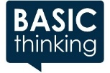



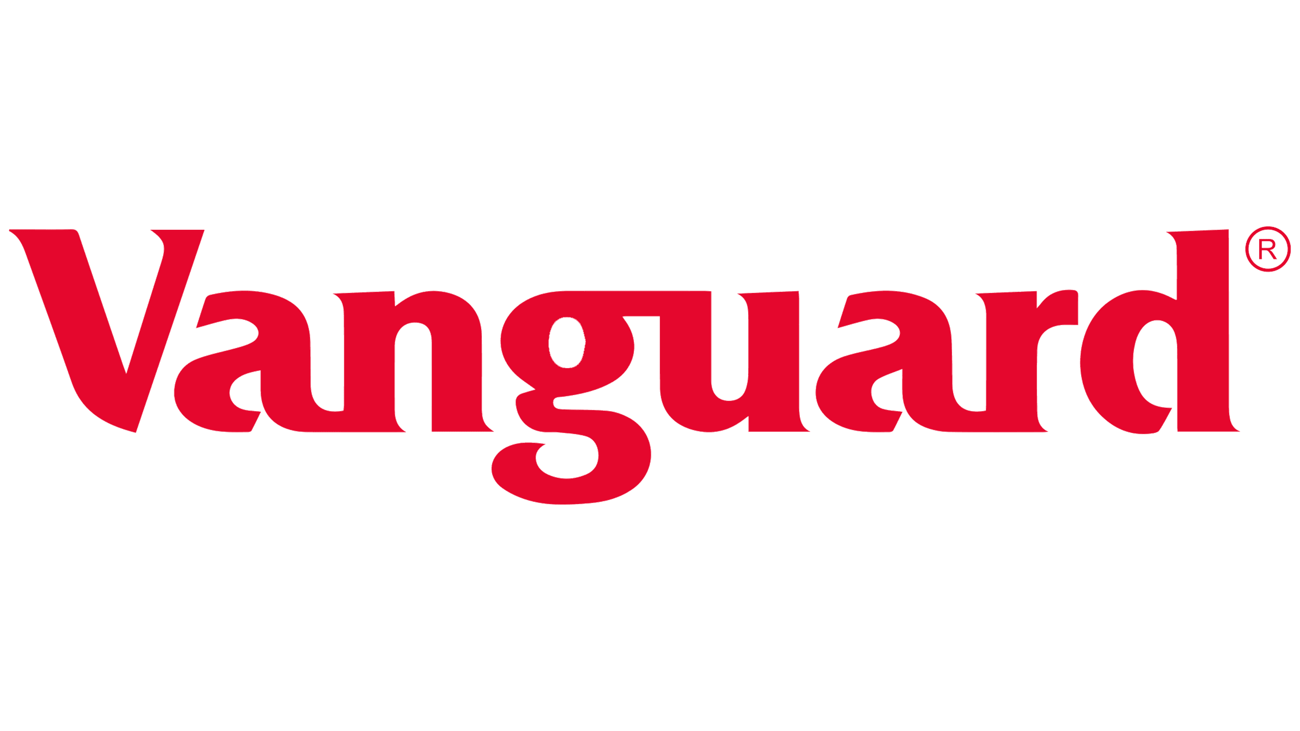


Proliferation of ‘Bad’ Bots
The persistent proliferation of bots is a problem across nearly every major digital platform including Instagram, WhatsApp, YouTube and Wikipedia
May 20, 2025
November 4, 2025
95 Million Bots: One in Ten Instagram Accounts Is Fake
Cybercriminals have built a business on YouTube’s blind spots
Jan 22, 2026
February 12, 2025
Experts warn of threat to democracy from
‘AI bot swarms’ infesting social media
A Platform Problem: Hate Speech and Bots Still Thriving on X
August 5, 2024
April 2, 2025
May 28, 2024
WhatsApp bans 6.8m accounts linked to scam
Wikipedia Faces Flood of AI Bots That Are Eating Bandwidth, Raising Costs
How Fake Accounts and Bots Are Ruining Facebook
This information is exclusively provided to VAB members and qualified marketers
PAGE 7

Slide 8
Fake Accounts on Social Media
The problem of bots stands out on Facebook where the number of fake accounts banned annually is equivalent to over half the world’s population
Banned Fake Facebook Accounts’ Share of Global Population
2018
2019
2020
2021
2022
2023
2024
Fake Accounts Banned by Facebook
3.34B
6.50B
5.80B
6.50B
5.80B
2.62B
4.33B
7.73B
7.81B
7.89B
7.95B
8.02B
8.09B
8.16B
Global Population*
Fake Accounts Banned % Share of Global Population
43%
83%
74%
82%
72%
32%
53%
Source: VAB analysis of Meta Transparency Center, Fake Accounts – Facebook, Accounts Actioned, as of 5/15/25. *VAB analysis of United Nations, Department of Economic and Social Affairs, Population Division (2024), World Population Prospects: The 2024 Revision, custom data acquired via UN Data Portal – Population Division website. ‘Accounts Actioned’ refers to fake accounts banned. To learn more about fake accounts, click here to download ‘How Many Fake Accounts Does Facebook Remove Each Year?’.
This information is exclusively provided to VAB members and qualified marketers
PAGE 8

Slide 9
Advertising: How much ad inventory is fake?
1
2
3
4
Audience
How many people
online are fake?
Advertising
How much ad inventory
is fake?
Products & Services
How many products, services and ads online are fake?
Content
How much online
content is fake?
This information is exclusively provided to VAB members and qualified marketers
PAGE 9

Slide 10




Opaque Ad Placements
Ad placements masked under ‘audience networks’ or ‘other’ line items make it difficult for marketers to understand what is real in their media buys
Google’s ad revenue from ‘undefined platforms’* is more than global print media spend
and much more than outdoor or radio
(Estimated Global Advertising Revenues by Media - 2025)
*Google Network & ‘Other’
Print
Outdoor
Radio
$44.8
Billion
$43.0
Billion
$35.9
Billion
$28.7
Billion
Source: Alphabet SEC company 10-K filings via SEC Edgar Search, for fiscal year ended 12/31/25. ‘Google Network’ includes revenues generated on Google Network properties participating in AdMob, AdSense, and Google Ad Manager. Reflects gross revenue which includes the dollars that Google pays in traffic acquisition costs (TAC) to partner sites. Adalytics Research LLC, ‘Does A Lack of Transparency Create Brand Safety Concerns For Search Advertisers?’ report, November 2023. Note: ‘Other’ represents the estimated 6.7% of examined Google search campaign ad budget was spent on Google Search Partners & Display Expansion per Adalytics Research. S&P Global Market Intelligence Kagan, Global Advertising Expenditure Forecasts, December 2025. To learn more about opaque ad placements, click here to download ‘Where do ad dollars go when they’re spent with Google?’.
This information is exclusively provided to VAB members and qualified marketers
PAGE 10

Slide 11


Cost of Digital Ad Fraud
Additionally, digital ad fraud costs marketers over $100 billion each year, with over $1 out of every $5 spent on digital ads being fraudulent
Estimated Global Cost of Digital Ad Fraud
$ in Billions
% of Global Digital Ad Spend Lost to Ad Fraud
in 2023, by platform
22%
Projected to more than double between 2023 – 2028
of digital ad spend
30%
of mobile ad spend
Source: Juniper Research, Quantifying the Cost of Ad Fraud: 2023-2028, 9/26/2023. To learn more about digital ad fraud, click here to download
‘What is Digital Ad Fraud?’. Digital ad fraud includes falsifying engagement across fake clicks, user overcounting, cookie stuffing & domain spoofing.
This information is exclusively provided to VAB members and qualified marketers
PAGE 11

Slide 12
Ad Fraud Impact on Brands
Over four in ten marketers know their brand has been affected by ad fraud, and the ad industry agrees that social media is the most vulnerable platform
Has digital ad fraud affected [your/your client’s] brand?
% of respondents
Media types most vulnerable to ad fraud in the next 12 months*
% of ad-tech, advertiser, agency and publisher experts who agree
Almost six of out every 10 marketers either know or wonder if they were affected by ad fraud
Source: VAB / Advertiser Perceptions ‘Marketer Sentiment on Ad Fraud’ Survey, November 2023. Survey base: Marketer and agency contacts from the Advertiser Perceptions ‘Senior Marketer’ and ‘Streaming Video’ online communities. Q7. Had digital ad fraud affected [your/your client’s] brand? Base = Total Respondents. *Integral Ad Science, The 2025 Industry Pulse Report, Dec 2024. To learn more about digital ad fraud, click here to download ‘Exposed: 5 Inconvenient Truths We Learned From Marketers’.
This information is exclusively provided to VAB members and qualified marketers
PAGE 12

Slide 13



Programmatic Ad Fraud
Opaque supply chains and ad placements are driving significant ad fraud in the programmatic digital advertising marketplace
Share of Programmatic Ad Fraud
26%
of programmatic digital ad spend
was wasted on unproductive
media placements
(invalid traffic, non-measurable ads, non-viewable ads
and Made-For-Advertising sites/apps)
21%
of desktop and mobile web is ad fraud
33%
of mobile app
is ad fraud
Source: Pixalate, Q3 2025 Global Invalid Traffic (IVT) & Ad Fraud Benchmarks Report, November 2025. *ANA, Programmatic Transparency Benchmark Q3 25, November 2025. Note: Programmatic digital ad spend includes Web, Mobile and ‘Other’ sources, but excludes CTV.
This information is exclusively provided to VAB members and qualified marketers
PAGE 13

Slide 14



App Store Ad Fraud
Criminals have even infiltrated mobile device app stores, scamming marketers and platforms by siphoning off ad spending to fraudulent apps
One example of mobile app advertising fraud known as ‘Vapor Threat’ used fake Android apps to deploy endless and intrusive full-screen interstitial video ads
Impact of ‘Vapor Threat’ Mobile Ad Fraud
200 Million
56 Million
daily ad bid requests
mobile app downloads across 180 scam apps
Source: Integral Ad Science, Vapor Threat Report, March 2025.
This information is exclusively provided to VAB members and qualified marketers
PAGE 14

Slide 15

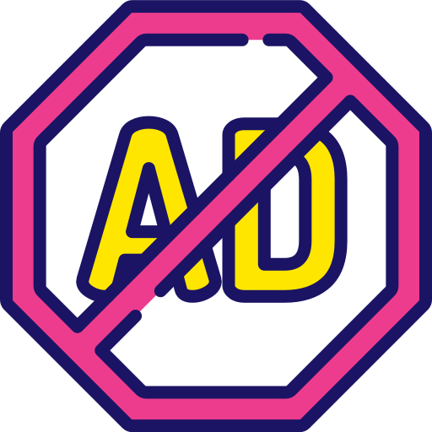
Ad Blocking
Even when a real digital ad can reach a real human, nearly half of online consumers might not see it anyways due to their use of an ad blocker
The widespread usage of ad blockers limits audience reach and obscures digital measurement metrics for marketers
45%
of U.S. consumers have installed or used an ad blocker on their web browser or mobile device
500+ Million
global downloads for AdBlock Plus,
not accounting for downloads of other popular ad blockers like AdBlock, uBlock Origin, etc.*
Source: YouGov, 48 market research – Two in five consumers don’t use ad blockers, April 2024. *Google Play Store, Adblock Plus - free ad blocker, as of 1/22/26.
This information is exclusively provided to VAB members and qualified marketers
PAGE 15

Slide 16
Products & Services: How many products, services and ads online are fake?
1
2
3
4
Audience
How many people
online are fake?
Advertising
How much ad inventory
is fake?
Products & Services
How many products, services and ads online are fake?
Content
How much online
content is fake?
This information is exclusively provided to VAB members and qualified marketers
PAGE 16

Slide 17



Consumer Scam Impact
Nearly three in four American adults have been hit by online scams, exposing deep consumer risks across digital platforms
% of American adults who say they have…
73%
experienced at least one form
of online scam or attack
(fraud, phishing, scam-product ads, etc.)
32%
experienced such a
scam in the past year
(2024–2025)
Source: Pew Research, Online Scams and Attacks in America Today, July 2025.
This information is exclusively provided to VAB members and qualified marketers
PAGE 17

Slide 18





Cost of Social Media Scams
Scams on social media platforms that tug at the wallet, heart and mind of their unsuspecting users cost U.S. consumers nearly $2 billion annually
U.S. Consumer Social Media Fraud Losses by Type*
2024
Investment-related
Romance Scams
52%
15%
$1.9 Billion
in consumer losses from
social media scams in 2024, accounting for the highest overall source of losses to scams
Online Shopping
Other
6%
27%
Source: U.S. Federal Trade Commission, A Scammy Snapshot of 2024, March 2025. Based on reports to Consumer Sentinel. *U.S. Federal Trade Commission, All Fraud Reports by Contact Method – Top Subcategories by Total Losses for Contact Method: Social Media, Q1-Q4 2024, as of 1/30/26.
This information is exclusively provided to VAB members and qualified marketers
PAGE 18

Slide 19
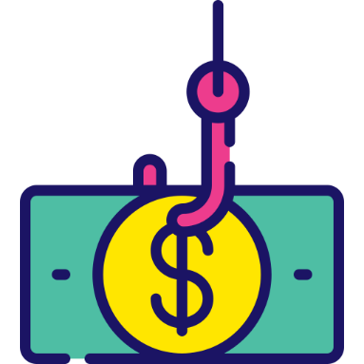

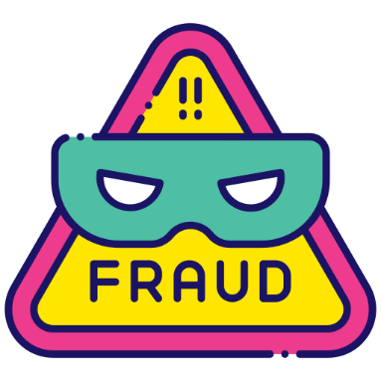
Social Media Scam Ads
Social media platforms have created a breeding ground for product scams, where they have been given leeway to ripoff consumers and businesses
70%
of newly active advertisers on Instagram and Facebook were promoting scams, poor quality products or illicit goods
8 to 32
financial fraud strikes* are allowed for Meta advertisers before their account is banned
4,400 ads
were found impersonating a real business’ name and phone number on Instagram and Facebook,
while the original, legitimate business purchased only 15 ads across
those two platforms
Source: New York Times, Meta Battles an ‘Epidemic of Scams’ as Criminals Flood Instagram and Facebook, 5/15/25. *Strikes on Meta for advertisers are a punitive, step-by-step enforcement system applied when ads or connected pages violate Community Standards or Advertising Policies.
This information is exclusively provided to VAB members and qualified marketers
PAGE 19

Slide 20



Platform Revenue from Scam Ads
In 2024, 10% of Meta’s total revenue ($16 billion) reportedly came from ads promoting scams and banned goods across their platforms
$16 Billion
of Meta’s revenue came from ads promoting scams and banned goods
in 2024, estimated at 10% of total revenue
“It is easier to advertise scams on Meta platforms than Google.”
"Scams don't just harm individual victims, they undermine trust in our entire advertising ecosystem, which is the
very foundation of our business model."
Meta Internal Review
via Reuters (11/6/25)
Meta Newsroom
(12/3/2025)
December 15, 2025
December 15, 2025
Meta’s $3 Billion Fraud Problem: How Chinese Advertisers Exploited Facebook and Instagram
Meta tolerates rampant ad fraud from China to safeguard billions in revenue
15 Billion
‘higher risk’ scam advertisements daily
on Meta platforms in 2024
December 3, 2025
Meta's detection systems identified and disrupted nearly 12 million accounts across Facebook, Instagram, and WhatsApp in the first half of 2025 associated with criminal scam centers.
Source: Reuters, Meta is earning a fortune on a deluge of fraudulent ads, documents show, 11/6/25. Estimates from Meta internal projections.
This information is exclusively provided to VAB members and qualified marketers
PAGE 20

Slide 21


Counterfeit Goods
Online marketplaces and social media are a hotbed of activity for counterfeit products and services which negatively impacts brands and consumers
59%
21%
of online counterfeit cases detected were found on marketplaces
of online counterfeit goods cases now start on social media
Source: Red Points via HomePage News, SPECIAL REPORT: Red Points Study Highlights Escalating E-Commerce Counterfeit Threat, October 2025.
This information is exclusively provided to VAB members and qualified marketers
PAGE 21

Slide 22


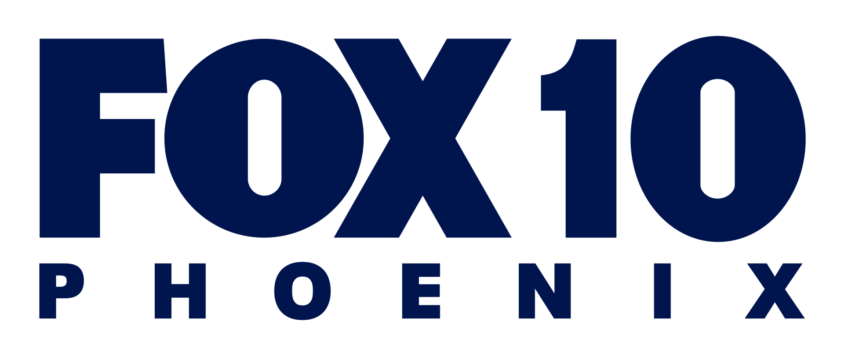




Online Marketplace Scams
Fake products are proliferating across online marketplaces, including Chinese companies that have been accused of misleading U.S. consumers
November 7, 2025
August 6, 2025
TikTok Shop faces deluge of 70 million products that violate its terms. AI is partly to blame.
How TikTok Shop and Social Commerce Are Fueling Counterfeits
December 3, 2025
March 28, 2024
Arizona AG sues Temu over allegations of data collection, ripping off businesses
Brands report a rise in imposter advertisers on platforms like Meta & TikTok
July 8, 2025
November 4, 2024
Most Facebook Marketplace rental listings appear to be scams
Shein fined $47 million for controversial practices
February 18, 2022
September 4, 2024
US adds AliExpress and WeChat to online fraud and piracy list
7 Common Temu Scams and How to Avoid Them
This information is exclusively provided to VAB members and qualified marketers
PAGE 22

Slide 23
Content: How much online content is fake?
1
2
3
4
Audience
How many people
online are fake?
Advertising
How many ad inventory
is fake?
Products & Services
How many products, services and ads online are fake?
Content
How much online
content is fake?
This information is exclusively provided to VAB members and qualified marketers
PAGE 23

Slide 24



Scams and Spam
YouTube exemplifies the breadth of scams that exist in online content based on what they are forced to remove from their platform each year
YouTube Removals for ‘Spam, Misleading and Scams’
Six Year Time Period: 2019-2024
Videos
Accounts
Comments
33 Million
videos removed for
spam, misleading and scams
Accounted for 18% of total removed videos
126 Million
accounts removed for
spam, misleading and scams
Accounted for 91% of total removed accounts
16 Billion comments removed for
spam, misleading and scams
Accounted for 71% of total removed comments
Source: VAB analysis of Google Transparency Report, YouTube Community Guidelines enforcement, as of 7/8/25. *Note: Aggregated removals by topic are estimated based on the percent of topic by total removals per quarter within the time period.
To learn more, click here to download ‘Deleted Scenes: Analyzing How Much ‘Unsafe’ Content YouTube Removes From Their Platform’.
This information is exclusively provided to VAB members and qualified marketers
PAGE 24

Slide 25










AI Slop
AI has ushered in a new era of risky online content, with the advent of low-effort ‘slop’ that is ruining consumers’ trust and experience with platforms
September 10, 2025
December 8, 2025
December 5, 2025
YouTube’s AI slop problem might be too big to stop
A.I. Videos Have Flooded Social Media. No One Was Ready.
Expert's urgent warning about YouTube 'AI slop' that could rewire your child's brain
What is AI Slop?
Low-quality, mass-generated content produced by AI
that feels generic, repetitive,
or poorly fact-checked.
It often lacks originality, nuance,
or human relevance and is typically created in high volume with little oversight, leading to a flood of mediocre or misleading content across the internet.
October 23, 2025
December 5, 2025
September 6, 2025
More Articles Are Now Created by AI Than Humans
AI Slop Is Ruining Reddit for Everyone
'AI Slop' Is Turning Up Everywhere. An Expert Explains What's at Stake.
August 28, 2025
March 11, 2025
February 17, 2025
'AI slop' videos may be annoying, but they're racking up views — and ad money
The Entire Internet Is Being Polluted by AI Slop
YouTube Is Flooded With AI Slop — And It Will Get Worse
This information is exclusively provided to VAB members and qualified marketers
PAGE 25

Slide 26




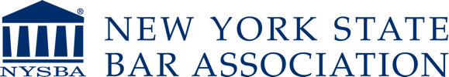
Deepfakes
The use of ‘Deepfake’ AI videos, which feature the likeness of famous people to cause misinformation and scam consumers, is also proliferating
33%
of consumers believe they
have been the target
of a deepfake scam
October 1, 2025
January 27, 2026
Meta Awash in Deepfake Scam Ads
Facebook led in deepfake-related fraud in 2025
March 4, 2025
August 4, 2025
Scammers seem to be using deepfake and AI-generated influencers on TikTok to sell you wellness products
How users are losing money to deepfake ads on Instagram
27%
of those consumers were scammed successfully
February 27, 2025
February 3, 2025
The Threat Of Deepfakes: We Need Collaboration To Combat It
The Deeply Complicated Issues Surrounding Deepfakes
Source: Sift, Q2 2025 Digital Trust Index: Navigating Digital Trust in the Age of AI, August 2025.
This information is exclusively provided to VAB members and qualified marketers
PAGE 26

Slide 27

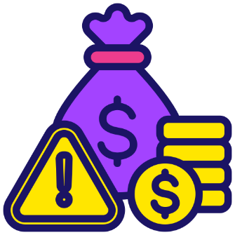


‘Made-For-Advertising’ Sites
‘MFA’ websites are often filled with spam, clickbait and stolen content which creates negative brand associations and wasted ad dollars
$1.7B
estimated ad spend lost to MFA sites in 2025
What Are ‘Made-For-Advertising’ Sites?
Low-quality websites created primarily to generate ad revenue
rather than provide real content.
Unlike legitimate publishers who invest in creating meaningful content and fostering loyal audiences, MFA sites prioritize
ad impressions and clicks, frequently employing low-cost traffic and
AI-generated or plagiarized
content to attract users.
Scale of Made-For-Advertising (MFA) in Digital*
18,273
MFA Websites
1,508
MFA Mobile Apps
Source: VAB analysis of ANA, Q3 2025 Programmatic Transparency Benchmark, November 2025 & Emarketer, Total Media Ad Spending – U.S., December 2025. MFA ad spend estimated from 0.4% share of total U.S. ad spend ($427.45B). *Pixilate, Made for Advertising (MFA) Websites & Mobile Apps Benchmarks Reports - Q3 2025, December 2025.
This information is exclusively provided to VAB members and qualified marketers
PAGE 27

Slide 28

Pirated Content
Online piracy and illegal streaming cost content producers $30 billion annually which also impacts hundreds of thousands of jobs in the U.S.
$30 Billion
in lost U.S. revenue from piracy
& illegal streaming, costing
the country up to 250,000 jobs
Source: Bloomberg, Streaming Pirates Are Hollywood’s New Villains, January 2024.
This information is exclusively provided to VAB members and qualified marketers
PAGE 28

Slide 29
Uncovering 20 Realities Across the Four Main Components of the Internet
1
2
3
4
Audience
How many people
online are fake?
Advertising
How much ad inventory
is fake?
Products & Services
How many products, services and ads online are fake?
Content
How much online
content is fake?
51% of internet traffic is non-human, 37% is ‘bad bots’
$44.8 billion is spent on ‘undefined platforms’ through Google
73% of adults have experienced at least one online scam or attack
33MM videos removed from YouTube for spam, misleading and scams
One in 10 Instagram accounts
are fake (95 Million bots)
Over $1 out of every $5 spent on digital ads is fraudulent
$1.9B in consumer losses from
social media scams in 2024
Although difficult to quantify, the internet has been flooded by ‘AI slop’
4.3 billion fake accounts were banned by Facebook in 2024
Social media is most vulnerable to fraud, says 59% of ad industry
70% of new FB & Insta advertisers were promoting scams or bad goods
33% of consumers believe they have been targeted by a deepfake scam
26% of programmatic digital ad spend is on unproductive media
$16 Billion of Meta’s revenue came from scam ads and banned goods
$1.7B estimated ad spend lost to ‘Made-For-Advertising’ sites in 2024
One fraud led to 50MM mobile app downloads across 180 scam apps
21% of online counterfeit goods cases now start on social media
$30B in lost U.S. revenue from piracy & illegal streaming
45% of consumers have installed or used an ad blocker
TikTok Shop faces deluge of 70MM products that violated its terms
This information is exclusively provided to VAB members and qualified marketers
PAGE 29

Slide 30

By contrast, Premium Video delivers
real audiences in real advertising environments aligning with real, professionally-produced content

Slide 31





The defining pillars of Premium Video align directly with the marketer benefits of Multiscreen TV
Professionally produced, long-form content with high emotional engagement in a brand safe environment regardless of platform or device and through transparent media partners
Premium Video
Professionally Produced, Long-Form Content
High Emotional Engagement
Brand Safe Environment
Cross-Platform Accessibility
Transparent
Ad Placements
Multiscreen TV
This information is exclusively provided to VAB members and qualified marketers
PAGE 31

Slide 32








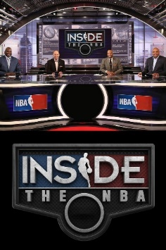
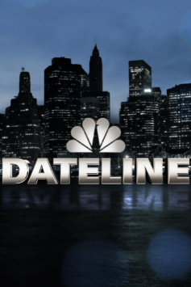










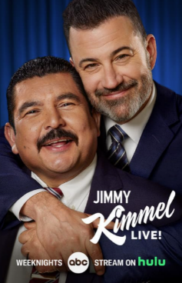







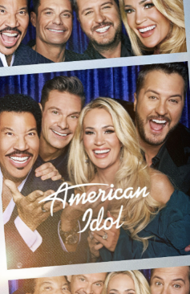
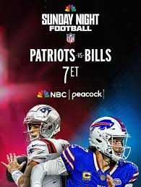
Multiscreen TV Creates Truly Premium Video Content
Multiscreen TV platforms spend over $100 billion each year to create truly premium, emotionally engaging video content
This information is exclusively provided to VAB members and qualified marketers
PAGE 32

Slide 33



The Emotional Connection with Multiscreen TV
Consumers’ passion for content on multiscreen TV reflects its ability to foster deep emotional connections and enduring appeal
Adult’s Passion for Premium Video Across Screens
A18+
Linear TV
Streaming
75%
75%
say that they
‘just love watching TV’
(A18-34: 74%)
say that they
‘love streaming TV shows’
(A18-34: 80%)
Source: VAB analysis of MRI-Simmons November 2025 Cord Evolution Study. Based on A18+ respondents, ‘any agree.’
This information is exclusively provided to VAB members and qualified marketers
PAGE 33

Slide 34
Multiscreen TV As The Most Trusted Platform
Multiscreen TV is the most trusted media platform by consumers,
who are also three times more likely to trust TV over social media
“Trust is very important for brand marketing. It’s the driver for purchasing behavior for most consumers. A lot of the time, trust is going to play a different role in the relationships consumers have with brands.”
TV is the #1 trusted media platform among adults, and they are…
3x
over 3x more likely to trust TV
vs. social media
- Matt Prince, Head of PR, Taco Bell
Taco Bell’s Matt Prince on how trust ties brands to new consumers, WARC, 9/24/24
Source: VAB analysis of MRI-Simmons Fall 2025 USA Study, A18+. Q: What is the media you trust the most? (pick one: TV, radio, podcasts, mobile internet, internet on computer, social media, magazines, newspapers).
This information is exclusively provided to VAB members and qualified marketers
PAGE 34

Slide 35

Multiscreen TV Delivers Real Audiences
Multiscreen TV platforms give marketers an opportunity to reach real, verified human audiences at scale in premium environments
Monthly P2+ Viewers and Reach % on Ad-Supported TV
National Broadcast & Cable TV, December 2025
249 Million
P2+ viewers
77%
P2+ reach
Source: XX
XX
Source: VAB analysis of Nielsen, NPower Reach & Frequency Time Period Report, 12/1/25-12/31/25, Updated Big Data + Panel, Live+7, P2+, Sources: Ad-Supported National Broadcast & Cable TV.
This information is exclusively provided to VAB members and qualified marketers
PAGE 35

Slide 36

Multiscreen TV Delivers Real Advertising Inventory
Multiscreen TV platforms offer trillions of opportunities to connect annually with real audiences through placements in transparent media environments
P2+ Impressions on Ad-Supported TV
National Broadcast & Cable TV, CY 2025
5.0 Trillion
Reported P2+ Impressions
(Equivalized)
Source: XX
XX
Source: VAB analysis of Nielsen AdIntel, 1/1/25-12/31/25, C3, Panel Only, P2+, Sources: Network TV, Spanish Language Network TV, Cable TV, Spanish Language Cable TV & Syndicated TV. Excludes Promos and PSAs. Impressions are equivalized.
This information is exclusively provided to VAB members and qualified marketers
PAGE 36

Slide 37



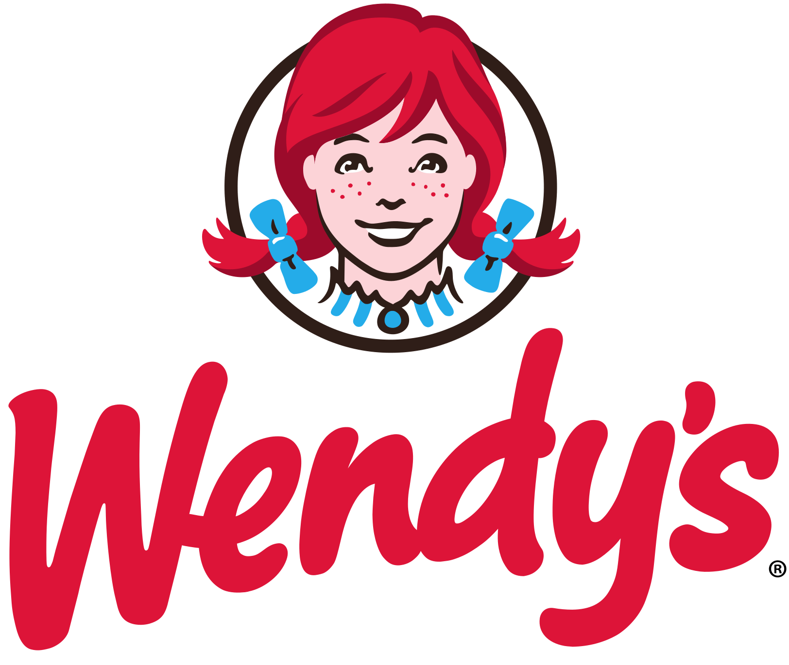

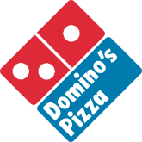

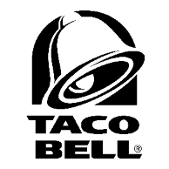

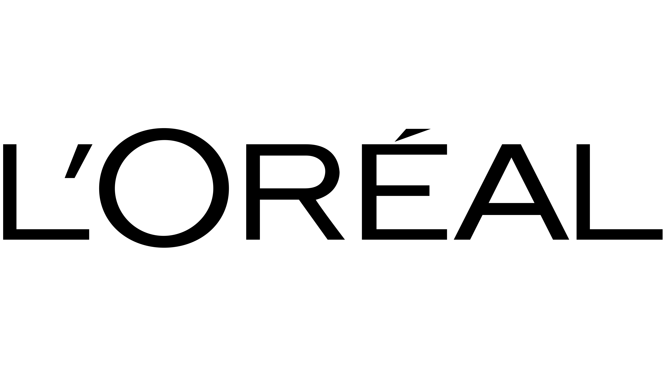



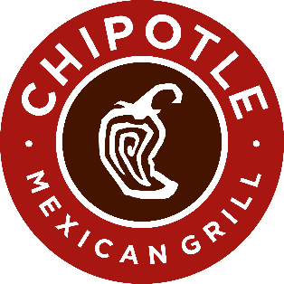

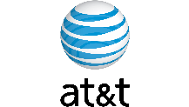





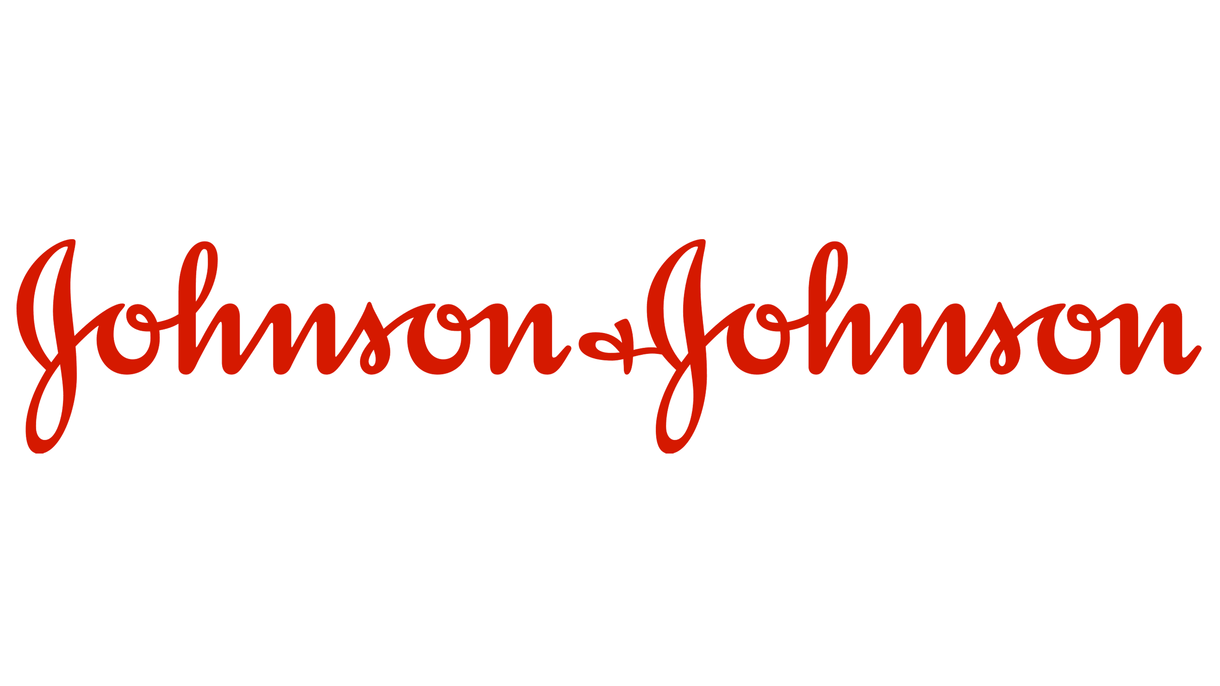


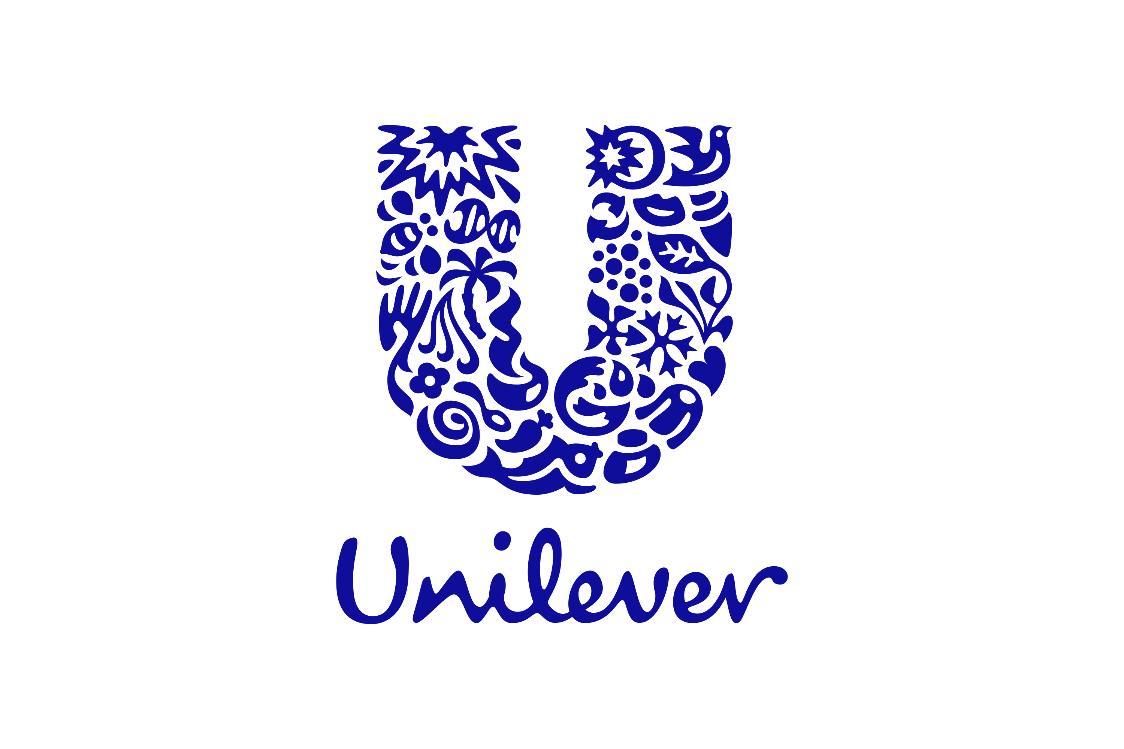







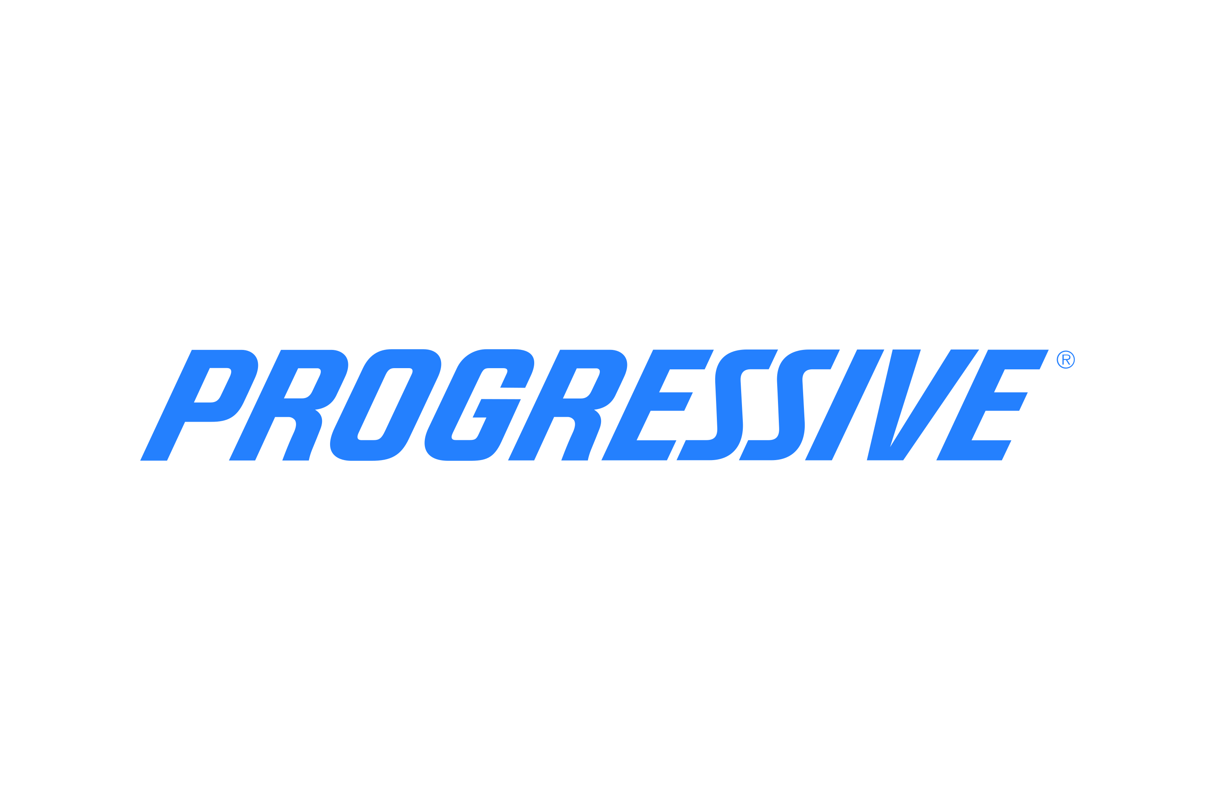
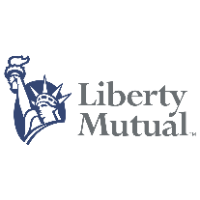
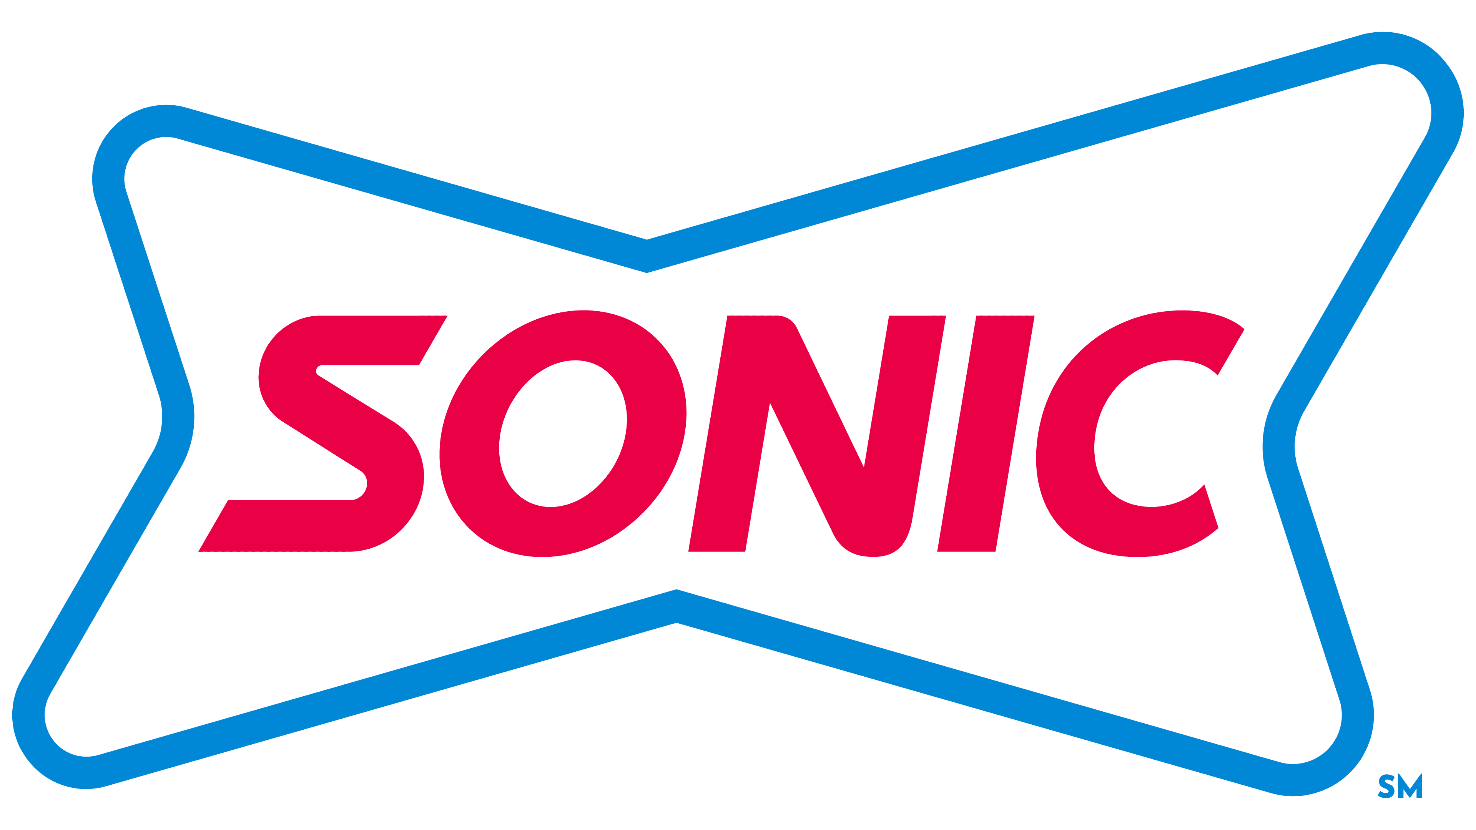
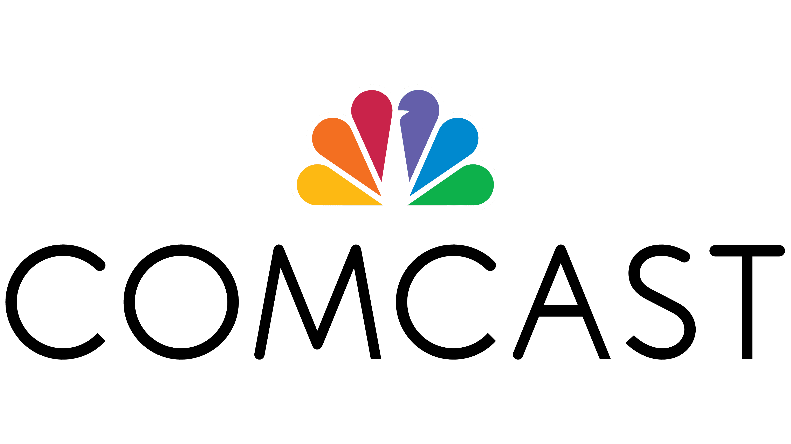








Multiscreen TV Features Legitimate Products & Services
Multiscreen TV platforms attract over 12,500 legitimate brands nationally which builds and enhances the reputation of other TV advertisers
Advertisers on Ad-Supported TV
National Broadcast & Cable TV, CY 2025
Sampling of Top U.S. National TV Advertisers
12,699
Brands
Source: VAB analysis of Nielsen Ad Intel, Brand Variants, 12/1/25-12/31/25. Sources: Network TV, Spanish Language Network TV, National Cable TV & National Spanish Language Cable TV.
This information is exclusively provided to VAB members and qualified marketers
PAGE 37

Slide 38
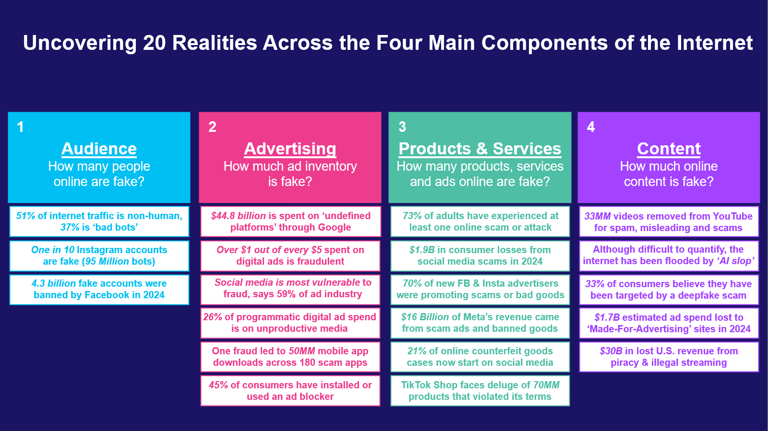
The Realities of Multiscreen TV’s ‘Premium Advantage’ for Marketers
Multiscreen TV’s
‘Premium Advantage’
$100+ Billion annual investment in
truly premium video content
75% of all adults say they love watching TV
and streaming content
The #1 most trusted media platform
by consumers
Habitually reaches real, verified human audiences at scale every day
Massive opportunities to reach real audiences in transparent media environments
Advertising environment provides a ‘halo effect’ that uplifts brand reputation
This information is exclusively provided to VAB members and qualified marketers
PAGE 38

Slide 39
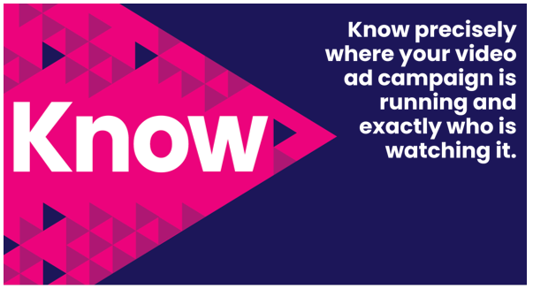
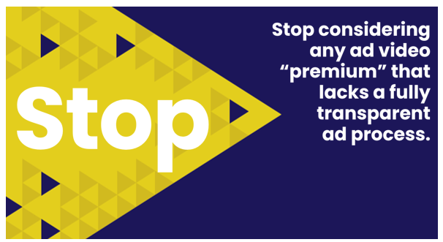
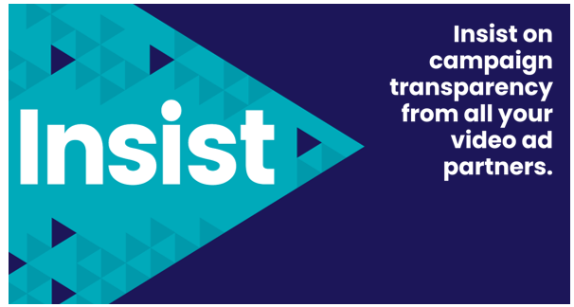
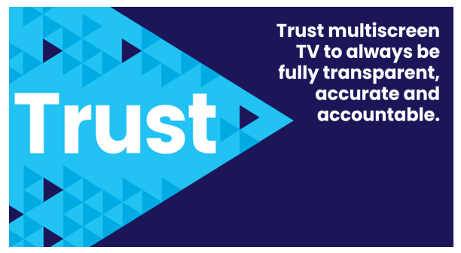
Marketers should always ask questions of their media partners to ensure their ads are placed in trusted, transparent and accountable platforms
This information is exclusively provided to VAB members and qualified marketers
PAGE 39

Slide 40

Adults over 50 account for 36% of the total population and nearly half of all adults
Bot-driven traffic, ad fraud, fake products, consumer scams and low-quality AI-generated material shape large portions of the online landscape, creating an illusion of scale and fostering questionable ad environments even among the largest digital platforms
Brands and consumers are both deeply affected by
the persistent issues on the internet including massive deceptions and online fraud, which collectively adds up
to over $100 billion in losses to bad actors, scammers
and criminals across websites and social media platforms
By contrast, the premium video environments of multiscreen TV creates unrivaled consumer and advertiser trust by delivering real, emotionally engaged audiences in real advertising environments that are aligned with professionally produced content where platforms spend over $100 billion each year to provide truly premium video programming
Key Marketer Takeaways
This information is exclusively provided to VAB members and qualified marketers
PAGE 40

Slide 41

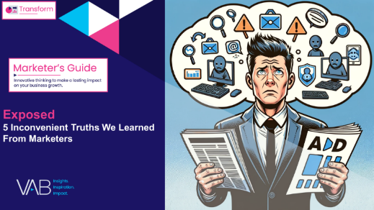
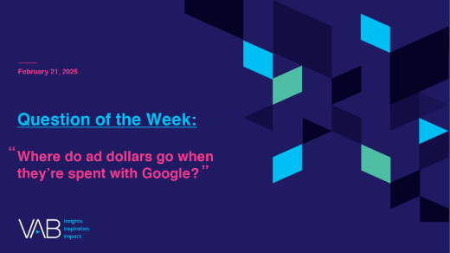
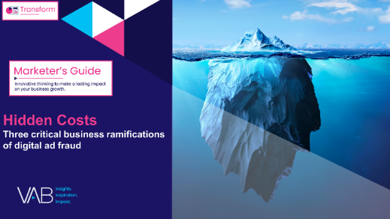
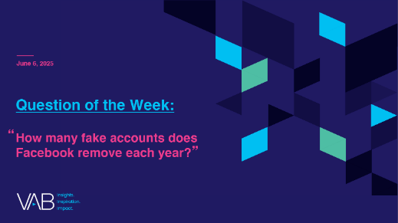
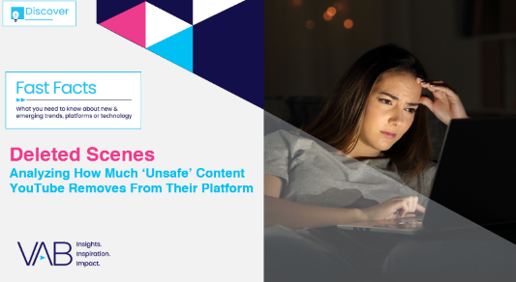


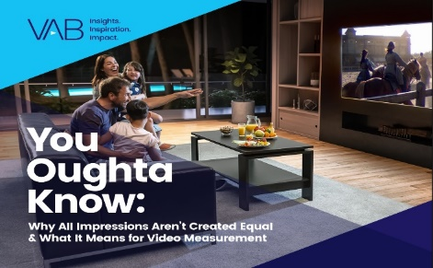
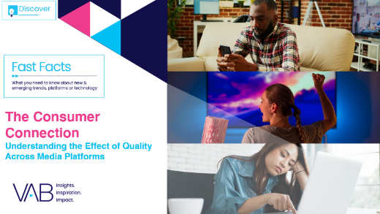





Looking for more data, insights and takeaways? Check out this related content on media transparency & the power of Premium Video
Transparency
Exposed
5 Inconvenient Truths We
Learned From Marketers
Where do ad dollars go when they’re spent with Google?
Hidden Costs
Three Critical Business
Ramifications of Digital Ad Fraud
How many fake accounts does Facebook remove each year?
Deleted Scenes
Analyzing How Much ‘Unsafe’ Content YouTube Removes From Their Platform
Visit our Transparency & Brand Safety Hub to learn more about the importance of a transparent, accurate and competitive video advertising marketplace.
Premium Video
The Power of Premium Video
What It Means for Multiscreen TV
and Why It Matters to Marketers
Best in Show
Five Advantages of Multiscreen TV,
From Brand to Performance
You Oughta Know
Why All Impressions Aren’t Created Equal & What It Means for Video Measurement
The Consumer Connection
Understanding the Effect of
Quality Across Media Platforms
Bigger, Bolder & More Ad-Supported
20 Streaming Trends That
Are Impacting Marketing Plans
Visit our Upfront Planning Resources Hub to stay informed on topics like convergent TV, cross-platform measurement and audience-first buying strategies.
This information is exclusively provided to VAB members and qualified marketers
PAGE 41

Slide 42


About VAB
VAB plays a dual role in the video advertising industry. We are leading the change to bring about a more innovative and transparent marketplace. We also provide the insights and thought leadership that enables marketers to develop business-driving marketing strategies.
Drawing on our marketing expertise, we simplify the complexities in our industry and discover new insights that transform the way marketers look at their media strategy.
We are committed to your business growth and proud to offer VAB members, brand marketers and agencies complimentary access to our continuously-growing Insights library. Get immediate access at theVAB.com.
This information is exclusively provided to VAB members and qualified marketers
PAGE 42

