Slide 1
#TVisSocial:
How “Live” TV Sparks Continuous Online Conversations
Member Center

Slide 2
Contents
Summary 3-6
Emotional Connections 3
Big Moments 4
Methodology 5
Twitter Demo Profile 6
Ad-Supported TV Topic Trends 7-16
Overall Trends 7
TV Breakout By Medium 8
By Night, By Time 9
# of Nights By Genre 10
# of Programs By Night 11-12
Program “Ownership” By Night 13
Weekend Topics 14
#1 Ranking Topics 15
TV Topics By Type 16
Genre Breakdown 17-29
Unique Topics By Genre 17
TV Hashtags 18
Genre Breakout 19
Genres By Day 20
Networks By Genre 21
Programs By Genre 22
Entertainment Programs By Platform 23-24
Trending Topics By Sport 25
Nationally Televised Sports 26
TV-Related Sports Topics 27
TV News Trending Topics 28
Debate Night Trending Topics 29
Non-TV Trending Topics 30
Tweet Cheat Sheet 31
Bonus Section For VAB Members: Cable vs Broadcast 32-38
Contact Us 39
2

Slide 3
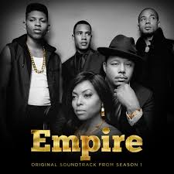




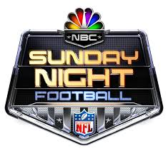
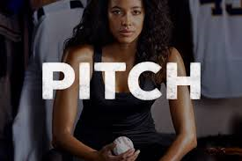
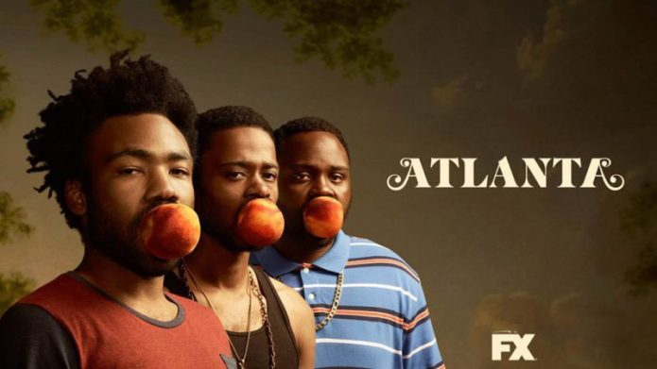



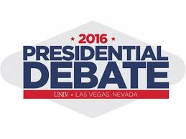
“Live” Ad-Supported TV Content Fosters Emotional Connections That Lead To Social Engagement
No longer a passive medium, ad-supported TV compels millions of people to actively share their “real-time” thoughts and opinions on the content they’re consuming live
Why?
Because TV consistently creates and captures moments that are exciting, entertaining, humorous, enlightening, uplifting, aspirational, inspirational and educational...moments that people almost immediately share and talk about online
Also, in addition to providing pure escapism, TV delivers engaging content centered on real-life themes that viewers can relate to…these shared experiences often lead viewers to take action by participating in online conversations
Family & Friends
Escapism
Competition
Inspirational
Informational
3
3

Slide 4
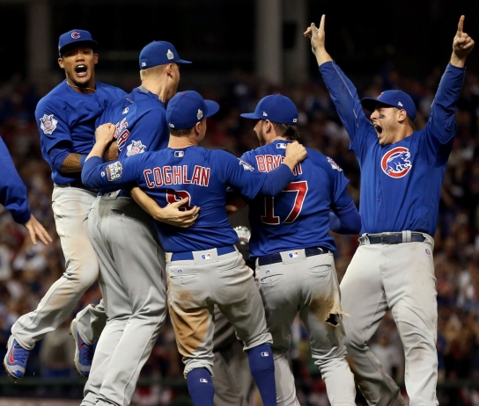
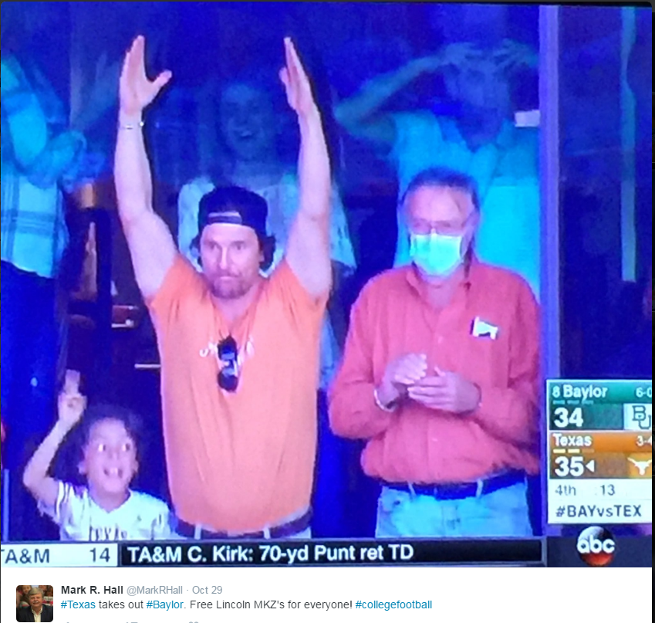
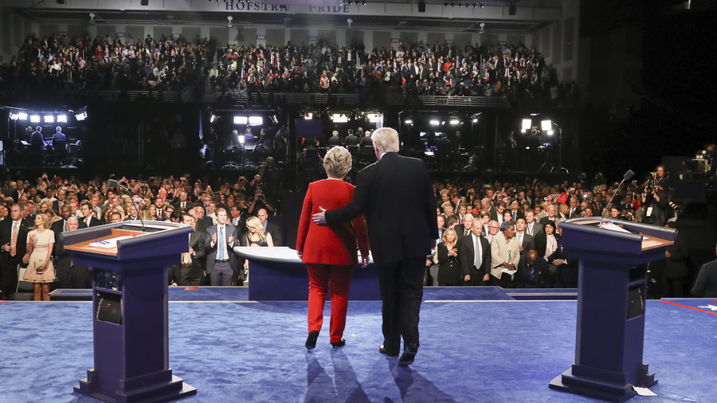
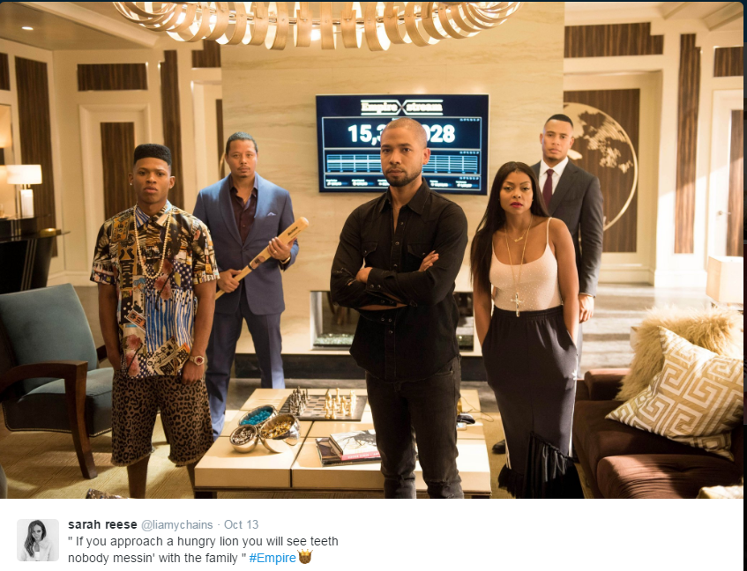
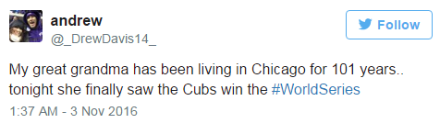
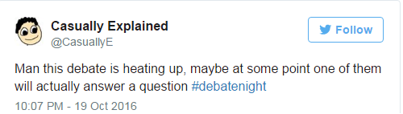
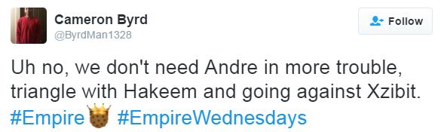
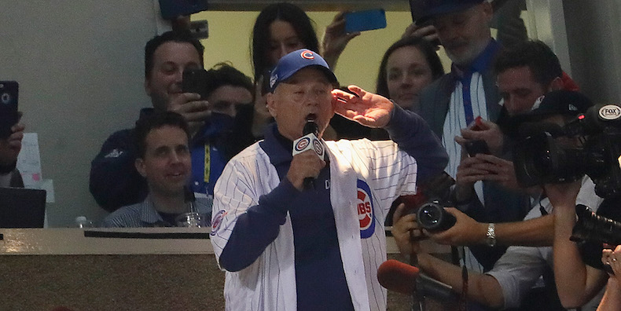
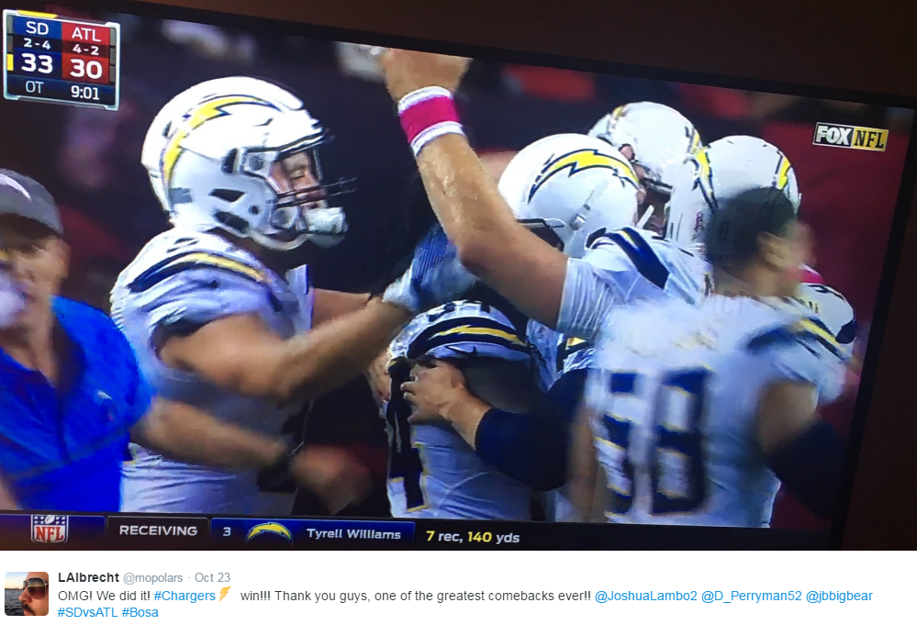
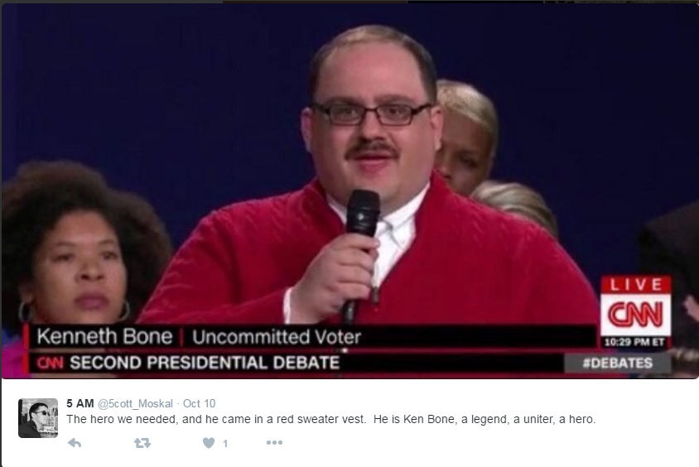
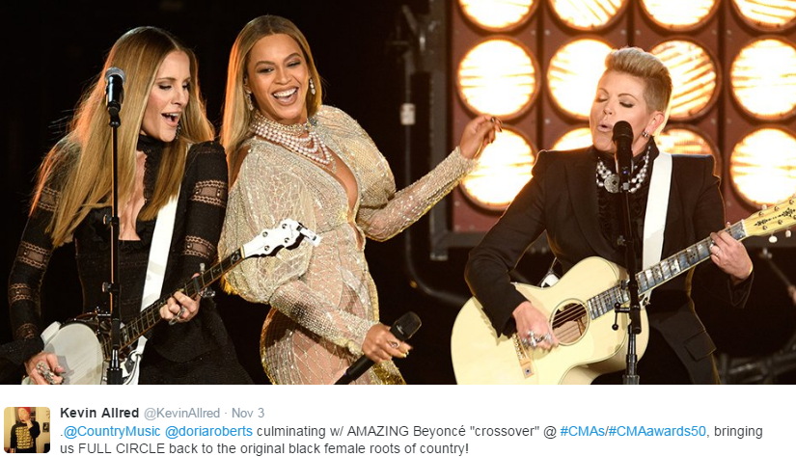
Ad-Supported TV Also Captures & Creates Society’s “Big Moments” Which Are Further Amplified On Social Media
Each month, Ad-supported TV gives us many memorable and iconic moments across sports, entertainment and news… moments that people couldn’t wait to talk about with others online. Here’s a look at some events during Oct/Nov ‘16:
Sports
News
Entertainment
After 108 years of futility, the Cubs win the World Series in a nail-biting, rain-delayed, extra inning Game 7
Last minute victories in both college…
Popular, Buzzed-About Shows Like Empire
The Presidential Debates…
“Take Me Out To The Ballgame” 7th Inning celebrity renditions at Wrigley
Beyoncé's surprise performance with the Dixie Chicks at the CMA Awards
…and the pros
…and Ken Bone
4

Slide 5
Quantifying How Much Ad-Supported TV Drives Online Social Conversation
“Live” Ad-Supported TV is an important fixture in people’s lives and nowhere is this more evident than on Twitter
Twitter is one of today’s most popular communication platforms for people to share their immediate thoughts and reactions to what’s going on in the world around them
To quantify the important role that TV plays in people’s lives, we analyzed the impact of TV programming on the top 10 trending Twitter topics over a four week time period
  Monday, October 10th, 2016 – Sunday, November 6th, 2016
Since trending topics are everchanging and a slight lag time typically exists for topics to start trending, we monitored four “points in time” each night to capture what people are talking about online throughout the evening
  8:15p, 9:15p, 10:15p, 11:15p
Geography reflects NYC-based Twitter trending data while ad-supported TV topics were grouped into two types:
  Direct: specific hashtags of televised entertainment shows, sports events or news programming
  Related: topics associated with specific TV programming including athletes, general team hashtags, collegiate school mentions (school & nicknames for football & basketball), show characters, celebrity personalities, and specific TV-related news references
5

Slide 6
Millennials Account For A Large Majority Of Total Time Spent On Twitter
Young Millennials (A18-24) are much more engaged with Twitter than other demographic age breaks
Twitter Usage
User Profile By Age
Total Minutes Spent By Age
18-34
40%
(170 index
vs. U.S. Pop)
18-34
58%
of total time spent
6
Source: comScore, mediametrix multiplatform, October 2016. Nielsen 2016-2017 Universe Estimate for A18-34 population comparison.

Slide 7
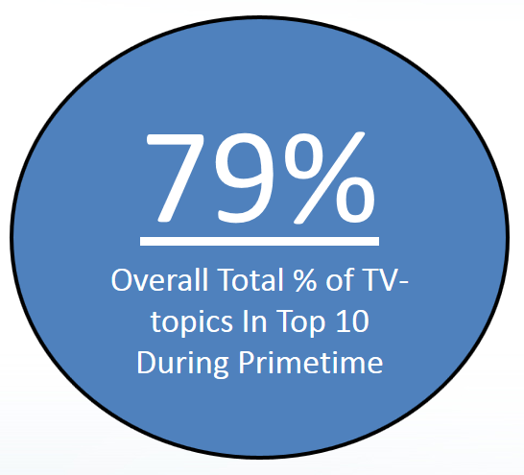
Ad-Supported TV Accounted For Nearly 8 Of The Top 10 Trending Twitter Topics Throughout Primetime Hours
Even though this analysis was done during the mid-October / early-November period, a time of heavy political discussion across the U.S., ad-supported TV dominated the top conversations on Twitter; even more so during the later primetime hours
8:15
Total % of
TV-topics In Top 10: 64%
9:15
Total % of
TV-topics In Top 10: 79%
10:15
Total % of
TV-topics In Top 10: 85%
11:15
Total % of
TV-topics In Top 10: 88%
7
Source: VAB custom analysis of Top 10 trending Twitter Topics each night (8:15p, 9:15p, 10:15p, 11:15p) aggregated during 4-week time period (10/10-2016 – 11/6/2016).
Results include both “direct” and “related” TV topics.

Slide 8
Two-Thirds Of The Top 10 Trending Twitter TV Topics Involved Programming On Ad-Supported Cable TV
Four-Week Time Period (Primetime)
% Breakout of Ad-Supported TV Topics By Medium
*Ad-Supported Cable TV & Broadcast TV includes programs or topics that aired, or were discussed, on multiple networks such as NFL’s Thursday Night Football (CBS/NFL Network) or the Presidential debates (broadcast networks / cable news networks)
8
Source: VAB custom analysis of Top 10 trending Twitter Topics each night (8:15p, 9:15p, 10:15p, 11:15p) aggregated during 4-week time period (10/10-2016 – 11/6/2016).
Results include both “direct” and “related” TV topics.

Slide 9
On Any Night At Any Given Time, At Least Half Of The Top 10 Trending Topics Were Based on Ad-Supported TV Content
Four Week Average: % of Top 10 Trending Topics That Are Based On TV Content
Monday
Tuesday
Wednesday
Thursday
Friday
Saturday
Sunday
Overall
84%
83%
84%
76%
55%
87%
87%
8:15p
63% 58% 68% 50% 50% 80% 87%
9:15p
90% 83% 80% 78% 53% 88% 85%
10:15p
93% 93% 92% 85% 55% 90% 90%
11:15p
93% 98% 98% 90% 63% 90% 85%
9
Source: VAB custom analysis of Top 10 trending Twitter Topics each night (8:15p, 9:15p, 10:15p, 11:15p) during 4-week time period (10/10-2016 – 11/6/2016). Reflects four week average by day and time. Results include both “direct” and “related” TV topics.

Slide 10
While Sports Is Always Popular, A TV Entertainment Topic Trended In The Top 10 Almost Every Night
By genre, sports TV was a Top 10 trending topic every night followed closely by entertainment; even topics from televised news programming trended highly in half of the monitored nights
Four-Week Time Period (Primetime)
# of Nights Ad-Supported TV Programming Trended In Top 10 Topics By Genre
10
Source: VAB custom analysis of Top 10 trending Twitter Topics each night (8:15p, 9:15p, 10:15p, 11:15p) during 4-week time period (10/10-2016 – 11/6/2016). Results include both “direct” and “related” TV topics.

Slide 11
On Average, Over Seven Different Ad-Supported TV Programs Trended In The Top 10 At Some Point During Each Night
# of TV Programs Trending In The Top 10 During Each Night
12
12
12
11
11
10
9
9
9
9
9
8
8
8
7
7
6
6
6
6
5
5
4
4
4
4
3
3
Sat
Sat
Mon
Tues
Wed
Thurs
Sat
Sat
Mon
Mon
Fri
Sun
Tues
Wed
Thurs
Tues
Wed
Thurs
Mon
Tues
Wed
Thurs
Fri
Sun
Fri
Sun
Fri
Sun
11
Source: VAB custom analysis of Top 10 trending Twitter Topics each night (8:15p, 9:15p, 10:15p, 11:15p) during 4-week time period (10/10-2016 – 11/6/2016). Results include both “direct” and “related” TV topics. In aggregate, 207 TV program episodes (includes multiple shows / games of same program) trended in the top 10 over the time period.

Slide 12

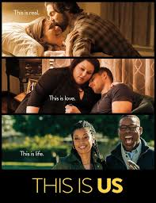

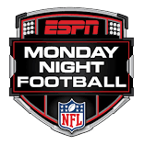



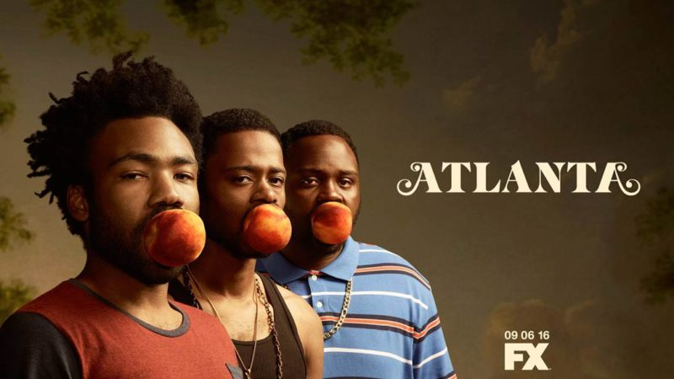
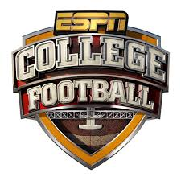
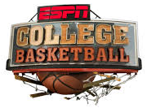
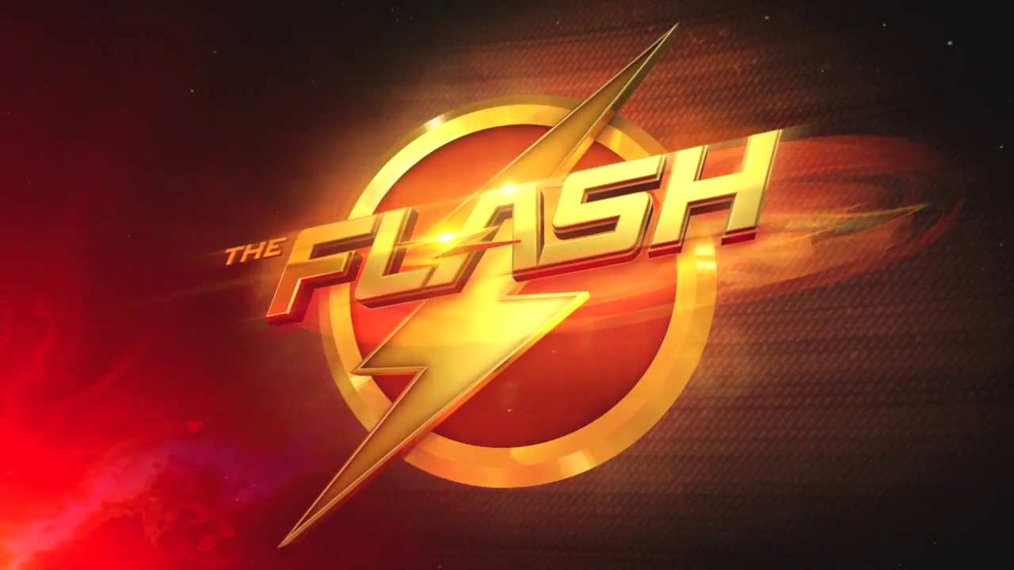

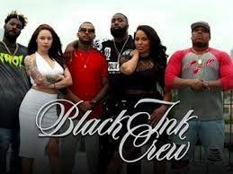
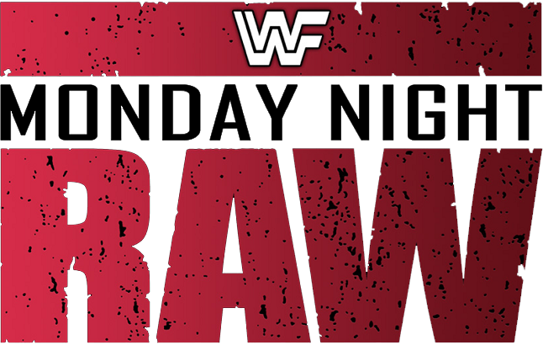



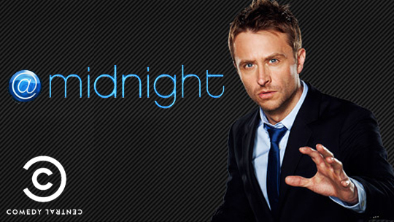
As Many As 12 Different Ad-Supported TV Programs Trended In The Top 10 During Some Nights
# of TV Programs Trending In The Top 10 During Each Night
12
12
12
11
11
10
9
9
9
9
9
9
8
8
8
8
7
7
6
6
6
6
5
5
4
4
4
4
3
3
Sat
Sat
Mon
Tues
Wed
Thurs
Sat
Sat
Mon
Mon
Fri
Sun
Tues
Wed
Thurs
Tues
Wed
Thurs
Mon
Tues
Wed
Thurs
Fri
Sun
Fri
Sun
Fri
Sun
12
Source: VAB custom analysis of Top 10 trending Twitter Topics each night (8:15p, 9:15p, 10:15p, 11:15p) during 4-week time period (10/10-2016 – 11/6/2016). Results include both “direct” and “related” TV topics. . In aggregate, 207 TV program episodes (includes multiple shows / games of same program) trended in the top 10 over the time period.

Slide 13


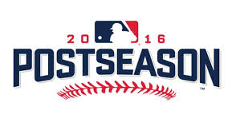

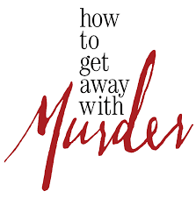
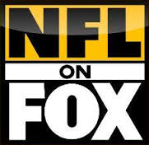
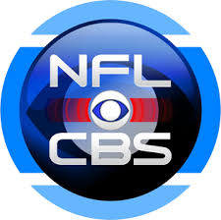
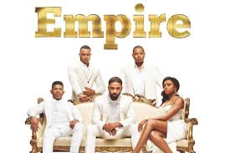
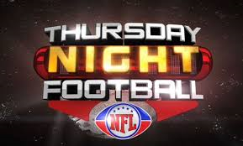
Several Ad-Supported TV Shows & Sports Events “Own” Specific Nights Of The Week
No other type of tweets is as much of a recurring topic as ad-supported TV
Trending In The Top 10 During At Least 3 of The 4 Weeks During The Oct / Nov Time Period Analyzed
Monday
Tuesday
Wednesday
Thursday
Friday
Saturday
Sunday
13
Source: VAB custom analysis of Top 10 trending Twitter Topics each night (8:15p, 9:15p, 10:15p, 11:15p) during 4-week time period (10/10-2016 – 11/6/2016). Note: “Empire” was included on Wednesday even though it only aired once during the time period analyzed due to FOX’s World Series coverage because it is historically one of the most popular trending topics on Wednesday nights when it airs.

Slide 14
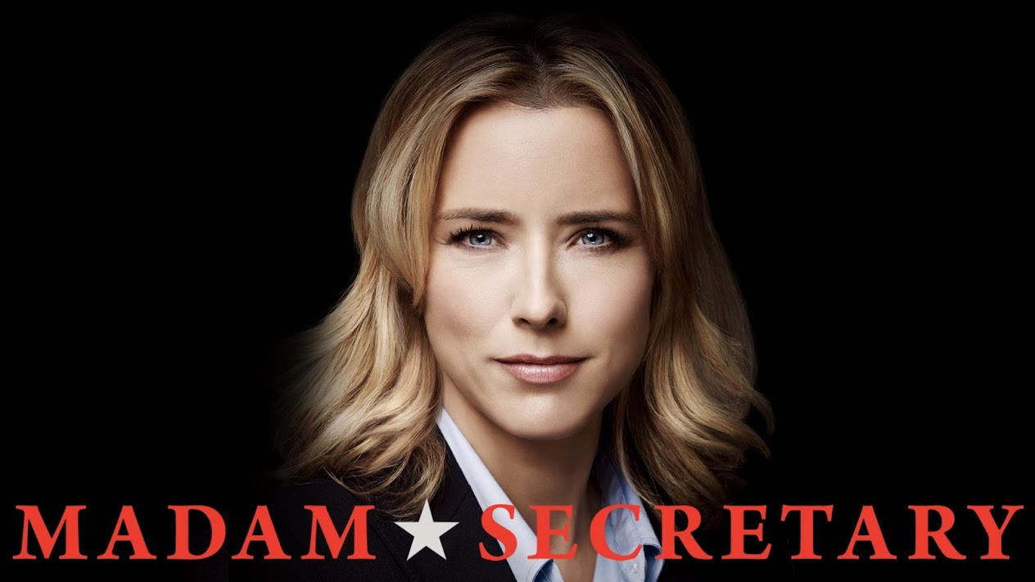






Although No TV Show “Owns” Friday Or Saturday, Programs That Are Compelling & Entertaining Will Spark Conversation
“Own” The Night
Friday
Saturday
Saturday, 10/15/16
All 4 time periods - Rank #1
Friday, 10/14/16
8:15p - Rank #3
Friday, 10/14/16
8:15p & 9:15p - Rank #5
Saturday, 10/29/16
10:15p - Rank #2
Friday, 10/14/16
10:15p - Rank #6
Friday, 11/4/16
10:15p - Rank #8
Friday, 10/21/16
8:15p - Rank #10
Saturday, 11/5/16
9:15p - Rank #5
14
Source: VAB custom analysis of Top 10 trending Twitter Topics each night (8:15p, 9:15p, 10:15p, 11:15p) during 4-week time period (10/10-2016 – 11/6/2016). Rank listings based on the highest rank among the four time periods of the night.

Slide 15

In Fact, 47 Different Ad-Supported TV Topics Trended #1 During Primetime Over The Four-Week Time Period
For 24 out of 28 nights, an Ad-Supported TV topic trended #1 during at least one of the four monitored “points in time”
Top Twitter Trending TV Topics By Night
Monday
Tuesday
Wednesday
Thursday
Friday
Saturday
Sunday
8:15p: #Supergirl (#1)
9:15p: #SuperGirl (#1)
10:15p: #RallyTogether (#1)
11:15p: #RallyTogether (#1)
9:15p: Kershaw (#1)
10:15p: #AtlantaFX (#1)
11:15p: #AtlantaFX (#1)
8:15p: Auston Matthews (#1)
9:15p: #Empire (#1)
10:15p: #Empire (#1)
11:15p: #QueenSugar (#1)
9:15p: #AllStars2 (#1)
10:15p: #AllStars2 (#1)
11:15p: #HTGAWM (#1)
11:15p: #ALCS (#1)
8:15p: #SurvivingCompton (#1)
9:15p: #SurvivingCompton (#1)
10:15p: #SurvivingCompton (#1)
11:15p: #SurvivingCompton (#1)
9:15p: Kershaw (#2)
10:15p: Kershaw (#2)
11:15p: Kershaw (#2)
10-Oct
11-Oct
12-Oct
13-Oct
14-Oct
15-Oct
16-Oct
8:15p: #BillyBushMadeMeDoIt (#1)
9:15p: #LHHH (#1)
10:15p: #DWTS (#1)
8:15p: #DrainTheSwamp (#1)
9:15p: #SDLive (#1)
10:15p: #SDLive (#1)
11:15p: #AtlantaFX (#1)
8:15p: #debatenight (#1)
9:15p: #debatenight (#1)
10:15p: #debatenight (#1)
11:15p: #debatenight (#1)
8:15p: #RockyHorror (#1)
9:15p: #RockyHorror (#1)
10:15p: #AlSmithDinner (#1)
11:15p: #AlSmithDinner (#1)
11:15p: #USFvsTEM (#2)
8:15p: #TAMUvsBAMA (#1)
9:15p: #TAMUvsBAMA (#1)
10:15p: Kershaw (#1)
11:15p: #Cubs (#1)
8:15p: #TheWalkingDead (#1)
9:15p: #TheWalkingDead (#1)
10:15p: #TheWalkingDead (#1)
11:15p: #TheWalkingDead (#1)
17-Oct
18-Oct
19-Oct
20-Oct
21-Oct
22-Oct
23-Oct
8:15p: #LHHH (#1)
9:15p: #LHHH (#1)
10:15p: #DWTS (#1)
11:15p: #DWTS (#1)
8:15p: #WorldSeries (#1)
9:15p: #WorldSeries (#1)
10:15p: #WorldSeries (#1)
11:15p: #WorldSeries (#1)
8:15p: #FLSenDebate (#1)
9:15p: #ConvenceMe (#1)
10:15p: #QueenSugar (#1)
11:15p: #AHSRoanoke (#1)
11:15p: #HTGAWM (#1)
11:15p: Bill Murray (#1)
8:15p: Baylor Football (#1)
9:15p: Lackey (#1)
10:15p: Lackey (#1)
11:15p: Vince Vaughn (#1)
8:15p: Aaron Rodgers (#2)
9:15p: #NYCFC (#2)
10:15p: Carol (TWD) (#2)
11:15p: Eddie Vedder (#2)
24-Oct
25-Oct
26-Oct
27-Oct
28-Oct
29-Oct
30-Oct
9:15p: #LHHH (#1)
10:15p: #DWTS (#1)
11:15p: Vikings (#1)
9:15p: Game 7 (#1)
10:15p: Game 7 (#1)
11:15p: #AtlantaFX (#1)
8:15p: #CMAawards50 (#1)
9:15p: #CMAawards50 (#1)
10:15p: #CMAawards50 (#1)
11:15p: #CMAawards50 (#1)
9:15p: GreysAnatomy (#1)
10:15p: #HTGAWM (#1)
11:15p: #HTGAWM (#1)
8:15p: Isiah Whitehead (#2)
9:15p: #Hornets (#2)
8:15p: UFCMexico (#1)
11:15p: BAMAvsLSU (#1)
8:15p: #RHOA (#1)
9:15p: #RHOA (#1)
10:15p: #RHOA (#1)
31-Oct
1-Nov
2-Nov
3-Nov
4-Nov
5-Nov
6-Nov
15
Source: VAB custom analysis of Top 10 trending Twitter Topics each night (8:15p, 9:15p, 10:15p, 11:15p) during 4-week time period (10/10-2016 – 11/6/2016. Results include both “direct” and “related” TV topics. Non #1 Red highlighted days reflect the highest trending TV-topic for that evening. Overall rank in parentheses. LHHH = Lop & Hip Hop: Hollywood

Slide 16
Over One-Third Of All Top 10 Trending Ad-Supported TV Topics Were Based On Official Show & Event Hashtags
Trending TV Topics By Type
“Related” Examples:
Entertainment
Daryl (The Walking Dead character)
Duffy (Basketball Wives LA)
Glen (The Walking Dead)
Ezekiel (The Walking Dead)
Rusev (WWE Monday Night Raw)
#Goldberg (WWE Monday Night Raw)
Laverne (Rocky Horror Picture Show)
Leah Murphy (Grey’s Anatomy)
Sports
Clayton Kershaw (LA Dodgers - MLB)
Joel Embiid (Philadelphia 76ers - NBA)
#RallyTogether (Cleveland Indians hashtag)
Brook Lopez (New Jersey Nets - NBA)
Knicks (New York Knicks - NBA)
Harold Reynolds (MLB commentator)
Falcons (Atlanta Falcons – NFL)
Clemson (NCAA Football)
Notre Dame (NCAA Football)
News
Melania Trump (Cooper 360 interview)
#ElectionNight
Bad Hombres (Presidential Debate)
BIGLY (Presidential Debate)
“Direct” Examples:
Entertainment
#DWTS
#LHHH
#TheFlash
#SDLive
#GreysAnatomy
#ThisIsUs
#TheWalkingDead
#AtlantaFX
#BlackInkChi
#HTGAWM
Sports
#NLCS
#WNBAFinals
#WorldSeries
#ALCS
#USFvsTEM
#UFCMexico
#BamavsLSU
News
#debatenight
#AlSmithDinner
#VPDebate
#Dateline
Direct: specific hashtags related to televised entertainment shows, sports events or news programming
Related: topics associated with TV programming airing during the trending timeframe including athletes, general team hashtags, collegiate school mentions (school & nicknames for football & basketball), show characters, celebrity personalities, and specific TV-related news references
16
Source: VAB custom analysis of Top 10 trending Twitter Topics each night (8:15p, 9:15p, 10:15p, 11:15p) during 4-week time period (10/10-2016 – 11/6/2016). Based on the aggregated number of top 10 Twitter trending topics over the 4-week time period.

Slide 17
On Average, Over 15 Unique Ad-Supported TV Topics
(Direct + Related) Trended In The Top 10 Throughout Each Night
437 unique TV topics trended over the four-week time period with entertainment the leading genre when it came to people using official program hashtags within their tweets
Genre % Breakout of
Program Hashtags (“Direct”)
437
Top 10 Trending TV Topics
Entertainment: 74
Direct: 58
Related: 16
Sports: 335
Direct: 43
Related: 292
News: 28
Direct: 6
Related: 22
17
Source: VAB custom analysis of Top 10 trending Twitter Topics each night (8:15p, 9:15p, 10:15p, 11:15p) during 4-week time period (10/10-2016 – 11/6/2016). Reflects count of unique topics.

Slide 18
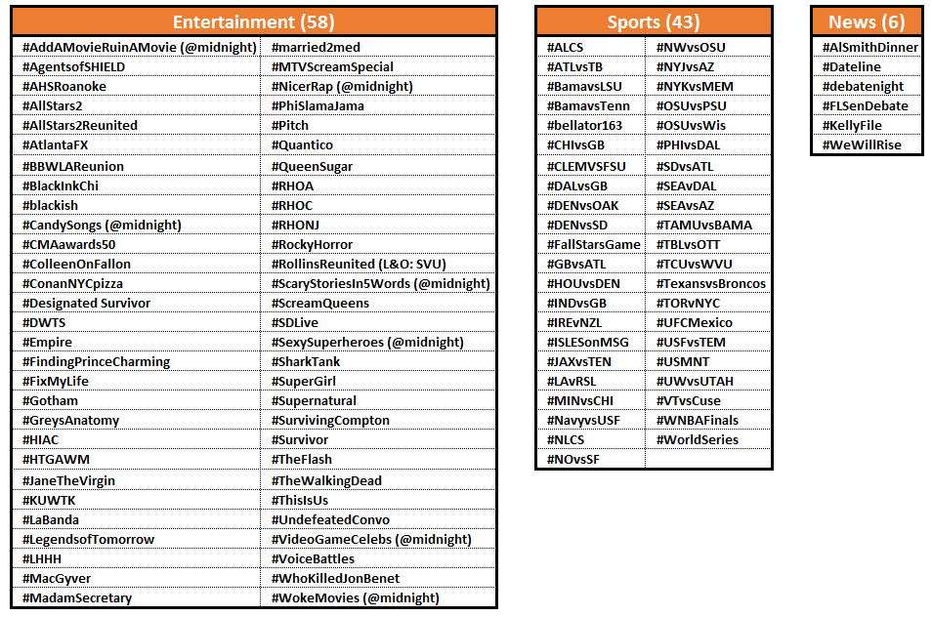
Nearly Four Official Ad-Supported TV Show Or Sports Event Hashtags Trended In The Top 10 During An Average Night
There were 107 official TV program hashtags, a majority of them entertainment show-based, that trended in the top 10 topics over the four-week time period
18
Source: VAB custom analysis of Top 10 trending Twitter Topics each night (8:15p, 9:15p, 10:15p, 11:15p) during 4-week time period (10/10-2016 – 11/6/2016).

Slide 19
Sports Accounted For Over Two-Thirds Of Total Ad-Supported TV Topics That Trended In The Top 10 Throughout The Time Period
Four-Week Time Period (Primetime)
Genre % Breakout of Top 10 Ad-Supported TV Trending Topics
19
Source: VAB custom analysis of Top 10 trending Twitter Topics each night (8:15p, 9:15p, 10:15p, 11:15p) aggregated during 4-week time period (10/10-2016 – 11/6/2016). Results include both “direct” and “related” TV topics.

Slide 20
Weekends Were Heavy With TV Sports Social Conversations While TV Entertainment Skewed Towards The Weeknights
In terms of trends throughout the night, Sports is particularly strong at the beginning of the night (8:15p) and towards the end (11:15p) while Entertainment programming is more likely to be talked about around the 10 o’clock hour
Four-Week Time Period (Primetime)
Genre-Specific Top 10 Ad-Supported TV Trending Topics By Day
20
Source: VAB custom analysis of Top 10 trending Twitter Topics each night (8:15p, 9:15p, 10:15p, 11:15p) aggregated during 4-week time period (10/10-2016 – 11/6/2016). Results include both “direct” and “related” TV topics.

Slide 21


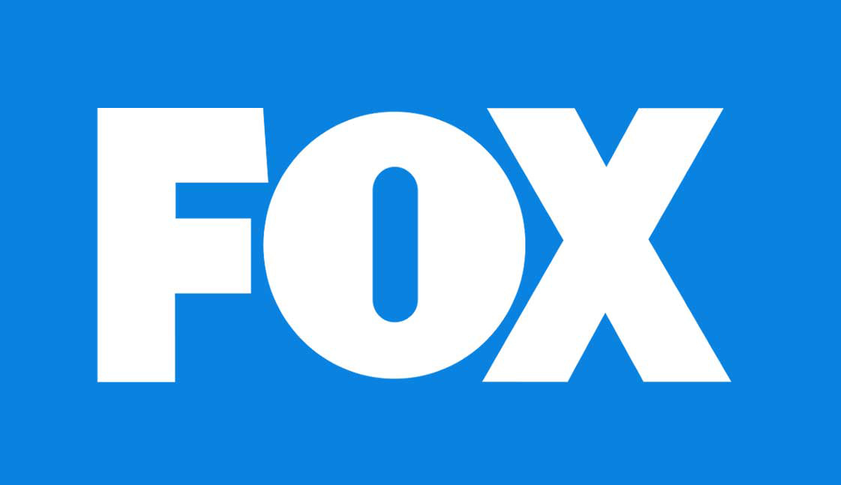




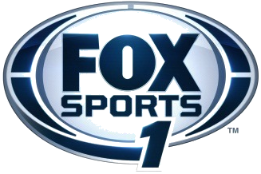




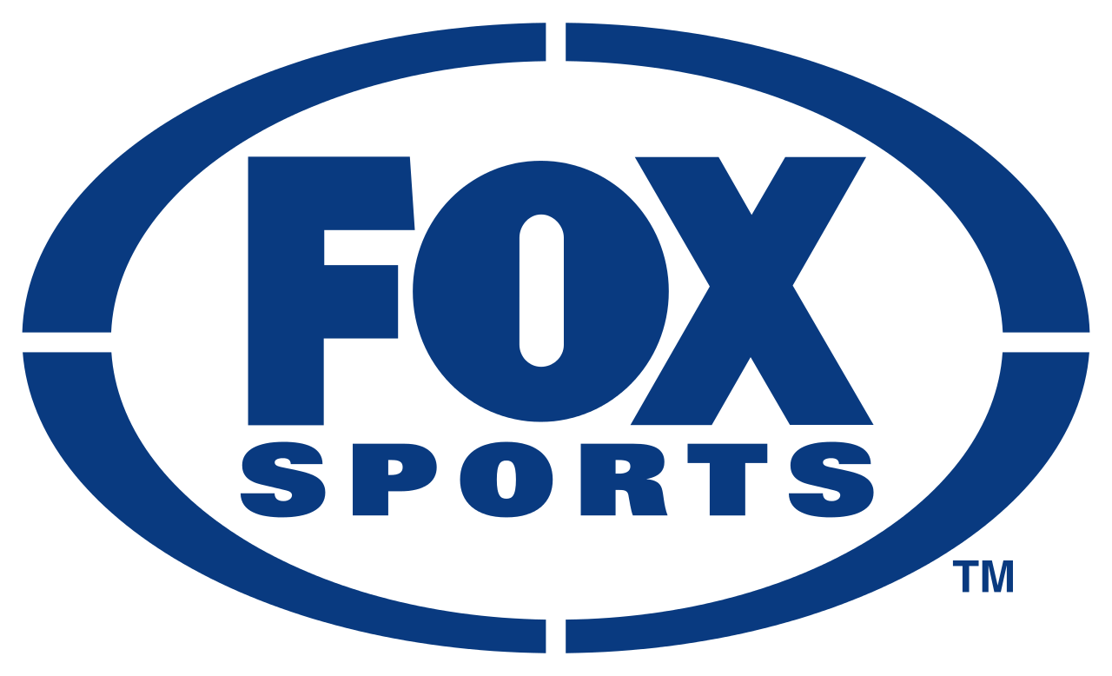











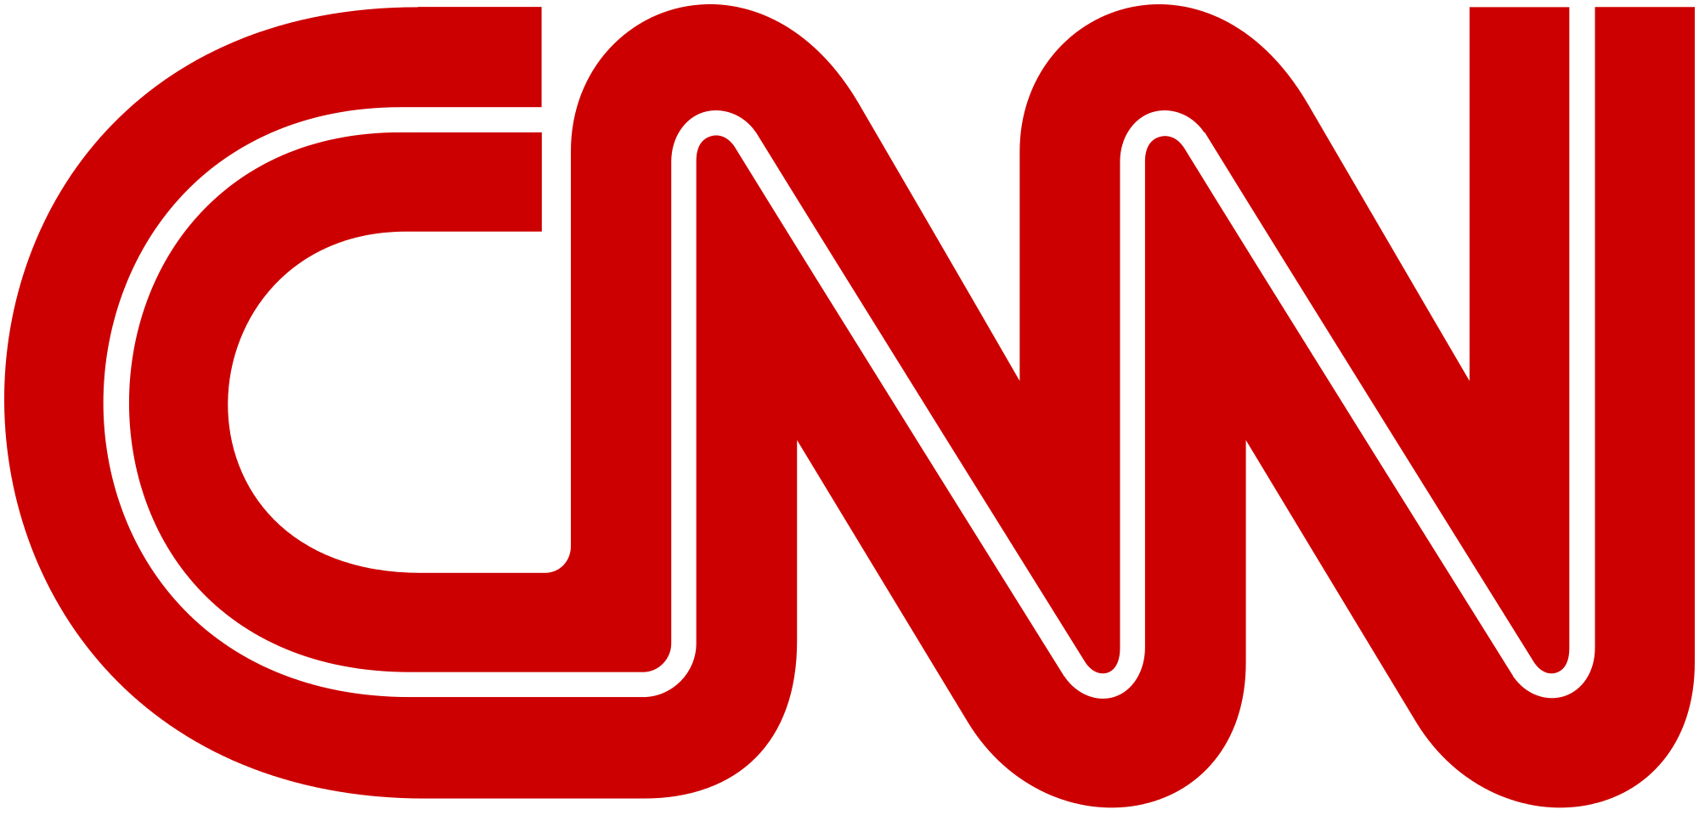






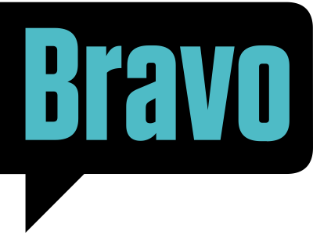






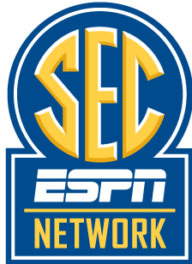




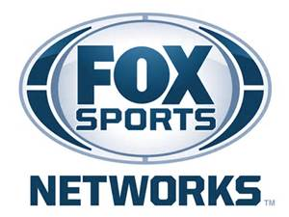



Programming From Over 46 Networks Were Top 10 Trending Topics During The Four-Week Primetime Analysis
Entertainment (19)
Sports (28+)
News (9)
National Networks (18)
Regional Networks (12+)
21
Source: VAB custom analysis of Top 10 trending Twitter Topics each night (8:15p, 9:15p, 10:15p, 11:15p) during 4-week time period (10/10-2016 – 11/6/2016). Results include both “direct” and “related” TV topics.

Slide 22
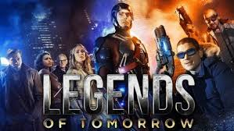
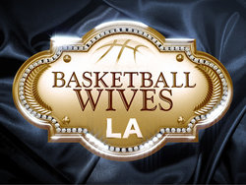






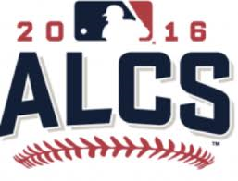
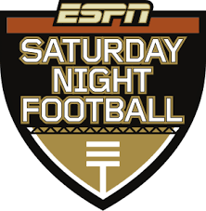
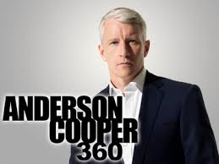
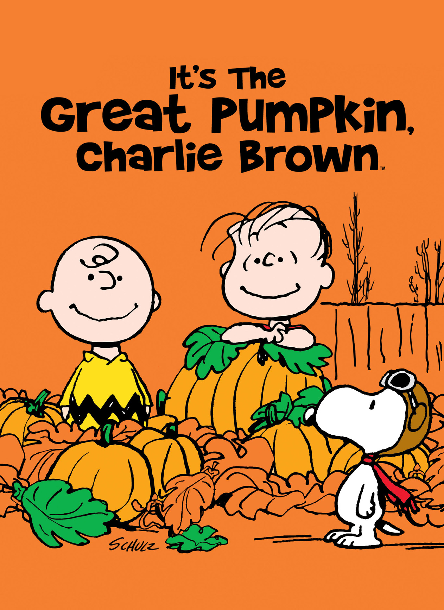

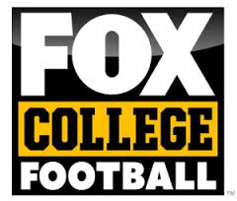

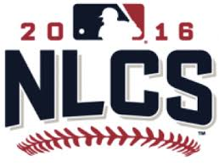




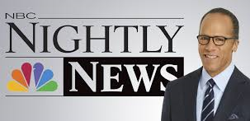

















































Over 97 TV Programs Trended In The Top 10 During The Four Week Primetime Analysis
Entertainment (53)
Sports (32+)
News (12+)
Various News Programming
22
Source: VAB custom analysis of Top 10 trending Twitter Topics each night (8:15p, 9:15p, 10:15p, 11:15p) during 4-week time period (10/10-2016 – 11/6/2016). Results include both “direct” and “related” TV topics.

Slide 23
When It Comes To Entertainment Programs, Nothing Else Gets People Talking Online Like Ad-Supported TV Content
Only one other ad-supported video platform, Twitch, had a program trend in the Top 10 at any point during the four-week primetime analysis
Four-Week Time Period (Primetime)
# of Top 10 Trending Entertainment Programs By Platform
(Netflix, Amazon, Hulu)
23
Source: VAB custom analysis of Top 10 trending Twitter Topics each night (8:15p, 9:15p, 10:15p, 11:15p) during 4-week time period (10/10-2016 – 11/6/2016). Based on unique program counts.

Slide 24






In Fact, Ad-Supported TV Accounts For 90% Of The Entertainment Content That Trended In The Top 10 Topics
Four-Week Time Period (Primetime)
% of Top 10 Trending Entertainment Programs By Platform
24
Source: VAB custom analysis of Top 10 trending Twitter Topics each night (8:15p, 9:15p, 10:15p, 11:15p) during 4-week time period (10/10-2016 – 11/6/2016). Based on unique program counts.

Slide 25
Sports Is A Very Popular Genre To Tweet About & All Major Leagues Had Several Games With Heavy Social Chatter
During the four-week time period, 355 separate sports TV topics (games, teams, athletes, etc) in total trended in the Top 10; an average of more than 12 per night
  Some nights, like Saturday November 5th, saw action from as many as six different sports trending in the Top 10 during primetime (MLB, MMA, NBA, NCAA Football, NHL, Rugby)
Four-Week Time Period (Primetime)
# of Top 10 Trending Topics By Sport
25
Source: VAB custom analysis of Top 10 trending Twitter Topics each night (8:15p, 9:15p, 10:15p, 11:15p) during 4-week time period (10/10-2016 – 11/6/2016). Results include both “direct” and “related” TV topics. Topics include direct program hashtags as well as sports TV-related topics tied to athletes, teams and game references. The 355 sports TV topics includes duplication for similar topics trending in different games (ex. Kershaw) which explains the slight variance with the overall unique sports figures on page 16.

Slide 26
Nationally Televised Sports Almost Automatically Spurred Some Of The Top Social Conversations During Their Airings
Almost 9 out of 10 nationally televised NFL, MLB, NBA and evening college football games across the major TV networks trend in the top 10 during primetime on their respective nights
NFL: 100% (12 out of 12 games)
MLB: 91% (21 out of 23 games)
88%
(53 out of 61 games)
Top 10 Trending Topics
NBA: 71% (10 out of 14 games)
NCAA Football: 83% (10 out of 12 games)
Source: VAB custom analysis of Top 10 trending Twitter Topics each night (8:15p, 9:15p, 10:15p, 11:15p) during 4-week time period (10/10-2016 – 11/6/2016). Results include both “direct” and “related” TV topics. NFL: Sunday Night Football on NBC – 10/16, 10/23, 10/30, 11/6; ESPN Monday Night Football – 10/10, 10/17, 10/24, 10/31; Thursday Night Football – 10/13, 10/20, 10/27, 11/3. NCAA Football: ESPN Friday Night Football – 10/14, 10/21, 10/28, 11/4; ABC Saturday Night Football – 10/15, 10/22, 10/29, 11/5; ESPN 10/15, 10/22, 10/29, 11/5. NBA: ESPN – 10/26, 10/28, 11/2, 11/4; TNT – 10/25, 10/27, 11/3. MLB: MLBN – 10/10; TBS – 10/10, 10/14, 10/15, 10/17, 10/18, 10/19; FS1 – 10/10, 10/11, 10/13, 10/15, 10/16, 10/18, 10/19, 10/20, 10/22; FOX – 10/25, 10/26, 10/28, 10/29, 10/30, 11/1, 11/2
26

Slide 27

TV Sports-Related Top Trending Topics Typically Involve Athletes, Team Hashtags & Names And Game References
During the four-week time period, 292 unique sports-related TV topics (excluding TV game / event hashtags) trended in the Top 10; an average of more than 10 per night
27
Source: VAB custom analysis of Top 10 trending Twitter Topics each night (8:15p, 9:15p, 10:15p, 11:15p) during 4-week time period (10/10-2016 – 11/6/2016). Results reflect just “related” sports TV topics and doesn’t include official televised event hashtags.

Slide 28
When Televised News Made Headlines During The Election Cycle, People Talked About It On Social Media…A Lot
Date
Topic / Rank
Description
Date
Topic / Rank
Description
#KenBoneFacts
Hashtag related to an audience member, now internet celebrity, of the previous night’s Presidential debate
#debatenight
3rd and final Presidential debate. Several other topics related to what was being said during the debate began trending throughout the night as well
10-Oct
8:15p - #2
9:15p - #3
19-Oct
All 4 Time Periods: #1
#ncgov
North Carolina governor televised debate and coverage by major TV news networks
#AlSmithDinner
Annual fundraiser dinner for support of Catholic charities that invites the Presidential candidates each election year to speak and is covered by the major TV news networks
11-Oct
8:15p - #3
20-Oct
9:15p - #2
10:15p - #1
11:15p - #1
#WeWillRise
CNN documentary: “We Will Rise: Michelle Obama’s Mission to Educate Girls Around the World”
#FLSenDebate
Hotly-contested Florida Senate debate featuring Marco Rubio and covered by the major TV news networks.
The final Puerto Rico gubernatorial debate which was covered by Univision
12-Oct
9:15p - #3
10:15p - #3
11:15p - #5
26-Oct
8:15p - #1
#ConvenceMe
9:15p - #1
#BillyBushMadeMeDoIt
Hashtags related to Melania Trump’s CNN interview with Anderson Cooper.
A user-generated hashtag begins trending after Melania blames Billy Bush for Trump’s comments about women
#MelaniaTrump
Rare speech given by Melania Trump, which was covered by the major TV news networks, who spoke about stopping cyber-bullying among other issues
8:15p - #1
8:15p - #2
9:15p - #4
17-Oct
#MelaniaTrump
3-Nov
8:15p - #3
9:15p - #2
#DrainTheSwamp
In a televised speech covered by the major news networks, Donald Trump unveils ethics and lobbying reform plan where he intends to “drain the swamp”
18-Oct
8:15p - #1
28
Source: VAB custom analysis of Top 10 trending Twitter Topics each night (8:15p, 9:15p, 10:15p, 11:15p) during 4-week time period (10/10-2016 – 11/6/2016).

Slide 29



Presidential Debate Nights Offered Particular Social Fodder For Twitter Users
Beyond the top trending #DebateNight hashtag, nine different topics related to the televised Presidential debate on October 19th trended in the top 10 throughout the night
#DebateNight: Top Trending Topic
TV-Related Topics in Top 10:
-#ChrisWallace
-#Putin
-#SCOTUS
-Bad Hombres
-BIGLY
-Emmys
-Hillary
-#MarkCuban
-Nasty Woman
“…And that’s what’s happened bigly”
“He started tweeting the Emmy’s were rigged against him”
“The Supreme Court needs to stand on the side of the American people”
“Such a
nasty woman”
“We have some bad hombres here and we’re going to get ‘em out”
“Putin would rather have a puppet as President”
#Hillary
The Moderator
The Debate “Undercard”
29
#MarkCuban
#ChrisWallace
Source: VAB custom analysis of Top 10 trending Twitter Topics on October 19th, 2016 (8:15p, 9:15p, 10:15p, 11:15p)

Slide 30

















Beyond TV, Many Of The Top Non-TV Trending Topics Were User-Generated Hashtags Focused On Silly Fun Or Subversive Political Statements
#BeRomanticIn4Words
#Animal90sBands
#3WordMotivationalSpeech
#ItsOnlyTrueLoveIf
#ObamacareInThreeWords
#ImThePosterChildFor
#TrumpBookReports
#MakeSongIntoPSAs
#RememberWhenTrump
#RejectedHillarySlogans
#ThingsNeverSaidInHorrorFilms
#DMYourCrushDay
#TrumpDrSeuss
#MyFirstCarIn3Words
#ThingsThe5thDentistRecommends
#JobsFor90sMovies
#PizzaIn4Words
Source: VAB custom analysis of Top 10 trending Twitter Topics each night (8:15p, 9:15p, 10:15p, 11:15p) during 4-week time period (10/10-2016 – 11/6/2016).
30

Slide 31
The Tweet Cheat Sheet Showing Ad-Supported TV’s Dominance Of Top Trending Twitter Topics
Twitter is a millennial-driven social media platform with the demographic accounting for 58% of the total time spent
Millennials, and the overall Twitter community, are highly engaged with ad-supported TV content through continuous social conversations every night
In fact, during the four weeks (28 nights) of “primetime” Twitter activity monitored:
  Almost 8 of the Top 10 trending topics at any point are based on ad-supported TV programming
  A televised sporting event trended in the Top 10 every night while an entertainment show trended in 26 nights
  7: average # of ad-supported TV programs that trended in the Top 10 each night
  12: highest # of ad-supported TV programs that trended in the Top 10 on an individual night
  15: average # of unique ad-supported TV topics that trended in the Top 10 each night
  437: total # of unique ad-supported TV topics that trended in the Top 10
  24: # of nights with a #1 trending ad-supported TV topic
  47: total # of ad-supported TV topics that trended #1
  107: # of “official” ad-supported TV show/sporting events hashtags that trended in the Top 10
  46+: # of ad-supported TV networks with at least one program that trended in the Top 10
  97+: total # of ad-supported TV programs that trended in the Top 10
  53: total # of entertainment shows that trended in the Top 10
  355: total # of separate sports topics (games, teams, athletes, etc) that trended in the Top 10
  88%: % of nationally televised sporting events that trended in the Top 10
31
Source: VAB custom analysis of Top 10 trending Twitter Topics each night (8:15p, 9:15p, 10:15p, 11:15p) aggregated during 4-week time period (10/10-2016 – 11/6/2016). Topics can differ from programs because topics also include show characters, athletes, team mentions of a televised event, etc. comScore, mediametrix multiplatform, October 2016.

Slide 32
Bonus Section For VAB Members:
Cable vs. Broadcast
32

Slide 33

Ad-Supported Cable TV Accounted For Over Half Of The Overall Top 10 Trending Twitter Topics Throughout Primetime Hours
51%
Overall Cable % of TV-topics In Top 10 During Primetime
Even though this analysis was done during the mid-October / early-November period, a time of heavy political discussion across the U.S., ad-supported cable TV dominated the top conversations on Twitter; even more so during the later primetime hours
8:15p
Cable % of
TV-topics In Top 10: 41%
9:15p
Cable % of
TV-topics In Top 10: 50%
10:15p
Cable % of
TV-topics In Top 10: 55%
11:15p
Cable % of
TV-topics In Top 10: 58%
33
Source: VAB custom analysis of Top 10 trending Twitter Topics each night (8:15p, 9:15p, 10:15p, 11:15p) aggregated during 4-week time period (10/10-2016 – 11/6/2016).
Results include both “direct” and “related” TV topics. Percentages include “cable TV / broadcast” figures as well, excluding those the overall % would be 48%.

Slide 34
Over Half Of The Top 10 Trending Topics Between Monday – Thursday Were Based on Ad-Supported Cable TV Content
Four Week Average: % of Top 10 Trending Topics That Are Based On Ad-Supported Cable TV Content
Monday
Tuesday
Wednesday
Thursday
Friday
Saturday
Sunday
Overall
69%
54%
51%
59%
38%
53%
34%
8:15p
53% 48% 38% 40% 40% 50% 13%
9:15p
68% 53% 50% 60% 35% 53% 30%
10:15p
75% 53% 55% 60% 33% 68% 45%
11:15p
83% 65% 63% 75% 43% 40% 43%
34
Source: VAB custom analysis of Top 10 trending Twitter Topics each night (8:15p, 9:15p, 10:15p, 11:15p) during 4-week time period (10/10-2016 – 11/6/2016). Reflects four week average by day and time. Results include both “direct” and “related” TV topics. Percentages include “cable TV / broadcast” programs.

Slide 35
Cable TV Sports And Entertainment Were Very Popular In The Social Sphere During Most Nights Of The Analysis Period
By genre, sports TV was a Top 10 trending topic almost every night followed closely by entertainment; even topics from televised news programming trended highly on several nights
Four-Week Time Period (Primetime)
# of Nights Ad-Supported TV Programming Trended In Top 10 Topics By Genre
35
Source: VAB custom analysis of Top 10 trending Twitter Topics each night (8:15p, 9:15p, 10:15p, 11:15p) during 4-week time period (10/10-2016 – 11/6/2016). Results include both “direct” and “related” TV topics. Includes “cable TV / broadcast” programming.

Slide 36
On Average, Five Different Ad-Supported Cable TV Programs Trended In The Top 10 At Some Point During Every Night
# of TV Programs Trending In The Top 10 During Each Night
9
9
8
7
7
7
6
6
6
6
5
5
5
5
5
5
4
4
4
3
3
3
3
3
3
2
2
1
Sat
Sat
Mon
Tues
Wed
Thurs
Sat
Sat
Mon
Mon
Fri
Sun
Tues
Wed
Thurs
Tues
Wed
Thurs
Mon
Tues
Wed
Thurs
Fri
Sun
Fri
Sun
Fri
Sun
36
Source: VAB custom analysis of Top 10 trending Twitter Topics each night (8:15p, 9:15p, 10:15p, 11:15p) during 4-week time period (10/10-2016 – 11/6/2016). Results include both “direct” and “related” TV topics. Includes “cable TV / broadcast” programming.

Slide 37
Across Genres, Ad-Supported Cable TV Had More Top 10 Trending Topics Throughout Primetime Than Broadcast TV
Four-Week Time Period (Primetime)
Genre % Breakout of Ad-Supported TV Topics By Medium
Entertainment
Sports
News
*Ad-Supported Cable TV & Broadcast TV includes programs or topics that aired, or were discussed, on multiple networks such as NFL’s Thursday Night Football (CBS/NFL Network) or the Presidential debates (broadcast networks / cable news networks)
37
Source: VAB custom analysis of Top 10 trending Twitter Topics each night (8:15p, 9:15p, 10:15p, 11:15p) aggregated during 4-week time period (10/10-2016 – 11/6/2016).
Results include both “direct” and “related” TV topics.

Slide 38
Outside Of The NFL, Cable TV Was The Clear Leader Over Broadcast TV In Social Conversation Across Sports Leagues
During the four-week time period, 237 separate sports topics on Ad-Supported Cable TV (games, teams, athletes, etc) in total trended in the Top 10; an average of more than 8 per night
Four-Week Time Period (Primetime)
# of Top 10 Trending Topics By Sport
115
79
57
56
23
9
*MLS: Top 10 trending topics – 3 on ad-supported cable TV; 1 on broadcast TV
38
Source: VAB custom analysis of Top 10 trending Twitter Topics each night (8:15p, 9:15p, 10:15p, 11:15p) during 4-week time period (10/10-2016 – 11/6/2016). Results include both “direct” and “related” TV topics. Topics include direct program hashtags as well as sports TV-related topics tied to athletes, teams and game references. The 355 sports TV topics includes duplication for similar topics trending in different games (ex. Kershaw) which explains the slight variance with the overall unique sports figures on page 16.

Slide 39


