Slide 1
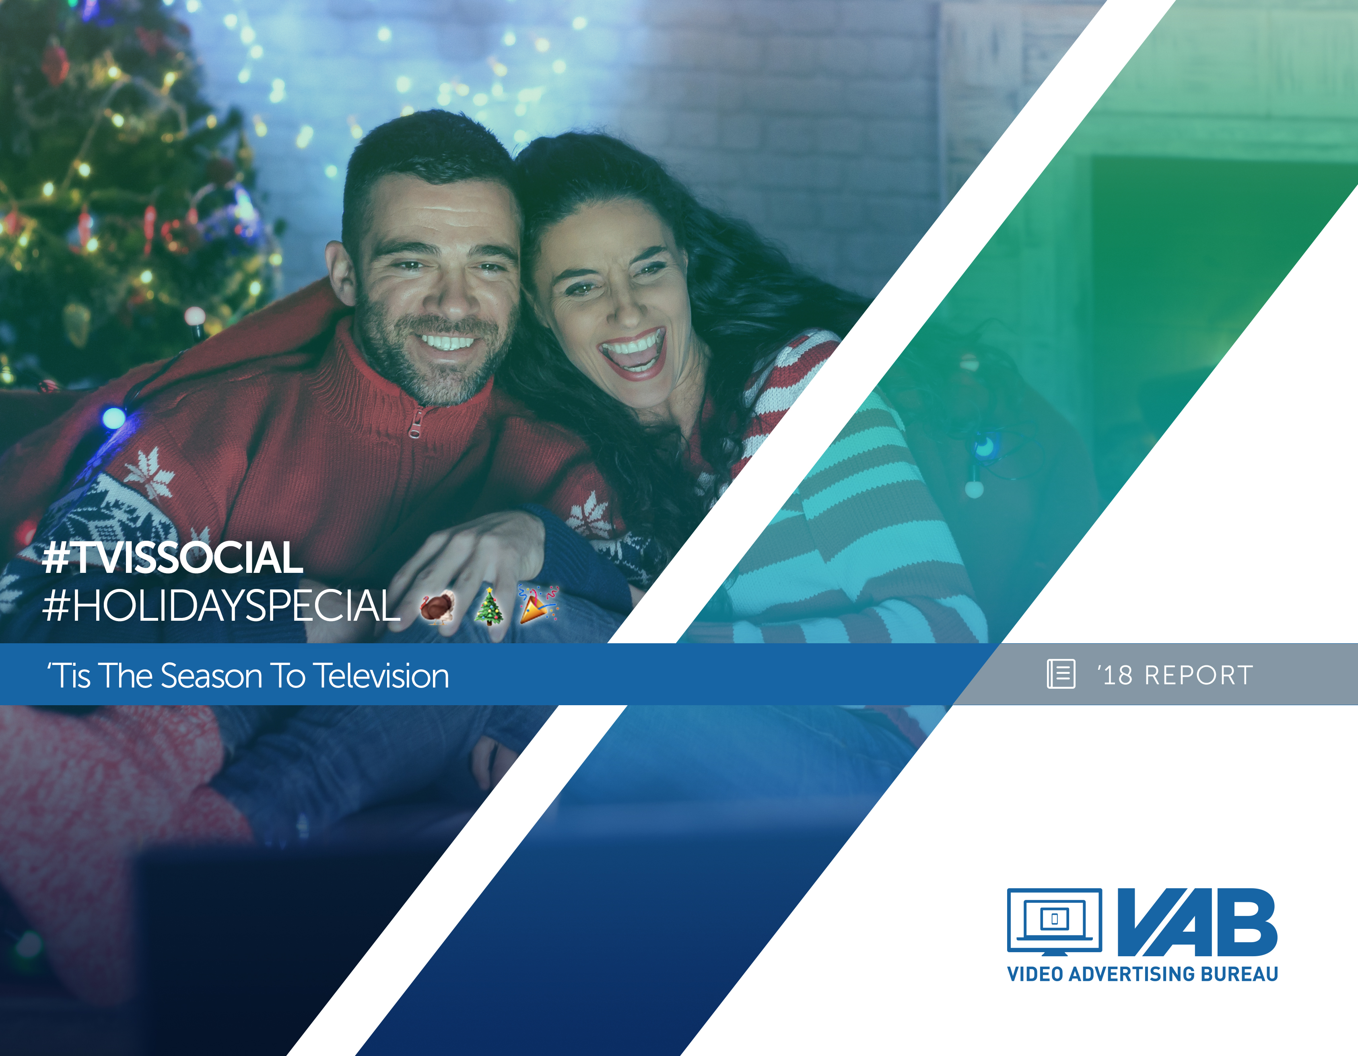



#TVisSocial #HolidaySpecial
‘Tis The Season To Television
Member Center

Slide 2
Timeline
Summary 3
Time Spent With Ad-Supported TV 4
Social Methodology 5
Top Trending Topics Analysis 6-13
Trending Details By Holiday 14-20
Non-TV Trending Topics 21
Related Reports 22
Contact Information 23

Slide 3



‘Tis The Season To Television
With powerful, iconic programming like the Macy’s Parade & NFL on Thanksgiving, It’s A Wonderful Life on Christmas Eve, NBA on Christmas Day, Countdown shows on New Year’s Eve, and the Rose Parade & college football bowl games on New Year’s Day, it’s not the dinner table that’s the central hub of family gatherings during the holidays, it’s the television.
This love of television, and the 5+ hours spent with it during each holiday, extends beyond people’s families and to the online social world where people can’t wait to share their anticipation and reactions to their favorite TV programming.
We monitored the top trending topics on Twitter during the five 4Q holidays and found that:
Overall, Ad-Supported TV accounted for 75% of the top 10 trending Twitter topics
Each holiday features multiple entertainment & sports TV programs that “own” the online social conversation
A few other entertainment-related pieces of content trended, but nothing comes close to the dominance of Ad-Supported TV during the holidays
  While 45 ad-supported sports & entertainment TV programs trended, only a few other platforms had any topic trend – YouTube (1), music (1), video games (1), online streaming (1)
#TVisSOCIAL #HolidaySpecial

Slide 4

On Average, P13+ Watched Over Five Hours Of “Live” Ad-Supported TV Programming During Each Holiday
P13+ Time Spent Viewing “Live” Ad-Supported TV
(Hrs:Mins)
% Reach:
64%
63%
64%
66%
68%
#TVisSOCIAL #HolidaySpecial
Source: VAB analysis of Nielsen NPower R&F Time Period Report, P13+, Live, ad-supported cable + broadcast TV, Total Day, 11/23/17, 12/24/17, 12/25/17, 12/31/17, 1/1/18.

Slide 5
Quantifying The Online Social Popularity Of Ad-Supported TV During Key 4th Quarter Holidays
Beyond viewing, we were interested in examining the greater role that TV plays in people’s lives during key 4Q holidays when people traditionally gather with family and friends. Therefore, we analyzed the impact of TV programming on the top 10 trending Twitter topics over five holiday time periods
  Thanksgiving (Thursday, 11/23/17), Christmas Eve (Sunday, 12/24/17), Christmas Day (Monday, 12/25/17), New Year’s Eve (Sunday, 12/31/17), New Year’s Day (Monday, 1/1/18)
Since trending topics are everchanging and a slight lag time typically exists for topics to start trending, we monitored “points in time” each day at :45 minutes past the hour to capture what people were talking about online during that hour
We also wanted to specifically hone in on the time periods when people are most likely gathered with family and friends, therefore we focused on monitoring a 13-hour time period (“all day”) for the national holidays and a four-hour time period (“primetime”) for the holiday eves
  Thanksgiving Day / Christmas Day / New Year’s Day: 11:45a, 12:45p, 1:45p, 2:45p, 3:45p, 4:45p, 5:45p, 6:45p, 7:45p, 8:45p, 9:45p, 10:45p, 11:45p
  Christmas Eve / New Year’s Eve: 8:45p, 9:45p, 10:45p, 11:45p
Geography reflects U.S.-based Twitter trending data while ad-supported TV topics reflect two types:
  Direct: specific hashtags of televised entertainment shows, sports events or news programming
  Related: topics associated with specific TV programming including athletes, general team hashtags, collegiate school mentions (school & nicknames for football & basketball), show characters, celebrity personalities, and specific TV-related news references
#TVisSOCIAL #HolidaySpecial

Slide 6



Ad-Supported TV Dominated Twitter’s Top 10 Trending Topics During Key Holiday Time Periods
75% of the aggregated top 10 trending topics across the five monitored holiday time periods were ad-supported TV-related topics
Thanksgiving Day
(11:45a-11:45p)
Christmas Eve
(8:45p-11:45p)
Christmas Day
(11:45a-11:45p)
New Year’s Eve
(8:45p-11:45p)
New Year’s Day
(8:45p-11:45p)
75%
75%
73%
78%
75%
% of Overall Top 10 Trending Topics on Twitter that were
ad-supported TV-related during each measurement time period
#TVisSOCIAL #HolidaySpecial
Source: VAB custom analysis of Top 10 trending Twitter Topics (United States) each night on the :45’s aggregated over each hour between 11a – 11p (11:45a-11:45p) during 11/23/2017, 12/25/17, 1/1/18 and on the :45’s of each primetime hour between 8p-11p (8:45p-11:45p) during 12/24/17 & 12/31/17.

Slide 7
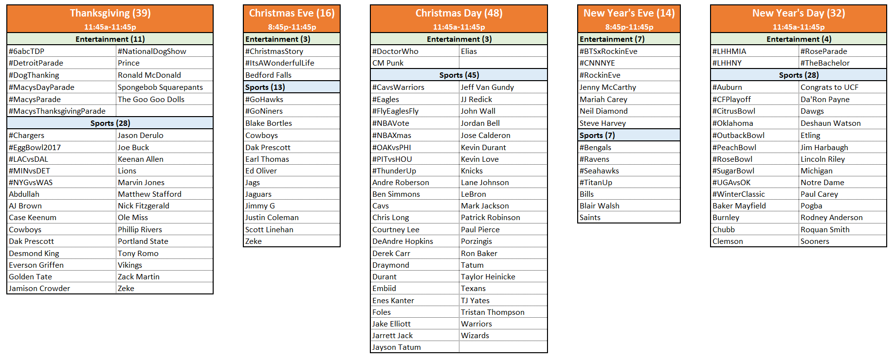
149 Different Ad-Supported TV Topics Trended In The Top 10 During The Five Holiday Monitored Time Periods
#TVisSOCIAL #HolidaySpecial
Source: VAB custom analysis of Top 10 trending Twitter Topics (United States) each night on the :45’s of each hour between 11a – 11p (11:45a-11:45p) during 11/23/2017, 12/25/17, 1/1/18 and on the :45’s of each primetime hour between 8p-11p (8:45p-11:45p) during 12/24/17 & 12/31/17.

Slide 8
17 Different Ad-Supported TV Topics Trended #1 During The Five Holiday Monitored Time Periods
An Ad-supported TV topic trended #1 during every primetime hour across the five holidays
Top Twitter Trending TV Topics By Holiday Time Period
Thanksgiving
(11:45a-11:45p)
Christmas Eve
(8:45p-11:45p)
Christmas Day
(11:45a-11:45p)
New Year’s Eve
(8:45p-11:45p)
New Year’s Day
(11:45a-11:45p)
6:45p - #LACvsDAL (#1)
7:45p - #Cowboys (#1)
8:45p - #Cowboys (#1)
9:45p - #Cowboys (#1)
10:45p - #NYGvsWAS (#1)
11:45p - #NYGvsWAS (#1)
8:45p - #Cowboys (#1)
9:45p - #Cowboys (#1)
10:45p - #ItsAWonderfulLife (#1)
11:45p - #ItsAWonderfulLife (#1)
3:45p - #NBAXmas (#1)
4:45p - #Cavs (#1)
5:45p - Lebron (#1)
6:45p - LeBron (#1)
7:45p - LeBron (#1)
8:45p - LeBron (#1)
9:45p - #DrWho (#1)
10:45p - #DrWho (#1)
11:45p - #OAKvsPHI (#1)
8:45p - #Bills (#1)
9:45p - #Bills (#1)
10:45p - #CNNNYE (#1)
11:45p - #CNNNYE (#1)
12:45p - #RoseParade
1:45p - #WinterClassic (#1)
2:45p - #WinterClassic (#1)
3:45p - Michigan (#1)
4:45p - #PeachBowl (#1)
5:45p - #RoseBowl (#1)
6:45p - #RoseBowl (#1)
7:45p - #RoseBowl (#1)
8:45p - #RoseBowl (#1)
9:45p - #RoseBowl (#1)
10:45p - #RoseBowl (#1)
11:45p - #RoseBowl (#1)
#TVisSOCIAL #HolidaySpecial
Source: VAB custom analysis of Top 10 trending Twitter Topics (United States) each night on the :45’s of each hour between 11a – 11p (11:45a-11:45p) during 11/23/2017, 12/25/17, 1/1/18 and on the :45’s of each primetime hour between 8p-11p (8:45p-11:45p) during 12/24/17 & 12/31/17.

Slide 9
Several Different Ad-Supported TV Programs Trended In The Top 10 At Some Point During Each Holiday Time Period
# of TV Programs Trending In The Top 10 During Each Holiday Time Period
Sports
Entertainment
13
10
9
8
5
(11:45a-11:45p)
(8:45p-11:45p)
(11:45a-11:45p)
(8:45p-11:45p)
(11:45a-11:45p)
#TVisSOCIAL #HolidaySpecial
Source: VAB custom analysis of Top 10 trending Twitter Topics (United States) each night on the :45’s aggregated over each hour between 11a – 11p (11:45a-11:45p) during 11/23/2017, 12/25/17, 1/1/18 and on the :45’s of each primetime hour between 8p-11p (8:45p-11:45p) during 12/24/17 & 12/31/17.

Slide 10

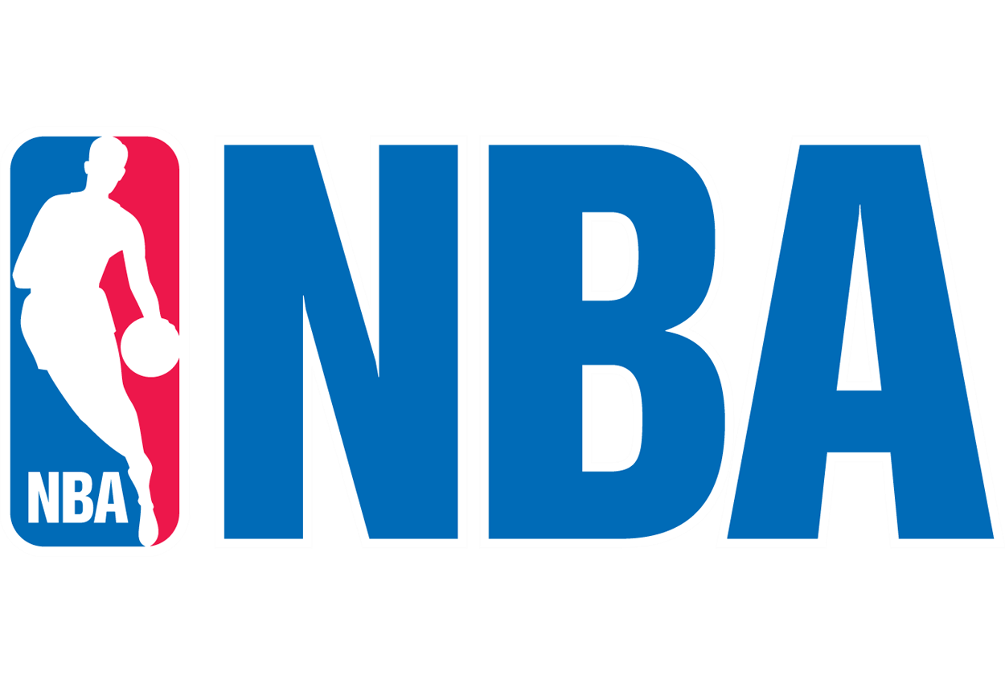
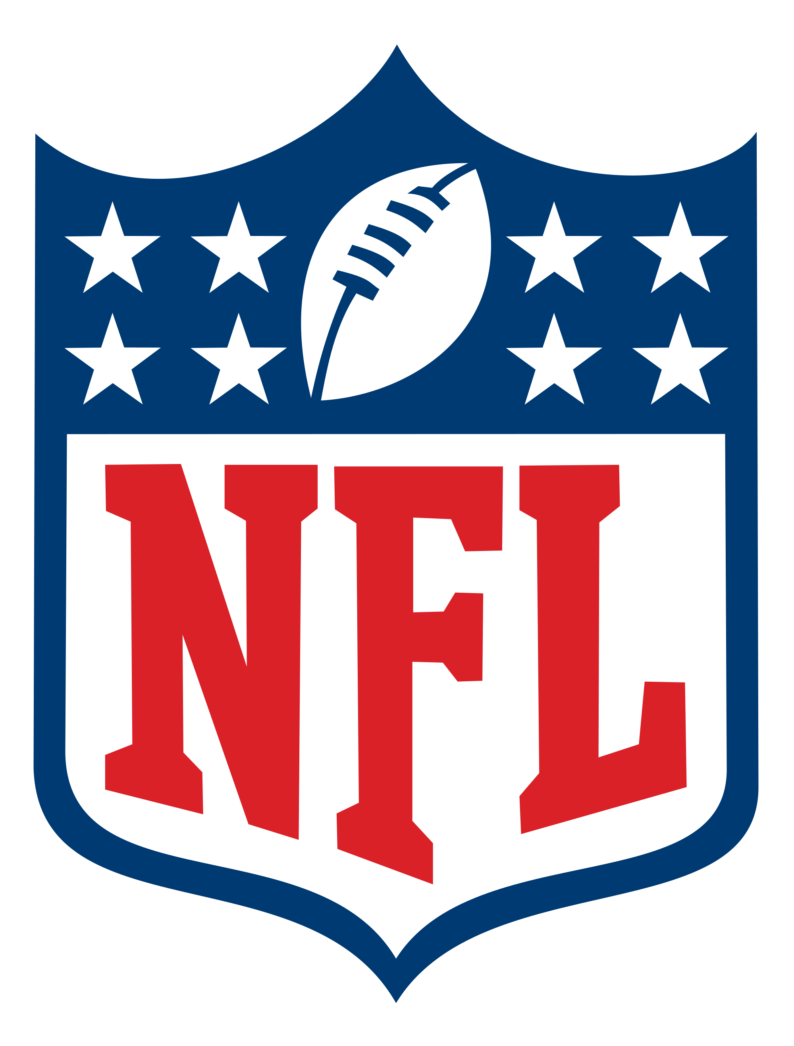













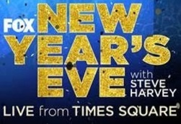

Several Ad-Supported TV Sports & Entertainment Shows “Own” Specific Holidays
Thanksgiving Day
(11:45a – 11:45p)
Christmas Eve
(8:45p – 11:45p)
Christmas Day
(11:45a – 11:45p)
New Year’s Eve
(8:45p – 11:45p)
New Year’s Day
(11:45a – 11:45p)
#TVisSOCIAL #HolidaySpecial
Source: VAB custom analysis of Top 10 trending Twitter Topics (United States) each night on the :45’s of each hour between 11a – 11p (11:45a-11:45p) during 11/23/2017, 12/25/17, 1/1/18 and on the :45’s of each primetime hour between 8p-11p (8:45p-11:45p) during 12/24/17 & 12/31/17.

Slide 11














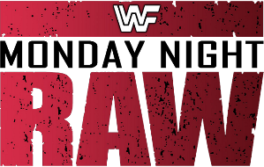





45 Different Ad-Supported TV Programs Trended In The Twitter Top 10 During The Five-Holiday Monitored Time Period
Entertainment (15)
Sports (30)
#TVisSOCIAL #HolidaySpecial
Source: VAB custom analysis of Top 10 trending Twitter Topics (United States) each night on the :45’s of each hour between 11a – 11p (11:45a-11:45p) during 11/23/2017, 12/25/17, 1/1/18 and on the :45’s of each primetime hour between 8p-11p (8:45p-11:45p) during 12/24/17 & 12/31/17.

Slide 12
During The Holidays, Nothing Else Gets People Talking Online Like Ad-Supported TV Programs
Five-Holiday Monitored Time Period
# of Top 10 Trending Programs / Content By Platform
(“Logan Paul” –
controversy surrounding “suicide forest” video)
(“Dedication 6” –
Lil Wayne released a new mixtape on Christmas)
(“Calvin” –
Calvin Johnson glitch in the Madden ‘18 Ultimate Team EA Sports Game)
(“MST3KTurkeyDay” –
MST3K marathon on Shout! Factory TV, Twitch, Pluto TV)
#TVisSOCIAL #HolidaySpecial
Source: VAB custom analysis of Top 10 trending Twitter Topics (United States) each night on the :45’s of each hour between 11a – 11p (11:45a-11:45p) during 11/23/2017, 12/25/17, 1/1/18 and on the :45’s of each primetime hour between 8p-11p (8:45p-11:45p) during 12/24/17 & 12/31/17.

Slide 13
The Holiday Season Saw TV Trending Topics Split Almost 60% / 40% Between Broadcast & Cable TV Respectively
Aggregated Five-Holiday Time Period
% Breakout of Ad-Supported TV Topics By Medium
*Ad-Supported Cable TV & Broadcast TV includes activities associated with the #NBAXmas hashtag and #RoseParade hashtag that aired, or were discussed, on multiple networks.
#TVisSOCIAL #HolidaySpecial
Source: VAB custom analysis of Top 10 trending Twitter Topics (United States) each night on the :45’s aggregated over each hour between 11a – 11p (11:45a-11:45p) during 11/23/2017, 12/25/17, 1/1/18 and on the :45’s of each primetime hour between 8p-11p (8:45p-11:45p) during 12/24/17 & 12/31/17.

Slide 14

Trending Details By Holiday

Slide 15
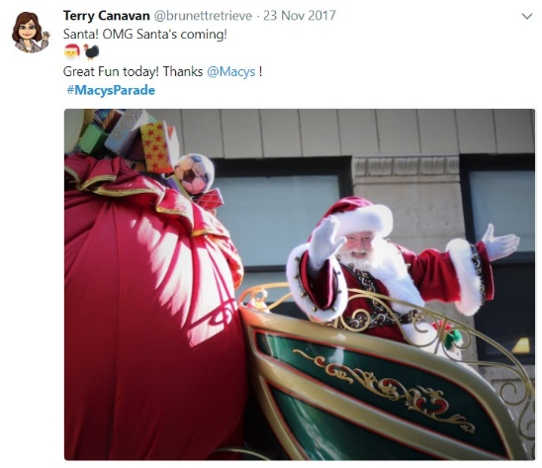



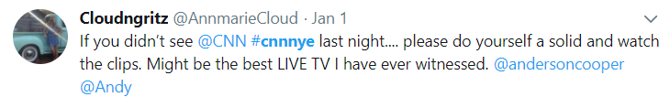
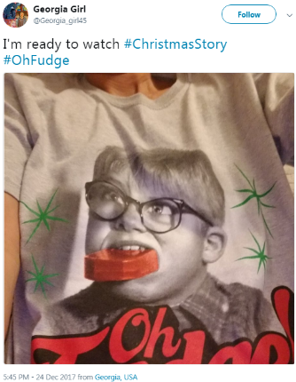
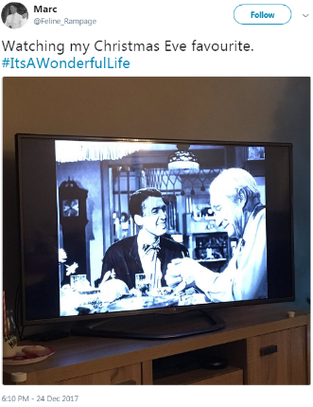
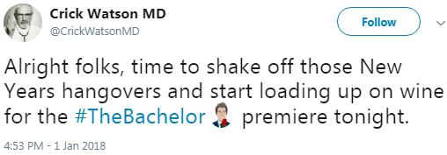
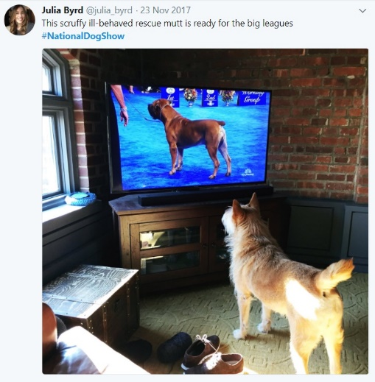
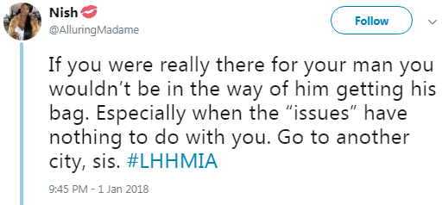
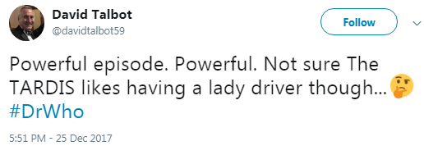



During The Holidays, People Log Onto Social Media To Share Their Anticipation & Excitement Over Their Favorite TV Programs
#TVisSOCIAL #HolidaySpecial
Source: VAB custom analysis of Top 10 trending Twitter Topics (United States): Data collected on the :45’s of each hour (11:45am-11:45pm) during: 11/23/2017, 12/25/17, 1/1/18. Data collected on the :45’s of each primetime hour (8:45pm-11:45pm) during 12/24/17 & 12/31/17

Slide 16
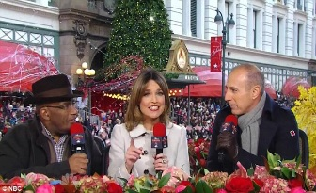
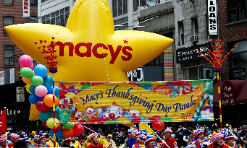
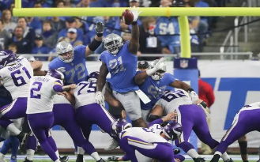
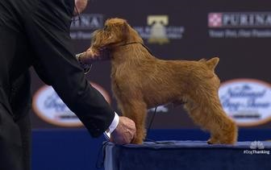
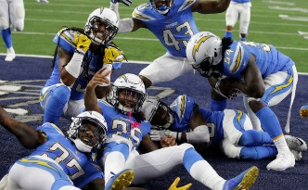
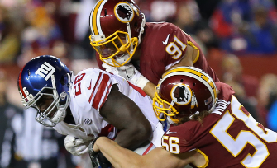
From The Macy’s Parade Through Evening Football Games, TV Programming Trended All Day On Twitter During Thanksgiving
75% of the Top 10 Twitter trending topics between 11a – 11p on Thanksgiving were Ad-Supported TV-related
Day
(11:45a – 7:45p)
Night
(8:45p – 11:45p)
#MacysParade
11:45a (#1), 12:45p (#2), 1:45p (#1), 2:45p (#5), 3:45p (#5), 4:45p (#9)
#LACvsDAL
5:45p (#3), 6:45p (#1)
/
#Cowboys / #Chargers
7:45p (#1/NA), 8:45p (#1/#5), 9:45p (#1/#8), 10:45p (#4/#6), 11:45p (#4/#9)
Related Trending Topics: Ronald McDonald, The Goo Goo Dolls, SpongeBob Squarepants, Prince
Related Trending Topics: Phillip Rivers, Keenan Allen, Desmond King, Dak Prescott, Zack Martin, Zeke, Tony Romo
#NationalDogShow
1:45p (#4), 2:45p (#3), 3:45p (#4), 4:45p (#6)
/
#DogThanking
5:45p (#7), 6:45p (#9)
#EggBowl
8:45p (#4), 9:45p (#10), 10:45p (#9)
#MINvsDET
1:45p (#5), 4:45p (#3)
#Lions / #Vikings
2:45p (#7/NA), 3:45p (#7/#6), 4:45p (#2/#5), 5:45p (#2/#6), 6:45p (#4/#5), 7:45p (#7/#9)
/
Related Trending Topics: Ole Miss, Nick Fitzgerald, AJ Brown
Related Trending Topics: Case Keenum, Everson Griffen, Matt Stafford, Ameer Abdullah, Marvin Jones, Golden Tate, Joe Buck, Jason Derulo
#NYGvsWAS
9:45p (#5), 10:45p (#1), 11:45p (#1)
#6abcTDP
11:45a (#7)
#DetroitParade
12:45p (#10)
Related Trending Topics: Jamison Crowder
*The above reflects the major TV events that trended on Twitter and does not represent all TV programming that trended
#TVisSOCIAL #HolidaySpecial
#6abcTDP = Philadelphia’s Thanksgiving Day Parade
(#) = ranking within the top 10 Twitter trending topics for that hour
Source: VAB custom analysis of Top 10 trending Twitter Topics (United States) on the :45’s of each hour (11:45a-11:45p) during 11/23/17

Slide 17
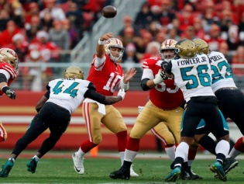
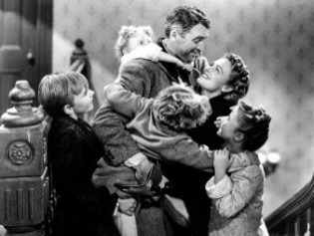
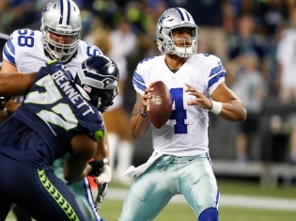
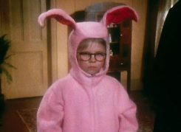
NFL Games & Holiday-Themed Movies Trended Throughout Primetime On Christmas Eve
75% of the Top 10 Twitter trending topics during primetime on Christmas Eve were Ad-Supported TV-related
Night
(8:45p – 11:45p)
#ItsAWonderfulLife
8:45p (#7), 9:45p (#4), 10:45p (#1), 11:45p (#1)
Related Trending Topics: Bedford Falls
#Cowboys / #GoHawks (Seattle Seahawks vs. Dallas Cowboys)
8:45p (#1/NA), 9:45p (#1/NA), 10:45p (#1/NA), 11:45p (#4/#8)
Related Trending Topics: Earl Thomas, Justin Coleman, Scott Linehan, Dak Prescott, Zeke
#Jaguars / #GoNiners (Jacksonville Jaguars vs. San Francisco 49ers)
8:45p (#5/NA), 9:45p (#7/#10)
Related Trending Topics: Jimmy G (trended between 8:45p-11:45p), Blake Bortles (trended between 8:45p-10:45p)
#ChristmasStory
10:45p (#8), 11:45p (#7)
*The above reflects the major TV events that trended on Twitter and does not represent all TV programming that trended
#TVisSOCIAL #HolidaySpecial
(#) = ranking within the top 10 Twitter trending topics for that hour
Source: VAB custom analysis of Top 10 trending Twitter Topics (United States) on the :45’s of each primetime hour (8:45p-11:45p) during 12/24/17

Slide 18
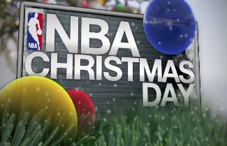
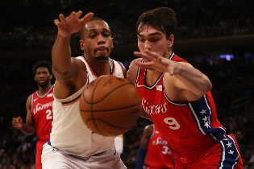
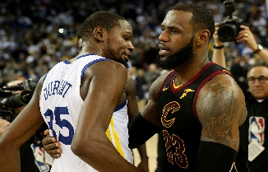
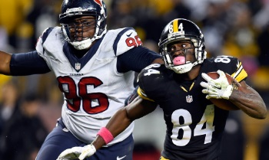
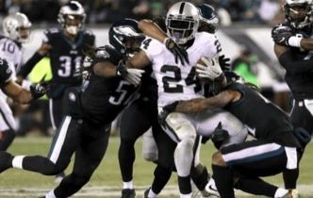
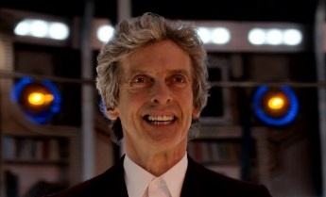
NBA & NFL Games Trended All Day On Christmas While Some Entertainment Shows Also Trended At Night
73% of the Top 10 Twitter trending topics between 11a – 11p on Christmas Day were Ad-Supported TV-related
Day
(11:45a – 7:45p)
Night
(8:45p – 11:45p)
#NBAXmas / #NBAVote
11:45a (#4/NA), 12:45p (#3/#5), 1:45p (#3/#8), 3:45p (#1/NA)
/
#CavsWarriors
5:45p (#2), 6:45p (#2), 7:45p (#7)
#LeBron
4:45p (#6), 5:45p – 8:45p (#1), 9:45p (#3), 10:45p (#5)
Related Trending Topics: Jose Calderon, Kevin Love, Tristan Thompson, Jordan Bell, Draymond Green, Kevin Durant, #Warriors, Jeff Van Gundy, Mark Jackson
Elias / CM Punk (WWE Raw)
8:45p (#5/#6), 9:45p (#9 / #10)
#ThunderUp
10:45p (#3), 11:45p (#8)
#Porzingis (New York Knicks vs. Philadelphia 76ers)
12:45p (#7), 1:45p (#6), 2:45p (#8)
Related Trending Topics: Jarrett Jack, Enes Kanter, Ron Baker, JJ Redick, Ben Simmons, Knicks, Embiid (trended through 4:45p)
#PITvsHOU (Pittsburgh Steelers vs. Houston Texans)
5:45p (#6), 7:45p (#3), 8:45p (#3)
Related Trending Topics: TJ Yates, #Texans, Taylor Heinicke, DeAndre Hopkins (trended through 9:45p)
#DoctorWho
9:45p (#1), 10:45p (#1), 11:45p (#4)
Paul Pierce (NBA Countdown)
1:45p (#10)
Jayson Tatum (Boston Celtics)
7:45p (#4), 9:45p (#8)
/
Related Trending Topics: John Wall, Wizards
#FlyEaglesFly
9:45p (#2), 10:45p (#2)
#OAKvsPHI
11:45p (#1)
Related Trending Topics: Foles, #Eagles, Chris Long, Jake Elliot, Patrick Robinson, Lane Johnson, Derek Carr, Lane Johnson
#TVisSOCIAL #HolidaySpecial
#6abcTDP = Philadelphia’s Thanksgiving Day Parade
(#) = ranking within the top 10 Twitter trending topics for that hour
Source: VAB custom analysis of Top 10 trending Twitter Topics (United States) on the :45’s of each hour (11:45a-11:45p) during 12/25/17

Slide 19
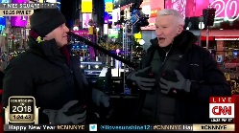
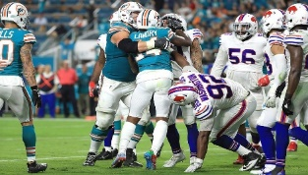
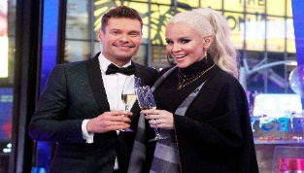
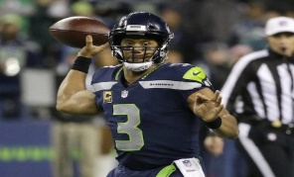
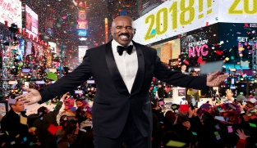
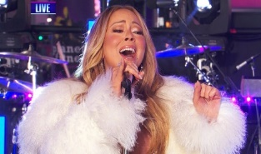
Televised New Year’s Eve Countdown Shows & NFL Games Consistently Trended Throughout Primetime On New Year’s Eve
78% of the Top 10 Twitter trending topics during primetime on New Year’s Eve were Ad-Supported TV-related
Night
(8:45p – 11:45p)
#CNNNYE
8:45p (#5), 9:45p (#2), 10:45p (#1), 11:45p (#1)
#TitanUp (Tennesee Titans)
8:45p (#10)
#RockinEve
9:45p (#3), 10:45p (#2), 11:45p (#2)
Related Trending Topics: Jenny McCarthy, Mariah Carey
#Ravens / #Bengals
8:45p (#4/#6), 9:45p (#9/NA)
#SteveHarvey (FOX’s New Year’s Eve with Steve Harvey)
9:45p (#8), 10:45p (#9), 11:45p (#5)
Related Trending Topics: Neil Diamond
#Bills (Buffalo Bills vs. Miami Dolphins)
8:45p (#1), 9:45p (#1), 10:45p (#3), 11:45p (#6)
#Seahawks (Seattle Seahawks vs. Arizona Cardinals)
8:45p (#10), 9:45p (#10), 10:45p (#7), 11:45p (#10)
Related Trending Topics: Blair Walsh
*The above reflects the major TV events that trended on Twitter and does not represent all TV programming that trended
#TVisSOCIAL #HolidaySpecial
(#) = ranking within the top 10 Twitter trending topics for that hour
Source: VAB custom analysis of Top 10 trending Twitter Topics (United States) on the :45’s of each primetime hour (8:45p-11:45p) during 12/31/17

Slide 20
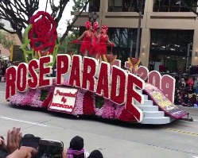
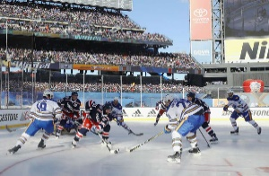
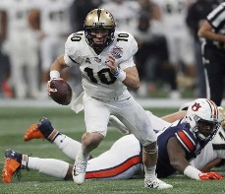
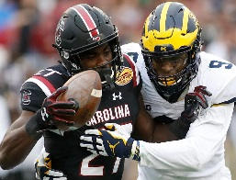
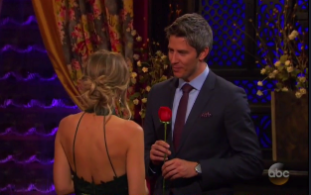
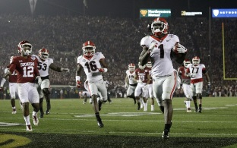
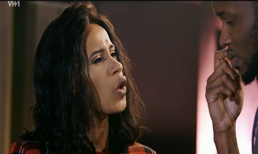
College Bowl Games & The NHL’s Winter Classic Trended All Day On New Year’s While Entertainment Shows Popped At Night
75% of the Top 10 Twitter trending topics between 11a – 11p on New Year’s Day were Ad-Supported TV-related
Day
(11:45a – 7:45p)
Night
(8:45p – 11:45p)
#RoseParade
11:45a (#2), 12:45p (#1), 1:45p (#3), 2:45p (#5), 3:45p (#7), 4:45p (#7)
#RoseBowl (Georgia vs. Oklahoma)
5:45p (#1), 6:45p (#1), 7:45p (#1), 8:45p (#1), 9:45p (#1), 10:45p (#1), 11:45p (#1)
#WinterClassic
11:45a (#4), 12:45p (#5), 1:45p (#1), 2:45p (#1), 3:45p (#2), 4:45p (#3), 5:45p (#8), 6:45p (#5)
Related Trending Topics: #Oklahoma, Rodney Anderson, Baker Mayfield, Lincoln Riley, Sooners, #UGAvsOK, Chubb, Dawgs, Roquan Smith
Related Trending Topics: Paul Carey
#TheBachelor
8:45p (#2), 9:45p (#2), 10:45p (#2), 11:45p (#4)
#OutbackBowl (South Carolina vs. Michigan)
12:45p (#4), 1:45p (#4), 2:45p (#4), 3:45p (#8)
Related Trending Topics: Jim Harbaugh, Michigan (trended through 7:45p)
#SugarBowl (Clemson vs. Alabama)
11:45p (#2)
#PeachBowl (University of Central Florida vs. Auburn)
1:45p (#5), 2:45p (#3), 3:45p (#4), 4:45p (#1), 5:45p (#2), 6:45p (#10), 7:45p (#6), 8:45p (#75)
Related Trending Topics: Da’Ron Payne, Deshaun Watson, Clemson (trended from 9:45p)
Related Trending Topics: #Auburn, Congrats to UCF
/
#Burnley (EPL)
1:45p (#9)
Notre Dame / #CitrusBowl
2:45p (#6/NA), 3:45p (NA/#5), 4:45p (#4/NA), 5:45p (NA/#7)
Love & Hip Hop:
#LHHNY
8:45p (#8)
#LHHMIA
9:45p (#3), 10:45p (#3), 11:45p (#5)
Related Trending Topics: Danny Etling
*The above reflects the major TV events that trended on Twitter and does not represent all TV programming that trended
#TVisSOCIAL #HolidaySpecial
#6abcTDP = Philadelphia’s Thanksgiving Day Parade
(#) = ranking within the top 10 Twitter trending topics for that hour
Source: VAB custom analysis of Top 10 trending Twitter Topics (United States) on the :45’s of each hour (11:45a-11:45p) during 1/1/18

Slide 21
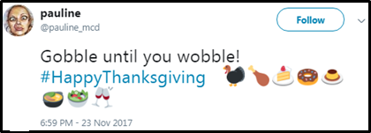
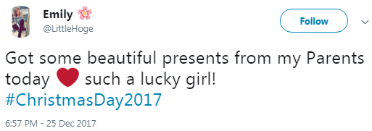
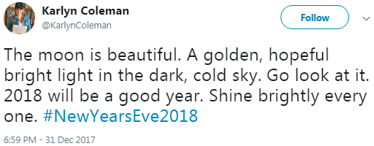
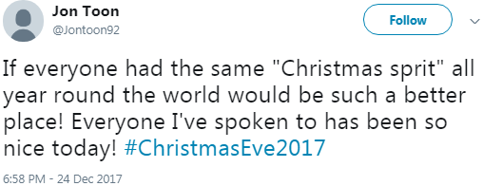
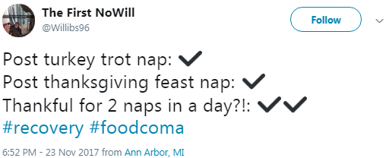
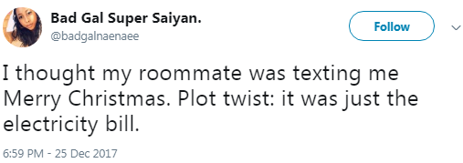
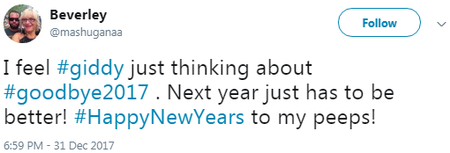




Besides Ad-Supported TV, The Other Trending Topics Were Mainly
Generic Holiday Hashtags With the Occasional Random Subject
#HappyThanksgiving
#ChristmasDay2017
#NewYearsEve2018
#ChristmasEve2017
Turkey Trot
#HappyNewYears
Merry Christmas
Starting 2018
#HowIStayOutOfJail
#MyDrunkAuntSaid
#SantaSchmovies
#TVisSOCIAL #HolidaySpecial
Source: VAB custom analysis of Top 10 trending Twitter Topics (United States): Data collected on the :45’s of each hour (11:45am-11:45pm) during: 11/23/2017, 12/25/17, 1/1/18
Data collected on the :45’s of each primetime hour (8:45pm-11:45pm) during 12/24/17 & 12/31/17

Slide 22




Ad-Supported TV Drives Social Conversation Throughout The Year, See How In Our Other #TVisSocial Reports
Click on link below to learn more about our first #TVisSocial analysis (Oct-Nov’16)
Click on link below to learn more about our second #TVisSocial analysis (May-June’17)
First Report - #TVisSocial
Second Report - #TVisSocial #Ep2
Click on link below to learn more about our 2017 Oscar Night #TVisSocial analysis
Click on link below to learn more about our 2017 Super Bowl #TVisSocial analysis
#TVisSocial Oscar Night Addendum
#TVisSocial Super Bowl Addendum
#TVisSOCIAL #HolidaySpecial

Slide 23


For More Information Visit Us Online
TheVAB.com
Follow us:
@VideoAdBureau
Like us:
facebook.com/VideoAdvertisingBureau

