Slide 1
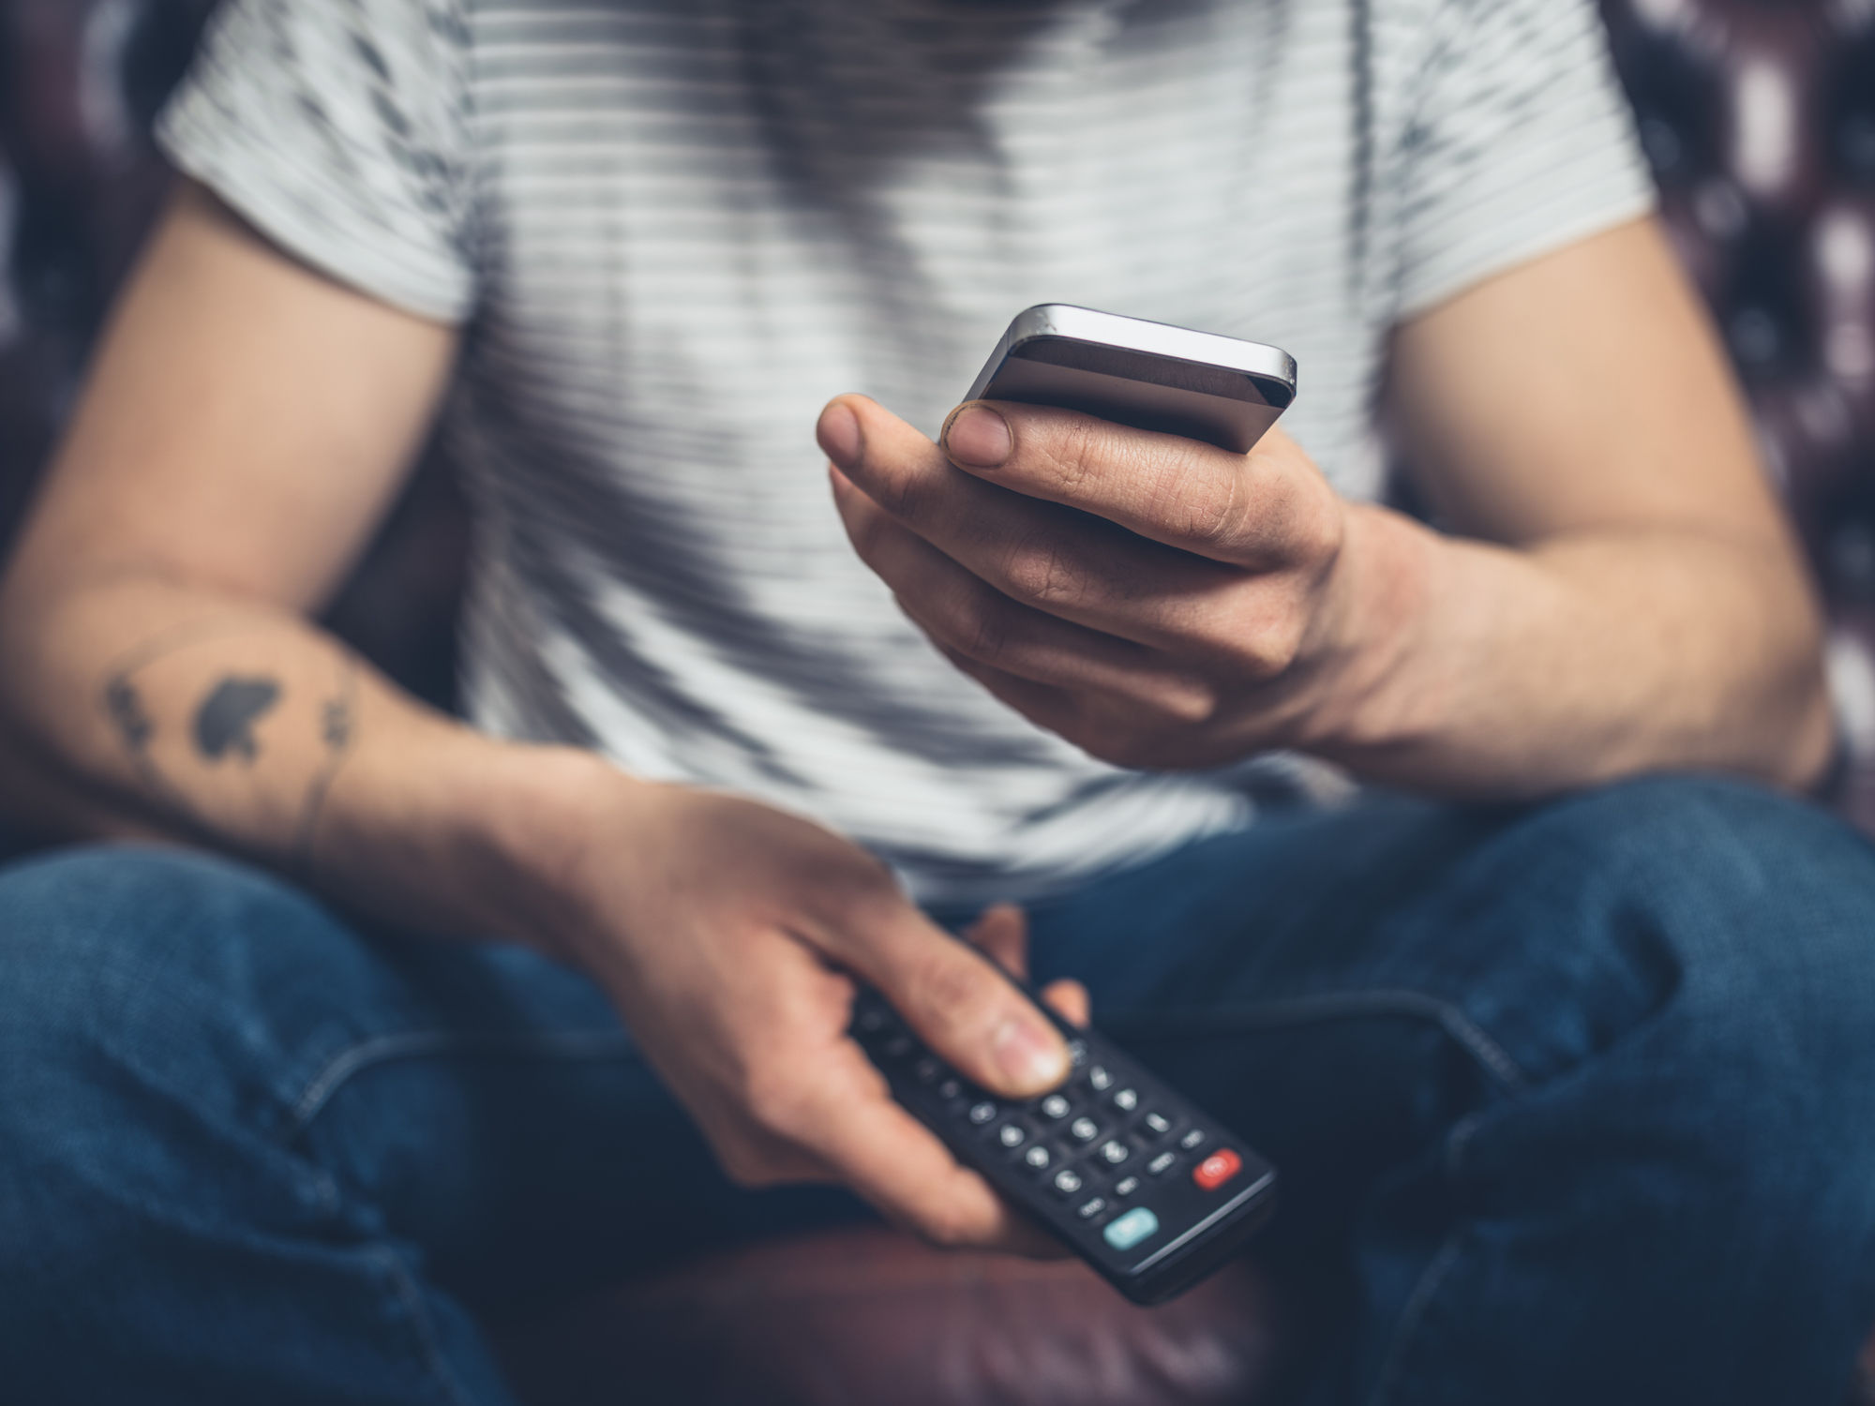

VIDEO ADVERTISING BUREAU - REPORT 2018
#TVisSocial
#FallSeason #Ep4
How ‘Live’ TV Drives Continuous Online Conversations
Notes:
https://www.istockphoto.com/photo/man-on-sofa-with-phone-and-remote-gm678524992-124308505

Slide 2
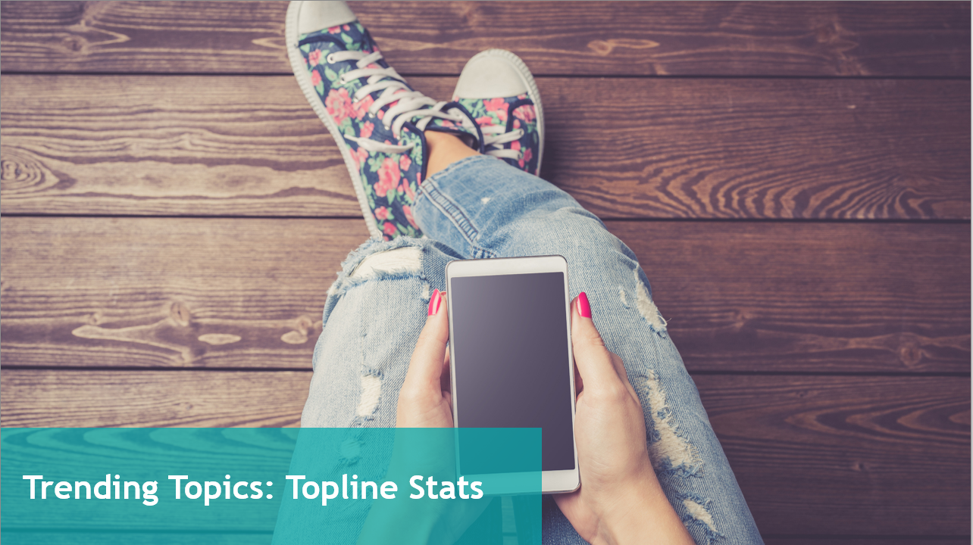
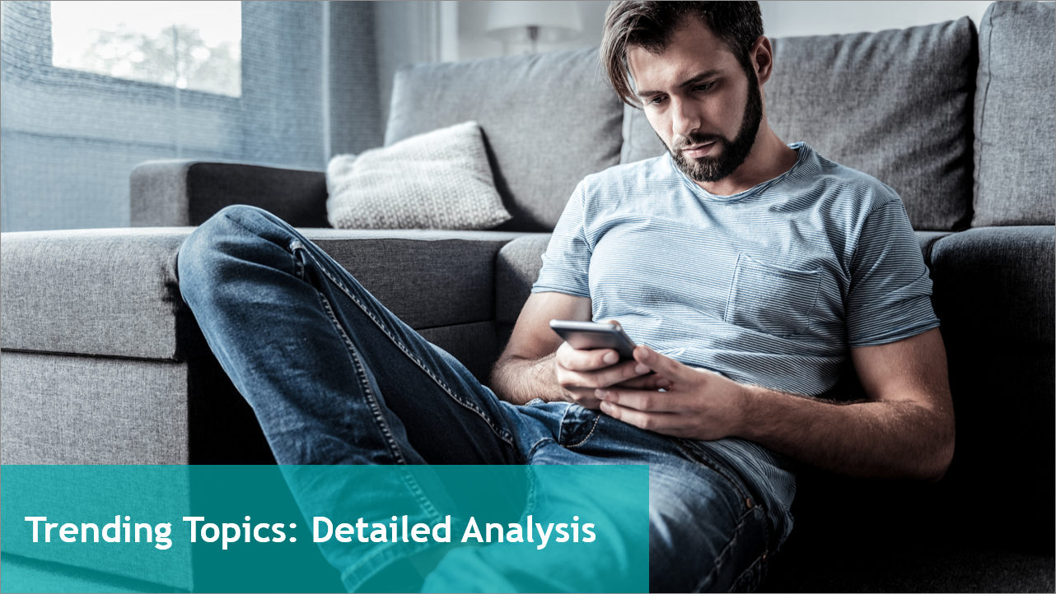
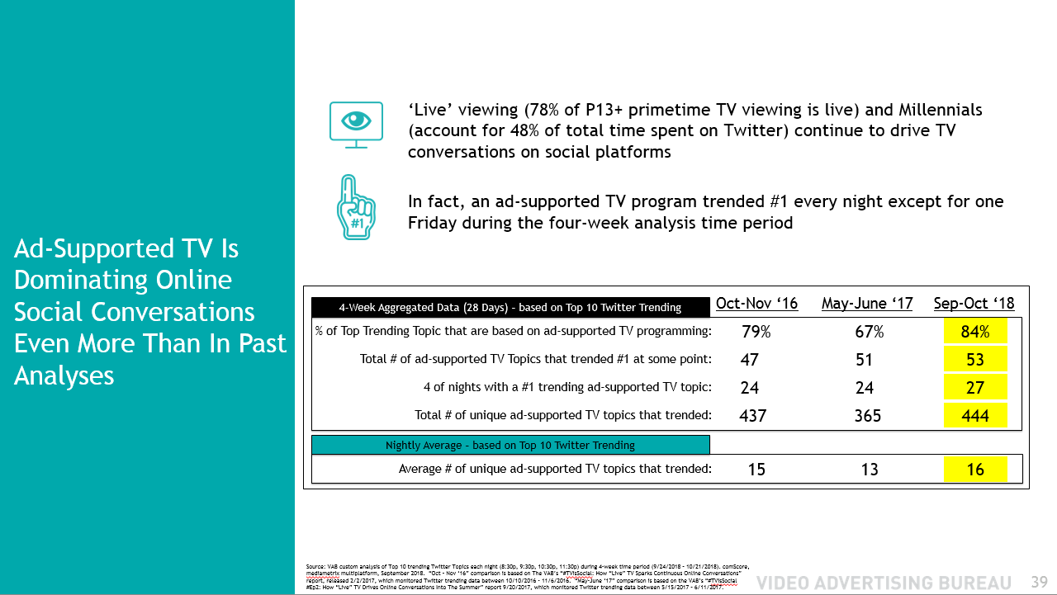
Timeline
1
Summary
2
How ‘Live’ TV Drives Social Engagement
3
Trending Topics: Topline Stats
4
Tweet Cheat Sheet
5
Trending Topics: Detailed Analysis
6
Bonus Section for VAB Members: Cable vs Broadcast
2

Slide 3
Welcome to the fourth installment of our #TVisSocial report series which follows our previous analyses from 4Q 2016, summer 2017 and 4Q 2017 Holidays.
In this report, covering the top 10 Twitter trending topics during a four-week period between September-October 2018 beginning with Fall broadcast premiere week, we found that:
Ad-Supported TV accounted for 84% of the total top 10 trending Twitter topics
  Led by Fall season premieres, award shows, MLB playoffs and football, this marks ad-supported TV’s highest share of top trending topics across our four analyses
On average, Ad-Supported TV accounted for over two-thirds of the top 10 trending topics each night of the week
At least one Ad-Supported TV-related topic trended #1 on 27 out of 28 nights
While some other media content trended, nothing comes close to the scale and dominance of Ad-Supported TV
  87 ad-supported TV programs trended while every other genre or platform only had a handful of trending content / programs: Music (7), YouTube (3), HBO (2), Netflix (2), PPV (1)
Ad-Supported TV Dominates The Online Social Conversation
Source: VAB custom analysis of Top 10 trending Twitter Topics each night (8:30p, 9:30p, 10:30p, 11:30p) during 4-week time period (9/24/2018 – 10/21/2018).
3

Slide 4



84%
Of The Top 10 topics Were Based On Ad-Supported TV Programming
87+
53
Programs Trended In The Top 10
+
Ad-Supported TV-Related Topics Trended #1
September-October 2018
By The Numbers:
Top Trending Stats
Live Ad-Supported TV in Primetime Drives Twitter’s Top 10 Trending Topics
47+
444
TV Networks Had a Program Trend In The Top 10
Unique Ad-Supported TV-Related Topics
77
TV Program-Related Hashtags Trended In Top 10
Source: VAB custom analysis of Top 10 trending Twitter Topics each night (8:30p, 9:30p, 10:30p, 11:30p) during 4-week time period (9/24/2018 – 10/21/2018).
4

Slide 5

How ‘Live’ TV Drives Social Engagement
Notes:
https://www.istockphoto.com/photo/happy-man-using-smartphone-and-copy-space-gm824167622-133444689

Slide 6
Primetime TV Viewing: % ‘Live’ vs. ‘Time-Shifted’
Overall, The Vast Majority Of People’s Television Viewing Continues To Be Done ‘Live’
Source: Nielsen NPower R&F Time Period Report, Primetime, Live vs. Live+7, ad-supported cable TV + broadcast TV, 9/24/2018 – 10/21/2018. P13+, P18-24, P18-34, P18-49.
6

Slide 7
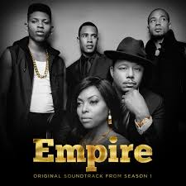
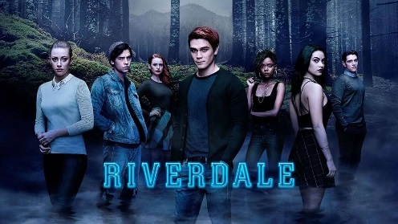
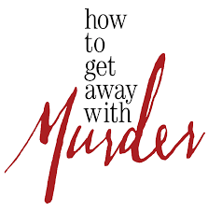
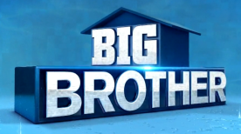
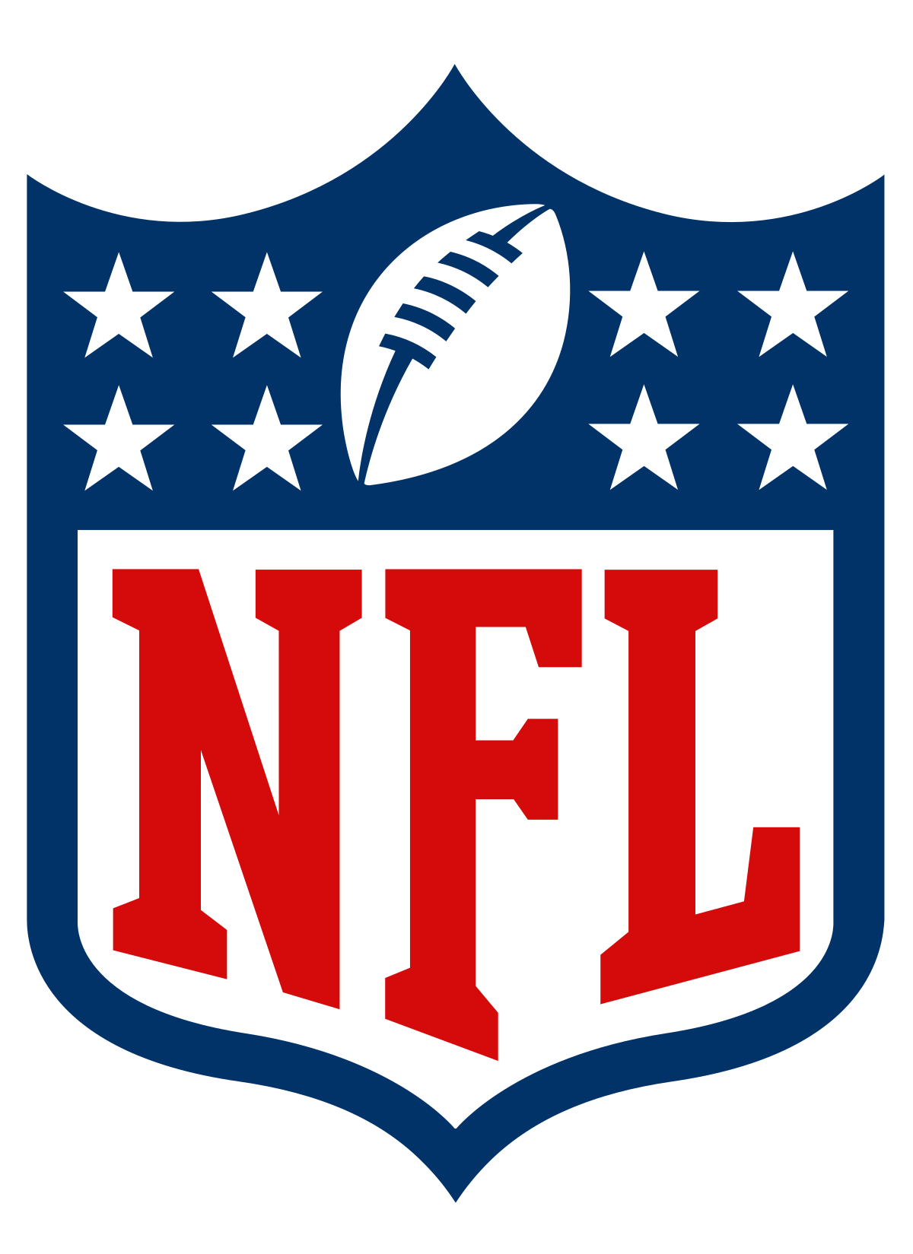
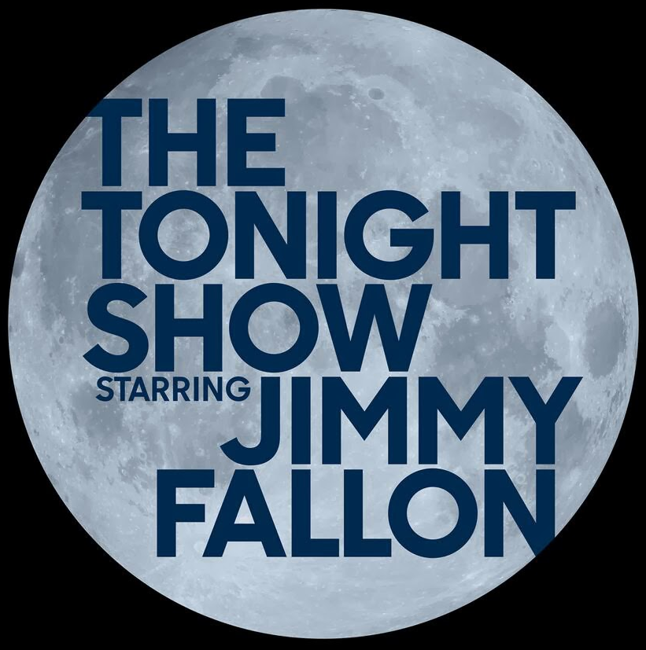
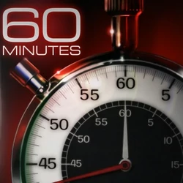
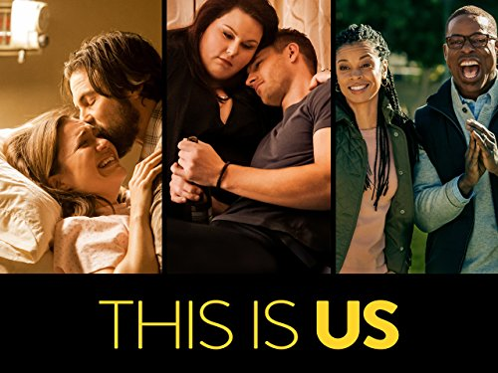



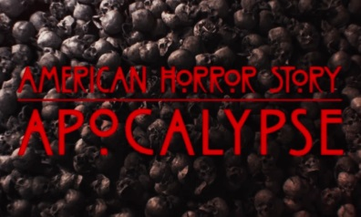

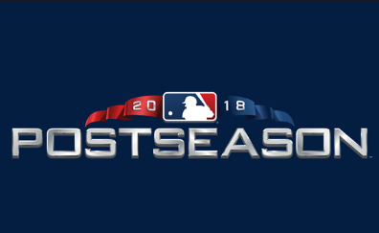





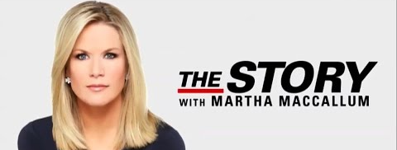

Ad-supported TV brings people together and compels millions to actively share their “real-time” thoughts and feelings on the content they’re consuming live
Why?
Because TV consistently creates and captures moments that are exciting, entertaining, humorous, enlightening, uplifting, aspirational, inspirational and educational...moments that people almost immediately share and talk about online
In addition to providing pure escapism, TV delivers engaging content centered on real-life themes that viewers can relate to and understand…these shared experiences often lead viewers to take action by participating in online conversations
‘Live’ Ad-Supported TV Content Fosters Emotional Connections That Lead To Social Engagement
Community
(Family & Friends)
Escapism
Competition
Informative
7

Slide 8
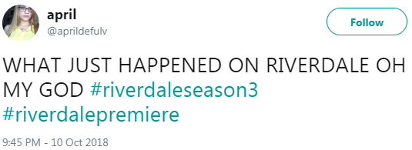
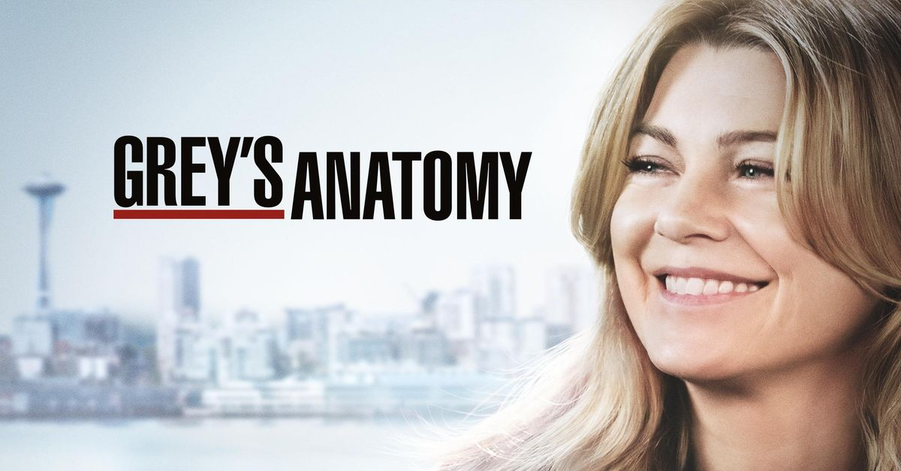
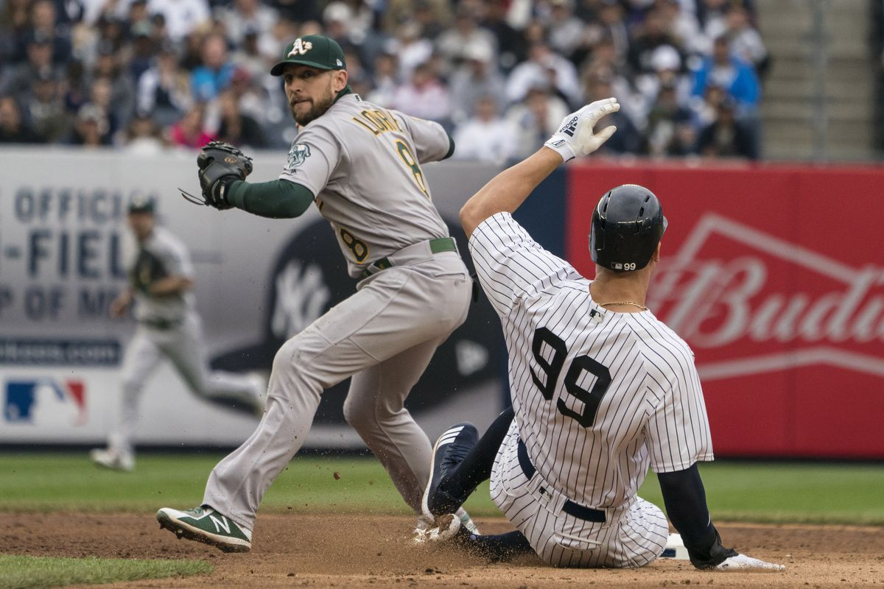
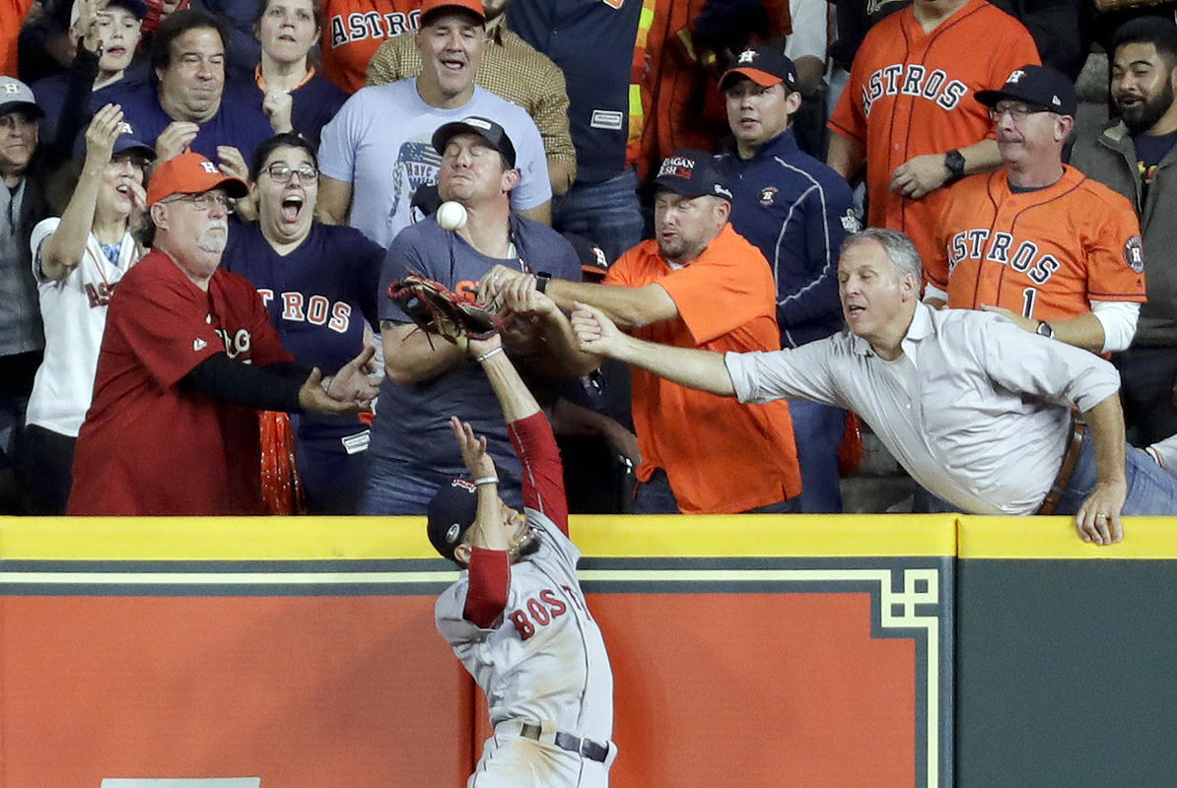
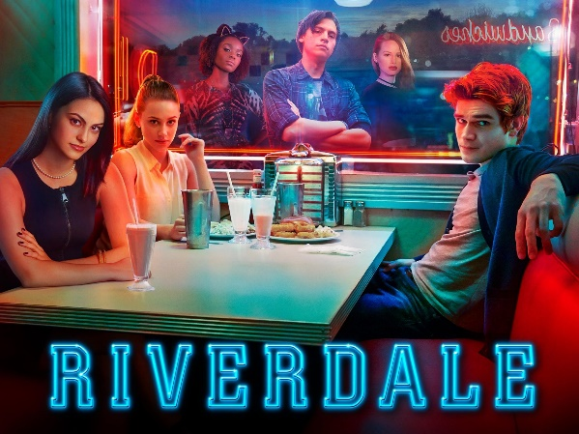
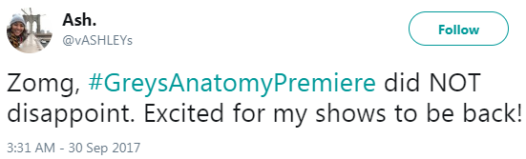
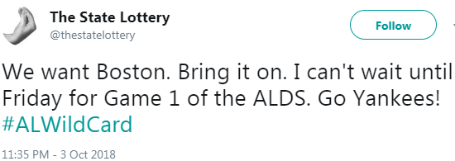
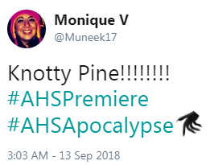
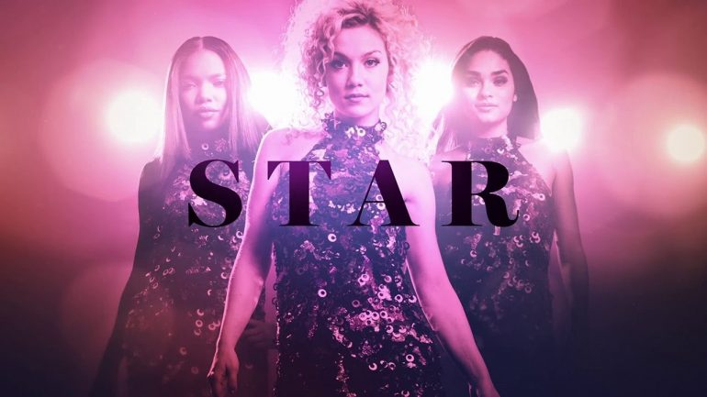
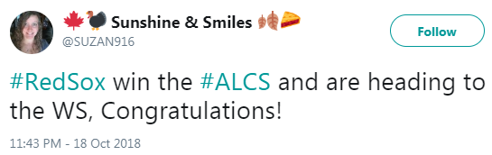
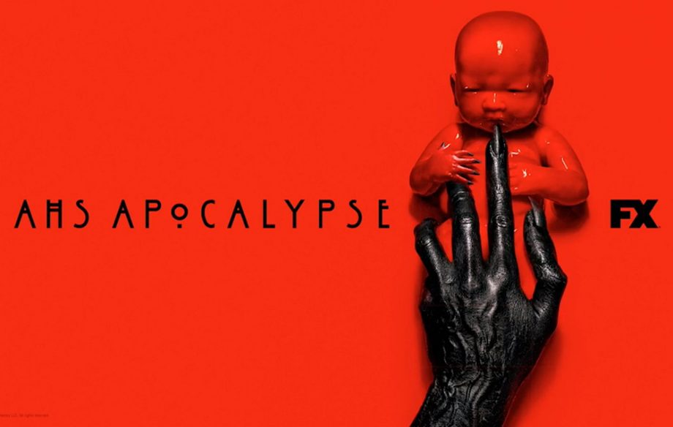
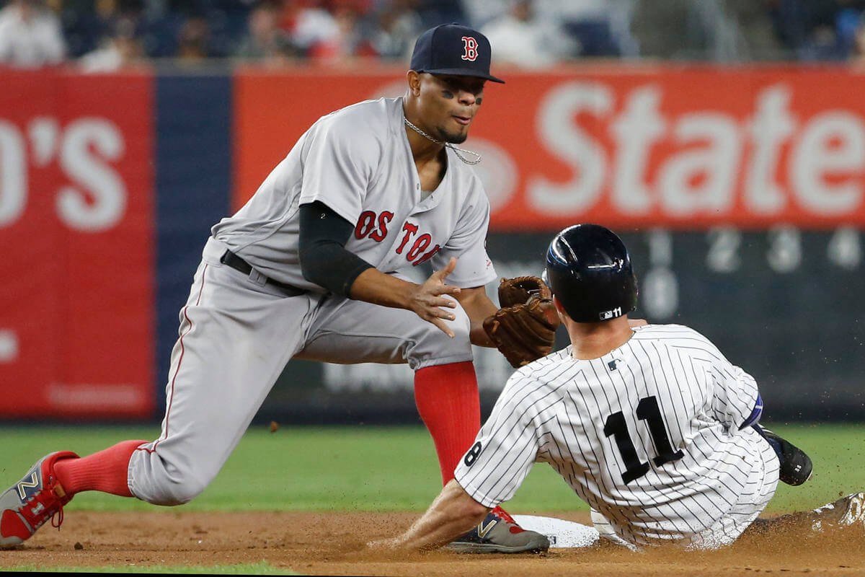
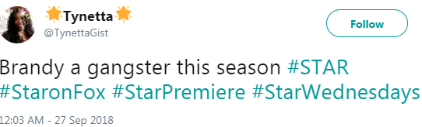
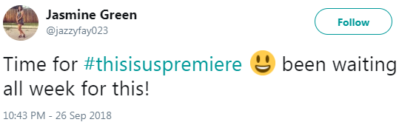
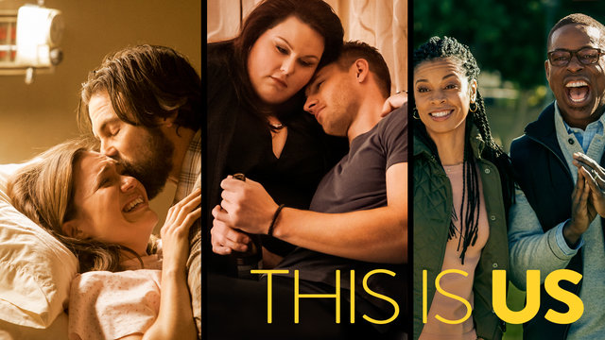
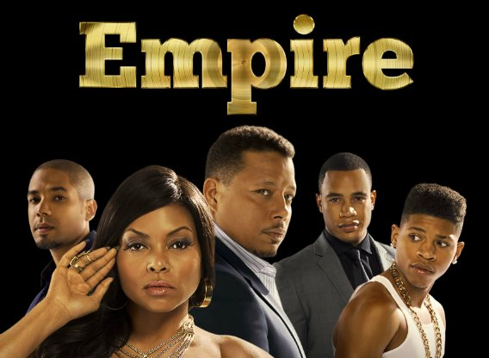
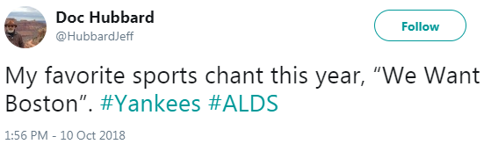
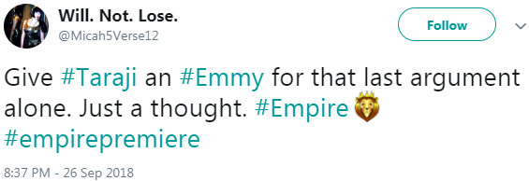
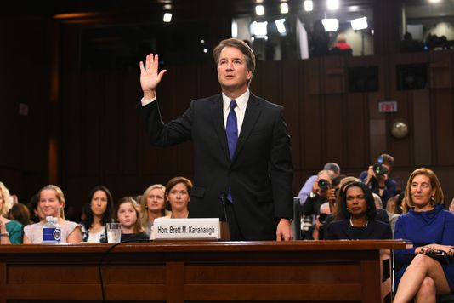
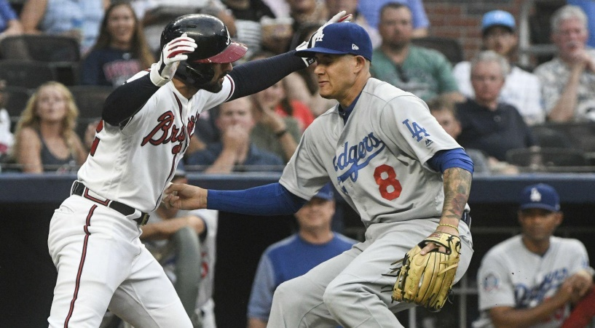
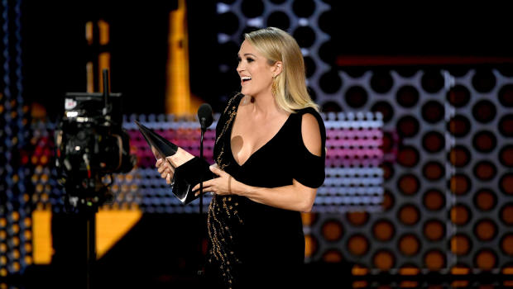
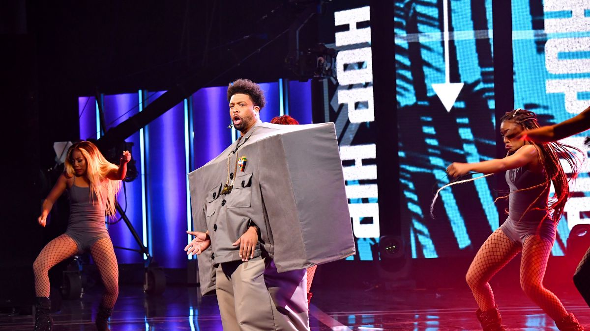
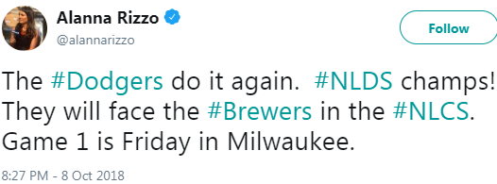
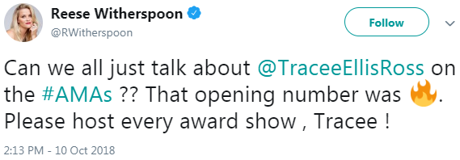

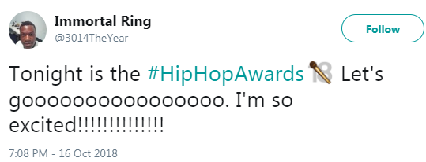

Each month, Ad-supported TV gives us many memorable and iconic moments across sports, entertainment and news…moments that people couldn’t wait to talk about with others online.
Here’s a look at some events between Sept 24th – Oct 21st:
Sports
Entertainment
The 2018 MLB Playoffs were filled with big market team match-ups
Fall Season Premieres off entertainment shows had audiences buzzing on Twitter…
Oakland A’s vs New York Yankees in AL Wildcard
Boston Red Sox vs Houston Astros in the ALCS
Ad-Supported TV Also Creates & Captures Society’s ‘Big Moments’ Which Are Further Amplified On Social Media
Boston Red Sox vs New York Yankees in the ALDS
News
Judge Kavanaugh Supreme Court Confirmation Hearings
Los Angeles Dodgers vs Atlanta Braves in the NLDS
…While Star-studded award shows drew engaged fans
8

Slide 9




Twitter is one of today’s most popular communication tools and their brand positioning - “See What’s Happening” – reflects a platform that’s built around what’s happening in the world and what people are talking about right now
x
“Live” TV, specifically, is an important fixture in people’s everyday lives and nowhere is this more evident than the conversations seen on Twitter
Twitter Is The Social Hub Of Real-Time Conversations
Centered Around ‘What’s Happening Now’
Twitter Users Who Are TV “Superfans”*
72%
60%
57%
54%
say a social platform, like Twitter, plays a role in their TV viewing
share their opinions about the shows they watch on Twitter
follow hashtags to keep up with what others are saying about a TV show
want to be the “go-to-source” for others on news and information about their favorite TV shows
*“TV Superfans” are a self-identified cluster within the “Twitter Insiders” online research community of approx. 7,000 users. Two-thirds of superfans report watching more than 3 hours of TV daily.
Source: Twitter proprietary study in partnership with Vizeum and Dentsu Aegis Network using “Twitter Insiders,” an online research community of approx. 7,000 users; January 2017.
9

Slide 10
Young Millennials (A18-24), specifically, are much more engaged with Twitter than other demographic age breaks
Twitter Usage
User Profile By Age
Total Minutes Spent By Age
Millennials Account For Almost Half Of Total Time Spent On Twitter
18-34
35%
(149 index
vs. U.S. Pop)
18-34
48%
of total time spent
Source: comScore, mediametrix multiplatform, September 2018. Nielsen 2018-2019 Universe Estimate for A18-34 population comparison.
10

Slide 11

Trending Topics: Topline Stats
Notes:
https://www.istockphoto.com/photo/woman-holding-modern-white-smart-phone-with-black-empty-screen-over-wooden-floor-gm818509734-132337967

Slide 12
To quantify the important role that TV plays in people’s lives, we analyzed the impact of TV programming on the top 10 trending Twitter topics during the first four weeks of the new Fall broadcast season
    Monday, September 24th, 2018 – Sunday, October 21st, 2018
Since trending topics are everchanging and a slight lag time typically exists for topics to start trending, we monitored four “points in time” each night to capture what people are talking about online throughout the evening
    8:30p, 9:30p, 10:30p, 11:30p
Ad-supported TV topics were grouped into two types:
    Direct: specific hashtags of televised entertainment shows, sports events or news programming
    Related: topics associated with specific TV programming including athletes, general team hashtags, collegiate school mentions (school & nicknames for football teams), show characters, celebrity personalities, and specific TV-related news references
Quantifying How Much Ad-Supported TV Drives Online Social Conversation
*Geography reflects United States-based Twitter Top 10 trending data
12

Slide 13
84%
Overall Total % of TV-topics in Top 10 During Primetime
Ad-Supported TV Accounted for Over
8 Of The Top 10 Trending Twitter Topics Through The Four-Week Time Period
Ad-supported TV dominates the top social conversations on Twitter deeper into the night as more primetime shows and sporting events air
8:30p
Total % of
TV-topics In Top 10: 73%
9:30p
Total % of
TV-topics In Top 10: 86%
10:30p
Total % of
TV-topics In Top 10: 88%
11:30p
Total % of
TV-topics In Top 10: 88%
Source: VAB custom analysis of Top 10 trending Twitter Topics each night (8:30p, 9:30p, 10:30p, 11:30p) aggregated during 4-week time period (9/24/2018 – 10/21/2018). Results include both “direct” and “related” TV topics.
13

Slide 14
Four Week Average: % of Top 10 Trending Topics That Are Based On TV Content
Monday
Tuesday
Wednesday
Thursday
Friday
Saturday
Sunday
Overall
84%
84%
88%
88%
68%
86%
87%
At Least Two-Thirds Of The Top 10 Trending Topics
On Any Night
Were Based on
Ad-Supported TV Content
8:30p
65% 78% 75% 68% 43% 90% 93%
9:30p
90% 83% 90% 93% 70% 85% 93%
10:30p
90% 85% 90% 95% 80% 90% 88%
11:30p
93% 93% 98% 95% 80% 80% 75%
Source: VAB custom analysis of Top 10 trending Twitter Topics each night (8:30p, 9:30p, 10:30p, 11:30p) aggregated during 4-week time period (9/24/2018 – 10/21/2018). Results include both “direct” and “related” TV topics.
14

Slide 15

Top Twitter Trending TV Topics By Night
Monday
Tuesday
Wednesday
Thursday
Friday
Saturday
Sunday
53 Different Ad-Supported TV Topics Trended #1 During Primetime Over The Four-Week Time Period
8:30p: #DWTS (#1)
9:30p: #Chris Conte (#1)
10:30p: #Fitzpatrick (#1)
11:30p: #Fitzpatrick (#1)
10:30p: #ThisIsUs (#1)
11:30p: #ThisIsUs (#1)
8:30p: #TrumpPressConf (#1)
9:30p: #STAR (#1)
10:30p: Kaycee (#1)
11:30p: #BB20 (#1)
8:30p: Lindsey Graham (#1)
9:30p: Rams (#1)
10:30p: Rams (#1)
11:30p: Rams (#1)
8:30p: KavanaughVote (#2)
9:30p: David Wright (#2)
10:30p: David Wright (#2)
11:30p: #WynonnaEarp (#2)
8:30p: David Wright (#1)
9:30p: Penn State (#1)
10:30p: Penn State (#1)
11:30p: Penn State (#1)
8:30p: Raiders (#1)
9:30p: Raiders (#1)
10:30p: LeBron (#1)
24-Sep
25-Sep
26-Sep
27-Sep
28-Sep
29-Sep
30-Sep
10:30p: Chiefs (#1)
11:30p: Chiefs (#1)
8:30p: #NLWIldCard (#1)
9:30p: Lester (#1)
10:30p: Lester (#1)
11:30p: Cubs (#1)
8:30p: Aaron Judge (#1)
9:30p: Yankees (#1)
10:30p: Yankees (#1)
11:30p: Yankees (#1)
8:30p: #NLDS (#1)
9:30p: #NLDS (#1)
10:30p: #NLDS (#1)
11:30p: Josh Gordon (#1)
9:30p: #RedSox (#1)
10:30p: #RedSox (#1)
11:30p: Kimbrel (#1)
8:30p: Texas (#1)
9:30p: Texas (#1)
8:30p: Eagles (#1)
1-Oct
2-Oct
3-Oct
4-Oct
5-Oct
6-Oct
7-Oct
9:30p: Severino (#1)
10:30p: Drew Brees (#1)
11:30p: Drew Brees (#1)
8:30p: #AMAs (#1)
9:30p: #AMAs (#1)
10:30p: #AMAs (#1)
11:30p:#AMAs (#1)
8:30p: Jimmy Butler (#1)
9:30p: #Riverdale (#1)
10:30p: Jimmy Butler (#1)
11:30p: #AHSApocalypse (#1)
9:30p: Barkley (#1)
10:30p: Giants (#1)
11:30p: Giants (#1)
9:30p: Grandal (#1)
10:30p: Kershaw (#1)
11:30p: Kershaw (#1)
8:30p: Bama (#1)
9:30p: Bama (#1)
10:30p: Verlander (#1)
11:30p: (Joe West (#1)
10:30p: Chiefs (#1)
11:30p: Chiefs (#1)
For 27 out of 28 nights, an Ad-Supported TV topic trended #1 during at least one of the four monitored ‘points in time’
8-Oct
9-Oct
10-Oct
11-Oct
12-Oct
13-Oct
14-Oct
8:30p: #SD1000 (#1)
9:30p: #SD1000 (#1)
10:30p: #TexasDebate (#1)
8:30p: Knicks (#1)
9:30p: Joe West (#1)
10:30p: #AHSApocalypse (#1)
11:30p: #AHSApocalypse (#1)
8:30p: #TexasTownHall (#1)
9:30p: Cardinals (#1)
10:30p: Cardinals (#1)
11:30p: LeBron (#1)
9:30p: David Freese (#1)
10:30p: Kawhi (#1)
8:30p: Purdue (#1)
9:30p: Purdue (#1)
10:30p: Puig (#1)
11:30p: Purdue (#1)
8:30p: Cowboys (#1)
9:30p: #FLGovDebate (#1)
10:30p: Bengals (#1)
11:30p: Chiefs (#1)
8:30p: #DWTS (#1)
9:30p: #Chris Conte (#1)
10:30p: #Fitzpatrick (#1)
11:30p: #Fitzpatrick (#1)
15-Oct
16-Oct
17-Oct
18-Oct
19-Oct
20-Oct
21-Oct
Source: VAB custom analysis of Top 10 trending Twitter Topics each night (8:30p, 9:30p, 10:30p, 11:30p) during 4-week time period (9/24/2018 – 10/21/2018. Results include both “direct” and “related” TV topics. Non #1 Gray highlighted days reflect the highest trending TV topic for that evening. Overall rank in parentheses. AMAs = American Music Awards.
15

Slide 16










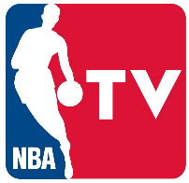















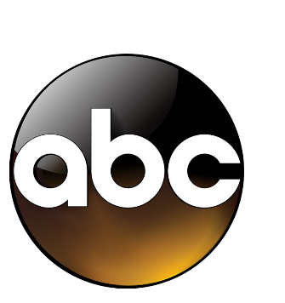










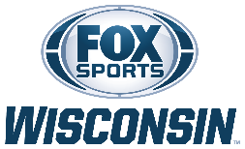



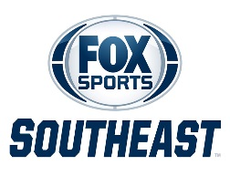

Entertainment (16)
Sports (27+)
News (7)
National Networks (16)
Programming From Over 47 Networks Trended In The Top 10 During The Four-Week Primetime Analysis
Regional Networks (11+)
Source: VAB custom analysis of Top 10 trending Twitter Topics each night (8:30p, 9:30p, 10:30p, 11:30p) during 4-week time period (9/24/2018 – 10/21/2018). Results include both “direct” and “related” TV topics.
16

Slide 17
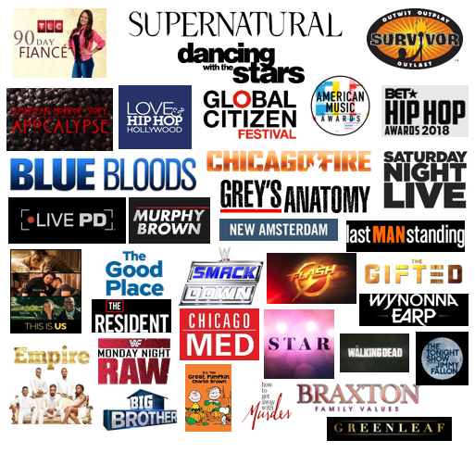
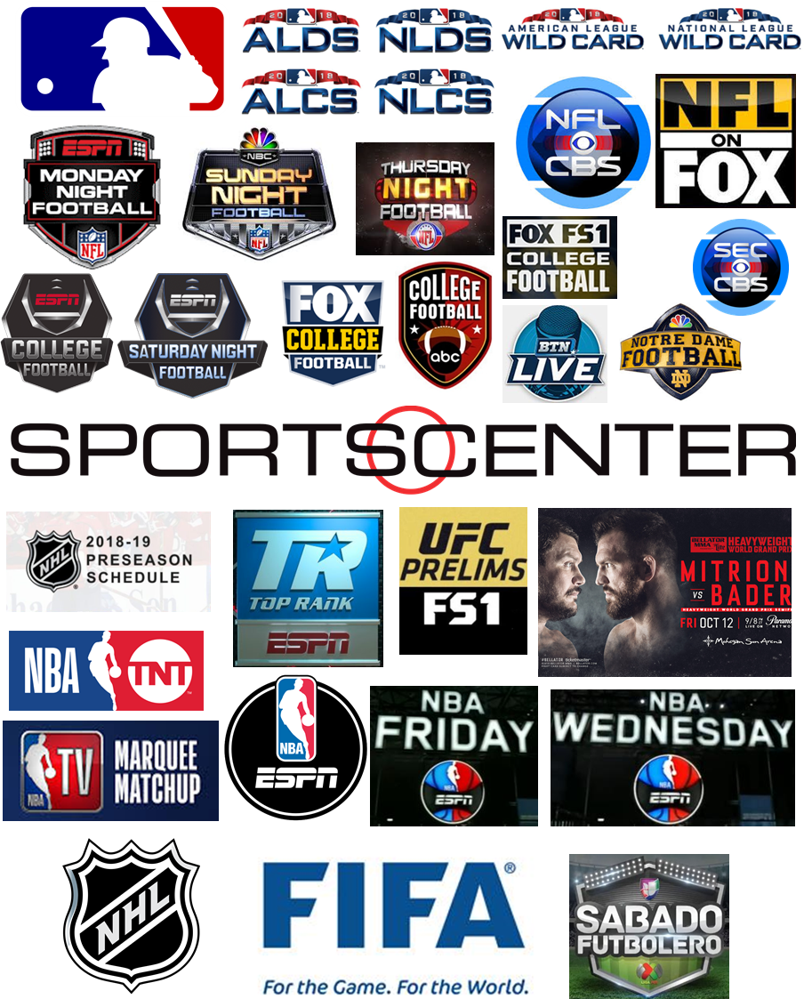
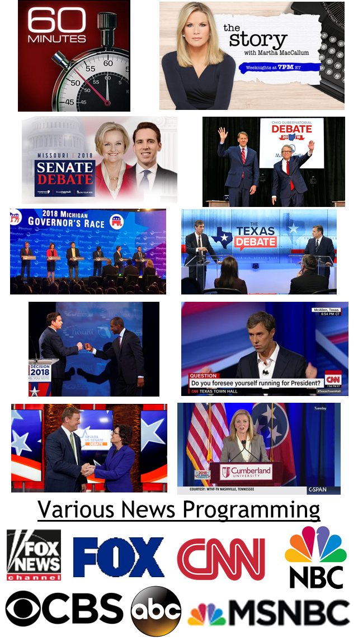
Entertainment (36)
Sports (39)
News (12+)
Over 87 TV Programs Trended In The Top 10 During The Four-Week Primetime Analysis
Source: VAB custom analysis of Top 10 trending Twitter Topics each night (8:30p, 9:30p, 10:30p, 11:30p) during 4-week time period (9/24/2018 – 10/21/2018). Results include both “direct” and “related” TV topics.
17

Slide 18
Four-Week Time Period
# of Top 10 Trending Programs / Content By Platform
When It Comes To Media Content, Nothing Else Gets People Talking Online Like Ad-Supported TV Programs
Lil’ Wayne:
Tha Carter V
Brockhampton
BTS (K-pop)
Quavo
Jennie (K-pop)
Aladdin
Wild Bunch
Hocus Pocus
Yes Theory:
Will Smith Grand 111Canyon Jump
Shane Dawson:
The Mind of Jake Paul
Insecure
The Shop
Iron Fist
Luke Cage
DAZN: Bellator 206
UFC 229
Queen Radio:
Niki Minaj
Interestingly, the two Netflix shows that trended on Twitter did so because the streaming service announced their cancellation; while one of the reasons YouTube trended was because the platform went down one night (#YouTubeDOWN)
*Music excludes Apple Music which is a separate entry
Source: VAB custom analysis of Top 10 trending Twitter Topics each night (8:30p, 9:30p, 10:30p, 11:30p) during 4-week time period (9/24/2018 – 10/21/2018). Based on unique program counts. For the purposes of this chart, “program / content” is an all-encompassing definition for individual pieces of content on each platform (albums & singles for music, channel on YouTube, etc).
18

Slide 19
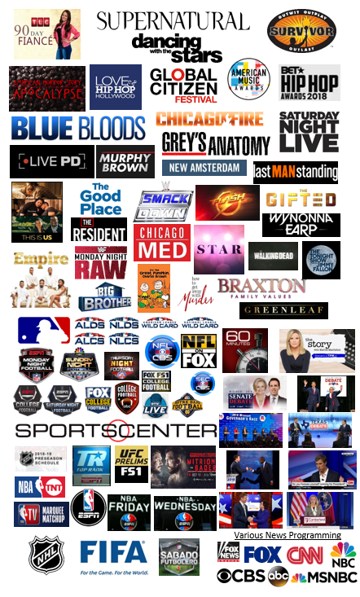
Four-Week Time Period
# of Top 10 Trending Programs / Content By Platform
In Fact, Ad-Supported TV Accounts For
Over 80% Of The Media Content That Trended In The Top 10
Source: VAB custom analysis of Top 10 trending Twitter Topics each night (8:30p, 9:30p, 10:30p, 11:30p) during 4-week time period (9/24/2018 – 10/21/2018). Based on unique program counts. For the purposes of this chart, “program / content” is an all-encompassing definition for individual pieces of content on each platform (albums & singles for music, channel on YouTube, etc).
19

Slide 20

‘Live’ viewing (78% of P13+ primetime TV viewing is live) and Millennials (account for 48% of total time spent on Twitter) continue to drive TV conversations on social platforms
In fact, an ad-supported TV program trended #1 every night except for one Friday during the four-week analysis time period
Tweet Cheat Sheet
Ad-Supported TV Is Dominating Online Social Conversations Even More Than In Past Analyses
4-Week Aggregated Data (28 Days) – based on Top 10 Twitter Trending
Oct-Nov ‘16
May-June ‘17
Sep-Oct ‘18
% of Top Trending Topics that are based on ad-supported TV programming:
79%
67%
84%
Total # of ad-supported TV Topics that trended #1 at some point:
47
51
53
# of nights with a #1 trending ad-supported TV topic:
24
24
27
Total # of unique ad-supported TV topics that trended:
437
365
444
Nightly Average – based on Top 10 Twitter Trending
Average # of unique ad-supported TV topics that trended:
15
13
16
*The above chart reflects a comparison of the three analyses within the #TVisSocial series that cover a four-week time period
Source: VAB custom analysis of Top 10 trending Twitter Topics each night (8:30p, 9:30p, 10:30p, 11:30p) during 4-week time period (9/24/2018 – 10/21/2018). comScore, mediametrix multiplatform, September 2018. “Oct – Nov ‘16” comparison is based on The VAB’s “#TVisSocial: How “Live” TV Sparks Continuous Online Conversations” report, released 2/2/2017, which monitored Twitter trending data between 10/10/2016 - 11/6/2016. “May-June ‘17” comparison is based on the VAB’s “#TVisSocial #Ep2: How “Live” TV Drives Online Conversations Into The Summer” report 9/20/2017, which monitored Twitter trending data between 5/15/2017 – 6/11/2017.
20

Slide 21
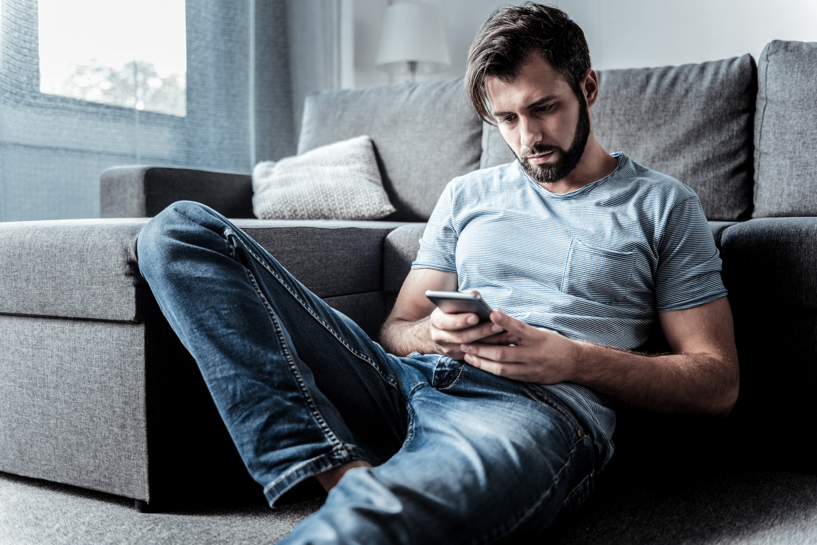
Trending Topics: Detailed Analysis
Notes:
https://www.istockphoto.com/photo/sad-cheerless-man-waiting-for-a-message-gm941724122-257382459

Slide 22
Four-Week Time Period
# of Nights Ad-Supported TV Programming Trended In Top 10 Topics By Genre
At Least One Televised Sporting Event Had A Related Topic Trend In The Top 10 Each Night
An Entertainment Show Trended On 85% Of The Nights Within The Analysis
Source: VAB custom analysis of Top 10 trending Twitter Topics each night (8:30p, 9:30p, 10:30p, 11:30p) aggregated during 4-week time period (9/24/2018 – 10/21/2018). Results include both “direct” and “related” TV topics.
22

Slide 23
# of TV Programs Trending In The Top 10 During Each Night
9
9
9
9
On Average, Over Six Different Ad-Supported TV Programs Trended In The Top 10 At Some Point During Each Night
8
8
7
7
7
7
6
6
6
6
6
6
5
5
5
5
5
5
4
4
4
4
4
3
Mon
Tues
Wed
Thurs
Fri
Sat
Sun
Mon
Tues
Wed
Thurs
Fri
Sat
Sun
Mon
Tues
Wed
Thurs
Fri
Sat
Sun
Mon
Tues
Wed
Thurs
Fri
Sat
Sun
Source: VAB custom analysis of Top 10 trending Twitter Topics each night (8:30p, 9:30p, 10:30p, 11:30p) aggregated during 4-week time period (9/24/2018 – 10/21/2018). Results include both “direct” and “related” TV topics.
23

Slide 24


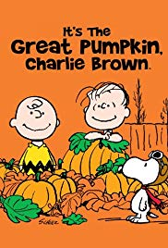









# of TV Programs Trending In The Top 10 During Each Night
9
9
9
9
As Many As Nine Different Ad-Supported TV Programs Trended In The Top 10 During Some Nights
8
8
7
7
7
6
6
7
6
6
5
6
6
5
5
5
4
5
5
4
4
4
4
3
Mon
Tues
Wed
Thurs
Fri
Sat
Sun
Mon
Tues
Wed
Thurs
Fri
Sat
Sun
Mon
Tues
Wed
Thurs
Fri
Sat
Sun
Mon
Tues
Wed
Thurs
Fri
Sat
Sun
Source: VAB custom analysis of Top 10 trending Twitter Topics each night (8:30p, 9:30p, 10:30p, 11:30p) aggregated during 4-week time period (9/24/2018 – 10/21/2018). Results include both “direct” and “related” TV topics.
24

Slide 25












Trending In The Top 10 During At Least 3 of The 4 Weeks During The Sept / Oct Time Period Analyzed
Monday
Tuesday
Wednesday
Thursday
Friday
Saturday
Sunday
Several Ad-Supported TV Shows & Sports ‘Own’ Specific Nights Of The Week
No other type of tweet is as much of a recurring topic as ad-supported TV programming
Source: VAB custom analysis of Top 10 trending Twitter Topics each night (8:30p, 9:30p, 10:30p, 11:30p) aggregated during 4-week time period (9/24/2018 – 10/21/2018). Results include both “direct” and “related” TV topics.
25

Slide 26
Four-Week Time Period
Ad-Supported TV Programs By Genre Within Top 10 Trending Topics
Sports And Entertainment Account For Nearly The Same Number Of Programs That Trended In The Top 10 During The Analysis
Source: VAB custom analysis of Top 10 trending Twitter Topics each night (8:30p, 9:30p, 10:30p, 11:30p) aggregated during 4-week time period (9/24/2018 – 10/21/2018). Results include both “direct” and “related” TV topics.
26

Slide 27
Between team hashtags, featured athletes and exciting plays made during a game, sports tends to have many more individual topics trending during an airing than entertainment programs
Four-Week Time Period
Genre % Breakout of Top 10 Ad-Supported TV Trending Topics
Aided By The MLB Playoffs Featuring Big Market Teams & The Football Season In Full Swing, Sports Accounts For A Majority Of The Total Ad-Supported TV Topics That Trended In The Top 10
Source: VAB custom analysis of Top 10 trending Twitter Topics each night (8:30p, 9:30p, 10:30p, 11:30p) aggregated during 4-week time period (9/24/2018 – 10/21/2018). Results include both “direct” and “related” TV topics.
27

Slide 28
Four-Week Time Period
Genre-Specific Top 10 Ad-Supported TV Trending Topics By Day
TV Entertainment Social Conversations Skew Towards Weeknights, While TV Sports Split Evenly Across Weeknights and Weekends
Source: VAB custom analysis of Top 10 trending Twitter Topics each night (8:30p, 9:30p, 10:30p, 11:30p) aggregated during 4-week time period (9/24/2018 – 10/21/2018). Results include both “direct” and “related” TV topics.
28

Slide 29
“Related” Examples:
Entertainment
Lana Del Ray (AMA Performer)
Kaycee (Big Brother 20 Winner)
Archie (CW’s Riverdale Character)
Mariah (AMA Performer)
Jessica Lange (AHS: Apocalypse)
R-Truth (WWE Smackdown Wrestler)
Annalise (How To Get Away With Murder)
Charlie Brown (It’s The Great Pumpkin)
Sports
Cowboys (Dallas Cowboys - NFL)
David Wright (New York Mets - MLB)
Penn State (NCAA Football)
Kershaw (Los Angeles Dodgers - MLB)
#DoDamage (Boston Red Sox Hashtag)
Fultz (Philadelphia 76ers - NBA)
Pat Mahomes (Kansas City Chiefs - NFL)
Chris Sale (Boston Red Sox - MLB)
Joe West (Umpire - MLB)
News
Ashley Kavanaugh
#TrumpPresser
Kamala Harris
Lindsey Graham
Trending TV Topics By Type
“Direct” Examples:
Entertainment
#90DayFiance
#AHSApocalypse
#AMAs
#STAR
#LHHH
#ThisIsUs
#Empire
#DWTS
#GreysAnatomy
#LivePD
Sports
#ALCS
#ALWildCard
#NLCS
#INDvsNE
#MondayNightFootball
#OSUvsPSU
#NYYvsBOS
News
#60Minutes
#KavanaughHearing
#TexasDebate
#TNSenateDebate
Three-Fourths Of Top 10 Trending Ad-Supported TV Topics Were Based On People, Characters Or Other Subjects Related To Programming
Direct: specific hashtags related to televised entertainment shows, sports events or news programming
Related: topics associated with TV programming airing during the trending timeframe including athletes, general team hashtags, collegiate school mentions (school & nicknames for football & basketball), show characters, celebrity personalities, and specific TV-related news references
Source: VAB custom analysis of Top 10 trending Twitter Topics each night (8:30p, 9:30p, 10:30p, 11:30p) aggregated during 4-week time period (9/24/2018 – 10/21/2018). Based on the aggregated number of top 10 Twitter trending topics over the 4-week time period.
29

Slide 30
Most of the sports topics that trend are related to the televised event – teams, participating athletes and coaches, and plays or other actions on the field or court
A Majority Of Entertainment Topics That Trend Feature The Specific Program Hashtag While Sports Topics Are Usually Based On Subjects Related To The Televised Event
Sports
Entertainment
News
Direct: specific hashtags related to televised entertainment shows, sports events or news programming
Related: topics associated with TV programming airing during the trending timeframe including athletes, general team hashtags, collegiate school mentions (school & nicknames for football & basketball), show characters, celebrity personalities, and specific TV-related news references
Source: VAB custom analysis of Top 10 trending Twitter Topics each night (8:30p, 9:30p, 10:30p, 11:30p) aggregated during 4-week time period (9/24/2018 – 10/21/2018). Results include both “direct” and “related” TV topics.
30

Slide 31
Entertainment: 84
Direct: 36
Related: 48
On Average, Almost 16 Unique Ad-Supported TV Topics (Direct + Related) Trended In The Top 10 Throughout Each Night
444
Top 10 Trending TV Topics
Sports: 334
Direct: 28
Related: 306
News: 26
Direct: 13
Related: 13
444 unique TV topics trended over the four-week time period with entertainment the leading genre when it came to people using official program hashtags (“direct”) within their tweets
Genre % Breakout of Program Hashtags (“Direct”)
Source: VAB custom analysis of Top 10 trending Twitter Topics each night (8:30p, 9:30p, 10:30p, 11:30p) aggregated during 4-week time period (9/24/2018 – 10/21/2018). Results include both “direct” and “related” TV topics.
31

Slide 32
There were 77 official TV program hashtags, almost half of them entertainment show-based, that trended in the top 10 over the four-week time period
Entertainment (36)
#90DayFiance | #LHHH
#AHSApocalypse | #LivePD
#AMAs | #MurphyBrown
#BB20 | #NewAmsterdam
#BB20Finale | #Riverdale
#BlackLightning | #SD1000
#BlueBloods | #SDLive
#ChicagoFire | #SNLPremiere
#ChicagoMed | #STAR
#DWTS | #Supernatural
#Empire | #Survivor
#GlobalCitizen | #TheFlash
#GreatPumpkin | #TheGifted
#Greenleaf | #TheGoodPlace
#GreysAnatomy | #TheResident
#HipHopAwards | #TheWalkingDead
#HTGAWM | #ThisIsUs
#LastManStanding | #WynonnaEarp
Sports (28)
#ALCS | #MondayNightFootball
#ALDS | #NLCS
#ALWildCard | #NLDS
#Bellator207 | #NLWildCard
#CINvsKC | #NYYvsBOS
#CLEvsOAK | #OSUvsPSU
#DALvsHOU | #OSUvsPUR
#DENvsAZ | #PHIvsNYG
#INDvsNE | #PITvsTB
#JAXvsDAL | #SFvsGB
#KCvsDEN | #UFC229
#KCvsNE | #UGAvsLSU
#LARvsSEA | #USAvCOL
#MINvsLAR | #WASvsNO
News (13)
#FLGovDebate
#TexasDebate
#TNSenateDebate
#OHGovDebate
#60Minutes
#TXGovDebate
#KavanaughConfirmation Hearings
#KavanaughFord
#TexasTownHall
#NVDebate
#KavanaughHearing
#MIGovDebate
#MoSenateDebate
Nearly Three Official Ad-Supported TV Show Or Sports/News Event Hashtags Trended In The Top 10 During An Average Night
Source: VAB custom analysis of Top 10 trending Twitter Topics each night (8:30p, 9:30p, 10:30p, 11:30p) aggregated during 4-week time period (9/24/2018 – 10/21/2018). Results include both “direct” and “related” TV topics.
32

Slide 33











Trending Program Hashtags
Trending Program-Related Topics
Reflecting Their High Level Of Engagement,
People Even ‘Talk’ Online About The
TV Characters On Their Favorite TV Shows
Direct
Related
#AHSApocalypse
“Mallory”
“Queenie”
#STAR
“Simone”
“Carlotta”
#ThisIsUs
“Randall”
“Kate”
Much of a TV character’s high social chatter centers on
“I can’t believe what just happened!” moments
#Riverdale
“Archie”
“Betty”
#TheWalkingDead
“Gregory”
“Maggie”
Source: VAB custom analysis of Top 10 trending Twitter Topics each night (8:30p, 9:30p, 10:30p, 11:30p) during 4-week time period (9/24/2018 – 10/24/2018). Results include both “direct” and “related” TV topics.
33

Slide 34




During the four-week time period, 406 separate sports TV topics (games, teams, athletes, etc) trended in the Top 10; an average of almost 15 topics per night
Four-Week Time Period
# of Top 10 Trending Topics By Sport
In Regards To Sports, All Major ‘In-Season’ Sports Feature Many Games Or Events With Heavy Social Chatter
NHL
Soccer
MMA (UFC & Bellator)
Boxing
Source: VAB custom analysis of Top 10 trending Twitter Topics each night (8:30p, 9:30p, 10:30p, 11:30p) during 4-week time period (9/24/2018 – 10/21/2018). Results include both “direct” and “related” TV topics. Topics include direct program hashtags as well as sports TV-related topics tied to athletes, teams and game references. The 406 sports TV topics includes duplication for similar topics trending in different games (ex. “Kershaw”)
34

Slide 35





During the four-week time period, 307 unique sports-related TV topics (excluding TV game / event hashtags) trended in the Top 10; an average of almost 11 topics per night
Most “Viral” Athlete By Major Sport
Patrick Mahomes
Kansas City Chiefs
David Wright
New York Mets
Markelle Fultz
Philadelphia 76ers
Dwayne Haskins
Ohio State Buckeyes
TV Sports-Related Trending Topics Typically Involve Athletes, Team Hashtags & Names And Game References
Source: VAB custom analysis of Top 10 trending Twitter Topics each night (8:30p, 9:30p, 10:30p, 11:30p) during 4-week time period (9/24/2018 – 10/21/2018). Results reflect just “related” sports TV topics and doesn’t include official televised event hashtags. “Most Viral Athlete” = the athlete who was a top 10 trending topic the most in their respective sport during the time period.
35

Slide 36
The NFL was responsible for 56% of the overall Top 10 trending Twitter topics on game nights (Thursdays, Sundays & Mondays), while College Football was responsible for 51% of topics on Saturday nights and the MLB was responsible for 34% on playoff game nights.
Daily # of Trending Topics by Top 4 Sports
Numerous Topics Specifically Related To MLB Playoff Games And College Football Saturdays Trended High
26
23
20
20
21
19
18
18
18
18
17
16
17
16
16
13
13
12
13
12
12
10
9
8
5
2
2
1
Mon
Tues
Wed
Thurs
Fri
Sat
Sun
Mon
Tues
Wed
Thurs
Fri
Sat
Sun
Mon
Tues
Wed
Thurs
Fri
Sat
Sun
Mon
Tues
Wed
Thurs
Fri
Sat
Sun
Source: VAB custom analysis of Top 10 trending Twitter Topics each night (8:30p, 9:30p, 10:30p, 11:30p) during 4-week time period (9/24/2018 – 10/21/2018). Results include both “direct” and “related” TV topics.
36

Slide 37




Example: Judge Brett Kavanaugh Confirmation Hearings
Monday
Friday
9/24 - Ashley Kavanaugh interviewed on Fox News’ The Story with Martha MacCallum
9/26 - President Trump calls allegations against Kavanaugh false at his press conference
9/27 - Judge Brett Kavanaugh’s Senate Judiciary Committee
Confirmation Hearings
9/28 – Senate Judiciary Committee votes on
Judge Kavanaugh
As For News,
‘Around The Clock’ TV Coverage Creates Continual Chatter Online For Major Current Events
Related Trending Topic on 9/24:
Ashley Kavanaugh (#9)
Related Trending Topics on 9/26:
#TrumpPressConference (#1)
#TrumpPresser (#8)
George Washington (#4)
Related Trending Topics on 9/27:
Lindsey Graham (#1)
#KavanaughHearing (#2)
#KavanaughFord (#5)
#KavanaughConfirmationHearings (#6)
Durbin (#7)
Merrick Garland (#8)
Kamala Harris (#9)
Judge Kavanaugh (#10)
Related Trending Topics on 9/28:
#KavanaughVote (#2)
(#) = highest trending rank achieved on the night
Source: VAB custom analysis of Top 10 trending Twitter Topics each night (8:30p, 9:30p, 10:30p, 11:30p) during 4-week time period (9/24/2018 – 10/21/2018). Results include both “direct” and “related” TV topics.
37

Slide 38






“Marty Balin, co-founder of Jefferson Airplane, dies”
Related Trending Topics on 9/28:
Marty Balin (#1)
Jefferson Airplane (#8)
“While at Yale, Judge Kavanaugh involved in a bar fight after a UB40 concert”
Related Trending Topics on 10/1:
ub40 (#1)
Red Red Wine (#7)
“Taylor Swift endorses a pair of Tennessee Democratic Candidates”
Related Trending Topic on 10/7:
Taylor Swift (#1)
What Trended Within The 16% Of Topics That Were Not Ad-Supported TV-Related?
Beyond
Non-Ad-Supported TV, Musicians Were A Popular Trending Topic As Their Cultural Relevancy Weaves Throughout Current Events
“Met Gala names Harry Styles & Lady Gaga among co-chairs”
Related Trending Topics on 10/9:
Met Gala (#9)
“Kanye West visits President Trump in the Oval Office”
Related Trending Topics on 10/11:
Kanye (#1)
Superman (#10)
“Ariana Grande & Pete Davidson split”
Related Trending Topics on 10/14:
Ariana (#1)
Pete (#2)
(#) = highest trending rank achieved on the night
Source: VAB custom analysis of Top 10 trending Twitter Topics each night (8:30p, 9:30p, 10:30p, 11:30p) during 4-week time period (9/24/2018 – 10/21/2018).
38

Slide 39

















Many Of The Other
Non-Ad-Supported TV Trending Topics Were Twitter-Generated Hashtags Related To Either Current Events Or Random Fun
39

Slide 40



Click on the links to see our other reports
First Report - #TVisSocial
(Fall: Oct-Nov ‘16)
Second Report - #TVisSocial #Ep2
(Summer: May-June ’17)
Want More?
Take A Look At Past Analyses Within Our #TVisSocial Series!
#TVisSocial #HolidaySpecial
(4Q Holidays: Nov-Dec ’17)
40

Slide 41

Bonus Section for Members
Cable Vs. Broadcast
Notes:
https://www.istockphoto.com/photo/young-unrecognisable-couple-at-home-watching-television-and-texting-gm845992924-138515747

Slide 42
Four-Week Time Period
% Breakout of Ad-Supported TV Topics By Medium
The Majority Of The Top 10 Trending Twitter TV Topics Involved Programming On Ad-Supported Cable TV
*Ad-Supported Cable TV & Broadcast TV includes programs or topics that aired, or were discussed, on multiple networks such as NFL Thursday Night Football and popular news events (i.e., the Kavanaugh confirmation hearings).
Source: VAB custom analysis of Top 10 trending Twitter Topics each night (8:30p, 9:30p, 10:30p, 11:30p) aggregated during 4-week time period (9/24/2018 – 10/21/2018). Results include both “direct” and “related” TV topics.
42

Slide 43
56%
Cable TV % of Overall Topics in Top 10 During Primetime
Ad-Supported Cable TV Accounted For Over 5 Of The Overall Top 10 Trending Twitter Topics Throughout Primetime Hours
Ad-supported cable TV dominates the top social conversations on Twitter deeper into the night as more primetime shows and sporting events air
8:30p
Cable TV % of
Overall Topics In Top 10: 40%
9:30p
Cable TV % of
Overall Topics In Top 10: 55%
10:30p
Cable TV % of
Overall Topics In Top 10: 64%
11:30p
Cable TV % of
Overall Topics In Top 10: 64%
Source: VAB custom analysis of Top 10 trending Twitter Topics each night (8:30p, 9:30p, 10:30p, 11:30p) aggregated during 4-week time period (9/24/2018 – 10/21/2018). Results include both “direct” and “related” TV topics. Percentages include programming that aired on both cable and broadcast such as NFL Thursday Night Football and televised news events that were covered by multiple TV networks.
43

Slide 44
Four Week Average: % of Top 10 Trending Topics That Are Based On Ad-Supported Cable TV Content
Monday
Tuesday
Wednesday
Thursday
Friday
Saturday
Sunday
Overall
79%
53%
58%
76%
64%
43%
18%
8:30p
58% 53% 48% 53% 35% 30% 8%
Well Over Half Of The Top 10 Trending Topics On Weeknights Were Based On Ad-Supported Cable TV Content
9:30p
83% 55% 45% 83% 63% 40% 18%
10:30p
85% 48% 60% 83% 80% 63% 30%
11:30p
90% 58% 78% 88% 78% 38% 18%
Source: VAB custom analysis of Top 10 trending Twitter Topics each night (8:30p, 9:30p, 10:30p, 11:30p) aggregated during 4-week time period (9/24/2018 – 10/21/2018). Results include both “direct” and “related” TV topics. Percentages include programming that aired on both cable and broadcast such as NFL Thursday Night Football and televised news events that were covered by multiple TV networks.
44

Slide 45
Cable TV Sports And Entertainment Were Very Popular In The Social Sphere During Most Nights Of The Analysis Period
Four-Week Time Period
# of Nights Ad-Supported Cable TV Programming Trended In Top 10 Topics By Genre
By genre, cable TV sports had at least one Top 10 trending topic every night followed by cable TV entertainment which saw a program trend on 75% of the nights; topics from televised news programming also trended highly on several nights
Source: VAB custom analysis of Top 10 trending Twitter Topics each night (8:30p, 9:30p, 10:30p, 11:30p) aggregated during 4-week time period (9/24/2018 – 10/21/2018). Results include both “direct” and “related” TV topics. Percentages include programming that aired on both cable and broadcast such as NFL Thursday Night Football and televised news events that were covered by multiple TV networks.
45

Slide 46
# of Ad-Supported Cable TV Programs Trending In The Top 10 During Each Night
On Average,
Over Three Different Ad-Supported Cable TV Programs Trended In The Top 10 At Some Point During Each Night
5
5
5
5
4
4
4
4
4
4
4
3
3
3
3
3
3
3
3
3
3
2
2
2
2
2
2
2
Mon
Tues
Wed
Thurs
Fri
Sat
Sun
Mon
Tues
Wed
Thurs
Fri
Sat
Sun
Mon
Tues
Wed
Thurs
Fri
Sat
Sun
Mon
Tues
Wed
Thurs
Fri
Sat
Sun
Source: VAB custom analysis of Top 10 trending Twitter Topics each night (8:30p, 9:30p, 10:30p, 11:30p) aggregated during 4-week time period (9/24/2018 – 10/21/2018). Results include both “direct” and “related” TV topics. Percentages include programming that aired on both cable and broadcast such as NFL Thursday Night Football and televised news events that were covered by multiple TV networks.
46

Slide 47
Four-Week Time Period
Genre % Breakout of Ad-Supported TV Topics By Medium
Ad-Supported Cable TV Had Many More Top 10 Trending Topics In Sports Than Broadcast TV
*Ad-Supported Cable TV & Broadcast TV includes programs or topics that aired, or were discussed, on multiple networks such as NFL Thursday Night Football and popular news events (i.e., the Kavanaugh confirmation hearings). Broadcast TV also includes local broadcast TV (i.e., statewide election debates)
Source: VAB custom analysis of Top 10 trending Twitter Topics each night (8:30p, 9:30p, 10:30p, 11:30p) aggregated during 4-week time period (9/24/2018 – 10/21/2018). Results include both “direct” and “related” TV topics.
47

Slide 48



Contact Us
Jason Wiese
SVP, Director of Strategic Insights
jasonw@thevab.com
Reed Kiely
Senior Multi-Platform Video Analyst reedk@thevab.com

