Slide 1

#TVisSocial #Ep2
How “Live” TV Drives Online Conversations Into The Summer
Member Center

Slide 2
Timeline
Summary 3-4
How “Live” TV Drives Social Engagement 5-10
Top Trending Topics Analysis 11-37
Methodology 12
Time Period Comparison 13
Overall Ad-Supported TV Trends 14-29
Genre Breakdown: Entertainment 30-32
Genre Breakdown: Sports 33-36
Genre Breakdown: News 37
Cinema Trending Topics 38
Non-TV/Cinema Trending Topics 39
Tweet Cheat Sheet 40
Bonus Section For VAB Members: Cable vs Broadcast 41-47
Contact Information 48
#TVisSOCIAL #Ep2

Slide 3
From The Fall Through The Summer, Ad-Supported TV Continues To Dominate The Online Social Conversation
Welcome to the second installment of our #TVisSocial report series which is a follow up to our original analysis that covered the October-November 2016 time period.
In this second report, covering a four week period between May-June, we found that:
Ad-Supported TV accounted for two-thirds (67%) of the top 10 trending Twitter topics
  Televised football games, both NFL and college, are such a driver of social conversation that a slight decline from the 79% share seen in the Fall was expected due to their absence in the second quarter
Even without football, Televised Sports remain a key driver of social conversation
  While the # of separate topics (games, teams, athletes) trending were lower in Summer vs. Fall, sports TV programming continues to trend every night, buoyed by the exciting NBA & NHL playoffs and nightly MLB action
Many more Entertainment Shows trended than in the Fall
  Between season finales and the launch of summer programming, people talked about a lot of TV shows (83 shows trended vs. 53 during the Fall) and made greater use of program/event hashtags (42% of topics vs. 36% in Fall)
Other content trended, but nothing comes close to the dominance of Ad-Supported TV
  While 83 ad-supported entertainment TV shows trended, every other platform only had a handful of trending content / programs – Pay-TV (8), Netflix (3), YouTube (2), PPV (1), Snapchat (1), Twitch (1), Facebook Live (1)
Note: We implemented two minor methodology changes between the two reports that, after analysis, we believe had no material effects on the results or findings:
1.) We shifted the trending geography to “United States” from “New York City”
2.) We shifted the hourly “point in time” monitoring period to the :30 minute mark from the :15 minute mark
#TVisSOCIAL #Ep2
Source: VAB custom analysis of Top 10 trending Twitter Topics each night (8:30p, 9:30p, 10:30p, 11:30p) during 4-week time period (5/15/2017 – 6/11/2017). Comparisons are based on The VAB’s “#TVisSocial: How “Live” TV Sparks Continuous Online Conversations” report, released 2/2/2017, which monitored Twitter trending data between 10/10/2016 - 11/6/2016.

Slide 4
May-June 2017 Trending Highlights & Notifications
67% of Top 10 Primetime Trending Twitter Topics Were Based On
Ad-Supported TV Programming
51 Ad-Supported TV-Related Topics Trended #1
365 Unique Ad-Supported TV-Related Topics Trended In Top 10
128 TV Program-Related Hashtags Trended In Top 10
Over 52 Networks Had a Program Trend In The Top 10
#TVisSOCIAL #Ep2
Source: VAB custom analysis of Top 10 trending Twitter Topics each night (8:30p, 9:30p, 10:30p, 11:30p) during 4-week time period (5/15/2017 – 6/11/2017).

Slide 5

How “Live” TV Drives Social Engagement

Slide 6
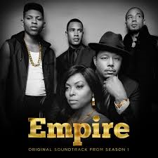






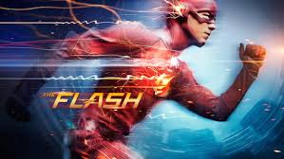




“Live” Ad-Supported TV Content Fosters Emotional Connections That Lead To Social Engagement
No longer a passive medium, ad-supported TV compels millions of people to actively share their “real-time” thoughts and opinions on the content they’re consuming live
Why?
Because TV consistently creates and captures moments that are exciting, entertaining, humorous, enlightening, uplifting, aspirational, inspirational and educational...moments that people almost immediately share and talk about online
Also, in addition to providing pure escapism, TV delivers engaging content centered on real-life themes that viewers can relate to…these shared experiences often lead viewers to take action by participating in online conversations
Family & Friends
Escapism
Competition
Inspirational
Informational
6
#TVisSOCIAL #Ep2

Slide 7
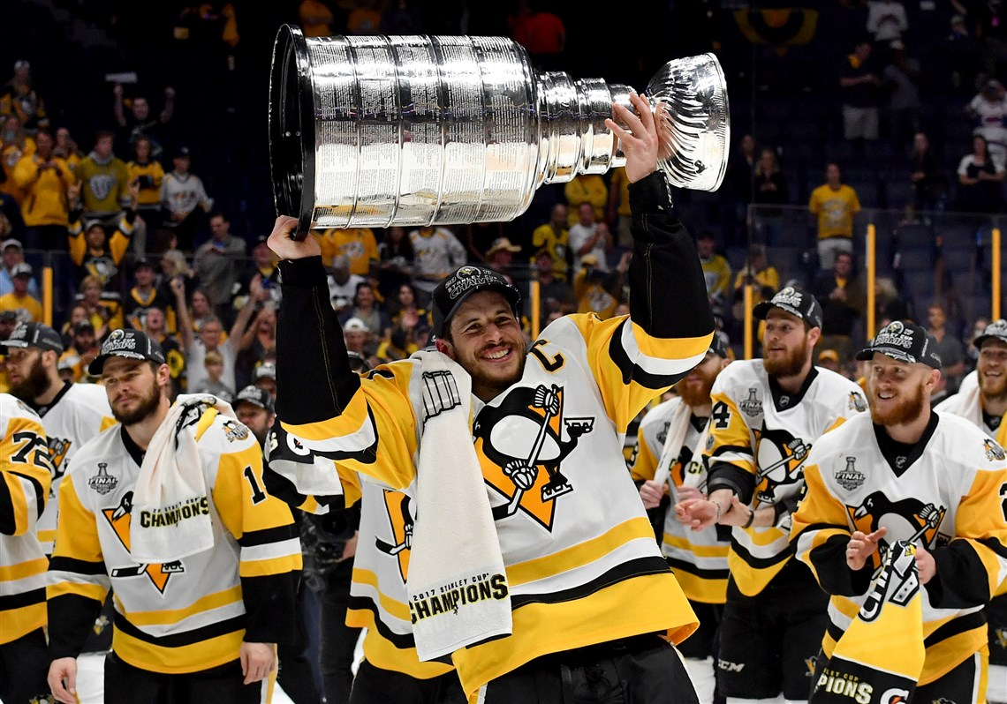
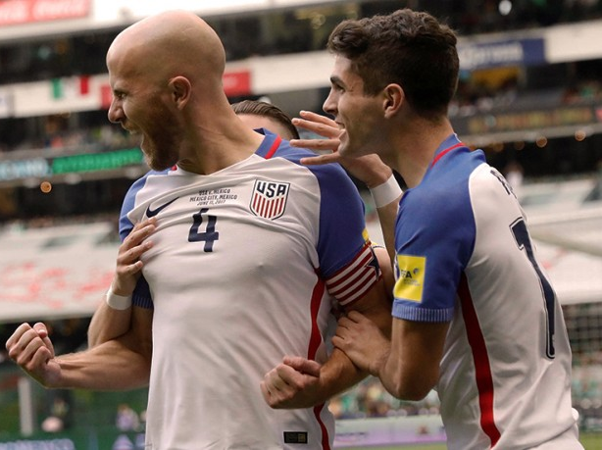
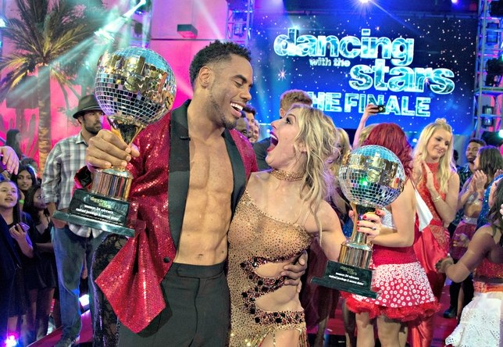
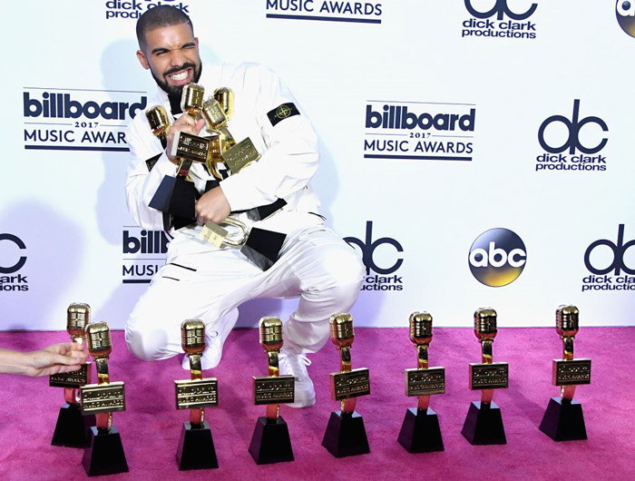
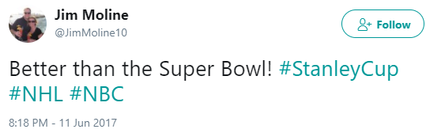
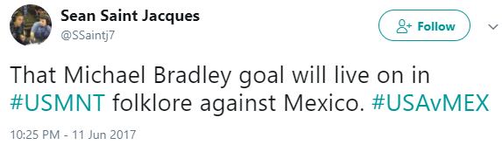
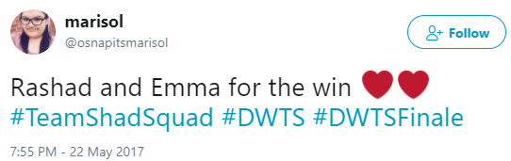
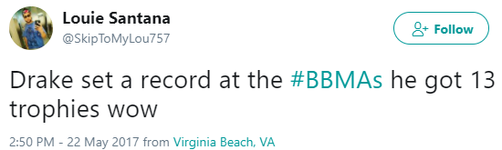
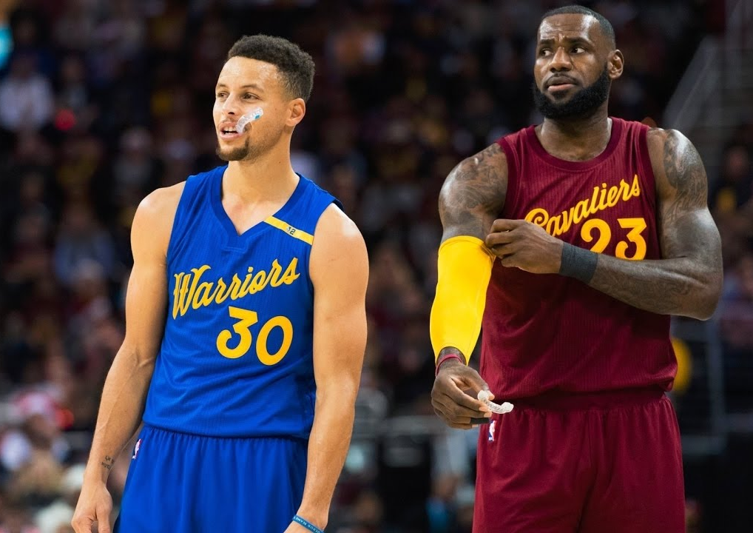
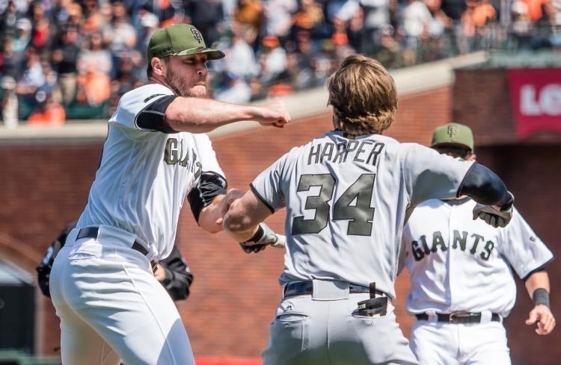
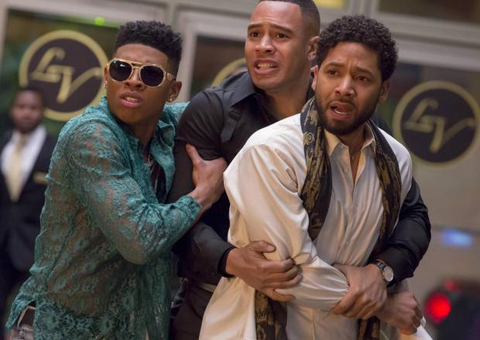
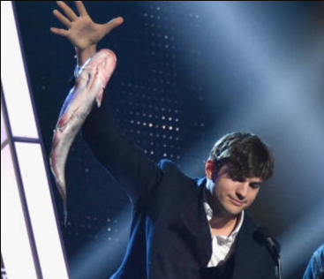
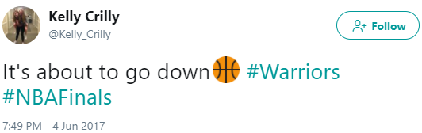
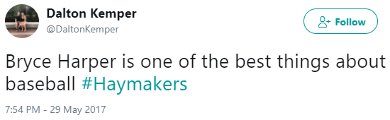
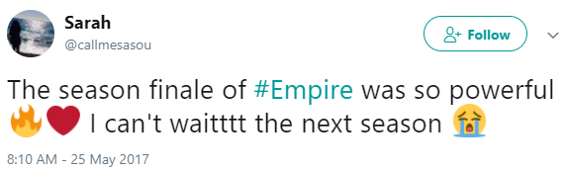
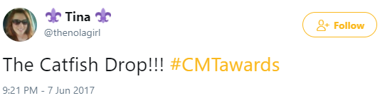
Ad-Supported TV Also Captures & Creates Society’s “Big Moments” Which Are Further Amplified On Social Media
Each month, Ad-supported TV gives us many memorable and iconic moments across sports, entertainment and news… moments that people couldn’t wait to talk about with others online. Here’s a look at some events during May/June ‘17:
Sports
Entertainment
Pittsburgh Penguins defeat Nashville to become back-to-back Stanley Cup Champions
USMNT scores unforgettable goal to earn a crucial tie against their rival, Mexico
Rashad Jennings & Emma Slater win
Dancing With the Stars in style
Drake breaks the record for most wins at the Billboard Music Awards
Golden State Warriors battle the Cleveland Cavaliers in a third consecutive NBA Finals
Washington Nationals’ Bryce Harper storms the mound after getting hit by a pitch
Empire’s explosively shocking season finale
Ashton Kutcher firing up Nashville with a catfish mic-drop at the CMT Awards
#TVisSOCIAL #Ep2
7

Slide 8
Overall, The Vast Majority Of People’s Total Television Viewing Continues To Be Done “Live”
Television Primetime Viewing: % “Live” vs. “Time-Shifted”
#TVisSOCIAL #Ep2
Source: Nielsen NPower R&F Time Period Report, Primetime, Live vs. Live+7, ad-supported cable TV + broadcast TV, 5/15/2017 – 6/11/2017. P2+, P18-24, P18-34, P18-49.

Slide 9
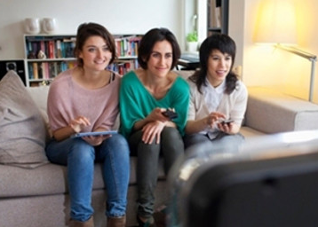
Twitter Is The Social Hub Of Real-Time Conversations
Centered Around “What’s Happening Now”
Twitter is one of today’s most popular communication tools and their brand positioning - “See What’s Happening” – reflects a platform that’s built around what’s happening in the world and what people are talking about right now
“Live” TV, specifically, is an important fixture in people’s everyday lives and nowhere is this more evident than the conversations seen on Twitter
Twitter Users Who Are TV “Superfans”*
72% say a social platform, like Twitter, plays a role in their TV viewing
57% follow hashtags to keep up with what others are saying about a TV show
54% want to be the “go-to-source” for others on news and information about their favorite TV shows
60% share their opinions about the shows they watch on Twitter
*“TV Superfans” are a self-identified cluster within the “Twitter Insiders” online research community of approx. 7,000 users. Two-thirds of superfans report watching more than 3 hours of TV daily.
#TVisSOCIAL #Ep2
Source: Twitter proprietary study in partnership with Vizeum and Dentsu Aegis Network using “Twitter Insiders,” an online research community of approx. 7,000 users; January 2017.

Slide 10
Millennials Account For A Majority Of Total Time Spent On Twitter,
A Popular Online “Meeting Place” To Discuss Current Topics
Young Millennials (A18-24) are much more engaged with Twitter than other demographic age breaks
Twitter Usage
User Profile By Age
Total Minutes Spent By Age
18-34
39%
(165 index
vs. U.S. Pop)
18-34
54%
of total time spent
#TVisSOCIAL #Ep2
Source: comScore, mediametrix multiplatform, June 2017. Nielsen 2016-2017 Universe Estimate for A18-34 population comparison.

Slide 11
Top Trending Topics Analysis

Slide 12
Quantifying How Much Ad-Supported TV Drives Online
Social Conversation
To quantify the important role that TV plays in people’s lives, we analyzed the impact of TV programming on the top 10 trending Twitter topics over a four week time period leading into, and covering the first part of, the summer season
  Monday, May 15th, 2017 – Sunday, June 11th, 2017
Since trending topics are everchanging and a slight lag time typically exists for topics to start trending, we monitored four “points in time” each night to capture what people are talking about online throughout the evening
  8:30p, 9:30p, 10:30p, 11:30p
Geography reflects United States-based Twitter trending data while ad-supported TV topics were grouped into two types:
  Direct: specific hashtags of televised entertainment shows, sports events or news programming
  Related: topics associated with specific TV programming including athletes, general team hashtags, collegiate school mentions (school & nicknames for football & basketball), show characters, celebrity personalities, and specific TV-related news references
#TVisSOCIAL #Ep2

Slide 13
First, There Was Virtually No Difference In TV’s Social Popularity Between May And The Post Memorial Day Time Period
TV-related topics dominated social conversations both before and after the first summer holiday; Television even held a majority of the top trending topics during Memorial Day Weekend itself
Topic Breakout: Overall Total % of Top 10 Trending Twitter Topics
May - Pre-Memorial Day Weekend
(May 15th – May 25th)
Memorial Day Weekend - June
(May 26th – June 11th)
Memorial Day Weekend: 58%
#TVisSOCIAL #Ep2
Source: VAB custom analysis of Top 10 trending Twitter Topics each night (8:30p, 9:30p, 10:30p, 11:30p) during 4-week time period (5/15/2017 – 6/11/2017). Pre-Memorial Day Weekend = 5/15 – 5/25; Memorial Day Weekend & Beyond = 5/26 – 6/11; Memorial Day Weekend = Friday, 5/26 – Monday, 5/29.
Results include both “direct” and “related” TV topics.

Slide 14
Overall, Ad-Supported TV Accounted For Nearly 7 Of The Top 10 Trending Twitter Topics Through The Four-Week Time Period
67%
Overall Total % of TV-topics in Top 10 During Primetime
Although this analysis was conducted as the summer season was getting underway between May-June,
ad-supported TV continued to dominate the top social conversations on Twitter
8:30p
Total % of
TV-topics In Top 10: 50%
9:30p
Total % of
TV-topics In Top 10: 70%
10:30p
Total % of
TV-topics In Top 10: 76%
11:30p
Total % of
TV-topics In Top 10: 72%
#TVisSOCIAL #Ep2
Source: VAB custom analysis of Top 10 trending Twitter Topics each night (8:30p, 9:30p, 10:30p, 11:30p) aggregated during 4-week time period (5/15/2017 – 6/11/2017).
Results include both “direct” and “related” TV topics.

Slide 15
At Least Half Of The Top 10 Trending Topics On Any Night
Were Based on Ad-Supported TV Content
Four Week Average: % of Top 10 Trending Topics That Are Based On TV Content
Monday
Tuesday
Wednesday
Thursday
Friday
Saturday
Sunday
Overall
81%
69%
66%
68%
51%
56%
78%
8:30p
65% 48% 40% 38% 35% 48% 78%
9:30p
85% 73% 68% 75% 55% 55% 80%
10:30p
85% 80% 80% 80% 58% 68% 80%
11:30p
88% 75% 78% 78% 58% 55% 73%
#TVisSOCIAL #Ep2
Source: VAB custom analysis of Top 10 trending Twitter Topics each night (8:30p, 9:30p, 10:30p, 11:30p) during 4-week time period (5/15/207 – 6/11/2017). Reflects four week average by day and time. Results include both “direct” and “related” TV topics.

Slide 16
At Least One Sporting Event & Entertainment Program Had A Related Topic Trend In The Top 10 Each Night
Four-Week Time Period
# of Nights Ad-Supported TV Programming Trended In Top 10 Topics By Genre
#TVisSOCIAL #Ep2
Source: VAB custom analysis of Top 10 trending Twitter Topics each night (8:30p, 9:30p, 10:30p, 11:30p) during 4-week time period (5/15/2017 – 6/11/2017). Results include both “direct” and “related” TV topics.

Slide 17

In Fact, 51 Different Ad-Supported TV Topics Trended #1
During Primetime Over The Four-Week Time Period
For 24 out of 28 nights, an Ad-Supported TV topic trended #1 during at least one of the four monitored “points in time”
Top Twitter Trending TV Topics By Night
Monday
Tuesday
Wednesday
Thursday
Friday
Saturday
Sunday
8:30p: #LHHATL (#1)
9:30p: #Game7 (#1)
10:30p: #Maddow (#1)
11:30p: #Family Hustle (#1)
8:30p: #NCIS (#1)
10:30p: #VoiceSaveJesse (#1)
11:30p: #VoiceSaveJesse (#1)
10:30p: #Empire (#1)
11:30p: Lebron (#1)
8:30p: #GreysAnatomy (#1)
9:30p: #Scandal (#1)
10:30p: #Scandal (#1)
11:30p: #Scandal (#1)
9:30p: #DragRace (#1)
10:30p: #DragRace (#1)
11:30p: Cavs (#1)
8:30p: Cloud Computing (#1)
8:30p: #BBMAs (#1)
9:30p: #BBMAs (#1)
10:30p: #BBMAs (#1)
11:30p: #BBMAs (#1)
15-May
16-May
17-May
18-May
19-May
20-May
21-May
9:30p: #TheBachelorette (#2)
10:30p: #TheBachelorette (#2)
11:30p: #TheBachelorette (#2)
9:30p: #TheFlash (#1)
10:30p: #SDLive (#1)
11:30p: Kyrie (#1)
8:30p: #DirtyDancing (#1)
9:30p: #DirtyDancing (#1)
10:30p: #Empire (#1)
11:30p: #DirtyDancing (#1)
10:30p: #GUHHATL (#1)
11:30p: #NBAFinals (#1)
8:30p: Trea Turner (#6)
10:30p: #FixMyLife (#2)
11:30p: #FixMyLife (#2)
8:30p: #CocaCola600 (#1)
9:30p: #Chivas (#1)
10:30p: #Chivas (#1)
11:30p: #Chivas (#1)
22-May
23-May
24-May
25-May
26-May
27-May
28-May
8:30p: Bryce Harper (#1)
9:30p: #TheBachelorette (#1)
10:30p: #TheBachelorette (#1)
11:30p: #StanleyCupFinal(#1)
9:30p: #SDLive (#1)
10:30p: #SDLive (#1)
11:30p:#InternetBands
(@Midnight) (#1)
9:30p: #StateOfBlackAmerica (#1)
10:30p: #StateOfBlackAmerica (#1)
11:30p:#SuperHeroHistory
(@Midnight) (#1)
9:30p: #NBAFinals (#1)
10:30p: #NBAFinals (#1)
11:30p: #NBAFinals (#1)
9:30p: #DragRace (#1)
10:30p: #LivePD (#1)
8:30p: #UCLFinal (#2)
8:30p: #OneLoveManchester (#1)
9:30p: #NBAFinals (#1)
11:30p: Kyrie (#1)
29-May
30-May
31-May
1-Jun
2-Jun
3-Jun
4-Jun
8:30p: #TheBachelorette (#1)
9:30p: #TheBachelorette (#1)
10:30p: #TheBachelorette (#1)
11:30p: #TheBachelorette (#1)
9:30p: #SDLive (#1)
10:30p: #SDLive (#1)
11:30p: #DogBroadway
(@Midnight) (#1)
8:30p: #CMTAwards (#1)
9:30p: #CMTAwards (#1)
10:30p: Deron Williams (#1)
11:30p: Kyrie (#1)
9:30p: #USMNT (#1)
10:30p: #USMNT (#1)
11:30p: #ElderlyBeatlesSongs
(@Midnight) (#1)
8:30p: Game4 (#1)
9:30p: Jeff Van Gundy (#1)
11:30p: Draymond (#1)
10:30p: #UFCAuckland (#1)
11:30p: #UFCAuckland (#1)
8:30p: #TonyAwards2017 (#1)
9:30p: #TonyAwards2017 (#1)
10:30p: #TonyAwards2017 (#1)
11:30p: #StanleyCup (#1)
5-Jun
6-Jun
7-Jun
8-Jun
9-Jun
10-Jun
11-Jun
Source: VAB custom analysis of Top 10 trending Twitter Topics each night (8:30p, 9:30p, 10:30p, 11:30p) during 4-week time period (4/15/2017 – 5/11/2017. Results include both “direct” and “related” TV topics. Non #1 Gray highlighted days reflect the highest trending TV topic for that evening. Overall rank in parentheses. LHHATL = Lop & Hip Hop: Atlanta; BBMAs = Billboard Music Awards.

Slide 18
On Average, Over Eight Different Ad-Supported TV Programs Trended In The Top 10 At Some Point During Each Night
# of TV Programs Trending In The Top 10 During Each Night
19
Sports
Entertainment
News
16
13
12
11
11
10
9
9
8
8
8
8
8
8
8
8
7
7
6
6
5
5
5
5
5
5
4
Tues
Wed
Sun
Thurs
Mon
Sat
Fri
Sun
Sat
Tues
Tues
Wed
Mon
Sat
Mon
Thurs
Tues
Wed
Fri
Sun
Thurs
Wed
Sat
Mon
Fri
Fri
Sun
Thurs
#TVisSOCIAL #Ep2
Source: VAB custom analysis of Top 10 trending Twitter Topics each night (8:30p, 9:30p, 10:30p, 11:30p) during 4-week time period (5/15-2017 – 6/11/2017). Results include both “direct” and “related” TV topics. In aggregate, 234 TV program episodes (includes multiple shows / games of same program) trended in the top 10 over the time period.

Slide 19
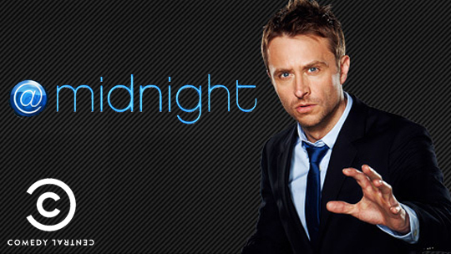




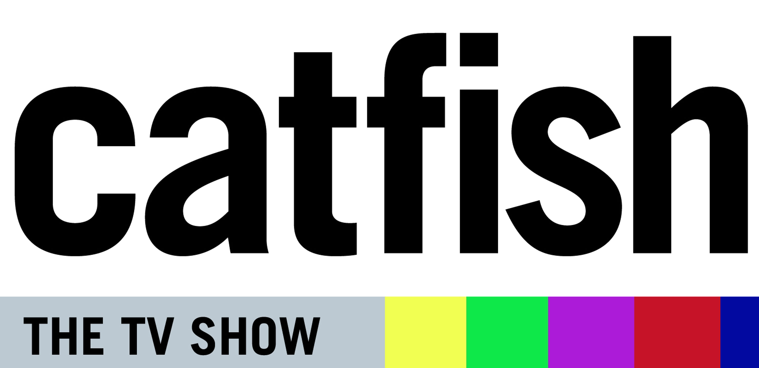
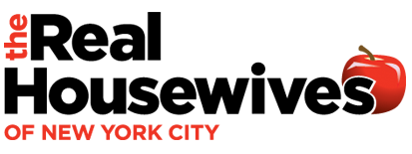


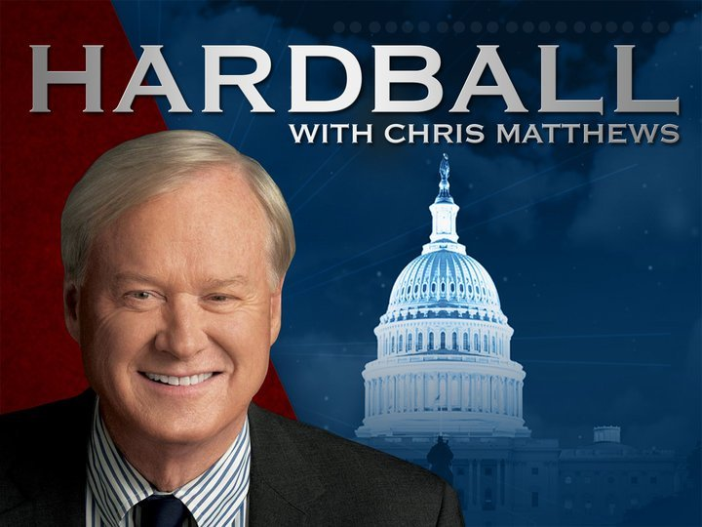




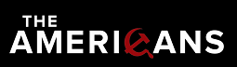



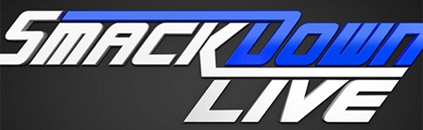
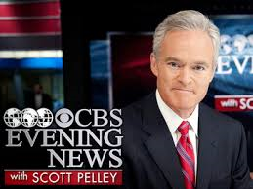





Many Programs Trended Each Night During Both The End Of The TV Season And In The Post-Memorial Day Summer Period
# of TV Programs Trending In The Top 10 During Each Night
19
Sports
Entertainment
News
16
13
12
11
11
10
9
9
8
8
8
8
8
8
8
8
7
7
6
6
5
5
5
5
5
5
4
Tues
Wed
Sun
Thurs
Mon
Sat
Fri
Sun
Sat
Tues
Tues
Wed
Mon
Sat
Mon
Thurs
Tues
Wed
Fri
Sun
Thurs
Wed
Sat
Mon
Fri
Fri
Sun
Thurs
#TVisSOCIAL #Ep2
Source: VAB custom analysis of Top 10 trending Twitter Topics each night (8:30p, 9:30p, 10:30p, 11:30p) during 4-week time period (5/15-2017 – 6/11/2017). Results include both “direct” and “related” TV topics.

Slide 20
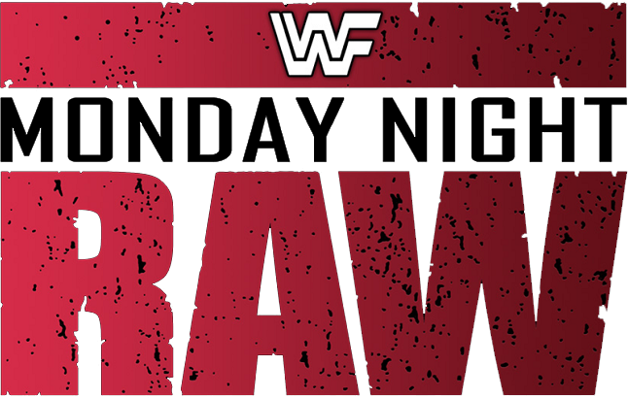









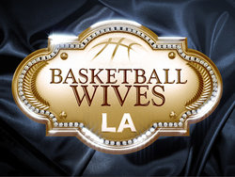

Several Ad-Supported TV Shows & Sports “Own” Specific
Nights Of The Week
No other type of tweet is as much of a recurring topic as ad-supported TV
Trending In The Top 10 During At Least 3 of The 4 Weeks During The May / June Time Period Analyzed
Monday
Tuesday
Wednesday
Thursday
Friday
Saturday
Sunday
#TVisSOCIAL #Ep2
Source: VAB custom analysis of Top 10 trending Twitter Topics each night (8:30p, 9:30p, 10:30p, 11:30p) during 4-week time period (5/15/2017 – 6/11/2017). Results include both “direct” and “related” TV topics.

Slide 21
Sports & Entertainment Both Account For A Large Portion Of The Total Ad-Supported TV Topics That Trended In The Top 10
Four-Week Time Period
Genre % Breakout of Top 10 Ad-Supported TV Trending Topics
#TVisSOCIAL #Ep2
Source: VAB custom analysis of Top 10 trending Twitter Topics each night (8:30p, 9:30p, 10:30p, 11:30p) aggregated during 4-week time period (5/15/2017 – 6/11/2017). Results include both “direct” and “related” TV topics.

Slide 22
TV Sports Social Conversations Split Evenly Across Weeknights and Weekends, While TV Entertainment Skewed Towards The Weeknights
Four-Week Time Period
Genre-Specific Top 10 Ad-Supported TV Trending Topics By Day
#TVisSOCIAL #Ep2
Source: VAB custom analysis of Top 10 trending Twitter Topics each night (8:30p, 9:30p, 10:30p, 11:30p) aggregated during 4-week time period (5/15/2017 – 6/11/2017).
Results include both “direct” and “related” TV topics.

Slide 23
Televised Sports Make Up Almost Half Of The Overall Top 10 Trending Topics In The Latter Half Of The Night
Social sports talk gains momentum through the night and heats up as east time zone games begin wrapping up while west time zone games start
76%
70%
72%
50%
#TVisSOCIAL #Ep2
Source: VAB custom analysis of Top 10 trending Twitter Topics each night (8:30p, 9:30p, 10:30p, 11:30p) aggregated during 4-week time period (5/15/2017 – 6/11/2017).
Results include both “direct” and “related” TV topics.

Slide 24
Almost Half Of All Top 10 Trending Ad-Supported TV Topics Were Based On Official Show & Sports Event Hashtags
Trending TV Topics By Type
“Related” Examples:
Entertainment
Vanessa Hudgens (BBMA Performer)
The Chainsmokers (BBMA Performers)
Lucious (Empire)
Olivia Pope (Scandal)
David Hyde Pierce (Tony Awards)
Samoa Joe (WWE Monday Night Raw)
Saul Goodman (Better Call Saul)
Enzo (WWE Monday Night Raw)
Sports
Pekka Rinne (Nashville Predators - NHL)
Tristan Thompson (Cleveland Cavaliers - NBA)
Christian Pulisic (US Men’s Soccer)
Sidney Crosby (Pittsburgh Penguins - NHL)
JaVale McGee (Golden State Warriors - NBA)
#Preds (Nashville Predators Hashtag)
Cloud Computing (Preakness Stakes)
#USMNT (US Men’s Soccer Hashtag)
Jeff Van Gundy (NBA Commentator)
News
Sean Hannity (Fox News Host)
#ComeyTestimony
Chris Matthews (MSNBC Host)
#GA06 (Atlanta District Debate Hashtag)
“Direct” Examples:
Entertainment
#TheBachelorette
#PLLEndGame
#DragRace
#LHHATL
#Arrow
#LivePD
#FixMyLife
#PrisonBreak
#BasketballWives
#Empire
Sports
#NBAFinals
#AllStarRace
#UFCAuckland
#StanleyCupFinal
#USAvMEX
#BelmontStakes
#CAVSvCeltics
News
#StateOfBlackAmerica
#Hardball
#PelosiTownHall
#Maddow
Direct: specific hashtags related to televised entertainment shows, sports events or news programming
Related: topics associated with TV programming airing during the trending timeframe including athletes, general team hashtags, collegiate school mentions (school & nicknames for football & basketball), show characters, celebrity personalities, and specific TV-related news references
#TVisSOCIAL #Ep2
Source: VAB custom analysis of Top 10 trending Twitter Topics each night (8:30p, 9:30p, 10:30p, 11:30p) aggregated during 4-week time period (5/15/2017 – 6/11/2017). Based on the aggregated number of top 10 Twitter trending topics over the 4-week time period.

Slide 25
On Average, Over 13 Unique Ad-Supported TV Topics
(Direct + Related) Trended In The Top 10 Throughout Each Night
365 unique TV topics trended over the four-week time period with entertainment the leading genre when it came to people using official program hashtags within their tweets
Genre % Breakout of
Program Hashtags (“Direct”)
365
Top 10 Trending TV Topics
Entertainment: 130
Direct: 90
Related: 40
Sports: 217
Direct: 31
Related: 186
News: 18
Direct: 7
Related: 11
#TVisSOCIAL #Ep2
Source: VAB custom analysis of Top 10 trending Twitter Topics each night (8:30p, 9:30p, 10:30p, 11:30p) during 4-week time period (5/15/2017 – 6/11/2017). Reflects count of unique topics.

Slide 26
A Large Majority Of Entertainment Topics That Trend Feature The Specific Program Hashtag
Most of the sports topics that trend are related to the televised event – teams, participating athletes and coaches, and plays or other actions on the court or field
Direct: specific hashtags related to televised entertainment shows, sports events or news programming
Related: topics associated with TV programming airing during the trending timeframe including athletes, general team hashtags, collegiate school mentions (school & nicknames for football & basketball), show characters, celebrity personalities, and specific TV-related news references
Source: VAB custom analysis of Top 10 trending Twitter Topics each night (8:30p, 9:30p, 10:30p, 11:30p) during 4-week time period (5/15/2017 – 6/11/2017). Reflects count of unique topics.

Slide 27
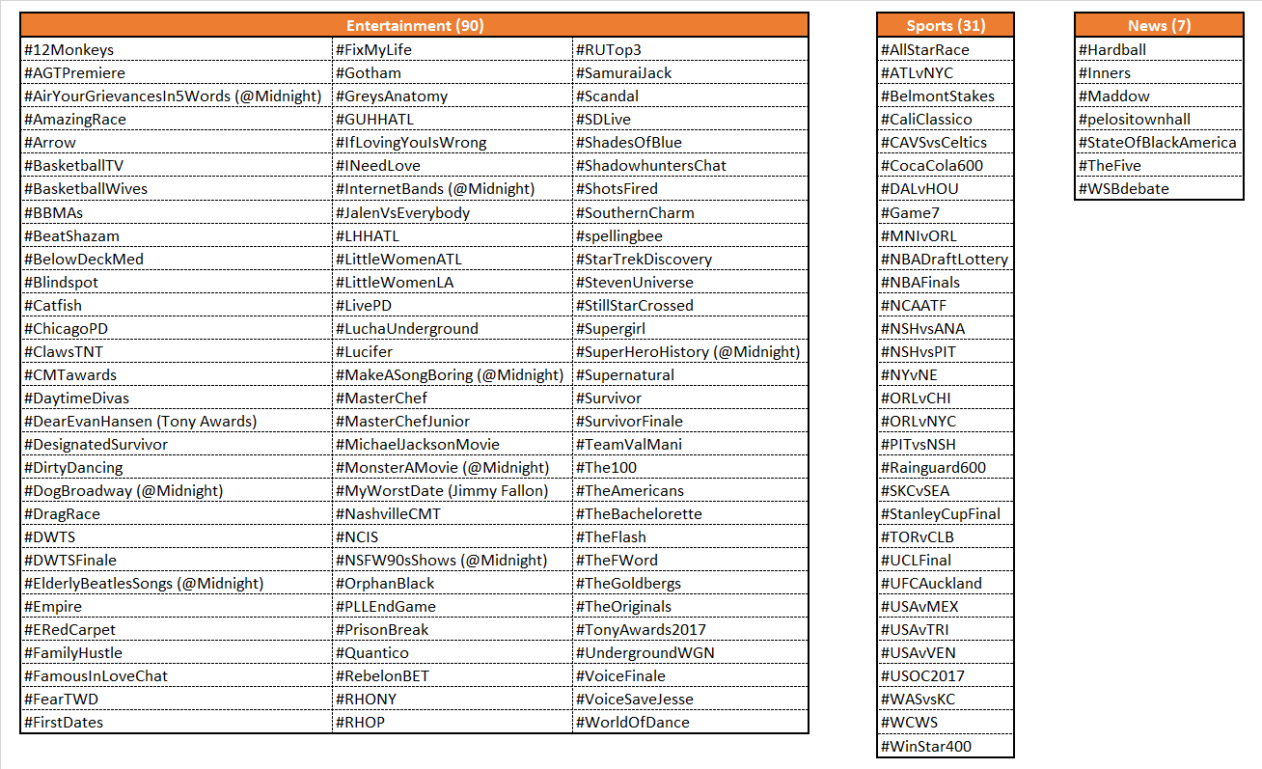
Nearly Five Official Ad-Supported TV Show Or Sports Event Hashtag Trended In The Top 10 During An Average Night
There were 128 official TV program hashtags, a majority of them entertainment show-based, that trended in the top 10 topics over the four-week time period
#TVisSOCIAL #Ep2
Source: VAB custom analysis of Top 10 trending Twitter Topics each night (8:30p, 9:30p, 10:30p, 11:30p) during 4-week time period (5/15/2017 – 6/11/2017).

Slide 28
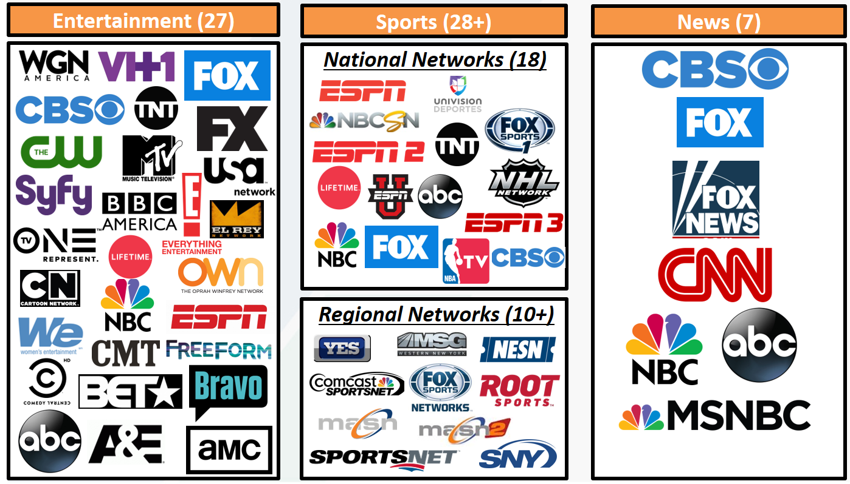
Programming From Over 52 Networks Were Top 10 Trending Topics During The Four-Week Primetime Analysis
#TVisSOCIAL #Ep2
Source: VAB custom analysis of Top 10 trending Twitter Topics each night (8:30p, 9:30p, 10:30p, 11:30p) during 4-week time period (5/15/2017 – 6/11/2017). Results include both “direct” and “related” TV topics.

Slide 29
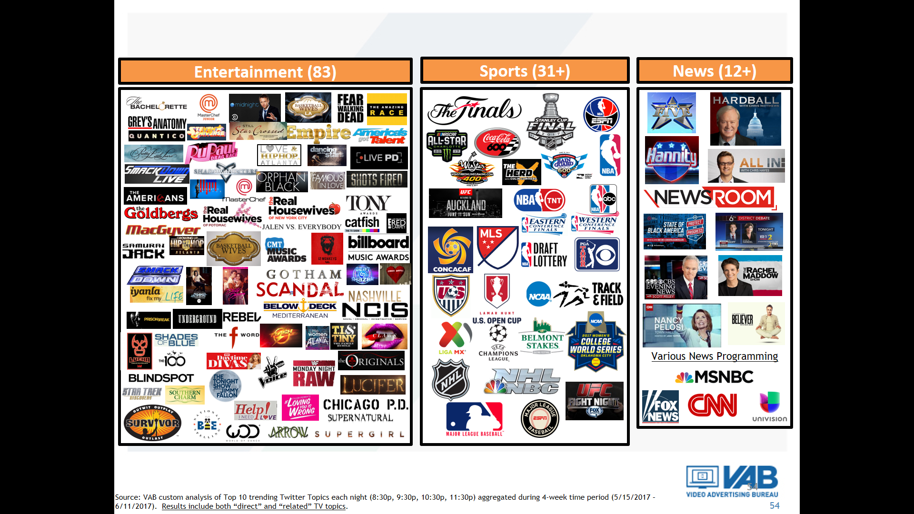
Over 126 TV Programs Trended In The Top 10 During The Four Week Primetime Analysis
#TVisSOCIAL #Ep2
Source: VAB custom analysis of Top 10 trending Twitter Topics each night (8:30p, 9:30p, 10:30p, 11:30p) during 4-week time period (5/15/2017 – 6/11/2017). Results include both “direct” and “related” TV topics.

Slide 30
When It Comes To Entertainment Content, Nothing Else Gets People Talking Online Like Ad-Supported TV Programs
Interestingly, two of the three Netflix shows that trended in the Top 10 on Twitter did so because the streaming service announced their cancellation (The Get Down & Sense8)
Four-Week Time Period
# of Top 10 Trending Entertainment Programs / Content By Platform
(HBO, Showtime, Starz)
(UFC Fight Pass, WWE Network)
#TVisSOCIAL #Ep2
Source: VAB custom analysis of Top 10 trending Twitter Topics each night (8:30p, 9:30p, 10:30p, 11:30p) during 4-week time period (5/15/2017 – 6/11/2017). Based on unique program counts. For the purposes of this chart, “program / content” is an all-encompassing definition for individual pieces of content on each platform (albums & singles for music, video games, channel on YouTube, live streaming and/or personality on a social media platform, etc).

Slide 31
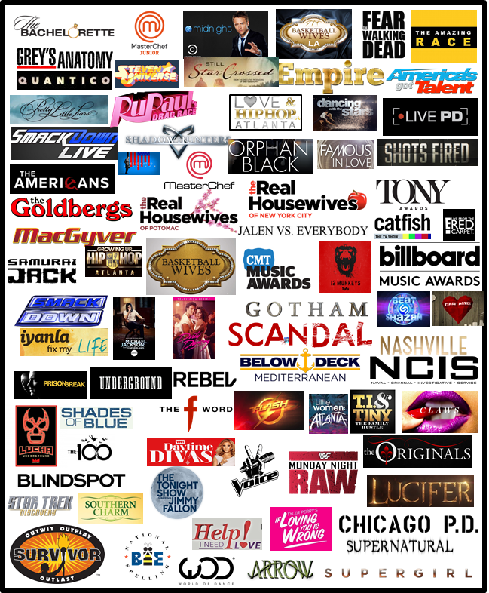
Ad-Supported TV Accounts For Two-Thirds Of The Entertainment Content That Trended In The Top 10 Topics
Four-Week Time Period
# of Top 10 Trending Entertainment Programs / Content By Platform
Other SVOD: 4 (3%)
Other platform “program” highlights: Netflix – House of Cards, Sense8, The Get Down; Music – T-Wayne, Rake It Up; Online Radio – Most Requested Live (iHeart Radio); YouTube – Car Boys; HBO – HBO Boxing, Mommy Dead & Dearest, Real Time with Bill Maher, The Leftovers; Showtime – Twin Peaks; Starz – American Gods; PPV – UFC 212; Facebook Live – CFDAAwards; Snapchat – Ask Ethan & Grayson; WWE Network – WWE Backlash; Video Games – Injustice 2, Life Is Strange 2; Other streaming – E3
Source: VAB custom analysis of Top 10 trending Twitter Topics each night (8:30p, 9:30p, 10:30p, 11:30p) during 4-week time period (5/15/2017 – 6/11/2017). Based on unique program counts. For the purposes of this chart, “program / content” is an all-encompassing definition for individual pieces of content on each platform (albums & singles for music, video games, channel on YouTube, live streaming and/or personality on a social media platform, etc).

Slide 32
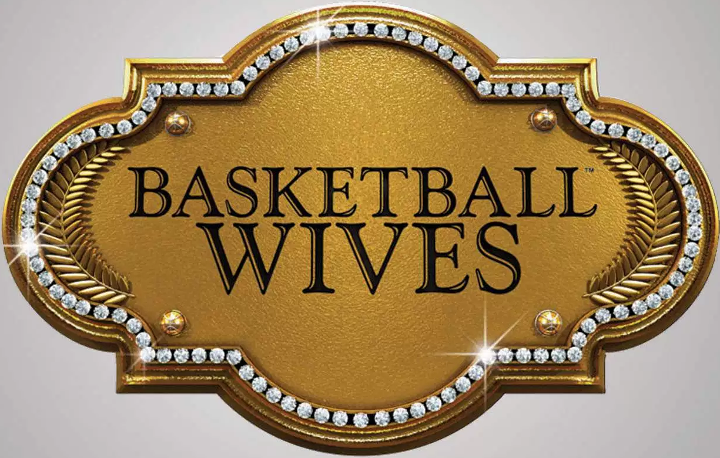
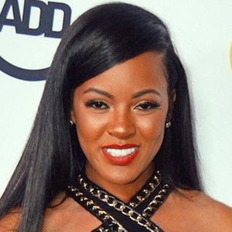
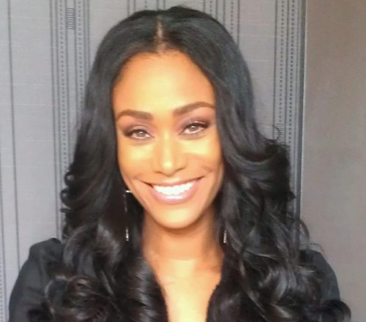
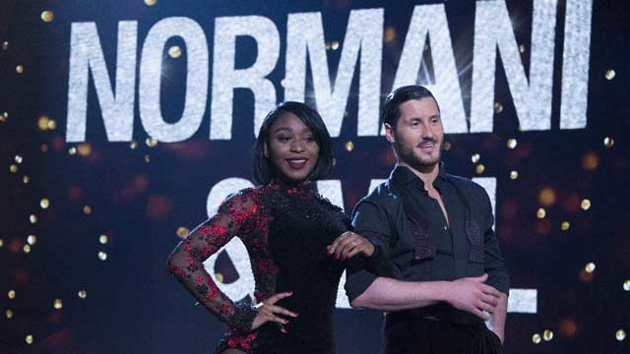
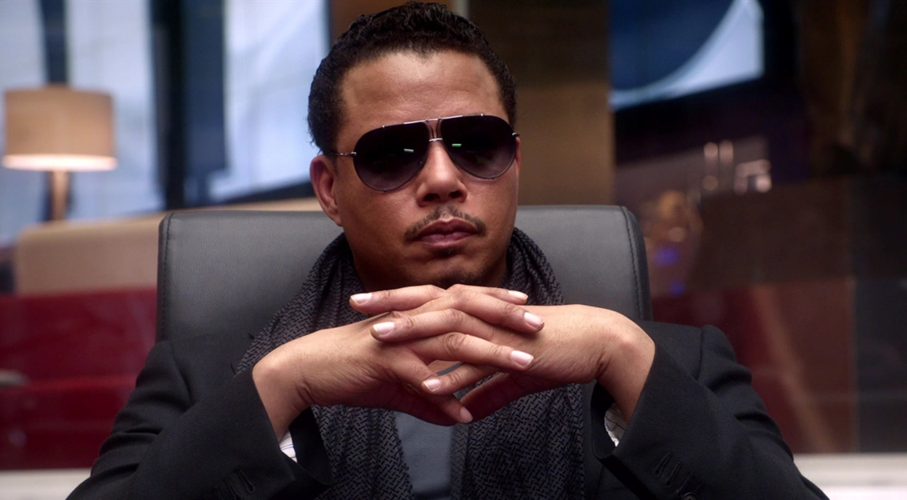

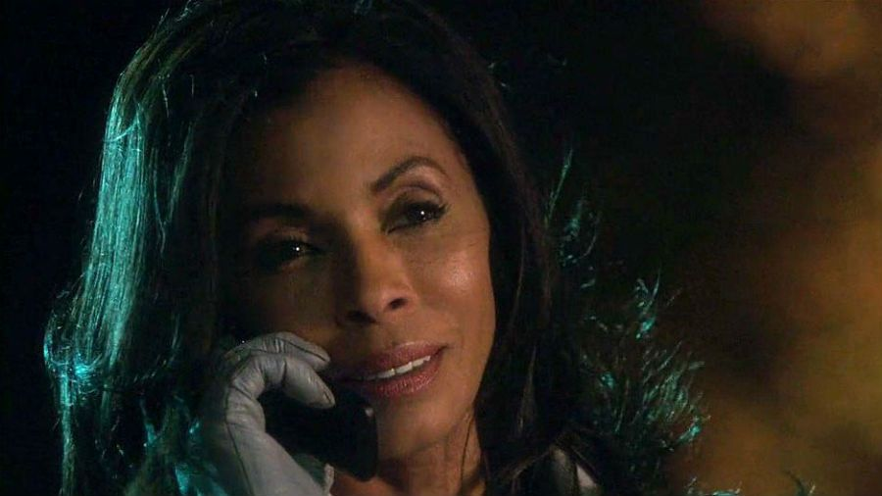
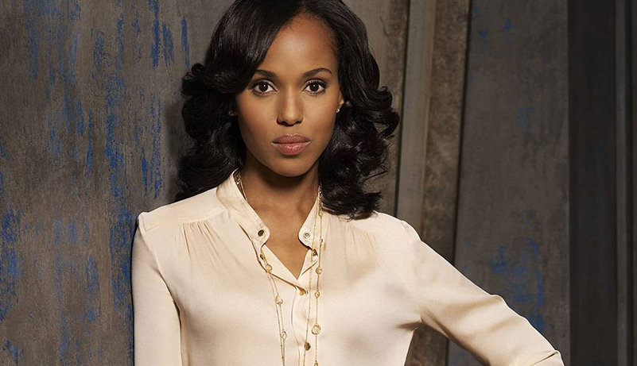

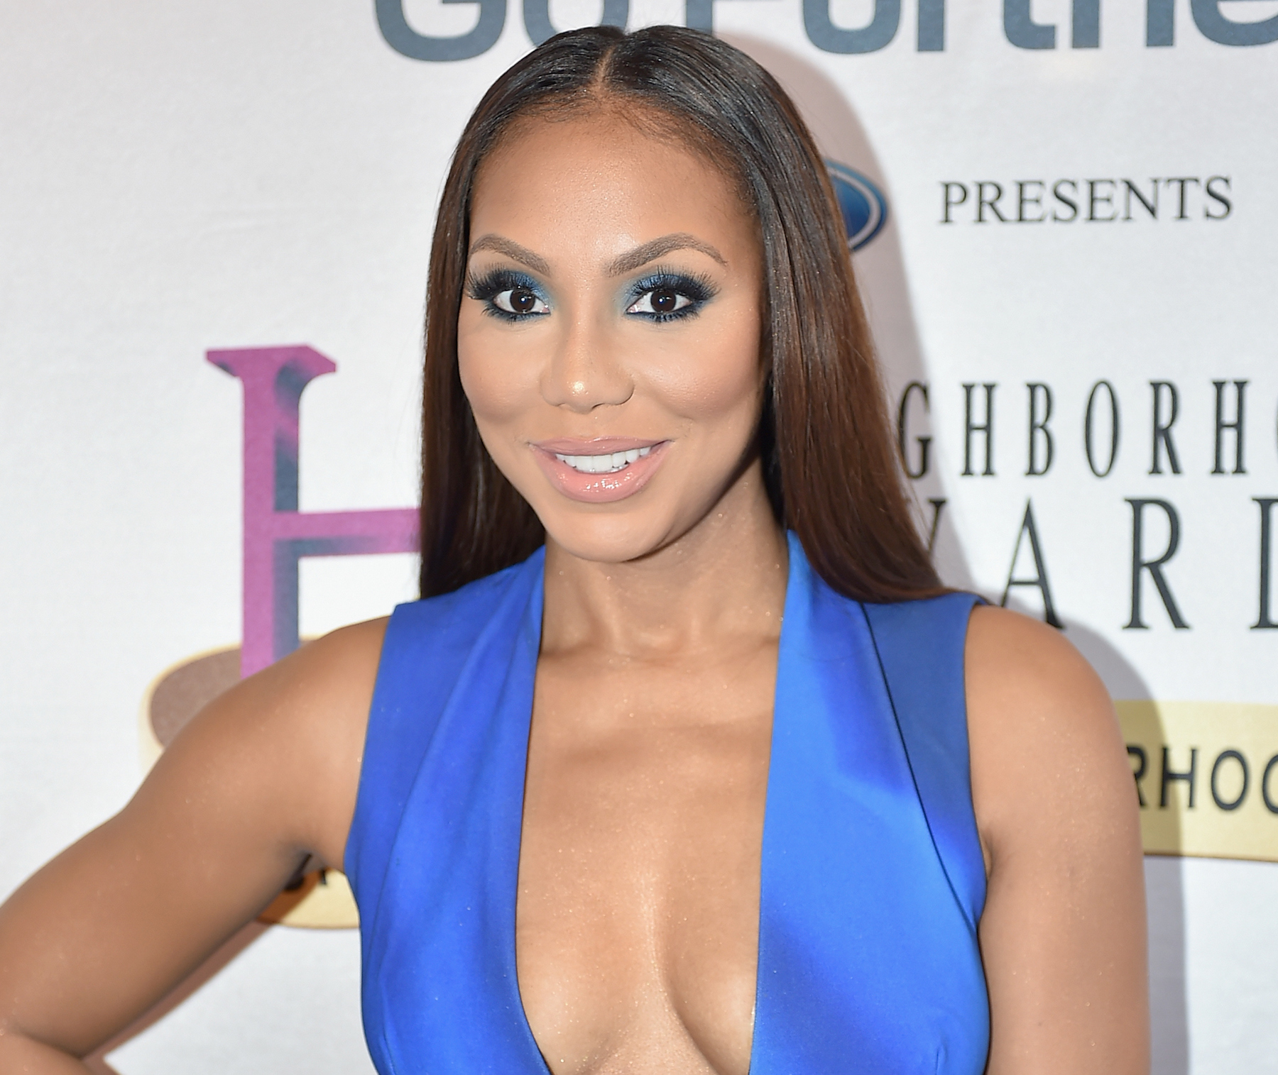
Reflecting Their High Level Of Program Engagement, People Also Heavily “Talk” About Show Characters Online As Well
Much of a character’s high social chatter centers on “I can’t believe what they just did!” entertainment
Trending Program Hashtags
Trending Program-Related Topics
#BasketballWives
“Malaysia”
“Tami”
#DWTS
#DWTSFinale
#TeamValMani
(Normani Kordei & Val Chmerkovskiy)
#Empire
“Lucious”
#Scandal
“Maya Pope”
“Olivia Pope”
#FamilyHustle
“Toya”
“Tamar”
#TVisSOCIAL #Ep2
Source: VAB custom analysis of Top 10 trending Twitter Topics each night (8:30p, 9:30p, 10:30p, 11:30p) during 4-week time period (5/15/2017 – 6/11/2017). Results include both “direct” and “related” TV topics.

Slide 33
All Major Sports That Are “In-Season” Feature Several Games Or Events With Heavy Social Chatter
During the four-week time period, 237 separate sports TV topics (games, teams, athletes, etc) in total trended in the Top 10; an average of more than 8 per night
  Some nights, like Saturday May 20th, saw primetime trending topics from as many as five different sports (Preakness Race, MLS Soccer, NASCAR, NBA & NHL Conference Finals)
Four-Week Time Period
# of Top 10 Trending Topics By Sport
*Notes: USMNT = U.S. Men’s National Team; NCAA Sports include College Baseball, College Softball & Track & Field; Int’l Soccer reflects Champions League & Liga MX; UFC reflects only trending topics related to ad-supported TV programming (not PPV)
#TVisSOCIAL #Ep2
Source: VAB custom analysis of Top 10 trending Twitter Topics each night (8:30p, 9:30p, 10:30p, 11:30p) during 4-week time period (5/5/2017 – 6/11/2017). Results include both “direct” and “related” TV topics. Topics include direct program hashtags as well as sports TV-related topics tied to athletes, teams and game references. The 237 sports TV topics includes duplication for similar topics trending in different games (ex. “LeBron”) which explains the slight variance with the overall unique sports figures on page 20.

Slide 34
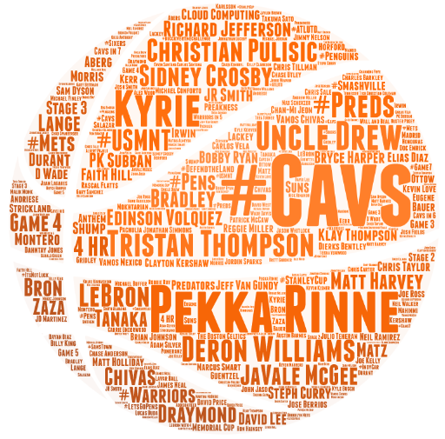
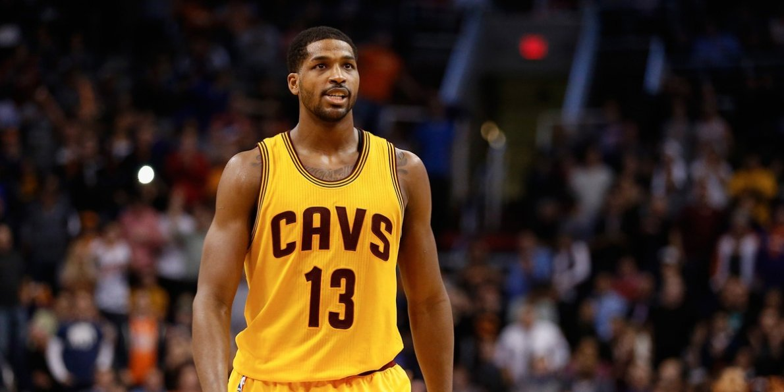
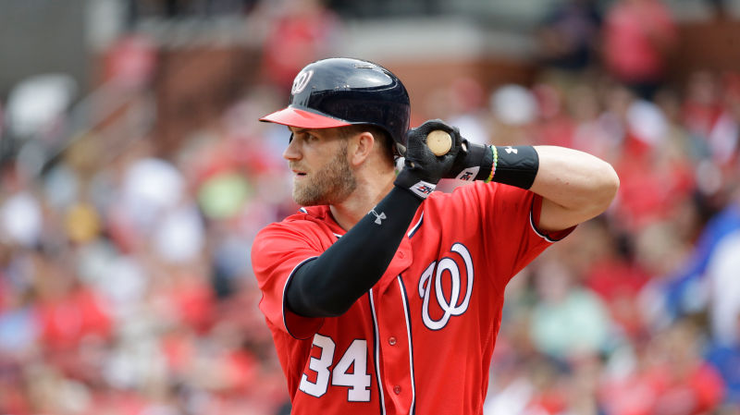
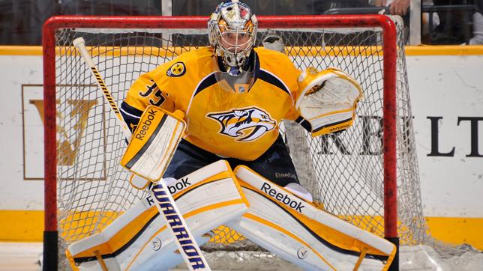
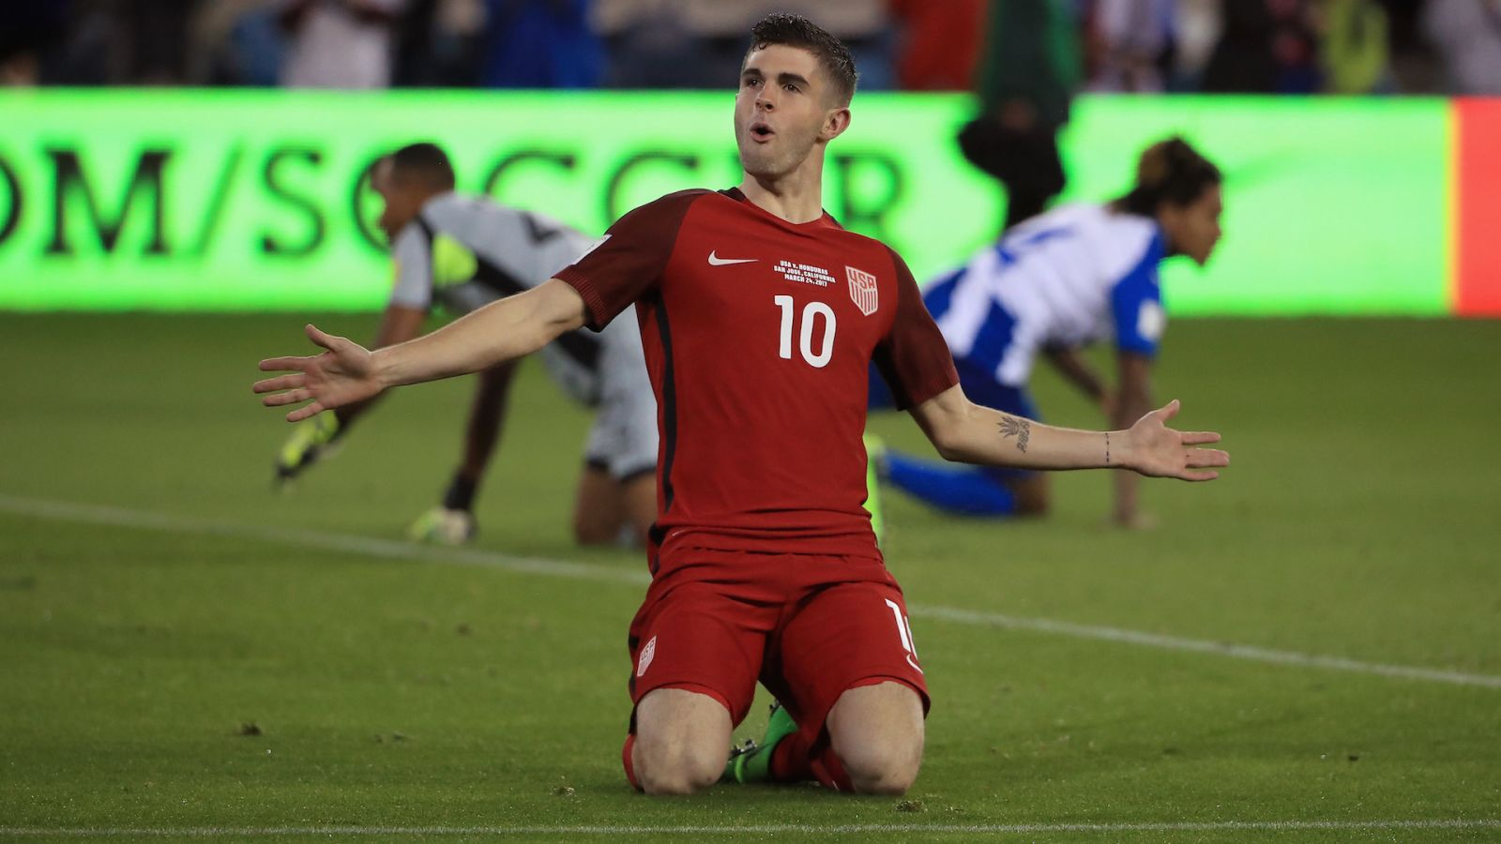
TV Sports-Related Top Trending Topics Typically Involve Athletes, Team Hashtags & Names And Game References
During the four-week time period, 205 unique sports-related TV topics (excluding TV game / event hashtags) trended in the Top 10; an average of more than 7 per night
Most “Viral” Athlete By Major Sport
NBA
MLB
Tristan Thompson
Cleveland Cavaliers
Bryce Harper
Washington Nationals
NHL
Men’s Soccer
Pekka Rinne
Nashville Predators
Christian Pulisic
USMNT
#TVisSOCIAL #Ep2
Source: VAB custom analysis of Top 10 trending Twitter Topics each night (8:30p, 9:30p, 10:30p, 11:30p) during 4-week time period (5/15/2017 – 6/11/2017). Results reflect just “related” sports TV topics and doesn’t include official televised event hashtags. “Most Viral Athlete” = the athlete who was a top 10 trending topic the most in their respective sport during the time period.

Slide 35
Numerous Topics Related To The Action Within Playoff Basketball Games Trended High During Game Nights
The NBA Finals, which led the sports category with the most trending topics, were also responsible for 54% of the overall Top 10 trending Twitter topics on game nights
Daily # of Trending Topics by Top 4 Sports
Baseball
Basketball
Hockey
Soccer
18
16
15
14
14
13
11
10
10
10
10
10
8
8
8
8
7
7
7
7
6
6
6
6
5
5
5
2
Tues
Wed
Sun
Thurs
Mon
Sat
Fri
Sun
Sat
Tues
Tues
Wed
Mon
Sat
Mon
Thurs
Tues
Wed
Fri
Sun
Thurs
Wed
Sat
Mon
Fri
Fri
Sun
Thurs
#TVisSOCIAL #Ep2
Source: VAB custom analysis of Top 10 trending Twitter Topics each night (8:30p, 9:30p, 10:30p, 11:30p) during 4-week time period (5/15/2017 – 6/11/2017).
Results include both “direct” and “related” TV topics.

Slide 36




Post-Season Sports Almost Automatically Spurred Some Of The Top Social Conversations Online During Their Airings
Almost 9 out of 10 nationally televised NBA & NHL playoff games across the major TV networks trended in the top 10 during primetime on their respective nights
86%
(25 out of 29 games)
Top 10 Trending Topics
NBA: 92% (12 out of 13 games)
NHL: 81% (13 out of 16 games)
#TVisSOCIAL #Ep2
Source: VAB custom analysis of Top 10 trending Twitter Topics each night (8:30p, 9:30p, 10:30p, 11:30p) during 4-week time period (5/15/2017 – 6/11/2017).
Results include both “direct” and “related” TV topics.

Slide 37
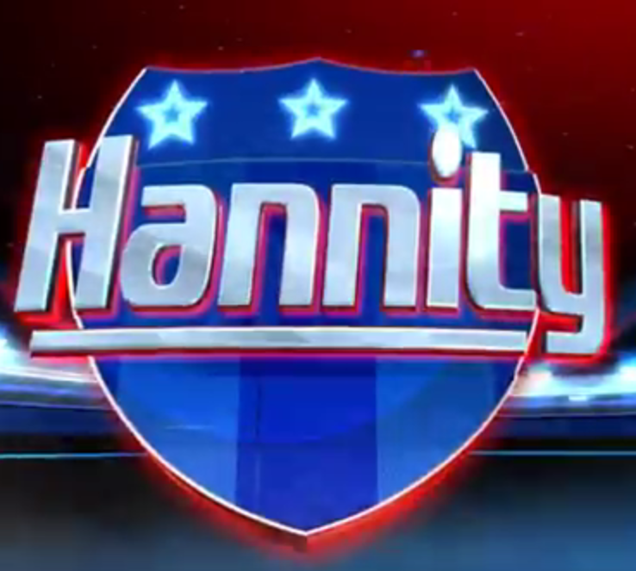

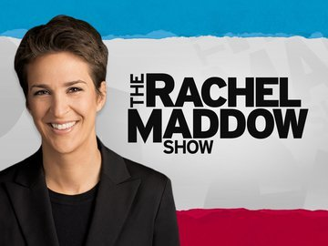
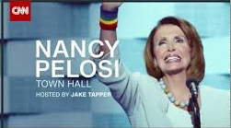

From A News Perspective, Trending Topics Came From Programming That Spans The Political Spectrum
Four-Week Time Period
% of TV Trending Topics By Major Cable News Network
#TheFive
“Sean Hannity”
“Hardball”
“Carter Page”
“Chris Matthews”
“Pat Buchanan”
“Jason Miller”
“Jeffrey Lord”
#Maddow
#pelositownhall
#Inners
“Reza Aslan”
#TVisSOCIAL #Ep2
Source: VAB custom analysis of Top 10 trending Twitter Topics each night (8:30p, 9:30p, 10:30p, 11:30p) during 4-week time period (5/15/2017 – 6/11/2017). Results include both “direct” and “related” TV topics.

Slide 38



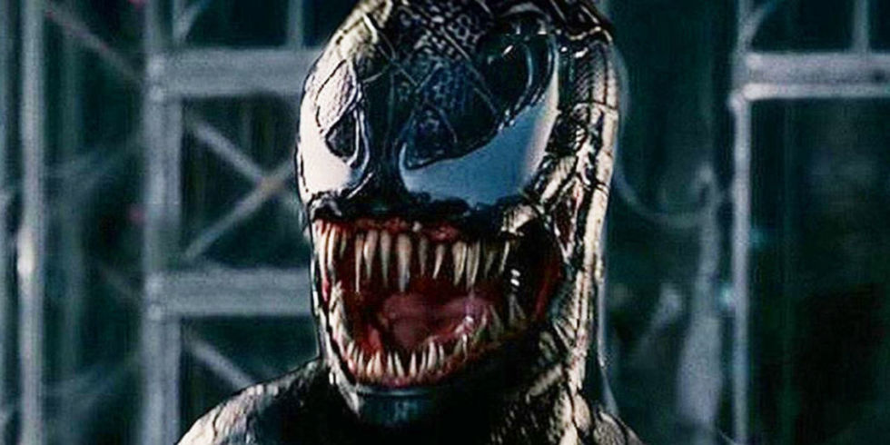
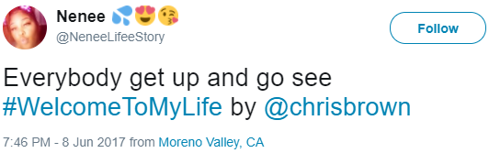







When It Comes To Movies, People Can’t Wait To Share Their Excitement Online When They See, Or Read About, Related Content
Special Premieres
New Trailer Released
Production Announcements
Cast & Crew Announcements
Thurs, June 8th – Chris Brown: Welcome To My Life is shown in theatres for one night only
_____________
#WelcomeToMyLife trends in the top 10 that night (reaches #6)
Fri, June 9th – Marvel releases the new trailer for Black Panther
_____________
Black Panther is #1 trending topic at Twitter during the 10:30p period
Fri, May 19th – Tom Hardy announced as Venom in a new Spiderman spinoff movie
_____________
Tom Hardy trends in the top 10 that night (reaches #6)
Tues, May 23rd – Tom Cruise tells an Australian talk show that Top Gun 2 will be filming in the next year.
_____________
Top Gun 2 trends in the top 10 throughout the night (reaches #4)
#TVisSOCIAL #Ep2
Source: VAB custom analysis of Top 10 trending Twitter Topics each night (8:30p, 9:30p, 10:30p, 11:30p) during 4-week time period (5/15/2017 – 6/11/2017).

Slide 39













Beyond TV & Cinema, Many Of The Other Trending Topics Were User-Generated Hashtags Focused On Random, Silly Fun
As the social success of @Midnight’s “Hashtag Wars” grew, several hashtag generator “copycats” native to Twitter have sprung up driving several organic Twitter topics to trend throughout the time period
#ThingsYouDontAccept
#IFinallyUnderstand
#PutSomeRandomGuyInASong
#5WordGraduationSpeech
#ItMakesMeSmileWhen
#AwkwardSuperheroOneLiners
#ISpendTooMuchTime
#MakeABandLessPopular
#MakeAMovieForeign
#OverheardAtABBQ
#OnlineDatingIn4Words
#JobsForMyClone
#DrunkFacebookPostsFromHistory
#TVisSOCIAL #Ep2
Source: VAB custom analysis of Top 10 trending Twitter Topics each night (8:30p, 9:30p, 10:30p, 11:30p) during 4-week time period (5/15/2017 – 6/11/2017).

Slide 40


Tweet Cheat Sheet: A One Page Rundown On The Strength
Of Ad-Supported TV To Drive Social Conversations
“Live” viewing (83% of P2+ primetime TV viewing is live) and Millennials (account for 54% of total time spent on Twitter) continue to drive TV conversations on social platforms
In fact, during the four weeks (28 nights) of “primetime” Twitter activity monitored:
Click on link below to learn more about our first #TVisSocial analysis (Oct-Nov’16)
First Report - #TVisSocial
#TVisSOCIAL #Ep2
Source: VAB custom analysis of Top 10 trending Twitter Topics each night (8:30p, 9:30p, 10:30p, 11:30p) during 4-week time period (5/15/2017 – 6/11/2017). Topics can differ from programs because topics also include show characters, athletes, team mentions of a televised event, etc. comScore, mediametrix multiplatform, June 2017.
“Oct – Nov ‘16” comparison is based on The VAB’s “#TVisSocial: How “Live” TV Sparks Continuous Online Conversations” report, released 2/2/2017, which monitored Twitter trending data between 10/10/2016 - 11/6/2016.

Slide 41
Bonus Section For Members:
Cable Vs. Broadcast

Slide 42
The Majority Of The Top 10 Trending Twitter TV Topics Involved Programming On Ad-Supported Cable TV
Four-Week Time Period
% Breakout of Ad-Supported TV Topics By Medium
*Ad-Supported Cable TV & Broadcast TV includes programs or topics that aired, or were discussed, on multiple networks such as popular news events (i.e., the Comey testimony) or soccer events.
#TVisSOCIAL #Ep2
Source: VAB custom analysis of Top 10 trending Twitter Topics each night (8:30p, 9:30p, 10:30p, 11:30p) aggregated during 4-week time period (5/15/2017 – 6/11/2017). Results include both “direct” and “related” TV topics.

Slide 43

Ad-Supported Cable TV Accounted For 4 Of The Overall Top 10 Trending Twitter Topics Throughout Primetime Hours
39%
Overall Cable % of TV-topics In Top 10 During Primetime
Although this analysis was conducted as the summer season was getting underway between May-June,
ad-supported cable TV made up a significant share of the top social conversations on Twitter
8:30p
Cable % of
TV-topics In Top 10: 32%
9:30p
Cable % of
TV-topics In Top 10: 41%
10:30p
Cable % of
TV-topics In Top 10: 41%
11:30p
Cable % of
TV-topics In Top 10: 40%
#TVisSOCIAL #Ep2
43
Source: VAB custom analysis of Top 10 trending Twitter Topics each night (8:30p, 9:30p, 10:30p, 11:30p) aggregated during 4-week time period (5/15/2017 – 6/11/2017).
Results include both “direct” and “related” TV topics.

Slide 44
Half Of The Top 10 Trending Topics Between Monday – Tuesday Were Based on Ad-Supported Cable TV Content
Four Week Average: % of Top 10 Trending Topics That Are Based On Ad-Supported Cable TV Content
Monday
Tuesday
Wednesday
Thursday
Friday
Saturday
Sunday
Overall
48%
51%
26%
34%
36%
45%
30%
8:30p
40% 40% 25% 23% 25% 33% 38%
9:30p
48% 50% 30% 38% 43% 45% 35%
10:30p
50% 58% 25% 35% 40% 55% 28%
11:30p
55% 55% 25% 43% 38% 48% 20%
#TVisSOCIAL #Ep2
Source: VAB custom analysis of Top 10 trending Twitter Topics each night (8:30p, 9:30p, 10:30p, 11:30p) during 4-week time period (5/25/207 – 6/11/2017). Reflects four week average by day and time. Results include both “direct” and “related” TV topics.

Slide 45
Cable TV Sports And Entertainment Were Very Popular In The Social Sphere During Almost Every Night Of The Analysis Period
By genre, sports TV was a Top 10 trending topic every night followed closely by entertainment; even topics from televised news programming trended highly on several nights
Four-Week Time Period
# of Nights Ad-Supported TV Programming Trended In Top 10 Topics By Genre
#TVisSOCIAL #Ep2
Source: VAB custom analysis of Top 10 trending Twitter Topics each night (8:30p, 9:30p, 10:30p, 11:30p) during 4-week time period (5/25/2017 – 6/11/2017). Results include both “direct” and “related” TV topics.

Slide 46
On Average, Over Five Different Ad-Supported TV Programs Trended In The Top 10 At Some Point During Each Night
# of Ad-Supported Cable TV Programs Trending In The Top 10 During Each Night
14
Sports
Entertainment
News
10
9
8
7
7
7
7
7
6
6
6
5
5
5
5
5
5
4
4
4
4
4
3
3
3
3
1
Tues
Wed
Sun
Thurs
Mon
Sat
Fri
Sun
Sat
Tues
Tues
Wed
Mon
Sat
Mon
Thurs
Tues
Wed
Fri
Sun
Thurs
Wed
Sat
Mon
Fri
Fri
Sun
Thurs
#TVisSOCIAL #Ep2
Source: VAB custom analysis of Top 10 trending Twitter Topics each night (8:30p, 9:30p, 10:30p, 11:30p) during 4-week time period (5/15-2017 – 6/11/2017). Results include both “direct” and “related” TV topics. In aggregate, 157 TV program episodes (includes multiple shows / games of same program) trended in the top 10 over the time period.

Slide 47
Ad-Supported Cable TV Had Many More Top 10 Trending Topics In Sports & News Than Broadcast TV
Four-Week Time Period
Genre % Breakout of Ad-Supported TV Topics By Medium
Entertainment
Sports
News
*Ad-Supported Cable TV & Broadcast TV includes programs or topics that aired, or were discussed, on multiple networks such as popular news events (i.e., the Comey testimony) or soccer events.
#TVisSOCIAL #Ep2
Source: VAB custom analysis of Top 10 trending Twitter Topics each night (8:30p, 9:30p, 10:30p, 11:30p) aggregated during 4-week time period (5/15/2017 – 6/11/2017). Results include both “direct” and “related” TV topics.
47

Slide 48


For More Information Visit Us Online
TheVAB.com
Follow us:
@VideoAdBureau
Like us:
facebook.com/VideoAdvertisingBureau

