Slide 1
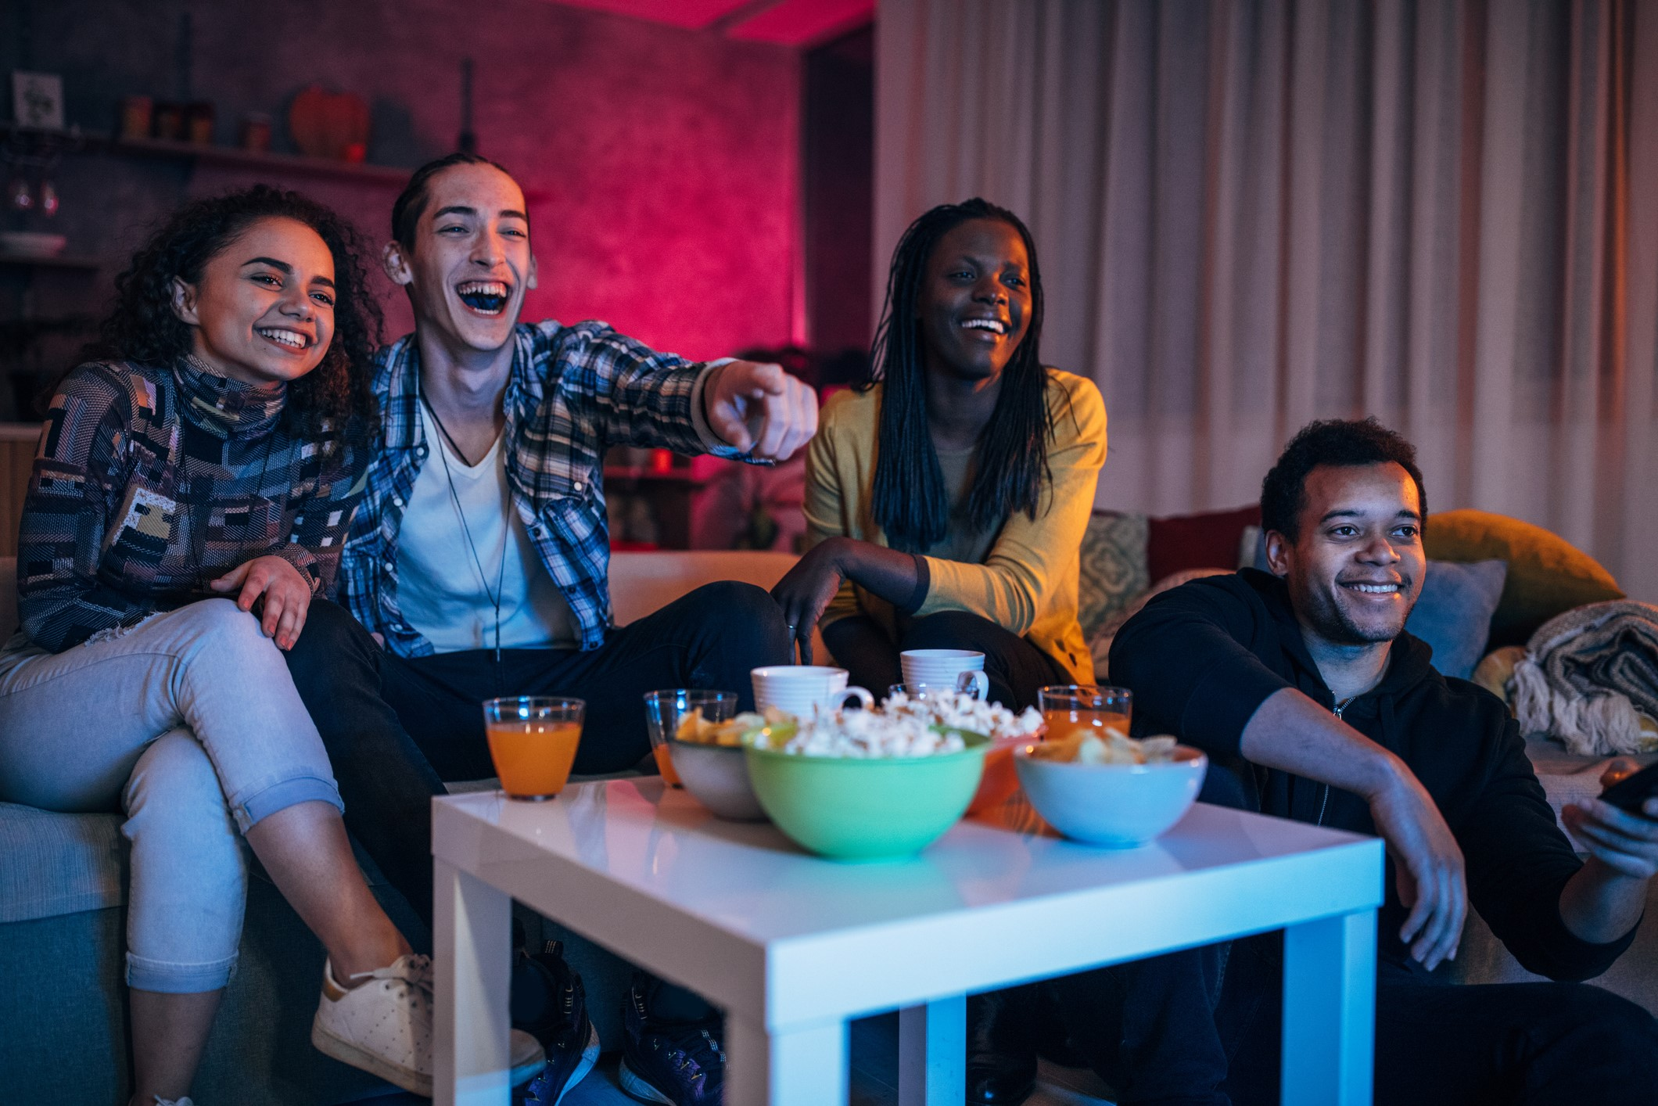

VIDEO ADVERTISING BUREAU - REPORT 2019
.................
TV Preferred
Understanding YouTube Enthusiasts’
Affinity For Video Content

Slide 2
Contents
1
Survey Overview
2
YouTube Enthusiasts Are Voracious Video Viewers Across Platforms
3
YouTube Enthusiasts’ Emotional Connection To TV Programming
4
Comparing Emotions & Behaviors: TV Programming vs. Original YouTube Videos
5
Parting Thoughts
6
Contact Information
2

Slide 3

The VAB Conducted A Custom Survey Quantifying The Emotional Attachment Between TV Programming & YouTube Content
Survey Methodology
The VAB commissioned Research Now to conduct the Program Engagement Survey fielded online in April 2018 with 1,000 Adult 18+ respondents surveyed.
Objectives
Primary: To understand the emotion viewers exhibit for ad-supported TV programs and how they express their attachment through their behaviors
Secondary: Compare their commitment to TV programming against how they engage with original YouTube content
Note: Ad-supported TV programs are defined as programs that are currently airing or originally aired on broadcast or cable TV, inclusive of all devices and methods of viewing (e.g. watching Breaking Bad on Netflix or catching up on recent episodes of This is Us on Hulu or viewing through network apps such as CBS All Access). All respondents live in a household that subscribes to a cable, telco or satellite TV service.
3

Slide 4

This Report Specifically Focuses On “YouTube Enthusiasts” –
Respondents Who Regularly Watch Original YouTube Content
Respondent Focus: “The YouTube Enthusiast”
YouTube Enthusiasts are respondents who watch original YouTube content 2x or more per month
  YouTube Original Content is defined as videos that were produced by an established YouTube personality that are only available on YouTube and do not appear on broadcast or cable TV. This does not include user generated videos (e.g. cat videos), professionally-produced music videos, or TV program content (e.g. clips from Late Night with Stephen Colbert)
  375 respondents (37.5%) identified themselves as YouTube Enthusiasts
4

Slide 5

“Emotions lead to action, while reason leads to conclusions.”
Neurologist, Donald B. Caine
Why are Emotions Important?
…They Drive Intention & Build Brands
Someone who is highly attached is
3x more likely to engage with the brand.
They are less price sensitive, go deeper into the product line and have a higher lifetime value to an advertiser.
5
Source: LEAP Media Investment

Slide 6

When It Comes To Video Consumption, It’s About “More” Not “Either/Or”
Naturally, the YouTube Enthusiast has an inherent affection towards the YouTube platform but that doesn’t mean they exclusively desire only digital-based, snackable, UGC content.
In fact, YouTube Enthusiasts are video addicts that are highly engaged with content across platforms including long-form, professionally-produced episodic programming from ad-supported TV.
When thinking about this segment, it’s important to understand that it’s not an “either/or” proposition between YouTube and TV but rather a desire for “more” content across platforms.
This report quantifies the ways the YouTube Enthusiast demonstrates their commitment, engagement and passion for TV programming as compared to all Adults. Then we compare this behavior to their engagement with original YouTube content.
The results may surprise you…
6

Slide 7

YouTube Enthusiasts: Topline Findings
They Are Voracious Video Viewers Across Platforms
They Are Emotionally Engaged With TV Programming
In addition to all the digital video they consume, including YouTube, their consumption of ad-supported TV is also on par with the average adult
Their deep emotional connection to TV motivates them to actively engage beyond the TV airings – they share and post video clips, follow actors on social media, read recaps, discuss with family & friends and buy goods and services related to what they see on TV
They Are More Committed To TV Programming Than To Original YouTube Content
Because of complex storylines and rich character development, they are more likely to prioritize and feel emotionally connected to TV programs and characters than to original YouTube content & YouTube personalities
7

Slide 8
YouTube Enthusiasts Are Voracious Video Viewers Across Platforms
They Are Voracious Video Viewers Across Platforms
They Are Emotionally Engaged With TV Programming
In addition to all the digital video they consume, including YouTube, their consumption of ad-supported TV is also on par with the average adult
Their deep emotional connection to TV motivates them to actively engage beyond the TV airings – they share and post video clips, follow actors on social media, read recaps, discuss with family & friends and buy goods and services related to what they see on TV
They Are More Committed To TV Programming Than To Original YouTube Content
Because of complex storylines and rich character development, they are more likely to prioritize and feel emotionally connected to TV programs and characters than to original YouTube content & YouTube personalities
8

Slide 9
YouTube Enthusiasts Are Voracious Video Viewers Who Watch Just As Much
Ad-Supported TV As The Average Adult
Hours Watched of Ad-Supported Cable/Broadcast TV Per Day
5+ Hours
50% Watch More Than 3 Hours/Day
49% Watch More Than 3 Hours/Day
4-5 Hours
3-4 Hours
2-3 Hours
50% Watch Less Than 3 Hours/Day
51% Watch Less Than 3 Hours/Day
1-2 Hours
Less Than 1 Hour
Source: VAB / Research Now “Program Engagement” Survey, April 2018. S3. On average, how much time do you spend watching broadcast (i.e. ABC, CBS, NBC, Fox) or Cable (i.e. ESPN, AMC, FX, CNN, TBS, HGTV, etc.) TV content in a given day? YouTube Enthusiasts = Respondents who watch original YouTube content 2x or more per month (375). Total Respondents=1,001. Numbers may exceed 100% due to rounding.
9

Slide 10


YouTube Enthusiasts Watch Their Favorite TV Programs Through A Variety Of Video Sources But Favor Ad-Supported Cable & Broadcast Over Any Other Platform
The 43% is most likely even higher specifically for ad-supported TV as it doesn’t take into account the Cable and Broadcast programming being watched on Hulu and other ad-supported streaming apps
On Ad-Supported Cable/Broadcast
On Netflix
On Amazon Prime
On Hulu
Streaming / On-Demand App / Provider (other than Netflix, Hulu & Amazon)
Other
Source: VAB / Research Now “Program Engagement” Survey, April 2018. Q11: Where do you watch the majority of your favorite TV programs? Check any that apply., YouTube Enthusiasts = Respondents who watch original YouTube content 2x or more per month (375). Total Respondents=1,001.
10

Slide 11
YouTube Enthusiasts Thrive On Conversation & Community With Others Which Is Why “Live” Viewing Is The Most Popular Way For Them To Watch Their Favorite TV Programs
Live as it airs
Time-shifted / through a DVR (another time, after it airs, delayed time)
Via a streaming service or OTT app (i.e. Netflix, Hulu, CBS All Access)
On Video-On-Demand (VOD) through a cable or set top box
Source: VAB / Research Now “Program Engagement” Survey, April 2018. Q12: How do you prefer to watch your favorite TV programs? Q13.5: Please rate how much you agree or disagree with the following statements. I like to watch my favorite TV programs with my friends / family. % of Respondents who agree-Top 2 Box (net). YouTube Enthusiasts = Respondents who watch original YouTube content 2x or more per month (375). Total Respondents=1,001.
11

Slide 12
YouTube Enthusiasts Are Emotionally Engaged With TV Programming
They Are Voracious Video Viewers Across Platforms
They Are Emotionally Engaged With TV Programming
In addition to all the digital video they consume, including YouTube, their consumption of ad-supported TV is also on par with the average adult
Their deep emotional connection to TV motivates them to actively engage beyond the TV airings – they share and post video clips, follow actors on social media, read recaps, discuss with family & friends and buy goods and services related to what they see on TV
They Are More Committed To TV Programming Than To Original YouTube Content
Because of complex storylines and rich character development, they are more likely to prioritize and feel emotionally connected to TV programs and characters than to original YouTube content & YouTube personalities
12

Slide 13



YouTube Enthusiasts Are More Likely Than The Average Adult To Experience Intense Emotions While Watching TV Due To Their Deep Connection With The Content
“Sat Through An Episode Of A TV Program In Anticipation / Worry About What's Going To Happen Next"
“Cried Because Of A Character's Death on a TV Program”
“Gotten Angry Or Upset About A Plot Twist On A TV Program”
YouTube Enthusiasts
63%
52%
47%
Adults 18+
59%
45%
43%
YouTube Enthusiasts
Adults 18+
Source: VAB / Research Now “Program Engagement” Survey, April 2018. TV: Q8: Which of the following statements are true for you? YouTube Enthusiasts = Respondents who watch original YouTube content 2x or more per month (375). Total Respondents=1,001.
13

Slide 14





This Emotional Bond With TV Programming Inspires Much Further Engagement
On Digital Platforms Before, During, And After The Program Airs
YouTube Enthusiasts
Adults 18+
“% Always or Frequently”
Follow Or 'Like' TV Programs/Characters/Actors On Facebook Or Instagram
64% / 29%
Go On Wikipedia To Learn More About A TV Show's Topic Or Actor/Character
62% / 34%
Share, Post Or Tweet Video Clips / Content About A TV Program
57% / 25%
Tweet About Or Read A Tweet About A TV Program
54% / 24%
Visit An Official Show Website
55% / 27%
YouTube Enthusiasts
Adults 18+
Source: VAB / Research Now “Program Engagement” Survey, April 2018. Q9: Please indicate how often you do the following. Respondents Answer = Always/Frequently.
YouTube Enthusiasts = Respondents who watch original YouTube content 2x or more per month (375). Total Respondents=1,001.
14

Slide 15
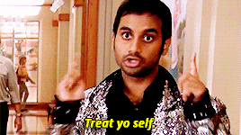
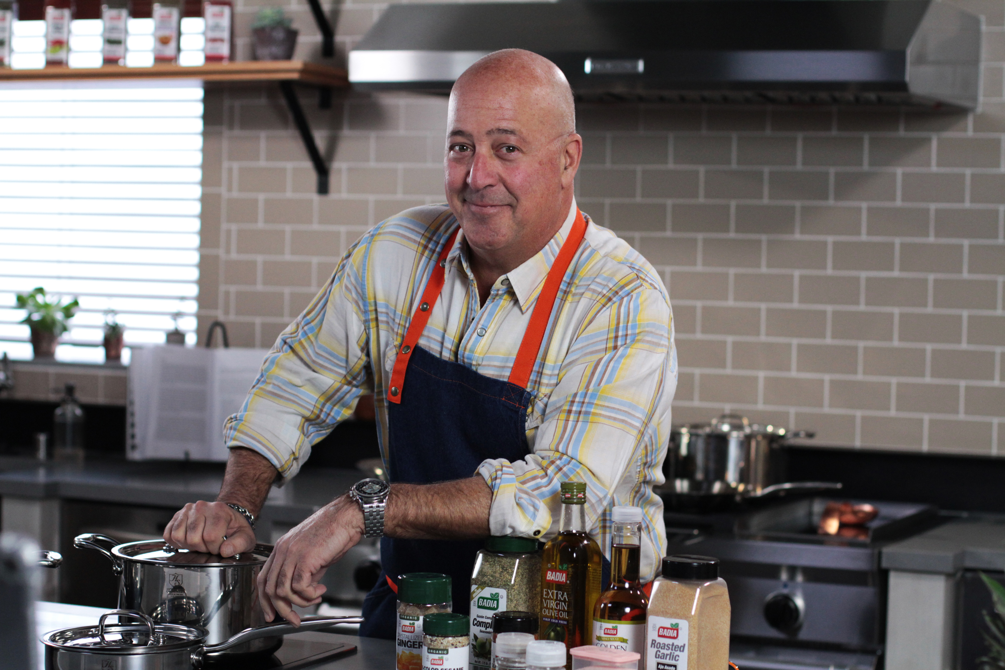

TV Programming Also Inspires YouTube Enthusiasts In Their Everyday Lives
“I have used a TV-related phrase in a conversation with family/friends/co-workers”
“I was inspired to make a food recipe based on a TV show or segment”
“I have dressed up like A TV character for Halloween or a themed party”
YouTube Enthusiasts
54%
52%
42%
Adults 18+
50%
41%
24%
YouTube Enthusiasts
Adults 18+
Source: VAB / Research Now “Program Engagement” Survey, April 2018. Q10: Which of the following statements are true for you? Check any that apply. YouTube Enthusiasts = Respondents who watch original YouTube content 2x or more per month (375). Total Respondents=1,001.
15

Slide 16



Most Importantly, This Deep Relationship YouTube Enthusiasts Have With TV Content Influences Their Purchasing Decisions
“I have eaten at a restaurant because it, or its chef / owner, was featured on a TV show”
“I have visited a location / vacationed at a place because it was featured on a TV show”
“Purchase a product I saw while watching a TV program (either a product I saw in an ad or in the actual program)”
49% / 37%
46% / 33%
56% / 25%
132 index vs. A18+
139 index vs. A18+
224 index vs. A18+
YouTube Enthusiasts
Adults 18+
Source: VAB / Research Now “Program Engagement” Survey, April 2018. Q9: Please indicate how often you do the following? Purchase a product I saw while watching a TV program (either a product I saw in an ad or in the actual program). Respondents Answer = Always/Frequently. Q10: Which of the following statements are true for you? Check any that apply. YouTube Enthusiasts = Respondents who watch original YouTube content 2x or more per month (375). Total Respondents=1,001.
16

Slide 17

In Terms of Their Favorite TV Programs, A Majority Of YouTube Enthusiasts Specifically Set Aside Some “Me Time” To Watch Every Episode
YouTube
Enthusiasts
Adults 18+
“I regularly set aside time in my busy schedule to watch my favorite TV programs”
70% / 62%
“I try to watch every new episode of my favorite TV programs”
79% / 76%
“Watching my favorite TV shows is my 'me-time‘”
77% / 69%
YouTube Enthusiasts
Adults 18+
Source: VAB / Research Now “Program Engagement” Survey, April 2018. Q13: Please rate how much you agree with the following statements. % of Respondents who agree-Top 2 Box (net); Q15: Which of the following statements are true for you? Check any that apply. YouTube Enthusiasts = Respondents who watch original YouTube content 2x or more per month (375). Total Respondents=1,001.
17

Slide 18
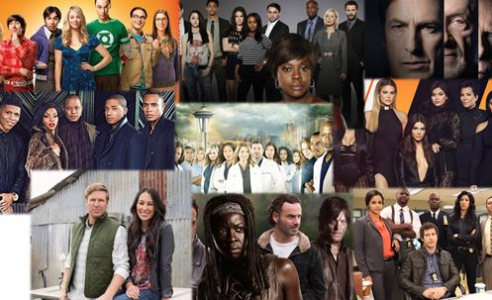
YouTube Enthusiasts Crave The Complex Storylines And Rich Character Development Of Their Favorite TV Programs
YouTube Enthusiasts are particularly drawn to the actors, characters, and plotlines of their favorite TV programs.
“I feel personally connected to the characters of my favorite TV programs”
“I have looked up the actors in the show to learn more about them ‘off the screen’ or to see what other shows/films they have been in”
“I have watched other shows or movies because an actor from one of my favorite TV programs was in it”
50% / 34%
59% / 52%
60% / 55%
YouTube Enthusiasts
Adults 18+
Source: VAB / Research Now “Program Engagement” Survey, April 2018. Q14: Keeping your favorite TV programs in mind, which of the following statements do you believe are true for you? Check any that apply. YouTube Enthusiasts = Respondents who watch original YouTube content 2x or more per month (375). Total Respondents=1,001.
18

Slide 19




Naturally, YouTube Enthusiasts Use YouTube As A Supplementary Destination To Get Even More TV-Related Content
Interestingly, they are 7% more likely to post comments on a TV show-related video clip
on YouTube than a video posted by their favorite YouTube personality.
“% Always or Frequently”
“I Watch Video Clips From TV Shows On YouTube”
“I Read Or Post Comments About TV Content On YouTube”
“I Subscribe To Or Have Watched TV Show’s YouTube Channel”
68% / 35%
59% / 27%
40% / 18%
YouTube Enthusiasts
Adults 18+
Source: VAB / Research Now “Program Engagement” Survey, April 2018. Q9: Please indicate how often you do the following. Respondents Answer = Always/Frequently. Q15: Which of the following statements are true for you? Check any that apply. Q20: How often do you typically post comments about a video on its YouTube page? YouTube Enthusiasts = Respondents who watch original YouTube content 2x or more per month (375). Total Respondents=1,001.
19

Slide 20




YouTube Enthusiasts Are More Passionate About TV Content Than The Average Adult
YouTube Enthusiast vs. Adults 18+ (Index)
Thirst For More
Actively Engaged
Index
Index
Visit A TV Show’s Official Website
204
Tweet About Or Read A Tweet About A TV Program
225
Follow Or “Like” TV Programs / Characters / Actors On Facebook Or Instagram
221
Share, Post Or Tweet Video Clips / Content About A TV Program
228
Go On Wikipedia To Learn More About A TV Show’s Topic Or Actor / Character
182
Discuss TV Programs With Friends, Family & Co-workers
167
Read Actor Or Cast News To Learn More About What’s Going On “Behind The Scenes”
157
Read Or Post Comments About TV Content On YouTube
219
Attached To The Characters & Programs
Inspired To Purchase
Index
Index
Feel Personally Connected To The Characters Of Their Favorite TV Programs
147
Have Purchased A Product I Saw While Watching A TV Program (either a TV ad or in the actual program)
224
Look Up The Actors In The Show To Learn More About Them ‘Off The Screen’ Or See What Other Shows / Films They have Been In
114
Visited A Location / Vacationed At A Place Because It Was Featured On A TV Show
139
Watch Other Shows Or Movies Because An Actor From One Of Their Favorite Programs Was In It
109
Eaten At A Restaurant Because It, Or Its Chef / Owner, Was Featured On A TV Show
132
Source: VAB / Research Now “Program Engagement” Survey, April 2018. YouTube Enthusiasts = Respondents who regularly watch original content on YouTube (375). Total Respondents=1,001.
20

Slide 21
YouTube Enthusiasts Are More Committed To TV Programming Than To Original YouTube Content
They Are Voracious Video Viewers Across Platforms
They Are Emotionally Engaged With TV Programming
In addition to all the digital video they consume, including YouTube, their consumption of ad-supported TV is also on par with the average adult
Their deep emotional connection to TV motivates them to actively engage beyond the TV airings – they share and post video clips, follow actors on social media, read recaps, discuss with family & friends and buy goods and services related to what they see on TV
They Are More Committed To TV Programming Than To Original YouTube Content
Because of complex storylines and rich character development, they are more likely to prioritize and feel emotionally connected to TV programs and characters than to original YouTube content & YouTube personalities
21

Slide 22











How We Define YouTube “Original Content”
  YouTube Original Content refers to videos that were produced by an established YouTube personality that are only available on YouTube and do not appear on broadcast or cable TV. This does not include user generated videos (e.g. cat videos), music videos, or TV program content (e.g. clips from Late Night with Stephen Colbert)
Examples Include:
Smosh
Jackie Aina
GoodMythicalMorning
PewDiePie
LauraInTheKitchen
Lele Pons
DudePerfect
KSI
JennaMarbles
PopularMMOs
22

Slide 23
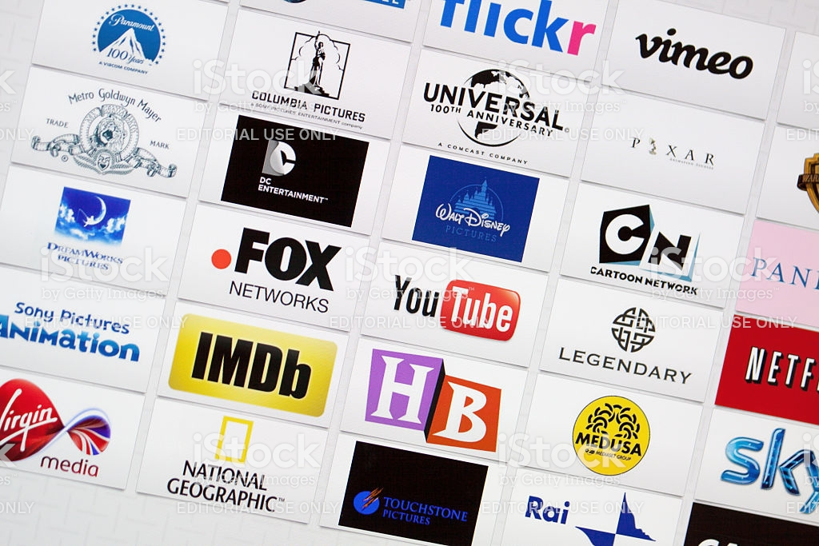


When Do YouTube Enthusiasts Prefer To Watch Content?
TV Programs
YouTube Originals
YouTube Enthusiasts don’t have the same sense of immediacy to watch original YouTube videos as they do with TV programming since the platform lacks the scale of conversation & community that ad-supported TV delivers
Source: VAB / Research Now “Program Engagement” Survey, April 2018. Q12: How do you prefer to watch your favorite TV programs? Q21: I watch new videos posted by my favorite YouTube Personality…; Time-shifted YouTube viewing includes viewing, within a few hours of posting, same day as posting, within a few days, within a few weeks, whenever I have time/don’t know. Base: YouTube Enthusiasts = Respondents who watch original YouTube content 2x or more per month (375).
23

Slide 24
YouTube Enthusiasts Are Video Addicts But They Are More Likely To Set Aside “Me Time” To Watch Their Favorite TV Show Than A Video From Their Favorite YouTube Personality
YouTube Enthusiasts
“I regularly set aside time in my busy schedule to watch my favorite TV programs”
“I regularly set aside time in my busy schedule to watch videos from my favorite YouTube personalities”
VS.
YouTube Enthusiasts Are Voracious Video Viewers And The YouTube Platform Complements Their TV Viewing Time
70%
64%
“I try to watch every new episode of my favorite TV programs
VS.
“I try to watch every new video posted by my favorite YouTube personality”
79%
70%
“Watching my favorite TV shows is my 'me-time‘”
VS.
“Watching my favorite YouTube personality is my 'me-time‘”
77%
72%
TV Programs
YouTube Original Videos
Source: VAB / Research Now “Program Engagement” Survey, April 2018. TV-Q13: Please rate how much you agree or disagree with the following statements; YouTube- Q18: Please rate how much you agree or disagree with the following statements. % of Respondents who agree-Top 2 Box (net). Base: YouTube Enthusiasts = Respondents who watch original YouTube content 2x or more per month (375).
24

Slide 25

YouTube Enthusiasts Have A Higher Emotional Engagement With TV Programs
Than They Do With Original YouTube Content
Emotional Response to TV Programs and YouTube Original Content
“Laughed Out Loud Because Of Something That Happened On A TV Program”
“Sat Through An Episode Of A TV Program In Anticipation / Worry About What's Going To Happen Next"
“Cried Because Of A Character's Death on a TV Program”
“Gotten Angry Or Upset About A Plot Twist On A TV Program”
70%
63%
52%
47%
“Laughed Out Loud Because Of Something That A YouTube Personality Did”
“Sat Through A Video Of A YouTube Personality In Anticipation / Worry About What's Going To Happen Next”
“Cried Because Of Something That Happened In A Video Of An Original YouTube Personality”
“Gotten Angry Or Upset About Something A YouTube Personality Did”
61%
43%
34%
34%
Source: VAB / Research Now “Program Engagement” Survey, April 2018. TV: Q8: Which of the following statements are true for you? YouTube: Q17: Which of the following statements are true for you? Check any that apply. Base: YouTube Enthusiasts = Respondents who watch original YouTube content 2x or more per month (375).
25

Slide 26

YouTube Enthusiasts Also Feel a Stronger Connection To Their Favorite TV Characters & Actors Than To Their Favorite YouTube Personalities
While YouTube personalities typically take center-stage on the platform, TV characters are more interesting to YouTube Enthusiasts because of their multifaceted complexity and involvement in intriguing storylines.
“I feel personally connected to the characters of my favorite TV programs”
“I have watched other shows or movies because an actor from one of my favorite TV programs was in it”
“I have looked up the actors in a TV program to learn more about them 'off the screen’”
50%
60%
59%
“I feel personally connected to my favorite YouTube personality”
“I have watched other videos, or video series, because my favorite YouTube personality was in it”
“I have looked up my favorite YouTube Personality to learn more about them 'off the screen’”
41%
48%
50%
Source: VAB / Research Now “Program Engagement” Survey, April 2018. TV: Q14: Keeping your favorite TV programs in mind, which of the following statements do you believe are true for you? YouTube: Q19: Keeping your favorite YouTube personalities in mind, which of the following statements do you believe are true for you? Check any that apply. Base: YouTube Enthusiasts = Respondents who watch original YouTube content 2x or more per month (375).
26

Slide 27

YouTube Enthusiasts Are Also More Likely To Be Advocates For Their
Favorite TV Programs Than For Their Favorite YouTube Personalities
“I discuss TV programs with friends, family, co-workers”
“I have tried to convince a friend to start watching my favorite TV program”
65%
50%
“I discuss new videos from my favorite YouTube personalities with friends, family, co-workers”
“I have tried to convince a friend to start watching my favorite YouTube personality”
60%
40%
“% After Every or Most Episodes / Video”
YouTube Enthusiasts
Adults 18+
Source: VAB / Research Now “Program Engagement” Survey, April 2018. TV - Q16: How often do you typically do the following after watching a new episode of one of your favorite TV programs? YouTube – Q20: How often do you typically do the following after watching a new video from your favorite YouTube personality? Respondents who answered “After every/most episodes”. TV - Q15: Which of the following statements are true for you? YouTube - Q19: which of the following statements do you believe are true for? Check any that apply. YouTube Enthusiasts = Respondents who watch original YouTube content 2x or more per month (375). Total Respondents=1,001.
27

Slide 28


Given Its Greater Emotional Engagement, It’s No Surprise That TV Is More Likely To Motivate Purchase Than Original YouTube Content Among YouTube Enthusiasts
YouTube Enthusiasts are 51% more likely to purchase a product that’s been shown or featured on ad-supported TV than they are to purchase a product featured in a video by their favorite YouTube personality
56%
37%
of YouTube Enthusiasts have purchased a product they saw while watching a TV program
(either a product I saw in an ad or in the actual program)
of YouTube Enthusiasts have purchased a product that their favorite YouTube personality has shown / featured during a video
Source: VAB / Research Now “Program Engagement” Survey, April 2018. TV: Q10: Which of the following statements are true for you? YouTube: Q19: Again, keeping your favorite YouTube personalities in mind, which of the following statements do you believe are true for you? Check any that apply. Base: YouTube Enthusiasts = Respondents who watch original YouTube content 2x or more per month (375).
28

Slide 29

While YouTube Enthusiasts Are Voracious Video Viewers Across Platforms,
They Are More Passionate About TV Programming Than Original YouTube Content
YouTube Enthusiasts: Ad-Supported TV vs. Original YouTube Content
(Index)
Emotionally Connected
Prioritization
Index
Index
Laughed Out Loud Because Of Something That Happened On A TV Program vs. Something A YouTube Personality Did
115
Regularly Set Aside Time In Their Schedule To Watch Their Favorite TV Programs vs. Videos From Their Favorite YouTube Personality
110
Cried Because Of A Character’s Death On A TV Program vs. Something That Happened In An Original YouTube Video
153
Try To Watch Every New Episode Of Their Favorite TV Program vs. New Video Posted By Their Favorite YouTube Personality
113
Gotten Angry Or Upset About A Plot Twist On A TV Program vs. Something A YouTube Personality Did
138
Watch TV Programs Live vs. As Soon As A YouTube Video Is Posted
185
Feel Personally Connected To The Characters Of Their Favorite TV Programs vs. Their Favorite YouTube Personality
157
Active Enthusiasts
Inspired To Purchase
Index
Index
Have Tried To Convince A Friend To Start Watching Their Favorite TV Program vs. YouTube Personality
125
Purchased a product they saw while watching a TV program (either a product I saw in an ad or in the actual program) vs. purchased a product that their favorite YouTube personality has shown / featured during a video
151
Read Online Recaps, Blogs Or Reviews About A TV Episode vs. Original YouTube Video
108
Source: VAB / Research Now “Program Engagement” Survey, April 2018. Base: YouTube Enthusiasts = Respondents who watch original YouTube content 2x or more per month (375 respondents).
29

Slide 30

Parting Thoughts
YouTube Enthusiasts are video addicts that are highly engaged with content across platforms. It’s not an “either/or” proposition between YouTube & TV but rather a desire for “more” content
Rich character development and gripping storylines result in deep emotional engagement in TV programming, more so than for original YouTube content
This deeper connection with TV inspires action – viewers hunt for more info on favorite actors and intriguing plotlines, discuss programs with friends and share on social media
Most importantly, this greater emotional engagement means that YouTube enthusiasts are 51% more likely to be inspired to purchase by TV programming than by original YouTube videos
30

Slide 31



Contact Us
Jason Wiese
SVP, Director of Strategic Insights
jasonw@thevab.com
Marianne Vita
VP, Strategic Insights
mariannev@thevab.com
Leah Montner-Dixon
Senior Multi-Platform Video Analyst leahm@thevab.com
VAB
@VideoAdBureau

