Slide 1


Slide 2
Contents
The Epicenter of American Society: TV IS Everywhere 3-7
No Platform Drives…
  Commerce 8-30
    TV’s Direct Economic Impact 9-10
    TV’s Influence On Other Industries 11-24
    TV-Related Consumer Product Lines & Extensions 25-28
    The “One-Day Outlier” For Commerce 29-30
  Communal Experiences 31-37
    In-Home Gatherings 32-34
    Out-Of-Home Get-Togethers 35-37
…Like TV’s Premium Video-At-Scale
Conclusion 38-39
Contact Information 40
VOL. I – commerce & communal experiences

Slide 3
The Epicenter of American Society: TV IS Everywhere
TV is everywhere…more specifically, Ad-Supported TV is everywhere.
It extends well beyond the living room and connected devices and into the physical world. It directly contributes billions to the economy, it impacts many industries outside of entertainment and, as further proof of its economic clout, it drives “real-life” communal experiences throughout the year.
It permeates popular culture by sparking trends, creating celebrities, inspiring viewers and igniting curiosity. It influences consumers in outlets beyond TV and it engages them through interactive experiences within local communities.
The physical presence of TV brands is complemented by constant virality within the digital realm. Whether it’s short clips from long-form programming, comedy sketches from a previous night’s show, user-generated memes or popularized phrases; the Internet is inundated with tailored TV content every day.
Furthermore, TV’s “scale of voice” can influence public policy while also changing people’s opinions and perceptions around hot button issues. It’s this same scale that drives awareness for social causes and raises millions in charitable donations through televised fundraisers and telethons.
Keep reading to see how TV brands live at the center of commerce & communal experiences…and stay tuned for the release of Volume II which shows how TV brands live at the center of culture & change.
VOL. I – commerce & communal experiences

Slide 4
No Platform Drives Commitment Like Ad-Supported TV’s Premium Video-At-Scale
Commerce
Communal Experiences
Culture
Celebrity
Curiosity
Change
Charity
-TV is a potent engine that drives the economy, both directly and indirectly
-TV’s scale drives awareness for social causes and raises millions through fundraising efforts
(Commerce)
-TV’s “big” content brings people together both in and out of the home
Ad-Supported TV Brands
(Change)
(Commerce)
-TV’s “scale of voice” has the ability to influence public policy and change opinions and perceptions around social issues
-TV is a driving force of popular culture in both the physical world and digital realm
(Change)
(Culture)
-TV has the innate ability to develop curious minds and “next level” engagement among viewers
-TV: It’s where stars are born!
(Culture)
(Culture)
VOL. I – commerce & communal experiences

Slide 5


























































































Hundreds Of Ad-Supported TV Shows Contribute To Commerce, Culture & Change…These Are Just A Few
And many, many more…
Vol. I – commerce & communal experiences
*The TV show logos above represents just some of the programs that are referenced within this report

Slide 6
In This First Report Of Our Two-Part Series, We Focus On How Ad-Supported TV Impacts Commerce, Both Directly & Indirectly
Commerce
Communal Experiences
Culture
Celebrity
Curiosity
Change
Charity
-TV is a potent engine that drives the economy, both directly and indirectly
-TV’s scale drives awareness for social causes and raises millions through fundraising efforts
(Commerce)
-TV’s “big” content brings people together both in and out of the home
Ad-Supported TV Brands
(Change)
(Commerce)
-TV’s “scale of voice” has the ability to influence public policy and change opinions and perceptions around social issues
-TV is a driving force of popular culture in both the physical world and digital realm
(Change)
(Culture)
-TV has the innate ability to develop curious minds and “next level” engagement among viewers
-TV: It’s where stars are born!
(Culture)
(Culture)
Vol. I – commerce & communal experiences

Slide 7
Before We Dive In Though, It’s Pop Quiz Time!
Theme: How TV Drives Commerce
Do you think you can answer these questions correctly? Don’t worry, all the information you need is provided in the following pages of this report.
In 2017, how much are ad-supported TV networks expected to directly contribute to the economy?__________
Which TV personality is credited with changing the way people travel by generating greater interest in local cuisines & experiences?__________________
Over the last decade, 30+ food & travel-related programs have featured this many restaurants & bars on their shows?_____________________
What reality TV star founded Skinnygirl Cocktails which she later sold for a reported $100MM?______________
In 2017, Kim Kardashian launched her own make-up line called KKW Beauty. How long did it take before it sold out?________________
Scrub Daddy had $100K sales prior to being featured on Shark Tank, what has its cumulative sales been in the four years since their pitch?____________________
According to DoorDash, how much did cupcake orders increase by on Election Night 2016?_________
On average, how much did consumers spend on food & related purchases during the Super Bowl?___________
How many chicken wings were estimated to have been eaten during Super Bowl 50?_______________
How many people were estimated to have missed work the Monday after Super Bowl 50?___________
Vol. I – commerce & communal experiences

Slide 8
No Platform Drives Commerce
Like TV’s Premium Video-At-Scale

Slide 9
The Film & Television Industry Is Not Just New York & Los Angeles, It’s An Industry That Employs Millions Across All 50 States
WA
ME
MT
ND
VT
MN
NH
$131 Billion contributed to the American Economy annually
OR
WI
NY
MA
SD
CT
ID
MI
RI
WY
PA
NJ
2 Million American Jobs in All 50 States
IA
NE
OH
MD
NV
IL
IN
DE
UT
WV
CO
VA
KS
MO
$51 Billion in wages for production & distribution jobs
CA
KY
TN
NC
OK
AR
SC
AZ
88,000 small businesses contribute to production
NM
MS
AL
GA
AK
LA
TX
FL
HI
Vol. I – commerce & communal experiences
Source: Motion Picture Association of America, data based on 2015 for film & television industry. https://www.mpaa.org/jobs-economy/

Slide 10
In 2017, Ad-Supported TV Networks Alone Will Contribute Over
$64 Billion To The Economy Through Programming Costs & Salaries
$69.5
$73.3
$68.0
$62.6
$64.1
Vol. I – commerce & communal experiences
Source: 2017 SNL Kagan, a division of S&P Global Market Intelligence, estimated. Ad-Supported TV networks include cable, broadcast and regional sports networks. “Salaries, Taxes & Other Expenses” are derived from companies’ Operating SG&A Expenses (selling, general, administration).

Slide 11
With It’s Ability To Influence Other Industries, Television’s Economic Impact Extends Well Beyond Entertainment
Three Examples Include The Following Categories:
            Home Improvement / Do-It-Yourself
            Food (Both At Home & Dining Out)
            Travel / Tourism
Vol. I – commerce & communal experiences

Slide 12






The Growth Of The Home Improvement Category Coincided With The Growth Of The “Home” TV Genre In The 2000’s
Popular “Home” TV Shows
(launch year)
Vol. I – commerce & communal experiences
Source: Home Improvement category reflects Home Depot & Lowe’s revenues, per SEC 10-K filings

Slide 13





Today, “Home” TV Show Hosts Have Become Stars While Extending Their Brands Well Beyond The TV Screen
Top “Home” TV Personalities
Jonathan & Drew Scott
Chip & Joanna Gaines
Nicole Curtis
Christina & Tarek El Moussa
Hilary Farr & David Visentin
Have 2 book deals - 1 book was on both the NYT & WSJ bestsellers lists
Have 2 books, as well as a magazine, The Magnolia Journal
Released a book which has made it onto the NYT & USA Today bestsellers lists
Have 1 pending book deal, put on hold due to divorce, which has made for tabloid fodder
Hilary runs her own company, Hilary Farr Design
Both Hilary & David have done stage-acting
Own Magnolia Market - which sells their home & garden collection - as well as a realty company
Has a line of home goods and apparel
Instagram Followers:
Jonathan-817,000
Drew- 811,000
Instagram Followers:
Christina-805,000
Tarek-218,000
Instagram Followers:
Hilary- 31,000
David- 5,000
212,000 Instagram Followers
Vol. I – commerce & communal experiences
Source: data as of September 2017

Slide 14






Culinary Is Another Category Whose Rise Coincided With The Rise Of Related TV Programming In The 2000’s
Popular “Food” TV Shows
(launch year)
vol. I – commerce & communal experiences
Source: Food category reflects Kroger’s, Albertson’s, Whole Foods, Stop & Shop, Publix revenues, per SEC 10-K filings

Slide 15
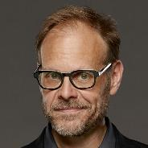


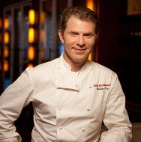

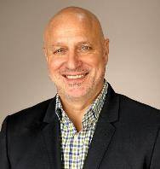
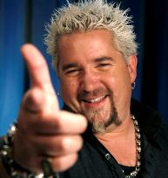
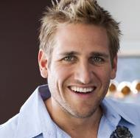
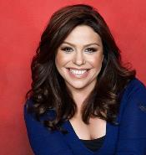
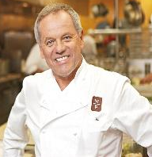


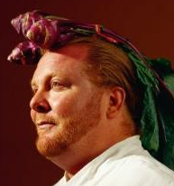
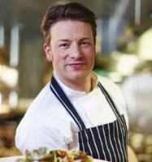
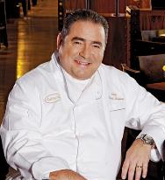

With The Rise Of The Food TV Genre Came The Creation
Of The “Celebrity Chef”
Alton Brown
Buddy Valastro
Gordon Ramsey
Bobby Flay
Martha Stewart
Tom Colicchio
Guy Fieri
Curtis Stone
Rachael Ray
Wolfgang Puck
Anthony Bourdain
Giada De Laurentiis
Mario Batali
Jamie Oliver
Emeril Lagasse
Vol. I – commerce & communal experiences

Slide 16
Celebrity Chefs Go Beyond Just Educating TV Viewers –
Most Have Restaurants And Sell Cookware, Books And Much More
Owns 26 restaurants located all over the world & has a line of cookware
Written 14 books & owns 5 restaurants & a line of sauces/rubs
Written 7 Books, 3 of which he illustrated himself
Owns Buddy V’s Ristorante in Las Vegas & Runs Buddy V’s Events
Owns a chain of cafes, has built a whole brand around own name
Alton Brown
Buddy Valastro
Gordon Ramsey
Bobby Flay
Martha Stewart
Owns 6 restaurants, has written 5 books & has lines of jewelry & cookware
Owns a line of cookware, endorsements range from mobile carriers to home décor, & wrote 27 books
Owns 20 restaurants with locations worldwide & has lines of cookware, food, wine, books etc.
Owns 7 restaurants & has written 3 cookbooks
Owns a line of cookware, 2 restaurants & has written 6 books
Tom Colicchio
Guy Fieri
Curtis Stone
Rachael Ray
Wolfgang Puck
Has written 13 books, fiction & nonfiction, & appeared in the film The Big Short
Has written 8 books, 2 of which have been on the NYT Best Sellers List & owns a restaurant in Las Vegas
Founded the Mario Batali Foundation, has 13 books, & owns 25 restaurants
Written 22 books, owns 4 restaurants & has a line of homeware
Founded the Emeril Lagasse Foundation, owns 13 restaurants, & has wide range of branded products & 29 books
Anthony Bourdain
Giada De Laurentiis
Mario Batali
Jamie Oliver
Emeril Lagasse
Vol. I – commerce & communal experiences

Slide 17
Certainly, The “Cult” Of Celebrity Chef Fandom Has Made Dining Out Cool Again Amongst Both Epicureans & Regular Diners
+48% vs. ‘00
Vol. I – commerce & communal experiences
Source: Bureau of Labor Statistics, Consumer Expenditure Survey. Reflects all consumers. Dining Out = “food away from home” as defined by the Bureau of Labor Statistics

Slide 18
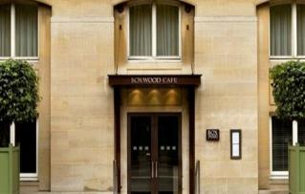
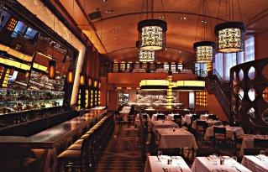
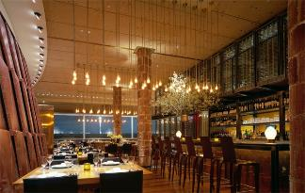
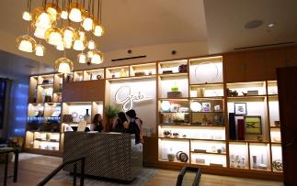
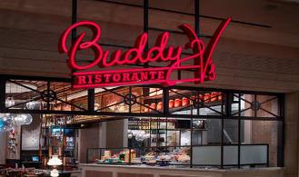
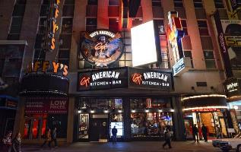
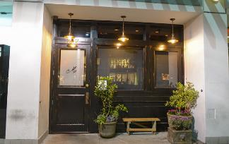
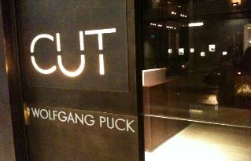
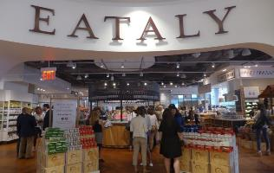
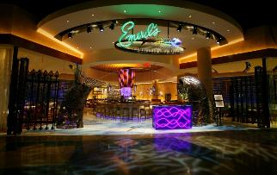
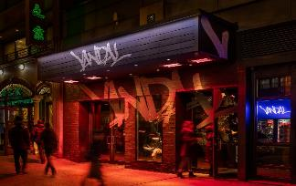
Through Their Restaurants, Celebrity TV Chefs Are “Physically” Well Represented Across The Country’s Biggest Cities
Gordon Ramsey
The Boxwood Café – West Hollywood
Bobby Flay
Bar Americain – New York City
Tom Colicchio
Craft – New York City, Los Angeles
Giada De Laurentiis
Giada – Las Vegas
Buddy Valastro
Buddy V’s Ristorante – Las Vegas
Guy Fieri
Guy’s American Kitchen & Bar
Curtis Stone
Maude – Beverly Hills
Wolfgang Puck
CUT – NYC, Beverly Hills, Las Vegas
Mario Batali
Eataly – New York City, Chicago
Emeril Lagasse
Emeril’s - New Orleans, Orlando
Chris Santos
Vandal – New York City
Vol. I – commerce & communal experiences

Slide 19

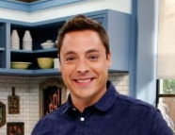
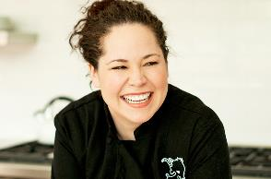








The Popularity Of Celebrity Chefs Has Driven The Success Of Reality Cooking Competitions & Created Untold Opportunities
Christine Hà
Having never studied cooking, she was the first blind contestant to compete in MasterChef and the winner of season 3. She took home a prize of $250K, as well as a cookbook deal . Her book Recipes from My Home Kitchen was published in 2013.
Jeff Mauro
The season 7 winner of Food Network Star, he is now the host of the Emmy-nominated show Sandwich King and co-hosts The Kitchen.
Stephanie Izard
The first female winner of Top Chef. Along with the $100K prize, she also received a $10K prize during the Top Chef Season 4 Reunion Special for being the Fan Favorite. She now owns 3 restaurants in Chicago, IL.
Cooking competition shows have become so popular with viewers, many have inspired spinoffs
Vol. I – commerce & communal experiences

Slide 20
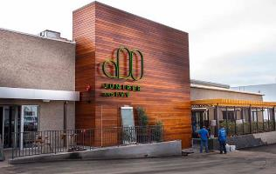
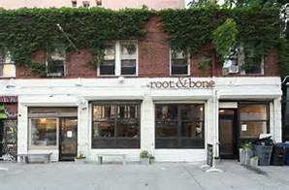
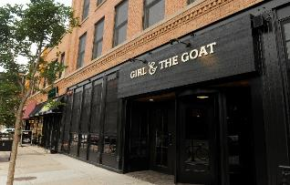
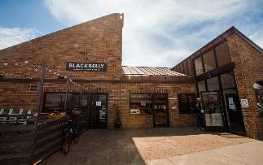
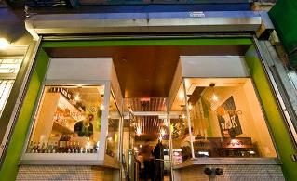
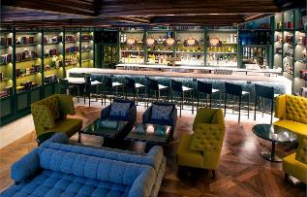
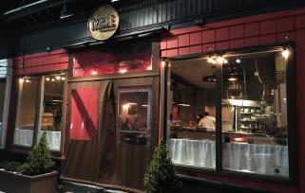
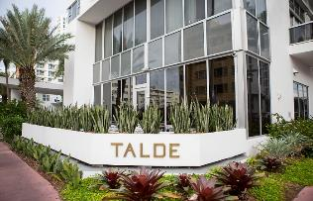
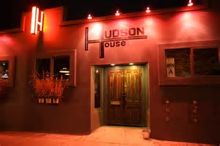
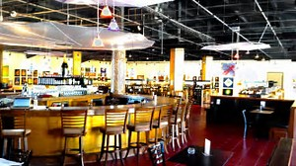
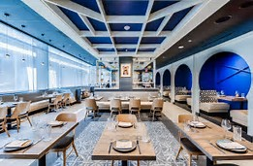
Beyond TV, Reality Cooking Show Contestants Have Been Making Their Mark Recently With Their Own Restaurants
Richard Blais – Top Chef Winner
Juniper And Ivy – San Diego
Jeff McInnis & Janine Booth –
Top Chef Contestants
Root & Bone – New York City
Stephanie Izard – Top Chef Contestant
The Girl & The Goat - Chicago
Hosea Rosenberg – Top Chef Winner
Blackbelly – Boulder, CO
Leah Cohen – Top Chef Contestant
Pig and Khao – New York City
Bryan & Michael Voltaggio – Top Chef Winner
Voltaggio Brothers – Oxon Hills, MD
Carl Dooley – Top Chef Contestant
The Cambridge Table – Cambridge, MA
Dale Talde – Top Chef Contestant
Talde – Miami, Brooklyn
Brooke Williamson – Top Chef Winner
Hudson House – Redondo Beach, CA
Frank Terzoli – Cutthroat Kitchen Winner
Fishmonger’s Market & Seafood Bar – San Diego
Mike Isabella – Top Chef Contestant
Arroz – Washington, DC
Vol. I – commerce & communal experiences

Slide 21
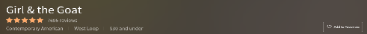

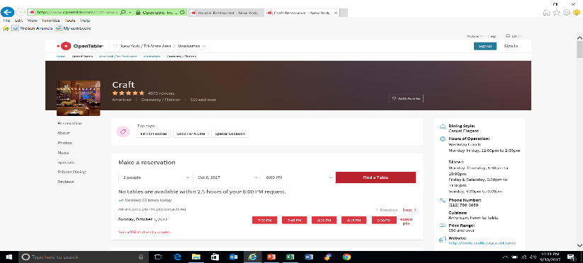
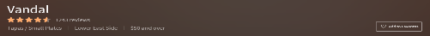

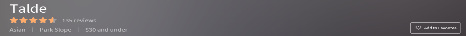

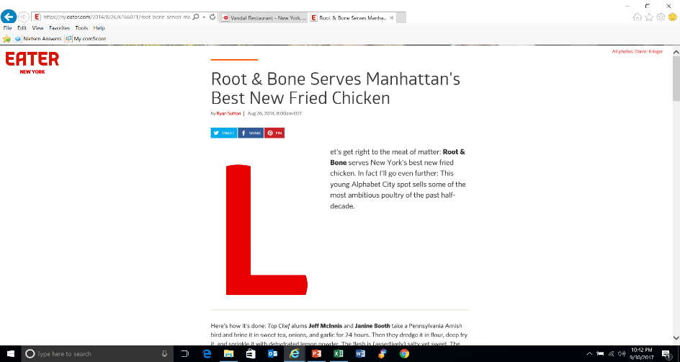
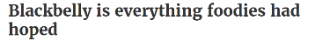
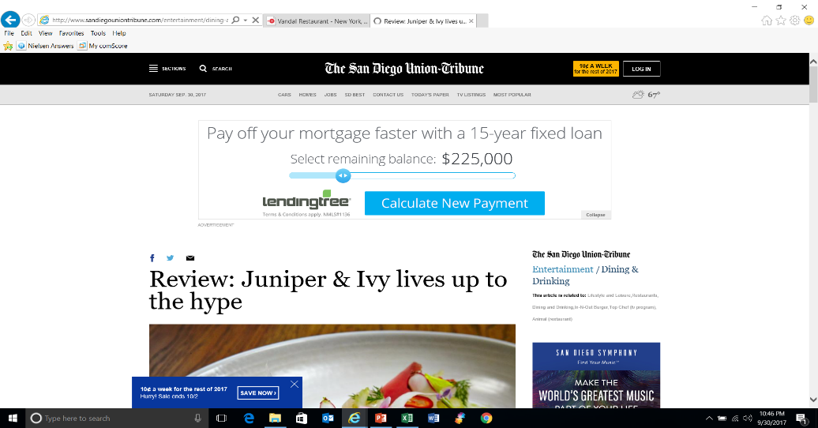
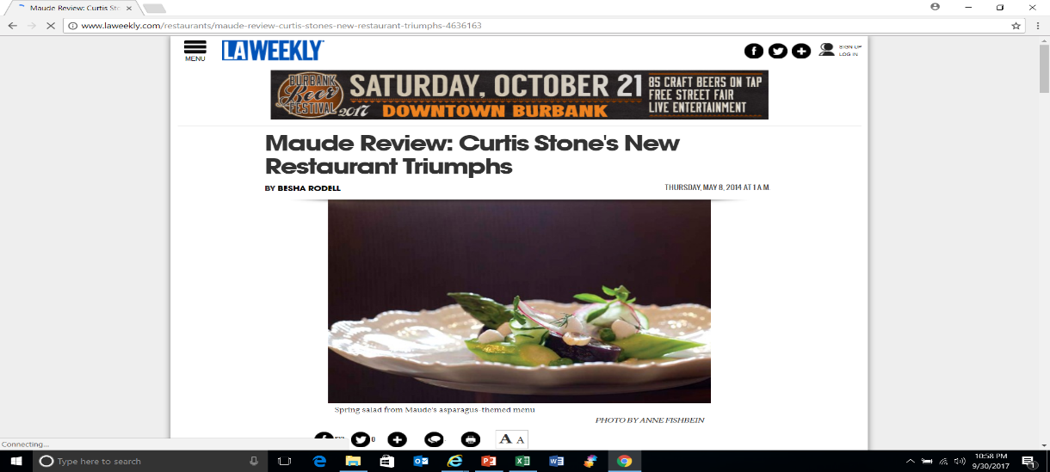
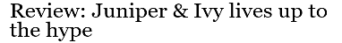

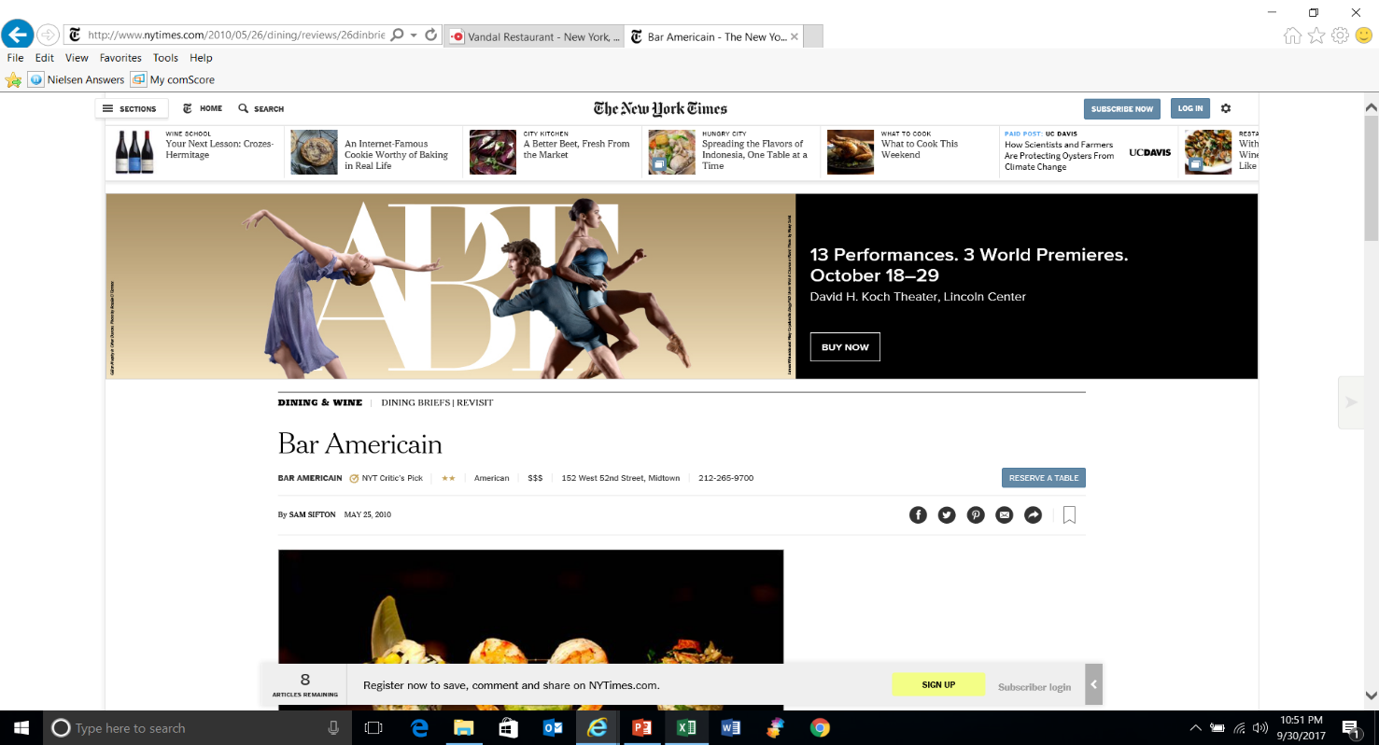
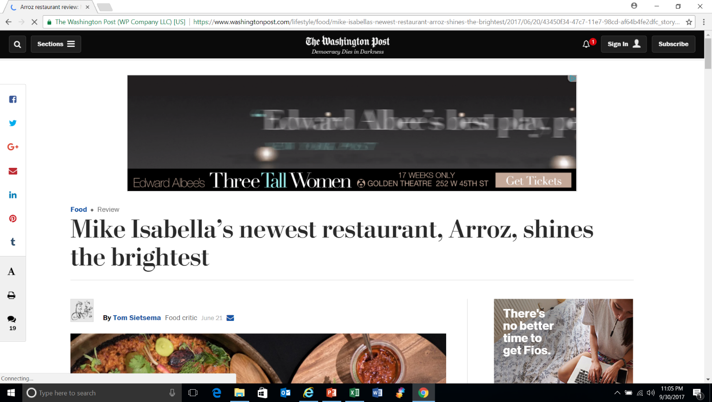

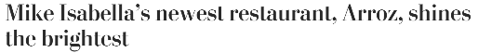
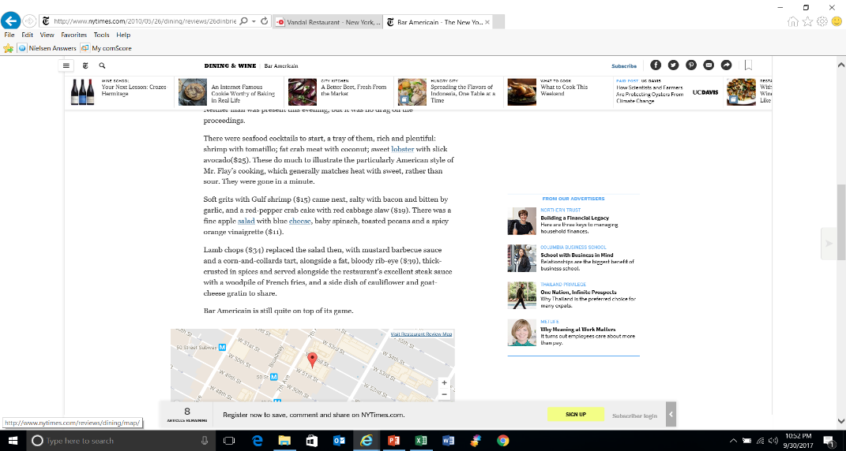
Celebrity TV Chefs & Reality Show Contestants Have Some
Of The Hottest, Critically Acclaimed, Most Liked Restaurants
Reservations For Desired Restaurants Are Consistently Hard To Get, Even A Week In Advance
Reality Show Contestants’ Restaurants Have Garnered High Ratings From Very Satisfied Customers
Many Restaurants Are Also Critically Acclaimed By Well-Respected Reviewers
Vol. I – commerce & communal experiences
Source: OpenTable rankings as of September 29th, 2017. Reservations were checked a week in advance for a Friday @ 8p seating.

Slide 22


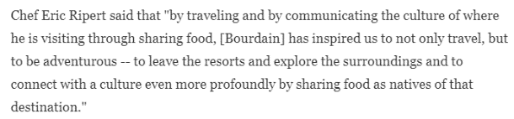


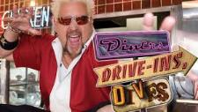
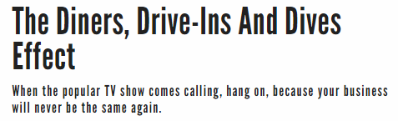





People’s Love Of Food Programming Is Also Changing The Way Many Travel & Helping Increase Local Tourism
TV personalities like Anthony Bourdain have been credited with changing the way people travel, generating more interest in delving into local cuisine and experiences
..And on a more localized level, Guy Fieri’s Diners, Drive-Ins & Dives has been cited with improving the sales of beloved restaurant gems throughout the country
The Smack Shack at Bar 1029, Minneapolis, MN
Casper & Runyon’s Nook, St. Paul, MN
Twisted Root Burger Co, Dallas, TX
Joe’s Gizzard City, Potterville, MI
Saw 300% Long-Term Increase in Business
Saw 100% Increase in Business shortly after airing
Saw 200% Increase in Business shortly after airing
Saw 40% Long-Term Increase in Business
Vol. I – commerce & communal experiences
Source: Minnesota Post, Livingston Daily, Dallas Observer

Slide 23








In Fact, Many Food Shows Have Gone Into Local Communities To Unveil Hidden Culinary & Libation Gems To The Masses
In the last several years, more than 30 ad-supported TV shows have featured over 4,000 local restaurants and bars as a part of their programming. Many of these establishments have boasted double- and triple-digit sales increases in the weeks following both their premiere date and re-run airings
Visited over 930 restaurants & bars in 45 states
Visited over 185 restaurants in 36 states
Rescued over 125 bars in 21 states
Visited over 180 restaurants in 29 states
Featured over 465 restaurants in 45 states
Visited over 40 restaurants in 11 states
Renovated 105 restaurants in 38 states
Featured 112 restaurants in 20 states
Vol. I – commerce & communal experiences
Source: tvfoodmaps.com

Slide 24




Along With Purely Food-Based TV Shows, Other Programming Has Also Influenced People’s Travel Plans
1in 5 (20%) Global Travelers Have Visited A Destination Because They Saw it On A TV Show
In the 48 hours after a Parts Unknown Sicily episode aired, U.S. online search activity for the three airports in Sicily soared 89% over the previous week
After the season 7 finale of The Bachelorette aired, which took place in Fiji, a major travel operator on the island saw a 250% increase in website page visits
The Seaside Heights Business Improvement District stated that they saw an estimated 20% increase in beach visitors during the run of Jersey Shore
After an episode of Bethenny Getting Married, where she and her husband honeymooned in St. Barts, a local reservations company stated that revenue from near term bookings were up 37%
Vol. I – commerce & communal experiences
Source: Parts Unknown = Priceline data from 2013. The Bachelorette = data from travel operator, Down Under Answers. Bethenny Getting Married = data from Wimco, a luxury vacation villa and hotel reservations company on St. Barts.

Slide 25
Furthermore, TV Impacts A Variety of Other Categories Through Consumer Product Extensions, Branded Lines Owned By TV Personalities And Support Of Entrepreneurs
Vol. I – commerce & communal experiences

Slide 26





























































































People Aren’t Just Watching TV Content, They’re Physically “Consuming” Their Favorite Brands As Well
From Babies to Boomers, people love to “badge” themselves with merchandise from TV shows
Vol. I – commerce & communal experiences

Slide 27









Additionally, Many TV Stars Are Branching Out With Their Own Product Lines Which Have Been Well-Received By Consumers
Bethenny Frankel, from The Real Housewives of New York City, founded Skinnygirl Cocktails which she later sold for an estimated $100 million
Jessica Alba, who gained fame by starring in Dark Angel, founded The Honest Company which sells safe, ethical, effective baby & household products. $300MM annual sales / $1.7B valuation
Earlier in 2017, Kim Kardashian launched her own make-up line called KKW Beauty. The 300K available kits were sold out in less than three hours, bringing in an estimated $14.4MM in sales.
Lauren Conrad, who gained fame from Laguna Beach & The Hills, has two fashion lines – LC Lauren Conrad & Paper Crown – with estimated annual sales of $60MM
Kylie Jenner, from Keeping Up With The Kardashians, launched Kylie Cosmetics in 2015 which has a reported $400MM in sales since inception
George Clooney, who achieved superstardom from ER, co-founded Casamigos Tequila which he later sold for an estimated $1 billion
Vol. I – commerce & communal experiences

Slide 28








Also, TV Shows Like “Shark Tank” Are Empowering & Enriching The Lives Of Everyday Inventors & Entrepreneurs
Examples of Shark Tank Success Stories
“Scrub Daddy”
“Squatty Potty”
“Tipsy Elves”
“Groovebook”
As of January 2017, the brand’s total revenues had surpassed $100MM in the four years since their pitch. Before Shark Tank, the company had $100K in sales
24 hours after the deal, the brand saw $1MM in sales. Revenues rose to $19MM in 2015 and 2016 sales were expected to top $30MM
The brand brought in $600K a year in sales before appearing on Shark Tank. In 2016, the company’s revenue was projected to hit $8MM
A gain of 50K subscribers shortly after the pitch then acquired by Shutterfly Inc. in 2014 for $14.5MM
“Ten Thirty One Productions”
“Buggy Beds”
“Wicked Good Cupcakes”
“Lollacup”
International growth across 23 countries with sales of more than $1.2MM after the pitch
Since the pitch, the company made $2MM and revenues are expected to grow to $2-3MM in 2017
In 2016, the company had $8MM in sales since the episode aired in season four
More than $1MM in sales since the pitch
Vol. I – commerce & communal experiences
Source: Investopedia, March 20th, 2017, supplemented with specific company data.

Slide 29
Ad-Supported TV Generates Billions For The U.S. Economy And Sells More Stuff For Brands Everyday…
…However, It Should Be Noted That On One Day A Year
– And Only One Day A Year –
TV Is The Primary Suspect In A Decrease Of Commerce…
At Least In The Workforce
Vol. I – commerce & communal experiences

Slide 30


The Day After The Super Bowl Is So Unproductive That People Have Started Petitions To Make It A National Holiday
In 2016, an estimated 1 in 10 Americans, or 16.5 Million, missed work the Monday after Super Bowl 50
64% of them (10.5MM) at least had the foresight to request the day off in advance
Another estimated 7.5 Million showed up late for work
Productivity drops precipitously with the country losing an estimated $1 Billion due to absences and tardiness
Thankfully, someone has tried to do something about this. Last year, Heinz Ketchup started a petition - now signed by 70,929 people - to make the Monday after the game a national holiday
Vol. I – commerce & communal experiences
Source: Workforce Institute; Change.org, *As of 9/15/17.

Slide 31
No Platform Drives Communal Experiences
Like TV’s Premium Video-At-Scale

Slide 32

Speaking Of The Super Bowl, The TV Event Is The Pinnacle For Get Togethers And Leads To Billions In Spending Each Year
Consumers watching the “big game” spend an average of $75 each on food and related purchases
Vol. I – commerce & communal experiences
Source: National Retail Federation Super Bowl Spending Survey, conducted by Prosper Insights & Analytics.

Slide 33












In Fact, You Can’t Search For A Major TV Event Without Finding Countless Articles On How To Plan The Perfect Viewing Party
Popular Party Planning Websites & Blogs Offer an Array of Viewing Party Planning Ideas
Vol. I – commerce & communal experiences

Slide 34






With All This In-Home Congregation, It’s No Surprise That Online Food Orders Surge During Major Televised Events
Super Bowl 2016 - 1.3 Billion Chicken Wings Were Eaten & GrubHub Orders for Wings Increased 97%.
2016 World Series Game 7- GrubHub Orders for Hot Dogs Increased 36% in Chicago.
2016 World Series Game 7 - Pizza Orders Increased by 67% on DoorDash.
Orders for Hot Dogs in Chicago Doubled & Orders Increased 12% Nationally on DoorDash.
Super Bowl 2016 - Pizza orders increased 37% compared to normal Sundays.
2016 World Series - Orders for Chicken Wings Grew 47% on DoorDash.
Election Night 2016 - Orders for Cupcakes Increased 79% on DoorDash.
Election Night 2016 - Alcohol Orders Almost Doubled on DoorDash & Postmates.
Election Night 2016 - Burgers Surged to Became the 2nd Most Popular Order on Postmates.
Vol. I – commerce & communal experiences
Source: Eater.com

Slide 35





Viewing Parties For Big TV Events Are Also A Popular Draw Outside The Home
Restaurants & bars attract viewers for anything from political debates to March Madness
Vol. I – commerce & communal experiences

Slide 36
These Out-Of-Home Social Gatherings Around TV Content Contribute Significantly To Program Rating Lifts As Well
Avg. Ratings Lift via OOH Viewing
+9%
+3%
+7%
Vol. I – commerce & communal experiences
Source: Nielsen’s “Content On The Go: A Look At Viewing Trends Among Out-Of-Home Consumers” Report, 8/4/17. P6+ Jan 2017 – May 2017. Out-of-home viewing includes locations such as bars, restaurants, gyms, airports, offices, etc. Read as: Viewers spent an additional 2 hours and 37 minutes watching Sports Events on TV outside of their home. Out-of-home viewing provided a 9% lift from the genre’s in-home viewership.

Slide 37






Thousands Join Large Viewing Parties Of Sporting Events & Celebrate In The Streets After Watching Their Team Win
Over 50K+ joined an outdoor viewing party in downtown Nashville for the Predators 2017 Stanley Cup Finals games
Over 40K+ fans gathered at a viewing party in Chicago’s Soldier Field to watch USA vs. Belgium in the Round 16 of the 2014 Men’s Soccer World Cup
Super Bowl viewing parties are held by large venues across the country every year, such as the Marquee Dayclub in Las Vegas
Fans celebrate in Kenmore Square after seeing the 2013 Boston Red Sox win their first World Series at home since 1918
Clevelanders celebrate after the Cavaliers win the 2016 NBA Finals and bring the city their first major sports championship in 52 years
Fans pack the streets outside of Wrigley Field immediately after watching the Chicago Cubs win their first World Series in 108 years
Vol. I – commerce & communal experiences

Slide 38
The Consumer Commitment To TV Content Is Unrivaled
No Platform Drives Commerce Like TV’s Premium Video-At-Scale…Why?
Unrivaled consumer commitment enables ad-supported TV networks to directly contribute $64 billion annually to the U.S. economy
TV content sparks trends across a variety of categories and ignites growth within other industries
From Babies to Boomers, people love to personally “badge” themselves with products related to TV brands and personalities
No Platform Drives Communal Experiences Like TV’s Premium Video-At-Scale…Why?
When people gather around a shared experience, both in and out of the home, they spend money…a lot of it.
Whether it’s the Super Bowl, an awards show or the season premiere of your favorite TV show, nothing delivers the scale of a shared experience like TV
There’s a near constant stream of “big” TV moments occurring throughout the year which elicits intense passion and drives incredible commitment from the viewing audience
Vol. I – commerce & communal experiences

Slide 39
Before You Go, Check To See How You Did On The Pop Quiz!
Remember, The Theme Is “How TV Drives Commerce”
With the answers below, you can wow your family, friends and co-workers with your TV knowledge at the next holiday family gathering, weekend get-together or Thursday night happy hour!
In 2017, how much are ad-supported TV networks expected to directly contribute to the economy? $64 Billion
Which TV personality is credited with changing the way people travel by generating greater interest in local cuisines & experiences? Anthony Bourdain
Over the last decade, 30+ food & travel-related programs have featured this many restaurants & bars on their shows? Approximately 4,000
What reality TV star founded Skinnygirl Cocktails which she later sold for a reported $100MM? Bethenny Frankel
In 2017, Kim Kardashian launched her own make-up line called KKW Beauty. How long did it take before it sold out? less than three hours
Scrub Daddy had $100K sales prior to being featured on Shark Tank, what has its cumulative sales been in the four years since their pitch? over $100 million
According to DoorDash, how much did cupcake orders increase by on Election Night 2016? +79%
On average, how much did consumers spend on food & related purchases during the Super Bowl? $75
How many chicken wings were estimated to have been eaten during Super Bowl 50? 1.3 billion
How many people were estimated to have missed work the Monday after Super Bowl 50? 16.5 million
Vol. I – commerce & communal experiences

Slide 40


For More Information Visit Us Online
TheVAB.com
Follow us:
@VideoAdBureau
Like us:
facebook.com/VideoAdvertisingBureau

