Slide 1






TV Means Business
How Premium Video Drives Sales in the Pharmaceutical Category

Slide 2
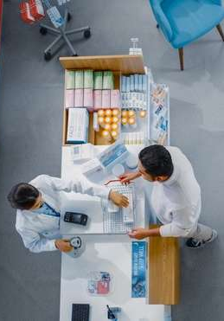
TV drives discovery and education which results in real sales impact for brands
Welcome to our new attribution series entitled ‘TV Means Business’ where we explore the impact of multiscreen TV advertising on business’s most important KPI: sales.
For our inaugural analysis, we examined the direct-to-consumer pharmaceutical category by analyzing the TV investment and full-funnel brand metrics of 17 major TV advertisers over a four-year time period (2021- 2024).
As a companion to our ‘Dedicated to Your Good Health’ guide released earlier this year, this report explores how TV investment by pharma brands drives ‘mid-funnel’ results like increased branded online search and website traffic which, in turn, has a direct and positive impact on sales (i.e., helping more patients get the remedies they need to treat their ailments).
Additionally, on the next page we’ve developed a framework for our analysis that will be similarly used in the future as we explore the impact of multiscreen TV advertising across additional categories.
This information is exclusively provided to VAB members and qualified marketers.
PAGE 2

Slide 3




Analysis Framework: How TV drives sales for the Direct-to-Consumer (DTC) Pharmaceutical category
1
2
3
4
Category
Brief
Attribution Analysis Methodology
Mid-Funnel Results
Sales
Impact
This information is exclusively provided to VAB members and qualified marketers.
PAGE 3

Slide 4

1
Category Brief: Pharmaceutical
People of all ages are more likely to get information on treatment remedies from TV ads and will act on them

Slide 5
Over 200 million U.S. adults currently suffer, or have recently suffered, from some sort of medical ailment
Have/Had an Ailment* in the last 12 months
Adults 18+
in millions
+16.4 MM
(+9%)
vs. 2021
78%
of adults 18+ are currently suffering a medical ailment, or 200 million adults
%
of A18+ pop
73%
76%
77%
78%
Source: VAB analysis of MRI-Simmons, Spring USA Doublebase Studies: 2021, 2022, 2023 & 2024, Adults 18+. *See appendix (page 54) for a full list of ailments that are included in this universe. Learn more about how TV drives discovery & encourages education in the pharma DTC category in ‘Dedicated to Your Good Health’
This information is exclusively provided to VAB members and qualified marketers.
PAGE 5

Slide 6



Adults actively research prescription remedies, they find them to be effective and believe that medicine has improved the quality of their lives
Health Attitudes
% any agree
‘I research treatment options on my own before asking my doctor about them’
‘Prescription drugs are more effective than over-the-counter remedies’
‘Medication has improved
the quality of my life’
P18+
60%
57%
67%
P18-49
61%
53%
61%
P50+
58%
62%
75%
Source: VAB analysis of MRI-Simmons, Spring USA Doublebase Study 2024. Any agree = agree completely or somewhat agree. Learn more about how TV drives discovery & encourages education in the pharma DTC category in ‘Dedicated to Your Good Health’
This information is exclusively provided to VAB members and qualified marketers.
PAGE 6

Slide 7




Adults of all ages are much more likely to get information on treatment remedies from pharma TV ads than any other media
How did you obtain information about an ailment or prescription drug?
Media platforms only
Adults were much more likely to get remedy information from TV ads than any other media
TV Ads vs…
Adults 18+
Adults 18-49
Adults 50+
5x
more likely than magazine ads
5x
more likely than magazine ads
4x
more likely than magazine ads
Magazine Ads
Brochures / Direct Mail
3x
more likely than direct mail
4x
more likely than direct mail
2x
more likely than direct mail
Social Media
2x
more likely than social media
2x
more likely than social media
2x
more likely than social media
Websites / Apps*
+47%
more likely than websites/apps
+51%
more likely than websites/apps
+43%
more likely than websites/apps
Source: VAB analysis of MRI-Simmons, Spring USA Doublebase Study 2024, P18+ Study Universe. Statement based on ‘in last 12 months.’ *excludes health information-related websites/apps.
This information is exclusively provided to VAB members and qualified marketers.
PAGE 7

Slide 8
TV ads also specifically drive patients to take actions during their ‘treatment journey’ as they seek out remedies to improve their health
‘Heavy’ TV Viewers vs. Adults 18+
Actions taken in the last 12 months after seeing a healthcare ad
39%
+17%
more likely to have…
+21%
more likely to have…
Consulted a pharmacist
Visited a product or drug website
of ‘heavy’ TV viewers have taken an action after seeing a healthcare ad
(115 index vs. average adult 18+)
+56%
more likely to have…
+29%
more likely to have…
Discussed an ad with their doctor
Asked their doctor to prescribe a specific drug
Source: VAB analysis of MRI-Simmons, Spring USA Doublebase Study 2024, P18+ Study Universe. *Prescription remedy includes both branded and generic remedies. ‘Heavy’ TV Viewer = Top 1 (Heavy) TV Quintile, includes men who watch 47.5+ hours weekly and women who watch 49.5+ hours weekly. Learn more about how TV drives discovery & encourages education in the pharma DTC category in ‘Dedicated to Your Good Health’
This information is exclusively provided to VAB members and qualified marketers.
PAGE 8

Slide 9
2
Attribution Analysis Methodology
We examined 17 major Pharma brands to quantify
TV’s impact across a patient’s path to treatment

Slide 10

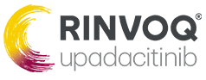
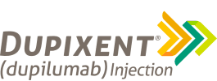
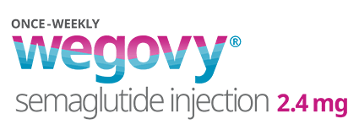

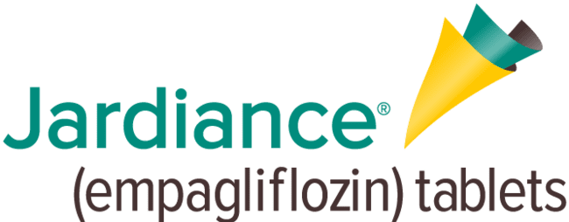

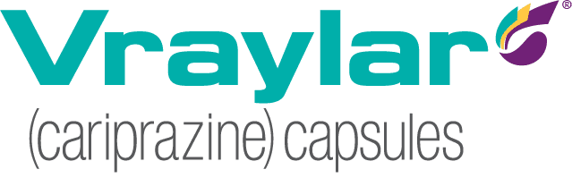
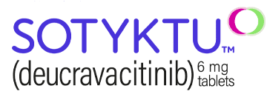
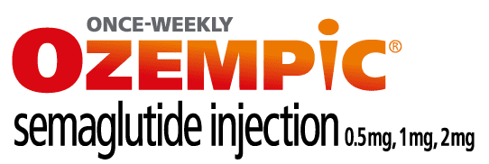


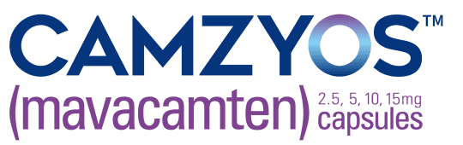

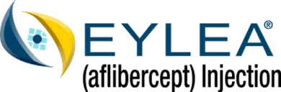
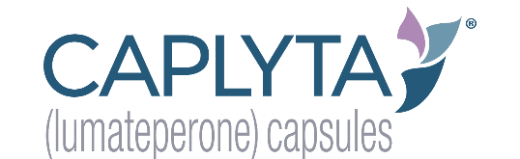

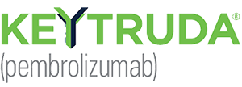
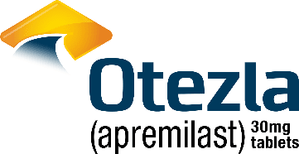

In 2024, 55% of the $7 billion in Pharma TV advertising was from 20 brands that offer remedies to mostly combat serious, invasive diseases
Top 20 Prescription Remedy Brands by TV Investment Spend
CY 2024
Crohn’s Disease / Psoriasis / Ulcerative Colitis
Rheumatoid Arthritis Ulcerative Colitis / Eczema
Depression / Alzheimer’s
Psoriasis /
Ulcerative Colitis
Eczema / Asthma
Obesity
Diabetes
($501.5 MM)
($466.7 MM)
($389.1 MM)
($362.9 MM)
($272.7 MM)
($184.5 MM)
($163.5 MM)
Depression / Bipolar Disorder
Psoriasis
Diabetes
COPD
RSV
HCM
Migraines / Wrinkles
($155.7 MM)
($149.3 MM)
($143.1 MM)
($133.1 MM)
($130.7 MM)
($114.3 MM)
($106.3 MM)
AMD
Bipolar Disorder
Tardive Dyskinesia
Cancer
Psoriasis
Menopause
($104.1 MM)
($99.1 MM)
($97.3 MM)
($97.1 MM)
($96.5 MM)
($95.0 MM)
Source: VAB analysis of Nielsen Ad Intel data, calendar year 2024. TV media includes Cable TV, Network TV, Spanish Language Cable TV, Spanish Language Network TV, Spot TV, Syndication TV; excludes promos and PSAs. Pharma represents ‘Pharmaceutical Houses’ sub-group category. COPD = Chronic Obstructive Pulmonary Disease; AMD = Age-related macular degeneration; RSV = Respiratory syncytial virus; HCM = Hypertrophic cardiomyopathy. Diabetes TV spending is specifically from Type 2 remedies; Cancer TV spending includes a mix of melanoma, lung, prostate, break head and neck cancer remedies. Learn more about how TV drives discovery & encourages education in the pharma DTC category in ‘Dedicated to Your Good Health’
This information is exclusively provided to VAB members and qualified marketers.
PAGE 10

Slide 11
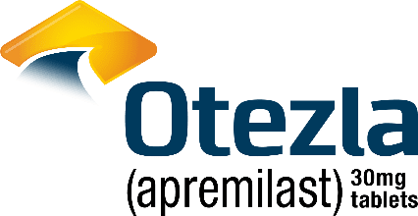




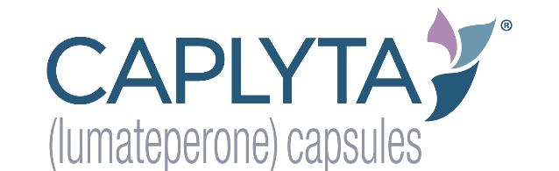


Of those 20 brands, 17 have publicly available revenue data which enabled us to create an analysis that correlates TV spend with full-funnel results
Brand Selection Methodology
17 Pharmaceutical DTC Brands Analyzed
Brands that were Top 20 Prescription Remedy TV Spenders in CY 2024
  These brands were also identified in our ‘Dedicated to Your Good Health’ report
&
Brands That Are Also Owned by a Publicly Traded Parent Company
  To understand pharma brand revenues figures, we utilize the publicly reported annual U.S. SEC filings (10-Ks, etc.)
17 Pharmaceutical Brands
included in this analysis
Source: VAB analysis of Nielsen Ad Intel data, calendar year 2024. TV media includes Cable TV, Network TV, Spanish Language Cable TV, Spanish Language Network TV, Spot TV, Syndication TV; excludes promos and PSAs. Pharma represents ‘Pharmaceutical Houses’ sub-group category.
This information is exclusively provided to VAB members and qualified marketers.
PAGE 11

Slide 12
To quantify the measurable impact that TV advertising has on Pharma brands, we analyzed branded online search, website traffic and sales
Outcomes Metrics by Purchase Funnel Stage
Analysis Methodology
Online Searches
Using Google Trends we compared the relative volume, quantified by the search index, of searches for Pharma brands before and after their TV launch.
Website Visitors
We analyzed website traffic data between July 2021 - June 2025 through Comscore to compare monthly unique visitors for each brands’ measured website before and after their TV launch.
Brand Revenue
Utilizing annual SEC filings (forms 10-K & 20-F) of Pharmaceutical houses that are publicly traded on major U.S. stock exchanges, we analyzed the brand level U.S. sales revenue between 2021 - 2024.
Awareness
Consideration
Online Searches
Intent
Website Visitors
Sales
Brand Revenue
Note: Form 10-K is an annual financial report filed by publicly traded companies with the U.S. Securities and Exchange Commission (SEC) that details their financial performance and business operations. Form 20-F is an annual financial report filed with the SEC by foreign private issuers that have securities listed on a U.S. stock exchange
This information is exclusively provided to VAB members and qualified marketers.
PAGE 12

Slide 13
3
Mid-Funnel Results: Pharmaceutical
Brands
TV ads drive discovery and education through increased branded online search and website visits
How to read the first charts in this section:
Google Search Trend Index = represents search interest relative to the highest point during a specific time period for a given region, a value of 100 is the peak popularity for the term, a value of 50 means that the term is half as popular.

Slide 14
Consideration
Ozempic: This treatment for diabetes more than doubled their branded online search queries when they launched their first TV campaign
Ozempic: Weekly Google Search Trends Index
Weeks of 12/3/17 – 8/5/18
2.4x
TV launch vs. prior week
7 months between FDA approval and TV launch
This Chart Plots:
The level of relative weekly Google search activity (for Ozempic) prior to its high point in search activity (the spike at the end of TV launch week)
Level of Ozempic search activity at the end of TV launch week
(100 index)
Level of search activity just before 7/29 TV campaign launch began
(42 index)
TV Launch: 7/29/18
Source: VAB analysis of Google Trends, United States only, All Categories, Web Search, weeks of 12/3/17 – 8/5/18. Google Search Index represents search interest relative to the highest point on the chart for the given region and time period, a value of 100 is the peak popularity for the term, a value of 50 means that the term is half as popular. VAB analysis of Nielsen Ad Intel, TV launch month is based on the first activity reported across national cable TV, broadcast TV, Spanish language cable TV, Spanish language broadcast TV, streaking TV between January 2015 – December 2024 (calendar months). Note: Light blue line marks the first day of TV spending for each brand.
This information is exclusively provided to VAB members and qualified marketers.
PAGE 14

Slide 15
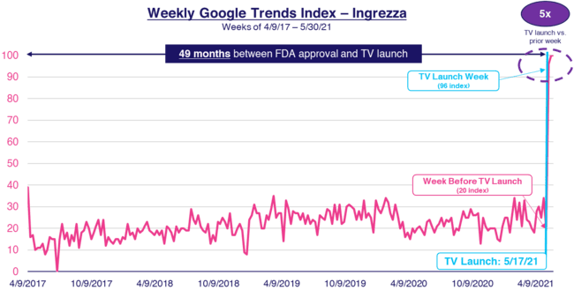
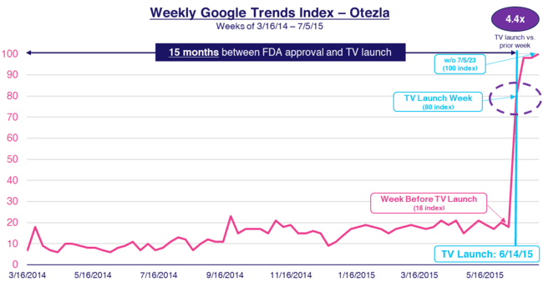

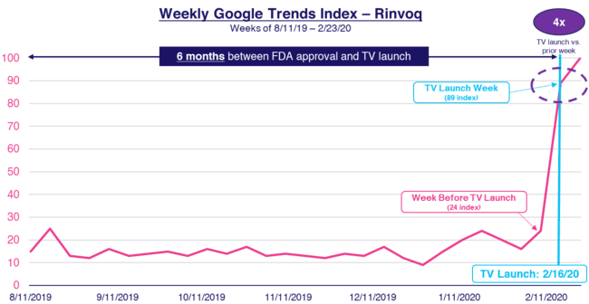
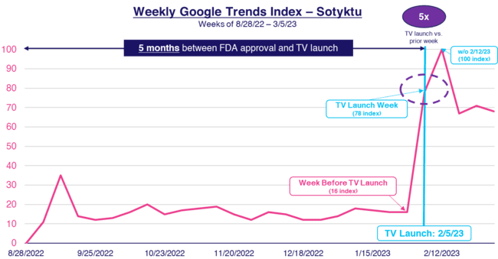
Consideration
First-time TV campaigns drove an ‘immediate spike’ in online search for brands, which was seen consistently across our analysis
These spikes in search occurred regardless of when brands launched TV after FDA approval, and presumably after search & social campaigns began for many brands
Pharma DTC TV Advertisers - Weekly Google Trends Index
FDA Approval Date through TV Campaign Launch
(Tardive Dyskinesia)
(Psoriasis)
49 months between FDA approval and TV launch
15 months between FDA approval and TV launch
(Rheumatoid Arthritis
Ulcerative Colitis / Eczema)
(Psoriasis)
7 months between FDA approval and TV launch
5 months between FDA approval and TV launch
Source: VAB analysis of Google Trends, United States only, branded web search. Time period for each brand is based on their FDA approval date through TV campaign launch. Google Search Index represents search interest relative to the highest point on the chart for the given region and time period, a value of 100 is the peak popularity for the term, a value of 50 means that the term is half as popular. VAB analysis of Nielsen Ad Intel, TV spend includes national cable TV, broadcast TV, Spanish language cable TV, Spanish language broadcast TV, January 2015 – December 2024 (calendar months); Note: Light blue line marks the first day of TV spending for each brand.
This information is exclusively provided to VAB members and qualified marketers.
PAGE 15

Slide 16
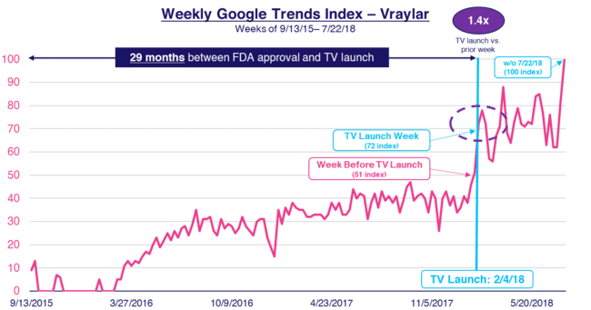
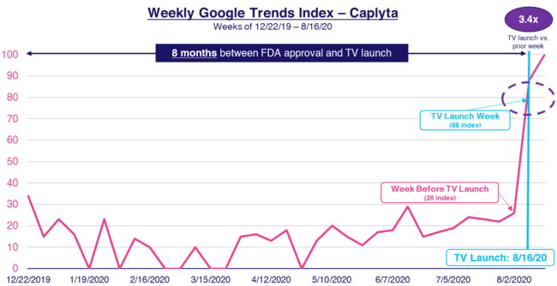
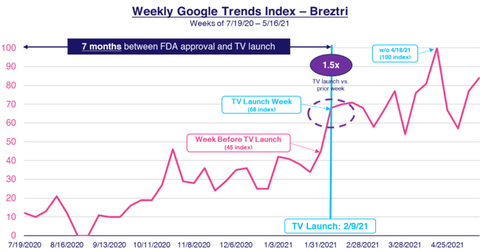
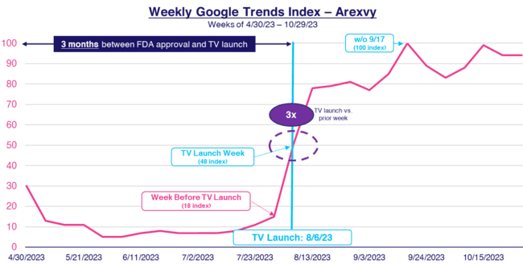

Consideration
A sustained TV advertising presence also drove steady growth in online searches for brands after the initial campaign launch
Pharma DTC TV Advertisers - Weekly Google Trends Index
FDA Approval Date through TV Campaign Launch
(Depression /
Bipolar Disorder)
(Bipolar Disorder)
29 months between FDA approval and TV launch
8 months between FDA approval and TV launch
(Chronic Obstructive Pulmonary Disease)
(Respiratory syncytial virus)
7 months between FDA approval and TV launch
3 months between FDA approval and TV launch
Source: VAB analysis of Google Trends, United States only, branded web search. Time period for each brand is based on their FDA approval date through TV campaign launch. Google Search Index represents search interest relative to the highest point on the chart for the given region and time period, a value of 100 is the peak popularity for the term, a value of 50 means that the term is half as popular. VAB analysis of Nielsen Ad Intel, TV spend includes national cable TV, broadcast TV, Spanish language cable TV, Spanish language broadcast TV, January 2015 – December 2024 (calendar months); Note: Light blue line marks the first day of TV spending for each brand.
This information is exclusively provided to VAB members and qualified marketers.
PAGE 16

Slide 17


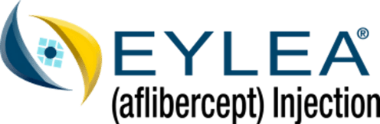

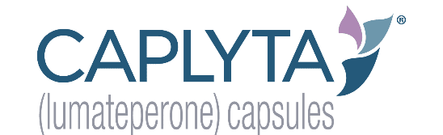

Consideration
The impact of TV is evident as 14 of the 16 Pharma advertisers saw their highest branded search volume occur once their TV campaign launched
16 Pharmaceutical DTC Brands Analyzed*
88%
of the 16 Pharmaceutical TV advertisers* saw their highest
brand search volume once
their TV campaign launched
Source: VAB analysis of Google Trends, United States only, branded web search. Google Search Index represents search interest relative to the highest point on the chart for the given region and time period. Note: Time period for each brand is their FDA approval date through 7/31/25. VAB analysis of Nielsen Ad Intel, TV activity based on reported spending across national cable TV, broadcast TV, Spanish language cable TV, Spanish language broadcast TV, January 2015 – December 2024 (calendar months). Analysis reflects 14 out of 16 brands with the highest brand search volume after they launched in TV. *Excludes Botox as their first TV ad aired in 2002, before Google Trends data began in 2004.
This information is exclusively provided to VAB members and qualified marketers.
PAGE 17

Slide 18



Intent
Greater online search led to outsized double-digit lifts in website traffic, especially as pharma brands increased their investment in TV
The 8 pharma brands included in this website traffic analysis reflect those brands whose websites were measured by Comscore between July 2021 – June 2025
Measured Website Traffic & TV Spend Analysis
8 Pharmaceutical DTC Brand Average
Jul ‘21 – Jun ’23
monthly average
Jul ‘23 – Jun ’25
monthly average
% Change
# Change
8 Pharmaceutical Brands Analyzed*
Unique Website Visitors
(monthly average)
222K
328K
+47%
+106K
U.S. TV Spend
(monthly average)
$13.1MM
$16.5MM
+26%
+$3.4MM
Source: VAB analysis of Comscore mediametrix multiplatform media trend data, P18+. July 2021 – June 2025 (calendar months), figures are based on monthly averages for the 8 brands analyzed. VAB analysis of Nielsen Ad Intel, national cable TV, national broadcast TV, Spanish language broadcast TV, Spanish language cable TV, spot TV or syndication TV. July 2021 – June 2025 (calendar months). *Brands included had measured website traffic on their branded websites during the July 2021 – June 2025 time period.
This information is exclusively provided to VAB members and qualified marketers.
PAGE 18

Slide 19
4
Sales Impact: Pharmaceutical Brands
TV delivers high-value audiences by converting greater online search and website traffic to higher adoption
of remedies by patients and increased sales for brands

Slide 20








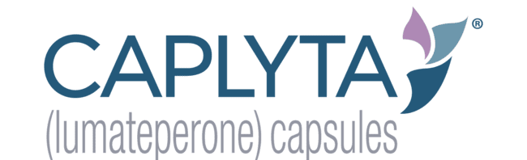
Sales
Increased mid-funnel results driven by higher TV investment has more than doubled the collective sales of the 17 brands over the last three years
17 Pharmaceutical DTC Brands: Annual U.S. Sales Revenue vs. TV Spend
‘24 vs ‘21
% Change
3-Year
CAGR*
2021
2022
2023
2024
U.S. Revenue
($ in B)
+131%
+32%
$37.6
$51.5
$70.2
$86.8
U.S. TV Spend
($ in B)
+106%
+27%
$1.6
$1.7
$2.4
$3.3
17 Pharmaceutical Brands Analyzed
Sources: Revenues are based on company filings (10-K) via SEC.gov (EDGAR). TV spend based on VAB analysis of Nielsen Ad Intel data (national cable TV, national broadcast TV, Spanish language broadcast TV, Spanish language cable TV, spot TV, syndication TV), Calendar years of 2021-2024. U.S. revenues for Ozempic & Wegovy were reported in Danish Krone, Dupixent & Arexvy were reported in Euros. *CAGR = compound annual growth rate (i.e., mean annual growth across the time period).
This information is exclusively provided to VAB members and qualified marketers.
PAGE 20

Slide 21
Sales
During our analysis period, many major pharma brands saw a tight correlation between increased TV investment and annual sales growth
Sampling of Pharmaceutical DTC Brands: Annual U.S. Sales Revenue & TV Spend
‘24 vs ‘21
% Change
3-Year
CAGR*
Brand
2021
2024
U.S. Revenue ($ in MM)
$9,765
$17,872
+83%
+22%
U.S. TV Spend ($ in MM)
$56
$97
+73%
+20%
U.S. Revenue ($ in MM)
$2,486
$10,086
+306%
+59%
U.S. TV Spend ($ in MM)
$167
$501
+201%
+44%
U.S. Revenue ($ in MM)
$1,271
$4,259
+235%
+50%
U.S. TV Spend ($ in MM)
$214
$467
+118%
+30%
U.S. Revenue ($ in MM)
$1,728
$3,260
+89%
+24%
U.S. TV Spend ($ in MM)
$67
$156
+132%
+32%
Sources: Revenues are based on company filings (10-K) via SEC.gov (EDGAR). TV spend based on VAB analysis of Nielsen Ad Intel data (national cable TV, national broadcast TV, Spanish language broadcast TV, Spanish language cable TV, spot TV, syndication TV), Calendar years of 2021-2024. *CAGR = compound annual growth rate (i.e., mean annual growth across the time period).
This information is exclusively provided to VAB members and qualified marketers.
PAGE 21

Slide 22
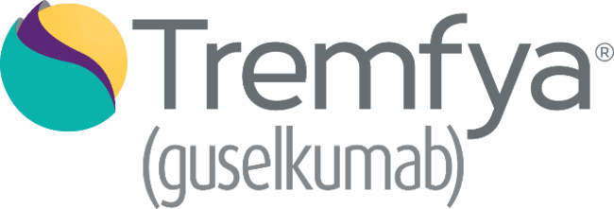

Sales
TV drives a direct impact on sales with double-digit compound annual growth seen consistently across brands of all revenue sizes
Sampling of Pharmaceutical DTC Brands: Annual U.S. Sales Revenue & TV Spend
‘24 vs ‘21
% Change
3-Year
CAGR*
Brand
2021
2024
U.S. Revenue ($ in MM)
$1,082
$2,314
+114%
+29%
U.S. TV Spend ($ in MM)
$67
$97
+44%
+13%
U.S. Revenue ($ in MM)
$1,503
$2,443
+63%
+18%
U.S. TV Spend ($ in MM)
$141
$185
+30%
+9%
U.S. Revenue ($ in MM)
$82
$681
+733%
+103%
U.S. TV Spend ($ in MM)
$33
$99
+196%
+44%
U.S. Revenue ($ in MM)
$115
$516
+349%
+65%
U.S. TV Spend ($ in MM)
$59
$133
+125%
+31%
Sources: Revenues are based on company filings (10-K) via SEC.gov (EDGAR). TV spend based on VAB analysis of Nielsen Ad Intel data (national cable TV, national broadcast TV, Spanish language broadcast TV, Spanish language cable TV, spot TV, syndication TV), Calendar years of 2021-2024. *CAGR = compound annual growth rate (i.e., mean annual growth across the time period).
This information is exclusively provided to VAB members and qualified marketers.
PAGE 22

Slide 23
Sales
Summary: Sales grew in proportion to the increase in TV investment across the 17 major pharmaceutical DTC brands within our analysis
17 Pharmaceutical DTC Brands: Annual U.S. Sales Revenue & TV Spend
Sources: Revenues are based on company filings (10-K) via SEC.gov (EDGAR). TV spend based on VAB analysis of Nielsen Ad Intel data (national cable TV, national broadcast TV, Spanish language broadcast TV, Spanish language cable TV, spot TV, syndication TV), Calendar years of 2021-2024. U.S. revenues for Ozempic & Wegovy were reported in Danish Krone, Dupixent & Arexvy were reported in Euros.
This information is exclusively provided to VAB members and qualified marketers.
PAGE 23

Slide 24
TV drives discovery and education which results in real sales impact for brands
TV ads, more than any other media, drives patients of all ages to educate themselves and take action during their ‘treatment journey’ as they seek out remedies to improve their health
The impact of TV is evident as 88% of pharma brands analyzed saw their highest branded search volume occur once their TV campaign launched
Greater online search led to outsized double-digit lifts in website traffic, especially as they increased their TV investment, for the eight brands that were measured
Increased mid-funnel results driven by greater TV investment more than doubled the collective sales of the 17 brands in our analysis (i.e., more patients getting the remedies they need to treat serious, invasive conditions).
Key Marketer Takeaways
This information is exclusively provided to VAB members and qualified marketers.
PAGE 24

Slide 25

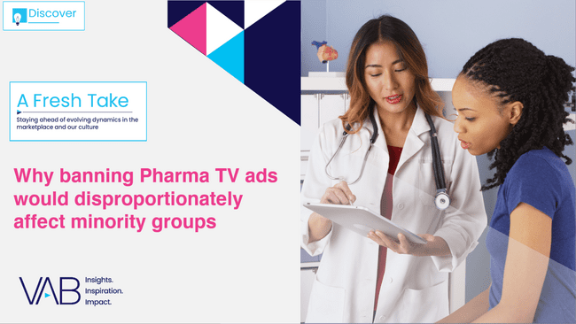
Download our two recently released insights reports below to learn more about the importance of TV advertising within the pharmaceutical category
Download to learn…
How Pharma TV ad investment has evolved
How TV campaigns impact branded online search based on an analysis of 58 first-time pharma DTC TV advertisers
How ‘Advanced TV’ solutions enable greater precision targeting within the pharma category
Download to learn…
How minority groups increasingly use prescription remedies for series ailments
How minority group are much more likely to act after seeing a pharma ad, leading to further education
Click report covers above to download
This information is exclusively provided to VAB members and qualified marketers.
PAGE 25

Slide 26




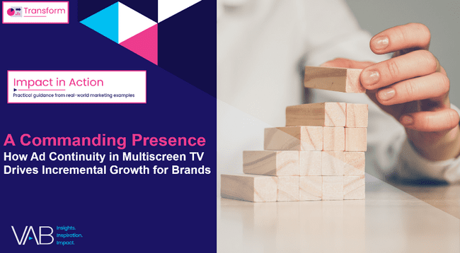

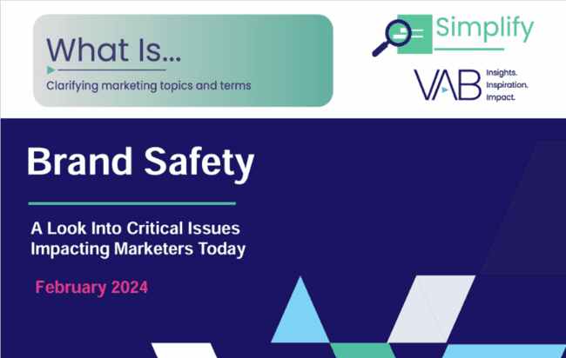
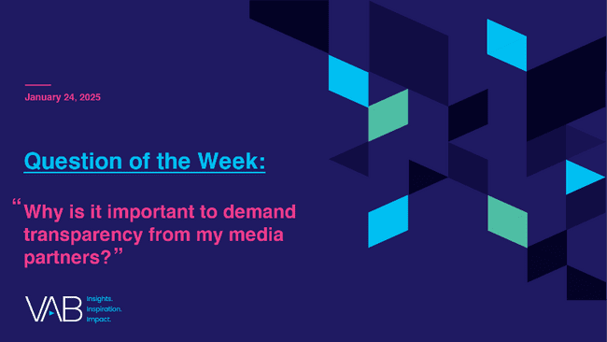
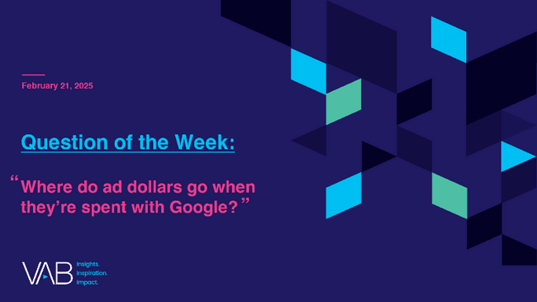
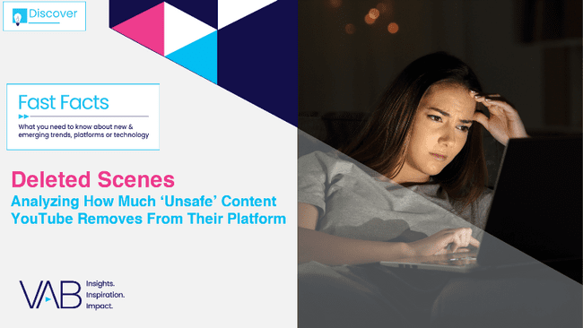
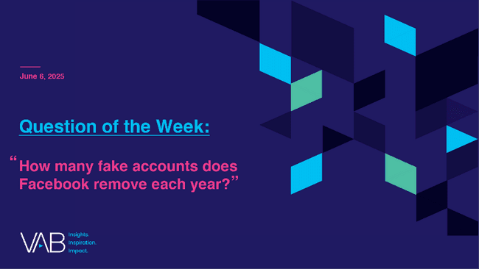

Discover more: Looking for more insights and takeaways? Check out these reports on premium video and brand safety & transparency
Power of Premium Video To Drive Brand Outcomes
The Power of Premium Video
What It Means for Multiscreen TV
and Why It Matters to Marketers
Best in Show
Five Advantages of Multiscreen TV,
From Brand to Performance
Breaking Through
How New Advertisers Are Using TV To Ignite Interest & Turn Consumers Into Customers
A Commanding Presence
How Ad Continuity in Multiscreen TV Drives Incremental Growth for Brands
25 Ways TV Grows Brands
Powering Performance Through
Full-Funnel Business Outcomes
Brand Safety, Trust and Transparency
What is Brand Safety?
A Look Into Critical Issues Impacting Marketers Today
Why is it important to demand transparency from my media partners?
Where do ad dollars go when they’re spent with Google?
Deleted Scenes
Analyzing How Much ‘Unsafe’ Content YouTube Removes From Their Platform
How many fake accounts does Facebook remove
each year?
This information is exclusively provided to VAB members and qualified marketers.
PAGE 26

Slide 27


About VAB
VAB plays a dual role in the video advertising industry. We are leading the change to bring about a more innovative and transparent marketplace. We also provide the insights and thought leadership that enables marketers to develop business-driving marketing strategies.
Drawing on our marketing expertise, we simplify the complexities in our industry and discover new insights that transform the way marketers look at their media strategy.
We are committed to your business growth and proud to offer VAB members, brand marketers and agencies complimentary access to our continuously-growing Insights library. Get immediate access at theVAB.com.
This information is exclusively provided to VAB members and qualified marketers.
PAGE 27

Slide 28
Over the last three years, the collective investment in TV by the 17 pharma DTC brands included within our analysis more than doubled
17 Pharmaceutical DTC Brands: Annual TV Investment
$ in Billions
17 Pharmaceutical Brands Analyzed
Sources: VAB analysis of Nielsen Ad Intel data (national cable TV, national broadcast TV, Spanish language broadcast TV, Spanish language cable TV, spot TV, syndication TV), Calendar years of 2021-2024.
This information is exclusively provided to VAB members and qualified marketers.
PAGE 28

