Slide 1





Is a TV campaign right for my business?
Marketer FAQs

Slide 2
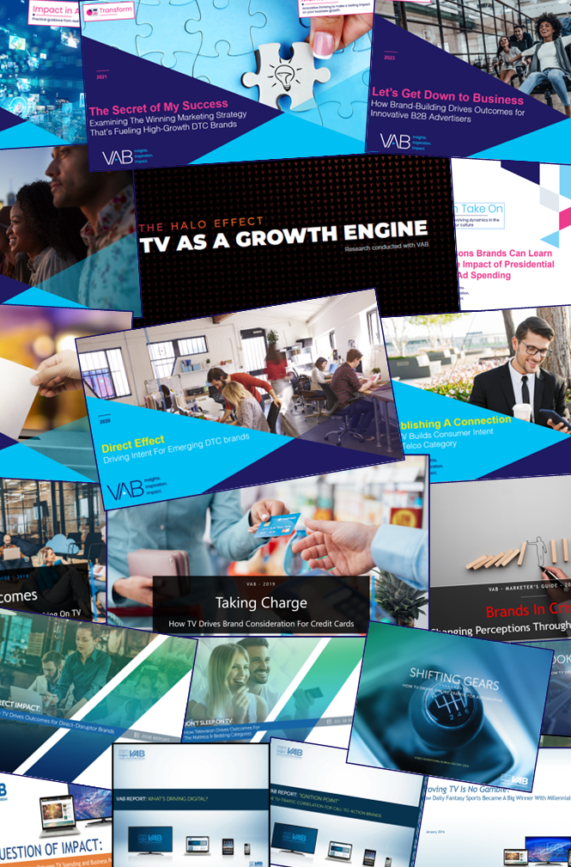



How can TV drive results for my business?
This is a question many business owners ask when creating their advertising campaigns.
Through VAB’s decade-long studying of the impact advertising has on driving outcomes, we explore how business of all kinds are using TV to accelerate their growth.
You’ll learn:
  How TV advertising drives results for businesses at all life stages, sizes and budget levels
  The impact TV campaigns have on converting all types of audiences, including young adults and multicultural, into brand customers
This information is exclusively provided to VAB members and qualified marketers.
PAGE 2

Slide 3


























































VAB has studied hundreds of brands across categories to understand the impact TV advertising has on business outcomes
Sampling of Brands Analyzed
This information is exclusively provided to VAB members and qualified marketers.
PAGE 3

Slide 4







Based on our analyses, we have seen successful businesses accelerate growth by capitalizing on seven key benefits of TV
Storytelling
Sight, sound and motion of a TV ad can convey strong brand identity and increase consumer engagement
Availability & Accessibility
Greater product availability in the digital age (ecommerce) enables brands to seek out the scale of TV earlier in their life stage
Legitimizer
TV creates, builds and enhances brand reputation while legitimizing their product or
service through high-quality programming
Targetability
Scalable data-driven targeting solutions like addressable TV, VOD and data-enabled linear TV create efficiency and limit waste
Inclusivity
Enhanced targeting capabilities through advanced TV solutions creates efficiencies which lowers the traditional cost of entry
Halo Effect
TV significantly improves the performance and ROI of all other digital channels as well as a brand’s online platforms
Full-Funnel Outcomes
Through greater measurement and enhanced attribution capabilities, TV has shown its ability to drive brand results
This information is exclusively provided to VAB members and qualified marketers.
PAGE 4

Slide 5
These benefits have enabled TV to drive results for businesses of all life stages, sizes and budget levels, with target audiences both big and small
TV Delivers For All Types of Businesses
TV Delivers All Types of Audiences
No business is too ‘young’ for TV
TV delivers new
customers
No business is too ‘niche’
for TV
TV delivers young
customers
No budget is too ‘small’
for TV
TV delivers multicultural customers
PAGE 5
click through the appropriate box if you would like to be brought directly to the corresponding slide

Slide 6

TV drives results for businesses at
all life stages, sizes and budget levels

Slide 7






No business is too ‘young’ for TV
Successful brands invest in TV early in their life stage to legitimize their product by associating with premium video programs and its advertisers
Total TV Investment in First 3 Years from Product Launch
($10.5MM)
($4.8MM)
($31.2MM)
($1.1MM)
($18.2MM)
($19.3MM)
($29.3MM)
($77.0MM)
($15.4MM)
($18.8MM)
($6.8MM)
($22.9MM)
($140.4MM)
($7.3MM)
($24.0MM)
($10.4MM)
($90.4MM)
($10.9MM)
($11.2MM)
($18.6MM)
Source: VAB analysis of Nielsen Ad Intel data, calendar years 2013-2018. TV spend includes national cable TV, broadcast TV, Spanish language cable TV, Spanish language broadcast TV, spot TV, syndication TV. Reflects the cume of the first 3 years of each brand’s TV spend. *Manscaped data reflects Jun ‘16 – Jun ’20 (calendar months) analysis.
Want to learn more? Click here to download ‘Direct Outcomes’
PAGE 7

Slide 8





No business is too ‘young’ for TV
Within the heavily competitive mattress category, awareness skyrocketed for young startup brands that launched TV early in their life stage
Sampling of Brands: Monthly Website Unique Visitors Comparison
Based Over a Three-Year Time Period: May ‘15 – Apr ‘18
Brand | Monthly Average: Prior to TV Launch | Monthly Average: TV Launch – Apr ‘18 | % Difference
 | N/A | 136K
 | 207K | 608K | +194%
 | N/A | 153K
 | 109K | 1,446K | +1,227%
 | 213K | 363K | +70%
 | N/A | 163K
Source: VAB analysis of comScore mediametrix multiplatform media trend data; total audience (Desktop P2+. Mobile 18+), May ‘15 – April ’18 (calendar months). VAB analysis of Nielsen Ad Intel data, TV spend (national cable TV, national broadcast TV, Spanish language broadcast TV, Spanish language cable TV, spot TV, syndication TV), May ’15 – Apr ’18 (calendar months). N/A = not enough traffic for comScore to measure. Averages are based on months with measured and reported unique visitor (000) data.
Want to learn more? Click here to download ‘Don’t Sleep on TV’
PAGE 8

Slide 9
No business is too ‘young’ for TV
Advertisers across all life stages see a wave of new customers to their digital platforms after launching on TV, especially younger brands
140 Direct-to-Consumer Brands (across 25+ categories)
Average Website Unique Visitors Comparison
‘When On’ TV Monthly Average During TV Campaign vs. Three-Month Average Prior to TV Launch
Three Years Old or Younger
(40 brands)
Between Four – Seven Years Old
(60 brands)
Eight Years or Older
(40 brands)
+138%
+72%
+23%
Unique Visitors % increase:
Unique Visitors increase:
+811K
+1,383K
+803K
Source: VAB analysis of Nielsen Ad Intel data, TV spend (national cable TV, national broadcast TV, Spanish language broadcast TV, Spanish language cable TV, spot TV, syndicated TV), Jun ‘16 – Jun ’20 (calendar months). VAB analysis of Comscore mediametrix multiplatform (desktop + mobile) media trend data; P18+, Jun ’16 – Jun ‘20 (calendar months).
Want to learn more? Click here to download ‘The Halo Effect’
PAGE 9

Slide 10







No business is too ‘niche’ for TV
Brands with finite targets are using audience-based TV buying to reach their best customer prospects and drive them to their digital platforms
Sampling of Business-to-Business Brands: Monthly Website Unique Visitors (000) Comparison
Based Over a Four-Year Time Period: Apr ‘18 – Apr ‘22
Brand | B2B Category | Three-Month Average: Prior to TV Launch | Monthly Average: ‘When On TV’ | # Diff (000) | % Diff
 | Software | 71 | 153 | +82 | +115%
 | Graphic Design | 5,281 | 9,480 | +4,199 | +80%
 | Security | 217 | 644 | +427 | +197%
 | Expense Mgmt. | 240 | 477 | +237 | +99%
 | Banking/Finance | 118 | 241 | +123 | +105%
 | Software | 142 | 306 | +164 | +116%
 | Staffing | 118 | 163 | +45 | +38%
 | Software | 1,288 | 1,723 | +434 | +34%
 | Comm. Real Estate | 144 | 419 | +275 | +191%
 | Freelancing | 1,542 | 1,759 | +216 | +14%
 | Software | 387 | 698 | +312 | +81%
 | Human Resources | 15 | 156 | +141 | +929%
Source: VAB analysis of Comscore mediametrix multiplatform media trend data, P18+. April 2018 – April 2022 (calendar months), figures are based on monthly averages for the 25 brands analyzed. ‘When On TV’ represents the monthly average for brands in months where they spend on national TV as measured through Nielsen AdIntel across the April 2018 – April 2022 (calendar months) time period across the 25 brands analyzed.
Want to learn more? Click here to download ‘Let’s Get Down to Business’
PAGE 10

Slide 11



No budget is too ‘small’ for TV
Brands across all investment levels see substantial and sustained
lifts in website traffic after they launch a TV campaign
36 ‘Emerging’ Direct-to-Consumer (DTC) Brands*
Average Monthly Website Unique Visitors (000)
Based Over a Four-Year Time Period: Jan ‘16 – Jan ‘20
$500K - $2MM TV Spend: 12 Brands Analysis
$2MM - $10MM TV Spend: 16 Brands Analysis
$10MM+ TV Spend: 8 Brands Analysis
+205%
(+5.3MM)
+126%
(+3.3MM)
+18%
(+376K)
+34%
(+693K)
+31%
(+338K)
+22%
(+236K)
(monthly average)
(TV launch – Jan ‘20)
(monthly average)
(TV launch – Jan ‘20)
(monthly average)
(TV launch – Jan ‘20)
(% & MM) vs. monthly average prior to TV launch
(% & MM) vs. monthly average prior to TV launch
(% & MM) vs. monthly average prior to TV launch
Source: VAB analysis of Nielsen Ad Intel data, TV spend (national cable TV, national broadcast TV, Spanish language broadcast TV, Spanish language cable TV, spot TV, syndication TV), Feb ‘18 – Jan ‘20 (calendar months). VAB analysis of Comscore mediametrix multiplatform media trend data, total audience (Desktop P2+, Mobile 18+), Jan ‘16 – Jan ‘20 (calendar months). ‘Prior to TV Launch’ reflects the average monthly unique visitors based on when each brand’s website began being measured by Comscore, or starting from January 2016 if measurement began before that month. *Reflects the 36 brands that are measured in Comscore and had reported monthly unique visitors in at least one month prior to their campaign launch.
Want to learn more? Click here to download ‘Direct Effect’
PAGE 11

Slide 12
TV converts all types of audiences into brand customers

Slide 13


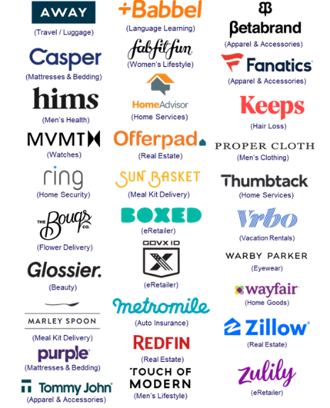
TV delivers new customers
TV campaigns expose brands to new audiences which delivers an influx of fresh, high-valued customers with more spending power
Unique Website Visitors Composition Shift
30 Direct-to-Consumer Brand Average
1Q ‘21 vs. 1Q ’17 (Monthly Avg)
30 DTC Brands Analyzed
Median Age
P50+ Comp %
+6.7
years
+14.1
percentage points
49.9 vs 43.2
1Q ’21 vs 1Q ’17* monthly average
52% vs 38%
1Q ’21 vs 1Q ’17* monthly average
30-Brand Cume TV spend between 2010-2016: $1.5B
30-Brand Cume TV spend between 2010-1Q 2021: $4.8B
Source: VAB analysis of Comscore mediametrix multiplatform media trend data, P18+. 1Q ’17: January – March ‘17, 1Q ‘21: January – March ‘21 (calendar months), monthly average within each quarter, P50+ comp% is based on monthly unique visitors; figures are based on monthly averages for each 3-month time period across the 30 brands analyzed. *1Q ‘17 (Jan-Mar ‘ 17) is reflective of the first 3-month measurement period available and is inclusive of a few brands that were first measured after this time period, based on their first 3-month measurement period. Note: Comscore did not begin measuring ‘median age’ as a reported metric until February ‘17, therefore the first time period reflects Feb-Apr ‘17.
Want to learn more? Click here to download ‘The Secret of My Success’
PAGE 13

Slide 14



TV delivers new customers
This audience shift drove increased digital platform engagement with
high-value customers who are more likely to become repeat visitors
Key Website Metrics: 30 Direct-to-Consumer Brand Average
1Q ‘21 vs. 1Q ‘17*: Monthly Avg Comparison
30 DTC Brands Analyzed
Unique Visitors (000)
Total Visits (000)
Total Minutes (MM)
# Difference
+3,156
+22,184
+95
% Difference
+63%
+135%
+89%
Total U.S. Internet Avg
% Difference
+10%
+26%
+34%
Source: VAB analysis of Comscore mediametrix multiplatform media trend data, P18+. 1Q ’17: January – March ’17, 1Q ’21: January – March ‘21 (calendar months), figures are based on monthly averages for each 3-month time period across the 30 brands analyzed. *1Q ’17 (Jan-Mar ’17) is reflective of the first 3-month measurement period available and is inclusive of a few brands that were first measured after this time period, based on their first 3-month measurement period. 30 brands total TV spend (between 1Q ‘17 – 1Q’21): $3.3B.
Want to learn more? Click here to download ‘The Secret of My Success’
PAGE 14

Slide 15

TV delivers new customers
Separately, AppleTV+’s consistent TV presence drove adoption and engagement of their new streaming service as total time spent on the platform grew in line with their TV investment
Apple TV+ - Cumulative Monthly U.S. Total TV Spend & Time Spent
Nov ’19 – Dec ‘20
Cume TV spend:
$174.7 MM
(Nov ‘19 launch – Dec ’20)
How to read - example: Dec ‘20 represents total measured time spent & TV spend from Nov ‘19 – Dec ’20 for Apple TV+
Source: VAB analysis of Nielsen AdIntel, Nov ‘19 – Dec ‘20 (calendar months). TV spend includes cable TV, broadcast TV, Spanish language cable TV, Spanish language broadcast TV, spot TV, and syndicated TV. U.S. TV spend only. VAB analysis of Comscore mediametrix multiplatform media trend data, total audience (Desktop P2+, Mobile 18+), Nov ‘19 – Dec ‘20 (calendar months), data represents Apple TV (mobile app).
Want to learn more? Click here to download ‘Analyzing Outcomes From The Tech Giants’ TV Investment’
PAGE 15

Slide 16





TV delivers young customers
TV campaigns for younger-targeted, disruptor brands inspire engagement and online conversion
Sampling of Younger-Skewing Disruptor Brands
Monthly Website Unique Visitors (000) Comparison
Based Over a Four-Year Time Period: Jan ‘16 – Jan ‘20
Based Over a Four-Year Time Period: Mar ‘16 – Feb ’19
Brand | Monthly Average: Prior to TV Launch | Monthly Average: TV Launch – Jan ‘20 | # Diff | % Diff
 | 5,467 | 22,020 | +16,553 | +303%
 | 2,920 | 3,923 | +1,003 | +34%
 | 765 | 1,662 | +897 | +117%
 | 549 | 1,081 | +532 | +97%
 | 286 | 474 | +188 | +66%
Brand | Monthly Average: Prior to TV Launch | Monthly Average: TV Launch – Feb ‘19 | # Diff | % Diff
 | 2,471 | 10,549 | +8,078 | +327%
 | 5,978 | 13,812 | +7,833 | +131%
 | 1,309 | 1,630 | +321 | +25%
 | 1,584 | 3,008 | +1,424 | +90%
 | 254 | 1,324 | +1,070 | +422%
Source: Direct Effect - VAB analysis of Nielsen Ad Intel data, TV spend (national cable TV, national broadcast TV, Spanish language broadcast TV, Spanish language cable TV, spot TV, syndication TV), Feb ‘18 – Jan ‘20 (calendar months). VAB analysis of Comscore mediametrix multiplatform media trend data, total audience (Desktop P2+, Mobile 18+), Jan ‘16 – Jan ‘20 (calendar months). ‘Prior to TV Launch’ reflects the average monthly unique visitors based on when each brand’s website began being measured by Comscore, or starting from January 2016 if measurement began before that month. Direct Outcomes - Source: VAB analysis of Nielsen Ad Intel data, TV spend (national cable TV, national broadcast TV, Spanish language broadcast TV, Spanish language cable TV, spot TV, syndication TV), March ‘15 – February ‘19 (calendar months). VAB analysis of Comscore mediametrix multiplatform media trend data, total audience (Desktop P2+, Mobile 18+), March ’15 – February ’19 (calendar months). ‘Prior to TV Launch’ reflects the average monthly unique visitors based on when each brand’s website began being measured by Comscore, or starting from March 2015 if measurement began before that month.
Want to learn more? Click here to download ‘Direct Effect’ and ‘Direct Outcomes’
PAGE 16

Slide 17

TV delivers young customers
Meta’s Oculus Quest 2 TV launch campaign drove search queries, dominating VR category SOV
Meta’s Oculus Quest 2 led category search queries with their share of voice (SOV) advantage in the VR category: $67 MM in 4Q ’20 TV spend vs. no spending by its competitors
Weekly Google Search Trend Indices & Total U.S. TV Spend
2020
Oct 13
Release Date
Source: VAB analysis of Nielsen AdIntel, 10/4/20-1/1/21, TV spend includes cable TV, broadcast TV, Spanish language cable TV, Spanish language broadcast TV, spot TV, and syndicated TV. U.S. TV spend only; VAB analysis of Google Trends, United States only, All Categories, Web Search, 10/4/20-1/1/21, SOV = Share of voice. *Google Search Index represents search interest relative to the highest point on the chart for the given region and time period, a value of 100 is the peak popularity for the term, a value of 50 means that the term is half as popular.
Want to learn more? Click here to download ‘Analyzing Outcomes From The Tech Giants’ TV Investment’
PAGE 17

Slide 18



TV delivers multicultural customers
TV campaigns that feature strong diversity, inclusivity and empowering messaging increase sales among multicultural audiences
Toyota’s RAV4 authentically connects with diverse audiences through TV campaigns that feature inclusivity and female empowerment messaging which has aided the brand in becoming the best-selling SUV in America.
Rav4 casts people of all ethnicities within their advertising campaigns and have created a host of Spanish-language ads. Additionally, the brand also created a Super Bowl ad with a female empowerment message about shattering perceptions.
Results: 2019 was Toyota RAV4’s highest annual unit sales ever and marked their eighth straight year of successive unit growth. In fact, RAV4 sold 130K+ units more than they did five years ago in 2015. Their Hybrid model is doing particularly well, posting a 92% increase YoY.
‘Bring The Heat’ TV spot - $42.0 MM
12-Month Campaign:
2/4/19 – 2/2/20
4,865 Airings / 1,874.8 MM HH IMPs
‘Toni’ TV spot - $21.6 MM
10-Month Campaign:
1/29/19 – 11/24/19
284 Airings / 330.5 MM HH IMPs
13 Spanish-Language TV spots - $22.6 MM
Various Flights: 1/12/16 – 3/29/20
7,018 Airings / 933.8 MM HH IMPs
Business Outcomes
Annual U.S. Unit Sales: +42% increase
in RAV4 vehicles sold annually in the U.S. over the last five years between 2015 and 2019 (315,142 vs. 448,071).
click image above to watch spot
click image above to watch spot
click image above to watch spot
Source: VAB analysis of iSpot.tv TV occurrence data, time period: 1/1/16 – 6/30/20, estimated media spend. Impressions represent US TV HHs and include activity within measured national broadcast and cable TV linear, national time-shifted, local, VOD and OTT. Revenues are based on Toyota Motor North America’s U.S. Sales Annual Summaries available through their online news pressroom portal.
Want to learn more? Click here to download ‘Do the Right Thing’
PAGE 18

Slide 19
Adults over 50 account for 36% of the total population and nearly half of all adults
TV can deliver quantifiable business outcomes for brands, no matter their life stage, company size or budget level
Advertisers can leverage TV campaigns to engage all types of audiences which inspires new customers, including both young and multicultural audiences, to take a brand action (e.g., search, website visit, sales, etc.)
Key Implications for Marketers
This information is exclusively provided to VAB members and qualified marketers.
PAGE 19

Slide 20

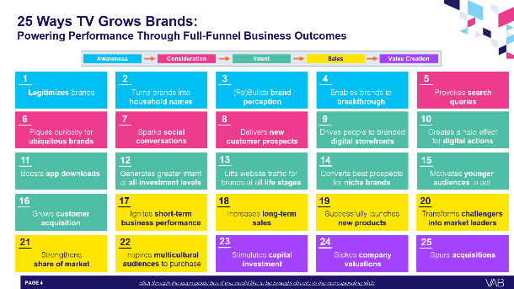
To learn more about how TV advertising can drive results for your business, download our full report below
‘25 Ways TV Grows Brands’ explores real-world examples of how TV drives full-funnel outcomes, distilled from a decade of VAB’s TV attribution reports across 1,000+ brands, 80+ categories and
30+ metrics analyzed.
This information is exclusively provided to VAB members and qualified marketers.
PAGE 20

Slide 21







Creators
Jason Wiese
Reed Kiely
SVP, Director of Strategic Insights
jasonw@thevab.com
Director, Data Insights & Trends
reedk@thevab.com
Let’s Get Down to Business
How Brand-Building Drives Outcomes
for Innovative B2B Advertisers
The Secret of My Success
Examining The Winning Marketing Strategy That’s Fueling High-Growth DTC Brands
Discover more
Looking for more data, insights and takeaways? Check out this related VAB content
The Halo Effect: TV as a Growth Engine
Why Brands are Accelerating their Path to TV
Do The Right Thing
How Diversity & Inclusion Drives
Brand Outcomes
Direct Effect
Driving Intent for Emerging DTC Brands
Analyzing Outcomes From
The “Tech Giants’” TV Investment
VAB Members, brand marketers and agencies get free and immediate access to VAB’s content library. Get access at theVAB.com
This information is exclusively provided to VAB members and qualified marketers.
PAGE 21

Slide 22


About VAB
VAB plays a dual role in the video advertising industry. We are leading
the change to bring about a more innovative and transparent marketplace. We also provide the insights and thought leadership that enables marketers to develop business-driving marketing strategies.
Drawing on our marketing expertise, we simplify the complexities in our industry and discover new insights that transform the way marketers look at their media strategy.
We are committed to your business growth and proud to offer VAB members, brand marketers and agencies complimentary access to our continuously-growing Insights library. Get immediate access at theVAB.com.
This information is exclusively provided to VAB members and qualified marketers.
PAGE 22

