Slide 1


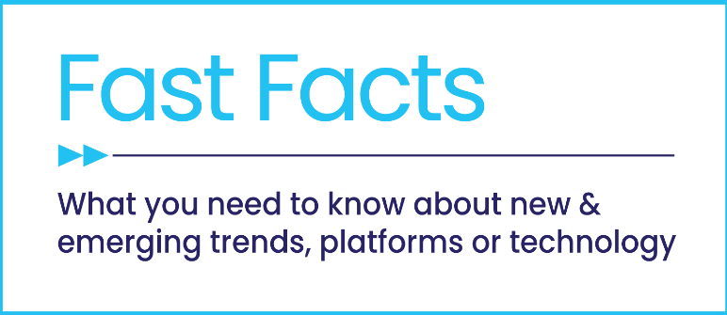


The Truth About CTV Ad Fraud
Clarifying confusion in the marketplace about multiscreen TV

Slide 2


Amidst the industry talk about “ad fraud” in CTV, it’s important to understand what fraud is…and what it isn’t.
There is a sharp contrast between ad fraud vs. normal viewing behaviors that impact advertising. This requires a closer look at how they present themselves across platforms.
What you’ll learn:
  What constitutes real fraud
  How ad fraud in CTV compares to other digital platforms
  How the viewing environment of a platform impacts both consumer and advertiser trust
  How to minimize exposure to fraudulent practices
This information is exclusively provided to VAB members and qualified marketers. Further distribution is prohibited.
PAGE 2

Slide 3
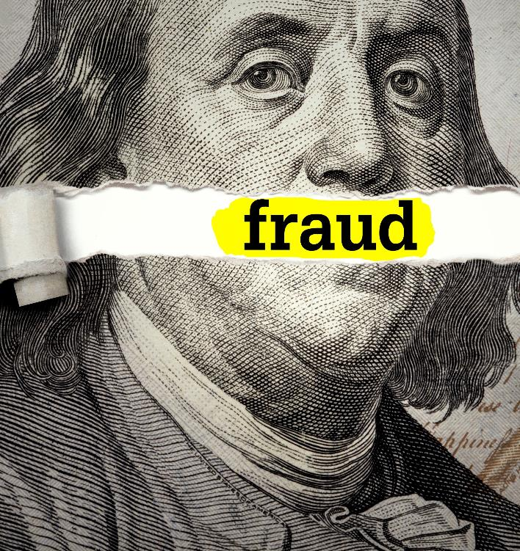




1
Ad fraud is defined by malicious intent of falsifying engagement
‘Advertising fraud’ refers to an individual, group or organization maliciously and intentionally falsifying engagement with an advertisement, often by impersonating human behaviors or knowingly miscalculating measurement metrics.
  e.g., fake clicks, overcounting users, cookie stuffing, domain spoofing, etc.
Advertising fraud can be split into the following areas*:
    Device-driven fraud - refers to the use of computers, servers, phones, and other devices by cybercriminals to counterfeit real ad impressions by impersonating real users
    Content-driven fraud - refers to the practice of creating fake sites and apps with fraudulent inventory and selling it to advertisers who believe their ads are showing up on real premium sites
Source: *HUMAN, How to Succeed in Ad Fraud by Really Trying, January 2, 2020.
This information is exclusively provided to VAB members and qualified marketers. Further distribution is prohibited.
PAGE 3

Slide 4


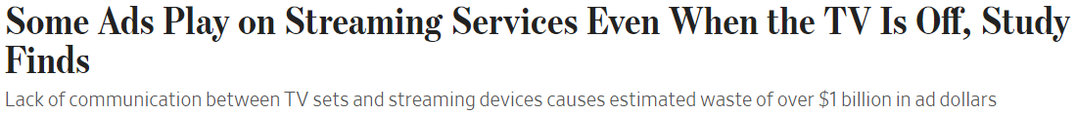

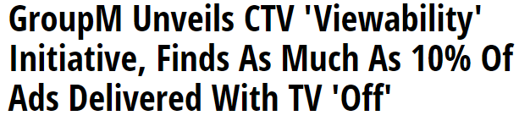
Normal viewer behaviors, like falling asleep while watching TV or turning the TV set off without shutting down an app, is not fraud
2
A study by GroupM and iSpot.TV discovered that some ads on CTV were continuing to run after the viewer watching via an HDMI-connected device had turned their TV off, coined by some as a ‘TV Off’ or ‘Dark Screen’ issue
What is not ‘fraud’?
Behavioral actions carried out unintentionally by the user / viewer, such as letting videos with ads being served continue to play on mute or turning off the TV set while a connected device continues to play
6/12/2022
6/13/2022
This information is exclusively provided to VAB members and qualified marketers. Further distribution is prohibited.
PAGE 4

Slide 5

To clarify confusion around ad fraud in multiscreen TV, particularly in CTV, we have investigated where there is fraud and the extent to which it is occurring

Slide 6
3
Over $85 billion is spent by U.S. advertisers across TV platforms, with Connected TV accounting for 24% of total investment
U.S. Linear TV & Connected TV Ad Spending
in billions
$83.0
$87.3
$77.0
$77.6
$73.0
$72.7
Source: eMarketer Insider Intelligence, U.S. TV Ad Spending, March 2023. Note: includes broadcast TV (network, syndication, and spot) and cable TV; excludes digital. eMarketer Insider Intelligence, U.S. Connected TV Ad Spending, March 2023. Note: digital advertising that appears on connected TV (CTV) devices; includes display ads that appear on home screens and in-stream video ads that appear on CTVs from platforms like Hulu, Roku, and YouTube; excludes network-sold inventory from traditional linear TV and addressable TV advertising. Estimates are based on the analysis of various elements related to the ad spending market, including macro-level economic conditions, historical trends of the advertising market, historical trends of each medium in relation to other media, reported revenues from major ad publishers, estimates from other research firms, data from benchmark sources, consumer media consumption trends, consumer device usage trends, and eMarketer interviews with executives at ad agencies, brands, media publishers, and other industry leaders.
This information is exclusively provided to VAB members and qualified marketers. Further distribution is prohibited.
PAGE 6

Slide 7





4
There are very limited opportunities overall for fraud to exist within premium, professionally-produced TV content
To note, rates of invalid CTV traffic have been trending down, with the IVT rate in the global open programmatic CTV ad marketplace dropping to 18% during Q4 2022 (vs. 26% in Q4 2021)*
Multiscreen TV ‘Ad Fraud’ Realities
(linear TV + CTV)
Ad fraud does not exist on linear TV
Fraud mostly happens through ‘low-quality’ programmatic, and is much less likely to happen through ‘publisher-direct’ or ‘premium’ programmatic solutions
‘Invalid Traffic (IVT)’ refers to advertising impressions, clicks on ads or other actions taken by malicious bots or any other forms of nonhuman traffic
Source: *Pixalate, Global Connected TV (CTV) Ad Supply Chain Trends, H2 2022. Invalid traffic (“IVT” - inclusive of ad fraud) by quarter in open programmatic CTV; global; as measured by Pixalate.
This information is exclusively provided to VAB members and qualified marketers. Further distribution is prohibited.
PAGE 7

Slide 8
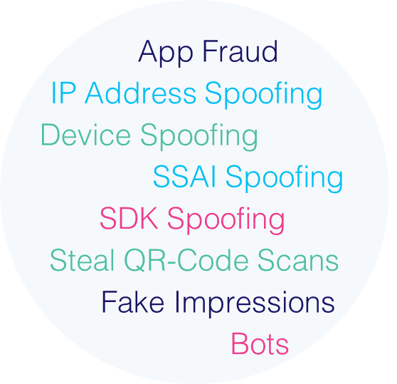


5
Though minimal, fraudsters are leveraging tactics like using other devices to impersonate CTV engagement or selling fake ad inventory
What are some examples of advertising fraud tactics on CTV?
Also known as ‘device impersonation,’ a tactic in which mobile or other digital devices are used to impersonate real CTV devices to make money off false impression delivery when, in reality,
no ads were served to real viewers
Device Spoofing
Occurs when fraudsters set up fake SSAI (server-side ad insertion) servers to generate fake CTV ad inventory across apps, IPs and devices
SSAI* Spoofing
Examples of CTV
Ad Fraud Tactics
Source: HUMAN, CTV Device Impersonation whitepaper, November 2019. DoubleVerify via Business Wire, 2/3/2022. *SSAI (server-side ad insertion) refers to the technology that stitches together ads within a video stream before the stream loads on a user’s device (AdExchanger, 7/11/2022).
This information is exclusively provided to VAB members and qualified marketers. Further distribution is prohibited.
PAGE 8

Slide 9


6
While CTV can be vulnerable to some ad fraud, estimate ranges are in the millions - much lower than the billions in non-CTV digital fraud
According to DoubleVerify, fraudulent CTV ad schemes may have siphoned away…
$6M – $8M+
$144M
each month from advertisers
annually from publishers in 2021
Source: DoubleVerify, Global Insights Report, 2022.
This information is exclusively provided to VAB members and qualified marketers. Further distribution is prohibited.
PAGE 9

Slide 10

7
In contrast to CTV, fraudulent digital ads are costing brands at least $23 billion each year
As bad actors become savvier at committing fraud, the industry is struggling to properly detect fraudulent activity, especially beyond ‘bots’
“The problem with fraud is that right now it isn’t (all) being recognized as fraud. Let’s just use round numbers. If they report 1%, everyone jumps to the conclusion that the other 99% is fine. But what they’re missing is that they never said it was human traffic,
they just failed to detect it was invalid traffic.”
$23 Billion
Augustine Fou
Independent Ad Fraud Researcher
(The Big Smoke, 1/14/2022)
Total Digital Advertising Spend Lost to Fraud in the U.S. in 2022
Beyond bots, detection of other forms of digital ad fraud - such as pixel stuffing, ad stacking and forced redirects - is often under-reported
Source: Juniper Research, Digital Advertising Fraud: 2021-2026 Market Summary, 2022.
This information is exclusively provided to VAB members and qualified marketers. Further distribution is prohibited.
PAGE 10

Slide 11
8
The share of estimated ad fraud in total TV is a small fraction of the ad fraud projection in non-CTV digital platforms
Estimated Digital Ad Fraud $$$ as a % of Total Digital Ad Spend*
Estimated CTV Ad Fraud $$$ as a % of Total TV Spend
0.3% - 0.4%
at least
10.3%
Estimated CTV Ad Fraud $$$ as a % of CTV TV Spend
1.2% - 1.4%
Source: Digital Ad Spend - VAB analysis of eMarketer Insider Intelligence data. eMarketer Insider Intelligence, U.S. Digital Ad Spending, March 2023. eMarketer Insider Intelligence, U.S. Digital Ad Spending, by Format, March 2023. Note: includes advertising that appears on desktop and laptop computers as well as mobile phones, tablets, and other internet-connected devices, and includes all the various formats of advertising on those platforms. Digital ad fraud $$$ estimates - Juniper Research, Digital Advertising Fraud: 2021-2026 Market Summary, 2022. TV / CTV Ad Spend - eMarketer Insider Intelligence, U.S. TV Ad Spending, March 2023. Note: includes broadcast TV (network, syndication, and spot) and cable TV; excludes digital. eMarketer Insider Intelligence, U.S. Connected TV Ad Spending, March 2023. Note: digital advertising that appears on connected TV (CTV) devices; includes display ads that appear on home screens and in-stream video ads that appear on CTVs from platforms like Hulu, Roku, and YouTube; excludes network-sold inventory from traditional linear TV and addressable TV advertising. Estimates are based on the analysis of various elements related to the ad spending market, including macro-level economic conditions, historical trends of the advertising market, historical trends of each medium in relation to other media, reported revenues from major ad publishers, estimates from other research firms, data from benchmark sources, consumer media consumption trends, consumer device usage trends, and eMarketer interviews with executives at ad agencies, brands, media publishers, and other industry leaders. CTV ad fraud $$$ estimates - DoubleVerify, Global Insights Report, 2022. *Based on % of 2022 ad revenue. **Based on % of 2021 ad revenue to align with 2021 CTV fraud $$$ estimates.
This information is exclusively provided to VAB members and qualified marketers. Further distribution is prohibited.
PAGE 11

Slide 12



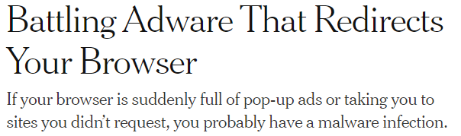
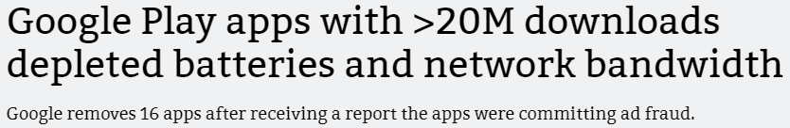

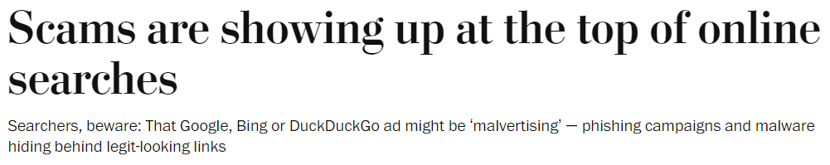

Ad fraud in CTV also does not normally impact the viewing experience unlike digital fraud which can lead to ad stuffing or computer viruses
9
CTV viewers are often unaware they’ve been exposed to fraudulent activity as they are still watching within a premium environment, however digital users run the risk of malware being installed on their device, which can lead to pop-up ads, battery drain and more
Examples of how consumers have been impacted by digital ad fraud schemes
10/20/2022
6/13/2018
9/16/2022
11/14/2022
This information is exclusively provided to VAB members and qualified marketers. Further distribution is prohibited.
PAGE 12

Slide 13
10
The quality viewing experience and premium environment creates a distinct trust advantage for TV ads among consumers
Types of Advertising U.S. Adults Find Trustworthy
% of respondents
U.S. adults are more likely to find ads on TV trustworthy vs. ads on digital platforms
2.5x
More Likely
to trust ads on TV
vs. ads on social media
1.5x
More Likely
to trust ads on TV
vs. ads on websites
Source: YouGov, Global Study: Which Types of Ads Do People Trust?, commissioned by Campaign, 2/5/2021. Note: Ages 18+ who selected very/somewhat trustworthy.
This information is exclusively provided to VAB members and qualified marketers. Further distribution is prohibited.
PAGE 13

Slide 14

11
Like consumers, marketers trust the premium environment of CTV and view it as less vulnerable to fraud than other digital platforms
Which media types will be most vulnerable to ad fraud in the next 12 months?
% of respondents
= ‘non-CTV’ digital
= CTV
Source: Integral Ad Science (IAS), The 2023 Industry Pulse Report, December 2022. Based on October 2022 IAS / YouGov survey of U.S. digital media experts who use programmatic advertising (n=356). Q. Which of the following media types will be most vulnerable to ad fraud in the next 12 months? (select up to three).
This information is exclusively provided to VAB members and qualified marketers. Further distribution is prohibited.
PAGE 14

Slide 15


















12
It is important for marketers to stay informed, prioritize working with premium platforms and seek solutions to further minimize ad fraud
Tips for minimizing fraudulent advertising in CTV
Focus on education to know both the risks of ad fraud and solutions for protecting brands & their campaigns
Utilize premium, trusted vendors to ensure purchased ad inventory is truly what it appears to be
Work with vetted measurement and data companies that specialize in audience and ad verification, as well as invalid traffic detection, to ensure ads are being seen by real viewers
  Learn about tools that can reduce the risk of ad fraud, such as ad verification, which can identify and block fraudulent traffic, & ad blocking technology which prevents ads from being displayed to bots*
  Examples of companies who can serve as trusted vendors:
  Examples of measurement companies:
Click through the logos above to be brought directly to the corresponding company’s website
Source: *Augustine Fou via LinkedIn, 3/22/23.
This information is exclusively provided to VAB members and qualified marketers. Further distribution is prohibited.
PAGE 15

Slide 16

Real ad fraud is defined by maliciously and intentionally falsifying human engagement, not normal viewing behaviors like falling asleep in front of the TV
Compared to other digital platforms, fraudulent ad activity is much less likely to occur within the premium environment of CTV and it doesn’t impact the viewing experience which enables greater consumer trust of TV advertising
As marketers develop their advertising campaigns,
it is important to understand what constitutes ad fraud, how it impacts different digital platforms and what solutions can be implemented to minimize exposure
to it while optimizing outcomes among real audiences
Key Marketer Takeaways
This information is exclusively provided to VAB members and qualified marketers. Further distribution is prohibited.
PAGE 16

Slide 17





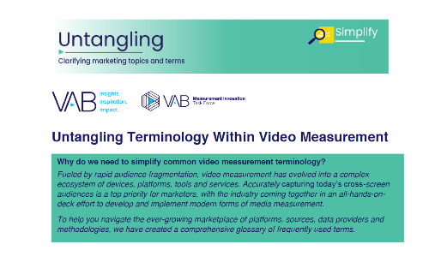
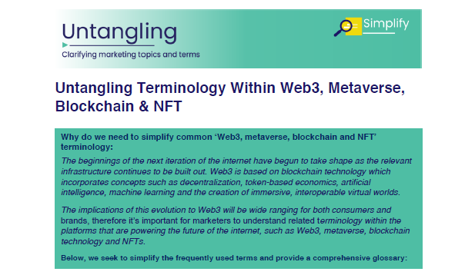


Creators
Jason Wiese
Leah Montner-Dixon
SVP, Director of Strategic Insights
jasonw@thevab.com
Associate Insights Director
leahm@thevab.com
What’s the Deal with Viewership Data Collection?
What’s the Deal with Identity?
Discover more
Looking for more data, insights and takeaways? Check out this related VAB content
Through Upfront season, marketers are making important decisions about their video investment strategy.
We’re here to help.
Visit our Upfront Planning Resource Center
for a curated a list of resources filled with the data, analysis and insights needed to make informed investment decisions.
You Oughta Know
Why all impressions aren’t created equal & what it means for video measurement
Data-Driven Opportunities in a Cookieless World
Untangling Terminology
Within Video Measurement
Untangling Terminology
Within Web3, Metaverse, Blockchain & NFT
VAB Members, brand marketers and agencies get free and immediate access to VAB’s content library. Get access at theVAB.com
This information is exclusively provided to VAB members and qualified marketers. Further distribution is prohibited.
PAGE 17

Slide 18


About VAB
VAB is an insights-driven organization that inspires marketers to reimagine their media strategies resulting in fully informed decisions.
Drawing on our marketing expertise, we simplify the complexities in our industry and discover new insights that transform the way marketers look at their media strategy.
We are committed to your business growth and proud to offer VAB members, brand marketers and agencies complimentary access to our continuously-growing Insights library. Get immediate access at theVAB.com.
Curious to learn more about VAB? Check out this quick video to see what we do and how we can help you develop business-driving marketing strategies.
This information is exclusively provided to VAB members and qualified marketers. Further distribution is prohibited.
PAGE 18

