Slide 1




A Trillion Dollar Opportunity:
How to Connect with Hispanic Consumers Through Streaming

Slide 2


Looking for new customers?
Discover how to connect with a trillion-dollar, brand-loyal audience
Did you know that nearly nine out of ten Hispanics are now streamers, a higher penetration than non-Hispanics?
Why is this important to marketers?
Understanding their unique streaming behaviors and cultural nuances allows marketers to develop relevant and authentic campaigns that drive engagement and brand loyalty across screens.
As the Hispanic segment collectively spends almost
$1 trillion annually on goods and services in the U.S., engaging them through streaming video is an important part of getting access to their wallets.
This information is exclusively provided to VAB members and qualified marketers. Further distribution is prohibited.
PAGE 2

Slide 3

Hispanics Are Passionate,
Highly Engaged Video Streamers

Slide 4


Nearly three-fourths of Hispanic streamers began using a new streaming service during Covid and almost all are likely to continue with the service
Covid-related streaming behaviors among Hispanic streamers
73%
Started using new streaming services as a result of the current COVID-19 pandemic
95%
Are likely to continue using the new streaming service they added as a result of COVID-19*
vs. 56%
of non-Hispanic respondents (131 index)
Source: VAB analysis of MRI-Simmons Cord Evolution Study, July 2021; P18+. Base = ‘Streamed in the past 12 months.’ *Base = ‘Added a new streaming service during COVID.’
This information is exclusively provided to VAB members and qualified marketers. Further distribution is prohibited.
PAGE 4

Slide 5


Hispanics see streaming as a communal experience and are more likely than non-Hispanics to co-view with others – both in-person and virtually
Hispanic streamers are not only watching more with others, but they are also highly engaged co-viewers with 46% ranking the ability to talk about shows with friends as an important aspect of their viewing experience* vs. 38% of non-Hispanics
COVID-related streaming behaviors among Hispanic streamers
70%
Are watching more together with the people they live with than before
56%
Are watching content remotely with others
(e.g., use Netflix Party, Discord, Zoom, etc. to co-view content)
vs. 57%
of non-Hispanic respondents (125 index)
vs. 42%
of non-Hispanic respondents (132 index)
Source: VAB analysis of MRI-Simmons Cord Evolution Study, July 2021; P18+. Base = 'Streamed in the past 12 months'; respondents who agree (top 2 box – strongly agree or somewhat agree). *Top 2 box – very important or somewhat important. Cision PR Newswire, Canela.TV & Target Team Up for Nostalgic Family Movie Weekends; Ryan’s World Season 7, 8/4/21.
This information is exclusively provided to VAB members and qualified marketers. Further distribution is prohibited.
PAGE 5

Slide 6




With more Hispanics streaming together, there are greater opportunities to engage with this attentive audience through their preferred genres
Hispanic streamers enjoy action, true crime and sitcoms and are much more likely to watch telenovelas and kids programming
‘In general, what types of TV programming do you typically watch?’
% of Hispanic streamers that watch the following
…and Hispanic streamers are more likely to enjoy other types of TV programming vs. non-Hispanics such as…
Soap operas / Telenovelas
(204 index)
Family / Kids
(152 index)
Cartoons
(140 index)
Source: VAB analysis of MRI-Simmons Cord Evolution Study, July 2021; P18+. ‘Comedies – satire, variety, sketch’ programming includes shows like SNL, Drunk History, Ridiculousness and more. Base = ‘Streamed in the past 12 months.’
This information is exclusively provided to VAB members and qualified marketers. Further distribution is prohibited.
PAGE 6

Slide 7





Hispanic streamers enjoy the large libraries of exclusive content and the convenience that allows them to stream any time, any place which enables marketers to reach viewers across many devices and screens
‘What are the benefits of streaming?’
% of Hispanic streamers (top 5 ranked)
45%
45%
44%
44%
41%
Large selection of TV shows, movies, and videos
It is convenient – I can watch anywhere on any device
There are TV shows, movies, or videos that I want to watch that are only available through streaming
Easier to catch up on shows / watch on my own schedule
It makes it easier to binge watch shows
Source: VAB analysis of MRI-Simmons Cord Evolution Study, July 2021; P18+. Base = ‘Streamed in the past 12 months.’
This information is exclusively provided to VAB members and qualified marketers. Further distribution is prohibited.
PAGE 7
This information is exclusively provided to VAB members and qualified marketers. Further distribution is prohibited.

Slide 8





Their insatiable appetite for content is driving them to subscribe to more services in order to access a wide variety of content
More than three-fourths (78%) of Hispanic streamers are always on the hunt for new shows to stream; often looking to access movies, original series, TV programs – both current and older shows – and sports
‘What drives you to want to use / subscribe to a new streaming service?’
% of Hispanic streamers (top 5 ranked)
48%
47%
35%
33%
26%
Access to movies
(old and new)
Access to original series exclusive to service
Access to series that no longer air on traditional TV networks
(e.g., Friends, How I Met Your Mother, Friday Night Lights, etc.)
Access to series that are currently airing on traditional TV networks
(e.g., The Walking Dead, The Good Place, This Is Us, etc.)
Access to sports events the service streams
vs. 20% of non-Hispanic respondents
Source: VAB analysis of MRI-Simmons Cord Evolution Study, July 2021; P18+. Base = ‘Streamed in the past 12 months.’
This information is exclusively provided to VAB members and qualified marketers. Further distribution is prohibited.
PAGE 8
This information is exclusively provided to VAB members and qualified marketers. Further distribution is prohibited.

Slide 9







Hispanic streamers are more likely to be ‘binge’ viewers, offering advertisers an opportunity to continually engage them while watching their favorite programming
Over half (53%) of Hispanic streamers regularly binge-watch their favorite TV programs and Hispanics greatly over index non-Hispanics on binge-viewing across TV networks’ streaming platforms
Binge watching behaviors among Hispanic ‘binge’ streamers
Where do you usually binge
watch a show?
What do you binge watch the most?
How has binge watching influenced your TV viewing?
73% of Hispanics binge through an online streaming service
16% of Hispanics binge through a TV network’s app
  vs. 11% of non-Hispanics (142 index)
12% of Hispanics binge through a TV network’s website
  vs. 9% of non-Hispanics (140 index)
45% say ‘I spend most of my time watching exclusive original shows from streaming services’
  vs. 37% of non-Hispanics (120 index)
31% say that ‘it’s easier than watching week to week’
  vs. 25% of non-Hispanics (121 index)
28% ‘enjoy storylines more when I binge’
  vs. 24% of non-Hispanics (120 index)
Source: VAB analysis of MRI-Simmons Cord Evolution Study, July 2021; P18+. To determine ‘% of regular binge watchers’ we used a base of ‘streamed in the past 12 months’ against ‘how often do you binge watch TV? – always/almost always or frequently.’ For binge-watching behaviors, we used a base of ‘How often do you binge watch TV? – always/almost always or frequently or sometimes or rarely.’ ‘Binge watching’ = three or more episodes in a single sitting. ‘Regularly binge watch’ = always/almost always or frequently. ‘Online streaming service’ includes Netflix, Hulu, Amazon Prime Video, etc. Non-Hispanics who ‘regular binge watch’ = 48%.
This information is exclusively provided to VAB members and qualified marketers. Further distribution is prohibited.
PAGE 9

Slide 10
Streaming Delivers Reach & Relevancy Across Valuable Hispanic Consumers

Slide 11
While the population has nearly doubled, Hispanic consumer buying power has more than tripled during the same time period to nearly
$1 trillion annually
U.S. Hispanic Annual Aggregate Expenditures
in millions
+220%
vs. 2000
+97%
vs. 2000
U.S. Hispanic Pop (000):
35,305
50,500
62,100
% of total U.S. pop:
12.5%
16.3%
18.7%
Source: VAB analysis of Consumer Expenditure Survey data, U.S. Bureau of Labor Statistics, 2000, 2010 & 2020. VAB analysis of U.S. Census Bureau data, population by sex, age, Hispanic origin, and race from Current Population Survey, Annual Social and Economic Supplement, 2000. U.S. Census Bureau 2020 data via Census.gov, 2020 Census Illuminates Racial and Ethnic Composition of the Country, 8/12/21. MM = millions.
This information is exclusively provided to VAB members and qualified marketers. Further distribution is prohibited.
PAGE 11

Slide 12
By understanding the varying degrees of language acculturation across the Hispanic population, marketers can utilize streaming to deliver relevant and authentic campaigns that speak directly to this audience
% of Hispanics that speak the following at home
82% of Hispanics speak Spanish
52% predominately speak Spanish
Source: VAB analysis of MRI-Simmons Spring Doublebase 2021. Base = ‘Spanish, Hispanic or Latino Origin or Descent.’
This information is exclusively provided to VAB members and qualified marketers. Further distribution is prohibited.
PAGE 12

Slide 13



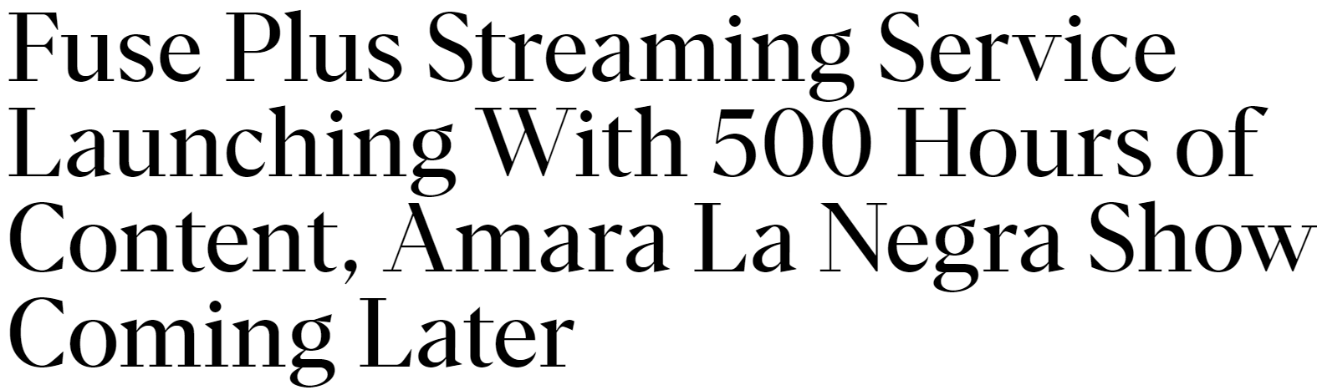

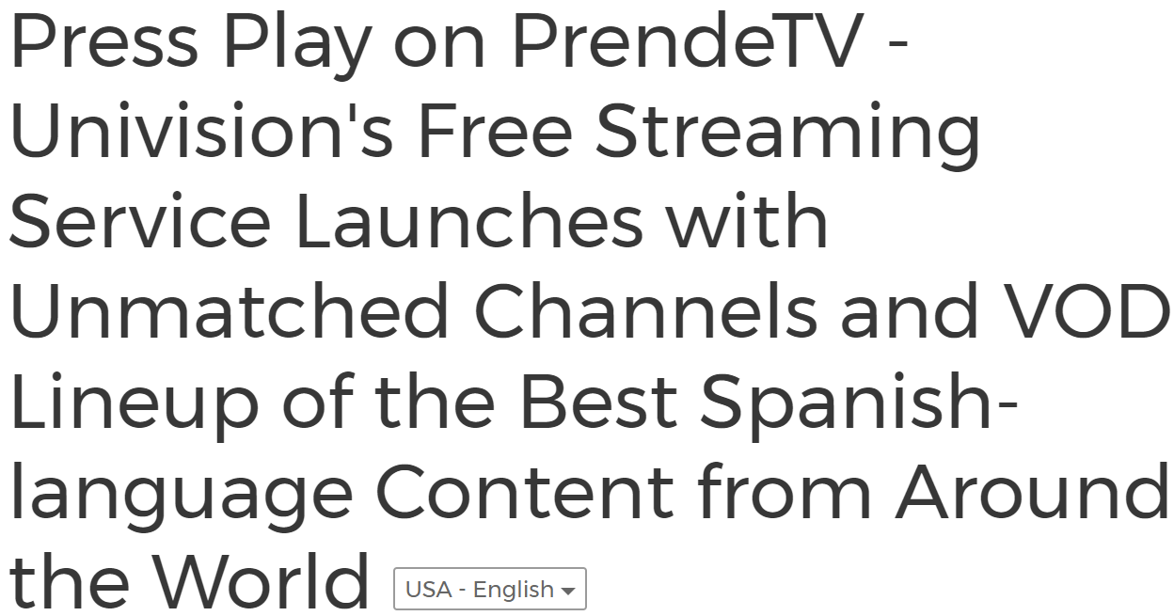

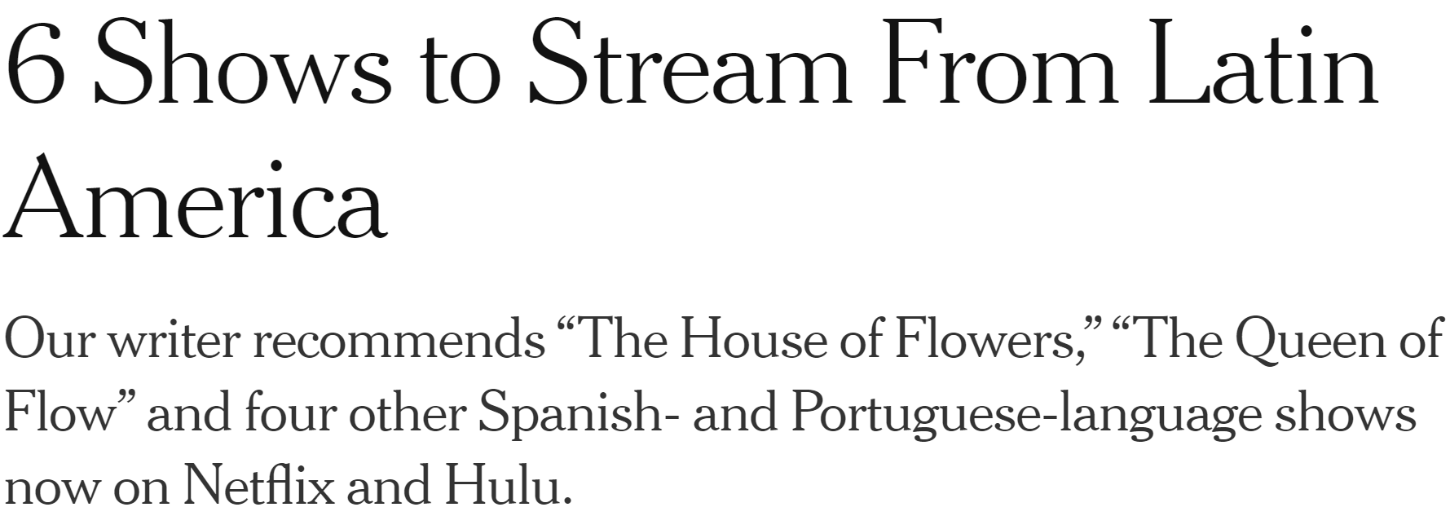

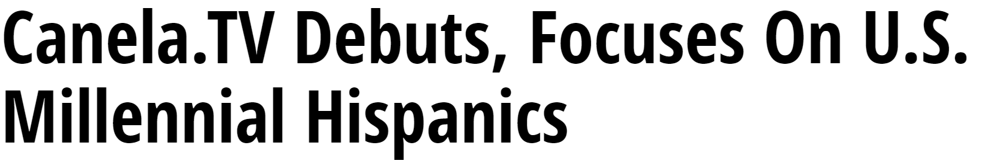
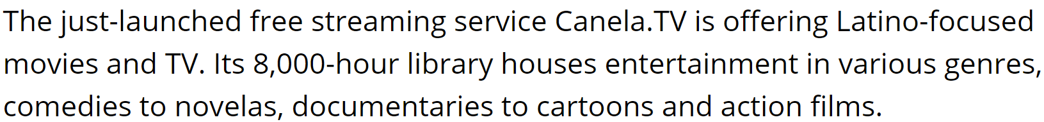



There has been an explosion of popular Spanish- & dual-language streaming content to meet increased demand, resulting in new opportunities for marketers to reach the growing Hispanic consumer segment
9/13/21
5/12/21
“There is a market for all sorts of streamed Spanish and Latinx-themed content, ranging from traditional telenovelas to content that speaks to the sensibilities of younger, bilingual, bicultural U.S. Latinx. Importantly, much of this content will not only appeal to Latinx consumers but other audiences as well.”
3/30/21
6/4/20
5/20/20
- Adriana Waterston, Senior Vice President, Insights & Strategy, Horowitz Research
U.S. Latinx Media Consumers Value a Diverse, Affordable, and Easy to Navigate High-Quality Spanish-Language Content Experience, 7/29/21
4/9/20
6/24/19
This information is exclusively provided to VAB members and qualified marketers. Further distribution is prohibited.
PAGE 13

Slide 14
The breadth of Spanish & bilingual streaming content has contributed to the near universal adoption of streaming across all Hispanics, regardless of their spoken language
% of Hispanics who have ‘streamed in the past 12 months’
…that speak the following at home
Total Hispanic
Spanish Only
Mostly Spanish, but some English
Both English & Spanish equally
Mostly English, but some Spanish
English Only
Total
non-Hispanic
July ‘21
87%
85%
88%
88%
88%
87%
79%
July ‘18
71%
66%
73%
70%
74%
73%
66%
Source: VAB analysis of MRI-Simmons Cord Evolution Study, July 2018, July 2019, July 2020 & July 2021; P18+.
This information is exclusively provided to VAB members and qualified marketers. Further distribution is prohibited.
PAGE 14

Slide 15
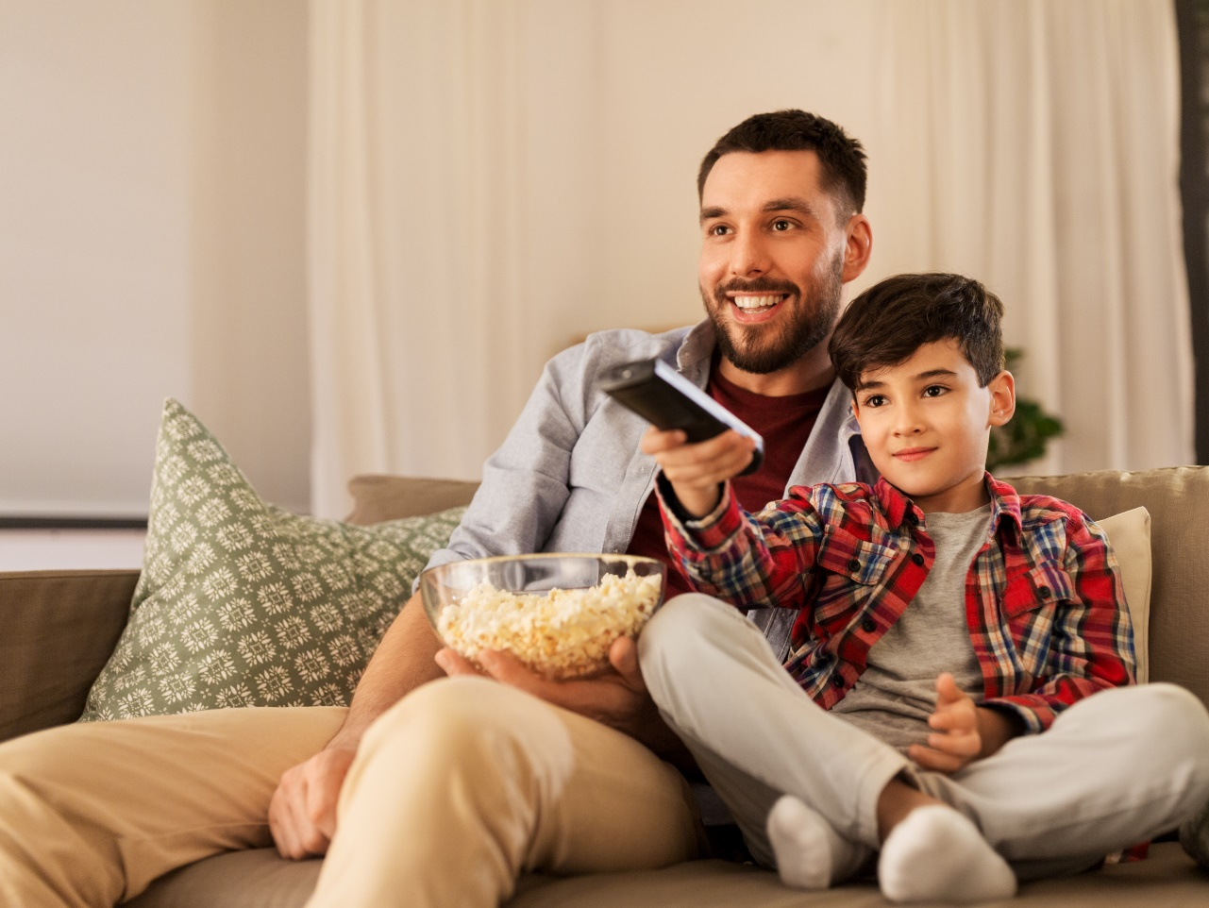
The inclusion of subtitles in Spanish-language content creates greater accessibility across languages and broadens the relevant programming for marketers when they are determining their buys
50% of Hispanic streamers have streamed Spanish-language content in the past 12 months
% of Hispanic streamers who have ‘streamed Spanish-language content in the past 12 months’
based on their preferred language to speak at home
Source: VAB analysis of MRI-Simmons Cord Evolution Study, July 2021; P18+. Base = ‘Streamed in the past 12 months.’
This information is exclusively provided to VAB members and qualified marketers. Further distribution is prohibited.
PAGE 15

Slide 16
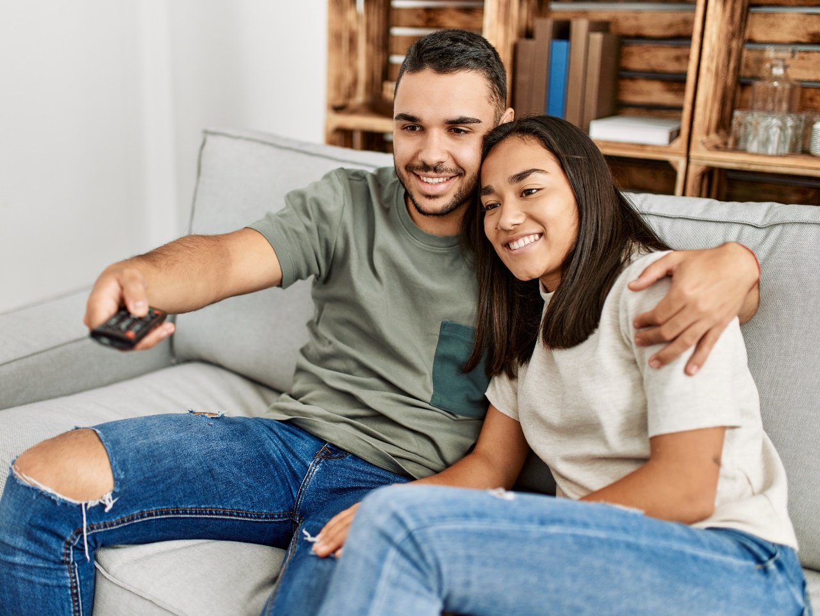
Over half (57%) of all Hispanic streamers wish there was even more Spanish-language content, creating opportunities for programmers to expand their audience through the development of more in-language programming
‘I wish there was more Spanish-language content to stream’
% of Hispanic streamers who agree, based on their preferred language to speak at home
Source: VAB analysis of MRI-Simmons Cord Evolution Study, July 2021; P18+. Base = 'Streamed in the past 12 months'; respondents who agree (top 2 box – strongly agree or somewhat agree).
This information is exclusively provided to VAB members and qualified marketers. Further distribution is prohibited.
PAGE 16

Slide 17
Hispanic Streamers Are Receptive to Advertising

Slide 18











The streaming landscape for ad-supported Latinx-targeted and Spanish-language content – through popular existing platforms and new, upstart standalone services – is significantly expanding
Nearly two-thirds (64%) of Hispanic streamers get excited when they hear about new streaming services / apps being launched in the future
Launch Dates of Popular Streaming Services Featuring Spanish-Language & Latinx-Themed Content
Mar. 31, 2014
Jan. 1, 2015
Aug. 2017
Jul. 15, 2020
Mar. 30, 2021
Sep. 13, 2021
← 2020
2021 →
Additionally, Spanish-language and Latinx-themed content has recently become even more accessible through both free and paid streaming services
Telemundo recently announced their new Hispanic Streaming business division geared towards developing programming for Peacock as well as for Telemundo’s and NBCUniversal’s other streaming platforms
Amazon Prime Video has been making substantial investments in Spanish and Latino-themed content and offers a library of Spanish-language originals
FuboTV offers Spanish-language content including Telemundo, Univision and popular sports programming
Discovery networks offer various Spanish-language mobile apps
Pantaya offers an extensive library of Spanish-language movies and series
OnDemandLatino offers primarily Spanish-language and Latinx-themed content
El Rey Network has recently moved from a linear TV channel to a streaming service via Roku
Source: VAB analysis of MRI-Simmons Cord Evolution Study, July 2021; P18+. Base = ‘Streamed in the past 12 months.’
This information is exclusively provided to VAB members and qualified marketers. Further distribution is prohibited.
PAGE 18

Slide 19
Growth among ad-supported services has been outpacing paid subscription services for Hispanic viewers and, with the increasing amount of free content available, there are even more platforms to reach this growing audience
% of Hispanic streamers that have access to a…
Free / Ad-Based Streaming Service
Subscription Streaming Service
+4%
vs. 2019
+2%
vs. 2020
+24%
vs. 2020
+6%
vs. 2019
Source: VAB analysis of MRI-Simmons Cord Evolution Study, July 2018, July 2019, July 2020 & July 2021; P18+. Base = ‘Streamed in the past 12 months.’
This information is exclusively provided to VAB members and qualified marketers. Further distribution is prohibited.
PAGE 19

Slide 20





Hispanic consumers across all acculturations, even many English speakers, appreciate when advertisers respect their culture and engage with them in Spanish which increases attention and fosters brand loyalty
% of Hispanic streamers who agree with the following statements
66%
‘I believe that companies who advertise in Spanish respect my culture and want my business’
54%
‘I am more likely to be loyal to a company that makes an effort to advertise in Spanish’
49%
‘When a product or service is advertised in Spanish,
I am more likely to pay attention to the advertisement and remember it later’
% of Hispanic streamers who agree and speak the following at home
Only Spanish - 74%
Mostly Spanish but some English - 74%
Both English & Spanish equally - 59%
Mostly English but some Spanish - 58%
Only English - 55%
Only Spanish - 69%
Mostly Spanish but some English - 60%
Both English & Spanish equally - 46%
Mostly English but some Spanish - 45%
Only English - 38%
Only Spanish - 73%
Mostly Spanish but some English - 65%
Both English & Spanish equally - 35%
Mostly English but some Spanish - 28%
Only English - 24%
Source: VAB analysis of MRI-Simmons Cord Evolution Study, July 2021; P18+. Base = 'Streamed in the past 12 months'; respondents who agree (any agree).
This information is exclusively provided to VAB members and qualified marketers. Further distribution is prohibited.
PAGE 20

Slide 21



Due to their high engagement with relevant content, Hispanic audiences - particularly Spanish speakers - are more receptive to advertisements on streaming services than non-Hispanics
% of Hispanic streamers who agree with the following statements
68%
‘I prefer streaming free video content with ads / commercials instead of paying for a subscription without ads / commercials’
47%
‘Ads / commercials are more memorable when
I see them while streaming’
55%
‘The ads / commercials I see on streaming services I use are relevant to me’
% of Hispanic streamers who agree and speak the following at home
Only Spanish - 72%
Mostly Spanish but some English - 69%
Both English & Spanish equally – 70%
Mostly English but some Spanish - 63%
Only English - 64%
vs. 61% of non-Hispanics who agree (111 index)
Only Spanish - 53%
Mostly Spanish but some English - 50%
Both English & Spanish equally – 53%
Mostly English but some Spanish - 43%
Only English - 40%
vs. 32% of non-Hispanics who agree (146 index)
Only Spanish - 60%
Mostly Spanish but some English - 55%
Both English & Spanish equally – 58%
Mostly English but some Spanish - 51%
Only English - 51%
vs. 42% of non-Hispanics agree (131 index)
Source: VAB analysis of MRI-Simmons Cord Evolution Study, July 2021; P18+. Base = 'Streamed in the past 12 months'; respondents who agree (top 2 box – strongly agree or somewhat agree).
This information is exclusively provided to VAB members and qualified marketers. Further distribution is prohibited.
PAGE 21

Slide 22
Hispanics now collectively represent a trillion-dollar opportunity for marketers and are more likely to be video streamers across all levels of acculturations than non-Hispanics
The explosion of Spanish-language and bilingual Latinx-themed content coupled with the high engagement of Hispanics through greater co-viewing and binge-watching has created many more opportunities for marketers to connect with this segment
Hispanics are much more likely to be receptive to advertisements on streaming platforms but its important for advertisers to be authentic and respectful of cultural nuances across all levels of acculturation
Key Marketer Takeaways
This information is exclusively provided to VAB members and qualified marketers. Further distribution is prohibited.
PAGE 22

Slide 23

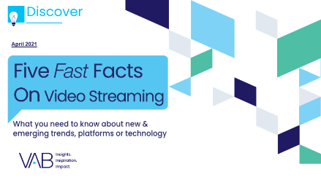
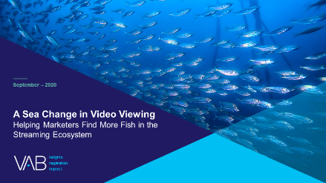

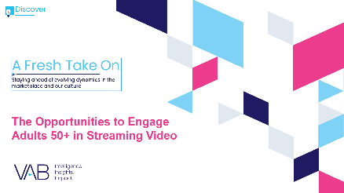


Creators
Leah Montner-Dixon
Karolina Guillen
Associate Insights Director
leahm@thevab.com
Insights Manager
karolinag@thevab.com
Discover more
Looking for more data, insights and takeaways? Check out this related VAB content
Five Fast Facts
The Growth of CTV Advertising
Five Fast Facts on
Video Streaming
A Sea Change in Video Viewing
Helping Marketers Find More Fish in the Streaming Ecosystem
Navigating the Flood
Charting Your Way Through
Today’s Streaming Ecosystem
To learn more about Hispanic streaming ad opportunities, click here for a directory
A Fresh Take On
The Opportunities to Engage Adults 50+ in Streaming Video
Do The Right Thing
How Diversity & Inclusion Drives Brand Outcomes
VAB Members, brand marketers and agencies get free and immediate access to VAB’s content library. Get access at theVAB.com
This information is exclusively provided to VAB members and qualified marketers. Further distribution is prohibited.
PAGE 23

Slide 24

About VAB
VAB is an insights-driven organization that inspires marketers to reimagine their media strategies resulting in fully informed decisions.
Drawing on our marketing expertise, we simplify the complexities in our industry and discover new insights that transform the way marketers look at their media strategy.
Discover
We keep you one step ahead with the latest thinking so you can create innovative, forward-looking strategies.
Simplify
We save you time by bringing you the latest data & actionable takeaways you can use to inform your marketing plans.
Transform
We help you build your brand by focusing on core marketing principles that will help drive tangible business outcomes.
We are committed to your business growth and proud to offer VAB members, brand marketers and agencies complimentary access to our continuously-growing Insights library. Get immediate access at theVAB.com.
This information is exclusively provided to VAB members and qualified marketers. Further distribution is prohibited.
PAGE 24

Slide 25











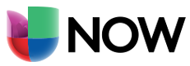










Hispanic Streaming Directory
click on any logo to learn more about each service
Standalone Spanish-Language Services
General Market with Spanish-Language & Latinx-Themed Content
Paid Subscription
Paid Subscription
Free Ad-Supported
Free Ad-Supported
This information is exclusively provided to VAB members and qualified marketers. Further distribution is prohibited.
PAGE 25

