Slide 1

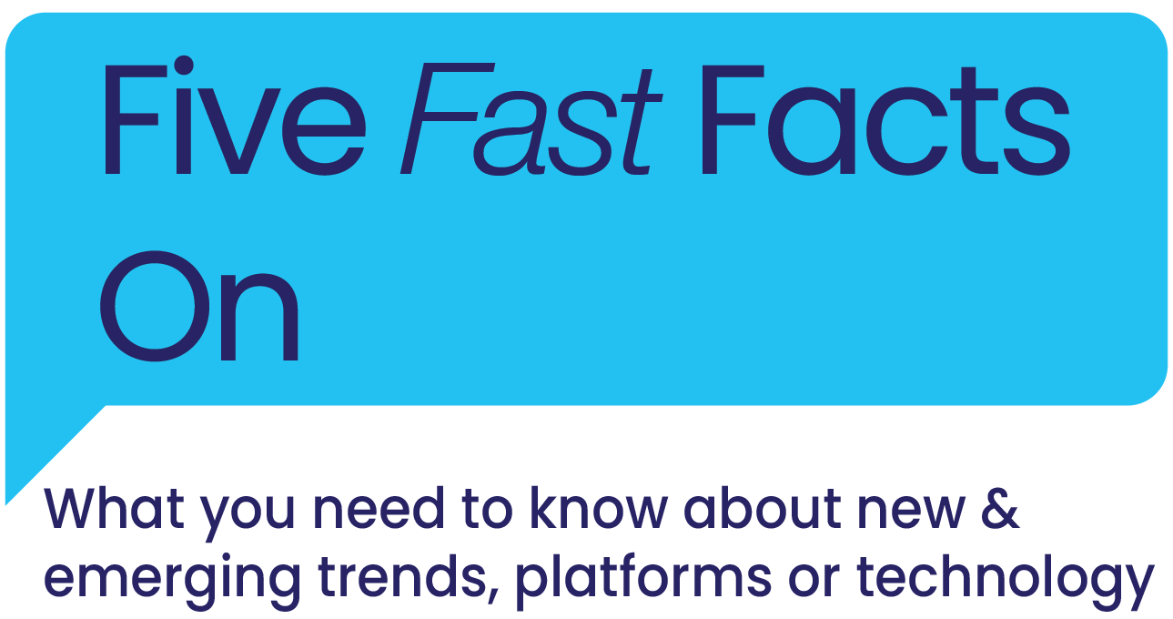



Slide 2
What is Triller?
Why is the industry talking about it?
Triller is a social media and entertainment platform where users create and discover short-form music video content, similar to TikTok.
Launched in 2015, Triller is centered around music video creation and virtual events. Users can make music videos with millions of songs and AI video-editing.
Recently valued at $1.25 billion, Triller has gained attention since reaching #1 in the App Store in August after the Trump administration tried to ban TikTok.
Triller has implemented bold marketing strategies and stunts to build awareness and ignite app downloads through viral live PPV boxing matches with athletes and influencers, celebrity partnerships, virtual events, and
a fan contest around Super Bowl weekend offering the winner a chance at $1MM.
Source: Business Insider ‘TikTok challenger Triller is reportedly exploring an IPO as questions swirl over its user numbers’, 10/12/20
This information is exclusively provided to VAB members and qualified marketers. Further distribution is prohibited.
PAGE 2

Slide 3

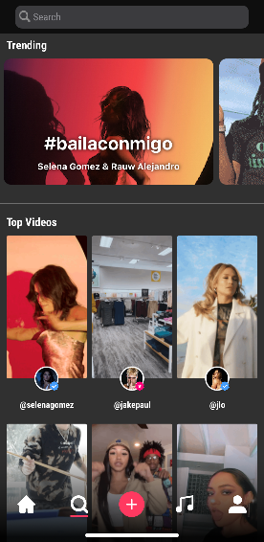
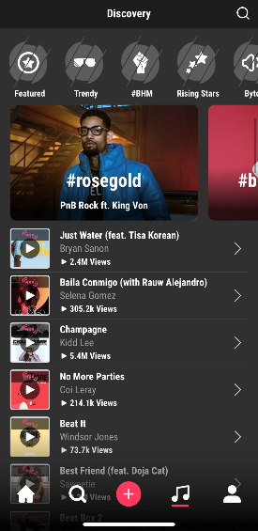
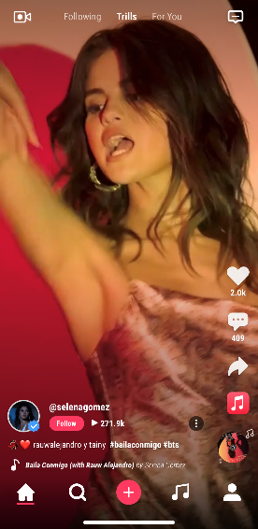
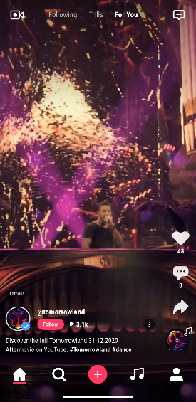
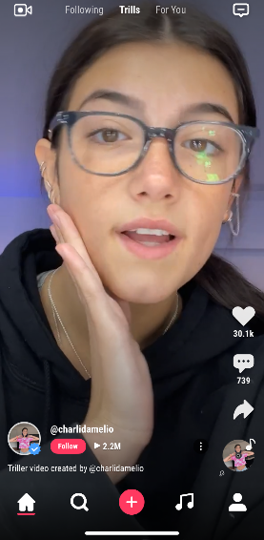
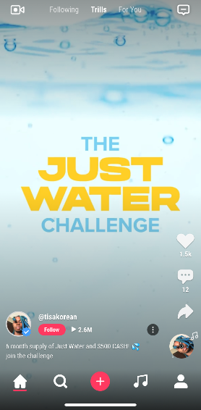

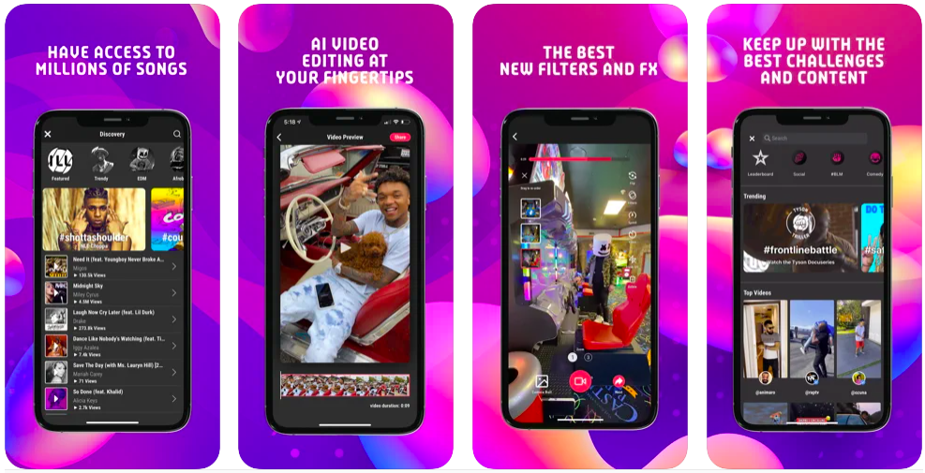


1
Triller’s unique user experiences like curated content and AI video-editing capabilities create several key differentiations between their platform and main competitors like TikTok
Screenshots from the app
Content Discovery
Triller’s feed is driven by leaderboards, trending hashtags and promoted campaigns, unlike TikTok’s content that’s personalized to each user.
Images from the App Store
Editing & AI Capabilities
According to Mike Lu, CEO of Triller, the app’s artificial intelligence creates professional music videos as opposed to simply adding music to its videos like TikTok.
This information is exclusively provided to VAB members and qualified marketers. Further distribution is prohibited.
PAGE 3

Slide 4





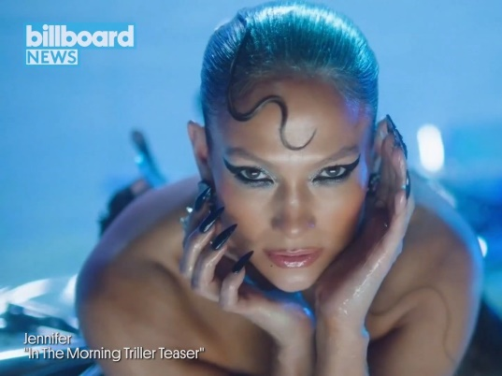
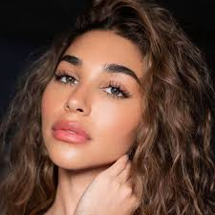
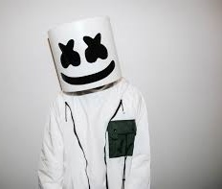
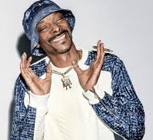
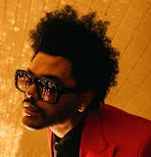
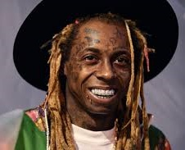
2
Triller offers an extensive music library with over 80 million songs available to stream in full
Triller has deep music industry ties which enables the platform to offer premium music video content through major record-label deals and garner investments from
big-name artists
Record-Label Deals
Triller has partnered with most major record labels including Warner Records, Sony Music and more.
Exclusive Content Releases
Artists like J.Lo and Chantel Jeffries have released music videos exclusively on the app.
“We are a music-first platform where culture comes to break…plus, the stream makes money for the artists. We’ve created a platform where the entire ecosystem can monetize itself”
Bonin Bough, Chief Growth Officer at Triller.
Celebrity Investors
Triller has received investments
from artists like Snoop Dogg,
The Weeknd and more.
The Drum, 10/21/2020
This information is exclusively provided to VAB members and qualified marketers. Further distribution is prohibited.
PAGE 4

Slide 5
3
Growth Initiatives Through Brand Partnerships
Devices
Media
Content
Triller has hosted virtual concerts and music competitions through paid partnerships with well-known brands like Pepsi and NYX Cosmetics.
To further legitimize their platform and attract new users, Triller is building distribution partnerships with mobile device makers, enabling content sharing through other popular social media platforms and developing partnerships with well-known brands
Triller is partnering with Samsung to come
pre-installed on millions of devices worldwide.
Snapchat now allows users to post videos directly to Triller via ‘Triller Stories’ on their app.
This information is exclusively provided to VAB members and qualified marketers. Further distribution is prohibited.
PAGE 5

Slide 6
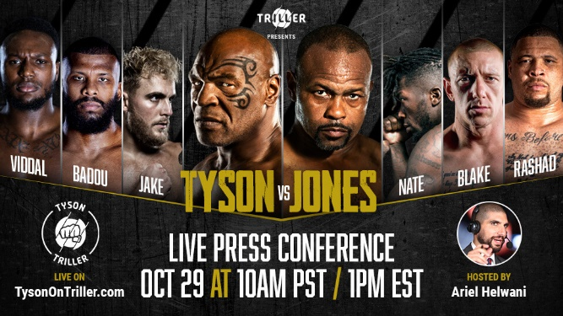
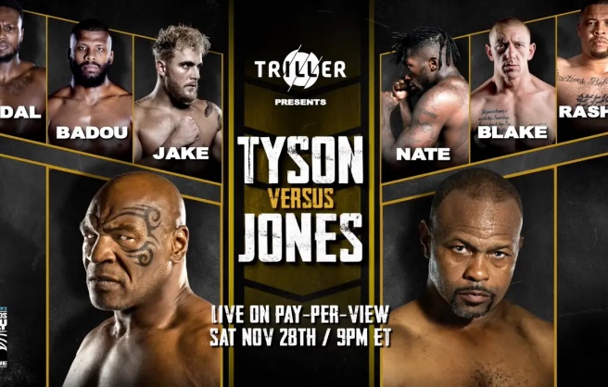

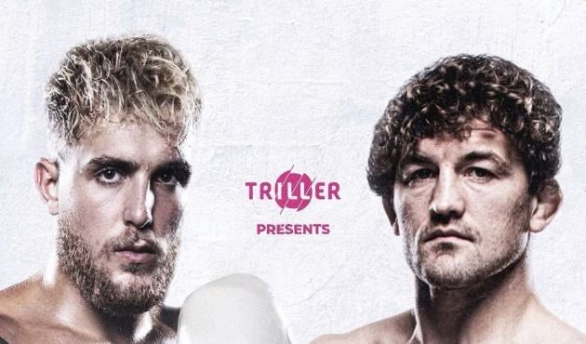
4
“We wanted to make this the catalyst for Triller’s live events and sports business”
-Paul Kavanaugh, Co-Owner of Triller, on producing the live Triller Battles series
Triller is implementing a marketing strategy to align with high-profile live sporting events that have major ‘talk value’ to push more app downloads and
to support their goal of becoming more than just a social media app through live streaming
10/29/2020
Triller hosted an exclusive live press conference prior to the fight where Mike Tyson would return to the ring in the first time in over 15 years.
11/28/2020
Triller was the title sponsor of the Mike Tyson vs. Roy Jones Jr. fight (8th most successful PPV fight in history: 30 MM+ viewers) which drove a 10x increase in Google search.
2/4 – 2/7/2021
After initially announcing their plan to run an ad during the Super Bowl, Triller changed tactics and partnered with VersusGame and Maxim to host a live promotional contest on their platform through Super Bowl weekend.
4/17/2021
Triller plans to continue the Triller Battles series confirming the upcoming fight between Jake Paul vs. Ben Askren.
Source: Google Search Trends, two-week comparison: w/o 11/8 & 11/15 vs. 11/22 & 11/29 (two weeks prior to boxing match vs. two weeks surrounding boxing match).
This information is exclusively provided to VAB members and qualified marketers. Further distribution is prohibited.
PAGE 6

Slide 7


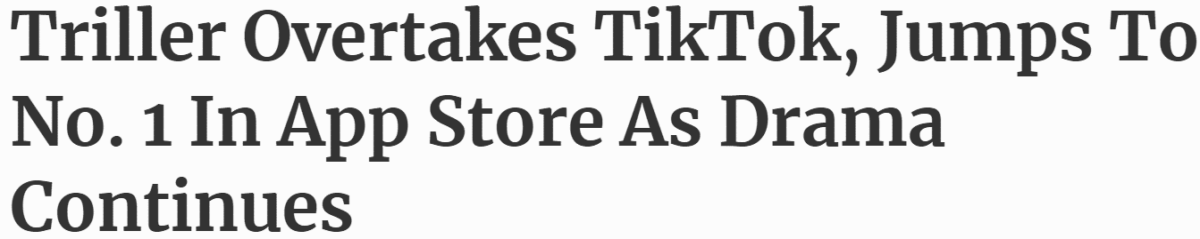
5
Triller has experienced steady growth over the
last two years through
their partnerships and marketing, and aided by
the Trump administration’s attempt to ban TikTok in August 2020, however the platform remains a fraction
of the size of TikTok which has seen even greater growth during the same
time period
August 3, 2020
+76%
YOY average monthly growth (2020 vs 2019)
+196%
YOY average monthly growth
TikTok:
16,649
26,030
54,295
72,158
Source: VAB analysis of Comscore MediaMetrix Media Trend multiplatform (desktop + mobile) data, January 2019 – December 2020. Total Audience (Desktop 2+, Mobile 18+), total digital population.
This information is exclusively provided to VAB members and qualified marketers. Further distribution is prohibited.
PAGE 7

Slide 8
Although currently a fraction of the audience size of established social video platforms like TikTok, Triller has been building its legitimacy and driving increased app downloads through a mix of high-profile marketing executions and strong distribution and content partnerships
Triller’s differentiation, which focuses on premium music content and AI editing capabilities, gives the brand a unique position within the social video space. And, although advertising opportunities are currently limited to brand partnerships with influencers, marketers can anticipate more viable ad opportunities in the future as the platform continues to build scale, assuming they maintain and strengthen their industry and influencer relationships
What does this mean for marketers?
This information is exclusively provided to VAB members and qualified marketers. Further distribution is prohibited.
PAGE 8

Slide 9
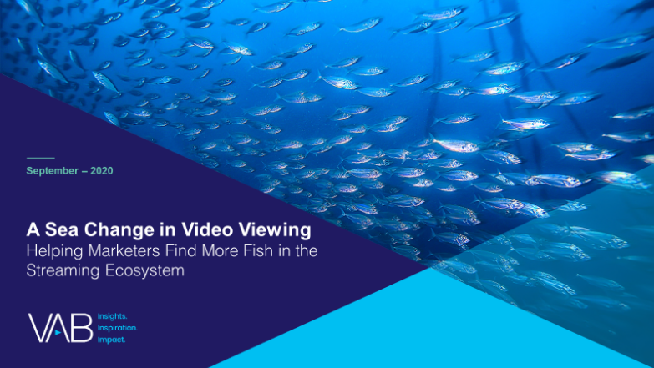
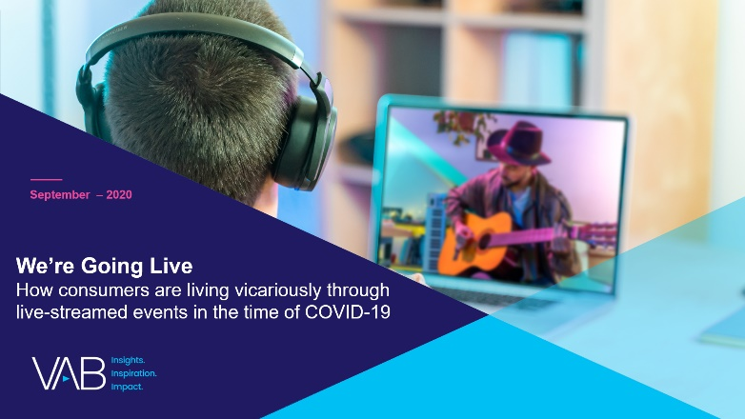

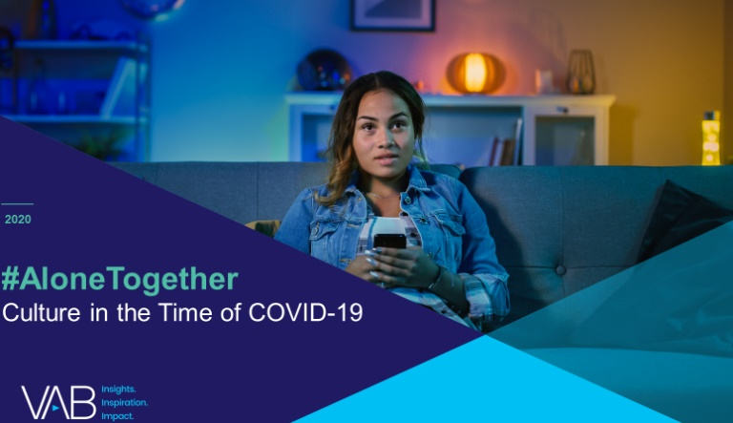
Discover more
Looking for more data, insights and takeaways? Check out this related VAB content
A Sea Change in Video Viewing
Helping Marketers Find More Fish in the Streaming Ecosystem
We’re Going Live
How Consumers are Living Vicariously Through Live-Streamed Events in the Time of COVID-19
Left To Your Own Devices
The Latest on Multiplatform Video Consumption Habits
#AloneTogether
Culture in the Time of COVID-19
VAB Members, brand marketers and agencies get free and immediate access to VAB’s content library. Get access at theVAB.com
This information is exclusively provided to VAB members and qualified marketers. Further distribution is prohibited.
PAGE 9

Slide 10


About VAB
VAB is an insights-driven organization that inspires marketers to reimagine their media strategies resulting in fully informed decisions.
Drawing on our marketing expertise, we simplify the complexities in our industry and discover new insights that transform the way marketers look at their media strategy.
Discover
We keep you one step ahead with the latest thinking so you can create innovative, forward-looking strategies.
Simplify
We save you time by bringing you the latest data & actionable takeaways you can use to inform your marketing plans.
Transform
We help you build your brand by focusing on core marketing principles that will help drive tangible business outcomes.
We are committed to your business growth and proud to offer VAB members, brand marketers and agencies complimentary access to our continuously-growing Insights library. Get immediate access at theVAB.com.
This information is exclusively provided to VAB members and qualified marketers. Further distribution is prohibited.
PAGE 10

