Slide 1



Case Study Corner
xx
Travel Category
Brand success stories highlighted through real-world multiscreen TV case studies

Slide 2





6 Travel category ‘real world’ case studies showcasing how multiscreen TV drives business outcomes across the funnel
Upper Funnel Outcomes
Awareness
Multiscreen TV campaigns that expand reach and drive brand recall against a brand’s best customer prospects*
Sampling of ‘awareness-based’ outcomes that can be measured:
Reach / Reach Extension / Incremental Reach
Ad / Brand Recall
Cost Efficiencies (Reach / Targeted IMPs)
Mid-to-Lower Funnel Outcomes
Action
Multiscreen TV campaigns that increase the likelihood the intended audience will be motivated to act*
Sampling of ‘action-based’ outcomes that can be measured:
Conversion Rates (website traffic,
app downloads, subscription sign-ups,
tune-in, foot traffic)
Sales / Revenues
Optimizations / ROI
Cost Efficiencies (Conversions)
Full-Funnel Outcomes
Awareness + Action
Multiscreen TV campaigns that expand reach and drive brand recall while also increasing the likelihood that the intended audience will be motivated to act*
Sampling of full-funnel outcomes:
Reach → Brand Recall → Conversion Rates → Sales → Optimizations →
Cost Efficiencies
*based on campaign KPIs
This information is exclusively provided to VAB members and qualified marketers.
PAGE 2

Slide 3
Upper Funnel
Case Studies
Awareness
Multiscreen TV campaigns expand reach
and drive brand recall against a brand’s
best customer prospects
Sampling of ‘awareness-based’ outcomes that can be measured:
    Reach / Reach Extension / Incremental Reach
    Ad / Brand Recall
    Cost Efficiencies (Reach / Targeted IMPs)
How Multiscreen TV drives
Awareness
This information is exclusively provided to VAB members and qualified marketers.
PAGE 3

Slide 4


Category:
Travel
Tune-In promo :30’s + long-form TV show results in greater brand exposure and communication of brand attributes
Challenge
Increase brand awareness for the travel destination, at scale, within budget
Communicate all brand attributes for the travel destination
Drive conversion to travel destination’s website
Solution
Produced Half-Hour Long Form Brand Engagement show to fully communicate all brand attributes.
Produce :30 tune-in promo spots that drives brand awareness and drives viewership to the Long Form Brand Engagement show.
Results
Tune-In 30’s + Long Form TV Show results in the greatest brand exposure and communication of all brand attributes
4x lift by having a media mix of Promo :30’s + Long Form TV Show over airing just the Long Form
Viewing Source / Media Type
Linear, FAST, VOD
Ad Impressions
100,000
24,000
100,000
6,000
Source: Leap Media Group, Travel Case Study.
This information is exclusively provided to VAB members and qualified marketers.
PAGE 4

Slide 5
Mid-To-Lower Funnel
Case Studies
Action
Multiscreen TV campaigns increase the likelihood that the intended audience will be motivated to act
(e.g., make a purchase, download an app, sign-up
for a subscription, make a booking, etc.)
Sampling of ‘action-based’ outcomes that can be measured:
    Conversion Rates (website traffic, app downloads, subscription sign-ups, tune-in, foot traffic)
    Sales / Revenues
    Optimizations / ROI
    Cost Efficiencies (Conversions)
How Multiscreen TV drives
Action
This information is exclusively provided to VAB members and qualified marketers.
PAGE 5

Slide 6






Category:
Travel
NGLMitú enabled a targeted campaign across online video and CTV to boost awareness and consideration for a travel brand
Challenge
A vacation rental brand sought to show their target audience their travel possibilities through categories and, in doing so, increase its relevance and encourage people to book with Airbnb.
Solution
NGLMitú leveraged media placements, such as OLV and CTV to raise brand awareness around the brand’s new ‘Categories’ offer and strengthen brand consideration during Q1 and Q2 2023
Target Segment
Hispanics ages 18-54
Results
The campaign resulted in a high VCR performance of 92% VCR and delivered over 10M views
Company / Platform
NGLMitú / Online video, CTV
10.4M
10.1M
Impressions
Video Views
92.4%
5K
Video Completion Rate
Clicks
Source: NGLMitú, Travel Case Study. 2/1/23 - 6/30/23.
This information is exclusively provided to VAB members and qualified marketers.
PAGE 6

Slide 7




Category:
Travel
A luxury resort brand increased their website traffic through addressable VOD
Challenge
A leading luxury resort group sought to increase traffic to their website
Solution
Using NBCU’s AdSmart audience targeting solution, the brand ran an addressable TV campaign across the NBCU VOD portfolio to reach their custom ‘traveler’ target. Data Plus Math was utilized to measure the impact of the campaign on driving traffic to the advertiser’s website.
Target Segment
Custom Mastercard ‘Luxury Hotel & Resort Travelers’
Results
By implementing a targeted addressable TV campaign, the brand saw a double-digit lift in overall website visitations
Company / Platform
NBCU’s AdSmart solution / Addressable TV
  (VOD: NBCU set-top box VOD, NBCU CTV O&O apps, NBCU on Hulu)
AdSmart drove double-digit site visitation lift
+24% lift in visitation to the advertiser’s website
+35% lift in unique visitors to the advertiser’s website
AdSmart drove double-digit page visitation lift across the site
+50% lift in visitation to the advertiser’s homepage
+56% lift in visitation to property search pages
+27% lift in visitation to resort booking pages
+42% lift in visitation to special offers pages
+34% lift in visitation to resort + flight booking pages
+19% lift in visitation to resort-only booking pages
Source: NBCU, AdSmart + Luxury Resort Case Study.
This information is exclusively provided to VAB members and qualified marketers.
PAGE 7

Slide 8

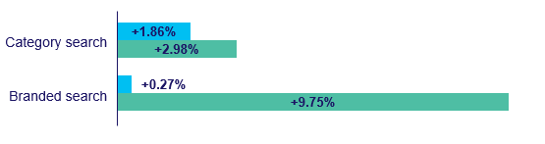

Category:
Travel
The LVCVA leveraged a cross-screen campaign strategy to drive search and store visits beyond their benchmarks
Challenge
The Las Vegas Convention and Visitors Authority and its agency, R&R Partners, needed to understand how their ad campaigns were influencing people’s attitudes, opinions and, more importantly, affecting behaviors.
Measurement Solution
To evaluate the performance of LVCVA’s digital campaigns spanning CTV/OTT, online video and display, both DISQO Brand Lift and DISQO Outcomes Lift were applied to samples of DISQO’s 100% opt-in audience to uncover insights into consumer attitudes and digital behaviors.
Target Audience
Travel Intenders (exposed audiences were compared to mirror-matched control groups with the same attributes and shopping behaviors)
Results
The campaign drove:
  2.98% lift in broad searches such as “what’s open in Vegas right now” or “fun things to do in Vegas,” outperforming the industry benchmark of 1.86;
  9.75% lift in lower-funnel “branded” searches aligned with Las Vegas-specific hotels, attractions, dining and shows
  17.47% lift in branded site visits.
Viewing Source / Media Type
Digital campaigns spanning CTV/OTT, online video and display
LVCVA Campaign Results – Brand Lift (Attitudinal) vs. Outcomes Lift (Behavioral)
Attitudinal Benchmark
Behavioral Metrics
Intent to visit
+2.00%
Branded search
+9.95%
Branded store visits
+17.47%
LVCVA Campaign Lift Results vs. DISQO’s Normative Benchmarks
Travel Benchmark
LVCVA
35x
Above the travel industry DISQO benchmark for driving branded search
Download the full Case Study
Source: Disqo, Disqo Leveraged Audience Insights to Lift Outcomes for a Hotel Brand, 2023.
This information is exclusively provided to VAB members and qualified marketers.
PAGE 8

Slide 9
Awareness
How Multiscreen TV drives
Full-Funnel Outcomes
Multiscreen TV campaigns expand reach
and drive brand recall against a brand’s
best customer prospects
Action
Multiscreen TV campaigns increase the likelihood
that the intended audience will be motivated to act
(e.g., visit a website, download an app, sign-up
for a subscription, make a purchase, etc.)
Case Studies
This information is exclusively provided to VAB members and qualified marketers.
PAGE 9

Slide 10






Category:
Travel
A hotel brand used an optimized TV campaign to increase their unique reach, conversion rates and cost efficiencies
Challenge
Choice Hotels wanted to increase their bookings by targeting and reaching frequent business travelers before their next trip
Solution
Choice partnered with Simulmedia to develop an optimized data-driven linear TV campaign that maximized the target audience reach, then Simulmedia’s viewing panel was matched with Choice’s loyalty card data to determine the campaign’s impact
Target Segment
Frequent business travelers supplemented with Choice’s 1st party CRM data
Results
The data-driven linear TV campaign drove positive impact across the funnel – increased unique reach, higher conversions and greater cost efficiencies
Company / Platform
Simulmedia / Data-driven linear
11.5%
59.4%
66.7%
37.7%
Unique Reach
Extension
(with just 18% of the budget)
Higher Conversion Rate by Exposed Viewers
Lower Cost per Reach
Lower Cost per Incremental Purchaser
Source: Simulmedia, Case Study: Choice Hotels Gives Bookings A Boost.
This information is exclusively provided to VAB members and qualified marketers.
PAGE 10

Slide 11





Category:
Travel
NGLMitú leveraged targeted media placements across their social platforms to drive amusement park visitation
Challenge
An amusement park sought to create buzz around a limited-time ‘Plaza de la Familia’ celebration and help drive visitation among travel-ready Hispanic families during the seasonal activation.
Solution
A campaign consisting of targeted media placements as well as emotionally engaging
and culturally-relevant custom social content
Target Segment
Travel-ready Hispanic families
Results
The campaign successfully amplified the resort campaign messaging across the NGLMitú media platform, delivering 101% of goal for media placements, and across the mitú social platforms, delivering 116% of goal for social placements
NGLMitú’s social placements overall exceeded their CTR and ER benchmarks
Company / Platform
NGLMitú Media Platform / Social video, Online video
101%
delivered of goal for media placements
116%
delivered of goal for social placements
7.75M+ Impressions
916K+ Views
883K+ Complete Views
27.1K+ Clicks
Source: NGLMitú, Travel Case Study. August – September 2023.
This information is exclusively provided to VAB members and qualified marketers.
PAGE 11

Slide 12
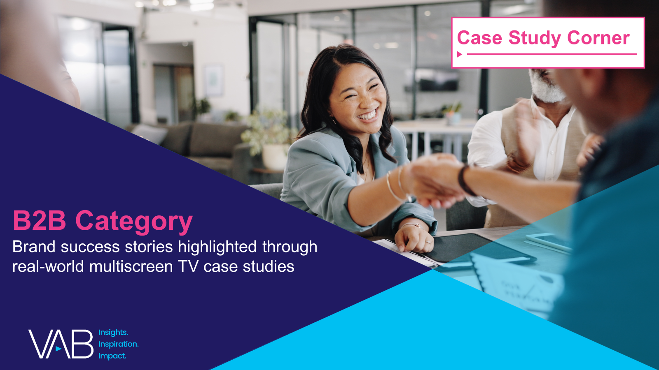






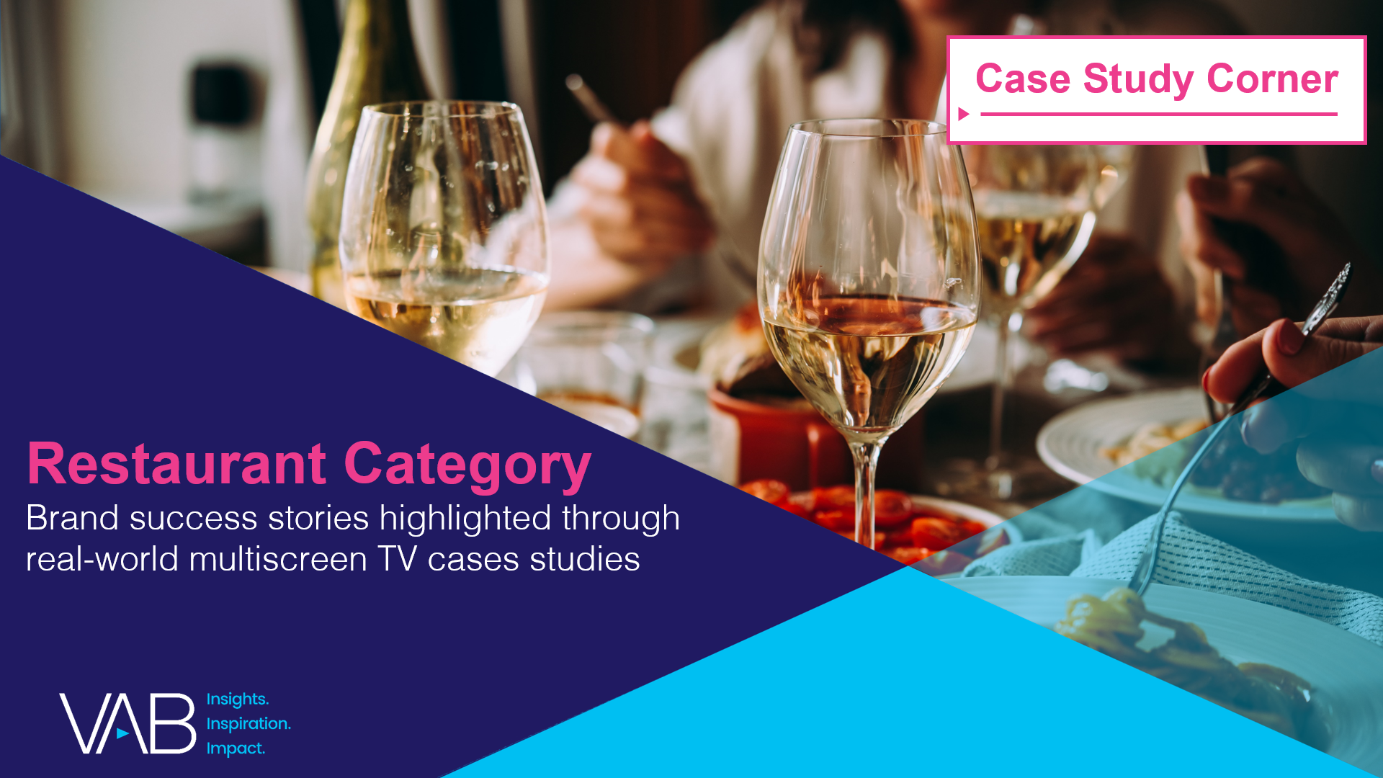
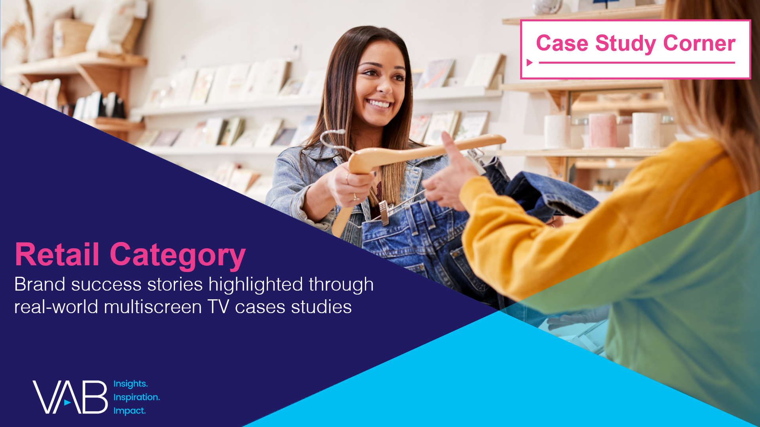

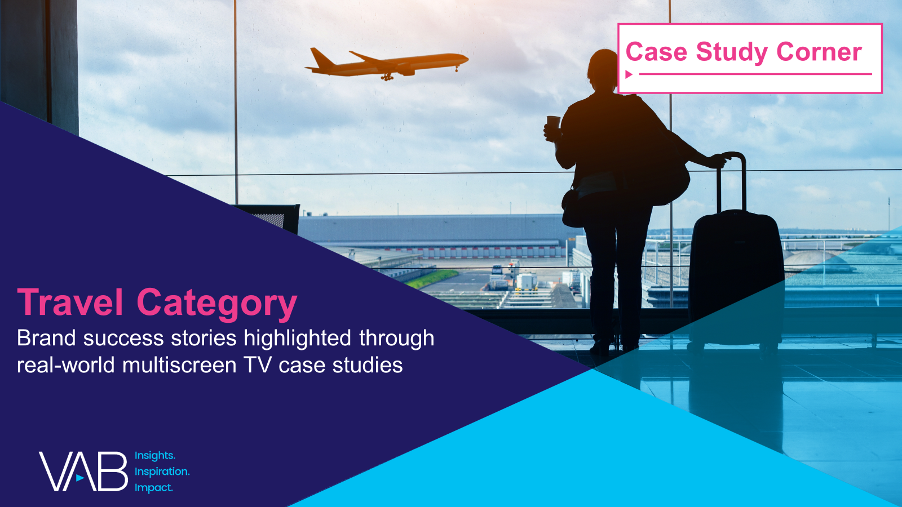
Want more? VAB has a wealth of case studies across additional categories
Business-to-Business (B2B)
Consumer Packaged Goods (CPG)
Entertainment & Tune-In
Financial Services & Insurance
Health, Wellness & Beauty
Home
Pharmaceuticals
Restaurants
Retail
Technology
Travel
Access more case studies at www.thevab.com
This information is exclusively provided to VAB members and qualified marketers.
PAGE 12

Slide 13








Want more? VAB also has case studies organized across multiscreen TV platforms including linear TV and streaming / CTV
Stream On
How can a convergent TV strategy drive business
results for my brand?
Proven Strategies & Tactics In Audience-Based TV Buying
Opportunities in VOD Addressable
Q1 ‘22 Today’s Innovations in Measurement
Q2 ‘22 Today’s Innovations in Measurement
Q3 ‘22 Today’s Innovations in Measurement
Q4 ‘22 Today’s Innovations in Measurement
Access more case studies at www.thevab.com
This information is exclusively provided to VAB members and qualified marketers.
PAGE 13

Slide 14


About VAB
VAB plays a dual role in the video advertising industry. We are leading the change to bring about a more innovative and transparent marketplace. We also provide the insights and thought leadership that enables marketers to develop business-driving marketing strategies.
Drawing on our marketing expertise, we simplify the complexities in our industry and discover new insights that transform the way marketers look at their media strategy.
We are committed to your business growth and proud to offer VAB members, brand marketers and agencies complimentary access to our continuously-growing Insights library. Get immediate access at theVAB.com.
This information is exclusively provided to VAB members and qualified marketers.
PAGE 14

